Slide 1
Non-Standard-Datenbanken und Data Mining
Graphdatenbanken
Prof. Dr. Ralf Möller
Universität zu Lübeck
Institut für Informationssysteme

Slide 2
Acknowledgements for slides 2-36
Graph databases and graph querying
Advances in Data Management, 2019
Dr. Petra Selmer
Query languages standards & research group, Neo4j

Slide 3
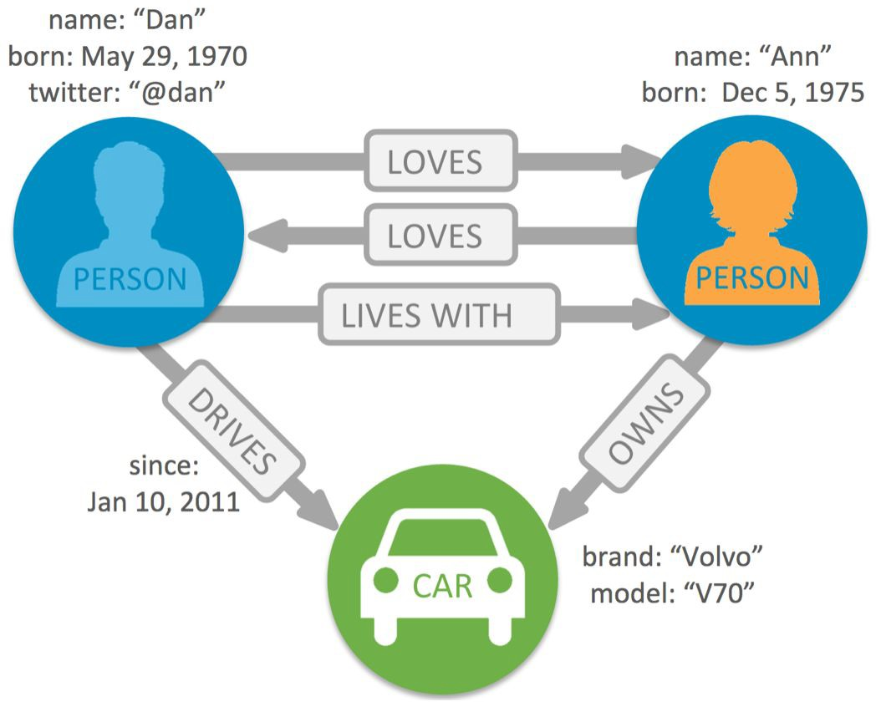
Property graph
Node
Represents an entity within the graph
Has zero or more labels
Has zero or more properties
(which may differ across nodes with the same label(s))
Edge
Adds structure to the graph
(provides semantic context for nodes)
Has one type
Has zero or more properties
Relates nodes by type and direction
Must have a start and an end node
Property
Name-value pair (map) that can go on nodes and edges
Represents the data: e.g. name, age, weight etc
String key; typed value (string, number, bool, list)
Graph databases and graph querying, Petra Selmer

Slide 4
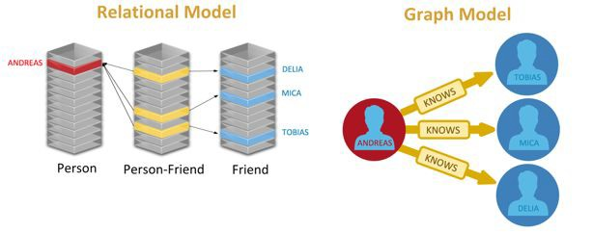
Relational vs. graph models
4
Graph databases and graph querying, Petra Selmer

Slide 5
Relationship-centric querying
Query complexity grows with need for JOINs Graph patterns not easily expressible in SQL
Recursive queries
Variable-length relationship chains Paths cannot be returned natively
Graph databases and graph querying, Petra Selmer

Slide 6
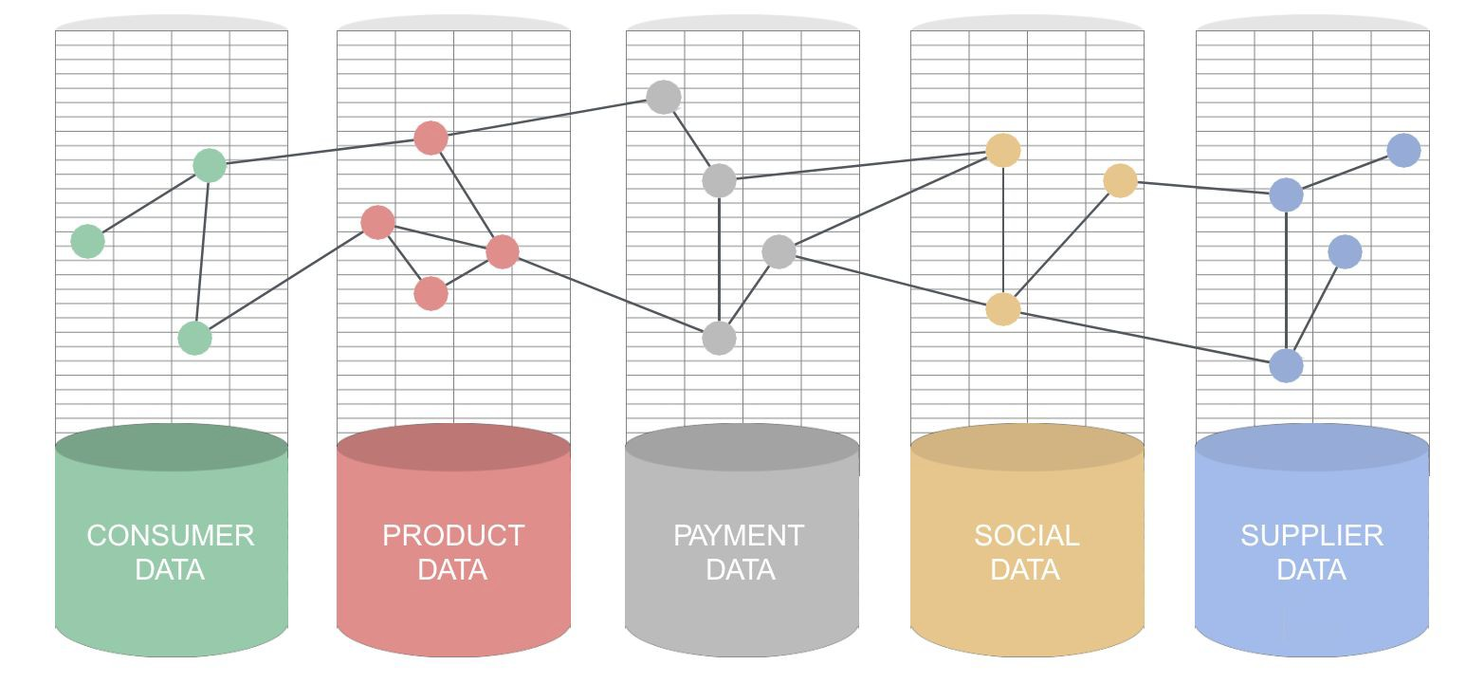
Data Integration
1
6
Graph databases and graph querying, Petra Selmer

Slide 7
Introducting Cypher
Declarative graph pattern matching language SQL-like syntax
DQL for reading data
DML for creating, updating and deleting data DDL for creating constraints and indexes
Graph databases and graph querying, Petra Selmer

Slide 8
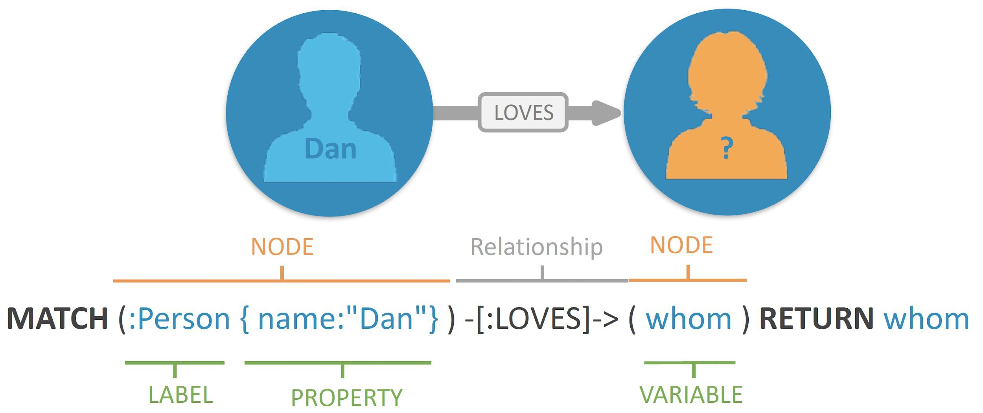
Searching for (matching) graph patterns
Nodes:
() or (n)
  Surround with parentheses
  Use an alias n to refer to our node later in the query
(n:Label)
  Specify a Label starting with a colon :
  Used to group nodes by roles or types (similar to tags)
(n:Label {prop: ‘value’})
  Nodes can have properties
Edges/Relationships:
--> or -[r:TYPE]->
  Wrapped in hyphens and square brackets
  A relationship type starts with a colon :
<>
  Specify the direction of the relationships
-[:KNOWS {since: 2010}]->
  Relationships can have properties
8
Graph databases and graph querying, Petra Selmer

Slide 9
Cypher: patterns
Used to query data
(n:Label {prop: ‘value’})-[:TYPE]->(m:Label)
Find Alice who knows Bob In other words:
find Person with the name ‘Alice’
who KNOWS
a Person with the name ‘Bob’
(p1:Person {name: ‘Alice’})-[:KNOWS]->(p2:Person {name: ‘Bob’})
Graph databases and graph querying, Petra Selmer

Slide 10
DML: Creating and updating data
// Data creation and manipulation CREATE (you:Person)
SET you.name = ‘Jill Brown’
CREATE (you)-[:FRIEND]->(me)
// Either match existing entities or create new entities.
// Bind in either case
MERGE (p:Person {name: ‘Bob Smith’})
ON CREATE SET p.created = timestamp(), p.updated = 0
ON MATCH SET p.updated = p.updated + 1
RETURN p.created, p.updated
Graph databases and graph querying, Petra Selmer

Slide 11
DQL: Reading data
// Pattern description (ASCII art) MATCH (me:Person)-[:FRIEND]->(friend)
// Filtering with predicates WHERE me.name = ‘Frank Black’
Multiple pattern parts can be defined in a single match clause (i.e. conjunctive patterns); e.g:
MATCH (a)-(b)-(c), (b)-(f)
AND friend.age > me.age
// Projection of expressions RETURN toUpper(friend.name)
// Order results
ORDER BY name, title DESC
AS name, friend.title AS title
Queries are graphs
Input: a property graph
Output: a table
Graph databases and graph querying, Petra Selmer

Slide 12
Cypher patterns
Node patterns
MATCH (), (node), (node:Node), (:Node), (node {type:"NODE"})
Relationship patterns
MATCH ()-->(), ()<--(), ()--()
MATCH ()-[edge]->(), (a)-[edge]->(b)
MATCH ()-[:RELATES]->()
MATCH ()-[edge {score:5}]->()
MATCH ()-[r:LIKES|:EATS]->()
MATCH ()-[r:LIKES|:EATS {age: 1}]->()
// Single relationship
// With binding
// With specific relationship type
// With property predicate
// Union of relationship types
// Union with property predicate
(applies to all relationship types specified)
Graph databases and graph querying, Petra Selmer

Slide 13
Cypher patterns
Variable-length relationship patterns
MATCH (me)-[:FRIEND*]-(foaf)
MATCH (me)-[:FRIEND*2..4]-(foaf)
MATCH (me)-[:FRIEND*0..]-(foaf)
MATCH (me)-[:FRIEND*2]-(foaf)
MATCH (me)-[:LIKES|HATES*]-(foaf)
// Traverse 1 or more FRIEND relationships
// Traverse 2 to 4 FRIEND relationships
// Traverse 0 or more FRIEND relationships
// Traverse 2 FRIEND relationships
// Traverse union of LIKES and HATES 1 or more times
// Path binding returns all paths (p)
MATCH p = (a)-[:ONE]-()-[:TWO]-()-[:THREE]-()
// Each path is a list containing the constituent nodes and relationships, in order RETURN p
// Variation: return all constituent nodes of the path RETURN nodes(p)
// Variation: return all constituent relationships of the path RETURN relationships(p)
Graph databases and graph querying, Petra Selmer

Slide 14
Cypher: linear composition and aggregation
Parameters: $param
1: MATCH (me:Person {name: $name})-[:FRIEND]-(friend) 2: WITH me, count(friend) AS friends
3: MATCH (me)-[:ENEMY]-(enemy)
4: RETURN friends, count(enemy) AS enemies
Aggregation (grouped by ‘me’)
WITH provides a horizon, allowing a query to be subdivided:
Further matching can be done after a set of updates
Expressions can be evaluated, along with aggregations
Essentially acts like the pipe operator in Unix
Linear composition
Query processing begins at the top and progresses linearly to the end
Each clause is a function taking in a table T (line 1) and returning a table T’
T’ then acts as a driving table to the next clause (line 3)
Graph databases and graph querying, Petra Selmer

Slide 15
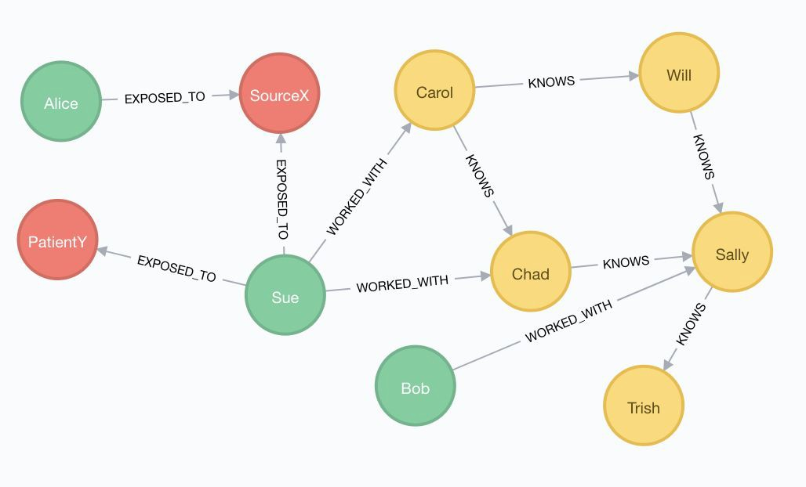

Example query: epidemic!
Assume a graph G containing doctors who have potentially been infected with a virus….
Graph databases and graph querying, Petra Selmer

Slide 16
Example query
The following Cypher query returns the name of each doctor in G who has perhaps been exposed to some source of a viral infection, the number of exposures, and the number of people known (both directly and indirectly) to their colleagues
1: MATCH (d:Doctor)
2: OPTIONAL MATCH (d)-[:EXPOSED_TO]->(v:ViralInfection)
3: WITH d, count(v) AS exposures
4: MATCH (d)-[:WORKED_WITH]->(colleague:Person)
5: OPTIONAL MATCH (colleague)<-[:KNOWS*]-(p:Person)
6: RETURN d.name, exposures, count(DISTINCT p) AS thirdPartyCount
Graph databases and graph querying, Petra Selmer

Slide 17
Example query
1: MATCH (d:Doctor)
2: OPTIONAL MATCH (d)-[:EXPOSED_TO]->(v:ViralInfection)
Matches all :Doctors, along with whether or not they have been :EXPOSED_TO a :ViralInfection
OPTIONAL MATCH analogous to outer join in SQL Produces rows provided entire pattern is found
If no matches, a single row is produced in which the binding for v is null
d | v
Sue | SourceX
Sue | PatientY
Alice | SourceX
Bob | null
Although we show the name property (for ease of exposition), it is actually the node that gets bound
Graph databases and graph querying, Petra Selmer

Slide 18
Example query
3: WITH d, count(v) AS exposures
WITH projects a subset of the variables in scope - d - and their bindings onwards (to 4).
WITH also computes an aggregation:
d is used as the grouping key implicitly (as it is not aggregated) for count() All non-null values of v are counted for each unique binding of d
Aliased as exposures
The variable v is no longer in scope after 3
d | exposures
Sue | 2
Alice | 1
Bob | 0
This binding table is now the driving table for the MATCH in 4
Graph databases and graph querying, Petra Selmer

Slide 19
Example query
4: MATCH (d)-[:WORKED_WITH]->(colleague:Person)
Uses as driving table the binding table from 3 Finds all the colleagues (:Person) who
have :WORKED_WITH our doctors
d | exposures | colleague
Sue | 2 | Chad
Sue | 2 | Carol
Bob | 0 | Sally
Graph databases and graph querying, Petra Selmer

Slide 20
Example query
5: OPTIONAL MATCH (colleague)<-[:KNOWS*]-(p:Person)
Finds all the people (:Person) who :KNOW our doctors’ colleagues (only in the one direction), both directly and indirectly (using :KNOWS* so that one or more relationships are traversed)
No Carol)<-[:KNOWS]-() pattern in G
d | exposures | colleague | p
Sue | 2 | Chad | Carol
Sue | 2 | Carol | null
Bob | 0 | Sally | Will
Bob | 0 | Sally | Chad
Bob | 0 | Sally | Carol*
Bob | 0 | Sally | Carol*
* This is due to the :KNOWS* pattern: Carol is reachable from
Sally via Chad and Will
(Carol :KNOWS Will and Chad)
Graph databases and graph querying, Petra Selmer

Slide 21
Example query results
1: MATCH (d:Doctor)
2: OPTIONAL MATCH (d)-[:EXPOSED_TO]->(v:ViralInfection)
3: WITH d, count(v) AS exposures
4: MATCH (d)-[:WORKED_WITH]->(colleague:Person)
5: OPTIONAL MATCH (colleague)<-[:KNOWS*]-(p:Person)
6: RETURN d.name, exposures, count(DISTINCT p) AS thirdPartyCount
+-------------------------------------------+
| d.name | exposures | thirdPartyCount |
+-------------------------------------------+
+-------------------------------------------+
| Bob | | | 0 | | 3 (Will, Chad, Carol)|
| Sue | | | 2 | | 1 (Carol) |
Graph databases and graph querying, Petra Selmer

Slide 22
Other functionality
Aggregating functions
count(), max(), min(), avg()
Operators
Mathematical, comparison, string-specific, boolean, list Map projections
Construct a map projection from nodes, relationships and properties
CASE expressions
Functions (scalar, list, mathematical, string, UDF, procedures)
Graph databases and graph querying, Petra Selmer

Slide 23
Property graphs are everywhere
Many implementations
Amazon Neptune, Oracle PGX, Neo4j Server, SAP HANA Graph, AgensGraph (over PostgreSQL), Azure CosmosDB, Redis Graph, SQL Server 2017 Graph, Cypher for Apache Spark, Cypher for Gremlin, SQL Property Graph Querying, TigerGraph, Memgraph, JanusGraph, DSE Graph, ...
Multiple languages
ISO SC32.WG3
Neo4j LDBC
Oracle W3C
Tigergraph
SQL PGQ (Property Graph Querying) openCypher
G-CORE (augmented with paths) PGQL
SPARQL (RDF data model)
SQL 2020
Participation from major DBMS vendors.
Neo4j’s contributions freely available*.
GSQL
...also imperative and analytics-based languages
* http://www.opencypher.org/references#sql-pg
Graph databases and graph querying, Petra Selmer

Slide 24
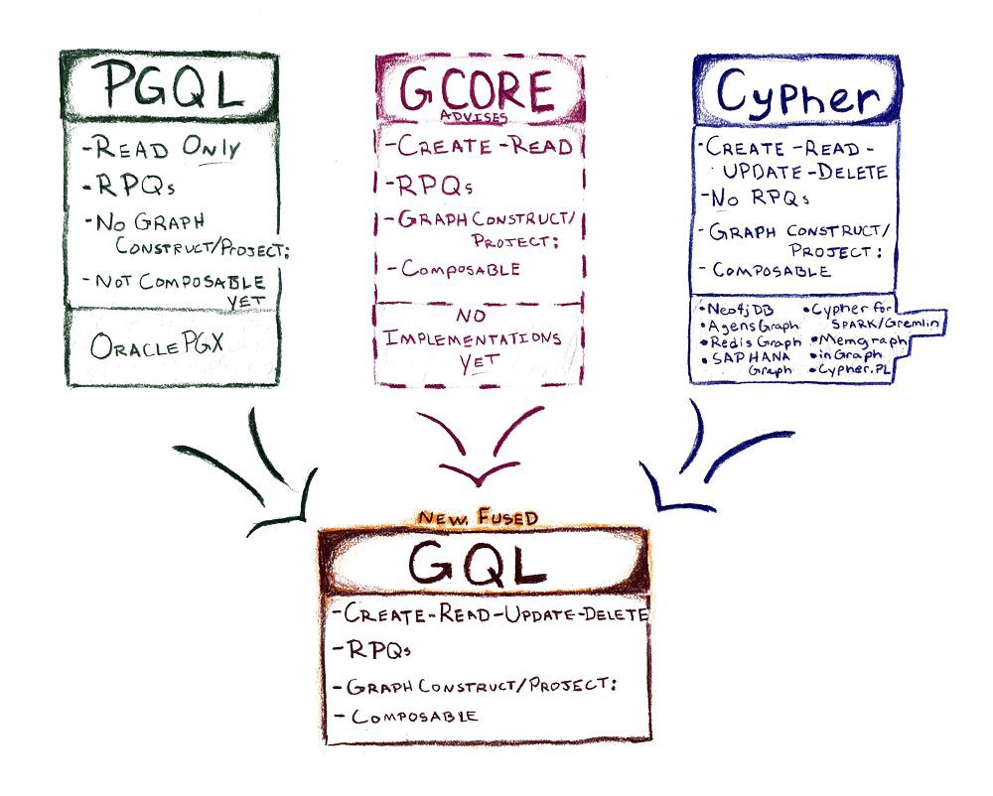
A new stand-alone / native query language for graphs
Graph Query Language (GQL)
Graphs first, not graphs “extra”
Targets the labelled PG model
Composable graph query language with support for updating data
Based on
“Ascii art” pattern matching
Published formal semantics (Cypher, G-CORE)
SQL PG extensions and SQL-compatible foundations (some data types, some functions, ...)
https://www.gqlstandards.org
GQL Documents also available at http://www.opencypher.org/references#sql-pg
Graph databases and graph querying, Petra Selmer

Slide 25
Example GQL Query
//from graph or view ‘friends’ in the catalog
FROM friends
//match persons ‘a’ and ‘b’ who travelled together
MATCH (a:Person)-[:TRAVELLED_TOGETHER]-(b:Person)
WHERE a.age = b.age
AND a.country = $country
AND b.country = $country
Illustrative syntax only!
//from view parameterized by country
FROM census($country)
//find out if ‘a’ and ‘b’ at some point moved to or were born in a place ‘p’
MATCH SHORTEST (a)-[:BORN_IN|MOVED_TO*]->(p)<-[:BORN_IN|MOVED_TO*]->(b)
//that is located in a city ‘c’
MATCH (p)-[:LOCATED_IN]->(c:City)
//aggregate the number of such pairs per city and age group
RETURN a.age AS age, c.name AS city, count(*) AS num_pairs
GROUP BY age
Regular path
queries
Graph databases and graph querying, Petra Selmer

Slide 26
Complex path patterns
Regular path queries (RPQs)
X, (likes.hates)*(eats|drinks)+, Y
Find a path whose edge labels conform to the regular expression, starting at node X and ending at node Y
(X and Y are node bindings)
Plenty of research in
this area since 1987!
SPARQL 1.1 has
support for RPQs: “property paths”
I. F. Cruz, A. O. Mendelzon, and P. T. Wood
A graphical query language supporting recursion
In Proc. ACM SIGMOD, pages 323–330, 1987
Graph databases and graph querying, Petra Selmer

Slide 27
Complex paths in the property graph data model
Property graph data model:
Properties need to be considered
Node labels need to be considered
Concatenation
a.b - a is followed by b
Alternation
a|b - either a or b
Transitive closure
* - 0 or more
+ - 1 or more
{m, n} - at least m, at most n
Optionality:
? - 0 or 1
Grouping/nesting
() - allows nesting/defines scope
Specifying a cost for paths (ordering and comparing)
Path patterns (e.g., GXPATH)
L. Libkin, W. Martens, and D. Vrgoč
Querying Graphs with Data
ACM Journal, pages 1-53, 2016
Graph databases and graph querying, Petra Selmer

Slide 28
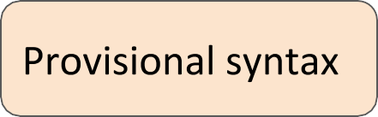
Composition of Path Patterns
Sequence / Concatenation:
Alternation / Disjunction: Transitive closure:
or more
or more n or more
At least n, at most m
()-/ 𝛂 𝛃 /-()
()-/ 𝛂 |𝛃 /-()
()-/ 𝛂* /-()
()-/ 𝛂+ /-()
()-/ 𝛂*n.. /-()
()-/ 𝛂*n..m /-()
Overriding direction for sub-pattern:
Left to right direction Right to left direction Any direction
()-/ 𝛂 > /-()
()-/ < 𝛂 /-()
()-/ < 𝛂 > /-()
28
Graph databases and graph querying, Petra Selmer

Slide 29
Path Pattern: example
PATH PATTERN
older_friends = (a)-[:FRIEND]-(b)
WHERE b.age > a.age
MATCH p=(me)-/~older_friends+/-(you)
WHERE me.name = $myName AND you.name = $yourName
RETURN p AS friendship
Graph databases and graph querying, Petra Selmer

Slide 30
Nested Path Patterns: Example
PATH PATTERN
older_friends = (a)-[:FRIEND]-(b) WHERE b.age
> a.age
PATH PATTERN
same_city = (a)-[:LIVES_IN]->(:City)<-[:LIVES_IN]-(b)
PATH PATTERN
older_friends_in_same_city = (a)-/~older_friends/-(b)
WHERE EXISTS { (a)-/~same_city/-(b) }
Graph databases and graph querying, Petra Selmer

Slide 31
Cost function for cheapest path search
PATH PATTERN road = (a)-[r:ROAD_SEGMENT]-(b) COST r.length
MATCH route = (start)-/~road*/-(end)
WHERE start.location = $currentLocation
AND end.name = $destination
RETURN route
ORDER BY cost(route) ASC LIMIT 3
Graph databases and graph querying, Petra Selmer

Slide 32
“Cyphermorphism”
Usefulness proven in practice over multiple industrial verticals: we have not seen any worst-case examples
Pattern matching today uses edge isomorphism (no repeated relationships)
:Person
{ name : Jack }
:Person
{ name : Anne }
:Person
{ name : Tom }
:FRIEND
:FRIEND
MATCH (p:Person {name: Jack})-[r1:FRIEND]-()-[r2:FRIEND]-(friend_of_a_friend)
RETURN friend_of_a_friend.name AS fofName
+---------+
| fofName |
+---------+
| “Tom” |
+---------+
Rationale was to avoid potentially returning infinite results for varlength patterns when matching graphs containing cycles (this would have been different if we were just checking for the existence of a path)
r1 and r2 may not be bound to the same relationship within the same pattern
Graph databases and graph querying, Petra Selmer

Slide 33
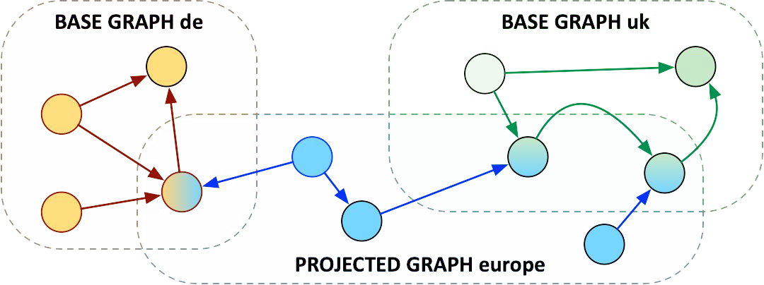
Graph projection
Sharing elements in the projected graph Deriving new elements in the projected graph
Shared edges always point to the same (shared) endpoints in the projected graph
Graph databases and graph querying, Petra Selmer

Slide 34
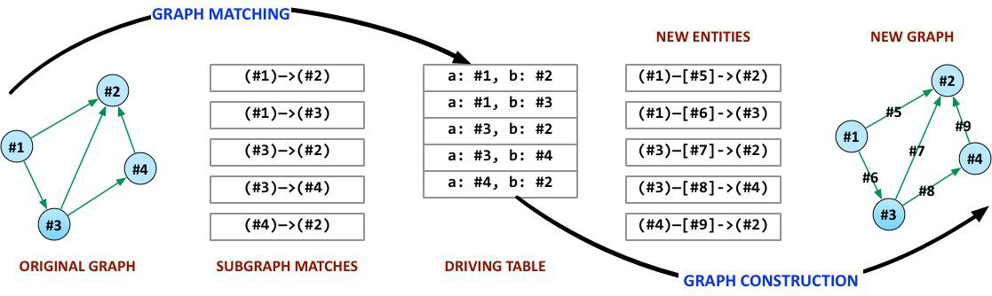
Projection is the inverse of pattern matching
Turns graphs into matches for the pattern
Turns matches for the pattern back into graphs
34
Graph databases and graph querying, Petra Selmer

Slide 35
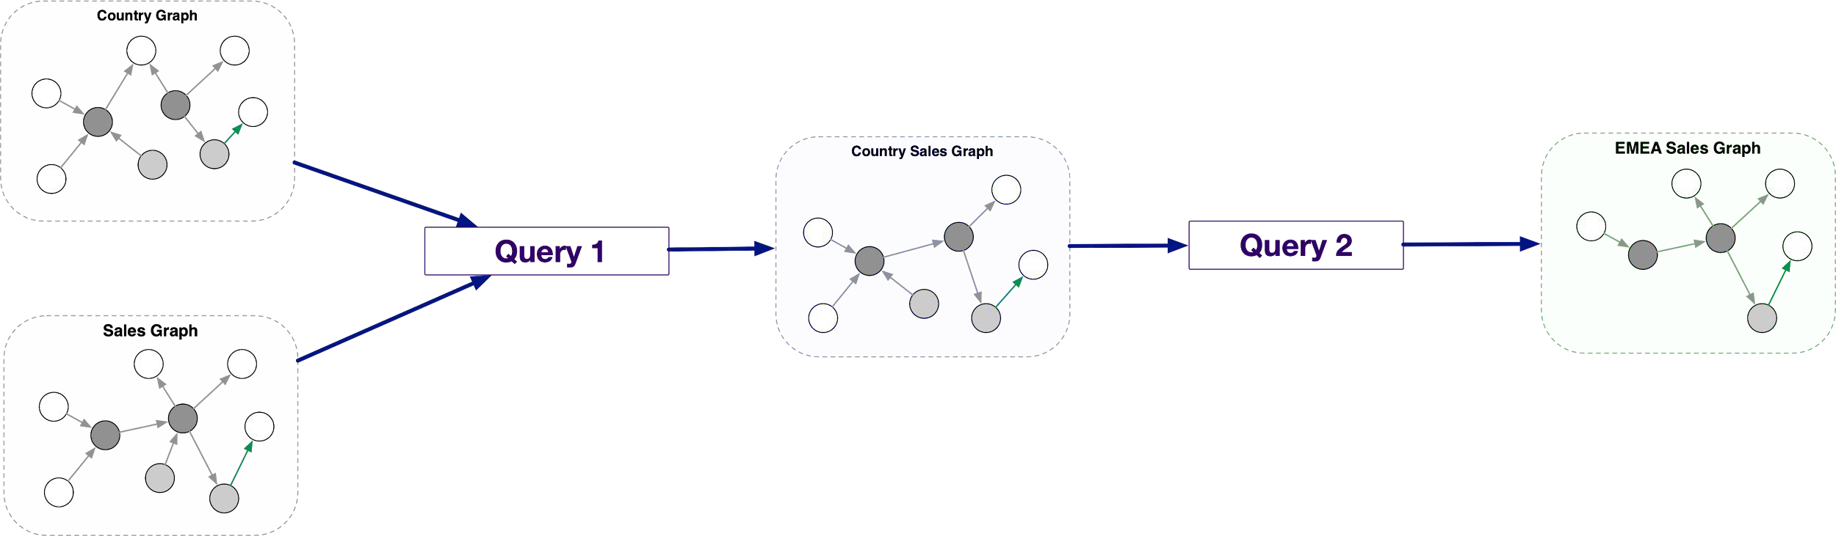
Queries are composable procedures
Use the output of one query as input to another to enable abstraction and views
Applies to queries with tabular output and graph output
Support for nested subqueries
Extract parts of a query to a view for re-use
Replace parts of a query without affecting other parts
Build complex workflows programmatically
Graph databases and graph querying, Petra Selmer

Slide 36
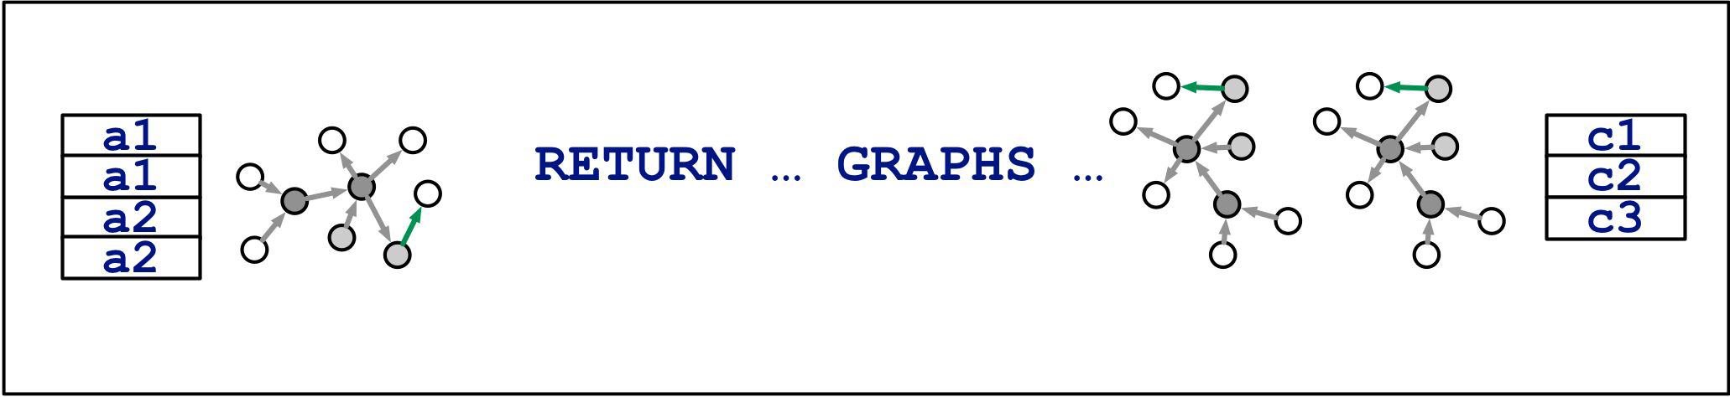
Implications
Pass both multiple graphs and tabular data into a query
Return both multiple graphs and tabular data from a query Select which graph to query
Construct new graphs from existing graphs
Graph databases and graph querying, Petra Selmer

Slide 37
Acknowledgements for slides 38-48
Slides are taken from the following Presentation
Emerging Graph Queries in Linked Data
  Arijit Khan, Yinghui Wu, Xifeng Yan
  Department of Computer Science
  University of California, Santa Barbara
All errors are mine
Emerging Graph Queries in Linked Data, Arijit Khan, Yinghui Wu, Xifeng Yan

Slide 38

Graph Search Queries
Retrieves all graphs from a graph database, such that they contain a given query graph (exact and approximate).
Containment Query
Similarity Query
Matching Query
Q
G₁
G₂
Emerging Graph Queries in Linked Data, Arijit Khan, Yinghui Wu, Xifeng Yan

Slide 39
Graph Search Queries
Retrieves all graphs from a graph database, that are similar to the query graph (exact and approximate).
Containment Query
Similarity Query
Matching Query
Q
G₁
G₂
Emerging Graph Queries in Linked Data, Arijit Khan, Yinghui Wu, Xifeng Yan

Slide 40
Graph Search Queries
Find all occurrences of a query graph in a large target network (exact and approximate).
Containment Query
Similarity Query
Matching Query
Q
G
Emerging Graph Queries in Linked Data, Arijit Khan, Yinghui Wu, Xifeng Yan

Slide 41
Containment Query
Subgraph Isomorphism Problem is NP-hard.
Filtering and Verification
Filtering Phase:
Feature-based index is used to filter out the negative results and generate candidate sets.
Verification Phase:
Precise Subgraph Isomorphism Testing to generate final results from the candidate set.
Q
G₁
G₂
G₁
---
Q
Containment Query
G₁
G₂
Q
G₁
G₂
---
G₁
---
Q
G₁
G₂
---
Edge Based Index
Filtering
Emerging Graph Queries in Linked Data, Arijit Khan, Yinghui Wu, Xifeng Yan

Slide 42

Similarity Query
Graph Isomorphism is neither known to be Polynomial or NP-Complete
Graph Edit Distance NP-hard
Q
Maximum Common Subgraph (MCS) based approach.
  | d( Q, MCS(Q,G₁) ) | = 2
  | d(G₁, MCS(Q,G₁)) | = 2
  Δ = |d( Q, MCS(Q,G₁) )| +
  |d(G₁, MCS(Q,G₁))| = 4
Maximum Common Subgraph (MCS) based approach.
  Δ = |d( Q, MCS(Q,G) )| +
  |d(G, MCS(Q,G))|
  MCS is NP-hard.
  Efficiently Finding MCS of two large networks (Approximate) - Zhu et al., CIKM ’11
  Indexing based on MCS in Filtering Phase – Zhu et. al., EDBT ‘12
G₁
  | d( Q, MCS(Q,G₂) ) | = 0
  | d(G₂, MCS(Q,G₂)) | = 10
  Δ = |d( Q, MCS(Q,G₁) )| +
  |d(G₁, MCS(Q,G₁))| = 10
G₂
42
Emerging Graph Queries in Linked Data, Arijit Khan, Yinghui Wu, Xifeng Yan

Slide 43
Similarity Query
Kernel Based Approach.
Measure similarity of two graphs by comparing their substructures.
Map two graphs G₁ and G₂ via mapping φ into feature space H.
a
r
φ ≡ length of all walks between every ordered pair of labels.
e.g., φ_{(c , a)} = φ_{(a , r)} = φ_{(r , t)} = 1
φ_{(a , t)} = 1+2 = 3
φ_{(c , t)} = 2+3 = 5
φ_{(c , c)} = 0 etc.
c
t
Measure their similarity in H as scalar product <φ(G₁), φ(G₂)> .
Kernel Trick: Compute inner product in H as kernel in input space k(G₁, G₂) = <φ(G₁), φ(G₂)> ; e.g., compute walks in the product graph G₁×G₂ .
- Positive Definite.
43
Emerging Graph Queries in Linked Data, Arijit Khan, Yinghui Wu, Xifeng Yan

Slide 44
Similarity Query
Complete Graph Kernel: Let k(G₁, G₂) = <φ(G₁),φ(G₂)> be a graph kernel. If φ is injective, k is called a complete graph kernel.
Example: The graph kernel that has one feature Φ_{H} for each possible graph H, each feature Φ_{H}(G) measuring how many subgraphs of G have the same structure as graph H.
The above example of Complete Graph Kernel is NP-hard.
Theorem: Computing any complete graph kernel is at least as hard as deciding whether two graphs are isomorphic [Gärtner et. al., COLT ‘03]
44
Emerging Graph Queries in Linked Data, Arijit Khan, Yinghui Wu, Xifeng Yan

Slide 45
Graph Kernels
Polynomial Time Computable Graph Kernels:
Random Walk - Kashima et al., ICML ’03
- Gaertner et al., COLT ’03
- Mahe et al., ICML ’04
- Vishwanathan et al., NIPS ‘06
Shortest Path - Borgwardt et. al., ICDM ‘05
Optimal assignment kernel - Froehlich et al, ICML ‘05
[NOT Positive definite, Vert, ‘08]
Weighted Decomposition Kernel - Menchetti et al., ICML ’05
Edit-Distance Kernel - Neuhaus et. al., SSPR/SPR ‘06
Subtree Kernel - Ramon et. al., Mining Graphs, Trees and Sequences ’04
- Shervashidze et. al., NIPS ’09
Cyclic Pattern Kernel - Horvath et al., KDD ’04
Neighborhood Kernel - Wang et. al., EDBT ’09
45
Emerging Graph Queries in Linked Data, Arijit Khan, Yinghui Wu, Xifeng Yan

Slide 46
Graph Pattern Mining
Given a graph dataset D, find all subgraphs g, s.t.
freq(g) ≥ θ
Where freq(g) is the (relative) number of graphs that contain g.
c
c
a
b
e
a
a
b
c
e
d
d
a
b
d
f
f
f
d
G₁
G₂
G₃
G₄
a
b
c
a
b
b
c
c
Θ=3
a
b
d
a
b
b
d
d
c
b
d
Emerging Graph Queries in Linked Data, Arijit Khan, Yinghui Wu, Xifeng Yan

Slide 47
Why Mine Graph Patterns?
Direct Use:
  Mining over-represented sub-structures in chemical databases.
  Mining conserved sub-networks.
  Program control flow analysis.
Indirect Uses:
  Index the data graph and query graph using local features.
  Building block of further analysis, i.e., Classification, Clustering, Similarity Searches, Indexing
Emerging Graph Queries in Linked Data, Arijit Khan, Yinghui Wu, Xifeng Yan

Slide 48
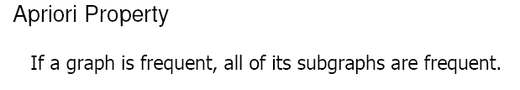
Why is Graph Mining Hard?
The search space is huge.
A graph with e edges has 2e subgraphs.
Exponential search space + graph isomorphism + subgraph isomorphism.
a
b
c
a
a
a
b
a
c
b
b
b
c
c
c
a
a
a
a
b
a
b
a
b
a
c
a
b
b
b
b
c
b
a
a
b
a
b
b
c
a
b
a
c
b
b
b
c
b
c
c
a
a
c
a
b
c
b
a
c
a
c
c
b
c
a
c
c
c
Pattern Search Tree
Emerging Graph Queries in Linked Data, Arijit Khan, Yinghui Wu, Xifeng Yan

Slide 49
Summary
Graph database language
  Cypher and others → GQL
Hardness results
Implementation issues
  Containment and matching
    Indexing / filtering (still false positive, no false negatives)
    Verification (eliminate false positives)
  Similarity
    Mapping into feature space
    with polynomial graph kernels
Graph mining

