Slide 1
Non-Standard-Datenbanken und Data Mining
Learned Index Structures
Prof. Dr. Ralf Möller
Universität zu Lübeck
Institut für Informationssysteme

Slide 2
Acknowledgements
Paper by Tim Kraska, Alex Beutel, Ed H. Chi, Jeffrey Dean, Neoklis Polyzotis
Presentations taken from 2 talks by
Deniz Altinbuken and John Yang (CS 294, 2019), resp.
Presentations are possibly adapted or extended
All faults are mine
Tim Kraska, Alex Beutel, Ed H. Chi, Jeffrey Dean, and Neoklis Polyzotis. 2018. The Case for Learned Index Structures. In Proc. of the 2018 International Conference on Management of Data (SIGMOD '18). 2018.

Slide 3
Main Idea
Assumption:
A model can be learned from specific data to
encode the sort order of lookup keys
Goal:
The model is to be used to effectively
predict the position or existence of records, such that …
… data records can be found approximately
or with minimal search (in case completeness matters)
3

Slide 4
Recap: Index Structures
Predict the location of a value given a key
  B-tree (range index)
    Model that takes a key as input and predicts the position of the first data record in a range such that the specified range of records is found with minimal search (scan)
  Hashmap
    Model that takes a key as input and predicts the position of a single data record (search in case of collisions)
  Bloom filter
    Binary classifier model, which, given a key,
    predicts if a key exists in a set or not (but with false positives)
4

Slide 5
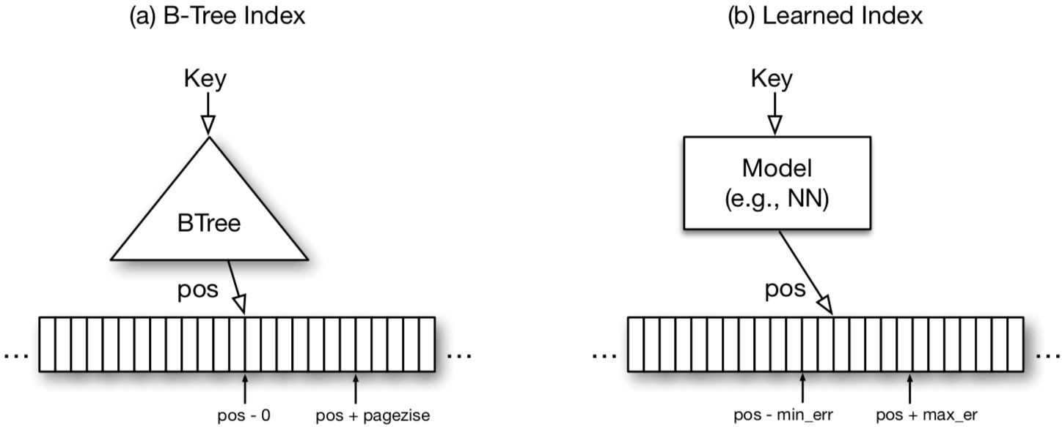
B-Tree
The B-tree provides a mapping from a lookup key into a position inside the sorted array of records (in case of a so-called clustered b-tree) or to the first page on disk to access
For efficiency, index to page granularity
Map a key to a position with
min and max error
5

Slide 6
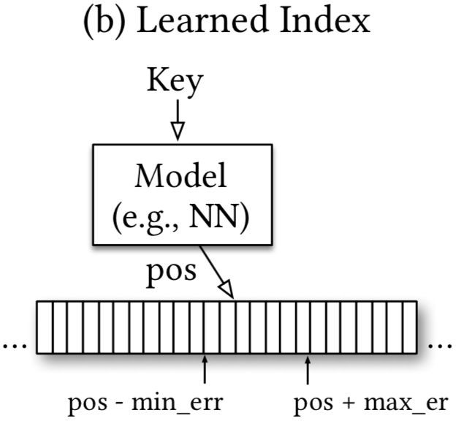
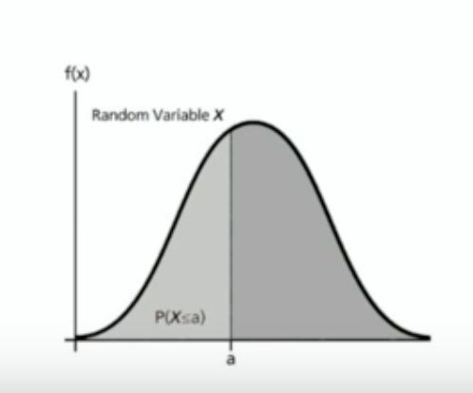
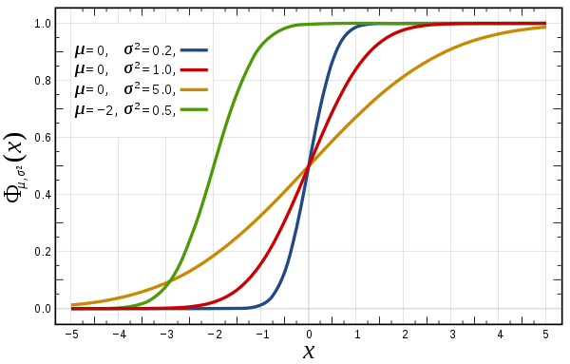
Key Idea
B-Trees as a Cumulative Distribution Function
Predicted Position = P(x < key) * # of Keys
Need to scan to the left as well as to the right in order to be complete
(doubly linked list of pages required)
If completeness required, scan starts too early:
more overhead
6

Slide 7
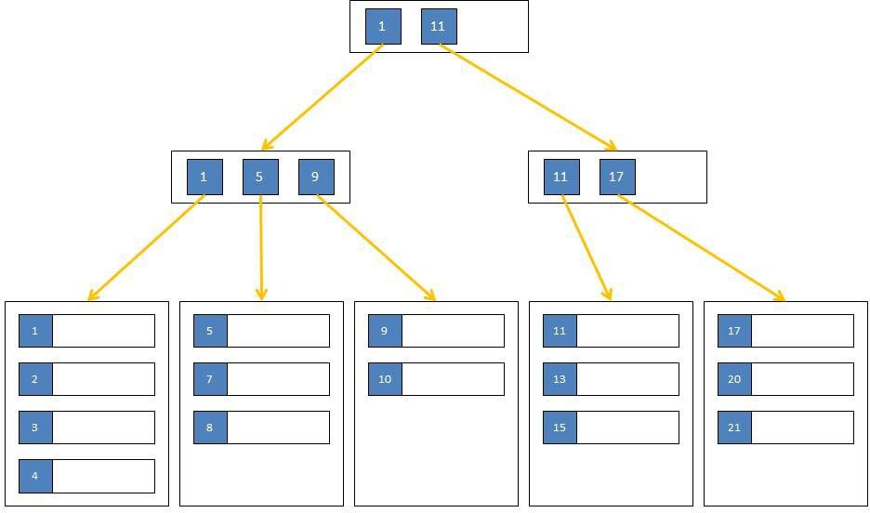
Challenges
Replace index structures such as B-trees with ML models providing guarantees about min and max error
Retain properties of B-trees
  Bounded cost for inserts and lookups
  Taking advantage of caches
  Map keys to pages
  that are not necessarily
  continuously mapped
  to memory or disk
CPU Cache
Main Memory
Disk / Main Memory
7

Slide 8
ML-derived models
Using ML models has the potential to transform
log n B-tree look-up costs into constant costs
(in the best case)
For instance, networks are able to learn a variety of multidimensional data distributions, mixtures and other data peculiarities
  Distributions allow for the estimation of positions
  Error estimations, e.g., by
  Markov, Chebyshev, Hoeffding, or Chernoff inequations
Balance the complexity of a model
with its accuracy and the complexity of acquiring the model
8

Slide 9
First Approach
Tensorflow implementation of B-Tree-like index
200M Web Server Log Records sorted by Timestamp
2 layer network, 32-width fully connected, ReLU activation function
Given the timestamp, predict the position!
Results:
Tensorflow: 1250 Predictions / Sec ~ 80000 ns Lookup
B-Trees: 300 ns Lookup,
900 ns w/ binary search across entire data set
Daunting?
Tim Kraska, Alex Beutel, Ed H. Chi, Jeffrey Dean, and Neoklis Polyzotis. 2018. The Case for Learned Index Structures. In Proc. of the 2018 International Conference on Management of Data (SIGMOD '18). 2018.
9

Slide 10

The Recursive Model Index
Improve last-mile accuracy
Reducing min/max error to 100 from 100M records using a single model is very hard
Reducing the error to 10k from 100M is much easier to achieve even with simple models
Reducing the error from 10k to 100 is simpler as the model can focus only on a subset of the data
Use a hierarchical approach where we can have models focus on smaller subsets of data.
10

Slide 11
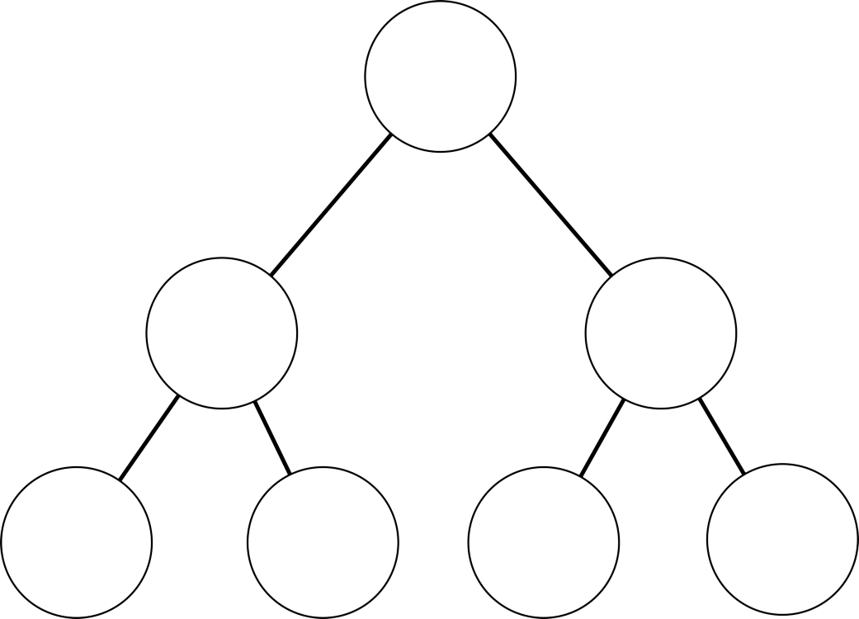
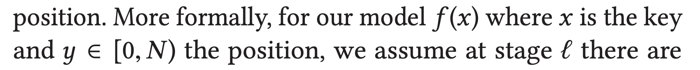
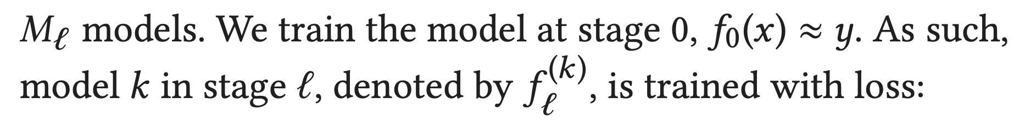
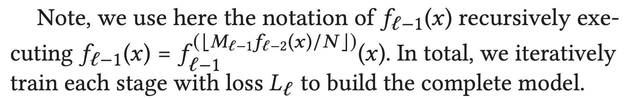
Recursive Model Index (RMI)
Problem: Accuracy of Last Mile Search
1.5 Million Records,
~60 Cycles
Solution: Recursive Regression Model
Idea: Reduce error across a hierarchy of models focusing on subsets of data
24K Records, 120 Cycles
Initialization
11

Slide 12
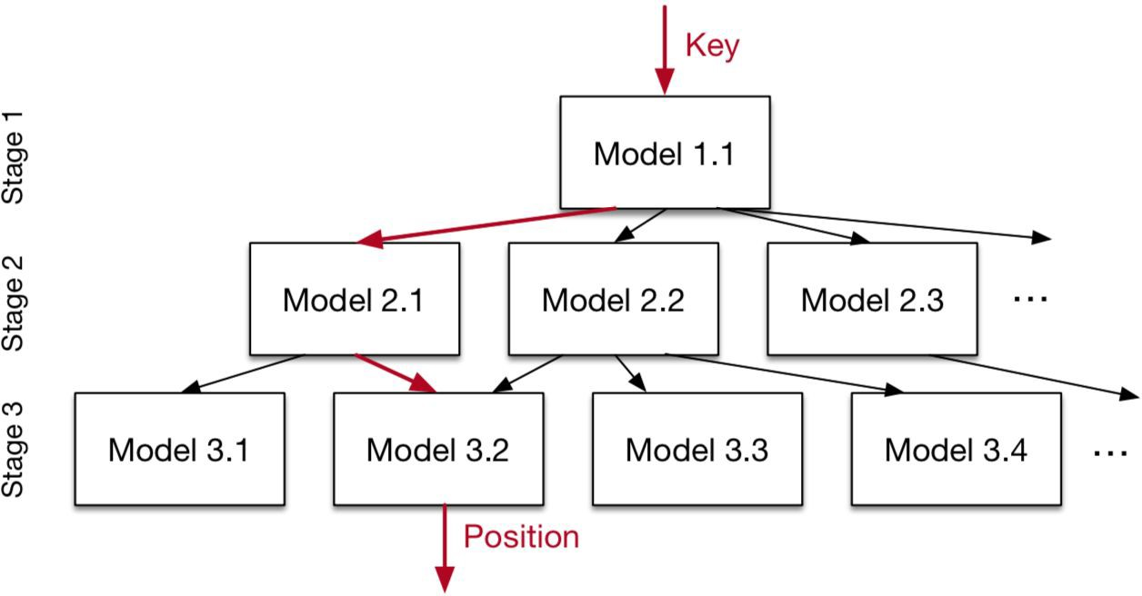
The Recursive Model Index
Take a layered approach and have models focus on limited layers:
Reduce from 100M to 1M
Reduce from 1M to 10k
Reduce from 10k to 100
12

Slide 13
Hybrid End-to-End Training
With a layered approach we can build mixtures of models!
Reduce from 100M to 1M
small ReLU NN
Reduce from 1M to 10k
Linear Regression
Linear Regression
Linear Regression
Reduce from 10k to 100
B-tree
B-tree
B-tree
B-tree
13

Slide 14
Hybrid Recursive Model Index
Problem: Specific data at the bottom of RMI may be harder to learn
Solution: Combine different models at different layers of RMI
Networks with ReLU activations at the top
Simple linear regression in the middle
Fall back on B-Trees if data is particularly difficult to learn
Tim Kraska, Alex Beutel, Ed H. Chi, Jeffrey Dean, and Neoklis Polyzotis. 2018. The Case for Learned Index Structures. In Proc. of the 2018 International Conference on Management of Data (SIGMOD '18). 2018.
14

Slide 15
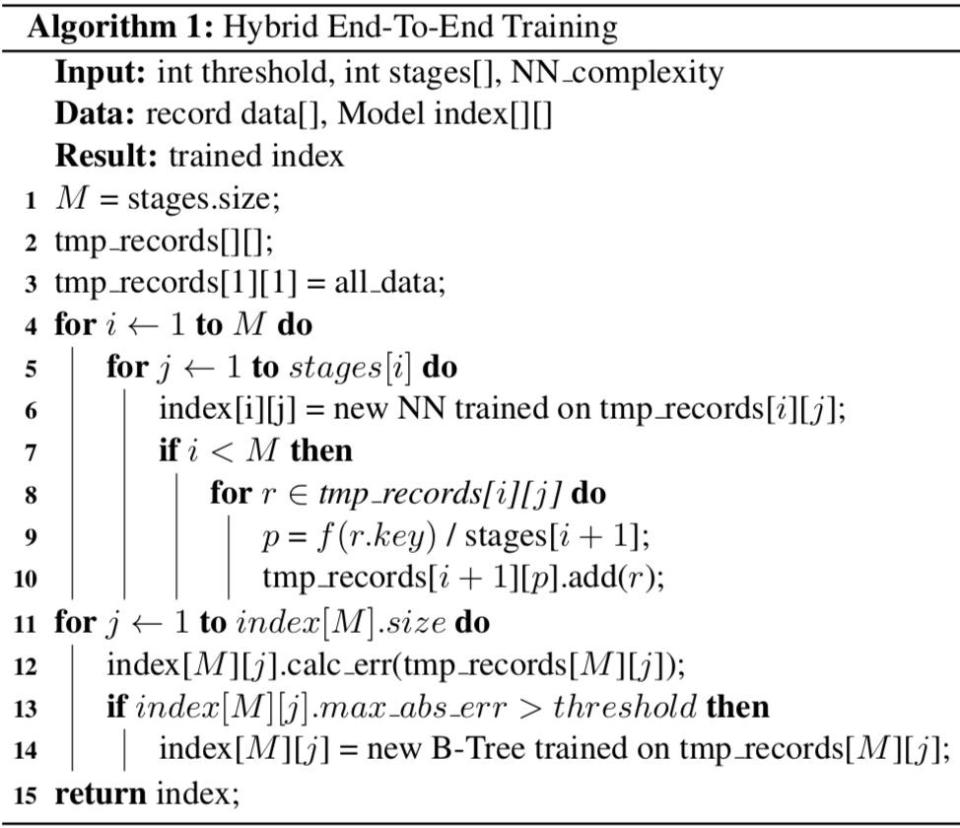
Hybrid End-to-End Training
Starting from the entire dataset (line 3), it trains first the
top-node model.
Based on the prediction of this model, it then picks the model from the next stage (lines 9 and 10) and adds all keys which fall into that model (line 10).
Finally, in the case of hybrid indexes, the index is optimized by replacing NN models with
B-trees if absolute min-/max-error is above a predefined threshold (lines 11-14).
15

Slide 16
Search Strategies
To find the record either binary search or scanning is used
Models might generate more information than page location
Model Binary Search
  Set first middle point to pos predicted by the model.
Biased Search
  Use standard deviation σ of the last stage model to set middle.
Biased Quaternary Search
  Pick three middle points as pos −σ, pos, pos + σ.
16

Slide 17
Indexing strings
Turn strings into inputs that the network model can use
  Represent string as a vector, where each element is the decimal ASCII value of a char
  Limit size of vector to N to have equally-sized inputs
Vector inputs slow the model down significantly
Further research is needed to speed up this case :)
17

Slide 18
Inserts and Updates
Appends
  No need to relearn if the model is able to
  learn the key trend for the new items
Inserts in the middle
  If inserts follow roughly a similar pattern as the learned CDF, retraining is not needed since the index “generalizes” over the new items and inserts become an O(1) operation.
18

Slide 19
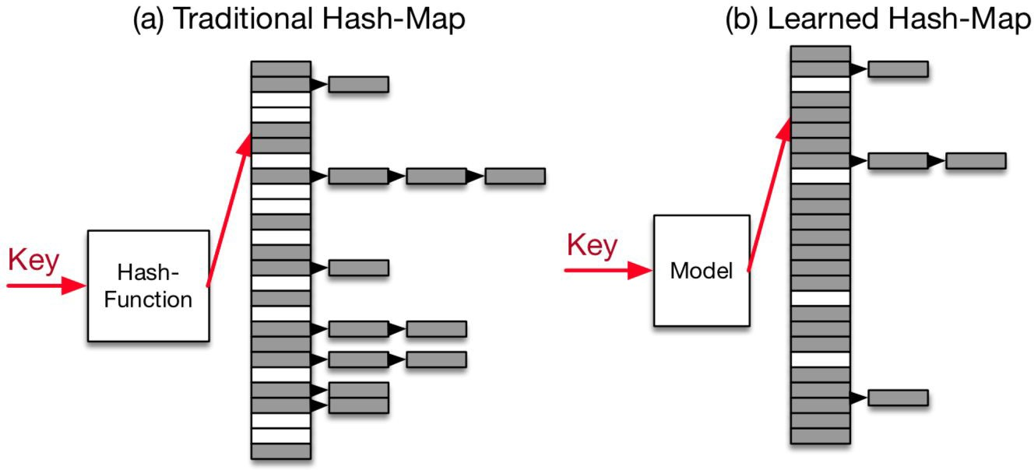
Hashmap
Hashmaps use a hash function to deterministically map keys to random positions inside an array
19

Slide 20
Hashmap
Main challenge is to reduce conflicts
Use a linked-list to handle the “overflow”
Use linear or quadratic probing
Most solutions allocate significantly more memory than records and combine it with additional data structures
20

Slide 21
Hashmap
If we could learn a model which uniquely maps every key into a unique position inside the array, we could avoid conflicts
Learned models are capable of reaching higher utilization of the hashmap depending on the learnt data distribution
Scale the distribution by the targeted size M of the hashmap and use h(K) = F(K)∗ M, K is key
If the model F perfectly learned the distribution, no conflicts would exist
21

Slide 22
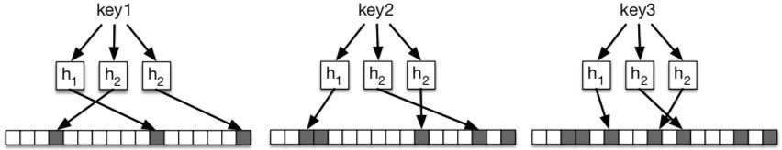
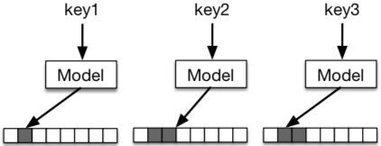
Bloom Filters and Learned Hashmaps
Bloom filters are probabilistic data structures used to test whether an element is a member of a set.
Bloom filter insertion
Learned bloom filter insertion
22

Slide 23
Bloom Filter
A bloom filter index needs to learn a function that separates keys from everything else
  A good hash function for a bloom filter can have
  lots of collisions among keys and lots of collisions among non-keys, but few collisions of keys and
  non-keys
23

Slide 24
Bloom Filter
As a classification problem: learn a model f that can predict if an input xis a key or non-key
Use sigmoid activation function
to find probability value in [0,1]
The output is the probability that input x is a key in our database
Choose a threshold t above which we will assume the key exists in our database
Tune threshold t to achieve the desired false positive rate
To prevent false negatives, use overflow bloom filter
24

Slide 25
B-tree Results
4 datasets to compare the performance of learned index structures with B-trees
  Compare lookup-time (model execution time + local search time)
  Compare index structure size
  Compare model error and error variance
These results focus on read performance only, loading and insertion time are not included
  A model without hidden layers can be trained
  on over 200M records in just few seconds
25

Slide 26
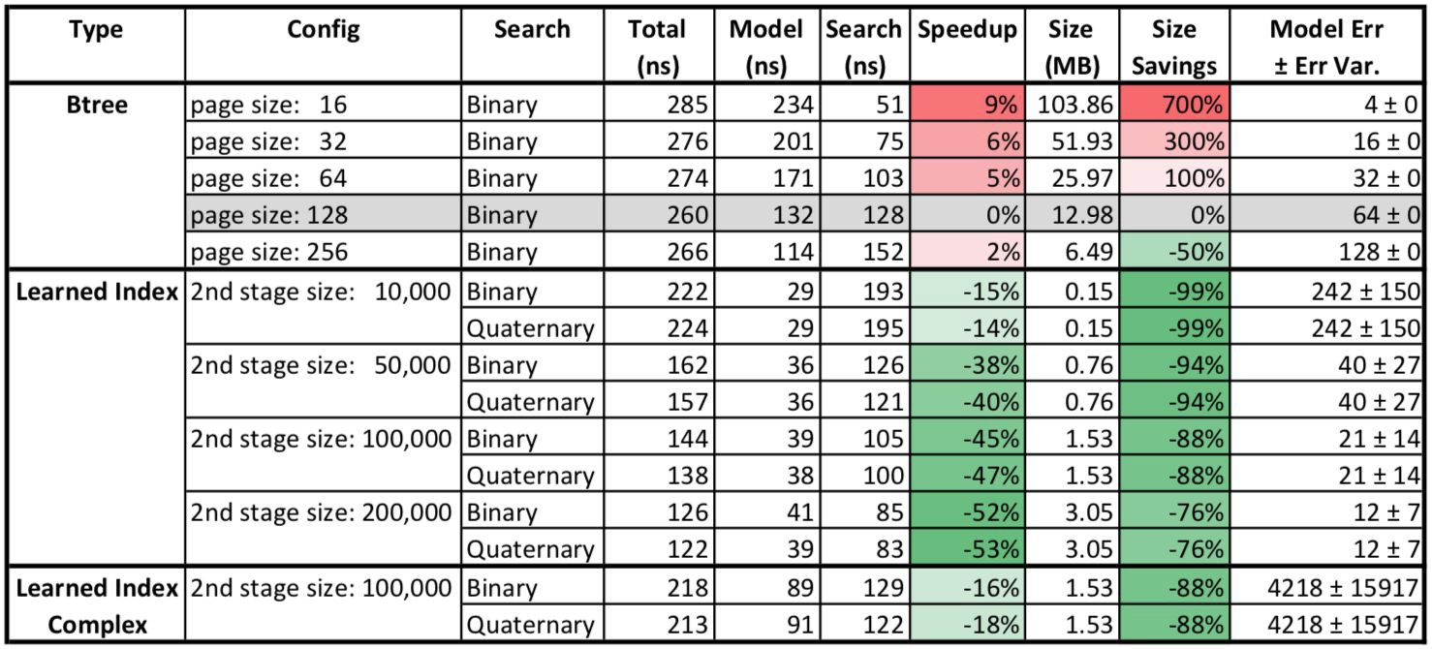
Web Log Dataset
The model error is the averaged standard error over all models on the last stage, whereas the error variance indicates how much this standard error varies between the models
200M log entries for requests to a
major university website.
Index over all unique timestamps.
Baseline
26

Slide 27
Web Log Dataset
Model is 3× faster and up to an order-of-magnitude smaller.
27

Slide 28
Web Log Dataset
Quarternary search only helps a little bit.
28

Slide 29
Web Log Dataset
The error is high, which influences the search time.
29

Slide 30
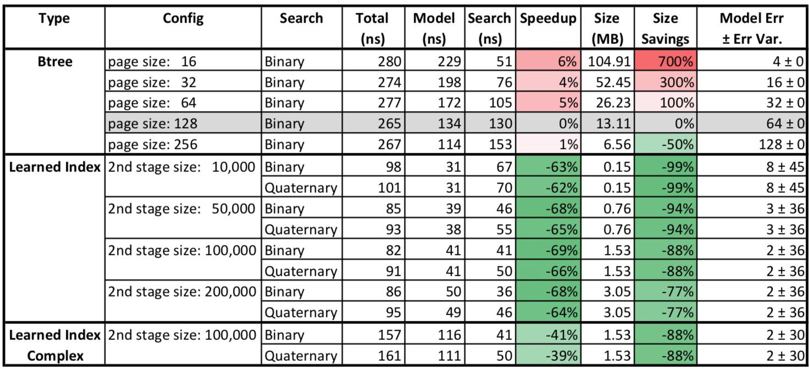
Maps Dataset
Index of the longitude of ≈ 200M user-maintained features across the world. Relatively linear.
30

Slide 31
Maps Dataset
Model is 3× faster and up to an order-of-magnitude smaller.
31

Slide 32
Maps Dataset
Quarternary search does not help.
32

Slide 33
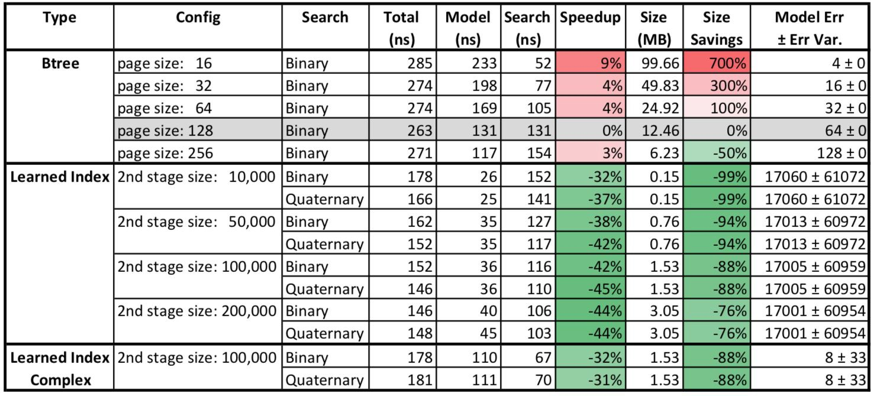
Lognormal Dataset
Synthetic dataset of 190M unique values to test how the index works on heavy-tail distributions. Highly non-linear, making the distribution more difficult to learn.
33

Slide 34
Lognormal Dataset
The error is high, which influences the search time.
34

Slide 35
Important Observations
3× faster and being up to an order-of-magnitude smaller.
Quarternary search only helps for some datasets.
The model accuracy varies widely. Most noticeable for the synthetic dataset and the weblog data the error is much higher.
Second stage size has a significant impact on the index size and lookup performance.
  This is not surprising as the second stage determines how many models have to be stored. Worth noting is that our second stage uses 10,000 or more models.
35

Slide 36
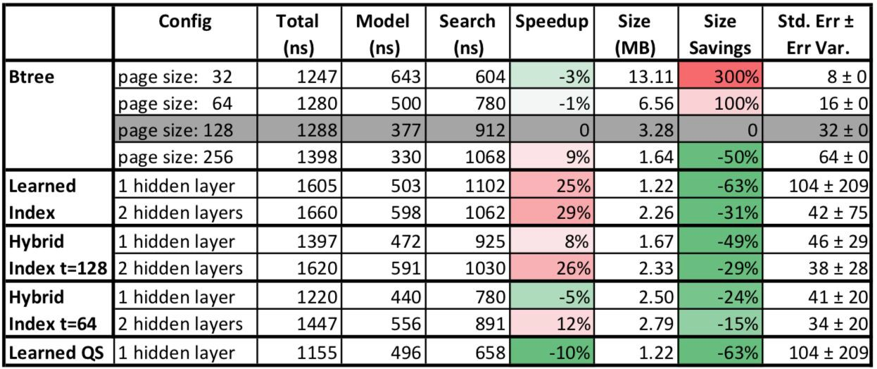
Web Document Dataset
The web-document dataset consists of the 10M non-continuous document-ids of a large web index used as part of a real product at a large internet company.
36

Slide 37
Web Document Dataset
Speedups for learned indexes is not as prominent, so hybrid indexes, which replace bad performing models with B-trees actually help to improve performance.
37

Slide 38
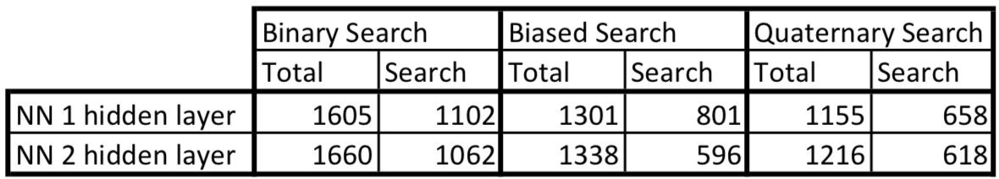
Web Document Dataset
Because cost of searching is higher, the different search strategies make a bigger difference. The reason why biased search and quaternary search performs better is that they can take the standard error into account.
38

Slide 39
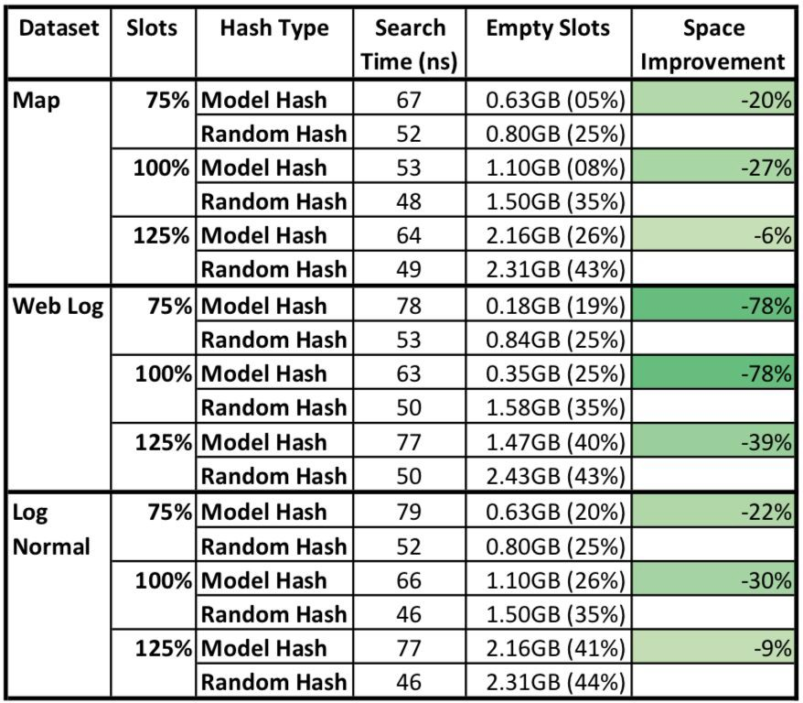
Hashmap Results
Use 3 int datasets.
Model hash has similar performance and utilizes the memory better.
When there are extra slots, the improvement disappears.
39

Slide 40
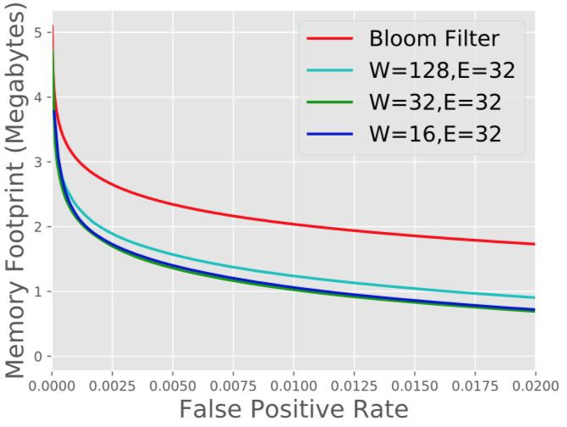
Bloom filter Results
Blacklisted phishing URLs dataset: 1.7M unique URLs.
The more accurate the model is, the better the savings in bloom filter size.
40

Slide 41
Bloom filter Results
A normal Bloom filter with a desired 1% false positive rate requires 2.04MB.
For a 16-dim GRU with a 32-dim embedding for each character; the model is 0.0259MB, with the spillover it is 1.07 MB.
41

Slide 42
Conclusion
Well known “static” structures perform surprisingly well
It is quite difficult to be faster with learning…
… and hierarchies of index function are pretty complex
But there is light at the end of the tunnel
Learning index structures
is just at the beginning

Slide 43
Future Work
Multi-Dimensional Indexes:
  Extend learned indexes
  to multi-dimensional index structures.
  Network models, especially ConvNets, are extremely good at capturing complex high-dimensional relationships
Learned Algorithms: A model can also speed-up sorting and joins, not just indexes
GPU/TPUs: GPU/TPUs will make the idea of learned indexes even more viable
43

