Slide 1
Einführung in
Web- und Data-Science
Time Series Analysis – ARIMA
Prof. Dr. Ralf Möller
Universität zu Lübeck
Institut für Informationssysteme

Slide 2
Acknowledgements
Introduction to Time Series Analysis, Raj Jain, Washington University in Saint Louis
http://www.cse.wustl.edu/~jain/cse567-13/

Slide 3
Time Series: Definition
Time series = stochastic process = sequence of randvars
A sequence of observations over time
Examples:
  Price of a stock over successive days
  Sizes of video frames
  Sizes of packets over network
  Sizes of queries to a database system
  Number of active virtual machines in a cloud
  …
x_{t}
Time t
Washington University in St. Louis
http://www.cse.wustl.edu/~jain/cse567-13/
©2013 Raj Jain

Slide 4
Introduction
Two questions of paramount importance when a data scientist examines time series data:
  Do the data exhibit a discernible pattern?
  Can this be exploited to make meaningful forecasts?

Slide 5
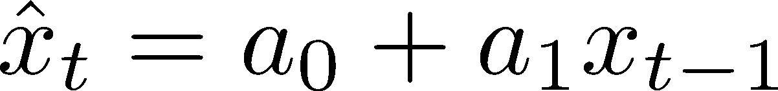
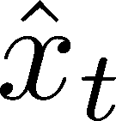
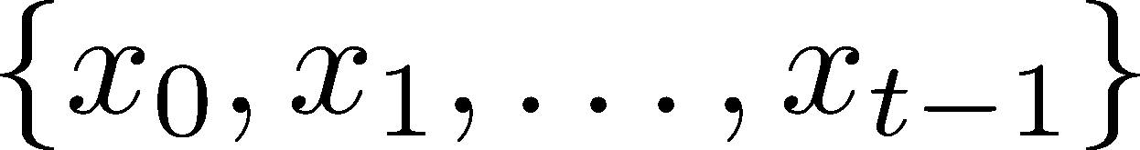
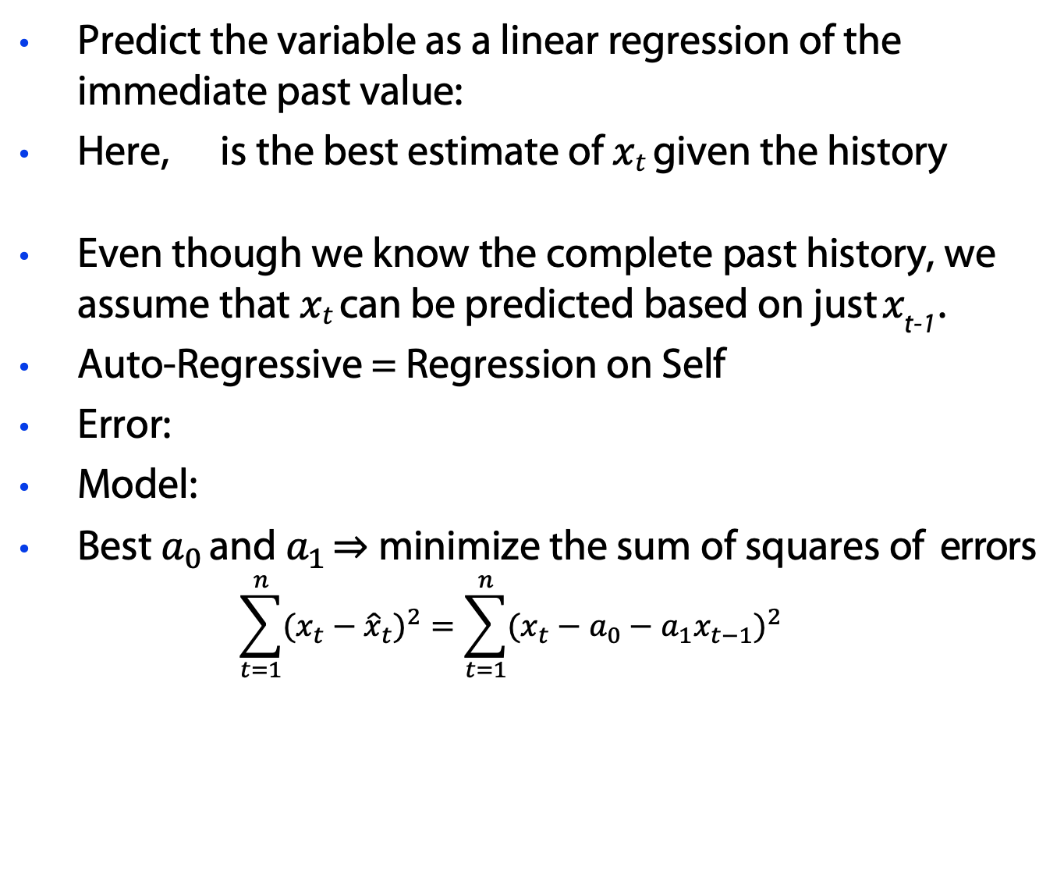
Autoregressive Models
Predict the variable as a linear regression of the immediate past value:
Here, is the best estimate of $xt$ given the history
Even though we know the complete past history, we assume that $xt$ can be predicted based on just $x_{\text{t}\text{−1}}$.
Auto-Regressive = Regression on Self
Error:
Model:
Best $a_{0}$ and $a_{1}$ ⇒ minimize the sum of squares of errors
$\sum_{t=1}^{n}{{(x_{t}−{\hat{x}}_{t})}^{2}}=\sum_{t=1}^{n}{{(x_{t}−a_{0}−a_{1}x_{t−1})}^{2}}$
Washington University in St. Louis
http://www.cse.wustl.edu/~jain/cse567-13/
©2013 Raj Jain

Slide 6
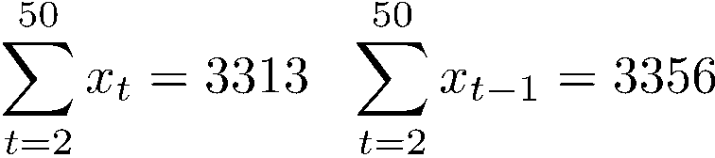
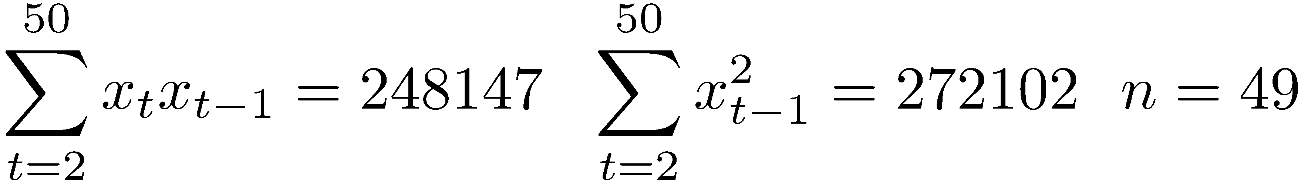
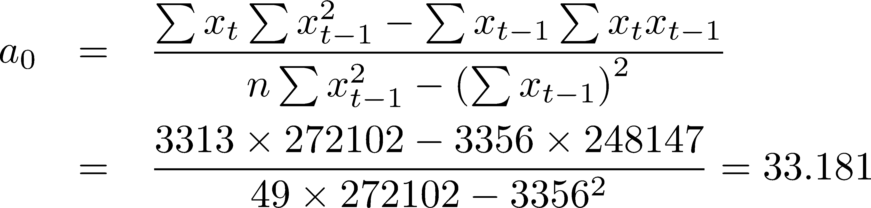
Example 1
The number of disk accesses for 50 database queries were measured to be: 73, 67, 83, 53, 78, 88, 57, 1, 29, 14, 80, 77, 19, 14, 41, 55, 74, 98, 84, 88, 78, 15, 66, 99, 80, 75, 124, 103, 57, 49, 70, 112, 107, 123, 79, 92, 89, 116, 71, 68, 59, 84, 39, 33, 71, 83, 77, 37, 27, 30.
For this data:
Washington University in St. Louis
http://www.cse.wustl.edu/~jain/cse567-13/
©2013 Raj Jain

Slide 7
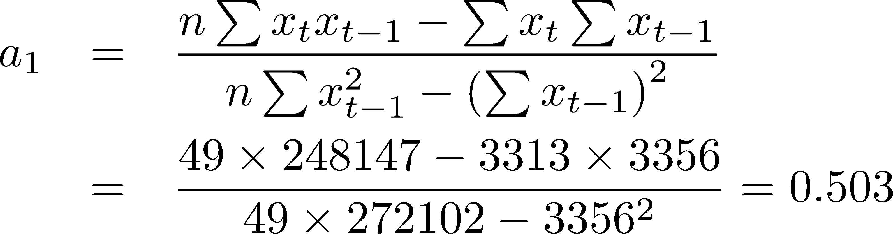
Example 1 (ctnd.)
SSE = 32995.57
SSE = Sum of squares error
Washington University in St. Louis
http://www.cse.wustl.edu/~jain/cse567-13/
©2013 Raj Jain

Slide 8
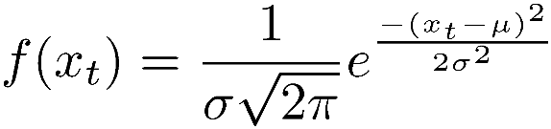
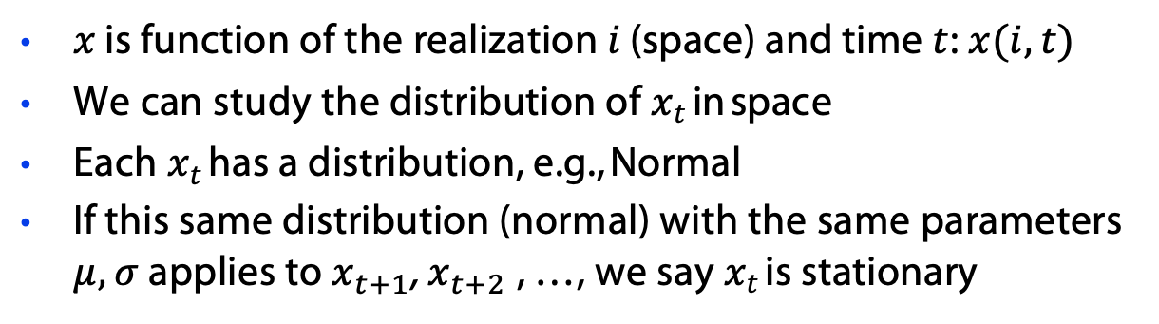
Stationary Process
Each realization of a random process will be different:
t
x_{t}
$x$ is function of the realization $i$ (space) and time $t$: $x(i, t)$
We can study the distribution of $xt$in space
Each $xt$has a distribution, e.g., Normal
If this same distribution (normal) with the same parameters $μ, σ$ applies to $x_{t+1}$, $x_{t+2}$, …, we say $xt$is stationary
Washington University in St. Louis
http://www.cse.wustl.edu/~jain/cse567-13/
©2013 Raj Jain

Slide 9
Stationary Process (ctnd.)
Stationary = Standing in time
⇒ Distribution does not change with time
Similarly, the joint distribution of x_{t} and x_{t-k} depends only on k not on t
Washington University in St. Louis
http://www.cse.wustl.edu/~jain/cse567-13/
©2013 Raj Jain

Slide 10
Assumptions
Linear relationship between successive values
Normal independent identically distributed (iid) errors:
  Normal errors
  Independent errors
Additive errors
x_{t} is a stationary process
Washington University in St. Louis
http://www.cse.wustl.edu/~jain/cse567-13/
©2013 Raj Jain

Slide 11
Visual Tests
x_{t} vs. x_{t-1} for linearity
Errors e_{t} vs. predicted values for additivity
Q-Q Plot of errors for Normality
Errors e_{t} vs. t for stationarity
Correlations for independence
140
120
100
x_{t}
80
60
40
20
0
0
^{x}t-1
20
40
60
80
100
120
140
Washington University in St. Louis
http://www.cse.wustl.edu/~jain/cse567-13/
©2013 Raj Jain

Slide 12

Visual Tests (cntd)
Q–Q plot
80
80
60
60
e_{t}
40
40
20
e
20
0
0
0
-20
20
40
60
80
100
120
-3
-2
-1
0
-20
1
2
3
-40
z
-40
80
60
40
-60
-60
-80
z ~ N(0,1)
-80
e_{t}
20
0
0
t
10
20
30
40
50
-20
-40
-60
-80
A Q–Q (quantile-quantile) plot is a probability plot, which is a graphical method for comparing two probability distributions by plotting their quantiles against each other.
Washington University in St. Louis
http://www.cse.wustl.edu/~jain/cse567-13/
©2013 Raj Jain

Slide 13
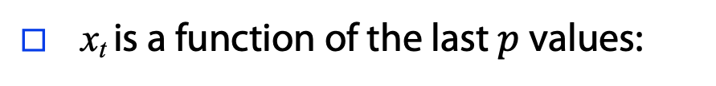
AR(p) Model
□ x_{t} is a function of the last $p$ values:
□ AR(2):
□ AR(3):
Washington University in St. Louis
http://www.cse.wustl.edu/~jain/cse567-13/
©2013 Raj Jain

Slide 14
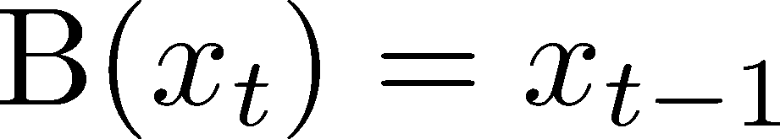
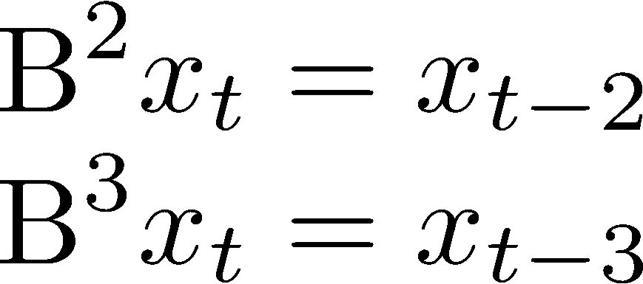
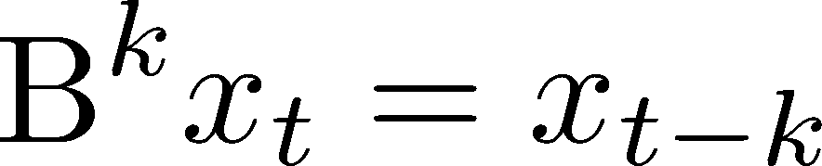
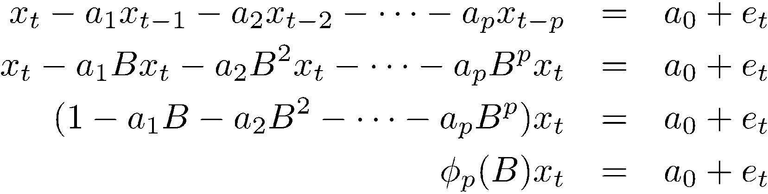
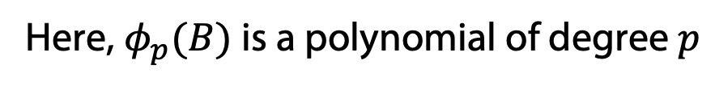
Backward Shift Operator
Similarly,
Or
Using this notation, AR(p) model is
Here, $φ_{p}(B)$is a polynomial of degree $p$
Washington University in St. Louis
http://www.cse.wustl.edu/~jain/cse567-13/
©2013 Raj Jain

Slide 15
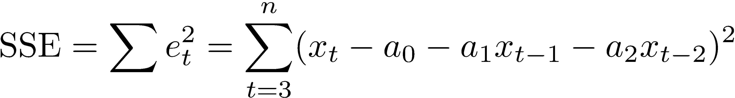
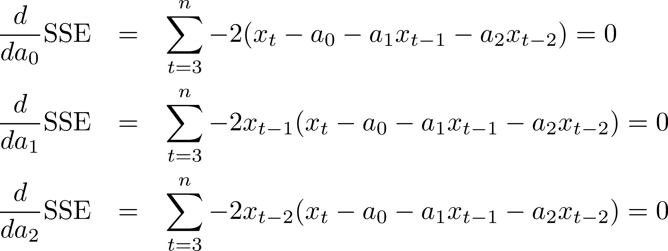
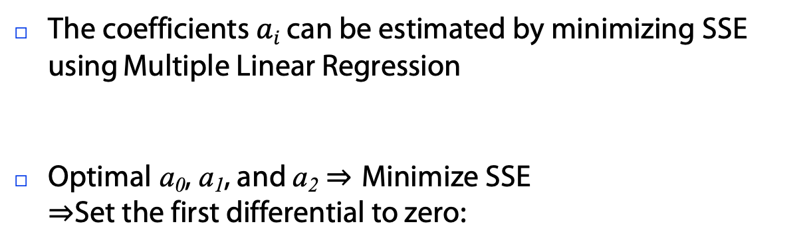
AR(p) Parameter Estimation
The coefficients $ai$ can be estimated by minimizing SSE using Multiple Linear Regression
Optimal a₀, a₁, and a₂ ⇒ Minimize SSE
⇒Set the first differential to zero:
Washington University in St. Louis
http://www.cse.wustl.edu/~jain/cse567-13/
©2013 Raj Jain

Slide 16
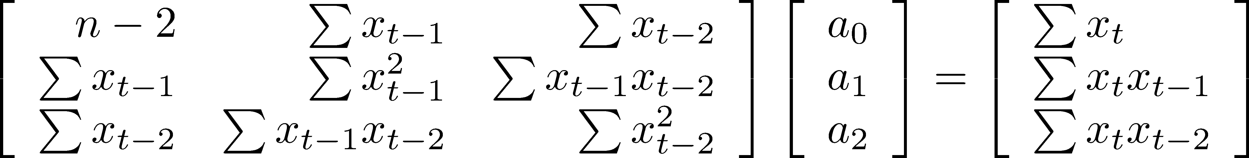
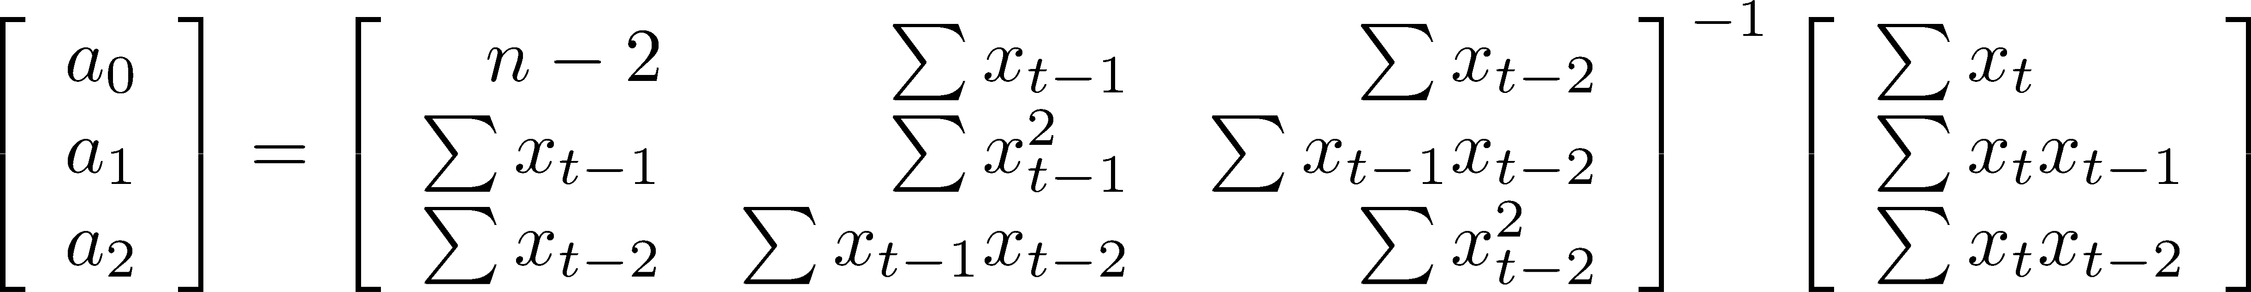
AR(p) Parameter Estimation (Cont)
The equations can be written as:
Note: All sums are for t=3 to n. n-2 terms
Multiplying by the inverse of the first matrix, we get:
Washington University in St. Louis
http://www.cse.wustl.edu/~jain/cse567-13/
©2013 Raj Jain

Slide 17
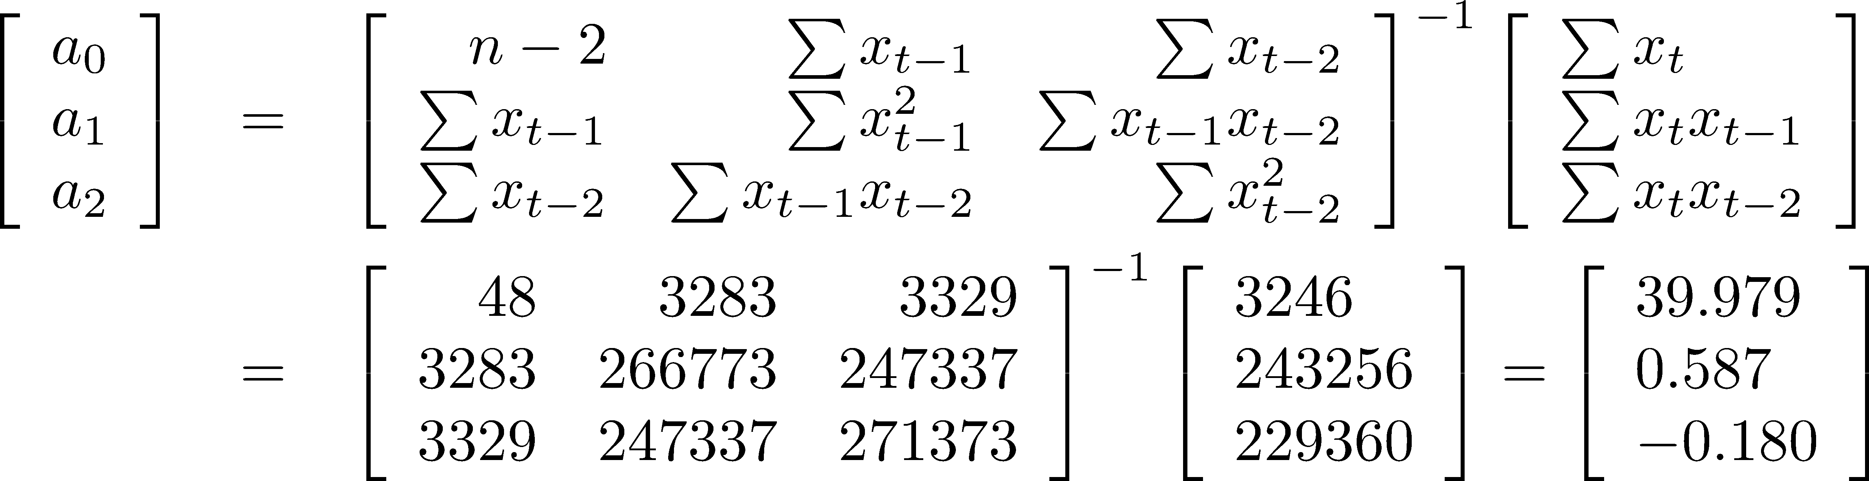
Example 2
Consider the data of Example 1 and fit an AR(2) model:
SSE= 31969.99
(3% lower than 32995.57 for AR(1) model)
Washington University in St. Louis
http://www.cse.wustl.edu/~jain/cse567-13/
©2013 Raj Jain

Slide 18
Summary AR(p)
Assumptions:
  Linear relationship between x_{t} and {x_{t-1}, ..., x_{t-p}}
  Normal iid errors:
    Normal errors
    Independent errors
  Additive errors
  x_{t} is stationary
Washington University in St. Louis
http://www.cse.wustl.edu/~jain/cse567-13/
©2013 Raj Jain

Slide 19
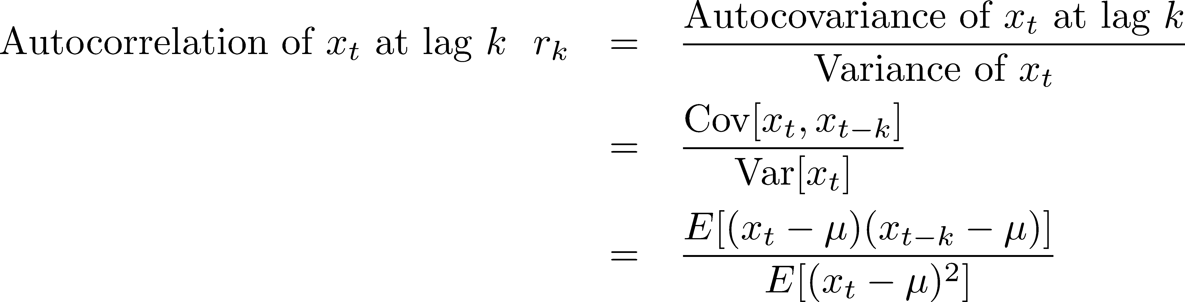
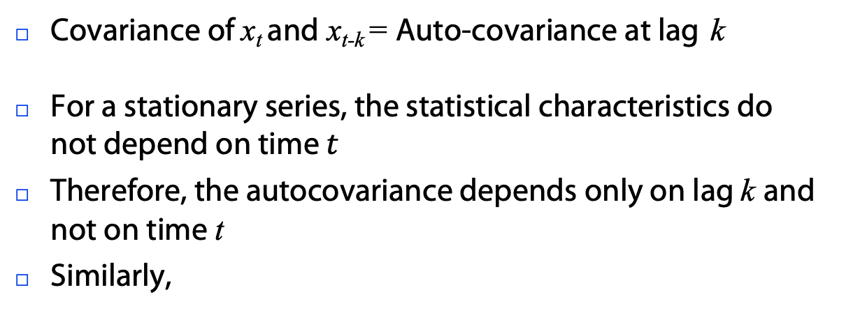
Autocorrelation
Covariance of x_{t} and x_{t-k} = Auto-covariance at lag k
For a stationary series, the statistical characteristics do not depend on time $t$
Therefore, the autocovariance depends only on lag k and not on time t
Similarly,
Washington University in St. Louis
http://www.cse.wustl.edu/~jain/cse567-13/
©2013 Raj Jain

Slide 20
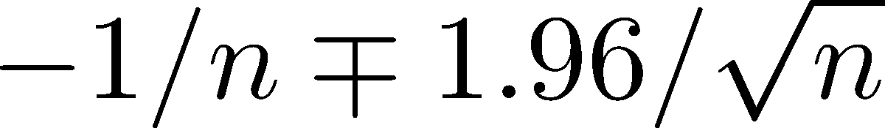
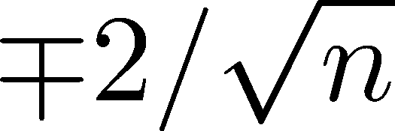

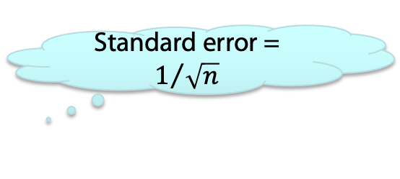
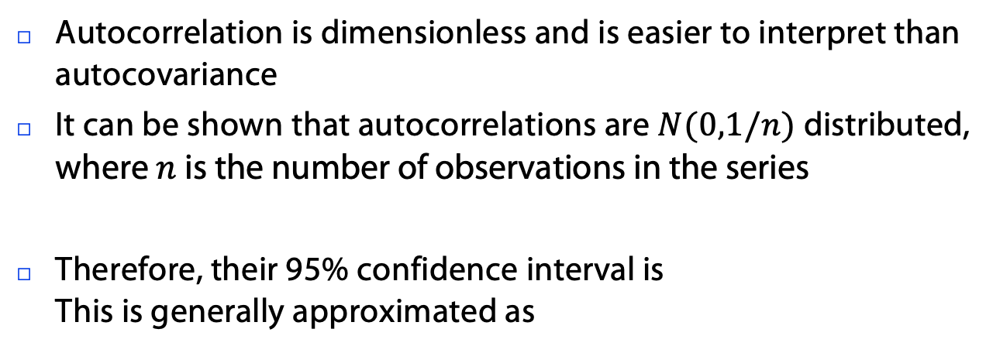
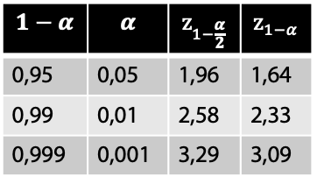
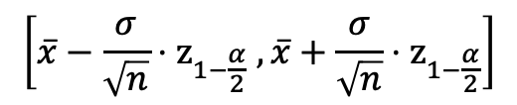
Autocorrelation (cntd.)
Autocorrelation is dimensionless and is easier to interpret than autocovariance
It can be shown that autocorrelations are $N(0,1/n)$distributed,
where $n$ is the number of observations in the series
Therefore, their 95% confidence interval is
This is generally approximated as
Standard error = $1/{\sqrt{n}}$
$$1−α$$ | $$α$$ | $$z_{1−\frac{α}{2}}$$ | $$z_{1−α}$$
0,95 | 0,05 | 1,96 | 1,64
0,99 | 0,01 | 2,58 | 2,33
0,999 | 0,001 | 3,29 | 3,09
$$\left[\overline{x}−\frac{σ}{\sqrt{n}}⋅z_{1−\frac{α}{2}} ,\overline{x}+\frac{σ}{\sqrt{n}}⋅z_{1−\frac{α}{2}}\right]$$
Washington University in St. Louis
http://www.cse.wustl.edu/~jain/cse567-13/
©2013 Raj Jain

Slide 21
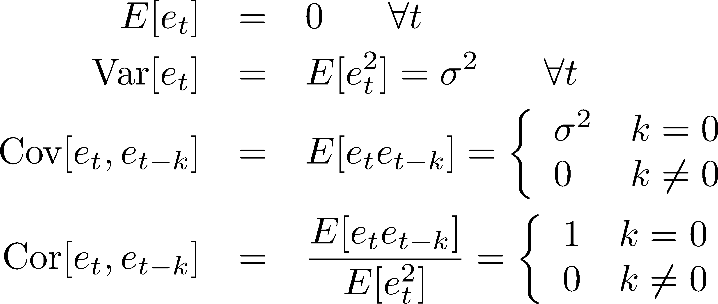
White Noise
Errors e_{t} are normal independent and identically distributed (IID) with zero mean and variance 𝜎²
Such IID sequences are called “white noise” sequences.
Properties:
0
k
Washington University in St. Louis
http://www.cse.wustl.edu/~jain/cse567-13/
©2013 Raj Jain

Slide 22
White Noise (cntd.)
The autocorrelation function of a white noise sequence is a
spike (𝛿 - function) at k=0
The Laplace transform of a 𝛿 - function is a constant. So in frequency domain white noise has a flat frequency spectrum
0 t 0 f
It was incorrectly assumed that white light has no color and, therefore, has a flat frequency spectrum and so random noise with flat frequency spectrum was called white noise
Ref: http://en.wikipedia.org/wiki/Colors_of_noise
Washington University in St. Louis
http://www.cse.wustl.edu/~jain/cse567-13/
©2013 Raj Jain

Slide 23
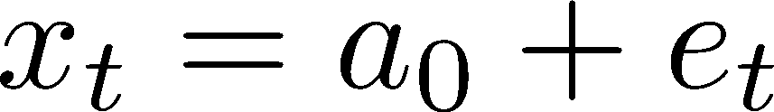

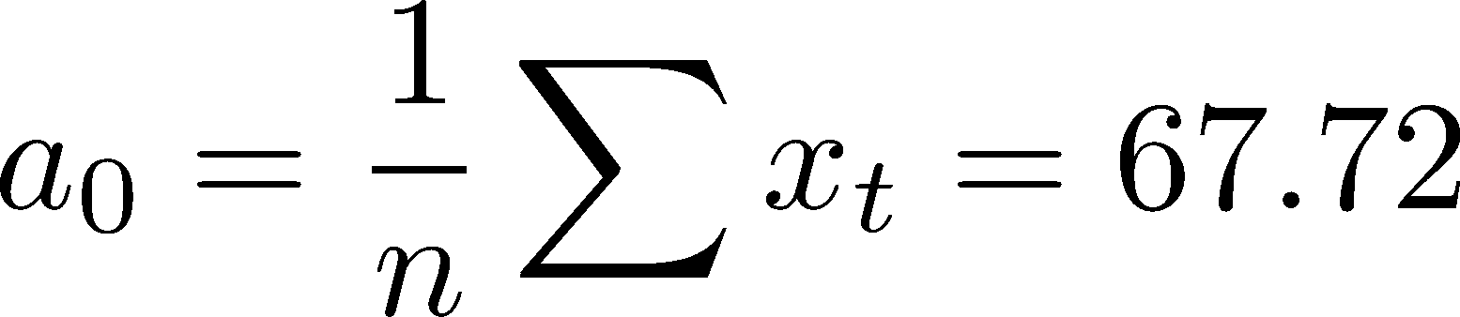
Example 3
□ Consider the data of Example 1. The AR(0) model is
80
60
e
40
□ SSE = 43702.08
20
0
-3
-2
-1
0
-20
1
2
3
-40
z
-60
-80
Washington University in St. Louis
http://www.cse.wustl.edu/~jain/cse567-13/
©2013 Raj Jain

Slide 24
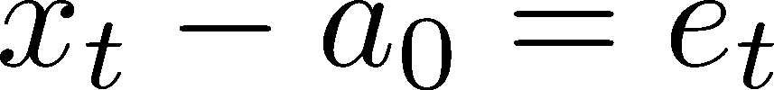
Moving Average (MA) Models
t
Moving Average of order 1: MA(1)
Moving Average of order 2: MA(2)
Moving Average of order q: MA(q)
Moving Average of order 0: MA(0) (Note: This is also AR(0))
x_{t}-a₀ is a white noise. a₀ is the mean of the time series
Washington University in St. Louis
http://www.cse.wustl.edu/~jain/cse567-13/
©2013 Raj Jain

Slide 25
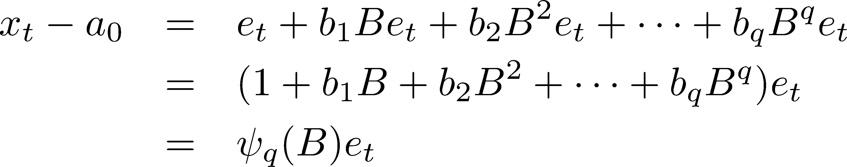
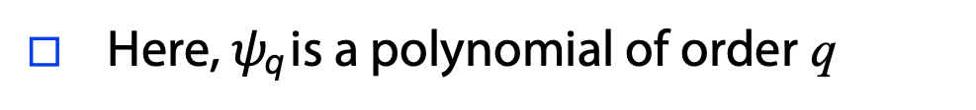
MA Models (cntd.)
□ Using the backward shift operator B, MA(q):
□ Here, $ψ$_{q} is a polynomial of order q
Washington University in St. Louis
http://www.cse.wustl.edu/~jain/cse567-13/
©2013 Raj Jain

Slide 26
Determining MA Parameters
Consider MA(1):
The parameters a₀ and b₁ cannot be estimated using standard regression formulas since we do not know errors. The errors depend on the parameters
So the only way to find optimal a₀ and b₁ is
by iteration
⇒ Start with some suitable values and change a₀ and b₁ until SSE is minimized and average of errors is zero
Washington University in St. Louis
http://www.cse.wustl.edu/~jain/cse567-13/
©2013 Raj Jain

Slide 27
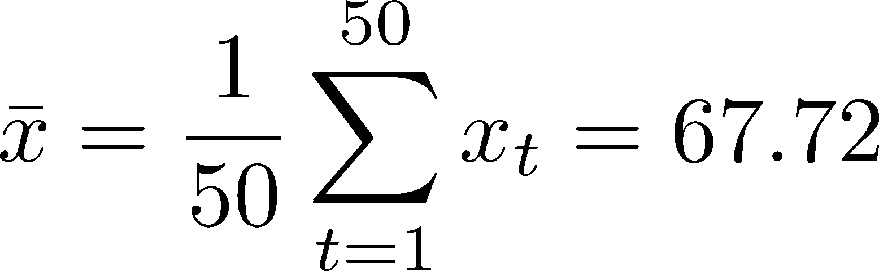
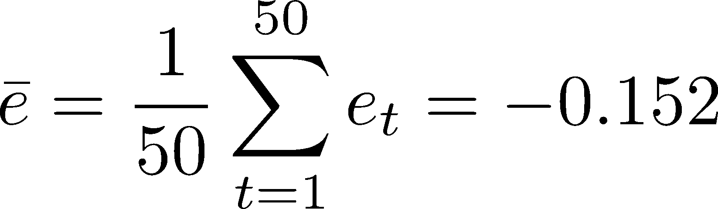
Example 4
Consider the data of Example 1
For these data:
□We start with a₀ = 67.72, b₁=0.4
Assuming e₀=0, compute all the errors and SSE
and SSE = 33542.65
We then adjust a₀ and b₁ until SSE is minimized
and mean error is close to zero
Washington University in St. Louis
http://www.cse.wustl.edu/~jain/cse567-13/
©2013 Raj Jain

Slide 28
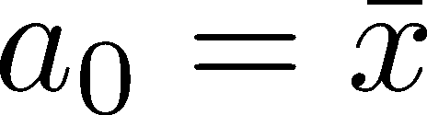
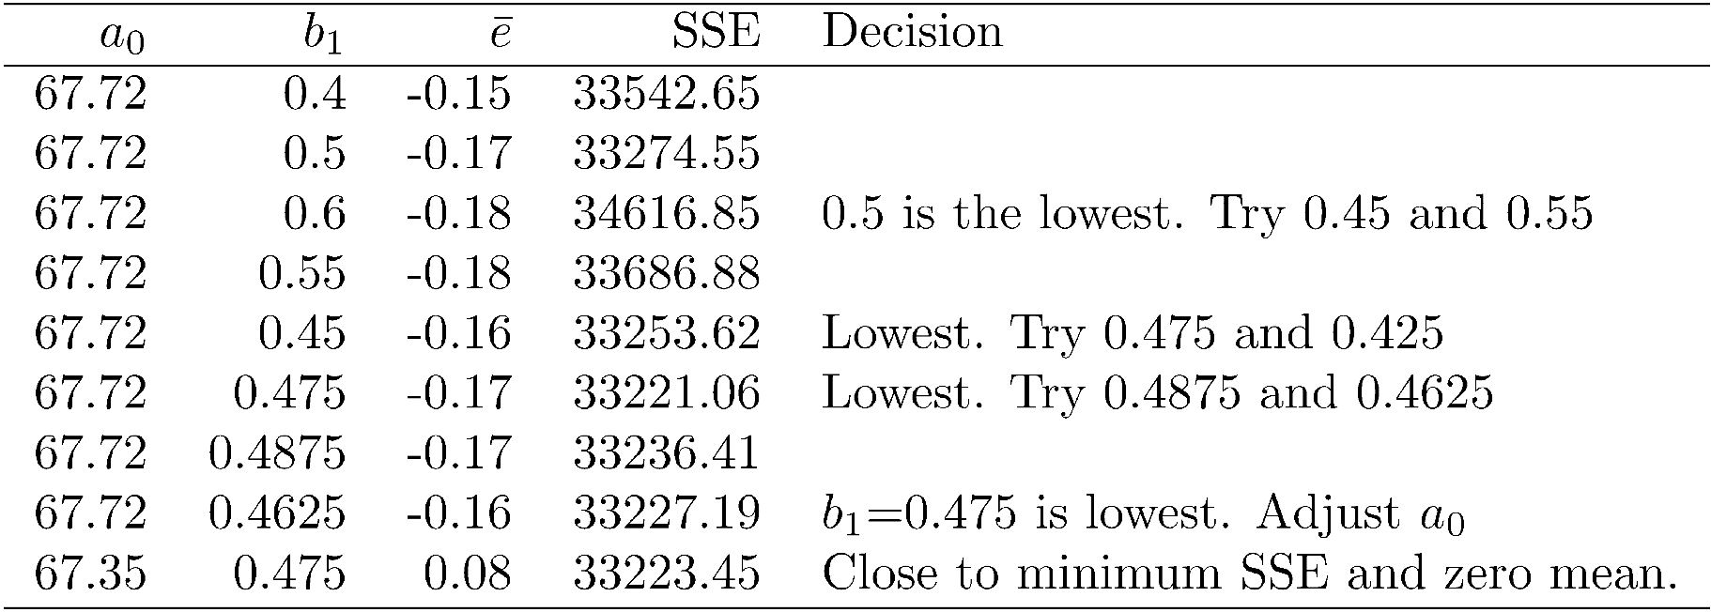
Example 4 (ctnd.)
□ The steps are: Starting with and b₁=0.4, 0.5, 0.6
Washington University in St. Louis
http://www.cse.wustl.edu/~jain/cse567-13/
©2013 Raj Jain

Slide 29
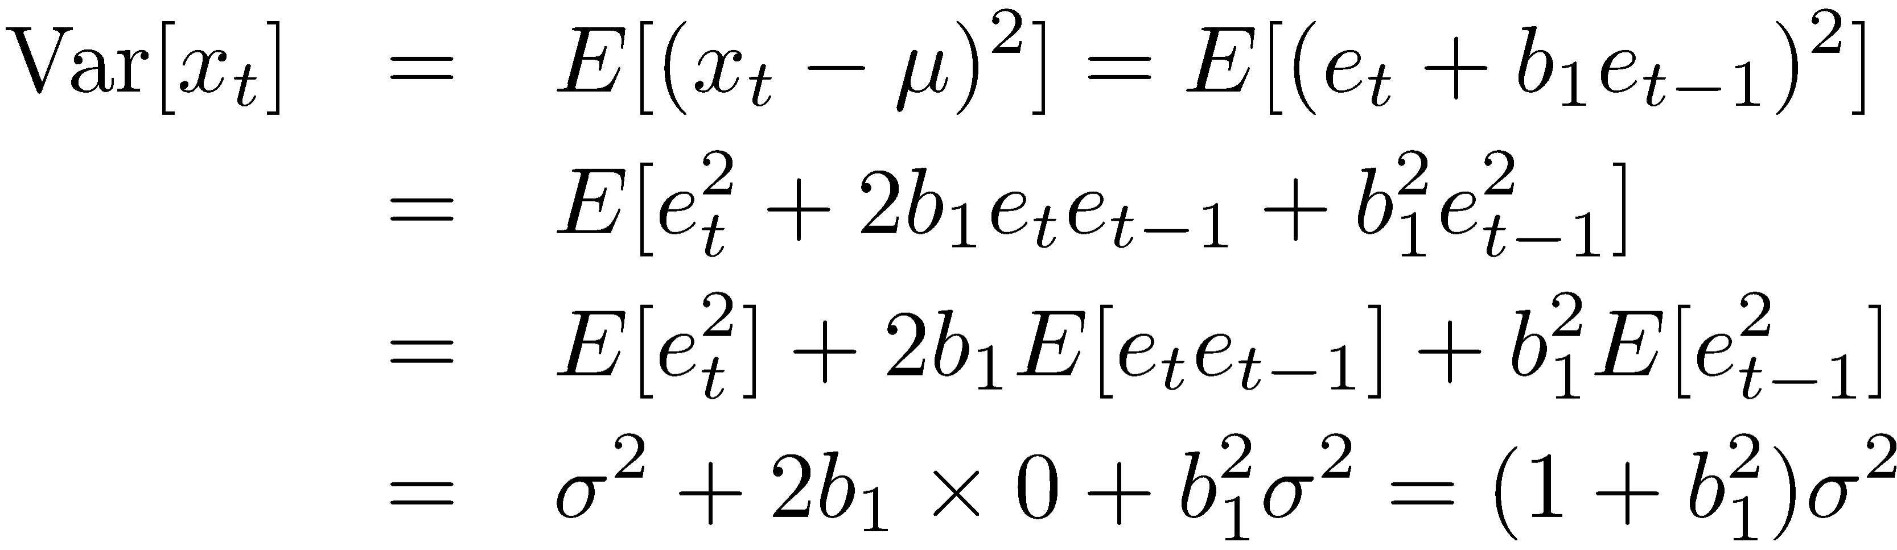
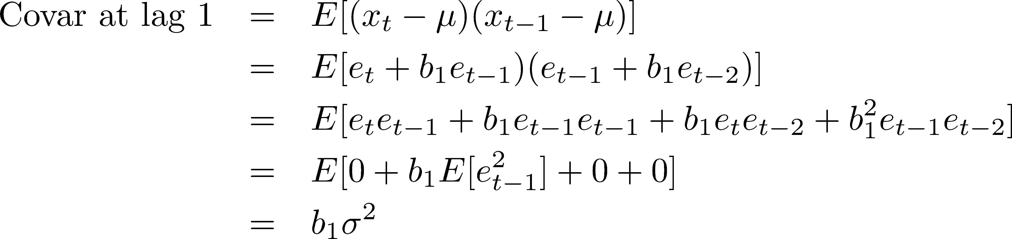
Autocorrelations for MA(1)
For this series, the mean is:
The variance is:
□ The autocovariance at lag 1 is:
Washington University in St. Louis
http://www.cse.wustl.edu/~jain/cse567-13/
©2013 Raj Jain

Slide 30
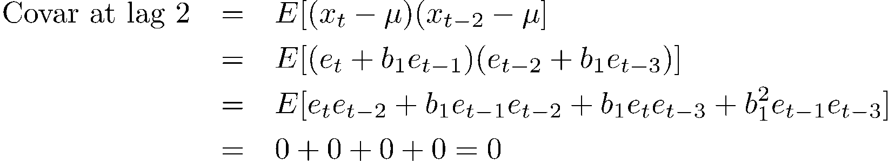
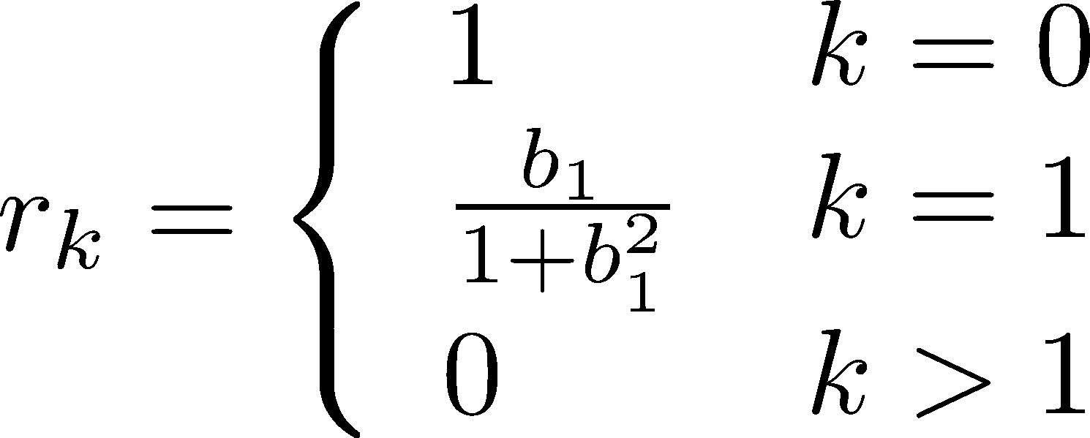
Autocorrelations for MA(1) (Cont)
The autocovariance at lag 2 is:
For MA(1), the autocovariance at all higher lags (k>1) is 0.
The autocorrelation is:
The autocorrelation of MA(q) series is non-zero only for lags k< q and is zero for all higher lags.
Washington University in St. Louis
http://www.cse.wustl.edu/~jain/cse567-13/
©2013 Raj Jain

Slide 31
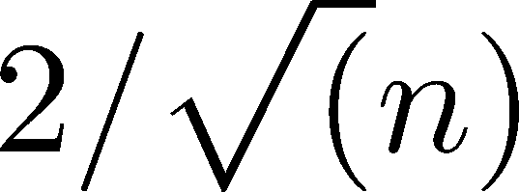
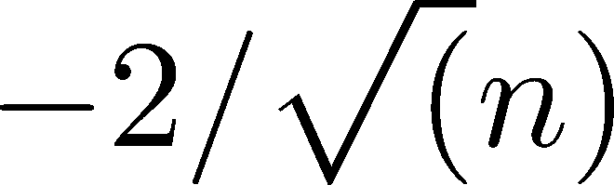
Determining the Order MA(q)
q=8
Autocorrelation r_{k}
0
Lag k
□ The order of the last significant r_{k} determines the order of the MA(q) model
See also: Box-Jenkins Method
Washington University in St. Louis
http://www.cse.wustl.edu/~jain/cse567-13/
©2013 Raj Jain

Slide 32
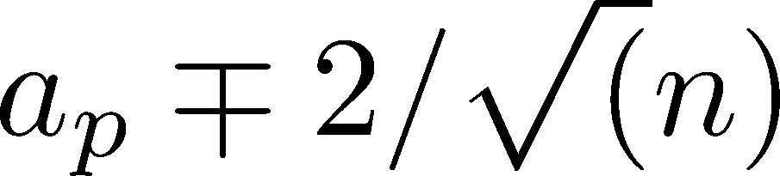
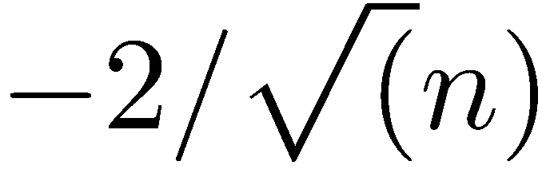
Determining the Order AR(p)
ACF of AR(1) is an exponentially decreasing fn of k
Fit AR(p) models of order p=0, 1, 2, …
Compute the confidence intervals of a_{p}:
After some p, the last coefficients a_{p} will not be significant for all higher order models.
This highest p is the order of the AR(p) model for the series.
This sequence of last coefficients is also called
Partial Autocorrelation Function (PACF)
p=8
r_{k}
PACF(k)
k
0
Lag k
Washington University in St. Louis
http://www.cse.wustl.edu/~jain/cse567-13/
©2013 Raj Jain

Slide 33
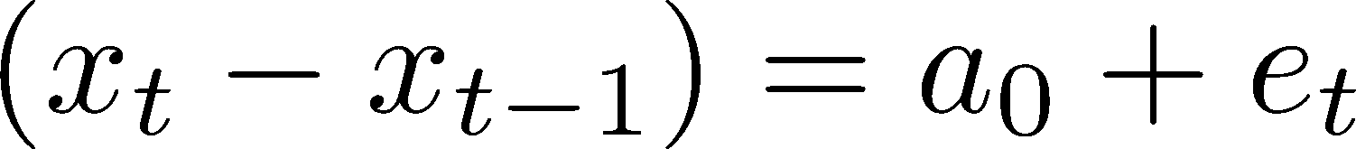
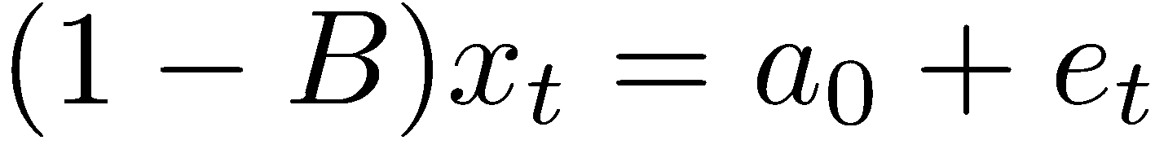
Non-Stationarity: Integrated Models
In the white noise model AR(0):
The mean a₀ is independent of time
If it appears that the time series is increasing approximately linearly with time, the first difference of the series can be modeled as white noise:
Or using the B operator: (1-B)x_{t} = x_{t}-x_{t-1}
This is called an "integrated" model of order 1 or I(1). Since the errors are integrated to obtain x.
Note that x_{t} is not stationary but (1-B)x_{t} is stationary.
x_{t} (1-B)x_{t}
t
t
Washington University in St. Louis
http://www.cse.wustl.edu/~jain/cse567-13/
©2013 Raj Jain

Slide 34

Integrated Models (cntd.)
If the time series is parabolic, the second difference can be modeled as white noise:
Or
This is an I(2) model
x_{t}
t
Washington University in St. Louis
http://www.cse.wustl.edu/~jain/cse567-13/
©2013 Raj Jain

Slide 35
ARMA and ARIMA Models
It is possible to combine AR, MA, and I models
ARMA(p, q) Model:
□ ARIMA(p,d,q) Model:
Washington University in St. Louis
http://www.cse.wustl.edu/~jain/cse567-13/
©2013 Raj Jain

Slide 36

Non-Stationarity due to Seasonality
The mean temperature in December is always lower than that in November and in May it is always higher than that in March
⇒Temperature has a yearly season.
One possible model could be I(12):
or
$${\left(1 −B\right)}^{12}x_{t}=a_{0}+e_{t}$$
Washington University in St. Louis
http://www.cse.wustl.edu/~jain/cse567-13/
©2013 Raj Jain

Slide 37
Summary
AR(1) Model:
MA(1) Model:
ARIMA(1,1,1) Model:
Washington University in St. Louis
http://www.cse.wustl.edu/~jain/cse567-13/
©2013 Raj Jain

