Slide 1
Intelligent Agents
Multi-Relational Latent Semantic Analysis
Ralf Möller
Universität zu Lübeck
Institut für Informationssysteme

Slide 2


Semantics Needs More Than Similarity
Tomorrow will be rainy.
Tomorrow will be sunny.
$similar($rainy, sunny$)$?
$antonym($rainy, sunny$)$?

Slide 3
Leverage Linguistic Knowledge
Can’t we just use the existing thesauri for information about synonyms and antonyms?
  Knowledge in these resources is never complete
  Often lack of “membership degree” for relations
    Various ways to measure “membership degree”
Goal: Create a continuous semantic representation that
  leverages existing rich linguistic resources,
  discovers new relations, and
  enables us to measure the “degree” of multiple relations (not just similarity)

Slide 4
Roadmap
Two opposite relations:
  Polarity Inducing Latent Semantic Analysis
Multiple relations:
  Multi-Relational Latent Semantic Analysis
Relational domain knowledge
Yih, Zweig & Platt. Polarity Inducing Latent Semantic Analysis. In EMNLP-CoNLL-12.
Chang, Yih & Meek. Multi-Relational Latent Semantic Analysis. In EMNLP-13.
Chang, Yih, Yang & Meek. Typed Tensor Decomposition of Knowledge Bases for Relation Extraction. In EMNLP-14.
EMNLP: Empirical Methods in Natural Language Processing
CoNLL: Computational Natural Language Learning
ACL; Annual Meeting of the Association for Computational Linguistics

Slide 5
Problem: Handling Two Opposite Relations
Can cope to some extent with homonyms and synonyms
due to word context
Embedding techniques cannot clearly distinguish antonyms
  “Distinguishing synonyms and antonyms is still perceived as a difficult open problem.” [Poon & Domingos 09]
Idea #1: Change the data representation
Synonyms: Different words, same meaning
Homonyms: Same words, different meanings
Antonyms: Opposite words
Hoifung Poon and Pedro Domingos. Unsupervised semantic parsing. In Proceedings EMNLP ‘09. 2009.

Slide 6
Polarity Inducing LSA
Data representation
  Encode two opposite relations in a matrix using “polarity”
    Synonyms & antonyms (e.g., from a thesaurus)
Factorization
  Apply SVD to the matrix to find latent components
Measuring degree of relation
  Cosine of latent vectors
Wen-tau Yih, Geoffrey Zweig, John Platt. Polarity Inducing Latent Semantic Analysis. In Proceedings EMNLP ‘12. 2012.

Slide 7
Encode Synonyms & Antonyms in Matrix
Joyfulness: joy, gladden; sorrow, sadden
Sad: sorrow, sadden; joy, gladden
Target word: row-vector
 | joy | gladden | sorrow | sadden | goodwill
Group 1: “joyfulness” | 1 | 1 | 1 | 1 | 0
Group 2: “sad” | 1 | 1 | 1 | 1 | 0
Group 3: “affection” | 0 | 0 | 0 | 0 | 1

Slide 8

Encode Synonyms & Antonyms in Matrix
Joyfulness: joy, gladden; sorrow, sadden
Sad: sorrow, sadden; joy, gladden
Inducing polarity
Target word: row-vector
 | joy | gladden | sorrow | sadden | goodwill
Group 1: “joyfulness” | 1 | 1 | -1 | -1 | 0
Group 2: “sad” | -1 | -1 | 1 | 1 | 0
Group 3: “affection” | 0 | 0 | 0 | 0 | 1
Cosine Score: $+ Synonyms$

Slide 9
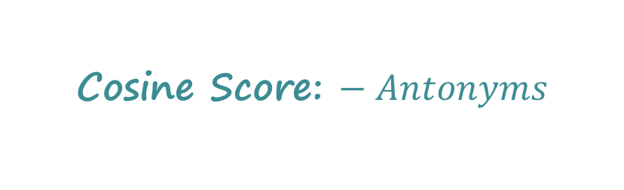
Encode Synonyms & Antonyms in Matrix
Joyfulness: joy, gladden; sorrow, sadden
Sad: sorrow, sadden; joy, gladden
Inducing polarity
Target word: row-vector
 | joy | gladden | sorrow | sadden | goodwill
Group 1: “joyfulness” | 1 | 1 | -1 | -1 | 0
Group 2: “sad” | -1 | -1 | 1 | 1 | 0
Group 3: “affection” | 0 | 0 | 0 | 0 | 1
Cosine Score: $− Antonyms$

Slide 10
Problem: How to Handle More Relations?
Limitation of the matrix representation
  Each entry captures a particular type of relation between two entities, or
  Two opposite relations with the polarity trick
Encoding other binary relations
  Is-A (hyponym) – ostrich is a bird
  Part-whole – engine is a part of car
Idea #2
  Encode multiple relations in a 3-way tensor
  (3-dim array)!
M. Nickel, V. Tresp, and H.-P. Kriegel. A three-way model for collective learning
on multi-relational data. In Proceedings of the 28th International Conference on
International Conference on Machine Learning, ICML’11, pages 809–816, 2011.

Slide 11



Encode Multiple Relations in Tensor
Represent word relations using a tensor
  Each slice encodes a relation between terms and target words.
gladden
gladden
joy
sadden
joy
sadden
feeling
feeling
joyfulness
1 | 1 | 0 | 0
1 | 1 | 0 | 0
0 | 0 | 1 | 0
0 | 0 | 0 | 0
joyfulness
0 | 0 | 0 | 0
0 | 0 | 1 | 0
1 | 0 | 0 | 0
0 | 0 | 0 | 0
gladden
gladden
sad
sad
anger
anger
Synonym layer
Antonym layer
Construct a tensor with two slices

Slide 12
Encode Multiple Relations in Tensor
Can encode multiple relations in the tensor
gladden
joy
sadden
feeling
1 | 1 | 0 | 0
1 | 1 | 0 | 0
0 | 0 | 1 | 0
0 | 0 | 0 | 0
1 | 1 | 0 | 0
1 | 1 | 0 | 0
0 | 0 | 1 | 0
0 | 0 | 0 | 0
0 | 0 | 0 | 1
0 | 0 | 0 | 0
0 | 0 | 0 | 1
0 | 0 | 0 | 1
joyfulness
gladden
sad
anger
Hyponym layer
Hyponym IS-A/TYPE-OF hypernym
Metonym: Substitute for another term
(substitute usually used for sth else)

Slide 13
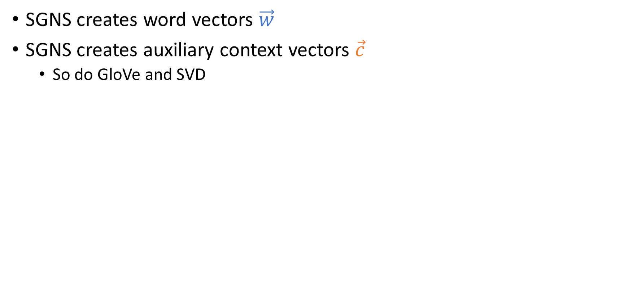



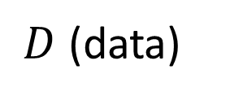



Tensor Decomposition – Analogy to SVD
Derive a low-rank approximation to generalize the data and to discover unseen relations
SVD
$$t_{1},t_{2},…, t_{n}$$
$$k$$
$$k$$
$$t_{1},t_{2},…, t_{n}$$
$$w_{1},w_{2},…, w_{d}$$
~
$$k$$
$$w_{1},w_{2},…, w_{d}$$
×
~
×
$$k$$
latent representation of words

Slide 14
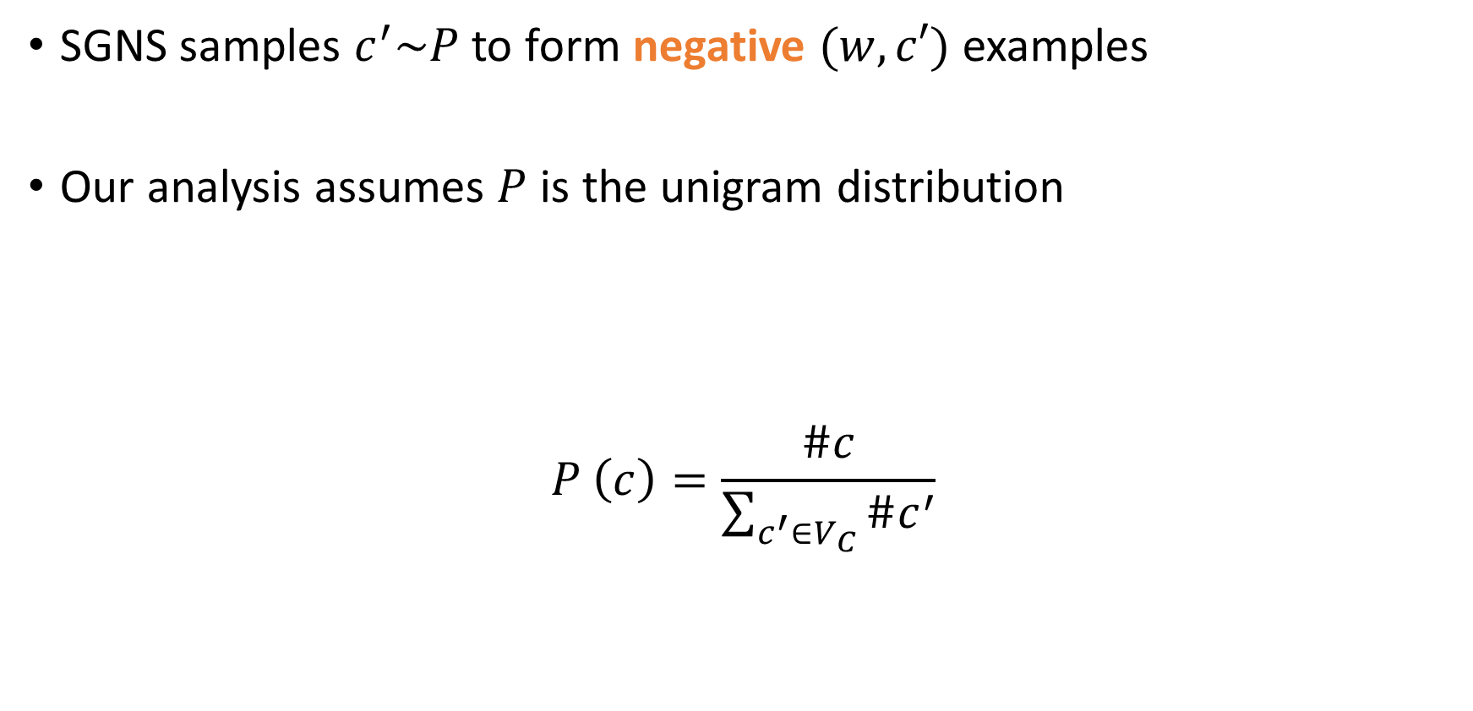

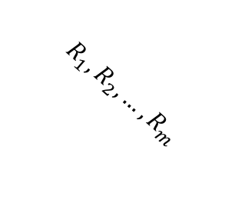

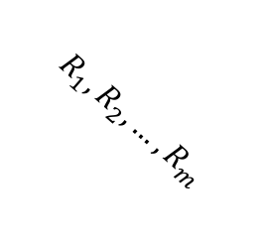
Tensor Decomposition – Analogy to SVD
Derive a low-rank approximation to generalize the data and to discover unseen relations
Apply Tucker decomposition and reformulate the results
(tensor factorization)
latent representation of a relation
(with k as a hyperparameter)
$$t_{1},t_{2},…, t_{n}$$
$$k$$
$$k$$
$$R_{1},R_{2},…, R_{m}$$
$$t_{1},t_{2},…, t_{n}$$
A
$$R_{1},R_{2},…, R_{m}$$
$$k$$
A^{T}
$$w_{1},w_{2},…, w_{d}$$
~
~
×
~
×
~
×
×
$$k$$
R_{k}
latent representation of words
Ledyard R. Tucker. "Some mathematical notes on three-mode factor analysis". Psychometrika. 31 (3): 279–311, 1966.

Slide 15
Measure Degree of Relation
Similarity
  Cosine of the latent vectors
Other relations (both symmetric and asymmetric)
  Take the latent matrix of the pivot relation (synonym)
  Take the latent matrix of the relation
  Cosine of the latent vectors after projection

Slide 16
Measure Degree of Relation: Raw Representation
$ant\left(\text{joy},\text{sadden}\right)=cos⁡\left(𝓦_{:,\text{joy},syn},𝓦_{:,\text{sadden},ant}\right)$
gladden
gladden
joy
sadden
joy
sadden
felling
felling
joyfulness
1 | 1 | 0 | 0
1 | 1 | 0 | 0
0 | 0 | 1 | 0
0 | 0 | 0 | 0
joyfulness
0 | 0 | 0 | 0
0 | 0 | 1 | 0
1 | 0 | 0 | 0
0 | 0 | 0 | 0
gladden
gladden
sad
sad
anger
anger
Synonym layer
Antonym layer

Slide 17
Measure Degree of Relation: Raw Representation
$ant\left(\text{joy},\text{sadden}\right)=cos⁡\left(𝓦_{:,\text{joy},syn},𝓦_{:,\text{sadden},ant}\right)$
gladden
gladden
joy
sadden
joy
sadden
felling
felling
joyfulness
1 | 1 | 0 | 0
1 | 1 | 0 | 0
0 | 0 | 1 | 0
0 | 0 | 0 | 0
joyfulness
0 | 0 | 0 | 0
0 | 0 | 1 | 0
1 | 0 | 0 | 0
0 | 0 | 0 | 0
gladden
gladden
sad
sad
anger
anger
Synonym layer
Antonym layer

Slide 18




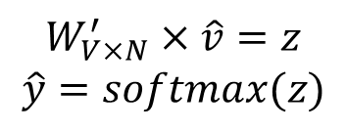


Measure Degree of Relation: Latent Representation
$rel\left({\text{w}}_{i},{\text{w}}_{j}\right)=cos⁡\left(S_{:,:,syn}V_{i,:}^{T},S_{:,:,rel}V_{j,:}^{T}\right)$
Cos ( , )
×
×
$$k$$
$$w_{1},w_{2},…, w_{n}$$
$$R_{1},R_{2},…, R_{m}$$
~
$$k$$
~
~
×
×
~
$$k$$
$$S$$
$$V^{T}$$

Slide 19
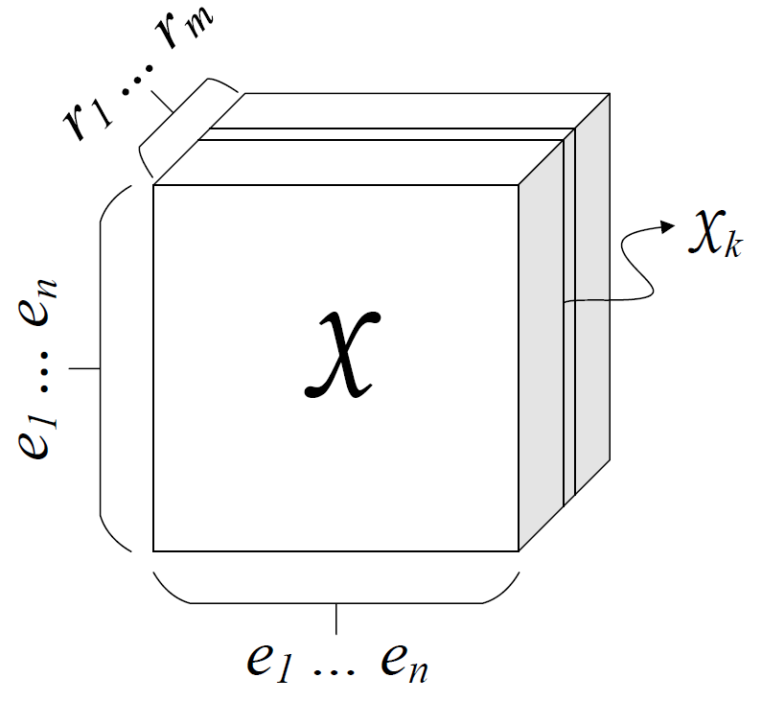
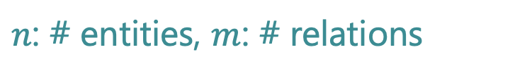
Knowledge Graphs (1/2)
Collection of subj-pred-obj triples – $(e_{1}, r, e_{2})$
Subject | Predicate | Object
Obama | Born-in | Hawaii
Bill Gates | Nationality | USA
Bill Clinton | Spouse-of | Hillary Clinton
Satya Nadella | Work-at | Microsoft
… | … | …
$n$: # entities, $m$: # relations
M. Nickel, V. Tresp, and H.-P. Kriegel. A three-way model for collective learning
on multi-relational data. In Proceedings of the 28th International Conference on
International Conference on Machine Learning, ICML’11, pages 809–816, 2011.

Slide 20
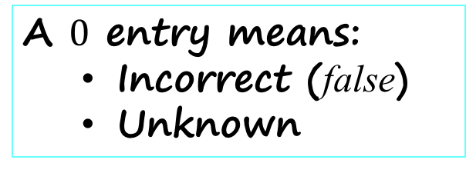
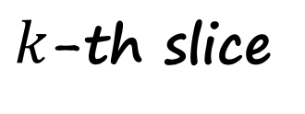
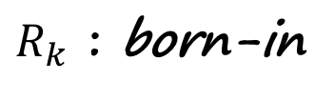

Knowledge Graphs (2/2)
$k$-th slice
$$𝒳_{k}$$
Hawaii
Obama
1
A $0$ entry means:
  Incorrect (false)
  Unknown
$R_{k}$ : born-in
M. Nickel, V. Tresp, and H.-P. Kriegel. A three-way model for collective learning
on multi-relational data. In Proceedings of the 28th International Conference on
International Conference on Machine Learning, ICML’11, pages 809–816, 2011.

Slide 21
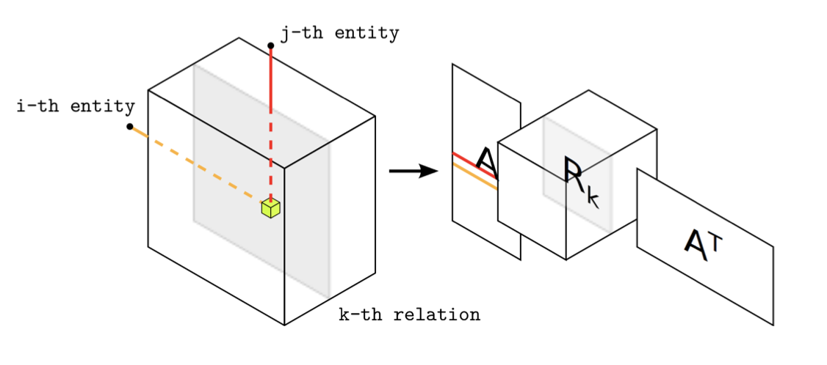
Factorization
M. Nickel, V. Tresp, and H.-P. Kriegel. A three-way model for collective learning
on multi-relational data. In Proceedings of the 28th International Conference on
International Conference on Machine Learning, ICML’11, pages 809–816, 2011.

Slide 22
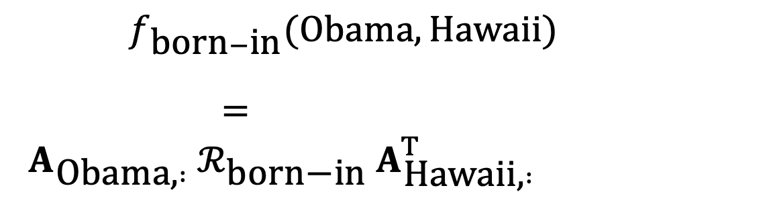
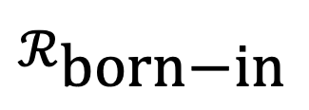


Measure the Degree of a Relationship
$f_{\text{born}−\text{in}}(\text{Obama},\text{Hawaii})$
$= A_{\text{Obama}\text{,} :} ℛ_{\text{born}\text{−}\text{in}} A_{\text{Hawaii}\text{,} :}^{T}$
$$A$$
Hawaii
$$ℛ_{\text{born}\text{−}\text{in}}$$
$$A^{T}$$
×
×
Obama
22

Slide 23
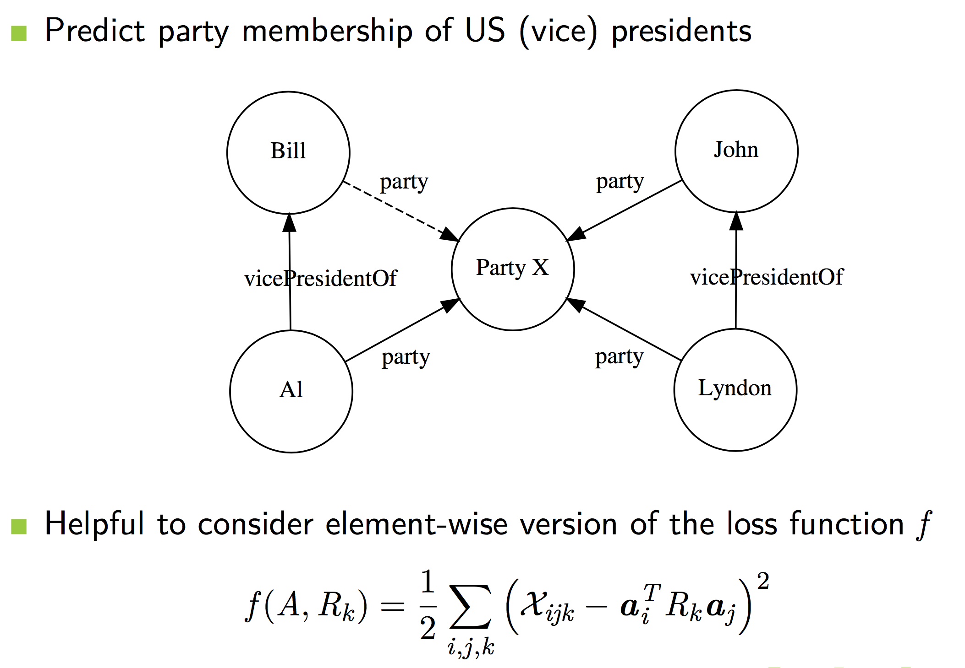
Prediction of Unknown Facts
Prediction of unknown fact party(Bill, Party X)

Slide 24
Problem: Relational Domain Knowledge
Relational data – the entity type
  Relation can only hold between the right types of entities
    Words having is-a relation have the same part-of-speech
    For relation born-in, the entity types are: (person, location)
Leverage type information to improve multi-relational LSA
Chang, Kai-Wei & Yih, Wen-tau & Yang, Bishan & Meek, Chris. Typed Tensor Decomposition of Knowledge Bases for Relation Extraction. In: Proc. EMNLP-14. 2014.

Slide 25
Knowledge Graph?
Where is the knowledge in a knowledge graph (KG) ?
  Queries as with SQL database
  Embedding approaches rank existence of tuples
  Thresholds difficult to specify
  Use top-k queries with ranking w.r.t. score to establish existence of relations (or links)
  Want as many “true” tuples as possible in the answer set
    Standard evaluation measures: Precision and Recall
  But applications may treat all query answers as true answers
  No uncertainty about answers to queries
Probabilistic database with open-world assumption ?
  Course “Non-standard Databases and Data Mining”
  But: Want sparsity (or “tuples computed on demand”)

Slide 26
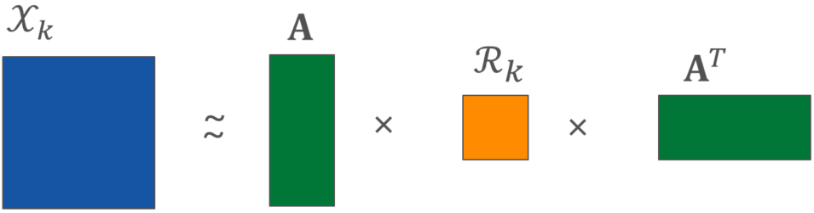
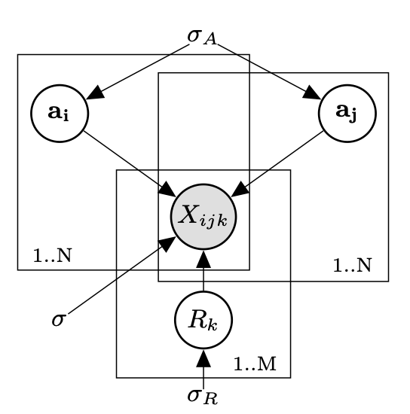
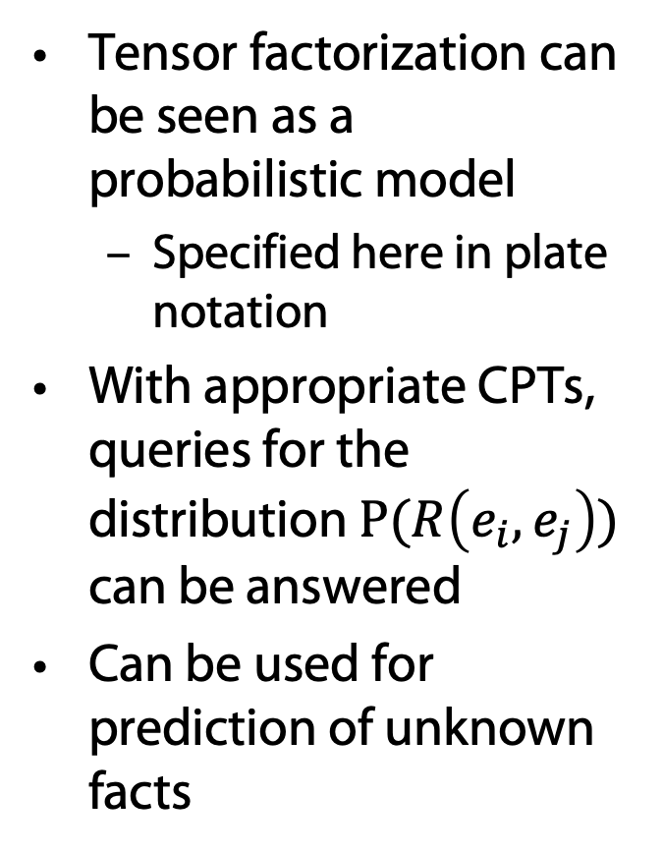
RESCAL: Graphical Model in Plate Notation
Tensor factorization can be seen as a probabilistic model
  Specified here in plate notation
With appropriate CPTs, queries for the distribution $P(R\left(e_{i}, e_{j}\right))$ can be answered
Can be used for prediction of unknown facts
Nickel, M, Tresp, V, Kriegel, HP: Factorizing YAGO. Scalable Machine Learning for Linked Data. In Proceedings of the 21st International World Wide Web Conference, 2012.

Slide 27
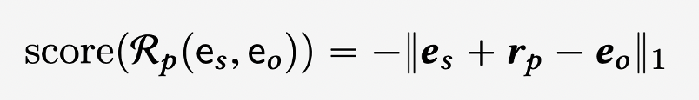
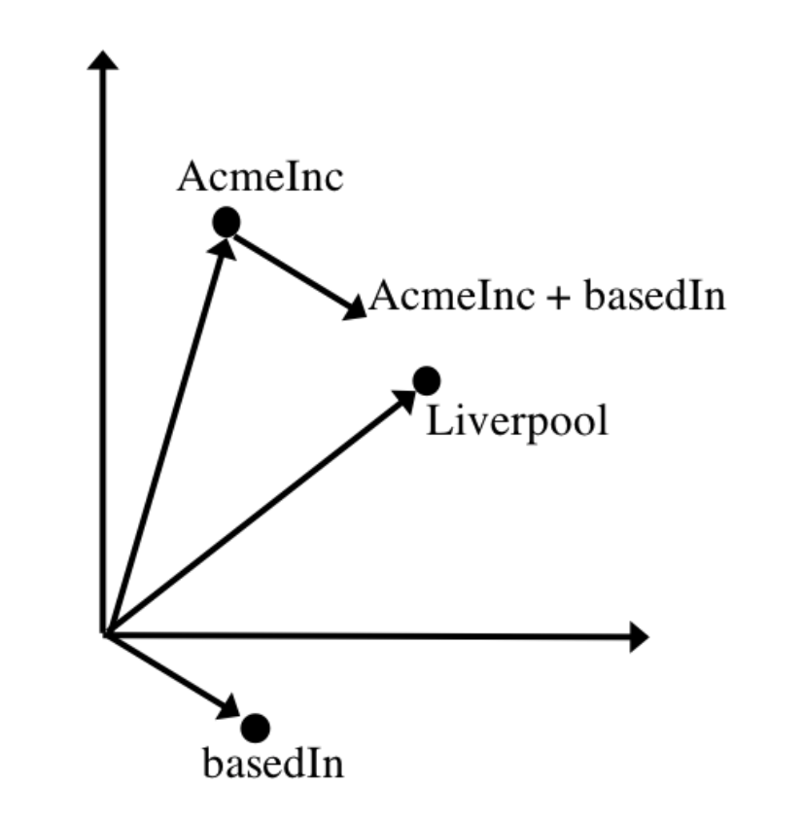
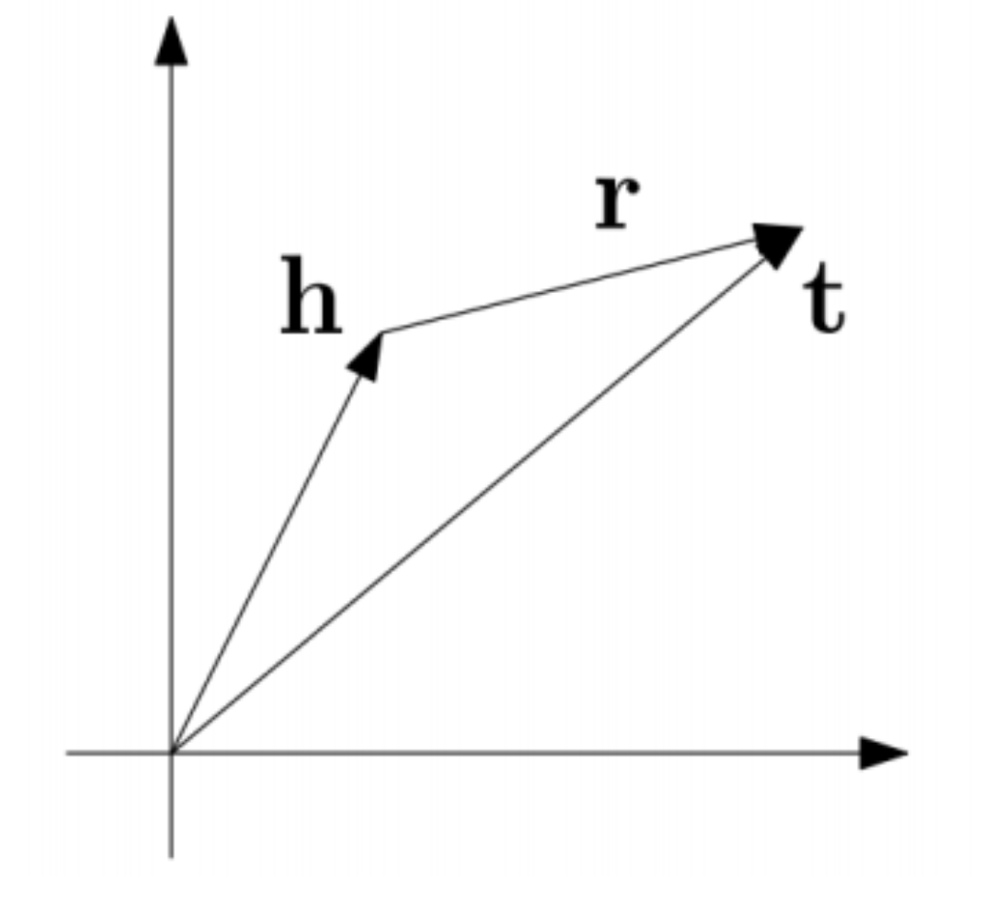
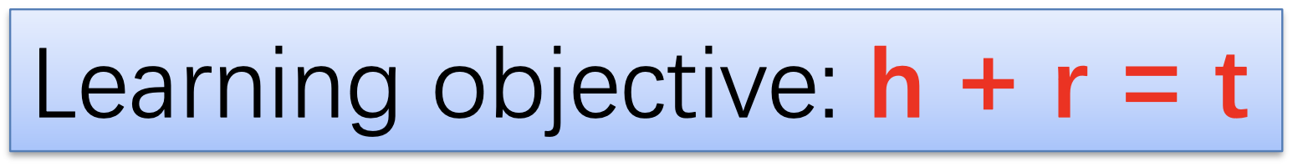
TransE: KG-Completion
Inspired by word2vec

Slide 28
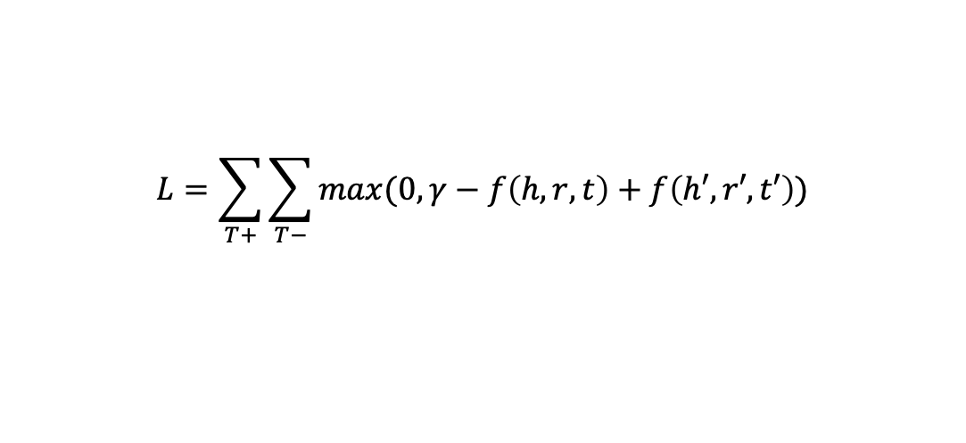
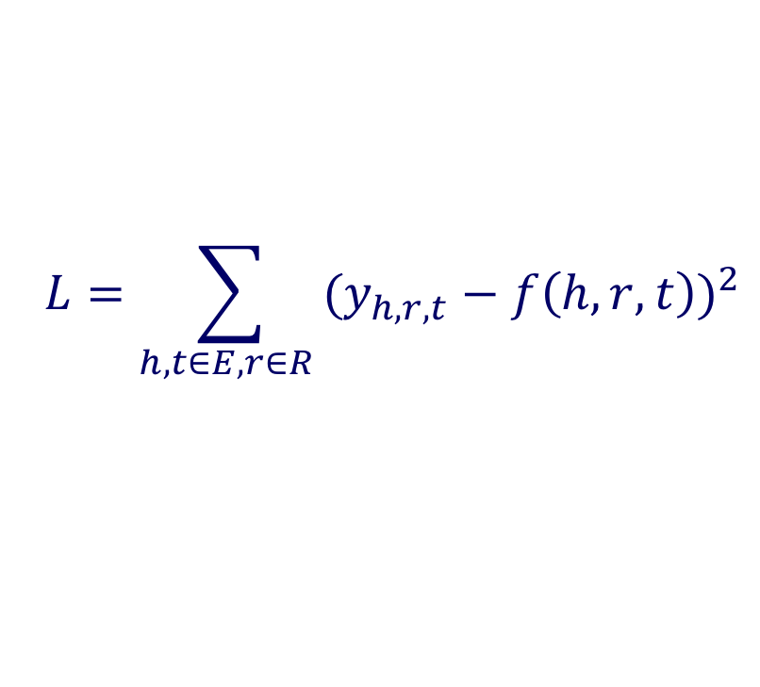
Loss Function
Closed-world assumption: square loss
Open-world assumption: triplet loss
  Need negative sampling
$$L=\sum_{h,t∈E, r∈R }{{(y_{h,r,t}−f\left(h,r,t\right))}^{2}}$$
Triple, triplet
$$L=\sum_{T+}{\sum_{T−}{max(0, γ−f\left(h,r,t\right)+f\left(h′,r′,t′\right))}}$$
Notes:
Not necessarily true

Slide 29
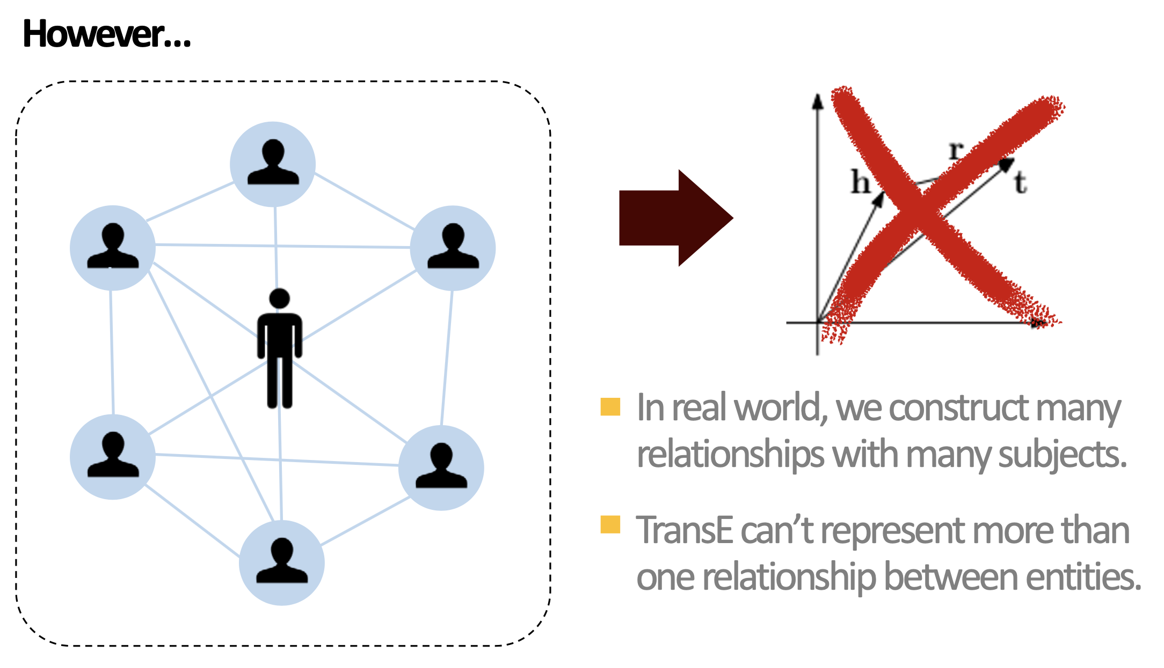
TransE: KG-Completion

Slide 30
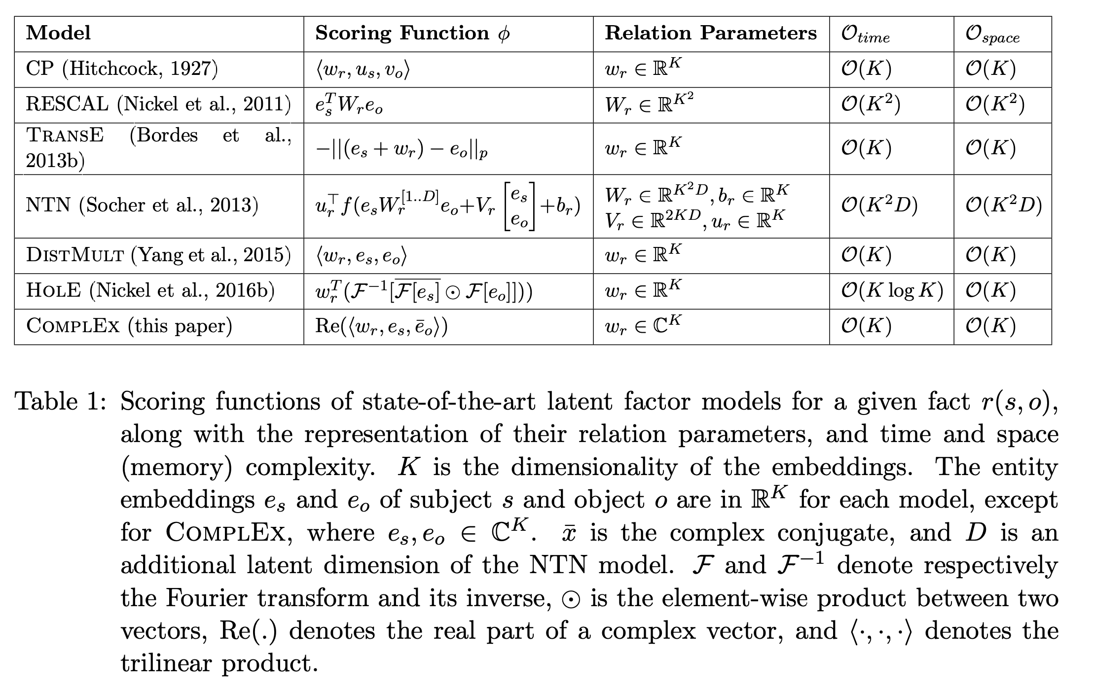
Overview
Théo Trouillon, Christopher R. Dance, Éric Gaussier, Johannes Welbl, Sebastian Riedel, and Guillaume Bouchard. 2017. Knowledge graph completion via complex tensor factorization. J. Mach. Learn. Res. 18, 1, 4735–4772. 2017.
F. L. Hitchcock. The expression of a tensor or a polyadic as a sum of products. J. Math. Phys, 6(1):164–189, 1927.

Slide 31
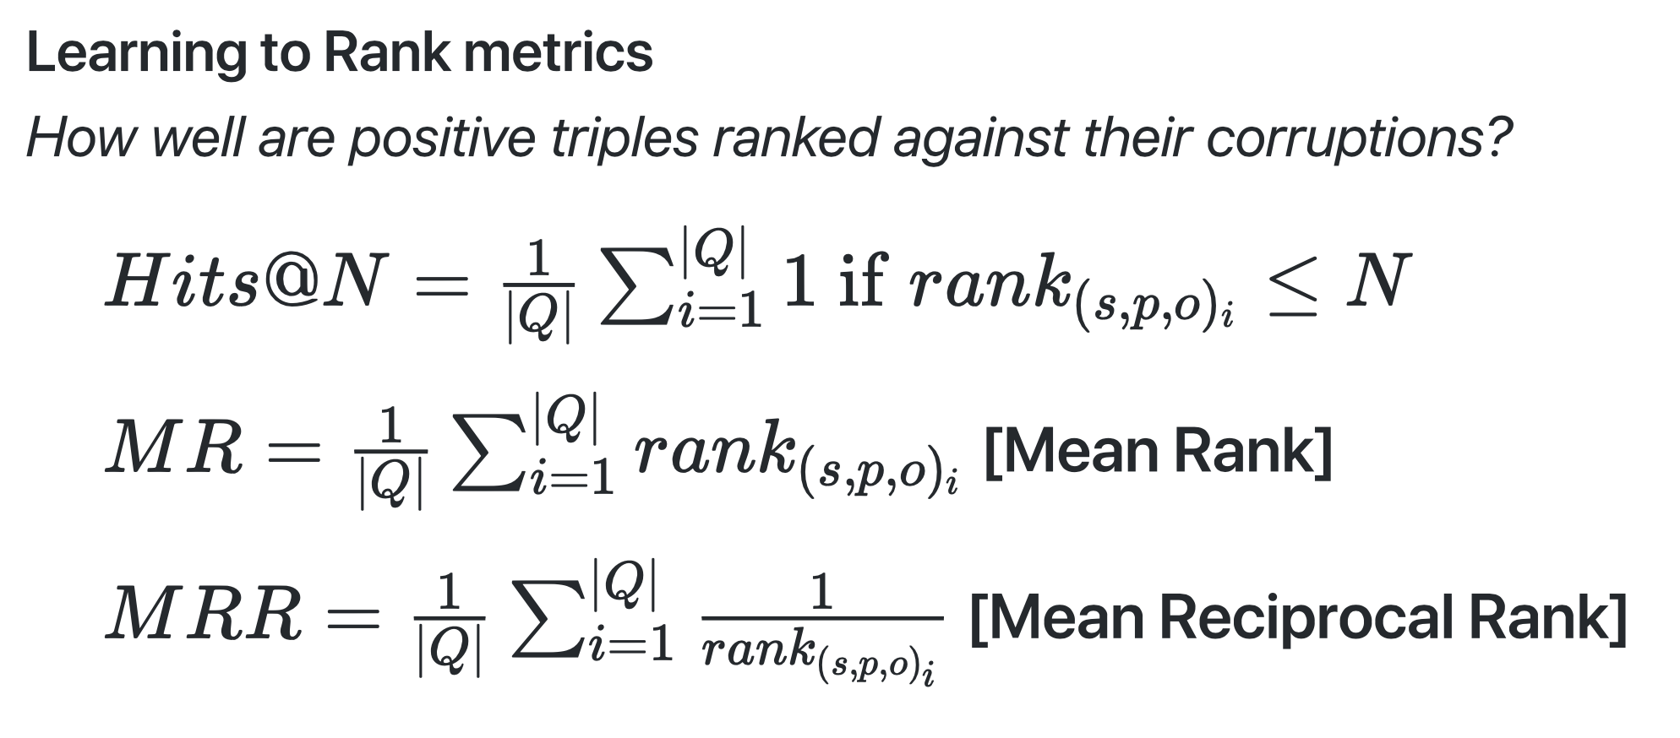
Evaluation Metrics

Slide 32
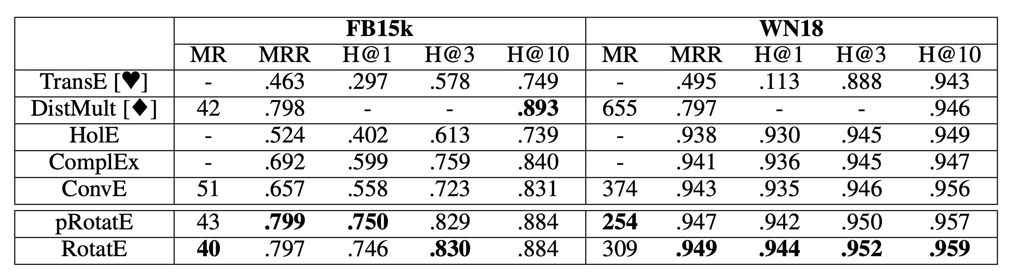
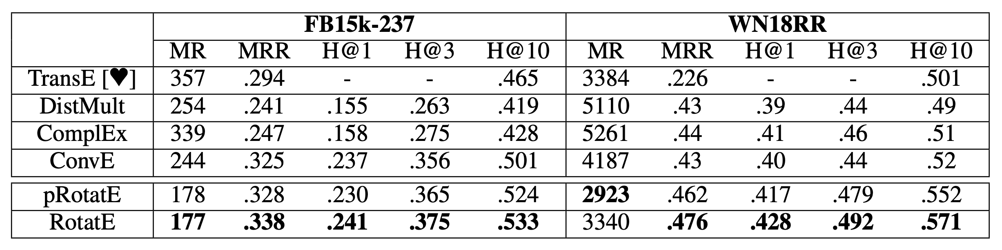
Evaluation
RotatE
Zhiqing Sun, Zhi-Hong Deng, Jian-Yun Nie, Jian Tang:
RotatE: Knowledge Graph Embedding by Relational Rotation in Complex Space. In Proc. ICLR 2019.

Slide 33
Summary
Very many RESCAL- and TransE-like approaches for handcrafted embeddings of relational data
None of the many approaches covers what’s in a text
There no knowledge in a knowledge graph ….
  but a formal subjective content description (SCD) of certain aspects
  SCDs might indeed be very helpful for certain applications
Forget about handcrafted approaches

