Slide 1
Intelligent Agents
1d-CNNs LSTMs ELMo Transformers BERT GPT
Ralf Möller
Universität zu Lübeck
Institut für Informationssysteme

Slide 2
Acknowledgements
Some slides are based on
  CS546: Machine Learning in NLP (Spring 2020)
    http://courses.engr.illinois.edu/cs546/
    Julia Hockenmaier http://juliahmr.cs.illinois.edu
    RNNs, LSTMs, ELMo, Transformers
  Machine Learning (Spring 2020)
    http://speech.ee.ntu.edu.tw/~tlkagk/courses_ML20.html
    李宏毅 (Hung-yi Lee ) http://speech.ee.ntu.edu.tw/~tlkagk/
    ELMo, BERT: http://speech.ee.ntu.edu.tw/~tlkagk/courses/ML_2019/Lecture/BERT%20(v3).pdf
Respective sources are indicated in the gray line at the bottom
Slides have been modified
  All errors are mine

Slide 3
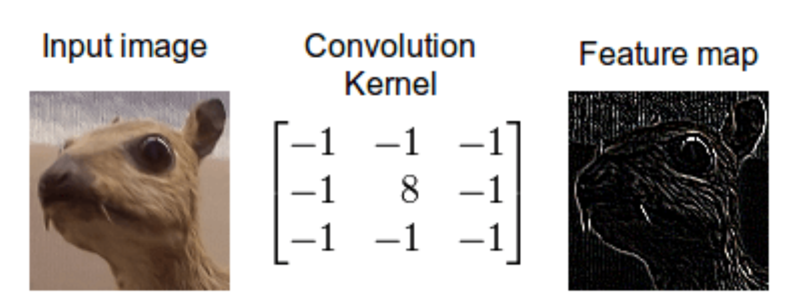
Recap: Convolution

Slide 4
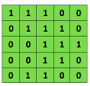
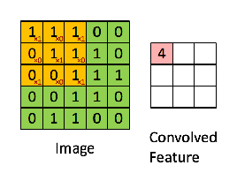

Recap: Convolutional Neural Networks (CNNs)
Main CNN idea for text:
Compute vectors for n-grams and group them afterwards
Example: “this takes too long” compute vectors for:
This takes, takes too, too long, this takes too, takes too long, this takes too long
Convolutional
3x3 filter
Input matrix
http://deeplearning.stanford.edu/wiki/index.php/Feature_extraction_using_convolution
Notes:
http://www.asimovinstitute.org/neural-network-zoo/

Slide 5
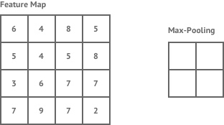
Recap: ConvNets (CNNs)
Main CNN idea for text:
Compute vectors for n-grams and group them afterwards
max pool
2x2 filters
and stride 2
Dimension reduction
https://shafeentejani.github.io/assets/images/pooling.gif

Slide 6
1d-CNNs for text
Text is a (variable-length) sequence of words (word vectors)
We can use a 1d-CNN to slide a window of n tokens across:
— filter size n = 3, stride = 1, no padding
The | quick | brown | fox | jumps | over | the | lazy | dog
The | quick | brown | fox | jumps | over | the | lazy | dog
The | quick | brown | fox | jumps | over | the | lazy | dog
The | quick | brown | fox | jumps | over | the | lazy | dog
The | quick | brown | fox | jumps | over | the | lazy | dog
The | quick | brown | fox | jumps | over | the | lazy | dog
— filter size n = 2, stride = 2, no padding:
The | quick | brown | fox | jumps | over | the | lazy | dog
The | quick | brown | fox | jumps | over | the | lazy | dog
The | quick | brown | fox | jumps | over | the | lazy | dog
The | quick | brown | fox | jumps | over | the | lazy | dog
CNNs (w/ ReLU and maxpool) can be used for classifying (parts of) the text
CS546 Machine Learning in NLP

Slide 7
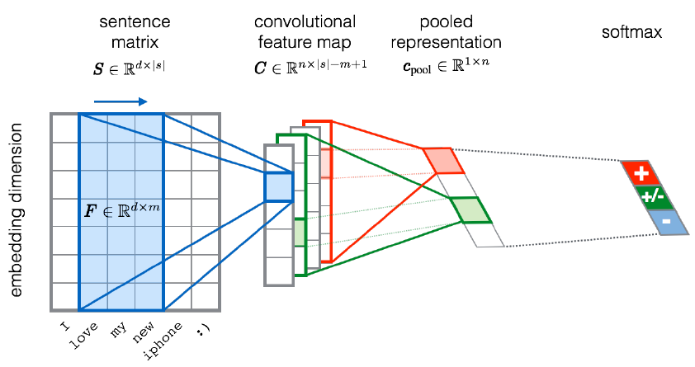
CNNs for sentiment analysis
Entities and relations
not really considered…
Severyn, Aliaksei, and Alessandro Moschitti. "UNITN: Training Deep Convolutional Neural Network for Twitter Sentiment Classification." SemEval@ NAACL-HLT. 2015.
Notes:
the width m of the convolution filters is set to 5
n = 300 feature maps
first layer embeds words into low-dimensional vectors.

Slide 8
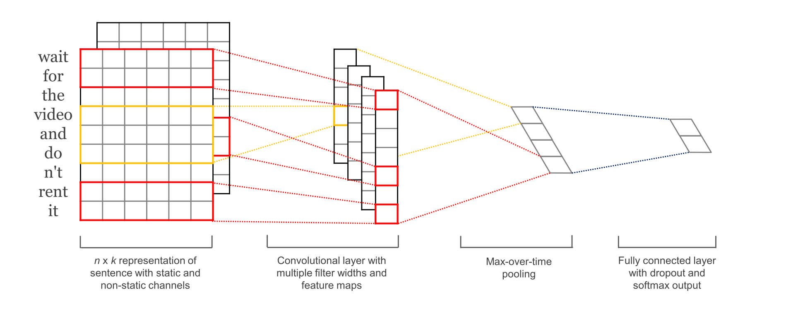
CNNs for sentence/text classification
Pretrained and task-specific embeddings: Multiple Channels
Kim, Y. “Convolutional Neural Networks for Sentence Classification”, EMNLP (2014)
sliding over 3, 4 or 5 words at a time
Static = pre-trained, non-static = task-specific

Slide 9
Fasttext (https://fasttext.cc )
Library for word embeddings and text classification
  static word embeddings and ngram features
  that get averaged together in one hidden layer
  hierarchical softmax output over class labels
Enriching word vectors with subword information
  Skipgram model where each word is a sum of character ngram embeddings and its own embedding
  Each word is deterministically mapped to ngrams
Piotr Bojanowski, Edouard Grave, Armand Joulin, Tomas Mikolov. Enriching Word Vectors with Subword Information. Transactions of the Association for Computational Linguistics, Volume 5. 135-146. 2017.
Armand Joulin, Edouard Grave, Piotr Bojanowski, Tomas Mikolov, Bag of Tricks for Efficient Text Classification. Proceedings of the 15th Conference of the European Chapter of the Association for Computational Linguistics: Volume 2, Short Papers. 427-431. 2017.
Alon Jacovi, Oren Sar Shalom, Yoav Goldberg. Understanding Convolutional Neural Networks for Text Classification. In Proceedings of the 2018 EMNLP Workshop BlackboxNLP: Analyzing and Interpreting Neural Networks for NLP. 2018.
CS546 Machine Learning in NLP

Slide 10









Recursive Networks – Or: Copying the Pattern
Basic computational network copied per time slice
Input: previous hidden state, output: next hidden state
Compare with HMM:
Computational model
output
hidden input
Declarative model (generative)
R_{t-1} | P(R_{t}|R_{t-1})
T F | 0.7 0.3
Rain_{t-1}
Rain_{t}
Rain_{t+1}
R_{t} | P(U_{t}|R_{t})
T F | 0.9 0.2
Umbrella_{t-1}
Umbrella_{t}
Umbrella_{t+1}
CS546 Machine Learning in NLP

Slide 11
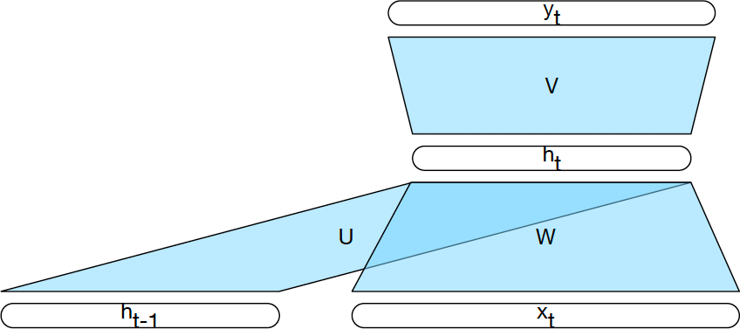
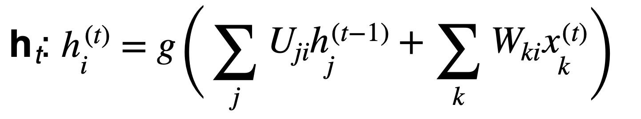
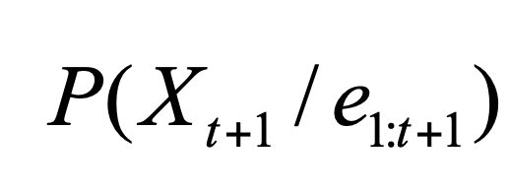
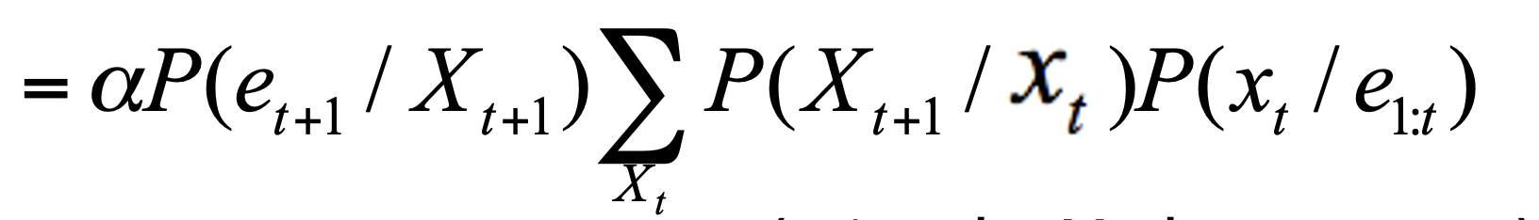
Computing the Hidden State
RNN
HMM Filtering
Computing the hidden state at time t: h^{(t)} = g(Uh^{(t−1)} + Wx^{(t)})
(t)
_{Ujih}(t−1) _{+ Wkix}(t)
The i-the element of h : h = g
t
i
( ∑
j
∑
k
)
j
k
What about hindsight queries (aka smoothing)?
CS546 Machine Learning in NLP

Slide 12
Recap: Activation Functions
Sigmoid (logistic function):
σ(x) = 1/(1 + e^{−x})
3
1/(1+exp(-x))
tanh(x) max(0,x)
2.5
2
Returns values bound above and below ^{1.5}
in the 0,1 range
Hyperbolic tangent:
tanh(x) = (e^{2x −1})/(e^{2x+1})
1
0.5
0
-0.5
-1
-3
-2
-1
0
1
2
3
Returns values bound above and below in the −1, +1 range
Rectified Linear Unit:
ReLU(x) = max(0, x)
Returns values bound below in the 0, +∞ range
CS546 Machine Learning in NLP

Slide 13
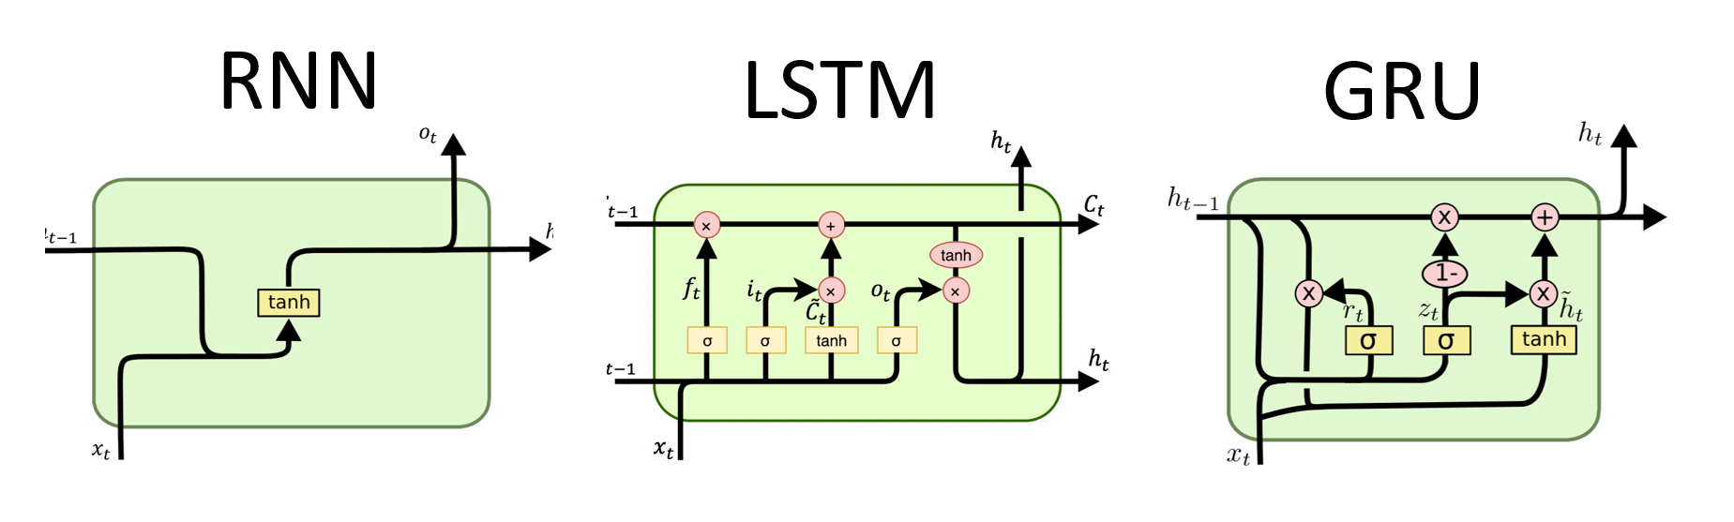




RNN Variants: LSTMs, GRUs
Long Short Term Memory networks (LSTMs) are RNNs with a more complex architecture to combine the last hidden state with the current input.
Gated Recurrent Units (GRUs) are a simplification of LSTMs
Both contain “gates” to control how much of the input or past hidden state to forget or remember
$$h_{t}$$
$$C_{t−1}$$
$$h_{t−1}$$
$$h_{t−1}$$
CS546 Machine Learning in NLP

Slide 14
Gates
A gate performs element-wise multiplication of
  the output of a d-dimensional sigmoid layer
  (all elements between 0 and 1), and
  a d-dimensional input vector
Result: a d-dimensional output vector which is like the input, except some dimensions have been (partially) “forgotten”
CS546 Machine Learning in NLP

Slide 15
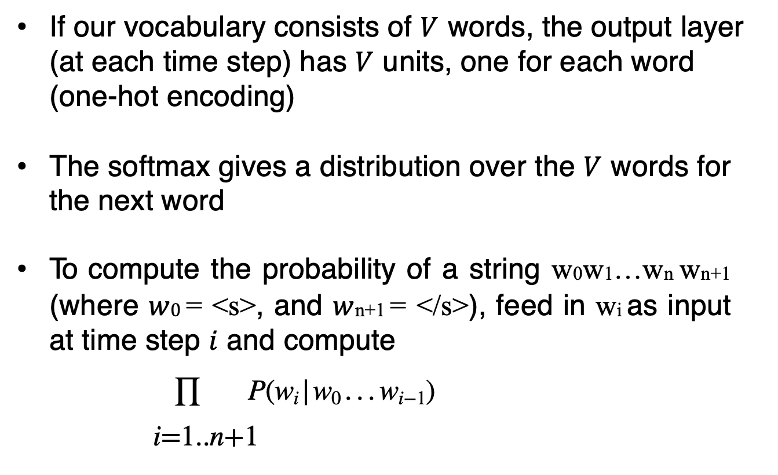
RNNs for Language Modeling
If our vocabulary consists of $V$ words, the output layer (at each time step) has $V$ units, one for each word (one-hot encoding)
The softmax gives a distribution over the $V$ words for the next word
To compute the probability of a string w0w1…wn wn+1 (where $w0$ = <s>, and $w$n+1 = </s>), feed in wi as input at time step $i$ and compute
∏ P(w_{i} | w₀ . . . w_{i−1})
i=1..n+1
CS546 Machine Learning in NLP

Slide 16
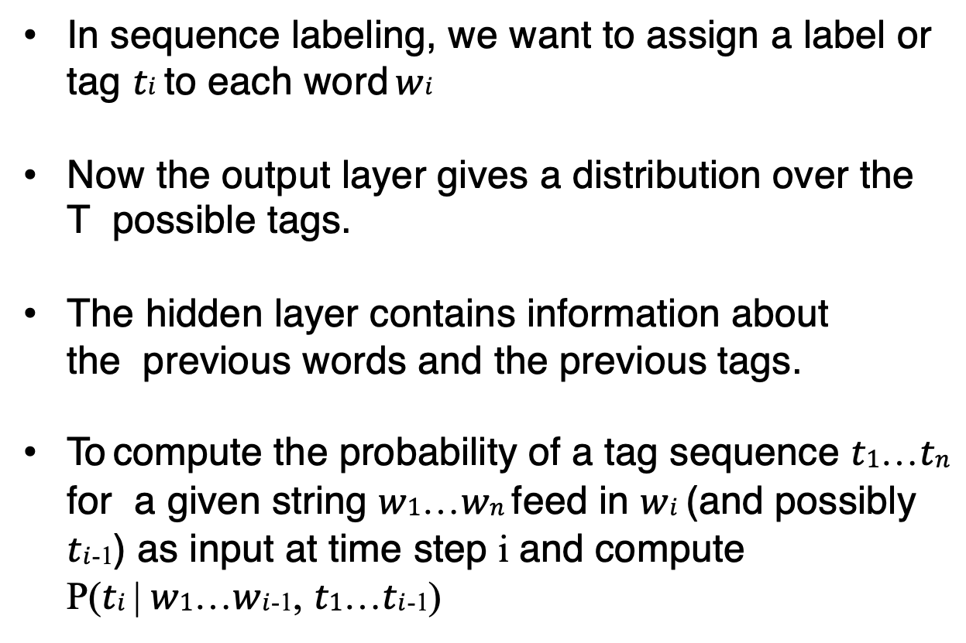
RNNs for Sequence Labeling
In sequence labeling, we want to assign a label or tag $ti$ to each word $wi$
Now the output layer gives a distribution over the T possible tags.
The hidden layer contains information about the previous words and the previous tags.
To compute the probability of a tag sequence $t1$…$tn$ for a given string $w1$…$wn$ feed in $wi$ (and possibly
$ti$-1) as input at time step i and compute
P($ti$ | $w1$…$wi$-1, $t1$…$ti$-1)
CS546 Machine Learning in NLP

Slide 17
Basic RNNs for Sequence Labeling
Each time step has a distribution over output classes
RNN
Janet
will
back
the
bill
Extension: add a HMM/CRF layer to capture dependencies among labels of adjacent tokens.
CS546 Machine Learning in NLP

Slide 18
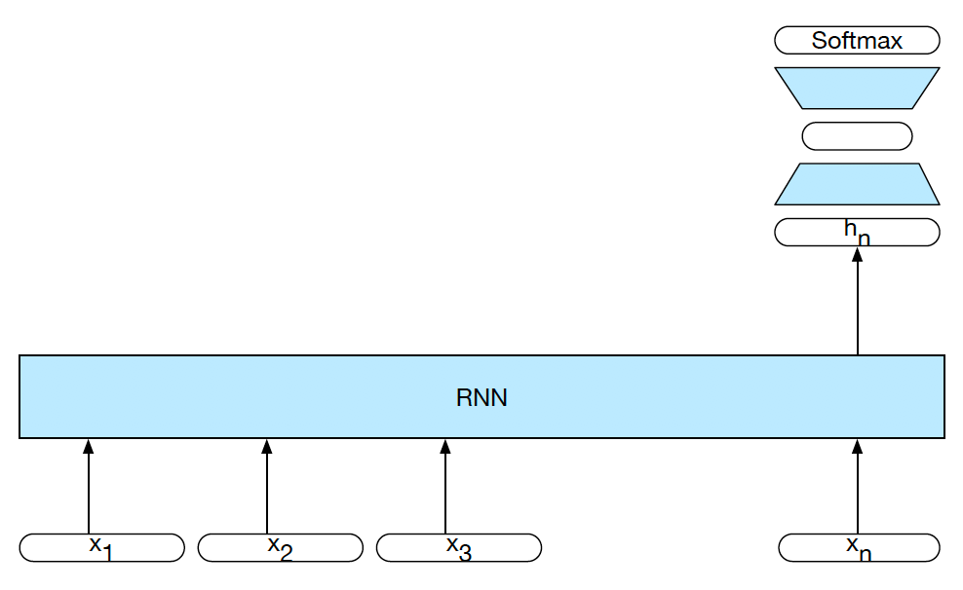
RNNs for Sequence Classification
If we just want to assign a label to the entire sequence, we don’t need to produce output at each time step, so we can use a simpler architecture.
We can use the hidden state of the last word in the sequence as input to a feedforward net:
CS546 Machine Learning in NLP

Slide 19
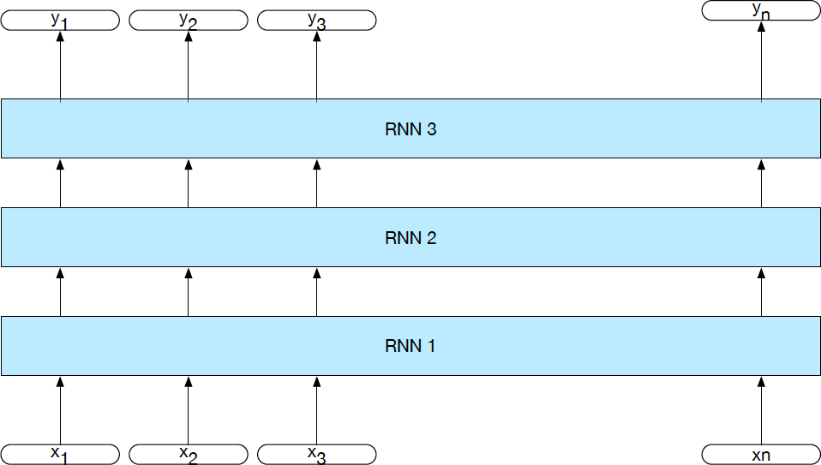
Stacked RNNs
We can create an RNN that has “vertical” depth (at each time step) by stacking multiple RNNs:
19
CS546 Machine Learning in NLP

Slide 20
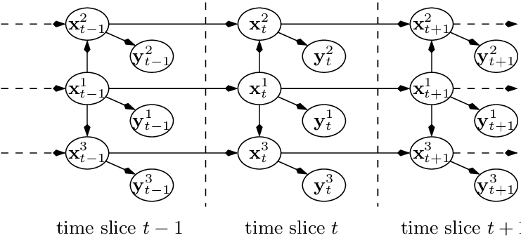
Comparison with Dynamic Baysian Networks

Slide 21
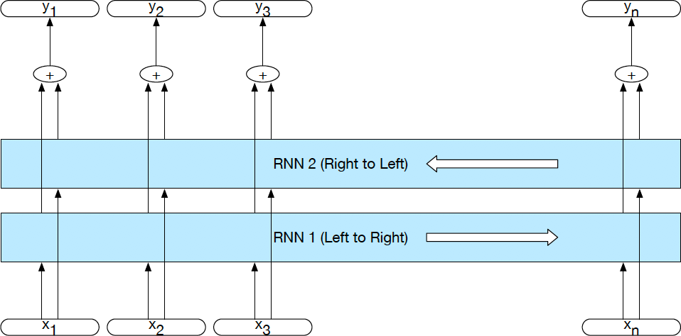
Bidirectional RNNs
Computational specification of smoothing?
Unless we need to generate a sequence, we can run two RNNs over the input sequence — one in the forward direction,
and one in the backward direction.
Their hidden states will capture different context information
Hidden state of biRNN: h^{(t)} = h^{(t)} ⊕ h^{(t)} where
⊕
is typically
bi fw bw
concatenation (or element-wise addition, multiplication)
CS546 Machine Learning in NLP

Slide 22
Bidirectional RNNs for sequence classification
Combine the hidden state of the last word of the forward RNN and the hidden state of the first word of the backward RNN into a single vector
Softmax
+
^{h}1_back
RNN 2 (Right to Left)
RNN 1 (Left to Right)
^{h}n_for
w
x₁
x₂
x₃
x_{n}
CS546 Machine Learning in NLP

Slide 23


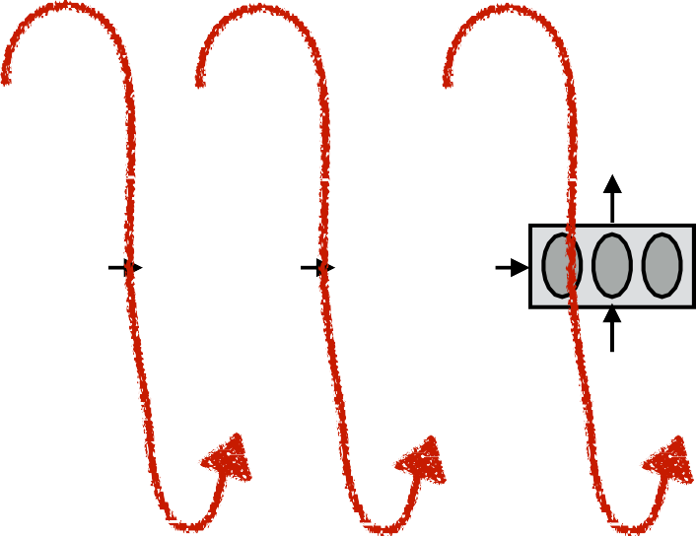




Encoder-Decoder (seq2seq) model
Task: Read an input sequence and return an output sequence
  Machine translation: translate source into target language
  Dialog system/chatbot: generate a response
Reading the input sequence: RNN Encoder
Generating the output sequence: RNN Decoder
Encoder Decoder
output
hidden
input
<s>
CS546 Machine Learning in NLP

Slide 24
Encoder-Decoder (seq2seq) Model
Encoder RNN:
reads in the input sequence
passes its last hidden state to the initial hidden state of the decoder
Decoder RNN:
generates the output sequence
typically uses different parameters from the encoder may also use different input embeddings
CS546 Machine Learning in NLP

Slide 25
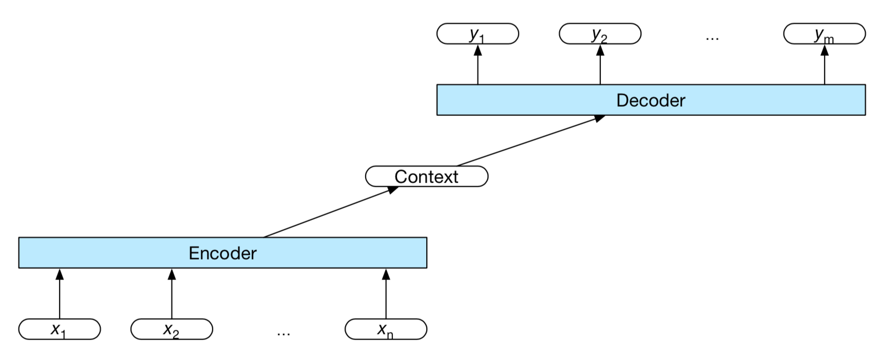
A More General View of seq2seq
In general, any function over the encoder’s output can be used as a representation of the context we want to condition the decoder on.
We can feed the context in at any time step during decoding (not just at the beginning).
CS546 Machine Learning in NLP

Slide 26
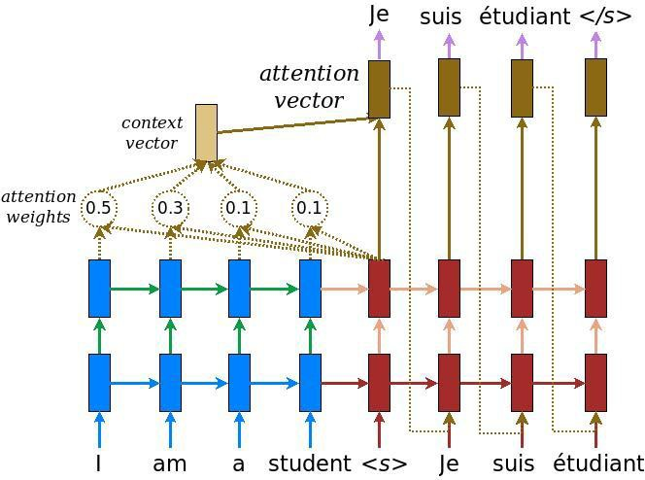
Attention Mechanisms
Define a distribution α = (α_{1t}, . . . , α_{St}) over the S elements of the input sequence that depends on the current output element t (with ∑ α_{st} = 1; ∀_{s∈1...S} 0 ≤ α_{st} ≤ 1 )
s=1..S
Use this distribution to compute a weighted average of the input: ∑ α_{st}o_{s} and feed that into the decoder.
s=1..S
https://www.tensorflow.org/tutorials/text/nmt_with_attention
CS546 Machine Learning in NLP

Slide 27
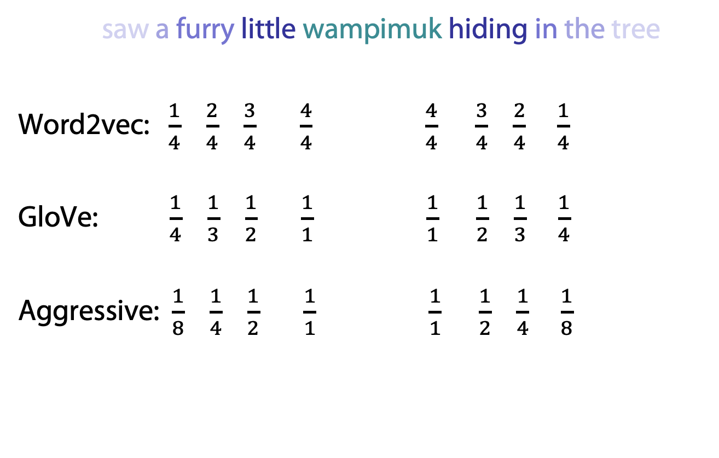
Remember? Dynamic Context Windows in word2vec
Marco saw a furry little wampimuk hiding in the tree.
Word2vec: $\frac{1}{4}$ $\frac{2}{4}$ $\frac{3}{4}$ $\frac{4}{4}$ $\frac{4}{4}$ $\frac{3}{4}$ $\frac{2}{4}$ $\frac{1}{4}$
GloVe: $\frac{1}{4}$ $\frac{1}{3}$ $\frac{1}{2}$ $\frac{1}{1}$ $\frac{1}{1}$ $\frac{1}{2}$ $\frac{1}{3}$ $\frac{1}{4}$
Aggressive: $\frac{1}{8}$ $\frac{1}{4}$ $\frac{1}{2}$ $\frac{1}{1}$ $\frac{1}{1}$ $\frac{1}{2}$ $\frac{1}{4}$ $\frac{1}{8}$
Notes:
…the more relevant it is.
word2vec does just that, by randomly sampling the size of the context window around each token.
What you see here are the probabilities that each specific context word will be included in the training data.
GloVe also does something similar, but in a deterministic manner, and with a slightly different distribution.
There are of course other ways to do this,
And they were all, apparently,
Applied to traditional algorithms about a decade ago.

Slide 28
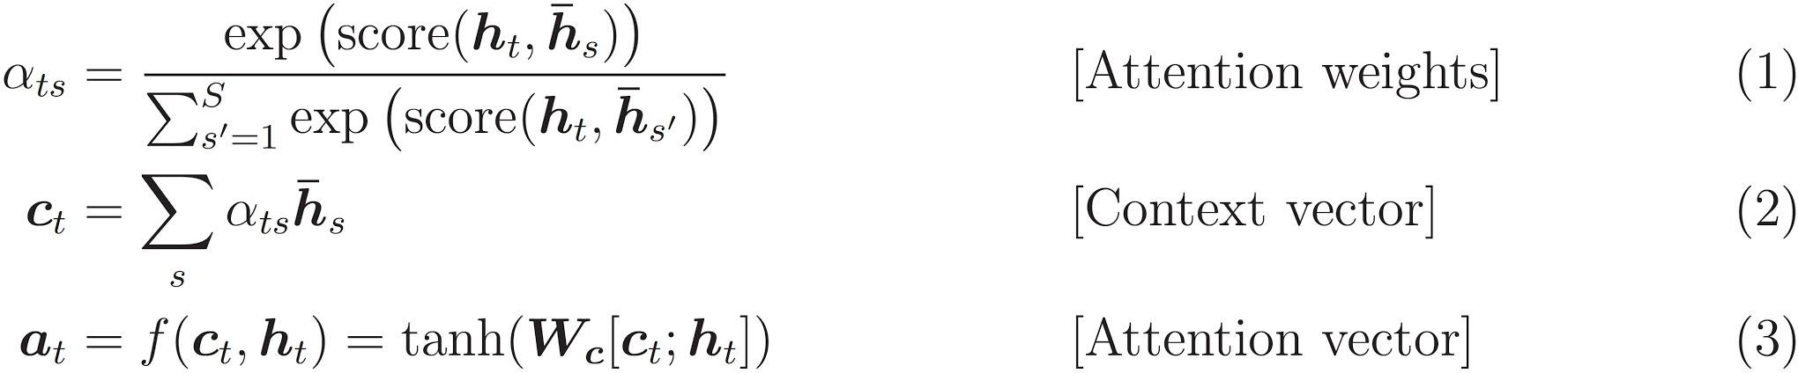
Attention Mechanisms
ht: current hidden state of decoder (target)
h’s: output of the encoder for word s (source)
Attention weights αts: distribution over h’s
αts depends on score(ht, h’s) Context vector ct: weighted average of h’s Attention vector αt: computed by feedforward layer over ct and ht
https://www.tensorflow.org/tutorials/text/nmt_with_attention
CS546 Machine Learning in NLP

Slide 29
From RNNs to LSTMs
In simple RNNs, hidden state depends
on previous hidden state and on the input:
  h_{t} = g(W_{h}[h_{t−1}, x_{t}] + b_{h}) with e.g. g=tanh
Vanishing gradient problem
  RNNs can’t be trained effectively on long sequences
LSTMs (Long Short-Term Memory networks) to the rescue
  Additional cell state passed through the network and
  updated at each time step
  LSTMs define four different layers (gates) that read in
  the previous hidden state and current input.
CS546 Machine Learning in NLP

Slide 30
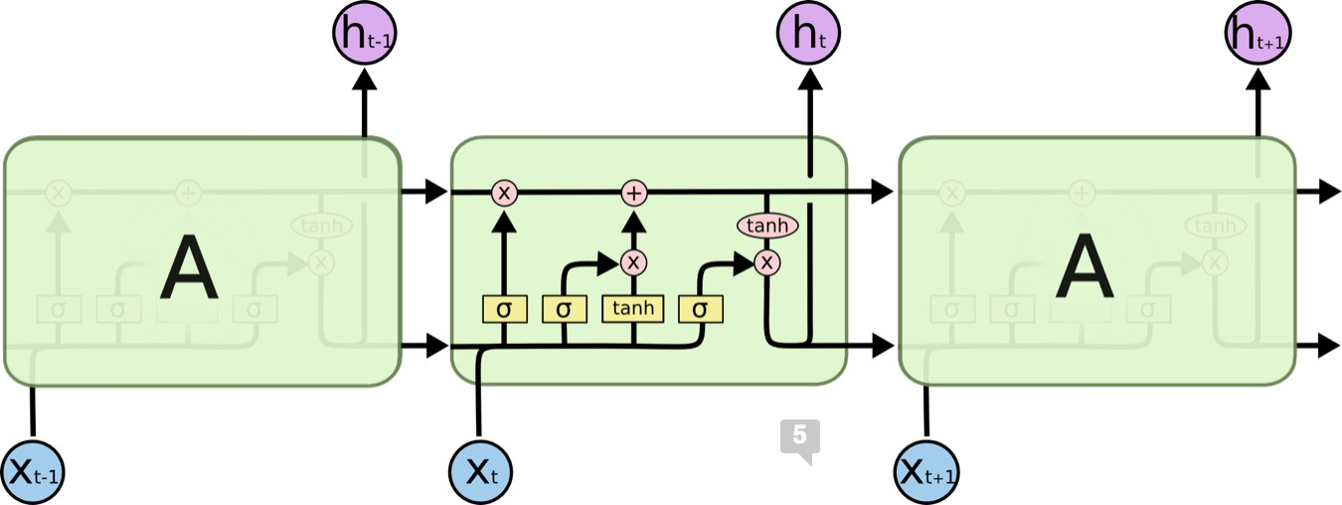
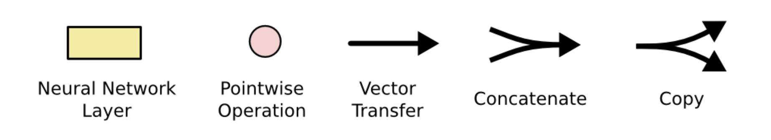
Long Short Term Memory Networks (LSTMs)
https://colah.github.io/posts/2015-08-Understanding-LSTMs/
CS546 Machine Learning in NLP

Slide 31
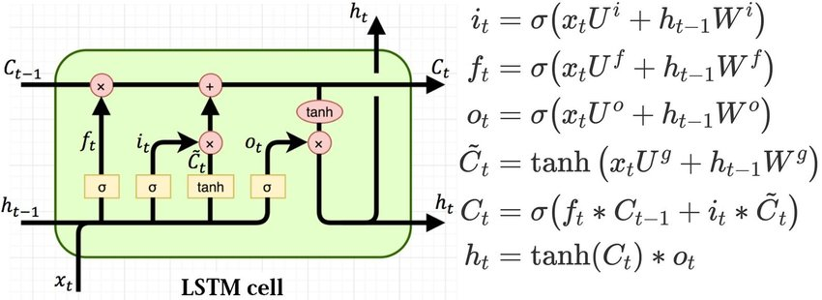
Long Short Term Memory Networks (LSTMs)
t
At time , the LSTM cell reads in
— a c-dimensional previous cell state vector c
t−1
— an h-dimensional previous hidden state vector h_{t−1}
— a d-dimensional current input vector At time , the LSTM cell returns
t
— a c-dimensional previous cell state vector c_{t}
— an h-dimensional previous hidden state vector h_{t} (which may also be passed to an output layer)
https://colah.github.io/posts/2015-08-Understanding-LSTMs/
CS546 Machine Learning in NLP

Slide 32
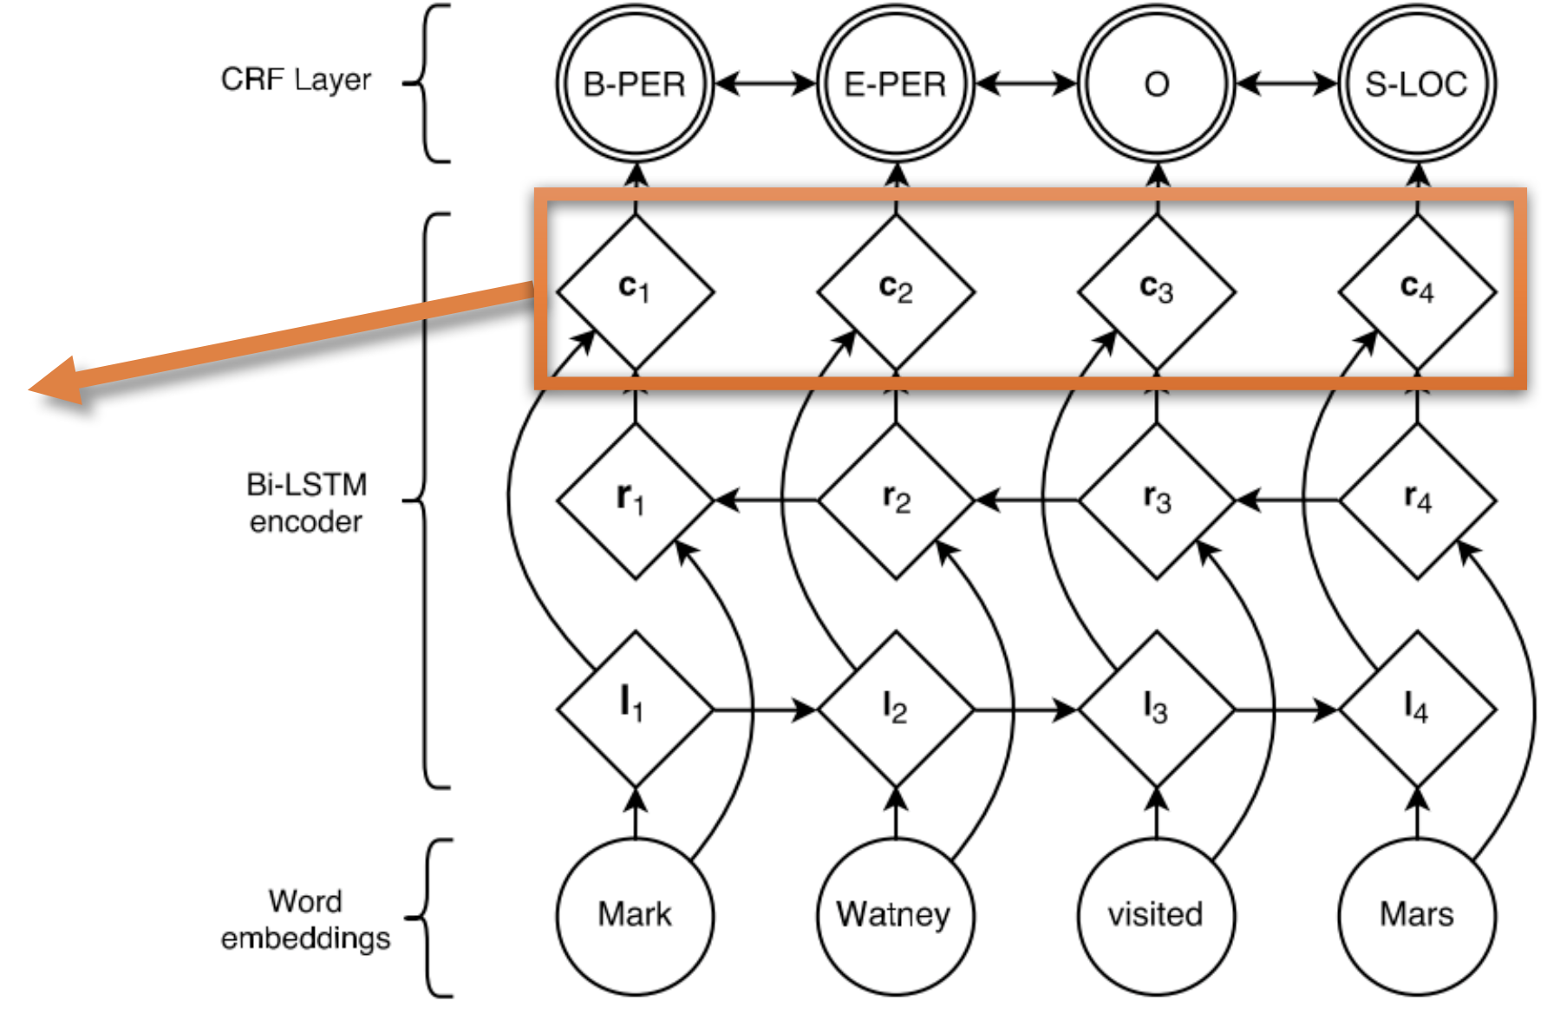
Bi-LSTM Encoder w/ HMM/CRF Layer
Contextualized
Representations
High computational effort

Slide 33
Embeddings from Language Models
Replace static embeddings (lexicon lookup) with context-dependent embeddings (produced by a deep language model)
=> Each token’s representation is a function of the entire input sentence, computed by a deep (multi-layer) bidirectional language model
=> Return for each token a (task-dependent) linear combination of its representation across layers.
=> Different layers capture different information
CS546 Machine Learning in NLP

Slide 34
Embeddings from Language Model (ELMO)
RNN-based language models (trained from lots of sentences)
e.g., given “潮水 退了 就 知道 誰 沒穿 褲子”
潮水
退了
就
潮水
退了
就
RNN
RNN
RNN
…
…
RNN
RNN
RNN
…
RNN
RNN
RNN
…
…
RNN
RNN
RNN
…
<BOS>
潮水
退了
退了
就
知道
潮水 退了 就 知道 誰 沒穿 褲子 = When the tide goes out, you know who's not wearing pants.
https://arxiv.org/abs/1802.05365
  http://speech.ee.ntu.edu.tw/~tlkagk/courses_ML20.html

Slide 35
ELMO
Each layer in deep LSTM can generate a latent representation.
Which one should we use???
…
…
…
…
…
…
RNN
RNN
RNN
…
…
RNN
RNN
RNN
…
$$h_{2}$$
RNN
RNN
RNN
…
…
RNN
RNN
RNN
…
RNN
RNN
RNN
…
…
RNN
RNN
RNN
…
$$h_{1}$$
<BOS>
潮水
退了
退了
就
知道
  http://speech.ee.ntu.edu.tw/~tlkagk/courses_ML20.html

Slide 36


ELMO
High computational effort, word2vec to the rescue?
=
$$α_{1}$$
+
$$α_{2}$$
ELMO
Learned with the
down stream tasks
潮水
退了
就
知道
……
  http://speech.ee.ntu.edu.tw/~tlkagk/courses_ML20.html

Slide 37
Transformers
Sequence transduction model
(no convolutions or recurrence)
Attention not only during decoding but also during encoding
  Self-attention
Captures more long-range dependencies than CNNs with fewer parameters
Easier to parallelize than recurrent nets
Faster to train than recurrent nets

Slide 38












Sequence
Next layer
$$b^{1}$$
$$b^{2}$$
$$b^{3}$$
$$b^{4}$$
$$a^{1}$$
$$a^{2}$$
$$a^{3}$$
$$a^{4}$$
$$a^{1}$$
$$a^{2}$$
$$a^{3}$$
$$a^{4}$$
Previous layer
Using CNN to replace RNN
Hard to parallelize !
Transformer by 李宏毅 Hung-yi Lee

Slide 39




Sequence
Filters in higher layer can consider longer sequence
Next layer
$$b^{1}$$
$$b^{2}$$
$$b^{3}$$
$$b^{4}$$
$$b^{1}$$
$$b^{2}$$
$$b^{3}$$
$$b^{4}$$
……
……
……
……
$$a^{1}$$
$$a^{2}$$
$$a^{3}$$
$$a^{4}$$
$$a^{1}$$
$$a^{2}$$
$$a^{3}$$
$$a^{4}$$
Previous layer
Using CNNs to replace RNN
Hard to parallelize !
(CNNs can be parallelized)
Transformer by 李宏毅 Hung-yi Lee

Slide 40





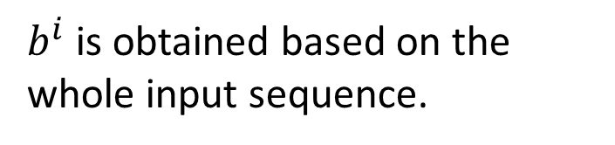



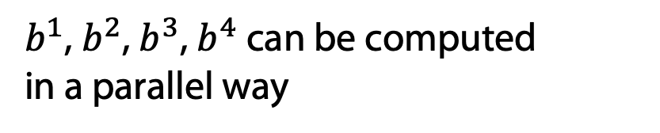

Self-Attention
$b^{i}$ is obtained based on the whole input sequence.
$b^{1}$, $b^{2}$, $b^{3}$, $b^{4}$ can be computed
in a parallel way
$$b^{1}$$
$$b^{2}$$
$$b^{3}$$
$$b^{4}$$
$$b^{1}$$
$$b^{2}$$
$$b^{3}$$
$$b^{4}$$
Self-Attention Layer
$$a^{1}$$
$$a^{2}$$
$$a^{3}$$
$$a^{4}$$
$$a^{1}$$
$$a^{2}$$
$$a^{3}$$
$$a^{4}$$
You can try to replace anything that has been done by RNN with self-attention.
Transformer by 李宏毅 Hung-yi Lee

Slide 41
Intelligent Agents
1d-CNNs LSTMs ELMo Transformers BERT GPT
Ralf Möller
Universität zu Lübeck
Institut für Informationssysteme

Slide 42
Recap: Embeddings from Language MOdel (ELMO)
Sequence-based word embeddings
(rather than bag-of-words based)
=
$$α_{1}$$
+
$$α_{2}$$
ELMO
Learned with the
downstream tasks
潮水
退了
就
知道
……
  http://speech.ee.ntu.edu.tw/~tlkagk/courses_ML20.html

Slide 43


Pre-Training & Fine Tuning
ELMo
pre-trained on large corpus (in self-supervised fashion)
2) Feature-based training ("fine-tuning")
on target/“downstream“ task
(supervised learning)
$$α_{1}$$
Pretrained
Model
$$α_{2}$$
Embedding
One or more layers

Slide 44
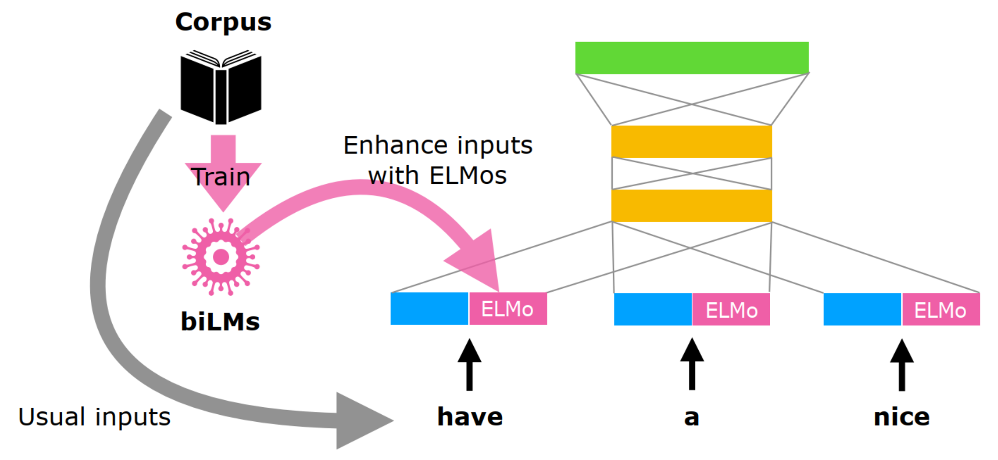
Integrate ELMos into other embeddings
https://www.slideshare.net/shuntaroy/a-review-of-deep-contextualized-word-representations-peters-2018

Slide 45
Recap: Attention in Recurrent Encoding/Decoding
CS546 Machine Learning in NLP

Slide 46
Recap: Transformers
Sequence transduction model
(no convolutions or recurrence)
Attention not only during decoding but also during encoding
  Self-attention
Captures more long-range dependencies than
recurrent architectures (and CNNs) with fewer parameters
Easier to parallelize than recurrent nets
Faster to train than recurrent nets

Slide 47









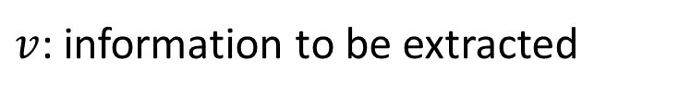





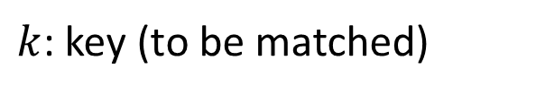


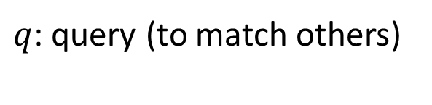








Self-attention
$q$: query (to match others)
https://arxiv.org/abs/1706.03762
$$q^{i}=W^{q}a^{i}$$
$k$: key (to be matched)
Attention is all you need.
$$k^{i}=W^{k}a^{i}$$
$v$: information to be extracted
$$v^{i}=W^{v}a^{i}$$
$$q^{1}$$
$$k^{1}$$
$$v^{1}$$
$$q^{2}$$
$$k^{2}$$
$$v^{2}$$
$$q^{3}$$
$$k^{3}$$
$$v^{3}$$
$$q^{4}$$
$$k^{4}$$
$$v^{4}$$
$$a^{1}$$
$$a^{2}$$
$$a^{3}$$
$$a^{4}$$
$$a^{i}=Wx^{i}$$
$$x^{1}$$
$$x^{2}$$
$$x^{3}$$
$$x^{4}$$
Transformer by 李宏毅 Hung-yi Lee

Slide 48






Self-attention
Take each query q, go to each key k, do attention
d is the dim of $q$ and $k$
Scaled Dot-Product Attention:
$$α_{1,i}=q^{1}∙k^{i}/\sqrt{d}$$
dot product
$$α_{1,1}$$
$$α_{1,2}$$
$$α_{1,3}$$
$$α_{1,4}$$
$$q^{1}$$
$$k^{1}$$
$$v^{1}$$
$$q^{2}$$
$$k^{2}$$
$$v^{2}$$
$$q^{3}$$
$$k^{3}$$
$$v^{3}$$
$$q^{4}$$
$$k^{4}$$
$$v^{4}$$
$$a^{1}$$
$$a^{2}$$
$$a^{3}$$
$$a^{4}$$
$$x^{1}$$
$$x^{2}$$
$$x^{3}$$
$$x^{4}$$
Transformer by 李宏毅 Hung-yi Lee

Slide 49




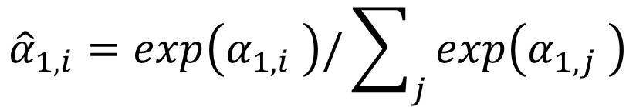
Self-attention
$${\hat{α}}_{1,i}=exp\left(α_{1,i} \right)/\sum_{j}{exp\left(α_{1,j} \right)}$$
$${\hat{α}}_{1,1}$$
$${\hat{α}}_{1,2}$$
$${\hat{α}}_{1,3}$$
$${\hat{α}}_{1,4}$$
Soft-max
$$α_{1,1}$$
$$α_{1,2}$$
$$α_{1,3}$$
$$α_{1,4}$$
$$q^{1}$$
$$k^{1}$$
$$v^{1}$$
$$q^{2}$$
$$k^{2}$$
$$v^{2}$$
$$q^{3}$$
$$k^{3}$$
$$v^{3}$$
$$q^{4}$$
$$k^{4}$$
$$v^{4}$$
$$a^{1}$$
$$a^{2}$$
$$a^{3}$$
$$a^{4}$$
$$x^{1}$$
$$x^{2}$$
$$x^{3}$$
$$x^{4}$$
Transformer by 李宏毅 Hung-yi Lee

Slide 50






Self-attention
$$b^{1}=\sum_{i}{{\hat{α}}_{1,i}v^{i} }$$
Considering the whole sequence
$$b^{1}$$
$${\hat{α}}_{1,1}$$
$${\hat{α}}_{1,2}$$
$${\hat{α}}_{1,3}$$
$${\hat{α}}_{1,4}$$
$$q^{1}$$
$$k^{1}$$
$$v^{1}$$
$$q^{2}$$
$$k^{2}$$
$$v^{2}$$
$$q^{3}$$
$$k^{3}$$
$$v^{3}$$
$$q^{4}$$
$$k^{4}$$
$$v^{4}$$
$$a^{1}$$
$$a^{2}$$
$$a^{3}$$
$$a^{4}$$
$$x^{1}$$
$$x^{2}$$
$$x^{3}$$
$$x^{4}$$
Transformer by 李宏毅 Hung-yi Lee
Notes:
Relation between attention and CNN
Global receptive field (compared to convolutional architectures)

Slide 51






Self-attention
$$b^{2}=\sum_{i}{{\hat{α}}_{2,i}v^{i} }$$
Take each query q, go to each key k, do attention
$$b^{2}$$
$${\hat{α}}_{2,1}$$
$${\hat{α}}_{2,2}$$
$${\hat{α}}_{2,3}$$
$${\hat{α}}_{2,4}$$
$$q^{1}$$
$$k^{1}$$
$$v^{1}$$
$$q^{2}$$
$$k^{2}$$
$$v^{2}$$
$$q^{3}$$
$$k^{3}$$
$$v^{3}$$
$$q^{4}$$
$$k^{4}$$
$$v^{4}$$
$$a^{1}$$
$$a^{2}$$
$$a^{3}$$
$$a^{4}$$
$$x^{1}$$
$$x^{2}$$
$$x^{3}$$
$$x^{4}$$
Transformer by 李宏毅 Hung-yi Lee
Notes:
Relation between attention and CNN
Global receptive field (compared to convolutional architectures)

Slide 52


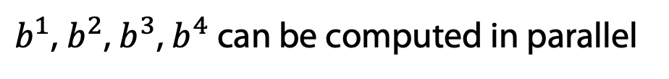


Self-attention
$b^{1}$, $b^{2}$, $b^{3}$, $b^{4}$ can be computed in parallel
$$b^{1}$$
$$b^{2}$$
$$b^{3}$$
$$b^{4}$$
Self-Attention Layer
$$a^{1}$$
$$a^{2}$$
$$a^{3}$$
$$a^{4}$$
$$x^{1}$$
$$x^{2}$$
$$x^{3}$$
$$x^{4}$$
Transformer by 李宏毅 Hung-yi Lee
Notes:
Relation between attention and CNN
Global receptive field (compared to convolutional architectures)

Slide 53




































Self-attention
$$q^{1}$$
$$q^{2}$$
$$q^{3}$$
$$q^{4}$$
$$a^{1}$$
$$a^{2}$$
=
$$a^{3}$$
$$W^{q}$$
$$a^{4}$$
$$Q$$
$$I$$
$$a^{1}$$
$$a^{2}$$
$$k^{1}$$
$$a^{3}$$
$$k^{2}$$
$$a^{4}$$
$$k^{3}$$
$$q^{i}=W^{q}a^{i}$$
$$k^{4}$$
=
$$W^{k}$$
$$K$$
$$I$$
$$k^{i}=W^{k}a^{i}$$
$$a^{1}$$
$$a^{2}$$
$$a^{3}$$
$$v^{1}$$
$$a^{4}$$
$$v^{2}$$
$$v^{3}$$
$$v^{4}$$
=
$$W^{v}$$
$$v^{i}=W^{v}a^{i}$$
$$V$$
$$I$$
$$q^{1}$$
$$k^{1}$$
$$v^{1}$$
$$q^{2}$$
$$k^{2}$$
$$v^{2}$$
$$q^{3}$$
$$k^{3}$$
$$v^{3}$$
$$q^{4}$$
$$k^{4}$$
$$v^{4}$$
$$a^{1}$$
$$a^{2}$$
$$a^{3}$$
$$a^{4}$$
$$x^{1}$$
$$x^{2}$$
$$x^{3}$$
$$x^{4}$$
Transformer by 李宏毅 Hung-yi Lee

Slide 54












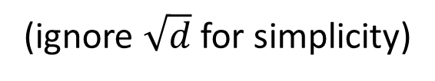










Self-attention
$$b^{1}$$
$${\hat{α}}_{1,1}$$
$${\hat{α}}_{1,2}$$
$${\hat{α}}_{1,3}$$
$${\hat{α}}_{1,4}$$
$$q^{1}$$
$$k^{1}$$
$$v^{1}$$
$$q^{2}$$
$$k^{2}$$
$$v^{2}$$
$$q^{3}$$
$$k^{3}$$
$$v^{3}$$
$$q^{4}$$
$$k^{4}$$
$$v^{4}$$
$$α_{1,1}=$$
$$k^{1}$$
$$q^{1}$$
$$α_{1,2}=$$
$$k^{2}$$
$$q^{1}$$
$$α_{1,1}$$
$$k^{1}$$
$$α_{1,2}$$
$$k^{2}$$
$$α_{1,3}=$$
$$k^{3}$$
$$q^{1}$$
$$α_{1,4}=$$
$$k^{4}$$
$$q^{1}$$
$$=$$
$$q^{1}$$
$$α_{1,3}$$
$$k^{3}$$
$$α_{1,4}$$
$$k^{4}$$
(ignore $\sqrt{d}$ for simplicity)
Transformer by 李宏毅 Hung-yi Lee
Notes:
Relation between attention and CNN
Global receptive field (compared to convolutional architectures)

Slide 55














































Self-attention
$$b^{2}=\sum_{i}{{\hat{α}}_{2,i}v^{i} }$$
$$b^{2}$$
$${\hat{α}}_{2,1}$$
$${\hat{α}}_{2,2}$$
$${\hat{α}}_{2,3}$$
$${\hat{α}}_{2,4}$$
$$q^{1}$$
$$k^{1}$$
$$v^{1}$$
$$q^{2}$$
$$k^{2}$$
$$v^{2}$$
$$q^{3}$$
$$k^{3}$$
$$v^{3}$$
$$q^{4}$$
$$k^{4}$$
$$v^{4}$$
$${\hat{α}}_{1,1}$$
$${\hat{α}}_{2,1}$$
$${\hat{α}}_{3,1}$$
$${\hat{α}}_{4,1}$$
$$α_{1,1}$$
$$α_{2,1}$$
$$α_{3,1}$$
$$α_{4,1}$$
$$k^{1}$$
$${\hat{α}}_{1,2}$$
$${\hat{α}}_{2,2}$$
$${\hat{α}}_{3,2}$$
$${\hat{α}}_{4,2}$$
$$α_{1,2}$$
$$α_{2,2}$$
$$α_{3,2}$$
$$α_{4,2}$$
$$k^{2}$$
$${\hat{α}}_{1,3}$$
$${\hat{α}}_{2,3}$$
$${\hat{α}}_{3,3}$$
$$=$$
$$q^{1}$$
$$q^{2}$$
$$q^{3}$$
$$q^{4}$$
$${\hat{α}}_{4,3}$$
$$α_{1,3}$$
$$α_{2,3}$$
$$α_{3,3}$$
$$α_{4,3}$$
$$k^{3}$$
$${\hat{α}}_{1,4}$$
$${\hat{α}}_{2,4}$$
$${\hat{α}}_{3,4}$$
$${\hat{α}}_{4,4}$$
softmax
$$α_{1,4}$$
$$α_{2,4}$$
$$α_{3,4}$$
$$Q$$
$$α_{4,4}$$
$$k^{4}$$
$$\hat{A}$$
$$A$$
$$K^{T}$$
Transformer by 李宏毅 Hung-yi Lee
Notes:
Relation between attention and CNN
Global receptive field (compared to convolutional architectures)

Slide 56



























Self-attention
$$b^{2}=\sum_{i}{{\hat{α}}_{2,i}v^{i} }$$
$$b^{2}$$
$${\hat{α}}_{2,1}$$
$${\hat{α}}_{2,2}$$
$${\hat{α}}_{2,3}$$
$${\hat{α}}_{2,4}$$
$$q^{1}$$
$$k^{1}$$
$$v^{1}$$
$$q^{2}$$
$$k^{2}$$
$$v^{2}$$
$$q^{3}$$
$$k^{3}$$
$$v^{3}$$
$$q^{4}$$
$$k^{4}$$
$$v^{4}$$
$${\hat{α}}_{1,1}$$
$${\hat{α}}_{2,1}$$
$${\hat{α}}_{3,1}$$
$${\hat{α}}_{4,1}$$
$${\hat{α}}_{1,2}$$
$${\hat{α}}_{2,2}$$
$${\hat{α}}_{3,2}$$
$${\hat{α}}_{4,2}$$
$$b^{1}$$
=
$$b^{2}$$
$$b^{3}$$
$$b^{4}$$
$$v^{1}$$
$$v^{2}$$
$$v^{3}$$
$$v^{4}$$
$${\hat{α}}_{1,3}$$
$${\hat{α}}_{2,3}$$
$${\hat{α}}_{3,3}$$
$${\hat{α}}_{4,3}$$
$$O$$
$$V$$
$${\hat{α}}_{1,4}$$
$${\hat{α}}_{2,4}$$
$${\hat{α}}_{3,4}$$
$${\hat{α}}_{4,4}$$
$$\hat{A}$$
Transformer by 李宏毅 Hung-yi Lee
Notes:
Relation between attention and CNN
Global receptive field (compared to convolutional architectures)

Slide 57
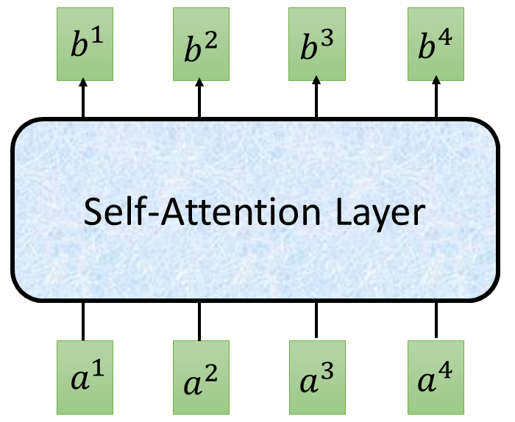


















Self-attention
$$O$$
$$Q$$
=
$$I$$
$$W^{q}$$
$$K$$
=
$$I$$
$$W^{k}$$
$$V$$
=
$$I$$
$$I$$
$$W^{v}$$
$$\hat{A}$$
$$A$$
=
$$Q$$
$$K^{T}$$
softmax
$$\hat{A}$$
$$O$$
=
$$V$$
Can be optimized with GPUs
Transformer by 李宏毅 Hung-yi Lee

Slide 58
























Multi-head Self-attention
(2 heads as example)
$$q^{i,1}=W^{q,1}q^{i}$$
$$b^{i,1}$$
$$q^{i,2}=W^{q,2}q^{i}$$
$$q^{i,1}$$
$$q^{i,2}$$
$$k^{i,1}$$
$$k^{i,2}$$
$$v^{i,1}$$
$$v^{i,2}$$
$$q^{j,1}$$
$$q^{j,2}$$
$$k^{j,1}$$
$$k^{j,2}$$
$$v^{j,1}$$
$$v^{j,2}$$
$$q^{i}$$
$$k^{i}$$
$$v^{i}$$
$$q^{j}$$
$$k^{j}$$
$$v^{j}$$
$$q^{i}=W^{q}a^{i}$$
$$a^{i}$$
$$a^{j}$$
Transformer by 李宏毅 Hung-yi Lee

Slide 59


Multi-head Self-attention
(2 heads as example)
$$q^{i,1}=W^{q,1}q^{i}$$
$$b^{i,1}$$
$$q^{i,2}=W^{q,2}q^{i}$$
$$b^{i,2}$$
$$q^{i,1}$$
$$q^{i,2}$$
$$k^{i,1}$$
$$k^{i,2}$$
$$v^{i,1}$$
$$v^{i,2}$$
$$q^{j,1}$$
$$q^{j,2}$$
$$k^{j,1}$$
$$k^{j,2}$$
$$v^{j,1}$$
$$v^{j,2}$$
$$q^{i}$$
$$k^{i}$$
$$v^{i}$$
$$q^{j}$$
$$k^{j}$$
$$v^{j}$$
$$q^{i}=W^{q}x^{i}$$
$$a^{i}$$
$$a^{j}$$
Transformer by 李宏毅 Hung-yi Lee

Slide 60





Multi-head Self-attention
(2 heads as example)
$$b^{i,1}$$
$$b^{i}$$
$$b^{i,1}$$
$$b^{i,2}$$
$$b^{i}$$
=
$$W^{O}$$
$$b^{i,2}$$
$$q^{i,1}$$
$$q^{i,2}$$
$$k^{i,1}$$
$$k^{i,2}$$
$$v^{i,1}$$
$$v^{i,2}$$
$$q^{j,1}$$
$$q^{j,2}$$
$$k^{j,1}$$
$$k^{j,2}$$
$$v^{j,1}$$
$$v^{j,2}$$
$$q^{i}$$
$$k^{i}$$
$$v^{i}$$
$$q^{j}$$
$$k^{j}$$
$$v^{j}$$
$$a^{i}$$
$$a^{j}$$
Transformer by 李宏毅 Hung-yi Lee

Slide 61



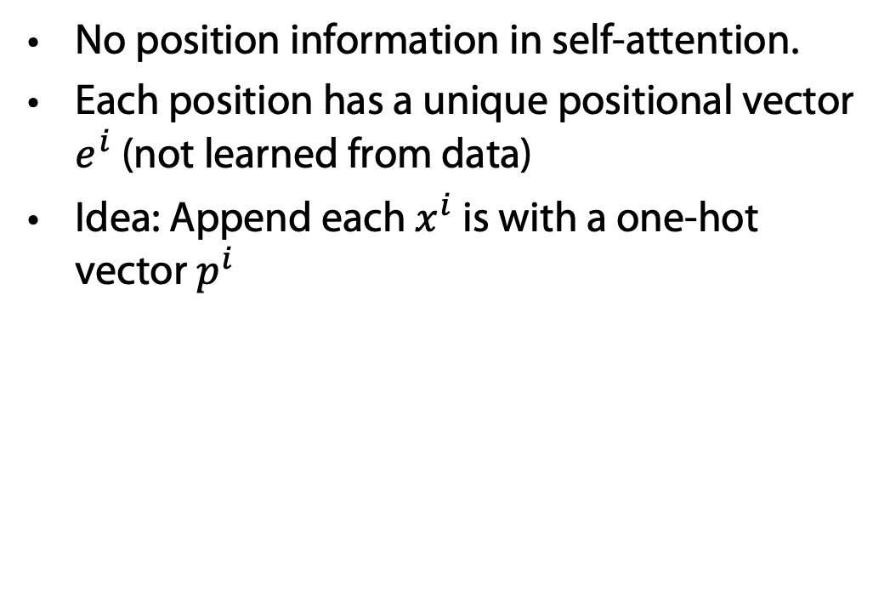















Positional Encoding
$$q^{i}$$
$$k^{i}$$
$$v^{i}$$
No position information in self-attention.
Each position has a unique positional vector $e^{i}$ (not learned from data)
Idea: Append each $x^{i}$ is with a one-hot vector $p^{i}$
$$e^{i}$$
+
$$a^{i}$$
$$x^{i}$$
More clever solution used in the original paper
$$x^{i}$$
$$a^{i}$$
$$W$$
=
$$W^{I}$$
$$x^{i}$$
$$p^{i}$$
$$W^{I}$$
$$W^{P}$$
$$p^{i}=$$
……
0
$$e^{i}$$
1
i-th dim
$$W^{P}$$
+
$$p^{i}$$
0
…
Transformer by 李宏毅 Hung-yi Lee

Slide 62
















Seq2seq with Attention
$$c^{1}$$
$$c^{2}$$
$$o^{1}$$
$$o^{2}$$
$$o^{3}$$
$$h^{1}$$
$$h^{2}$$
$$h^{3}$$
$$h^{4}$$
Self-Attention Layer
Self-Attention Layer
$$x^{1}$$
$$x^{2}$$
$$x^{3}$$
$$x^{4}$$
$$c^{1}$$
$$c^{2}$$
$$c^{3}$$
Encoder
Decoder
Transformer by 李宏毅 Hung-yi Lee

Slide 63
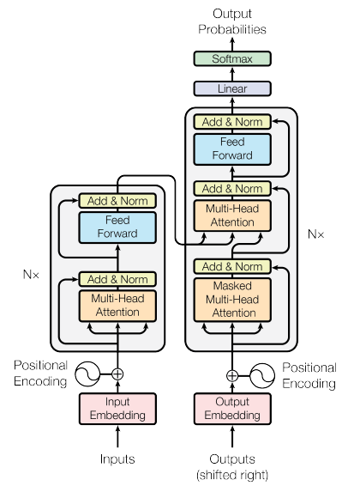
Transformer
machine
learning
Using Chinese to English translation as example
Encoder
Decoder
機 器 學 習
<BOS>
machine
Transformer by 李宏毅 Hung-yi Lee

Slide 64




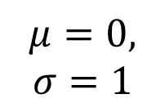
Transformer
Layer Norm:
https://arxiv.org/abs/1607.06450
Batch Size
Layer
Norm
$$b^{′}$$
Batch Norm:
$$μ=0,$$
$$σ=1$$
https://www.youtube.com/watch?v=BZh1ltr5Rkg
+
Batch
$$b$$
$$μ=0,σ=1$$
Layer
…
$$a$$
attend on the input sequence
Masked: attend on the generated sequence [MASK]
Transformer by 李宏毅 Hung-yi Lee
Notes:
(two layer2, with one relu)

Slide 65
Masked Multihead Attention
Decoder should work in parallel as well
During training all output tokens are known
Copy output #token times
For each position use [MASK] token in copies
Attention becomes possible during training also for decoding
Train decoder such that [MASK] is replaced correctly while paying attention to the overall output training data

Slide 66
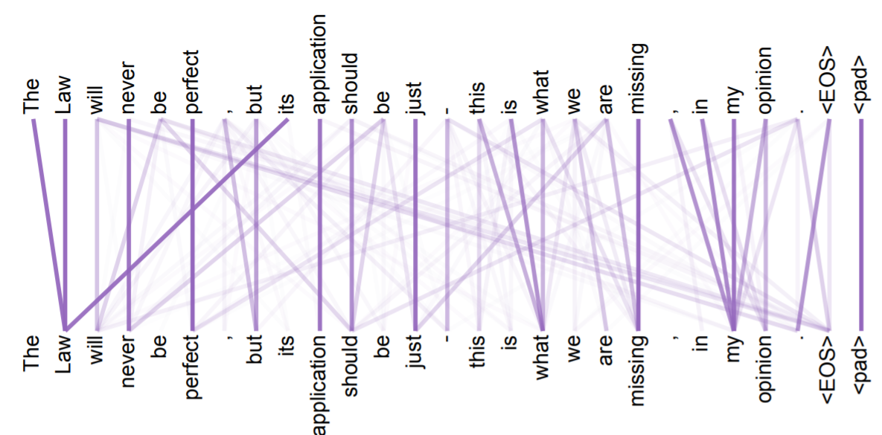
Attention Visualization
https://arxiv.org/abs/1706.03762
Transformer by 李宏毅 Hung-yi Lee

Slide 67
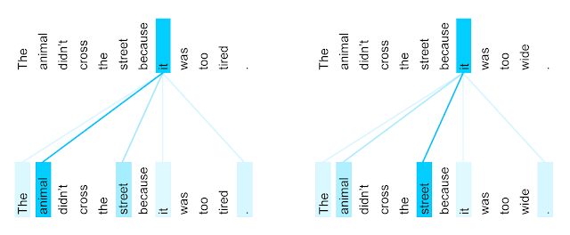
Attention Visualization
The encoder self-attention distribution for the word “it” from the 5th to the 6th layer of a Transformer trained on English to French translation (one of eight attention heads).
https://ai.googleblog.com/2017/08/transformer-novel-neural-network.html
Transformer by 李宏毅 Hung-yi Lee

Slide 68
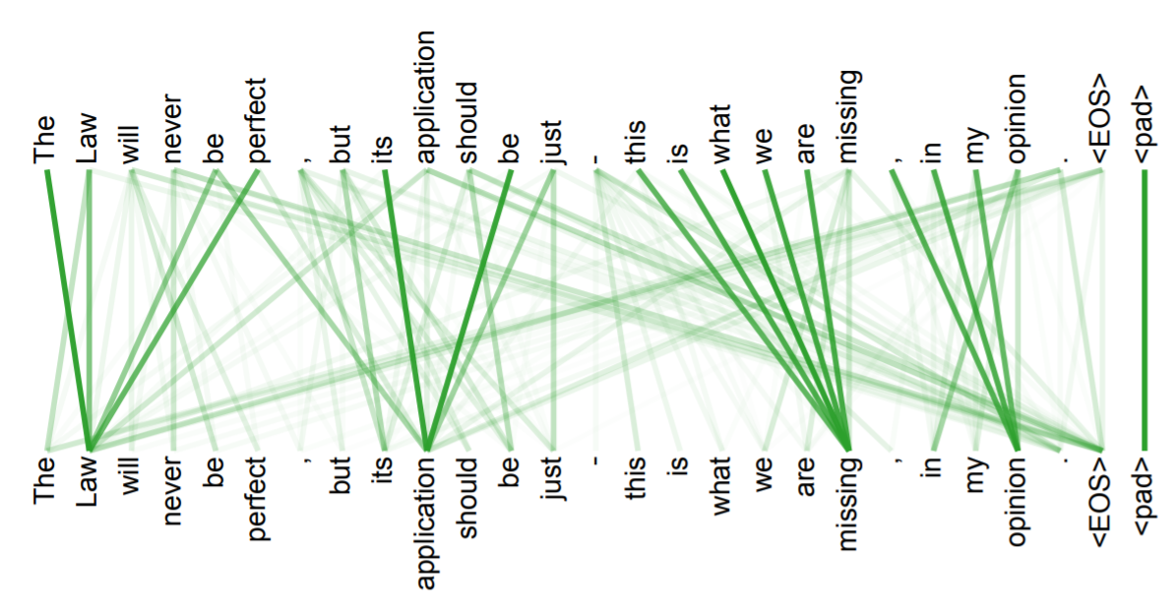
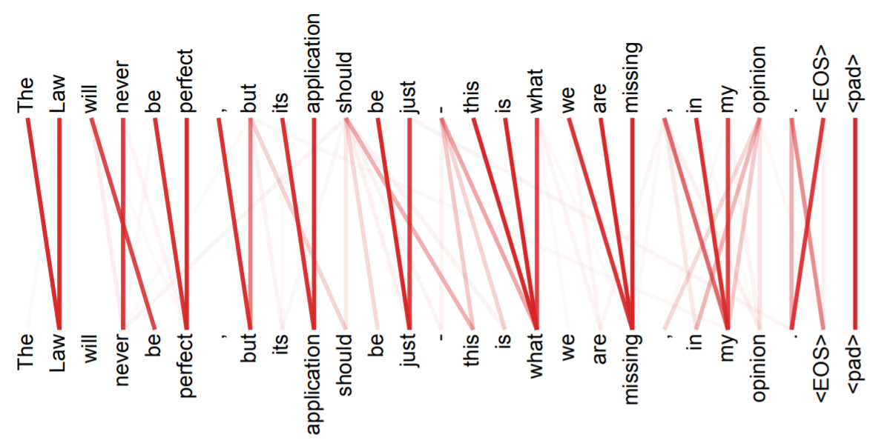
Multi-head
Attention
Transformer by 李宏毅 Hung-yi Lee

Slide 69
Pre-Training & Fine Tuning
1) Download LM
pre-trained on large corpus (in self-supervised fashion)
2) Feature-based training ("fine-tuning")
on target task (supervised learning)
Pretrained
Model
Embedding
One or more layers
Usually frozen after pre-training

Slide 70
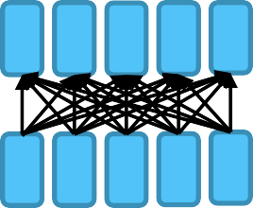
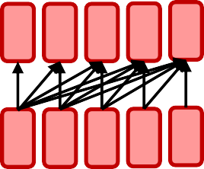

²Model Pre-Training
Encoder
  Bidirectional context
  Examples: BERT and its variants
Decoder
  Language modeling; better for generation
  Example: GPT-2, GPT-3, LaMDA
Encoder-Decoder
  Sequence-to-sequence model
  Examples: Transformer, BART, T5

Slide 71
³Model Pre-Training
Encoder
  Bidirectional context
  Examples: BERT and its variants
◉ Decoder
○ Language modeling; better for generation
○ Example: GPT-2, GPT-3, LaMDA
◉ Encoder-Decoder
○ Sequence-to-sequence model
○ Examples: Transformer, BART, T5

Slide 72
Bidirectional Encoder Representations from Transformers (BERT)
BERT = Encoder of Transformer
Learned from a large amount of text without annotation
Encoder
……
BERT
潮水
退了
就
知道
……
  http://speech.ee.ntu.edu.tw/~tlkagk/courses_ML20.html

Slide 73
Training of BERT
vocabulary size
Predicting the masked word
Approach 1:
Masked LM
Linear Multi-class
Classifier
……
BERT
潮水
[MASK]
……
退了
就
知道
  http://speech.ee.ntu.edu.tw/~tlkagk/courses_ML20.html
Notes:
Can we compare BERT and ELMO??

Slide 74
Training of BERT – Approach 2: Next Sentence Prediction
yes
[CLS]: the position that outputs classification results
Linear Binary
Classifier
[SEP]: the boundary of two sentences
Approaches 1 and 2 are used at the same time.
BERT
[CLS]
醒醒
吧
[SEP]
你
沒有
妹妹
Wake up , you have no sister
  http://speech.ee.ntu.edu.tw/~tlkagk/courses_ML20.html

Slide 75
Training of BERT – Approach 2: Next Sentence Prediction
No
[CLS]: the position that outputs classification results
Linear Binary
Classifier
[SEP]: the boundary of two sentences
Approaches 1 and 2 are used at the same time.
BERT
[CLS]
醒醒
吧
[SEP]
眼睛
業障
重
Wake up , eyes have heavy karma
  http://speech.ee.ntu.edu.tw/~tlkagk/courses_ML20.html

Slide 76
How to use BERT – Case 1
class
Linear Classifier
Trained from Scratch
Input: single sentence,
output: class
Example:
Sentiment analysis,
Document Classification
BERT
Fine-tune
[CLS]
w₁
w₂
w₃
sentence
  http://speech.ee.ntu.edu.tw/~tlkagk/courses_ML20.html
Notes:
(https://arxiv.org/abs/1805.12471)

Slide 77

How to use BERT – Case 2
class
class
class
Linear Cls
Linear Cls
Linear Cls
Input: single sentence,
output: class of each word
Example: Semantic role labelling
BERT
[CLS]
w₁
w₂
w₃
sentence
  http://speech.ee.ntu.edu.tw/~tlkagk/courses_ML20.html
Notes:
(https://arxiv.org/abs/1805.12471)

Slide 78
How to use BERT – Case 3
Class
Input: two sentences, output: class
Example: Natural Language Inference
Linear Classifier
Given a “premise”, determining whether a “hypothesis” is T/F/ unknown.
BERT
[CLS]
w₁
w₂
[SEP]
w₃
w₄
w₅
Sentence 1
Sentence 2
  http://speech.ee.ntu.edu.tw/~tlkagk/courses_ML20.html
Notes:
determining whether a “hypothesis” is true (entailment), false (contradiction), or undetermined (neutral) given a “premise”.

Slide 79











How to use BERT – Case 4
https://rajpurkar.github.io/SQuAD-explorer/
Extraction-based Question Answering (QA) (E.g. SQuAD)
17
Document:
$$D=\left\{d_{1},d_{2},⋯,d_{N}\right\}$$
Query:
$$Q=\left\{q_{1},q_{2},⋯,q_{N}\right\}$$
77
79
$$D$$
QA
Model
$$s$$
$$e$$
$$s=17,e=17$$
$$Q$$
output: two integers ($s$, $e$)
Answer:
$$A=\left\{q_{s}, ⋯,q_{e}\right\}$$
$$s=77,e=79$$
S=start, e=end
  http://speech.ee.ntu.edu.tw/~tlkagk/courses_ML20.html

Slide 80
How to use BERT – Case 4
Learned from scratch
0.3
0.5
0.2
s = 2, e = 3
Softmax
The answer is “d₂ d₃”.
dot product
BERT
[CLS]
q₁
q₂
[SEP]
d₁
d₂
d₃
question
document
  http://speech.ee.ntu.edu.tw/~tlkagk/courses_ML20.html
Notes:
determining whether a “hypothesis” is true (entailment), false (contradiction), or undetermined (neutral) given a “premise”.

Slide 81

BERT Pre-Training & Fine Tuning
Keep BERT frozen after pre-training
Create BERT embeddings for labeled dataset for "downstream task" and train new model on these embeddings
1) Download BERT pre-trained on large corpus (in self-supervised fashion)
2) Feature-based training ("fine-tuning")
on target task (supervised learning)
BERT
Model
Embedding
One or more layers

Slide 82
How to use BERT – Case 4
Learned from scratch
0.1
0.2
0.7
s = 2, e = 3
Softmax
The answer is “d₂ d₃”.
dot product
BERT
[CLS]
q₁
q₂
[SEP]
d₁
d₂
d₃
question
document
  http://speech.ee.ntu.edu.tw/~tlkagk/courses_ML20.html
Notes:
determining whether a “hypothesis” is true (entailment), false (contradiction), or undetermined (neutral) given a “premise”.

Slide 83


Example Application: Summarization
Summarizer
Document Set
Can BERT be used to summarize text?
https://arxiv.org/abs/1801.10198
Transformer by 李宏毅 Hung-yi Lee

Slide 84
BERT as a Markov Random Field Language Model
Wang et al. show that BERT
(as described by Devlin et al., 2018)
is essentially a Markov random field language model
Alex Wang, Kyunghyun Cho. BERT has a Mouth, and It Must Speak: BERT as a Markov Random Field Language Model. Volume:
In Proc. of the Workshop on Methods for Optimizing and Evaluating Neural Language Generation, June 2019.
https://arxiv.org/abs/1902.04094
  http://speech.ee.ntu.edu.tw/~tlkagk/courses_ML20.html

Slide 85
Recap: From word2vec/ELMo via Transformers to BERT
Language modeling is the “ultimate” NLP task
  I.e., a perfect language model is also a perfect question answering/entailment/sentiment analysis model
  Training a massive language model learns millions of latent features which are useful for these other NLP tasks
E.g., for natural language inference
  No internal “logical” representation
  Use language directly to infer new propositions
    What kind of a thing is the meaning of a sentence?
    What concrete phenomena do you have to deal with to understand a sentence?
BERT was just a start – many extensions in the literature
https://nlitutorial.github.io

Slide 86
⁶ Model Pre-Training
◉ Encoder
○ Bidirectional context
○ Examples: BERT and its variants
Decoder
  Language modeling; better for generation
  Example: GPT-2, GPT-3, LaMDA
◉ Encoder-Decoder
○ Sequence-to-sequence model
○ Examples: Transformer, BART, T5

Slide 87
GPT (Generative Pre-trained Transformer)
Developed by OpenAI
Unidirectional: trained to predict next word in a sentence
GPT (110 million parameters)
Radford, A., Narasimhan, K., Salimans, T., & Sutskever, I. (2018). Improving language understanding by generative pre-training. https://cdn.openai.com/research-covers/language-unsupervised/ language_understanding_paper.pdf
GPT-2 1.5 billion parameters)
Radford, A., Wu, J., Child, R., Luan, D., Amodei, D., & Sutskever, I. (2019). Language models are unsupervised multitask learners. OpenAI blog, 1(8), 9.
https://cdn.openai.com/better-language-models/language_models_are_unsupervised_multitask_learners.pdf
GPT-3 (175 billion parameters)
Brown, T. B., Mann, B., Ryder, N., Subbiah, M., Kaplan, J., Dhariwal, P., ... & Amodei, D. (2020). Language models are few-shot learners. arXiv preprint arXiv:2005.14165. https://arxiv.org/abs/2005.14165

Slide 88



Generative Pre-Training (GPT)
Transformer Decoder
BERT (340M)
ELMO (94M)
GPT-2 (1.5B)
https://d4mucfpksywv.cloudfront.net/better-language-models/language_models_are_unsupervised_multitask_learners.pdf
Notes:
93.6M
340M
1542M
40 GB

Slide 89
Generative Pre-Training (GPT)
退了
Many Layers …
AutoregressionAR(1)
$$b^{2}$$
$${\hat{α}}_{2,1}$$
$${\hat{α}}_{2,2}$$
$$q^{1}$$
$$k^{1}$$
$$v^{1}$$
$$q^{2}$$
$$k^{2}$$
$$v^{2}$$
$$q^{3}$$
$$k^{3}$$
$$v^{3}$$
$$q^{4}$$
$$k^{4}$$
$$v^{4}$$
$$a^{1}$$
$$a^{2}$$
$$a^{3}$$
$$a^{4}$$
<BOS>
潮水
退了
  http://speech.ee.ntu.edu.tw/~tlkagk/courses_ML20.html

Slide 90
Generative Pre-Training (GPT)
就
Attention on generated sequence as a whole
Many Layers …
$$b^{3}$$
$${\hat{α}}_{3,1}$$
$${\hat{α}}_{3,2}$$
$${\hat{α}}_{3,3}$$
$$q^{1}$$
$$k^{1}$$
$$v^{1}$$
$$q^{2}$$
$$k^{2}$$
$$v^{2}$$
$$q^{3}$$
$$k^{3}$$
$$v^{3}$$
$$q^{4}$$
$$k^{4}$$
$$v^{4}$$
$$a^{1}$$
$$a^{2}$$
$$a^{3}$$
$$a^{4}$$
<BOS>
潮水
退了
就
  http://speech.ee.ntu.edu.tw/~tlkagk/courses_ML20.html

Slide 91

Application: Summaries (Open AI)

Slide 92


Slide 93


Slide 94


Slide 95
LLMs of the GPT family
Generate term papers
Generate code
Generate Powerpoint presentations
Generate useful completions of texts in Word?
…
The successor to GPT-3, most likely called GPT-4, is expected to be unveiled in the near future, perhaps as soon as 2023
Interim versions: GPT-3.5, GPT-3.6

Slide 96

Compatibility vs. Alignment in LLMs
A model's capability is typically evaluated by how well it is able to optimize its objective function, the mathematical expression that defines the goal of the model
Alignment, on the other hand, is concerned with what we actually want the model to do versus what it is being trained to do
Models like the original GPT-3 are misaligned

Slide 97
Assessment GPT-3
Capable of generating human-like text, but they may not always produce output that is consistent with human expectations or desirable values
In practical applications, however, these models are intended to perform some form of valuable cognitive work,
  and there is a clear divergence between the way these models are trained and the way we would like to use them
Humans generate language by choosing text sequences that are best for the given situation,
  using our background knowledge and common sense to guide this process
Language model training strategies can produce misalignment
(e.g., using [MASK])
  Model which is only trained to predict the next word (or a masked word) in a text sequence, may not necessarily be learning some higher-level representations of its meaning
  Model struggles to generalize for tasks or contexts that require a deeper understanding of language

Slide 98


Slide 99

Train on Curated Dataset

Slide 100


Slide 101
InstructGPT: Reinforcement Learning from Human Feedback (RLHF)
Pretraining a language model (LM),
  OpenAI used a smaller version of GPT-3 for its first popular RLHF model, InstructGPT
Gathering data and training a reward model (RM, aka preference model), and
  Get a model that takes in a sequence of text, and returns a scalar reward which should numerically represent the human preference
  The training dataset of prompt-generation pairs for the RM is generated by sampling a set of prompts from a predefined dataset
Fine-tuning the LM with reinforcement learning
https://huggingface.co/blog/rlhf

Slide 102

Train a Reward (Preference) Model
ELO rating: https://en.wikipedia.org/wiki/Elo_rating_system

Slide 103
Fine-Tuning
Human annotators are used to rank the generated text outputs from the LM.
  One may initially think that humans should apply a scalar score directly to each piece of text in order to generate a reward model, but this is difficult to do in practice.
  The differing values of humans cause these scores to be uncalibrated and noisy. Instead, rankings are used to compare the outputs of multiple models and create a much better regularized dataset.
There are multiple methods for ranking the text.
  One method that has been successful is to have users compare generated text from two language models conditioned on the same prompt.
  By comparing model outputs in head-to-head matchups, an Elo system can be used to generate a ranking of the models and outputs relative to each-other.
  These different methods of ranking are normalized into a scalar reward signal for training
At this point in the RLHF system, we have an initial language model that can be used to generate text and a preference model that takes in any text and assigns it a score of how well humans perceive it. Next, we use reinforcement learning (RL) to optimize the original language model with respect to the reward model.
ELO rating: https://en.wikipedia.org/wiki/Elo_rating_system
https://huggingface.co/blog/rlhf

Slide 104
Reinforcement Learning
Policy is a language model that takes in a prompt and returns a sequence of text (or just probability distributions over text).
The action space of this policy is all the tokens corresponding to the vocabulary of the language model (often on the order of 50k tokens) and
the observation space is the possible input token sequences, which is also quite large (size of vocabulary ^ number of input tokens).
The reward function is a combination of the preference model and a constraint on policy shift.
Fine-tuning some or all of the parameters of a copy of the initial LM with a policy-gradient RL algorithm, Proximal Policy Optimization (PPO)
Parameters of the LM are frozen because fine-tuning an entire 10B or 100B+ parameter model is prohibitively expensive (for more, see Low-Rank Adaptation (LoRA) for LMs or the Sparrow LM from DeepMind)
https://huggingface.co/blog/rlhf

Slide 105

Reinforcement Learning
https://huggingface.co/blog/rlhf

Slide 106
Intelligent Agents
1d-CNNs LSTMs ELMo Transformers BERT GPT
Ralf Möller
Universität zu Lübeck
Institut für Informationssysteme

Slide 107

AE and AR
Autoencoding(AE) Language Modeling:
The AE language model aims to reconstruct the original data from corrupted input.
Corrupted input: The corrupted input means we use [MASK] to replace the original token
Can be implemented with self-attention
Example:
BERT

Slide 108


AE and AR
An autoregressive model’s output h_{t} at time t depends on not just x_{t}, but also all x_{s} from previous time steps.
Autoregressive (AR) language modeling:
given a text sequence x = (x1, · · · , xT ), AR language modeling factorizes the likelihood into a forward product.$\text{p}\text{(}\text{x}\text{)}=\prod{\text{p}\text{(}\text{xt}\text{ | }\text{x}\text{<}\text{t}\text{)}}$
Examples:
GPT , ELMO
Can also be implemented with attention
(GPT, not ELMO)

Slide 109
Summarization
Extractive Text Summarization
  The traditional method with the main objective to identify the significant sentences of the text and add them to the summary. Note that the summary obtained contains exact sentences from the original text data.
  Can be done with encoder (e.g., BERT)
Abstractive Text Summarization
  The advanced method, with the approach to identify the important sections, interpret the context and reproduce the text in a new way. This ensures that the core information is conveyed through the shortest text possible. Note that here, the sentences, in summary, are generated by the model, not just extracted from the original text data.
  Need Decoder (e.g., GPT-x, PEGASUS)
https://medium.com/analytics-vidhya/text-summarization-using-bert-gpt2-xlnet-5ee80608e961
https://ai.googleblog.com/2020/06/pegasus-state-of-art-model-for.html

Slide 110
Summarization with attention-based AE + AR
No recurrence in transformers???
Document Set
Summarizer

Slide 111

Universal Transformer
https://arxiv.org/abs/1807.03819

Slide 112

Universal Transformer
https://ai.googleblog.com/2018/08/moving-beyond-translation-with.html
Notes:
Why it is named universal ?
https://medium.com/@pocheng0118/a-brief-overview-vanilla-transformer-v-s-universal-transformer-%E7%84%A1%E6%89%80%E4%B8%8D%E8%83%BD%E7%9A%84%E9%80%9A%E7%94%A8%E8%A8%88%E7%AE%97%E6%A8%A1%E5%9E%8B-d9e89dcef080

Slide 113

http://arxiv.org/abs/2004.08900
Costs: Not for the faint hearted
$2.5k - $50k (110 million parameter model)
$10k - $200k (340 million parameter model)
$80k - $1.6m (1.5 billion parameter model)

Slide 114
Tricks: Subtoken Encoding
03
Byte Pair Encoding (BPE)
Word embedding sometimes is too high level, pure character embedding too low level. For example, if we have learned
old older oldest
We might also wish the computer to infer
smart smarter smartest
But at the whole word level, this might not be so direct. Thus, the idea is to break the words up into pieces like er, est, and embed frequent fragments of words.
GPT adapts this BPE scheme.
CS 886 Deep Learning for Biotechnology, Ming Li

Slide 115
Tricks: Subtoken Encoding
03
Byte Pair Encoding (BPE)
GPT uses BPE scheme. The subwords are calculated by:
Split word to sequence of characters (add </w> char)
Joining the highest frequency pattern.
Keep doing step 2, until it hits the pre-defined maximum number of sub-words or iterations.
Example (5, 2, 6, 3 are number of occurrences)
{‘l o w </w>’: 5, ‘l o w e r </w>’: 2, ‘n e w e s t </w>’: 6, ‘w i d e s t </w>’: 3 }
{‘l o w </w>’: 5, ‘l o w e r </w>’: 2, ‘n e w es t </w>’: 6, ‘w i d es t </w>’: 3 }
{‘l o w </w>’: 5, ‘l o w e r </w>’: 2, ‘n e w est </w>’: 6, ‘w i d est </w>’: 3 } (“est” freq. 9)
{‘lo w </w>’: 5, ‘lo w e r </w>’: 2, ‘n e w est</w>’: 6, ‘w i d est</w>’: 3 } (“lo” freq 7)
…..
CS 886 Deep Learning for Biotechnology, Ming Li

Slide 116
More Powerful Pre-Trained Model – GPT 3
Pretraining and Fine-tuning
Pre-Training & Fine-Tuning
Pre-Training & In-Context Learning
unannotated data
Model
Model
pre-train
pre-train
Instruct GPT
Model
Model
task-specific
annotated data
fine-tune
no learning
Model
Model
fine-tune
no learning
Need to store new params

Slide 117
The Amazing Power of Large Language Models
Large scale leads to a particularly interesting emergent behavior called in-context learning
With in-context learning, the text given to the model is a written description (optional) plus some examples. The last example is left unfinished for the model to complete
  Use language models to learn tasks given only a few examples
  Give the LLM a prompt that consists of a list of input-output pairs that demonstrate a task
  At the end of the prompt, we append a test input and allow the LM to make a prediction just by conditioning on the prompt and predicting the next tokens
https://ai.stanford.edu/blog/understanding-incontext/

Slide 118

Example
In-context learning is competitive with models trained with much more labeled data and is state-of-the-art on LAMBADA (commonsense sentence completion) and TriviaQA (question answering)
Other examples: Writing code from natural language descriptions, helping with app design mockups, and generalizing spreadsheet functions
https://ai.stanford.edu/blog/understanding-incontext/

Slide 119




¹¹ GPT-3 “In-Context” Learning
Zero-Shot
Traditional Fine-Tuning
One-Shot
Few-Shot

Slide 120


One-shot or Few-shot Learning? GPT-3 175B
Reading Comprehension
$d_{1},d_{2},⋯,d_{N}$,
”Q:”, $q_{1},q_{2},⋯,q_{N}$, “A:”
CoQA
Summarization
$d_{1},d_{2},⋯,d_{N}$,”TL;DR:”
TL;DR=Too long; didn’t read.
English sentence 1
=
French sentence 1
Translation
English sentence 2
=
French sentence 2
Tom B. Brown et al.
Language Models are Few-Shot Learners.
https://arxiv.org/abs/2005.14165.
2020.
English sentence 3
=
  http://speech.ee.ntu.edu.tw/~tlkagk/courses_ML20.html
Notes:
展現神蹟

Slide 121
In-context learning: Analysis
In-context learning describes a different paradigm of “learning”
where the model is fed input normally as if it were a black box,
and the input to the model describes a new task with some possible examples
while the resulting output of the model reflects that new task as if the model had “learned”

Slide 122

Evaluation
https://blog.inten.to/gpt-3-language-models-are-few-shot-learners-a13d1ae8b1f9

Slide 123
Understanding context learning
An Explanation of In-context Learning as Implicit Bayesian Inference
  https://arxiv.org/abs/2111.02080
Rethinking the Role of Demonstrations: What Makes In-Context Learning Work?
  https://arxiv.org/abs/2202.12837
Can in-context learning help us with dialogues?

Slide 124
ChatGPT
Interactive, conversational model
Part of GPT-3.5 family
  fine-tuned mostly on programming code
ChatGPT
  is a sibling model to InstructGPT
    ChatGPT is similar but not identical
    slight differences in the data collection setup
  a fine-tuned version of GPT-3.5 that’s essentially
  a general-purpose chatbot
Dialogue format of ChatGPT makes it possible for ChatGPT to answer followup questions, admit its mistakes, challenge incorrect premises, and reject inappropriate requests

Slide 125
Similar Approaches
OPT (Meta, LLM)
  https://ai.facebook.com/blog/democratizing-access-to-large-scale-language-models-with-opt-175b/
Galactica (Meta, LLM for science)
  https://galactica.org/
Pegasus (Google, LLM, text summarization)
  https://ai.googleblog.com/2020/06/pegasus-state-of-art-model-for.html

Slide 126
Back to Agents
Why is few-shot learning important?
Agents can use pretrained model
Few-shot learning for specifying dedicated tasks!
From language models to general intelligence?
Implementing agents might be difficult
Is there any hope that ordinary people can get access to GPT-3 / ChatGPT for fine-tuning?

Slide 127
Distillation
A.k.a., model compression
Idea has been around for a long time:
  Model Compression (Bucila et al, 2006)
  Distilling the Knowledge in a Neural Network (Hinton et al, 2015)
Simple technique:
  Train “Teacher”: Use SOTA pre-training + fine-tuning technique to train model with maximum accuracy
  Label a large amount of unlabeled input examples with Teacher
  Train “Student”: Much smaller model (e.g., 50x smaller) which is trained to mimic Teacher output
  Student objective is typically Mean Square Error or Cross Entropy
Contextual Word Representations with BERT and Other Pre-trained Language Models

Slide 128

Distillation
Example distillation results
  50k labeled examples, 8M unlabeled examples
Well-Read Students Learn Better: On the Importance of Pre-training Compact Models (Turc et al, 2020)
Distillation works much better than pre-training + fine-tuning with smaller model
Contextual Word Representations with BERT and Other Pre-trained Language Models

Slide 129
Why does distillation work so well?
A hypothesis:
Finetuning mostly just picks up and tweaks existing latent features
This requires an oversized model, because only a subset of the features are useful for any given task
Distillation allows the model to only focus on those features
Supporting evidence: Simple self-distillation of a small model
(e.g., distilling a smaller BERT model) doesn’t work very well
Contextual Word Representations with BERT and Other Pre-trained Language Models

Slide 130
¹⁶ GPT-J
GPT-3 was released by OpenAI, has 175 billion parameters
and is not openly available.
GPT-J is a 6 billion parameter model released by Eleuther AI. The goal of the group is to democratize huge language models, so they released GPT-J and it is currently publicly available.
https://github.com/TheProtaganist/gpt-j

Slide 131
Summary: Large Language models
Translating one language into another,
Summarizing a long document into a brief highlight,
Answering information-seeking questions
Open-domain dialog
  converse about any topic
  dialog models should adhere to
  Responsible AI practices
  avoid making factual statements that are not supported by external information sources.
https://ai.googleblog.com/2022/01/lamda-towards-safe-grounded-and-high.html

