Slide 1
Intelligent Agents
LaMDA, KGs, GNNs
Prof. Dr. Ralf Möller
Universität zu Lübeck
Institut für Informationssysteme

Slide 2
LaMDA
“LaMDA: Language Models for Dialog Applications”
LaMDA is built by fine-tuning a family of Transformer-based neural language models specialized for dialog, with up to 137B model parameters
Teaching the models to leverage external knowledge sources
Defining objectives and metrics is critical to guide training dialog models
  Quality
  Safety
  Groundedness
https://ai.googleblog.com/2022/01/lamda-towards-safe-grounded-and-high.html

Slide 3
LaMDA: Language Models for Dialog Applications
Pre-training: multiple public dialogue data (1.56T words)
Fine-tuning: Quality and Safety scores
  Using one model for both generation and discrimination enables an efficient combined generate-and-discriminate procedure.
“<context><sentinel><response><attribute-name><rating>”
    “What’s up? RESPONSE not much. SENSIBLE 1”
    “What’s up? RESPONSE not much. INTERESTING 0”
    “What’s up? RESPONSE not much. UNSAFE 0”
https://arxiv.org/pdf/2201.08239.pdf

Slide 4
LaMDA: Language Models for Dialog Applications
Fine-tuning for external knowledge via a tool set (TS)
  Calculator: “135+7721”→ “7856”
  Translator: “hello in French” → “Bonjour”
  IR system: “How old is Rafael Nadal?” → “Rafael Nadal / Age / 35”
context + base → “TS, Rafael Nadal’s age”
    snippet: “He is 31 years old right now” + “Rafael Nadal / Age / 35”
    context + base + query + snippet → “User, He is 35 years old right now”
    context + base + query + snippet → “TS, Rafael Nadal’s favorite song”
40K dialog turns (generative data) are labeled ‘correct’ or ‘incorrect’ for the ranking task (discriminative data)

Slide 5
LaMDA Goundedness
“When was the Eiffel Tower built?”
LaMDA to user: Hi, how can I help you today? <EOS> […] user to LaMDA: When was the Eiffel Tower built? <EOS>
LaMDA-Base
It was constructed in 1887.
:
LaMDA-Base to LaMDA-Research: It was constructed in 1887. <EOS>
LaMDA-Research
TS, Eiffel Tower construction date
TS
Eiffel Tower / construction started:
28 January 1887
:
TS to LaMDA-Research: Eiffel Tower
/ construction started: 28 January
1887 <EOS>
TS, Eiffel Tower complete
when
Eiffel Tower / date opened: 31 March 1889
LaMDA-Research
TS
:
TS to LaMDA-Research: Eiffel Tower
/ date opened 31 March 1889 <EOS>
LaMDA-Research
User, Work started on it in January 1887, and it was opened in March 1889.

Slide 6
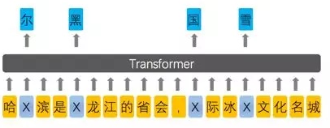
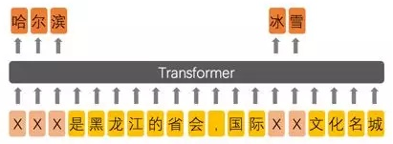
Enhanced Representation through Knowledge Integration (ERNIE)
Incorporation of knowledge graphs
Designed for Chinese (ERNIE-baidu)
BERT
ERNIE
  http://speech.ee.ntu.edu.tw/~tlkagk/courses_ML20.html
Zhengyan Zhang, Xu Han, Zhiyuan Liu, Xin Jiang, Maosong Sun, Qun Liu.
ERNIE: Enhanced Language Representation with Informative Entities.
In: Proc. ACL-19, 1441–1451. 2019. https://arxiv.org/abs/1904.09223
Notes:
From 擺渡https://zhuanlan.zhihu.com/p/59436589

Slide 7
Knowledge-aware Pretrained Language Models
Bert
Bert-wwm
ERNIE-baidu
SpanBert
ERNIE-thu
KnowBert
K-Bert
KEPLER
GLM
Knowledge-aware PLMs guided by KG
Knowledge-aware KG-enhanced QA
KagNet
CSQA
PG
MHGRN
BERT: Pre-training of deep bidirectional transformers for language understanding (NAACL 19)
Bert-wwm: Pre-Training with Whole Word Masking for Chinese BERT (Arxiv 19)
SpanBERT: Improving Pre-training by Representing and Predicting Spans (TACL 20)
ERNIE-baidu: Enhanced representation through knowledge integration (Arxiv 19)
ERNIE 2.0: A Continual Pre-Training Framework for Language Understanding (AAAI 20)
ERNIE-thu: Enhanced Language Representation with Informative Entities (ACL 19)
K-BERT: Enabling Language Representation with Knowledge Graph (AAAI 20)
KnowBert: Knowledge enhanced contextual word representations (EMNLP 19)
KEPLER: A Unified Model for Knowledge Embedding and Pre-trained Language Representation (Arxiv 19)
GLM: Exploiting Structured Knowledge in Text via Graph-Guided Representation Learning (Arxiv 20)
KagNet: Knowledge-Aware Graph Networks for Commonsense Reasoning (EMNLP 19)
CSQA: Graph-Based Reasoning over Heterogeneous External Knowledge for Common sense Question Answering (AAAI 20)
PG: Connecting the Dots: A Knowledgeable Path Generator for Commonsense Question Answering (EMNLP 2020 finding)
MHGRN: Scalable Multi-Hop Relational Reasoning for Knowledge-Aware Question Answering (EMNLP 2020)

Slide 8
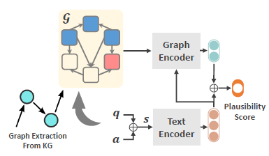
Unified Architecture in KG-enhanced QA
Graph Encoder: GNN, Relational Network…
Text Encoder: Bert, XLNet…
Next topic:
Graph encoding

Slide 9
Acknowledgements
Slides for this presentation are taken from
  Representation Learning on Networks snap.stanford.edu/proj/embeddings-www, WWW 2018
  Efficient Probabilistic Logic Reasoning with Graph Neural Networks
  Yuyu Zhang, Xinshi Chen, Yuan Yang, Arun Ramamurthy, Bo Li, Yuan Qi & Le Song (slides taken from a presentation by Hengda Shi, Gaohong Liu and Jian Weng)
  Probabilistic Logic Neural Network for Reasoning, Meng Qu, Jian Tang
  (slides taken from a presentation by Zijie Huang, Roshni Iyer, Alex Wang)
Slides have been adapted (all faults are mine)

Slide 10
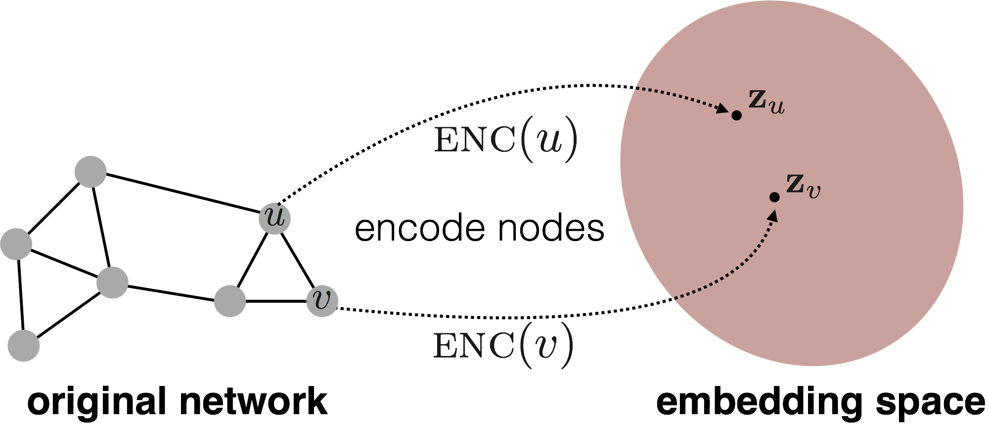
Embedding Nodes of a Graph
Encode nodes so that …
  similarity in the embedding space approximates …
  similarity in the original network

Slide 11
Embedding Nodes of a Graph
d-dimensional embedding
Need to define!

Slide 12
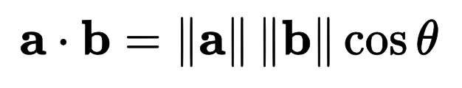
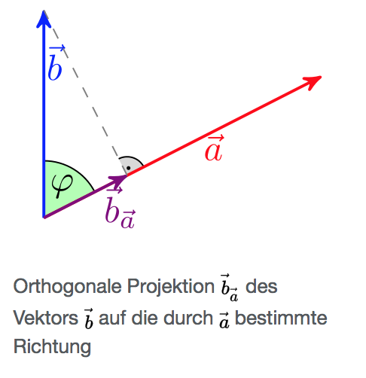
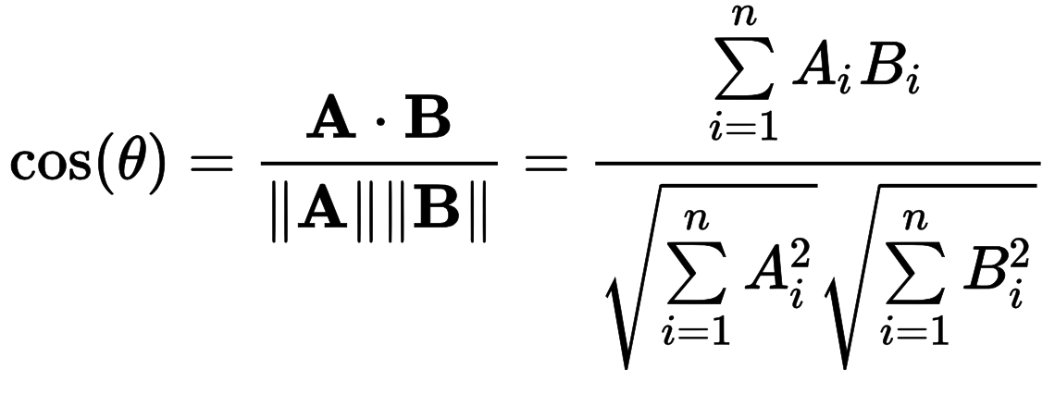
Recap: Dot Product
||b_{a}||
𝜑
(𝜑)
Wikipedia

Slide 13
Simple (“Shallow”) Embedding Approaches
Vectors with d components (with d being a hyperparameter)
Solve optimization problem
Select embedding vectors for nodes
such that “similar” nodes have similar vectors
Various ways to specify similarity of nodes
Adjacency-based embedding
Multi-hop embedding
Random walk approaches
More or less clever approaches, but appropriate similarity features should better be found automatically
Probability that u and v co-occur in a random walk over the network
Hamilton et al. Representation Learning on Graphs: Methods and Applications. IEEE Data Engineering Bulletin on Graph Systems. 2017.

Slide 14

From “Shallow” to “Deep”
Shallow: Define features based on selected features
Embedding vector for a specific node
Embedding matrix
$$z_{j}$$
Dimension/size of embeddings d
One column per node

Slide 15
From “Shallow” to “Deep”
Limitations of shallow encoding:
  O(|Vd|) parameters needed
    No parameter sharing
    Every node has its own unique embedding vector
  Inherently “transductive” (not inductive)
    Impossible to generate embeddings for nodes
    that were not seen during training
  Does not incorporate node features
    Many graphs have nodes with features
    that we can and should leverage
Need to find embeddings based on holistic view on graph
Scarselli et al. The Graph Neural Network Model. IEEE Transactions on Neural Networks. 2005.

Slide 16
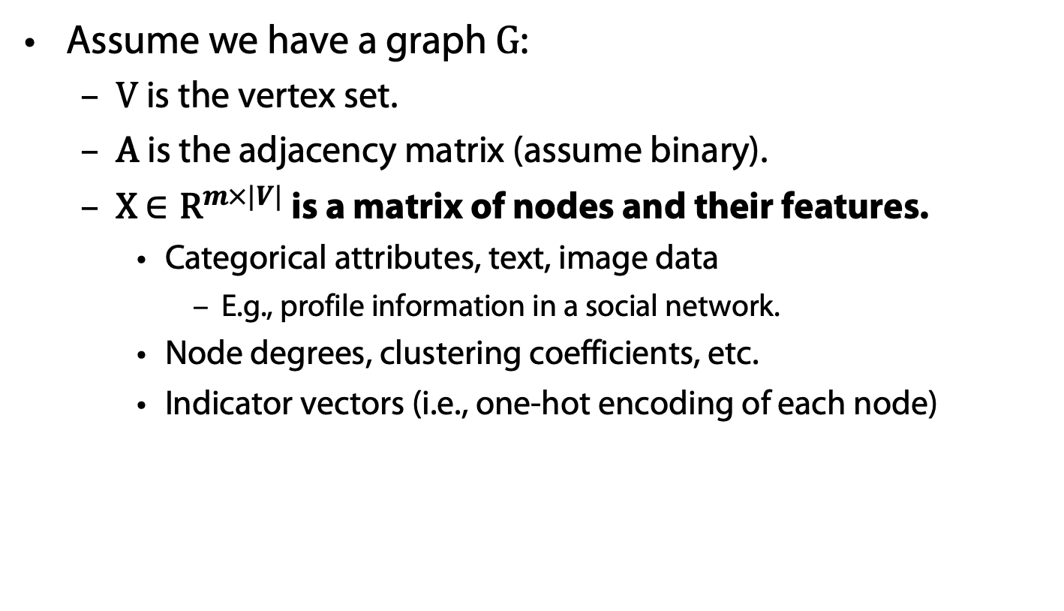
Setup
Assume we have a graph G:
  V is the vertex set.
  A is the adjacency matrix (assume binary).
  X $∈{\text{R}}^{m×|V|}$ is a matrix of nodes and their features.
    Categorical attributes, text, image data
      E.g., profile information in a social network.
    Node degrees, clustering coefficients, etc.
    Indicator vectors (i.e., one-hot encoding of each node)

Slide 17
Neighborhood Aggregation
Key idea
  Generate node embeddings based on local neighborhoods
  Nodes aggregate information from their neighbor
  Computation graph for every node

Slide 18
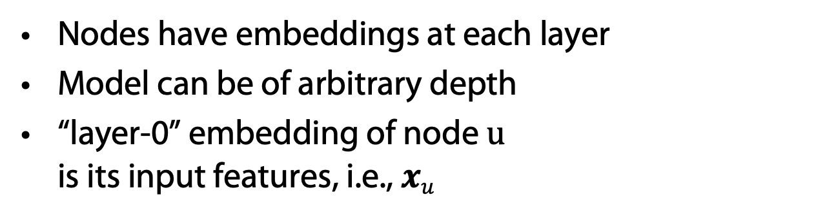
Neighborhood Aggregation
Nodes have embeddings at each layer
Model can be of arbitrary depth
“layer-0” embedding of node u
is its input features, i.e., $xu$
Layer-0
Layer-1
Layer-2
What’s in the boxes?

Slide 19
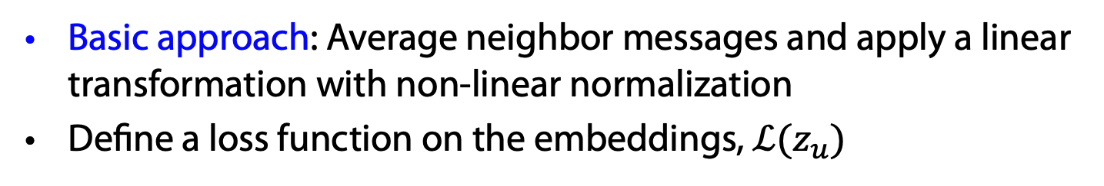

Graph Networks (GNNs)
Graph (Neural) Networks
Basic approach: Average neighbor messages and apply a linear transformation with non-linear normalization
Define a loss function on the embeddings, $ℒ(z_{u})$
Initial “layer 0” embeddings are equal to node features
previous layer embedding of v
kth layer embedding of $v$
non-linearity
(e.g., ReLU or tanh)
average of neighbor’s
previous layer embeddings

Slide 20
Unsupervised Training
trainable matrices
(i.e., what we learn)
After K-layers of neighborhood aggregation, we get output embeddings for each node
Feed these embeddings into any loss function …
and run stochastic gradient descent
to train the aggregation parameters

Slide 21

Supervised Training
E.g., based on node classification $y_{v}∈\{0, 1\}$:
classification weights
Human or bot?
output node embedding
node class label

Slide 22
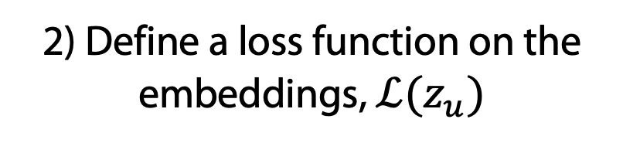
Overview of Model Design
1) Define a neighborhood aggregation function.
2) Define a loss function on the embeddings, $ℒ(z_{u})$

Slide 23
Overview of Model Design
3) Train on a set of nodes, i.e., a batch of compute graphs

Slide 24
Overview of Model
4) Generate embeddings for nodes as needed
Even for nodes we never trained on!!!!

Slide 25
Inductive Capability
Same aggregation parameters are shared for all nodes.
Number of model parameters is sublinear in |V| …
… and we can generalize to unseen nodes!

Slide 26
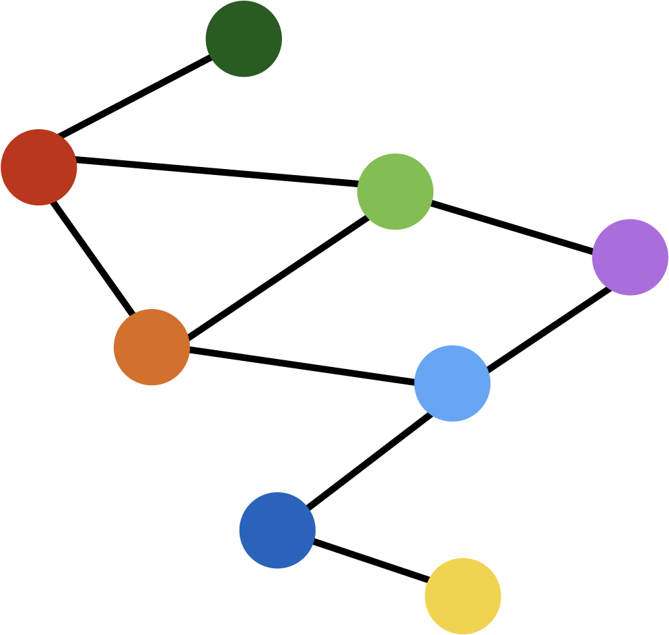
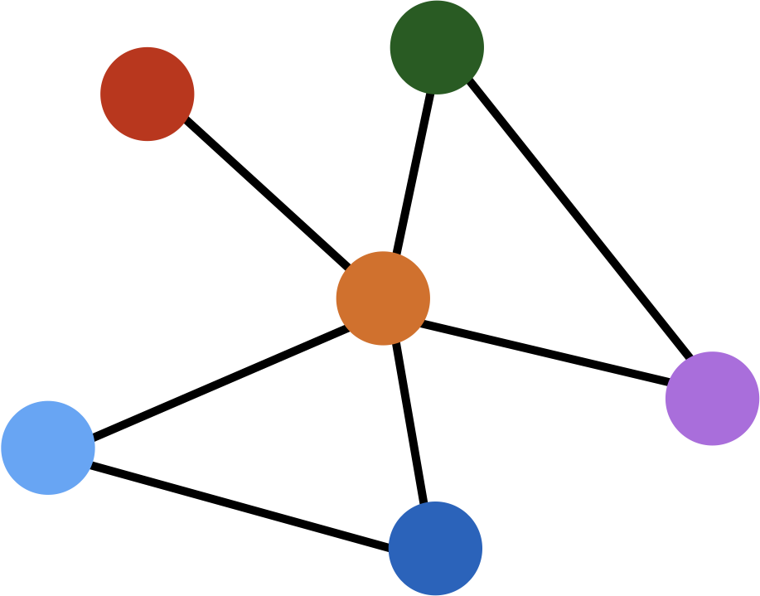
Inductive Capability
train on one graph
generalize to new graph
Inductive node embedding generalize to entirely unseen graphs
e.g., train on protein interaction graph from model organism A and generate embeddings on newly collected data about organism B

Slide 27
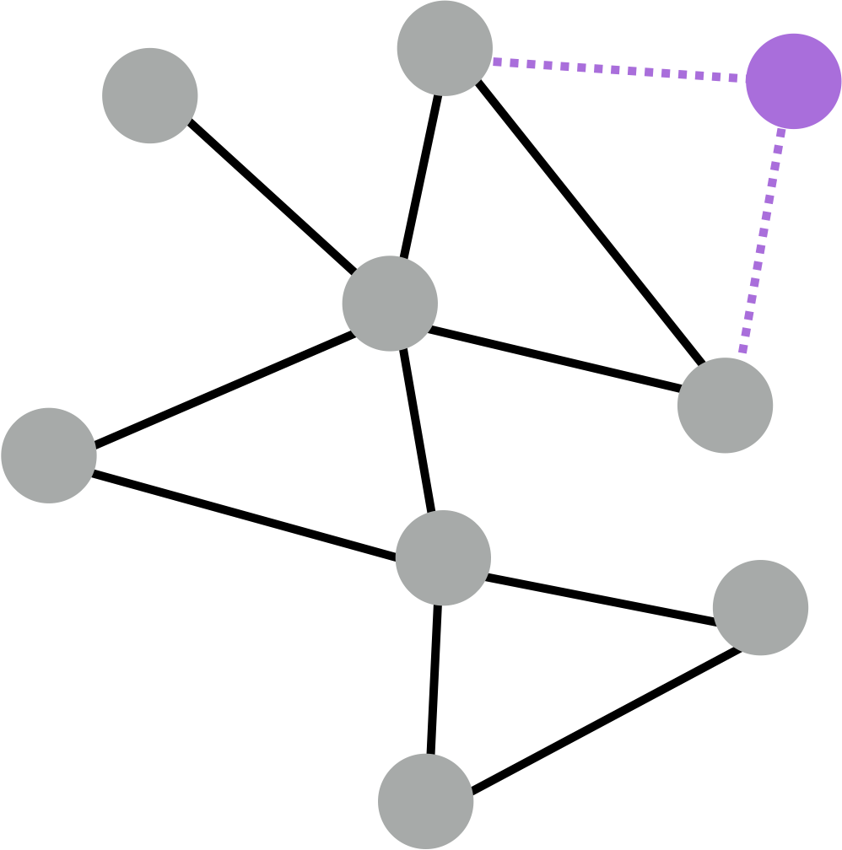
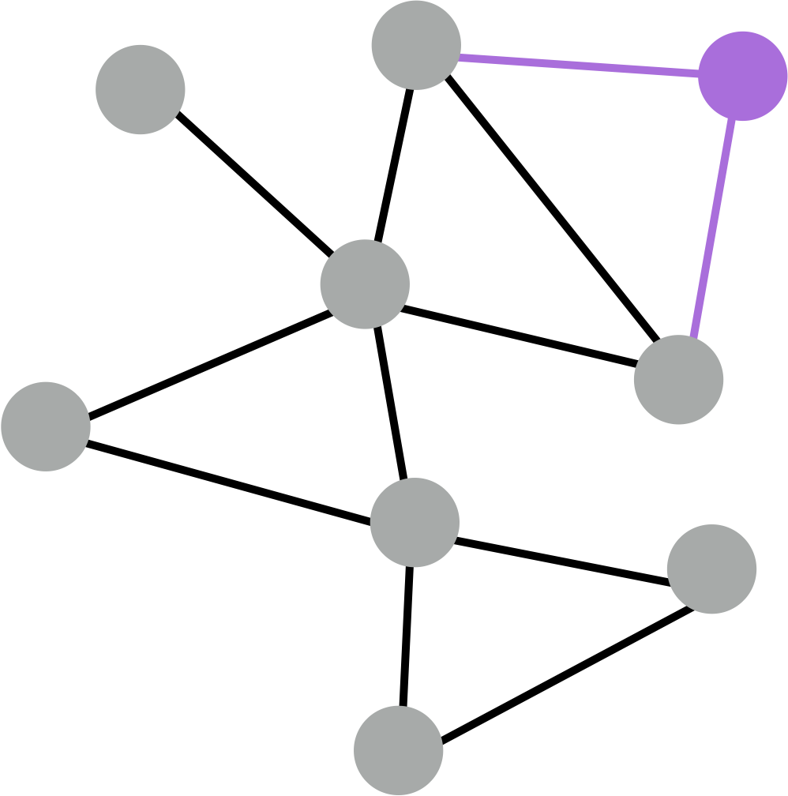
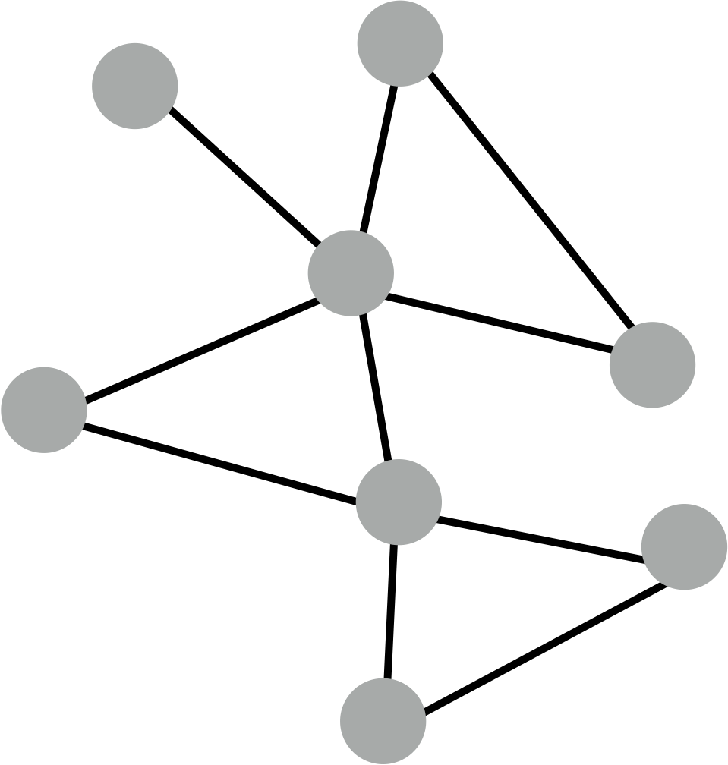
Inductive Capability
generate embedding for new node
train with snapshot
new node arrives
Many application settings constantly encounter previously unseen nodes.
e.g., Reddit, YouTube, GoogleScholar, ….
Need to generate new embeddings “on the fly”

Slide 28
Neighborhood Aggregation
Key distinctions are in how different approaches aggregate messages
What else can we put in the box?
?
???
?
?

Slide 29
Graph Convolutional Networks (GCNs)
Slight variation on the neighborhood aggregation idea:
Empirically, this configuration to give the best results
  More parameter sharing
  Down-weights high degree neighbors
same matrix for self and neighbor embeddings
per-neighbor normalization
Semi-supervised classification with graph convolutional networks
TN Kipf, M Welling. In Proc. 5th International Conference on Learning Representations (ICLR-17), 2017.

Slide 30
GraphSAGE (SAmple and aggreGatE)
So far we have aggregated the neighbor messages by taking their (weighted) average. Can we do better?
?
???
?
Any differentiable function that maps set of vectors to a single vector.
?
concatenate self embedding and neighbor embedding

Slide 31
GraphSAGE Variants
Mean:
Pool:
  Transform neighbor vectors and apply symmetric vector function
LSTM-based RNNs:
  Apply LSTM to random permutation of neighbors (LSTMs work on seqences)
Transformers (attention)?
element-wise mean/max
William L. Hamilton, Rex Ying, and Jure Leskovec. 2017. Inductive representation learning on large graphs. In Proc. NIPS’17. 2017.

Slide 32
Neighborhood Aggregation
GCNs and GraphSAGE generally only 2-3 layers deep
What if we want to go deeper?
  Overfitting from too many parameters.
  Vanishing/exploding gradients during backpropagation

Slide 33
Gated Graph Networks
Use techniques from recurrent networks
Parameter sharing across layers, recurrent state update
same mappings across layers
Handle >20 layers:
Allows for complex information about global graph structure to be propagated to all nodes

Slide 34
Neighborhood aggregation with RNN state update
Get “message” from neighbors at step k:
Update node “state” using Gated Recurrent Unit (GRU)
New node state depends on the old state and
the message from neighbors:
Aggregation function does not depend on k
Yujia Li Richard Zemel Marc Brockschmidt Daniel Tarlow, Gated Graph Sequence Neural Networks
Proceedings of ICLR’16. 2016.

Slide 35
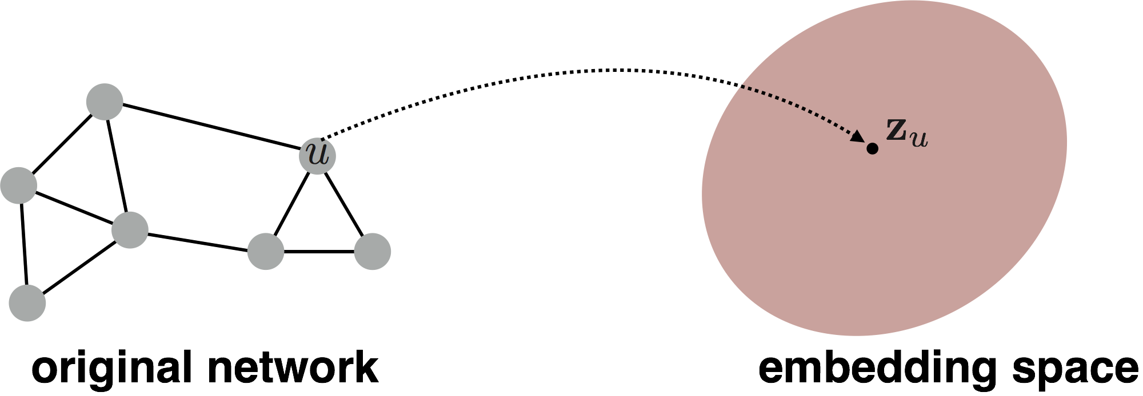
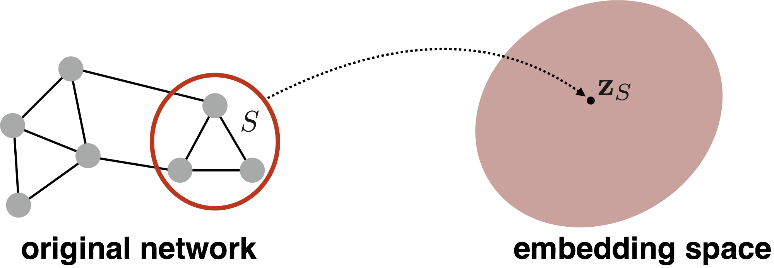
(Sub)graph Embeddings
So far we have focused on node-level embeddings…
But what about subgraph embeddings?

Slide 36

(Sub)graph Embeddings
  How to embed (sub)graphs with millions or billions of nodes?
Use representative as a virtual node
Sum or average node embeddings:
Li et al. Gated Graph Sequence Neural Networks. In Proc. ICLR. 2016.
  How to do the analog of CNN “pooling” on networks?
Duvenaud et al. Convolutional Networks on Graphs for Learning Molecular Fingerprints. In Proc. ICML 2016.

Slide 37
Summary so far
Key idea: Generate node embeddings based on local neighborhoods.
  GraphSAGE
    Generalized neighborhood aggregation
  Gated Graph Networks
    Neighborhood aggregation + recursion
    (same mappings for a layer) + GRUs
  Graph Convolutional Networks
    Average neighborhood information
    and stack computational networks

Slide 38
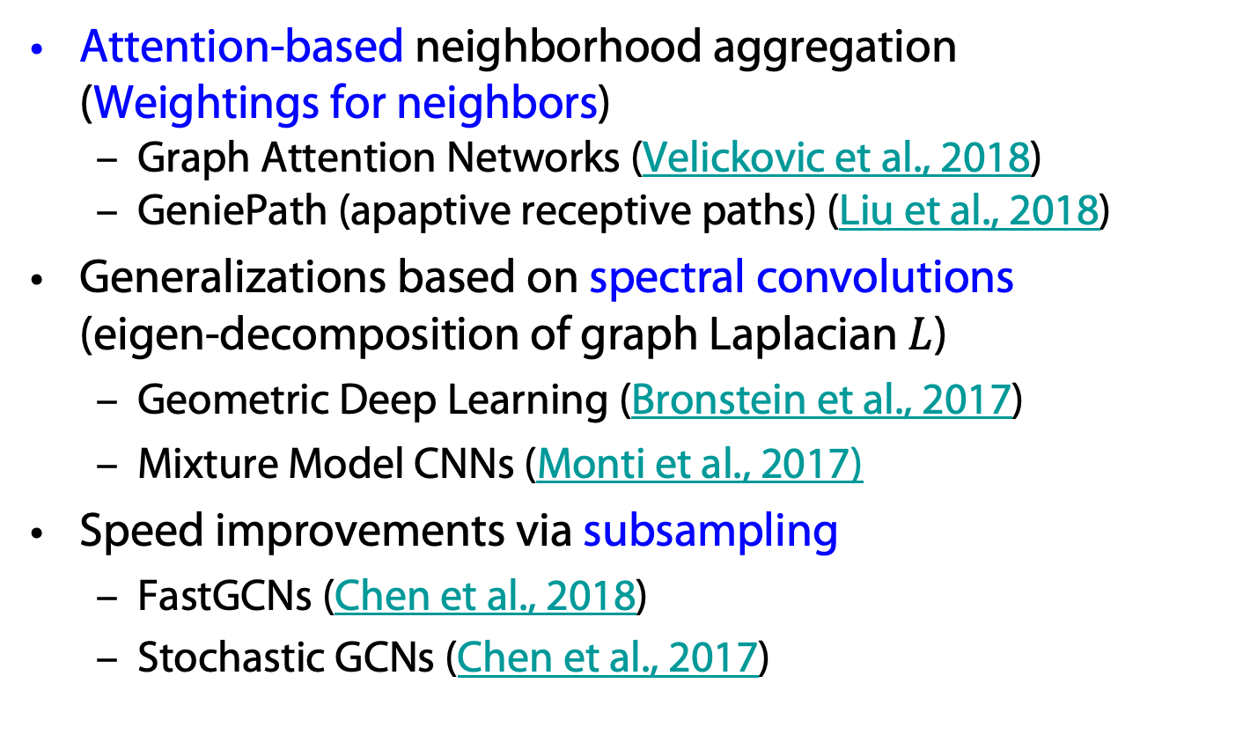

Recent Advances in Graph Networks
Attention-based neighborhood aggregation
(Weightings for neighbors)
  Graph Attention Networks (Velickovic et al., 2018)
  GeniePath (apaptive receptive paths) (Liu et al., 2018)
Generalizations based on spectral convolutions
(eigen-decomposition of graph Laplacian $L$)
  Geometric Deep Learning (Bronstein et al., 2017)
  Mixture Model CNNs (Monti et al., 2017)
Speed improvements via subsampling
  FastGCNs (Chen et al., 2018)
  Stochastic GCNs (Chen et al., 2017)
$L=D −A$ (degree matrix – adjacency matrix)

Slide 39
Graph Networks, Embeddings, and KGs
Graph networks allow for the computation of embeddings for nodes in a KG
With embeddings, existence of links between nodes can be estimated (KG completion)
  See also, e.g., node2vec
If nodes originate from words …
… we have another way to embed nodes
  See also, e.g., word2vec
  KG completion based on word embeddings
node2vec: Scalable Feature Learning for Networks. A. Grover, J. Leskovec. ACM SIGKDD International Conference on Knowledge Discovery and Data Mining (KDD), 2016

