Slide 1
Intelligent Agents
Vision and Language
Prof. Dr. Ralf Möller
Universität zu Lübeck
Institut für Informationssysteme

Slide 2
vision & language
Acknowledgements
CS 685, Spring 2022
Advanced Natural Language Processing http://people.cs.umass.edu/~miyyer/cs685/
Mohit Iyyer
College of Information and Computer Sciences University of Massachusetts Amherst
some slides adapted from Vicente Ordonez, Fei-Fei Li, and Jacob Andreas
http://people.cs.umass.edu/~miyyer/cs685/

Slide 3
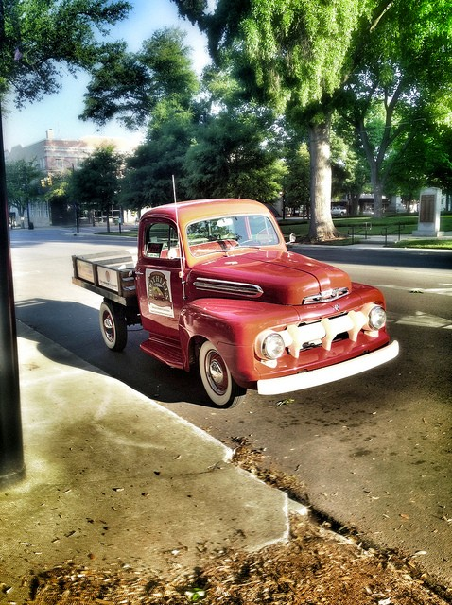

Image captioning
A red truck is parked
on a street lined with trees
http://people.cs.umass.edu/~miyyer/cs685/

Slide 4

Visual question answering
•
Is this truck considered “vintage”?
Does the road look new? What kind of tree is behind the truck?
•
•
http://people.cs.umass.edu/~miyyer/cs685/

Slide 5
We’ve seen how to compute representations of words and sentences. What about images?
http://people.cs.umass.edu/~miyyer/cs685/

Slide 6
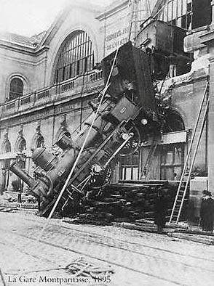
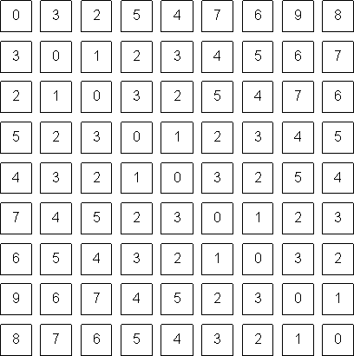
Grayscale images are matrices
What range of values can each pixel take?
http://people.cs.umass.edu/~miyyer/cs685/

Slide 7

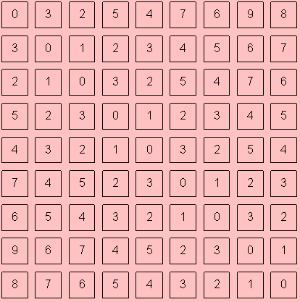
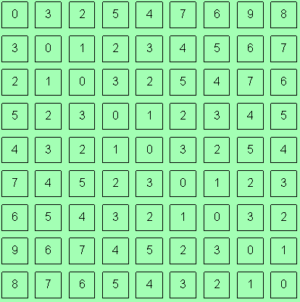
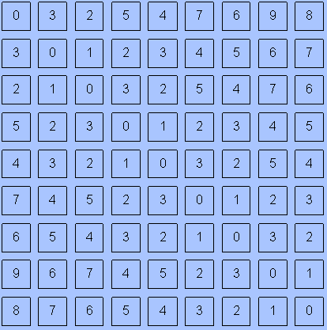
Color images are tensors
𝑐h𝑎𝑛𝑛𝑒𝑙 𝑥 h𝑒𝑖𝑔h𝑡 𝑥 𝑤𝑖𝑑𝑡h
Channels are usually RGB: Red, Green, and Blue
Other color spaces: HSV, HSL, LUV, XYZ, Lab, CMYK, etc
http://people.cs.umass.edu/~miyyer/cs685/

Slide 8
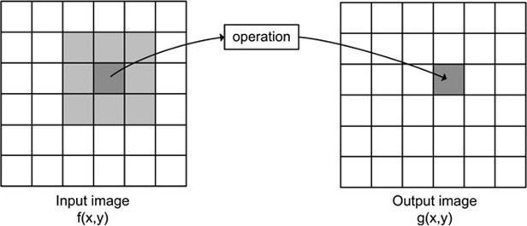
Convolution operator
𝑘(𝑥, 𝑦)
𝑔₍𝑥, 𝑦₎ = ∑ ∑ 𝑘(𝑢, 𝑣)𝑓(𝑥 − 𝑢, 𝑦 − 𝑣)
𝑣 𝑢
Image Credits: http://what-when-how.com/introduction-to-video-and-image-processing/neighborhood-processing-introduction-to-video- and-image-processing-part-1/
http://people.cs.umass.edu/~miyyer/cs685/

Slide 9
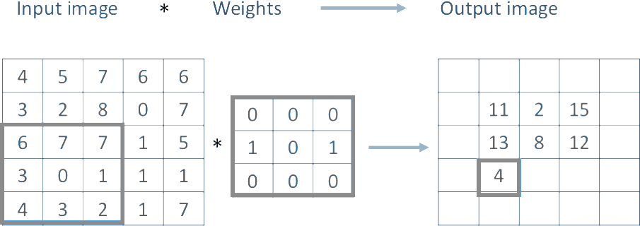
(Filter, Kernel)
?
http://people.cs.umass.edu/~miyyer/cs685/

Slide 10
Demo:
http://setosa.io/ev/image-kernels/
http://people.cs.umass.edu/~miyyer/cs685/

Slide 11
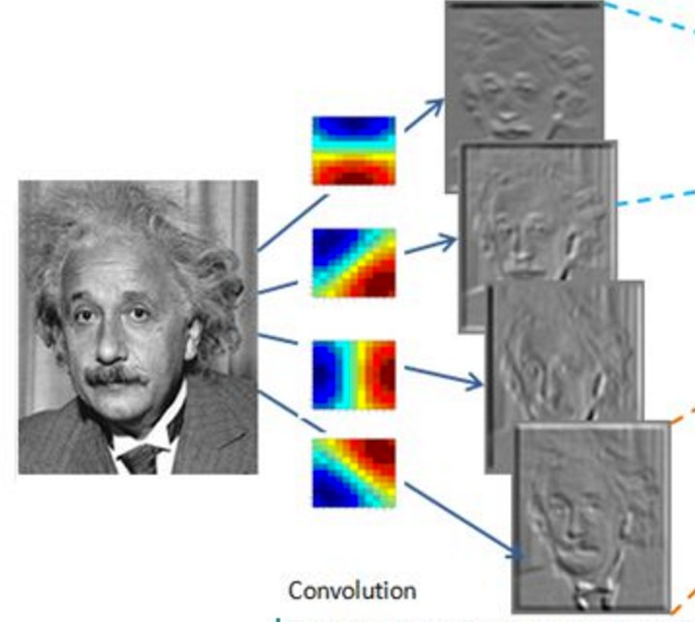
Convolutional Layer (with 4 filters)
weights: 4x1x9x9
Input: 1x224x224
Output: 4x224x224
if zero padding, and stride = 1
http://people.cs.umass.edu/~miyyer/cs685/

Slide 12
Convolutional Layer (with 4 filters)
weights: 4x1x9x9
Input: 1x224x224
Output: 4x112x112
if zero padding, but stride = 2
http://people.cs.umass.edu/~miyyer/cs685/

Slide 13
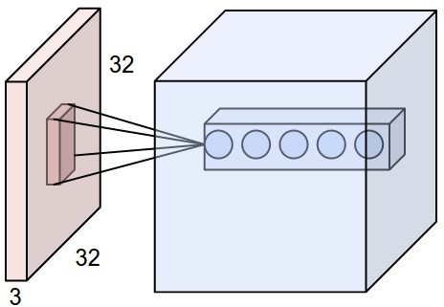
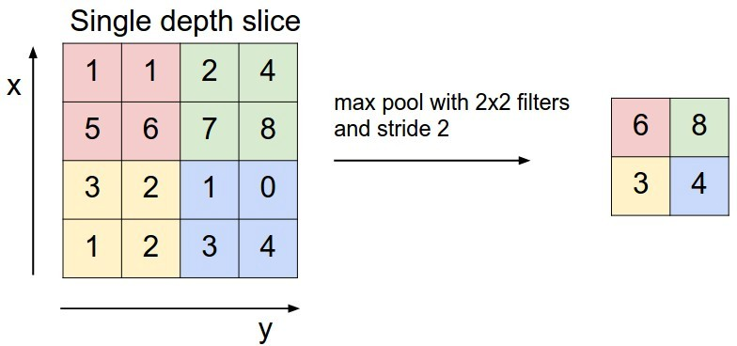
Pooling layers to reduce dimensionality
Convolutional Layers: slide a set of small filters over the image
Why reduce dimensionality?
Pooling Layers: reduce dimensionality of representation
12
image: https://cs231n.github.io/convolutional-networks/
http://people.cs.umass.edu/~miyyer/cs685/

Slide 14
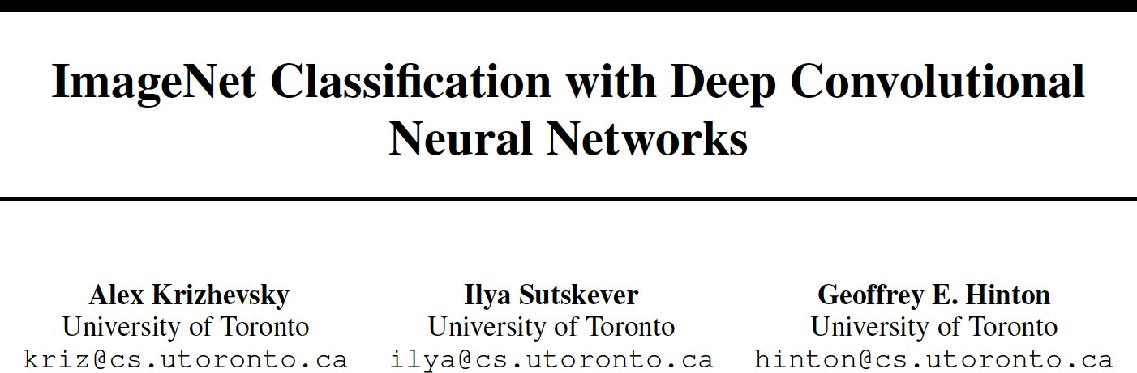
Alexnet
The paper that started the deep learning revolution!
http://people.cs.umass.edu/~miyyer/cs685/

Slide 15
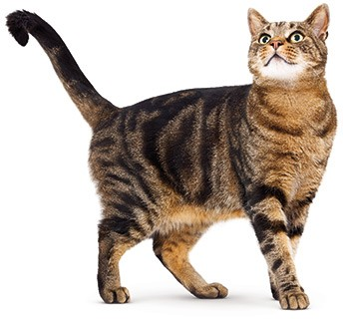
Image classification
Classify an image into 1000 possible classes:
e.g. Abyssinian cat, Bulldog, French Terrier, Cormorant, Chickadee,
Red fox, banjo, barbell, hourglass, knot, maze, viaduct, etc.
cat, tabby cat (0.71) Egyptian cat (0.22)
red fox (0.11)
…..
Train on ImageNet challenge dataset, ~1.2 million images
http://people.cs.umass.edu/~miyyer/cs685/

Slide 16
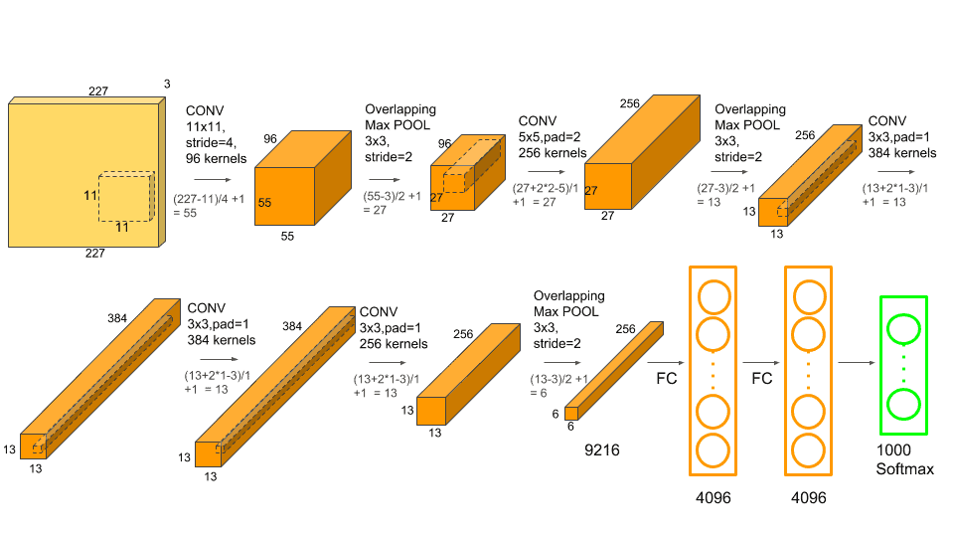
Alexnet
Initially vectors of 227*227*3 = 154 587 features).
Represented as a vector of 4096 features
The two fully connected and softmax layers are similar to a multi layer perception and could actually be replaced by other kinds of classifiers such as Random Forests or SVMs. However they are really important for the training phase of the neural net.
https://learnopencv.com/understanding-alexnet/

Slide 17
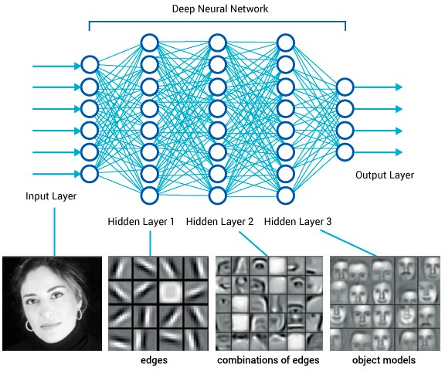
What is happening?
https://www.saagie.com/fr/blog/object-detection-part1
http://people.cs.umass.edu/~miyyer/cs685/

Slide 18
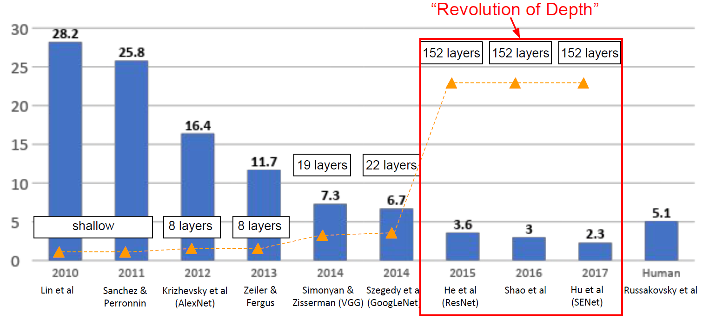
Revolution of depth
He et al.(2015), Deep Residual Learning for Image Recognition

Slide 19
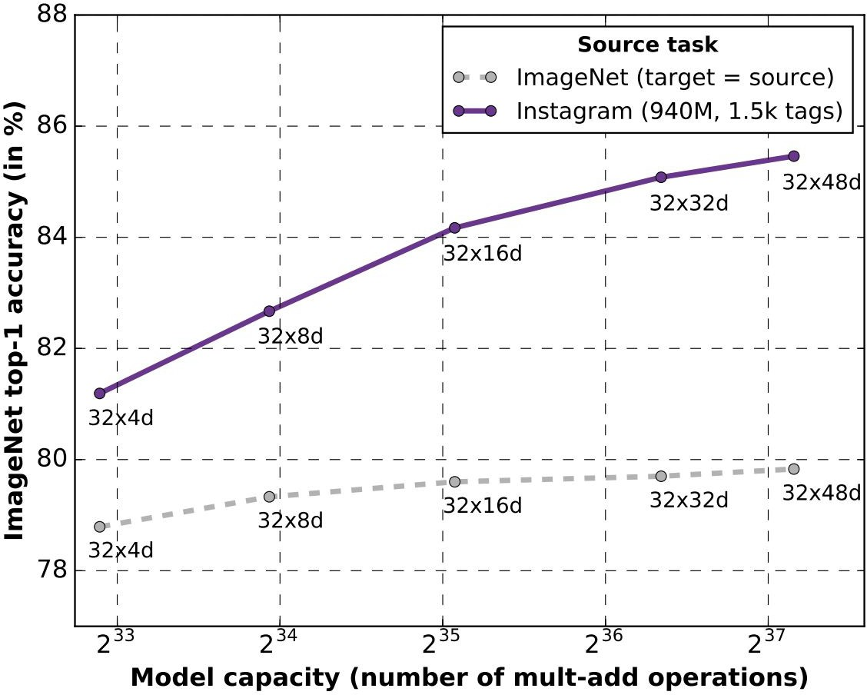
lmageNet pretraining -> lnstagram pretraining
Bigger models are saturated on lmageNet, but with more data bigger models do better
Biggest network was pretrained on 3.5B lnstagram images
Trained on 336 GPUs for 22 days
Mahajan et al, "Exploring the Limits of Weakly Supervised Pretraining", arXiv 2018
http://people.cs.umass.edu/~miyyer/cs685/

Slide 20

At the end of the day, …
… we generate a fixed size vector from an image and run a classifier over it
CNN (
)=
softmax: predict ‘truck’
http://people.cs.umass.edu/~miyyer/cs685/

Slide 21
Key insight
This vector is useful for many more tasks than just
image classification! We can use it for transfer learning
CNN (
)=
http://people.cs.umass.edu/~miyyer/cs685/

Slide 22
Simple visual QA
i := CNN(image) → use an existing network trained for image classification and freeze weights
q := BERT(question) → learn weights
Answer = softmax(linear([i;q]))
Why isn’t this a real cool way of doing visual QA?
http://people.cs.umass.edu/~miyyer/cs685/

Slide 23
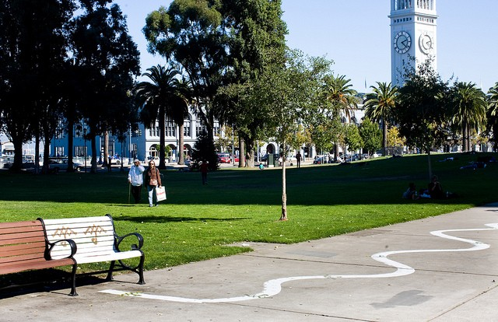



Visual attention
Use the question representation q to determine where in the image to look
How many benches are shown?
http://people.cs.umass.edu/~miyyer/cs685/

Slide 24


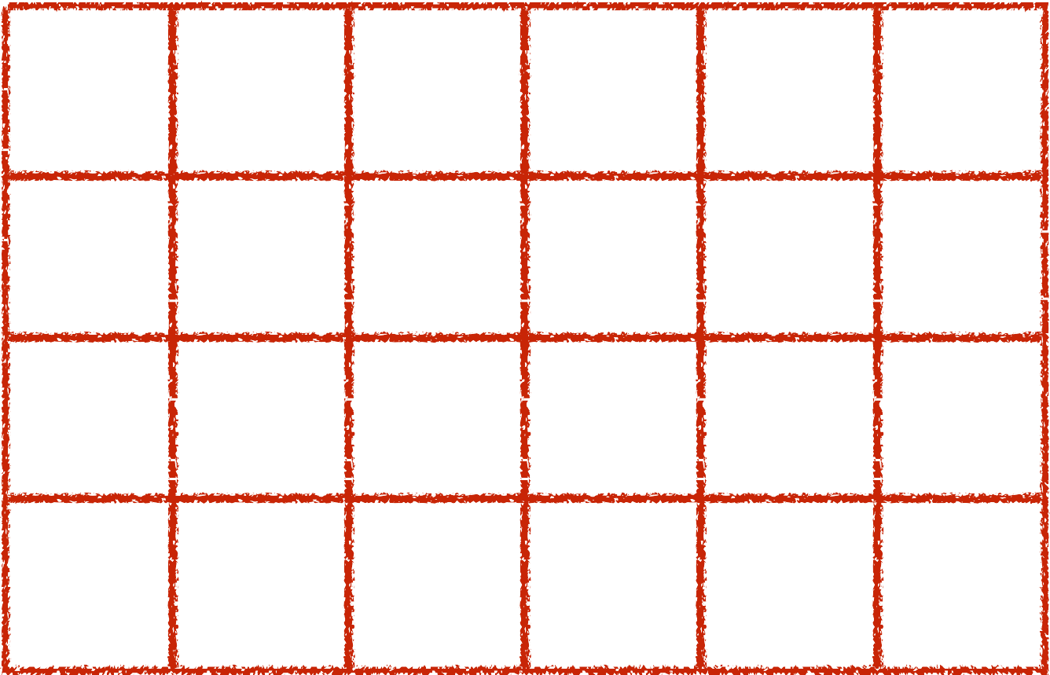


softmax: predict answer
Attention over final convolutional layer in network: 196 boxes, captures color and positional information
0.0 | 0.0 | 0.0 | 0.0 | 0.0 | 0.0
0.05 | 0.05 | 0.0 | 0.0 | 0.0 | 0.0
0.2 | 0.1 | 0.05 | 0.0 | 0.0 | 0.0
0.3 | 0.2 | 0.05 | 0.0 | 0.0 | 0.0
How many benches are shown?
http://people.cs.umass.edu/~miyyer/cs685/

Slide 25
Attention over final convolutional layer in network: 196 boxes, captures color and positional information
softmax: predict answer
0.0 | 0.0 | 0.0 | 0.0 | 0.0 | 0.0
0.05 | 0.05 | 0.0 | 0.0 | 0.0 | 0.0
0.2 | 0.1 | 0.05 | 0.0 | 0.0 | 0.0
0.3 | 0.2 | 0.05 | 0.0 | 0.0 | 0.0
How can we compute these attention scores?
How many benches are shown?
http://people.cs.umass.edu/~miyyer/cs685/

Slide 26
Hard Attention
softmax: predict answer
Attention over final convolutional layer in network: 196 boxes, captures color and positional information
0.0 | 0.0 | 0.0 | 0.0 | 0.0 | 0.0
0.0 | 0.0 | 0.0 | 0.0 | 0.0 | 0.0
0.0 | 0.0 | 0.0 | 0.0 | 0.0 | 0.0
1.0 | 0.0 | 0.0 | 0.0 | 0.0 | 0.0
We can use reinforcement learning to focus on just one box
How many benches are shown?
http://people.cs.umass.edu/~miyyer/cs685/

Slide 27
Grounded question answering
Is there a red shape above a circle?
yes
Slide credit: Jacob Andreas
http://people.cs.umass.edu/~miyyer/cs685/

Slide 28



Neural nets learn lexical groundings
Is there a red shape above a circle?
yes
[Iyyer et al. 2014, Bordes et al. 2014, Yang et al. 2015, Malinowski et al., 2015]
Slide credit: Jacob Andreas
http://people.cs.umass.edu/~miyyer/cs685/

Slide 29
Semantic parsers learn composition
Is there a red shape above a circle?
yes
[Wong & Mooney 2007, Kwiatkowski et al. 2010, Liang et al. 2011, A et al. 2013]
Slide credit: Jacob Andreas
http://people.cs.umass.edu/~miyyer/cs685/

Slide 30
Neural module networks learn both!
Is there a red shape above a circle?
yes
Slide credit: Jacob Andreas
http://people.cs.umass.edu/~miyyer/cs685/

Slide 31
Neural module networks
Is there a red shape above a circle?
red
↦
↦
true
exists
↦
above
Slide credit: Jacob Andreas
http://people.cs.umass.edu/~miyyer/cs685/

Slide 32
Neural module networks
Is there a red shape above a circle?
exists
nd
a
red
above
red
↦
circle
↦
true
exists
↦
above
Slide credit: Jacob Andreas
http://people.cs.umass.edu/~miyyer/cs685/

Slide 33
Neural module networks
yes
Is there a red shape above a circle?
exists
nd
a
red
above
red
↦
circle
↦
true
exists
↦
above
Slide credit: Jacob Andreas
http://people.cs.umass.edu/~miyyer/cs685/

Slide 34
Sentence meanings are computations
Is there a red shape above a circle?
exists
and
red
above
circle
Slide credit: Jacob Andreas
http://people.cs.umass.edu/~miyyer/cs685/

Slide 35
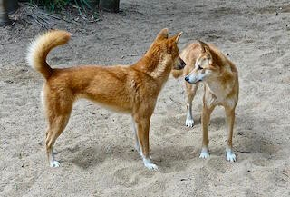
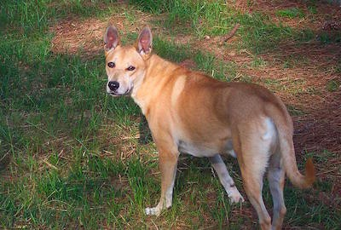
NLVR²: natural language for visual reasoning! (Suhr et al., 2018)
TRUE OR FALSE: the left image contains twice the number of dogs as the right image, and at least two dogs in total are standing.
http://people.cs.umass.edu/~miyyer/cs685/

Slide 36
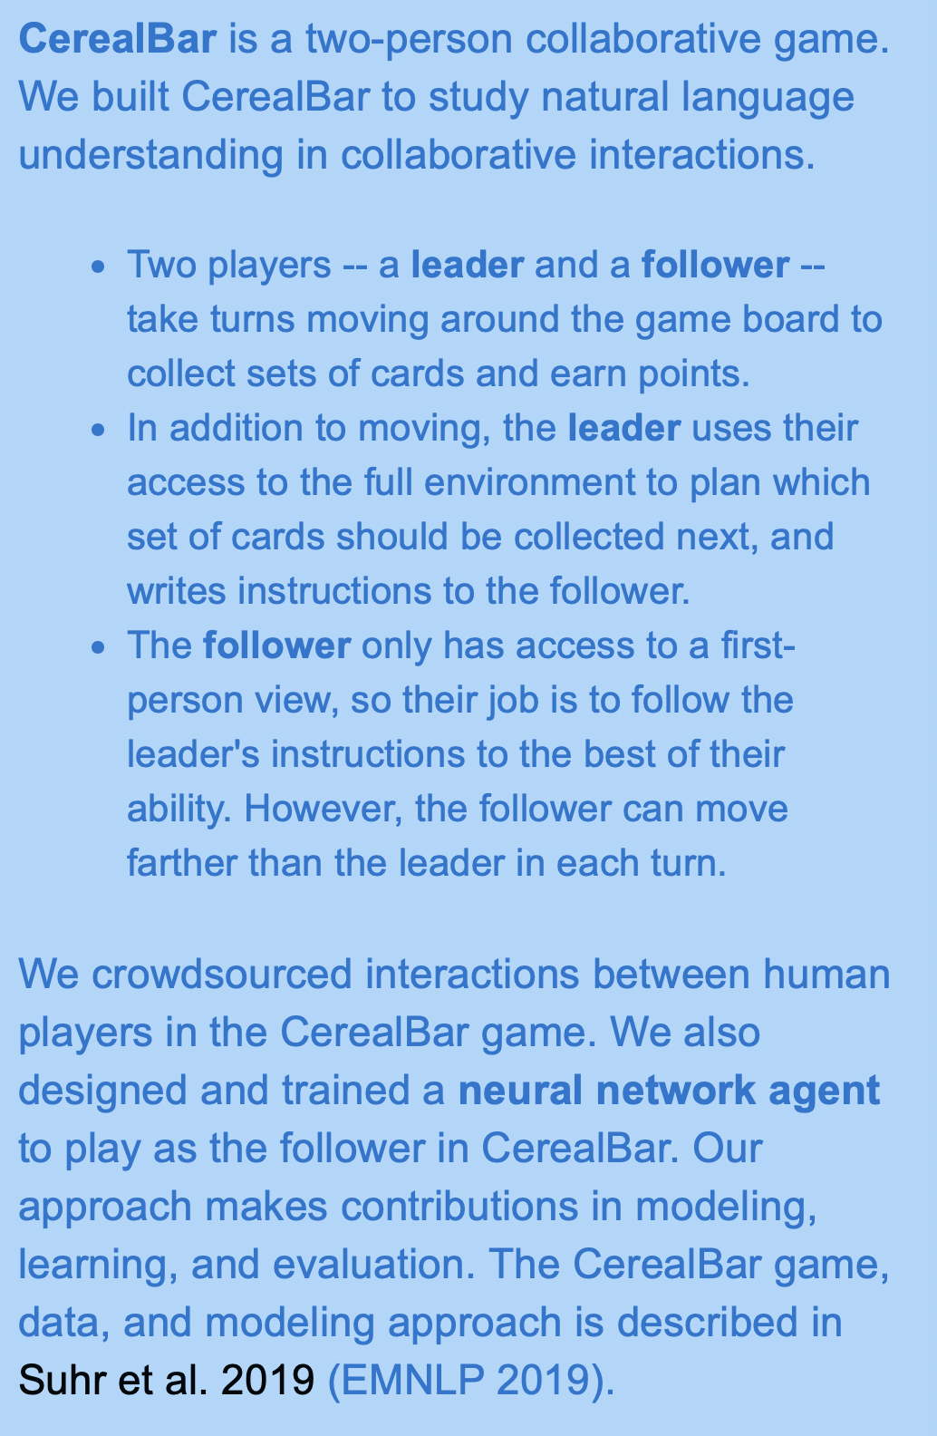
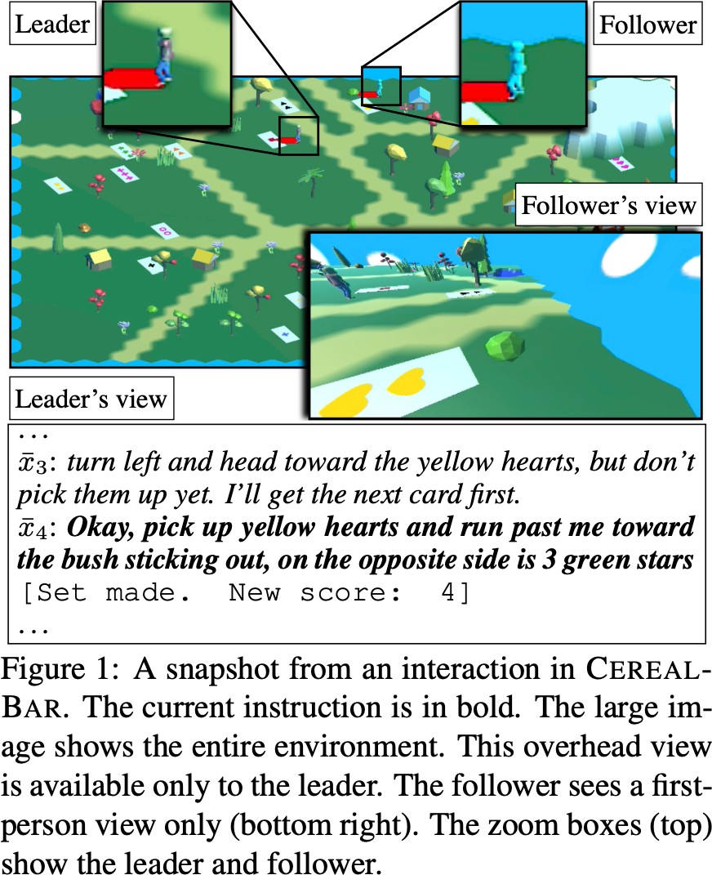
CerealBar: Situated, Collaborative Natural Language Understanding
https://lil.nlp.cornell.edu/cerealbar/
http://people.cs.umass.edu/~miyyer/cs685/

Slide 37
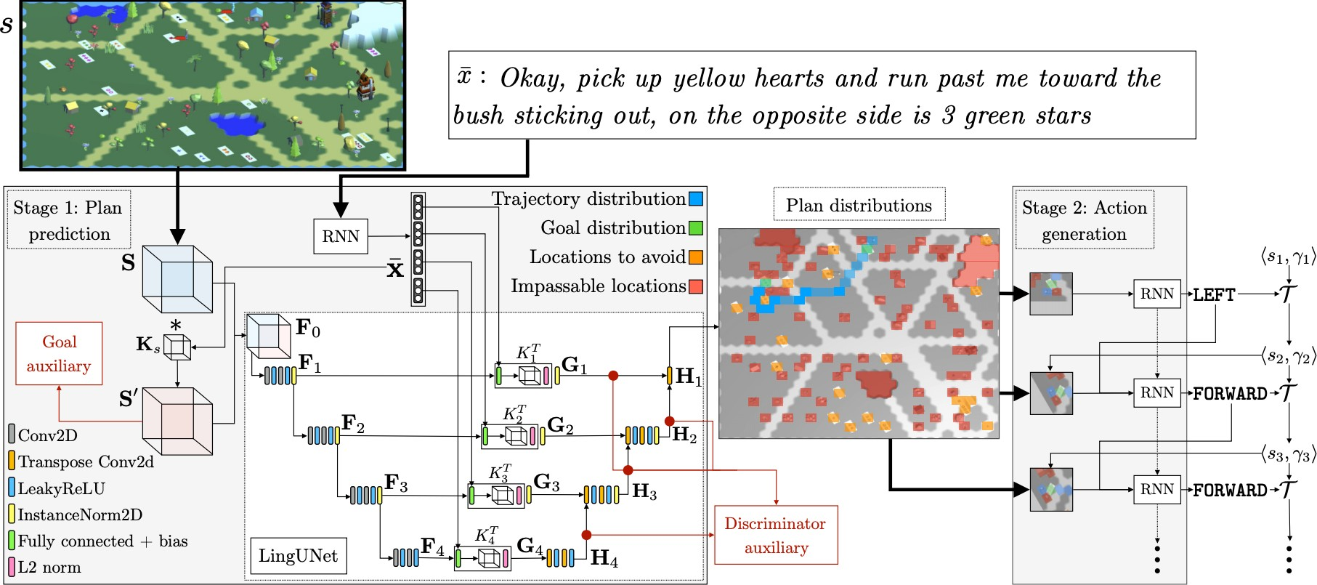
Suhr et al., 2019 (“CEREALBAR”)
http://people.cs.umass.edu/~miyyer/cs685/

Slide 38
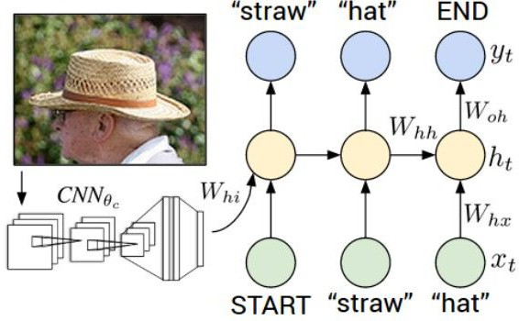
Image Captioning
Figure fr Visual-S Image D copyrigh Reprodu
Around 2014
Explain Images with Multimodal Recurrent Neural Networks, Mao et al.
Deep Visual-Semantic Alignments for Generating Image Descriptions, Karpathy and Fei-Fei
Show and Tell: A Neural Image Caption Generator, Vinyals et al.
Long-term Recurrent Convolutional Networks for Visual Recognition and Description, Donahue et al.
Learning a Recurrent Visual Representation for Image Caption Generation, Chen and Zitnick
http://people.cs.umass.edu/~miyyer/cs685/

Slide 39

test image
This image is CCO public domain
http://people.cs.umass.edu/~miyyer/cs685/

Slide 40
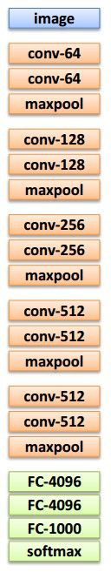
test image
This is our ImageNet CNN, now used as a feature extractor
http://people.cs.umass.edu/~miyyer/cs685/

Slide 41
test image
This is our ImageNet CNN, now used as a feature extractor
X
http://people.cs.umass.edu/~miyyer/cs685/

Slide 42
test image
xO
<STA RT>
<START>
http://people.cs.umass.edu/~miyyer/cs685/

Slide 43
test image
yO
before:
h = tanh(Wxh * x + Whh * h)
hO
Wih
now:
h = tanh(Wxh * x + Whh * h + Wih * v)
xO
<STA RT>
V
let’s use the image features to create a conditional LM
<START>
http://people.cs.umass.edu/~miyyer/cs685/

Slide 44

test image
yO
hO
sample!
xO
<STA RT>
straw
<START>
http://people.cs.umass.edu/~miyyer/cs685/

Slide 45
test image
yO
y1
hO
h1
xO
<STA RT>
straw
<START>
http://people.cs.umass.edu/~miyyer/cs685/

Slide 46

test image
yO
y1
hO
h1
sample!
xO
<STA RT>
straw
hat
<START>
http://people.cs.umass.edu/~miyyer/cs685/

Slide 47
test image
yO
y1
y2
hO
h1
h2
xO
<STA RT>
straw
hat
<START>
http://people.cs.umass.edu/~miyyer/cs685/

Slide 48
test image
yO
y1
y2
sample
<END> token
=> finish.
hO
h1
h2
xO
<STA RT>
straw
hat
<START>
http://people.cs.umass.edu/~miyyer/cs685/

Slide 49
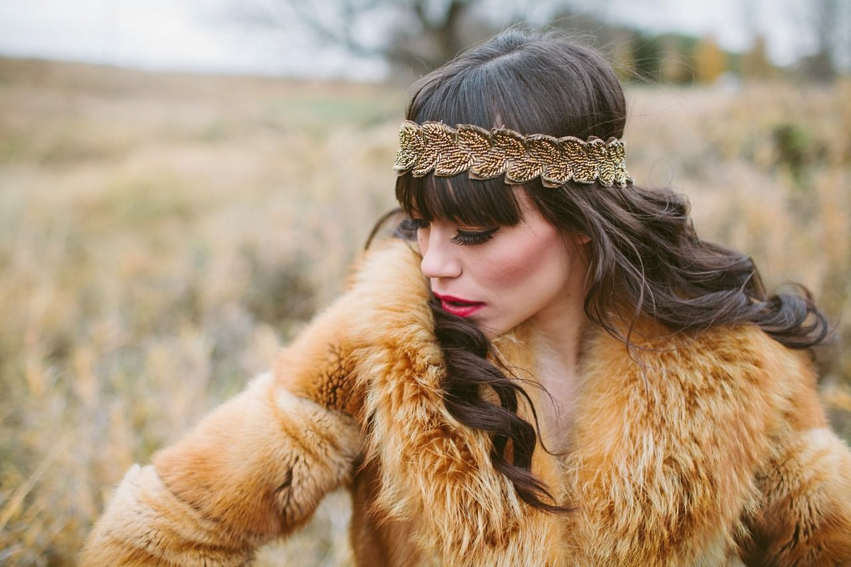
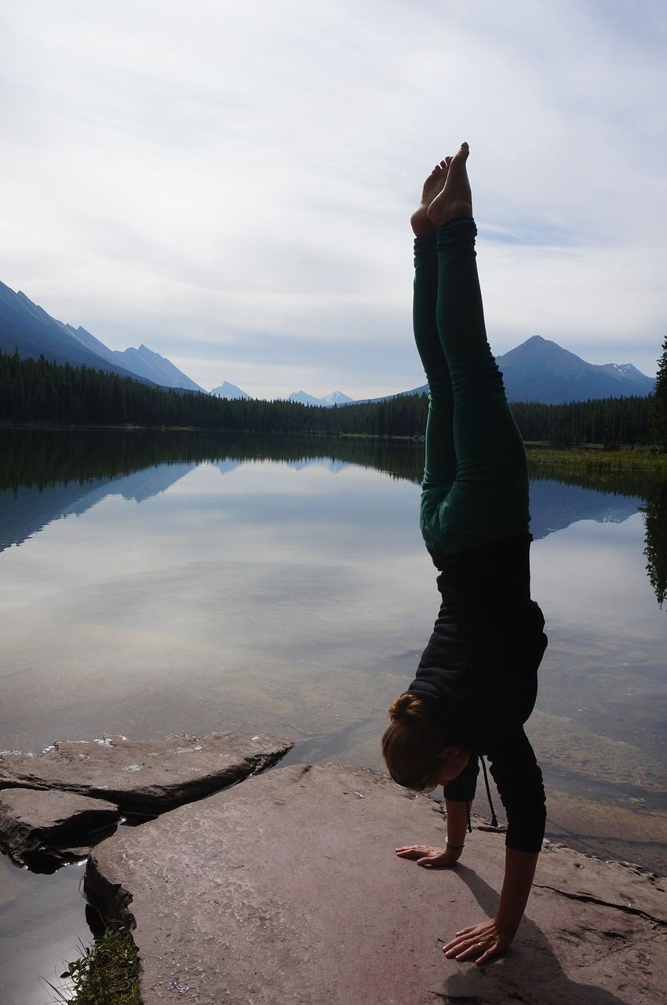
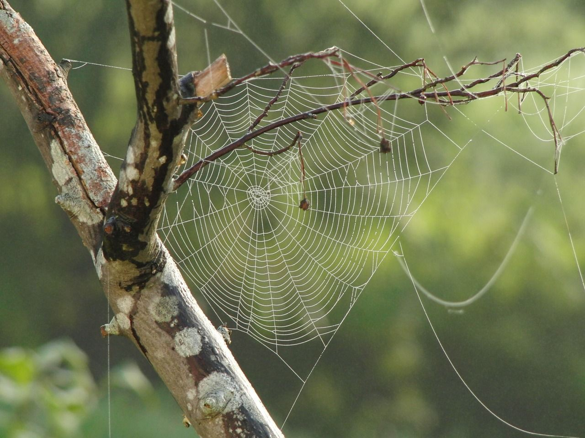

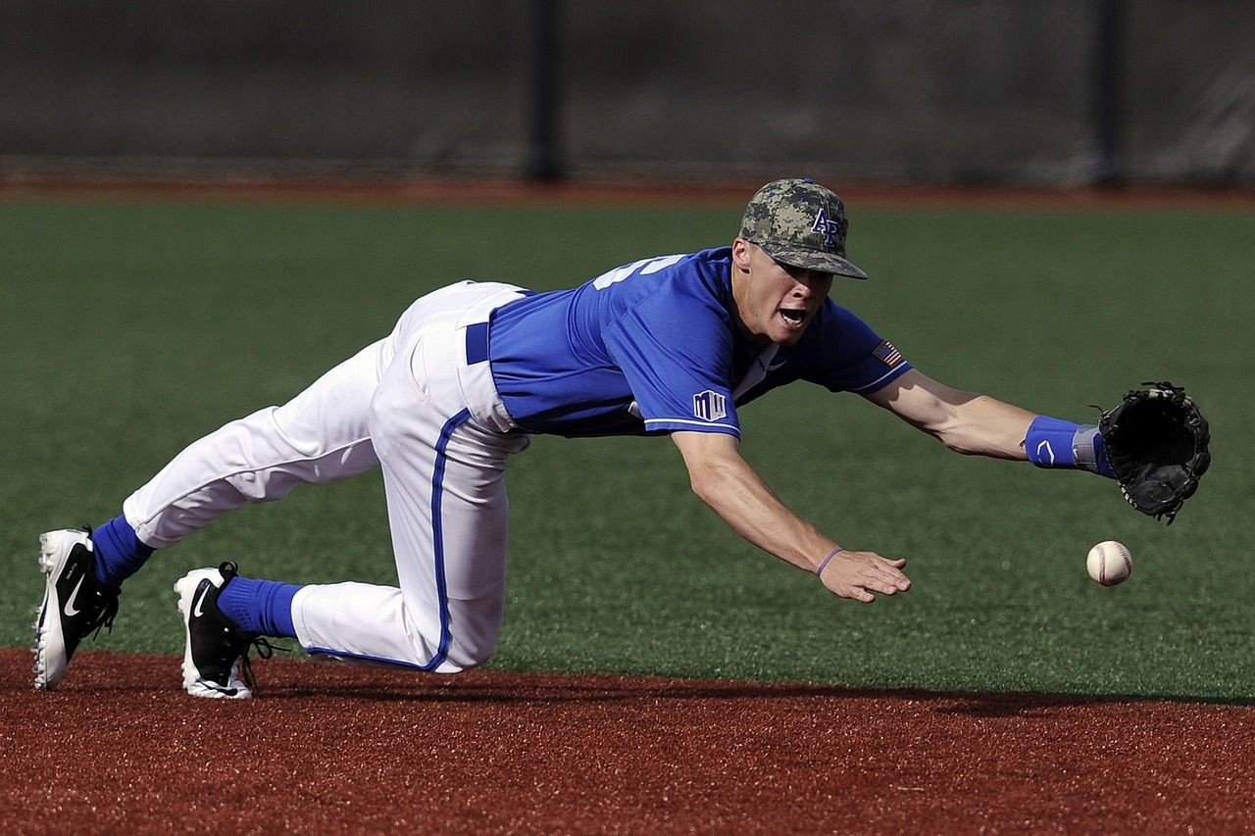
lmage Captioning: Failure Cases
Captions generated using neuraltalk2
All images are CCO Public domain: fu
coat, handstand, spider web, basebal
A bird is perched on a tree branch
A woman is holding a cat in her hand
A man in a baseball unitorm throwing a ball
A woman standing on a beach holding a surtboard
A person holding a computer mouse on a desk
http://people.cs.umass.edu/~miyyer/cs685/

Slide 50
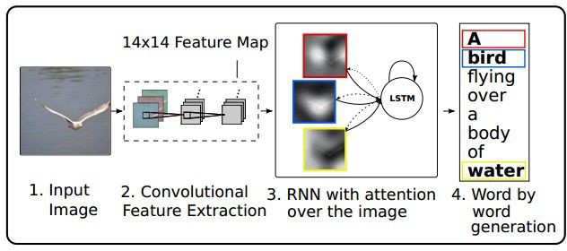
Image Captioning with Attention
RNN focuses its attention at a different spatial location when generating each word
Xu et al, "Show, Attend, and Tell: Neural Image Caption Generation with Visual Attention", ICML 2015
http://people.cs.umass.edu/~miyyer/cs685/

Slide 51
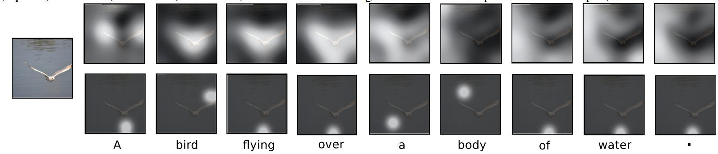
Image Captioning with Attention
Soft attention
Hard attention
Xu et al, "Show, Attend, and Tell: Neural Image Caption Generation with Visual Attention", ICML 2015
http://people.cs.umass.edu/~miyyer/cs685/

Slide 52
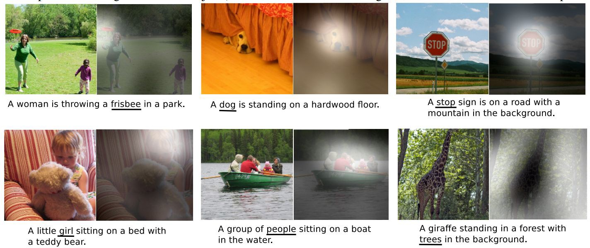
Image Captioning with Attention
Xu et al, "Show, Attend, and Tell: Neural Image Caption Generation with Visual Attention", ICML 2015
http://people.cs.umass.edu/~miyyer/cs685/

Slide 53
Image Captioning using Transformers
Hybrid Solution
person
wearing
hat [END]
y₁
y₂
y₃
y₄
^{z}0,0 | ^{z}0,1 | ^{z}0,2
^{z}1,0 | ^{z}1,1 | ^{z}1,2
^{z}2,0 | ^{z}2,1 | ^{z}2,2
...
^{c}0,0 ^{c}0,1 ^{c}0,2 ^{c}2,2
Transformer decoder
CNN
Transformer encoder
Extract spatial features from a pretrained CNN
Features: H x W x D
y₀
y₁
y₂
y₃
^{z}0,0
^{z}0,1
...
^{z}0,2 ^{z}2,2
[START] person wearing hat
Fei-Fei Li, Jiajun Wu, Ruohan Gao
http://people.cs.umass.edu/~miyyer/cs685/

Slide 54
Image Captioning using transformers
- Perhaps we don't need convolutions at all?
person
wearing
hat [END]
y₁
y₂
y₃
y₄
^{z}0,0 | ^{z}0,1 | ^{z}0,2
^{z}1,0 | ^{z}1,1 | ^{z}1,2
^{z}2,0 | ^{z}2,1 | ^{z}2,2
...
^{c}0,0 ^{c}0,1 ^{c}0,2 ^{c}2,2
Transformer decoder
CNN
Transformer encoder
Extract spatial features from a pretrained CNN
Features: H x W x D
y₀
y₁
y₂
y₃
^{z}0,0
^{z}0,1
...
^{z}0,2 ^{z}2,2
[START] person wearing hat
Fei-Fei Li, Jiajun Wu, Ruohan Gao
http://people.cs.umass.edu/~miyyer/cs685/

Slide 55
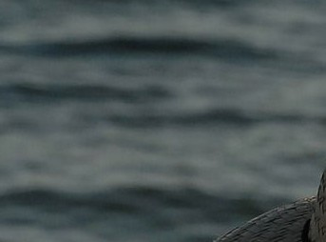
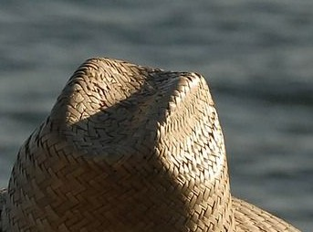
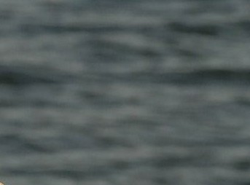
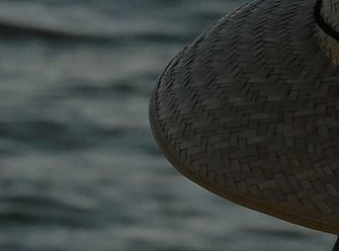
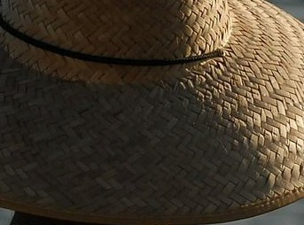




Image Captioning using ONLY transformers
- Transformers from pixels to language
person wearing
y₁ y₂
hat [END]
y₃
y₄
...
Transformer decoder
^{c}0,0 ^{c}0,1 ^{c}0,2 ^{c}2,2
Transformer encoder
...
y₀
y₁
y₂
y₃
[START] person wearing hat
Fei-Fei Li, Jiajun Wu, Ruohan Gao
Dosovitskiy et al, “An Image is Worth 16x16 Words: Transformers for Image Recognition at Scale”, ArXiv 2020 Colab link to an implementation of vision transformers
http://people.cs.umass.edu/~miyyer/cs685/

Slide 56
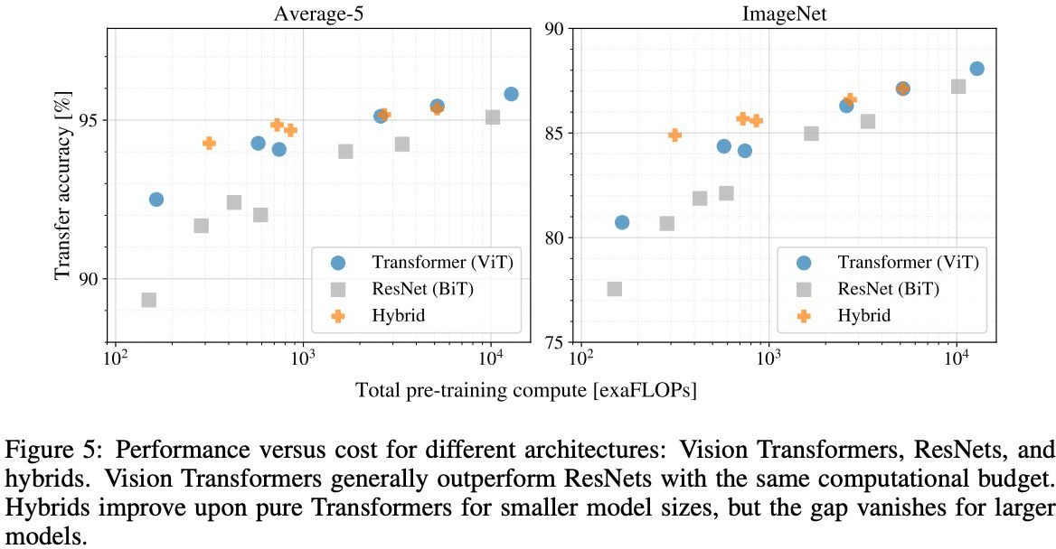
Vision Transformers (ViT) vs. ResNets (BiT)
The BiT model was proposed in Big Transfer (BiT): General Visual Representation Learning by Alexander Kolesnikov, Lucas Beyer, Xiaohua Zhai, Joan Puigcerver, Jessica Yung, Sylvain Gelly, Neil Houlsby. BiT is a simple recipe for scaling up pre-training of ResNet-like architectures (specifically, ResNetv2). The method results in significant improvements for transfer learning.
Fei-Fei Li, Jiajun Wu, Ruohan Gao
98
Dosovitskiy et al, “An Image is Worth 16x16 Words: Transformers for Image Recognition at Scale”, ArXiv 2020 Colab link to an implementation of vision transformers
http://people.cs.umass.edu/~miyyer/cs685/

Slide 57
Intelligent Agents
Vision and Language
Prof. Dr. Ralf Möller
Universität zu Lübeck
Institut für Informationssysteme

Slide 58
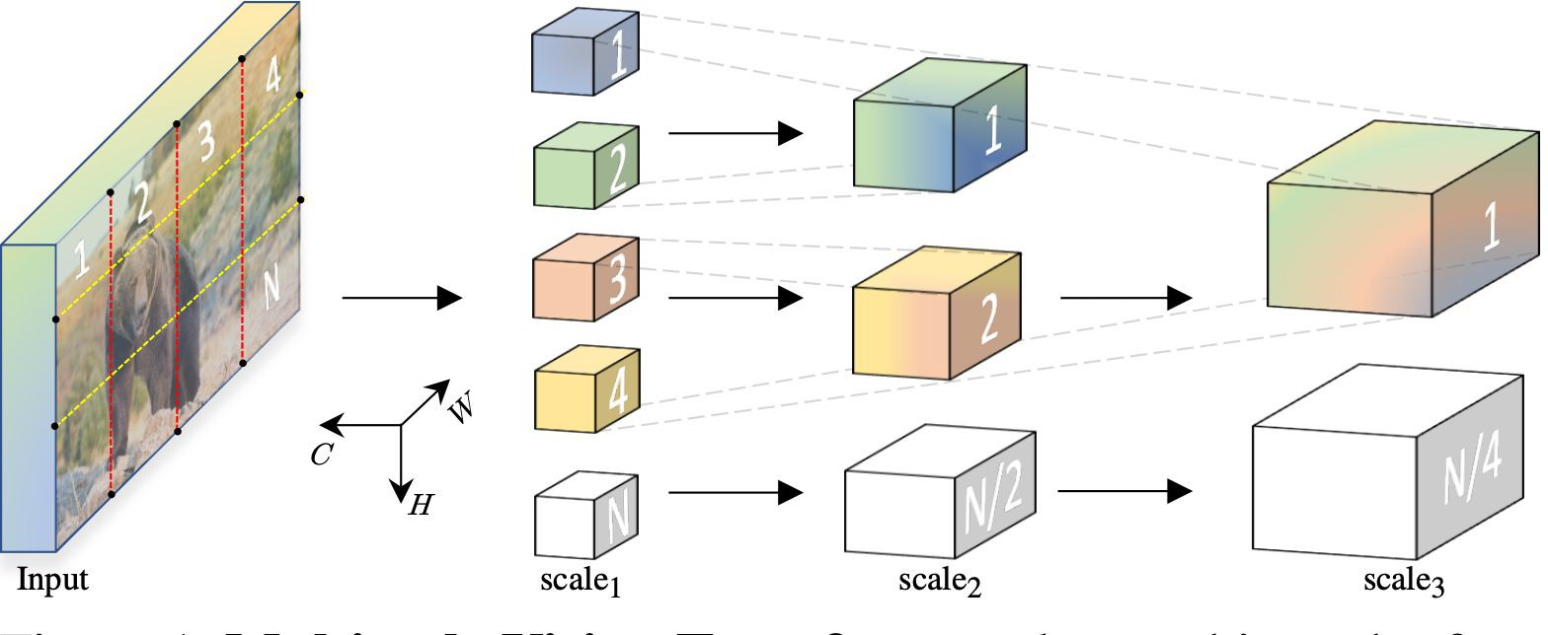
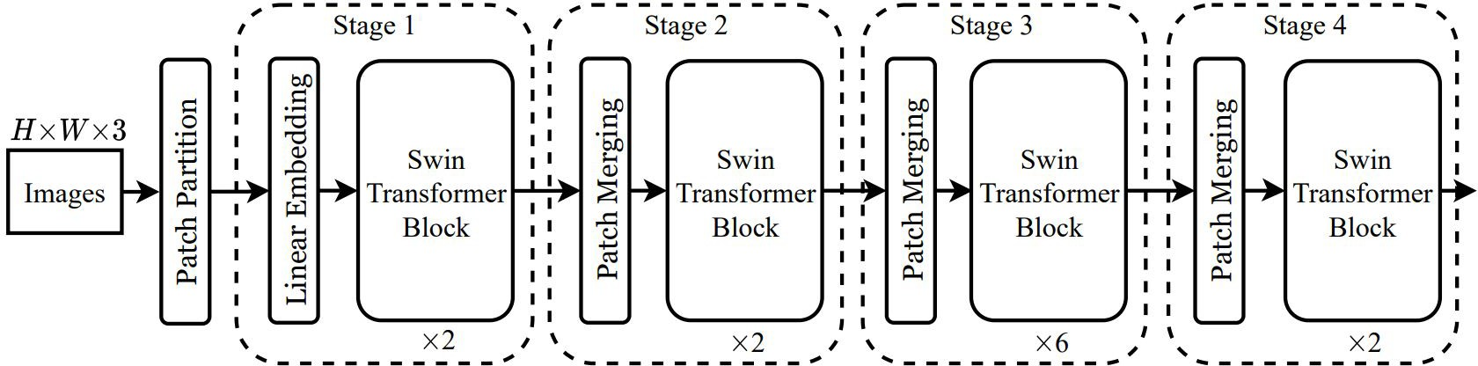
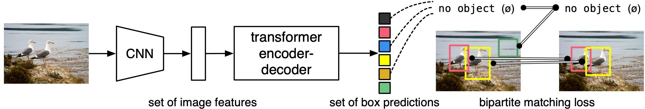
Vision Transformers
Liu et al, “Swin Transformer: Hierarchical Vision Transformer using Shifted Windows”, CVPR 2021
Fan et al, “Multiscale Vision Transformers”, ICCV 2021
Carion et al, “End-to-End Object Detection with Transformers”, ECCV 2020
Fei-Fei Li, Jiajun Wu, Ruohan Gao
58
http://people.cs.umass.edu/~miyyer/cs685/

Slide 59

ViLBERT (Vision and Language BERT)
ViLBERT: Pretraining Task-Agnostic Visiolinguistic Representations for Vision-and-Language Tasks
Jiasen Lu, Dhruv Batra, Devi Parikh, and Stefan Lee. ViLBERT: pretraining task-agnostic visiolinguistic representations for vision-and-language tasks. Proceedings of the 33rd International Conference on Neural Information Processing Systems. Curran Associates Inc., Red Hook, NY, USA, Article 2, 13–23. 2019
Presented by - Sidharth Singla, 20774908

Slide 60

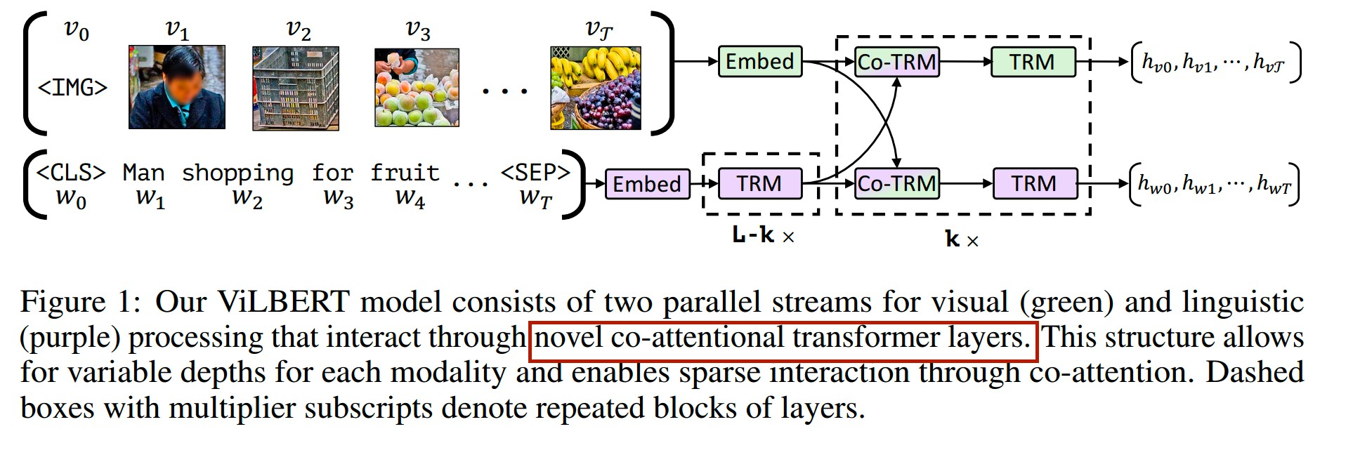

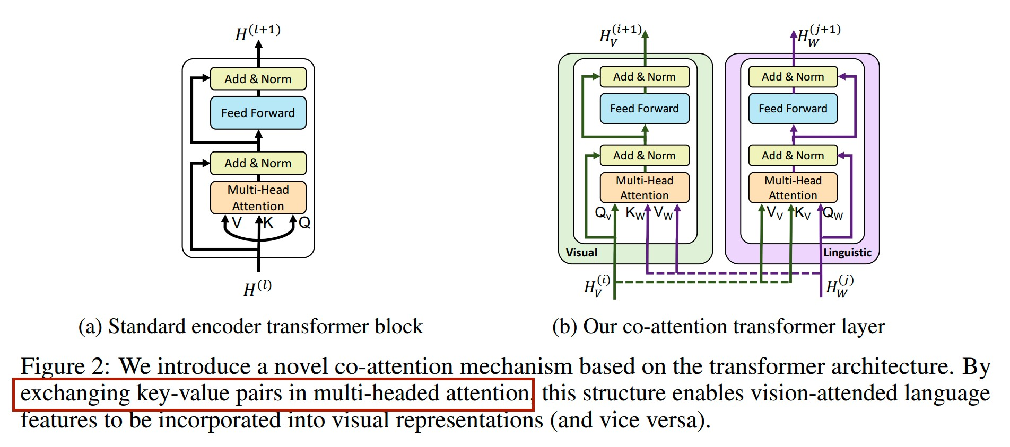
Model

Slide 61
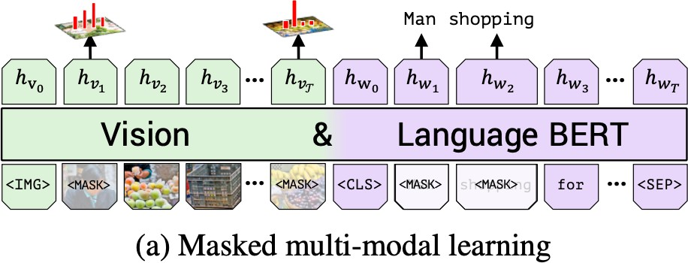
Pretraining: Masked Multi-Modal Learning Task
  Approximately 15% of both words and image region are masked and reconstructed given the remaining inputs
  Image features zeroed out 90% and unaltered 10%. Masked text inputs are handled as in BERT
  Model predicts a distribution over semantic classes rather than directly regressing the masked feature values for the corresponding image region
  Supervision by output distribution for the region from the pretrained detection model used. Minimize KL divergence

Slide 62
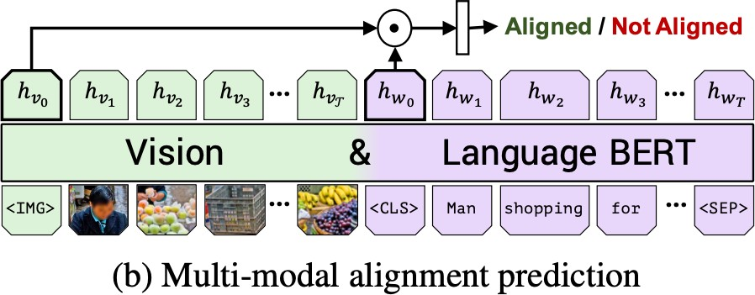
Pretraining: Multi-modal alignment task
  Prediction whether the text describes the image(image aligned with the text).
  Element-wise product between hIMG and hCLS and a linear layer is learnt to make the binary prediction
  Trained on Conceptual Captions Dataset
    Collection of 3.3 million image-caption pairs automatically scraped
    from alt-text enabled web images
https://ai.google.com/research/ConceptualCaptions/

Slide 63
Transfer tasks
Pretrained ViLBERT model transferred to a set of four established vision-and-language tasks and one diagnostic task.
Fine-tuning strategy to modify the pretrained base model and perform the new task by training the entire model end-to-end.

Slide 64
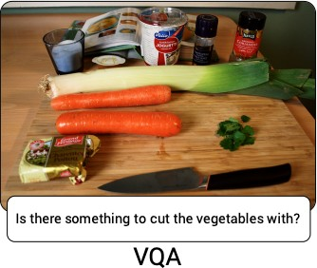
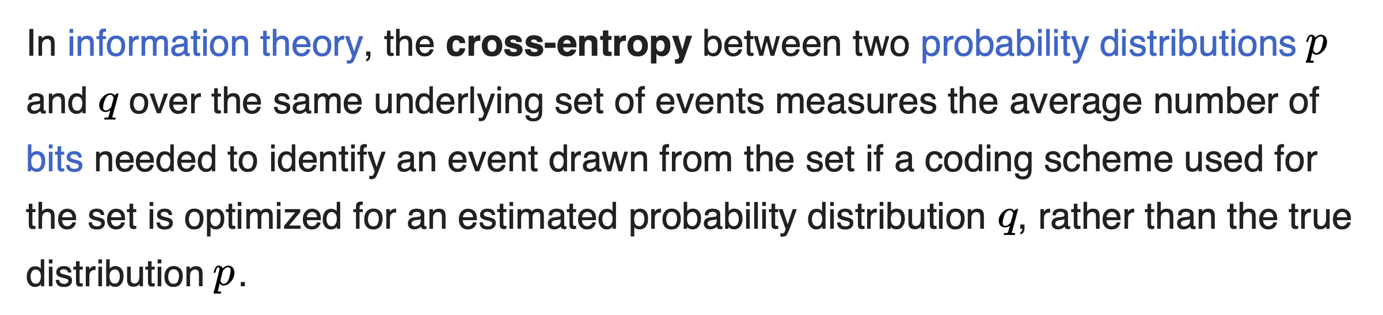
Visual Question Answering (VQA)
Training and Evaluation on VQA 2.0 dataset
Fine-tuning:
Two layer MLP is learnt on top of the elementwise product of the image and text representations hIMG and hCLS.
Multi-label classification task:
Binary cross-entropy loss.
Batch size 256. Maximum 20 epochs. Initial learning rate 4e-5.

Slide 65
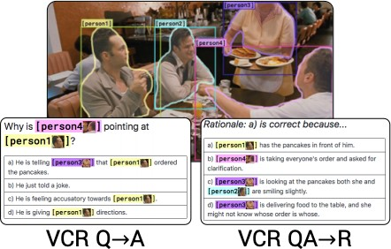
Visual Commonsense Reasoning (VCR)
  Given an image, Visual Question Answering (Q->A) and Answer justification (QA->R).
  Trained on Visual Commonsense Reasoning (VCR) dataset having object tags integrated into the language providing direct grounding supervision and explicitly excludes referring expressions.
  Fine-tuning: Question and each possible response is concatenated and four different text inputs are passed along with the image. A linear layer is learnt on top of the post- element-wise product representation.
  Softmax prediction. Loss - Cross-entropy loss. 20 epochs. Batch size 64. Initial learning rate 2e-5.
https://paperswithcode.com/dataset/vcr

Slide 66
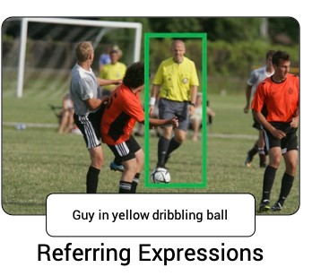
Grounding Referring Expressions
  Localize an image region given a natural language reference.
  Training and Evaluation is done on RefCOCO+ dataset.
  Bounding box proposals provided by MAttNet[5], which use a Mask R-CNN are directly used.
  Fine-tuning: Final representation hvi is passed into a learned linear layer to predict a matching score. IoU is computed with the ground truth box thresholding at 0.5.
  Loss - Binary cross-entropy loss. Maximum 20 epochs. Batch size 256. Initial learning rate 4e-5.

Slide 67

Caption-Based Image Retrieval
Caption-Based Image Retrieval
  Identifying an image from a pool given a caption describing its content.
  Training and Evaluation is done on the Flickr30k dataset.Trained in a 4-way multiple-choice setting by randomly sampling three distractors for each image-caption pair - substituting a random caption, a random image, or a hard negative from among the 100 nearest neighbors of the target image.
  Alignment score(same as in alignment prediction pretraining) is computed for each. Softmax applied. Loss - Cross-entropy loss. 20 epochs. Batch size 64. Initial learning rate 2e-5.
‘Zero-shot’ Caption-Based Image Retrieval
  Pre-trained multi-modal alignment prediction model on Conceptual Captions dataset is used directly. No fine-tuning.
  Demonstrates that the pretraining has developed the ability to ground text.Tested on the caption- based image retrieval task test-set.

Slide 68
Contrastive pretraining
During unsupervised contrastive pre-training,
the unlabeled images are clustered in the latent space,
forming fairly good decision boundaries between different classes.
Based on this clustering, the subsequent supervised fine-tuning
will achieve better performance than random initialization.

Slide 69







Nowadays: Many different V&L BERTs
Single- & Dual-Stream Architectures
Single-Stream
Concat image—text inputs
[CLS]
Lang embed
[CLS]
w1
w1
…
…
wT
wT
[SEP]
[SEP]
Image embed
[IMG]
Dual-Stream
Image and text independently
Cross-modal layers
  Intra-modal
  Inter-modal
v1
v1
vK
vK
[CLS]
Lang embed
[CLS]
w1
w1
…
…
wT
wT
[SEP]
[SEP]
Image embed
[IMG]
v1
v1
vK
vK
5

Slide 70
General approach
AI becomes successful:
Not just knowledge representation languages,
but systems that can be used out of the box and that can be fine-tuned
Unsupervised pretraining
  Zero-shot training / generalization
  Few-shot training / examples
  Effective for very large vision&language models
Fine-tuning for specific tasks
  Reinforcement

Slide 71
CLIP
Acknowledgements
CLIP
Learning Transferable Visual Models From Natural Language Supervision
Alec Radford, JongWook Kim, Chris Hallacy, Aditya Ramesh, Gabriel Goh, Sandhini Agarwal, Girish Sastry, Amanda Askell, Pamela Mishkin, Jack Clark, Gretchen Krueger, Ilya Sutskever
OpenAI
Alec Radford, Jong Wook Kim, Chris Hallacy, Aditya Ramesh, Gabriel Goh, Sandhini Agarwal, Girish Sastry, Amanda Askell, Pamela Mishkin, Jack Clark, Gretchen Krueger, Ilya Sutskever:
Learning Transferable Visual Models From Natural Language Supervision. ICML 2021: 8748-8763

Slide 72
Contrastive language-image pretraining
•
ViLBERT and similar methods (e.g., LXMERT) rely on small labeled datasets like MS COCO and Visual Genome (~100K images each)
•
OpenAI collected 400 million (image, text) pairs from the web
•
Then, they train an image encoder and a text encoder with a simple contrastive loss: given a collection of images and text, predict which (image, text) pairs actually occurred in the dataset

Slide 73

Method: Contrastive Pre-training

Slide 74
Method: Contrastive Pre-training
Batch of texts
Paired
Batch of images
(Resized & Cropped)

Slide 75
Method: Contrastive Pre-training
Transformer / CBOW
ResNet / ViT

Slide 76
Method: Contrastive Pre-training
Linear Projection 1
Linear Projection 2

Slide 77
Method: Contrastive Pre-training
Cosine Similarity Matrix

Slide 78
Method: Contrastive Pre-training
Cross-entropy on dimension 1
Maximize the diagonal and minimize the others
Cross-entropy on dimension 2

Slide 79
Method: Contrastive Pre-training
Cross-entropy on dimension 1
Pick the right image given the text
&
Pick the right text given the image
Cross-entropy on dimension 2

Slide 80

Method: Zero-Shot Testing
Core:
Images and text have been mapped into a common feature space

Slide 81
Method: Zero-Shot Testing
The classes are not pre-defined but chosen on demand
(No fine-tuning)

Slide 82
Method: Zero-Shot Testing
Classes on demand

Slide 83
Method: Zero-Shot Testing
Text Prompts
A photo of plane
A photo of car
A photo of dog
…
A photo of bird

Slide 84
Method: Zero-Shot Testing
A photo of plane
A photo of car
A photo of dog
…
A photo of bird
Encode and cache prompts
Encode test image

Slide 85
Method: Zero-Shot Testing
A photo of plane
A photo of car
A photo of dog
…
A photo of bird
Compute similarities and pick the best class

Slide 86
Method: Zero-Shot Testing
Zero-shot testing is super flexible!
A photo of plane
A photo of car
A photo of dog
…
A photo of bird

Slide 87
Method: Zero-Shot Testing – Prompt Engineering
Class names as baseline prompts
Problematic:
A single word is often ambiguous, i.e., the dog ‘boxer’ and the athlete ‘boxer’
It is rare on the web that a image is paired with a single word

Slide 88
Method: Zero-Shot Testing – Prompt Engineering
Class names as baseline prompts
Problematic:
A single word is often ambiguous, i.e., the dog ‘boxer’ and the athlete ‘boxer’
It is rare on the web that a image is paired with a single word
Prompt engineering examples:
A photo of a {label}. (For general classification)
This is a {label}. (For general classification)
A photo of a {label}, a type of pet. (For pet classification)
A photo of a {label}, a type of food. (For food classification)
A satellite photo of a {label}. (For satellite image classification)
A digit “{label}”. (For digit classification)

Slide 89




Slide 90
Method: Zero-Shot Testing – Prompt Engineering
Class names as baseline prompts
Problematic:
A single word is often ambiguous, i.e., the dog ‘boxer’ and the athlete ‘boxer’
It is rare on the web that a image is paired with a single word
Prompt engineering examples:
A photo of a {label}. (For general classification)
This is a {label}. (For general classification)
A photo of a {label}, a type of pet. (For pet classification)
A photo of a {label}, a type of food. (For food classification)
A satellite photo of a {label}. (For satellite image classification)
A digit “{label}”. (For digit classification)
Prompt ensemble examples (average the prompt features):
A photo of a {label}.
A photo of a small {label}.
A photo of a big {label}.
(This could match the object no matter its size)

Slide 91

Method: Zero-Shot Testing – Prompt Engineering

Slide 92

Compare with decidated image classifier?
Few-shot or fully-supervised
For training, class labels must be known beforehand
Using an image extractor paired with a classifier
is also known as linear probe evaluation

Slide 93

Linear Probe CLIP
Use only the CLIP’s Image Encoder to get the image features and fed them into a linear classifier. Even with this setup, CLIP’s few-shot-learning capabilities are outstanding.
NB: Pretrained in combination with text encoder
Few-shot or fully-supervised

Slide 94

Experiments: Zero-shot

Slide 95
Experiments: Zero-shot
Zero-shot CLIP outperforms fully-supervised ResNet linear probe on 16 datasets

Slide 96
Experiments: Zero-shot
Limited examples per class

Slide 97
Experiments: Zero-shot
Fine-grained

Slide 98
Experiments: Zero-shot
Action recognition
(More verbs on web than in ImageNet)

Slide 99
Experiments: Zero-shot
General classification

Slide 100
Experiments: Zero-shot
Specialized: satellite, medical, self-driving, synthetic scenes
(Rare on web)

Slide 101

Experiments: Zero-shot
Still large room for zero-shot CLIP

Slide 102

Experiments: Zero-shot
More compute power
could help
power.

Slide 103

Experiments: Few-shot
Zero-shot CLIP = 4-shot Linear CLIP
Few-shot Linear CLIP > Others

Slide 104

Experiments: Linear probe
Linear probe CLIP is STOA
Event better on more diverse datasets
Transformer is better than ConvNet with enough data
ImageNet-like datasets
More diverse datasets

Slide 105

Experiments: CLIP is more robust to domain shift

Slide 106
Experiments: CLIP is more robust to domain shift
Semantically similar datasets
in similar or distinct domains

Slide 107
Experiments: CLIP is more robust to domain shift
Zero-shot CLIP is robust

Slide 108
Experiments: CLIP is more robust to domain shift
Zero-shot CLIP is robust

Slide 109

Code Released

Slide 110
Code Released
Easy to get CLIP features

Slide 111
Conclusion CLIP
Multi-modal pre-training on a web scale gives STOA performances
Zero-shot may enable a new paradigm to develop vision systems
No data annotation, model training, hyper-parameter tuning is needed
Only ‘import clip’ and design the prompts
Especially for non-specialized tasks
At least, CLIP features are more accurate and robust than ResNet features
Images and languages are mapped into a common space
This is how human understand concepts
Towards general intelligence
But currently, more like a super fuzzy reverse search engine
Easy to use:
Released codes and models
Unreleased data and prompts

