Slide 1
Intelligent Agents Language-Vision-Models: DALL-E
Prof. Dr. Ralf Möller
Universität zu Lübeck
Institut für Informationssysteme

Slide 2
Generate Images from Text – Naïve Approach
Concatenate the set of text tokens with the unrolled set of pixel values in a corresponding image (typically unrolled top left to bottom right).
Given this sequence of text and pixel values, we can factor the distribution p(x∣y) autoregressively: p(x∣y) = p(x1, x2, x3, ...∣y) = p(x1∣y)p(x2∣x1, y)p(x3∣x1, x2, y)... Here xi is the ith pixel value in the unrolled image.
We now estimate p(x∣y) by running maximum likelihood estimation on any autoregressive sequence model (e.g. LSTM or Transformer) over each of these p(xi∣xi−1, xi−2, ..., x2, x1, y) factors. That is to say, we want to train a model to predict the next pixel value in an image, given some text and all previous pixel values.
How is it so good ? (DALL-E Explained Pt. 2). Charlie Snell

Slide 3
Use RNN decoder to generate images??
An armchair in the shape of […]
How is it so good ? (DALL-E Explained Pt. 2). Charlie Snell

Slide 4
Generate Images from Text – Naïve Approach
Not realistic
Concatenate the set of text tokens with the unrolled set of pixel values in a corresponding image (typically unrolled top left to bottom right).
Given this sequence of text and pixel values, we can factor the distribution p(x∣y) autoregressively: p(x∣y) = p(x1, x2, x3, ...∣y) = p(x1∣y)p(x2∣x1, y)p(x3∣x1, x2, y)... Here xi is the ith pixel value in the unrolled image.
We now estimate p(x∣y) by running maximum likelihood estimation on any autoregressive sequence model (e.g. LSTM or Transformer) over each of these p(xi∣xi−1, xi−2, ..., x2, x1, y) factors. That is to say, we want to train a model to predict the next pixel value in an image, given some text and all previous pixel values.
How is it so good ? (DALL-E Explained Pt. 2). Charlie Snell

Slide 5
Acknowledgements
Zero-Shot Text-to-Image Generation
Authors: Aditya Ramesh, Mikhail Pavlov, Gabriel Goh, Scott Gray, Chelsea Voss, Alec Radford, Mark Chen, and Ilya Sutskever
Open AI (ICML 2021)
Presentation from: Adam Kutchak, George Lu, Fernando Treviño, and Sarah Wilson
Zero-Shot Text-to-Image Generation. Aditya Ramesh, Mikhail Pavlov, Gabriel Goh, Scott Gray, Chelsea Voss, Alec Radford, Mark Chen, Ilya Sutskever Proceedings of the 38th International Conference on Machine Learning, PMLR 139:8821-8831, 2021.

Slide 6
Introduction
Generate Images from text captions
12 billion parameters version of GPT-3
Dataset comprised of 3.3 million text - image pairs
Combine unrelated concepts

Slide 7
Related Works
Autoencoder - (encoder - decoder)
Variational Autoencoders (continuous state space)
Vector Quantized-Variational AutoEncoder VQ-VAE (discrete quantized state space)

Slide 8
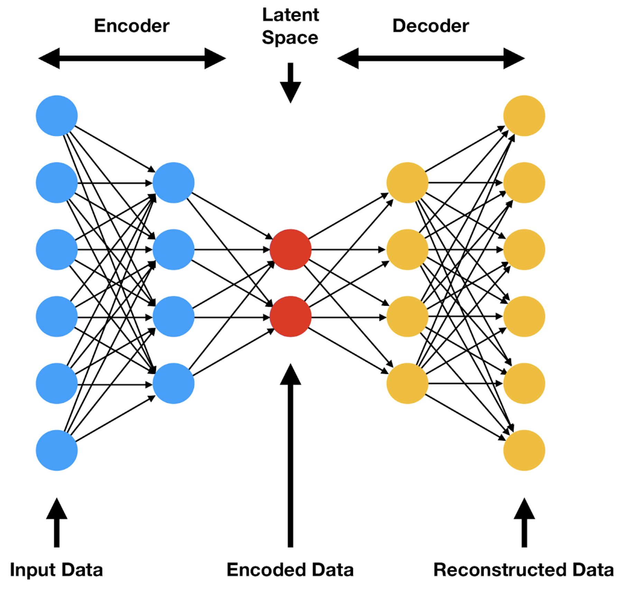
Related Work - Autoencoder
Understanding VQ-VAE (DALL-E Explained Pt. 1)). Charlie Snell

Slide 9
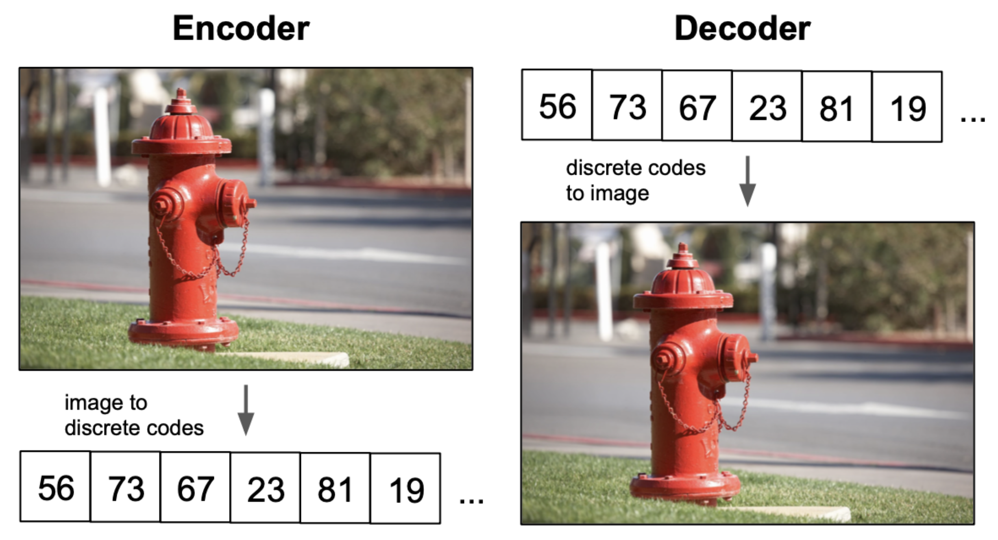
Related Work - Autoencoder
Understanding VQ-VAE (DALL-E Explained Pt. 1)). Charlie Snell

Slide 10
Related Work - Autoencoder problem
Continuous latent space, but…

Slide 11
Related Work - Variational Autoencoder
Consider our latent space z as a random variable
First let’s enforce a prior $p(z)$ on our latents, in most VAEs this is typically just a standard gaussian distribution $𝒩(0, 1)$
Given a raw datapoint x, we also define a posterior for the latent space as $p(z∣x)$
The goal is to compute this posterior for the data, which we can express using Bayes’ rule as
But… $p(x)$ is intractable
Need approximation
Understanding VQ-VAE (DALL-E Explained Pt. 1)). Charlie Snell

Slide 12
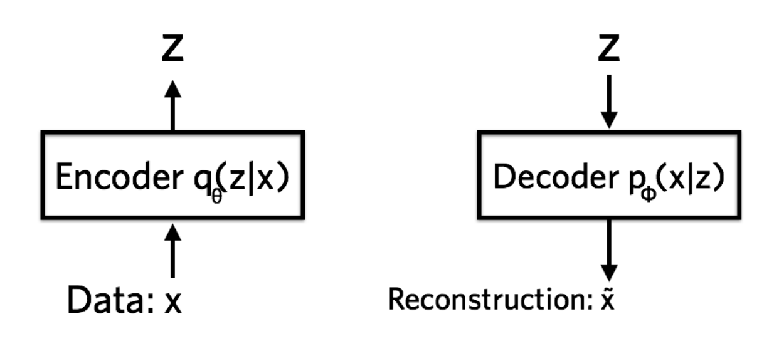
Related Work - Variational Autoencoder
Restrict approximation of the posterior to a specific family of distributions: independent gaussians. Call this approximated distribution q(z∣x)
VAE: Add a prior to the autoencoder latent space: Approximate $p(z)$ with $q(z|x)$
Derive loss function:
ELBO: See course on Probabilistic and Differential Programming
Understanding VQ-VAE (DALL-E Explained Pt. 1)). Charlie Snell

Slide 13
Variational Autoencoder as a Generator

Slide 14
Related Work - Autoencoder vs. VAE

Slide 15
Variational Autoencoder as a Generator

Slide 16
Variational Autoencoder as a Generator

Slide 17
Related Work - VQ-VAE
Want discrete latent space?
Vector Quantized VAE

Slide 18
DALL-E – Central Idea

Slide 19
Model
Transformer to model text and image tokens as single stream of data
Pixels as image tokens takes up too much memory
Likelihood objectives prioritize short range dependencies between pixels
Solution: 2 stage training!
1.
2.

Slide 20
Stage One: Learning the Visual Codebook
Discrete Variational Autoencoder (dVAE)
Similar to VQ-VAE (in VQ-GAN) but uses distribution instead of nearest neighbor

Slide 21
Stage One: Learning the Visual Codebook
Discrete Variational Autoencoder (dVAE) encoder
Latent vector 1’s distribution
Latent vector 2’s distribution

Slide 22
Stage One: Learning the Visual Codebook
Discrete Variational Autoencoder (dVAE) decoder
Gumbel softmax distribution becomes categorical over training schedule

Slide 23
Stage One: Learning the Visual Codebook
Discrete Variational Autoencoder (dVAE) encoder
Issue: Can’t differentiate backprop through category distribution of the bottleneck
Solution: Relax the bottleneck to include vectors from convex hull of set of codebook vectors

Slide 24
Stage One: Learning the Visual Codebook
Gumbel Softmax Relaxation
Sample: z = codebook[argmax_{i}[g_{i} + log(q(e_{i}|x))
Gives weights y_{i}
Sampled latent vector is the sum of the weighted codebook vectors
Differentiable
Relaxation temperature annealing schedule for hyperparameter 𝛕

Slide 25
Stage Two: Learning Prior Distribution
Transformer
Predict distribution for next token
Sample distribution and repeat until 1024 image tokens

Slide 26
Google’s Approaches
Pegasus (Google, LLM, text summarization)
https://ai.googleblog.com/2020/06/pegasus-state-of-art-model-for.html
Flamingo (Google’s GPT-3 and CLIP)
https://www.deepmind.com/blog/tackling-multiple-tasks-with-a-single-visual-language-model
Imagen (Google’s DALL-E)
https://imagen.research.google
Bard (Google’s answer to ChatGPT, soon)
https://blog.google/technology/ai/bard-google-ai-search-updates/

Slide 27
Meta’s Approaches
OPT (Meta, LLM)
https://ai.facebook.com/blog/democratizing-access-to-large-scale-language-models-with-opt-175b/
Galactica (Meta, LLM chatbot for science)
https://galactica.org/

