Slide 1
Intelligent Agents
Perception: Language and Vision
Prof. Dr. Ralf Möller
Universität zu Lübeck
Institut für Informationssysteme

Slide 2
Perception: Agenda (subject to adaptations)
Perception in intelligent systems for information retrieval (web-mining agent(s))
(Written) Language
  Probabilistic dimension reduction, latent content descriptions, topic models, LDA, LDA-HMM
  Representation learning for sequential structures, embedding spaces, word2vec, CBOW, skip-gram, hierarchical softmax, negative sampling
  Language models (1d-CNNs. RNNs, LSTMs, ELMo, Transformers, BERT,
  GPT-4/PaLM 2), Natural language inference and query answering
  Retrieval, annotation, summarization services (tl;dr)
Vision (2D-CNNs, Deep Architectures: AlexNet, ResNet)
Combining language and vision
  CLIP (OpenAI) / LIT (Google) / data2vec (Facebook) / Flamingo (DeepMind), DALL-E and beyond
Data structure interpretation
  Knowledge graph embedding with GNNs, combining embedding-based KG completion with probabilistic graphical models (ExpressGNN, pLogicNet), MLN inference and learning based on embedded knowledge graphs, GMNNs)

Slide 3
Acknowledgements
Next 8 slides taken from:
  Synthesizing Explainable and Deceptive Behavior for Human-AI Interaction
  Subbarao Kambhampati
  http://bit.ly/3bno2io

Slide 4
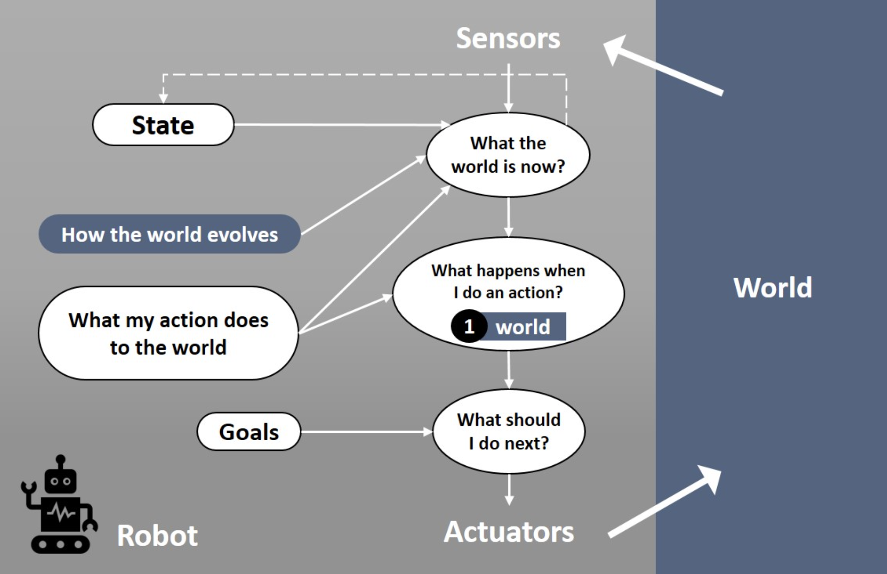
Agents
Challenges of Human-Aware AI Systems: Subbarao Kambhampati

Slide 5
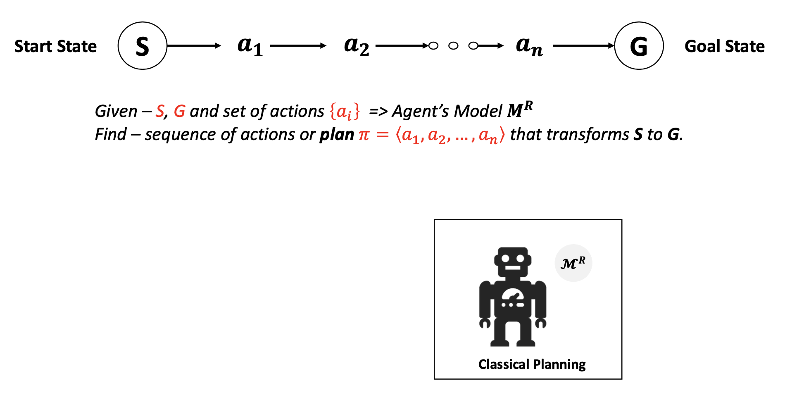
Classical planning
Challenges of Human-Aware AI Systems: Subbarao Kambhampati

Slide 6
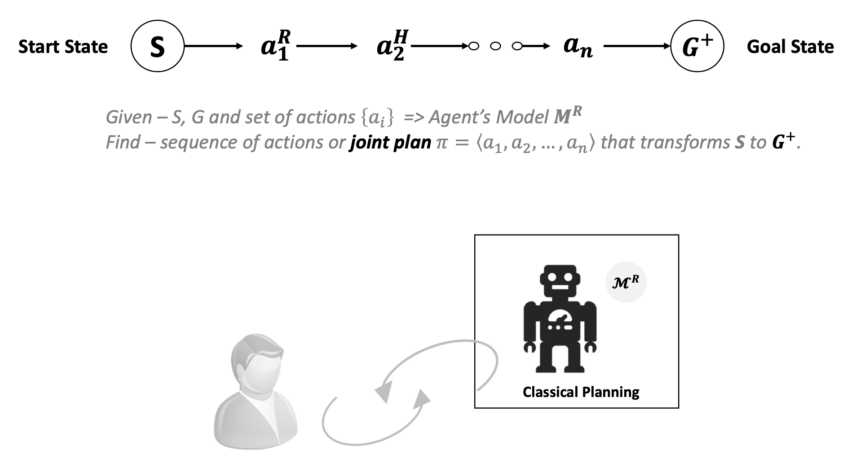
Joint planning
Challenges of Human-Aware AI Systems: Subbarao Kambhampati

Slide 7
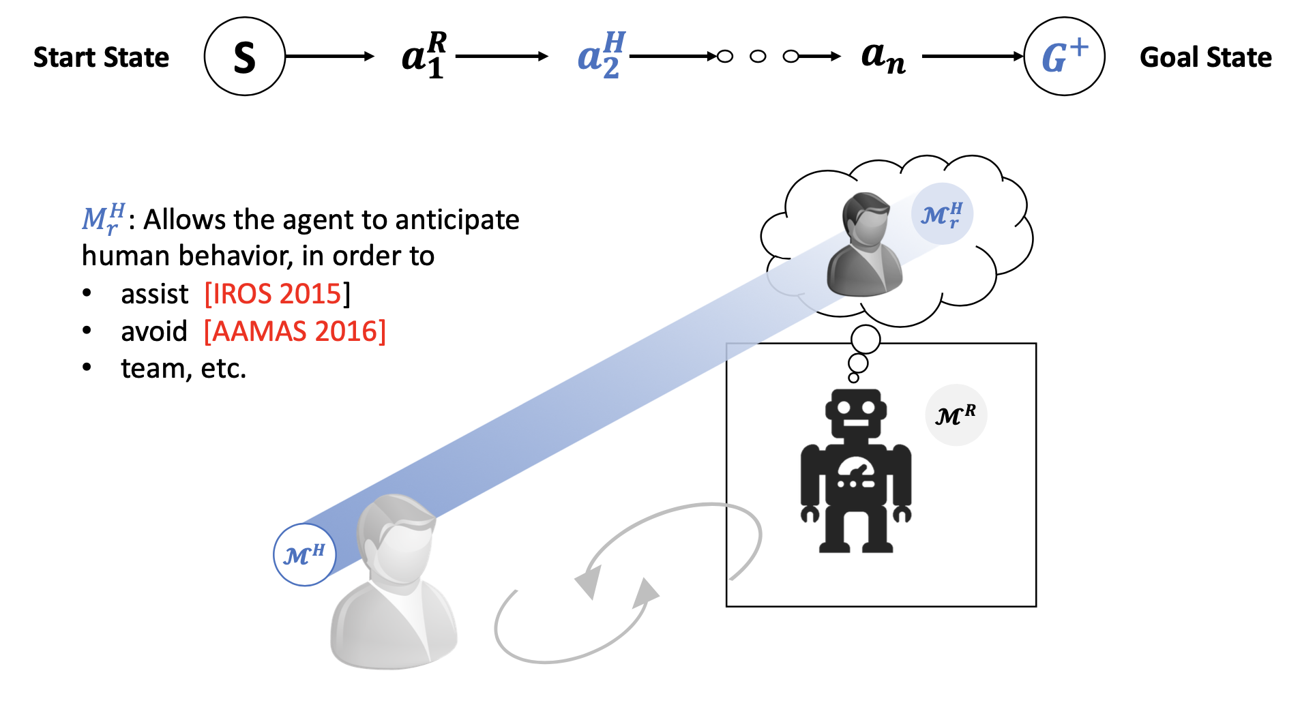
Agent model for human behavior anticipation
~
~
Challenges of Human-Aware AI Systems: Subbarao Kambhampati

Slide 8
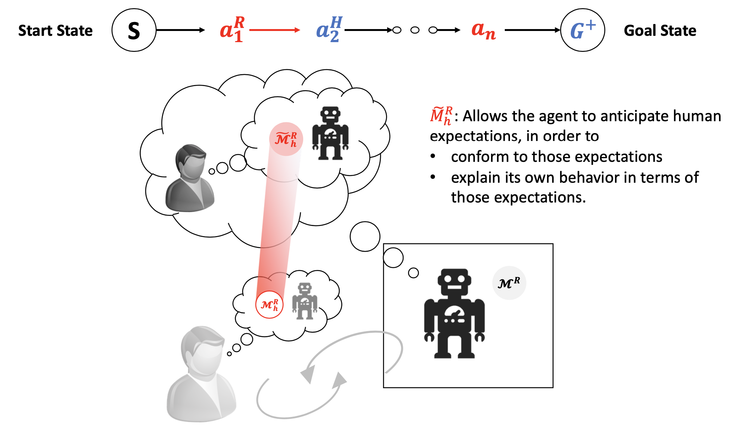
Agent model for human exceptation anticipation
Challenges of Human-Aware AI Systems: Subbarao Kambhampati

Slide 9
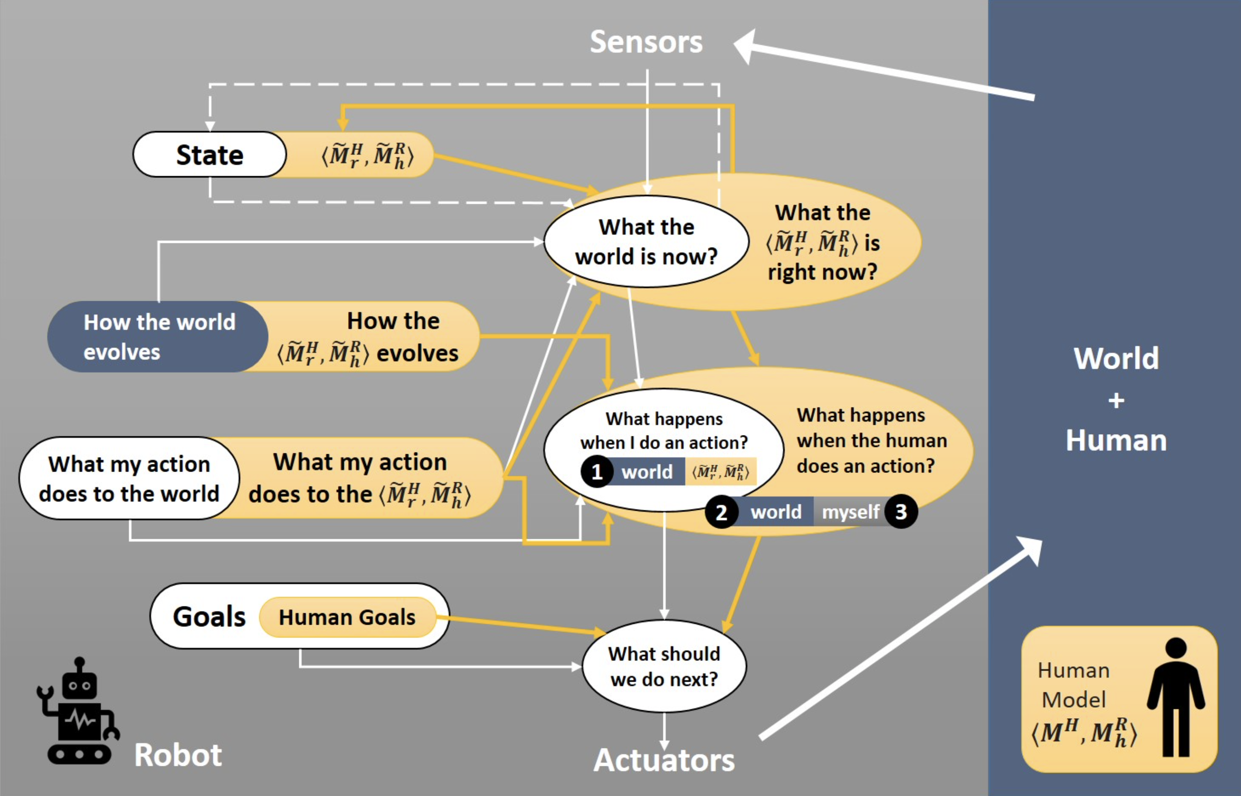
Human specifies goal: Solve a certain problem
“Mental models”
M^{R}
M^{H} human model of the problem to be solved
M^{R}_{h} is the human’s understanding of the robot’s M^{R}
M^{R} robot model of the problem to be solved
M^{H}_{r} is the robot’s understanding of M^{H} (anticipate human behavior)
M^{R}_{h} is the robot’s understanding of M^{R}_{h} (anticipate human’s expectations)
~
~
Challenges of Human-Aware AI Systems: Subbarao Kambhampati

Slide 10
What causes differences in mental models?
Expectations on capabilities / actions
  Human may have misconceptions about robot’s actions
  Certain actions in human’s mental model may not be feasible for the robot
Expected state of the world
  Human may assume certain facts are true in the world
  (even if they are not true)
Expected goals
  Human may have misconceptions about the robot’s goals/intentions
  Robot might need to diagnose this
Sensor model differences
  Human may have partial observability of the robot’s activities
  Human may have incorrect beliefs about robot’s observational capabilities
Challenges of Human-Aware AI Systems: Subbarao Kambhampati

Slide 11
Where do mental models come from?
In certain applications mental models are known beforehand
Learning simple models for generating explanations/explicability
  This will be covered later
Learning full models (transition functions, rewards)
  Through interaction with users

Slide 12


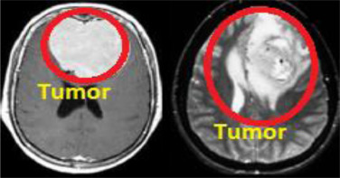




AI Hypothesis: Agent exhibits intelligent behavior
(agere: handeln)
Percepts
Feedback
G: “Goals”
M: Models
Behavior specification instead of
goal
Action
Explanation

Slide 13
Goal Specification
For specific problem classes M^{H}, goal specification languages must be developed to specify M^{R}
  If goal specifications cannot sensibly be provided by humans for a certain application domain,
  AI researchers do need to continue their work
We will consider …
  how information retrieval (IR) goals can be represented
  and communicated to a web-mining agent (IR agent)
  how uncertainty about IR goals can be reduced
  how reinforcement feedback can be
  collected by the IR agent

Slide 14
Recap: Document and query representation
Only represent occurrences of terms with incidence matrix?
Use word counts?
Use word frequencies?
What about terms that occur in certain documents but seldomly in the corpus?

Slide 15
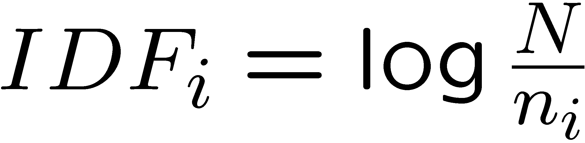
Recap: TF.IDF
Introduction to Web and Data Science
Non-standard Databases and Data Mining
f_{ij} = number of terms t_{i} in document d_{j}
n_{i} = Number of documents with term i
N = Total number of documents
TF.IDF measure
w_{ij} = TF_{ij} ⋅ IDF_{i}
TF_{ij} = f_{ij} / number of terms in d_{j}

Slide 16
Acknowledgements
Some slides taken from:
  Introduction to Information Retrieval
  Christopher Manning and Prabhakar Raghavan

Slide 17
How exact is the
representation of the document ?
How well is query
matched to data?
How exact is the
representation of the query ?
How relevant is the result
to the query ?
Query
representation
Query
Document Representation
TYPICAL IR
PROBLEM
Query
Answer
Document collection
17

Slide 18
Why probabilities in IR?
User
Information Need
Query
Representation
Understanding
of user need is
uncertain
How to match?
Document
Representation
Uncertain guess of
whether document has relevant content
Documents
In traditional IR systems, matching between each document and
query is attempted in a semantically imprecise space of index terms
Probabilities provide a principled foundation for uncertain reasoning
Can we use probabilities to quantify our uncertainties?

Slide 19
Probability Ranking Principle
Collection of Documents
User issues a query
A set of documents is found and needs to be returned
Question: In what order to present documents to user ?
Need a formal way to judge the
“goodness” of documents w.r.t. queries
Idea: Probability of relevance of the documents
w.r.t. query
Ben He, Probability Ranking Principle, Reference Work Entry, Encyclopedia of Database Systems, Ling Liu, Tamer, Öszu (Eds.),
2168-2169, Springer, 2009.

Slide 20
Probabilistic Approaches to IR
Probability Ranking Principle (Robertson, 70ies;
Maron, Kuhns, 1959)
IR as Probabilistic Inference
(van Rijsbergen & et al., since 70ies)
Probabilistic IR (Croft, Harper, 70ies)
Probabilistic Indexing (Fuhr & et al., late 80ies-90ies)
Robertson S.E. The probability ranking principle in IR.
J. Doc., 33:294–304, 1977.
M. E. Maron and J. L. Kuhns. On Relevance, Probabilistic Indexing and Information Retrieval. J. ACM 7, 3, 216-244, 1960.
van Rijsbergen C.J. Inform. Retr.. Butterworths, London,
2nd edn., 1979.
Croft W.B. and Harper D.J. Using probabilistic models of document retrieval without relevance information. J. Doc., 35:285–295, 1979.
Norbert Fuhr. 1989. Models for retrieval with probabilistic indexing. Inf. Process. Manage. 25, 1, 55-72, 1989.

Slide 21
Let us recap probability theory
Bayesian probability formulas
Odds:

Slide 22
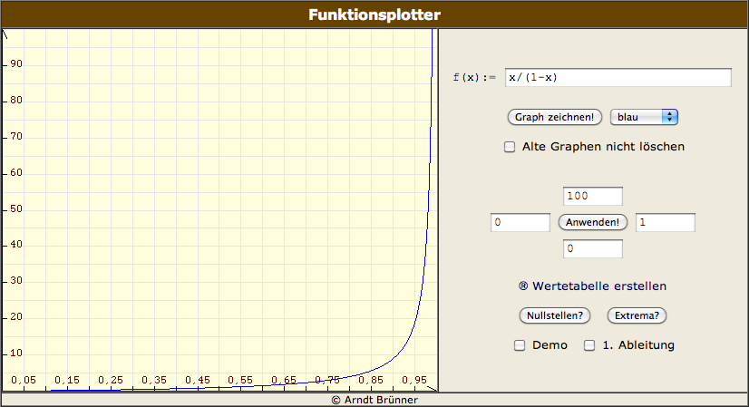
Odds vs. Probabilities

Slide 23
Probability Ranking Principle
Let x be a document in the retrieved collection.
Let R represent Relevance=true of a document w.r.t. given (fixed)
query and let NR represent Relevance=false.
Need to find p(R|x) - probability that a retrieved document x
is relevant.
p(R),p(NR) - prior probability
of retrieving a relevant or non-
relevant document, respectively
p(x|R), p(x|NR) - probability that if a relevant or non-relevant
document is retrieved, it is x.
van Rijsbergen, Cornelis Joost. Information Retrieval,
2nd edition. Butterworths, 1979
23

Slide 24
Probability Ranking Principle
Ranking Principle (Bayes’ Decision Rule):
If p(R|x) > p(NR|x) then x is relevant,
If p(R|x) ≤ p(NR|x) then x is not relevant
Note:
24

Slide 25
Probability Ranking Principle
Claim: PRP minimizes the average probability of error
If we decide NR
If we decide R
Expected overall error
p(error) is minimal when all p(error|x) are minimal
Bayes’ decision rule minimizes each p(error|x).
Ranking Principle (Bayes’ Decision Rule):
If p(R|x) > p(NR|x) then x is relevant,
If p(R|x) ≤ p(NR|x) then x is not relevant
25

Slide 26
Probability Ranking Principle
More complex case: retrieval costs
  C : cost of retrieval of relevant document
  C’ : cost of retrieval of non-relevant document
  d : a document
Documents d are ranked according to the
Probability Ranking Principle when it holds that :
If
for any other d’ not yet retrieved,
then
d is the next document to be retrieved

Slide 27
Intelligent Autonomous Systems
“Mental models”
Behavior spec
M^{R}
M^{H} human model of the problem to be solved
M^{R} robot model of the problem to be solved
M^{R}_{h} is the human’s understanding of the robot’s M^{R}
M^{H}_{r} is the robot’s understanding of M^{H} (anticipate human behavior)
M^{R}_{h} is the robot’s understanding of M^{R}_{h} (anticipate human’s expectations)
~
~
Challenges of Human-Aware AI Systems: Subbarao Kambhampati

Slide 28
Relevance models
Given: PRP to be applied
  “Relevance” of each document is independent
  of relevance of other documents
Need to estimate probability: P(R|q,d)
Binary Independence Retrieval (BIR):
  Many documents D - one query q
  Estimate P(R|q,d) by considering
  whether d ∈ D is relevant for q
Binary Independence Indexing (BII):
  One document d - many queries Q
  Estimate P(R|q,d) by considering whether a document d is relevant for a query q ∈ Q

Slide 29
Binary Independence Retrieval
“Binary” = Boolean: documents are represented as binary vectors of terms:
  iff term i is present in document x.
“Independence”: terms occur in documents independently
Different documents can be modeled as same vector.

Slide 30
Binary Independence Retrieval
Queries: binary vectors of terms
Given query q,
  for each document d need to compute
  p(Relevant=true|q,d)
  replace with computing p(Relevant=true|q,x)
  where x is vector representing d
Interested only in ranking
Will use odds (the higher, the better):

Slide 31
Binary Independence Retrieval
Constant for each query
Needs estimation
Using Independence Assumption:
So :
31

Slide 32
Binary Independence Retrieval
Since xi is either 0 or 1:
Let
Assume, for all terms not occurring in the query (qi=0)
Then...
32

Slide 33
Binary Independence Retrieval
All matching terms
Non-matching query terms (too many)
All matching terms
All query terms
33

Slide 34
Binary Independence Retrieval
Constant for
each query
Only quantity to be estimated
for rankings
Optimize Retrieval Status Value (RSV):
34

Slide 35
Binary Independence Retrieval
All boils down to computing RSV.
For all query terms i:
Find docs containing term i (→ inverted index)
Nonstandard Databases and Data Mining
So, how do we compute ci’s from our data ?
35

Slide 36
Binary Independence Retrieval
Estimating RSV coefficients: Groundtruth for subset of docs
  It is known wether docs are relevant or not
For each term i look at the following table:
Estimates:
36

Slide 37
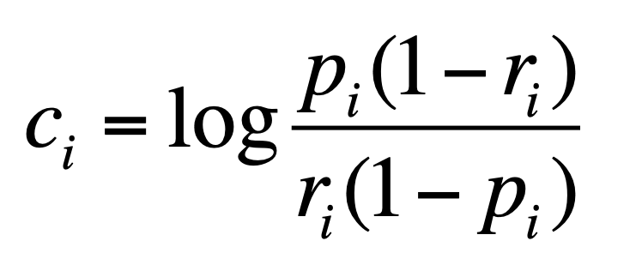
Binary Independence Retrieval
Estimating RSV coefficients.
For each term i look at the following table:
Estimates:
37

Slide 38
Avoid division by 0
38

Slide 39
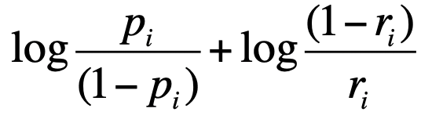
Estimation in practice
If non-relevant documents are approximated by the whole collection (S=s=0), then r_{i} (prob. of occurrence term i in non-relevant documents for query) is n/N and
  log (1– r_{i})/r_{i} = log (N – n)/n ≈ log(1+ (N –n)/n) = log N/n = IDF
Idea cannot be easily extended to p_{i}
Estimate p_{i} (probability of occurrence of term i in relevant docs):
  From relevant documents if we know some
  Use constant 0.5 – then just get idf weighting of terms
  (p_{i} and 1-p_{i} cancel out)
  …
We have a nice theoretical foundation of TF.IDF
(in the binary case: TF=1 or TF=0)
Karen Sparck Jones. A statistical interpretation of term specificity and its application in retrieval. In Document retrieval systems, Vol. 3. Taylor Graham Publishing, London, UK, UK 132-142. 1988.
Greiff, Warren R., A Theory of Term Weighting Based on Exploratory Data Analysis. In: Proceedings of the 21st Annual International ACM SIGIR Conference on Research and Development
in Information Retrieval, pp. 11-19, 1998.
Robertson S.E., Understanding inverse document frequency: On
theoretical arguments for idf. J. Doc., 60:503–520, 2004.

Slide 40
Iteratively estimating p_{i}
Nonstandard Databases and Data Mining
Expectation Maximization:
Assume that p_{i} constant over all q_{i} in query
  p_{i} = 0.5 (even odds) for any given doc
Determine guess of relevant document set from subset V:
  V is fixed size set of highest ranked documents on this model
We need to improve our guesses for p_{i} and r_{i}, so
  Use distribution of q_{i} in docs in V. Let V_{i} be set of documents containing q_{i}
    p_{i} = |V_{i}| / |V|
  Assume if not retrieved then not relevant
    r_{i} = (n_{i} – |V_{i}|) / (N – |V|)
Go to 2. until convergence then return ranking

Slide 41
Probabilistic Relevance Feedback
Guess a preliminary probabilistic description of R and use it to retrieve a first set of documents V, as above.
Interact with the user to refine the description: learn some definite members of R and NR
Reestimate p_{i} and r_{i} on the basis of these
  Or can combine new information with original guess (use Bayesian prior):
Repeat, thus generating a
succession of approximations
to R.
𝜆 is
prior
weight
Notes:
explicit Bayesian smoothing with a prior

Slide 42
Binary Independence Indexing
“Learning” from queries
  More queries: better results
p(q|x,R) - probability that if document x had been deemed relevant, query q had been asked
The rest of the framework is similar to BIR

Slide 43
Recap
Agents have goals
  Example: provide a good IR service
Goals reflected as utilities
  If IR is good, agent’s utility is maximized
Our goal: Understand IR principles
  Mathematical foundations of IR (e.g., PRP)
  IR quality measures
  …
These insights motivate the content of the course

Slide 44
Binary Independence Retrieval vs.
Binary Independence Indexing
BIR
BII
Many Documents,
One Query
Bayesian Probability:
Varies: document representation
Constant: query (representation)
One Document,
Many Queries
Bayesian Probability
Varies: query
Constant: document
44

Slide 45
PRP and BIR/BII: The lessons
Getting reasonable approximations of probabilities is possible.
Simple methods work only with restrictive assumptions:
  term independence
  terms not in query do not affect the outcome
  boolean representation of documents/queries
  document relevance values are independent
Some of these assumptions can be removed

Slide 46
Summary: Probabilistic Information Retrieval
PRP defines a well-defined framework for IR
  Can understand pragmatic approaches (e.g., TF.IDF)
  Can be used for formalizing IR (What is the IR problem?)
  Provides for means to compute ranking of results
Agents can use different models
and different QA strategies for IR
We will see soon:
  Agents can update internal models by
  reinforcement feedback
  Agents can adapt strategies to new user queries
  (new goals to be expected)

Slide 47
Recap: Agent architecture M^{R} = IR(Q)
Action:
Return retrieved docs
Waiting for feedback
(possibly with
follow-up queries)
Retrieved docs
to be evaluated
by human
M^{R}
Challenges of Human-Aware AI Systems: Subbarao Kambhampati

Slide 48
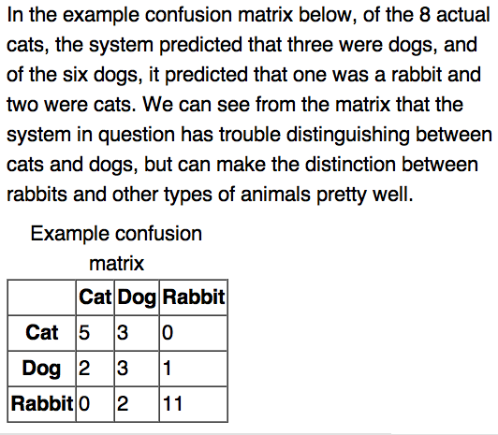
Confusion Matrix (e.g., for Classification)
Understanding where an agent has deficiencies
(Direct) feedback:
Present confusion matrix to an agent
Reinforcement:
Relevance feedback for retrieval results
(agent might build confusion matrix internally)
48

Slide 49
Unranked retrieval evaluation: Precision and Recall
retrieved & irrelevant
Not retrieved & irrelevant
Entire document collection
irrelevant
Relevant documents
Retrieved documents
retrieved & relevant
not retrieved but relevant
relevant
retrieved
not retrieved

Slide 50
Unranked retrieval evaluation: Precision and Recall
Precision: fraction of retrieved docs that are relevant = P(retr & rel | retrieved)
Recall: fraction of relevant docs that are retrieved = P(retr & rel | relevant in repos)
Precision = tp/(tp + fp)
Recall = tp/(tp + fn)
 | Relevant | Not Relevant
Retrieved | true positives (tp) | false positives (fp)
Not Retrieved | false negatives (fn) | true negatives (tn)
Difficult to optimize
both indicators at the
same time
Minimize fp
(can be achieved by returning 0 docs)
Minimize fn
(if 0 docs returned, fn is maximized)
50

Slide 51
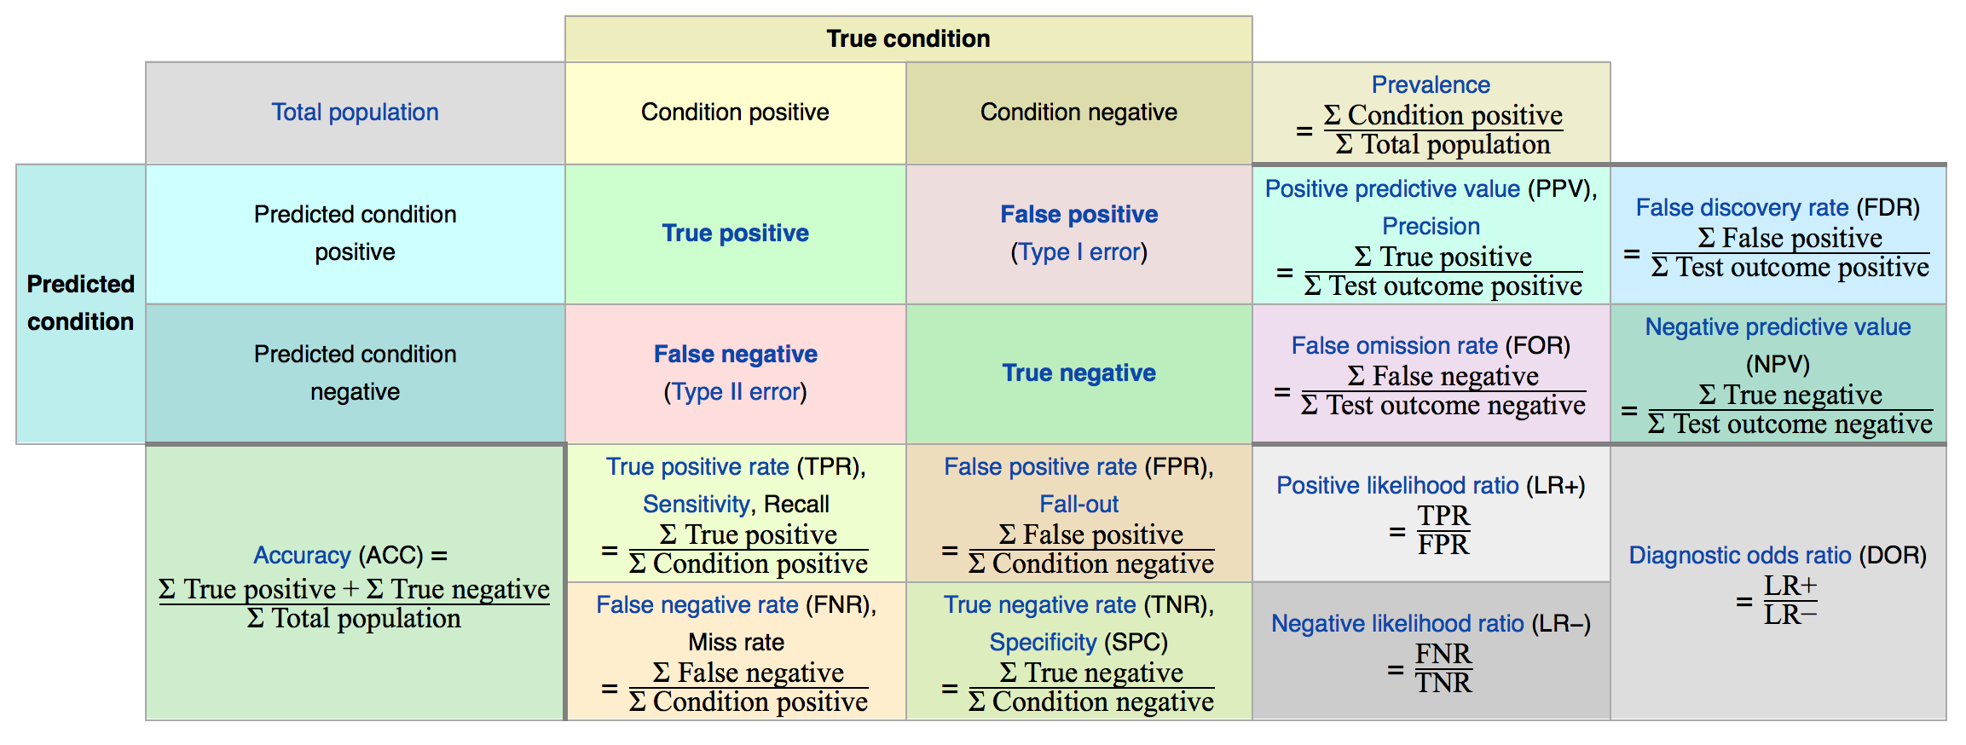
Overview on evaluation measures
[Wikipedia]
https://en.wikipedia.org/wiki/Evaluation_measures_(information_retrieval)#Mean_average_precision

Slide 52
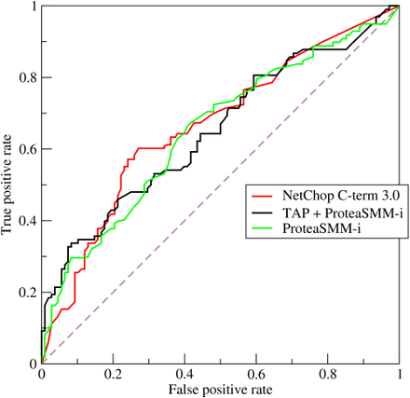
Relative operating characteristic (ROC)
What if goal specification involves control parameters?
E.g., for strategies
Investigate effects of
parameter adjustments
Compare TP rate (recall)
and FP rate (fall-out)
Example w/ three
strategies
Measure:
Area under curve (AUC)
curve = ROC
Strategy 1
Strategy 2
Strategy 3
Wikipedia

Slide 53
Back to Precision and Recall
Determining Recall can be difficult
Total number of relevant items is sometimes not available – use pooling
  Sample across the database and perform relevance judgment on these items
  Apply different retrieval algorithms to the same database for the same query. The aggregate of relevant items is taken as the total relevant set
First instruct agent to do IR on known corpus (train agent to use best QA strategy)
Then send it out.
Information Retrieval and Web Search, IR Evaluation and IR Standard Text Collections, Rada Mihalcea

Slide 54
Standard Methodology for Measuring Relevance in IR
To measure relevance effectiveness of ad-hoc IR,
we need:
  A document collection
  A suite of information needs, expressible as queries
    Must be representative of actual user needs
    Sample from query logs, if available
  Binary assessments of either Relevant or Nonrelevant for each query and each document
    Can be more nuanced, e.g., 0, 1, 2, 3, …
    Use pooling, when it is unfeasible to assess every (q, d) pair
Information Retrieval and Web Search, IR Evaluation and IR Standard Text Collections, Rada Mihalcea

Slide 55
The TREC Benchmark
TREC: Text REtrieval Conference (http://trec.nist.gov/)
  Became an annual conference in 1992, co-sponsored by the National Institute of Standards and Technology (NIST) and DARPA.
  Participants are given parts of a standard set of documents and TOPICS (from which queries have to be derived) in different stages for training and testing.
  Participants submit the P/R values for the final document and query corpus and present their results at the conference.
Information Retrieval and Web Search, IR Evaluation and IR Standard Text Collections, Rada Mihalcea

Slide 56
Trade-off between Recall and Precision
Returns relevant documents but
misses many useful ones too
The ideal
1
Precision
0
1
Recall
Returns most relevant
documents but also
includes lots of
Irrelevant documents
Precision and Recall are inverse proportional
Information Retrieval and Web Search, IR Evaluation and IR Standard Text Collections, Rada Mihalcea

Slide 57
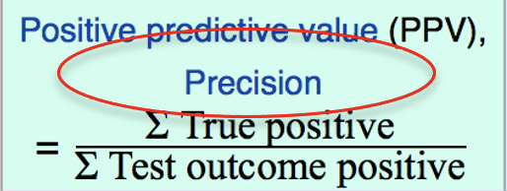
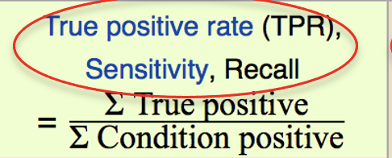
F-measure
Introduction to Web and Data Science
One measure of performance that takes into account both recall and precision
Precision (P) and Recall (R) are rates
Harmonic mean of recall and precision:
In contrast to arithmetic mean,
both need to be high for harmonic mean to be high
Information Retrieval and Web Search, IR Evaluation and IR Standard Text Collections, Rada Mihalcea

Slide 58
Ranked Retrieval Measures
Binary relevance:
  11-point Interpolated Precision-Recall Curve
  R-precision
  Precision@K (P@K) and Recall@K (R@K)
  Mean Average Precision (MAP)
Information Retrieval and Web Search, IR Evaluation and IR Standard Text Collections, Rada Mihalcea

Slide 59
Recall-Precision Curves: An Example
Let total # of relevant docs = 6
Check each new recall point:
R=1/6=0.167; P=1/1=1
R=2/6=0.333; P=2/2=1
R=3/6=0.5; P=3/4=0.75
R=4/6=0.667; P=4/6=0.667
Missing one
relevant document:
Never reach
100% recall
R=5/6=0.833; p=5/13=0.38
Information Retrieval and Web Search, IR Evaluation and IR Standard Text Collections, Rada Mihalcea

Slide 60
Interpolating a Recall/Precision Curve
Interpolate a precision value for each standard recall level:
  r_{j} ∈{0.0, 0.1, 0.2, 0.3, 0.4, 0.5, 0.6, 0.7, 0.8, 0.9, 1.0}
  r₀ = 0.0, r₁ = 0.1, …, r₁₀=1.0
The interpolated precision at the j-th standard recall level is the maximum known precision at any recall level between the j-th and (j + 1)-th level:
Information Retrieval and Web Search, IR Evaluation and IR Standard Text Collections, Rada Mihalcea

Slide 61
Interpolating a Recall/Precision Curve: An Example
Precision
1.0
0.8
0.6
0.4
0.2
0.2
0.4
0.6
0.8
1.0
Recall
Information Retrieval and Web Search, IR Evaluation and IR Standard Text Collections, Rada Mihalcea

Slide 62
Average Recall/Precision Curve
Typically average performance over a large set of queries.
Compute average precision at each standard recall level across all queries.
Plot average precision/recall curves to evaluate overall system performance on a document/query corpus.
Average:
  Micro-average: compute P/R/F
  once for the entire set of queries
  Macro-average: average of within-query precision/recall
Information Retrieval and Web Search, IR Evaluation and IR Standard Text Collections, Rada Mihalcea

Slide 63
How To Compare Two or More Systems
The curve closest to the upper right-hand corner of the graph indicates the best performance
Information Retrieval and Web Search, IR Evaluation and IR Standard Text Collections, Rada Mihalcea

Slide 64
R-precision
Precision at the R-th position in the ranking of results for a query that has R relevant documents.
R = # of relevant docs = 6
R-Precision = 4/6 = 0.67
Information Retrieval and Web Search, IR Evaluation and IR Standard Text Collections, Rada Mihalcea

Slide 65

Precision@K
Set a rank threshold K.
Compute % of documents relevant in top K.
  Ignores documents ranked lower than K.
Example:
  Prec@3 of 2/3
  Prec@4 of 2/4
  Prec@5 of 3/5
In a similar way we have Recall@K
Information Retrieval and Web Search, IR Evaluation and IR Standard Text Collections, Rada Mihalcea

Slide 66

Mean Average Precision (MAP)
Consider rank position of each of the R relevant docs:
  K₁, K₂, … K_{R}
Compute Precision@K for each K₁, K₂, … K_{R}.
Average precision = average of P@K.
Example: has AvgPrec of
MAP is Average Precision across multiple queries.
Information Retrieval and Web Search, IR Evaluation and IR Standard Text Collections, Rada Mihalcea

Slide 67
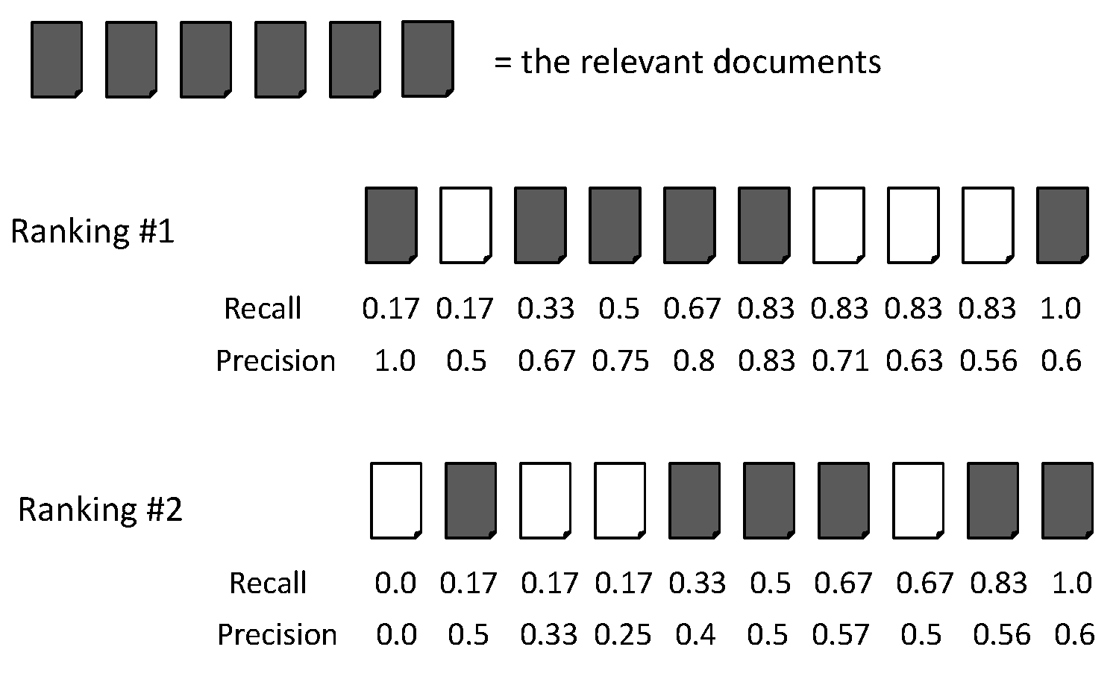
Average Precision for Comparing Rankings
Ranking #1 = (1.0+0.67+0.75+0.8+0.83+0.6) /6 = 0.78
Ranking #2 = (0.5+0.4+0.5+0.57+0.56+0.6) /6 = 0.5
Information Retrieval and Web Search, IR Evaluation and IR Standard Text Collections, Rada Mihalcea

Slide 68
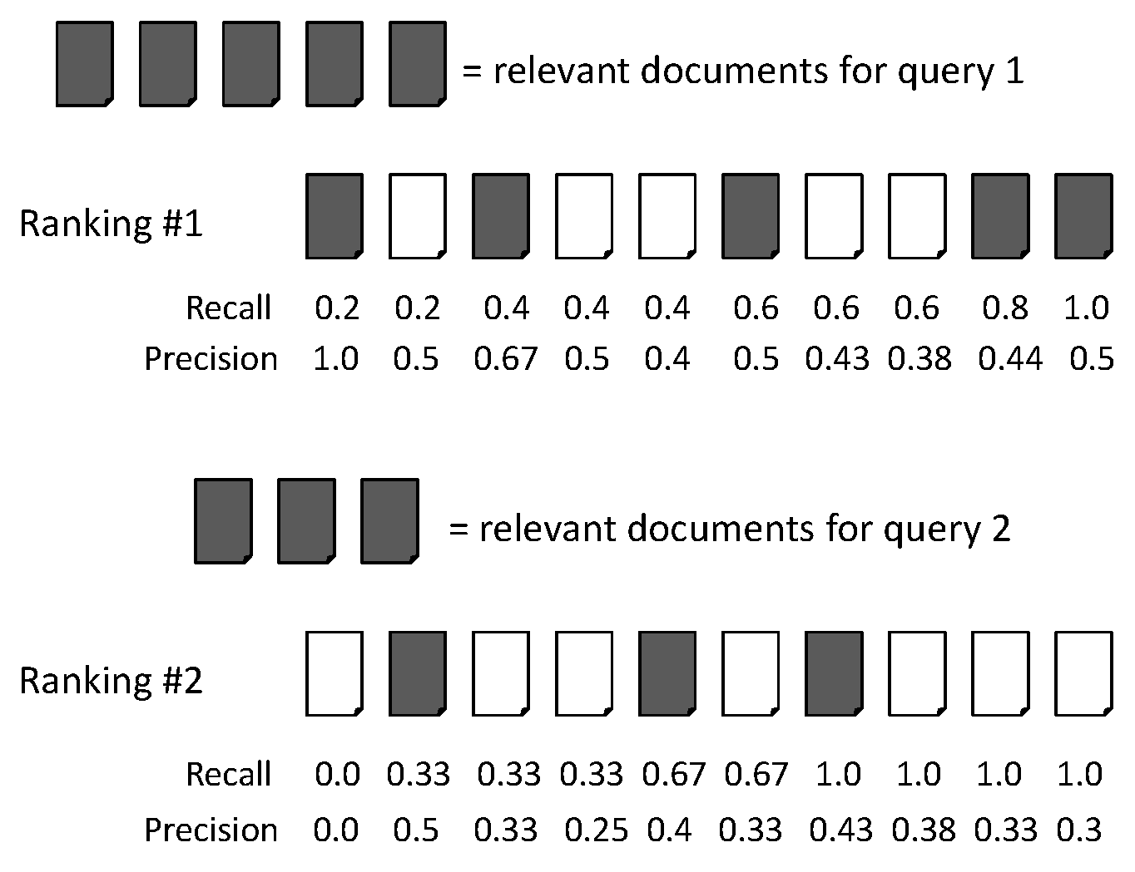
Mean Average Precision (MAP)
Average precision query 1 = (1.0+0.67+0.5+0.44+0.5)/5 = 0.62
Average precision query 2 = (0.5+0.4+0.43)/3 = 0.44
MAP = (0.62 + 0.44)/2 = 0.53
Information Retrieval and Web Search, IR Evaluation and IR Standard Text Collections, Rada Mihalcea

Slide 69
Mean Average Precision (MAP)
If a relevant document never gets retrieved, we assume the precision corresponding to that relevant document to be zero.
MAP is macro-averaging: each query counts equally.
A commonly used measure in current IR research,
along with P/R/F
Information Retrieval and Web Search, IR Evaluation and IR Standard Text Collections, Rada Mihalcea

Slide 70
Collaboration: Measure for inter-judge (dis)agreement
Kappa measure
  (Dis)Agreement measure among judges
  Designed for categorical judgments
  Corrects for chance agreement
𝜅 = [ P(A) – P(E) ] / [ 1 – P(E) ]
P(A) – proportion of time judges agree (observed)
P(E) – what agreement would be by chance (hypothetical)
𝜅 = 0 for chance agreement, 1 for total agreement
In statistics many other measures are defined
Cohen, Jacob, "A coefficient of agreement for nominal scales". Educational and Psychological Measurement 20 (1): 37–46, 1960
70
Notes:
70

Slide 71
Kappa Measure: Example
P(A)? P(E)?
Number of docs | Judge 1 | Judge 2
300 | Relevant | Relevant
70 | Nonrelevant | Nonrelevant
20 | Relevant | Nonrelevant
10 | Nonrelevant | Relevant
71
Notes:
71

Slide 72
Kappa Example
P(A) = 370/400 = 0.925
P(nonrelevant) = (10+20+70+70)/800 = 0.2125
P(relevant) = (10+20+300+300)/800 = 0.7878
P(E) = 0.2125² + 0.7878² = 0.665
𝜅 = (0.925 – 0.665)/(1-0.665) = 0.776
𝜅 > 0.8 = good agreement
0.67 < 𝜅 < 0.8 -> “tentative conclusions”
Depends on purpose of study
For >2 judges: average pairwise 𝜅s
Carletta, J. C., Assessing agreement on classification tasks:
The kappa statistic. Computational Linguistics, 22(2), 249-254, 1996
72
Notes:
72

Slide 73
Relevance Feedback: Rocchio Algorithm
The Rocchio algorithm incorporates relevance feedback information into the vector space model.
Want to maximize |sim(Q, C_{r}) - sim(Q, C_{nr})| where C_{r} and C_{nr} denote relevant and non-relevant doc vectors, respectively
The optimal query vector for separating relevant and non-relevant documents (with cosine sim.):
Q_{opt} = optimal query; C_{r} = set of rel. doc vectors in corpus; N = collection size
Unrealistic definition:
We don’t know relevant documents in corpus
73
Notes:
73
Q = query, Cr = relevant documents Cnr = not relevant documents

Slide 74
The Theoretically Best Query
x
x
x
x
o
x
x
x
x
x
x
x
x
o
x
o
x
o
x
x
Δ
o
o
x
x
x non-relevant documents
o relevant documents
Optimal query
74

Slide 75
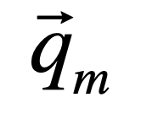
Rocchio 1971 Algorithm (SMART System)
Useful in practice:
q_{m} = modified query vector; q₀ = original query vector; α,β,γ: weights (hand-chosen or set empirically); D_{r} = set of known relevant doc vectors; D_{nr} = set of known irrelevant doc vectors
New query moves toward relevant documents and away from irrelevant documents
Tradeoff α vs. β/γ : If we have a lot of judged documents, we want a higher β/γ.
Term weights ( elements) can go negative
  Negative term weights are ignored (set to 0)
Wikipedia: Gerard Salton, The SMART (System for the Mechanical Analysis and Retrieval of Text or Salton’s Magic Automatic Retriever of Text) Information Retrieval System is an information retrieval system, developed at Cornell University in the 1960s. Many important concepts in information retrieval were developed as part of research on the SMART system, including the vector space model, relevance feedback, and Rocchio algorithm.
Salton, G. (Ed.). The SMART retrieval system: Experiments in automatic document processing. Englewood Cliffs, NJ: Prentice-Hall. 1971.
75
Notes:
75
SMART: Cornell (Salton) IR system of 1970s to 1990s.

Slide 76
Relevance feedback on initial query
Initial query
x
x
x
o
x
x
x
x
Δ
x
x
x
o
x
o
x
Δ
x
o
x
o
o
x
x
x
x
Revised query
x known non-relevant documents
o known relevant documents
76
Notes:
Salton, G. (1968). Automatic information organization and retrieval. New York: McGraw-Hill Book Company.
Salton, G. (Ed.). (1971). The SMART retrieval system: Experiments in automatic document processing. Englewood Cliffs, NJ: Prentice-Hall.

Slide 77
Positive vs Negative Feedback
Positive feedback is more valuable than negative feedback (so, set 𝛾 < 𝛽;
e.g. 𝛾 = 0.25, 𝛽 = 0.75).
Why?
  Many systems only allow positive feedback (𝛾=0).
77
Notes:
77
It’s harder for user to give negative feedback (absence of evidence is not evidence of absence). It’s also harder to use since relevant documents can often form tight cluster, but non-relevant documents rarely do. Usually there are very many non-relevant documents (and rather few relevant ones). Thus, non-relevant ones give less specific information due to a larger prior.

Slide 78
Relevance feedback in vector spaces
We can modify the query based on relevance feedback and apply standard vector space model.
Use only the docs that were marked.
Relevance feedback can
improve recall and precision
Any idea for relevance feedback in probabilistic IR?
78
Notes:
78
Just as we modified the query in the vector space model, we can also modify it here. I’m not aware of work that uses language model based Ir this way.

Slide 79
What about Learning to Rank?
Embedding data into vector spaces is a very old idea
Why not using machine learning to find classifiers?
  Traditional ranking functions in IR used a very small number of features, e.g.,
    Term frequency
    Inverse document frequency
    …
  Easy to tune weighting coefficients by hand
More and more features can be defined
Introduction to Information Retrieval, Sec. 15.4.

Slide 80
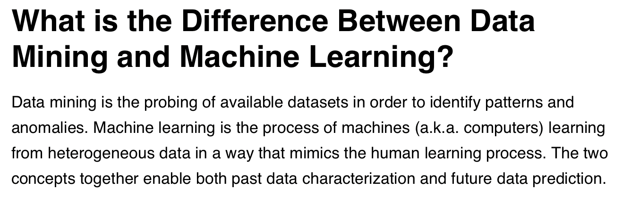
Difference between Data Mining and ML?
https://www.discoverdatascience.org/articles/data-mining-vs-machine-learning/
Well, current ML does not even attempt to show that learning processes are cognitively plausible
In principle, there is no difference between data mining and ML.
Data mining deals with secondary memory
(more interesting)

Slide 81
Why is machine learning needed now?
Modern systems – especially on the Web – use a huge number of features:
  Log frequency of query word in anchor text?
  Query word in color on page?
  # of images on page?
  # of (out) links on page?
  PageRank of page? (-> for PageRank, see course EWDS)
  URL length?
  URL contains “~”?
  Page edit recency?
  Page length?
New York Times (2008-06-03):
  Google was using over 200 such features
  [in a quotation of a previous Google representative]
Introduction to Information Retrieval, Sec. 15.4.

Slide 82
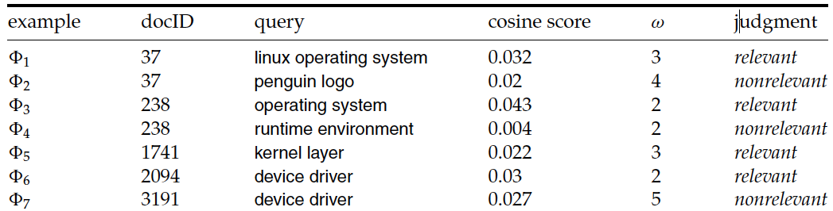







Using classification for ad hoc IR
Sec. 15.4.1
Collect a training corpus of (q, d, r) triples
  Relevance r is here binary (but may be multiclass, with 3–7 values)
  Document is represented by a feature vector
    x = (α, ω) α is cosine similarity,
    ω is minimum query window size
      ω is the the shortest text span that includes all query words
      Query term proximity is a very important new weighting factor
  Train a machine learning model to predict the class r of a document-query pair
$ψ_{1}$
$ψ_{2}$
$ψ_{3}$
$ψ_{4}$
$ψ_{5}$
$ψ_{6}$
$ψ_{7}$

Slide 83
Using classification for ad hoc IR
Sec. 15.4.1
0.05
Decision surface
R
cosine score α
R
N
R
R
R
R
R
N
N
0.025
R
R
R
R
N
N
N
N
N
N
N
0
2
3
4
5
Term proximity ω
Introduction to Information Retrieval, Sec. 15.4.

Slide 84
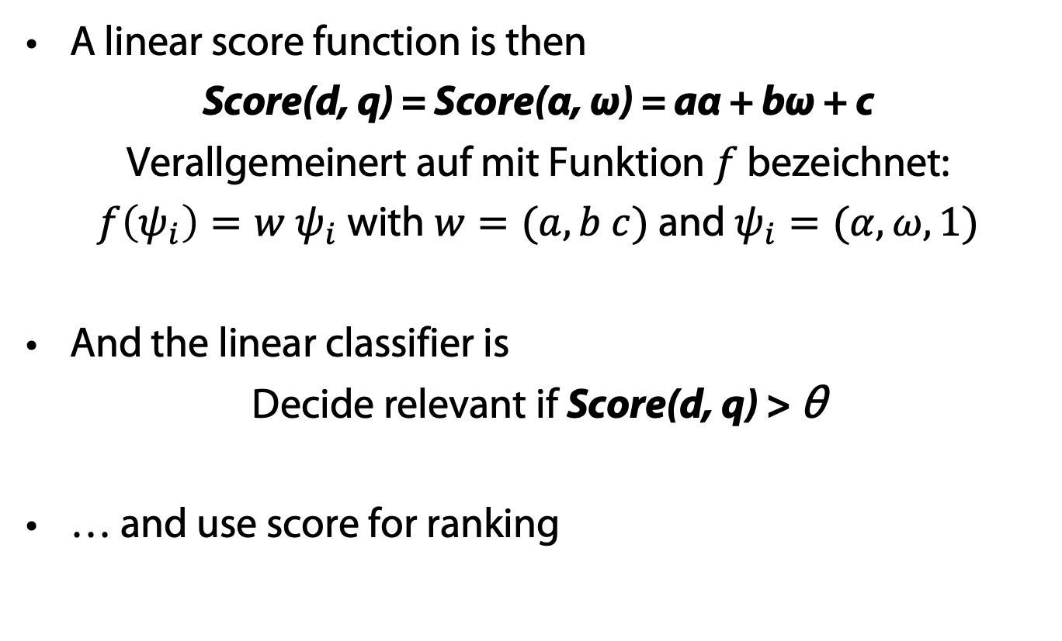
Scoring for ad hoc IR
Sec. 15.4.1
A linear score function is then
Score(d, q) = Score(α, ω) = aα + bω + c
Verallgemeinert auf mit Funktion $f$ bezeichnet:
$f\left(ψ_{i}\right)=w$ $ψ_{i}$ with $w=(a, b c)$ and $ψ_{i}=(α, ω, 1)$
And the linear classifier is
Decide relevant if Score(d, q) > θ
… and use score for ranking
Is this a machine learning or a data mining approach?
Introduction to Information Retrieval, Sec. 15.4.

Slide 85
Support Vector Machines (SVMs → EWDS)
Mapping instances of two classes into a space, in which they are linearly separable
  Mapping function is called kernel function
Computing of separation surface defined via
optimization problem
Formulation as a problem, not as a procedure!
V. Vapnik, A. Chervonenkis, A note on one class of perceptrons. Automation and Remote Control, 25, 1964
Boser, B. E.; Guyon, I. M.; Vapnik, V. N., A training algorithm for optimal margin classifiers. Proceedings of the fifth annual workshop on Computational learning theory – COLT '92. p. 144, 1992
Vapnik, V., Support-vector networks,
Machine Learning. 20 (3): 273–297, 1995

Slide 86
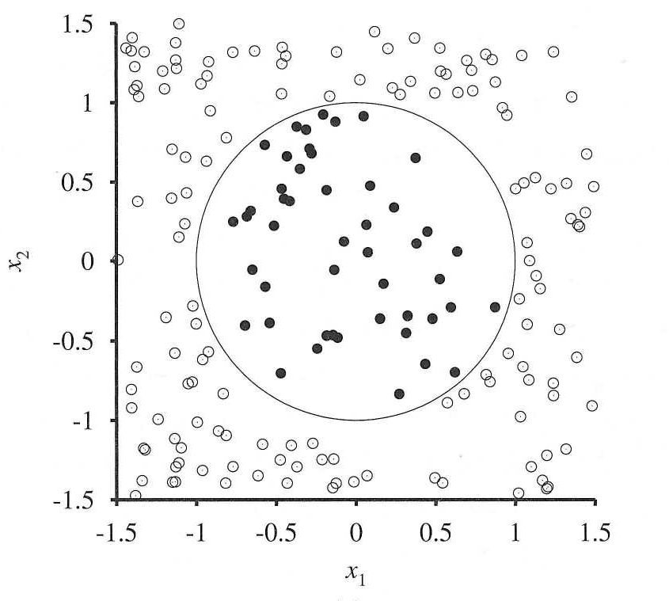
Nonlinear Separation
y = -1
y = +1

Slide 87
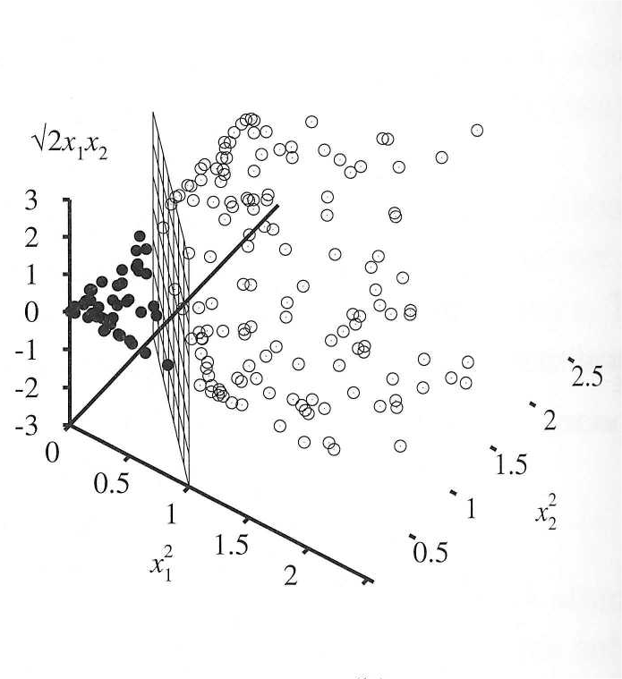

Slide 88
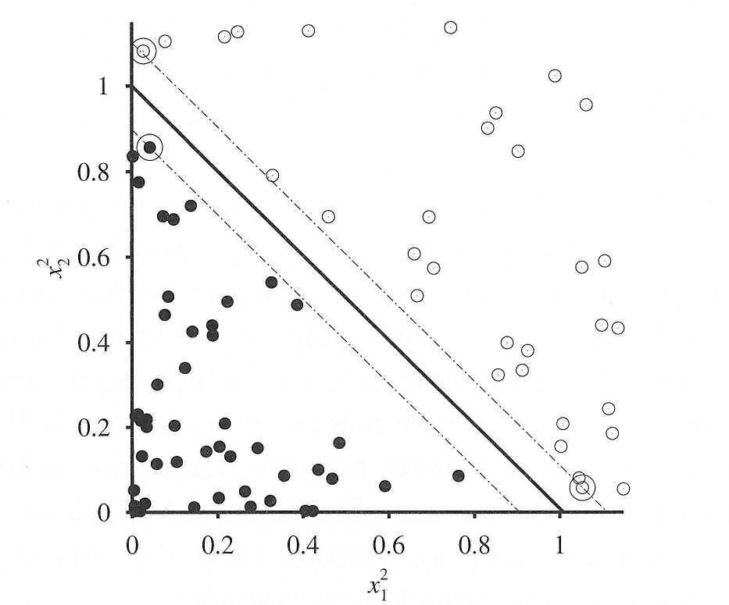
Support Vectors
margin
separator
Support vectors
determined via
optimization problem
support vectors

Slide 89
Multi-class SVMs?
SVMs for multiple class labels
Combination of multiple SVMs
Assume that classes are ordered (ordinal scale)
Ordinal regression instead of classification

Slide 90
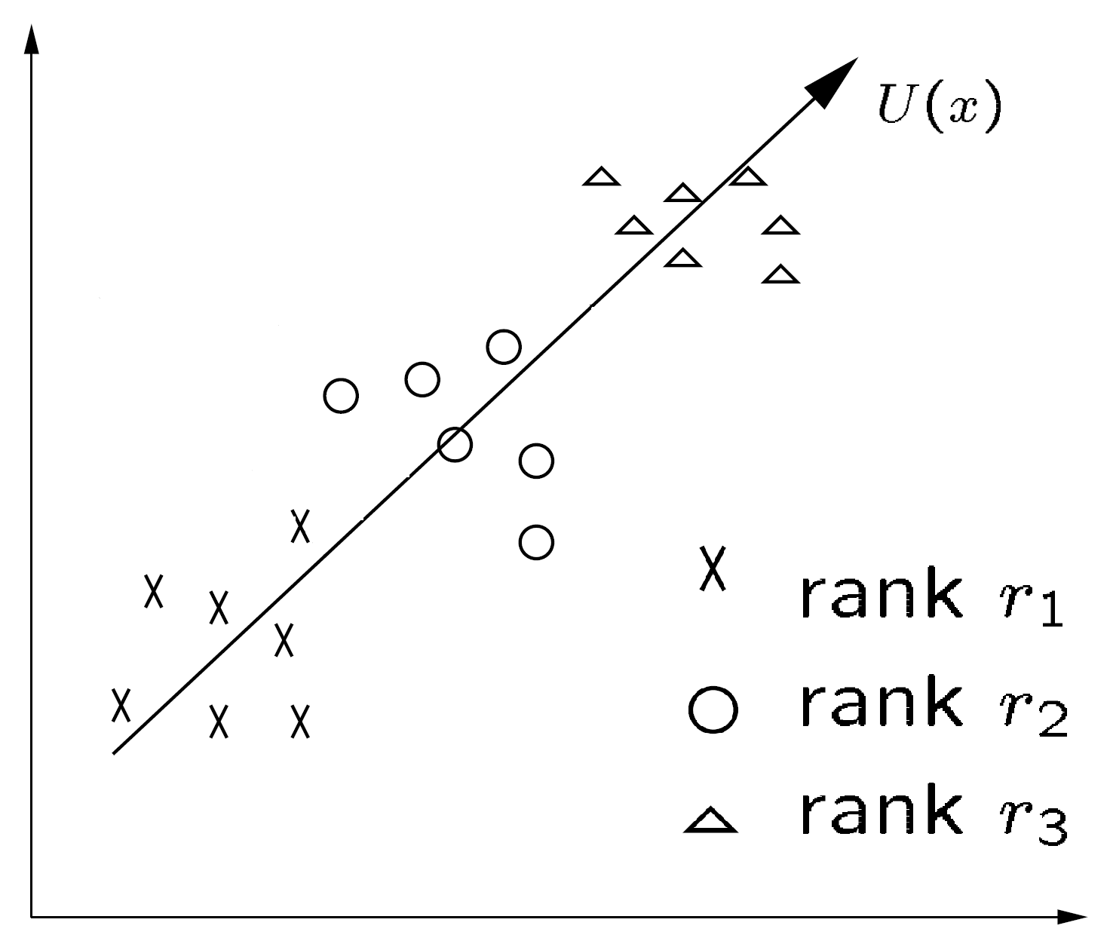

The Ranking SVM
Sec. 15.4.2
Ranking Model: f(ψ_{i}),e. g. $f\left(ψ_{i}\right)=w$ $ψ_{i}$ (linear model)
Introduction to Information Retrieval, Sec. 15.4.

Slide 91
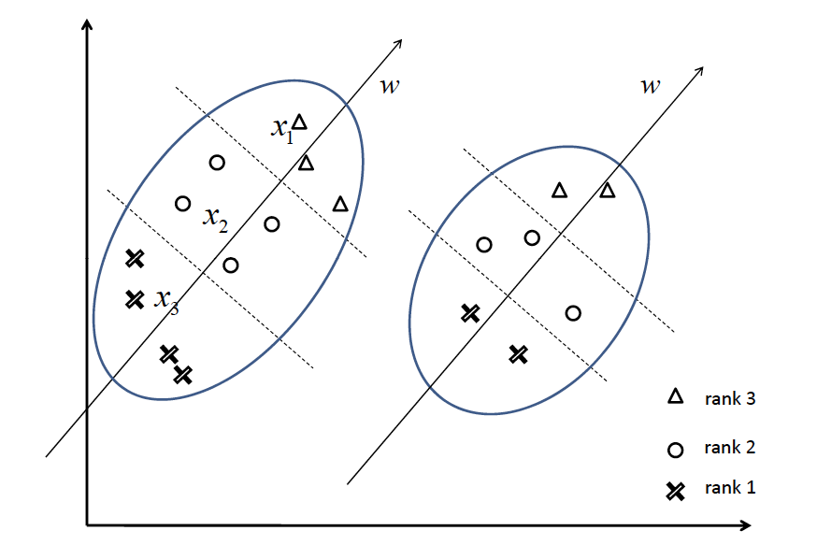
Two queries in the original space
Introduction to Information Retrieval, Sec. 15.4.

Slide 92
An SVM classifier for information retrieval
Experiments:
  4 TREC data sets
  (Data3, Data4, Data5, WT10G (web))
  Comparisons with Lemur (LM),
  a state-of-the-art open source IR engine
  Linear kernel normally best or almost as good as quadratic kernel, and so used in reported results
  6 features, all variants of tf, idf, and tf.idf scores
Ramesh Nallapati. Discriminative models for information retrieval. In Proceedings of the 27th annual international ACM SIGIR conference on Research and development in information retrieval (SIGIR '04). Association for Computing Machinery, New York, NY, USA, 64–71. 2004.
Introduction to Information Retrieval, Sec. 15.4.

Slide 93
An SVM classifier for information retrieval
Train \ Test |  | Disk 3 | Disk 4-5 | WT10G (web)
Disk 3 | LM | 0.1785 | 0.2503 | 0.2666
 | SVM | 0.1728 | 0.2432 | 0.2750
Disk 4-5 | LM | 0.1773 | 0.2516 | 0.2656
 | SVM | 0.1646 | 0.2355 | 0.2675
At best the results are about equal to LM
  Actually, a little bit below
Paper’s advertisement: Easy to add more features
  This is illustrated on a homepage finding task on WT10G:
  Baseline LM 52% success@10, baseline SVM 58%
  SVM with URL-depth, and in-link features: 78% S@10
Introduction to Information Retrieval, Sec. 15.4.
Notes:
Success@10: the percentage of queries for which an answer is found in the top 10 documents

Slide 94
Overview
Moderate number of features
  SVMs: 2000-2007
Very high number of features
  Deep composition of high-dimensional linear and piecewise linear functions: 2007-2014
  + Learn latent features in different composition layers
  → EWDS
Input sequences (order between dimensions)
  Transformer networks: 2014 …
  + Learn influence weights of different parts of input
  (“attention”)

Slide 95
IR Agents: Summary
Goal: Fulfill information need of human user
  Information need specified in various ways (e.g., query vector)
  Agent employs strategies to best fulfill its goal(s)
Agent receives reinforcement feedback (“reward”)
(e.g., as relevance feedback)
Agent changes its goal fulfillment strategies for dealing with the same or similar goals
  E.g., by applying the Rocchio Algorithm
Agent possibly extends its model of the user
Agent could refine goals to meet expectations
  Reduce uncertainty
Agent could contact other agents to acquire new information

