Slide 1
Intelligent Agents
Sequential Structures, Word Semantics, and Embeddings
Prof. Dr. Ralf Möller
Universität zu Lübeck
Institut für Informationssysteme

Slide 2
Motivation: Part Of Speech Tagging
Annotate each word in a sentence with a part-of-speech (POS) tags.
Lowest level of syntactic analysis.
Useful for subsequent syntactic parsing and word sense disambiguation
Topic modeling as discussed before could be extended to better consider POS tags
John saw the saw and decided to take it to the table.
NNP VBD DT NN CC VBD TO VB PRP IN DT NN
Abbreviations: https://sites.google.com/site/partofspeechhelp/home
CS 388 Natural Language Processing: Raymond J. Mooney

Slide 3
Information Extraction
Identify phrases in language that refer to specific types of entities and relations in text.
Named entity recognition is the task of identifying names of people, places, organizations, etc. in text.
people organizations places
  Michael Dell is the CEO of Dell Computer Corporation and lives in Austin Texas.
Extract pieces of information relevant to a specific application, e.g. used car ads:
make model year mileage price
  For sale, 2002 Toyota Prius, 20,000 mi, $15K or best offer. Available starting July 30, 2006.
CS 388 Natural Language Processing: Raymond J. Mooney

Slide 4
Semantic Role Labeling
For each clause, determine the semantic role played by each noun phrase that is an argument to the verb.
  agent patient source destination instrument
  John drove Mary from Austin to Dallas in his Toyota Prius.
  The hammer broke the window.
Also referred to as “case role analysis,” “thematic analysis,” and “shallow semantic parsing”
CS 388 Natural Language Processing: Raymond J. Mooney

Slide 5
Sequence Labeling as Classification
Using Outputs as Inputs
Better input features are usually the categories of the surrounding tokens, but these are not available yet.
Can use category of either the preceding or succeeding tokens by going forward or back and using previous output.
CS 388 Natural Language Processing: Raymond J. Mooney

Slide 6
Forward Classification
John saw the saw and decided to take it to the table.
classifier
NNP
CS 388 Natural Language Processing: Raymond J. Mooney

Slide 7
Forward Classification
NNP
John saw the saw and decided to take it to the table.
classifier
VBD
CS 388 Natural Language Processing: Raymond J. Mooney

Slide 8
Forward Classification
NNP VBD
John saw the saw and decided to take it to the table.
classifier
DT
CS 388 Natural Language Processing: Raymond J. Mooney

Slide 9
Forward Classification
NNP VBD DT
John saw the saw and decided to take it to the table.
classifier
NN
CS 388 Natural Language Processing: Raymond J. Mooney

Slide 10
Forward Classification
NNP VBD DT NN
John saw the saw and decided to take it to the table.
classifier
CC
CS 388 Natural Language Processing: Raymond J. Mooney

Slide 11
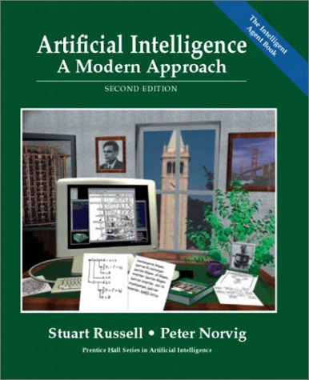
More general perspective…
sensors
?
environment
agent
actuators
t₁, t₂, t₃, …

Slide 12
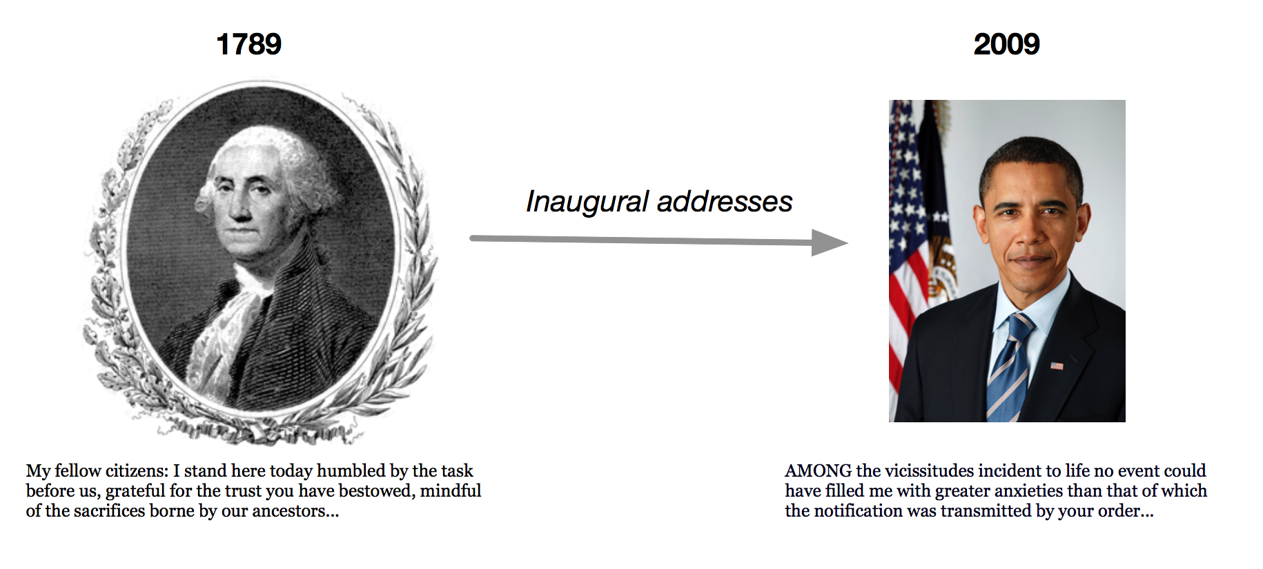
Dynamic Topic Models
In LDA the order of documents does not matter
Not appropriate for sequential corpora (e.g., that span hundreds of years)
Further, we may want to track how language changes over time
Let the topics drift in a sequence.
David M. Blei and John D. Lafferty. Dynamic topic models.
In Proc. ICML '06. pp. 113-120. 2006.

Slide 13
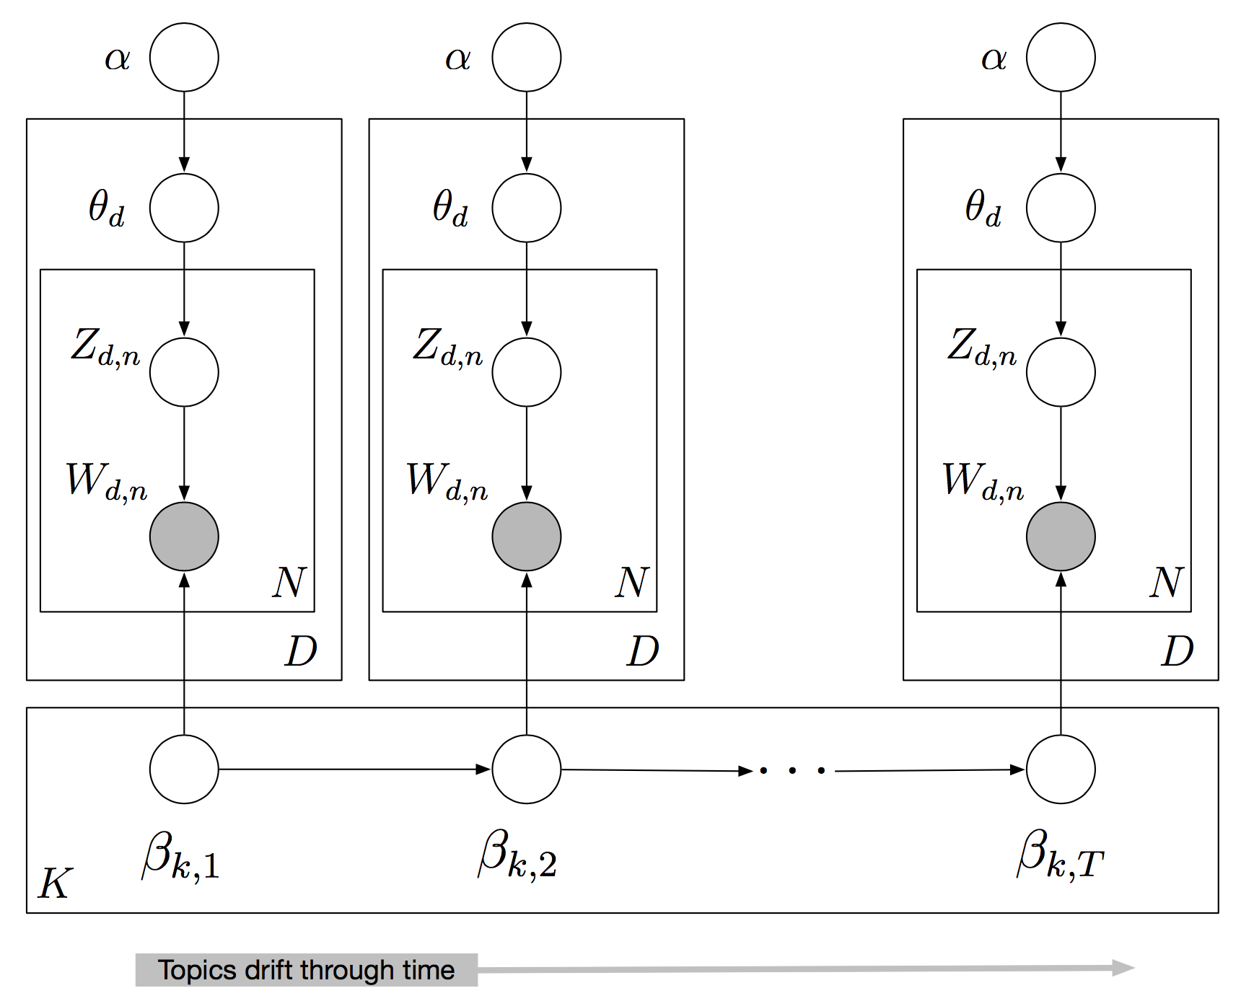

Slide 14
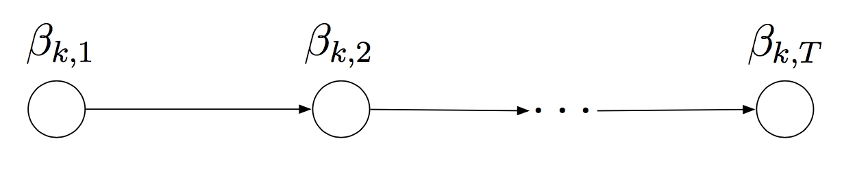
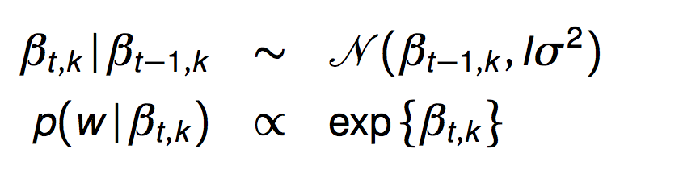
Dynamic Topic Models
Use a logit normal distribution to model topics evolving over time
Embed it in a state-space model on the log of the topic distribution
Let us make inferences about sequences of documents
Probabilistic Topic Models, David Blei, 2013

Slide 15
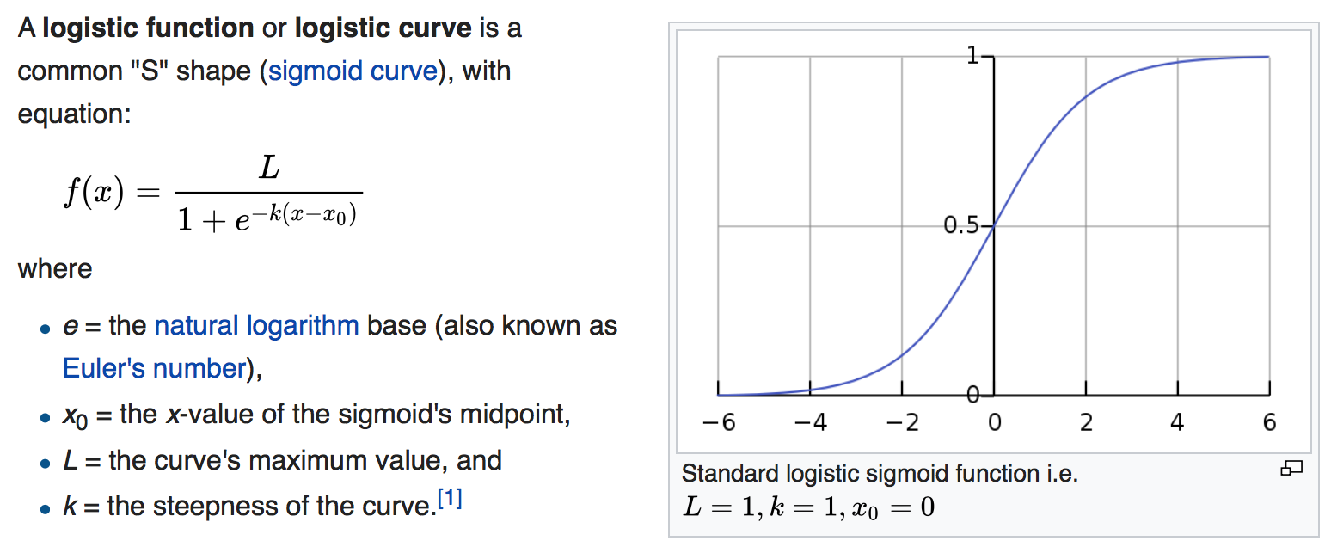
Recap: Logistic function
[Wikipedia]

Slide 16
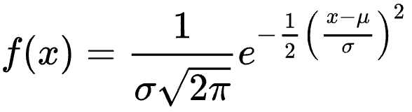
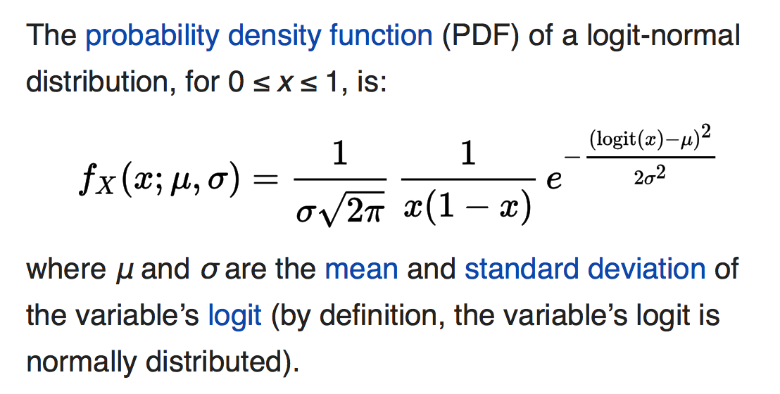
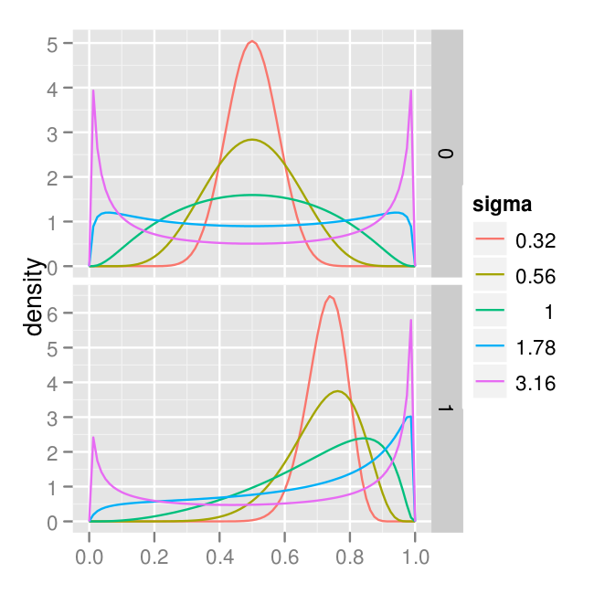
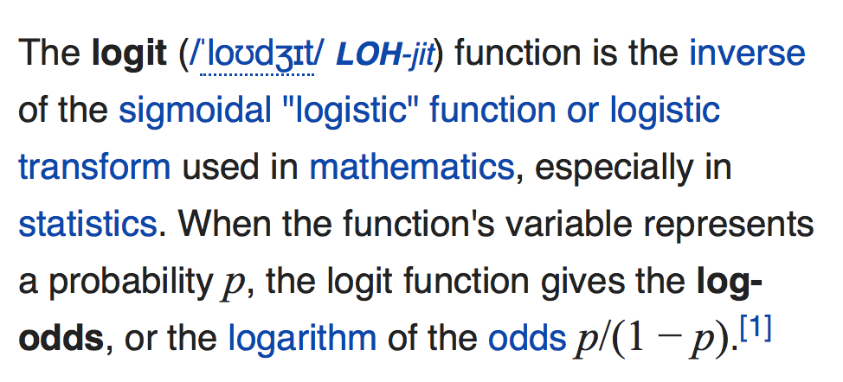
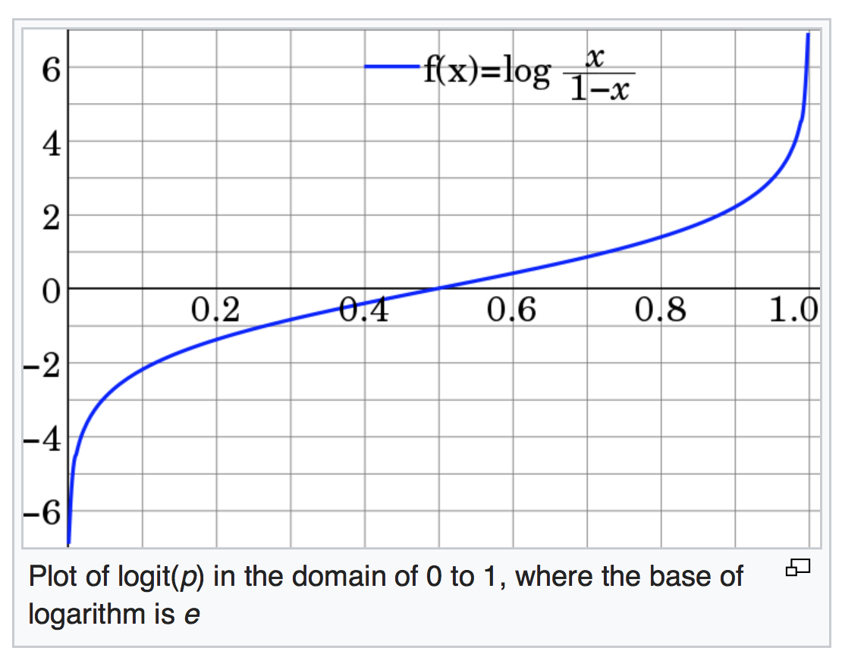
Logit Normal Distribution
Normal Distribution
𝜇 =
𝜇 =
Logit = log of odds
[Wikipedia]

Slide 17
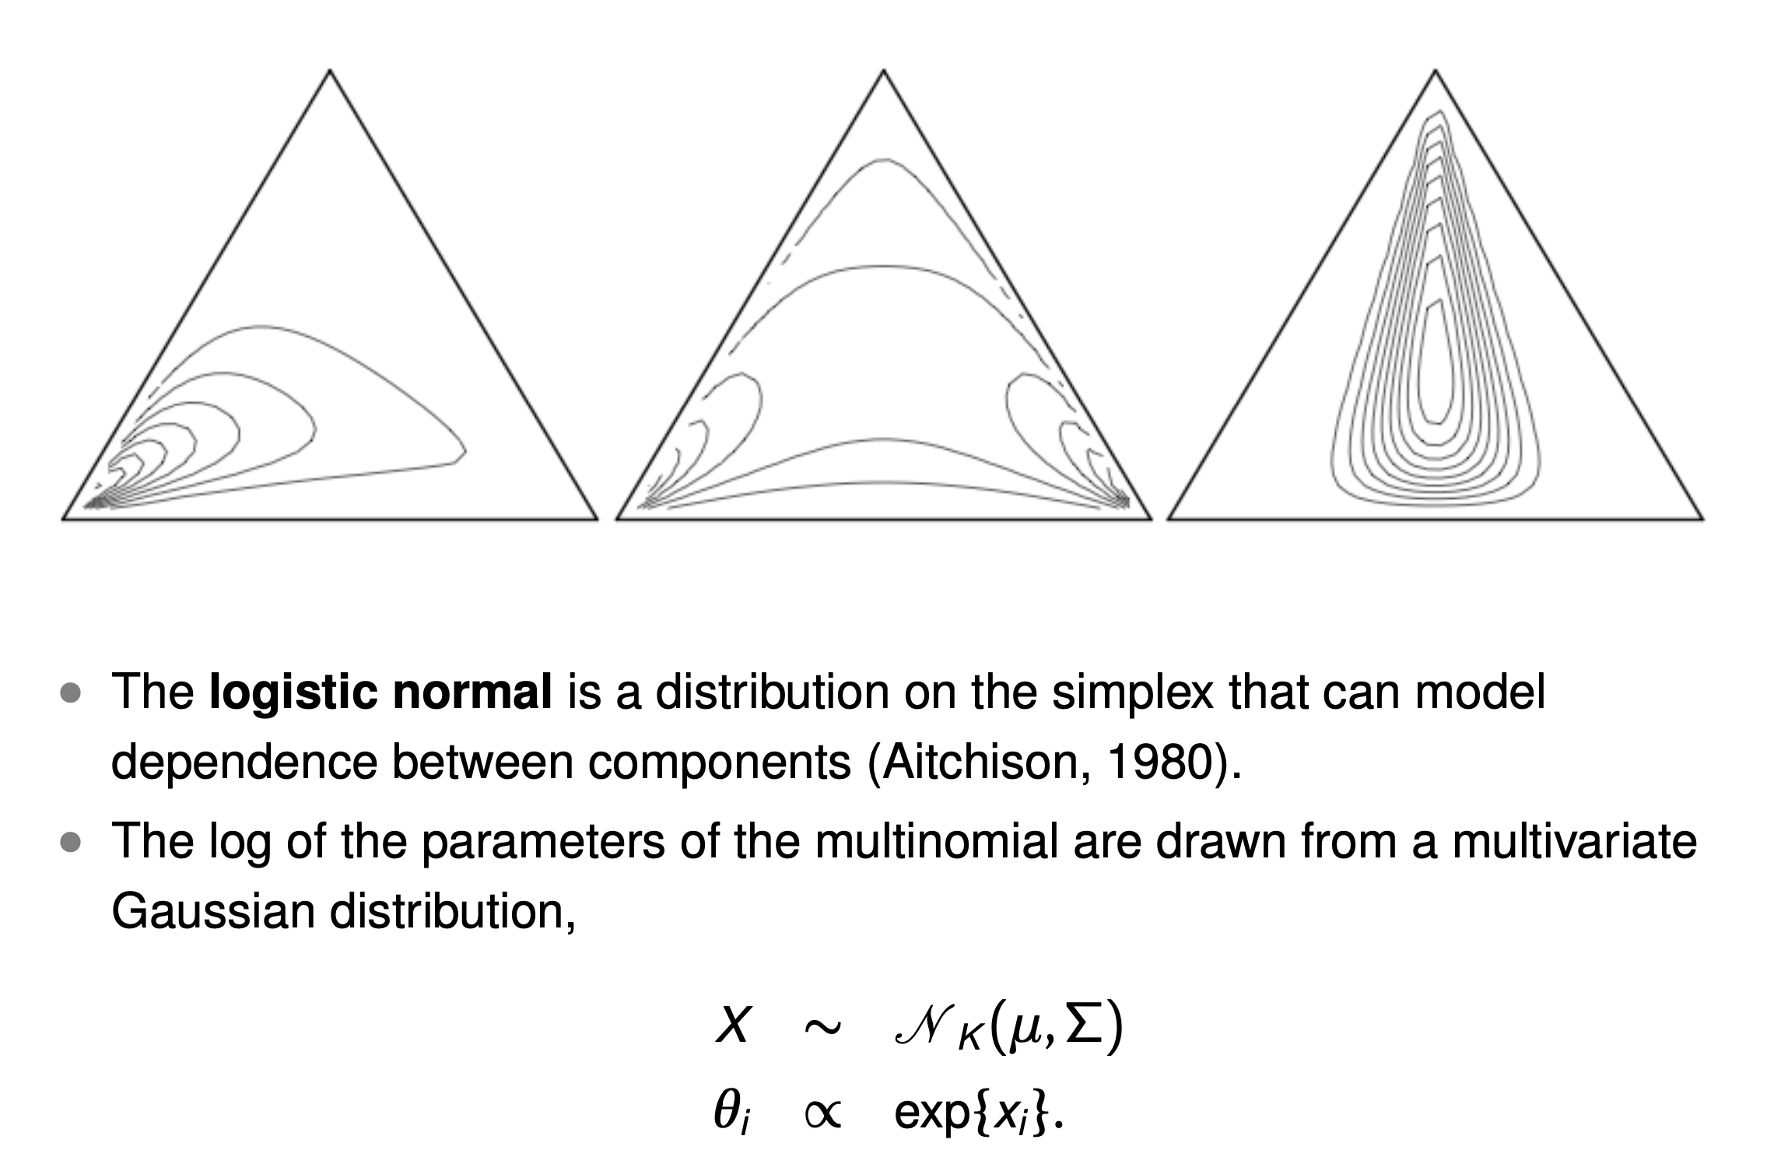
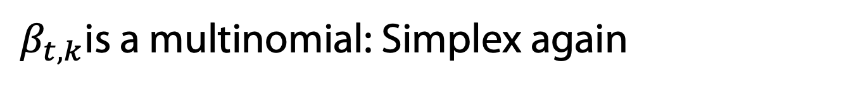
$β_{t,k}$is a multinomial: Simplex again

Slide 18
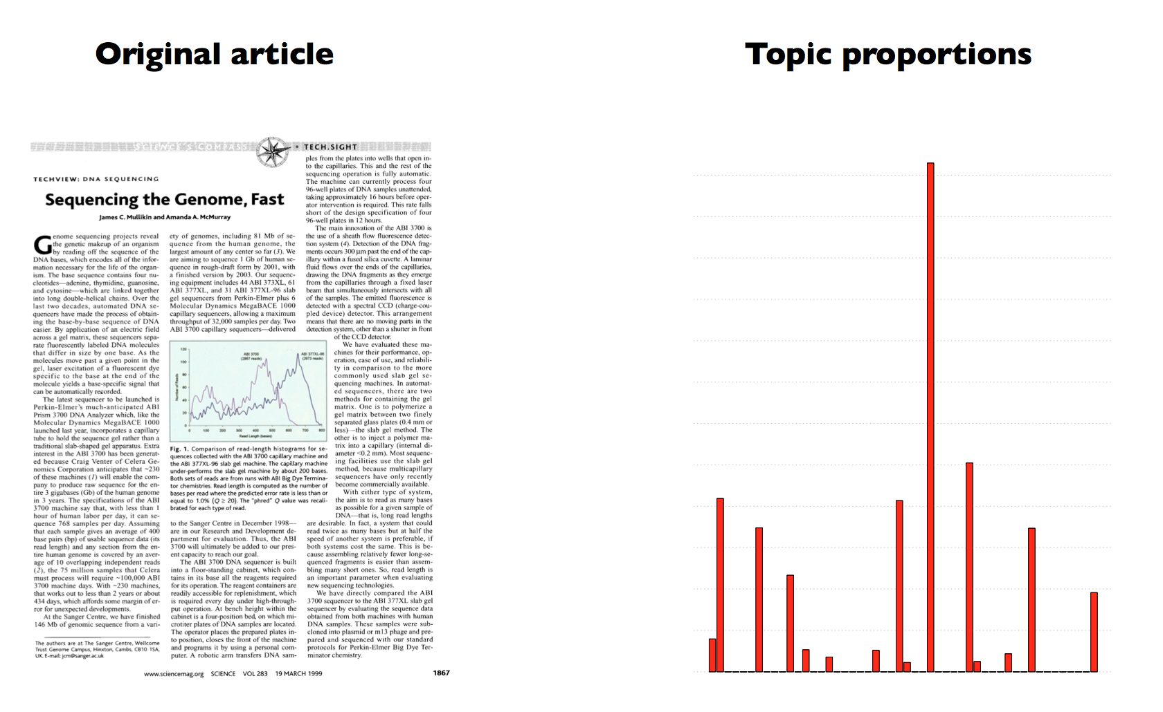
Dynamic Topic Models
Probabilistic Topic Models, David Blei, 2013

Slide 19
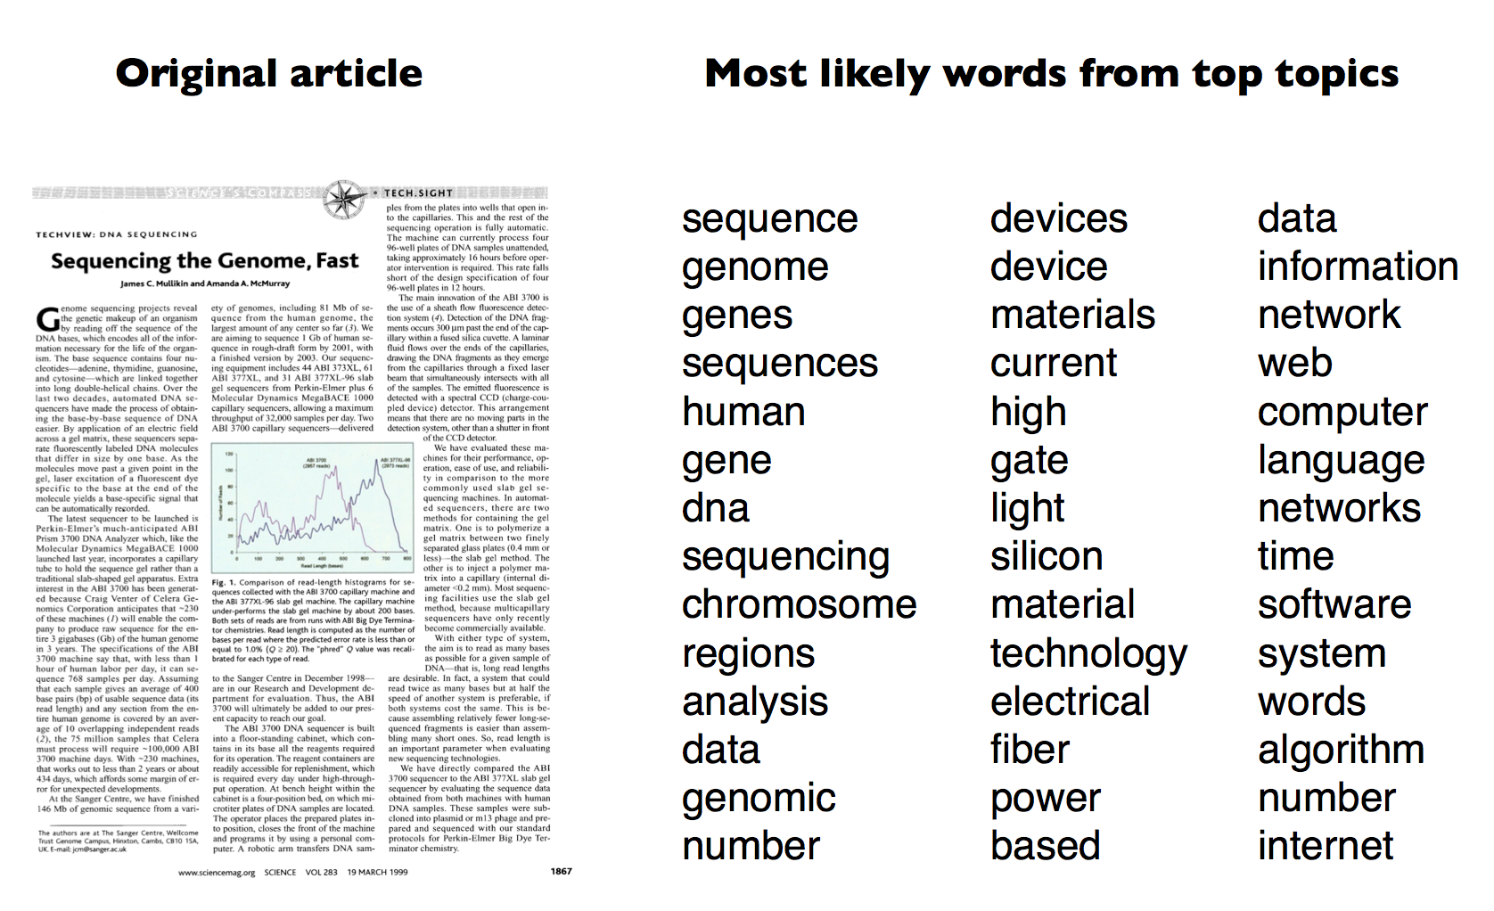
Dynamic Topic Models
Probabilistic Topic Models, David Blei, 2013

Slide 20
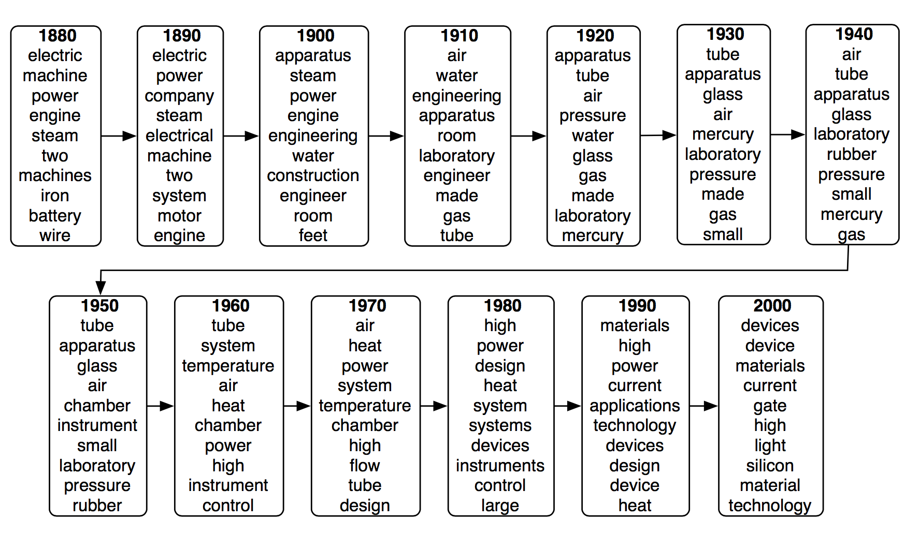
Dynamic Topic Models
Probabilistic Topic Models, David Blei, 2013

Slide 21
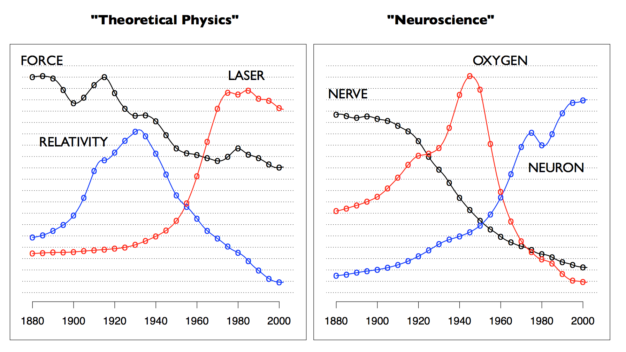
Dynamic Topic Models
David M. Blei and John D. Lafferty. Dynamic topic models.
In Proc. ICML '06. pp. 113-120. 2006.
Probabilistic Topic Models, David Blei, 2013

Slide 22
Dynamic Topic Models
Understand developments
Distributions of topics over time
Discretization of time might be a problem
  Runtime increases dramatically
  Continuous dynamic topic models
Many applications
  E.g., comparison of science areas,
  analysis of scientific work
How can we compare distributions?
Wang, Chong; Blei, David; Heckerman, David. "Continuous Time Dynamic Topic Models". Proceedings of ICML'08, 2008.

Slide 23
Recap: Huffman code example
1
Exp. len
0
1
.5
.5
D
0
1
.25
.25
C
1
If we need to send many messages (A,B,C or D) and they have this probability distribution and we use this code, then over time, the average bits/message should approach 1.75
0
.125
.125
A
B

Slide 24
Recap: Information Theory Background
Assume that you need to send messages from a repertoire of n messages
If there are n equally probable possible messages, then the probability p of each is 1/n or n = 1/p
Information (number of bits) conveyed by a message is
log(n) = log(1/p)= -log(p)
E.g., if there are 16 messages, then log(16) = 4 and we need 4 bits to identify/send each message.
In general, if we are given a probability distribution
  P = (p₁, p₂, .., p_{n})
Expected information induced by distribution P (aka entropy of P):
  I(P) = -(p₁*log(p₁) + p₂*log(p₂) + .. + p_{n}*log(p_{n}))
  = - ∑_{i} p_{i}*log(p_{i}) = ∑_{i} p_{i}*log(1/p_{i})
What if one used an erroneous distribution q?
  One might use too many bits for more frequent messages

Slide 25
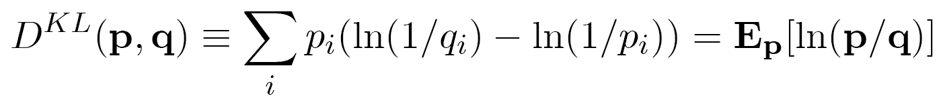
The KL Divergence
The cross-entropy, or Kullback-Leibler divergence, between two distributions p and q measures the expected information gain (reduction in average number of bits per event) due to replacing the “wrong” distribution q with the “right” distribution p:
Not symmetric

Slide 26
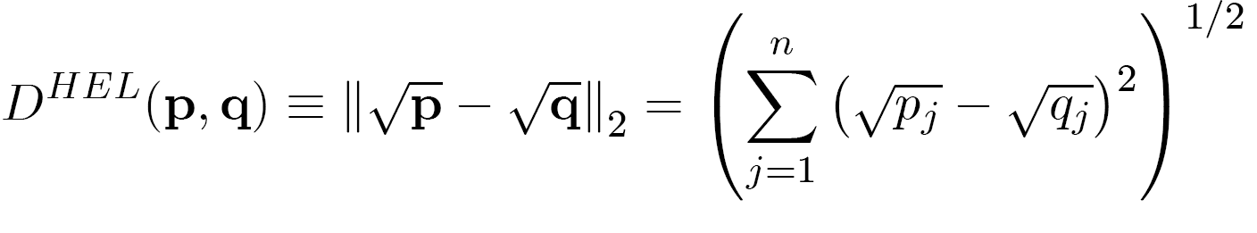
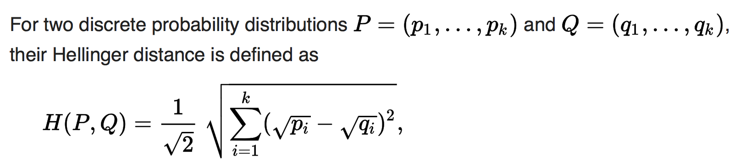
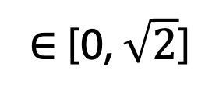
Hellinger Distance
The Hellinger distance is a symmetric measure of distance between two distributions that is popular in machine learning applications:
Sometimes value should be in [0, 1]
∈ [0, $\sqrt{2}$]
[Wikipedia]

Slide 27
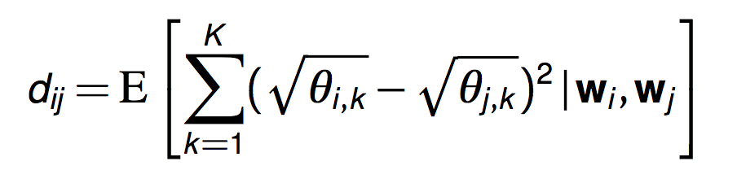
Dynamic Topic Models
Time-corrected similarity shows a new way of using the posterior
Consider the expected Hellinger distance between the topic proportions of two documents,
Uses the latent structure to define similarity
Time has been factored out because the topics associated to the components are different from year to year
Similarity of documents based only on topic proportions

Slide 28
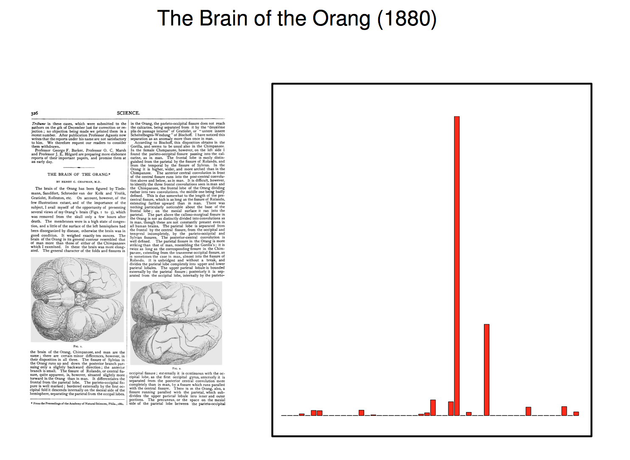
Dynamic Topic Models

Slide 29
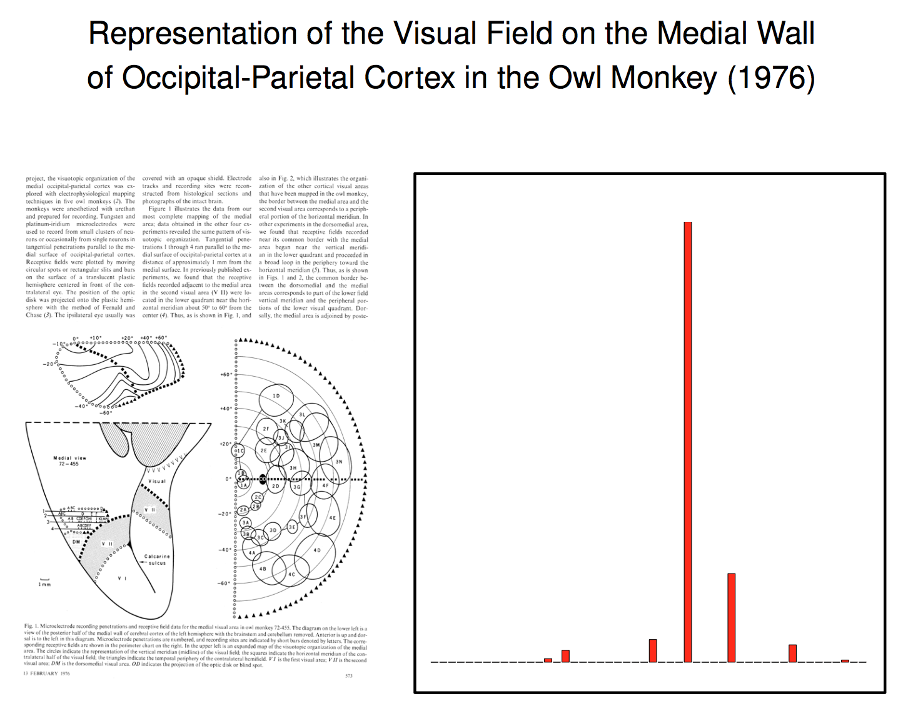
Dynamic Topic Models

Slide 30
Dynamic Topic Models: Summary
Can model changes of topics (= word distributions) in corpora over time
Uses a technique for
modeling temporal influences
As a by-product we have discussed
techniques for comparing distributions

Slide 31
Word-Word Associations in Document Retrieval
Recap
  LSI: Documents as vectors, dimension reduction
Topic Modeling
  Topic = Word distribution
  From LDA-Model: P(Z | w)
  Assumption: Bag of words model
  (independence, naïve Bayes, unigram distribution)
Words are not independent of each other
Word similarity measures
Extend query with similar words automatically
Extend query with most frequent followers/predecessors
Insert words in anticipated gaps in a string query
Need to represent more aspects of word semantics

Slide 32
Approaches for Representing Word Semantics
Beyond bags of words
Distributional Semantics (Count)
Used since the 90’s
Sparse word-context PMI/PPMI matrix
Decomposed with SVD
Word Embeddings (Predict)
Inspired by deep learning
word2vec
(Mikolov et al., 2013)
GloVe
(Pennington et al., 2014)
Underlying Theory: The Distributional Hypothesis (Harris, ’54; Firth, ‘57)
“Similar words occur in similar contexts”
https://www.tensorflow.org/tutorials/word2vec
https://nlp.stanford.edu/projects/glove/
Notes:
There are two approaches for creating these vectors:
First, we’ve got the traditional count-based approach,
where the most common variant is the word-context PMI matrix.
The other, cutting-edge, approach, is word embeddings,
Which has become extremely popular with word2vec.
Now, the interesting thing…
…is that both approaches rely on the same linguistic theory: the distributional hypothesis.
<pause>
Now, in previous work, that I’ll talk about in a minute,
we showed that the two approaches are even more related.

Slide 33
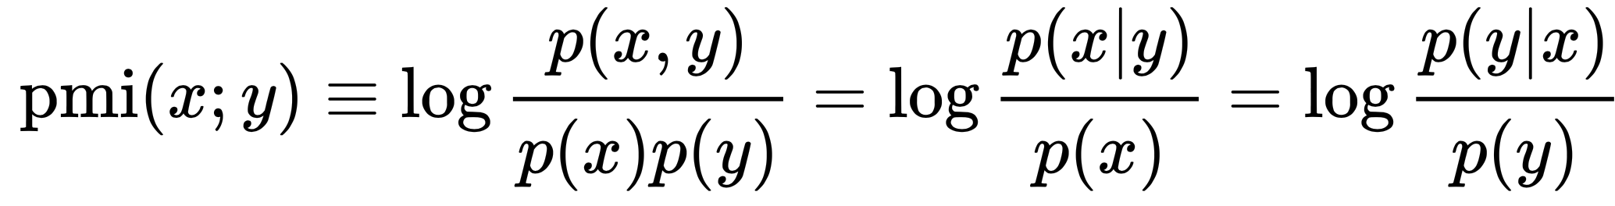
Point(wise) Mutual Information: PMI
Measure of association used in information theory and statistics
Positive PMI: PPMI(x, y) = max( pmi(x, y), 0 )
Quantifies the discrepancy between the probability of their coincidence given their joint distribution and their individual distributions, assuming independence
Finding collocations and associations between words
Countings of occurrences and co-occurrences of words in a text corpus can be used to approximate the probabilities p(x) or p(y) and p(x,y) respectively
Kenneth Ward Church and Patrick Hanks. "Word association norms, mutual information, and lexicography". Comput. Linguist. 16 (1): 22–29. 1990.

Slide 34
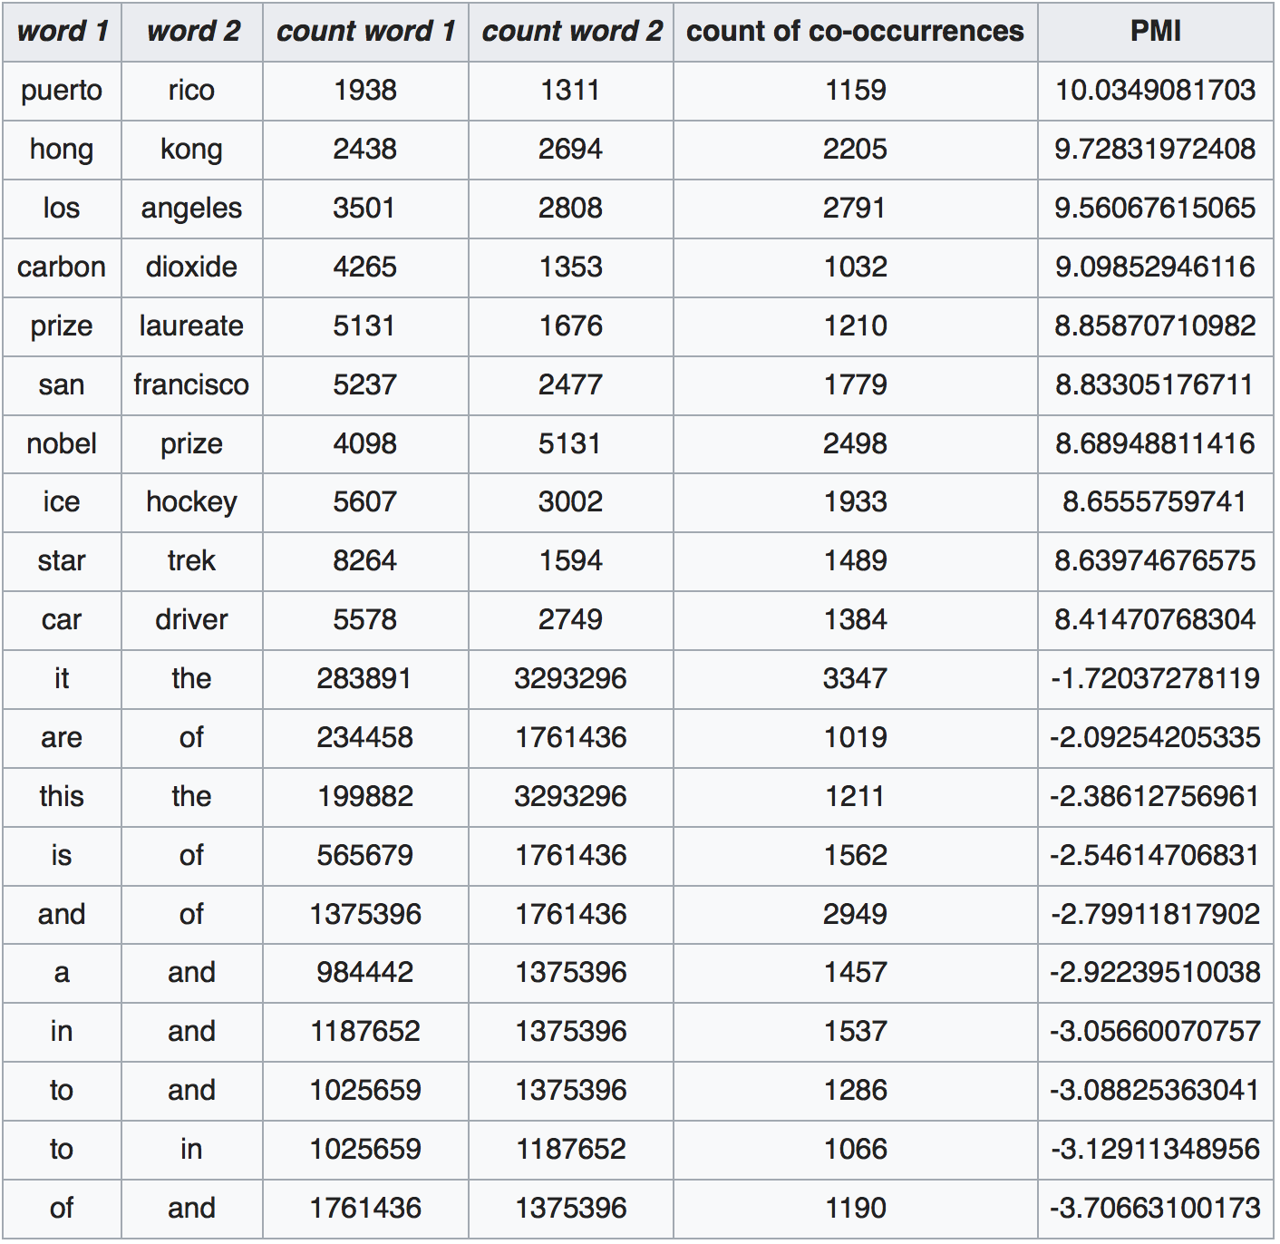
PMI – Example
Counts of pairs of words getting the most and the least PMI scores in the first 50 millions of words in Wikipedia (dump of October 2015)
Filtering by 1,000 or more co-occurrences.
The frequency of each count can be obtained by dividing its value by 50,000,952. (Note: natural log is used to calculate the PMI values in this example, instead of log base 2)
[Wikipedia]

Slide 35
The Contributions of Word Embeddings
What’s really improving performance?
Novel Algorithms
(objective + training method)
Skip Grams + Negative Sampling
CBOW + Hierarchical Softmax
Noise Contrastive Estimation
GloVe
…
New Hyperparameters
(preprocessing, smoothing, etc.)
Subsampling of Frequent Words
Dynamic Context Windows
Context Distribution Smoothing
Adding Context Vectors
…
Improving Distributional Similarity with Lessons Learned from Word Embeddings, Omer Levy, Yoav Goldberg, Ido Dagan, Transactions of the Association for Computational Linguistics, Volume 3, 2015.
Notes:
Or maybe a bit of both?
<pause>

Slide 36
Embedding Approaches
Represent each word with a low-dimensional vector
Word similarity = vector similarity
Key idea: Predict surrounding words of every word
Faster and can easily incorporate a new sentence/document or add a word to the vocabulary

Slide 37
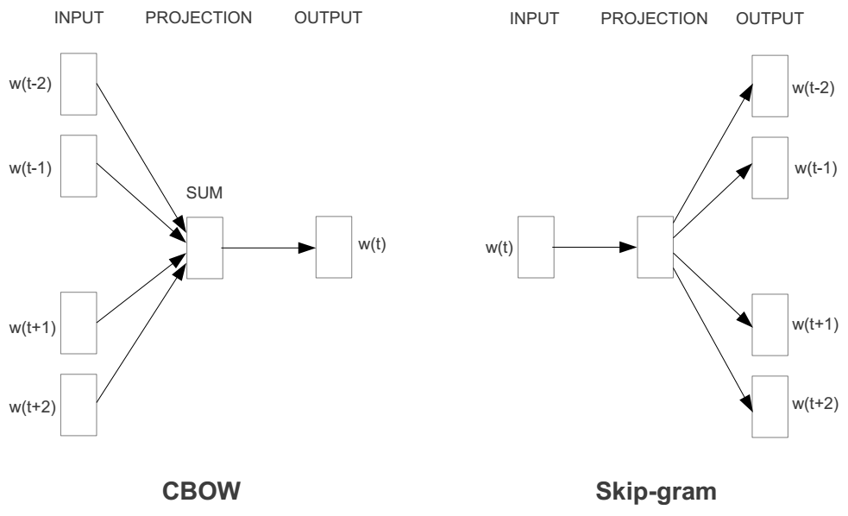
Represent the meaning of a word – word2vec
2 basic network models:
  Continuous Bag of Word (CBOW): use a window to predict the middle word
  Skip-gram (SG): use a word to predict the surrounding ones in window.

Slide 38
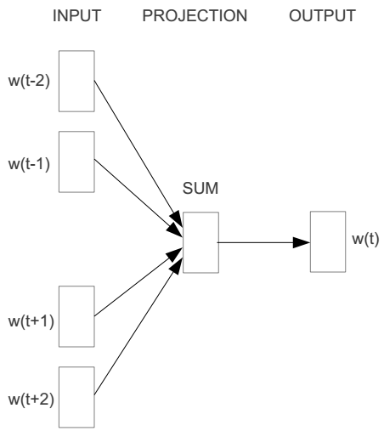
Word2vec – Continuous Bag of Words
E.g. “The cat sat on floor”
  Window size = 2
the
cat
sat
on
floor
Distributed Representations of Words and Phrases and their Compositionality
Tomas Mikolov, Ilya Sutskever, Kai Chen, Greg Corrado, Jeffrey Dean, NIPS 2013

Slide 39
Input layer
Index of cat in vocabulary
0
1
0
cat
0
Hidden layer
Output layer
0
0
0
0
0
0
…
0
0
0
one-hot
vector
0
sat
one-hot
vector
0
0
0
0
1
0
…
1
0
on
0
0
0
0
…
0

Slide 40



We must learn W and W’
Input layer
0
1
0
cat
0
$$W_{V×N}$$
Hidden layer
Output layer
0
0
0
0
0
0
V-dim
…
0
0
$${W′}_{N×V}$$
0
0
sat
0
0
0
0
1
0
$$W_{V×N}$$
N-dim
…
V-dim
1
0
on
0
0
0
0
V-dim
…
N will be the size of word vector
0

Slide 41
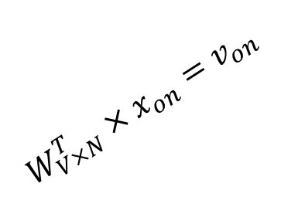

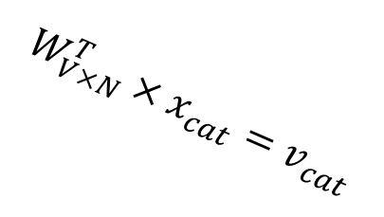


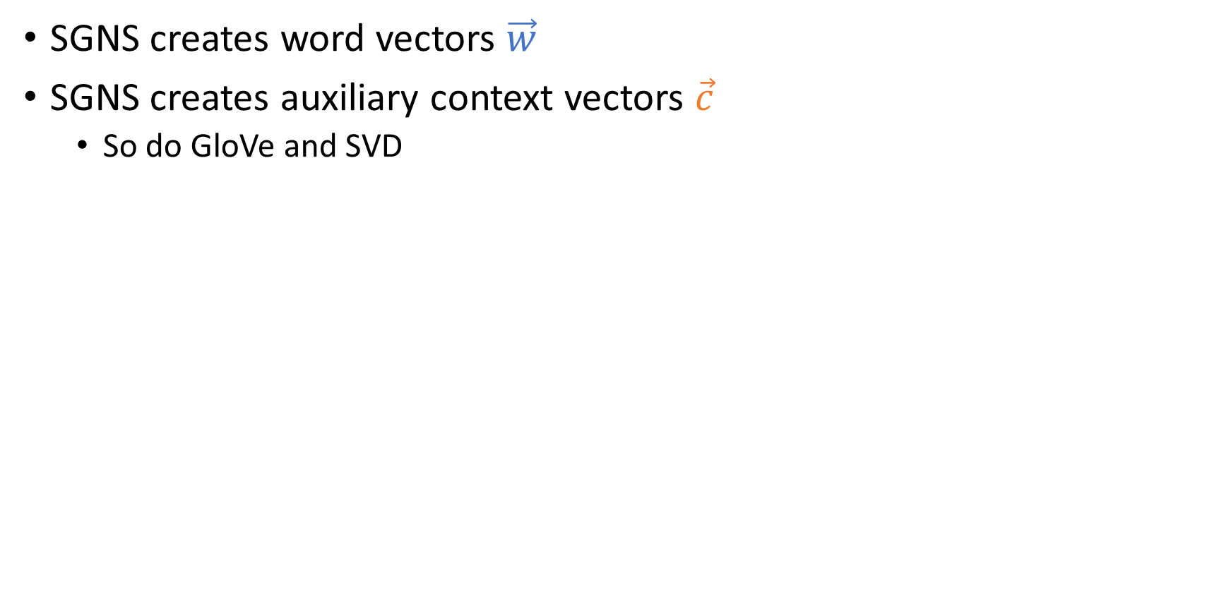
$$W_{V×N}^{T} ×x_{cat}=v_{cat}$$
0.1 | 2.4 | 1.6 | 1.8 | 0.5 | 0.9 | … | … | … | 3.2
0.5 | 2.6 | 1.4 | 2.9 | 1.5 | 3.6 | … | … | … | 6.1
… | … | … | … | … | … | … | … | … | …
… | … | … | … | … | … | … | … | … | …
0.6 | 1.8 | 2.7 | 1.9 | 2.4 | 2.0 | … | … | … | 1.2
0
2.4
2.6
…
…
1.8
Input layer
1
$$×$$
0
$$=$$
0
0
1
0
0
0
x_{cat}
0
0
Output layer
0
0
0
$$W_{V×N}^{T}×x_{cat}=v_{cat}$$
…
0
0
0
0
0
V-dim
…
0
0
$$\hat{v}=\frac{v_{cat}+v_{on}}{2}$$
0
+
0
sat
0
0
0
0
$$W_{V×N}^{T}×x_{on}=v_{on}$$
1
0
…
V-dim
1
Hidden layer
0
x_{on}
0
0
N-dim
0
0
V-dim
…
0

Slide 42

$$W_{V×N}^{T} ×x_{on}=v_{on}$$
0.1 | 2.4 | 1.6 | 1.8 | 0.5 | 0.9 | … | … | … | 3.2
0.5 | 2.6 | 1.4 | 2.9 | 1.5 | 3.6 | … | … | … | 6.1
… | … | … | … | … | … | … | … | … | …
… | … | … | … | … | … | … | … | … | …
0.6 | 1.8 | 2.7 | 1.9 | 2.4 | 2.0 | … | … | … | 1.2
0
1.8
2.9
…
…
1.9
Input layer
0
$$×$$
0
$$=$$
0
1
1
0
0
0
x_{cat}
0
0
Output layer
0
0
0
$$W_{V×N}^{T}×x_{cat}=v_{cat}$$
…
0
0
0
0
0
V-dim
…
0
0
$$\hat{v}=\frac{v_{cat}+v_{on}}{2}$$
0
+
0
sat
0
0
0
0
$$W_{V×N}^{T}×x_{on}=v_{on}$$
1
0
…
V-dim
1
Hidden layer
0
x_{on}
0
0
N-dim
0
What is the effect of averaging?
Concatenation?
0
V-dim
…
0

Slide 43






Input layer
0
1
0
cat
0
$$W_{V×N}$$
Hidden layer
Output layer
0
0
0
0
0
0
V-dim
…
0
0
$$W_{N×V}^{′}×\hat{v}=z$$
0
$$\hat{y}=softmax(z)$$
0
0
0
0
0
$$\hat{v}$$
1
0
$$W_{V×N}$$
…
1
N-dim
0
on
0
${\hat{y}}_{sat}$
0
0
V-dim
0
V-dim
…
N will be the size of word vector
0

Slide 44
Logistic function
[Wikipedia]

Slide 45
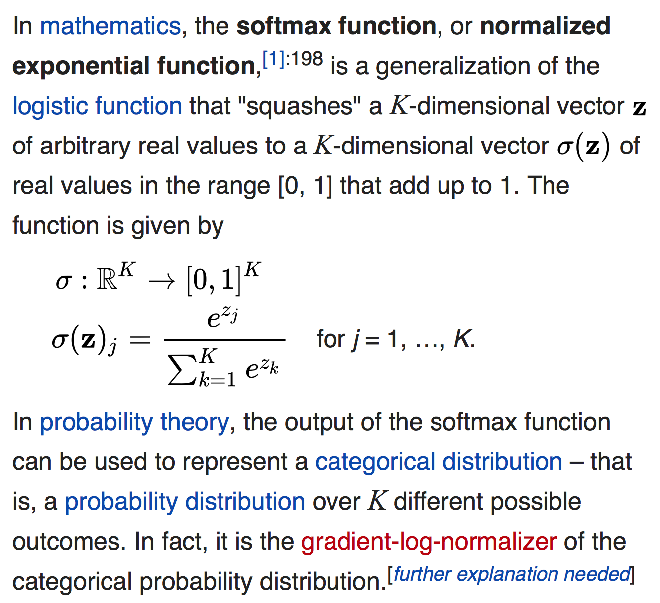
softmax(z)
The
[Wikipedia]

Slide 46


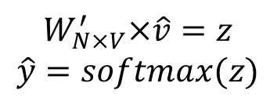
Input layer
0
We would prefer $\hat{y}$ close to ${\hat{y}}_{sat}$
1
0
cat
0
$$W_{V×N}$$
Hidden layer
Output layer
0
0
0
0
0.01
0.02
0.00
0.02
0.01
0.02
0.01
0.7
…
0.00
0
0
V-dim
…
0
0
$$W_{N×V}^{′}×\hat{v}=z$$
$$\hat{y}=softmax(z)$$
0
0
0
0
0
0
$$\hat{v}$$
1
0
$$W_{V×N}$$
…
1
N-dim
0
on
0
${\hat{y}}_{sat}$
0
0
V-dim
0
V-dim
…
N will be the size of word vector
$\hat{y}$
0

Slide 47
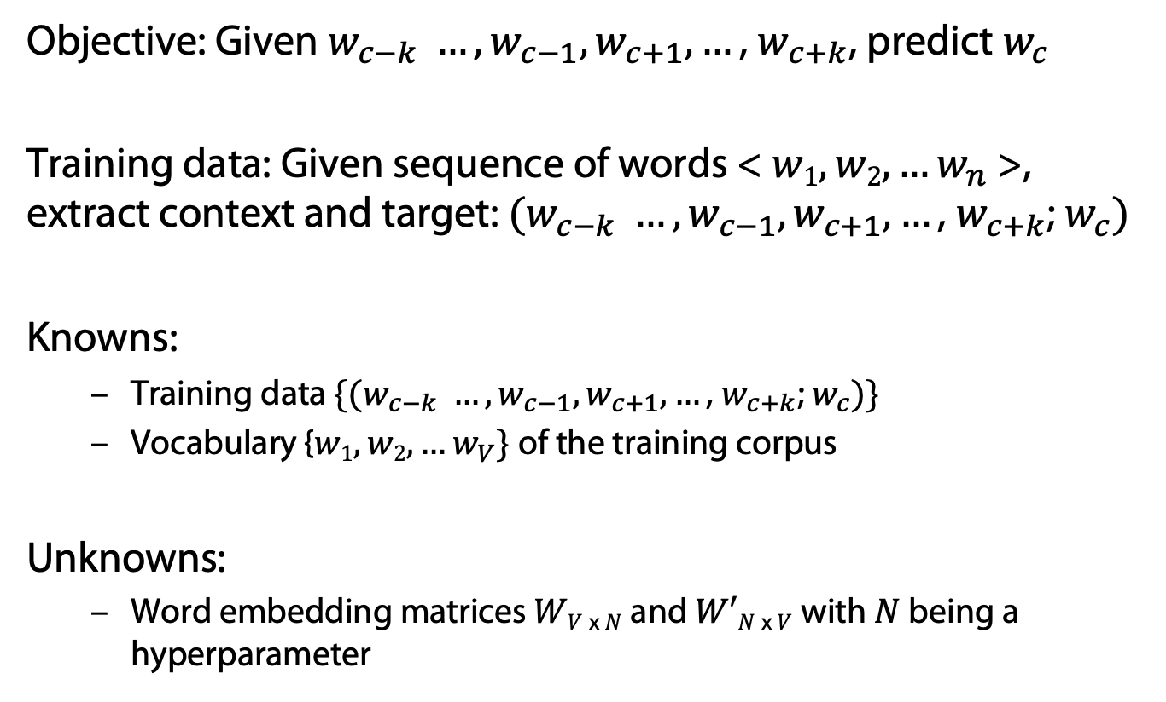
CBOW Model
Objective: Given $w_{c−k} …,w_{c−1},w_{c+1}, …\text{, }w_{c+k}$, predict $w_{c}$
Training data: Given sequence of words < $w1, w2, …w_{n}$>, extract context and target: $(w_{c−k} …,w_{c−1},w_{c+1}, …\text{, }w_{c+k}$; $w_{c})$
Knowns:
  Training data $\{(w_{c−k} …,w_{c−1},w_{c+1}, …\text{, }w_{c+k}$; $w_{c})\}$
  Vocabulary {$w1, w2, …w_{V}\}$of the training corpus
Unknowns:
  Word embedding matrices $WV$ _{x} $N$ and $W′N$ _{x} $V$ with $N$ being a hyperparameter

Slide 48
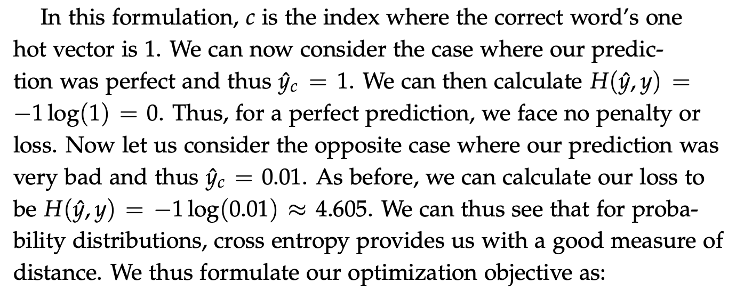

Loss Function for Learning
How to determine word embedding matrices?
Cross entropy for comparing probability distributions
  $H\left(\hat{y}, y\right)=−\sum_{j=1}^{V}{yj log(\hat{y}j)}$
$y$ is a one-hot vector with a “one” at position $c$
  $H\left(\hat{y}, y\right)=−y_{c} log\left(\hat{y}c\right)=−log(\hat{y}c)$

Slide 49
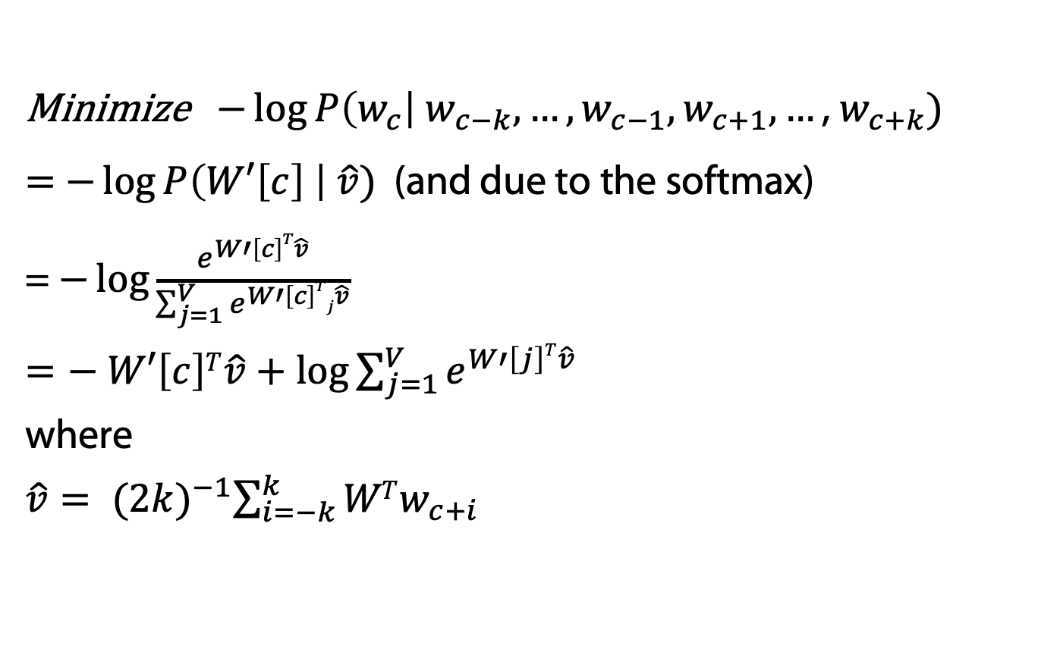
CBOW: Derivation of Learning Procedure
Minimize $−\log{P\left(w_{c}\right| w_{c−k}, …,w_{c−1},w_{c+1}, …\text{, }w_{c+k})}$
= $−\log{P\left(W′\left[c\right] \right| \hat{v})}$ (and due to the softmax)
= $−\log{\frac{e^{W′\left[c\right]T\hat{v}}}{\sum_{j=1}^{V}{e^{W′\left[c\right]Tj\hat{v}}}}}$
$=− W′\left[c\right]T\hat{v}+\log{\sum_{j=1}^{V}{e^{W′\left[j\right]T\hat{v}}}}$
where
$\hat{v}= {(2k)}^{−1}\sum_{i=−k}^{k}{WTw_{c+i}}$
Use gradient descent to update word vectors

Slide 50




$$W_{V×N}^{T}$$
0.1 | 2.4 | 1.6 | 1.8 | 0.5 | 0.9 | … | … | … | 3.2
0.5 | 2.6 | 1.4 | 2.9 | 1.5 | 3.6 | … | … | … | 6.1
… | … | … | … | … | … | … | … | … | …
… | … | … | … | … | … | … | … | … | …
0.6 | 1.8 | 2.7 | 1.9 | 2.4 | 2.0 | … | … | … | 1.2
Contains word vectors
Input layer
0
1
0
x_{cat}
0
Output layer
0
0
$$W_{V×N}^{}$$
0
0
0
0
V-dim
…
0
0
$$W_{N×V}^{′}$$
0
0
sat
0
0
0
0
1
0
$$W_{V×N}^{}$$
…
1
0
V-dim
x_{on}
0
Hidden layer
0
N-dim
0
0
V-dim
…
0
We can consider either W or W’ as the word’s representation.
Or even take the average.
Notes:
W contains input word vectors.
W’ contains output word vectors.
We can consider either W or W’ as the word’s representation. Or even take the average.

Slide 51
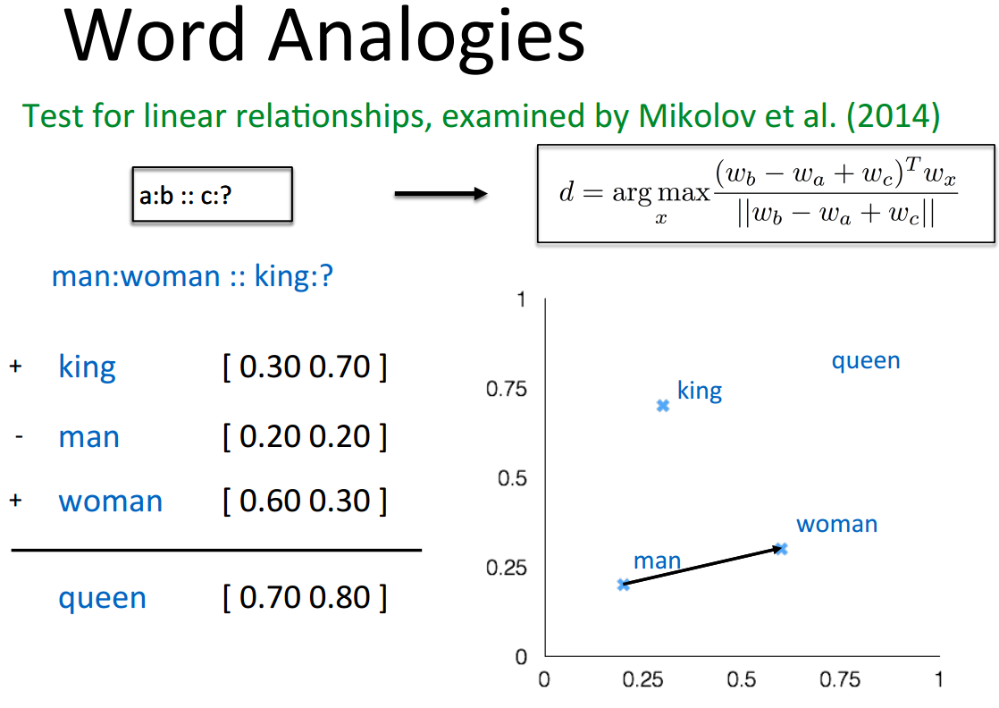
Intrinsic Evaluation

Slide 52
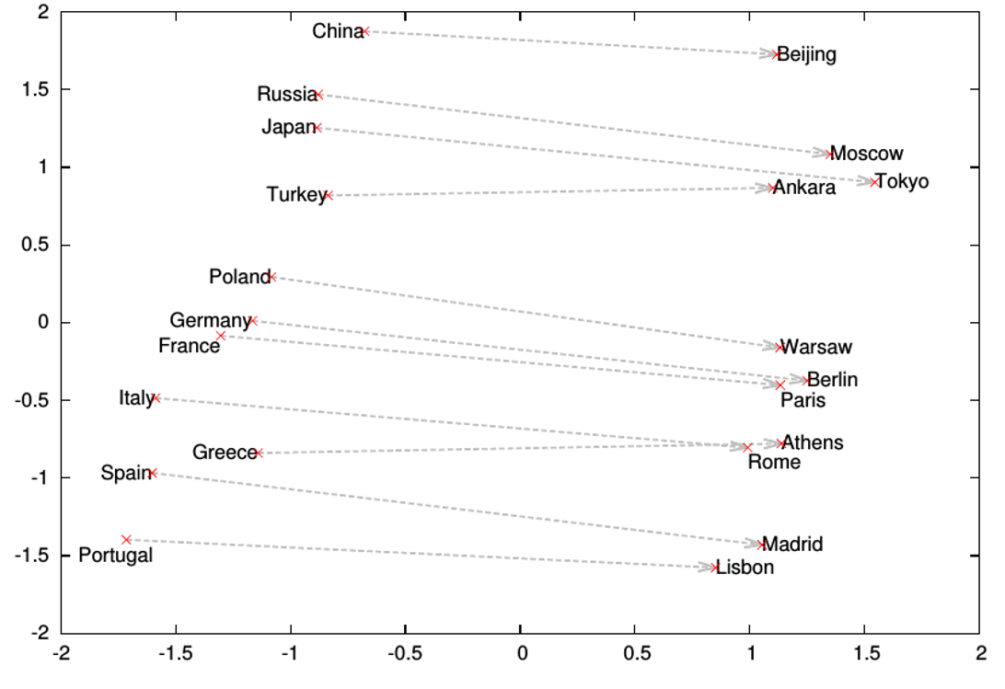
Word analogies

Slide 53
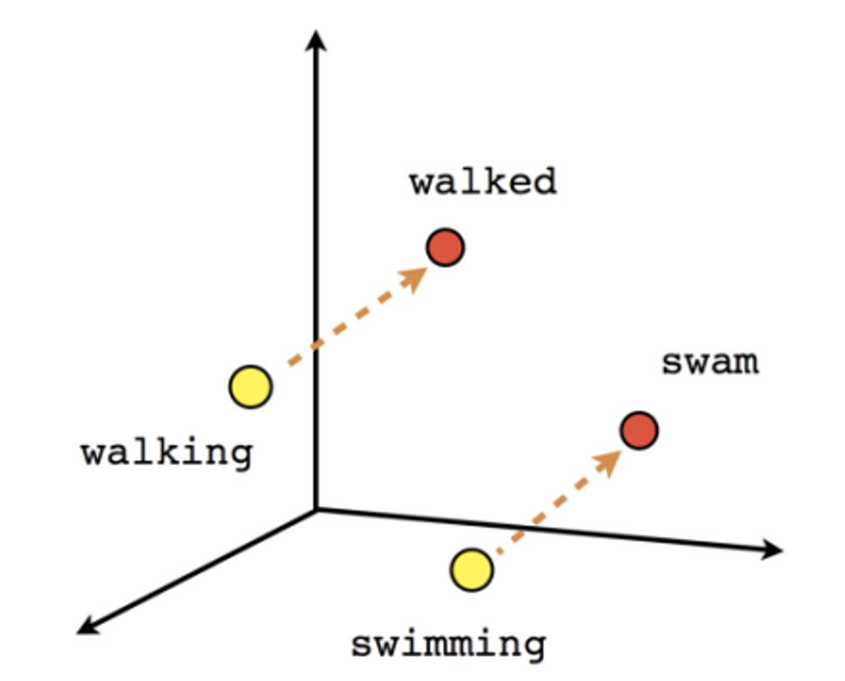
Word Analogies (Tense)

Slide 54
Extrinsic Evaluation
Evaluate in applications
  Sentiment analysis
  …

Slide 55

CBOW
Input layer
0
We would prefer $\hat{y}$ close to ${\hat{y}}_{sat}$
1
0
cat
0
$$W_{V×N}$$
Hidden layer
Output layer
0
0
0
0
0.01
0.02
0.00
0.02
0.01
0.02
0.01
0.7
…
0.00
0
0
V-dim
…
0
0
$$\hat{v}=\frac{v_{cat}+v_{on}}{2}$$
$$W_{N×V}^{′}×\hat{v}=z$$
$$\hat{y}=softmax(z)$$
0
0
sat
0
0
0
0
$$\hat{v}$$
1
0
$$W_{V×N}$$
…
1
N-dim
0
on
0
${\hat{y}}_{sat}$
0
0
V-dim
0
V-dim
…
N will be the size of word vector
$\hat{y}$
0

Slide 56




Skip-Gram
We would prefer $\hat{y}$ close to $z$
Ouptut layer
Hidden layer
Input layer
0.01
0.5
0.00
0.4
0.01
0.02
0.01
0.01
…
0.00
0
0
cat
1
0
on
0
0
1
$$W_{V×N}×\hat{v}=z$$
$$W_{N×V}^{′}×w_{c}=\hat{v}$$
0
0
0
sat
0
0
$$\hat{y}=softmax(z)$$
0
0
0
1
V-dim
…
$$\hat{v}$$
…
0
0
N-dim
${\hat{y}}_{sat}$
V-dim
$\hat{y}$
N will be the size of word vector

Slide 57
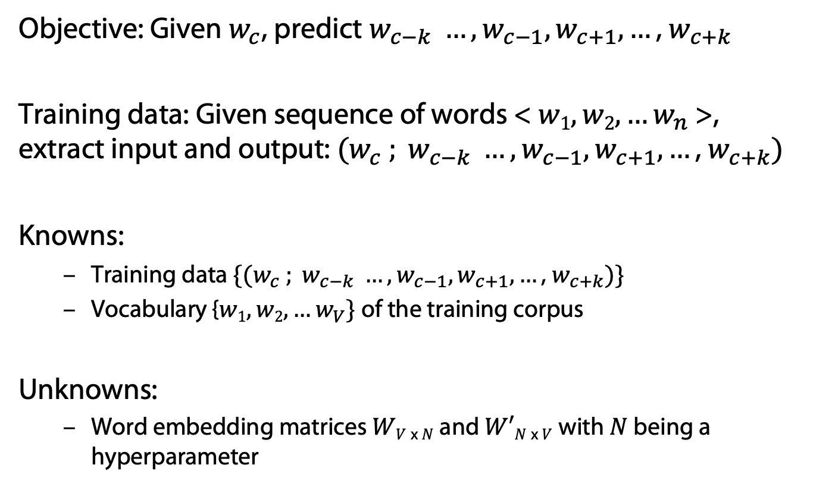
Skip-Gram Model
Objective: Given $w_{c}$, predict $w_{c−k} …,w_{c−1},w_{c+1}, …\text{, }w_{c+k}$
Training data: Given sequence of words < $w1, w2, …w_{n}$>, extract input and output: $(w_{c} ; w_{c−k} …,w_{c−1},w_{c+1}, …\text{, }w_{c+k})$
Knowns:
  Training data $\{(w_{c} ; w_{c−k} …,w_{c−1},w_{c+1}, …\text{, }w_{c+k})\}$
  Vocabulary {$w1, w2, …w_{V}\}$of the training corpus
Unknowns:
  Word embedding matrices $WV$ _{x} $N$ and $W′N$ _{x} $V$ with $N$ being a hyperparameter

Slide 58
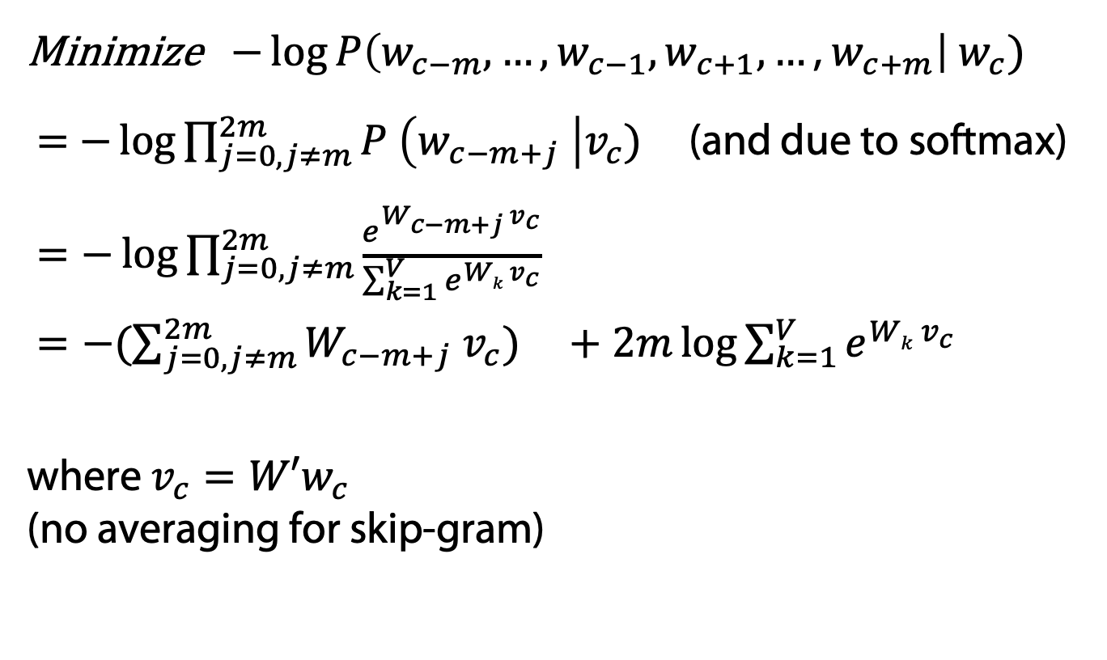
Skip-Gram: Derivation of Learning Procedure
Minimize $−\log{P\left(w_{c−m}, …,w_{c−1},w_{c+1}, …\text{, }w_{c+m}\right| w_{c})}$
= $−\log{\prod_{j=0, j≠m}^{2m}{P \left(w_{c−m+j} \right|v_{c})}}$ (and due to softmax)
$=−\log{\prod_{j=0, j≠m}^{2m}{\frac{e^{W_{c−m+j}{ v}_{c}}}{\sum_{k=1}^{V}{e^{Wk{ v}_{c}}}}}}$
$=−(\sum_{j=0, j≠m}^{2m}{W_{c−m+j}{ v}_{c}}) +2m\log{\sum_{k=1}^{V}{e^{Wk{ v}_{c}}}}$
where $v_{c}=W′w_{c}$
(no averaging for skip-gram)
Use stochastic gradient decent to minimize and then to update word vectors
word2vec Explained: Deriving Mikolov et al.’s Negative-Sampling Word-Embedding Method, Yoav Goldberg and Omer Levy, arxiv, 2014.

Slide 59
What is word2vec?
word2vec is not a single algorithm
It is a software package for representing words as vectors, containing:
  Two distinct models
    CBoW
    Skip-Gram
  Various training methods
    Softmax is a bottleneck (discussed next)
  A rich preprocessing pipeline
    Dynamic Context Windows
    Subsampling of Frequent Words
    Deleting Rare Words (left out)
Notes:
Now, we’re going to focus on Skip-Grams with Negative Sampling,
Which is considered the state-of-the-art.

Slide 60
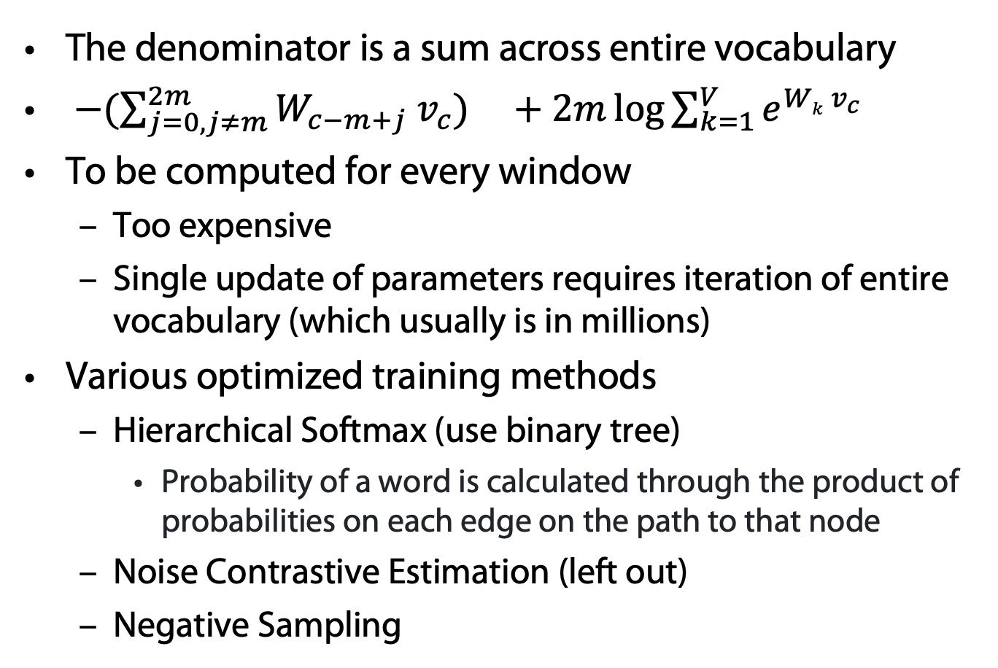
Softmax is a Bottleneck (CBOW and Skip-Gram)
Rong, X. word2vec Parameter Learning Explained (cite arxiv:1411.2738). 2014.
The denominator is a sum across entire vocabulary
$−(\sum_{j=0, j≠m}^{2m}{W_{c−m+j}{ v}_{c}}) +2m\log{\sum_{k=1}^{V}{e^{Wk{ v}_{c}}}}$
To be computed for every window
  Too expensive
  Single update of parameters requires iteration of entire vocabulary (which usually is in millions)
Various optimized training methods
  Hierarchical Softmax (use binary tree)
    Probability of a word is calculated through the product of probabilities on each edge on the path to that node
  Noise Contrastive Estimation (left out)
  Negative Sampling

Slide 61
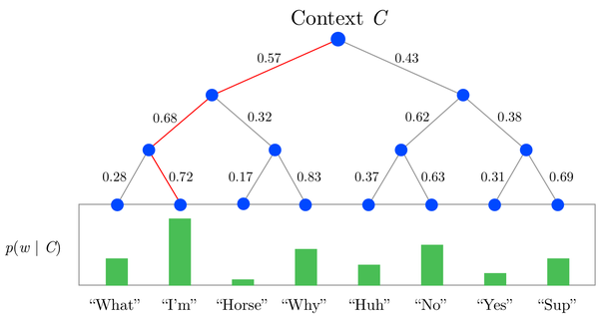
Tree for Computing Word Probabilities

Slide 62
Hierarchical softmax using Trees
target word
Replace computation with V vectors of target words
by computation with log(V) vectors
Need to learn
word history
path to
target word
at node j
predicted word
vector
vector at node j
of target word
sigmoid
ch(n) = left(+) or right child(-)
Mikolov, T., Chen, K., Corrado, G., Dean, J.:
Efficient Estimation of Word Representations in Vector Space.
In: ICLR Workshop. 2013.

Slide 63
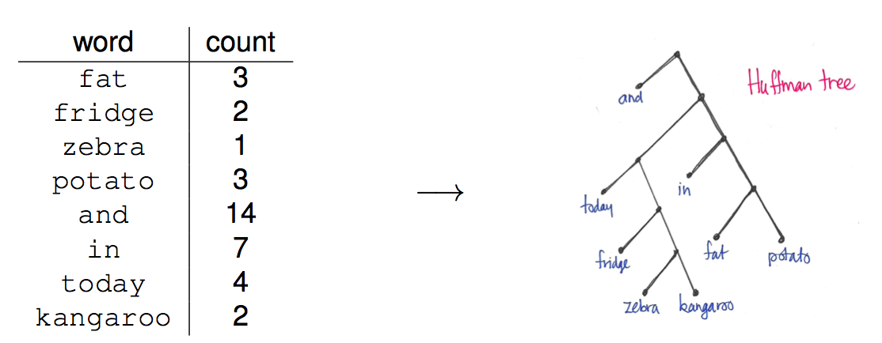
Huffman Trees instead of Balanced Trees

Slide 64
Noise-Contrastive Estimation
Conditional probability of word w in the data:
Conditional probability that word w comes
from data D and not from the noise distribution:
  Auxiliary binary classification problem:
    Positive examples (data) vs. negative examples (noise)
  Scaling factor k: noisy samples k times more likely than data samples
    Noise distribution: based on unigram word probabilities
  Empirically, model can cope with un-normalized probabilities:
A. Mnih and K. Kavukcuoglu (2013) “Learning word embeddings efficiently with noise-contrastive estimation“,
In: Proc. NIPS, 2013
Tutorial on neural probabilistic language models, Piotr Mirowski, Microsoft Bing, 2014

Slide 65
Noise-Contrastive Estimation
Conditional probability that word w comes
from data D and not from the noise distribution:
  Auxiliary binary classification problem:
    Positive examples (data) vs. negative examples (noise)
  Scaling factor k: noisy samples k times more likely than data samples
    Noise distribution: based on unigram word probabilities
  Introduce log of difference between:
    score of word w under data distribution
    and unigram distribution score of word w
Tutorial on neural probabilistic language models, Piotr Mirowski, Microsoft Bing, 2014

Slide 66
Noise-Contrastive Estimation
New loss function to maximize:
Compare to Maximum Likelihood learning:
Tutorial on neural probabilistic language models, Piotr Mirowski, Microsoft Bing, 2014

Slide 67
Comparison
Noise contrastive estimation
Negative sampling
  Remove normalization term in probabilities
Compare to Maximum Likelihood learning:
Tutorial on neural probabilistic language models, Piotr Mirowski, Microsoft Bing, 2014

Slide 68
Skip-Grams with Negative Sampling (SGNS)
Marco saw a furry little wampimuk hiding in the tree.
Distributed Representations of Words and Phrases and their Compositionality
Tomas Mikolov, Ilya Sutskever, Kai Chen, Greg Corrado, Jeffrey Dean, NIPS 2013
Notes:
And we want to understand what a wampimuk is.

Slide 69

Skip-Grams with Negative Sampling (SGNS)
Marco saw a furry little wampimuk hiding in the tree.
words contexts
wampimuk furry
wampimuk little
wampimuk hiding
wampimuk in
… …
$D$ (data)
“word2vec Explained…”
Goldberg & Levy, arXiv 2014
Notes:
What SGNS does is take the context words around “wampimuk”,
And in this way,
Constructs a dataset of word-context pairs, D.

Slide 70


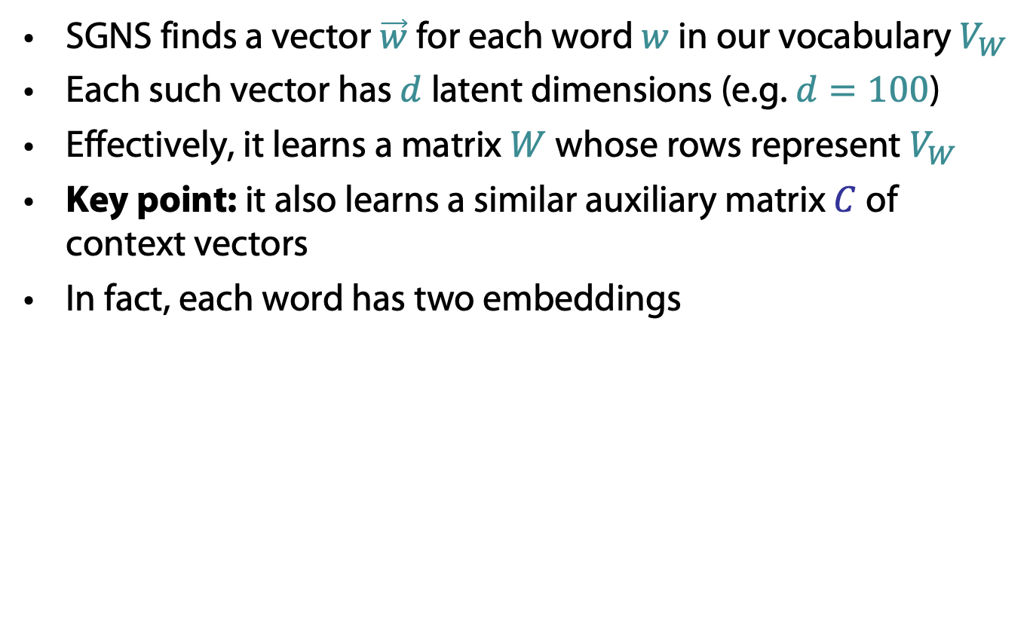
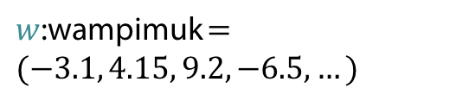







Skip-Grams with Negative Sampling (SGNS)
SGNS finds a vector $\vec{w}$ for each word $w$ in our vocabulary $V_{W}$
Each such vector has $d$ latent dimensions (e.g. $d=100$)
Effectively, it learns a matrix $W$ whose rows represent $V_{W}$
Key point: it also learns a similar auxiliary matrix $C$ of context vectors
In fact, each word has two embeddings
$$d$$
$$d$$
$d$ was called $N$ before
$$W$$
$w$:wampimuk $=(−3.1, 4.15, 9.2, −6.5,…)$
$$C$$
$$V_{W}$$
$$V_{C}$$
$$≠$$
$c$:wampimuk $=(−5.6, 2.95, 1.4, −1.3,…)$
“word2vec Explained…”
Goldberg & Levy, arXiv 2014
Notes:
Now, using D,
SGNS is going to learn a vector for each word in the vocabulary
A vector of say… 100 latent dimensions.
Effectively, it’s learning a matrix W,
Where each row is a vector that represents a specific word.
Now, a key point in understanding SGNS,
Is that it also learns an auxiliary matrix C of context vectors
So in fact, each word has two different embeddings
Which are not necessarily similar.

Slide 71
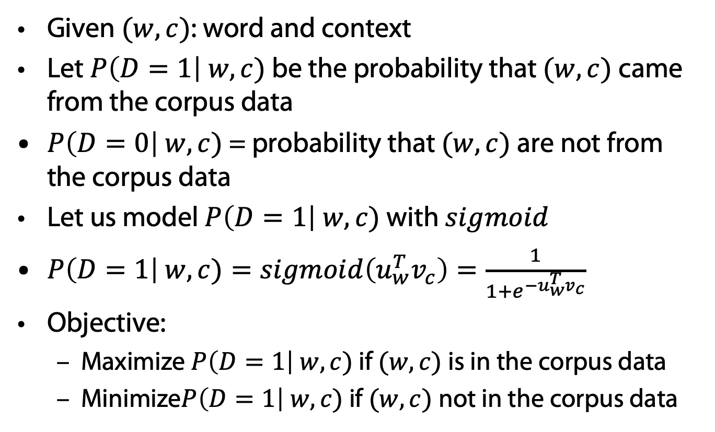

Coming back to Negative Sampling
Given $(w, c)$: word and context
Let $P\left(D=1\right| w, c)$ be the probability that $(w, c)$came from the corpus data
$P\left(D=0\right| w, c)$ = probability that $(w, c)$are not from the corpus data
Let us model $P\left(D=1\right| w, c)$ with $sigmoid$
$P\left(D=1\right| w, c)=sigmoid\left(u_{w}^{T}v_{c}\right)=\frac{1}{1+e^{−u_{w}^{T}v_{c}}}$
Objective:
  Maximize $P\left(D=1\right| w, c)$ if $(w, c)$is in the corpus data
  Minimize$P\left(D=1\right| w, c)$ if $(w, c)$not in the corpus data
$$u_{v}=Ww v_{c}=Cc$$
Distributed Representations of Words and Phrases and their Compositionality
Tomas Mikolov, Ilya Sutskever, Kai Chen, Greg Corrado, Jeffrey Dean, NIPS 2013

Slide 72

Skip-Grams with Negative Sampling (SGNS)
Maximize: $σ\left(\vec{w}⋅\vec{c_{ }}\right)$
  $c$ was observed with $w$
words contexts
wampimuk furry
wampimuk little
wampimuk hiding
wampimuk in
“word2vec Explained…”
Goldberg & Levy, arXiv 2014
Notes:
…SGNS maximizes the similarity between word and context vectors that were observed together.

Slide 73

Skip-Grams with Negative Sampling (SGNS)
Maximize: $σ\left(\vec{w}⋅\vec{c_{ }}\right)$
  $c$ was observed with $w$
words contexts
wampimuk furry
wampimuk little
wampimuk hiding
wampimuk in
Minimize: $σ\left(\vec{w}⋅\vec{c_{ }}′\right)$
  $c′$ was hallucinated with $w$
words contexts
wampimuk Australia
wampimuk cyber
wampimuk the
wampimuk 1985
“word2vec Explained…”
Goldberg & Levy, arXiv 2014
Notes:
…and minimizes the similarity between word and context vectors hallucinated together.

Slide 74


Math behind Negative Sampling
Maximum Likelihood approach for learning 𝜃 $=\left(W, C\right)$
$$u_{v}=Ww v_{c}=Cc$$
Distributed Representations of Words and Phrases and their Compositionality
Tomas Mikolov, Ilya Sutskever, Kai Chen, Greg Corrado, Jeffrey Dean, NIPS 2013

Slide 75



Math behind Negative Sampling
Maximize log likelihood = minimize –log likelihood
$\tilde{D}$ is the negative corpus with wrong contexts
Generate $\tilde{D}$ on the fly by randomly sampling from the vocabulary
New objective function for observing context word $w_{c−m+j}$ $(j=0..2m)$ given the center word $w_{c}$ would be
Sigmoid

Slide 76

Skip-Grams with Negative Sampling (SGNS)
“Negative Sampling”
SGNS samples $k$ contexts $c^{′}$ at random
as negative examples
“Random” = unigram distribution
$$P_{ }^{ }\left(c\right)=\frac{\#c}{\sum_{c^{′}∈V_{C}}{{\left(\#c^{′}\right)}^{}}}$$
Changing this distribution has a significant effect
Distributed Representations of Words and Phrases and their Compositionality
Tomas Mikolov, Ilya Sutskever, Kai Chen, Greg Corrado, Jeffrey Dean, NIPS 2013
Notes:
Now, the way SGNS hallucinates is really important.
It’s actually where it gets its name from.
For each observed word-context pair,
SGNS samples k contexts at random,
As negative examples
Now, when we say random, we mean the unigram distribution
And Spoiler Alert: changing this distribution has quite a significant effect.

Slide 77


Context Distribution Smoothing
In practice, it’s a smoothed
unigram distribution
$$P_{ }^{0.75}\left(c\right)=\frac{{\left(\#c\right)}^{0.75}}{\sum_{c^{′}∈V_{C}}{{\left(\#c^{′}\right)}^{0.75}}}$$
This little change makes a big difference
Distributed Representations of Words and Phrases and their Compositionality
Tomas Mikolov, Ilya Sutskever, Kai Chen, Greg Corrado, Jeffrey Dean, NIPS 2013
Notes:
In practice, it’s actually a smoothed unigram distribution.
And this tiny little change, makes quite a big difference.

Slide 78


Context Distribution Smoothing
We can adapt context distribution smoothing to PMI!
Replace $P(c)$ with $P_{ }^{0.75}\left(c\right)$
$$PMI^{0.75}\left(w,c\right)=\log{\frac{P(w,c)}{P\left(w\right)⋅P^{0.75}\left(c\right)}}$$
Consistently improves
PMI on every task
Always use Context
Distribution Smoothing!
Notes:
Now, what’s neat about context distribution smoothing
Is that we can adapt it to PMI!
This is done by simply replacing the probability of C with the smoothed probability.
Just like this:
And this tweak consistently improves performance on every task.
So if there’s one technical detail you should remember from this talk, it’s this:
Always use context distribution smoothing!

Slide 79





Math behind CBOW with Negative Sampling
Likewise for CBOW
Objective:
  where $\{{\tilde{u}}_{k} | k=1..K\}$ is sampled from vocabulary
  (also use context distribution smoothing)
Rather than:

Slide 80




What is SGNS learning?
Take SGNS’s embedding matrices ($W$ and $C$)
$$d$$
$$d$$
$$W$$
$$C$$
$$V_{W}$$
$$V_{C}$$
“Neural Word Embeddings as Implicit Matrix Factorization”
Levy & Goldberg, NIPS 2014
Notes:
If we take the embedding matrices

Slide 81





What is SGNS learning?
Take SGNS’s embedding matrices ($W$ and $C$)
Multiply them
What do you get?
$$d$$
$$W$$
$$V_{C}$$
$$V_{W}$$
$$d$$
$$C$$
“Neural Word Embeddings as Implicit Matrix Factorization”
Levy & Goldberg, NIPS 2014
Notes:
And multiply them
What do we get?

Slide 82





What is SGNS learning?
A $V_{W}×V_{C}$ matrix
Each cell describes the relation between a specific word-context pair
$\vec{w}⋅\vec{c}= ?$
$$d$$
$$V_{C}$$
$$W$$
$$V_{C}$$
$$?$$
$$V_{W}$$
$$d$$
$$C$$
$$=$$
$$V_{W}$$
“Neural Word Embeddings as Implicit Matrix Factorization”
Levy & Goldberg, NIPS 2014
Notes:
We get a pretty big, square matrix,
Where each cell describes the relation between a specific word, w,
With a specific context, c.

Slide 83

What is SGNS learning?
Levy&Goldberg [2014] proved that for large enough $d$ and enough iterations …
$$d$$
$$V_{C}$$
$$W$$
$$V_{C}$$
$$?$$
$$V_{W}$$
$$d$$
$$C$$
$$=$$
$$V_{W}$$
“Neural Word Embeddings as Implicit Matrix Factorization”
Levy & Goldberg, NIPS 2014
Notes:
So in our NIPS paper, we proved that with enough dimensions and iterations…

Slide 84


What is SGNS learning?
Levy&Goldberg [2014] proved that for large enough $d$ and enough iterations …
… one obtains the word-context PMI matrix
$$d$$
$$V_{C}$$
$$W$$
$$V_{C}$$
$$M^{PMI}$$
$$V_{W}$$
$$d$$
$$C$$
$$=$$
$$V_{W}$$
“Neural Word Embeddings as Implicit Matrix Factorization”
Levy & Goldberg, NIPS 2014
Notes:
…SGNS will converge to the classic word-context PMI matrix…

Slide 85



What is SGNS learning?
Levy&Goldberg [2014] proved that for large enough $d$ and enough iterations …
… one obtains the word-context PMI matrix …
shifted by a global constant
$Opt\left(\vec{w}⋅\vec{c}\right)=PMI\left(w,c\right)−\log{k}$
$$d$$
$$V_{C}$$
$$W$$
$$V_{C}$$
$$M^{PMI}$$
$$V_{W}$$
$$d$$
$$C$$
$$=$$
$$V_{W}$$
$$−\log{k}$$
where $k$ is the number of negative examples
“Neural Word Embeddings as Implicit Matrix Factorization”
Levy & Goldberg, NIPS 2014
Notes:
…with a little twist.
Now, recall that k is the number of negative samples generated for each positive example (w,c) \in D.
This is of course the optimal value, and not necessarily what we get in practice.

Slide 86
What is SGNS learning?
SGNS is doing something very similar to the older approaches
SGNS factorizes the traditional word-context PMI matrix
So does SVD!
Notes:
So to sum it up, SGNS is doing what we’ve been doing in NLP for a couple of decades:
It’s factorizing the PMI matrix,
Apparently, just like SVD.
And, while I didn’t explain it, GloVe also factorizes a similar matrix.

Slide 87
But embeddings are still better, right?
Plenty of evidence that embeddings outperform traditional methods
  “Don’t Count, Predict!” (Baroni et al., ACL 2014)
  GloVe (Pennington et al., EMNLP 2014)
How does this fit with our story?
Marco Baroni, Georgiana Dinu, Germán Kruszewski. Don’t count, predict! A systematic comparison of context-counting vs. context-predicting semantic vectors. In: Proc. ACL-14, 238–247, 2014.
Jeffrey Pennington, Richard Socher, Christopher Manning.
GloVe: Global Vectors for Word Representation.
In: Proc. EMNLP-.14, 1532–1543, 2014.
Notes:
But embeddings are still better, right?
There’s plenty of evidence,
Even a couple of papers.
So how does this fit with our story?

Slide 88
The Big Impact of “Small” Hyperparameters
word2vec & GloVe are more than just algorithms…
Introduce new hyperparameters
May seem minor, but make a big difference in practice
Notes:
So like I said at the beginning, word2vec and GloVe are more than just algorithms.
They introduce many new hyperparameters,
Which may seem minor,
but as it turns out, they make a pretty big difference in practice.

Slide 89
New Hyperparameters
Preprocessing (word2vec)
  Dynamic Context Windows
  Subsampling of Frequent Words
  Deleting Rare Words
Postprocessing (GloVe)
  Adding Context Vectors
Association Metric (SGNS)
  Shifted PMI
  Context Distribution Smoothing
Notes:
…we’ll look at Context Distribution Smoothing,
and see how we can adapt it to traditional count-based methods.

Slide 90
Dynamic Context Windows
Marco saw a furry little wampimuk hiding in the tree.
Notes:
So dynamic context windows
Let’s say we have our sentence from earlier,
And we want to look at a context window of 4 words around wampimuk.

Slide 91
Dynamic Context Windows
Marco saw a furry little wampimuk hiding in the tree.
Notes:
Now, some of these context words are obviously more related to the meaning of wampimuk than others.
The intuition behind dynamic context windows, is that the closer the context is to the target…

Slide 92

Dynamic Context Windows
Marco saw a furry little wampimuk hiding in the tree.
Word2vec: $\frac{1}{4}$ $\frac{2}{4}$ $\frac{3}{4}$ $\frac{4}{4}$ $\frac{4}{4}$ $\frac{3}{4}$ $\frac{2}{4}$ $\frac{1}{4}$
GloVe: $\frac{1}{4}$ $\frac{1}{3}$ $\frac{1}{2}$ $\frac{1}{1}$ $\frac{1}{1}$ $\frac{1}{2}$ $\frac{1}{3}$ $\frac{1}{4}$
Aggressive: $\frac{1}{8}$ $\frac{1}{4}$ $\frac{1}{2}$ $\frac{1}{1}$ $\frac{1}{1}$ $\frac{1}{2}$ $\frac{1}{4}$ $\frac{1}{8}$
The Word-Space Model (Sahlgren, 2006)
Magnus Sahlgren, The Word-Space Model,
Dissertation, Stockholm Univ., 2006.
Notes:
…the more relevant it is.
word2vec does just that, by randomly sampling the size of the context window around each token.
What you see here are the probabilities that each specific context word will be included in the training data.
GloVe also does something similar, but in a deterministic manner, and with a slightly different distribution.
There are of course other ways to do this,
And they were all, apparently,
Applied to traditional algorithms about a decade ago.

Slide 93


Subsampling of Frequent Words
Counter imbalance of rare and frequent words
Each word in the training set is discarded with a probability computed by
where $f(w_{i})$ is the number of occurrences of word $w_{i}$ and $t$ is a chosen threshold
Distributed Representations of Words and Phrases and their Compositionality
Tomas Mikolov, Ilya Sutskever, Kai Chen, Greg Corrado, Jeffrey Dean, NIPS 2013

Slide 94

Adding Context Vectors
SGNS creates word vectors $\vec{w}$
SGNS creates auxiliary context vectors $\vec{c}$
  So do GloVe and SVD
Instead of just $\vec{w}$
Represent a word as: $\vec{w}+\vec{c}$
Introduced by Pennington et al. (2014)
Only applied to GloVe
Notes:
So, each word has two representations, right?
So what if instead of using just the word vectors,
We’d also use the information in the context vectors,
to represent our words?
This trick was introduced as part of GloVe,
But it was also only applied to GloVe,
and not to the other methods.

Slide 95
Don’t Count, Predict! ?
“word2vec is better than count-based methods”
[Baroni et al., 2014]
Hyperparameter settings account for most of the reported gaps in count-based approaches
Embeddings do not really outperform count-based methods
No unique conclusion available
Marco Baroni, Georgiana Dinu, Germán Kruszewski. Don’t count, predict! A systematic comparison of context-counting vs. context-predicting semantic vectors. In: Proc. ACL-14, 238–247, 2014.
Notes:
So, in “don’t count, predict”,
The authors show that word2vec is better than count-based methods.
And, while they did tune a lot of different hyperparameters,
Other hyperparameters remained hidden inside the code.
And it turns out,
That these hidden hyperparameters account for most of the reported performance gaps.
In our experiments, we show that embeddings are not really better than count-based methods.

Slide 96
Problem
Learn low-dimensional, dense representations (or embeddings) for documents.
Document embeddings can be used off-the-shelf to solve many IR applications such as,
  Document Classification
  Document Retrieval
  Document Ranking
Doc2Sent2Vec: A Novel Two-Phase Approach for Learning Document Representation, Ganesh J, Manish Gupta, Vasudeva Varma

Slide 97
Power of 2Vec Representations
Bag-of-words (BOW) or Bag-of-n-grams
  Data sparsity
  High dimensionality
  Not/hardly capturing word order
Latent Dirichlet Allocation (LDA)
  Computationally inefficient for larger dataset.
Paragraph Vector
  Dense representation
  Compact representation
  Captures word order
  Efficient to estimate
Doc2Sent2Vec: A Novel Two-Phase Approach for Learning Document Representation, Ganesh J, Manish Gupta, Vasudeva Varma

Slide 98


Represent the meaning of sentence/paragraph/doc
Paragraph Vector (Le and Mikolov, 2014)
  Extend word2vec to text level
  Also two models: add paragraph vector as the input
Quoc Le and Tomas Mikolov. Distributed representations of sentences and documents. In Proceedings ICML'14. 2014.

Slide 99
Paragraph Vector
Learn document embedding by predicting the next word in the document using the context of the word and the (‘unknown’) document vector as features.
Resulting vector captures the topic of the document.
Update the document vectors, but not the word vectors [Le et al.]
Update the document vectors, along with the word vectors [Dai et al.]
  Improvement in the accuracy for document similarity tasks.
Quoc Le and Tomas Mikolov. Distributed representations of sentences and documents. In Proceedings ICML'14. 2014.
Dai, A.M., Olah, C., Le, Q.V., Corrado, G.S.: Document embedding with paragraph vectors. In: NIPS Deep Learning Workshop. 2014
Doc2Sent2Vec: A Novel Two-Phase Approach for Learning Document Representation, Ganesh J, Manish Gupta, Vasudeva Varma

Slide 100
Doc2Sent2Vec Idea - Being granular helps
Should we learn the document embedding from the word context directly?
Can we learn the document embedding from the sentence context?
  Explicitly exploit the sentence-level and word-level coherence to learn document and sentence embedding respectively.
Doc2Sent2Vec: A Novel Two-Phase Approach for Learning Document Representation, Ganesh J, Manish Gupta, Vasudeva Varma

Slide 101
Notation
Document Set: D = {d₁, d₂, …, d_{M}}; ‘M’ documents;
Document: d_{m} = {s(m,1), s(m,2), …, s(m,T_{m})}; ‘T_{m}’ sentences;
Sentence: s(m,n) = {w(n,1), w(n,2), …, w(n,T_{n})}; ‘T_{n}’ words;
Word: w(n,t);
Doc2Sent2Vec’s goal is to learn low-dimensional representations of words, sentences and documents as a continuous feature vector of dimensionality D_{w} , D_{s} and D_{d} respectively.
Doc2Sent2Vec: A Novel Two-Phase Approach for Learning Document Representation, Ganesh J, Manish Gupta, Vasudeva Varma

Slide 102

Architecture Diagram
Doc2Sent2Vec: A Novel Two-Phase Approach for Learning Document Representation, Ganesh J, Manish Gupta, Vasudeva Varma

Slide 103
Phase 1: Learn Sentence Embedding
Idea: Learn sentence representation from the word sequence within the sentence.
Input Features:
  Context words for target word w(n,t): w(n,t-c_{w}), …, w(n,t-1), w(n,t+1), …, w(n,t+c_{w}) (where ‘c_{w}’ is the word context size)
  Target Sentence: s(m,n) (where ‘m’ is the document id)
Output: w(n,t)
Task: Predict the target word using the concatenation of word vectors of context words along with the sentence vector as features.
  Maximize the word likelihood:
  L_{word} = P(w(n,t)| w(n,t-c_{w}), …, w(n,t-1), w(n,t+1), …, w(n,t+c_{w}), s(m,n))
Doc2Sent2Vec: A Novel Two-Phase Approach for Learning Document Representation, Ganesh J, Manish Gupta, Vasudeva Varma

Slide 104
Phase 2: Learn Document Embedding
Idea: Learn document representation from the sentence sequence within the document.
Input Features:
  Context sentences for target sentence s(m,t): s(m,t-c_{s}), …, s(m,t-1), s(m,t+1), …, s(m,t+c_{S}) (where ‘c_{S}’ is the sentence context size)
  Target Document: d(m)
Output: s(m,t)
Novel Task: Predict the target sentence using the concatenation of sentence vectors of context sentences along with the document vector as features.
  Maximize the sentence likelihood:
    L_{sent} = P(s(m,t)| s(m,t-c_{s}), …, s(m,t-1), s(m,t+1), …, s(m,t+c_{S}), d(m))
Doc2Sent2Vec: A Novel Two-Phase Approach for Learning Document Representation, Ganesh J, Manish Gupta, Vasudeva Varma

Slide 105
Training
Overall objective function: L = L_{word} + L_{sent}
Use Stochastic Gradient Descent (SGD) to learn parameters
Use Hierarchical Softmax (Mikolov et al.) to facilitate faster training
Doc2Sent2Vec: A Novel Two-Phase Approach for Learning Document Representation, Ganesh J, Manish Gupta, Vasudeva Varma

Slide 106
Latent Relational Structures
Processing natural language data:
Tokenization/Sentence Splitting
Part-of-speech (POS) tagging
Phrase chunking
Named entity recognition
Coreference resolution
Semantic role labeling
Ronan Collobert and Jason Weston. A unified architecture for natural language processing: deep neural networks with multitask learning. In Proceedings ICML '08. pp. 160–167. 2008.
An Introduction to Machine Learning and Natural Language Processing Tools, , V. Srikumar, M. Sammons, N. Rizzolo

Slide 107
Phrase Chunking
Identifies phrase-level constituents in sentences
  [NP Boris] [ADVP regretfully] [VP told] [NP his wife]
  [SBAR that] [NP their child] [VP could not attend] [NP night school] [PP without] [NP permission] .
Useful for filtering: identify e.g. only noun phrases, or only verb phrases
Used as source of features, e.g. distance, (abstracts away determiners, adjectives, for example), sequence,…
  More efficient to compute than full syntactic parse
  Applications in e.g. Information Extraction – getting (simple) information about concepts of interest from text documents
Hand-crafted chunkers (regular expressions/finite automata)
HMM/CRF-based chunk parsers derived from training data
An Introduction to Machine Learning and Natural Language Processing Tools, , V. Srikumar, M. Sammons, N. Rizzolo

Slide 108
Named Entity Recognition
Identifies and classifies strings of characters representing proper nouns
[PER Neil A. Armstrong] , the 38-year-old civilian commander, radioed to earth and the mission control room here: “[LOC Houston] , [ORG Tranquility] Base here; the Eagle has landed."
Useful for filtering documents
  “I need to find news articles about organizations in which Bill Gates might be involved…”
Disambiguate tokens: “Chicago” (team) vs. “Chicago” (city)
Source of abstract features
  E.g. “Verbs that appear with entities that are Organizations”
  E.g. “Documents that have a high proportion of Organizations”
An Introduction to Machine Learning and Natural Language Processing Tools, , V. Srikumar, M. Sammons, N. Rizzolo

Slide 109
Named Entity Recogniton: Definition
NE involves identification of proper names in texts, and classification into a set of predefined categories of interest
  Three universally accepted categories: person, location and organisation
  Other common tasks: recognition of date/time expressions, measures (percent, money, weight etc), email addresses etc.
  Other domain-specific entities: names of drugs, medical conditions, names of ships, bibliographic references etc
NER ist not easy
“Introduction to Named Entity Recognition”, University of Sheffield

Slide 110
Named Entity Classification
Category definitions are intuitively quite clear, but there are many grey areas.
Many of these grey areas are caused by metonymy.
  Person vs. Artefact: “The ham sandwich wants his bill.” vs “Bring me a ham sandwich.”
  Organisation vs. Location : “England won the World Cup” vs. “The World Cup took place in England”.
  Company vs. Artefact: “shares in MTV” vs. “watching MTV”
  Location vs. Organisation: “she met him at Heathrow” vs. “the Heathrow authorities”
“Introduction to Named Entity Recognition”, University of Sheffield

Slide 111
Basic Problems in NE
Variation of NEs – e.g. John Smith, Mr Smith, John.
Ambiguity of NE types
  John Smith (company vs. person)
  May (person vs. month)
  Washington (person vs. location)
  1945 (date vs. time)
Ambiguity with common words, e.g. “may”
“Introduction to Named Entity Recognition”, University of Sheffield

Slide 112
More complex problems in NER
Issues of style, structure, domain, genre etc.
  Punctuation, spelling, spacing, formatting, ….all have an impact
Dept. of Computing and Maths
Manchester Metropolitan University
Manchester
United Kingdom
> Tell me more about Leonardo
> Da Vinci
“Introduction to Named Entity Recognition”, University of Sheffield

Slide 113
List Lookup Approach
System that recognises only entities stored in its lists (gazetteers).
Advantages - Simple, fast, language independent, easy to retarget
Disadvantages – collection and maintenance of lists, cannot deal with name variants, cannot resolve ambiguity
“Introduction to Named Entity Recognition”, University of Sheffield

Slide 114
Shallow Parsing Approach
Internal evidence – names often have internal structure. These components can be either stored or guessed.
location:
CapWord + {City, Forest, Center}
e.g. Sherwood Forest
Cap Word + {Street, Boulevard, Avenue, Crescent, Road}
e.g. Portobello Street
“Introduction to Named Entity Recognition”, University of Sheffield

Slide 115
Shallow Parsing Approach
External evidence - names are often used in very predictive local contexts
Location:
“to the” COMPASS “of” CapWord
e.g. to the south of Loitokitok
“based in” CapWord
e.g. based in Loitokitok
CapWord “is a” (ADJ)? GeoWord
e.g. Loitokitok is a friendly city
“Introduction to Named Entity Recognition”, University of Sheffield

Slide 116
Difficulties in Shallow Parsing Approach
Ambiguously capitalised words (first word in sentence)
[All American Bank] vs. All [State Police]
Semantic ambiguity
“John F. Kennedy” = airport (location)
“Philip Morris” = organisation
Structural ambiguity
[Cable and Wireless] vs. [Microsoft] and [Dell]
[Center for Computational Linguistics] vs. message from [City Hospital] for [John Smith].
“Introduction to Named Entity Recognition”, University of Sheffield

Slide 117
Coreference
Identify all phrases that refer to each entity of interest – i.e., group mentions of concepts
[Neil A. Armstrong] , [the 38-year-old civilian commander], radioed to [earth]. [He] said the famous words, “[the Eagle] has landed”."
The Named Entity Recognizer only gets us part-way…
…if we ask, “what actions did Neil Armstrong perform?”, we will miss many instances (e.g., “He said…”)
Coreference resolver abstracts over different ways of referring to the same person
  Useful in feature extraction, information extraction
An Introduction to Machine Learning and Natural Language Processing Tools, , V. Srikumar, M. Sammons, N. Rizzolo

Slide 118


Semantic Role Labeling (SRL)
SRL reveals relations and arguments in the sentence (where relations are expressed as verbs)
Cannot abstract over variability of expressing the relations – e.g. kill vs. murder vs. slay…
An Introduction to Machine Learning and Natural Language Processing Tools, , V. Srikumar, M. Sammons, N. Rizzolo

Slide 119
Why is SRL Important – Applications
Question Answering
  Q: When was Napoleon defeated?
  Look for: [_{PATIENT} Napoleon] [_{PRED} defeat-synset] [_{ARGM-TMP} *ANS*]
Machine Translation
  English (SVO) Farsi (SOV)
  [_{AGENT} The little boy] [_{AGENT} pesar koocholo] boy-little
  [_{PRED} kicked] [_{THEME} toop germezi] ball-red
  [_{THEME} the red ball] [_{ARGM-MNR} moqtam] hard-adverb
  [_{ARGM-MNR} hard] [_{PRED} zaad-e] hit-past
Document Summarization
  Predicates and Heads of Roles summarize content
Information Extraction
  SRL can be used to construct useful rules for IE
Automatic Semantic Role Labeling, S. Wen-tau Yih, K. Toutanova

Slide 120
Some History
Minsky 74, Fillmore 1976: Frames describe events or situations
  Multiple participants, “props”, and “conceptual roles”
  E.g., agent, instrument, target, time, …
Levin 1993: verb class defined by sets of frames (meaning-preserving alternations) a verb appears in
  {break,shatter,..}: Glass X’s easily; John Xed the glass, …
  Cut is different: The window broke; *The window cut.
FrameNet, late ’90s: based on Levin’s work: large corpus of sentences annotated with frames
PropBank
Marvin Minky. A Framework for Representing Knowledge Marvin Minsky,
MIT-AI Laboratory Memo 306, June, 1974.
Charles J. Fillmore, Frame semantics and the nature of language
Annals of the New York Academy of Sciences 280(1):20 – 32, 1976.
Levin, B. English Verb Classes and Alternations: A Preliminary Investigation, University of Chicago Press, Chicago, IL. 1993.
Automatic Semantic Role Labeling, S. Wen-tau Yih, K. Toutanova

Slide 121
FrameNet
Frame: Hit_target (hit, pick off, shoot)
Agent Target Instrument Manner | Means Place Purpose Subregion Time
Lexical units (LUs):
Words that evoke the frame
(usually verbs)
Core
Non-Core
Frame elements (FEs):
The involved semantic roles
  [_{Agent} Kristina] hit [_{Target} Scott] [_{Instrument} with a baseball] [_{Time} yesterday ].
Gildea, Daniel; Jurafsky, Daniel. "Automatic Labeling of Semantic Roles”. Computational Linguistics. 28 (3): 245–288. 2002.
Notes:
Moving toward statistical approaches for semantic role labeling, the first available corpus is FrameNet, which is developed in UC Berkeley. According to their definition, semantic frames are representations of situation types, such as eating or walking, together with lists of participants and conceptual roles that are components of such situations. For example, the frame shown on this slide is the hit_target situation.
In their terminology, there are two types of components of a frame. One is lexical units, which are words that evoke the frame, such as hit, pick off, and shoot here.
The other component is frame elements, which are the semantic roles involved in this frame.
Frame elements can be further categorized into 2 types, one is core elements, and the other is non-core frame elements.
------------------
http://framenet.icsi.berkeley.edu/index.php?option=com_wrapper&Itemid=118&frame=Hit_target&
What is a frame and how do you know when you've got one? Semantic frames are schematic representations of situation types (eating, spying, removing, classifying, etc.) together with lists of the kinds of participants, props, and other conceptual roles that are seen as components of such situations. The semantic arguments of a predicating word correspond to what we call the frame elements of the frame associated with that word.
In principle, work on a new frame begins with the native speaker analyst's intuitive judgment that some particular conceptual pattern underlies one or more lexical units in the language in a systematic way. We are satisfied with such judgments when we see that we can analyze sentences containing the words we've assigned to the frame in terms of the frame elements that we defined in characterizing the frame.
In real life, the actual experience is a kind of cognitive zigzag: a frame is proposed, and some words are suggested for illustrating the frame. Frame elements are suggested that the analyst thinks these words would have in common. In the course of doing some initial annotation, however, we often discover distinctions among the words that were not at first noticed, and often a slightly different version of the frame is formulated--one which no longer welcomes some of the words in the original list, but takes in some new ones.

Slide 122
Proposition Bank (PropBank)
Transfer sentences to propositions
  Kristina hit Scott → hit(Kristina,Scott)
Penn TreeBank → PropBank
  Add a semantic layer on Penn TreeBank
  Define a set of semantic roles for each verb
  Each verb’s roles are numbered
  …[A0 the company] to … offer [A1 a 15% to 20% stake] [A2 to the public]
  …[A0 Sotheby’s] … offered [A2 the Dorrance heirs] [A1 a money-back guarantee]
  …[A1 an amendment] offered [A0 by Rep. Peter DeFazio] …
  …[A2 Subcontractors] will be offered [A1 a settlement] …
Palmer M, Kingsbury P, Gildea D. "The Proposition Bank: An Annotated Corpus of Semantic Roles". Computational Linguistics. 31 (1): 71–106. 2005.
Notes:
The next corpus, which is the main focused data in this tutorial, is the proposition bank, or PropBank.
PropBank is developed in U Penn by a team led by Martha Palmer. The name of “proposition” comes from the goal of transferring sentences into propositions.

Slide 123
Semantic Role Labeling (SRL)
SRL reveals relations and arguments in the sentence (where relations are expressed as verbs)
Cannot abstract over variability of expressing the relations – e.g. kill vs. murder vs. slay…
An Introduction to Machine Learning and Natural Language Processing Tools, , V. Srikumar, M. Sammons, N. Rizzolo

