Slide 1
Intelligent Agents
Multi-Relational Latent Semantic Analysis
Ralf Möller
Universität zu Lübeck
Institut für Informationssysteme

Slide 2


Semantics Needs More Than Similarity
Tomorrow will be rainy.
Tomorrow will be sunny.
$similar($rainy, sunny$)$?
$antonym($rainy, sunny$)$?

Slide 3
Leverage Linguistic Knowledge
Can’t we just use the existing thesauri for information about synonyms and antonyms?
  Knowledge in these resources is never complete
  Often lack of “membership degree” for relations
    Various ways to measure “membership degree”
Goal: Create a representation that
  leverages existing rich linguistic resources,
  discovers new relations, and
  enables us to measure the “degree” of multiple relations (not just similarity)

Slide 4
Roadmap
Two opposite relations:
  Polarity Inducing Latent Semantic Analysis
Multiple relations:
  Multi-Relational Latent Semantic Analysis
Relational domain knowledge
Yih, Zweig & Platt. Polarity Inducing Latent Semantic Analysis. In EMNLP-CoNLL-12.
Chang, Yih & Meek. Multi-Relational Latent Semantic Analysis. In EMNLP-13.
Chang, Yih, Yang & Meek. Typed Tensor Decomposition of Knowledge Bases for Relation Extraction. In EMNLP-14.
EMNLP: Empirical Methods in Natural Language Processing
CoNLL: Computational Natural Language Learning
ACL; Annual Meeting of the Association for Computational Linguistics

Slide 5
Problem: Handling Two Opposite Relations
Can cope to some extent with homonyms and synonyms
due to word context
Embedding techniques cannot clearly distinguish antonyms
  “Distinguishing synonyms and antonyms is still perceived as a difficult open problem.” [Poon & Domingos 09]
Idea #1: Change the data representation
Synonyms: Different words, same meaning
Homonyms: Same words, different meanings
Antonyms: Opposite words
Hoifung Poon and Pedro Domingos. Unsupervised semantic parsing. In Proceedings EMNLP ‘09. 2009.

Slide 6
Encode Synonyms & Antonyms in Matrix
Joyfulness: joy, gladden; sorrow, sadden
Sad: sorrow, sadden; joy, gladden
Target word: row-vector
 | joy | gladden | sorrow | sadden | goodwill
Group 1: “joyfulness” | 1 | 1 | 1 | 1 | 0
Group 2: “sad” | 1 | 1 | 1 | 1 | 0
Group 3: “affection” | 0 | 0 | 0 | 0 | 1
Wen-tau Yih, Geoffrey Zweig, John Platt. Polarity Inducing Latent Semantic Analysis. In Proceedings EMNLP ‘12. 2012.

Slide 7

Encode Synonyms & Antonyms in Matrix
Joyfulness: joy, gladden; sorrow, sadden
Sad: sorrow, sadden; joy, gladden
Inducing polarity
Target word: row-vector
 | joy | gladden | sorrow | sadden | goodwill
Group 1: “joyfulness” | 1 | 1 | -1 | -1 | 0
Group 2: “sad” | -1 | -1 | 1 | 1 | 0
Group 3: “affection” | 0 | 0 | 0 | 0 | 1
Cosine Score: $+ Synonyms$

Slide 8
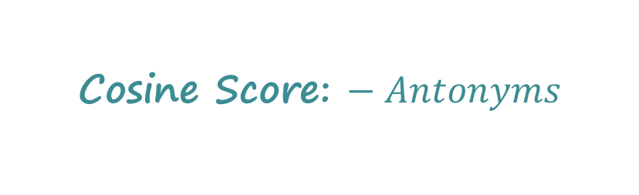
Encode Synonyms & Antonyms in Matrix
Joyfulness: joy, gladden; sorrow, sadden
Sad: sorrow, sadden; joy, gladden
Inducing polarity
Target word: row-vector
 | joy | gladden | sorrow | sadden | goodwill
Group 1: “joyfulness” | 1 | 1 | -1 | -1 | 0
Group 2: “sad” | -1 | -1 | 1 | 1 | 0
Group 3: “affection” | 0 | 0 | 0 | 0 | 1
Cosine Score: $− Antonyms$

Slide 9
Problem: How to Handle More Relations?
Limitation of the matrix representation
  Each entry captures a particular type of relation between two entities, or
  Two opposite relations with the polarity trick
Encoding other binary relations
  Is-A (hyponym) – ostrich is a bird
  Part-whole – engine is a part of car
Idea #2
  Encode multiple relations in a 3-way tensor
  (3-dim array)!
M. Nickel, V. Tresp, and H.-P. Kriegel. A three-way model for collective learning
on multi-relational data. In Proceedings of the 28th International Conference on
International Conference on Machine Learning, ICML’11, pages 809–816, 2011.

Slide 10



Encode Multiple Relations in Tensor
Represent word relations using a tensor
  Each slice encodes a relation between terms and target words.
gladden
gladden
joy
sadden
joy
sadden
feeling
feeling
joyfulness
1 | 1 | 0 | 0
1 | 1 | 0 | 0
0 | 0 | 1 | 0
0 | 0 | 0 | 0
joyfulness
0 | 0 | 0 | 0
0 | 0 | 1 | 0
1 | 0 | 0 | 0
0 | 0 | 0 | 0
gladden
gladden
sad
sad
anger
anger
Synonym layer
Antonym layer
Construct a tensor with two slices

Slide 11
Encode Multiple Relations in Tensor
Can encode multiple relations in the tensor
gladden
joy
sadden
feeling
1 | 1 | 0 | 0
1 | 1 | 0 | 0
0 | 0 | 1 | 0
0 | 0 | 0 | 0
1 | 1 | 0 | 0
1 | 1 | 0 | 0
0 | 0 | 1 | 0
0 | 0 | 0 | 0
0 | 0 | 0 | 1
0 | 0 | 0 | 0
0 | 0 | 0 | 1
0 | 0 | 0 | 1
joyfulness
gladden
sad
anger
Hyponym layer
Hyponym IS-A/TYPE-OF hypernym
Metonym: Substitute for another term
(substitute usually used for sth else)

Slide 12
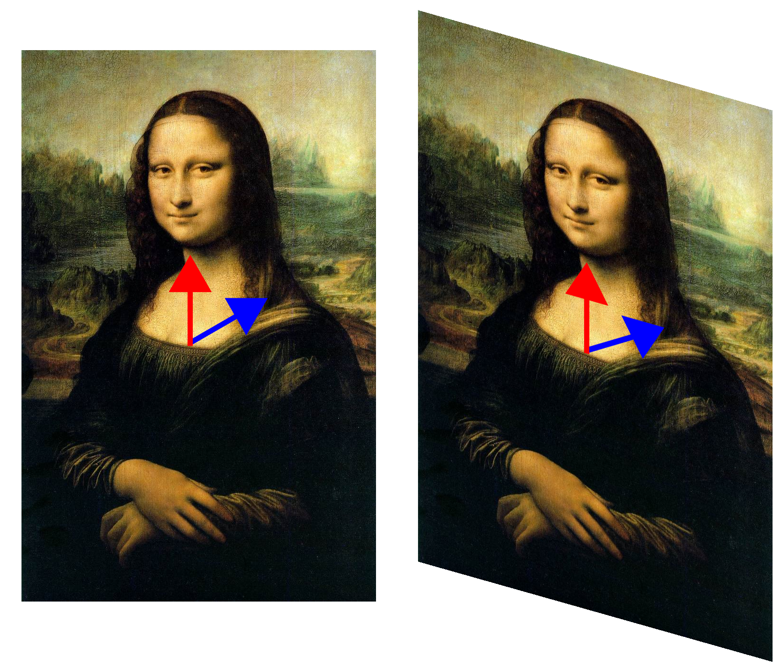
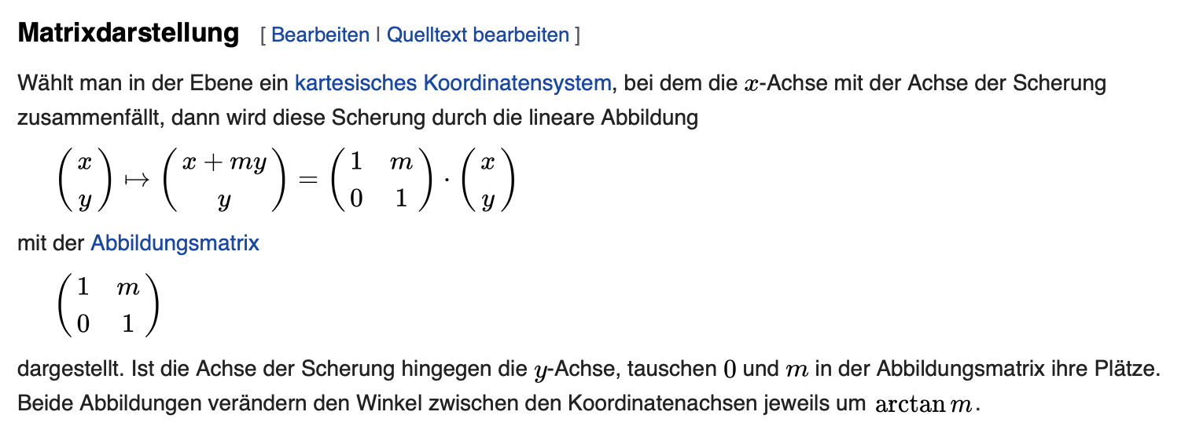

Wiederholung: Abbildung von Daten
Beispiel: Scherung
Der rote Pfeil ändert sich nicht
Eigenvektor
[Wikipedia]

Slide 13
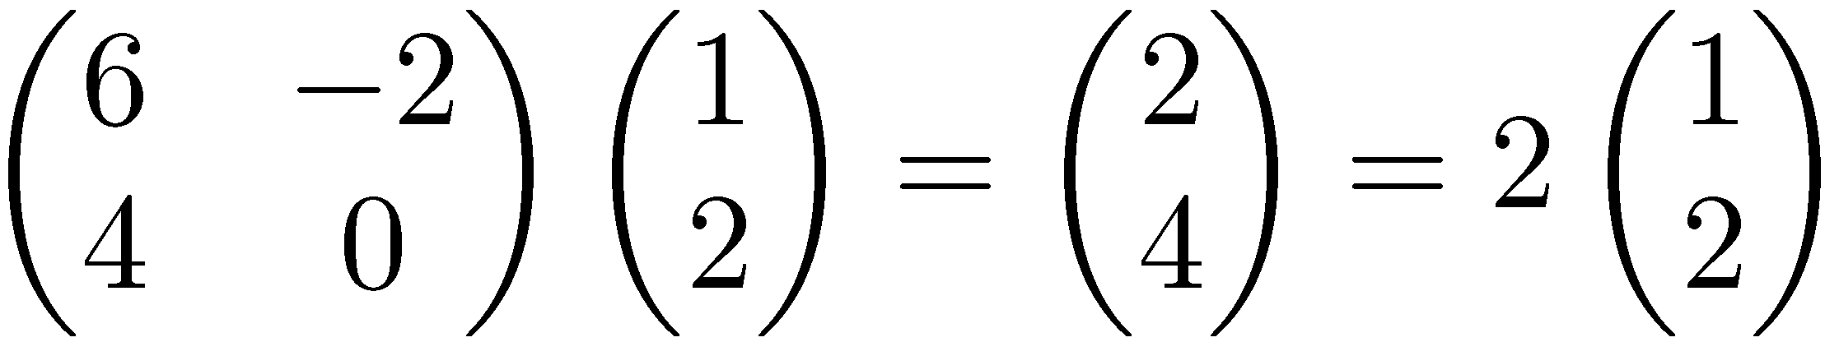
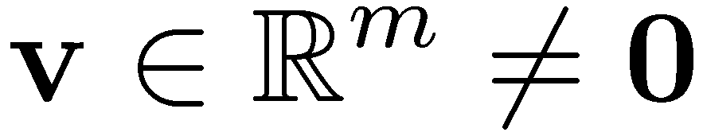

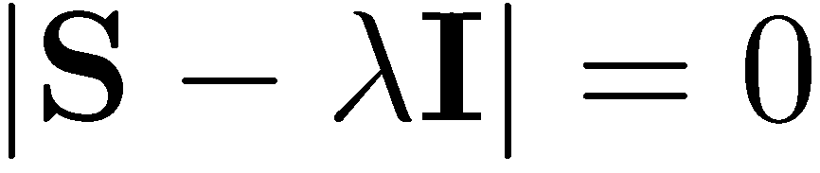
Eigenwerte und Eigenvektoren
Eigenvektoren (für eine quadratische m×m Matrix S)
Wie viele Eigenwerte gibt es maximal?
Beispiel
(rechter) Eigenvektor
Eigenwert
Determinante
Hat eine von 0 verschiedene Lösung falls
Gleichung m-ter Ordnung in λ mit maximal m verschiedenen Lösungen (Nullstellen des charakteristischen Polynoms)
– möglicherweise komplex, obwohl S real ist.

Slide 14


Singulärwertzerlegung
Für eine m×n Matrix A vom Rang r gibt es eine Faktorisierung
(Singulärwertzerlegung, engl. Singular Value Decomposition
= SVD) wie folgt:
m×m
m×n
n×n
Spalten von U: links-singuläre Eigenvektoren von AA^{T}
Spalten von V: rechts-singuläre Eigenvektoren von A^{T}A
Eigenwerte λ₁ … λ_{r} von AA^{T} sind Eigenwerte von A^{T}A
$$σ_{i}=\sqrt{λ_{i}}$$
$$Σ=diag(σ_{1},⋯,σ_{r})$$
Singulärwerte

Slide 15
Scherung mit Einheitsvektoren
A
T
A
T
[Wikipedia]

Slide 16

Approximation durch Matrix mit kleinem Rang
SVD kann zur Berechnung einer optimalen Approximation einer Matrix A vom Rang r durch eine Matrix A_{k} mit kleinerem Rang k verstanden werden
A_{k} und X sind beides m×n Matrizen
Typischerweise k << r
Frobenius-Norm

Slide 17
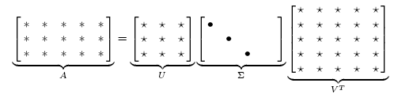

Approximation durch Matrix mit kleinem Rang
Optimierungsproblem k fix
Lösung mittels SVD
$$A_{k}=U∙diag(σ_{1},⋯,σ_{k}, 0,⋯,0)∙V^{T}$$
Setze kleinste r-k
Eigenwerte auf 0
Neue Dokumente
k
C. Eckart, G. Young, The approximation of a matrix by another of lower rank. Psychometrika, 1, 211-218, 1936

Slide 18
Anwendung zur Informationsrecherche
Eine Term-Dokument-Matrix kann m=50000, n=10 Millionen Einträge haben (Rang nah bei 50000)
Wir können eine Approximation A₁₀₀ konstruieren mit Rang 100 und kleinstem Frobenius-Fehler
  Auch Hauptkomponentenanalyse genannt
  (engl. Principle Component Analysis, PCA)
Die neue Matrix (siehe vorigen Präsentation)
definiert latente Merkmale
(keine verstehbaren Terme mehr) für die Informationsrecherche (Latent Semantic Indexing, LSI)

Slide 19
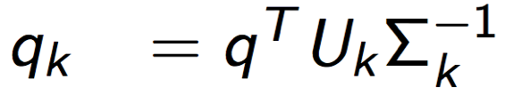

Wie behandeln wir Anfragen?
U_{k}
𝛴_{k}
q_{k}^{T}
q
Anfrage q (dünn besetzt)
Eine Anfrage q wird wie folgt in den LSI-Raum abgebildet
Anfrage q_{k} ist nicht dünn besetzt
Anfragebeantortung über k nächste Nachbarn (Cosinusabstand)

Slide 20
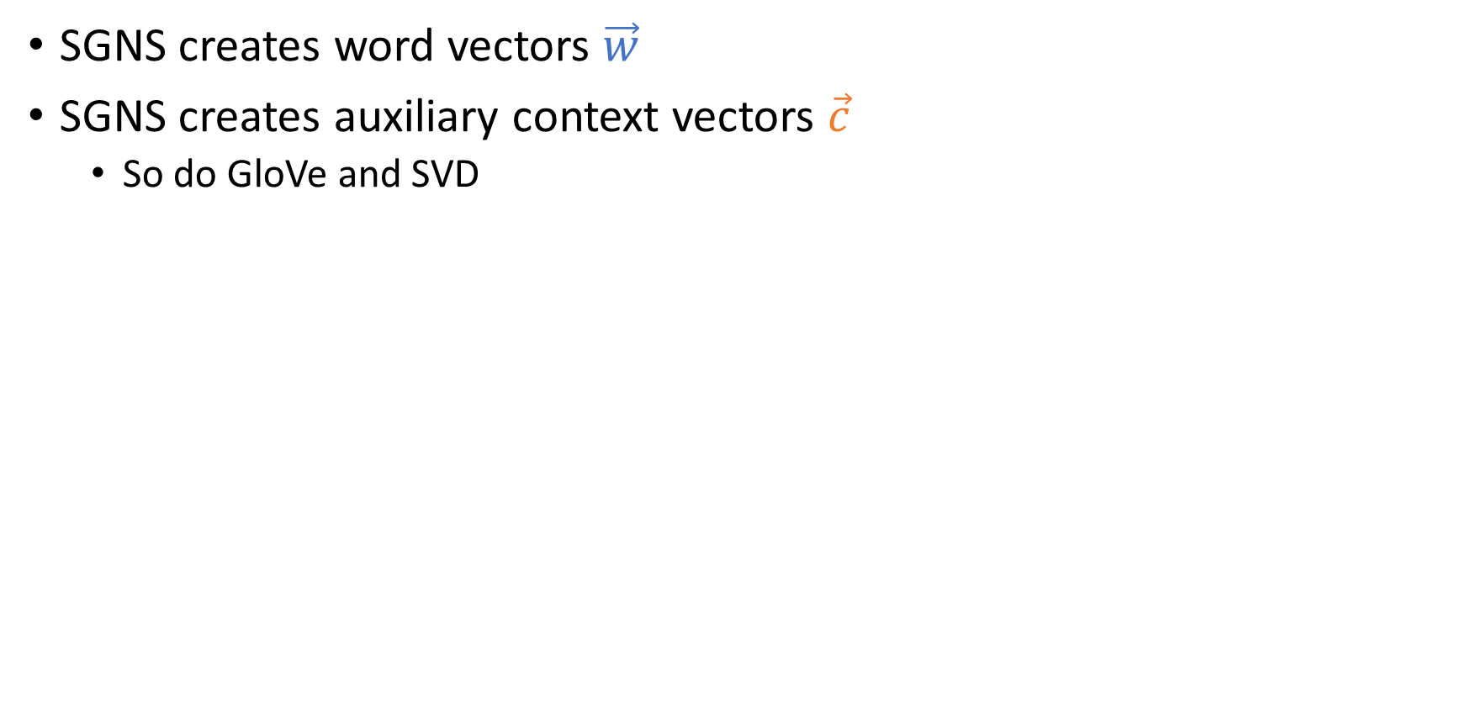



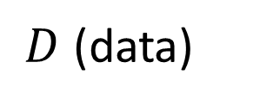



Tensor Decomposition – Analogy to SVD
Derive a low-rank approximation to generalize the data and to discover unseen relations
SVD
$$t_{1},t_{2},…, t_{n}$$
$$k$$
$$k$$
$$t_{1},t_{2},…, t_{n}$$
$$w_{1},w_{2},…, w_{d}$$
~
$$k$$
$$w_{1},w_{2},…, w_{d}$$
×
~
×
$$k$$
latent representation of words

Slide 21
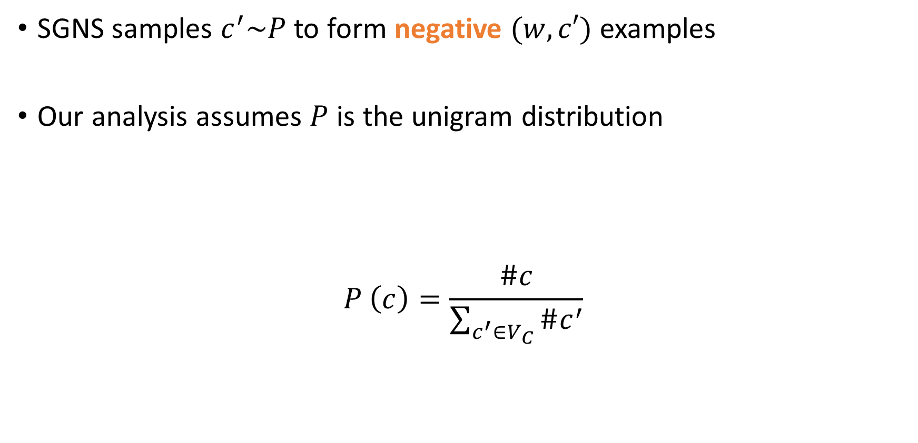

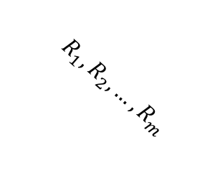

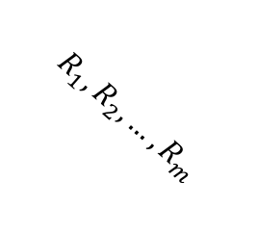
Tensor Decomposition – Analogy to SVD
Derive a low-rank approximation to generalize the data and to discover unseen relations
Apply Tucker decomposition and reformulate the results
(tensor factorization)
latent representation of a relation
(with k as a hyperparameter)
$$t_{1},t_{2},…, t_{n}$$
$$k$$
$$k$$
$$R_{1},R_{2},…, R_{m}$$
$$t_{1},t_{2},…, t_{n}$$
A
$$R_{1},R_{2},…, R_{m}$$
$$k$$
A^{T}
$$w_{1},w_{2},…, w_{d}$$
~
~
×
~
×
~
×
×
$$k$$
R_{k}
latent representation of words
Ledyard R. Tucker. "Some mathematical notes on three-mode factor analysis". Psychometrika. 31 (3): 279–311, 1966.

Slide 22
Measure Degree of Relation: Raw Representation
$ant\left(\text{joy},\text{sadden}\right)=cos⁡\left(𝓦_{:,\text{joy},syn},𝓦_{:,\text{sadden},ant}\right)$
gladden
gladden
joy
sadden
joy
sadden
felling
felling
joyfulness
1 | 1 | 0 | 0
1 | 1 | 0 | 0
0 | 0 | 1 | 0
0 | 0 | 0 | 0
joyfulness
0 | 0 | 0 | 0
0 | 0 | 1 | 0
1 | 0 | 0 | 0
0 | 0 | 0 | 0
gladden
gladden
sad
sad
anger
anger
Synonym layer
Antonym layer

Slide 23
Measure Degree of Relation: Raw Representation
$ant\left(\text{joy},\text{sadden}\right)=cos⁡\left(𝓦_{:,\text{joy},syn},𝓦_{:,\text{sadden},ant}\right)$
gladden
gladden
joy
sadden
joy
sadden
felling
felling
joyfulness
1 | 1 | 0 | 0
1 | 1 | 0 | 0
0 | 0 | 1 | 0
0 | 0 | 0 | 0
joyfulness
0 | 0 | 0 | 0
0 | 0 | 1 | 0
1 | 0 | 0 | 0
0 | 0 | 0 | 0
gladden
gladden
sad
sad
anger
anger
Synonym layer
Antonym layer

Slide 24




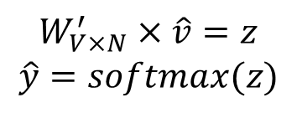


Measure Degree of Relation: Latent Representation
$rel\left({\text{w}}_{i},{\text{w}}_{j}\right)=cos⁡\left(S_{:,:,syn}V_{i,:}^{T},S_{:,:,rel}V_{j,:}^{T}\right)$
Cos ( , )
×
×
$$k$$
$$w_{1},w_{2},…, w_{n}$$
$$R_{1},R_{2},…, R_{m}$$
~
$$k$$
~
~
×
×
~
$$k$$
$$S$$
$$V^{T}$$

Slide 25
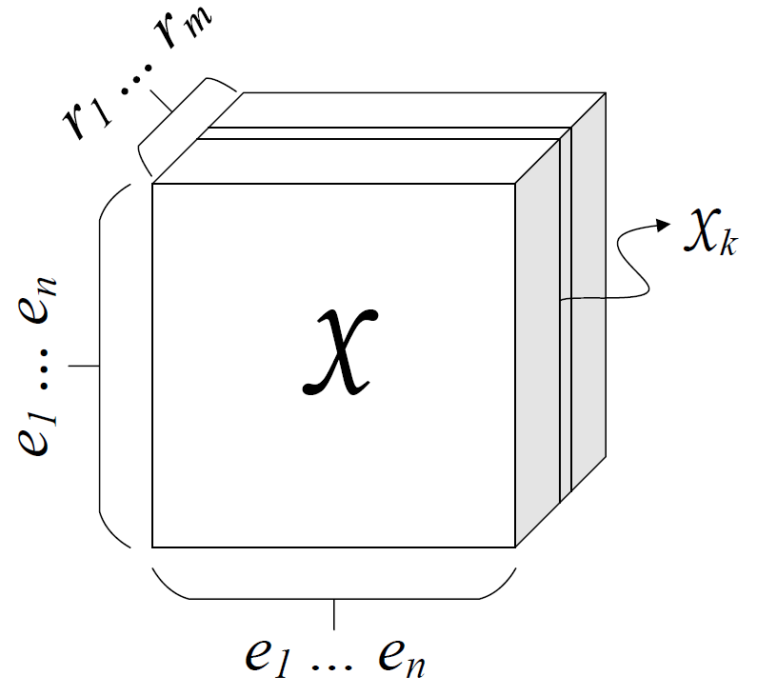
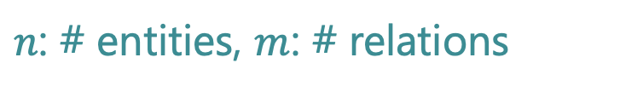
Knowledge Graphs (1/2)
Collection of subj-pred-obj triples – $(e_{1}, r, e_{2})$
Subject | Predicate | Object
Obama | Born-in | Hawaii
Bill Gates | Nationality | USA
Bill Clinton | Spouse-of | Hillary Clinton
Satya Nadella | Work-at | Microsoft
… | … | …
$n$: # entities, $m$: # relations
M. Nickel, V. Tresp, and H.-P. Kriegel. A three-way model for collective learning
on multi-relational data. In Proceedings of the 28th International Conference on
International Conference on Machine Learning, ICML’11, pages 809–816, 2011.

Slide 26
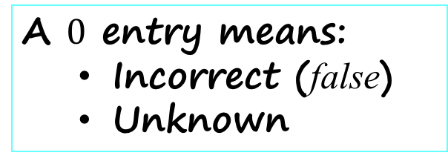
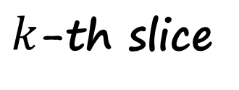
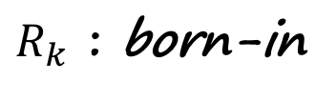

Knowledge Graphs (2/2)
$k$-th slice
$$𝒳_{k}$$
Hawaii
Obama
1
A $0$ entry means:
  Incorrect (false)
  Unknown
$R_{k}$ : born-in
M. Nickel, V. Tresp, and H.-P. Kriegel. A three-way model for collective learning
on multi-relational data. In Proceedings of the 28th International Conference on
International Conference on Machine Learning, ICML’11, pages 809–816, 2011.

Slide 27
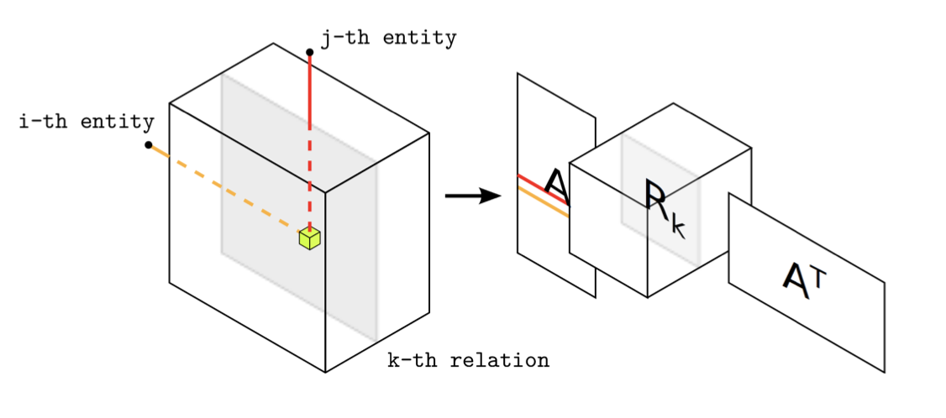
Factorization
M. Nickel, V. Tresp, and H.-P. Kriegel. A three-way model for collective learning
on multi-relational data. In Proceedings of the 28th International Conference on
International Conference on Machine Learning, ICML’11, pages 809–816, 2011.

Slide 28
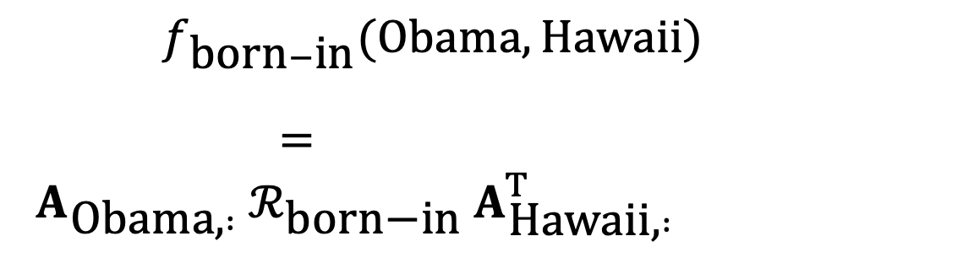
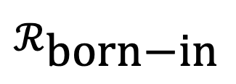


Measure the Degree of a Relationship
$f_{\text{born}−\text{in}}(\text{Obama},\text{Hawaii})$
$= A_{\text{Obama}\text{,} :} ℛ_{\text{born}\text{−}\text{in}} A_{\text{Hawaii}\text{,} :}^{T}$
$$A$$
Hawaii
$$ℛ_{\text{born}\text{−}\text{in}}$$
$$A^{T}$$
×
×
Obama
28

Slide 29
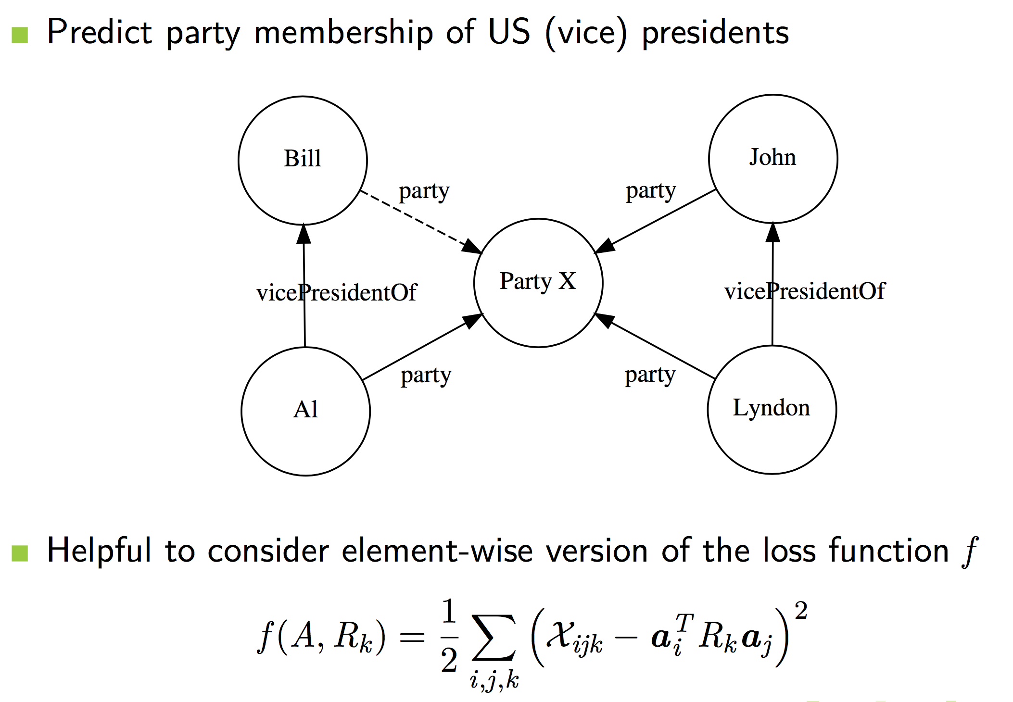
Prediction of Unknown Facts
Prediction of unknown fact party(Bill, Party X)

Slide 30
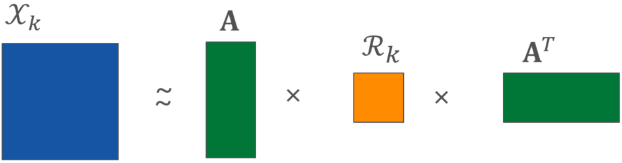
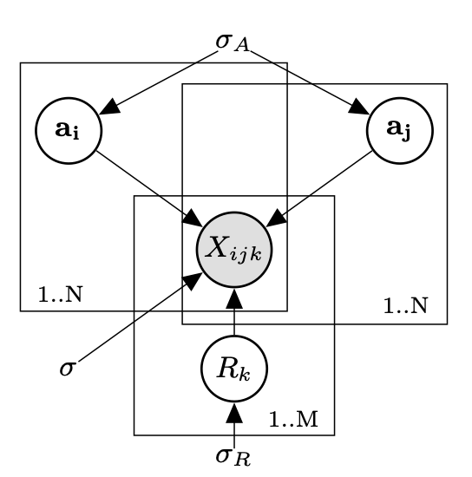
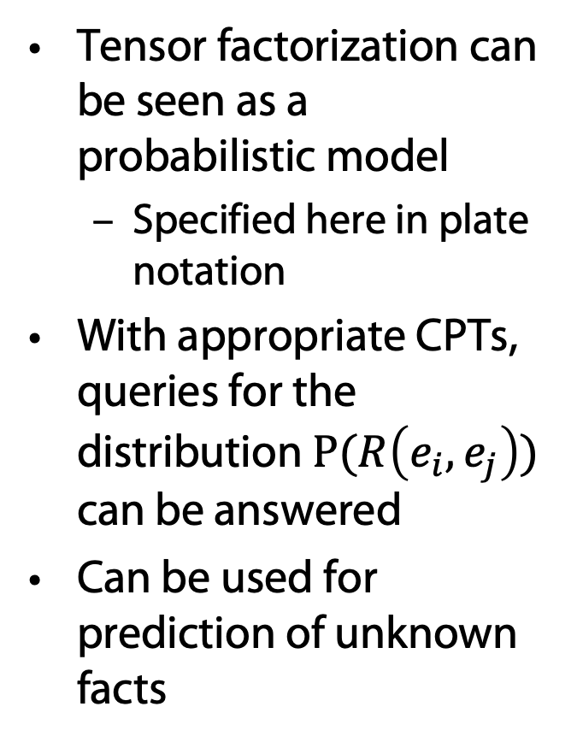
RESCAL: Graphical Model in Plate Notation
Tensor factorization can be seen as a probabilistic model
  Specified here in plate notation
With appropriate CPTs, queries for the distribution $P(R\left(e_{i}, e_{j}\right))$ can be answered
Can be used for prediction of unknown facts
Nickel, M, Tresp, V, Kriegel, HP: Factorizing YAGO. Scalable Machine Learning for Linked Data. In Proceedings of the 21st International World Wide Web Conference, 2012.

Slide 31
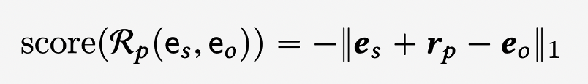
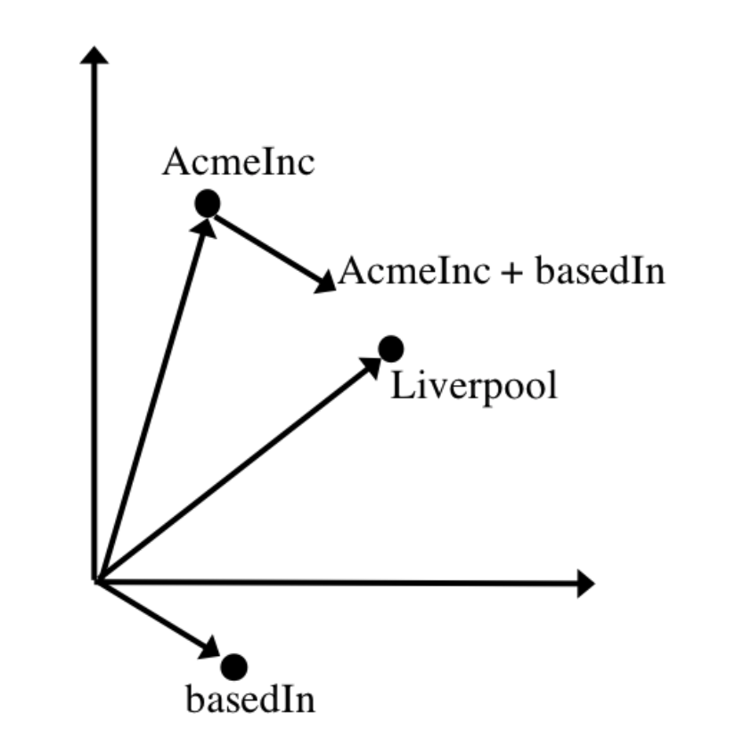
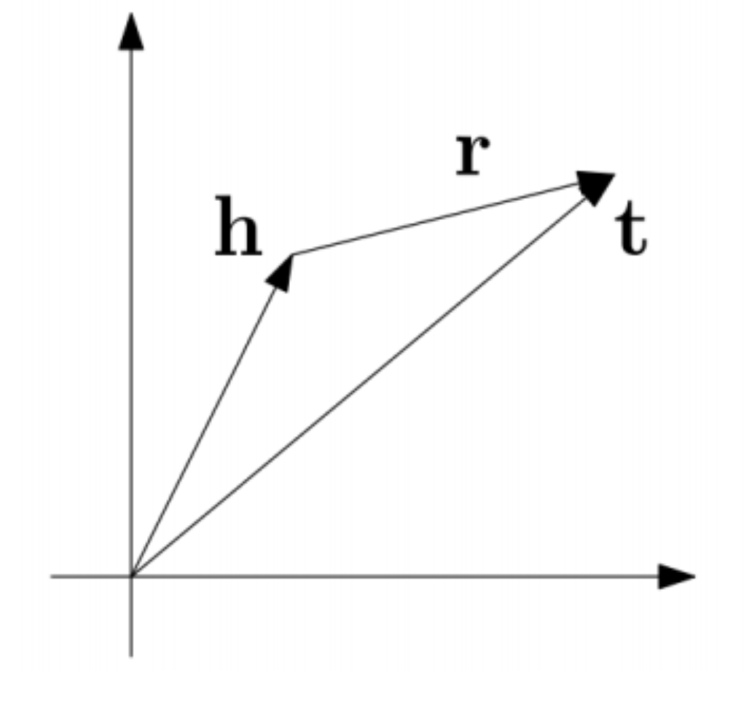
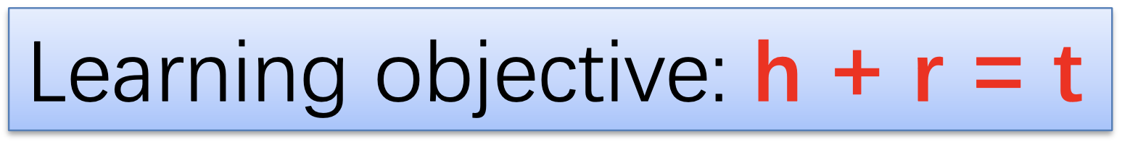
TransE: KG-Completion
Inspired by word2vec

Slide 32
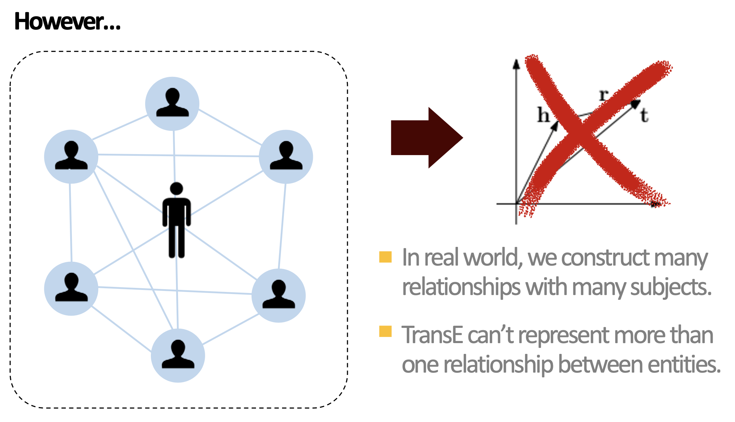
TransE: KG-Completion

Slide 33
Summary
Very many RESCAL- and TransE-like approaches for handcrafted embeddings of relational data
None of the many approaches covers what’s in a text
Forget about handcrafted approaches

