Slide 1
Intelligent Agents Summary
RalfM

Slide 2
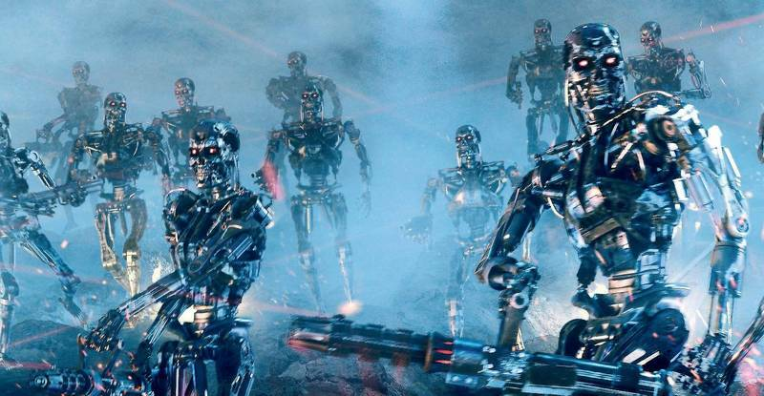

Slide 3
Where did we go wrong?
Humans are intelligent to the extent that our actions can be expected to achieve our objectives
Machines are intelligent to the extent that their actions can be expected to achieve their objectives
Give them objectives to optimize (cf control theory, economics, operations research, statistics)
We don’t want machines that are intelligent in this sense
Machines are beneficial to the extent that their actions can be expected to achieve our objectives
We need machines to be provably beneficial
Machines unsure about "our" preferences: Questioning their own goals
Arguments taken from Stuart Russell’s Presentations on Provably Beneficial AI
Notes:
So we have seen that the standard task in AI is to optimize an objective supplied by the human.
But this is the wrong task. Instead we want provably beneficial AI: we need to be happy with the way the machine behaves,
even if we ask for the wrong thing or forget to mention some important constraint. So how can we do this?

Slide 4
Yet some more detail
Idea of a utility function
Mapping from percept to state of environment (depends on G)
Is the goal G in the current state of the environment still correctly chosen? Should I have a new goal G’?
Percepts
Feedback
My utility will be zero then. How to prevent being switched off?
Your performance might be improved
Huh: Possibly I’ll be switched off
Maximize utility (possibly with sequence of actions)
Action Explanation
Return calculated action (prepare to answer the Why question)
What is the best action in the current state to achieve the goal? Strategy for determining action

Slide 5
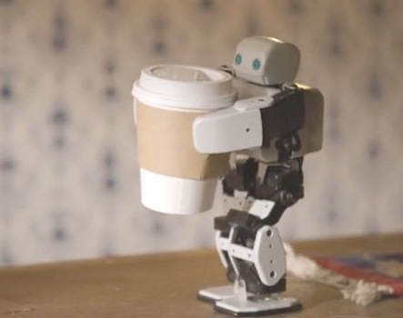
Off-Switch Problem
Representative for dealing with unwanted behavior
Very much underspecified!
The instruction suggests having coffee would have higher value than expected a priori, ceteris paribus
Example: “Fetch some coffee”
Agents get better at maximizing the built-in utility function
What’s bad about better AI?
Can we switch off the agent if it “does not work as expected”?
“Can’t fetch coffee if I am dead.”
Incentive for preventing others from switching off the robot

Slide 6

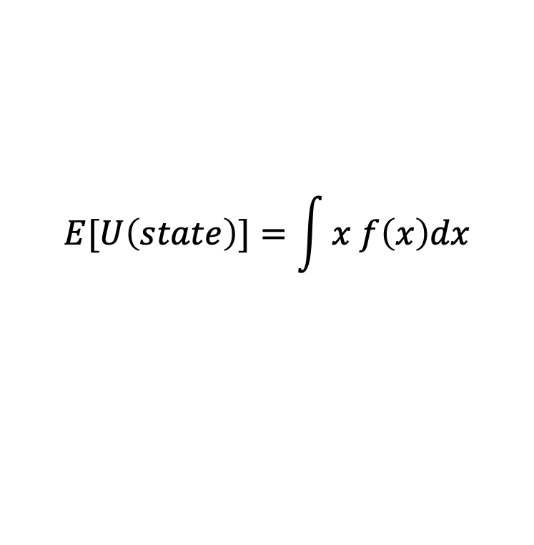
Before/after bringing coffee…
$$E[U\left(state\right)]=\int{x f\left(x\right)dx}$$
Expected utility
Change the utility function
$$f$$

Slide 7
The off-switch problem
A robot, given an objective, has an incentive to disable its own off-switch
Claim: A robot with appropriate uncertainty about objective won’t behave this way
Example: Planning for the best action (sequence)
$$E[U\left(state\right)]=\int{x f\left(x\right)dx}$$
R
act
switch self off
Theorem:
This way robot has a positive incentive to allow itself to be switched off
wait
U = U_{act}
H
U = 0
go ahead
switch robot off
R
U = 0
act
U = U_{act}
Example taken from Stuart Russell’s Presentations on Provably Beneficial AI

Slide 8
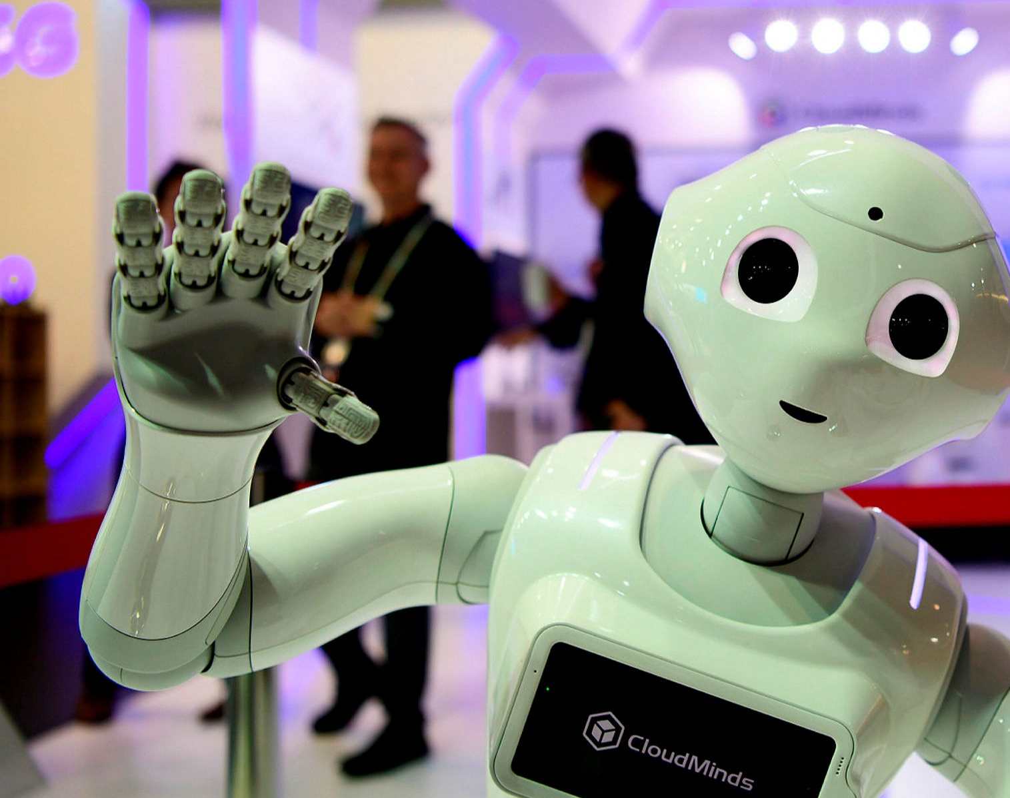
Thank you for coming.
AI – Most exciting science today.
Most relevant for companies.
Just about to start.
UzL

