Slide 1
Einführung in
Web- und Data-Science
Inductive Learning
Prof. Dr. Ralf Möller
Universität zu Lübeck
Institut für Informationssysteme

Slide 2
Version space
Inductive Learning

Slide 3


Inductive Learning
Chapter 18/19
Chapters 3 and 4
Material adopted from
Yun Peng, Chuck Dyer,
Gregory Piatetsky-Shapiro & Gary Parker

Slide 4
Card Example: Guess a Concept
Given a set of examples
  Positive: e.g.,
  Negative: e.g.,
What cards are accepted?
  What concept lays behind it?
4♣ 7♣ 2♠
5♥ j♠
Notes:
Rank, suit

Slide 5
Card Example: Guess a Concept
(r=1) v … v (r=10) v (r=J) v (r=Q) v (r=K) ⇔ ANY-RANK(r)
(r=1) v … v (r=10) ⇔ NUM(r)
(r=J) v (r=Q) v (r=K) ⇔ FACE(r)
(s=♠) v (s=♣) v (s=♦) v (s=♥) ⇔ ANY-SUIT(s)
(s=♠) v (s=♣) ⇔ BLACK(s)
(s=♦) v (s=♥) ⇔ RED(s)
A hypothesis is any sentence of the form:
R(r) ∧ S(s)
where:
R(r) is ANY-RANK(r), NUM(r), FACE(r), or (r=x)
S(s) is ANY-SUIT(s), BLACK(s), RED(s), or (s=y)
Notes:
Jack
Spade, Diamond, Clubs, Heart

Slide 6
Simplified Representation
For simplicity, we represent a concept by rs, with:
r ∈ {a, n, f, 1, …, 10, j, q, k}
s ∈ {a, b, r, ♣, ♠, ♦, ♥}
For example:
n♠ represents:
NUM(r) ∧ (s=♠)
aa represents:
ANY-RANK(r) ∧ ANY-SUIT(s)
Notes:
Jake spade club Quee

Slide 7
Extension of a Hypothesis
The extension of a hypothesis h is
the set of objects that satisfies h
Examples:
The extension of f♠ is: {j♠, q♠, k♠}
The extension of aa is the set of all cards

Slide 8
Most general/Specific Hypothesis
Inductive Learning

Slide 9
More General/Specific Relation
Let h1 and h2 be two hypotheses in H
h1 is more general than h2 iff the extension of h1 is a proper superset of the extension of h2
Examples:
aa is more general than f♦
f♥ is more general than q♥
fr and nr are not comparable

Slide 10
More General/Specific Relation
Let h1 and h2 be two hypotheses in H
h1 is more general than h2 iff the extension of h1 is a proper superset of the extension of h2
The inverse of the “more general” relation is the “more specific” relation
The “more general” relation defines a partial ordering on the hypotheses in H

Slide 11
Example: Subset of Partial Order
aa
na
ab
4a
nb
a♣
4b
n♣
…
…
1♠
4♣
k♥

Slide 12
G-Boundary / S-Boundary of V
A hypothesis in V is most general
iff no hypothesis in V is more general
G-boundary G of V: Set of most general
hypotheses in V

Slide 13
G-Boundary / S-Boundary of V
A hypothesis in V is most general iff no hypothesis in V is more general
G-boundary G of V: Set of most general hypotheses in V
A hypothesis in V is most specific iff no hypothesis in V is more specific
S-boundary S of V: Set of most specific hypotheses in V
all inconsistent
G1 G2 G3
S1 S2 S3
all inconsistent

Slide 14
Example: G-/S-Boundaries of V
G
aa
aa
We replace every hypothesis in S
whose extension does not
contain 4♣
by its generalization set
Now suppose that 4♣ is
given as a positive example
na
ab
4a
nb
a♣
4b
n♣
…
…
S
4♠
4♣
4♣
k♥

Slide 15
Example: G-/S-Boundaries of V
The generalization set
of an hypothesis h is the
set of the hypotheses
that are immediately more
general than h
G
aa
aa
na
ab
Generalization
set of 4♠
4a
nb
a♣
n♠
4b
n♣
…
…
S
4♠
4♣
4♣
k♥

Slide 16
Example: G-/S-Boundaries of V
G
aa
aa
We remove every hypothesis in S
that is more general
than another hypothesis in S
na
ab
4a
nb
a♣
4b
n♣
S
4♣

Slide 17
Example: G-/S-Boundaries of V
G
aa
na
ab
Here, both G and S have size 1.
This is not the case in general!
4a
nb
a♣
4b
n♣
S
4♣

Slide 18
Example: G-/S-Boundaries of V
aa
na
ab
4a
nb
a♣
4b
n♣
Let 7♣ be the next
(positive) example
Generalization
set of 4♣
4♣

Slide 19
Example: G-/S-Boundaries of V
aa
na
ab
4a
nb
a♣
4b
n♣
Let 7♣ be the next
(positive) example
4♣

Slide 20
Example: G-/S-Boundaries of V
Specialization
set of aa
aa
na
ab
nb
a♣
n♣
Let 5♥ be the next
(negative) example

Slide 21
Example: G-/S-Boundaries of V
G and S, and all hypotheses in between
form exactly the version space
ab
nb
a♣
n♣

Slide 22
Example: G-/S-Boundaries of V
At this stage …
ab
No
Yes
nb
a♣
Maybe
n♣
Do 8♣, 6♦, j♠
satisfy CONCEPT?

Slide 23
Example: G-/S-Boundaries of V
ab
nb
a♣
n♣
Let 2♠ be the next
(positive) example

Slide 24
Example: G-/S-Boundaries of V
ab
nb
Let j♠ be the next
(negative) example

Slide 25
Example: G-/S-Boundaries of V
+ 4♣ 7♣ 2♠
– 5♥ j♠
nb
NUM(r) ∧ BLACK(s)

Slide 26
Example: G-/S-Boundaries of V
Let us return to the
version space …
… and let 8♣ be the next
(negative) example
ab
nb
a♣
The only most specific
hypothesis disagrees with
this example, so no
hypothesis in H agrees with
all examples
n♣

Slide 27
Example: G-/S-Boundaries of V
Let us return to the
version space …
… and let j♥ be the next
(positive) example
ab
nb
a♣
The only most general
hypothesis disagrees with
this example, so no
hypothesis in H agrees with
all examples
n♣

Slide 28
Selection Strategy
Inductive Learning

Slide 29
Example-Selection Strategy
Suppose that at each step the learning procedure has the possibility to select the object (card) of the next example
Let it pick the object such that, whether the example is positive or not, it will eliminate one-half of the remaining hypotheses
Then a single hypothesis will be isolated in
O(log |H|) steps

Slide 30
Example
aa
na
ab
9♣?
j♥?
j♣?
nb
a♣
n♣

Slide 31
Example-Selection Strategy
Suppose that at each step the learning procedure has the possibility to select the object (card) of the next example
Let it pick the object such that, whether the example is positive or not, it will eliminate one-half of the remaining hypotheses
Then a single hypothesis will be isolated in O(log |H|) steps
But picking the object that eliminates half the version space may be expensive

Slide 32
Noise
If some examples are misclassified, the version space may collapse
Possible solution:
Maintain several G- and S-boundaries, e.g., consistent with all examples, all examples but one, etc…

Slide 33
Decision Trees
Inductive Learning

Slide 34
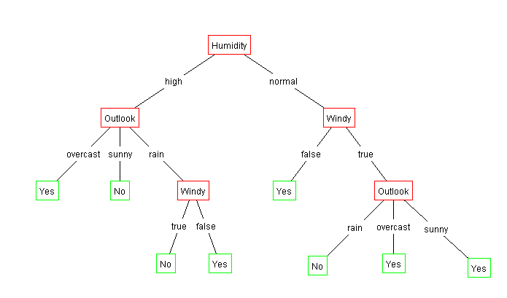
Decision Trees
Outlook | Temperature | Humidity | Windy | Play?
sunny | hot | high | false | No
sunny | hot | high | true | No
overcast | hot | high | false | Yes
rain | mild | high | false | Yes
rain | cool | normal | false | Yes
rain | cool | normal | true | No
overcast | cool | normal | true | Yes
sunny | mild | high | false | No
sunny | cool | normal | false | Yes
rain | mild | normal | false | Yes
sunny | mild | normal | true | Yes
overcast | mild | high | true | Yes
overcast | hot | normal | false | Yes
rain | mild | high | true | No

Slide 35
Decision trees
An internal node is a test on an attribute.
A branch represents an outcome of the test, e.g., Color=red.
A leaf node represents a class label
At each node, one attribute is chosen to split training examples into distinct classes as much as possible
A new case is classified by following a matching path to a leaf node.

Slide 36
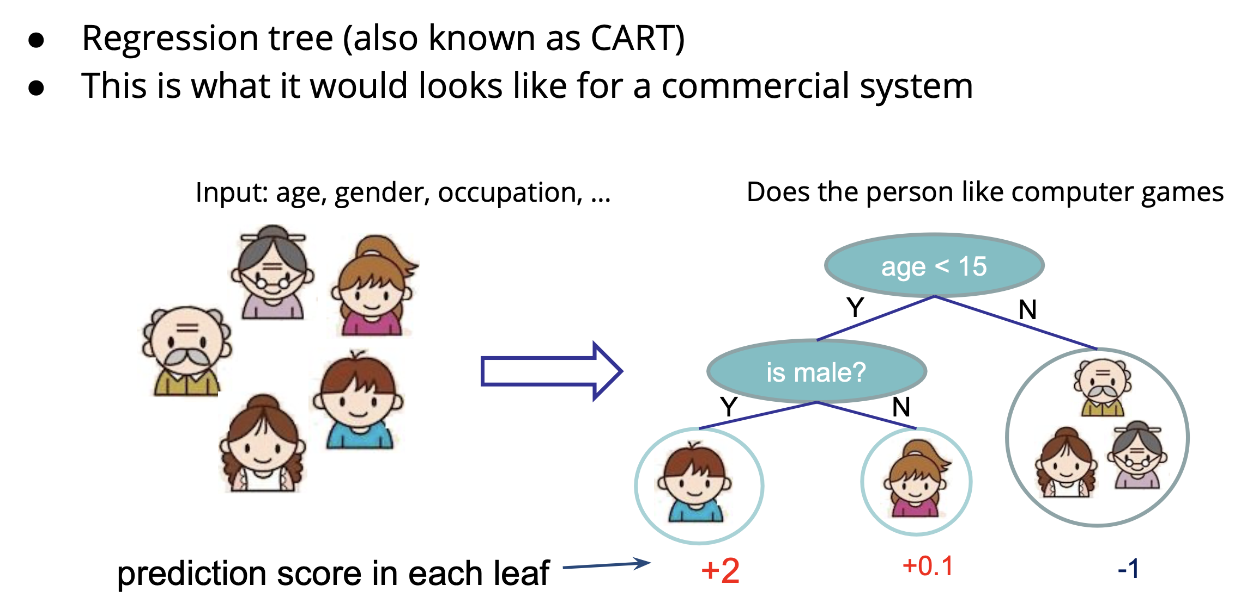
Regression Trees

Slide 37
Building Decision Trees
Top-down tree construction
  At start, all training examples are at the root.
  Partition the examples recursively by choosing one attribute each time.
Bottom-up tree pruning
  Remove subtrees or branches, in a bottom-up manner, to improve the estimated accuracy on new cases.
R. Quinlan, Learning efficient classification procedures, Machine Learning: an artificial intelligence approach, Michalski, Carbonell & Mitchell (eds.), Morgan Kaufmann, p. 463-482., 1983

Slide 38
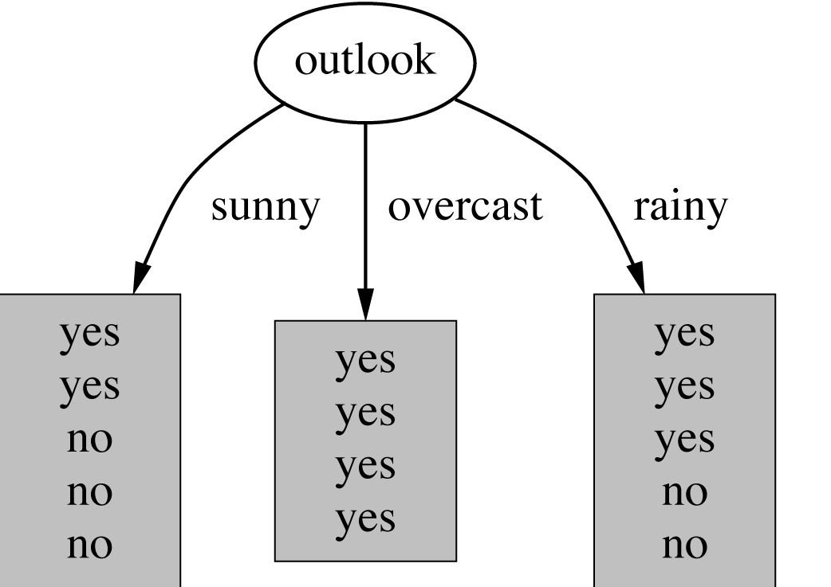
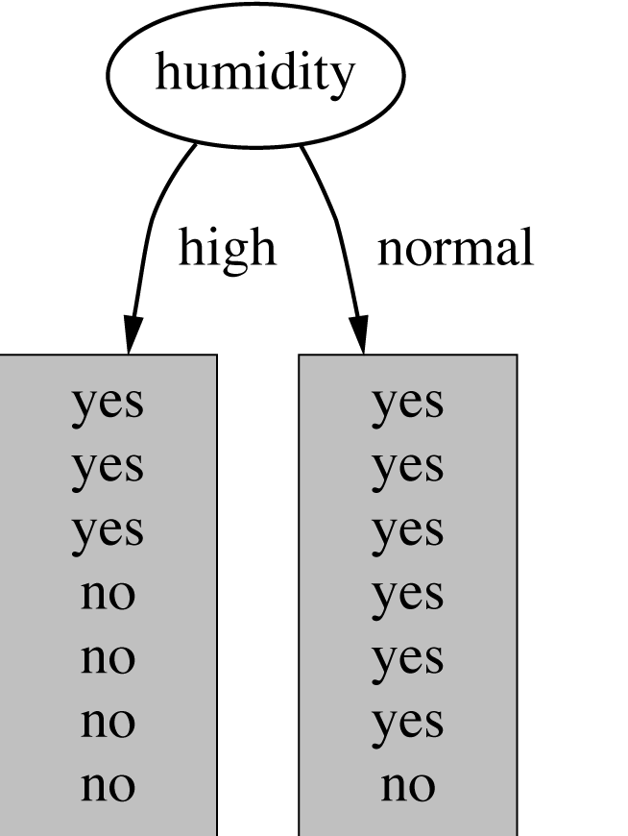
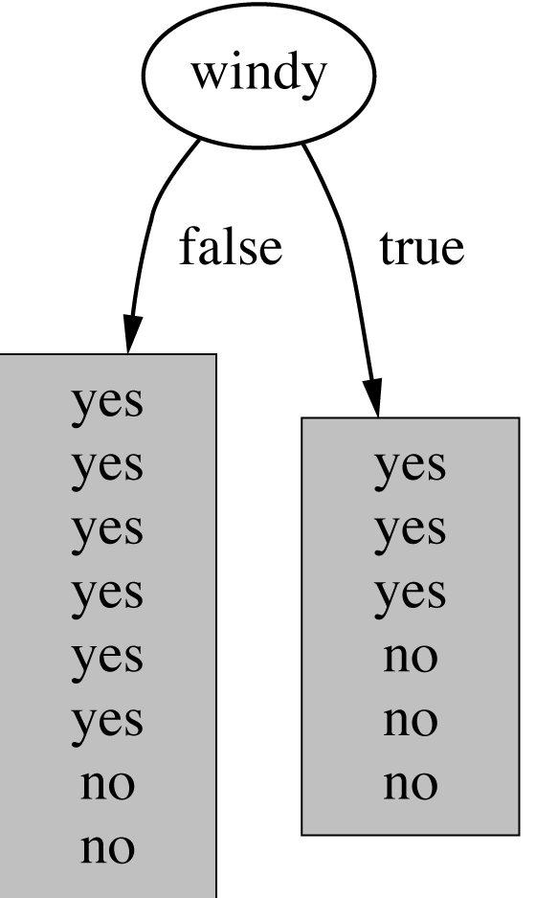
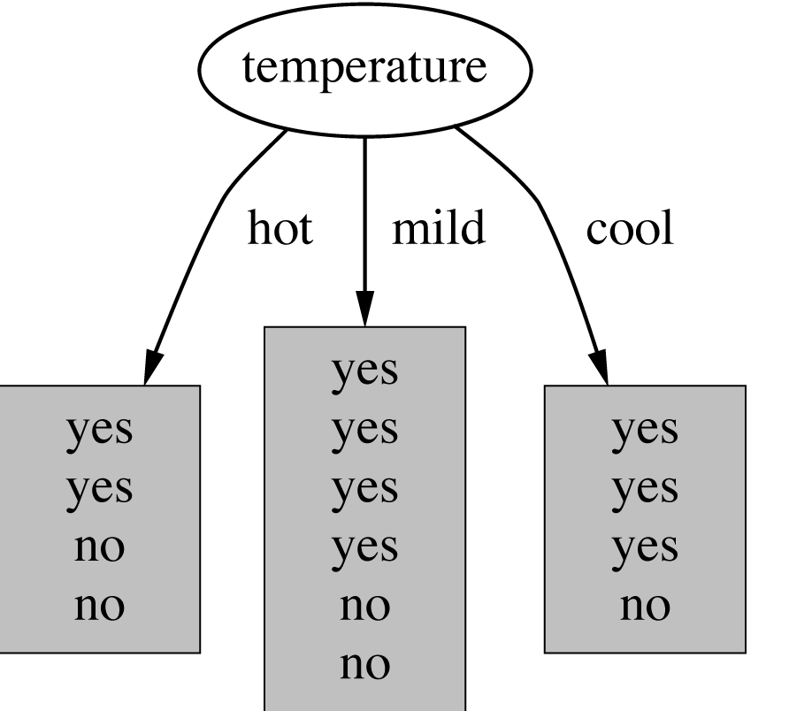
Which attribute to select?

Slide 39
Choosing the Best Attribute
The key problem is choosing which attribute to split a given set of examples.
Some possibilities are:
  Random: Select any attribute at random
  Least-Values: Choose the attribute with the smallest number of possible values
  Most-Values: Choose the attribute with the largest number of possible values
  Information gain: Choose the attribute that has the largest expected information gain, i.e., select attribute that will result in the smallest expected size of the subtrees rooted at its children.

Slide 40
Information theory
Inductive Learning

Slide 41
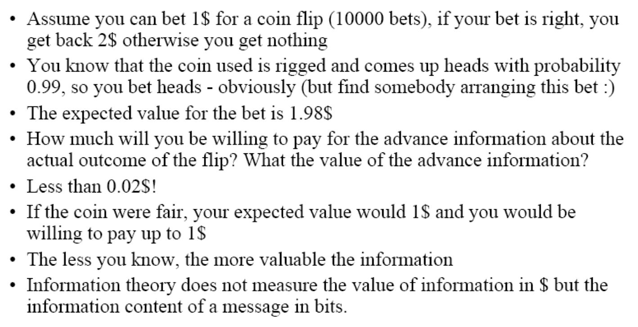
Information Theory

Slide 42
Huffman code example
1
Exp. len
0
1
.5
.5
D
0
1
.25
.25
C
1
If we need to send many messages (A,B,C or D) and they have this probability distribution and we use this code, then over time, the average bits/message should approach 1.75
0
.125
.125
A
B

Slide 43
Information Theory Background
If there are n equally probable possible messages, then the probability p of each is 1/n
Information (number of bits) conveyed by a message is log(n) = -log(p)
Eg, if there are 16 messages, then log(16) = 4 and we need 4 bits to identify/send each message.
In general, if we are given a probability distribution
  P = (p₁, p₂, .., p_{n})
the information conveyed by distribution (aka entropy of P) is:
  I(P) = -(p₁*log(p₁) + p₂*log(p₂) + .. + p_{n}*log(p_{n}))
  = - ∑_{i} p_{i}*log(p_{i})

Slide 44
Information Theory Background
Information conveyed by distribution (aka entropy of P) is:
  I(P) = -(p₁*log(p₁) + p₂*log(p₂) + .. + p_{n}*log(p_{n}))
Examples:
  if P is (0.5, 0.5) then I(P) is 1
  if P is (0.67, 0.33) then I(P) is 0.92,
  if P is (1, 0) or (0,1) then I(P) is 0.
The more uniform is the probability distribution, the greater is its information
The entropy is the average number of bits/message needed to represent a stream of messages

Slide 45
Example: attribute “Outlook”, 1
Outlook | Temperature | Humidity | Windy | Play?
sunny | hot | high | false | No
sunny | hot | high | true | No
overcast | hot | high | false | Yes
rain | mild | high | false | Yes
rain | cool | normal | false | Yes
rain | cool | normal | true | No
overcast | cool | normal | true | Yes
sunny | mild | high | false | No
sunny | cool | normal | false | Yes
rain | mild | normal | false | Yes
sunny | mild | normal | true | Yes
overcast | mild | high | true | Yes
overcast | hot | normal | false | Yes
rain | mild | high | true | No

Slide 46
Example: attribute “Outlook”, 2
“Outlook” = “Sunny”:
“Outlook” = “Overcast”:
“Outlook” = “Rainy”:
Expected information for attribute:
Note: log(0) is not defined, but we evaluate 0*log(0) as zero

Slide 47
Computing the information gain
Information gain:
(information before split) – (information after split)

Slide 48
Computing the information gain
Information gain:
(information before split) – (information after split)
Information gain for attributes from weather data:

Slide 49
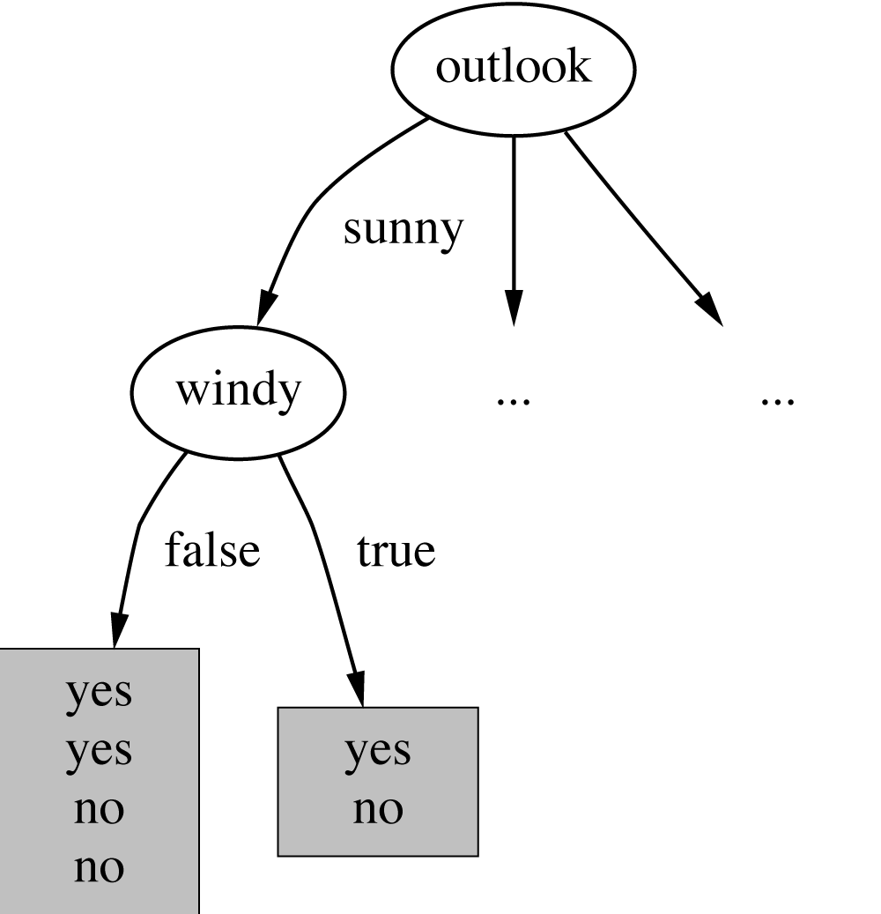
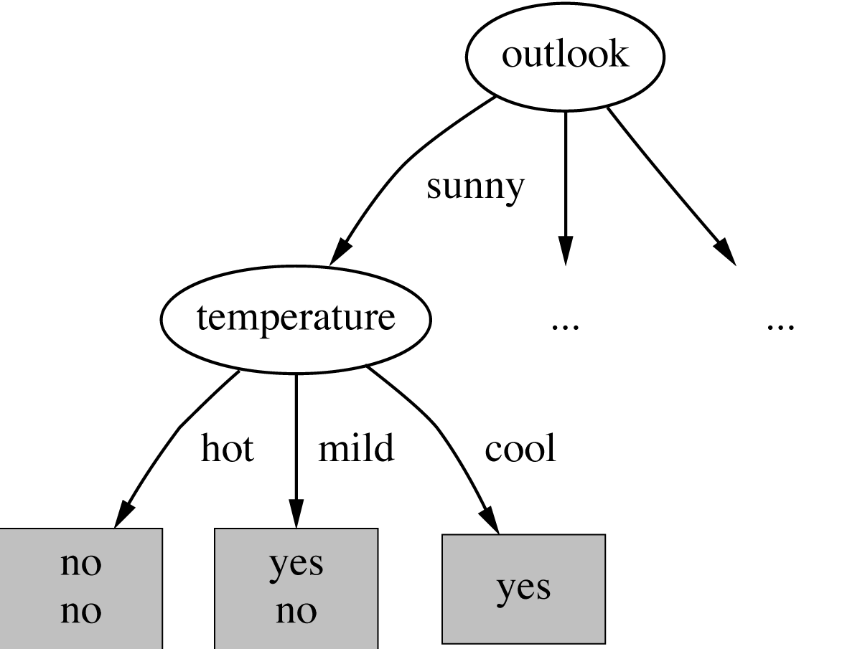
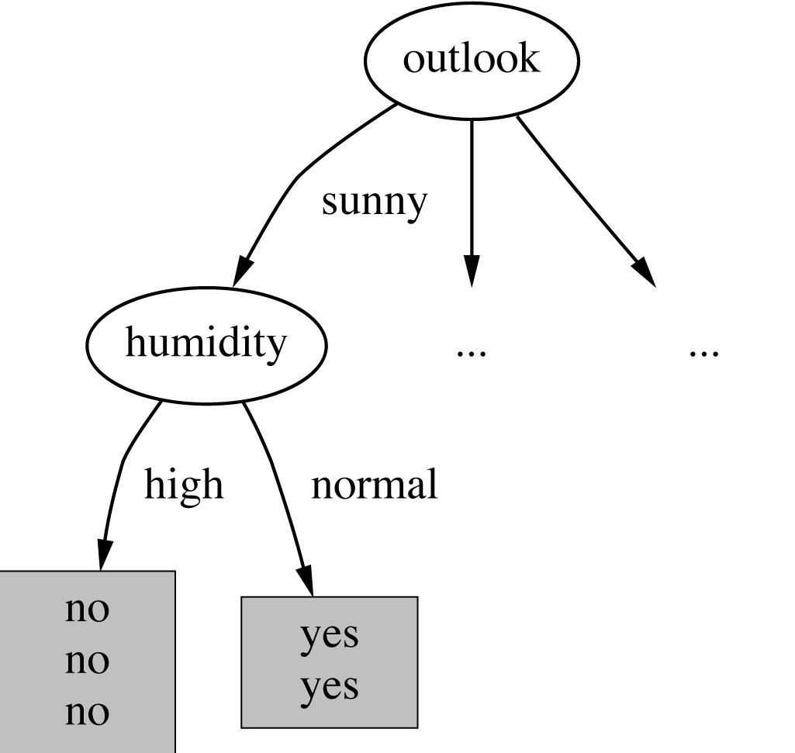
Continuing to split

Slide 50
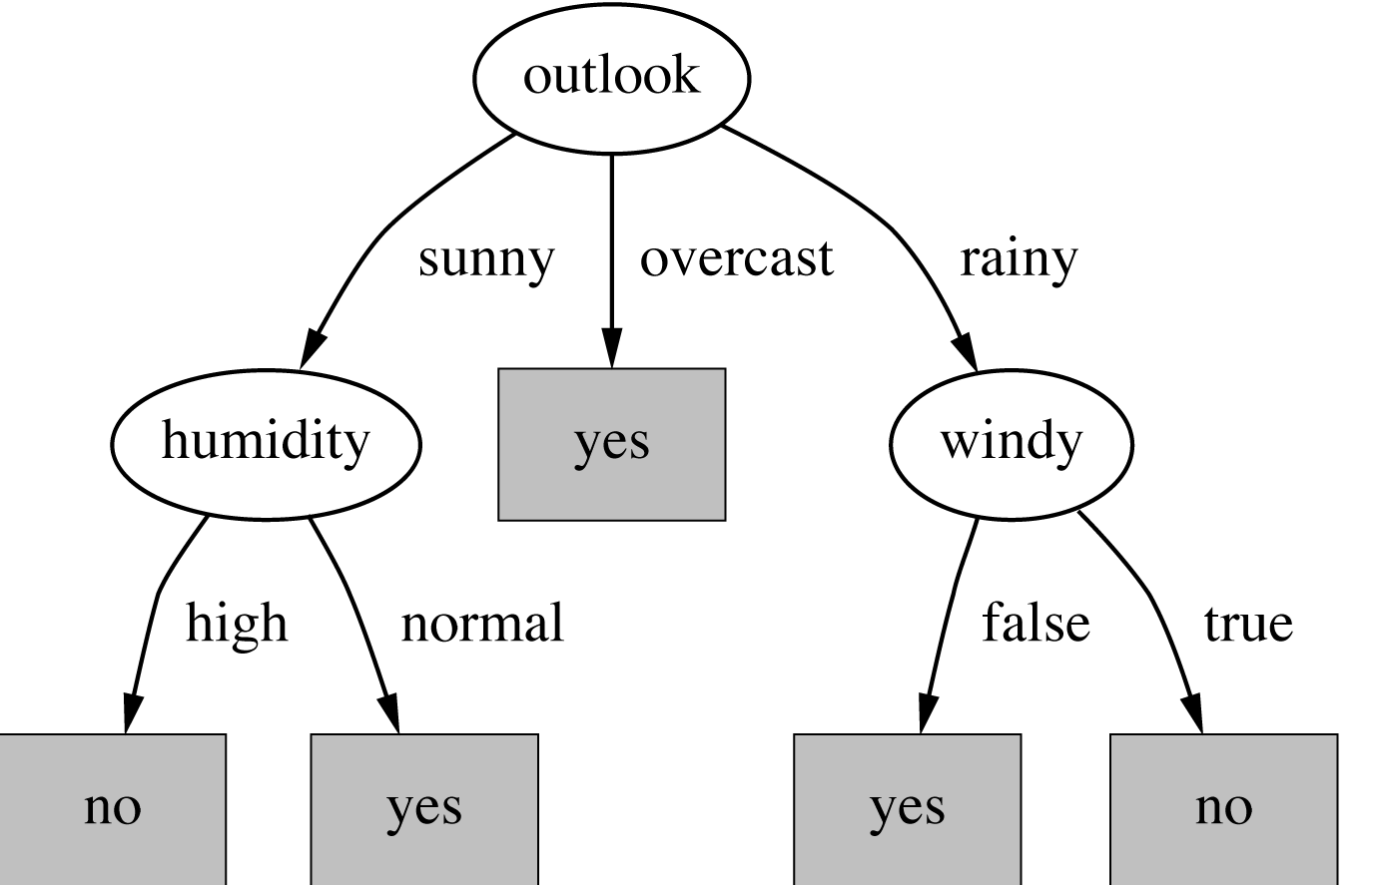
The final decision tree
Note: not all leaves need to be pure; sometimes identical instances have different classes
  ⇒ Splitting stops when data can’t be split any further

Slide 51
Evaluating decision trees
Inductive Learning

Slide 52
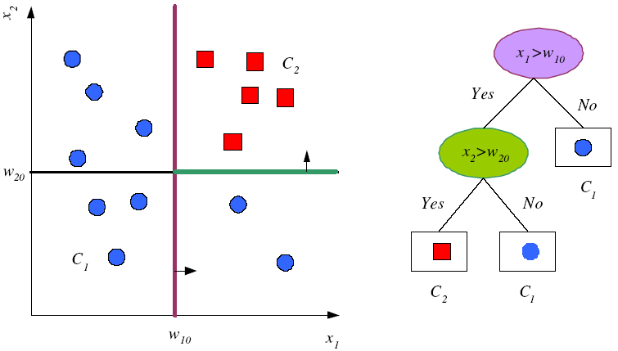
Univariate Splits

Slide 53
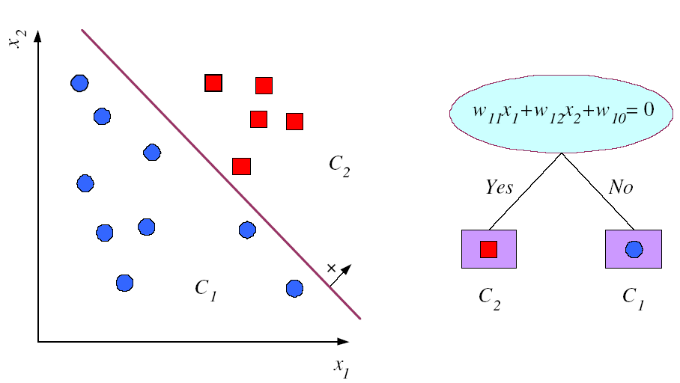
Multivariate Splits
≥ 0

Slide 54
1R – Simplicity First!
Classification
Given: Table with data
Goal: Learn decision function
Based on rules that all test one particular attribute
One branch for each value
Each branch assigns most frequent class
Error rate: proportion of instances that don’t belong to the majority class of their corresponding branch
Choose attribute with lowest error rate
(Assumes nominal attributes)
Outlook | Temp | Humidity | Windy | Play
Sunny | Hot | High | False | No
Sunny | Hot | High | True | No
Overcast | Hot | High | False | Yes
Rainy | Mild | High | False | Yes
Rainy | Cool | Normal | False | Yes
Rainy | Cool | Normal | True | No
Overcast | Cool | Normal | True | Yes
Sunny | Mild | High | False | No
Sunny | Cool | Normal | False | Yes
Rainy | Mild | Normal | False | Yes
Sunny | Mild | Normal | True | Yes
Overcast | Mild | High | True | Yes
Overcast | Hot | Normal | False | Yes
Rainy | Mild | High | True | No

Slide 55
Evaluating the Weather Attributes
Classification
Outlook | Temp | Humidity | Windy | Play
Sunny | Hot | High | False | No
Sunny | Hot | High | True | No
Overcast | Hot | High | False | Yes
Rainy | Mild | High | False | Yes
Rainy | Cool | Normal | False | Yes
Rainy | Cool | Normal | True | No
Overcast | Cool | Normal | True | Yes
Sunny | Mild | High | False | No
Sunny | Cool | Normal | False | Yes
Rainy | Mild | Normal | False | Yes
Sunny | Mild | Normal | True | Yes
Overcast | Mild | High | True | Yes
Overcast | Hot | Normal | False | Yes
Rainy | Mild | High | True | No
Attribute | Rules | Errors | Total errors
Outlook | Sunny → No | 2/5 | 4/14
 | Overcast → Yes | 0/4
 | Rainy → Yes | 2/5
Temp | Hot → No* | 2/4 | 5/14
 | Mild → Yes | 2/6
 | Cool → Yes | 1/4
Humidity | High → No | 3/7 | 4/14
 | Normal → Yes | 1/7
Windy | False → Yes | 2/8 | 5/14
 | True → No* | 3/6
* indicates a tie
Notes:
Does simplicity really pay off? How do we check? -> cross validation

Slide 56
Assessing Performance of a Learning Algorithm
Take out some of the training set
  Train on the remaining training set
  Test on the excluded instances
  Cross-validation

Slide 57
Cross-Validation
Split original set of examples, train
Examples D
-
+
-
-
+
-
-
-
-
+
+
+
+
-
-
+
Train
+
+
+
-
-
-
+
+
Hypothesis space H

Slide 58
Cross-Validation
Evaluate hypothesis on testing set
Testing set
-
-
-
-
+
+
+
+
+
+
-
-
+
Hypothesis space H

Slide 59
Cross-Validation
Evaluate hypothesis on testing set
Testing set
-
+
+
-
+
+
+
Test
-
+
+
-
-
-
Hypothesis space H

Slide 60
Cross-Validation
Compare true concept against prediction
9/13 correct
Testing set
-
-
-
+
-
+
-
-
+
+
+
+
+
+
+
-
+
+
+
+
-
-
-
-
+
-
Hypothesis space H

Slide 61
Common Splitting Strategies
k-fold cross-validation: k random partitions
Dataset
Train
Test

Slide 62
Common Splitting Strategies
k-fold cross-validation: k random partitions
Leave-p-out: all possible combinations of p instances
Dataset
Train
Test
Notes:
p=1 == n-fold special case

Slide 63
Discussion of 1R
1R was described in a paper by Holte (1993)
  Contains an experimental evaluation on 16 datasets (using cross-validation so that results were representative of performance on future data)
  Minimum number of instances was set to 6 after some experimentation
  1R's simple rules performed not much worse
  than much more complex classifiers
Simplicity first pays off!
Robert C. Holte, Very Simple Classification Rules Perform Well on Most Commonly Used Datasets, Journal Machine Learning Volume 11, Issue 1 , pp 63-90, 1993

Slide 64
From ID3 to C4.5: History
ID3 (Quinlan) – 1960s
CHAID (Chi-squared Automatic Interaction Detector) – 1960s
CART (Classification And Regression Tree)
  Uses another split heuristics (Gini impurity measure)
C4.5 innovations (Quinlan):
  Permit numeric attributes
  Deal with missing values
  Pruning to deal with noisy data
C4.5 - one of best-known
and most widely-used learning algorithms
  Last research version: C4.8, implemented in Weka as J4.8 (Java)
  Commercial successor: C5.0 (available from Rulequest)

Slide 65
Dealing with Numeric (Metric) Attributes
Outlook | Temperature | Humidity | Windy | Play
Sunny | 85.3 | 85 | False | No
Sunny | 80.2 | 90 | True | No
Overcast | 83.8 | 86 | False | Yes
Rainy | 75.2 | 80 | False | Yes
… | … | … | … | …
64 65 68 69 70 71 72 72 75 75 80 81 83 85 Yes | No | Yes Yes Yes | No No | Yes Yes Yes | No | Yes Yes | No
Discretize numeric attributes
Divide each attribute's range into intervals
  Sort instances according to attribute's values
  Place breakpoints where the class changes
  This minimizes the total error

Slide 66
The problem of Overfitting
This procedure is very sensitive to noise
  One instance with an incorrect class label will probably produce a separate interval
Also: time stamp attribute will have zero errors
Simple solution:
enforce minimum number of instances in majority class per interval

Slide 67
Discretization Example
Example (with min = 3):
Final result for temperature attribute
64 65 68 69 70 71 72 72 75 75 80 81 83 85 Yes | No | Yes Yes Yes | No No | Yes Yes Yes | No | Yes Yes | No
Same decision for both intervals
64 65 68 69 70 71 72 72 75 75 80 81 83 85 Yes No Yes Yes Yes | No No Yes Yes Yes | No Yes Yes No

Slide 68
With Overfitting Avoidance
Resulting rule set:
Attribute | Rules | Errors | Total errors
Outlook | Sunny → No | 2/5 | 4/14
 | Overcast → Yes | 0/4
 | Rainy → Yes | 2/5
Temperature | ≤ 77.5 → Yes | 3/10 | 5/14
 | > 77.5 → No* | 2/4
Humidity | ≤ 82.5 → Yes | 1/7 | 3/14
 | > 82.5 and ≤ 95.5 → No | 2/6
 | > 95.5 → Yes | 0/1
Windy | False → Yes | 2/8 | 5/14
 | True → No* | 3/6

Slide 69
Numeric Attributes – Advanced
Standard method: binary splits
  E.g. temp < 45
Unlike nominal attributes,
every attribute has many possible split points
Solution is straightforward extension:
  Evaluate info gain (or other measure)
  for every possible split point of attribute
  Choose “best” split point
  Info gain for best split point is info gain for attribute
Computationally more demanding

Slide 70
Example
Split on temperature attribute:
  E.g. temperature < 71.5: yes/4, no/2
  temperature ≥ 71.5: yes/5, no/3
  Info([4,2],[5,3])
  = 6/14 info([4,2]) + 8/14 info([5,3])
  = 0.939 bits
Place split points halfway between values
Can evaluate all split points in one pass!
64 65 68 69 70 71 72 72 75 75 80 81 83 85 Yes No Yes Yes Yes No No Yes Yes Yes No Yes Yes No

Slide 71
Missing as a Separate Value
Missing value denoted “?” in C4.X (Null value)
Simple idea: treat missing as a separate value
Q: When is this not appropriate?
A: When values are missing due to different reasons
  Example 1: blood sugar value could be missing when it is very high or very low
  Example 2: field IsPregnant missing for a male patient should be treated differently (no) than for a female patient of age 25 (unknown)

Slide 72
Missing Values – Advanced
Questions:
  How should tests on attributes with different unknown values be handled?
  How should the partitioning be done in case of examples with unknown values?
  How should an unseen case with missing values be handled?

Slide 73
Missing Values – Advanced
Info gain with unknown values during learning
  Let T be the training set and X a test on an attribute with unknown values and F be the fraction of examples where the value is known
  Rewrite the gain:
  Gain(X) = probability that A is known ∗ (info(T) – info_{X}(T))+
  probability that A is unknown ∗ 0
  = F ∗ (info(T) – info_{X}(T))
Consider instances w/o missing values
Split w.r.t. those instances
Distribute instances with missing values proportionally

Slide 74
Pruning
Inductive Learning

Slide 75
Pruning
Goal: Prevent overfitting to noise in the data
Two strategies for “pruning” the decision tree:
  Postpruning - take a fully-grown decision tree and discard unreliable parts
  Prepruning - stop growing a branch when information becomes unreliable
Postpruning preferred in practice—prepruning can “stop too early”

Slide 76
Post-pruning
First, build full tree
Then, prune it
  Fully-grown tree shows all attribute interactions
Two pruning operations:
  Subtree replacement
  Subtree raising

Slide 77
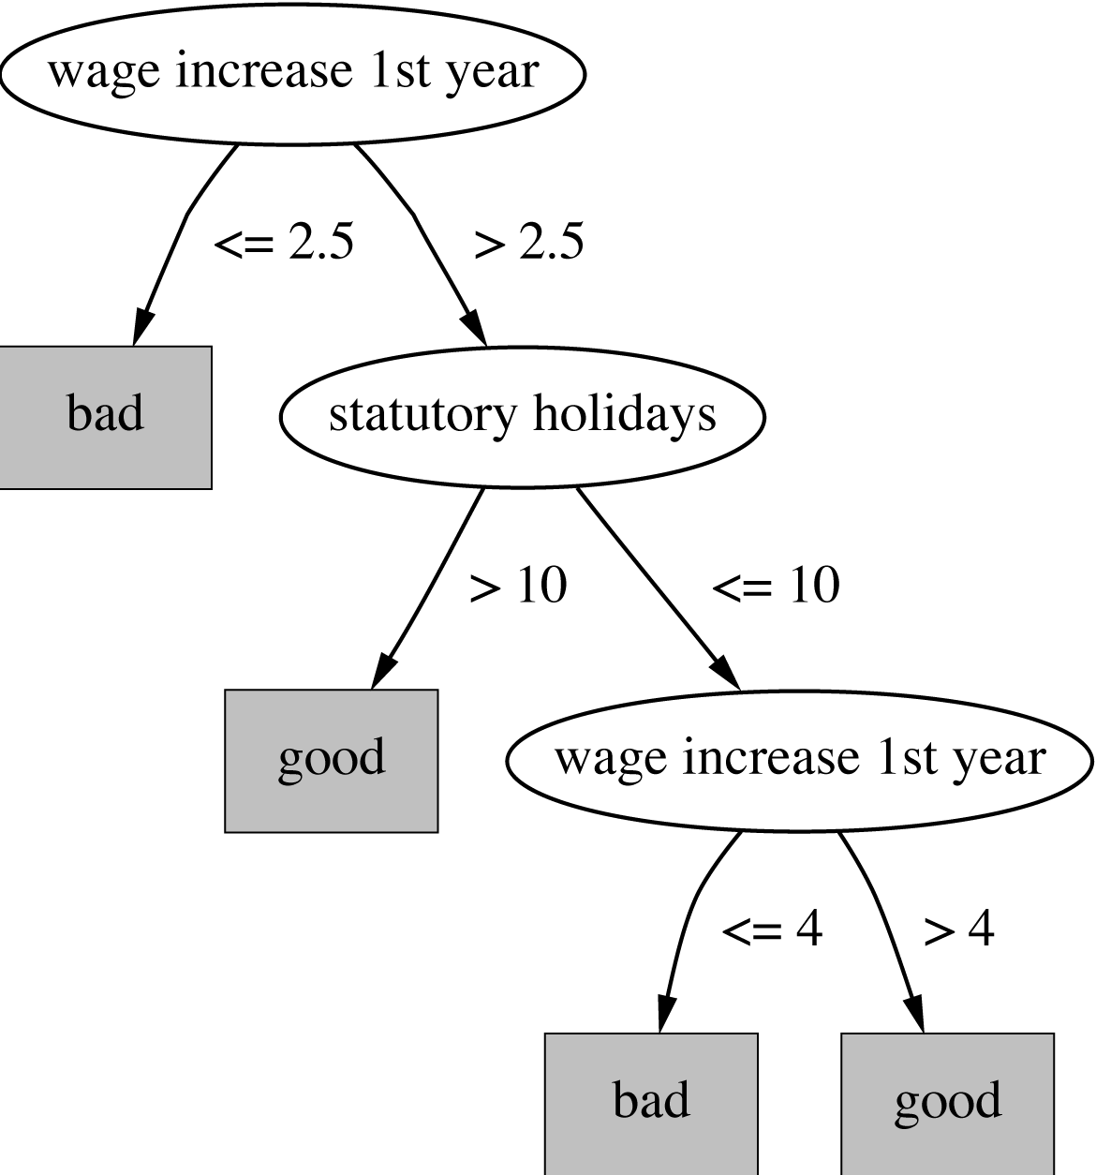
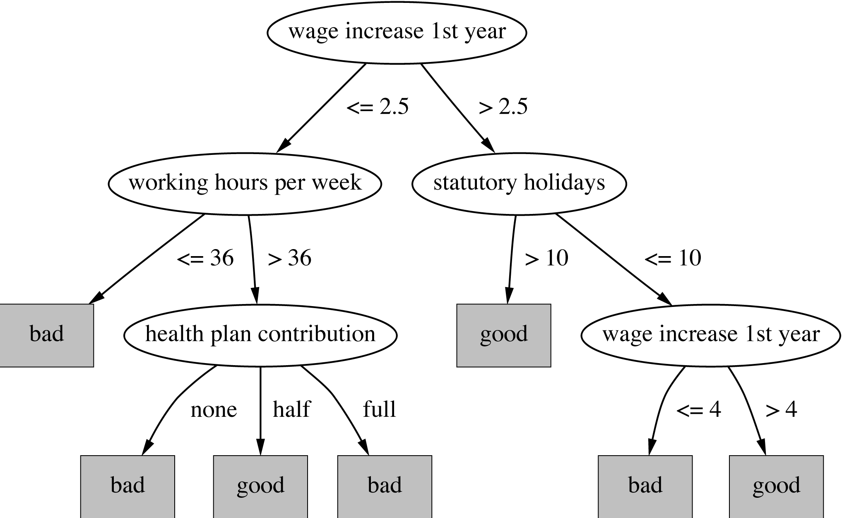
Subtree replacement
Bottom-up
Consider replacing a tree only after considering all its subtrees

Slide 78
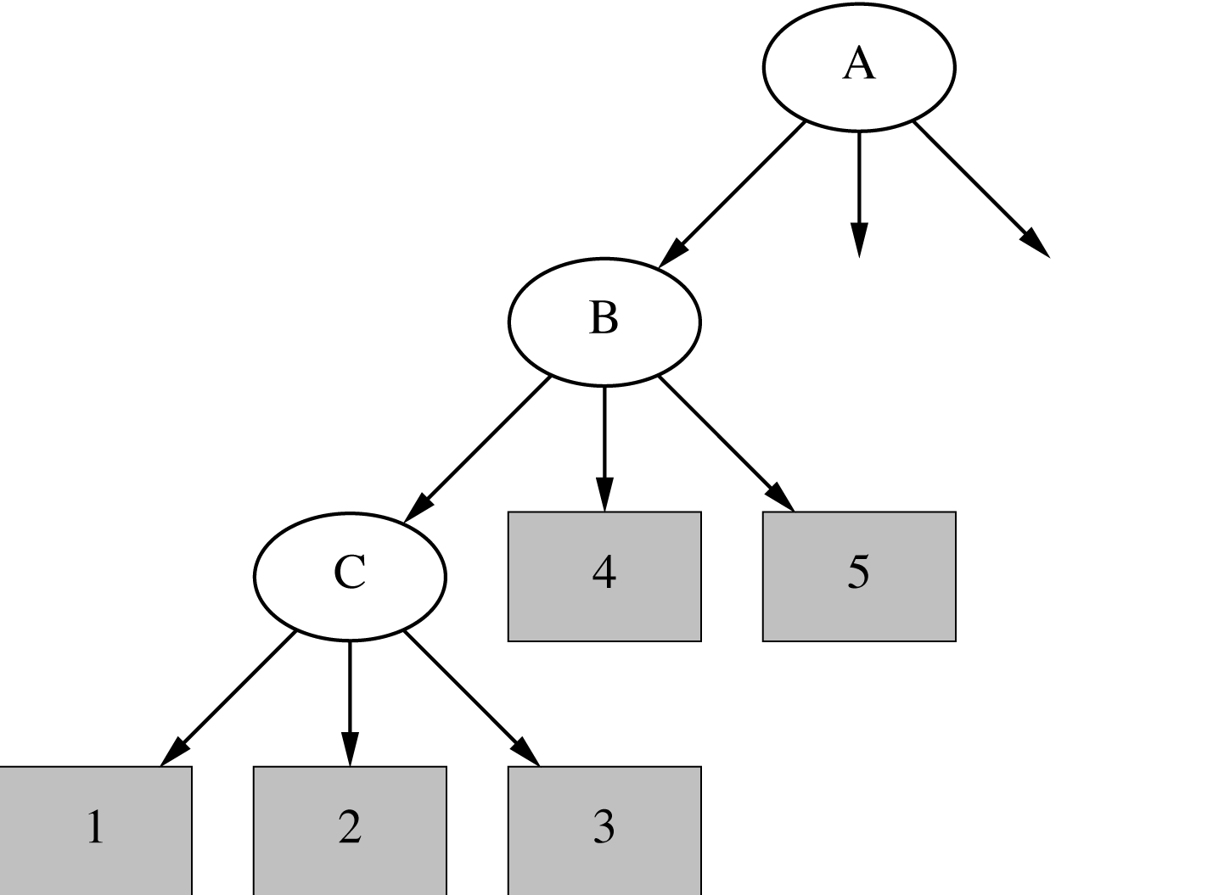
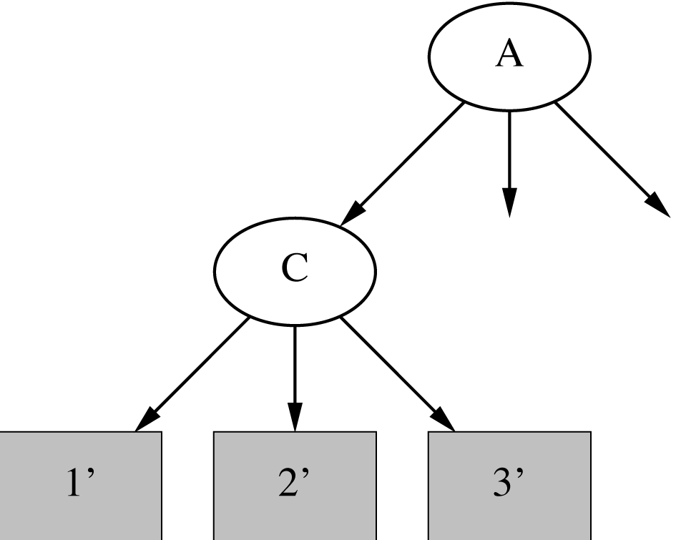
*Subtree raising
Delete node
Redistribute instances
Slower than subtree replacement
(Worthwhile?)
X

Slide 79
Post-pruning
First, build full tree
Then, prune it
  Fully-grown tree shows all attribute interactions
Expected Error Pruning

Slide 80
Estimating Error Rates
Prune only if it reduces the estimated error
Error on the training data is NOT a useful estimator
  Q: Why would it result in very little pruning?
Use hold-out set for pruning
(“reduced-error pruning”)

Slide 81
Expected Error Pruning
Approximate expected error assuming that we prune at a particular node.
Approximate backed-up error from children assuming we did not prune.
If expected error is less than backed-up error, prune.

Slide 82
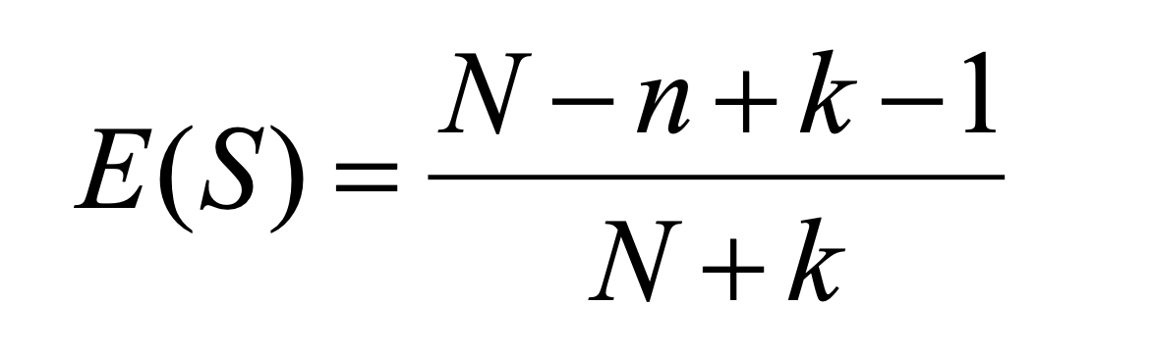
Static Expected Error
If we prune a node, it becomes a leaf labeled C
What will be the expected classification error at this leaf?
S is the set of examples in a node
k is the number of classes
N examples in S
C the majority class in S
n out of N examples in S belong to C
Laplace error estimate – based on the assumption that the distribution of probabilities that examples will belong to different classes is uniform.

Slide 83
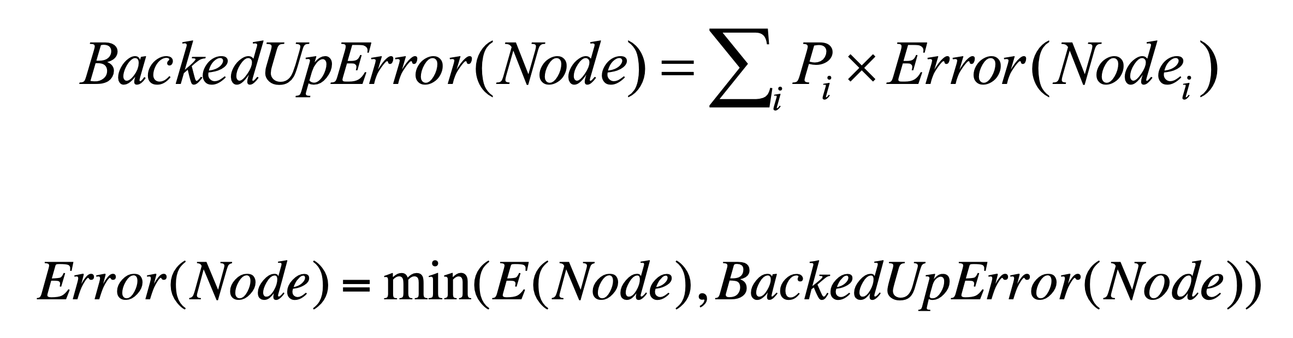
Backed-up Error
For a non-leaf node Node
Let children of Node be Node₁, Node₂, etc.
  Probabilities can be estimated by relative frequencies of attribute values in sets of examples that fall into child nodes

Slide 84
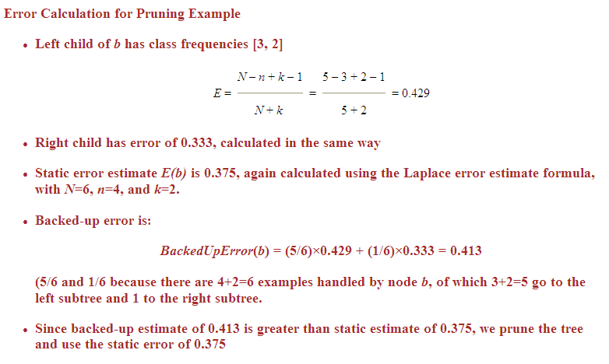
Example Calculation
b
[4,2]
[3,2]
[1,0]

Slide 85
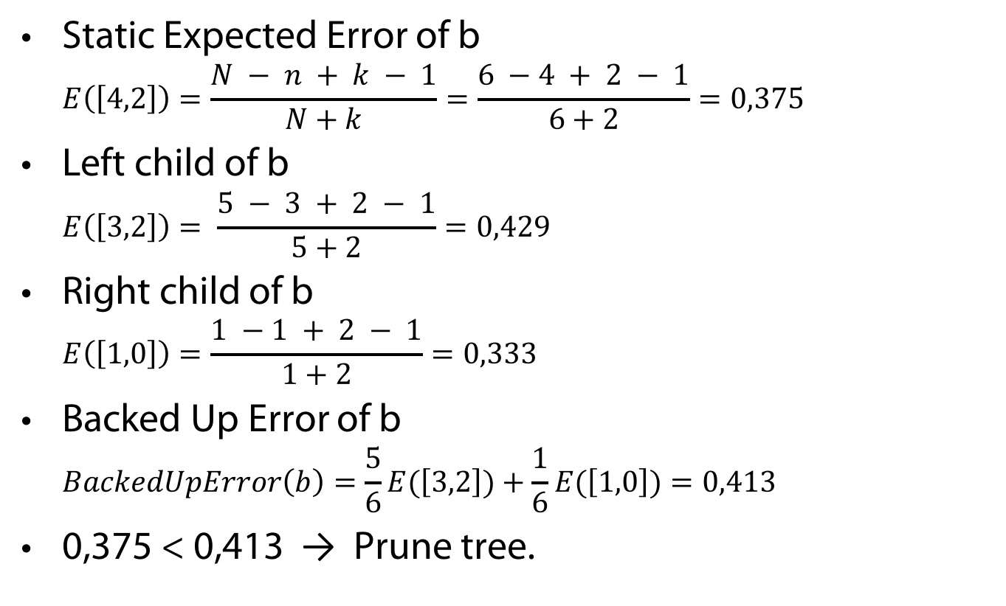
Example Calculation
Static Expected Error of b
$E\left(\left[4,2\right]\right)=\frac{N − n + k − 1}{N+k}=\frac{6 −4 + 2 − 1}{6+2}=0,375$
Left child of b
$E\left(\left[3,2\right]\right)= \frac{5 − 3 + 2 − 1}{5+2}=0,429$
Right child of b
$E\left(\left[1,0\right]\right)=\frac{1 −1 + 2 − 1}{1+2}=0,333$
Backed Up Error of b
$BackedUpError\left(b\right)=\frac{5}{6}E(\left[3,2\right])+\frac{1}{6}E(\left[1,0\right])=0,413$
0,375 < 0,413 → Prune tree.
b
[4,2]
[3,2]
[1,0]

Slide 86
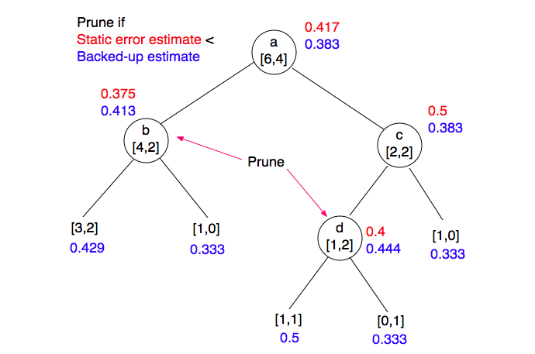
Example

Slide 87
Regression Trees
Build a regression tree:
Divide the predictor space into J distinct not overlapping regions R₁,R₂,R₃,…,R_{J}
We make the same prediction for all observations in the same region; use the mean of responses for all training observations that are in the region

Slide 88
x₂
Region2
Region1
y=2.2
y=3.2
Region3
y=5.6
x₁

Slide 89
Finding the sub-regions
The regions could have any shape.
But we choose just rectangles
x₂
Region2
x₂
Region2
Region1
Region1
Y=2.5
y=2.2
Y=2.9
Y=3.2
Region3
Region3
Y=5.1
y=5.6
x₁
x₁

Slide 90
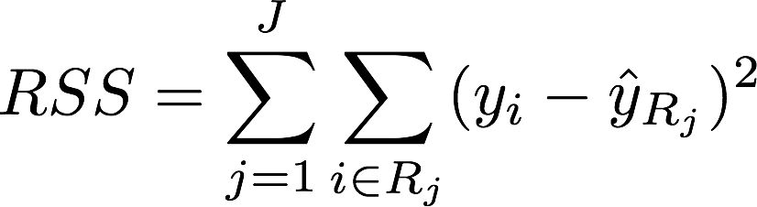

Find boxes R₁, . . . , R_{J} that minimize the RSS
where is the mean response value of all training observations in the R_{j} region
This computationally very expensive!
Solution: Top down approach, greedy approach
recursive binary splitting

Slide 91
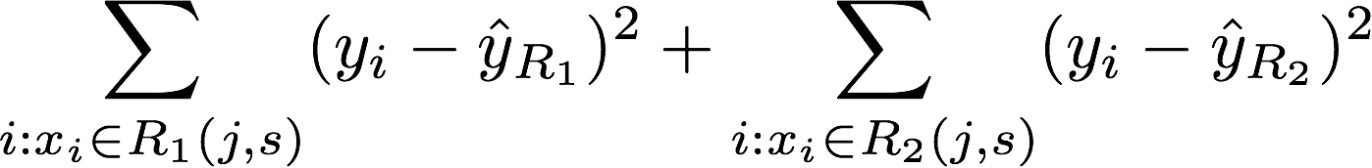
Recursive Binary Splitting
Consider all predictor X_{p} and all the all possible values of the cutpoints s for each of the predictors. Choose the predictor and cutpoint s.t. it minimizes the RSS
  This can be done quickly, assuming number of predictors is not very large
Repeat #1 but only consider the sub-regions
Stop: node contains only one class or node contains less than n data points or max depth is reached

Slide 93
From Decision Trees to Rules
Refund = Yes → No
Refund = No ∧
Marital Status = {Single, Divorced} ∧ Taxable Income < 80k → No
Refund = No ∧
Marital Status = {Single, Divorced} ∧ Taxable Income > 80k → Yes
Refund = No ∧
Marital Status = Married → No
Notes:
93

Slide 94
From Decision Trees to Rules
Derive a rule set from a decision tree:
Write a rule for each path from the root to a leaf.
  The left-hand side is easily built from the label of the nodes and the labels of the arcs.
Rules are mutually exclusive and exhaustive.
Rule set contains as much information as the tree
Notes:
94

Slide 95
Rules Can Be Simplified
Initial Rule: (Refund=No) ∧ (Status=Married) → No
Simplified Rule: (Status=Married) → No
Notes:
95

Slide 96
Rules Can Be Simplified
The resulting rules set can be simplified:
  Let LHS be the left hand side of a rule.
  Let LHS' be obtained from LHS by eliminating some conditions.
  We can certainly replace LHS by LHS' in this rule if the subsets of the training set that satisfy respectively LHS and LHS' are equal.
  A rule may be eliminated by using meta-conditions such as "if no other rule applies".
Notes:
96

Slide 97
VSL vs DTL
Decision tree learning (DTL) is more efficient if all examples are given in advance; else, it may produce successive hypotheses, each poorly related to the previous one
Version space learning (VSL) is incremental
DTL can produce simplified hypotheses that do not agree with all examples
DTL has been more widely used in practice
Notes:
Meta Dendral – Molecul breaking rules for mass spectrometer
Lex – symbolic integration problems

