Slide 1
Einführung in
Web- und Data-Science
Ensemble Learning
Prof. Dr. Ralf Möller
Universität zu Lübeck
Institut für Informationssysteme

Slide 2


Recap: Decision Trees
Person | Age | Male? | Height > 55”
Alice | 14 | 0 | 1
Bob | 10 | 1 | 1
Carol | 13 | 0 | 1
Dave | 8 | 1 | 0
Erin | 11 | 0 | 0
Frank | 9 | 1 | 1
Gena | 8 | 0 | 0
Male?
Yes
No
Age>9?
Age>10?
Yes
No
Yes
No
1
0
1
0
2

Slide 3
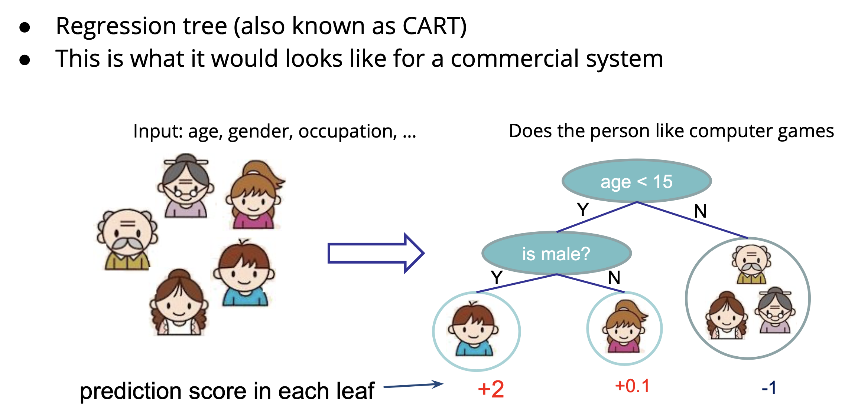
Regression Trees

Slide 4
Ensembles of Classifiers
  None of the classifiers is perfect
Idea
  Combine the classifiers to improve performance
Ensembles of classifiers
  Combine the classification results from different classifiers to produce the final output
    Unweighted voting
    Weighted voting
4
CS 4700, Foundations of Artificial Intelligence, Carla P. Gomes

Slide 5


Example: Weather Forecast
Reality
1
2
3
4
5
Combine
X
X
X
X
X
X
X
X
X
X
X
X
X
5
CS 4700, Foundations of Artificial Intelligence, Carla P. Gomes

Slide 6
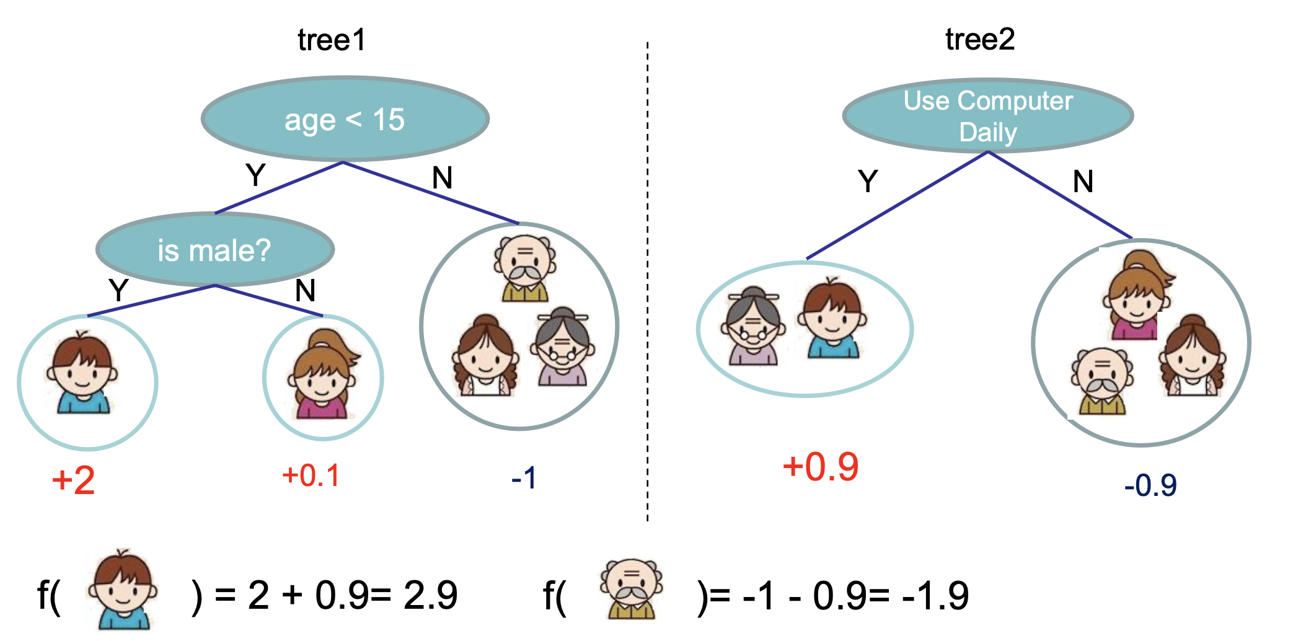
Regression Tree Ensembles

Slide 7
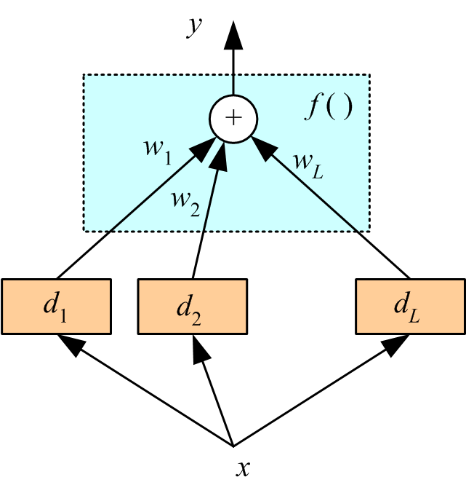
Voting
Linear combination of d_{j} ∈ {-1, 1}
Unweighted voting: w_{j} = 1/L
Also possible d_{j} ∈ ℤ
High values for |y| means
high "confidence"
Possibly use sign(y) ∈ {-1, 1}

Slide 8
Outline
Bias/Variance Tradeoff
Ensemble methods that minimize variance
  Bagging [Breiman 94]
  Random Forests [Breiman 97]
Ensemble methods that minimize bias
  Boosting [Freund&Schapire 95, Friedman 98]
  Ensemble Selection
Subsequent slides are based on a presentation by Yisong Yue
An Introduction to Ensemble Methods
Bagging, Boosting, Random Forests, and More
8

Slide 9
Generalization Error
“True” distribution: P(x,y)
  Unknown to us
Train: h(x) = y
  Using training data S = {(x₁,y₁),…,(x_{n},y_{n})}
  Sampled from P(x,y)
Generalization Error:
  L(h) = E_{(x,y)~P(x,y)}[ f(h(x),y) ]
  E.g., f(a,b) = (a-b)²
9

Slide 10
Person | Age | Male? | Height > 55”
James | 11 | 1 | 1
Jessica | 14 | 0 | 1
Alice | 14 | 0 | 1
Amy | 12 | 0 | 1
Bob | 10 | 1 | 1
Xavier | 9 | 1 | 0
Cathy | 9 | 0 | 1
Carol | 13 | 0 | 1
Eugene | 13 | 1 | 0
Rafael | 12 | 1 | 1
Dave | 8 | 1 | 0
Peter | 9 | 1 | 0
Henry | 13 | 1 | 0
Erin | 11 | 0 | 0
Rose | 7 | 0 | 0
Iain | 8 | 1 | 1
Paulo | 12 | 1 | 0
Margaret | 10 | 0 | 1
Frank | 9 | 1 | 1
Jill | 13 | 0 | 0
Leon | 10 | 1 | 0
Sarah | 12 | 0 | 0
Gena | 8 | 0 | 0
Patrick | 5 | 1 | 1
Person | Age | Male? | Height > 55”
Alice | 14 | 0 | 1
Bob | 10 | 1 | 1
Carol | 13 | 0 | 1
Dave | 8 | 1 | 0
Erin | 11 | 0 | 0
Frank | 9 | 1 | 1
Gena | 8 | 0 | 0
y
h(x)
Generalization Error:
L(h) = E_{(x,y)~P(x,y)}[ f(h(x),y) ]
…
10

Slide 11
Bias/Variance Tradeoff
Treat h (x|S) as a random function
  Depends on training data S
L = E_{S}[ E_{(x,y)~P(x,y)}[ f(h (x|S),y) ] ]
  Expected generalization error
  Over the randomness of S
11

Slide 12
Bias/Variance Tradeoff
Squared loss: f(a,b) = (a-b)²
Consider one data point (x,y)
Notation:
  Z = h(x|S) – y
  ž = E_{S}[Z]
  Z-ž = h(x|S) – E_{S}[h(x|S)]
Expected Error
E_{S}[(Z-ž)²] = E_{S}[Z² – 2Zž + ž²]
= E_{S}[Z²] – 2E_{S}[Z]ž + ž²
= E_{S}[Z²] – ž²
E_{S}[f(h(x|S),y)] = E_{S}[Z²]
= E_{S}[(Z-ž)²] + ž²
Bias = systematic error resulting from the effect that the expected value of estimation results differs from the true underlying quantitative parameter being estimated.
Variance
Bias
12

Slide 13
Example
y
x
13

Slide 14
h(x|S)
14

Slide 15
h(x|S)
15

Slide 16
h(x|S)
16

Slide 17
Bias
Variance
Bias
Variance
Bias
Variance
E_{S}[(h(x|S) - y)²] = E_{S}[(Z-ž)²] + ž²
Z = h(x|S) – y
ž = E_{S}[Z]
Expected Error
Variance
Bias
17

Slide 18
Outline
Bias/Variance Tradeoff
Ensemble methods that minimize variance
  Bagging
  Random Forests
Ensemble methods that minimize bias
  Boosting
  Ensemble Selection
Subsequent slides by Yisong Yue
An Introduction to Ensemble MethodsBoosting,
Bagging, Random Forests and More
18

Slide 19
Bagging
P(x,y)
S’
Goal: reduce variance
Ideal setting: many training sets S’
  Train model using each S’
  Average predictions
sampled independently
Variance reduces linearly
Bias unchanged
E_{S}[(h(x|S) - y)²] = E_{S}[(Z-ž)²] + ž²
Z = h(x|S) – y
ž = E_{S}[Z]
Expected Error
Variance
Bias
“Bagging Predictors” [Leo Breiman, 1994]
Bagging = Bootstrap Aggregation
http://statistics.berkeley.edu/sites/default/files/tech-reports/421.pdf
19

Slide 20
Bagging
Sampling schemes may be without replacement ('WOR'—no element can be selected more than once in the same sample) or with replacement ('WR'—an element may appear multiple times in the one sample). [Wikipedia]
S
S’
Goal: reduce variance
In practice: resample S’ with replacement
  Train model using each S’
  Average predictions
from S
Variance reduces sub-linearly
(Because S’ are correlated)
Bias often increases slightly
E_{S}[(h(x|S) - y)²] = E_{S}[(Z-ž)²] + ž²
Z = h(x|S) – y
ž = E_{S}[Z]
Expected Error
Variance
Bias
“Bagging Predictors” [Leo Breiman, 1994]
Bagging = Bootstrap Aggregation
http://statistics.berkeley.edu/sites/default/files/tech-reports/421.pdf
20

Slide 21
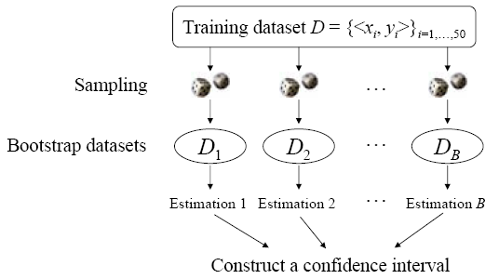
Bagging
21

Slide 22
DT
Bagged DT
Variance
Better
Bias
Bias
“An Empirical Comparison of Voting Classification Algorithms: Bagging, Boosting, and Variants”
Eric Bauer & Ron Kohavi, Machine Learning 36, 105–139, 1999
22

Slide 23
Random Forests
Goal: reduce variance
  Bagging can only do so much
  Resampling training data converges asymptotically to minimum reachable error
Random Forests: sample data & features!
  Sample S’
  Train DT
    At each node, sample feature subset
  Average predictions
Further de-correlates trees
“Random Forests – Random Features” [Leo Breiman, 1997]
http://oz.berkeley.edu/~breiman/random-forests.pdf
23

Slide 24
The Random Forest Algorithm
Given a training set S
For i := 1 to k do:
Build subset Si by sampling with replacement from S
Learn tree T_{i} from S_{i}
At each node:
Choose best split from random subset of F features
Each tree grows to the largest extent, and no pruning
Make predictions according to majority vote of the set of k trees.
24

Slide 25
Outline
Bias/Variance Tradeoff
Ensemble methods that minimize variance
  Bagging
  Random Forests
Ensemble methods that minimize bias
  Boosting
  Ensemble Selection
Yoav Freund and Robert Schapire who won the Gödel Prize in 2003
Y. Freund, and R. Shapire, “A decision-theoretic generalization of on-line learning and an application to boosting”, Proceedings of the Second European Conference on Computational Learning Theory, 1995, pp. 23–37.
25

Slide 26
Selection of a Series of Classifiers
Next set of training instance is determined by weighted sampling
Training instances that are wrongly predicted by Classifier₁ motivate the selection of the best classifier from a pool able to deal with previously erroneously classified instances
Original training set
Data set ₁
Data set ₂
… ...
Data set _{T}
… ...
Classifier₁
Classifier₂
… ...
Classifier_{T}
weighted combination
Pool of Classifiers
26

Slide 27
Person | Age | Male? | Height > 55”
James | 11 | 1 | 1
Jessica | 14 | 0 | 1
Alice | 14 | 0 | 1
Amy | 12 | 0 | 1
Bob | 10 | 1 | 1
Xavier | 9 | 1 | 0
Cathy | 9 | 0 | 1
Carol | 13 | 0 | 1
Eugene | 13 | 1 | 0
Rafael | 12 | 1 | 1
Dave | 8 | 1 | 0
Peter | 9 | 1 | 0
Henry | 13 | 1 | 0
Erin | 11 | 0 | 0
Rose | 7 | 0 | 0
Iain | 8 | 1 | 1
Paulo | 12 | 1 | 0
Margaret | 10 | 0 | 1
Frank | 9 | 1 | 1
Jill | 13 | 0 | 0
Leon | 10 | 1 | 0
Sarah | 12 | 0 | 0
Gena | 8 | 0 | 0
Patrick | 5 | 1 | 1
Person | Age | Male? | Height > 55”
Alice | 14 | 0 | 1
Bob | 10 | 1 | 1
Carol | 13 | 0 | 1
Dave | 8 | 1 | 0
Erin | 11 | 0 | 0
Frank | 9 | 1 | 1
Gena | 8 | 0 | 0
How to implement weighted sampling?
…
27

Slide 28
Example of a Good Classifier: Bias minimal
+
−
+
+
−
+
−
−
+
−
How can we automatically construct such a classifier?
28

Slide 29
AdaBoost (Adaptive Boosting)
Wanted: Two-class classifier for pattern recognition problem
Given: Pool of 11 classifiers (experts)
For a given pattern x_{i} each expert k_{j} can emit an opinion k_{j}(x_{i}) ∈ {-1, 1}
Final decision: sign(C(x)) where
C(x_{i}) = α₁k₁(x_{i}) + α₂k₂(x_{i}) + · · · + α₁₁k₁₁(x_{i})
k₁, k₂, . . . , k₁₁ denote the eleven experts
α₁, α₂, . . . , α₁₁ are the weights we assign to the opinion of each expert
Problem: How to derive α_{j} (and k_{j})?
Rojas, R. (2009). AdaBoost and the super bowl of classifiers a tutorial introduction to adaptive boosting. Freie University, Berlin, Tech. Rep.

Slide 30
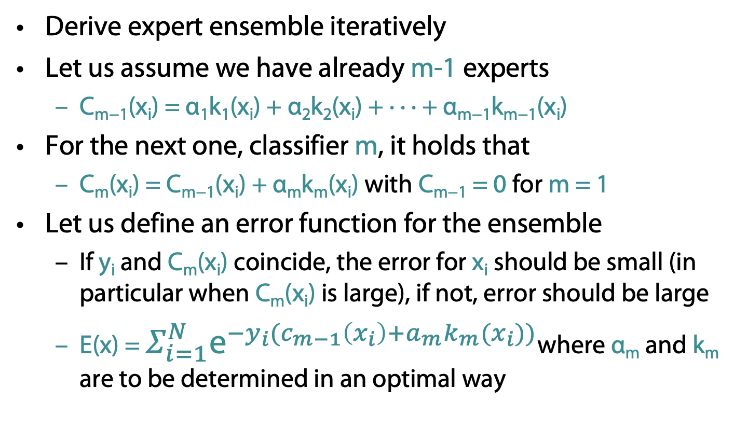
AdaBoost: Constructing the Ensemble
Derive expert ensemble iteratively
Let us assume we have already m-1 experts
  C_{m−1}(x_{i}) = α₁k₁(x_{i}) + α₂k₂(x_{i}) + · · · + α_{m−1}k_{m−1}(x_{i})
For the next one, classifier m, it holds that
  C_{m}(x_{i}) = C_{m−1}(x_{i}) + α_{m}k_{m}(x_{i}) with C_{m−1} = 0 for m = 1
Let us define an error function for the ensemble
  If y_{i} and C_{m}(x_{i}) coincide, the error for x_{i} should be small (in particular when C_{m}(x_{i}) is large), if not, error should be large
  E(x) = $Σ_{i=1}^{N}{\text{e}}^{{−y}_{i}(c_{m−1}\left(x_{i}\right)+a_{m}k_{m}(x_{i}))}$where α_{m} and k_{m} are to be determined in an optimal way

Slide 31
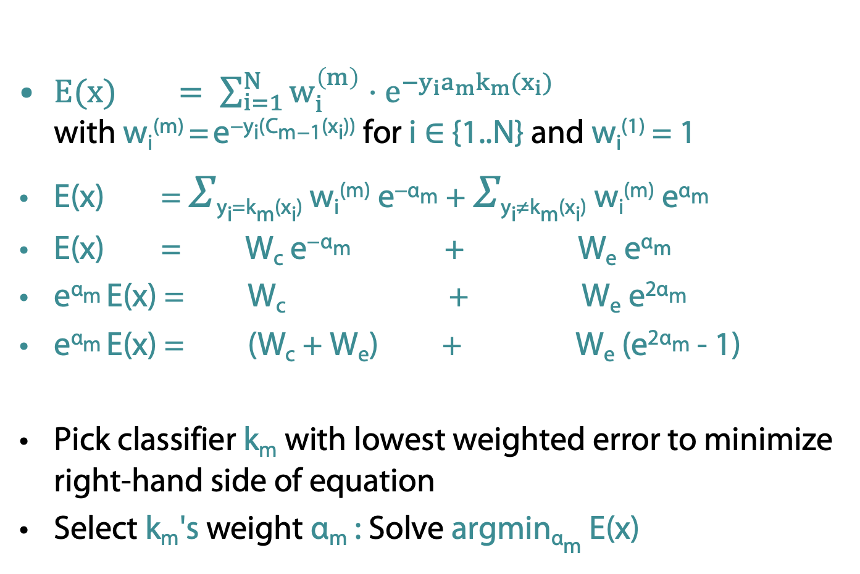
AdaBoost (cntd.)
$E(x) = \sum_{i=1}^{N}{w_{i}^{\left(m\right)}}⋅e^{−y_{i}a_{m}k_{m}(x_{i})}$
with w_{i}^{(m)} = e^{−yi(Cm−1(xi))} for i ∈ {1..N} and w_{i}⁽¹⁾ = 1
E(x) = 𝛴_{yi=km(xi)} w_{i}^{(m)} e^{−αm} + 𝛴_{yi≠km(xi)} w_{i}^{(m)} e^{αm}
E(x) = W_{c} e^{−αm} + W_{e} e^{αm}
e^{αm} E(x) = W_{c} + W_{e} e^{2αm}
e^{αm} E(x) = (W_{c} + W_{e}) + W_{e} (e^{2αm} - 1)
Pick classifier k_{m} with lowest weighted error to minimize right-hand side of equation
Select k_{m}'s weight α_{m} : Solve argmin_{αm} E(x)
e^{2αm} > 1
constant in each iteration, call it W

Slide 32
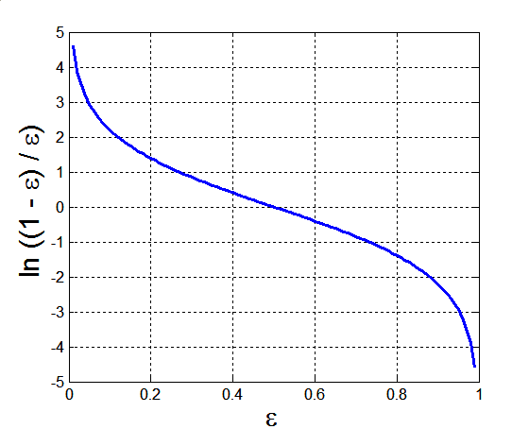
AdaBoost (cntd.)
𝛿E/𝛿α_{m} = - W_{c} e^{−αm} + W_{e} e^{αm}
Find minimum
- W_{c} e^{−αm} + W_{e} e^{αm} = 0
- W_{c} + W_{e} e^{2αm} = 0
α_{m} = ½ ln (W_{c} / W_{e})
α_{m} = ½ ln ((W – W_{e}) / W_{e})
α_{m} = ½ ln ((1 – 𝜀_{m}) / 𝜀_{m})
with 𝜀_{m} = W_{e} / W being the
percentage rate of error
given the weights of the
data points

Slide 33
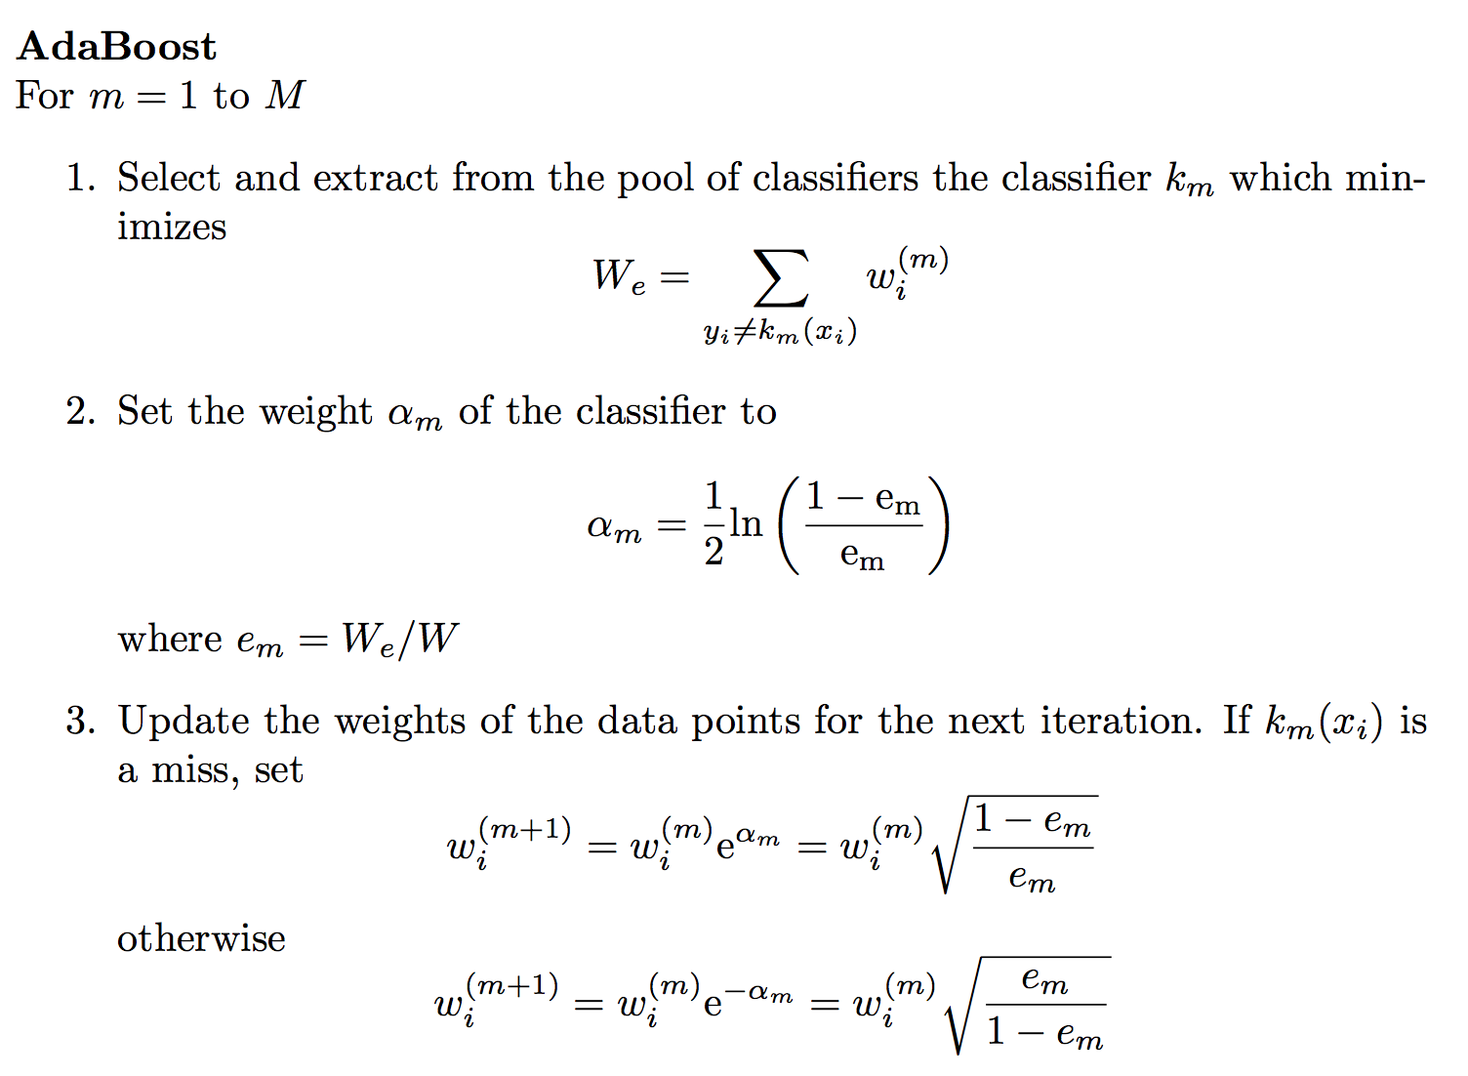
𝜀_{m}
𝜀_{m}
𝜀_{m}
𝜀_{m}
𝜀_{m}
𝜀_{m}
𝜀_{m}

Slide 34
Round 1 of 3
+
+
O
−
−
+
+
O
+
+
O
−
−
+
−
+
−
−
−
+
+
−
−
h₁
ε₁ = 0.300
α₁=0.424
D₂

Slide 35
Round 2 of 3
+
+
−
−
+
+
+
+
−
−
O
−
+
−
O
+
−
−
+
+
−
−
O
ε₂ = 0.196
α₂=0.704
h₂
D₂

Slide 36
Round 3 of 3
+
−
O
+
+
−
h₃
−
STOP
+
O
−
+
O
−
ε₃ = 0.344
α₂=0.323

Slide 37
Final Hypothesis
0.42
+ 0.70
+ 0.32
H_{final} = sign[ 0.42(h1? 1|-1) + 0.70(h2? 1|-1) + 0.32(h3? 1|-1) ]
+
−
+
+
+
−
−
−
+
−

Slide 38
AdaBoost with Decision Trees
h(x) = 𝛼₁h₁(x)
+ 𝛼₂h₂(x)
+ … + 𝛼_{n}h_{n}(x)
S’ = {(x,y,w₁)}
S’ = {(x,y,w₂)}
S’ = {(x,y,w_{n}))}
…
h₁(x)
h₂(x)
h_{n}(x)
w – weighting on data points
𝛼 – weight of linear combination
Stop when validation
performance plateaus
https://www.cs.princeton.edu/~schapire/papers/explaining-adaboost.pdf

Slide 39
DT
Bagging
AdaBoost
Variance
Better
Boosting often uses weak models
E.g, “shallow” decision trees
Weak models have lower variance
Bias
Bias
“An Empirical Comparison of Voting Classification Algorithms: Bagging, Boosting, and Variants”
Eric Bauer & Ron Kohavi, Machine Learning 36, 105–139, 1999

Slide 40
Gradient Boosting (XGBoost) Ensemble Learning
The term "gradient" in gradient boosting refers to the fact that the method is based on minimizing the gradient of the loss function
  Fit each new model to the gradient of the loss function with respect to the ensemble's predictions
  By iteratively minimizing the loss function's gradient, the ensemble of models is improved, leading to the term "gradient boosting"
XGBoost: popular implementation of gradient boosting
  Parallelization
  Regularization (penalty on the complexity of the loss function to prevent overfitting)
  Captures non-linear relationships between features and the target variable
Gradient boosting has been widely used in machine learning and has been a key component in many winning models of Kaggle competitions
https://de.wikipedia.org/wiki/XGBoost

Slide 41
Bagging vs Boosting
Bagging: the construction of complementary base-learners is left to chance and to the unstability of the learning methods
Boosting: actively seek to generate complementary base-learners--- training the next base-learner based on the mistakes of the previous learners

Slide 42
Ensemble Selection
Training S’
H = {2000 models trained using S’}
Validation V’
S
Maintain ensemble model as combination of H:
h(x) = h₁(x) + h₂(x) + … + h_{n}(x)
+ h_{n+1}(x)
Denote as h_{n+1}
Add model from H that maximizes performance on V’
Repeat
Models are trained on S’
Ensemble built to optimize V’
“Ensemble Selection from Libraries of Models”
Caruana, Niculescu-Mizil, Crew & Ksikes, ICML 2004

Slide 43
Method | Minimize Bias? | Minimize Variance? | Other Comments
Bagging | Complex model class. (Deep DTs) | Bootstrap aggregation (resampling training data) | Does not work for simple models.
Random Forests | Complex model class. (Deep DTs) | Bootstrap aggregation + bootstrapping features | Only for decision trees.
Gradient Boosting (AdaBoost) | Optimize training performance. | Simple model class. (Shallow DTs) | Determines which model to add at run-time.
Ensemble Selection | Optimize validation performance | Optimize validation performance | Pre-specified dictionary of models learned on training set.
…and many other ensemble methods as well.
State-of-the-art prediction
performance
  Won Netflix Challenge
  Won numerous KDD Cups
  Industry standard
The Netflix Prize sought to substantially
improve the accuracy of predictions
about how much someone is going to enjoy
a movie based on their movie preferences. 2009
Although the data sets were constructed to preserve customer privacy,
the Prize has been criticized by privacy advocates. In 2007 two researchers
from the University of Texas were able to identify individual users by
matching the data sets with film ratings on the Internet Movie Database.

Slide 44
Better
Average performance over many datasets
Random Forests perform the best
“An Empirical Evaluation of Supervised Learning in High Dimensions”
Caruana, Karampatziakis & Yessenalina, ICML 2008

Slide 45
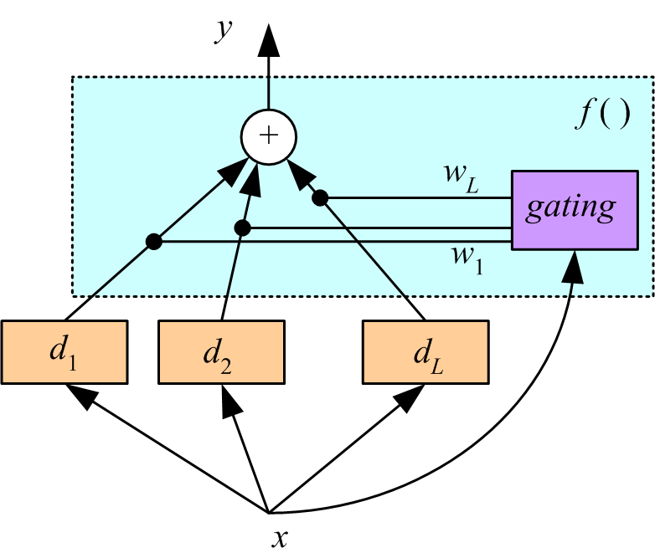
Mixture of Experts: Gating
Voting where weights are input-dependent (gating)
Different input regions convered by different learners (Jacobs et al., 1991)
Gating decides which expert
to use
Need to learn the individual
experts as well as the gating functions w_{i}(x):
Σw_{j}(x) = 1, for all x

Slide 46
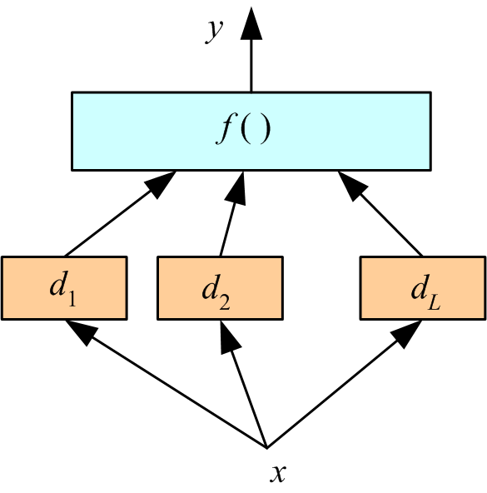
Mixture of Experts: Stacking
Combiner f () is another learner (Wolpert, 1992)

Slide 47
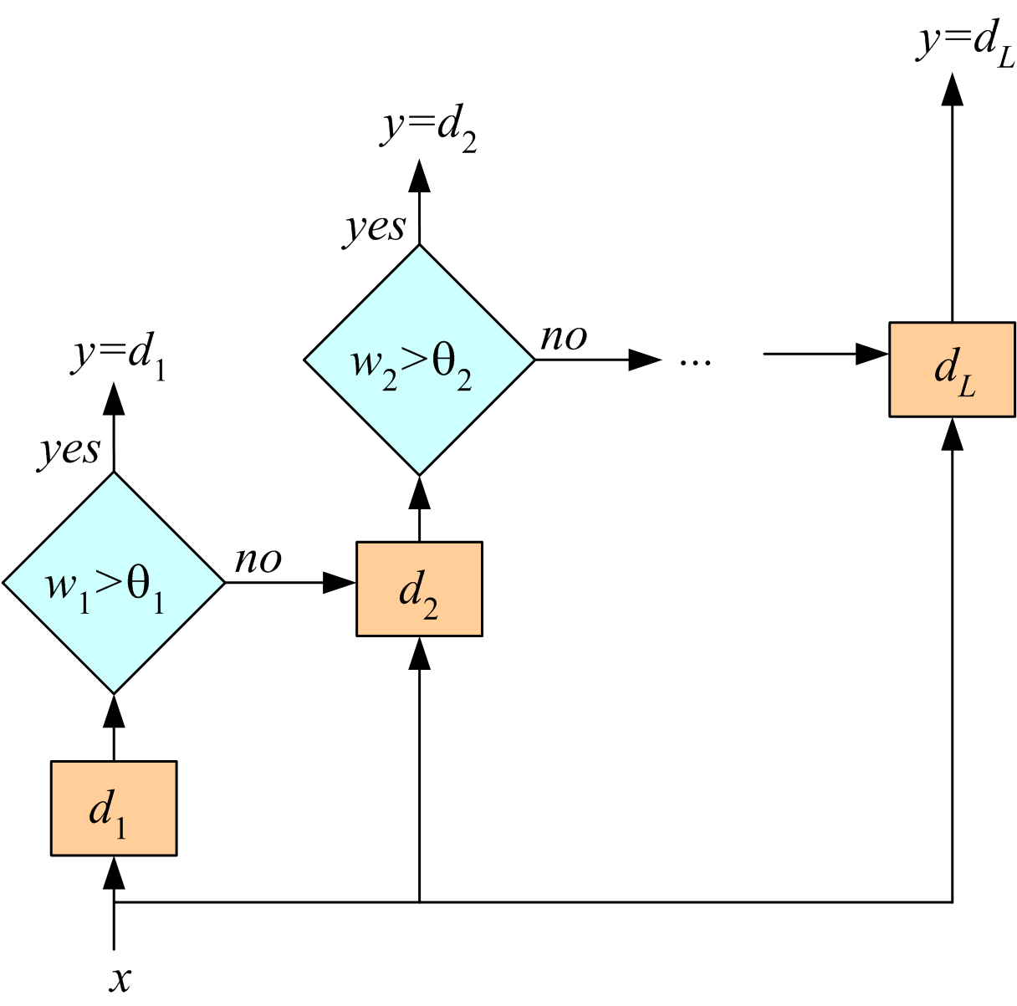
Mixture of Experts: Cascading
Use d_{j} only if preceding ones are not confident
Cascade learners in order of complexity

