Slide 1
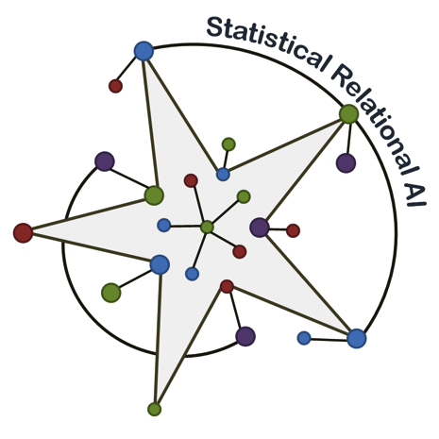
Ensuring Security in Critical Infrastructures with Probabilistic Relational Modeling Part 1 Summer School “Hot Topics in Cyber Security” Rome
Ralf Möller
Joint work with Mona Lange and Alexander Motzek
Universität zu Lübeck
Institute of Information Systems

Slide 2
Claim
Probabilistic Relational Models (PRMs)
Statistical Relational AI aka Stochastic Relational AI (StaRAI)
… are hot topics in cyber security
We need StaRAI for ensuring cyber security
Studying this topic pays off

Slide 3
The Context: Where it All Started – PANOPTESEC
Cyber defense decision support system
Risk based approach accounting for the dynamic nature of ICT and the constantly evolving capabilities of cyber attackers
In cooperation with Acea S.p.A.
Critical infrastructure use case
Partially supported by EU
www.panoptesec.eu
3

Slide 4
Proactive Cyber Defense
Probabilistic Information
4

Slide 5
Reactive Cyber Defense
Scalability
5

Slide 6
Agenda
Part 1
Propositional probabilistic models
Bayesian Networks
Hidden Markov Models
… and how they can be used to reason about cyber security
Mission Impact Model
Low Level Correlator
Part 2
Relational probabilistic models
LLC and HOC (to some extent)
6

Slide 7
Mission Impact Model (MIM)
Business Functions and Resources: „Workflows“

Slide 8
Hierarchy and Impact in Business Models
X→ Y: Probability of Y being affected conditional X is infected
Resources
Functions
Processes
What‘s the meaning for 2 and more „inputs“
Company
8

Slide 9
Baysian Networks: Introduction
I'm at work, neighbor John calls to say my alarm is ringing, but neighbor Mary doesn't call. Sometimes it's set off by minor earthquakes. Is there a burglary?
Variables: Burglary, Earthquake, Alarm, JohnCalls, MaryCalls
Network topology reflects "causal" knowledge:
A burglar can set the alarm off
An earthquake can set the alarm off
The alarm can cause Mary to call
The alarm can cause John to call
Notes:
Burglar alarm system installed. Judea Pearl researcher and living in LA

Slide 10
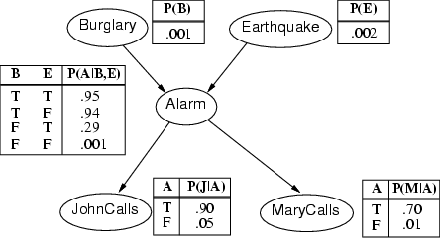
Example contd.
Notes:
John nearly calls ervery time the alarm is ringing but sometimes confuses whether it is the telephone or the alarm.
Mary often hears loud music. J & M only Alarm means we assume that they can not directly observe burglars and minor earthquakes.
Rows sum up to one because they represent all the cases for a variable. One must be the case. Any irrelevant attributes are encoded in prob-> laziness, ignorance

Slide 11
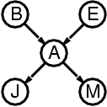
Compactness of Full Joint Encoding Due to Network Sparseness
A CPT for Boolean X_{i} with k Boolean parents has 2^{k} rows for the combinations of parent values
Each row requires one number p for X_{i} = true (the number for X_{i} = false is just 1-p)
If each variable has no more than k parents, the complete network requires n · 2^{k} numbers
i.e., grows linearly with n, vs. 2^{n} for the full joint distribution
For burglary net, 1 + 1 + 4 + 2 + 2 = 10 numbers (vs. 2⁵-1 = 31)

Slide 12
Semantics
The full joint distribution is defined as the product of the local conditional distributions:
P (X₁, … ,X_{n}) = π_{i = 1} P (X_{i} | Parents(X_{i}))
e.g., P(j ∧ m ∧ a ∧ ¬b ∧ ¬e)
= P (j | a) P (m | a) P (a | ¬b, ¬e) P (¬b) P (¬e)
= 0.90x0.7x0.001x0.999x0.998 ≈ 0.00063
n

Slide 13
Noisy-OR-Representation
A
B
A
B
0.8
0.1
C
Meaning
C
A
B
c
f
f
0.0
f
t
0.1
t
f
0.8
t
t
0.1+0.8 - 0.1*0.8
Substantial reduction of the probabilities to be stored

Slide 14
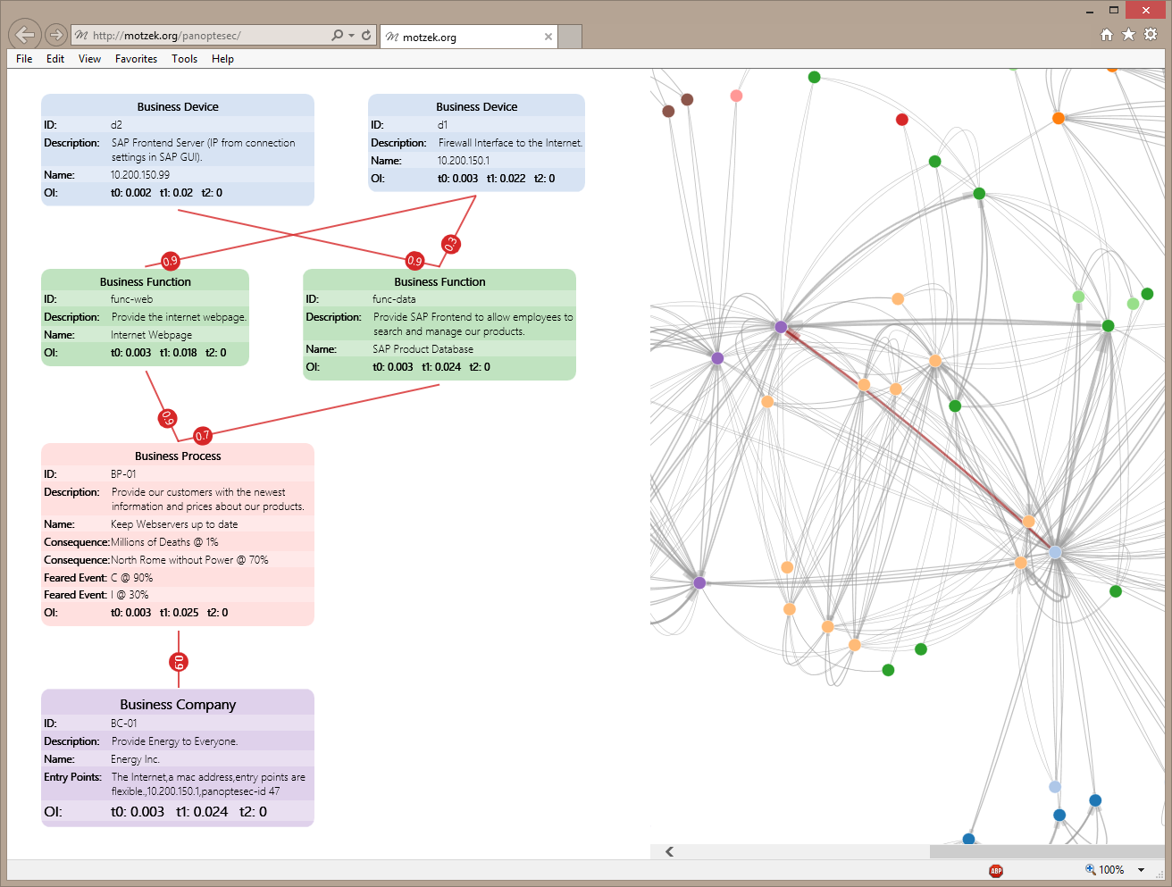
Joint distribution:
Bayesian Network
14

Slide 15
what must be true to allow for a certain (desired) conclusion?
15

Slide 16
(Calculation over tree sum-product evaluation tree
with path length n (=number of RVs) and degree d
(=maximal number domain elements) )
16

Slide 17
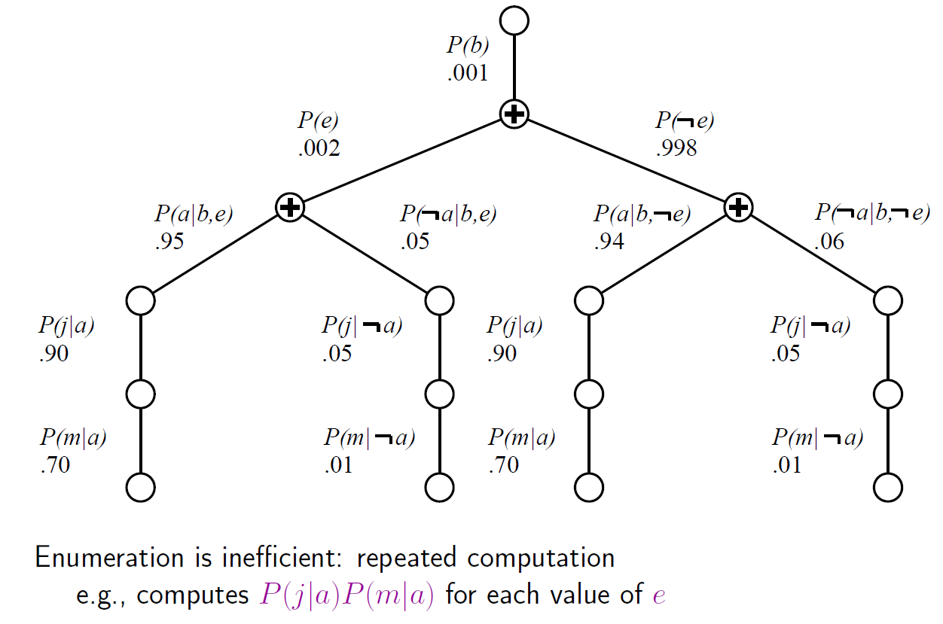
Evaluation Tree
Can do better with Variable Elimination (VE)
17

Slide 18
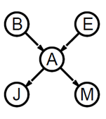
Basic Objects of VE
Track objects called factors
(right-to-left, in tree: bottom up)
Initial factors are local CPTs
During elimination create new factors
P(M|A)
f_{M}(A)
18

Slide 19
Join by pointwise product
19

Slide 20
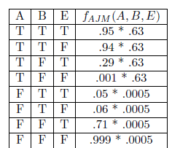
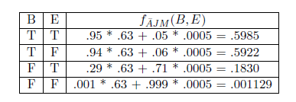
Summing out
Summing out a
20

Slide 21
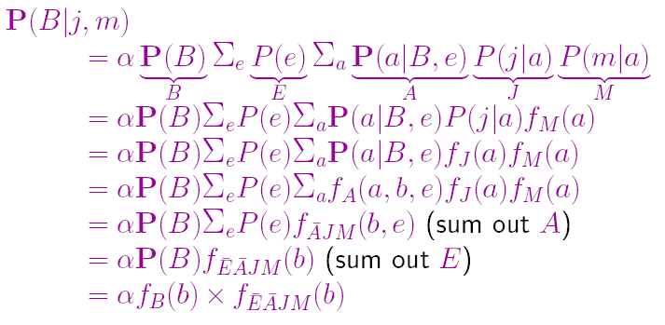
VE Result for Burglary Example
21

Slide 22
Dynamic Bayesian Networks (DBNs)
R_{t-1} | P(R_{t}|R_{t-1})
T F | 0.7 0.3
Rain_{t-1}
Rain_{t}
Rain_{t+1}
State
Umbrella_{t-1}
Umbrella_{t}
Umbrella_{t+1}
Observation
R_{t} | P(U_{t}|R_{t})
T F | 0.9 0.2
Special case: Hidden Markov Model

Slide 23
DBNs can be more complex

Slide 24
DBN – Basic Inference Task
Filtering: Forward Messages

Slide 25
DBN – Basic Inference Task
Prediction:
Compute the posterior distribution over the future state, given all evidence to date.
for some k>0
The task of prediction can be seen simply as filtering without the addition of new evidence (need to sum out future evidence values).

Slide 26
DBN – Basic Inference Task
Smoothing or hindsight inference:
Compute the posterior distribution over the past state, given all evidence up to the present.
for some k such that 0 ≤ k < t.
Hindsight provides a better estimate of the state than was available at the time, because it incorporates more evidence from the “future”.

Slide 27
DBN – Basic Inference Task
Most-likely explanation:
Compute the sequence of states that is most likely to have generated a given sequence of observation.
Algorithms for this task are useful in many applications, including, e.g., speech recognition.

Slide 28
Most-Likely Explanation
max

Slide 29
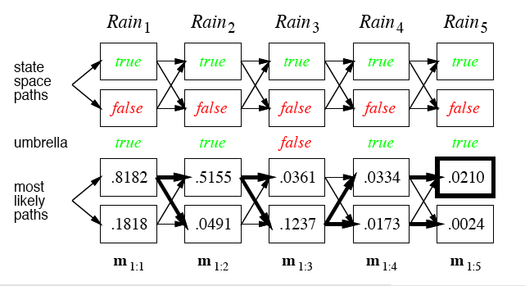
Rain/Umbrella Example

Slide 30
Back to the ACEA Use Case

Slide 31
ACEA Use Case
I: ICT, H: HCI, S: SCADA, R: Remote Terminal Unit, C: Controlling, D: Distribution
Central data processing facility: controlling (BPC) and distributing power (BPD) is provided by multiple SCADA servers (BFS), which use ICT (BPI ) to control and manage the individual RTUs (BPR), which are monitored by human machine interfaces (business function BFH )

Slide 32
ACEA Use Case
Device dependent Business/Mission Functions, Processes and Companies illustrated with weighted dependency links
Provides capability for prioritized security response plans based on business impact
Analysis of mission impact due to ‘shock events’
External events include
Impact of known vulnerabilities
Impact of incidents
Impact of proposed response plans
Short term and long term impact
32

Slide 33
ACEA Use Case: Respource Dependency Model
A -> B if A requires B to satisfy certain requests from its clients
Estimated by Analyzing Network Traffic
Extracted from one day traffic captures for the SMIA2011 challenge use case. Red nodes are directly impacted by vulnerabilities and affect other nodes transitively (first-step edges highlighted in red) and are remotely placed from mission critical devices (green). Thicker and darker edges represent higher dependency degrees. For visualization some insignificant dependencies are not displayed.

Slide 34
Local Models for Dependencies Can Induce Cycles
X→ Y: Probability of B being affected given A is infected
Short Term
Vs.
Long Term
Estimated by Analyzing Network Traffic (possibly with threshold)
Short Term
Vs.
Long Term
Cyclic dependencies resolved by unrolling
External Events
(short term and long term probs)

Slide 35
Activator (Dynamic) Bayesian Networks – A(D)BNs
35

Slide 36
Indirect Dependencies
36

Slide 37
Mutual Dependencies and Influences: Causality?
37

Slide 38
Dependencies and Influences: Unrolling over Time
38

Slide 39
Dependencies and Influences: Unrolling over Time?
39

Slide 40
Dependencies and Influences: Unrolling over Time?
Need cycles and activators
So, this way, we don‘t understand the world correctly
40

Slide 41
Causality Restored by Activators
41

Slide 42
What if there are too few activator observations?
Cycles are not resolved
Joint distribution not well-defined
Inference algorithms do not return correct results or tools do not work at all (syntax error)
Need to unroll the network as an approximation
Specify distribution over topological orders: extended A(D)BNs – eA(D)BNs
Each topological order defines distribution
Distribution over distributions
Summing out over all topological orders (given evidence, some might be ruled out)
So, basically we’re fine?
42

Slide 43
What‘s Wrong with These Models?
Influence structures w/o cycles are hard to learn … and cycles are difficult to deal with
Reasoning can get slow or results are only approximated if there is not enough information provided such that cycles disappear
Try another modeling paradigm supporting “mutual influences”
How to find business models / workflows?
Learn to identify workflows based on mining network traffic
Formally represent workflows as stochastic processes
Mission Oriented Network Analysis (MONA)
43

Slide 44
Low Level Correlator (LLC)
online
Correlation (multi-threaded, window-based)
Correlated prioritized event
Security Sensor Events
Syslog
(Normalization)
Analyzer ID | Time
CEDET01IDS | 2016-01-24 1:02:31.20
Source IP Address | Destination IP Address
20 85.1.1.8 | 132.8.1.5
CVE ID | Tag
CVE-2016- 00034 | VULNVERIFIED
Monitored System
Network Traffic
MONA
Workflows involving mission-critical systems
Network and Vulnerability Inventory
offline
IP
Vulnerability identifier
132.8.1.5 CVE-2016-0034
44

Slide 45
Network Dependency Analyzer (NDA)
Direct Dependency: A -> B, if A requires B to satisfy certain requests from its clients [Chen, Xu, al.]
Indirect Dependency: A -> B; A -> C if request A -> B and A-> C are caused by the same activity
1 1
Number of Packets
0 0 0 0 0
1 2 3 4 5 6 7
Time
(a) Client!DNS
Server
1
1
Number of Packets
0 0
0 0 0
1 2 3
4 5 6 7
Time
(b) Client!Load
balancing server
Xu Chen, Ming Zhang, Zhuoqing Morley Mao, and Paramvir Bahl. “Automating Network Application Dependency Discovery: Experi- ences, Limitations, and New Solutions.” In: Proc. 8th USENIX Symposium on Operating Systems Design and Implementation (OSDI 2008). pp. 117–130 . 2008.
45

Slide 46
Detecting Dependencies in a Time Window [t_{min} … t_{max}]
Normalized cross-correlation for histograms r (patterns) and s (signal)
Discretization of time
Mean
Best alignment at
Standard Deviation
Similarity if
46

Slide 47
Hidden Markov Models for Probalistic Workflow Modeling
1 1
Number of Packets
DNS
hidden state
lbs
db
0 0 0 0 0
webserver
1 2 3 4 5 6 7
Time
lbs
(a) Client!DNS
Server
DNS
lbs
1
1
webserver webserver
Number of Packets
observation
lbs
db
0 0
0 0 0
Proxy
1 2 3
4 5 6 7
Time
direct dependency indirect dependency
lbs load balancing server db database
client server
observation hidden state
(b) Client!Load
balancing server

Slide 48
Workflows for Event Prioritization: Most-Likely Sequence
Using a list of mission-critical network devices, most-likely workflows can be used to identify whether mission-critical network devices are affected.
Event Prioritization
DNS
hidden state
lbs
db
webserver
lbs
DNS
lbs
webserver webserver
observation
lbs
db
Proxy
48

Slide 49
Caveat and Challenges
Automatically derived LLC workflow patterns have no names
Learn structures that have meaning for humans?
One can nevertheless analyze patterns that are most-likely for a specific observation sequence
Mutual influences difficult to model with BNs
“Unrolling approximations” rather inefficient
Propositional nature of models (no objects and relations)
Models for real-world applications are unnecessarily large
Reasoning gets inefficient
Next: Probabilistic relational models (undirected)
49

Slide 50
Our Research
Mona Lange, Ralf Möller: Time Series Data Mining for Network Service Dependency Analysis, In: International Joint Conference SOCO 16-CISIS 16-ICEUTE 16, San Sebastián, Spain, October 19-21, 2016, Manuel Graña, López-Guede, José Manuel, Oier Etxaniz, Álvaro Herrero, Héctor Quintián, Emilio Corchado (Ed.), Springer International Publishing, p.584-594
Mona Lange, Felix Kuhr, Ralf Möller: Using a Deep Understanding of Network Activities for Workflow Mining, In: KI 2016: Advances in Artificial Intelligence - 39th Annual German Conference on AI, Klagenfurt, Austria, September 26-30, 2016, Springer, Lecture Notes in Computer Science, Vol.9904, p.177-184
Mona Lange, Felix Kuhr, Ralf Möller: Using a Deep Understanding of Network Activities for Network Vulnerability Assessment, In: ECAI 2016 - 22nd European Conference on Artificial Intelligence, 29 August-2 September 2016, The Hague, The Netherlands - Including Prestigious Applications of Artificial Intelligence (PAIS 2016), 2016, Gal A. Kaminka, Fox, Bouquet, Hüllermeier, Dignum, Dignum, Frank van Harmelen (Ed.), IOS Press, Frontiers in Artificial Intelligence and Applications, Vol.285, p.1583-1585
Mona Lange, Felix Kuhr, Ralf Möller: Using a Deeper Understanding of Network Activities for Security Event Management, In: International Journal of Network Security & Its Applications (IJNSA), 2016
Alexander Kott, Mona Lange, Jackson Ludwig: Assessing Mission Impact of Cyber Attacks: Towards a Model-Driven Paradigm in: IEEE Security Privacy, 2016, Vol.15, (5), p.65-74
Mona Lange: Time Series Data Mining for Context-Aware Event Analysis, Dissertation, Universität zu Lübeck, 2017
http://www.ifis.uni-luebeck.de/~moeller/PhDs/Lange/Mona-Dissertation.pdf
*I would like to thank the whole PANOPTESEC team for their work and contributions! The focus was on specific topics and global references in the tutorial are necessarily incomplete Apologies to anyone whose work I did not cite. Please have a look at the references of the above-mentioned publications.
50

Slide 51
Our Research
Alexander Motzek, Ralf Möller: Indirect Causes in Dynamic Bayesian Networks Revisited
In: IJCAI 2 15: 24th International Joint Conference on Artificial Intelligence, Buenos Aires, Argentina, pp. 703-709
In: JAIR, Journal of Artificial Intelligence Research
Alexander Motzek, Ralf Möller : Exploiting Innocuousness in Bayesian Networks
In: AI 2 15: 28th Australasian Joint Conference on Artificial Intelligence, Canberra, ACT, Australia, pp. 411-423
Alexander Motzek, Ralf Möller: Context- and Bias-Free Probabilistic Mission Impact Assessment
In: Computers & Security
Gustavo Gonzalez Granadillo, Alexander Motzek, Joaquin Garcia-Alfaro, Hervé Debar: Selection of Mitigation Actions Based on Financial and Operational Impact Assessments In: ARES 2 16: 11th International Conference on Availability, Reliability and Security, Salzburg, Austria
Alexander Motzek, Christina Geick, Ralf Möller: Semantic Normalization and Merging of Business Dependency Models
In: CBI 2016: 18th IEEE Conference on Business Informatics, Paris, France
Alexander Motzek: Indirect Causes, Dependencies and Causality in Bayesian Networks, Dissertation, Universität zu Lübeck, 2016 http://adbn.motzek.org/adbn-com-rev.pdf
*I would like to thank the whole PANOPTESEC team for their work and contributions! The focus was on specific topics and global references in the tutorial are necessarily incomplete. Apologies to anyone whose work I did not cite. Please have a look at the references of the above-mentioned publications.
51

