Slide 1
AMaLDA Or: Why agents should still try to understand the world
Ralf Möller

Slide 2
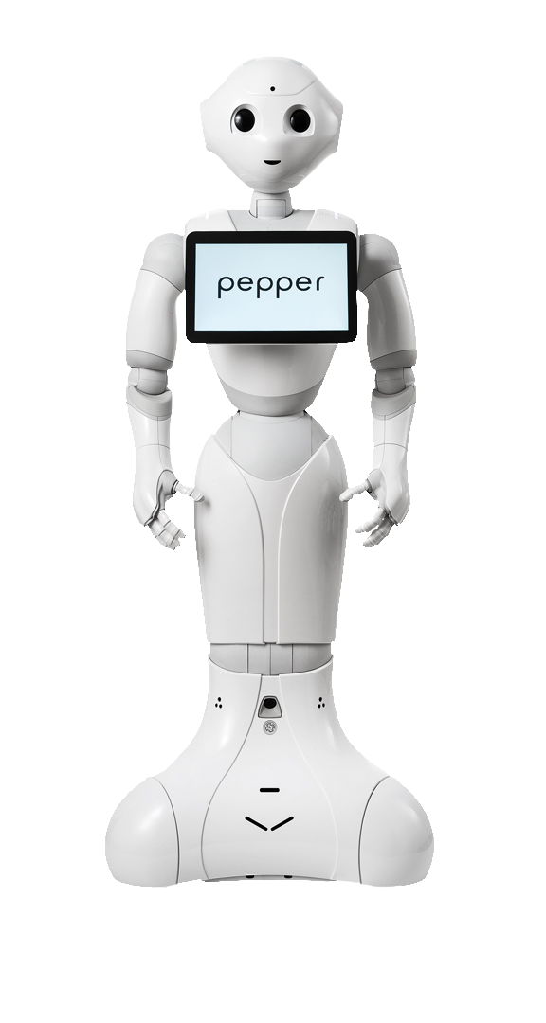
AI: Science about agents acting in the world (Lat. agere: act)
AI as a science investigates social mechanisms of agents and humans
Percepts
Perception
Feedback
Task Description → Goal
Self reflection
G: “Goals” M: Models
Optimize local success measure (utility)
Planning for explanation
Action Explanation
Action planning

Slide 4
Perception & Planning
Rely on GPT-4V for perception?
Agents need to learn while running, i.e., it should be able to generate its own training data
Percepts
Perception
Feedback
Task Description → Goal
Self reflection
G: “Goals” M: Models
Planning for explanation
Action Explanation
Action planning

Slide 6
Perception: Solving Inverse Problems
Given: 3D-Scene description
Determine position pos of light source?
Guess position
Call render(pos, scene)

Slide 7
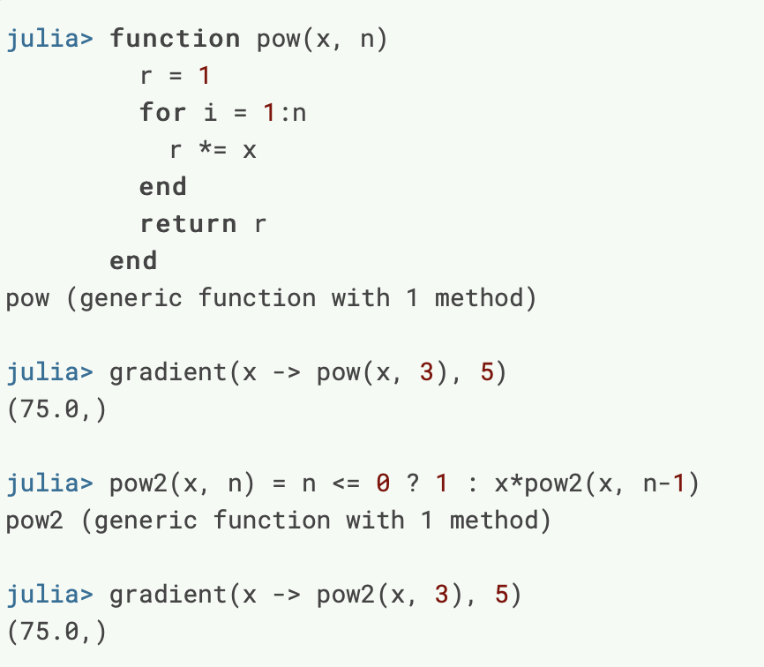
Gradient of loss function based on output and expected output (i.e., input)

Slide 8
Perception: Solving Inverse Problems
Representation
Guess position and color
Call render((pos, color) ,scene)
Color?

Slide 9
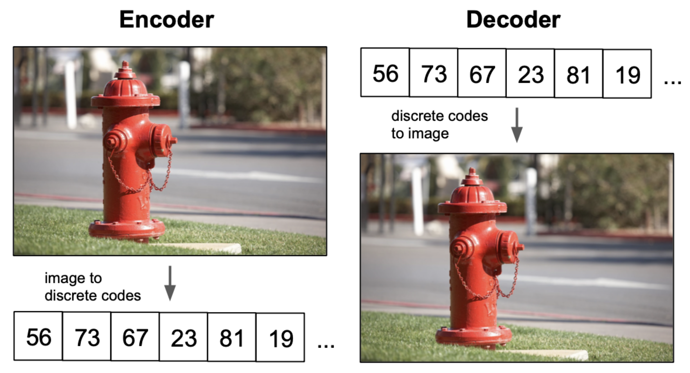
Autoencoder
Can get training data with a model of the world
Map data into vector space: Embedding representation
Reconstruction-optimal encoding? Points? Gaussians?
Understanding VQ-VAE (DALL-E Explained Pt. 1)). Charlie Snell

Slide 10
Perception & Planning
Can get training data with a model of the world
Percepts
Perception
Feedback
Task Description → Goal
Understanding the world pays back
Self reflection
G: “Goals” M: Models
Planning for explanation
Next
Action Explanation
Action planning

Slide 11
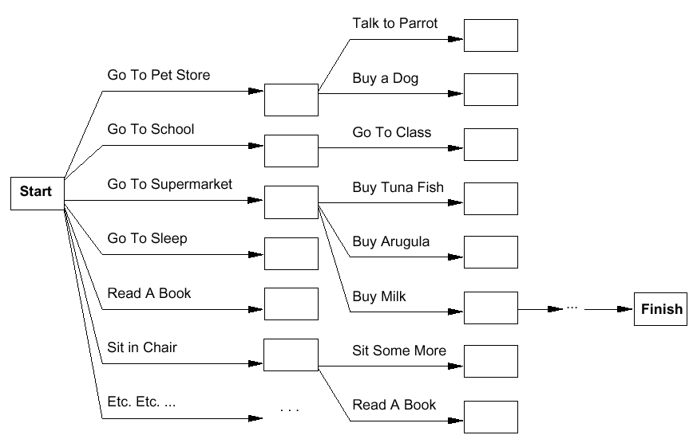
Planning as Search
Have milk, bananas, and a drill
Bernhard Nebel

Slide 12
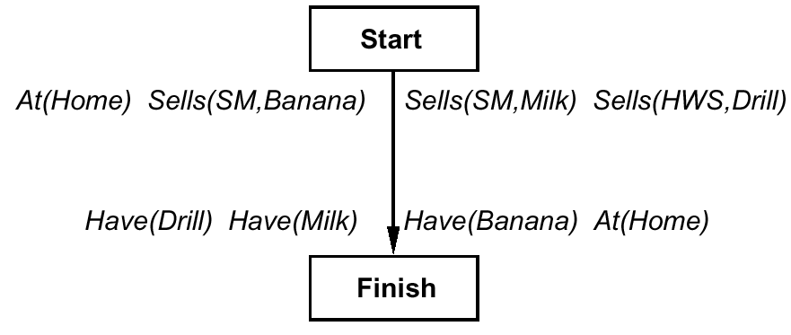
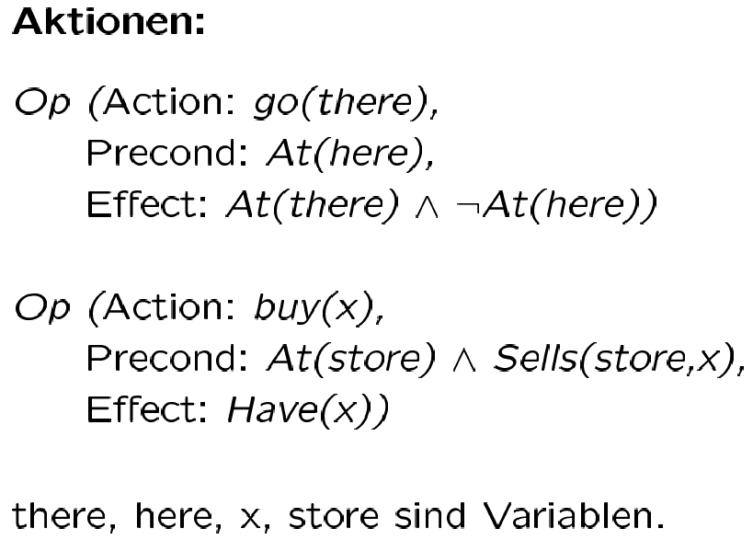
Planning Operators
Who defines the operators?
12
Bernhard Nebel

Slide 13
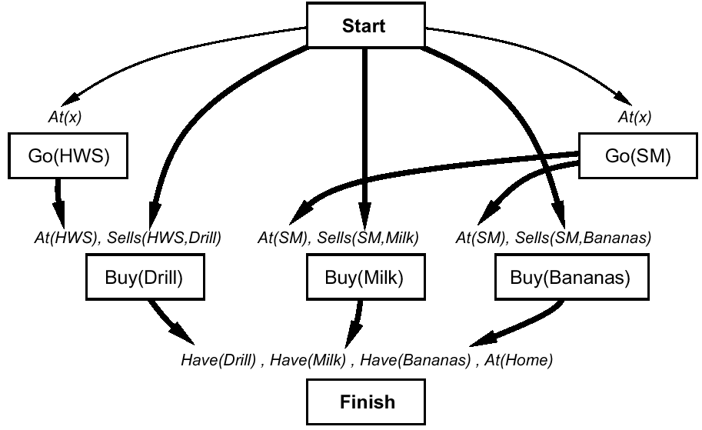
Plan Refinement
Go to the right store…
Bernhard Nebel

Slide 14
Slow Planning all the Time?
Percepts
Perception
Feedback
Task Description → Goal
Self reflection
G: “Goals” M: Models
Planning for explanation
Action Explanation
Action planning

Slide 16
Utility of an Action Sequence
Consider the action sequence $a=$ (U,R) from [3,2]
A run produces one of 7 possible histories, each with a probability
Utility of the sequence is the expected utility of histories $h$:
$$U(a)=\sum_{h}{U_{h}P\left(h\right)}$$
Optimal sequence = the one with maximum utility
+1
[3,2]
3
-1
2
[3,2]
[3,3]
[4,2]
State space
1
[3,1]
[3,2]
[3,3]
[4,1]
[4,2]
[4,3]
1
2
3
4
Notes:
only if the sequence is executed blindly!

Slide 17
Markov Decision Problem (Defines a Policy)
Policy $π$
Complete mapping from states to actions
Optimal policy $π^{∗}$
Always yields a history (ending at terminal state) with maximum expected utility
Act()
repeat
s ← sensed state
if s is terminal then
exit
a ← 𝜋(s)
perform a
+1
Note that [3,2] is a “dangerous” state that the optimal policy tries to avoid
3
-1
2
1
How to compute $π^{∗}$?
Solving a Markov Decision Process
1
2
3
4

Slide 18
Acting slow and fast
Need Planning Operators:
Brittleness Problem
Percepts
Perception
Feedback
Task Description → Goal
Self reflection
G: “Goals” M: Models
Rely on GPT-4V for planning?
Planning for explanation
Action Explanation
Action planning

Slide 19
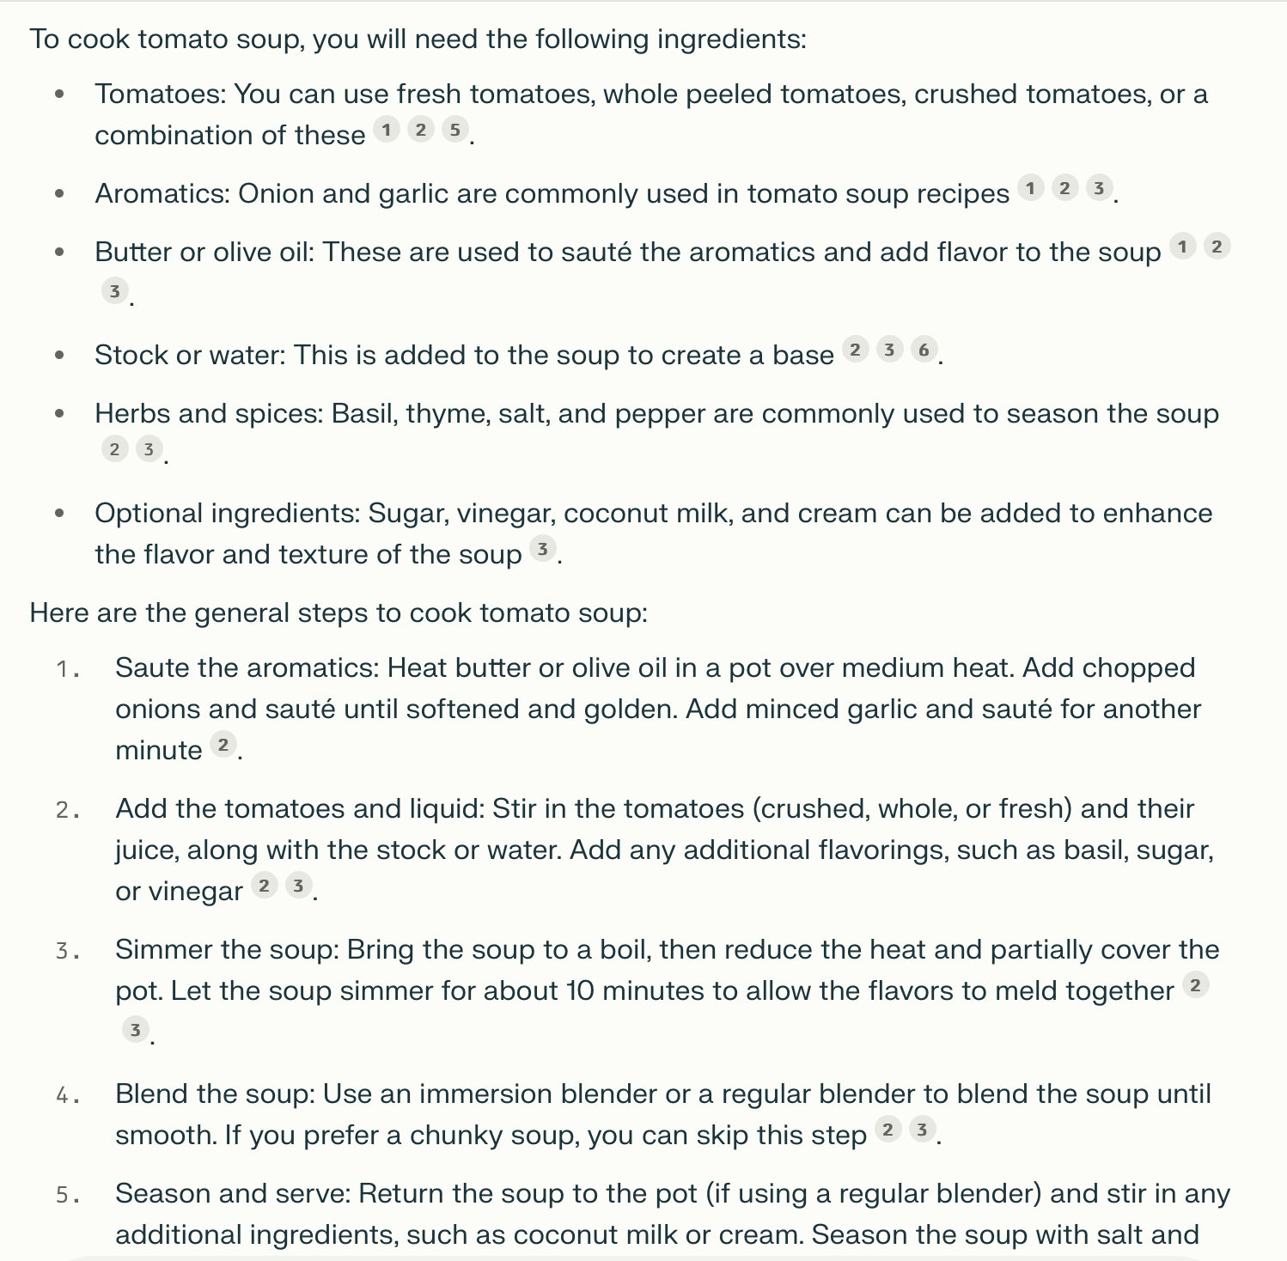
Process LLM output
Parsing
Transformation into:
Objects
Sub-Actions

Slide 20
Process LLM output
Parsing
Transformation into:
Objects
Sub-Actions

Slide 21
Planning with LLMs?
Prompting
Transformation of output into sub-actions
Further refinement
…
Reductions to base actions
Perplexity.ai

Slide 22
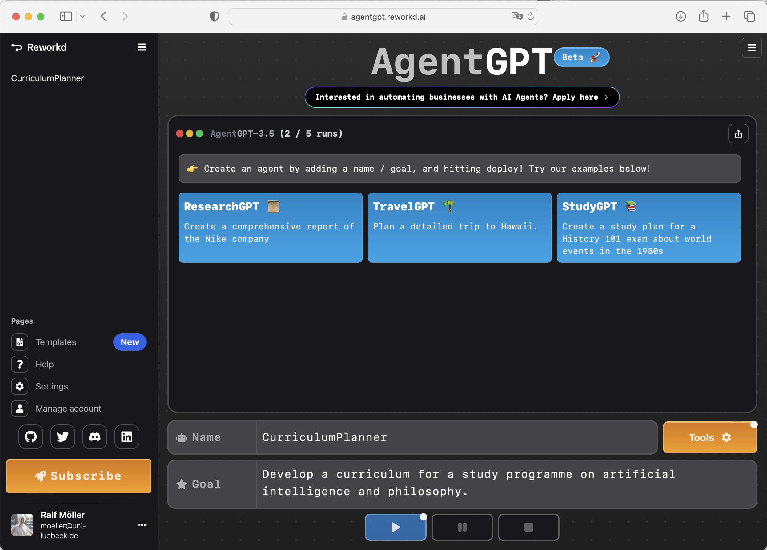
Special case of AutoGPT – more abstract

Slide 23
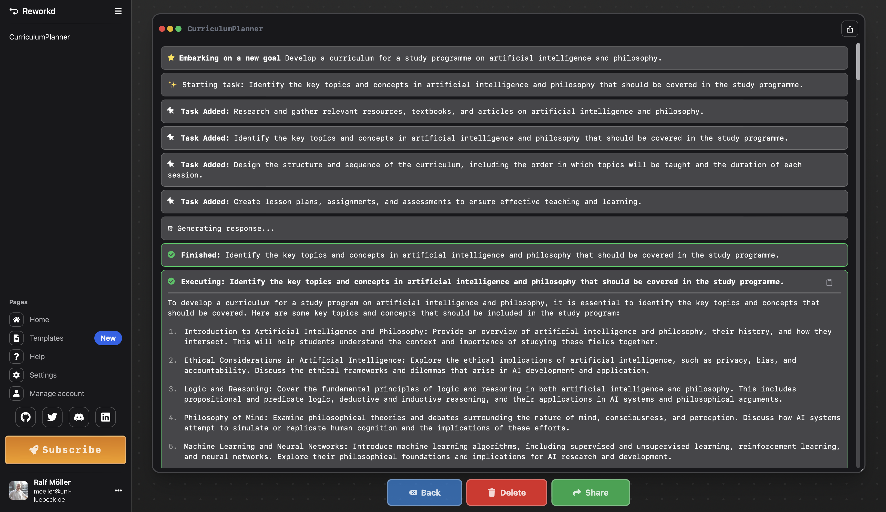

Slide 24
GPTs @ Open.AI
Tailored iterations of GPT-4 (called GPTs)
Crafted for distinct purposes
Enhancing productivity in various tasks ranging from everyday activities to specific professional assignments
No coding required
Connect GPTs to the real world
Basic actions allow GPTs to integrate external data or interact with the real-world. Connect GPTs to databases, plug them into emails, or make them your shopping assistant.

Slide 25
Does this work in a physical world?
It will probably be too slow
Will it be possible to learn a policy and use it in non-critical situations?

Slide 26
FMEA – Failure Mode and Effect Analysis
Systematische, proaktive Methode zur Analyse und Behandlung möglicher Fehler
System als Graph mit
Komponenten Funktionen Failures
Berücksichtigung von Schweregrad, Auftretens- und Entdeckungswahrscheinlichkeit
Weit verbreitet in Automobilindustrie, Luft- und Raumfahrt, Rüstungsindustrie,…
Component
Function
Error / Failure
Measure
Ventilator
Ventilation unit
Provide pressure
PEEP to small
…
…
…

Slide 27
FMEA in Medical Domain
Based on Failure-Mode and Effects Analsis (FMEA)
System “Human" as a graph with
Components / ”Anatomy” Funktions / “Physiology” Failures / “Pathology”
+ Universal patient-independent knowledge base
- Manual development (currently)
Human
Pulmonary System
Oxygen supply
Supply too low
Component
Function
Error / Failure
Measure
Alveolar space
Provide volume
Volume too low
Alveoli
Gas exchange
Atelectasis
Increase PEEP
…
…
…
Ventilator
Causality
Ventilation unit
Provide pressure
PEEP to small
…
…
…

Slide 28
Project MCEA
Reasoning about specific patient
Semantics: Markov Decision Process, which, in turn, defines a policy
-
-
-O+2
e1ns

Slide 29
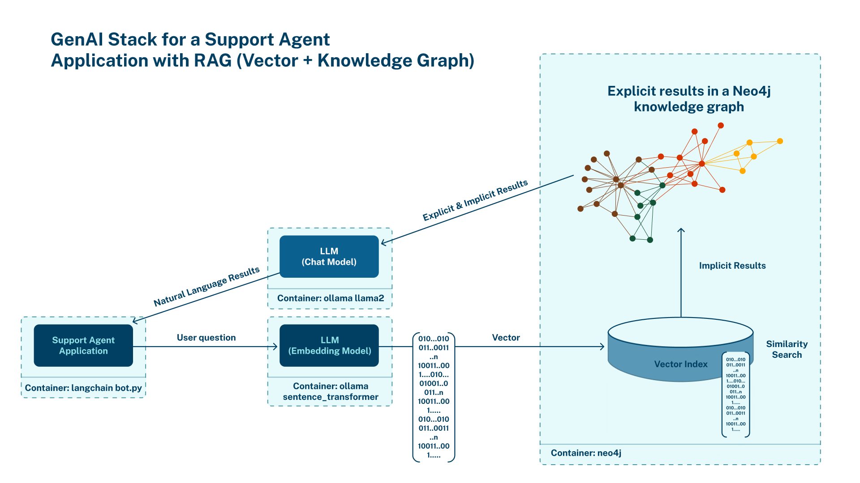
Retrieval-Augmented Generation (RAG)
Can be anything: Graphs, texts, …
Ü+
Flat integration
modifiziert nach [https://neo4j.com/developer-blog/genai-app-how-to-build/]

Slide 30
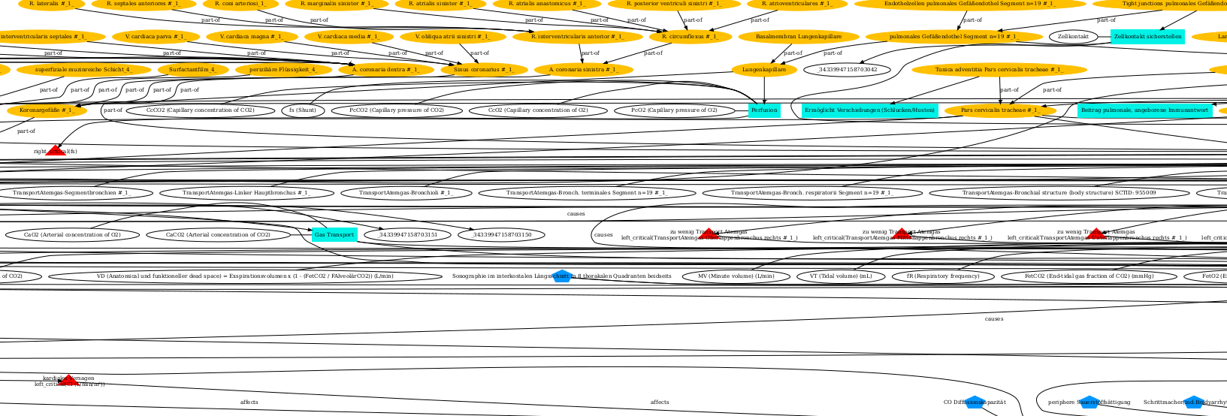
Very Large Knowledge Graph

Slide 31
GenAI (LMs) and Formal Models (FMs): LMFMs
LLM
What may be the cause of insufficient DO2?
Train a combined model LMFM
Deep integration
Automatically derive relevant graph parts

Slide 32
We can generate situation-specific MDPs from text
Understanding the world pays back
Automatically derive MDPs

Slide 33
Thanks for your attention
RalfM

