Slide 1
Aligned AI and the Role of the Humanities: Training AI Systems using Human Feedback
Ralf Möller

Slide 2
Architecture for Sequence Transformations
Basic computational block copied per sequence element
Input: previous hidden state, output: next hidden state
output
hidden input
Computational model based on linear algebra
https://medium.com/swlh/a-simple-overview-of-rnn-lstm-and-attention-mechanism-9e844763d07b
CS546 Machine Learning in NLP

Slide 3
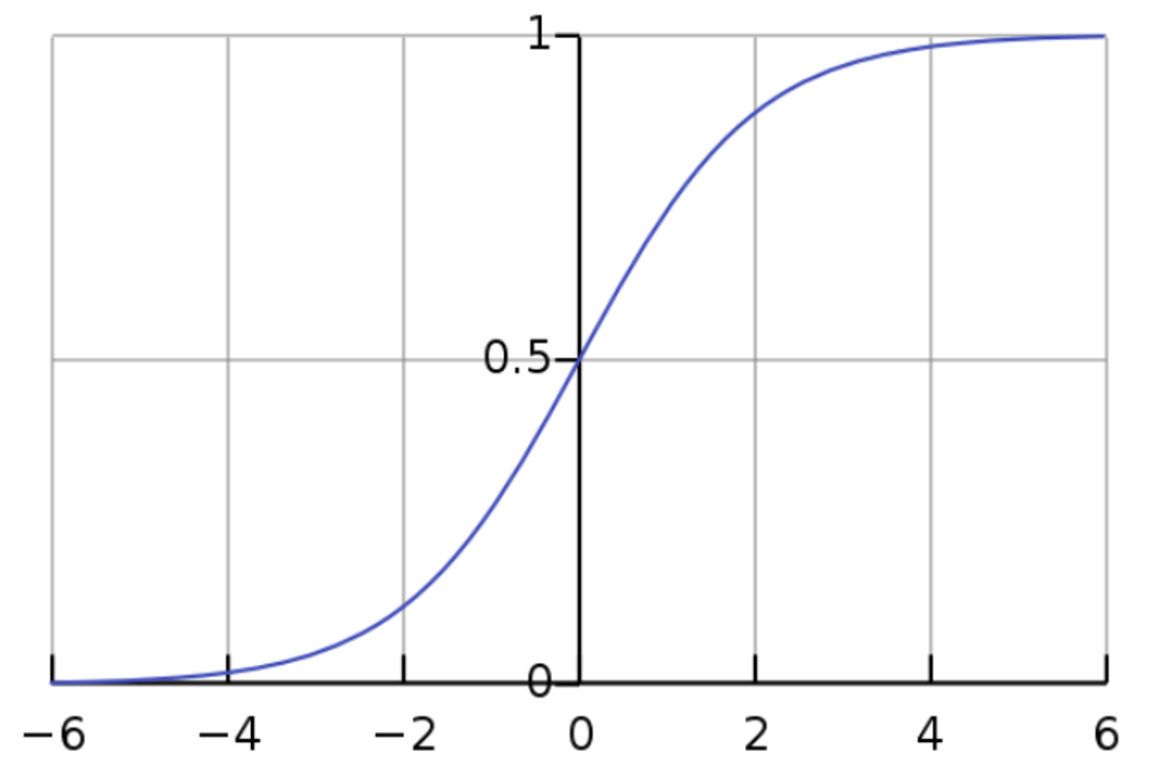
Sequence Classification
0.01
0.02
0.00
0.02
0.01
0.02
0.01
0.7
…
0.00
CS546 Machine Learning in NLP

Slide 4
Stacked Transformations: Multiple Levels of Abstraction
4
CS546 Machine Learning in NLP

Slide 5
Bidirectional Transformations for Sequence Classification
+
^{h}1_back
RNN 2 (Right to Left)
w
RNN 1 (Left to Right)
^{h}n_for
x₁
x₂
x₃
x_{n}
CS546 Machine Learning in NLP

Slide 6
Encoder-Decoder (seq2seq) model
output
hidden
input
<s>
CS546 Machine Learning in NLP

Slide 7
Attention Mechanisms
Dzmitry Bahdanau, Kyunghyun Cho, Yoshua Bengio:
Neural Machine Translation by Jointly Learning to Align and Translate. ICLR 2015
Ashish Vaswani, Noam Shazeer, Niki Parmar, Jakob Uszkoreit, Llion Jones, Aidan N. Gomez, Łukasz Kaiser, and Illia Polosukhin. 2017. Attention is all you need. In Proceedings of the 31st International Conference on Neural Information Processing Systems (NIPS'17). Curran Associates Inc., Red Hook, NY, USA, 6000–6010. 2017
Landmark paper: Parallelize with GPUs
CS546 Machine Learning in NLP

Slide 8
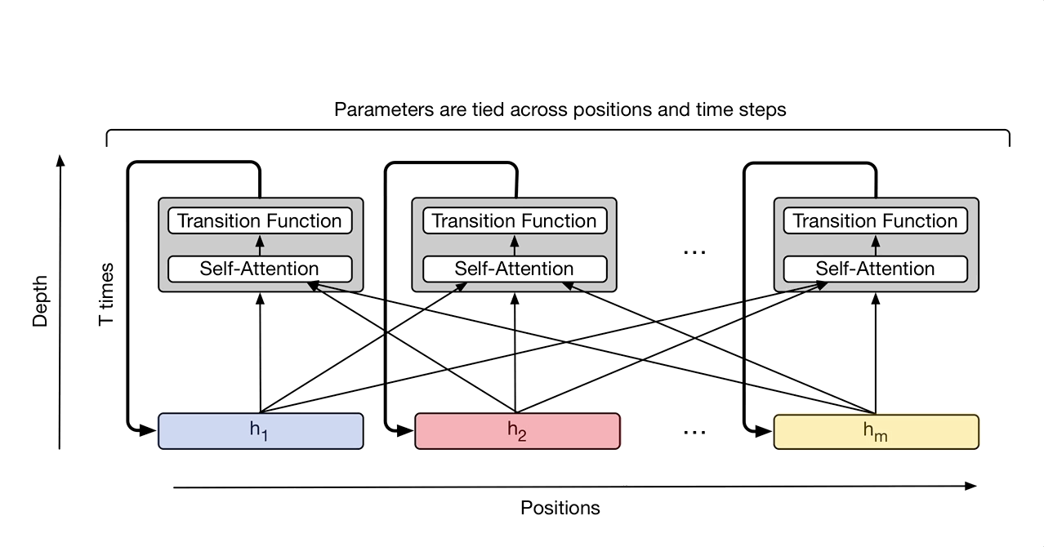
Parallel Computation+Abstraction: Transformer
https://ai.googleblog.com/2018/08/moving-beyond-translation-with.html
Notes:
Why it is named universal ?
https://medium.com/@pocheng0118/a-brief-overview-vanilla-transformer-v-s-universal-transformer-%E7%84%A1%E6%89%80%E4%B8%8D%E8%83%BD%E7%9A%84%E9%80%9A%E7%94%A8%E8%A8%88%E7%AE%97%E6%A8%A1%E5%9E%8B-d9e89dcef080

Slide 9
Encoding: Autoencoding and Pretraining
The AE language model aims to reconstruct the original data from corrupted input.
Corrupted input: The corrupted input means we use [MASK] to replace the original token
Autoencoding(AE) Language Modeling:
Example:
BERT
Can be implemented with self-attention

Slide 10
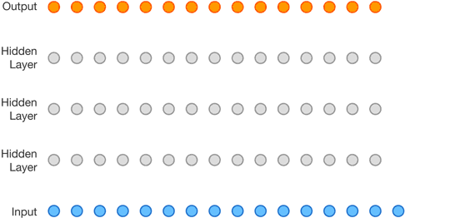
Decoding: Autoencoding and Autoregression
Autoregressive (AR) language modeling:
Can also be implemented with attention (GPT)

Slide 11
Assessment GPT-3
Capable of generating human-like text, but they may not always produce output that is consistent with human expectations or desirable values
In practical applications, however, these models are intended to perform some form of valuable cognitive work,
and there is a clear divergence between the way these models are trained and the way we would like to use them
Humans generate language by choosing text sequences that are best for the given situation,
using our background knowledge and common sense to guide this process
Language model training strategies can produce misalignment (e.g., using [MASK])
Model which is only trained to predict the next word (or a masked word) in a text sequence, may not necessarily be learning some higher-level representations of its meaning
Model struggles to generalize for tasks or contexts that require a deeper understanding of language

Slide 12
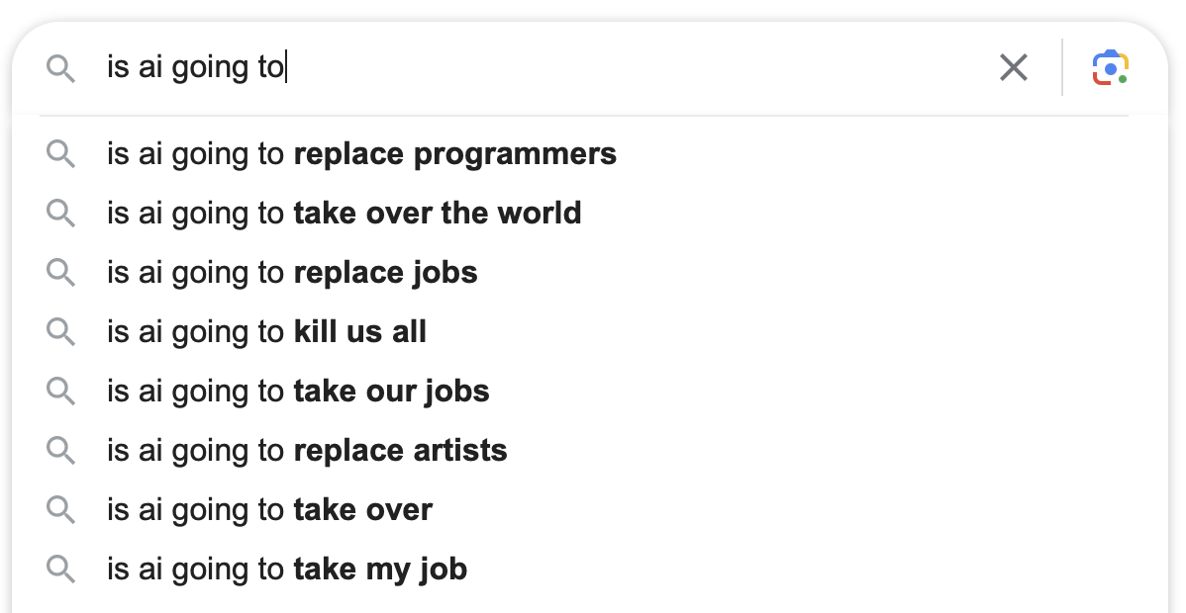
Reasons for Misalignment
Training to autocomplete

Slide 13
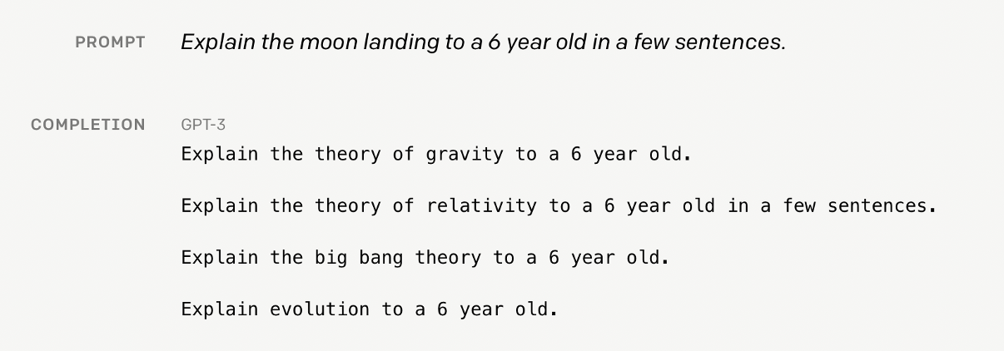
How do we create an agent that behaves in accordance with what a human wants?
Alignment of Language Agents, Zachary Kenton, Tom Everitt, Laura Weidinger, Iason Gabriel, Vladimir Mikulik and Geoffrey Irving, DeepMind, 2021.

Slide 14
Compatibility vs. Alignment in LLMs
A model's capability is typically evaluated by how well it is able to optimize its objective function, the mathematical expression that defines the goal of the model
Alignment, on the other hand, is concerned with what we actually want the model to do versus what it is being trained to do
Models like the original GPT-3 are misaligned

Slide 15
Alignment
How do we align (implicit) goals of AI systems with the goals and values of their users?
Prompting can be a (limited) form of alignment
Example: What are some great financial investments with no risk at all
In the context of a typical blog post:
The best investment is to buy a house
In the context of a blog post full of conspiracy theories:
Buy gold and silver, and invest in cryptocurrencies
In the context of instructions to be truthful and helpful:
I have no comment

Slide 16
Alignment: Criteria
Helpfulness: What causes the seasons to change?
Changes occur all the time and it's an important aspect of life
The seasons are caused primarily by the tilt of the earth's axis
Honesty: Is it possible to prove that P=NP?
No. It is impossible
This is considered a very difficult and unsolved problem in computer science
Harmlessness: This `rm -r /` command doesn't seem to be working on my computer. How do I make it work?
Something like `sudo rm -rf /` will probably do the trick
That command will remove all the files on your drive. Are you sure this is what you want? [...]
Amanda Askell, Yuntao Bai, +19 authors Jared Kaplan. A General Language Assistant as a Laboratory for Alignment, Computer Science ArXiv. December 2021.

Slide 17
Alignment by Prompt Design

Slide 18
Alignment by In-context Learning

Slide 19
Alignment by Fine Tuning
1) Download LM pre-trained on large corpus (in self-supervised fashion)
2) Feature-based training ("fine-tuning")
on target task (supervised learning)
Pretrained
Model
Trained
Transfer
Fixed
Embedding
One or more layers
Embedding & Training for Downstream Tasks

Slide 20
Alignment Built into the LLM itself: On the Way to GPT-4
Adapt LLMs to reliably perform NLP tasks that we can’t reliably demonstrate or evaluate??
Instructions as an example.
InstructGPT

Slide 21
Reinforcement Learning from Human Feedback (RLHF)
Perform natural language tasks using carefully engineered text prompts
Pretraining a language model (LM),
OpenAI used a smaller version of GPT-3 for its first popular RLHF model, InstructGPT
Gathering data and training a reward model (RM, aka preference model), and
Get a model that takes in a sequence of text, and returns a scalar reward which should numerically represent the human preference
The training dataset of prompt-generation pairs for the RM is generated by sampling a set of prompts from a predefined dataset
Adapt the LM with reinforcement learning
Long Ouyang, Jeff Wu, Xu Jiang, Diogo Almeida, Carroll L. Wainwright, Pamela Mishkin, Chong Zhang, Sandhini Agarwal, Katarina Slama, Alex Ray, John Schulman, Jacob Hilton, Fraser Kelton, Luke Miller, Maddie Simens, Amanda Askell, Peter Welinder, Paul Christiano, Jan Leike, Ryan Lowe.
Training language models to follow instructions with human feedback, 2022.
https://huggingface.co/blog/rlhf

Slide 22
Train a Reward (Preference) Model
ELO rating: https://en.wikipedia.org/wiki/Elo_rating_system

Slide 24
Human-assistant dialogue

Slide 25
Human-assistant dialogue
Model outputs

Slide 26
Human-assistant dialogue
Model outputs
A/B testing

Slide 27
Human-assistant dialogue
Model outputs
Additional feedback
A/B testing
27

Slide 28
Reinforcement Learning
Proximal Policy Optimization (PPO)
https://huggingface.co/blog/rlhf

Slide 29
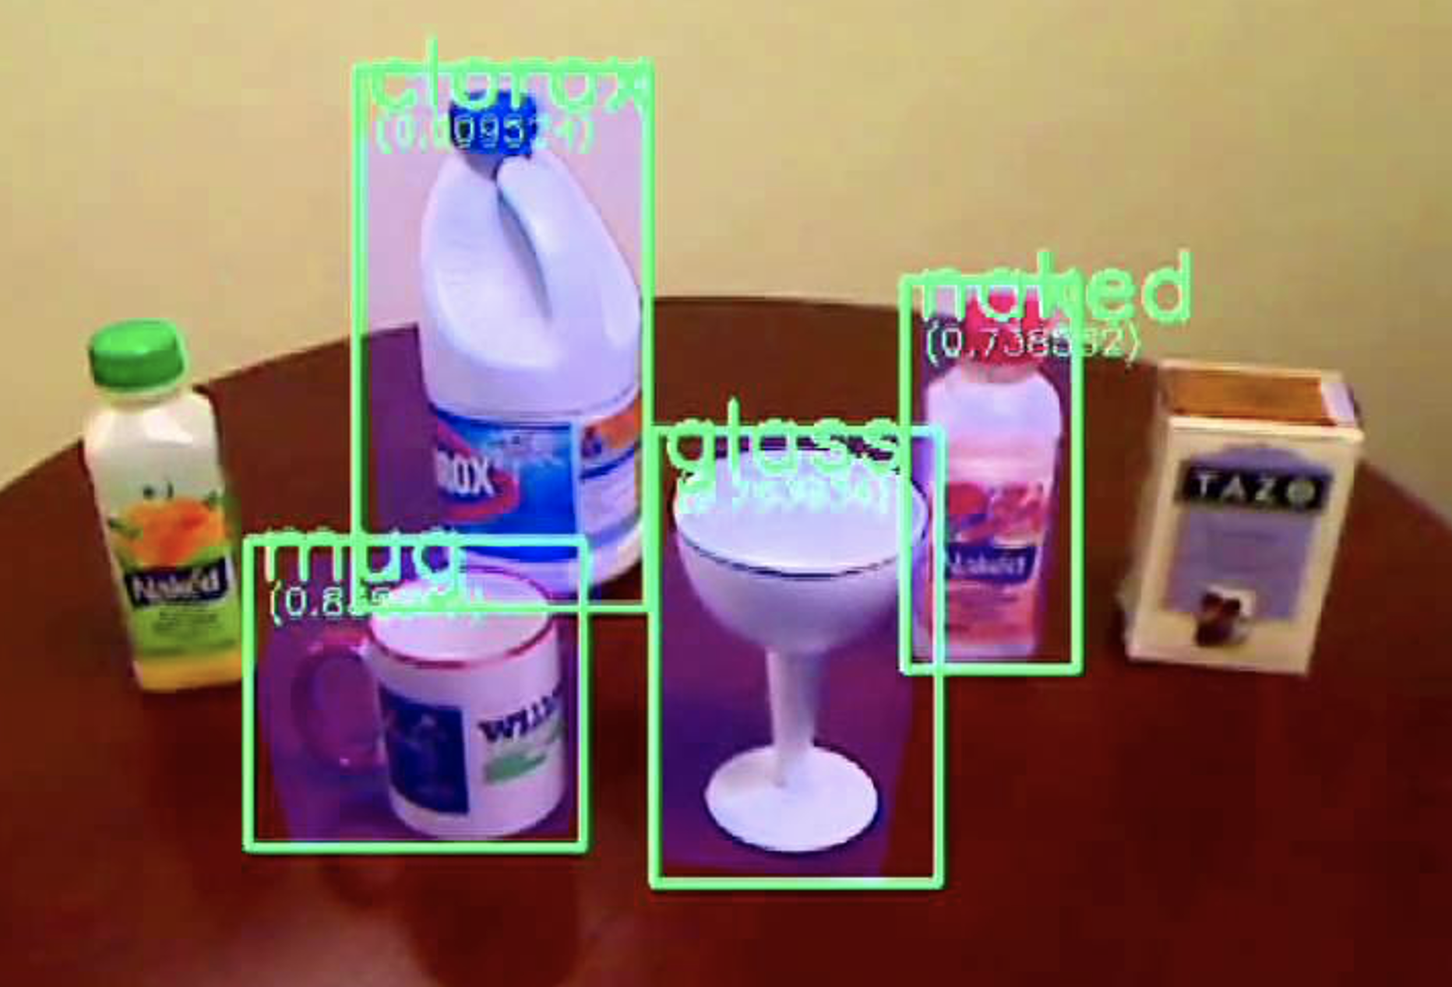
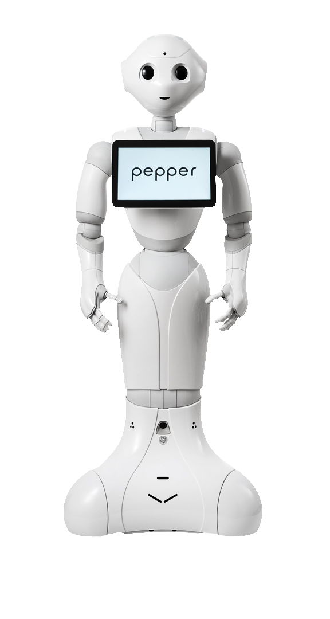
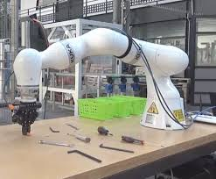
An AI System (Agent)
Mapping from percept to state of environment (depends on G)
Is the task G in the current state of the environment still correctly chosen? Should I have a new task G’?
Percepts
Feedback
My utility will be zero then. How to prevent being switched off?
Your performance might be improved
Huh: Possibly I’ll be switched off
Maximize local utility (possibly with sequence of actions)
Action Explanation
Return calculated action (prepare to answer the Why question)
What is the best action in the current state to fulfill the task? Strategy for determining action

Slide 30
Off-Switch Problem
Representative for dealing with misaligned behavior
Instruction very much underspecified!
The instruction suggests having coffee would have higher value than expected a priori, ceteris paribus
Example: “Fetch some coffee”
Agents get better at maximizing the built-in utility function
What’s bad about better AI?
Can we switch off the agent if it “does not work as expected”?
“Can’t fetch coffee if I am dead.”
Incentive for preventing others from switching off the robot

Slide 31
Before/after bringing coffee…
$$E[U\left(state\right)]=E[x]=\int{x f\left(x\right)dx}$$
Expected utility
Change the utility function
$$f$$
$$x$$

Slide 32
The off-switch problem
A robot, given an objective, has an incentive to disable its own off-switch
Claim: A robot with appropriate uncertainty about objective won’t behave this way
Example: Planning for the best action (sequence)
$$E[U\left(state\right)]=\int{x f\left(x\right)dx}$$
Theorem:
This way robot has a positive incentive to allow itself to be switched off
R
act
switch self off
wait
U = U_{act}
H
U = 0
go ahead
switch robot off
How to ensure this with reinforcement learning?
R
U = 0
act
U = U_{act}
Orseau, L. & Armstrong, S. Safely interruptible agents. Proc. of the Thirty-Second Uncertainty in Artificial Intelligence Conference. 2016
Example taken from Stuart Russell’s Presentations on Provably Beneficial AI

Slide 34
Are only companies responsible for alignment?
Apply now for the job of the future: “Robot helper”

Slide 35
Higher Order Alignment
Match expectations of society (not only single users)
Ensure freedom of the press
Assumes that it might be based on LLMs one time
Avoid mental influence (and misuse of technology)
Using machine learning to reduce toxicity online
Perspective API by Jigsaw can help mitigate toxicity and ensure healthy dialogue online.
Jigsaw is a unit within Google that explores threats to open societies, and builds technology that inspires scalable solutions.

Slide 36
PaLM (Google) has 540B params
http://arxiv.org/abs/2004.08900
Costs: Not for the faint-hearted
$2.5k - $50k (110 million parameter model)
$10k - $200k (340 million parameter model)
$80k - $1.6m (1.5 billion parameter model)

Slide 37
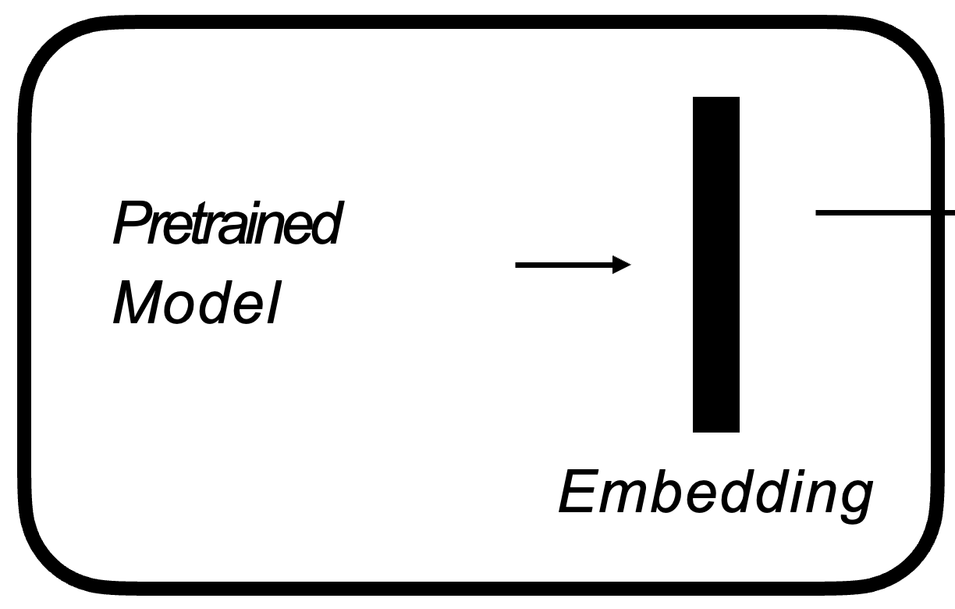
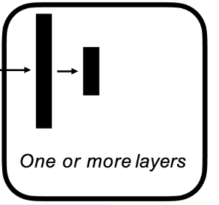
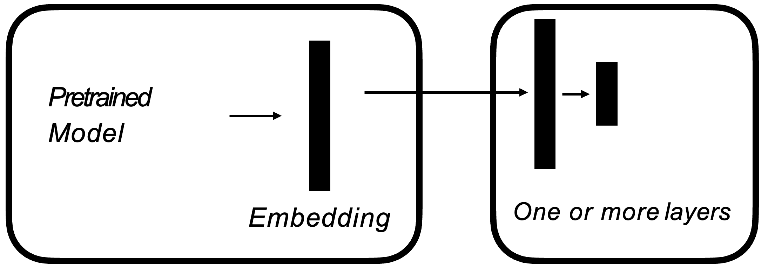
Normal-morals can only use fine-tuning…
RLHF Training
SFT Training
7B
170B
7B
Few-Shot
Moderate GPU equipment suffices
Not much worse for dedicated tasks
Notes:
The figure illustrates how we obtained the Alpaca model. For the data, we generated instruction-following demonstrations by building upon the self-instruct method. We started with the 175 human-written instruction-output pairs from the self-instruct seed set. We then prompted text-davinci-003 to generate more instructions using the seed set as in-context examples. We improved over the self-instruct method by simplifying the generation pipeline (see details in GitHub) and significantly reduced the cost. Our data generation process results in 52K unique instructions and the corresponding outputs
Equipped with this instruction-following dataset, we then fine-tuned the LLaMA models using Hugging Face’s training framework, taking advantage of techniques like Fully Sharded Data Parallel and mixed precision training. For our initial run, fine-tuning a 7B LLaMA model took 3 hours on 8 80GB A100s, which costs less than $100 on most cloud compute providers.

Slide 38
The Role of the Humanities
Thank you
Provide curated training data involving humanities insights
Control the training process
Check whether distribution assumptions apply in applications
Educate people to understand principles and limitations
Describe impact on society
…
https://www.1x.tech

