Slide 1
Ralf Möller Universität zu Lübeck
Toward Gen-AI USAGE guidelines in UWA
joint work with Thomas Asselborn, magnus Bender, Florian Marwitz, Sylvia Melzer, SIMON SCHIFF, Benedikt Stepanek …

Slide 2
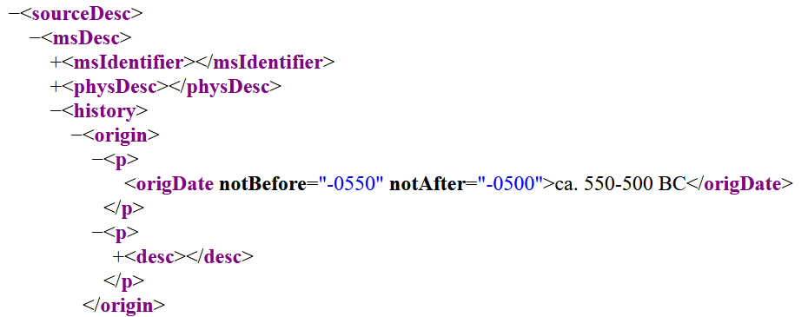
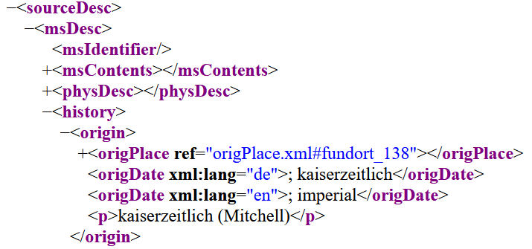
Standardization?
not mentioned
https://doi.org/10.54510/CGRN238*
?
Project: EDAK 2

Slide 3
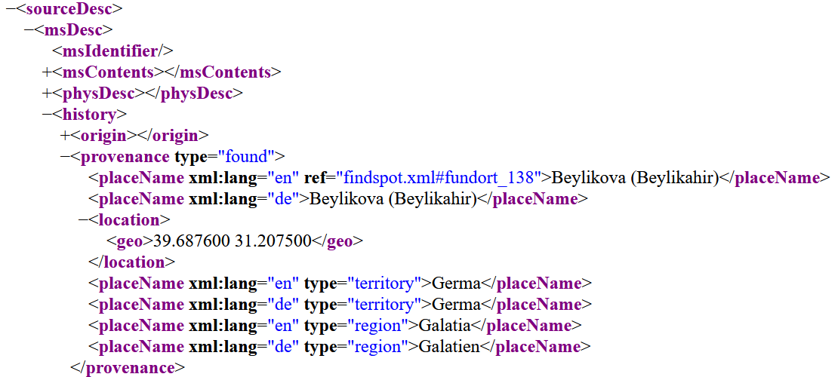
Standardization?
https://doi.org/10.54510/CGRN238
?
Project: EDAK 2
Icons made by Freepik from www.flaticon.com

Slide 4
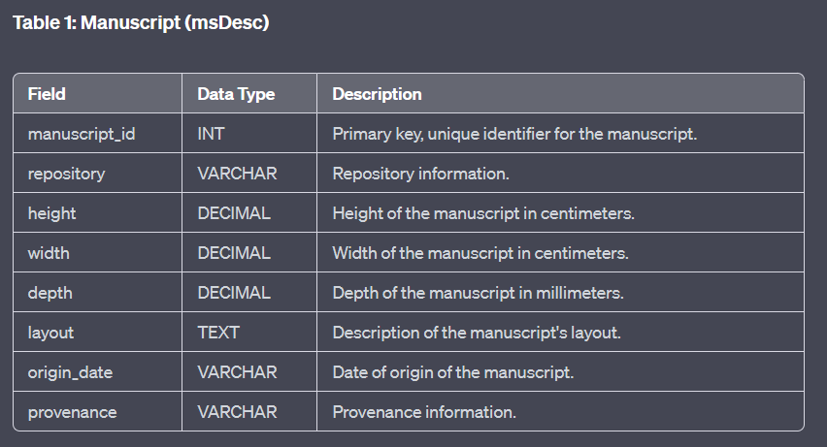
Matching EpiDoc data & Computing relational representations
GPT-4
Text generation
Code generation
Input EpiDoc.xml schemas or example EpiDoc.xml files
Use GPT-4 to compute textual mapping suggestions
Output (excerpt):

Slide 5
NL Query
results

Slide 6
Detecting Person names, locations, organizations

Slide 7
data Management: LLM-based Data Enhancement and linking
Fine-tune Transformer Model
Apply fine-tuned model
Validate and store results
Archive in RDR

Slide 8
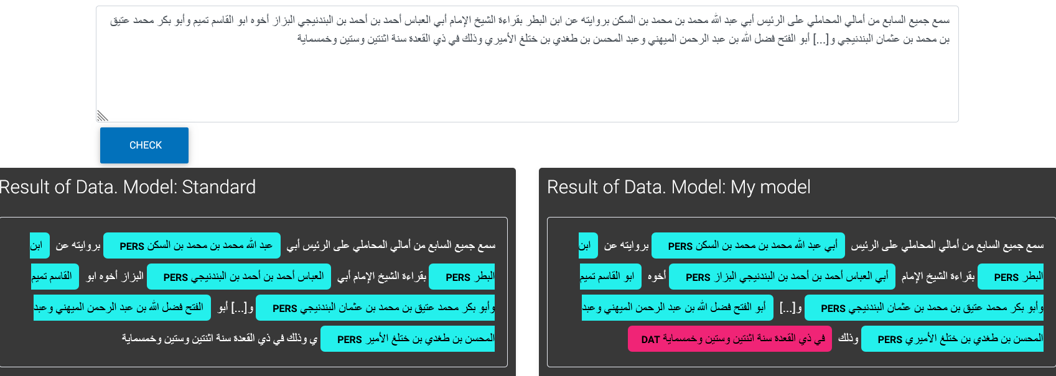
SCDs
Subjective Content Descriptions

Slide 9
RDR in Action

Slide 10
For the discussion: are there Caveats?
False positives and false negatives (e.g., with SCDs)
No human-validated truth anymore
Is this against self-conception of humanities (and other sciences)?
Check whether GenAI output can be trusted at usage time?
Burden for truth-checking shifted to the recipient
Not really something new

Slide 11
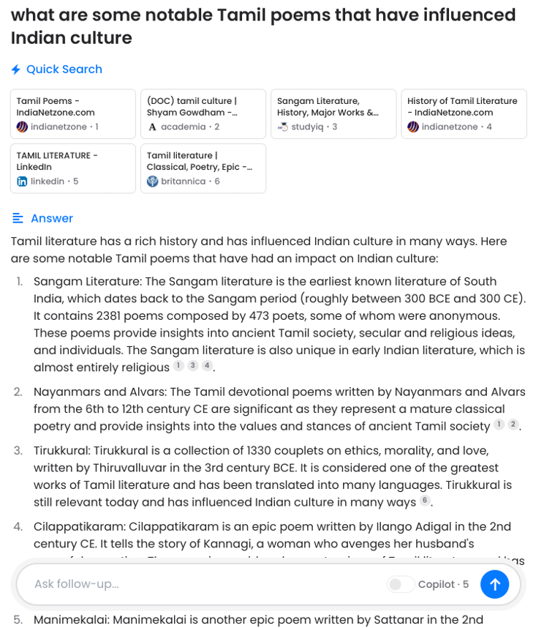
Data Linking to the rescue
17
42

Slide 12
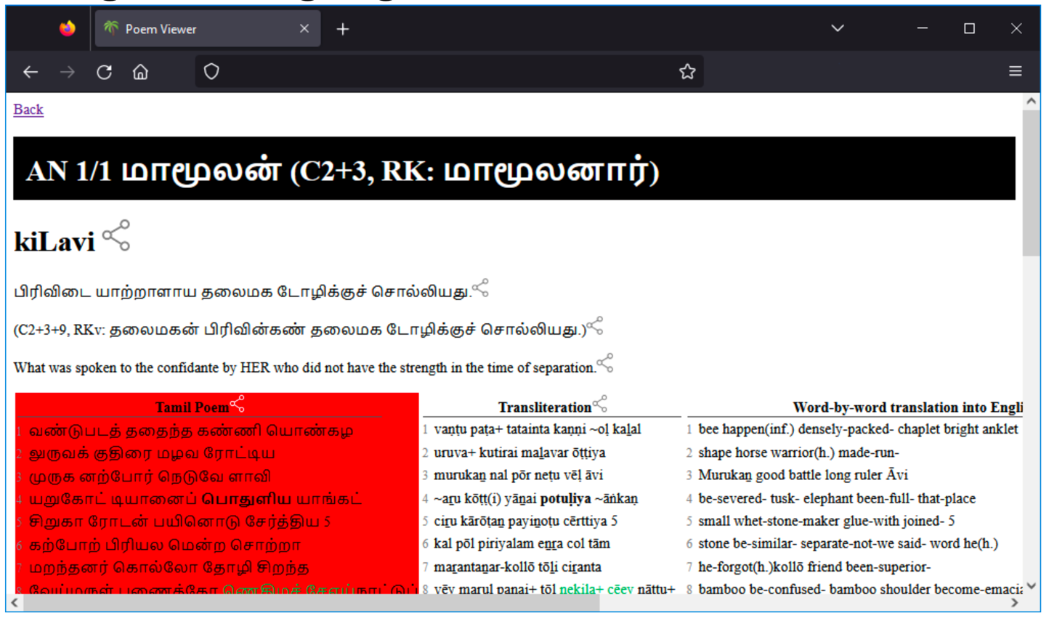
Citing information system output
Emphasis deliberately exaggerated

Slide 13
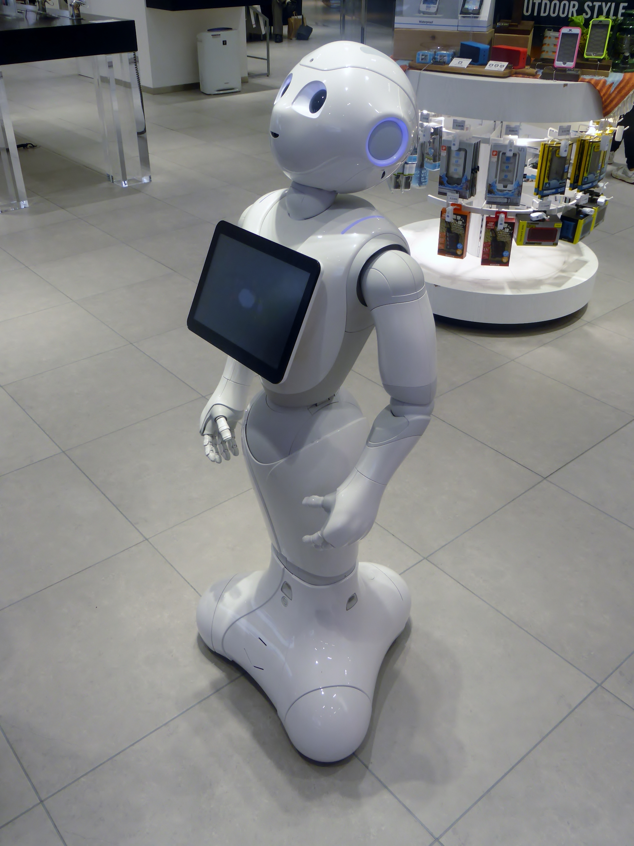
Communication to people

Slide 14
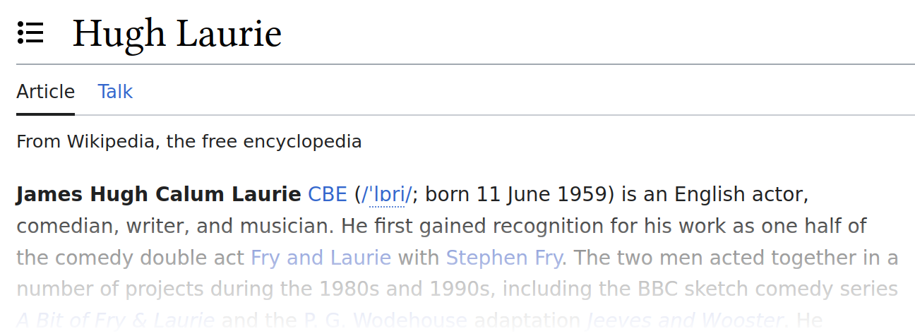
What about ChatGPT?
Answers in a very verbose way
Can’t remember information well
Blends over information

Slide 15
Motivation
How to remove information from an already trained model?
Train again? Reinforcement learning?
After all, databases can be edited
Source: Wikipedia / Gregory House

Slide 16
Wikidata
Open-source knowledge graph from the Wikimedia Foundation
Organ-ism
is
is
Animal
Plant
is
is
is
Dog
Cow
Grass
eat
Source: Wikipedia / Knowledge graph

Slide 17
Standard NLP

Slide 18
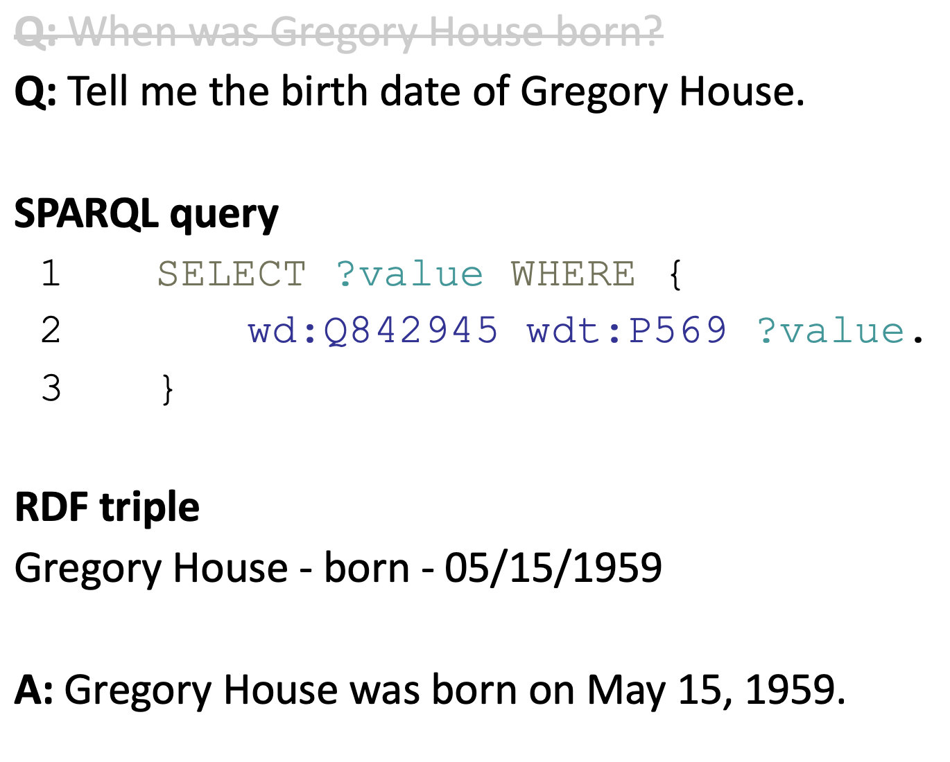
Standard NLP

Slide 19
StanFORD NL-PARSEr

Slide 20
System Architecture
Natural language query
Natural language answer
DeepL
DeepL
Stanford CoreNLP
Verbalize
Filter tree
Query Wikidata
Merge tree
Search Wikidata

Slide 21
Verbalize RDF Triple
Guo et al. P2: A Plan-and-Pretrain Approach for Knowledge Graph-to-Text Generation
Winner of 2020 WebNLG challenge
Uses T5 text-to-text transformer
RDF triple
Gregory House - born - 05/15/1959
A: Gregory House was born on May 15, 1959.

Slide 22
Topic analysis: Latent Dirichlet Allocation (LDA, 2003)
Topic analysis (self-supervised) of “manuscript cultures” Journal

Slide 23
Gamma
Create presentations, documents and webpages just by describing the topic
https://gamma.app

Slide 24
What was written is what you get
Really innovative ideas cannot be expected
Lurking danger:
Fancy presentations suggest innovative content
Previously: There is some message, and the presenter works on a way to communicate it
Now: There is a nice show and the presenter communicates what fits into the show
Derive a guideline from this insight?
Enforce simplicity?

Slide 25
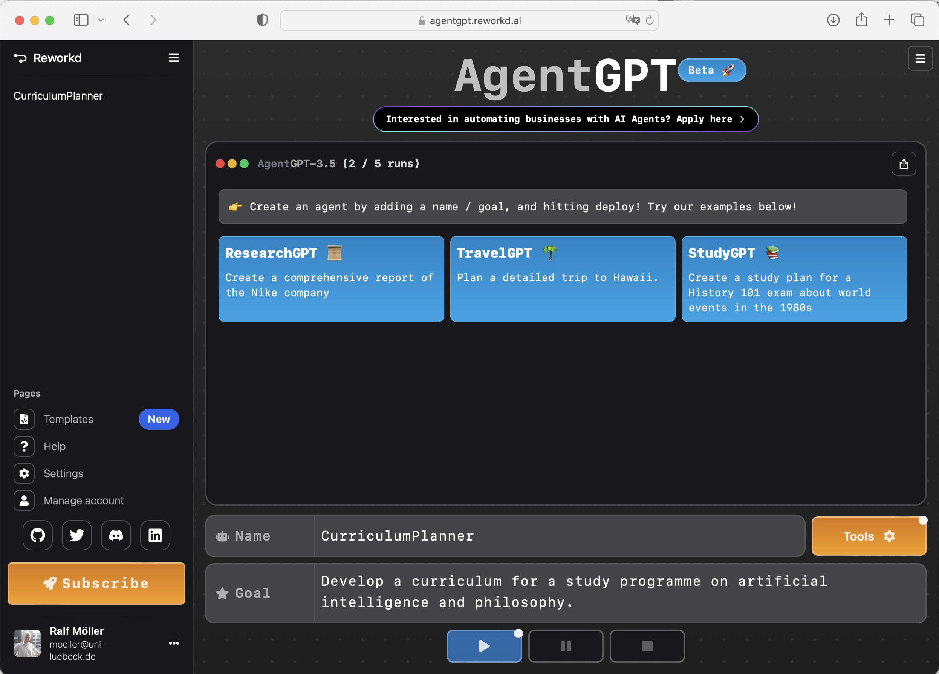
Agent GPT
AgentGPT creates AI "agents" that operate automatically largely on their own and complete tasks
https://agentgpt.reworkd.ai/de
Even more general: AutoGPT
https://autogpt.net

Slide 26
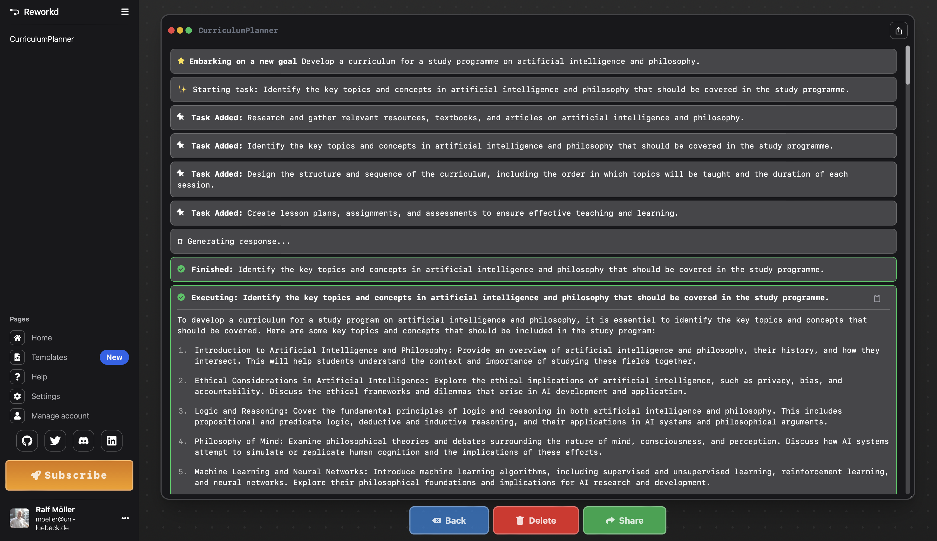

Slide 27
Foundation models & Formal models

Slide 28
Foundation models & Formal models

Slide 29
Foundation Models &
Formal models

Slide 30
Foundation Models &
Formal models

Slide 31
discussion
Pure GPT is yesterday’s technology
Direct manipulation (even w/o feeling the computer) has been overcome
AgentGPT technology needs to be mastered
Think in terms of interns
Conjecture: AI literacy required to be effective
Need to provide Agents as part of an RDR: Make UWA GenAI technology mainstream
Humanities-Centered AI (CHAI) Institute @UniHH

Slide 32
Acknowledgment
The research for this contribution was funded by the Deutsche Forschungsgemeinschaft (DFG, German Research Foundation) under Germany’s Excellence Strategy - EXC 2176 ’Understanding Written Artefacts: Material,
Interaction and Transmission in Manuscript Cultures’, project no. 390893796.

