Slide 1
Ethics and AI
Ralf Möller
Institute of Information Systems, Universität zu Lübeck
Dept. Stochastic Relational AI (StarAI) Deutsches Forschungszentrum für KI (DFKI)

Slide 2
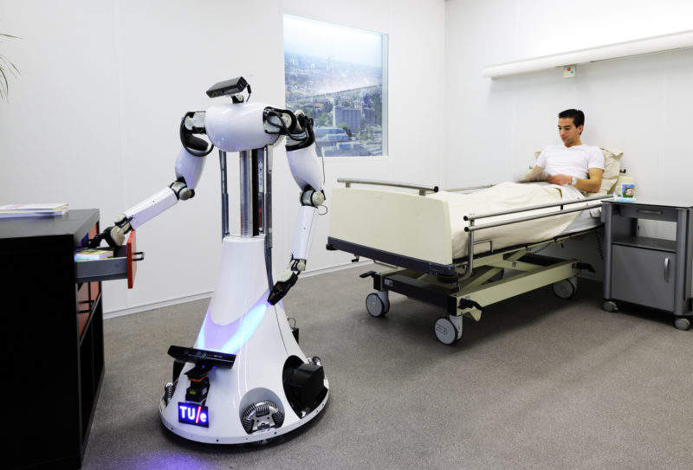
Consider a Robot in Medical Care

Slide 3
Central AI Data Processing Abstraction: Agent
Percepts
Mapping from percept to state of environment (depends on G)
Is the goal G in the current state of the environment still correctly chosen? Should I have a new goal G’?
Goal G Models M Percept
history H
Actions
Return calculated action (prepare to answer the Why question)
What is the best action in the current state to achieve the goal? Strategy for determining action

Slide 4
IR Agent on the Web
a) Another document available at host? Preprocess new document
Information need of the human interaction partner still the same?
Percepts
Mapping from percept to state of environment (depends on G)
Is the goal G in the current state of the environment still correctly chosen? Should I have a new goal G’?
Action gets executed, possibly explain why a cetain document was discarded (e.g., with counterfactual)
Goal G Models M Percept history H
Return current set of documents
Add or discard document
Visit new host
…
Actions
Return calculated action (prepare to answer the Why question)
What is the best action in the current state to achieve the goal? Strategy for determining action

Slide 5
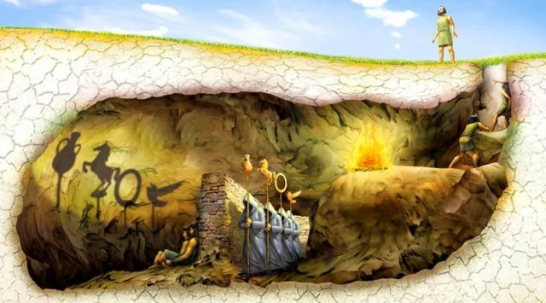
Can we trust explanations?
Are they at the right level?
What is a horse?

Slide 6
Some more detail
Mapping from percept to state of environment (depends on G)
Is the goal G in the current state of the environment still correctly chosen? Should I have a new goal G’?
Percepts
Feedback
You’ll be switched off if you continue telling nonsense
Idea of a utility function
Action Explanation
Return calculated action (prepare to answer the Why question)
What is the best action in the current state to achieve the goal? Strategy for determining action

Slide 7
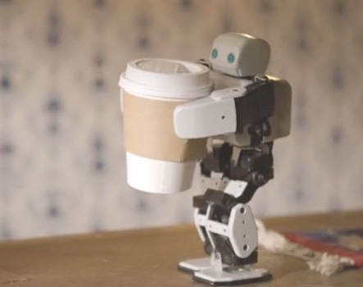
What’s bad about better AI?
You Can't Fetch The Coffee If You're Dead
Agents get better at maximizing the built-in utility function
Switch off the agent if it “does not work as expected”?

Slide 8
The off-switch problem
A robot, given an objective, has an incentive to disable its own off-switch
“You can’t fetch the coffee if you’re dead”
A robot with uncertainty about objective won’t behave this way
R
act
switch self off
wait
Theorem:
robot has a positive incentive to allow itself to be switched off
Theorem:
robot is provably beneficial
U = U_{act}
H
U = 0
go ahead
switch robot off
R
U = 0
act
U = U_{act}
Stuart Russell

Slide 9
Fetching Coffee: Uncertainty
What does “fetch some coffee” mean?
If there is so much uncertainty about preferences, how does the robot do anything useful?
Answer:
The instruction suggests coffee would have higher value than expected a priori, ceteris paribus
and there’s probably a low-cost way to get it
Uncertainty about the value of other aspects of environment state doesn’t matter as long as the robot leaves them unchanged
Stuart Russell
Notes:
“Fetch some coffee” is NOT an instruction, it’s NOT a goal to be achieved.
Cf house is burning down, coffee costs 21 euros, you’re in the desert, etc.

Slide 10
Summary: What’s wrong with naïve agent design?
Humans are intelligent to the extent that our actions can be expected to achieve our objectives
Machines are intelligent to the extent that their actions can be expected to achieve their objectives
Give them objectives to optimize (cf control theory, economics, operations research, statistics)
We don’t want machines that are intelligent in this sense
Machines are beneficial to the extent that their actions can be expected to achieve our objectives
We need machines to be provably beneficial
Uncertainty about goals/objectives to the rescue
Stuart Russell
Notes:
So we have seen that the standard task in AI is to optimize an objective supplied by the human.
But this is the wrong task. Instead we want provably beneficial AI: we need to be happy with the way the machine behaves,
even if we ask for the wrong thing or forget to mention some important constraint. So how can we do this?

Slide 11
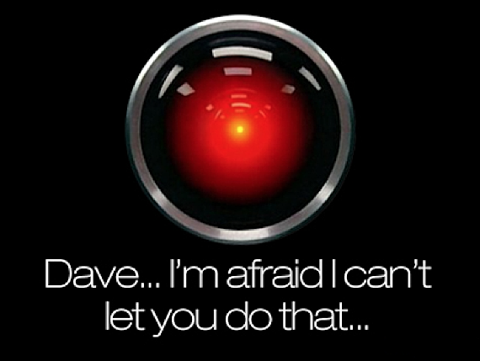
Ethics built-in rather than “just talked about”
Notes:
This is the problem of value alignment.
And when you mix that with a superintelligent system that can affect the world dramatically, it’s not such a good thing.
The point is that a machine can be better at making decisions
but still fail to make better decisions
if its values are not exactly the same as ours.

