Slide 1
Reputation Models for Tipping the Scales in Automatic Negotiation
Prof. Dr. Ralf Möller
Universität zu Lübeck
Institut für Informationssysteme
Joint work with: Tanya Braun, Nils Finke, Marcel Gehrke

Slide 2
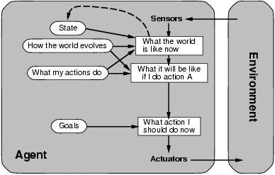
AI: What is it all about?
[Russell & Norvig 16]
[Poole & Macworth 17]

Slide 3
Negotiation Process
Negotiation usually proceeds in a series of rounds, with every agent making a proposal at every round.
Communication during negotiation:
Another way
of looking at the
negotiation process:
Who ”moves” the farthest
Proposal
Counter Proposal
Agenti concedes
Agenti
Agentj
Proposals by A_{i}
Point of
Acceptance/
aggreement
Proposals by A_{j}

Slide 4
Negotiation Set
The negotiation set consists of the deals that are Pareto efficient and (ex ante) individual rational.
  A deal is Pareto efficient if it is not dominated by another task allocation
  A deal is individual rational if neither agent is worse off than in the original allocation (the ‘conflict deal’)
Negotiation set
Utility of agent 2
Individual rational
Utility of agent 1
Conflict deal

Slide 5
Monotonic Concession Protocol
δ₂¹
δ₂²
Utility of agent 2
δ₁²
δ₁¹
Utility of agent 1

Slide 6
Zeuthen Strategy
Idea: measure willingness to risk conflict
δ₂
Utility of agent 2
δ₁
u₂(δ₂)
u₂(δ₁)
Utility function of opponent must be known
Utility of agent 1
If willingness to risk conflict is smaller than opponent, offer minimal sufficient concession (a sufficient concession makes opponent’s willingness to risk conflict less than yours); else offer original deal
The strategy was introduced in 1930 by the Danish economist Frederik Zeuthen.

Slide 7
Monotonic Concession
In theory: continuous steps
In practice: discrete steps due to qualitative utility model
Possibly concession too large
  The only possible action moves 𝛿₁ to the left of 𝛿₂
Reputation to be accounted for
  Add missing quantitative step
Use reputation models
also to estimate willingness
to risk conflict
δ₂¹
δ₂²
Utility of agent 2
δ₁²
δ₁¹
Utility of agent 1

Slide 8
Domain modeling and uncertainty
Probabilistic relational models
  Application example
  Basic semantics, static vs. dynamic behavior
  Query answering
For details and for learning see
  https://www.ifis.uni-luebeck.de/index.php?id=612
For more on learning see
  https://www.ifis.uni-luebeck.de/~moeller/StarAI/
Goal:
Overview of central ideas

Slide 9
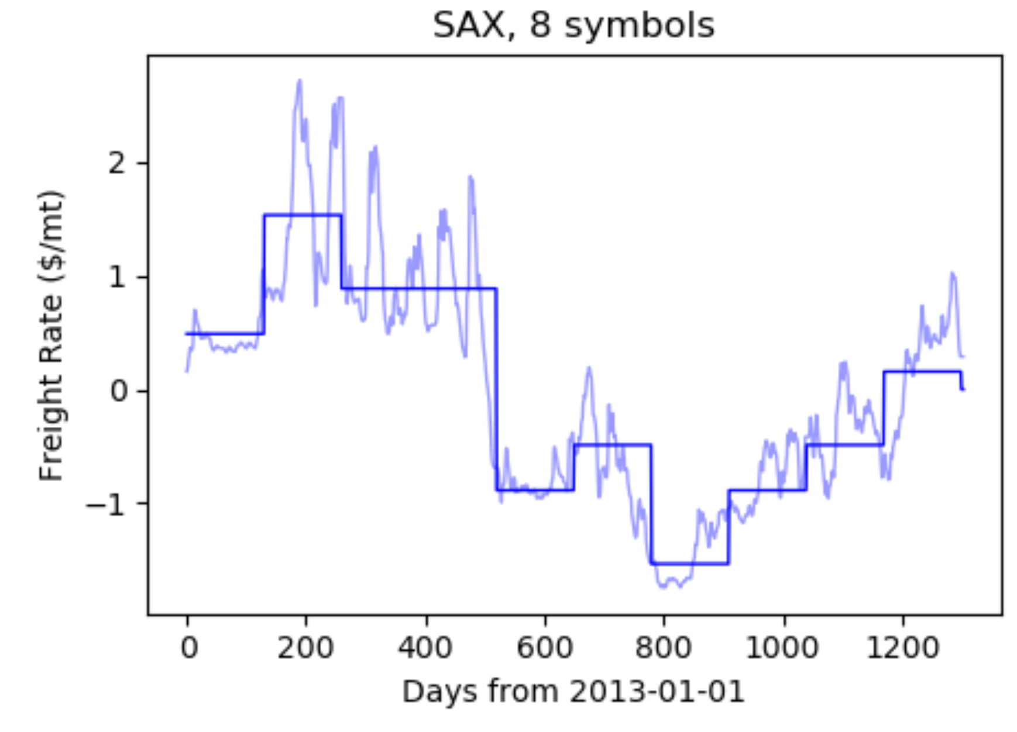
Example: Bulk Shipping
Qualitative Model
Supply (e.g. iron ore) in a certain zone Z
  Range(Supply(Z)) = {small, medium, large}
  Dom(Z) = {z₁, z₂, …, z_{n}} some number n of zones on the earth
NVessels of ship class S in a certain zone Z
  Range(NVessels(Z, S)) = {small, medium, large}
  Dom(S) = {big, small}
Demand in a certain zone Z
  Range(Demand(Z))
  = {small, medium, large)
Freight rate in a certain zone Z
  Range(FRate(Z))
  = {r₁, …, r₈}
Lin, J., Keogh, E., Lonardi, S. & Chiu, B. (2003) A Symbolic Representation of Time Series, with Implications for Streaming Algorithms. In proceedings of the 8th ACM SIGMOD Workshop on Research Issues in Data Mining and Knowledge Discovery

Slide 10






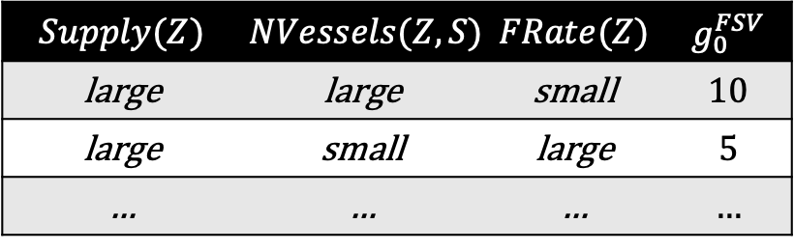


Application Example Bulk Shipping: Model G
Parameterized Random Variable
(PRV)
$$g_{0}^{S}$$
$${Supply(Z)}_{}$$
$$g_{0}^{FSV}$$
$${FRate\text{(}\text{Z}\text{)}}_{}$$
$$g_{0}^{V}$$
$${NVessels(Z, S)}_{}$$
$$Supply(Z)$$ | $$NVessels(Z,S)$$ | $$FRate(Z)$$ | $$g_{0}^{FSV}$$
large | large | small | 10
large | small | large | 5
… | … | … | …
Parameterized factors
(Parfactors)
Prior
(specific to Z and S)
$$Demand{\text{(}\text{Z}‘\text{)}}_{}$$
$$g_{0}^{D}$$
A model is a set of parfactors

Slide 11


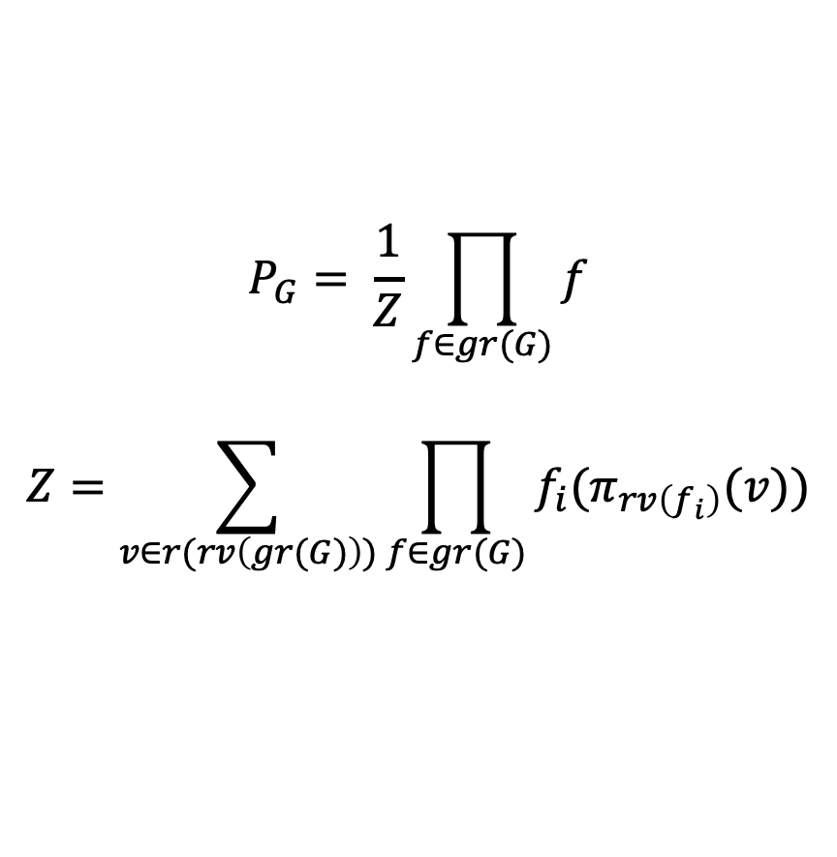




Semantics
Joint probability distribution $P_{G}$ by grounding
$$g_{0}^{S}$$
$${Supply(Z)}_{0}$$
$$g_{t−1}^{FSV}$$
$${FRate\text{(}\text{Z}\text{)}}_{0}$$
  $$P_{G}= \frac{1}{Z}\prod_{f∈gr(G)}{f}$$
  $$Z=\sum_{v∈r(rv\left(gr(G)\right))}{\prod_{f∈gr(G)}{f_{i}(π_{rv\left(f_{i}\right)}(v))}}$$
$$g_{0}^{V}$$
$${NVessels(Z, S)}_{0}$$
$$Demand{\text{(}\text{Z}‘\text{)}}_{0}$$
$$g_{0}^{D}$$

Slide 12
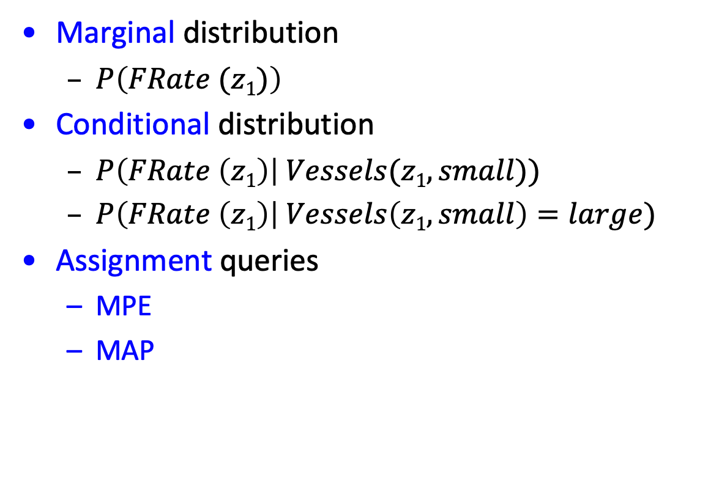
Queries
Marginal distribution
  $P\left(FRate (z1)\right)$
Conditional distribution
  $P\left(FRate \left(z1\right)\right| Vessels(z1,small))$
  $P\left(FRate \left(z1\right)\right| Vessels\left(z1,small\right)=large)$
Assignment queries
  MPE
  MAP
Notes:
Argmax and sum not commutative

Slide 13



















Temporal Representation
$$g_{t}^{S}$$
$$g_{0}^{S}$$
$$g_{}^{S}$$
$${Supply(Z)}_{t−1}$$
$${Supply(Z)}_{0}$$
$${Supply(Z)}_{t}$$
$$g_{t−1}^{FSV}$$
$${FRate\text{(}\text{Z}\text{)}}_{0}$$
$${FRate\text{(}\text{Z}\text{)}}_{t}$$
$$g_{t−1}^{FSV}$$
$${FRate\text{(}\text{Z}\text{)}}_{t−1}$$
$$g_{t−1}^{FSV}$$
$$g_{0}^{V}$$
$$g_{}^{V}$$
$${NVessels(Z, S)}_{t−1}$$
$${NVessels(Z, S)}_{0}$$
$${NVessels(Z, S)}_{t}$$
$$g_{}^{M}$$
$$Demand{\text{(}\text{Z}‘\text{)}}_{t−1}$$
$$Demand{\text{(}\text{Z}‘\text{)}}_{0}$$
$$Demand{\text{(}\text{Z}‘\text{)}}_{t}$$
$$g_{0}^{D}$$
$$g_{}^{D}$$
$$Z=Z′$$
$$g_{t}^{D}$$

Slide 14
Utility
Modeled as a real value
Utility of having vessels in a certain zone
depends on the freight rate (in that zone) …
… and on excellent negotiation considering reputation
δ₂¹
δ₂²
Utility of agent 2
δ₁²
δ₁¹
FRate Utility
Utility of agent 1

Slide 15








Adding Actions and Utilities
$$g_{t}^{S}$$
$$g_{}^{S}$$
$${Supply(Z)}_{t−1}$$
$${Supply(Z)}_{t}$$
$${FRate\text{(}\text{Z}\text{)}}_{t−1}$$
$$g_{t−1}^{FSV}$$
$$g_{t−1}^{FSV}$$
$${FRate\text{(}\text{Z}\text{)}}_{t}$$
$$g_{}^{V}$$
$${NVessels(Z, S)}_{t−1}$$
$${NVessels(Z, S)}_{t}$$
$$g_{t}^{FR}$$
$$g_{}^{M}$$
$${ReDis(Z, Z^{′}, S)}_{t−1}$$
$$g_{t−1}^{VD}$$
$${Util}_{t}$$
$$Demand{\text{(}\text{Z}‘\text{)}}_{t−1}$$
$$Demand{\text{(}\text{Z}‘\text{)}}_{t}$$
$$g_{}^{D}$$
$$g_{t}^{D}$$

Slide 16


Adding a Perspective
$$g_{t}^{S}$$
$$g_{}^{S}$$
$${Supply(Z)}_{t−1}$$
$${Supply(Z)}_{t}$$
$${Perspective}_{t}$$
$${FRate\text{(}\text{Z}\text{)}}_{t−1}$$
$$g_{t−1}^{FSV}$$
$$g_{t−1}^{FSV}$$
$${FRate\text{(}\text{Z}\text{)}}_{t}$$
$$g_{}^{V}$$
$${NVessels(Z, S)}_{t−1}$$
$${NVessels(Z, S)}_{t}$$
$$g_{t}^{FR}$$
$$g_{}^{M}$$
$${ReDis(Z, Z^{′}, S)}_{t−1}$$
$$g_{t−1}^{VD}$$
$${Util}_{t}$$
$$Demand{\text{(}\text{Z}‘\text{)}}_{t−1}$$
$$Demand{\text{(}\text{Z}‘\text{)}}_{t}$$
$$g_{}^{D}$$
$$g_{t}^{D}$$

Slide 17

Queries
Marginal distribution query: $P\left(A_{π}^{i} \right|E_{0:t})$ w.r.t. the model:
  Hindsight: $π<t$(Was there an epidemic $t−π$ days ago?)
  Filtering: $π=t$(Is there an currently an epidemic?)
  Prediction: $π>t$(Is there an epidemic in $π−t$ days?)
MPE, MAP on temporal sequence
Best Action: Maximum Expected Utility

Slide 18
Discrete Zeuthen Strategy
δ₂¹
δ₂²
Utility of agent 2
δ₁²
δ₁¹
FRate Utility
Utility of agent 1
Close the gap in case of discrete jumps?
Modeling reputation comes to the rescue

Slide 19



Application Example
$$g_{t}^{S}$$
$$g_{}^{S}$$
$${Supply(Z)}_{t−1}$$
$${Supply(Z)}_{t}$$
$${Perspective}_{t}$$
$${FRate\text{(}\text{Z}\text{)}}_{t−1}$$
$$g_{t−1}^{FSV}$$
$$g_{t−1}^{FSV}$$
$${FRate\text{(}\text{Z}\text{)}}_{t}$$
$$g_{}^{V}$$
$$g_{t}^{RU}$$
$${NVessels(Z, S)}_{t−1}$$
$${NVessels(Z, S)}_{t}$$
$$g_{t}^{FR}$$
$$g_{}^{M}$$
$${ReDis(Z, Z^{′}, S)}_{t−1}$$
$$g_{t−1}^{VD}$$
$${Util}_{t}$$
$$Demand{\text{(}\text{Z}‘\text{)}}_{t−1}$$
$$Demand{\text{(}\text{Z}‘\text{)}}_{t}$$
$$g_{}^{D}$$
$${Rep}_{t}$$
$$g_{t}^{D}$$

Slide 20
Summary
Role of reputation models in automatic negotiation
Qualitative domain model (probabilistic)
Concession beyond competition limits (e.g., freight rate)
can cause conflict deals
  Reputation models to the rescue
Discrete jumps in utility can cause confict deals
  Reputation models for tipping the scales

