Slide 1
Ethical Issues in Producing, Storing, and Using Data GenAI@UWA
Some Comments on the DFG-Guidelines and the Application of GenAI in Scientific Education & Research Ralf Möller
ralf.moeller@uni-hamburg.de

Slide 2
DFG Guidelines on GenAI Technology
Guidelines emphasize the transparent handling of text and image content generation as an important aspect in research
Conditions to ensure good research practice
Disclose the use of generative models when making their results publicly available in documents, including funding proposals submitted to the DFG
Ensure that the use of generative models does not infringe anyone else's intellectual property (plagiarism and other IPR violations)
Only natural persons responsible can appear as authors in research publications
Use of generative models in the preparation of reviews is not permitted
Documents provided for review are confidential and may not be used as input for generative models
https://www.csmc.uni-hamburg.de/about/ethics/ethics-guidelines-long-version.pdf
https://www.dfg.de/resource/blob/174052/1a235cb138c77e353789263b8730b1df/kodex-gwp-en-data.pdf

Slide 3
EXC 2176 UWA – Rules and Regulations Update 19 October 2023
Has the new document been published?
“Use of Artificial Intelligence Technologies in research and writing processes
UWA does not take a positive or negative stance towards the use of AI technologies in the research and writing process.
If used, the following rules have to be followed:
The use of generative models has to be acknowledged in the publication.(‘In the research and writing of this ... the following generative models have been used: ...').
The use of generative models does not infringe anyone else's intellectual property and does not result in scientific misconduct, for example in the form of plagiarism.”

Slide 4
GenAI: Large Language Models (LLMs)
Translating one language into another,
Summarizing a long document into a brief highlight,
Answering information-seeking questions
Open-domain dialog
Converse about any topic
Dialog models should adhere to Responsible AI practices
accountability, inclusiveness, reliability and safety, fairness, transparency, and privacy and security
Avoid making factual statements that are not supported by external information sources.
https://ai.googleblog.com/2022/01/lamda-towards-safe-grounded-and-high.html

Slide 5
Summarization
Prompt
> Summarise the impact of gall ink on manuscript production as reported in the journal "manuscript cultures" edited by the Center of the Studies of Manuscript Cultures in Hamburg.
Perpexity.AI

Slide 6
Too Long; Didn’t Read – TL;DR:
Prompt
>
…
Agency: How Manuscripts Affect and Create Social Realities Michael Kohs and Sabine Kienitz | Hamburg

Slide 7
Follow-up Questions as Inspiration
Perpexity.AI

Slide 8
Writing Improvement (e.g., https://app.rytr.me/)
Automatic translation of the beginning of the homepage of the Institute of Informationssysteme, Lübeck:
With automatically computed changes in writing style:
The Institute for Information Systems (IFIS) is one of the Institutes of Computer Science at the Section for Computer Science/Technology of the University of Lübeck. It was established in 1993 as the first core informatics institute at the University of Lübeck. Since October 2014, the institute has been operated by Prof. Dr. Ralf Möller.
The central research object of IFIS is Well-Founded Artificial Intelligence (well-founded AI). In this context, we examine principles that are fundamental for intelligent systems with verifiable properties. It is not only about creating a certain impressive functionality (no matter how fragile) somehow experimentally with basic models, as so often tried to do, but - based on basic models, but also with reference to relational, non-embedded probabilistic or energy-based structures - to derive understandable architectures with formally tangible properties in order to create intelligent systems that are useful for all people.
The Institute for Information Systems (IFIS) is one of the institutes within the Computer Science section at the University of Lübeck, specializing in computer science and technology. The institute was established in 1993 as the first core informatics institute at the University of Lübeck. Since October 2014, it has been operated by Prof. Dr. Ralf Möller.
The main research focus of IFIS is Well-Founded Artificial Intelligence (well-founded AI). In this context, we explore the principles that form the foundation for intelligent systems with verifiable properties. It's not just about creating an impressive functionality, even if it's fragile, through experimental means with basic models, as is often attempted. Instead, it's about building upon those basic models and, In addition, these architectures aim to create intelligent systems that are not only useful for all people but also derive understandable structures with formally tangible properties. This includes referencing relational, non-embedded probabilistic, or energy-based structures.

Slide 9
Large Language Models: A Bird’s Eye View: Graham Neubig

Slide 10
Pre-Training & Fine Tuning
1) Download LM pre-trained on large corpus (in self-supervised fashion)
2) Feature-based training ("fine-tuning")
on target task (supervised learning)
Pretrained
Model
Trained
Transfer
Fix
Embedding
One or more layers
Shallow fine tuning (SFT)
Embedding & Training for Downstream Tasks

Slide 11
Person Names, Locations, Organizations

Slide 12
Fine Tuning a Free Arabic Language Model

Slide 13
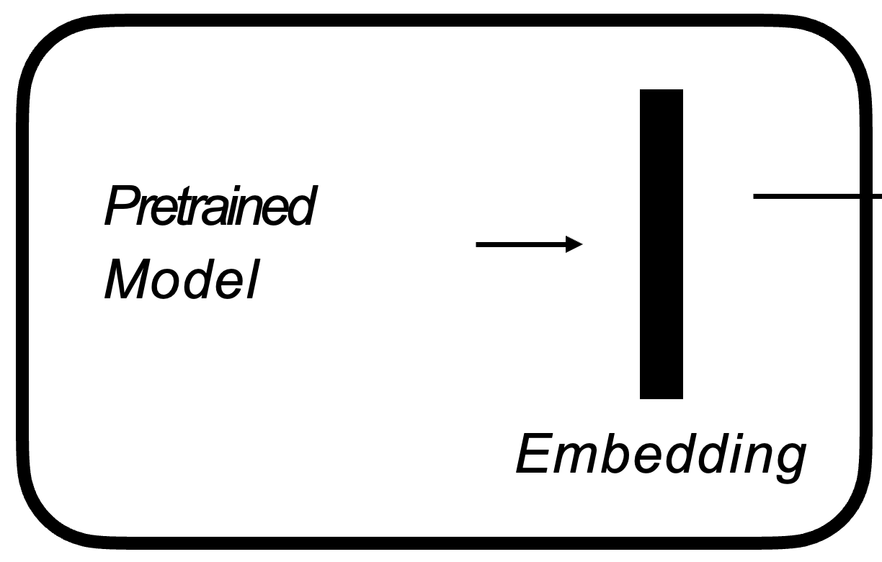
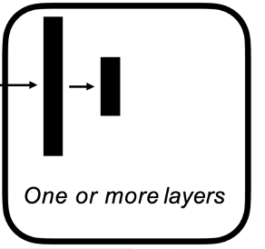
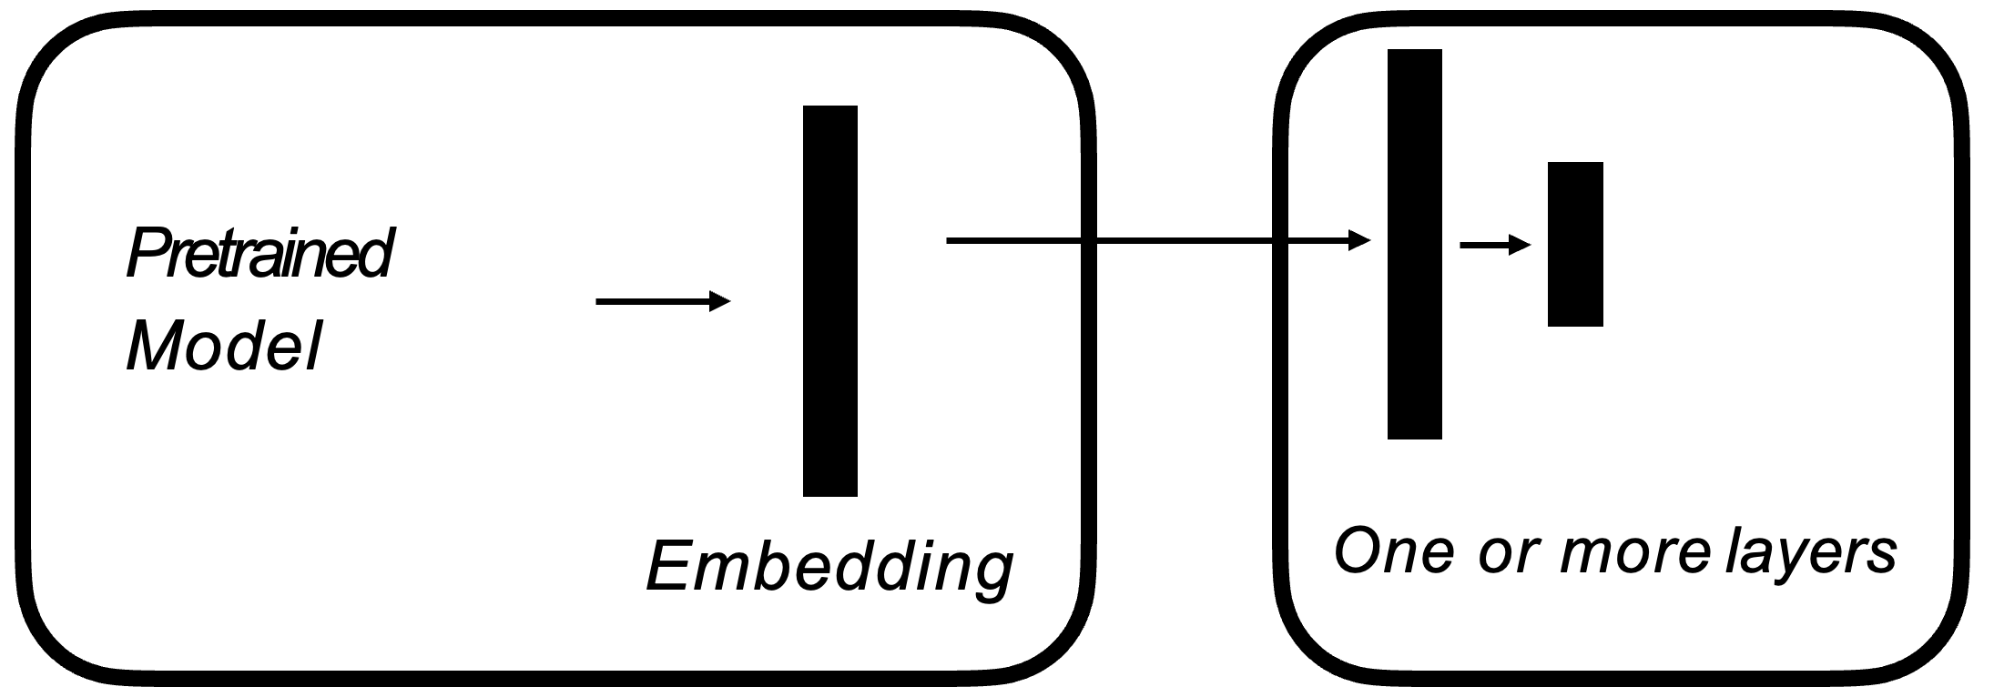
LLaMA vs Alpaca
RLHF Training
SFT Training
7B
170B
7B
Few-Shot
Relatively simple
Have students generate LMs rather than write static term papers!
See also Mistral and Mixtral
Notes:
The figure illustrates how we obtained the Alpaca model. For the data, we generated instruction-following demonstrations by building upon the self-instruct method. We started with the 175 human-written instruction-output pairs from the self-instruct seed set. We then prompted text-davinci-003 to generate more instructions using the seed set as in-context examples. We improved over the self-instruct method by simplifying the generation pipeline (see details in GitHub) and significantly reduced the cost. Our data generation process results in 52K unique instructions and the corresponding outputs
Equipped with this instruction-following dataset, we then fine-tuned the LLaMA models using Hugging Face’s training framework, taking advantage of techniques like Fully Sharded Data Parallel and mixed precision training. For our initial run, fine-tuning a 7B LLaMA model took 3 hours on 8 80GB A100s, which costs less than $100 on most cloud compute providers.

Slide 14
Merging LLMs
https://github.com/cg123/mergekit

Slide 15
Questions?
Can scholars submit copyrighted publications (articles, papers) to GenAI-Systems to fine-tune a language models, e.g., for question answering?
This can collide with copyright laws (you may read a paper and comment on it, but you may not republish content even in “changed” forms)
Can scholars train their own language models with copyrighted publications (and legally publish the language models afterwards)?
Is it possible to do this with open-science publications? What about intellectual property rights (IPR)?

Slide 16
Legal status not fully understood.
Perpexity.AI

Slide 17
Interim Insights
An organization should provide its own pretrained LLMs with its own publications included
New ways of publishing new results (offer for merging into other LLMs)s
Research data management plus LLM management
An organization’s own journals or single articles and papers should be explicitly provided for training large language models (LLMs) by the organization’s scholars/scientists
Data also matter for LLM usage

Slide 18
Retrieval-Augmented Generation (RAG)
PR

Slide 19
Cool research topic: RAG right from RDR
Perpexity.AI

Slide 20
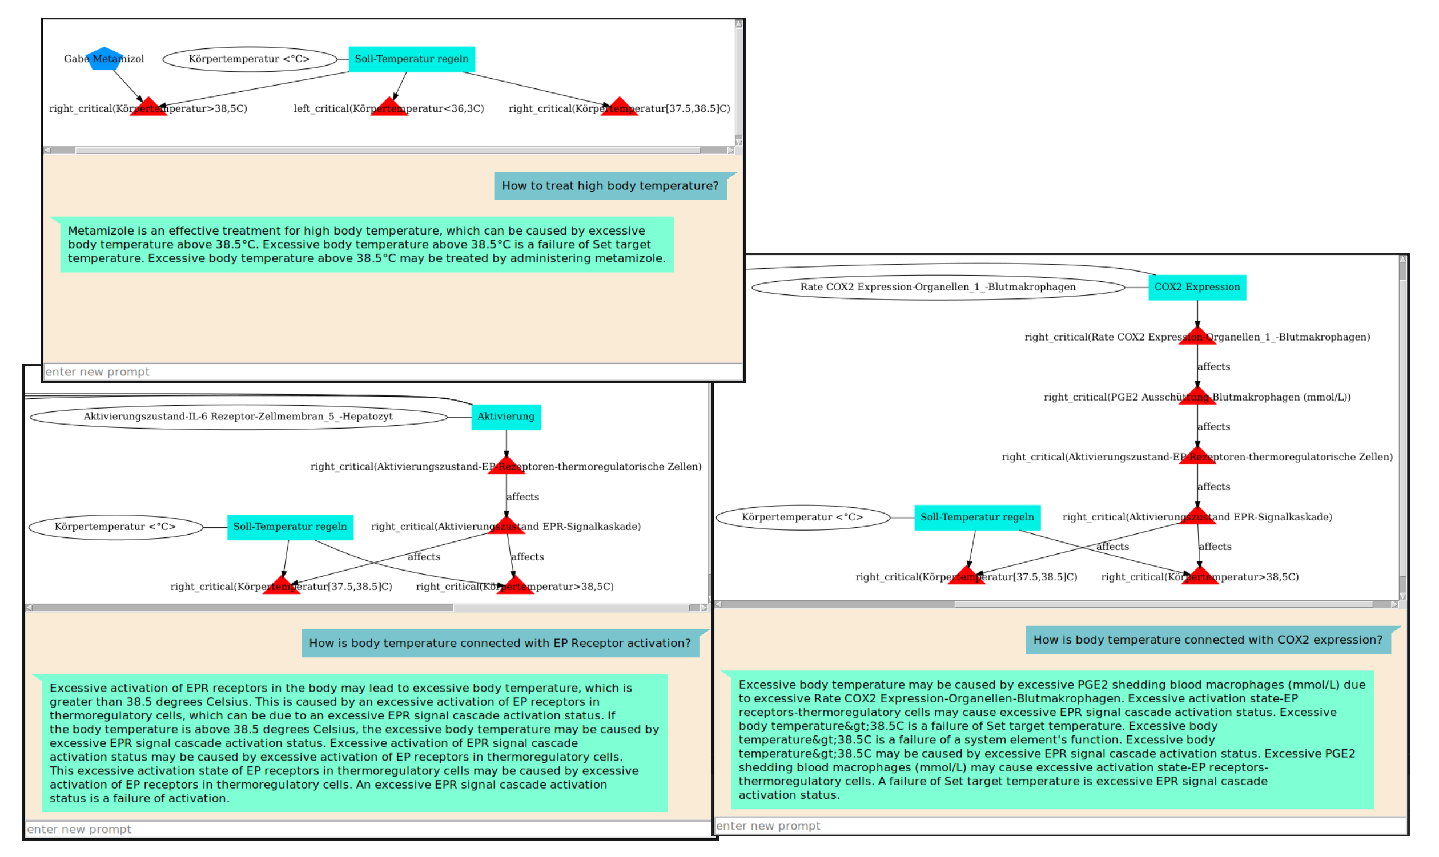
GenAI & Formal Diagrammatic Models

Slide 21
Example: Failure Mode and Effects Analysis
Semantics = Markov Decision Process
Best action in every state (compare to chess playing)
-
-O+2

Slide 22
Beyond RAG
Not only data, but models
Models have a semantics
Decision or computational problems defined w.r.t. semantics
Example: “Compute best action in every possible state.”
Solutions of decision (or computational) problems define more data
→ semanticRAG

Slide 23
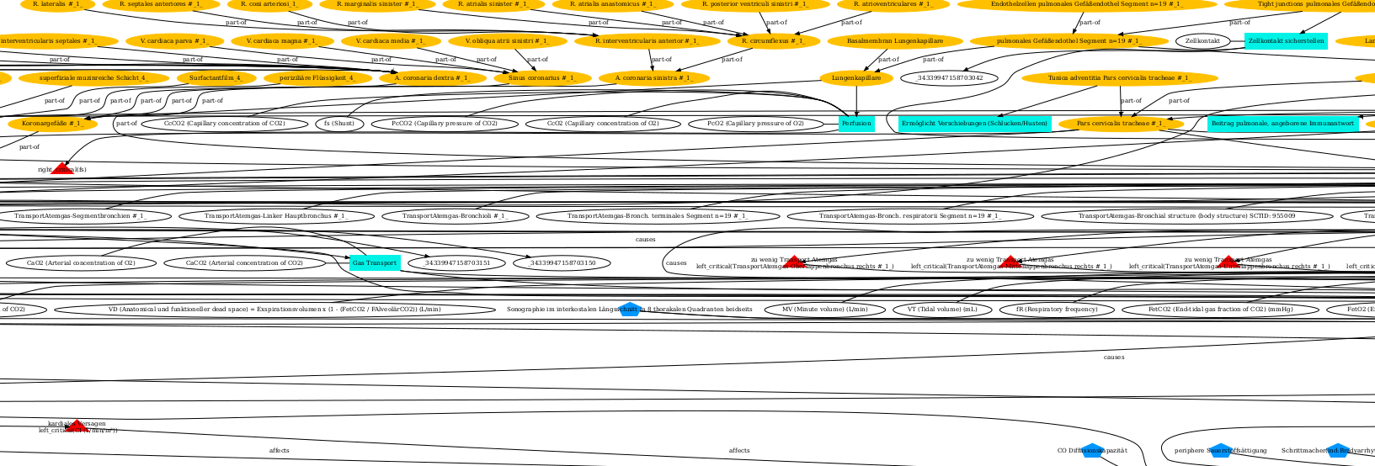
Practical models are very large

Slide 24
Symbol grounding with LLMs

Slide 25
Training for semanticRAG
Generate cloze texts from model elements
Model elements relevant for text are automatically known
Models semantics matters for cloze filling (semanticRAG)
Deep fine tuning (e.g., based on GPT-2)

Slide 26
Pre-Training as a Start & Fine Tuning
1) Download LM pre-trained on large corpus (in self-supervised fashion)
2) Feature-based training ("fine-tuning")
on target task (supervised learning)
Pretrained
Model
Trained
Transfer as a start
Trained
Embedding
One or more layers
Deep fine tuning (DFT)
Embedding & Training for Downstream Tasks

Slide 27
Code Generation (examples with Perplexity.AI)
Integrate GenAI programming into education

Slide 28
Data Analysis (1)
“To read a CSV file and represent its content as a Python data frame, you can use the pandas library. Here's a code snippet to achieve this:”
“This code first reads the CSV file into a DataFrame, then computes the mean and variance with reference to the "age" attribute. After that, it clusters the tuples with reference to "age" using the KMeans algorithm. The resulting mean, variance, and the clustered DataFrame are then printed.
For more details on KMeans clustering and its parameters, you can refer to the provided search results¹ ².”

Slide 29
Data Analysis (2)
> Use DBSCAN instead of KMeans.
“In this code, the DBSCAN class from the sklearn.cluster module is used to perform density-based clustering. The eps parameter sets the maximum distance between two samples for one to be considered as in the neighborhood of the other, and min_samples sets the number of samples in a neighborhood for a point to be considered as a core point.
DBSCAN is a density-based clustering algorithm that does not require the number of clusters to be specified beforehand, making it more flexible than KMeans¹ ². It is suitable for handling clusters of multiple sizes and structures and is not strongly influenced by outliers² ⁴.”

Slide 30
Insights
Ensure an organization is well-represented in commercial LLMs
Instead of requiring students to just write simple term papers let them train language models for QA
Instructor can check language models with queries possibly automatically rather than read (not always well-written) essays
Ensure an organization is aware that available training material (licensing) and training compute must be made available to students
Teach LLM training in combination with DBs and formal models
Beyond RAG → semanticRAG
Teach programming with GenAI technology
Avoid labs with naïve programming tasks

Slide 31
Comments on Regulations
“The use of generative models has to be acknowledged in the publication.(‘In the research and writing of this ... the following generative models have been used: ...’)”
Generating acknowledgements will become a very tedious task!
As annoying a cooking acceptance (or refusal) on web pages
“The use of generative models does not infringe anyone else's intellectual property and does not result in scientific misconduct, for example in the form of plagiarism.”
Easier said than realized!

Slide 32
Thank you

