Slide 1
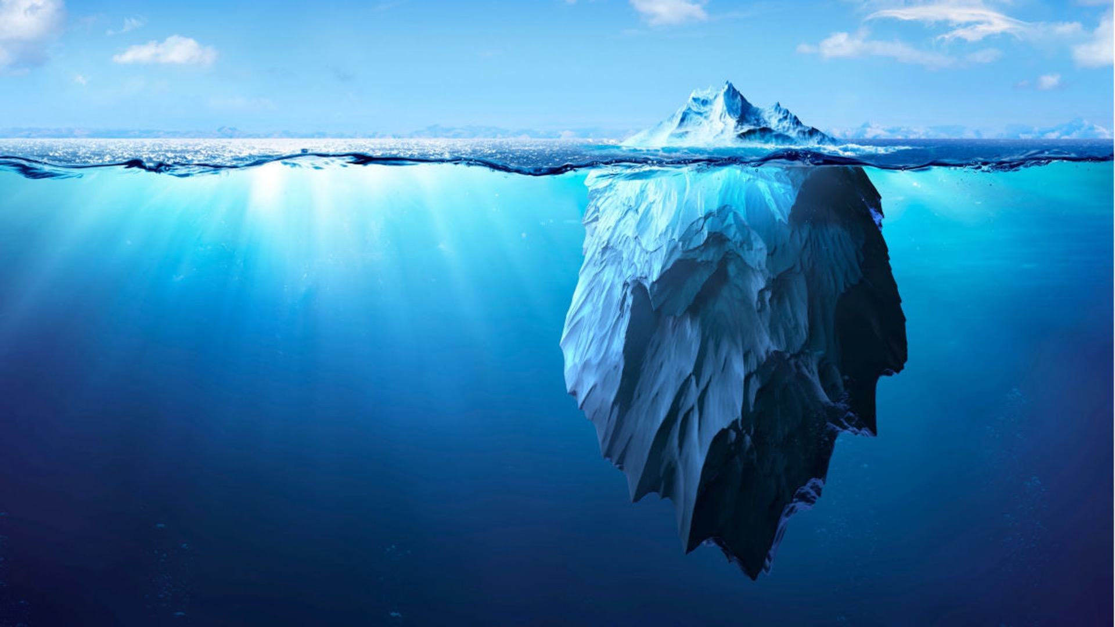
From Word Embeddings to Language Models
A tip of the iceberg tour
RalfM

Slide 2
Recap: Document and query representation
Only represent occurrences of terms with incidence matrix?
Use word counts?
Use word frequencies?
What about terms that occur in certain documents but seldomly in the corpus?

Slide 3
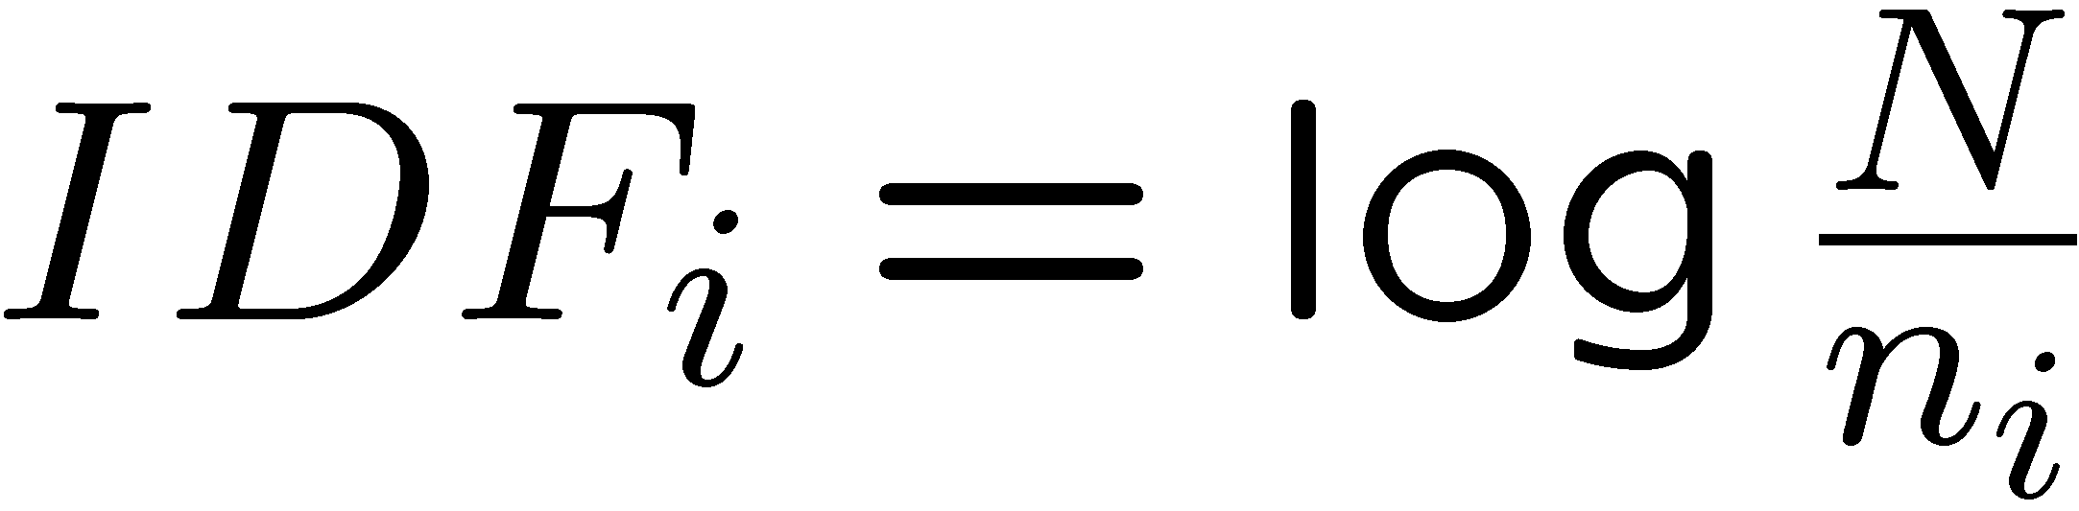
Recap: TF.IDF / LSH
Indyk, Piotr.; Motwani, Rajeev. (1998). "Approximate Nearest Neighbors: Towards Removing the Curse of Dimensionality.". Proceedings of 30th Symposium on Theory of Computing.
Similarly for multimedia objects:
Locality sensitive hashing
f_{ij} = number of terms t_{i} in document d_{j}
n_{i} = Number of documents with term i
N = Total number of documents
TF.IDF measure
w_{ij} = TF_{ij} ⋅ IDF_{i}
TF_{ij} = f_{ij} / number of terms in d_{j}
K. Spärck Jones. A Statistical Interpretation of Term Specificity and Its Application in Retrieval. Journal of Documentation 28: 11–21, 1972

Slide 4
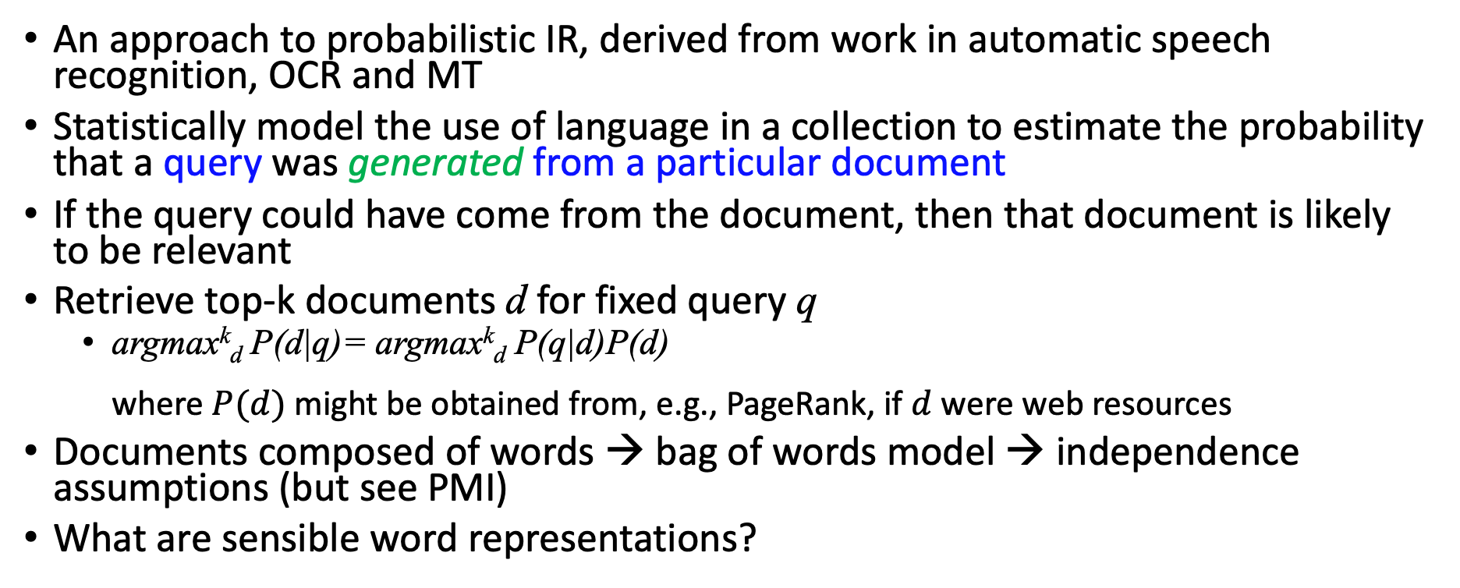
Recap: Language Models
An approach to probabilistic IR, derived from work in automatic speech recognition, OCR and MT
Statistically model the use of language in a collection to estimate the probability that a query was generated from a particular document
If the query could have come from the document, then that document is likely to be relevant
Retrieve top-k documents d for fixed query q
  argmax^{k}_{d} P(d|q)= argmax^{k}_{d} P(q|d)P(d)
  where $P(d)$ might be obtained from, e.g., PageRank, if $d$ were web resources
Documents composed of words → bag of words model → independence assumptions (but see PMI)
What are sensible word representations?
Jay M. Ponte and W. Bruce Croft. A language modeling approach to information retrieval. In Proceedings of the 21st annual international ACM SIGIR conference on Research and development in information retrieval (SIGIR '98). ACM, New York, NY, USA, 275-281. 1998.

Slide 5
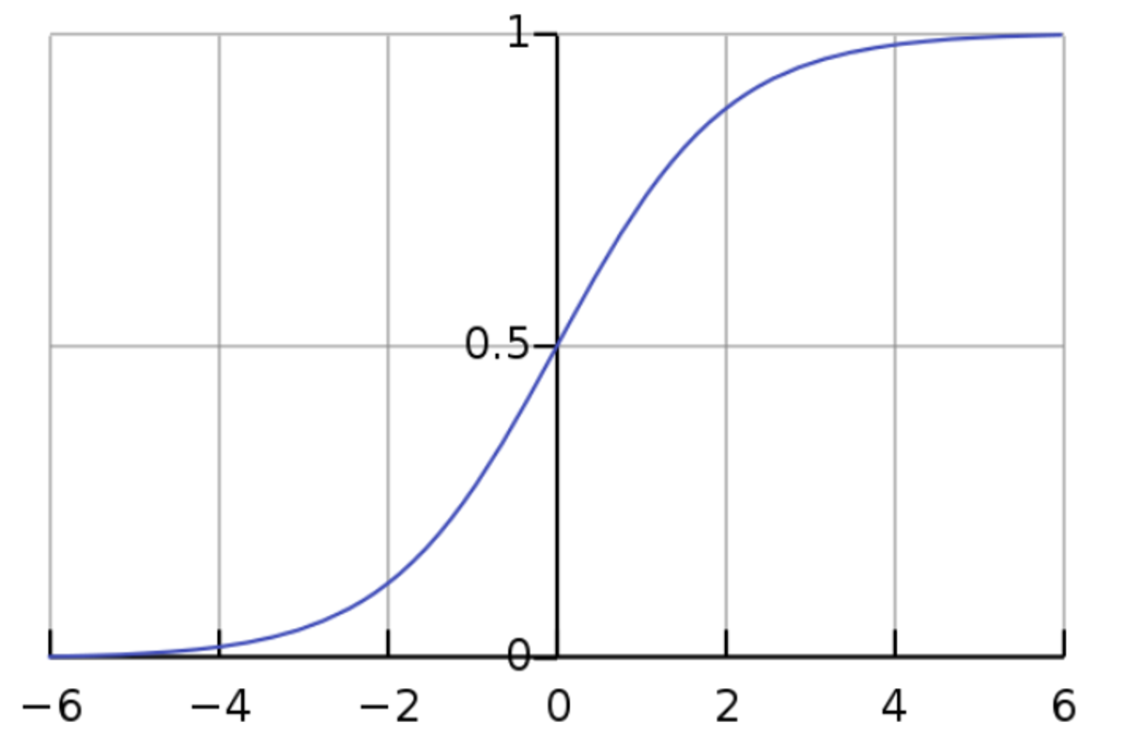

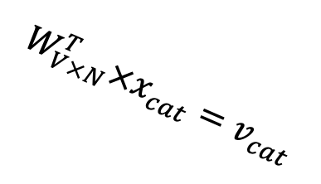





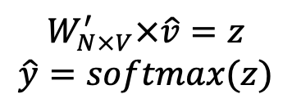
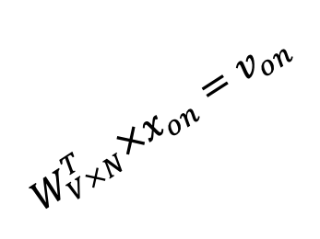

Recap: Word Embedding: word2vec
Self-supervised learning by filling a mask token is easy
$$W_{V×N}^{T} ×x_{cat}=v_{cat}$$
0.1 | 2.4 | 1.6 | 1.8 | 0.5 | 0.9 | … | … | … | 3.2
0.5 | 2.6 | 1.4 | 2.9 | 1.5 | 3.6 | … | … | … | 6.1
… | … | … | … | … | … | … | … | … | …
… | … | … | … | … | … | … | … | … | …
0.6 | 1.8 | 2.7 | 1.9 | 2.4 | 2.0 | … | … | … | 1.2
0
2.4
2.6
…
…
1.8
Input layer
1
$$×$$
0
$$=$$
0
0
1
0
0
0
We would prefer $\hat{y}$ close to ${\hat{y}}_{sat}$
x_{cat}
0
0
Output layer
0
0
0
$$W_{V×N}^{T}×x_{cat}=v_{cat}$$
…
0.01
0.02
0.00
0.02
0.01
0.02
0.01
0.7
…
0.00
0
0
0
0
0
V-dim
…
0
0
$$\hat{v}=\frac{v_{cat}+v_{on}}{2}$$
0
+
0
sat
0
0
0
0
$$W_{V×N}^{T}×x_{on}=v_{on}$$
1
0
…
V-dim
1
Hidden layer
0
x_{on}
0
${\hat{y}}_{sat}$
0
N-dim
$$W_{N×V}^{′}×\hat{v}=z$$
$$\hat{y}=softmax(z)$$
0
V-dim
0
V-dim
…
$\hat{y}$
0
Distributed Representations of Words and Phrases and their Compositionality
Tomas Mikolov, Ilya Sutskever, Kai Chen, Greg Corrado, Jeffrey Dean, NIPS 2013

Slide 6
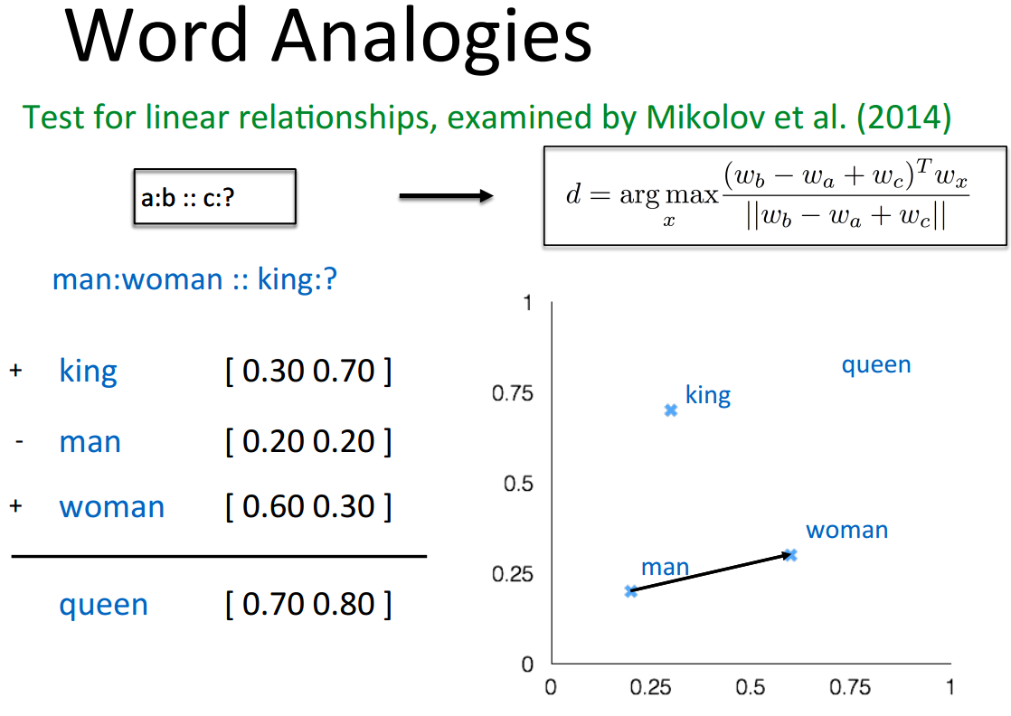
Word Embeddings and
word2vec Explained: Deriving Mikolov et al.’s Negative-Sampling Word-Embedding Method, Yoav Goldberg and Omer Levy, arxiv, 2014.

Slide 7
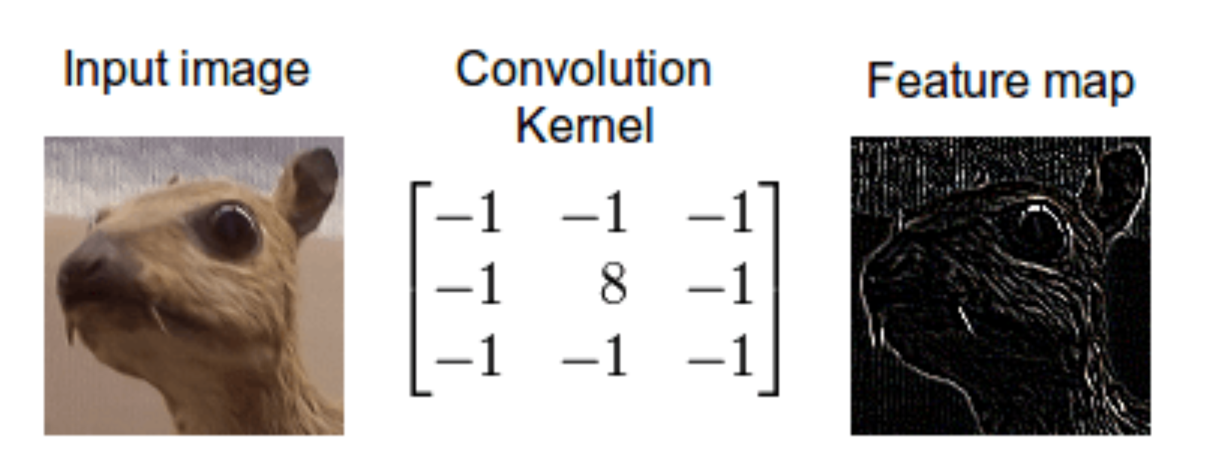
Recap: Convolution

Slide 8
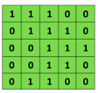
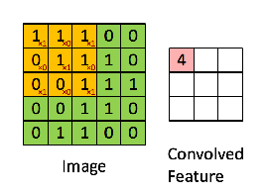

Recap: Convolutional Neural Networks (CNNs)
Convolutional
3x3 filter
Input matrix
http://deeplearning.stanford.edu/wiki/index.php/Feature_extraction_using_convolution
Notes:
http://www.asimovinstitute.org/neural-network-zoo/

Slide 9
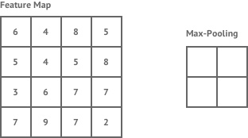
Recap: ConvNets (CNNs)
max pool
2x2 filters
and stride 2
Dimension reduction
https://shafeentejani.github.io/assets/images/pooling.gif

Slide 10
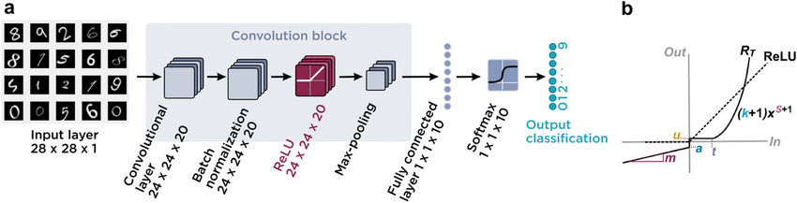

Slide 11
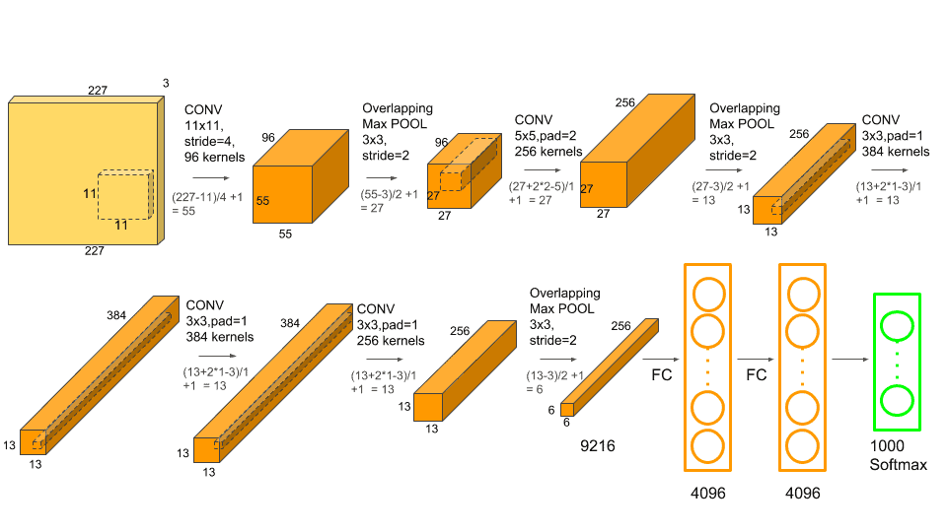
Computer Vision Example: Alexnet
Initially vectors of 227*227*3 = 154 587 features).
Represented as a vector of 4096 features
The two fully connected and softmax layers are similar to a multi layer perception and could actually be replaced by other kinds of classifiers such as Random Forests or SVMs. However they are really important for the training phase of the neural net.
https://learnopencv.com/understanding-alexnet/

Slide 12
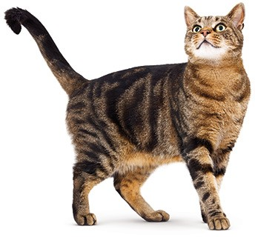
Image classification
Classify an image into 1000 possible classes:
e.g. Abyssinian cat, Bulldog, French Terrier, Cormorant, Chickadee,
Red fox, banjo, barbell, hourglass, knot, maze, viaduct, etc.
cat, tabby cat (0.71) Egyptian cat (0.22)
red fox (0.11)
…..
Train on ImageNet challenge dataset, ~1.2 million images

Slide 13
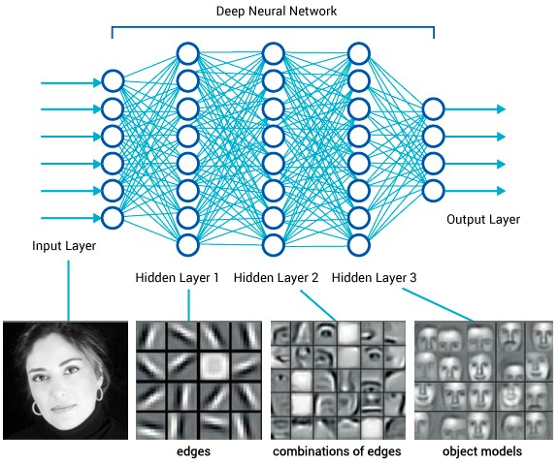
What is happening?

Slide 14
1d-CNNs for text
Text is a (variable-length) sequence of words (word vectors)
We can use a 1d-CNN to slide a window of n tokens across:
— filter size n = 3, stride = 1, no padding
The | quick | brown | fox | jumps | over | the | lazy | dog
The | quick | brown | fox | jumps | over | the | lazy | dog
The | quick | brown | fox | jumps | over | the | lazy | dog
The | quick | brown | fox | jumps | over | the | lazy | dog
The | quick | brown | fox | jumps | over | the | lazy | dog
The | quick | brown | fox | jumps | over | the | lazy | dog
— filter size n = 2, stride = 2, no padding:
The | quick | brown | fox | jumps | over | the | lazy | dog
The | quick | brown | fox | jumps | over | the | lazy | dog
The | quick | brown | fox | jumps | over | the | lazy | dog
The | quick | brown | fox | jumps | over | the | lazy | dog
CNNs (w/ ReLU and maxpool) can be used for classifying (parts of) the text
Bengio Y, Ducharme R, Vincent P, Jauvin C. A neural probabilistic language model. J Mach Learn Res 3:1137–1155. 2003.

Slide 15
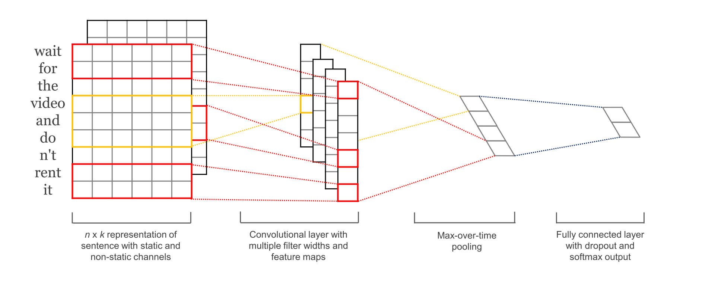
CNNs for sentence/text classification
Pretrained and task-specific embeddings: Multiple Channels
Kim, Y. “Convolutional Neural Networks for Sentence Classification”, EMNLP (2014)
sliding over 3, 4 or 5 words at a time
Static = pre-trained, non-static = task-specific

Slide 16
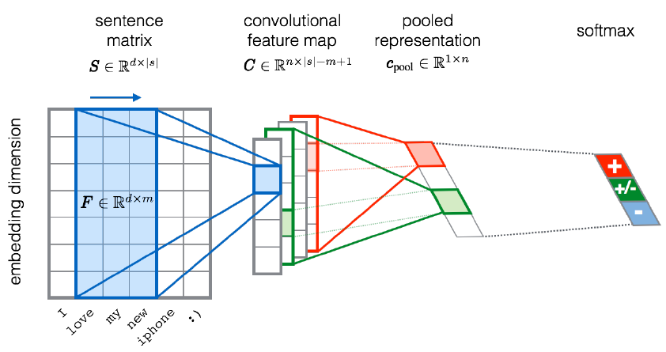
CNNs for sentiment analysis
Entities and relations
not really considered…
Severyn, Aliaksei, and Alessandro Moschitti. "UNITN: Training Deep Convolutional Neural Network for Twitter Sentiment Classification." SemEval@ NAACL-HLT. 2015.
Notes:
the width m of the convolution filters is set to 5
n = 300 feature maps
first layer embeds words into low-dimensional vectors.

Slide 17
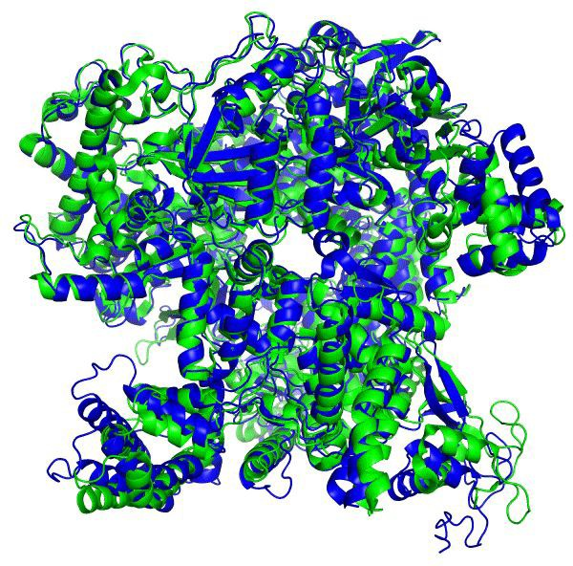
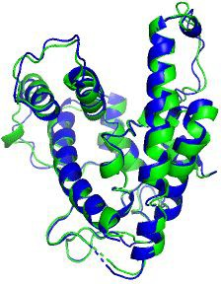
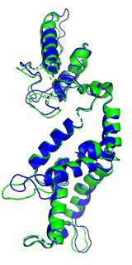
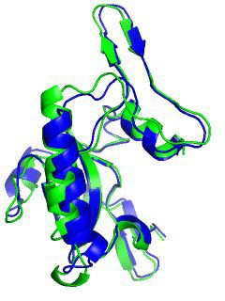
Protein example: T1044 (RNA Polymerase)
© 2020 DeepMind Technologies Limited
T1042
Ground truth Prediction
T1043

Slide 18


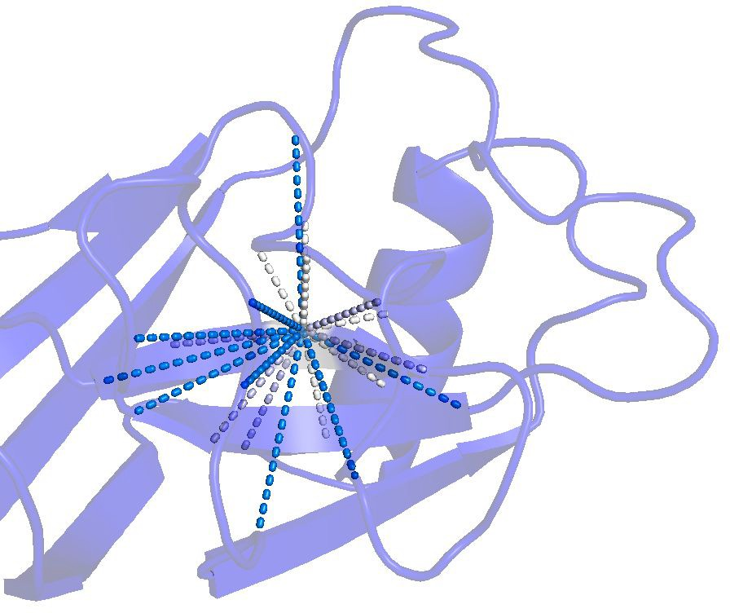

Putting our protein knowledge into the model
© 2020 DeepMind Technologies Limited
Physical insights are built into the network structure, not just a process around it
End-to-end system directly producing a structure instead of inter-residue distances
Inductive biases reﬂect our knowledge of protein physics and geometry
  The positions of residues in the sequence are de-emphasized
  Instead residues that are close in the folded protein need to communicate
  The network iteratively learns a graph of which residues are close, while reasoning over this implicit graph as it is being built
residues
residues

Slide 19
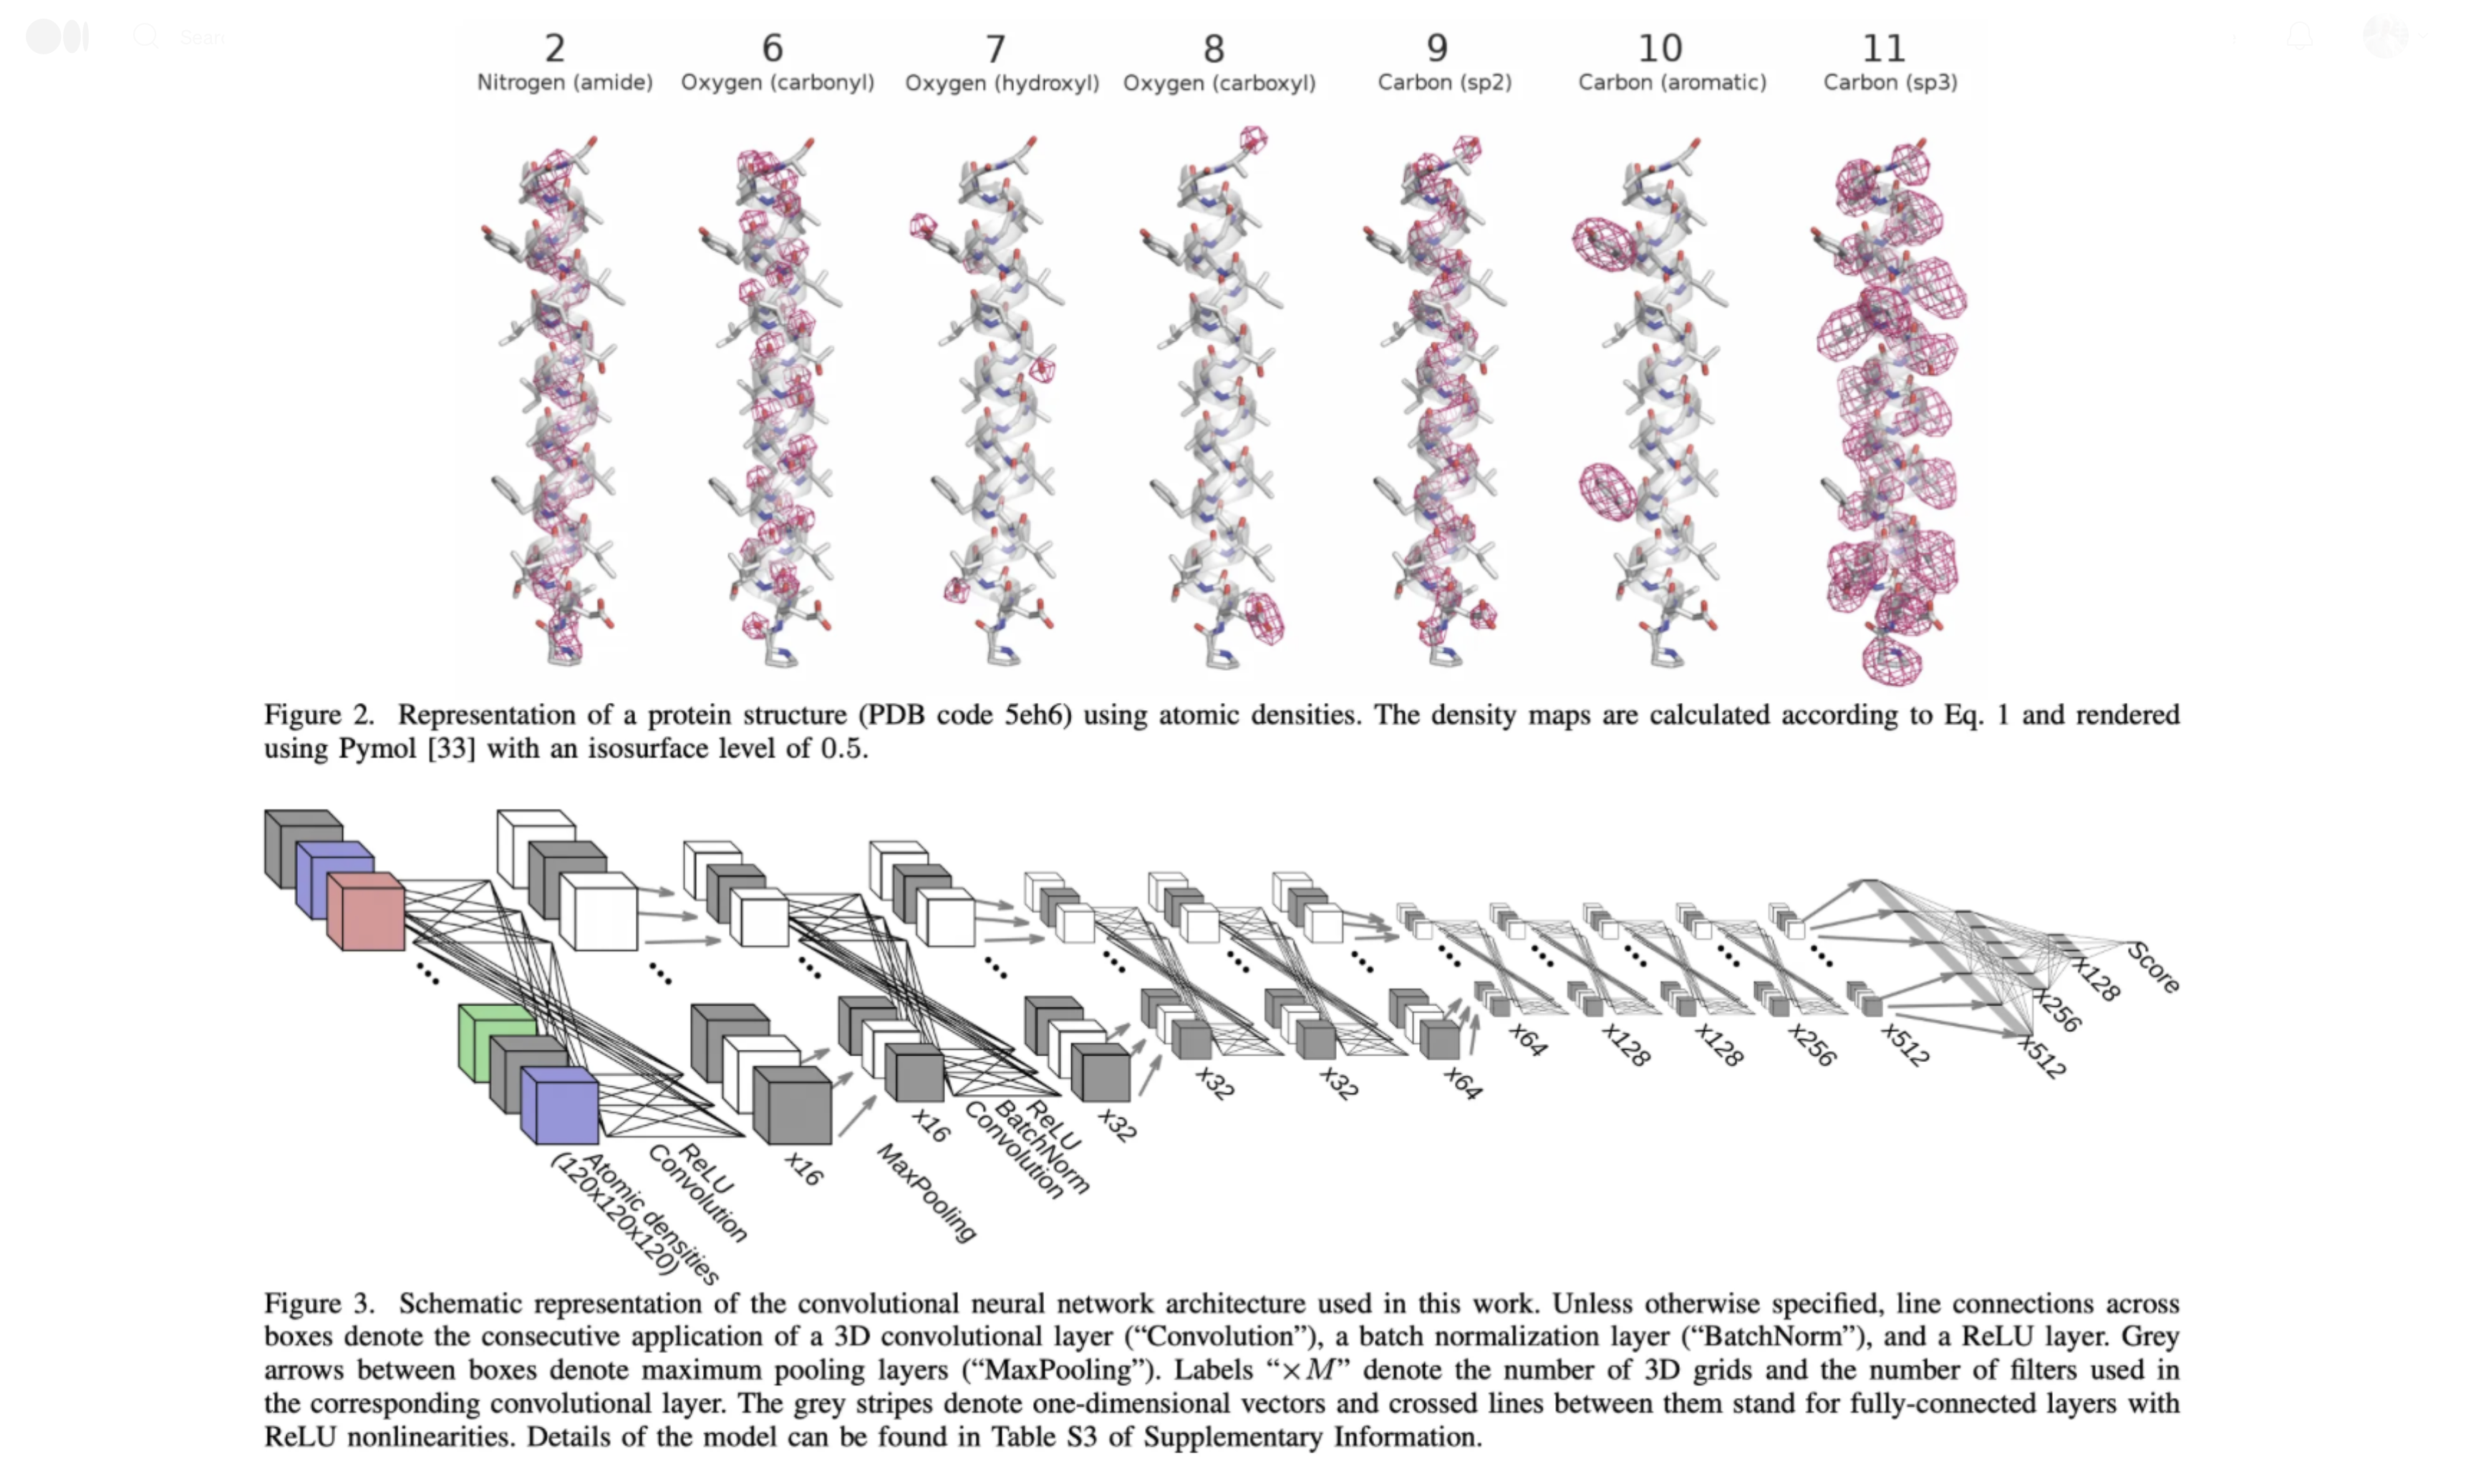
© 2020 DeepMind Technologies Limited

Slide 20









Recursive Networks – Or: Copying the Pattern
Basic computational network copied per time slice
Input: previous hidden state, output: next hidden state
Compare with HMM:
Computational model
output
hidden input
Declarative model (generative)
R_{t-1} | P(R_{t}|R_{t-1})
T F | 0.7 0.3
Rain_{t-1}
Rain_{t}
Rain_{t+1}
R_{t} | P(U_{t}|R_{t})
T F | 0.9 0.2
Umbrella_{t-1}
Umbrella_{t}
Umbrella_{t+1}
https://medium.com/swlh/a-simple-overview-of-rnn-lstm-and-attention-mechanism-9e844763d07b
CS546 Machine Learning in NLP

Slide 21
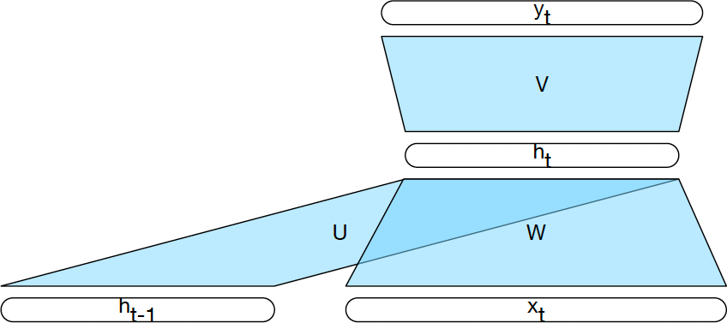
Computing the Hidden State

Slide 22
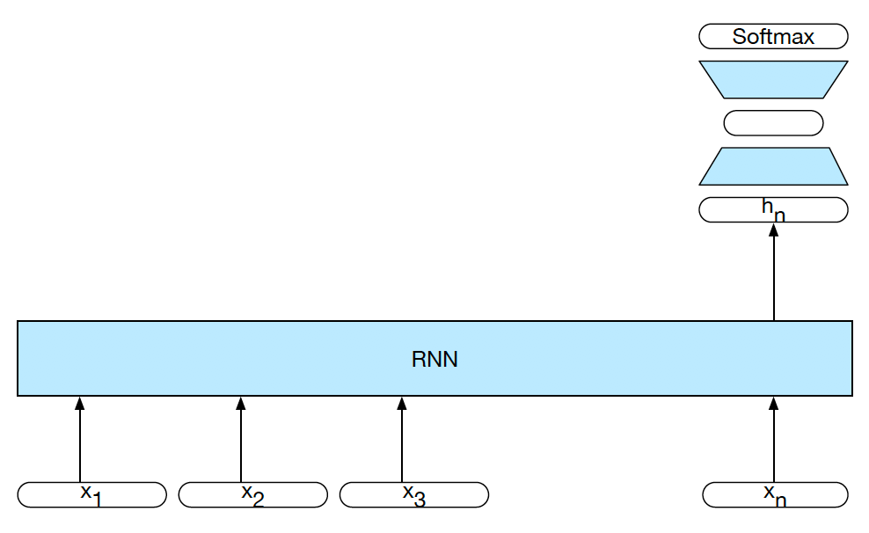
RNNs for Sequence Classification
CS546 Machine Learning in NLP

Slide 23
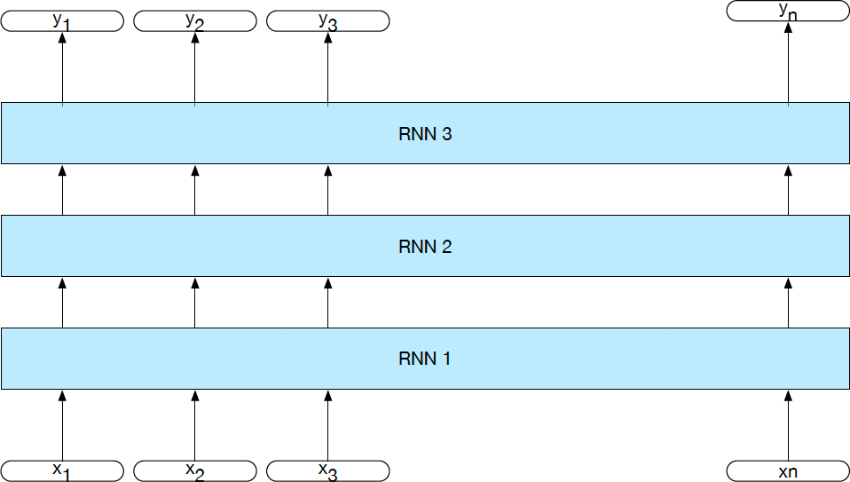
Stacked RNNs
23
CS546 Machine Learning in NLP

Slide 24
Bidirectional RNNs for sequence classification
+
^{h}1_back
RNN 2 (Right to Left)
w
RNN 1 (Left to Right)
^{h}n_for
x₁
x₂
x₃
x_{n}
CS546 Machine Learning in NLP

Slide 25


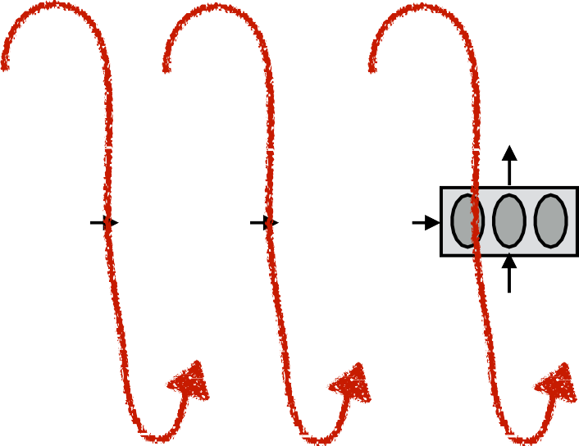




Encoder-Decoder (seq2seq) model
output
hidden
input
<s>
CS546 Machine Learning in NLP

Slide 26
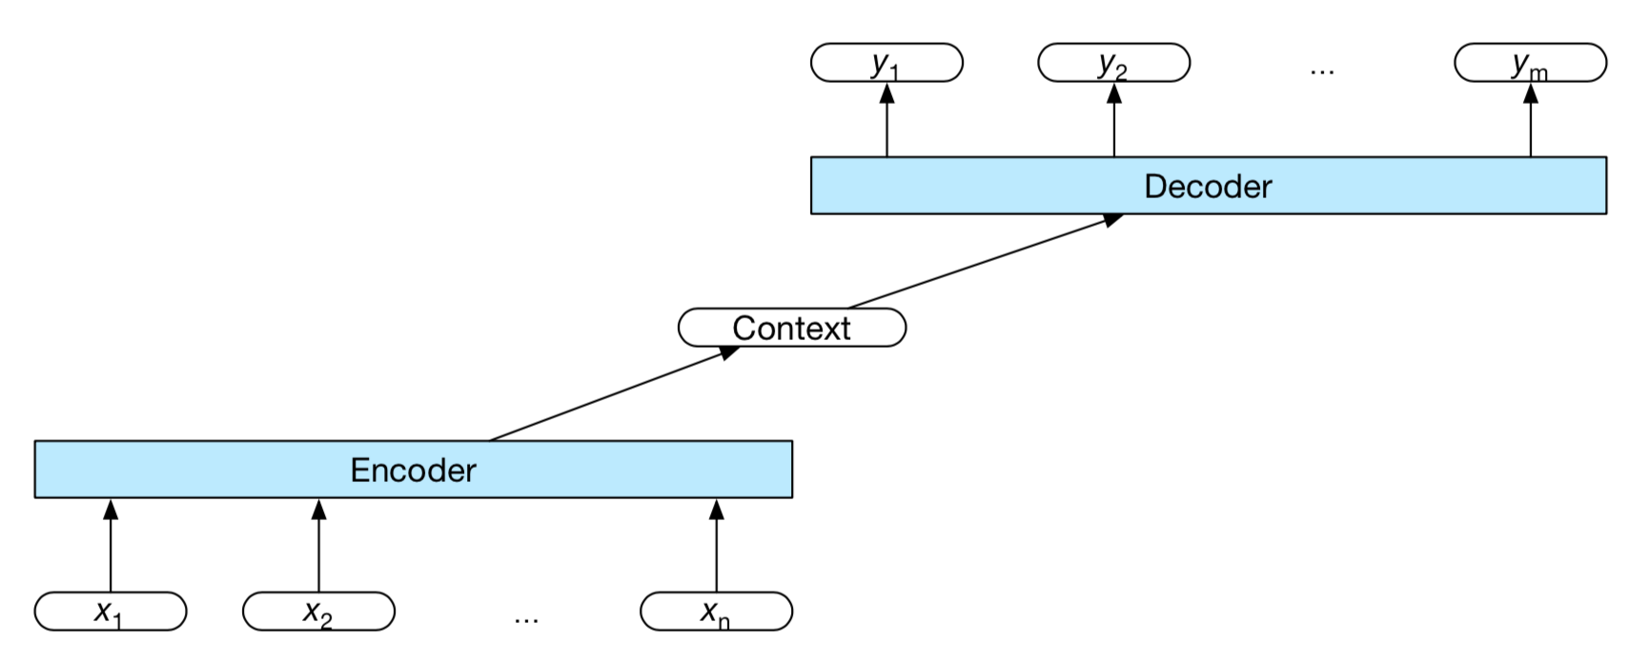
A More General View of seq2seq
CS546 Machine Learning in NLP

Slide 27
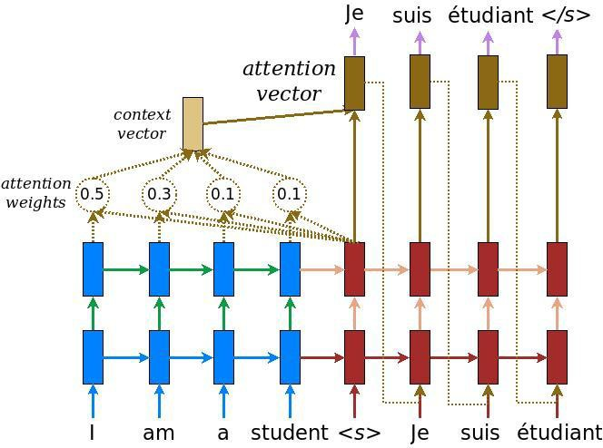
Attention Mechanisms
Dzmitry Bahdanau, Kyunghyun Cho, Yoshua Bengio:
Neural Machine Translation by Jointly Learning to Align and Translate. ICLR 2015
Ashish Vaswani, Noam Shazeer, Niki Parmar, Jakob Uszkoreit, Llion Jones, Aidan N. Gomez, Łukasz Kaiser, and Illia Polosukhin. 2017. Attention is all you need. In Proceedings of the 31st International Conference on Neural Information Processing Systems (NIPS'17). Curran Associates Inc., Red Hook, NY, USA, 6000–6010. 2017
Parallelize with
GPUs
CS546 Machine Learning in NLP

Slide 28





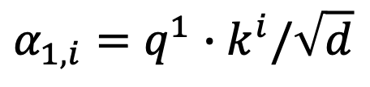




















Self-attention
Take each query q, go to each key k, do attention
d is the dim of $q$ and $k$
Scaled Dot-Product Attention:
$$α_{1,i}=q^{1}∙k^{i}/\sqrt{d}$$
dot product
$$α_{1,1}$$
$$α_{1,2}$$
$$α_{1,3}$$
$$α_{1,4}$$
$$q^{1}$$
$$k^{1}$$
$$v^{1}$$
$$q^{2}$$
$$k^{2}$$
$$v^{2}$$
$$q^{3}$$
$$k^{3}$$
$$v^{3}$$
$$q^{4}$$
$$k^{4}$$
$$v^{4}$$
$$a^{1}$$
$$a^{2}$$
$$a^{3}$$
$$a^{4}$$
$$x^{1}$$
$$x^{2}$$
$$x^{3}$$
$$x^{4}$$
Transformer by 李宏毅 Hung-yi Lee

Slide 29




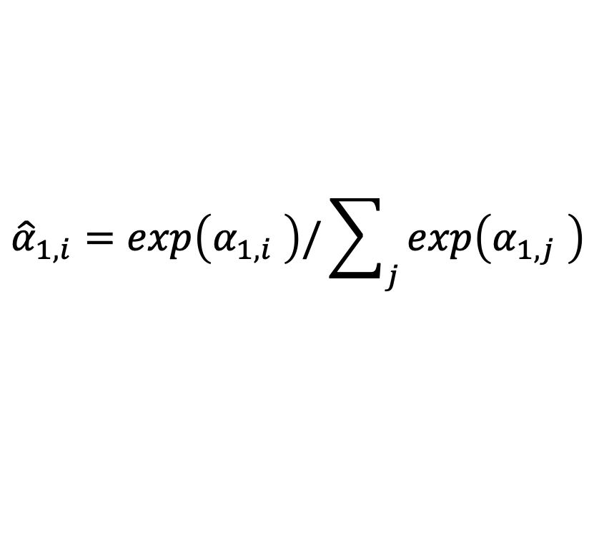
Self-attention
$${\hat{α}}_{1,i}=exp\left(α_{1,i} \right)/\sum_{j}{exp\left(α_{1,j} \right)}$$
$${\hat{α}}_{1,1}$$
$${\hat{α}}_{1,2}$$
$${\hat{α}}_{1,3}$$
$${\hat{α}}_{1,4}$$
Soft-max
$$α_{1,1}$$
$$α_{1,2}$$
$$α_{1,3}$$
$$α_{1,4}$$
$$q^{1}$$
$$k^{1}$$
$$v^{1}$$
$$q^{2}$$
$$k^{2}$$
$$v^{2}$$
$$q^{3}$$
$$k^{3}$$
$$v^{3}$$
$$q^{4}$$
$$k^{4}$$
$$v^{4}$$
$$a^{1}$$
$$a^{2}$$
$$a^{3}$$
$$a^{4}$$
$$x^{1}$$
$$x^{2}$$
$$x^{3}$$
$$x^{4}$$
Transformer by 李宏毅 Hung-yi Lee

Slide 30


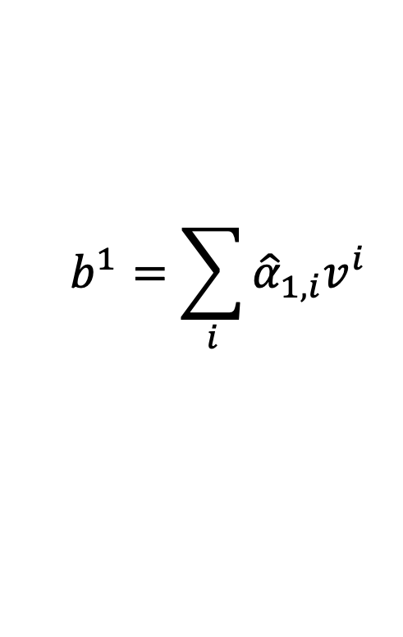



Self-attention
$$b^{1}=\sum_{i}{{\hat{α}}_{1,i}v^{i} }$$
Considering the whole sequence
$$b^{1}$$
$${\hat{α}}_{1,1}$$
$${\hat{α}}_{1,2}$$
$${\hat{α}}_{1,3}$$
$${\hat{α}}_{1,4}$$
$$q^{1}$$
$$k^{1}$$
$$v^{1}$$
$$q^{2}$$
$$k^{2}$$
$$v^{2}$$
$$q^{3}$$
$$k^{3}$$
$$v^{3}$$
$$q^{4}$$
$$k^{4}$$
$$v^{4}$$
$$a^{1}$$
$$a^{2}$$
$$a^{3}$$
$$a^{4}$$
$$x^{1}$$
$$x^{2}$$
$$x^{3}$$
$$x^{4}$$
Transformer by 李宏毅 Hung-yi Lee
Notes:
Relation between attention and CNN
Global receptive field (compared to convolutional architectures)

Slide 31


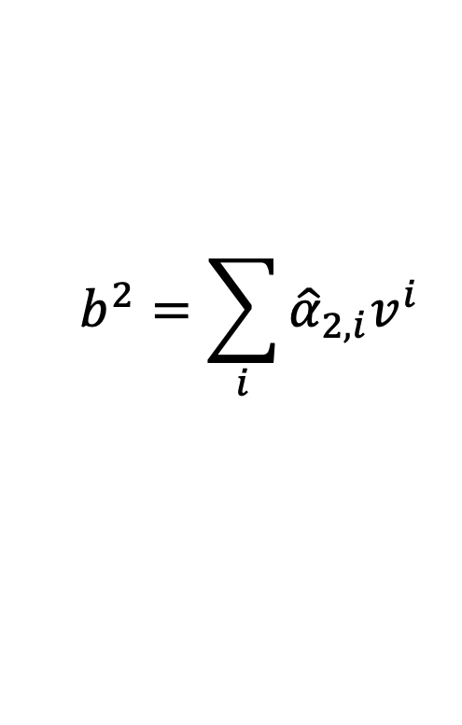



Self-attention
$$b^{2}=\sum_{i}{{\hat{α}}_{2,i}v^{i} }$$
Take each query q, go to each key k, do attention
$$b^{2}$$
$${\hat{α}}_{2,1}$$
$${\hat{α}}_{2,2}$$
$${\hat{α}}_{2,3}$$
$${\hat{α}}_{2,4}$$
$$q^{1}$$
$$k^{1}$$
$$v^{1}$$
$$q^{2}$$
$$k^{2}$$
$$v^{2}$$
$$q^{3}$$
$$k^{3}$$
$$v^{3}$$
$$q^{4}$$
$$k^{4}$$
$$v^{4}$$
$$a^{1}$$
$$a^{2}$$
$$a^{3}$$
$$a^{4}$$
$$x^{1}$$
$$x^{2}$$
$$x^{3}$$
$$x^{4}$$
Transformer by 李宏毅 Hung-yi Lee
Notes:
Relation between attention and CNN
Global receptive field (compared to convolutional architectures)

Slide 32



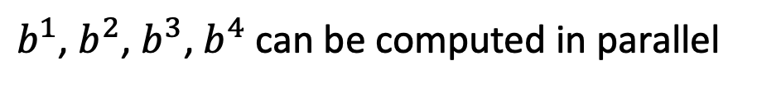


Self-attention
$b^{1}$, $b^{2}$, $b^{3}$, $b^{4}$ can be computed in parallel
$$b^{1}$$
$$b^{2}$$
$$b^{3}$$
$$b^{4}$$
Self-Attention Layer
$$a^{1}$$
$$a^{2}$$
$$a^{3}$$
$$a^{4}$$
$$x^{1}$$
$$x^{2}$$
$$x^{3}$$
$$x^{4}$$
Transformer by 李宏毅 Hung-yi Lee
Notes:
Relation between attention and CNN
Global receptive field (compared to convolutional architectures)

Slide 33















































Self-attention
$$q^{1}$$
$$q^{2}$$
$$q^{3}$$
$$q^{4}$$
$$a^{1}$$
$$a^{2}$$
=
$$a^{3}$$
$$W^{q}$$
$$a^{4}$$
$$Q$$
$$I$$
$$a^{1}$$
$$a^{2}$$
$$k^{1}$$
$$a^{3}$$
$$k^{2}$$
$$a^{4}$$
$$k^{3}$$
$$q^{i}=W^{q}a^{i}$$
$$k^{4}$$
=
$$W^{k}$$
$$K$$
$$I$$
$$k^{i}=W^{k}a^{i}$$
$$a^{1}$$
$$a^{2}$$
$$a^{3}$$
$$v^{1}$$
$$a^{4}$$
$$v^{2}$$
$$v^{3}$$
$$v^{4}$$
=
$$W^{v}$$
$$v^{i}=W^{v}a^{i}$$
$$V$$
$$I$$
$$q^{1}$$
$$k^{1}$$
$$v^{1}$$
$$q^{2}$$
$$k^{2}$$
$$v^{2}$$
$$q^{3}$$
$$k^{3}$$
$$v^{3}$$
$$q^{4}$$
$$k^{4}$$
$$v^{4}$$
$$a^{1}$$
$$a^{2}$$
$$a^{3}$$
$$a^{4}$$
$$x^{1}$$
$$x^{2}$$
$$x^{3}$$
$$x^{4}$$
Transformer by 李宏毅 Hung-yi Lee

Slide 34












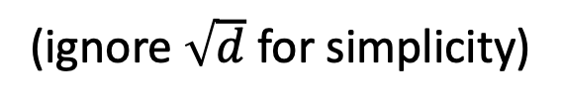











Self-attention
$$b^{1}$$
$${\hat{α}}_{1,1}$$
$${\hat{α}}_{1,2}$$
$${\hat{α}}_{1,3}$$
$${\hat{α}}_{1,4}$$
$$q^{1}$$
$$k^{1}$$
$$v^{1}$$
$$q^{2}$$
$$k^{2}$$
$$v^{2}$$
$$q^{3}$$
$$k^{3}$$
$$v^{3}$$
$$q^{4}$$
$$k^{4}$$
$$v^{4}$$
$$α_{1,1}=$$
$$k^{1}$$
$$q^{1}$$
$$α_{1,2}=$$
$$k^{2}$$
$$q^{1}$$
$$α_{1,1}$$
$$k^{1}$$
$$α_{1,2}$$
$$k^{2}$$
$$α_{1,3}=$$
$$k^{3}$$
$$q^{1}$$
$$α_{1,4}=$$
$$k^{4}$$
$$q^{1}$$
$$=$$
$$q^{1}$$
$$α_{1,3}$$
$$k^{3}$$
$$α_{1,4}$$
$$k^{4}$$
(ignore $\sqrt{d}$ for simplicity)
Transformer by 李宏毅 Hung-yi Lee
Notes:
Relation between attention and CNN
Global receptive field (compared to convolutional architectures)

Slide 35

























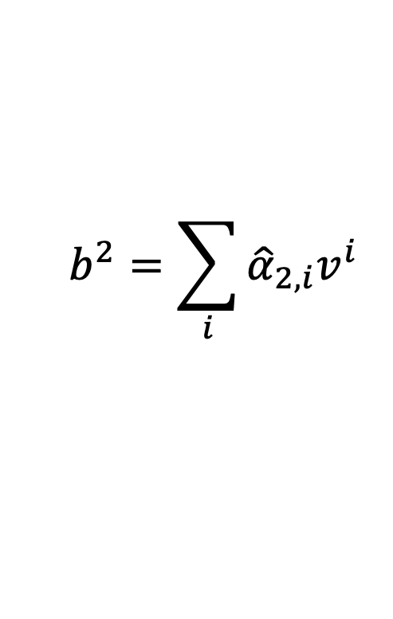




















Self-attention
$$b^{2}=\sum_{i}{{\hat{α}}_{2,i}v^{i} }$$
$$b^{2}$$
$${\hat{α}}_{2,1}$$
$${\hat{α}}_{2,2}$$
$${\hat{α}}_{2,3}$$
$${\hat{α}}_{2,4}$$
$$q^{1}$$
$$k^{1}$$
$$v^{1}$$
$$q^{2}$$
$$k^{2}$$
$$v^{2}$$
$$q^{3}$$
$$k^{3}$$
$$v^{3}$$
$$q^{4}$$
$$k^{4}$$
$$v^{4}$$
$${\hat{α}}_{1,1}$$
$${\hat{α}}_{2,1}$$
$${\hat{α}}_{3,1}$$
$${\hat{α}}_{4,1}$$
$$α_{1,1}$$
$$α_{2,1}$$
$$α_{3,1}$$
$$α_{4,1}$$
$$k^{1}$$
$${\hat{α}}_{1,2}$$
$${\hat{α}}_{2,2}$$
$${\hat{α}}_{3,2}$$
$${\hat{α}}_{4,2}$$
$$α_{1,2}$$
$$α_{2,2}$$
$$α_{3,2}$$
$$α_{4,2}$$
$$k^{2}$$
$${\hat{α}}_{1,3}$$
$${\hat{α}}_{2,3}$$
$${\hat{α}}_{3,3}$$
$$=$$
$$q^{1}$$
$$q^{2}$$
$$q^{3}$$
$$q^{4}$$
$${\hat{α}}_{4,3}$$
$$α_{1,3}$$
$$α_{2,3}$$
$$α_{3,3}$$
$$α_{4,3}$$
$$k^{3}$$
$${\hat{α}}_{1,4}$$
$${\hat{α}}_{2,4}$$
$${\hat{α}}_{3,4}$$
$${\hat{α}}_{4,4}$$
softmax
$$α_{1,4}$$
$$α_{2,4}$$
$$α_{3,4}$$
$$Q$$
$$α_{4,4}$$
$$k^{4}$$
$$\hat{A}$$
$$A$$
$$K^{T}$$
Transformer by 李宏毅 Hung-yi Lee
Notes:
Relation between attention and CNN
Global receptive field (compared to convolutional architectures)

Slide 36


























Self-attention
$$b^{2}=\sum_{i}{{\hat{α}}_{2,i}v^{i} }$$
$$b^{2}$$
$${\hat{α}}_{2,1}$$
$${\hat{α}}_{2,2}$$
$${\hat{α}}_{2,3}$$
$${\hat{α}}_{2,4}$$
$$q^{1}$$
$$k^{1}$$
$$v^{1}$$
$$q^{2}$$
$$k^{2}$$
$$v^{2}$$
$$q^{3}$$
$$k^{3}$$
$$v^{3}$$
$$q^{4}$$
$$k^{4}$$
$$v^{4}$$
$${\hat{α}}_{1,1}$$
$${\hat{α}}_{2,1}$$
$${\hat{α}}_{3,1}$$
$${\hat{α}}_{4,1}$$
$${\hat{α}}_{1,2}$$
$${\hat{α}}_{2,2}$$
$${\hat{α}}_{3,2}$$
$${\hat{α}}_{4,2}$$
$$b^{1}$$
=
$$b^{2}$$
$$b^{3}$$
$$b^{4}$$
$$v^{1}$$
$$v^{2}$$
$$v^{3}$$
$$v^{4}$$
$${\hat{α}}_{1,3}$$
$${\hat{α}}_{2,3}$$
$${\hat{α}}_{3,3}$$
$${\hat{α}}_{4,3}$$
$$O$$
$$V$$
$${\hat{α}}_{1,4}$$
$${\hat{α}}_{2,4}$$
$${\hat{α}}_{3,4}$$
$${\hat{α}}_{4,4}$$
$$\hat{A}$$
Transformer by 李宏毅 Hung-yi Lee
Notes:
Relation between attention and CNN
Global receptive field (compared to convolutional architectures)

Slide 37
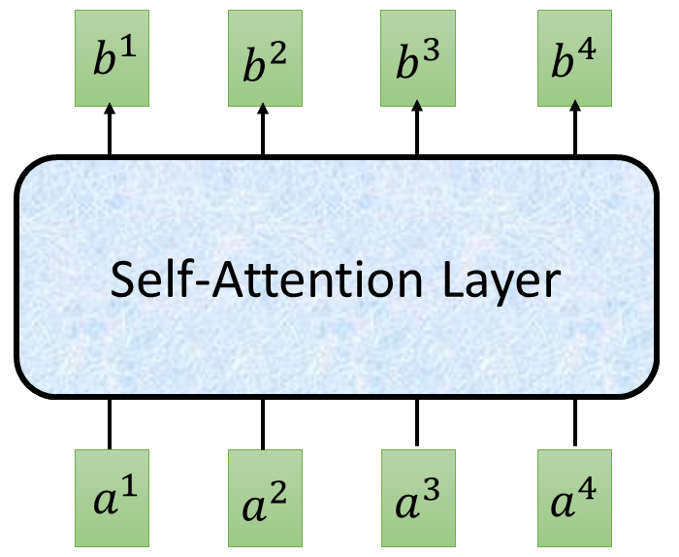


















Self-attention
$$O$$
$$Q$$
=
$$I$$
$$W^{q}$$
$$K$$
=
$$I$$
$$W^{k}$$
$$V$$
=
$$I$$
$$I$$
$$W^{v}$$
$$\hat{A}$$
$$A$$
=
$$Q$$
$$K^{T}$$
softmax
$$\hat{A}$$
$$O$$
=
$$V$$
Can be optimized with GPUs
Transformer by 李宏毅 Hung-yi Lee

Slide 38
























Multi-head Self-attention
(2 heads as example)
$$q^{i,1}=W^{q,1}q^{i}$$
$$b^{i,1}$$
$$q^{i,2}=W^{q,2}q^{i}$$
$$q^{i,1}$$
$$q^{i,2}$$
$$k^{i,1}$$
$$k^{i,2}$$
$$v^{i,1}$$
$$v^{i,2}$$
$$q^{j,1}$$
$$q^{j,2}$$
$$k^{j,1}$$
$$k^{j,2}$$
$$v^{j,1}$$
$$v^{j,2}$$
$$q^{i}$$
$$k^{i}$$
$$v^{i}$$
$$q^{j}$$
$$k^{j}$$
$$v^{j}$$
$$q^{i}=W^{q}a^{i}$$
$$a^{i}$$
$$a^{j}$$
Transformer by 李宏毅 Hung-yi Lee

Slide 39


Multi-head Self-attention
(2 heads as example)
$$q^{i,1}=W^{q,1}q^{i}$$
$$b^{i,1}$$
$$q^{i,2}=W^{q,2}q^{i}$$
$$b^{i,2}$$
$$q^{i,1}$$
$$q^{i,2}$$
$$k^{i,1}$$
$$k^{i,2}$$
$$v^{i,1}$$
$$v^{i,2}$$
$$q^{j,1}$$
$$q^{j,2}$$
$$k^{j,1}$$
$$k^{j,2}$$
$$v^{j,1}$$
$$v^{j,2}$$
$$q^{i}$$
$$k^{i}$$
$$v^{i}$$
$$q^{j}$$
$$k^{j}$$
$$v^{j}$$
$$q^{i}=W^{q}x^{i}$$
$$a^{i}$$
$$a^{j}$$
Transformer by 李宏毅 Hung-yi Lee

Slide 40





Multi-head Self-attention
(2 heads as example)
$$b^{i,1}$$
$$b^{i}$$
$$b^{i,1}$$
$$b^{i,2}$$
$$b^{i}$$
=
$$W^{O}$$
$$b^{i,2}$$
$$q^{i,1}$$
$$q^{i,2}$$
$$k^{i,1}$$
$$k^{i,2}$$
$$v^{i,1}$$
$$v^{i,2}$$
$$q^{j,1}$$
$$q^{j,2}$$
$$k^{j,1}$$
$$k^{j,2}$$
$$v^{j,1}$$
$$v^{j,2}$$
$$q^{i}$$
$$k^{i}$$
$$v^{i}$$
$$q^{j}$$
$$k^{j}$$
$$v^{j}$$
$$a^{i}$$
$$a^{j}$$
Transformer by 李宏毅 Hung-yi Lee

Slide 41



















Positional Encoding
$$q^{i}$$
$$k^{i}$$
$$v^{i}$$
No position information in self-attention.
Each position has a unique positional vector $e^{i}$ (not learned from data)
Idea: Append each $x^{i}$ is with a one-hot vector $p^{i}$
$$e^{i}$$
+
$$a^{i}$$
$$x^{i}$$
More clever solution used in the original paper
$$x^{i}$$
$$a^{i}$$
$$W$$
=
$$W^{I}$$
$$x^{i}$$
$$p^{i}$$
$$W^{I}$$
$$W^{P}$$
$$p^{i}=$$
……
0
$$e^{i}$$
1
i-th dim
$$W^{P}$$
+
$$p^{i}$$
0
…
Transformer by 李宏毅 Hung-yi Lee

Slide 42
















Seq2seq with Attention
$$c^{1}$$
$$c^{2}$$
$$o^{1}$$
$$o^{2}$$
$$o^{3}$$
$$h^{1}$$
$$h^{2}$$
$$h^{3}$$
$$h^{4}$$
Self-Attention Layer
Self-Attention Layer
$$x^{1}$$
$$x^{2}$$
$$x^{3}$$
$$x^{4}$$
$$c^{1}$$
$$c^{2}$$
$$c^{3}$$
Encoder
Decoder
Transformer by 李宏毅 Hung-yi Lee

Slide 43
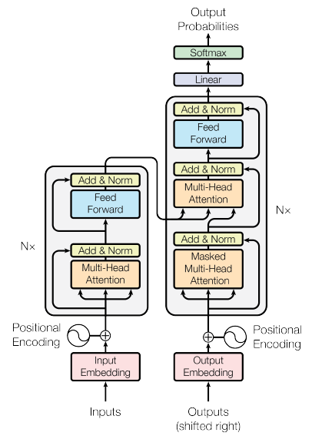
Transformer
machine
learning
Using Chinese to English translation as example
Encoder
Decoder
機 器 學 習
<BOS>
machine
Transformer by 李宏毅 Hung-yi Lee

Slide 44




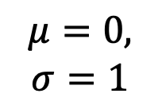
Transformer
Layer Norm:
https://arxiv.org/abs/1607.06450
Batch Size
Layer
Norm
$$b^{′}$$
Batch Norm:
$$μ=0,$$
$$σ=1$$
https://www.youtube.com/watch?v=BZh1ltr5Rkg
+
Batch
$$b$$
$$μ=0,σ=1$$
Layer
…
$$a$$
attend on the input sequence
Masked: attend on the generated sequence [MASK]
Transformer by 李宏毅 Hung-yi Lee
Notes:
(two layer2, with one relu)

Slide 45
Bidirectional Encoder Representations from Transformers (BERT)
BERT = Encoder of Transformer
Learned from a large amount of text without annotation
Encoder
……
BERT
潮水
退了
就
知道
……
  http://speech.ee.ntu.edu.tw/~tlkagk/courses_ML20.html

Slide 46






Generative Pre-Training (GPT)
退了
Many Layers …
AutoregressionAR(1)
$$b^{2}$$
$${\hat{α}}_{2,1}$$
$${\hat{α}}_{2,2}$$
$$q^{1}$$
$$k^{1}$$
$$v^{1}$$
$$q^{2}$$
$$k^{2}$$
$$v^{2}$$
$$q^{3}$$
$$k^{3}$$
$$v^{3}$$
$$q^{4}$$
$$k^{4}$$
$$v^{4}$$
$$a^{1}$$
$$a^{2}$$
$$a^{3}$$
$$a^{4}$$
<BOS>
潮水
退了
  http://speech.ee.ntu.edu.tw/~tlkagk/courses_ML20.html

Slide 47



Generative Pre-Training (GPT)
就
Attention on generated sequence as a whole
Many Layers …
$$b^{3}$$
$${\hat{α}}_{3,1}$$
$${\hat{α}}_{3,2}$$
$${\hat{α}}_{3,3}$$
$$q^{1}$$
$$k^{1}$$
$$v^{1}$$
$$q^{2}$$
$$k^{2}$$
$$v^{2}$$
$$q^{3}$$
$$k^{3}$$
$$v^{3}$$
$$q^{4}$$
$$k^{4}$$
$$v^{4}$$
$$a^{1}$$
$$a^{2}$$
$$a^{3}$$
$$a^{4}$$
<BOS>
潮水
退了
就
  http://speech.ee.ntu.edu.tw/~tlkagk/courses_ML20.html

Slide 48













Inductive Bias for Deep Learning Models
© 2020 DeepMind Technologies Limited
Convolutional Networks (e.g. computer vision)
data in regular grid
information ﬂow to local neighbours
Recurrent Networks (e.g. language)
data in ordered sequence
information ﬂow sequentially
Graph Networks (e.g. recommender systems or molecules)
data in ﬁxed graph structure
information ﬂow along ﬁxed edges
Attention Module (e.g. language)
data in unordered set
information ﬂow dynamically controlled by the network (via keys and queries)

Slide 50
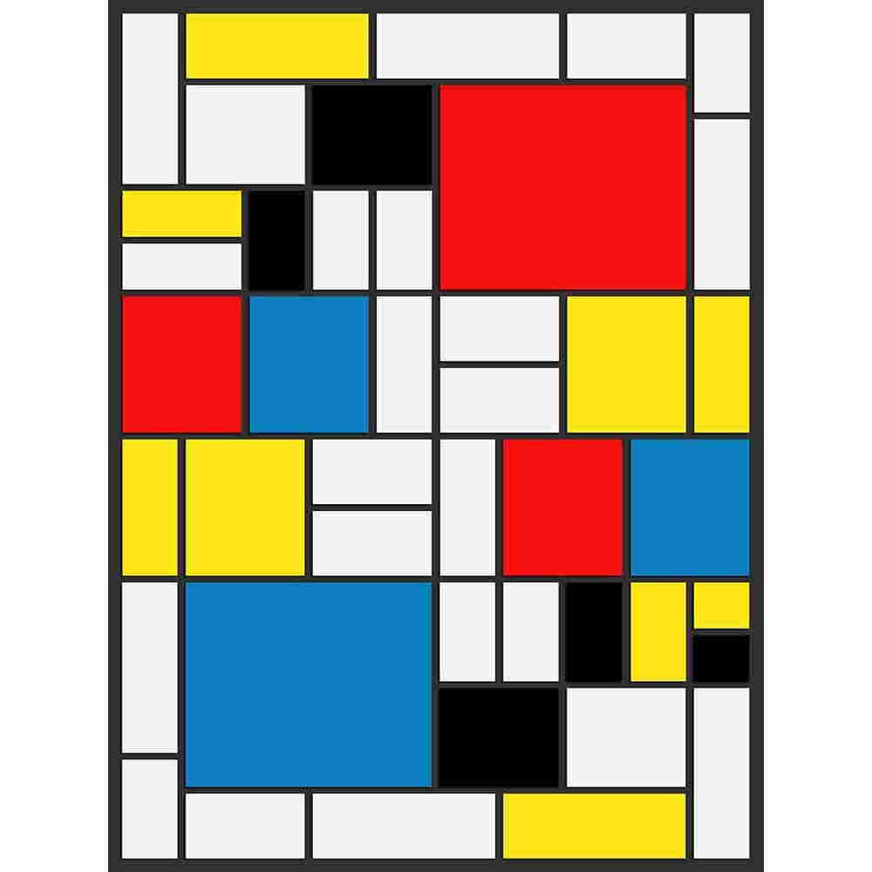

Slide 51
Hallucinations

Slide 53
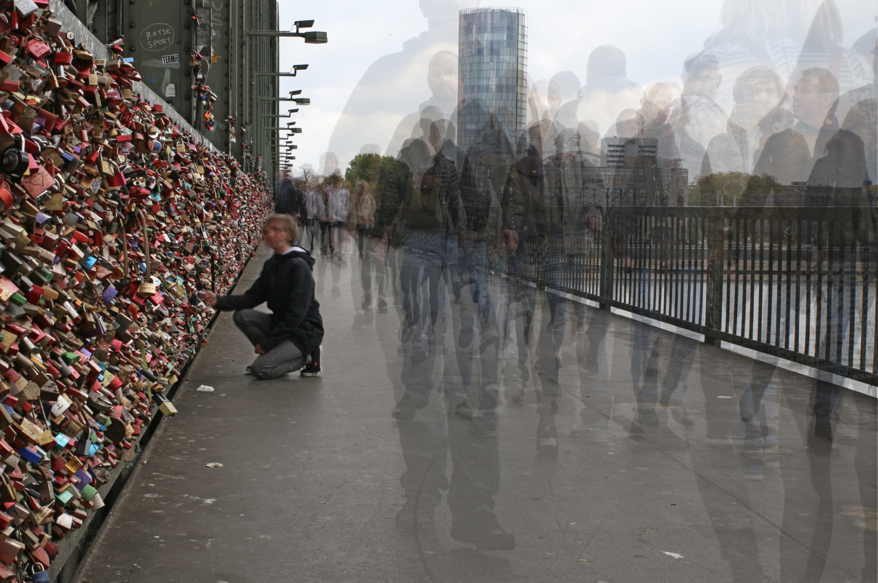
Überblendungen

Slide 54
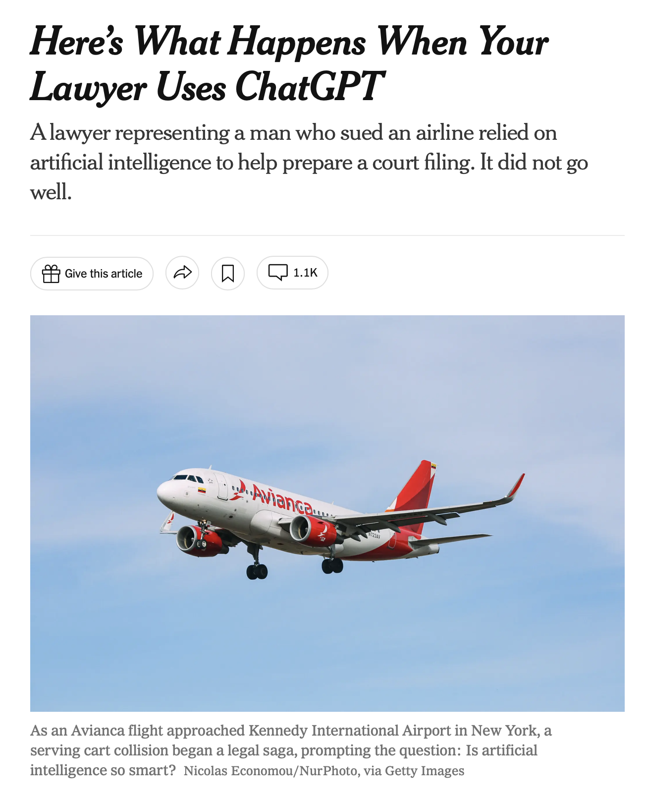
That was because ChatGPT had invented everything.

Slide 55
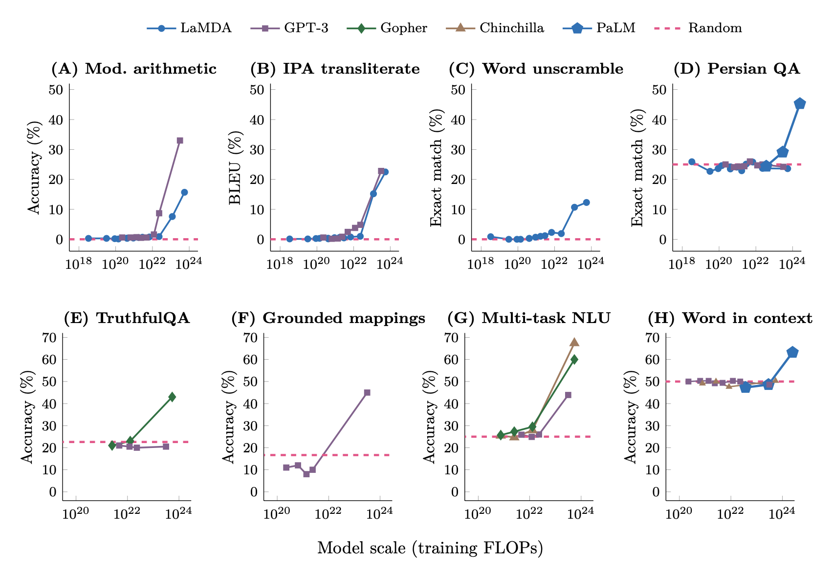
Emergente
Fähigkeiten
Hoffnung für AGI?
Haben wir
General
Problem
Solver?

Slide 56
Emergenz: Lineare statt logarithmische Skala
Generelle Kurvenform mit einer linearen Skala auf der x-Achse
Unerwarteter Leistungsanstieg

Slide 57

Evidence for specific patients and specific action recommendations? More hallucinations expected!
540B
Not publicly available!

Slide 58
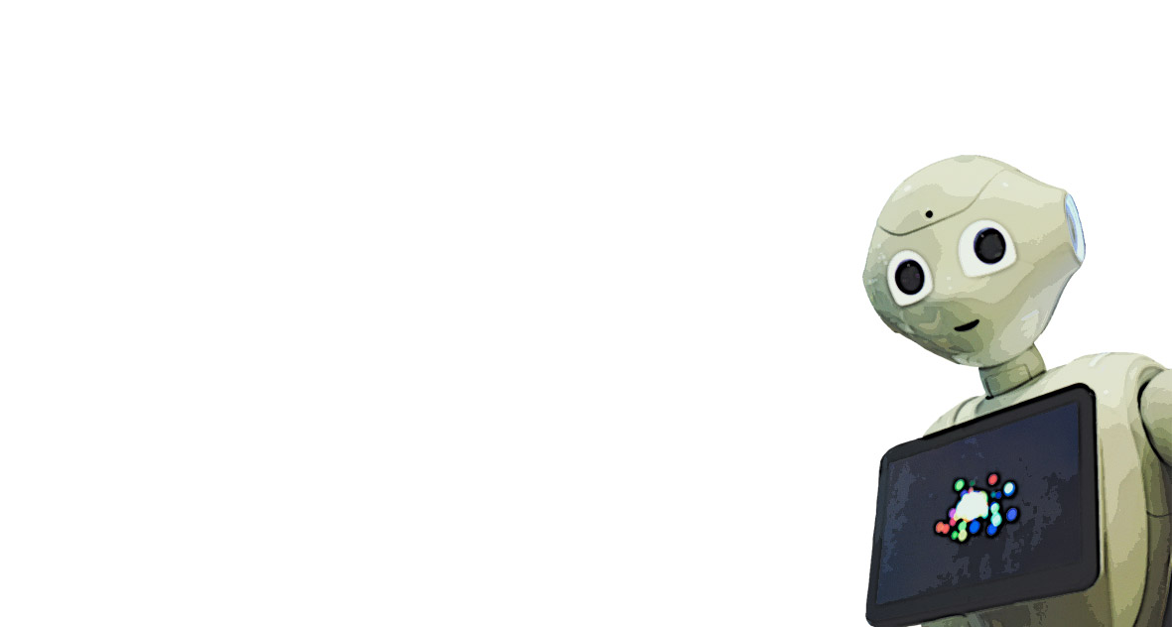

Examples
MCEA-GPT: Apps from Biomedical Language Models
The patient is low on oxygen
LLMs in MCEA: Philipp’s Demonstrators
Input: "The patient has pain in his chest and trouble breathing"
Top related statement: „Pneumothorax is a dysfunction of the pleural membrane structure formation pleural cavity. It can cause alveolar collapse, which is a disorder of the function of the pulmonary alveolar
Failure cause: “Pneumothorax”
Failure mode: “alveolar collapse”
Inadequate oxygenation is a disorder of the function respiration of the structure of the respiratory system respiration. It can cause insufficient oxygen supply, which is a disorder of function respiration of the structure of the cardiopulmonary circulatory system demand-adapted oxygen supply to all cells.
Dr. Pepper, GP

Slide 59
Creating statements from FMEA models
Use (failure mode, failure cause, failure effect) triples to create a statement:
  [failure cause] is a failure of [cause-SE] to [cause-function]. It may cause [failure mode], which is a failure of [mode-SE] to [mode-function].
  Releasing Prostaglandin is a failure of the NG’s function to fight pathogens. It may cause fever, which is a failure of the function of the thermoregulatory network to regulate temperature.

Slide 60



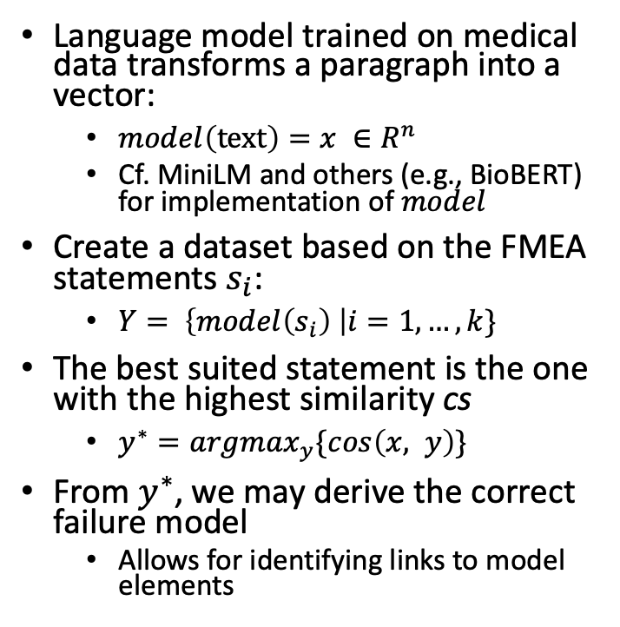

Test Setup – Associative Conversation
Language model trained on medical data transforms a paragraph into a vector:
  $model\left(text\right)=x ∈R^{n}$
  Cf. MiniLM and others (e.g., BioBERT) for implementation of $model$
Create a dataset based on the FMEA statements $s_{i}$:
  $Y= \left\{model\left(s_{i}\right) \right|i=1,…,k\}$
The best suited statement is the one with the highest similarity cs
  $y^{∗}=argmax_{y}\{cos\left(x, y\right)\}$
From $y^{∗}$, we may derive the correct failure model
  Allows for identifying links to model elements
“The patient is low on oxygen”
Transform with language model
“lung edema”
$$x$$
$$y$$
“inadequate oxygenation”
“cardiac arrest”
Compare to database
BioBERT: https://arxiv.org/abs/1901.08746. MiniML: https://arxiv.org/abs/2002.10957

Slide 61

Example
Input: „The patient has trouble breathing and has fluid in his lungs“
Top related statement: „Interstitial pulmonary edema is a failure of the function of the interstitium pulmonary alveoli segment of fluid in the interstitium. It can cause too much extravascular lung water (pulmonary edema), which is a failure of the function of the respiratory system structure extravascular lung water.“
Failure Cause: “Interstitial pulmonary edema”
Failure Mode: “too much extravascular lung water (pulmonary edema)”

Slide 62
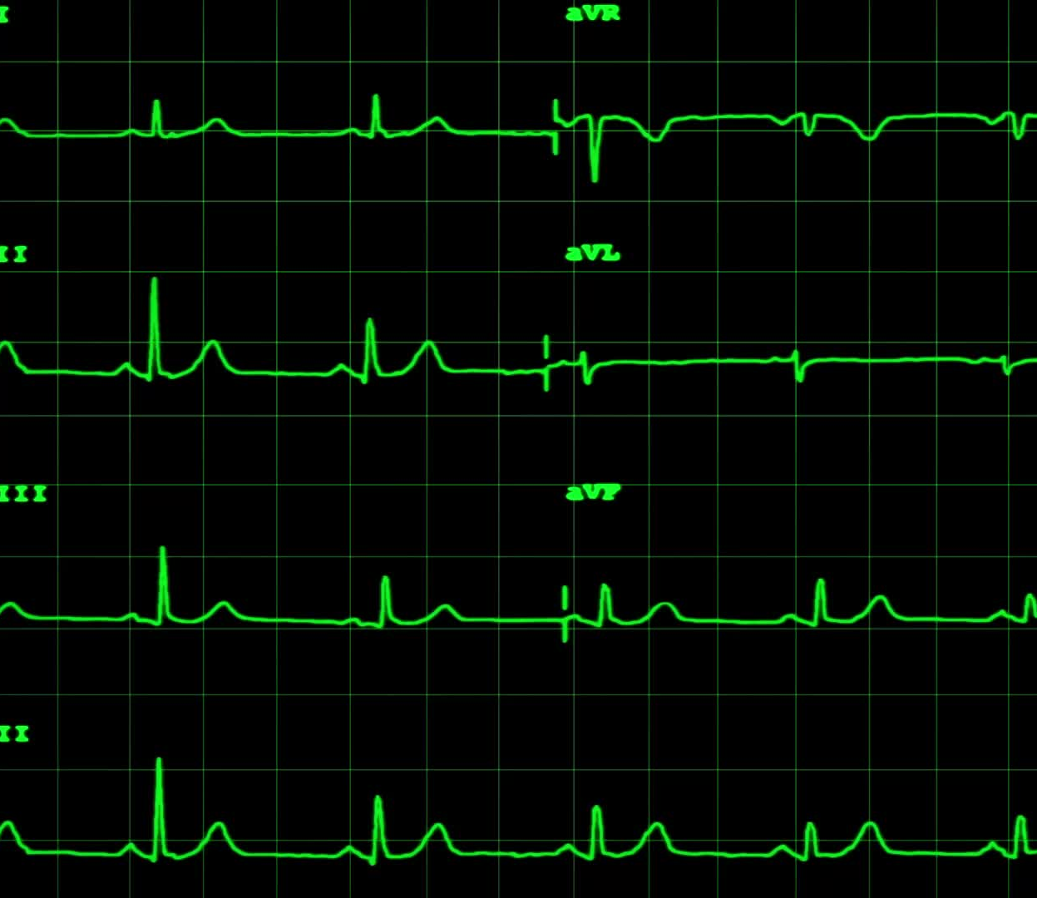
Example
Input: „The patient has no pulse“
Top related statement: „Cardiac failure is a failure of the function of the cardiovascular system to transport oxygen. It can cause circulatory insufficiency, which is a failure of the function of the circulation of the cardiopulmonary circulation system structure.“
Failure Cause: “Cardiac failure”
Failure Mode: “circulatory insufficiency”

Slide 63


Conversation Example

Slide 64
Extend GPT-4 or Train our Own Model?
Plugins (not yet for ordinary mortals)
  Access up-to-date information (possibly on the web)
  Run computations
  Use third-party services
Distillation
  Train a large model using generic labelled data.
  Train a small model to mimic the large model using task-specific unlabelled data (and task-specific labelled data, if available).
Fine-tuning
  Insert small trainable networks into underlying transformers
  Retrain final (prediction) layers while keeping the others (attention) fixed
https://developers.reinfer.io/blog/2022/04/11/efficient-transformers-part2

Slide 65
Pre-Training & Fine Tuning
1) Download LM
pre-trained on large corpus (in self-supervised fashion)
2) Feature-based training ("fine-tuning")
on target task (supervised learning)
Pretrained
Model
Trainiert
Transfer
Fix
Embedding
One or more layers
Embedding & Training for Downstream Tasks

Slide 66




LLaMA vs Alpaca
RLHF Training
SFT Training
7B
170B
7B
Few-Shot
Relativ simpel
Commercial Use Prohibited
GPT-J gut genug?
Notes:
The figure illustrates how we obtained the Alpaca model. For the data, we generated instruction-following demonstrations by building upon the self-instruct method. We started with the 175 human-written instruction-output pairs from the self-instruct seed set. We then prompted text-davinci-003 to generate more instructions using the seed set as in-context examples. We improved over the self-instruct method by simplifying the generation pipeline (see details in GitHub) and significantly reduced the cost. Our data generation process results in 52K unique instructions and the corresponding outputs
Equipped with this instruction-following dataset, we then fine-tuned the LLaMA models using Hugging Face’s training framework, taking advantage of techniques like Fully Sharded Data Parallel and mixed precision training. For our initial run, fine-tuning a 7B LLaMA model took 3 hours on 8 80GB A100s, which costs less than $100 on most cloud compute providers.

Slide 67


Slide 68

AI with Neural Networks
The best snake oil…

Slide 69

Thank you

Slide 70

Contrastive Pre-training

Slide 71

Method: Zero-Shot Testing
The classes are not pre-defined but chosen on demand
(No fine-tuning)

Slide 72
Method: Zero-Shot Testing
Classes on demand

Slide 73
Method: Zero-Shot Testing
Text Prompts
A photo of plane
A photo of car
A photo of dog
…
A photo of bird
Encode and cache prompts
Compute similarities and pick the best class
Encode test image

