Slide 1
Knowledge-based AI
Ralf Möller
Institute of Information Systems
DFKI Lübeck

Slide 2
Simpson’s Paradox (Example)
Record recovery rates of 700 patients given access to a drug
 | Recovery rate with drug | Recovery rate without drug
Men | 81/87 (93%) | 234/270 (87%)
Women | 192/263 (73%) | 55/80 (69%)
Combined | 273/350 (78%) | 289/350 (83%)
Paradox:
For men, taking drugs has benefit
For women, taking drugs has benefit, too
But: for all persons taking drugs has no benefit
2

Slide 3
Resolving the Paradox (Informally)
We have to understand the causal mechanisms that lead to the data in order to resolve the paradox
In drug example
Why has taking drug less benefit for women?
Answer: Estrogen has negative effect on recovery
Data: Women more likely to take drug than men
Choosing randomly any person taking drugs will rather give a woman – and for these recovery is less beneficial
In this case: Have to consider segregated data
(not aggregated data)
3

Slide 4
Resolving the Paradox Formally
We have to understand the causal mechanisms that lead to the data in order to resolve the paradox
Due to confounder structure
Use segregated approach
Gender
Drug usage
Recovery
Drug usage and recovery have common cause
Gender is a confounder
4

Slide 5
Simpson’s Paradox (Again)
Record recovery rates of 700 patients given access to a drug w.r.t. blood pressure (BP) segregation
 | Recovery rate with drug | Recovery rate without drug
Low BP | 234/270 (87%) | 81/87 (93%)
High BP | 55/80 (69%) | 192/263 (73%)
Combined | 289/350 (83%) | 273/350 (78%)
BP recorded at end of experiment
This time segregated data recommend not using drug whereas aggregated data does
5

Slide 6
Resolving the Paradox (Informally)
We have to understand the causal mechanisms that lead to the data in order to resolve the paradox
In this example
Drug effect: lowering blood pressure (but may have toxic effects)
Hence: In aggregated population drug usage recommended
In segregated data one sees only toxic effects
6

Slide 7
Resolving the Paradox Formally
We have to understand the causal mechanisms that lead to the data in order to resolve the paradox
Graph structure is different
Use combined approach
MCEA Medical Cause and Effect Analysis Very nice project about to start
Blood pressure
Drug usage
Recovery
7

Slide 8
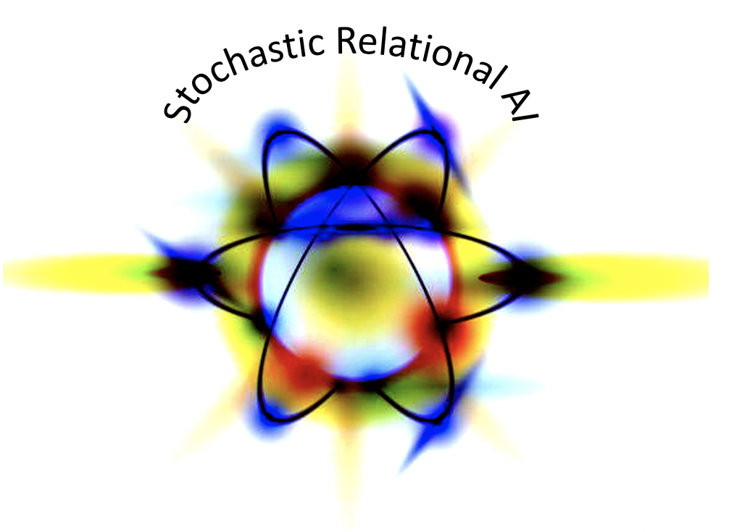
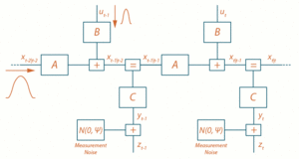
GofAI: Example Formalisms
There is nothing wrong with GofAI,
except that you need to understand the formalisms
(Probabilistic) Functional modeling / programming
f (h) = M₁ h , g (x) = M₂ x , softmax(f (g (x)))
Dimensions of M₁ and M₂: Hyperparameters
Learning of the matrices M₁ and M₂ by backpropagation, built-in gradient descent
Possibly functions are deeply nested (deep learning)
Since the early 50s expressivity ever increased (not only linear transformations)
Cascades of filters (convolutional networks)
Recursion, windows, attention/focus elements
Variational autoencoders (generative networks)
Fixed points / Nash equilibria (GAN architectures)
…
Domain knowledge “reflected” in function composition (network architecture) and in training data selection
Probabilistic dynamic modeling
StaR-AI / Hybrid Factor Graphs / Causal Graphs
Various learning procedures (ML, EM)
Domain knowledge made explicit in models and in training data selection
Hybrid Factor Graphs
Input layer
Hidden layer(s)
Output layer
M₂
h₁
M₁
x₁
h₂
o₁
x₂
h₃
x₃
h₄
o₂
x₄
h₅
f(g(x))
x
g(x)
8

Slide 9
GofAI = Glassbox AI
GofAI = Whitebox AI
“AI-Methods”
Need Abstractions!
9

Slide 10
New AI: Think Beyond Formalisms
Nano robots, Cyber attackers /defenders, …
Think about Agents
An agent is considered as intelligent from the outside (by humans) if it can act autonomously in a locally optimal (rational) way (well aware of bounded rationality) to fulfil a set of human-specified goals unexpectedly fast, while being human-compatible and human-aware
Users should not care about how the agent achieves its performance, but just specify goals
Users should not have to study formalisms to benefit from AI
Like in DBs: Specify queries, not storage layout and access algorithms
10

Slide 11
Old AI: Simulating People
New AI: Agents Working for People
Emancipation of AI from
simulation of human problem-solving behavior or human physiology
for internal modeling and computation
11

Slide 12
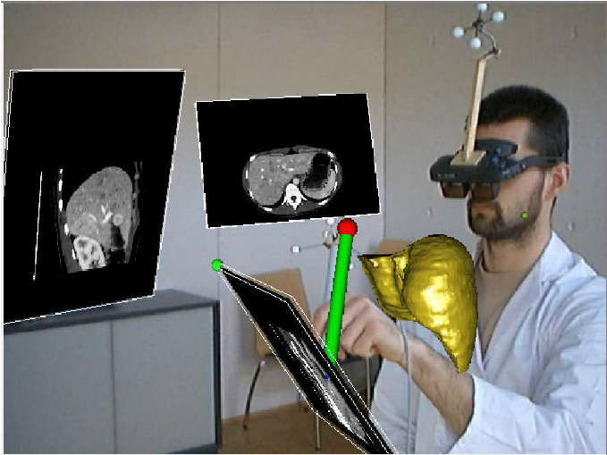
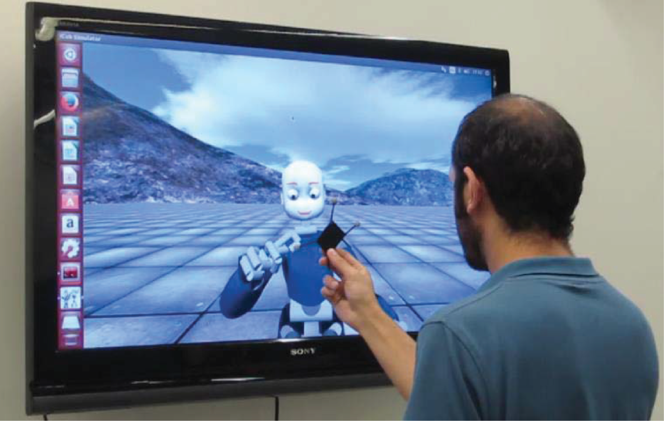
My motto: Do not confuse people with brain pictures when talking about AI
12

Slide 13
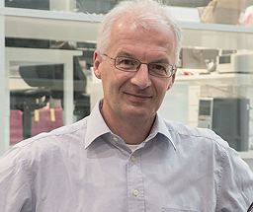
The Future of AI is Knowledge-based
… and the future is now
Anticipation of Human Knowledge
for Human-aware Interaction rather than Representation of Human Knowledge for Machine Problem Solving
Provide black boxes not white boxes
Human-Aware AI
13

