Slide 1
What you always wanted to know about Modeling Materials for Epigraphy: Dos and Don'ts … and never dared to ask
Ralf Möller
Spokesperson Data Linking Research Unit UWA ExC
Institute of Information Systems
Universität zu Lübeck

Slide 2
Modelling Materials: Some Early Approaches
Plinius Ontology of Ceramic Materials
Naive Physics and Modeling Liquids
Naive Physics and Modeling Matter
Capture human commonsense reasoning with first-order logic
Vet, P.E., Speel, P., & Mars, N.J.. The Plinius ontology of ceramic materials. In: Workshop Notes ECAI’94: Workshop on Comparison of Implemented Ontologies, 1994.
Patrick J. Hayes. Naive physics I: ontology for liquids. In Readings in qualitative reasoning about physical systems, Daniel S. Weld and Johan de Kleer (Eds.). Morgan Kaufmann Publishers Inc., San Francisco, CA, USA 484-502. 1989.
Barry Smith and Roberto Casati. Naive Physics: An Essay in Ontology(1)
From: Philosophical Psychology, 7/2, 225-244, 1994.
Ernest Davis, The Naive Physics Perplex, AI Magazine Volume 19 Number 4. 1998.
Ernest Davis, Ontologies and Representations of Matter, Proc. AAAI. 2010.

Slide 3
Quality Criteria for Models
Gruber’s five criteria:
Clarity
Coherence
Extensibility
Minimal encoding bias
Minimal ontological commitment
Gruber, T.R., Toward Principles for the Design of Ontologies Used for Knowledge Sharing. International Journal Human- Computer Studies. 43(5-6): p. 907-928. 1995.

Slide 4
Modeling Languages: Commitments
Vector spaces
points/vectors (n-dimensional)
equality, metric
Vector logic Quantum logic
Modal logic
…

Slide 5
MatML (1999-2005) XML for Data Exchange
<MatML_Doc>
<Material>
<BulkDetails>
<Name>1350</Name>
<Class>metal</Class>
<Subclass>aluminum alloy</Subclass>
<Specification>ASTM B230</Specification>
<ProcessingDetails>
<Name>H18</Name>
</ProcessingDetails>
<PropertyData property=”p1” source=”s1”>
<Data format=”integer”>23,17,15</Data>
</PropertyData>
</BulkDetails>
<Metadata>
<DataSourceDetails id=”s1”>
<Name>
“Properties of Aluminum Alloys - Tensile,
Creep, and Fatigue Data at High and Low
Temperatures.”
</Name>
</DataSourceDetails>
<PropertyDetails id=”p1”>
<Name> Axial-Stress Fatigue Strength</Name>
<Units name=”ksi” Description=”kip per square inch”>
<Unit>kip</Unit>
<Unit power=”-2”>inch</Unit>
</Units>
</PropertyDetails>
</Metadata>
</Material>
</MatML_Doc>
http://www.matml.org
Interoperability
Confusion about concrete material references and general material descriptions
C.P. Sturrock E.F. Begley J.G. Kaufman, MatML – Materials Markup Language Workshop Report. NISTIR 6785. National Institute of Standards and Technology. 2001.

Slide 6
MatOnto (2005-now)
Cheung, K., Drennan, J., & Hunter, J. Towards an Ontology for Data-driven Discovery of New Materials. AAAI Spring Symposium: Semantic Scientific Knowledge Integration. 2008.

Slide 7
MatOnto: Upper Model (DOLCE)
Descriptive Ontology for Linguistic and Cognitive Engineering (DOLCE)

Slide 8
MatOnto: Semantics?
Cheung, K., Drennan, J., & Hunter, J. Towards an Ontology for Data-driven Discovery of New Materials. AAAI Spring Symposium: Semantic Scientific Knowledge Integration. 2008.

Slide 9
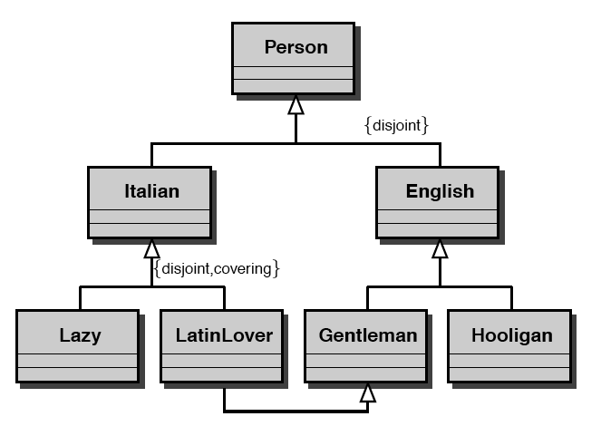
One of the Dos: “Deep Models”
Italian
Lazy guys
LatinLovers
English
G
H
Guy
© Enrico Franconi, Free University of Bolzano

Slide 10
Inference
Guy
No longer any latin lovers
All Italians lazy?
© Enrico Franconi, Free University of Bolzano

Slide 11
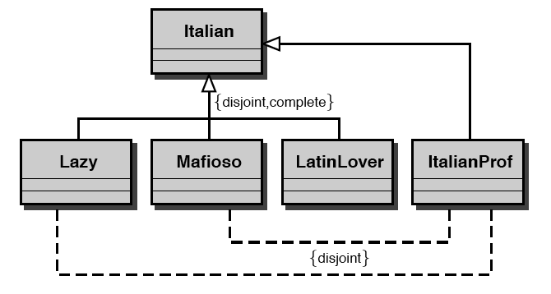
Italy again
Guy
© Enrico Franconi, Free University of Bolzano

Slide 12
More Than a Hierarchy … Ontologies
Decidable fragment of first-order logic
Pitfalls of using set theory: What about bulk notions
such as metal or sandstone?
Kenya
https://emmc.info/

Slide 13
“Semantic Interoperability” with Ontologies
What’s in a link?
What’s in a class?
Nonsense
Ref [1] Not disclosed

Slide 14
Is Set Theory the Right Thing? – Don’ts
?
Even if ontology had been carefully specified: Find the right class name in a hierarchy of 100,000 nodes?
Ashino, T.. Materials Ontology: An Infrastructure for Exchanging Materials Information and Knowledge. Data Science Journal, 9, pp.54–61, 2010.

Slide 15
Maybes: Upcoming Standards
NFDI4MSE https://nfdi4mse.de
FAIRMAT https://fairdi.eu/fairmat/consortium
EMMO European Materials & Modelling Ontology from EMMC
Hardly directly usable for humanities researchers
EMMC: European Materials Modeling Council

Slide 16
EMMO: European Materials & Modelling Ontology
134 pages

Slide 17
EMMO
For machines to provide
Mesoscopic: materials of an intermediate length (nano to micro)

Slide 18
Back to Humanities
Need manageable materials descriptions: Names
E.g., used in TEI descriptions for epigraphy descriptions
Cf. usage of contemporary names vs. ancient names
Could combine names with links to materials data
Spectrogram data
Possibly with automatic materials classifications according to reference libraries
EMMO specs (stemming from materials analysis machines)
…

Slide 19
TEI (https://tei-c.org)
Possibly generated automatically
<msDesc> <msIdentifier> … </msIdentifier> <msContents> <p> <quote>Hic incipit Bruitus Anglie,</quote> the <title>De origine et gestis Regum Angliae</title> of Geoffrey of Monmouth (Galfridus Monumetensis): beg. <quote>Cum mecum multa &amp; de multis.</quote> In Latin.</p> </msContents> <physDesc> <p> <material>Parchment</material>: written in more than one hand: 7¼ x 5⅜ in., i + 55 leaves, in double columns: with a few coloured capitals.</p> </physDesc> <history> …
</history> </msDesc>

Slide 20
EAGLE: Europeana network of Ancient Greek and Latin Epigraphy

Slide 21
EAGLE Materials Vocabulary
Names for materials (in different languages)
Synonmys
Relations
Relations (possibly transitive)
Narrower term
Broader term
Related term
Language-oriented modeling
Available in so-called SKOS-Format
No set theory
SKOS Simple Knowledge Organization System
https://www.w3.org/2004/02/skos/

Slide 22
Summary: Dos
Use natural language for material names (e.g., inspired by EAGLE vocabularies)
Language oriented semantics
… and use links to materials data (data linking DOIs) … or computations on these data
Vocabularies are not static
Possibly exploit materials data links to automatically associate NL terms used in publications (or in TEI descriptions)
Automatically propose extensions to EAGLE materials vocabularies?

