Slide 1
Knowledge-based AI
From the Old Days
to the Future
Ralf Möller
Institute of Information Systems

Slide 2
The Old Days
Awful fallacy:
Assumption that one should solve problems with computers
as one assumes
that humans do it
A system is intelligent if it
can do things that (only) humans can do
Definition from last century
See, hear, speak, solve problems, …

Slide 3
Good ol’ fashioned AI (GofAI)
There is nothing wrong
with GofAI,
except that people get
confused with the
notion of knowledge
Fallacy:
Assumption that humans understand how humans do it and can
easily represent knowledge of humans
for problem solving
For humans, problem solving requires knowledge
Knowledge representation
  AI research: Semantics of knowledge representation languages
    Inference problems defined on a knowledge base
    Inference also called “reasoning” (emphasizing the process, not the goal)
  AI research: Expressivity of knowledge representation languages
  AI research: Complexity of inference problems on knowledge bases
  AI research: Inference algorithms (for solving inference problems)
Users study semantics (and syntax) of representation languages and …
  … specify a knowledge base manually
  … provide data such that knowledge base is generated automatically (“learning”)
    Systems need a trainer

Slide 4
GofAI: Declarative Formalisms
Verbalizable Knowledge
Logic
  Propositional logic, relational logic
  Modal logics, temporal logic…
  First-order logic
    Expressive but undecidable, incomplete QA
    Fragments: 2-Vars, description logics, guarded fragment, …
  Non-classical logics
  Domain knowledge represented as set of formulas
  Various learning techniques (inductive logic programming)
Propositional probabilistic networks
  Domain knowledge represented in network structure and parameters
    Domain-specific conditional independence assumptions
  Network structure and parameter learning
    Maximum-likelihood, stochastic gradient descent, …
…
  Application problems mapped onto inference problems on formulas/networks

Slide 5
GofAI: Computational Formalisms
Tacit Knowledge
Functional modeling / programming
  f (h) = M₁ h , g (x) = M₂ x , softmax(f (g (x)))
  Learning of the matrices M₁ and M₂ by stochastic gradient descent
  on loss function (backpropagation, built-in gradient)
  Multiple logistic regressions at the same time
  Possibly functions deeply nested (deep learning)
  Dimensions of M₁ and M₂: Hyperparameter
  Since the early 50s expressivity ever increased
  (not only linear transformations)
    Cascades of filters (convolutional networks)
    Variational autoencoders (generative networks)
    Fixed points / Nash equilibrium (GAN architectures)
    Recursion, windows, attention/focus elements
    …
  No notion of query answering
  Domain knowledge represented in
  parameters (of matrices) and
  function composition (network architecture)
…
Input layer
Hidden layer(s)
Output layer
M₂
h₁
M₁
x₁
h₂
o₁
x₂
h₃
x₃
h₄
o₂
x₄
h₅
f(g(x))
x
g(x)

Slide 6
Lessons Learnt in the Trenches…
Even worse:
ontology
or
semantic technology
Avoid notions that cause problems …
Knowledge base / neural network
  Use the notion of a model
Knowledge graph = set of ground formulas
  Use the notion of a database
Knowledge representation languages
  Use notion of a modeling language / modeling formalism
Inference or reasoning
  Use the notion of query answering w.r.t. model
Learning
  Use the notion of generating a model from data or fitting a model to data
Knowledge of humans is too hard to capture
Avoid wishful thinking
Avoid suggestive naming
Systems use models

Slide 7
Verbalizable and Tacit Knowledge Representation in Previous Projects
Optimized Query Answering w.r.t. First-Order Theories (EU)
Dynamic Risk Approaches for Automated Cyber Defense (EU)
Computer Aided Semantic Annotation of Multimedia Data (EU)
Bootstrapping Ontology Evolution by Multimedia Information Extraction (EU)
Preference-Based Scene Interpretation (DFG)
Thinking Ontologies (EU)
Description Logic for Space (DFG)
Semantikbasierte formale Repräsentations- und Anfragebeantwortungstechniken für räumliche Problemstellungen (DFG)

Slide 8
Verbalizable and Tacit Knowledge Representation in Previous Projects
Optimized Query Answering w.r.t. First-Order Theories (EU)
Dynamic Risk Approaches for Automated Cyber Defense (EU)
Computer Aided Semantic Annotation of Multimedia Data (EU)
Bootstrapping Ontology Evolution by Multimedia Information Extraction (EU)
Preference-Based Scene Interpretation (DFG)
Thinking Ontologies (EU)
Description Logic for Space (DFG)
Formale Repräsentations- und Anfragebeantwortungstechniken für räumliche Problemstellungen (DFG)

Slide 9
New AI: Agents not Formalisms
Agents can solve problems that human cannot solve (alone)!
An agent is considered as intelligent (by humans)
if it can act autonomously in a locally optimal (rational) way
(well aware of bounded rationality)
to satisfy a set of human-specified goals unexpectedly fast,
while being human-compatible and human-aware
The properties require adaptiveness
(with online refitting of models and anticipation of human knowledge)

Slide 10
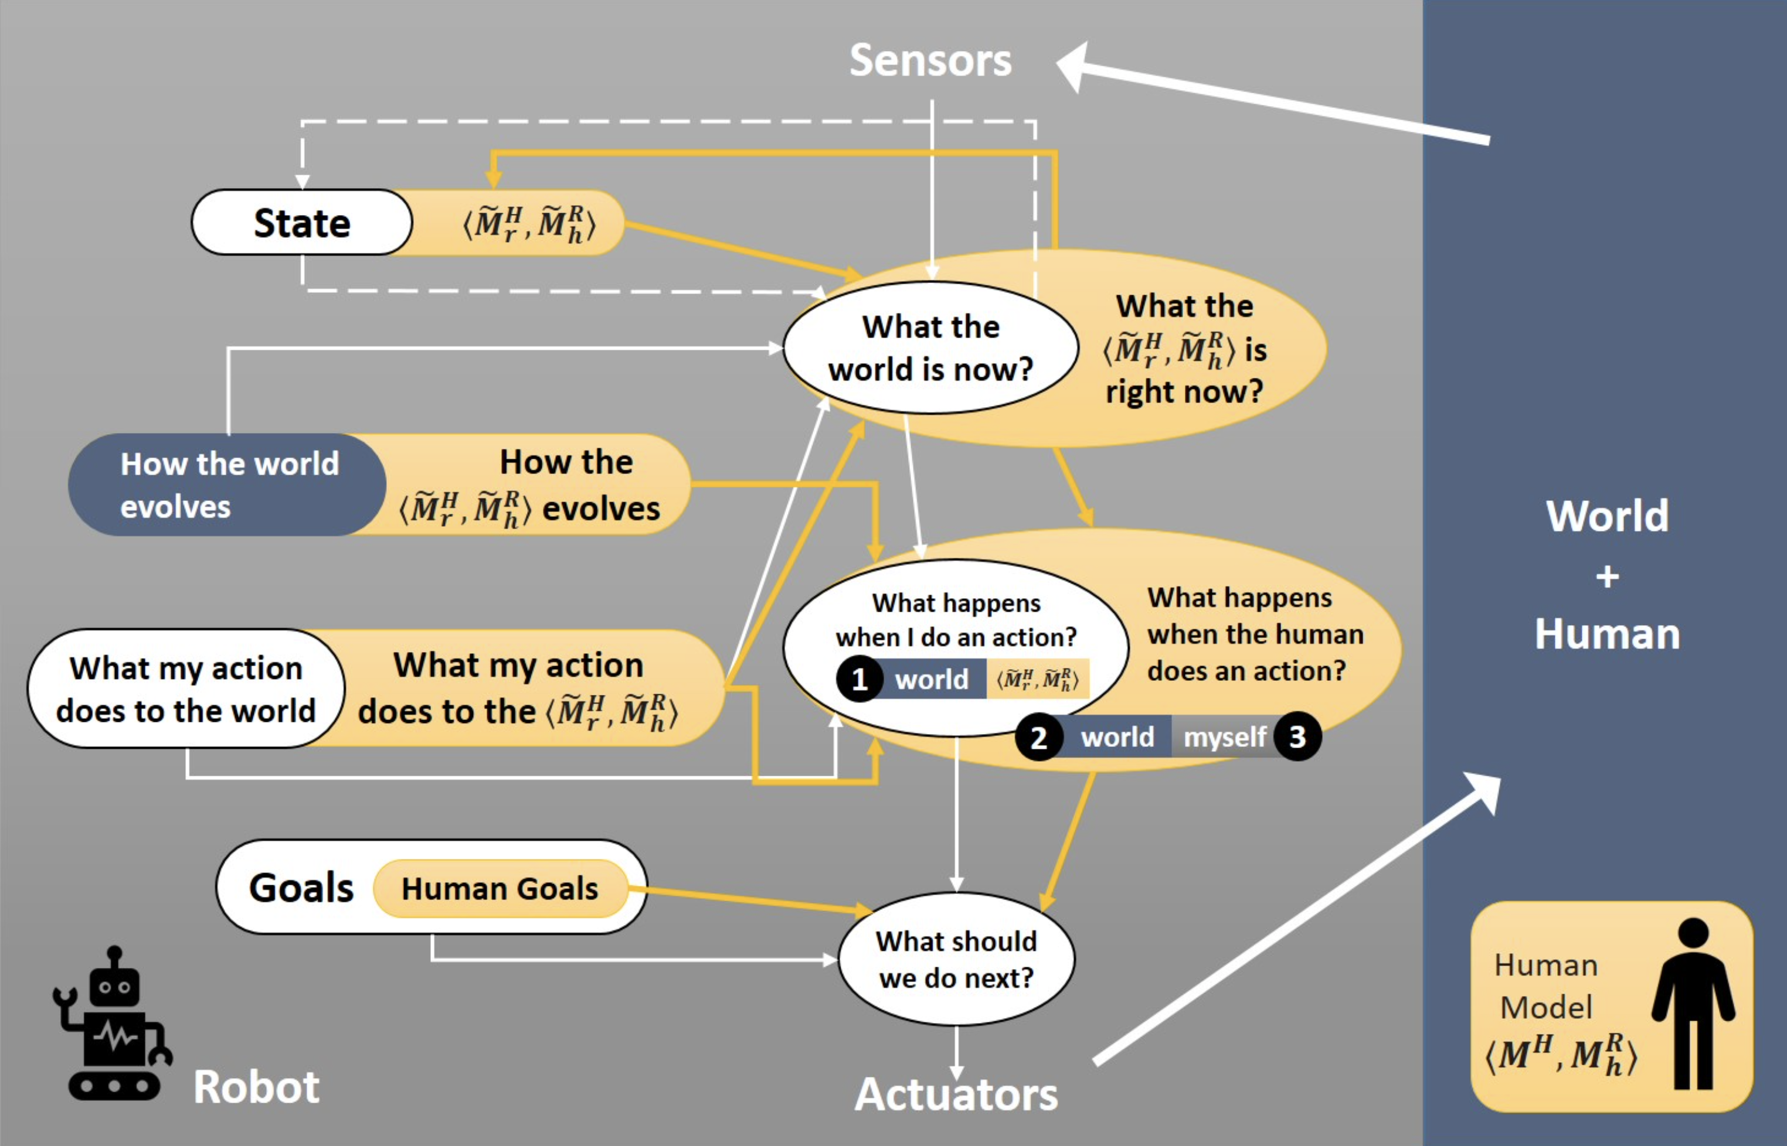
Human specifies goal: Example IR
Challenges of Human-Aware AI Systems: Subbarao Kambhampati
M^{R}
M^{H} human understanding of the problem to be solved
M^{R} robot’s model of the problem to be solved
M^{R}_{h} is the human’s understanding of the robot’s M^{R}
M^{H}_{r} is the robot’s model of M^{H} (anticipate human behavior)
M^{R}_{h} is the robot’s model of M^{R}_{h} (anticipate human’s expectations)
~
~

Slide 11
Human specifies goal: Example Tumor Recognition
Challenges of Human-Aware AI Systems: Subbarao Kambhampati
M^{R}
M^{H} human understanding of the problem to be solved (Provide Tumor Recognition Model)
M^{R} robot’s model of the problem to be solved
M^{R}_{h} is the human’s understanding of the robot’s M^{R}
M^{H}_{r} is the robot’s model of M^{H} (anticipate human behavior)
M^{R}_{h} is the robot’s model of M^{R}_{h} (anticipate human’s expectations)
~
~

Slide 12
New AI: Finally, after all those years…
…there is no longer a simulation model of human reasoning imposed
Still there are modeling languages used by agents …
Probabilistic Dynamic Modeling – StaR-AI / Hybrid Factor Graphs / Causal Graphs
  Model-based encoding of (non-stationary) probabilistic processes
  Fitting of models to data, e.g., by gradient descent (learning)
  Higher expressivity – declarative formalism: Algorithmics of efficient QA
  Lower expressivity – computational formalism w/ probabilistic semantics:
  Encoding, e.g., as (dynamic) arithmetic circuits
  (deeply nested sum-product networks)
Differential Programming
  Functional modeling extended to include components specified as arbitrary programs
  Automatic differentiation of programs for learning with gradient descent
  Computational formalism that allows for model-based learning
  Differential learning w/ small or incomplete data
Probabilistic Differential Programming
  Computational/declarative formalism with model-based learning (on GPUs)
  w/ small/incomplete data and probabilistic semantics
  Encoding of relational data into data in embedding spaces and vice versa

Slide 13
Related Projects
Upcoming: DFKI Activities (SH Gov)
Upcoming: Medical Cause and Effects Analysis (SH Gov)
Upcoming: Model-based System Penetration Testing w/ Honeypot-driven Model Acquisition (BMBF)
Upcoming: Digitization of Smart Materials and their Production Processes (BMBF)
Data Linking (DFG Cluster of Excellence „Understanding Written Artefacts“ , UHH)
Mittelstand 4.0 Kompetenzzentrum Kiel (BMWi)
  Message classification for customer support
  Sales data analysis
  Detection of welding faults in X-ray images (completed)
Industrial activities (external PhDs)
  Entropy Features for Multivariate Time Series (Innovex)
  First-Order Gaussian Processes and Non-Parametric Models (McKinsey)
  Logistics Optimization Support (Oldendorff Carriers)
  Balancing Accuracy and Model Complexity in Sum-Product Networks for Signal Data Processing (VW)
Big Data Analysis for Healthcare Applications (CISCO-COPICOH, completed)

Slide 14
Back to Agents
Agents not only use models
Agents build models that are appropriate to fulfil the agents’ goals or maximize the utilities derived from preference structures and goals
Agents automatically derive approximation algorithms for query answering with respect to the models that they find appropriate

Slide 15
Old AI: Agents simulating People
New AI: Agents Working for People
Emancipation of AI from
human intelligence simulation
and human physiology simulation
for internal modeling and computation

Slide 16
The Future of AI is Knowledge-based
Anticipation of Human Knowledge
for Human-aware Interaction
rather than
Representation of Human Knowledge
for Machine Problem Solving
Human-Aware AI

Slide 17
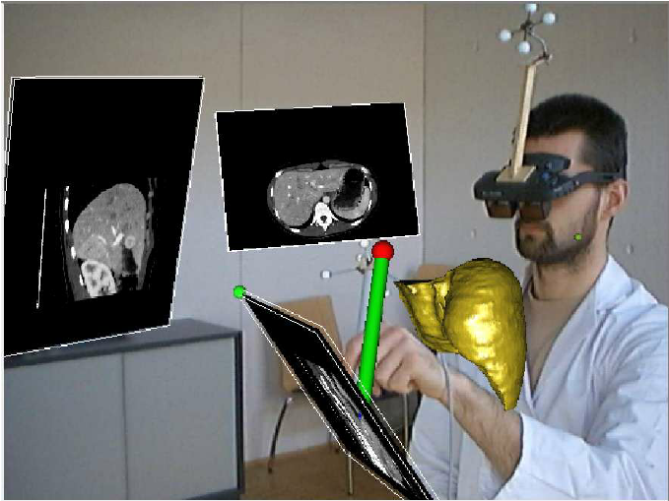
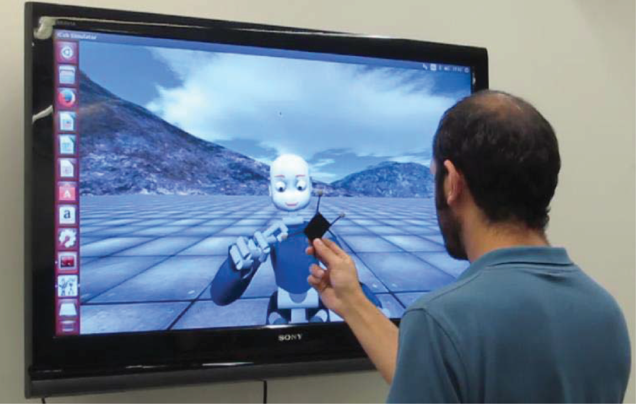
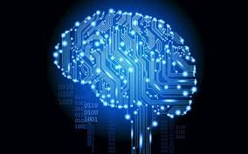
My motto:
Do not confuse people with brain pictures when talking about AI
Disembodiment preferred
as a principle
My personal opinion

