Slide 1
Stochastisch-relationale KI im Gesundheitswesen An Application to Gene Analysis
Ralf Möller
Institut für Informationssysteme, Universität zu Lübeck
DFKI
Presentation is based on:
Nikita, Sakhanenko, David Galas.
Markov Logic Networks in the Analysis of Genetic Data
Journal of Computational Biology, Volume 17, Number 11, pp. 1491–1508, 2010.

Slide 2
Knowledge-based Genotype-Phenotype Associations
Genome-wide association studies (GWAS) and similar statistical studies of g-p-linkage data assume simple (additive) models of gene interactions
Methods often miss substantial parts of g-p-linkage
Methods do not use any biological knowledge about underlying mechanisms
Unconstrained GWAS require way too many population samples, and can succeed only in detecting a limited range of effects
Goal: Incorporate knowledge into statistical analysis
Need probability theory to capture uncertainty
Need FO Logic to avoid “model explosion”
Stochastic Relational AI (Star-AI)
Deal with complex, non-additive genetic interactions
Learning with datasets of “reasonable” size
Need more data!
Just like the ever repeated quest for an even larger collider in physics research
Advertisement: Star-AI to the rescue
No worries: Only one spot
Nikita, Sakhanenko, David Galas. Markov Logic Networks in the Analysis of Genetic Data
Journal of Computational Biology, Volume 17, Number 11, pp. 1491–1508, 2010.

Slide 3
Model Joint Distribution w/ Markov Random Field
Propositional Logic
Why don’t we use First-Order Logic?
MRFs are too simple: Model “explodes” with more complex phenotype reprsentations and interaction on many genes?

Slide 4
FO-Signature for Biological Knowledge Base
RelWS(x, v)
2-argument predicate which captures a relation between a wild type and a single mutant
RelWD(x, y, v)
Relation between a wild type and a double mutant
RelSS(x, y, v)
Relation between two single mutants
RelSD(x, y, x, v)
Relation between a single mutant and a double mutant
Int(x, y, c)
Interaction between two genes wtih interaction type c
x, y: Genes: Domains {g1, g2}
v: Phenotype values: Domain {0, 1, 2}
c: Interaction types: Domain {A, B}
Signature elements are also called atoms
Nikita, Sakhanenko, David Galas. Markov Logic Networks in the Analysis of Genetic Data
Journal of Computational Biology, Volume 17, Number 11, pp. 1491–1508, 2010.

Slide 5
Dependencies between Instantiations of Atoms
Just a small subgraph

Slide 6
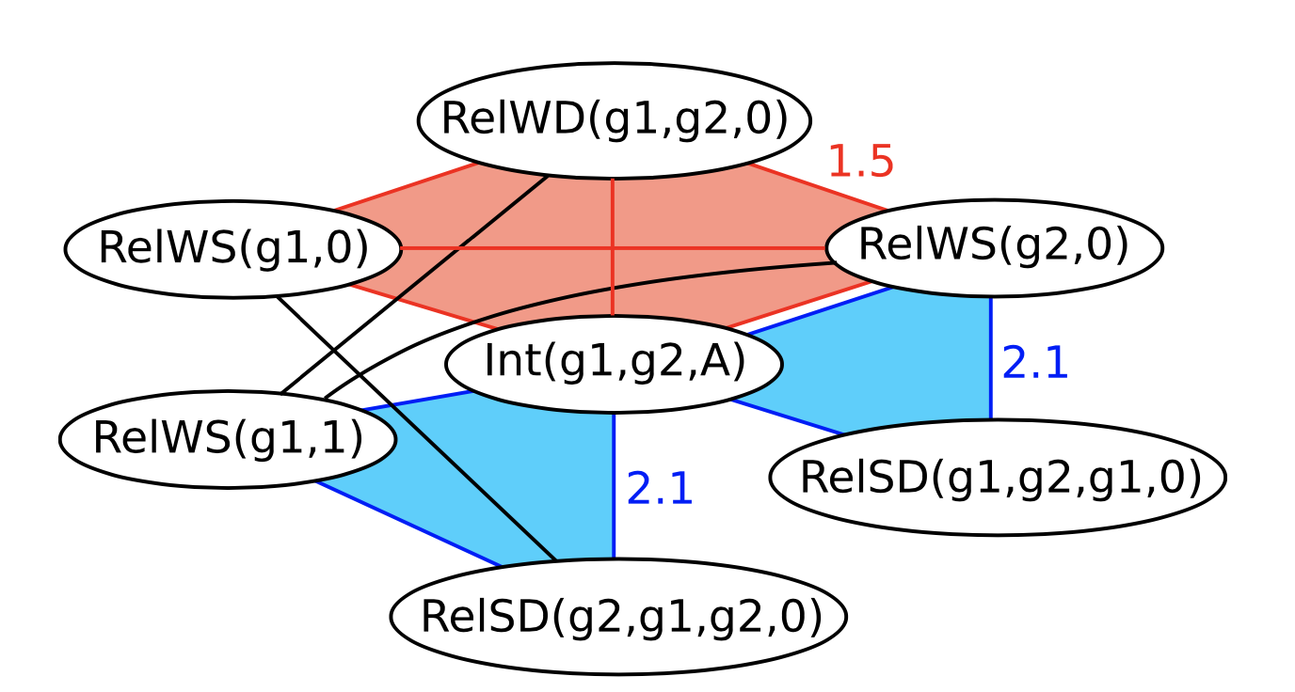
Objects, Relations, Uncertainty about Formulas
Markov Logic Network (MLN)
Depending on the type of interaction between two genes Int(x, y, c), there is a dependency between RelWS(x, v) and RelSD(y, x, y, v)
Three statements RelWS(x,v), RelWS(y,u), and RelWD(x,y,w), together determine the type of gene interaction Int(x, y, c)
1.5
{A, B},
Formulas need not always be true
2.1
{A, B},
Mathematics behind this representation language:
Joint probability distribution over ground atoms (in this case Boolean randvars)
Definition of jpd based on weights associated with formulas (details omitted for brevity)

Slide 7
Query Language
What is the probability that a ground atom $Q$ is true (event) given that every ground atom from a set $\{E1, …,Em\}$is true (conjunction of evidences)?
Query semantics based on MLN groundings

Slide 8
MLN Query Answering Algorithms
Lifted reasoning makes knowledge-based AI practical
Naïve grounding (combinatorial)
Clever grounding (consider only relevant groundings, still combinatorial)
Sampling (maybe quite inexact, approximation quality hard to control)
Lifted query answering (exact, FPT: exponential in “tree width”, which is fixed for a model and small, linear in size of variable domains for liftable model classes)
Tanya Braun. Rescued from a Sea of Queries: Exact Inference in Probabilistic Relational Models Dissertation 2020
Tanya Braun, Ralf Möller, Marcel Gehrke.
https://www.ifis.uni-luebeck.de/index.php?id=672
Tutorial at ECAI 2020

Slide 9
MLN Learning from Application Data
Estimate ground joint probability distribution from data
Learning goal: Encode jpd in sparse form using MLNs
Full MLN learning:
Take model signature from database schema
Determine suitable formulas from predicates in signature
Determine weights using maximum likelihood estimator
Weight learning only (formulas given):
Determine weights using maximum likelihood estimator
Lifted learning needs more work
]
Lise Getoor, Ben Taskar. Introduction to Statistical Relational Learning. MIT Press, 2007.

Slide 10
Application: Yeast Sporulation
Set of 374 progeny of a cross between two yeast strains (a wine and an oak strain) differing widely in their efficiency of sporulation
For each of the progeny, the sporulation efficiency (phenotype) was measured and assigned a value from {very_low, low, medium, high, very_high}
Each yeast progeny strain was genotyped at 225 markers (uniformly distributed along the genome)
Each marker takes on one of two possible values indicating whether it derived from the oak or wine parent genotype
Nikita, Sakhanenko, David Galas. Markov Logic Networks in the Analysis of Genetic Data
Journal of Computational Biology, Volume 17, Number 11, pp. 1491–1508, 2010.

Slide 11
Knowledge Base and its Use
Our Research (Tanya Braun): Lifted reasoning (reasoning with placeholders) makes Star-AI practical
Goal: Model the effect of a single marker on the phenotype, i.e., sporulation efficiency:
Signature of the model
G(s, m, g): Markers’ genotype values across yeast crosses (evidence, predictor)
E(s, v): Phenotype (sporulation efficiency) across yeast crosses (target)
s: Strain
m: Marker
g: Genotype value (indicating wine or oak parent)
v: Phenotype value (very_low, …, very_high)
Information need: Find optimal strains
KB: MLN patterns:
Semantics: Formulas and their weights define probability distribution over grounded predicates
Queries: P( E(Strain, very_high)=true | G(Strain, m₁, g₁)=true, …, G(Strain, m₁₇, g₂₃)=true )
Answer to satisfy information need: Return strains with k-highest probability values
Formulas need not always be true

Slide 12
Challenges
I do not merely “apply AI methods” I do AI research: Generalize intelligence across applications
Does an engineer apply physics methods?
Develop Intelligent Agents for
Finding optimal targets for given predictors, improve through reinforcement (embodiment)
Allow for cooperating agents to organize learning autonomously
Generalize results from precision medicine
Deal with interaction of gene sequences in a genome rather than single genes/markers?
Exploit results on temporal reasoning (dynamic Star-AI)?
Compile MLNs (declarative formalism) into Deep Networks (computational model)?
Compile MLNs into (Lifted) Tensor Networks for faster execution on a quantum computer?
Exploit entanglement of qubits in a lifted way to compute with “reasonable” number of qubits
Marcel Gehrke, Ralf Möller, Tanya Braun. Taming Reasoning in Temporal Probabilistic Relational Models in: Proceedings of the 24th European Conference on Artificial Intelligence (ECAI 2020), 2020.
Marcel Gehrke. Taming Reasoning in Temporal Probabilistic Relational Models Dissertation 2021

Slide 13
Take-Home Messages
Do not rely on “More Data will Solve the Problem” daydream
Incorporate Domain Knowledge into Statistical Analysis
Finite graph structures and FO-style logic
Lifting to make reasoning practical
Also think in terms of Intelligent Agents and, e.g., reinforcement learning in an “embodied” setting, say, rather than only about gutting fashionable “AI methods” to pimp up data analyses

Slide 14
Bibliography
Application scenario:
Nikita, Sakhanenko, David Galas. Markov Logic Networks in the Analysis of Genetic Data. Journal of Computational Biology, Volume 17, Number 11, pp. 1491–1508, 2010.
See also:
Yi, N., Yandell, B.S., Churchill, G.A., et al. 2005. Bayesian model selection for genome-wide epistatic quantitative trait loci analysis. Genetics 170, pp. 1333–1344, 2005.
Luc De Raedt, Kristian Kersting, Sriraam Natarajan and David Poole, Statistical Relational Artificial Intelligence: Logic, Probability, and Computation, Synthesis Lectures on Artificial Intelligence and Machine Learning. 2016
For QA as well as learning algorithms for Star-AI, see:
https://www.ifis.uni-luebeck.de/index.php?id=672
https://www.ifis.uni-luebeck.de/index.php?id=703&L=2

