Slide 1
The Reality in AI Wishful Thinking Considered Harmful
Prof. Dr. Ralf Möller
Universität zu Lübeck
Institute of Information Systems

Slide 2
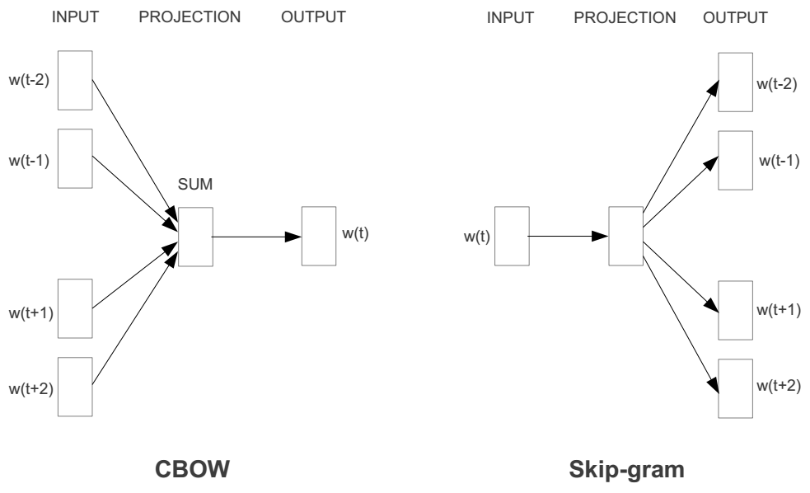
Example: Representing the meaning of words
Use a window of words to predict the middle word
Use a word to predict the surrounding ones in window
Pool
Richard Socher, Stanford CS224d: Deep Learning for NLP

Slide 3
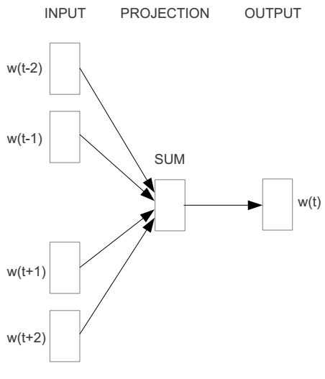
Word2vec
E.g. “The cat <sat> on floor”
Window size = 2
the
cat
Pool
sat
on
floor
Richard Socher, Stanford CS224d: Deep Learning for NLP

Slide 4
Input layer
Index of cat in vocabulary
0
1
0
cat
0
Hidden layer
Output layer
0
0
0
0
0
0
…
0
0
0
one-hot
vector
0
sat
one-hot
vector
0
0
0
0
1
0
…
1
0
on
0
0
0
0
…
0
Richard Socher, Stanford CS224d: Deep Learning for NLP

Slide 5
We must learn W and W’
Input layer
0
1
0
cat
0
$$W_{V×N}$$
Hidden layer
Output layer
0
0
0
0
0
0
V-dim
…
0
0
$${W′}_{N×V}$$
0
0
sat
0
0
0
0
1
0
$$W_{V×N}$$
N-dim
…
V-dim
1
0
on
0
0
0
0
V-dim
…
N will be the size of word vector
0
Richard Socher, Stanford CS224d: Deep Learning for NLP

Slide 6
$$W_{V×N}^{T} ×x_{cat}=v_{cat}$$
0.1 | 2.4 | 1.6 | 1.8 | 0.5 | 0.9 | … | … | … | 3.2
0.5 | 2.6 | 1.4 | 2.9 | 1.5 | 3.6 | … | … | … | 6.1
… | … | … | … | … | … | … | … | … | …
… | … | … | … | … | … | … | … | … | …
0.6 | 1.8 | 2.7 | 1.9 | 2.4 | 2.0 | … | … | … | 1.2
0
2.4
2.6
…
…
1.8
Input layer
1
$$×$$
0
$$=$$
0
0
1
0
0
0
x_{cat}
0
0
Output layer
0
0
0
$$W_{V×N}^{T}×x_{cat}=v_{cat}$$
…
0
0
0
0
0
V-dim
…
0
0
$$\hat{v}=\frac{v_{cat}+v_{on}}{2}$$
0
+
0
sat
0
0
0
0
$$W_{V×N}^{T}×x_{on}=v_{on}$$
1
0
…
V-dim
1
Hidden layer
0
x_{on}
0
0
N-dim
0
0
V-dim
…
0
Richard Socher, Stanford CS224d: Deep Learning for NLP

Slide 7
$$W_{V×N}^{T} ×x_{on}=v_{on}$$
0.1 | 2.4 | 1.6 | 1.8 | 0.5 | 0.9 | … | … | … | 3.2
0.5 | 2.6 | 1.4 | 2.9 | 1.5 | 3.6 | … | … | … | 6.1
… | … | … | … | … | … | … | … | … | …
… | … | … | … | … | … | … | … | … | …
0.6 | 1.8 | 2.7 | 1.9 | 2.4 | 2.0 | … | … | … | 1.2
0
1.8
2.9
…
…
1.9
Input layer
0
$$×$$
0
$$=$$
0
1
1
0
0
0
x_{cat}
0
0
Output layer
0
0
0
$$W_{V×N}^{T}×x_{cat}=v_{cat}$$
…
0
0
0
0
0
V-dim
…
0
0
$$\hat{v}=\frac{v_{cat}+v_{on}}{2}$$
0
+
0
sat
0
0
0
0
$$W_{V×N}^{T}×x_{on}=v_{on}$$
1
0
…
V-dim
1
Hidden layer
0
x_{on}
0
0
N-dim
0
0
V-dim
…
0
Richard Socher, Stanford CS224d: Deep Learning for NLP

Slide 8
Input layer
0
1
0
cat
0
$$W_{V×N}$$
Hidden layer
Output layer
0
0
0
0
0
0
V-dim
…
0
0
$$W_{N×V}^{′}×\hat{v}=z$$
0
$$\hat{y}=softmax(z)$$
0
0
0
0
0
$$\hat{v}$$
1
0
$$W_{V×N}$$
…
1
N-dim
0
on
0
${\hat{y}}_{sat}$
0
0
V-dim
0
V-dim
…
N will be the size of word vector
0
Richard Socher, Stanford CS224d: Deep Learning for NLP

Slide 9
Input layer
0
We would prefer $\hat{y}$ close to ${\hat{y}}_{sat}$
1
0
cat
0
$$W_{V×N}$$
Hidden layer
Output layer
0
0
0
0
0.01
0.02
0.00
0.02
0.01
0.02
0.01
0.7
…
0.00
0
0
V-dim
…
0
0
$$W_{N×V}^{′}×\hat{v}=z$$
$$\hat{y}=softmax(z)$$
0
0
0
0
0
0
$$\hat{v}$$
1
0
$$W_{V×N}$$
…
1
N-dim
0
on
0
${\hat{y}}_{sat}$
0
0
V-dim
0
V-dim
…
N will be the size of word vector
$\hat{y}$
0
Richard Socher, Stanford CS224d: Deep Learning for NLP

Slide 10
Learning as Matrix Factorization
$$W_{V×N}^{T}$$
0.1 | 2.4 | 1.6 | 1.8 | 0.5 | 0.9 | … | … | … | 3.2
0.5 | 2.6 | 1.4 | 2.9 | 1.5 | 3.6 | … | … | … | 6.1
… | … | … | … | … | … | … | … | … | …
… | … | … | … | … | … | … | … | … | …
0.6 | 1.8 | 2.7 | 1.9 | 2.4 | 2.0 | … | … | … | 1.2
Contains word vectors
Input layer
0
1
0
x_{cat}
0
Output layer
0
0
$$W_{V×N}^{}$$
0
0
0
0
V-dim
…
0
0
$$W_{N×V}^{′}$$
0
0
sat
0
0
0
0
1
0
$$W_{V×N}^{}$$
…
1
0
V-dim
x_{on}
0
Hidden layer
0
N-dim
0
0
V-dim
…
0
We can consider either W or W’ as the word’s representation.
Richard Socher, Stanford CS224d: Deep Learning for NLP
Notes:
W contains input word vectors.
W’ contains output word vectors.
We can consider either W or W’ as the word’s representation. Or even take the average.

Slide 11
Word Analogies
||w_{x}||
Richard Socher, Stanford CS224d: Deep Learning for NLP

Slide 12
Linear Mappings as part of Perceptrons
is the sigmoid function
Processing unit is called Perceptron (1958, can be stacked – Multilayer Perceptron, MLP)
Theory of setting up linear maps available (backpropagation learning rule)

Slide 13
The Pitfall
MLPs are a very simple devices (~ 60 years old)
Can be integrated into a data processing architecture
Stacks of linear maps and pooling units
Can be trained fast (due GPUs) to achieve good performance
Game industry is most influential for AI
Cool thing, but often strangely named
Human neural networks propagate information using frequency encodings
Amplitude of action potentials constant
Neural Networks
Wishful Thinking!

Slide 14
Whishful Thinking Considered Harmful
Unsolicited expectations of everyday people
Layman tend to overestimate flexibility
Cannot (easily) represent uncertainty of output results
Quality control difficult
Another Pitfall: Notion of Embodiment

Slide 15
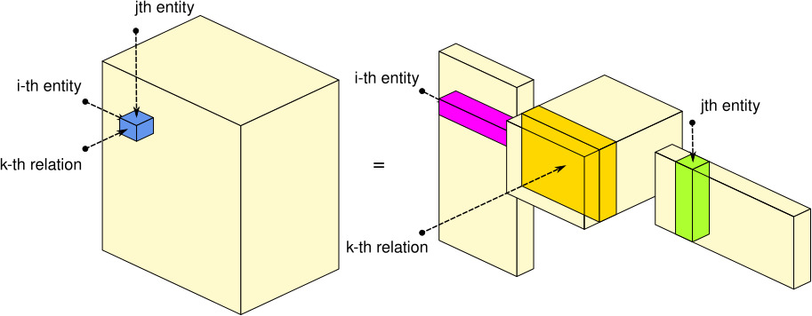
Networks are Everywhere
Tensor Diagram by Maximilian Nickel

Slide 16
Probabilistic Propositional Networks

Slide 17
Probabilistic Relational Networks
Hindsight:
Logic is Back in AI
Logic has never been away

