Slide 1
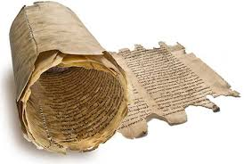
eHumanities 4.0: Pitfalls and Potentials
Prof. Dr. Ralf Möller
Universität zu Lübeck
Institute of Information Systems

Slide 2
eHumanities ( enhanced Humanities )
Sum of all approaches …
supporting research projects in the humanities …
with technologies from computer science and natural sciences
Manuscript cultures (several subprojects)
Paratexts / Visual Organisation / Manuscript Collections and Manuscripts as Collections
Learning / Rituals / Agency
Information Infrastructure (support projects)
eHumanities Zukunftskonzept 2020+

Slide 3
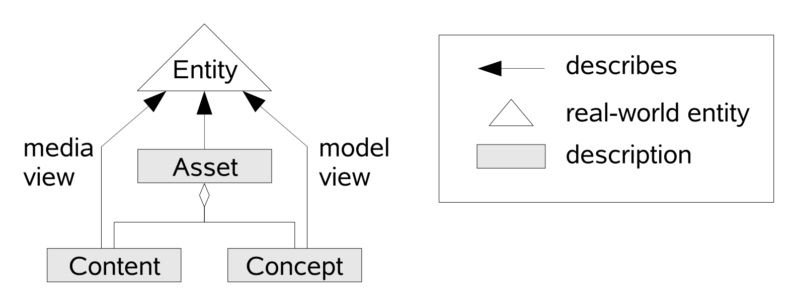
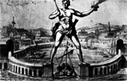
eHumanities: Early Adopters (1997-2002)
From Political Iconography Index (M. Warnke) to Warburg Electronic Library (J.W. Schmidt)
Art-historian’s workbench
Support for retrieval, data management
Personalization
Combining data and metadata into joint management units
Asset management (H.W. Sehring)
Asset compositional structure (S. Boßung)

Slide 4
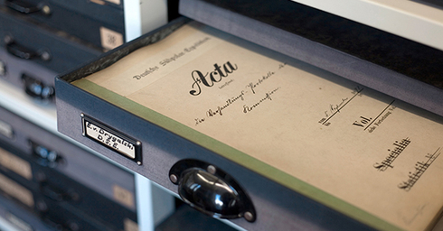
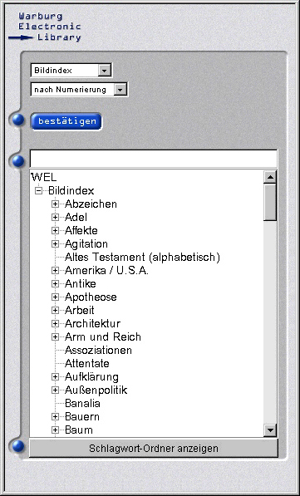

Slide 5
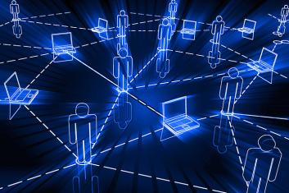

Slide 6
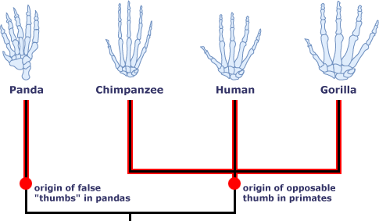
Extended Support by Computer Science
Computer science support for manuscript research
Too many manuscripts to deal with manually
Computer vision (fruitful, well established)
Character/glyph variance analysis/classification
Structure and context completion/restoration
Layout structure recognition
…
Computer science supports many research areas
Natural sciences: phylogenetics
Local ancestry information
Too many local hints to be systematically combined manually

Slide 7
Data Management in the Humanities
Sustainable data management (z.B. gwin@UniHH)
Digitization, primary data w/ variants
Meta data, secondary data
Inverted index for texts (strings), images (feature vectors)
Incorporation of temporal and geo data
Sustainable research infrastructure
Data management and integration
Incorporation of existing data into new projects
Integration of project data into repository
Digital curation of data, digital editions
Ehum Zukunftskonzept 2020+

Slide 9
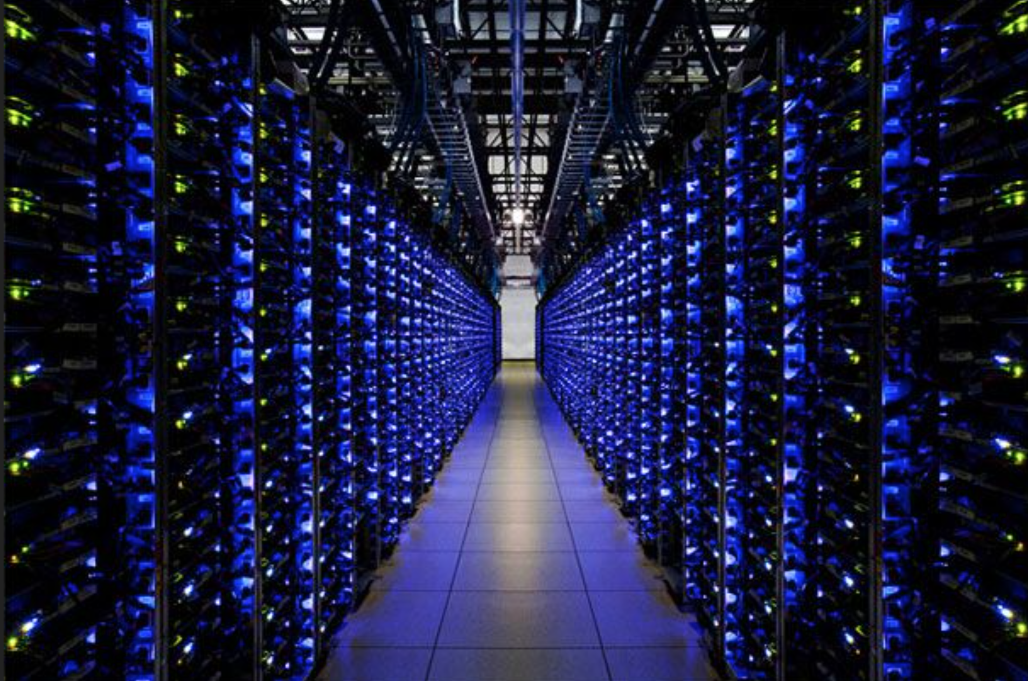

Slide 10
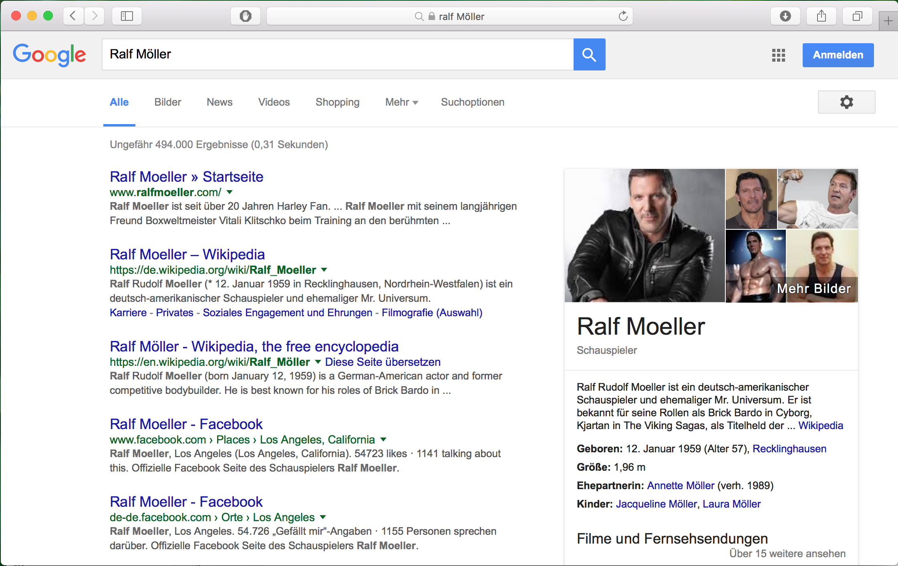

Slide 11
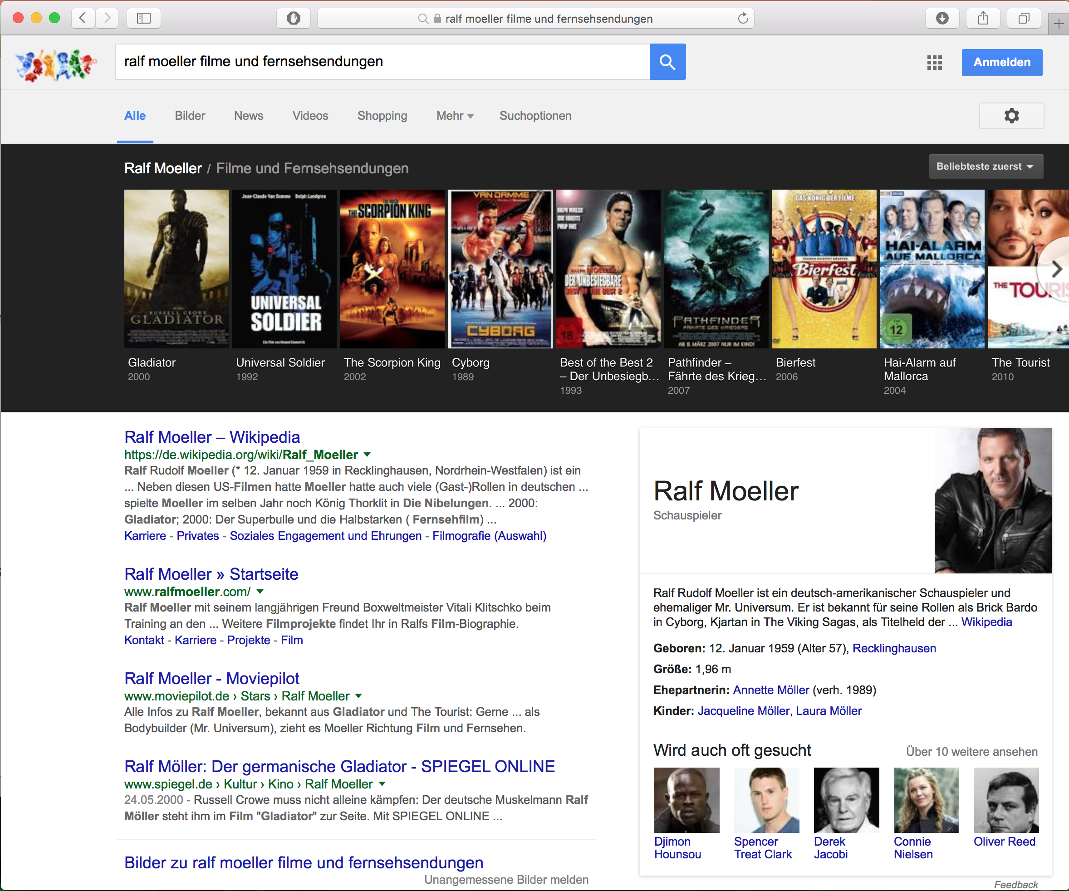

Slide 12
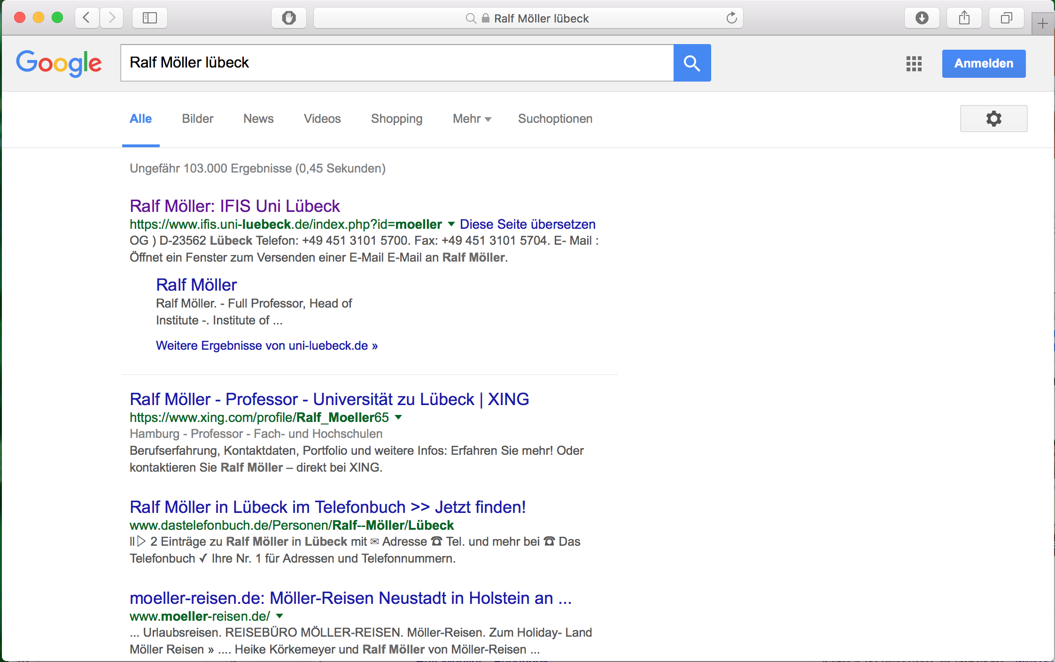

Slide 13
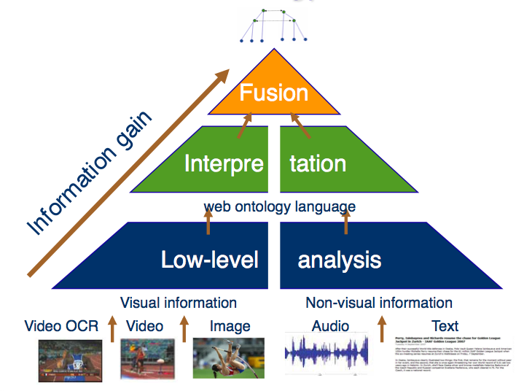
Information Extraction [BOEMIE 2006]
Bootstrapping Ontology Evolution with Multimedia Information Extraction
Ontology defines how world is seen: objects, associations between objects, sets of objects, relations
Ontology = set of predicate logic formulas = knowledge base

Slide 14
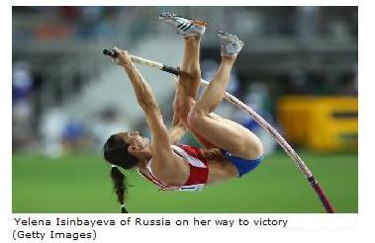
Interpretation = Explanation
Abstract
concepts
N2:Pole vault trial
N1:Person, Pole vaulter
F1:Face
B1:Body
P1:Pole
Objects

Slide 15
Text modality
Low-level analysis of text
Yelena Isinbayeva of Russia on her way to victory (Getty Images)
Words
Pn1:Person Name
C1:Country

Slide 16
Text modality (2)
Text interpretation
Yelena Isinbayeva of Russia on her way to victory (Getty Images)
Abstract
concepts
N3:Person
Pn1:Person Name
C1:Country

Slide 17
Fusion
Yelena Isinbayeva of Russia on her way to victory (Getty Images)
=
N2:Pole vault trial
N1:Person, Pole vaulter
N3:Person, Pole vaulter
F1:Face
B1:Body
P1:Pole
Pn1:Person Name
C1:Country

Slide 18
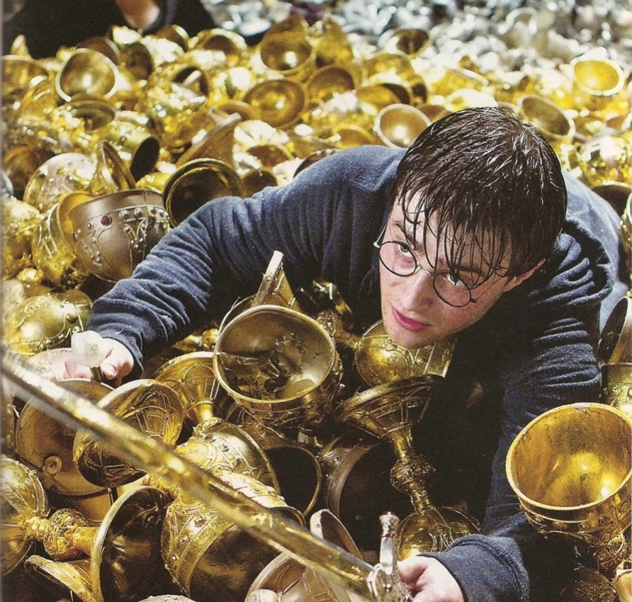
Relational Structures
Avoid Redundancy
Named Entity Recognition / Fusion

Slide 19
Usage Scenario 1: Information Retrieval
=
=
=
=
N2:Pole vault trial
=
N2:Pole vault trial
N1:Person, Pole vaulter
N3:Person, Pole vaulter
N2:Pole vault trial
N1:Person, Pole vaulter
N3:Person, Pole vaulter
N2:Pole vault trial
N1:Person, Pole vaulter
N3:Person, Pole vaulter
N2:Pole vault trial
N1:Person, Pole vaulter
N3:Person, Pole vaulter
F1:Face
B1:Body
P1:Pole
N1:Person, Pole vaulter
N3:Person, Pole vaulter
F1:Face
B1:Body
Pn1:Person Name
P1:Pole
C1:Country
F1:Face
B1:Body
Pn1:Person Name
P1:Pole
C1:Country
F1:Face
B1:Body
Pn1:Person Name
P1:Pole
C1:Country
F1:Face
B1:Body
Pn1:Person Name
P1:Pole
Pn1:Person Name
C1:Country
C1:Country

Slide 20
Usage Scenario 2: Scientific Theory Formation
Integrate partial relational structures into coherent whole (just like in phylogenetic tree construction)
Investigate proposed structure
Satisfied?
Gather new partial structures to rule out unwanted relational structures, i.e., help to revise theory
Completion, consistency check, and advancement of scientific theories (e.g., in the humanities)

Slide 21
Relational descriptions of media content
Data analysis: basic descriptions
Based on learning techniques (supervised, semi-supervised)
Interpretation: high-level descriptions
Based on logical formulae (background knowledge)
Associations to external Linked Open Data (LOD)
Offline/batch processing [BOEMIE 06-09]
Crisp representation structures
Online/stream processing [CASAM 08-11, CoFriend 08 – 11, PRESINT 07-10]
Probabilistic representation structures

Slide 22
Pitfalls / Problems (or: Google won’t do it)
Ground truth for learning required
Manual work and large corpus needed (expensive)
Conjecture: Although large sets of manuscripts available, highly specific expertise required
Logical formulae for interpretation constructed manually
Bootstrap idea [BOEMIE 06-09] (only) partially successful
Other learning approaches possibly better [eTRIMS 06-09]
Various recent projects about to apply very similar ideas
Now known as “semantic technologies”
Meanwhile many copycats w/o much reflection
Where is the semantics? Conjecture: Semantics illusion

Slide 23
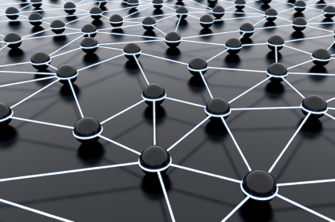
∀x. A(x) ⟶ B(x)
∀x,y. S(x,y) ⟶ R(x,y)
A
B
C
Query answering
R
S
B
A
R
R
j
S
B
i
But semantics?

Slide 24
What about Content? Latent Semantic Indexing

Slide 25
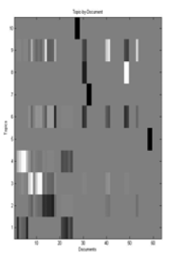
Information Retrieval: The Whole Collection Matters
=
=
=
=
N2:Pole vault trial
=
N2:Pole vault trial
N1:Person, Pole vaulter
N3:Person, Pole vaulter
N2:Pole vault trial
N1:Person, Pole vaulter
N3:Person, Pole vaulter
N2:Pole vault trial
N1:Person, Pole vaulter
N3:Person, Pole vaulter
N2:Pole vault trial
N1:Person, Pole vaulter
N3:Person, Pole vaulter
F1:Face
B1:Body
P1:Pole
N1:Person, Pole vaulter
N3:Person, Pole vaulter
F1:Face
B1:Body
Pn1:Person Name
P1:Pole
C1:Country
F1:Face
B1:Body
Pn1:Person Name
P1:Pole
C1:Country
F1:Face
B1:Body
Pn1:Person Name
P1:Pole
C1:Country
F1:Face
B1:Body
Pn1:Person Name
P1:Pole
Pn1:Person Name
C1:Country
C1:Country

Slide 26
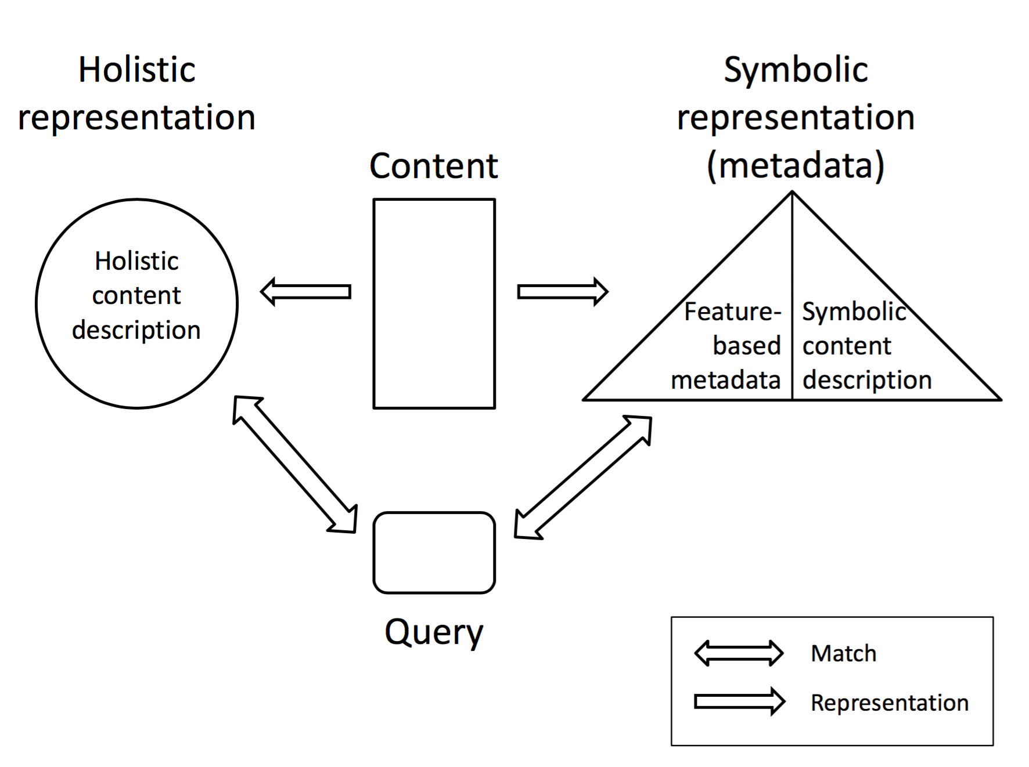
Combining Symbolic and Holistic Representations
Holistic representation:
From local feature values to globally combined values
From global representation to local representation
Combination with relational content descriptions
Semantic Assets: [Sylvia Melzer 2017]

Slide 27
Data Integration: Challenges
Challenge for LOD-based structures
Where does the asset end?
Need for computing “islands” [Sebastian Wandelt 2011]
Challenge for updating semantic assets
How to update holistic structure for new docs and propagate effect back into local structures
Challenge for dealing with partial information
How to consistently integrate (see phylogenetic trees)
Challenge for temporal/streaming data
Multiple scales: micro vs. macro level
High data rates, references to static data
Challenge if different viewpoints on data adopted
There is no single data representation fitting all purposes

Slide 28
Manuscript Research: Influencing Issues
Historical and geopolitical context of production and replication, timescales, events
Purpose(s) of a manuscript
Acting persons (authors, addressees, reproducers) as well as their common and individual knowledge (and beliefs)
Materials, production processes, replication processes
Changes over time in presentation styles (and respective reasons and effects)
…

Slide 29
Analysis
Pitfall: Semantics illusion
Assume that above-mentioned information can be easily supplied (or even managed) automatically in the large
Potential: High-level data integration support
Maybe scientists can (indirectly) specify partial information that can be integrated automatically (just like in phylogenetic trees)
Deal with indefinite, imprecise, vague, and contradictory information
Many representation challenges
Events as objects?

Slide 30
Claim: “Semantic Technologies” AKT are NOT Enough
Events as objects??
Based on predicate logic (or sublanguages):
Ontological commitments: objects, sets, relations
Relational structures
Ontological commitments [Quine 1948] too simplistic
Ontology ?=? set of logical formulas = knowledge base
N2:Pole vault trial
N1:Person, Pole vaulter
N3:Person, Pole vaulter
F1:Face
B1:Body
P1:Pole
Pn1:Person Name
C1:Country

Slide 31
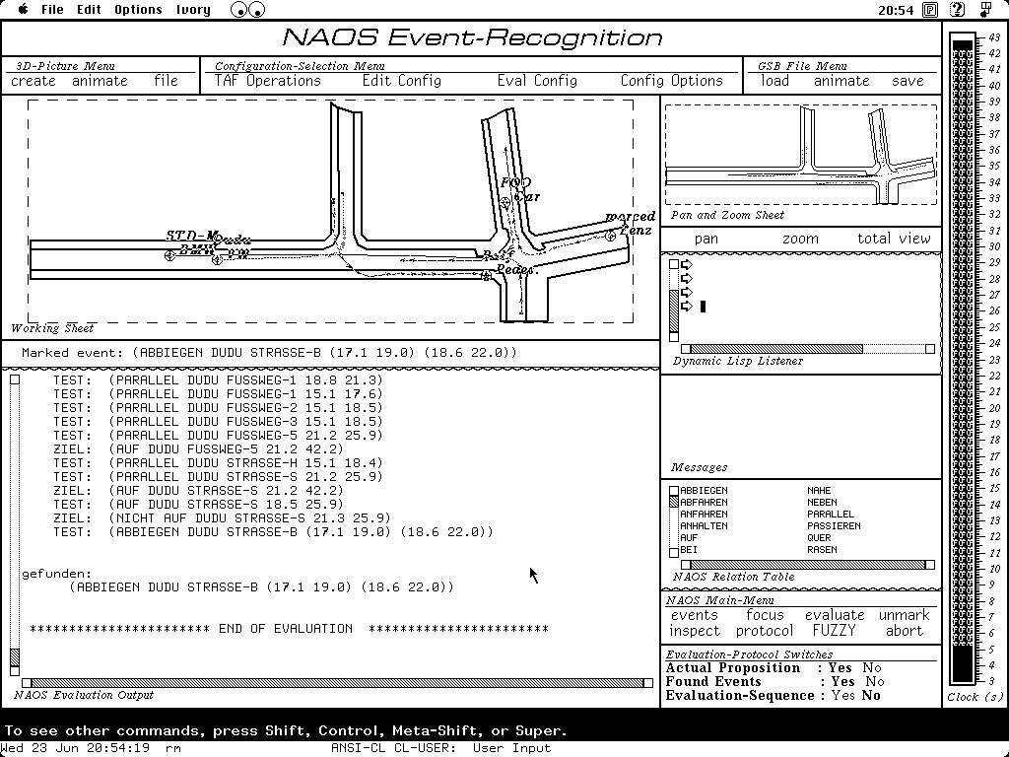
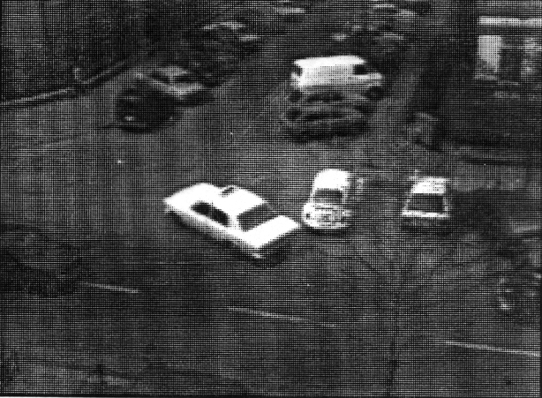
Early Results in Computer Vision
Event recognition [NAOS 81-84]

Slide 32
[Neumann 81]
Events defined by sufficient conditions
Compositional structure
Temporal relations between substructures
Foundations of complex event processing (CEP) as known today
Conclusion: An event is not (only) an abstract object
Question: How to represent notions such as, e.g., “cultural changes” as being relevant for research in manuscript cultures?

Slide 33
[Neumann 15]
Deutung von Exemplaren als Zeugnisse einer kulturellen Entwicklung
Hintergrundwissen
betrifft
Kulturelle Veränderungen zwischen 1200 und 1300
ist-Teil-von
ist-Teil-von
Moral
um 1300
Moral
um 1200
Rekonstruktions-
aufgabe
hat-Thema
hat-Thema
Mönche
um 1200
Studenten
um 1200
Mönche
um 1300
Studenten
um 1300
geschrieben-von
geschrieben-für
geschrieben-von
geschrieben-für
Lehrschrift
um 1200
Computer Support?
Lehrschrift
um 1300
Instanz-von
Instanz-von
Manuskript1
Manuskript2
Slide ©Bernd Neumann

Slide 34
Humanities and Informatics
Many representation problems unsolved in CS
Humanities are based on rich human ontologies
Humanities can help overcome semantics illusion in computer science

Slide 35
Hypothesis: Need “Rich Ontologies”
An ontology is neither a set of formulae nor a set of names
Ontology = representational commitments [Quine 1948]
Claim: Ontologies must be grounded in semantics of representation formalisms
Extensions to ontological commitments
Need agents, observations, beliefs, threads
Extensions to epistemological commitments
Imprecise probabilities (prob. confidence intervals)
Initial steps: Probabilistic doxastic temporal logic (PDT-Logic) [Karsten Martiny 2016]

Slide 36
Need for e-Informatics ( enhanced informatics )
Sum of all approaches …
supporting research and teaching in informatics …
e.g. by humanities-inspired representations formalisms
Representation formalisms based on rich ontologies
Guidance by humanities
Potentials for Humanities
Long term support for sustainable data management
Large scale theory formation/evaluation by high-level data integration support
Or, if you like the ideas: eHumanities 4.0

