Slide 1
Web-Mining Agents Data Mining
Prof. Dr. Ralf Möller
Dr. Özgür L. Özçep
Universität zu Lübeck
Institut für Informationssysteme
Tanya Braun (Übungen)

Slide 2
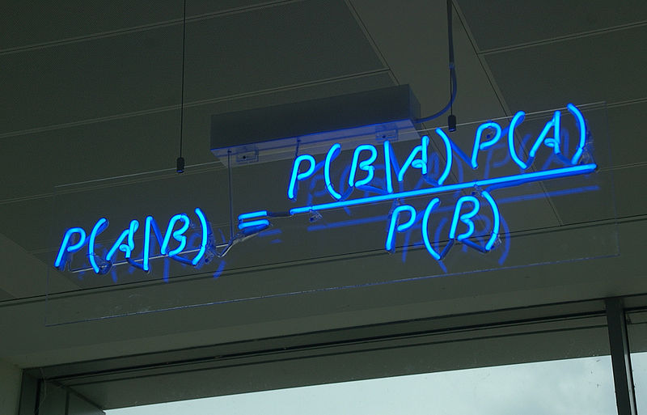
Web-Mining Agents
Data Mining Track
Uncertainty

Slide 3
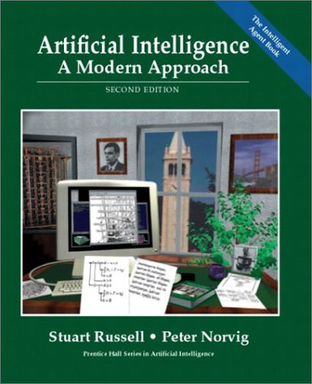
Uncertainty
AIMA Chapter 13

Slide 4
Outline
Agents
Uncertainty
Probability
Syntax and Semantics
Inference
Independence and Bayes' Rule
Bayesian Networks

Slide 5
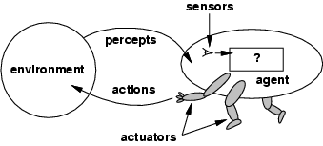
Agents and environments
The agent function maps from percept histories to actions: [f: P* → A]
The agent program runs on the physical architecture to produce f
agent = architecture + program architecture: PC, robotic car, …
Notes:
Percepts depend on sensor??? Faulty??? Actions might not be fully determenistic???

Slide 6
A simple knowledge-based agent

Slide 7
Special case: Information retrieval agents
Agent should be allowed to “extract information” from their host environment …
... and “make the information available” to their creator (owner)
Very simple example: Linear regression
Percepts = Tuples from a database table
Extract information = compute a model (here: a line with parameters w₀, w₁) of the data
“Make information available” = send the model
(w₀, w₁) to the creator, not the data
Data would be too large anyway in general settings

Slide 8
Agents can use simple machine learning
Model class (hypothesis space):
Loss function:
Optimization procedure:
From the viewpoint of the agent creator, the model
g(x | θ*) is seen as information (in particular if all elements of the hypothesis space are equally likely)
For the agent, the model is just data as well

Slide 9
Model representation formalisms
Polynomial functions (or polynomial rings, algebraic varieties)
Logics (many kinds)
Probability theory
…

Slide 10
Overview
Motivation for probabilistic representations in agent context
Probabilistic representation formalism (Bayesian networks)
“Practical” query answering algorithms
Learning Bayesian network (BN) representations
Apply BN representations for information retrieval

Slide 11
Acknowledgement
The next slides on the Wumpus game (see the AIMA book) are taken from a course on Artificial Intelligence by Thomas Schwarz, S.J., COEN, SCU

Slide 12
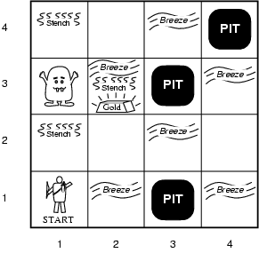
Example: Wumpus world (PEAS description)
Performance measure
gold +1000, death -1000
-1 per step, -10 for using the arrow
Environment
Squares adjacent to Wumpus are smelly
Squares adjacent to pit are breezy
Glitter iff gold is in the same square
Shooting kills Wumpus if you are facing it
Shooting uses up the only arrow
Grabbing picks up gold if in same square
Releasing drops the gold in same square
Actuators: Left turn, Right turn, Forward, Grab, Release, Shoot
Sensors: Stench, Breeze, Glitter, Bump, Scream

Slide 13
Excursion: Wumpus world properties
Fully Observable
No – only local perception
Deterministic
Yes – outcomes exactly specified
Episodic
No – sequential at the level of actions
Static
Yes – Wumpus and Pits do not move
Discrete
Yes
Single-agent?
Yes – Wumpus is essentially a natural feature

Slide 14
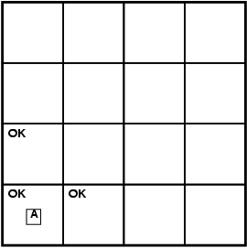
Exploring a Wumpus world

Slide 15
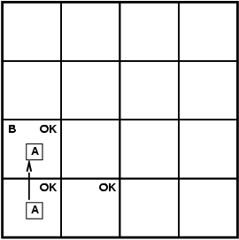
Exploring a Wumpus world

Slide 16
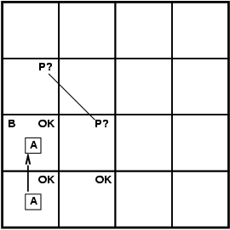
Exploring a Wumpus world

Slide 17
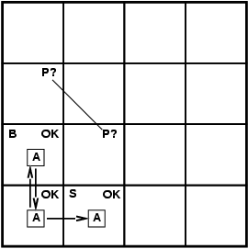
Exploring a Wumpus world

Slide 18
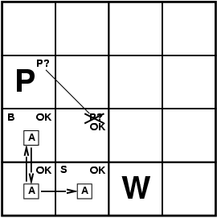
Exploring a Wumpus world

Slide 19
Exploring a Wumpus world

Slide 20
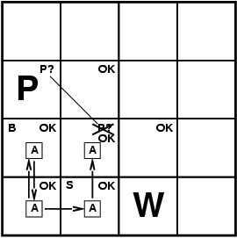
Exploring a Wumpus world

Slide 21
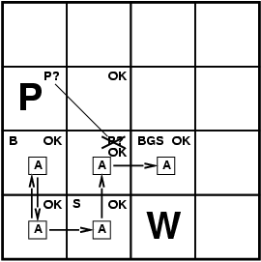
Exploring a Wumpus world

Slide 22
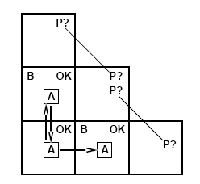
Exploring a Wumpus world
Tight Spot
A pit might be in all new rooms
No safe room
Can use probabilistic reasoning
To do next

Slide 23
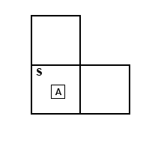
Exploring a Wumpus world
Another tight spot
Wumpus might be in any of the two new locations
Claim:
With representations for dealing with uncertainty a Wumpus playing agent will play better in the long term
But we need to ensure that
model complexity is “manageable”
typical-case complexity for probabilistic computation problems is “not too high”

Slide 24
Uncertainty
Let action A_{t} = leave for airport t minutes before flight
Will A_{t} get me there on time?
Problems:
partial observability (road state, other drivers' plans, etc.)
noisy sensors (traffic reports)
uncertainty in action outcomes (flat tire, etc.)
immense complexity of modeling and predicting traffic
Hence, it seems that a purely logical approach either
risks falsehood: “A₂₅ will get me there on time”, or
leads to conclusions that are too weak for decision making:
“A₂₅ will get me there on time if there's no accident on the bridge and it doesn't rain and my tires remain intact etc etc.”
(A₁₄₄₀ might reasonably be said to get me there on time but I'd have to stay overnight in the airport …)

Slide 25
Problems of logic in certain domains
Diagnosis:
Toothache => Cavity
Cavity => Toothache
The connection between toothaches and cavities is just not a logical consequence. For medical diagnosis (classical) logic does not seem to be appropriate.
∨ GumProblem ∨ Abscess ∨ …

Slide 26
Methods for handling uncertainty
Logic:
Assume my car does not have a flat tire
Assume A₂₅ works unless contradicted by evidence
Issues: What assumptions are reasonable? How to handle contradiction?
Rules with fudge factors (belief in the rule):
A₂₅ ⊢_{0.3} get there on time
Sprinkler ⊢_{0.99} WetGrass
WetGrass ⊢ _{0.7} Rain
Issues: Problems with combination, e.g., Sprinkler causes Rain??
Probability
Model agent's degree of belief
Given the available evidence,
A₂₅ will get me there on time with probability 0.04

Slide 27
Probability
Probabilistic assertions summarize effects of
laziness: failure to enumerate exceptions, qualifications, etc.
theoretical ignorance: no complete theory
practical ignorance: lack of relevant facts, initial conditions, tests, etc.
Subjective probability:
Probabilities relate propositions to agent's own state of knowledge
e.g., P(A₂₅ | no reported accidents) = 0.06
These are not assertions about the world
Probabilities of propositions change with new evidence:
e.g., P(A₂₅ | no reported accidents, 5 a.m.) = 0.15
Notes:
The first probability still holds but does not help us much. Probability statements are made relative to the knowledge state which is a partial view of the real world
For the diagnosis. P(cavity| toothache) is 0.8 During the diagnosis this still holds unless the cavity was observed. But if another disease is found (Gum Disease) than this might also drop to 0.4
Source for that evidence might come from statistical data or some general dental knowledge and might be different in different societies

Slide 28
Making decisions under uncertainty
Suppose I have the following belief( degree)s:
P(A₂₅ gets me there on time | …) = 0.04
P(A₉₀ gets me there on time | …) = 0.70
P(A₁₂₀ gets me there on time | …) = 0.95
P(A₁₄₄₀ gets me there on time | …) = 0.9999
Which action to choose?
Depends on my preferences for missing flight vs. time spent waiting, etc.
Utility theory is used to represent and infer preferences
Decision theory = probability theory + utility theory
Notes:
The fundamental idea of decision theory is that an agent is rational if and only if it chooses the action that yields the highest expected utility averaged over all the possible outcomes of the action. Maximum Expected Utility MEU.

Slide 29
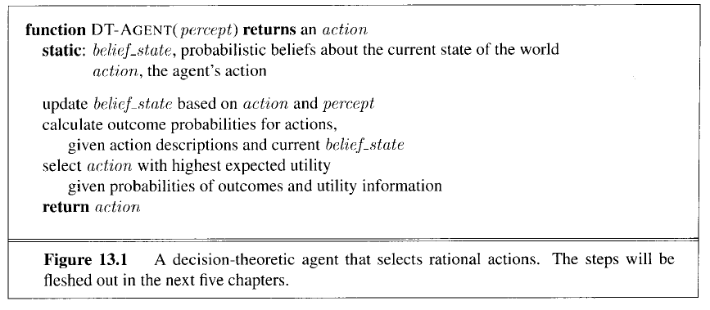
Decision theoretic agent

Slide 30
Probability theory: Representation formalism
Basic element: random variable (RV)
Similar to propositional logic: possible worlds defined by assignment of values to random variables.
Boolean random variables
e.g., Cavity (do I have a cavity?). Domain is < true , false >
Discrete random variables
e.g., Weather is one of < sunny, rainy, cloudy, snow >
Domain values must be exhaustive and mutually exclusive
Elementary propositions are constructed by assignment of a value to a random variable: e.g.,
Weather = sunny,
Cavity = false (abbreviated as ¬cavity)
Cavity = true (abbreviated as cavity)
Complex propositions formed from elementary propositions and standard logical connectives, e.g., Weather = sunny ∨ Cavity = false
Notes:
NB: Technically, random variables are functions RV: PossibleWorlds -> SetofValues
``Domain’’ of a random variable RV: Image RV[PossibleWorlds] of function RV

Slide 31
Syntax
Atomic event: A complete specification of the state of the world about which the agent is uncertain E.g., if the world is described by only two Boolean variables: Cavity and Toothache,
then there are 4 distinct atomic events:
Cavity = false ∧Toothache = false
Cavity = false ∧ Toothache = true
Cavity = true ∧ Toothache = false
Cavity = true ∧ Toothache = true
Atomic events are mutually exclusive and exhaustive
Notes:
Also sometimes called sample space (all possible atomic events) Sum of all world states where the proposition is true

Slide 32
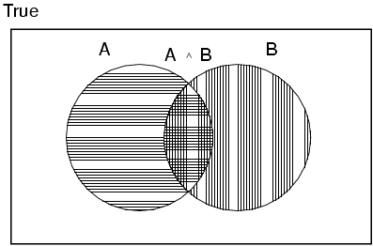
Axioms of probability
For any propositions A, B
0 ≤ P(A) ≤ 1
P(true) = 1 and P(false) = 0
( true stands for a tautology such as (A v ¬A);
false stands for a contradiction such as A & ¬A) )
P(A ∨ B) = P(A) + P(B) - P(A ∧ B)
Notes:
True stands for any tautological proposition (such as A or non A);
False for any contradictory proposition (such as A and non A)
Can derive
P(non A ) = 1 – P(A)

Slide 33
Example world
Example: Dentist problem with four variables:
Toothache (I have a toothache)
Cavity (I have a cavity)
Catch (steel probe catches in my tooth)
Weather (sunny,rainy,cloudy,snow )

Slide 34
Prior probability
Prior or unconditional probabilities of propositions
e.g., P(Cavity = true) = 0.1 and P(Weather = sunny) = 0.72 correspond to belief prior to arrival of any (new) evidence
Probability distribution gives values for all possible assignments:
P(Weather) = <0.72,0.1,0.08,0.1> (normalized, i.e., sums to 1 because one must be the case)
Notes:
Prior can come from statistical date or other insights e.g. dice (computational)

Slide 35
Full joint probability distribution
Joint probability distribution for a set of random variables gives the probability of every atomic event on those random variables
P(Cavity,Whether) = a 2 × 4 matrix of values:
Weather = sunny rainy cloudy snow
Cavity = true 0.144 0.02 0.016 0.02
Cavity = false 0.576 0.08 0.064 0.08
Full joint probability distribution: all random variables involved
P(Toothache, Catch, Cavity, Weather)
Every query about a domain can be answered by the full joint distribution

Slide 36
Probability for continuous variables
Notes:
For continous variables we cannot write down (the graph of) the distribution explicitly so we define it by a density function. P(20.5)=0 because it is not probable to have exactly 20.5.
Instead probabilty is defined for a small region arount 20.5
P(temp=x)= 1/8 for 18<=x<=26 ; = 0 otherwise

Slide 37
Discrete random variables: Notation
Dom(W) = {sunny, rainy, cloudy, snow} and Dom(W) disjoint from domain of other random variables:
Atomic event “W=rainy” often written as “rainy”
Example: P(rainy), the random variable W is instantiated by the value rainy
Boolean variable C
Atomic event “C=true” written as “c”
Atomic event “C=false” written as “¬c”
Examples: P(c) or P(¬c)

Slide 38
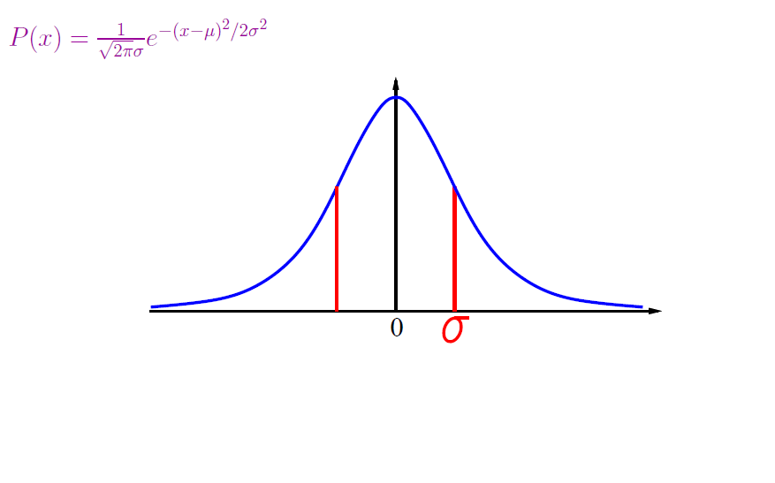
P(x) for P(X=x) also used for continuous random vars

Slide 39
Conditional probability
Conditional or posterior probabilities
e.g., P(cavity | toothache) = 0.8 or: <0.8>
i.e., given that toothache is all I know
(Notation for conditional distributions:
P(Cavity | Toothache) = 2-element vector of 2-element vectors)
If we know more, e.g., cavity is also given, then we have
P(cavity | toothache,cavity) = 1
New evidence may be irrelevant, allowing simplification, e.g.,
P(cavity | toothache, sunny) = P(cavity | toothache) = 0.8
This kind of inference, sanctioned by domain knowledge, is crucial

Slide 40
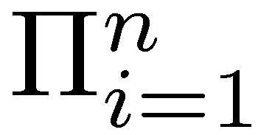
Conditional probability
Definition of conditional probability (in terms of unconditional probability):
P(a | b) = P(a ∧ b) / P(b) if P(b) > 0
Product rule gives an alternative formulation (∧ is commutative):
P(a ∧ b) = P(a | b) P(b) = P(b | a) P(a)
A general version holds for whole distributions, e.g.,
P(Weather,Cavity) = P(Weather | Cavity) P(Cavity)
View as a set of 4 × 2 equations, not matrix mult. (1,1) P(Weather=sunny |Cavity=true) P(Cavity=true)
(1,2) P(Weather=sunny |Cavity=false) P(Cavity=false), ….
Chain rule is derived by successive application of product rule:
P(X₁, …,X_{n}) = P(X₁,...,X_{n-1}) P(X_{n} | X₁,...,X_{n-1})
= P(X₁,...,X_{n-2}) P(X_{n-1} | X₁,...,X_{n-2}) P(X_{n} | X₁,...,X_{n-1})
= …
= P(X_{i} | X₁, … ,X_{i-1})
Notes:
Proovable Rules are important for algorithmically rewriting of statements.
First rules makes sense because we know that b=true we can rule out other worlds. Reduce view of the world sum also to one because
Sum must be one. Therefore the fraction.
Note that for i = 1 in last formula one has P(X1)

Slide 41
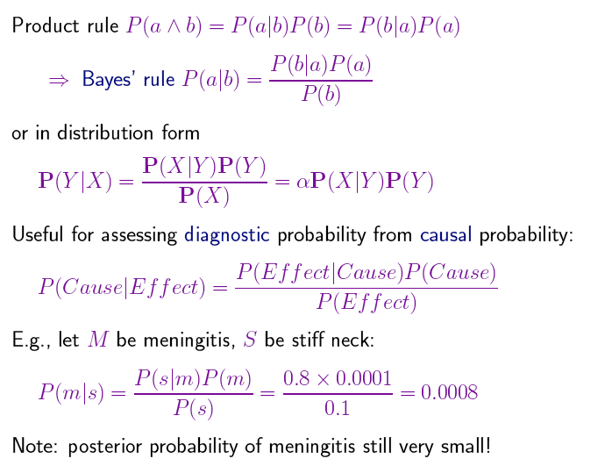
Bayes‘ Rule

Slide 42
Inference by enumeration
Start with the joint probability distribution:
For any proposition φ, sum the atomic events where φ is true: P(φ) = Σ_{ω:ω⊨φ} P(ω)

Slide 43
Inference by enumeration
Start with the joint probability distribution:
For any proposition φ, sum the atomic events where it is true: P(φ) = Σ_{ω:ω╞φ} P(ω)
P(toothache) = 0.108 + 0.012 + 0.016 + 0.064 = 0.2
Unconditional or marginal probability of toothache
Process is called marginalization or summing out

Slide 44
Marginalization and conditioning
Let Y, Z be sequences of random variables s.t. Y ∪ Z denotes all random variables describing the world
Marginalization
P(Y) = Σ_{z ∈ Z}P(Y,z)
Conditioning
P(Y) = Σ_{z ∈ Z}P(Y|z)P(z)

Slide 45
Inference by enumeration
Start with the joint probability distribution:
For any proposition φ, sum the atomic events where it is true: P(φ) = Σ_{ω:ω⊨φ} P(ω)
P(cavity ∨ toothache) = 0.108 + 0.012 + 0.072 + 0.008+ 0.016 + 0.064 = 0.28 (P(cavity ∨ toothache) = P(cavity) + P(toothache) – P(cavity ∧ toothache))

Slide 46
Inference by enumeration
Start with the joint probability distribution:
Can also compute conditional probabilities:
P(¬cavity | toothache) = P(¬cavity ∧ toothache)
P(toothache)
= 0.016+0.064
0.108 + 0.012 + 0.016 + 0.064
= 0.4 P(cavity | toothache) = 0.108+0.012/0.2 = 0.6

Slide 47
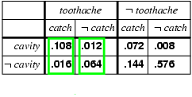
Normalization
Denominator P(z) (or P(toothache) in the example before) can be viewed as a normalization constant α
P(Cavity | toothache) = α P(Cavity,toothache)
= α [P(Cavity,toothache,catch) + P(Cavity,toothache,¬ catch)]
= α [<0.108,0.016> + <0.012,0.064>]
= α <0.12,0.08> = <0.6,0.4>
General idea: compute distribution on query variable by fixing evidence variables (Toothache) and summing over hidden variables (Catch)

Slide 48
Bayes‘ Rule

Slide 49
Inference by enumeration, contd.
Typically, we are interested in
the posterior joint distribution of the query variables Y
given specific values e for the evidence variables E
(X are all variables of the modeled world)
Let the hidden variables be H = X - Y – E then the required summation of joint entries is done by summing out the hidden variables:
P(Y | E = e) = αP(Y,E = e) = αΣ_{h}P(Y,E= e, H = h)
The terms in the summation are joint entries because Y, E and H together exhaust the set of random variables (X)
Obvious problems:
Worst-case time complexity O(d^{n}) where d is the largest arity and n denotes the number of random variables
Space complexity O(d^{n}) to store the joint distribution
How to find the numbers for O(d^{n}) entries?

Slide 50
Independence
A and B are independent iff
P(A, B) = P(A) P(B)
(or alternatively: iff one of the following holds:
P(A|B) = P(A) and P(A) ≠ 0 and P(B) ≠ 0
P(A) = 0 or P(B) = 0))
P(Toothache, Catch, Cavity, Weather)
= P(Toothache, Catch, Cavity) P(Weather)
32 entries reduced to 12;
for n independent biased coins, O(2^{n}) →O(n) Absolute independence powerful but rare
Dentistry is a large field with hundreds of variables, none of which are independent. What to do?

Slide 51
Conditional independence
P(Toothache, Cavity, Catch) has 2³ – 1 = 7 independent entries
If I have a cavity, the probability that the probe catches in it doesn't depend on whether I have a toothache:
(1) P(catch | toothache, cavity) = P(catch | cavity)
The same independence holds if I haven't got a cavity:
(2) P(catch | toothache,¬cavity) = P(catch | ¬cavity)
Catch is conditionally independent of Toothache given Cavity:
P(Catch | Toothache,Cavity) = P(Catch | Cavity)
Equivalent statements:
P(Toothache | Catch, Cavity) = P(Toothache | Cavity)
P(Toothache, Catch | Cavity) = P(Toothache | Cavity) P(Catch | Cavity)

Slide 52
Conditional independence contd.
Write out full joint distribution using chain rule:
P(Toothache, Catch, Cavity)
= P(Toothache | Catch, Cavity) P(Catch, Cavity)
= P(Toothache | Catch, Cavity) P(Catch | Cavity) P(Cavity) conditional independence
= P(Toothache | Cavity) P(Catch | Cavity) P(Cavity)
i.e., 2 + 2 + 1 = 5 independent numbers
In most cases, the use of conditional independence reduces the size of the representation of the joint distribution from exponential in n to linear in n.
Conditional independence is our most basic and robust form of knowledge about uncertain environments.

Slide 53
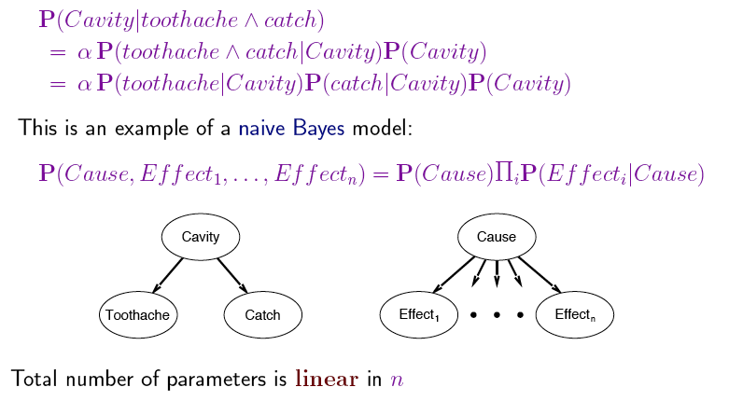
Bayes’ Rule (2)

Slide 54
Why is Bayes‘ theorem interesting?

Slide 55
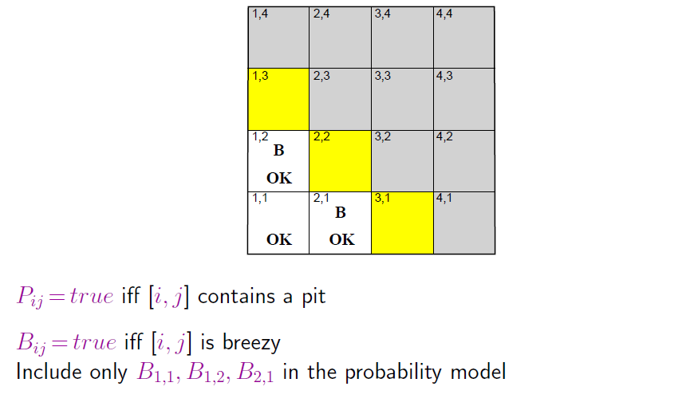
Wumpus World

Slide 56
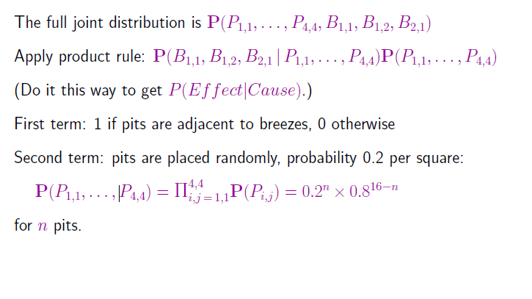
Specifying the probability model

Slide 57
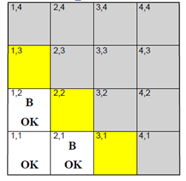
Observations and query

Slide 58
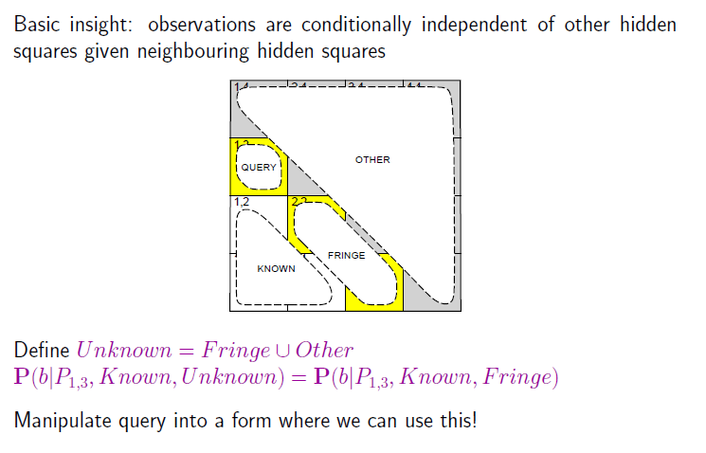
Using conditional independence

Slide 59
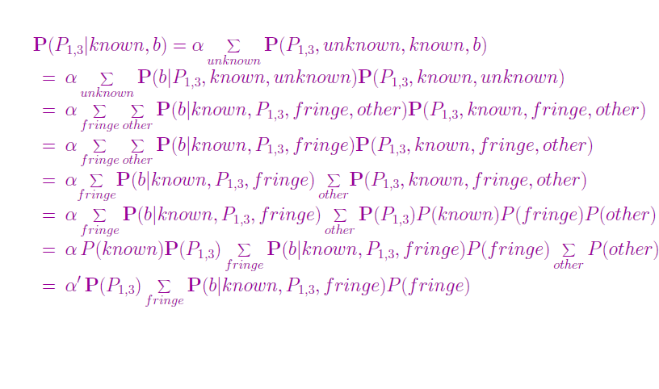
Using conditional independence contd.
In an upcoming later lecture we will investigate the
systematic approach to the „tricks“ used here

Slide 60
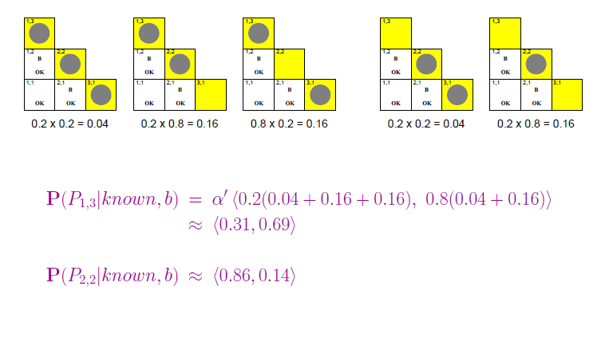
Using conditional independence contd.

Slide 61
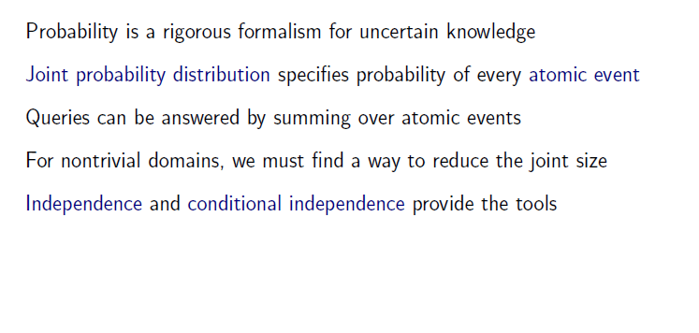
Summary

