Slide 1
Web-Mining Agents
Part: Data Mining
Prof. Dr. Ralf Möller
Dr. Özgür L. Özçep
Universität zu Lübeck
Institut für Informationssysteme
Tanya Braun (Exercises)

Slide 2
Acknowledgements
Slides from AIMA book provided by Cristina Conati, UBC
http://www.cs.ubc.ca/~conati/index.php

Slide 3
Overview
Full Bayesian Learning
MAP learning
Maximun Likelihood Learning
Learning Bayesian Networks
  Fully observable
  With hidden (unobservable) variables

Slide 4
Full Bayesian Learning
In the learning methods we have seen so far, the idea was always to find the best model that could explain some observations
In contrast, full Bayesian learning sees learning as Bayesian updating of a probability distribution over the hypothesis space, given data
  H is the hypothesis variable
  Possible hypotheses (values of H) h₁…, h_{n}
  P(H) = prior probability distribution over hypothesis space
j_{th} observation d_{j} gives the outcome of random variable D_{j}
  training data d= d₁,..,d_{k}

Slide 5
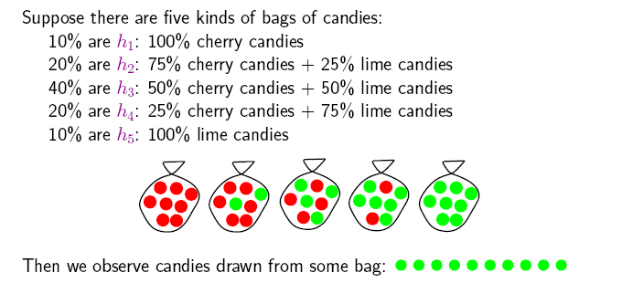
Example
Suppose we have 5 types of candy bags
  10% are 100% cherry candies (h₁₀₀)
  20% are 75% cherry + 25% lime candies (h₇₅)
  40% are 50% cherry + 50% lime candies (h₅₀)
  20% are 25% cherry + 75% lime candies (h₂₅)
  10% are 100% lime candies (h₀)
Then we observe candies drawn from some bag
θ = the parameter that defines the fraction of cherry candy in a bag
h_{θ} = corresponding hypothesis
Which bag has generated my 10 observations? P(h_{θ} |d).
What flavour will the next candy be? Prediction P(X|d)

Slide 6
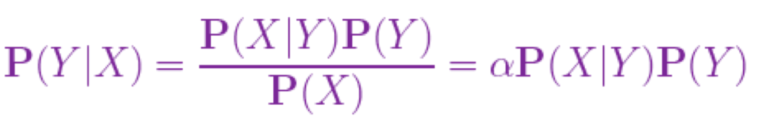
Full Bayesian Learning
Given the data so far, each hypothesis h_{i} has a posterior probability:
  P(h_{i} |d) = αP(d| h_{i}) P(h_{i}) (Bayes theorem)
  where P(d| h_{i}) is called the likelihood of the data under each hypothesis
Predictions over a new entity X are a weighted average over the prediction of each hypothesis:
  P(X|d) =
  = ∑_{i} P(X, h_{i} |d)
  = ∑_{i} P(X| h_{i},d) P(h_{i} |d)
  = ∑_{i} P(X| h_{i}) P(h_{i} |d)
  ~ ∑_{i} P(X| h_{i}) P(d| h_{i}) P(h_{i})
  The weights are given by the data likelihood and prior of each h
No need to pick one
best-guess hypothesis!
The data does not add anything to a prediction given an hp

Slide 7
Example
If we re-wrap each candy and return it to the bag, our 10 observations are independent and identically distributed, i.i.d, so
  P(d| h_{θ}) = ∏_{j} P(d_{j}| h_{θ}) for j=1,..,10
For a given h_{θ}, the value of P(d_{j}| h_{θ}) is
  P(d_{j} = cherry| h_{θ}) = θ; P(d_{j} = lime|h_{θ}) = (1-θ)
Given observations, of which c are cherry and l = N-c lime
  Binomial distribution: probability of # of successes in a sequence of N independent trials with binary outcome, each of which yields success with probability θ.
For instance, after observing 3 lime candies in a row:
  P([lime, lime, lime] | h₅₀) = 0.5³ because the probability of seeing lime for each observation is 0.5 under this hypotheses

Slide 8
All-limes: Posterior Probability of H
P(h₁₀₀|d)
P(h₇₅|d)
P(h₅₀|d)
P(h₂₅|d)
P(h₀|d)
P(h_{i} |d) = αP(d| h_{i}) P(h_{i})
Initially, the hp with higher priors dominate (h₅₀ with prior = 0.4)
As data comes in, the finally best hypothesis (h₀) starts dominating, as the probability of seeing this data given the other hypotheses gets increasingly smaller
  After seeing three lime candies in a row, the probability that the bag is the all-lime one starts taking off

Slide 9
Prediction Probability
∑_{i} P(next candy is lime| h_{i}) P(h_{i} |d)
The probability that the next candy is lime increases with the probability that the bag is an all-lime one

Slide 10
Overview
Full Bayesian Learning
MAP learning
Maximun Likelihood Learning
Learning Bayesian Networks
  Fully observable
  With hidden (unobservable) variables

Slide 11
MAP approximation
Full Bayesian learning seems like a very safe bet, but unfortunately it does not work well in practice
  Summing over the hypothesis space is often intractable (e.g., 18,446,744,073,709,551,616 Boolean functions of 6 attributes)
Very common approximation: Maximum a posterior (MAP) learning:
  Instead of doing prediction by considering all possible hypotheses, as in
    P(X|d) = ∑_{i} P(X| h_{i}) P(h_{i} |d)
  Make predictions based on h_{MAP} that maximises P(h_{i} |d)
    I.e., maximize P(d| h_{i}) P(h_{i})
    P(X|d)~ P(X| h_{MAP} )

Slide 12
MAP approximation
MAP is a good approximation when P(X |d) ≈ P(X| h_{MAP})
  In our example, h_{MAP} is the all-lime bag after only 3 candies, predicting that the next candy will be lime with p =1
  The Bayesian learner gave a prediction of 0.8, safer after seeing only 3 candies
P(h₁₀₀|d)
P(h₇₅|d)
P(h₅₀|d)
P(h₂₅|d)
P(h₀|d)

Slide 13
Bias
As more data arrive, MAP and Bayesian prediction become closer, as MAP’s competing hypotheses become less likely
Often easier to find MAP (optimization problem) than deal with a large summation problem
P(H) plays an important role in both MAP and Full Bayesian Learning (defines learning bias)
Used to define a tradeoff between model complexity and its ability to fit the data
  More complex models can explain the data better => higher P(d| h_{i}) danger of overfitting
  But they are less likely a priory because there are more of them than simpler model => lower P(h_{i})
  I.e., common learning bias is to penalize complexity

Slide 14
Overview
Full Bayesian Learning
MAP learning
Maximum Likelihood Learning
Learning Bayesian Networks
  Fully observable
  With hidden (unobservable) variables

Slide 15
Maximum Likelihood (ML) Learning
Further simplification over full Bayesian and MAP learning
  Assume uniform priors over the space of hypotheses
  MAP learning (maximize P(d| h_{i}) P(h_{i})) reduces to maximizing P(d| h_{i})
When is ML appropriate?
Howard, R.: Decision analysis: Perspectives on inference, decision, and experimentation. Proceedings of the IEEE 58(5), 632-643, 1970

Slide 16
Maximum Likelihood (ML) Learning
Further simplification over Full Bayesian and MAP learning
  Assume uniform prior over the space of hypotheses
  MAP learning (maximize P(d| h_{i}) P(h_{i})) reduces to maximize P(d| h_{i})
When is ML appropriate?
  Used in statistics as the standard (non-bayesian) statistical learning method by those who distrust subjective nature of hypotheses priors
  When the competing hypotheses are indeed equally likely (e.g. have same complexity)
  With very large datasets, for which P(d| h_{i}) tends to overcome the influence of P(h_{i})

Slide 17
Overview
Full Bayesian Learning
MAP learning
Maximum Likelihood Learning
Learning Bayesian Networks
  Fully observable (complete data)
  With hidden (unobservable) variables

Slide 18
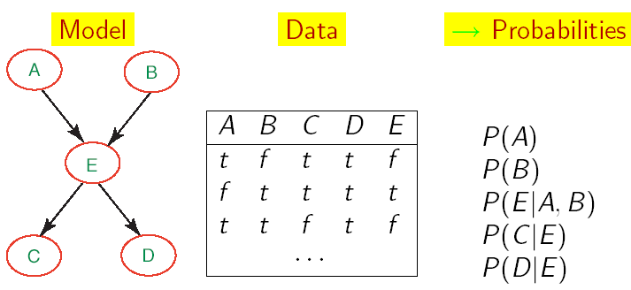
Learning BNets: Complete Data
We start by applying ML to the simplest type of BNets learning:
  Known structure
  Data containing observations for all variables
    All variables are observable, no missing data
The only thing that we need to learn are the network’s parameters

Slide 19
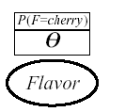
ML learning: example
Back to the candy example:
  New candy manufacturer that does not provide data on the probability of fraction θ of cherry candy in its bags
  Any θ is possible: continuum of hypotheses h_{θ}
  Reasonable to assume that all θ are equally likely (we have no evidence of the contrary): uniform distribution P(h_{θ})
  θ is a parameter for this simple family of models, that we need to learn
Simple network to represent this problem
  Flavor represents the event of drawing a cherry vs. lime candy from the bag
  P(F=cherry), or P(cherry) for brevity, is equivalent to the fraction θ of cherry candies in the bag
We want to infer θ by unwrapping N candies from the bag

Slide 20
ML learning: example (cont’d)
Unwrap N candies, c cherries and l = N-c lime (and return each candy in the bag after observing flavor)
As we saw earlier, this is described by a binomial distribution
  P(d| h_{θ}) = ∏_{j} P(d_{j}| h_{θ}) = θ^{c} (1- θ)^{l}
With ML we want to find θ that maximizes this expression, or equivalently its log likelihood (L)
  L(P(d| h_{θ}))
  = log (∏_{j} P(d_{j}| h_{θ}))
  = log (θ^{c} (1- θ)^{l} )
  = c log(θ) + l log(1- θ)
Notes:
NB: log likelihood better to handle as many distributitons specified by with exponential functions

Slide 21
ML learning: example (cont’d)
To maximize, we differentiate L(P(d| h_{θ}) with respect to θ and set the result to 0
Doing the math gives

Slide 22
Frequencies as Priors
So this says that the proportion of cherries in the bag is equal to the proportion (frequency) of cherries in the data
Now we have justified why this approach provides a reasonable estimate of node priors

Slide 23
General ML procedure
Express the likelihood of the data as a function of the parameters to be learned
Take the derivative of the log likelihood with respect to each parameter
Find the parameter value that makes the derivative equal to 0
The last step can be computationally very expensive in real-world learning tasks

Slide 24
More complex example
The manufacturer chooses the color of the wrapper probabilistically for each candy based on flavor, following an unknown distribution
  If the flavour is cherry, it chooses a red wrapper with probability θ₁
  If the flavour is lime, it chooses a red wrapper with probability θ₂
The Bayesian network for this problem includes 3 parameters to be learned
  θ, θ₁, θ₂

Slide 25
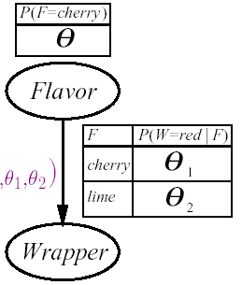
More complex example
The manufacturer chooses the color of the wrapper probabilistically for each candy based on flavor, following an unknown distribution
  If the flavour is cherry, it chooses a red wrapper with probability θ₁
  If the flavour is lime, it chooses a red wrapper with probability θ₂
The Bayesian network for this problem includes 3 parameters to be learned
  θ θ ₁ θ ₂

Slide 26
Another example (cont’d)
P( W=green, F = cherry| h_{θθ1θ2}) = (*)
= P( W=green|F = cherry, h_{θθ1θ2}) P( F = cherry| h_{θθ1θ2})
= (1-θ ₁) θ
We unwrap N candies
  c are cherry and l are lime
  r^{c} cherry with red wrapper, g^{c} cherry with green wrapper
  r^{l} lime with red wrapper, g^{l} lime with green wrapper
  every trial is a combination of wrapper and candy flavor similar to event (*) above, so
P(d| h_{θθ1θ2})
= ∏_{j} P(d_{j}| h_{θθ1θ2}) = θ^{c} (1-θ) ^{l} (θ ₁) ^{rc} (1-θ ₁) ^{gc} (θ ₂) ^{r l} (1-θ ₂) ^{g l}

Slide 27
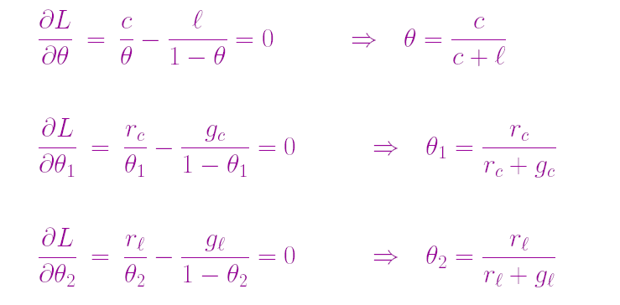
Another example (cont’d)
Maximize the log of this expression
  clogθ + l log(1- θ) + r^{c} log θ ₁ + g^{c} log(1- θ ₁) + r^{l} log θ ₂ + g ^{l} log(1- θ ₂)
Take derivative with respect of each of θ, θ ₁ ,θ ₂
  (The terms not containing the derivation variable disappear)

Slide 28
ML parameter learning in Bayes nets
Frequencies again!
This process generalizes to every fully observable Bnet.
With complete data and ML approach:
  Parameters learning decomposes into a separate learning problem for each parameter (CPT), because of the log likelihood step
  Each parameter is given by the frequency of the desired child value given the relevant parents values

Slide 29
Very Popular Application
C
Naïve Bayes models: very simple
Bayesian networks for classification
  Class variable (to be predicted) is the root node
  Attribute variables X_{i} (observations) are the leaves
Naïve because it assumes that the attributes are conditionally independent of each other given the class
Deterministic prediction can be obtained by picking the most likely class
Scales up really well: with n boolean attributes we just need…….
X_{n}
X₁
X₂
...
2n+1 parameters

Slide 30
Problem with ML parameter learning
With small datasets, some of the frequencies may be 0 just because we have not observed the relevant data
Generates very strong incorrect predictions:
  Common fix: initialize the count of every relevant event to 1 before counting the observations

Slide 31
Probability from Experts
An alternative to learning probabilities from data is to get them from experts
Problems
  Experts may be reluctant to commit to specific probabilities that cannot be refined
  How to represent the confidence in a given estimate
  Getting the experts and their time in the first place
One promising approach is to leverage both sources when they are available
  Get initial estimates from experts
  Refine them with data

Slide 32
Combining Experts and Data
Get the expert to express her belief on event A as the pair
  <n,m>
  i.e. how many observations of A they have seen (or expect to see) in m trials
Combine the pair with actual data
  If A is observed, increment both n and m
  If ¬A is observed, increment m alone
The absolute values in the pair can be used to express the expert’s level of confidence in her estimate
  Small values (e.g., <2,3>) represent low confidence
  The larger the values, the higher the confidence

Slide 33
Combining Experts and Data
Get the expert to express her belief on event A as the pair
  <n,m>
  i.e. how many observations of A they have seen (or expect to see) in m trials
Combine the pair with actual data
  If A is observed, increment both n and m
  If ¬A is observed, increment m alone
The absolute values in the pair can be used to express the expert’s level of confidence in her estimate
  Small values (e.g., <2,3>) represent low confidence, as they are quickly dominated by data
  The larger the values, the higher the confidence as it takes more and more data to dominate the initial estimate (e.g. <2000, 3000>)

Slide 34
Overview
Full Bayesian Learning
MAP learning
Maximum Likelihood Learning
Learning Bayesian Networks
  Fully observable (complete data)
  With hidden (unobservable) variables

Slide 35
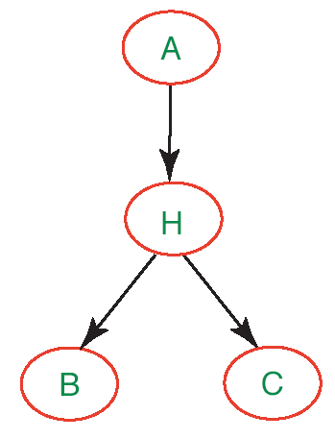
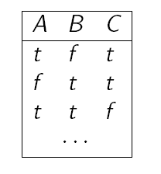
Learning Parameters with Hidden Variables
So far we have assumed that we can collect data on all variables in the network
What if this is not true, i.e. the network has hidden variables?
Clearly we can‘t use the frequency approach, because we are missing all the counts involving H

Slide 36
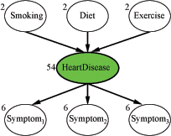
Quick Fix
Get rid of the hidden variables.
It may work in the simple network given earlier, but what about the following one?
  Each variable has 3 values (low, moderate, high)
  the numbers attached to the nodes represent how many parameters need to be specified for the CPT of that node
  78 probabilities to be specified overall

Slide 37
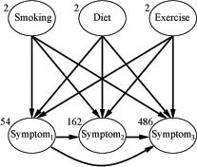
Not Necessarily a Good Fix
The symptom variables are no longer conditionally independent given their parents
  Many more links, and many more probabilities to be specified: 708 overall
  Need much more data to properly learn the network

Slide 38
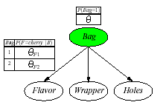
Example: The cherry/lime candy world again
Two bags of candies (1 and 2) have been mixed together
Candies are described by 3 features: Flavor and Wrapper as before, plus Hole (whether they have a hole in the middle)
Candies‘ features depend probabilistically from the bag they originally came from
We want to predict for each candy, which was its original bag, from its features: Naïve Bayes model
θ= P(Bag = 1)
θ_{Fj} = P(Flavor = cherry|Bag = j)
θ_{Wj} = P(Wrapper = red|Bag = j)
θ_{Hj} = P(Hole = yes|Bag = j)
j =1,2

Slide 39
Expectation-Maximization (EM)
If we keep the hidden variables, and want to learn the network parameters from data, we have a form of unsupervised learning
  The data do not include information on the true nature of each data point (i.e. no categorization label)
Expectation-Maximization
  General algorithm for learning model parameters from incomplete data
  We‘ll see how it works on learning parameters for Bnets with discrete variables

Slide 40
Bayesian learning: Bayes’ rule
Given some model space (set of hypotheses h_{i}) and evidence (data D):
  P(h_{i}|D) = α P(D|h_{i}) P(h_{i})
We assume that observations are independent of each other, given a model (hypothesis), so:
  P(h_{i}|D) = α ∏_{j} P(d_{j}|h_{i}) P(h_{i})
To predict the value of some unknown quantity, X (e.g., the class label for a future observation):
  P(X|D) = ∑_{i} P(X|D, h_{i}) P(h_{i}|D) = ∑_{i} P(X|h_{i}) P(h_{i}|D)
These are equal by our
independence assumption

Slide 41
Bayesian learning
We saw three ways of Bayesian learning:
  Full Bayesian Learning aka BMA (Bayesian Model Averaging)
  MAP (Maximum A Posteriori) hypothesis
  MLE (Maximum Likelihood Estimate)
Another principle (see later lectures) is
  MDL (Minimum Description Length) principle: Use some encoding to model the complexity of the hypothesis, and the fit of the data to the hypothesis, then minimize the overall description length of h_{i} + D

Slide 42
Parameter estimation
Assume known structure
Goal: estimate BN parameters θ
  CPT entries P(X | Parents(X))
A parameterization θ is good if it is likely to generate the observed data:
Maximum Likelihood Estimation
(MLE) Principle: Choose θ*
so as to maximize Score
i.i.d. samples

Slide 43
EM: general idea
If we had data for all the variables in the network, we could learn the parameters by using ML (or MAP) models
  Frequencies of the relevant events as we saw in previous examples
If we had the parameters in the network, we could estimate the posterior probability of any event, including the hidden variables P(H|A,B,C)

Slide 44
EM: General Idea
The algorithm starts from “invented” (e.g., randomly generated) information to solve the learning problem, i.e.
  Determine the network parameters
It then refines this initial guess by cycling through two basic steps
  Expectation (E): update the data with predictions generated via the current model
  Maximization (M): given the updated data, update the model parameters using the Maximum Likelihood (ML) approach
    This is the same step that we described when learning parameters for fully observable networks

Slide 45
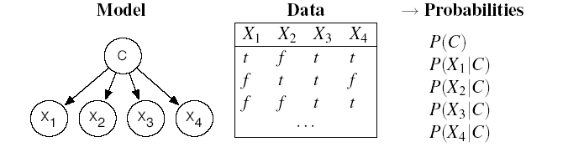
EM: How it Works on Naive Bayes
Consider the following data,
  N examples with Boolean attributes X1, X2, X3, X4
which we want to categorize in one of three possible values of class C = {1,2,3}
We use a Naive Bayes classifier with hidden variable C
?
?
?
?
?

Slide 46
EM: Initialization
The algorithm starts from “invented” (e.g., randomly generated) information to solve the learning problem, i.e.
  Determine the network parameters
?
?
?
?
?
Define
arbitrary
parameters

Slide 47
EM: Expectation Step (Get Expected Counts)
?
?
?
?
?
What would we need to learn the network parameters using
the ML approach?
  P(C = i) = #(data with C=i) / #(all datapoints) for i=1,2,3
  P(X_{h} = val_{k} |C = i) = #(data with X_{h} = val_{k} and C=i) / #(data with C=i)
  for all values val_{k} of X_{h} and i=1,2,3
Remember that the equations result from our already derived knowledge
that the most likelihood is given by frequencies!

Slide 48
EM: Expectation Step (Get Expected Counts)
We only have #(all datapoints) = N.
We approximate all other necessary counts with expected counts derived from the model with “invented” parameters
Expected count is the sum, over all N examples in my dataset, of the probability that each example is in category i

Slide 49
EM: Expectation Step (Get Expected Counts)
How do we get the necessary probabilities from the model?
Easy with a Naïve bayes network
Also available from Naïve Bayes. You do the necessary transformations
Naïve bayes “invented parameters”

Slide 50
EM: Expectation Step (Get Expected Counts)
By a similar process we obtain the expected counts of examples with attribute X_{h}= val_{k} and belonging to category i.
These are needed later for estimating P(X_{h} | C):
  for all values val_{k} of X_{h} and i=1,2,3
For instance
Again, get these probabilities from model with current parameters

Slide 51
EM: General Idea
The algorithm starts from “invented” (e.g., randomly generated) information to solve the learning problem, i.e.
  the network parameters
It then refines this initial guess by cycling through two basic steps
  Expectation (E): compute expected counts based on the generated via the current model
  Maximization (M): given the expected counts, update the model parameters using the Maximum Likelihood (ML) approach
    This is the same step that we described when learning parameters for fully observable networks

Slide 52
Maximization Step: (Refining Parameters)
Now we can refine the network parameters by applying ML to the expected counts
  for all values val_{k} of X_{j} and i=1,2,3

Slide 53
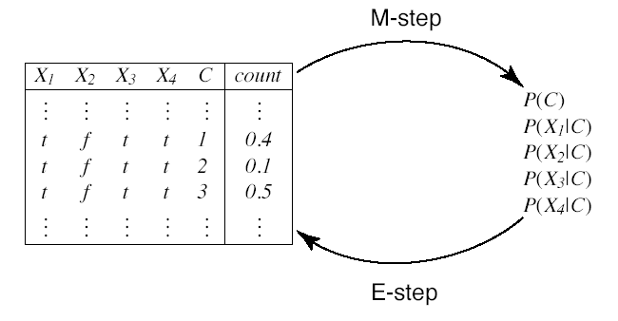
EM Cycle
Ready to start the E-step again
Expected Counts
(“Augmented data”)
Probabilities

Slide 54
Procedure EM(X,D,k)
Inputs: X set of features X={X₁,...,X_{n}} ; D data set on features {X₁,...,X_{n}}; k number of classes
Output: P(C), P(X_{i}|C) for each i∈{1:n}, where C={1,...,k}.
Local
real array A[X₁,...,X_{n},C]
real array P[C]
real arrays M_{i}[X_{i},C] for each i∈{1:n}
real arrays P_{i}[X_{i},C] for each i∈{1:n}
s← number of tuples in D
Assign P[C], P_{i}[X_{i},C] arbitrarily
repeat
// E Step
for each assignment 〈X₁=v₁,...,X_{n}=v_{n}〉∈D do
let m ←|〈X₁=v₁,...,X_{n}=v_{n}〉∈D|
for each c ∈{1:k} do
A[v₁,...,v_{n},c]←m×P(C=c|X₁=v₁,...,X_{n}=v_{n})
end for each
end for each
// M Step
for each i∈{1:n} do
M_{i}[X_{i},C]=∑_{X1,...,Xi-1,Xi+1,...,Xn} A[X₁,...,X_{n},C]
P_{i}[X_{i},C]=(M_{i}[X_{i},C])/(∑_{C} M_{i}[X_{i},C])
end for each
P[C]=∑_{X1,...,Xn} A[X₁,...,X_{n},C]/s
until probabilities do not change significantly
end procedure

Slide 55
Example: Back to the cherry/lime candy world
Two bags of candies (1 and 2) have been mixed together
Candies are described by 3 features: Flavor and Wrapper as before, plus Hole (whether they have a hole in the middle)
Candies‘ features depend probabilistically from the bag they originally came from
We want to predict for each candy, which was its original bag, from its features: Naïve Bayes model
θ = P(Bag = 1)
θ_{Fj} = P(Flavor = cherry|Bag = j)
θ_{Wj} = P(Wrapper = red|Bag = j)
θ_{Hj} = P(Hole = yes|Bag = j)
j =1,2

Slide 56
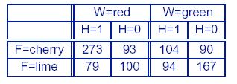
Data
Assume that the true parameters are
  θ= 0.5;
  θ_{F1} = θ_{W1} = θ_{H1} = 0.8;
  θ_{F2} = θ_{W2} = θ_{H2} = 0.3;
The following counts are “generated” from P(C, F, W, H)
(N = 1000)
We want to re-learn the true parameters using EM

Slide 57
EM: Initialization
Assign arbitrary initial parameters
  Usually done randomly; here we select numbers convenient for computation
We‘ll work through one cycle of EM to compute θ^{(1).}

Slide 58
E-step
First, we need the expected count of candies from Bag 1,
  Sum of the probabilities that each of the N data points comes from bag 1
  Be flavor_{j}, wrapper_{j}, hole_{j} the values of the corresponding attributes for the j^{th} datapoint

Slide 59
E-step
This summation can be broken down into the 8 candy groups in the data table.
  For instance the sum over the 273 cherry candies with red wrap and hole (first entry in the data table) gives

Slide 60
M-step
If we do compute the sums over the other 7 candy groups we get
At this point, we can perform the M-step to refine θ, by taking the expected frequency of the data points that come from Bag 1

Slide 61
One More Parameter
If we want to do the same for parameter θ_{F1}
E-step: compute the expected count of cherry candies from Bag 1
Can compute the above value from the Naïve model as we did earlier
TRY AS AN EXCERCISE
M-step: refine θ_{F1} by computing the corresponding expected frequencies

Slide 62
Learning Performance
After a complete cycle through all the parameters, we get
For any set of parameters, we can compute the log likelihood as we did in the previous class
It can be seen that the log likelihood increases with each EM iteration (see textbook)
EM tends to get stuck in local maxima, so it is often combined with gradient-based techniques in the last phase of learning

Slide 63
Learning Performance
After a complete cycle through all the parameters, we get
For any set of parameters, I can compute the log likelihood as we did in the previous class
It can be shown that the log likelihood increases with each EM iteration, surpassing even the likelihood of the original model after only 3 iterations

Slide 64
EM: Discussion
For more complex Bnets the algorithm is basically the same
  In general, I may need to compute the conditional probability parameter for each variable X_{i} given its parents Pa_{i}
  θ_{ijk}= P(X_{i} = x_{ij}|Pa_{i =} pa_{ik})
The expected counts are computed by summing over the examples, after having computed all the necessary
P(X_{i} = x_{ij},Pa_{i =} pa_{ik}) using any Bnet inference algorithm
The inference can be intractable, in which case there are variations of EM that use sampling algorithms for the E-Step

Slide 65
EM: Discussion
The algorithm is sensitive to “degenerated” local maxima due to extreme configurations
  e.g., data with outliers can generate categories that include only 1 outlier each because these models have the highest log likelihoods
  Possible solution: re-introduce priors over the learning hypothesis and use the MAP version of EM

Slide 66
Learning Bayesian network structures
Given training set
Find model that best matches D
  model selection
  parameter estimation
B
E
Inducer
A
C
Data D

Slide 67
Model selection
Goal: Select the best network structure, given the data
Input:
  Training data
  Scoring function
Output:
  A network that maximizes the score

Slide 68
Structure selection: Scoring
Bayesian: prior over parameters and structure
  get balance between model complexity and fit to data as a byproduct
Score (G:D) = log P(G|D) = α log [P(D|G) P(G)]
Marginal likelihood just comes from our parameter estimates
Prior on structure can be any measure we want; typically a function of the network complexity (MDL principle)
Can we learn G’s params from D?
Does G explain D with ML?
Prior w.r.t. MDL
Same key property: Decomposability
Score(structure) = Σ_{i} Score(family of X_{i})
Notes:
Remember: MDL = minimum description length, here network complexity; the more complex a system the lesser its probability.

Slide 69
Heuristic search
B
E
Add E→C
A
B
E
Δscore(C)
A
C
Reverse E→A
C
Δscore(A)
Delete E→A
B
E
Δscore(A)
B
E
A
A
C
C

Slide 70
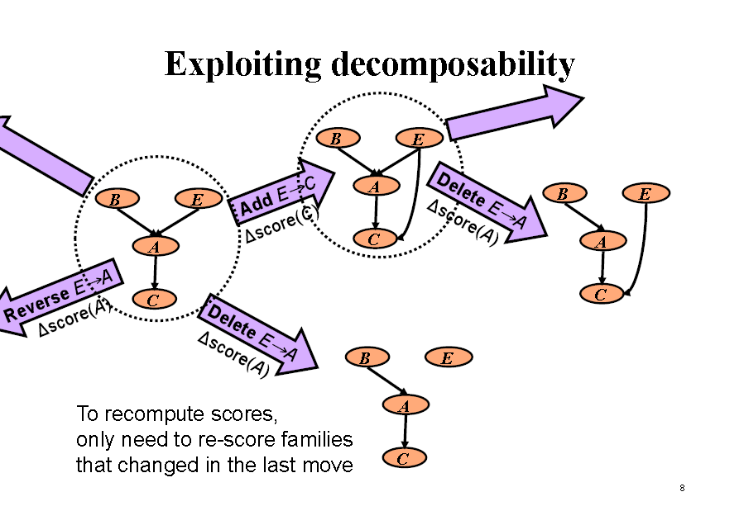

Slide 71
Variations on a theme
Known structure, fully observable: only need to do parameter estimation
Known structure, hidden variables:
use expectation maximization (EM) to estimate parameters
Unknown structure, fully observable: do heuristic search through structure space, then parameter estimation
Unknown structure, hidden variables: too hard to solve!

