Slide 1
Web-Mining Agents
Clustering
Prof. Dr. Ralf Möller
Dr. Özgür L. Özçep
Universität zu Lübeck
Institut für Informationssysteme
Tanya Braun (Exercises)

Slide 2
Clustering
Initial slides by Eamonn Keogh

Slide 3
What is Clustering?
Also called unsupervised learning, sometimes called classification by statisticians and sorting by psychologists and segmentation by people in marketing
Organizing data into classes such that there is
  high intra-class similarity
  low inter-class similarity
Finding the class labels and the number of classes directly from the data (in contrast to classification).
More informally, finding natural groupings among objects.

Slide 4
Intuitions behind desirable distance measure properties
D(A,B) = D(B,A) Symmetry
  Otherwise you could claim “Alex looks like Bob, but Bob looks nothing like Alex.”
D(A,A) = 0 Constancy of Self-Similarity
  Otherwise: “Alex looks more like Bob, than Bob does.”
D(A,B) >= 0 Positivity
D(A,B) ≤ D(A,C) + D(B,C) Triangular Inequality
  Otherwise: “Alex is very like Carl, and Bob is very like Carl, but Alex is very unlike Bob.”
If D(A,B) = 0 then A = B Separability
  Otherwise you could not tell different objects apart.
D fulfilling 1.-4. is called a pseudo-metric
D fulfilling 1.-5. is called a metric

Slide 5
Edit Distance Example
How similar are the names “Peter” and “Piotr”?
Assume the following cost function
Substitution 1 Unit
Insertion 1 Unit
Deletion 1 Unit
D(Peter,Piotr) is 3
It is possible to transform any string Q into string C, using only Substitution, Insertion and Deletion.
Assume that each of these operators has a cost associated with it.
The similarity between two strings can be defined as the cost of the cheapest transformation from Q to C.
Note that for now we have ignored the issue of how we can find this cheapest transformation
Peter
Piter
Pioter
Piotr
Substitution (i for e)
Insertion (o)
Piotr
Pedro
Piero
Peter
Deletion (e)
Pyotr
Petros
Pietro
Pierre

Slide 6
A Demonstration of Hierarchical Clustering using String Edit Distance
Pedro (Portuguese)
Petros (Greek), Peter (English), Piotr (Polish), Peadar (Irish), Pierre (French), Peder (Danish), Peka (Hawaiian), Pietro (Italian), Piero (Italian Alternative), Petr (Czech), Pyotr (Russian)
Cristovao (Portuguese)
Christoph (German), Christophe (French), Cristobal (Spanish), Cristoforo (Italian), Kristoffer (Scandinavian), Krystof (Czech), Christopher (English)
Miguel (Portuguese)
Michalis (Greek), Michael (English), Mick (Irish!)
Since we cannot test all possible trees we will have to use heuristic search of all possible trees. We could do this:
Bottom-Up (agglomerative): Starting with each item in its own cluster, find the best pair to merge into a new cluster. Repeat until all clusters are fused together.
Top-Down (divisive): Starting with all the data in a single cluster, consider every possible way to divide the cluster into two. Choose the best division and recursively operate on both sides.
Piotr
Pedro
Piero
Peter
Peka
Mick
Pyotr
Pietro
Pierre
Peder
Petros
Peadar
Miguel
Krystof
Michael
Michalis
Crisdean
Cristovao
Christoph
Cristobal
Kristoffer
Christophe
Cristoforo
Christopher

Slide 7
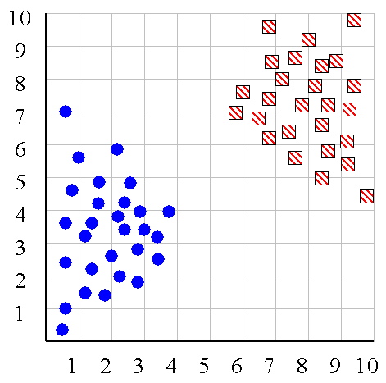
We can look at the dendrogram to determine the “correct” number of clusters. In this case, the two highly separated subtrees are highly suggestive of two clusters. (Things are rarely this clear cut, unfortunately)

Slide 8
One potential use of a dendrogram is to detect outliers
The single isolated branch is suggestive of a data point that is very different to all others
Outlier

Slide 9
Partitional Clustering
Nonhierarchical, each instance is placed in exactly one of K nonoverlapping clusters.
Since only one set of clusters is output, the user normally has to input the desired number of clusters K.

Slide 10
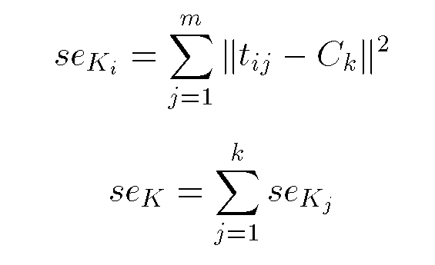
Squared Error
10
C_{i}
9
8
7
6
5
4
3
2
k = number of clusters
C_{i} = centroid of cluster i
t_{ij} = examples in cluster i
1
1
2
3
4
5
6
7
8
9
10
Objective Function

Slide 11
Algorithm k-means
1. Decide on a value for k.
2. Initialize the k cluster centers (randomly, if necessary).
3. Decide the class memberships of the N objects by assigning them to the nearest cluster center.
4. Re-estimate the k cluster centers, by assuming the memberships found above are correct.
5. If none of the N objects changed membership in the last iteration, exit. Otherwise goto 3.

Slide 12
K-means Clustering: Step 1
Algorithm: k-means, Distance Metric: Euclidean Distance
5
4
k₁
3
k₂
2
1
k₃
0
0
1
2
3
4
5

Slide 13
K-means Clustering: Step 2
Algorithm: k-means, Distance Metric: Euclidean Distance
5
4
k₁
3
k₂
2
1
k₃
0
0
1
2
3
4
5

Slide 14
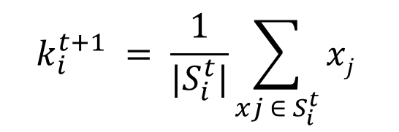
K-means Clustering: Step 3
Algorithm: k-means, Distance Metric: Euclidean Distance
5
4
k₁
3
2
k₃
k₂
1
0
0
1
2
3
4
5

Slide 15
K-means Clustering: Step 4
Algorithm: k-means, Distance Metric: Euclidean Distance
5
4
k₁
3
2
k₃
k₂
1
0
0
1
2
3
4
5

Slide 16
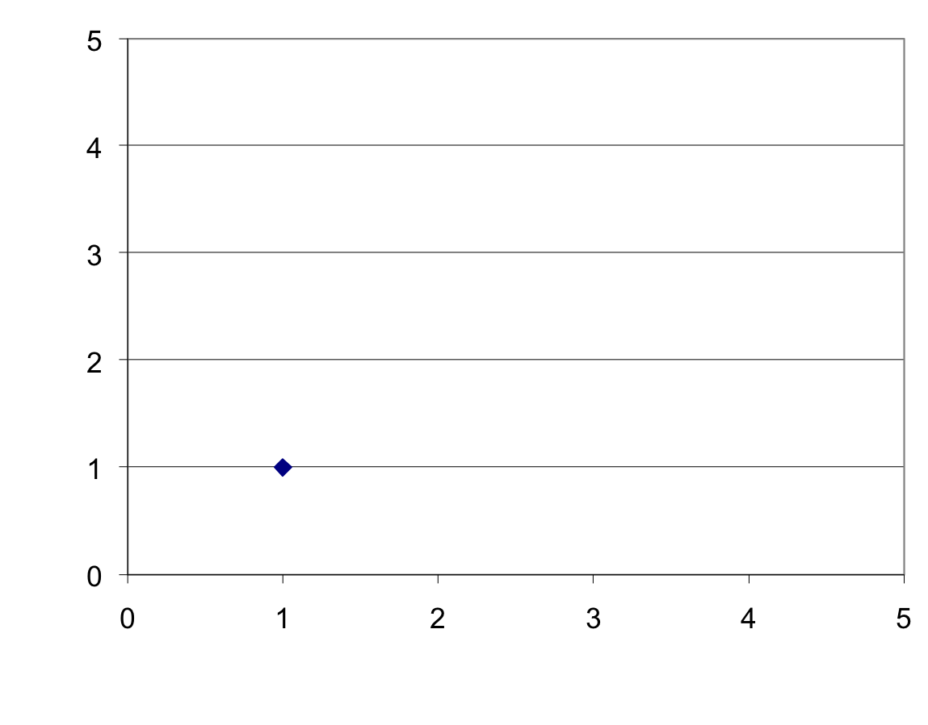
K-means Clustering: Step 5
Algorithm: k-means, Distance Metric: Euclidean Distance
k₁
k₂
k₃

Slide 17
Comments on the K-Means Method
Strength
  Relatively efficient: O(tkn), where n is # objects, k is # clusters, and t is # iterations. Normally, k, t << n.
  Often terminates at a local optimum. The global optimum may be found using techniques such as: deterministic annealing and genetic algorithms
Weakness
  Applicable only when mean is defined, then what about categorical data? Need to extend the distance measurement.
    Ahmad, Dey: A k-mean clustering algorithm for mixed numeric and categorical data, Data & Knowledge Engineering, Nov. 2007
  Need to specify k, the number of clusters, in advance
  Unable to handle noisy data and outliers
  Not suitable to discover clusters with non-convex shapes
  Tends to build clusters of equal size

Slide 18
How can we tell the right number of clusters?
In general, this is an unsolved problem. However there are many approximate methods. In the next few slides we will see an example.
10
9
For our example, we will use the familiar katydid/grasshopper dataset.
However, in this case we are imagining that we do NOT know the class labels. We are only clustering on the X and Y axis values.
8
7
6
5
4
3
2
1
1
2
3
4
5
6
7
8
9
10

Slide 19
When k = 1, the objective function is 873.0
C_{i}
1
2
3
4
5
6
7
8
9
10

Slide 20
When k = 2, the objective function is 173.1
1
2
3
4
5
6
7
8
9
10

Slide 21
When k = 3, the objective function is 133.6
1
2
3
4
5
6
7
8
9
10

Slide 22
We can plot the objective function values for k equals 1 to 6…
The abrupt change at k = 2, is highly suggestive of two clusters in the data. This technique for determining the number of clusters is known as “knee finding” or “elbow finding”.
1.00E+03
9.00E+02
8.00E+02
7.00E+02
6.00E+02
Objective Function
5.00E+02
4.00E+02
3.00E+02
2.00E+02
1.00E+02
0.00E+00
k
1
2
3
4
5
6
Note that the results are not always as clear cut as in this toy example

Slide 23
EM Clustering
Soft clustering: Probabilities for examples being in a cluster
Idea: Data produced by mixture (sum) of distributions G_{i} for each cluster (= component c_{i})
  With apriori probability P(c_{i}) cluster c_{i} is chosen
  And then element drawn according to G_{i}
In many cases
  G_{i} = N(μ_{i,} σ²_{i}) =
  Gaussian distribution with expectation value μ_{i} and variance σ²_{i}
  So component c_{i =} c_{i}(μ_{i,} σ²_{i}) identified by μ_{i} and σ²_{i}
Problem: P(c_{i}) and parameters of G_{i} not known
Solution: Use the general iterative Expectation-Maximization approach

Slide 24
EM Algorithm

Slide 25
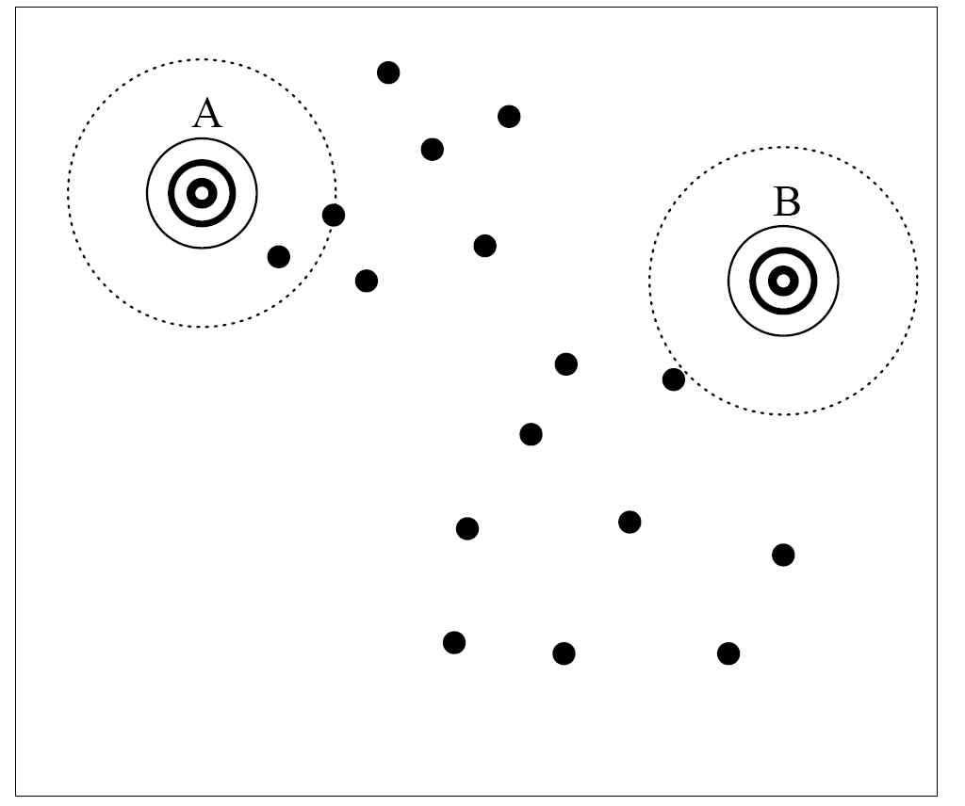
Processing : EM Initialization
  Initialization :
    Assign random value to parameters

Slide 26
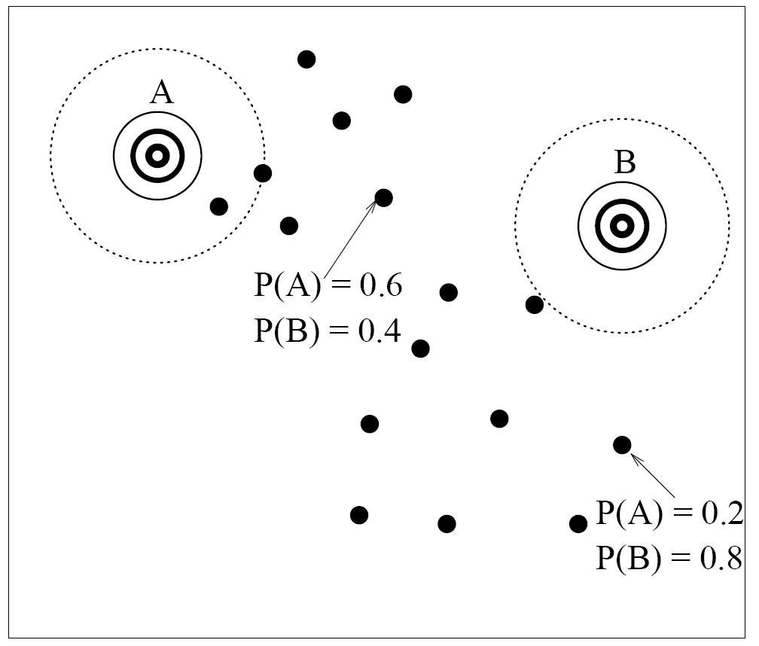
Processing : the E-Step
Mixture of Gaussians
  Expectation :
    Pretend to know the parameter
    Assign data point to a component
Notes:
Expectation : as we pretend to know the param, we infer the probability that each data point belongs to each component
Use the other graph (with stars) ??

Slide 27
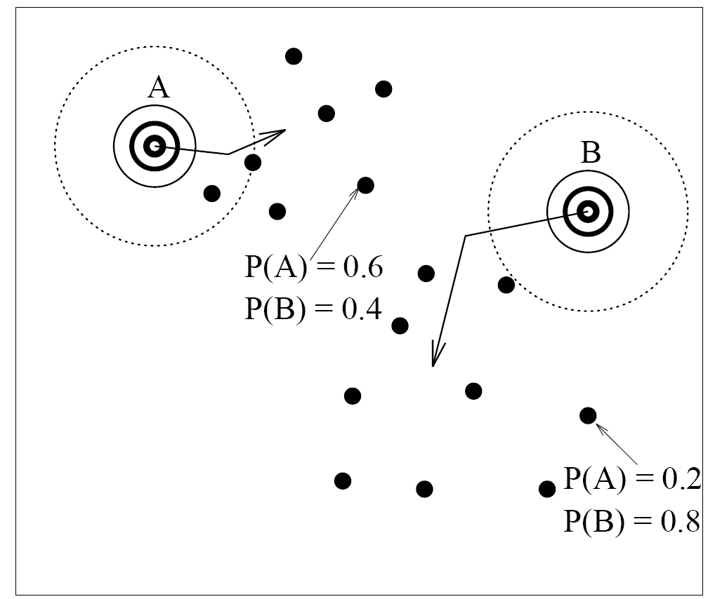
Processing : the M-Step (1/2)
Mixture of Gaussians
  Maximization :
    Fit the parameter to its set of points
Notes:
Maximization : modify the parameter so it maximizes its coherence with data points (covariance ??)

Slide 30

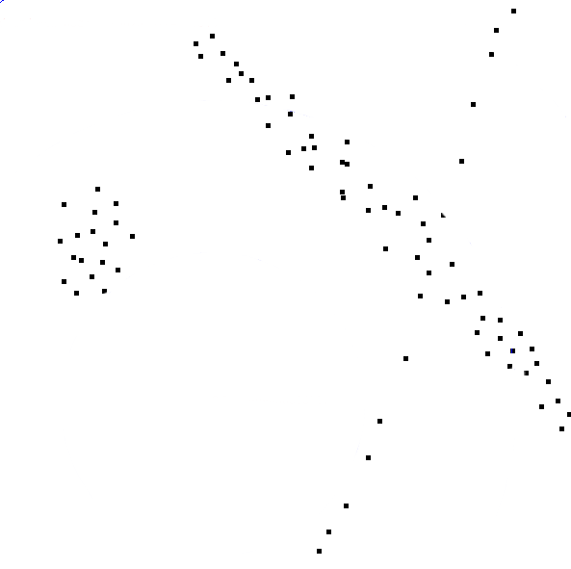

Slide 31
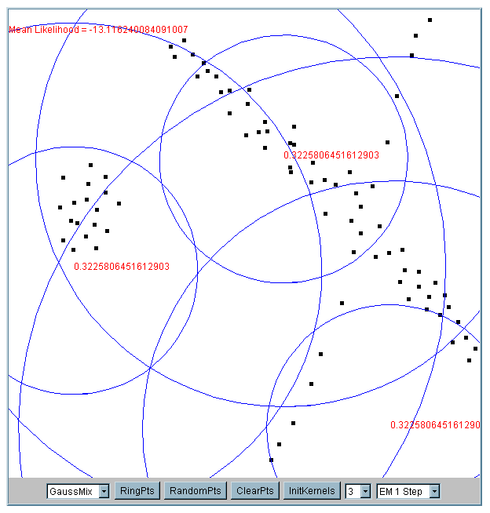
Iteration 1
The cluster means are randomly assigned

Slide 32
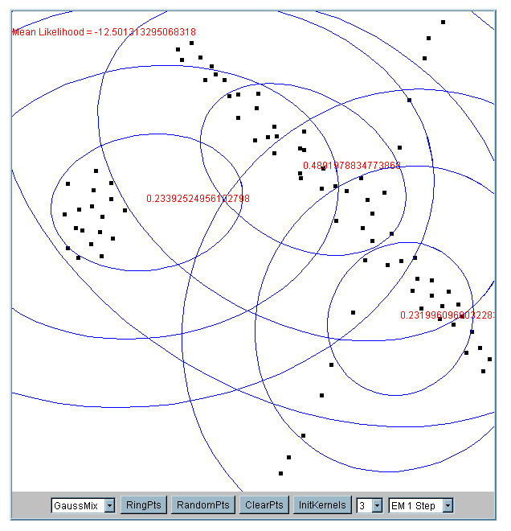
Iteration 2

Slide 33
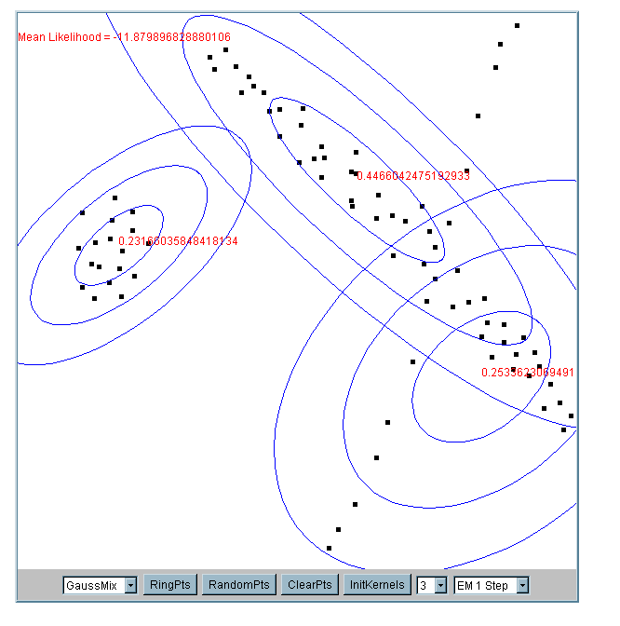
Iteration 5

Slide 34
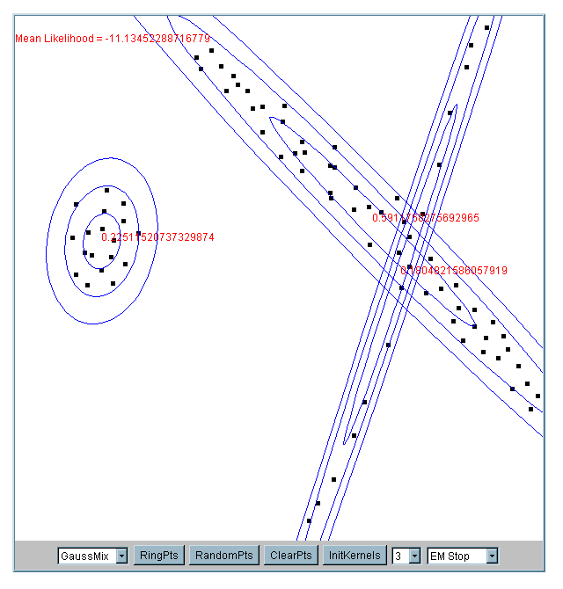
Iteration 25

Slide 35
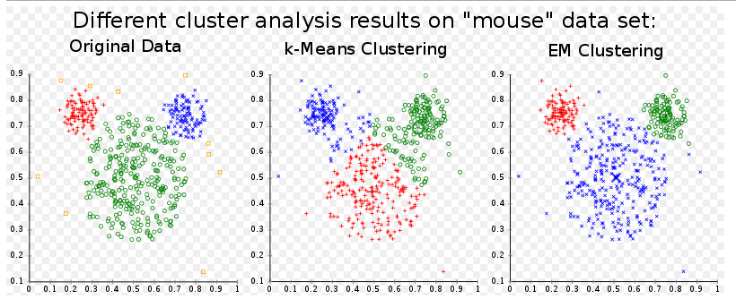
Comments on the EM
K-Means is a special form of EM
EM algorithm maintains probabilistic assignments to clusters, instead of deterministic assignments, and multivariate Gaussian distributions instead of means
Does not tend to build clusters of equal size
Source: http://en.wikipedia.org/wiki/K-means_algorithm

Slide 36
What happens if the data is streaming…
(We will investigate streams in more
detail in next lecture)
Nearest Neighbor Clustering
Not to be confused with Nearest Neighbor Classification
Items are iteratively merged into the existing clusters that are closest.
Incremental
Threshold, t, used to determine if items are added to existing clusters or a new cluster is created.

Slide 37
10
9
8
7
Threshold t
6
5
4
3
1
t
2
1
2
1
2
3
4
5
6
7
8
9
10

Slide 38
10
9
8
7
6
New data point arrives…
It is within the threshold for cluster 1, so add it to the cluster, and update cluster center.
5
4
3
1
3
2
1
2
1
2
3
4
5
6
7
8
9
10

Slide 39
New data point arrives…
It is not within the threshold for cluster 1, so create a new cluster, and so on..
10
4
9
8
7
6
5
4
3
1
3
2
1
2
Algorithm is highly order dependent…
It is difficult to determine t in advance…
1
2
3
4
5
6
7
8
9
10

Slide 40
The CURE Algorithm
Following slides on CURE algorithm
from J. Leskovec, A. Rajaraman, J. Ullman:
Mining of Massive Datasets, http://www.mmds.org
Extension of k-means to clusters
of arbitrary shapes

Slide 41
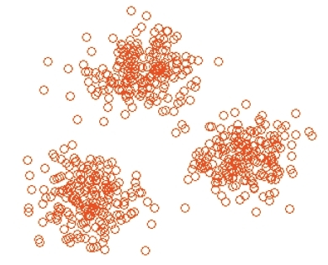
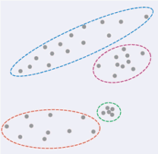
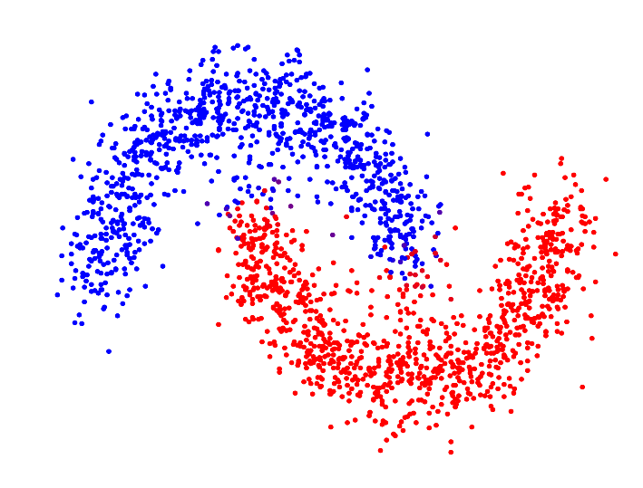
The CURE Algorithm
Vs.
Problem with BFR/k-means:
  Assumes clusters are normally
  distributed in each dimension
  And axes are fixed – ellipses at
  an angle are not OK
CURE (Clustering Using REpresentatives):
  Assumes a Euclidean distance
  Allows clusters to assume any shape
  Uses a collection of representative
  points to represent clusters
BFR algorithm not considered in this lecture
(Extension of k-means to handle data in secondary storage)

Slide 42
Example: Stanford Salaries
h
h
h
e
e
e
h
e
e
e
h
e
e
e
e
salary
h
e
h
h
h
h
h
h
h
age

Slide 43
Starting CURE
2 Pass algorithm. Pass 1:
0) Pick a random sample of points that fit in main memory
1) Initial clusters:
  Cluster these points hierarchically – group
  nearest points/clusters
2) Pick representative points:
  For each cluster, pick a sample of points, as dispersed as possible
  From the sample, pick representatives by moving them (say) 20% toward the centroid of the cluster

Slide 44
Example: Initial Clusters
h
h
h
e
e
e
h
e
e
e
h
e
e
e
e
h
salary
e
h
h
h
h
h
h
h
age

Slide 45
Example: Pick Dispersed Points
h
h
h
e
e
e
h
e
e
e
h
e
e
e
e
h
salary
e
Pick (say) 4
remote points
for each
cluster.
h
h
h
h
h
h
h
age

Slide 46
Example: Pick Dispersed Points
h
h
h
e
e
e
h
e
e
e
h
e
e
e
e
h
salary
e
Move points
(say) 20%
toward the
centroid.
h
h
h
h
h
h
h
age

Slide 47
Finishing CURE
Pass 2:
Now, rescan the whole dataset and
visit each point p in the data set
Place it in the “closest cluster”
  Normal definition of “closest”:
  Find the closest representative to p and
  assign it to representative’s cluster
p

Slide 48
Spectral Clustering
Acknowledgements for subsequent slides to
Xiaoli Fern
CS 534: Machine Learning 2011
http://web.engr.oregonstate.edu/~xfern/classes/cs534/

Slide 49
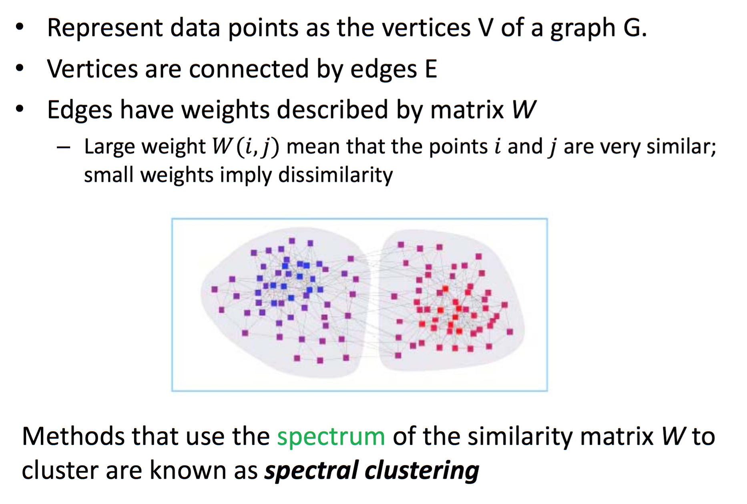
Spectral Clustering

Slide 50
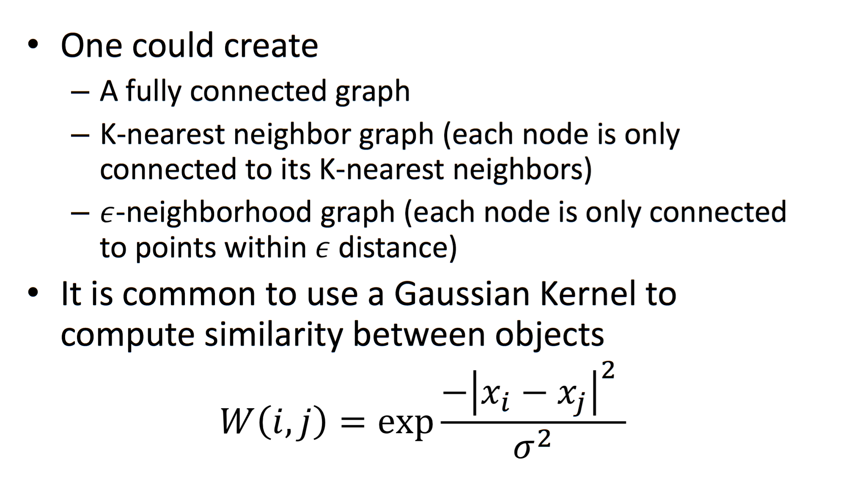
How to Create the Graph?

Slide 51
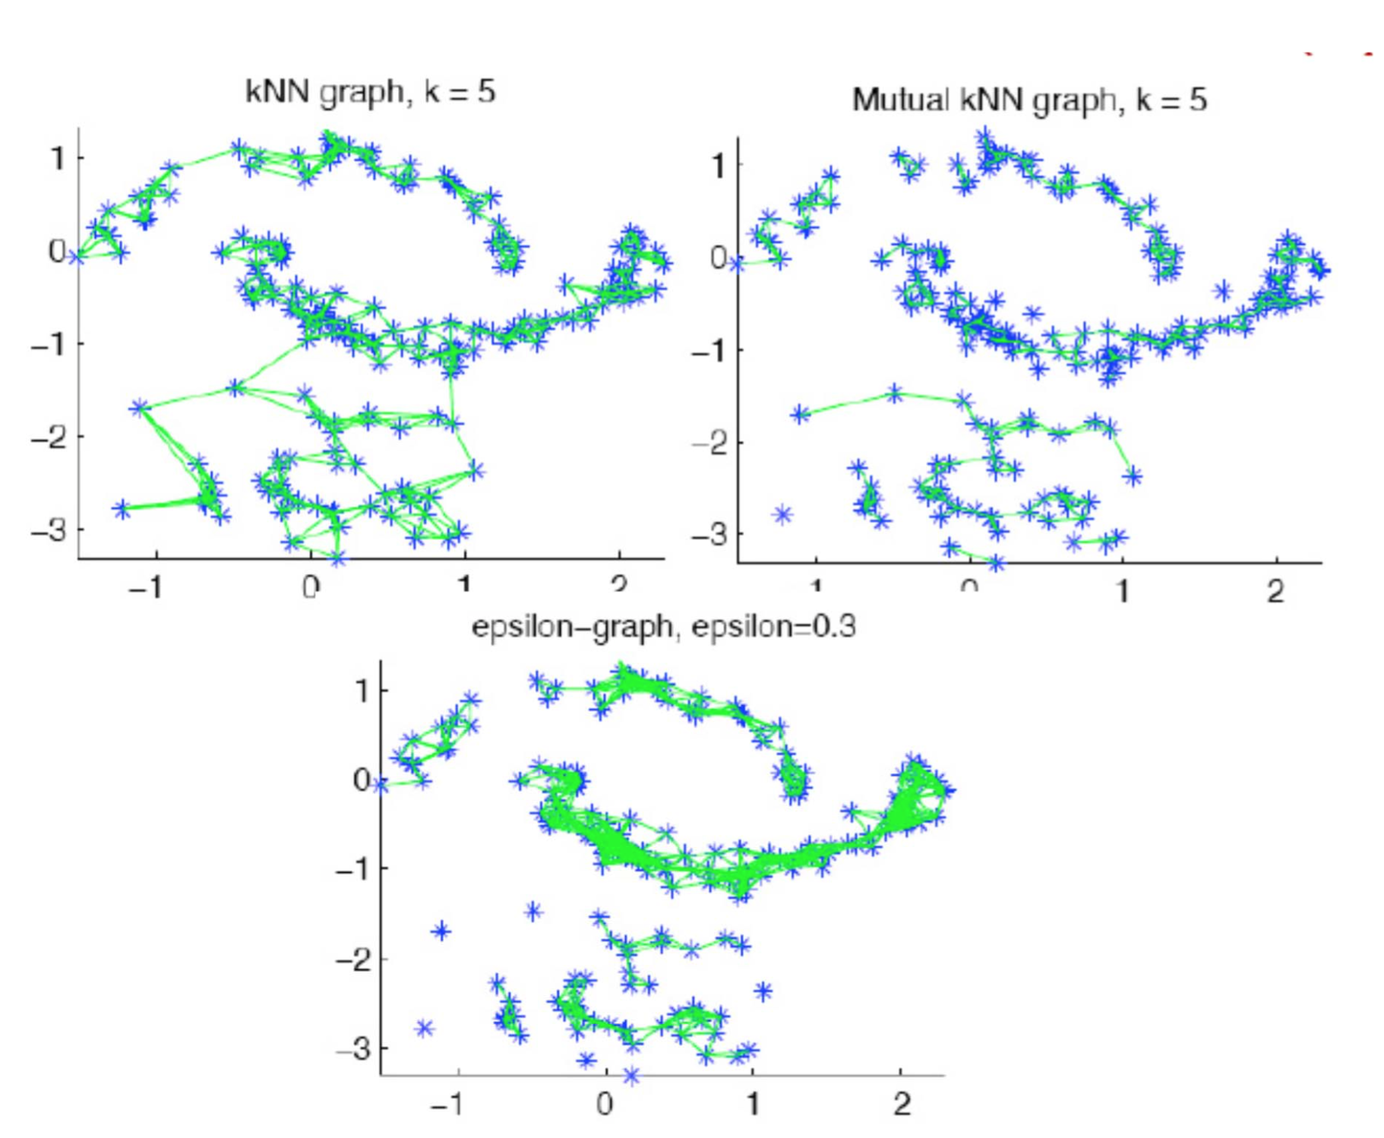

Slide 52
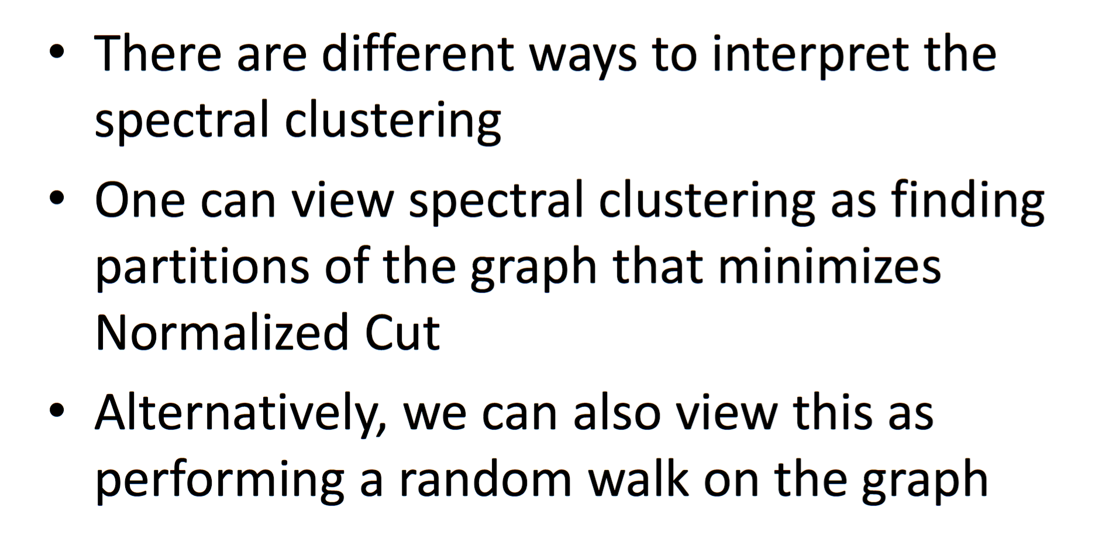
Motivations / Objectives

Slide 54
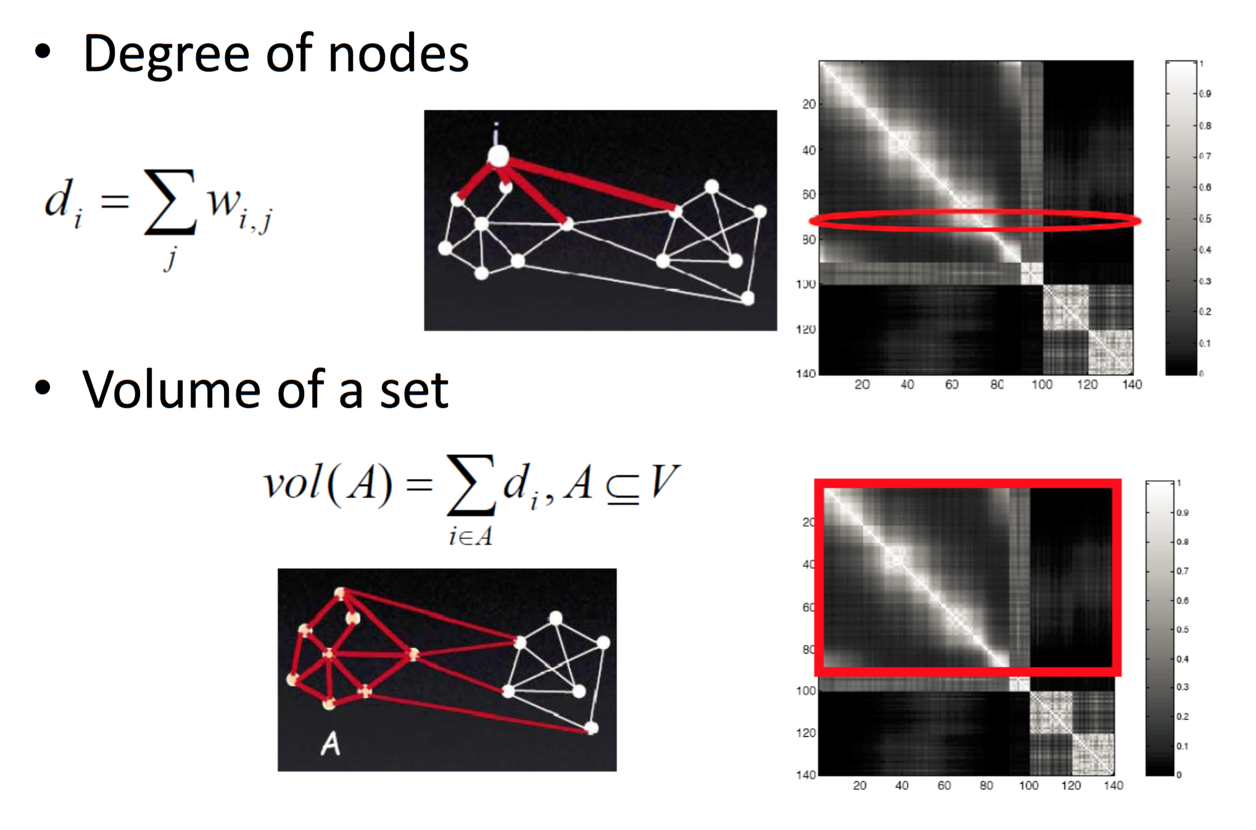
Graph Terminologies

Slide 55
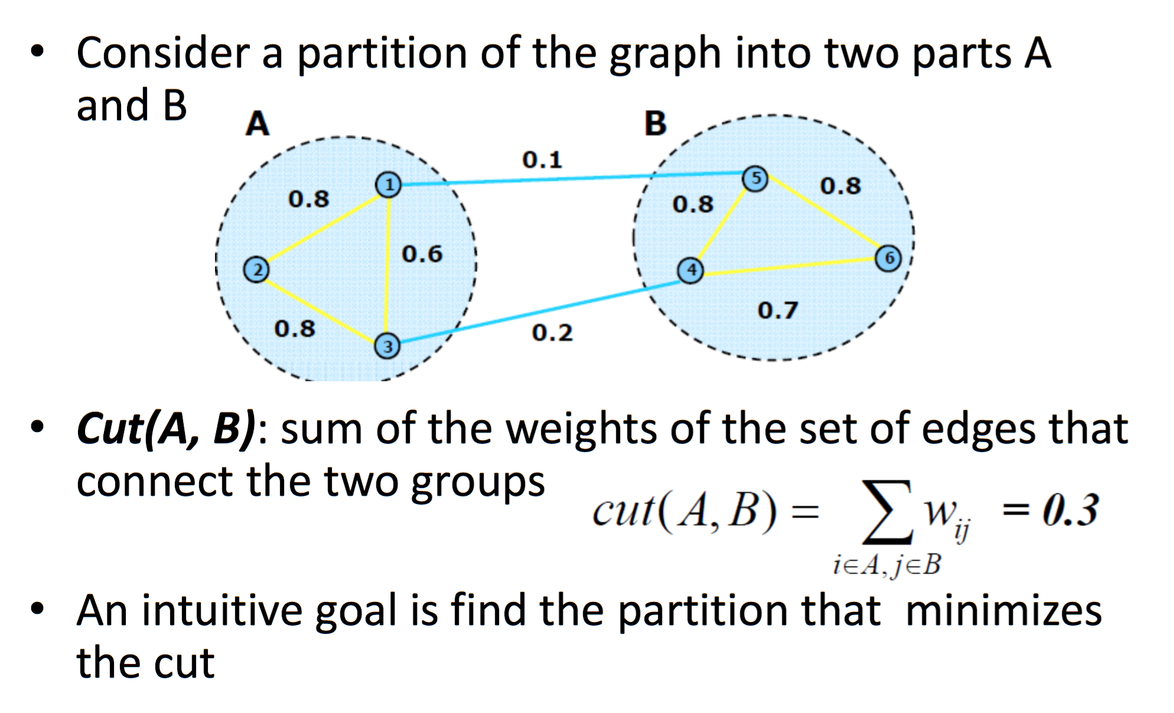
Graph Cut

Slide 56
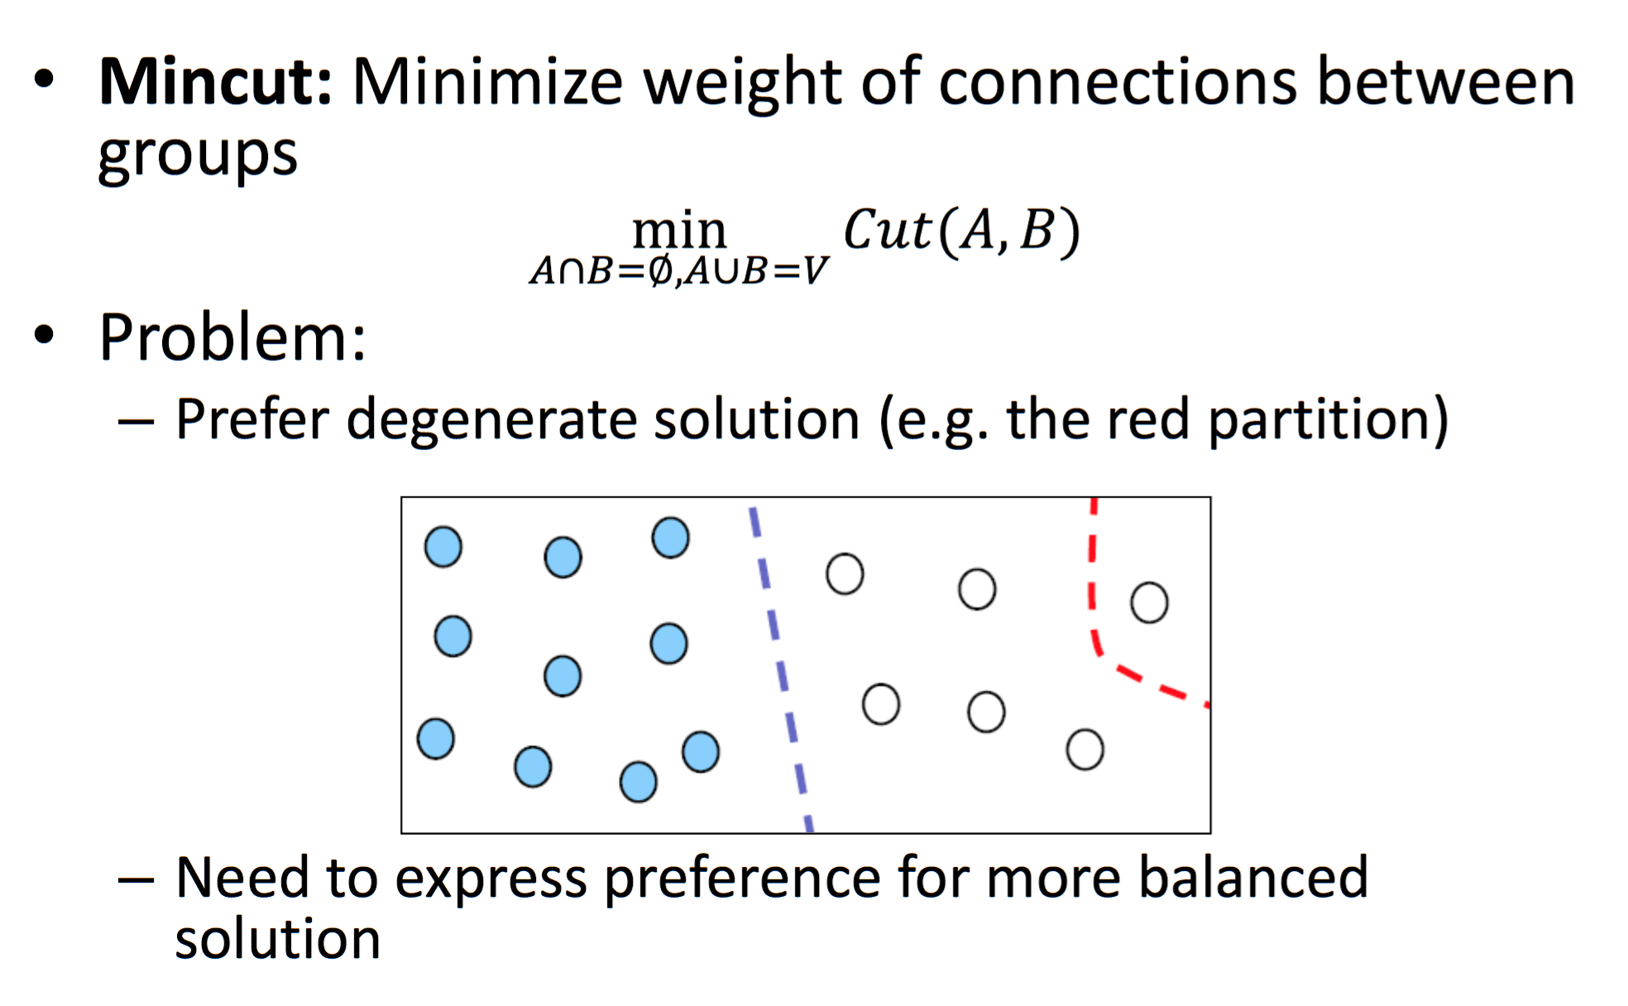
Min Cut Objective

Slide 57
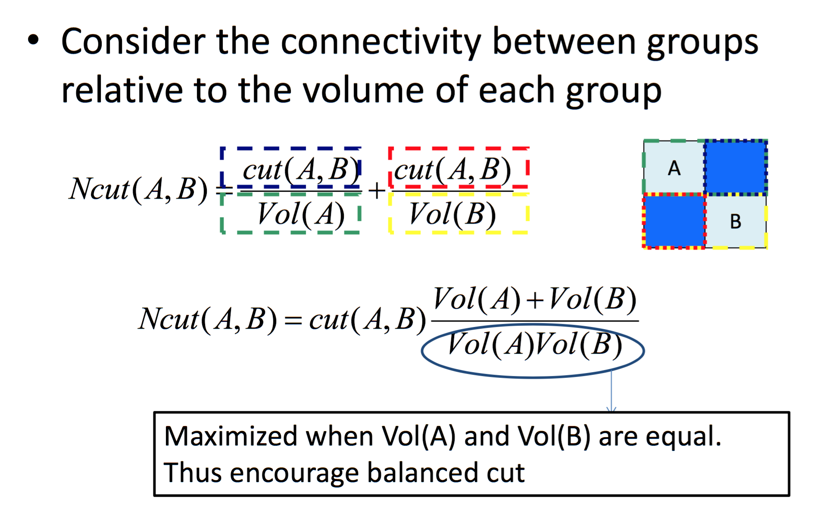
Normalized Cut

Slide 58
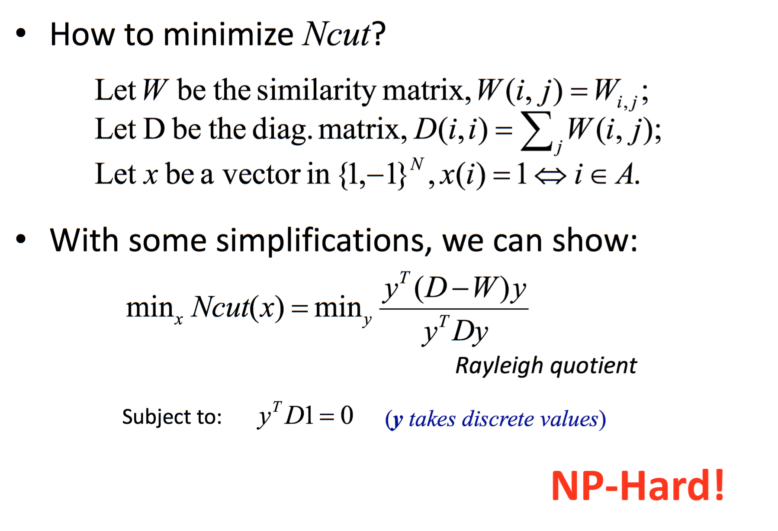
Optimizing Ncut Objective

Slide 59
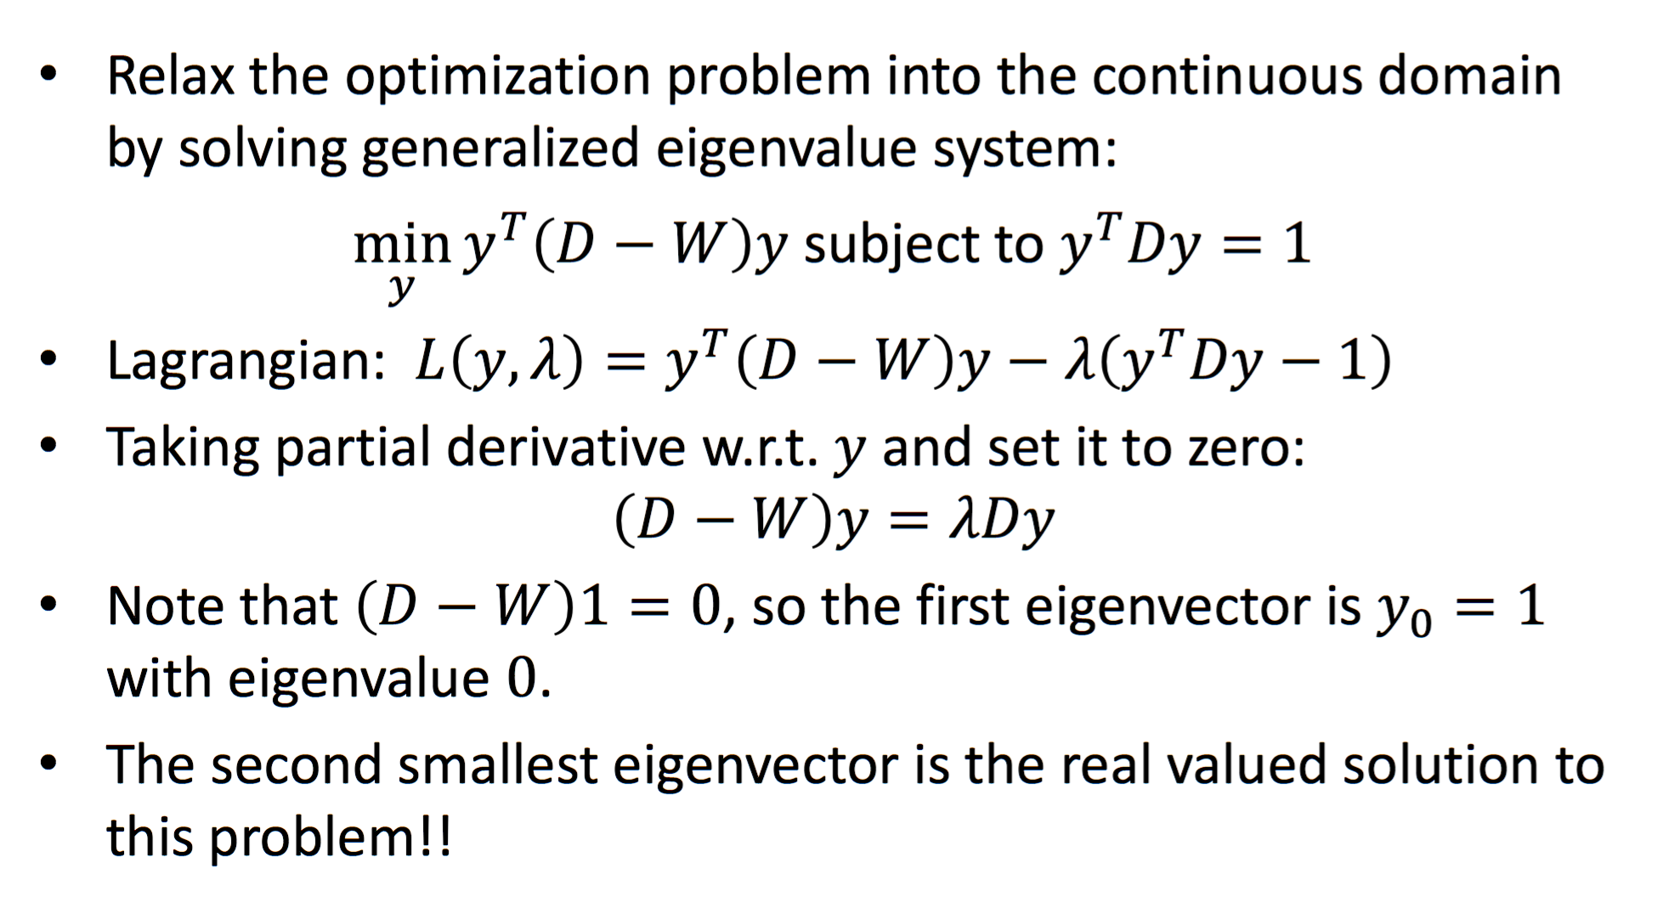
Solving Ncut

Slide 60
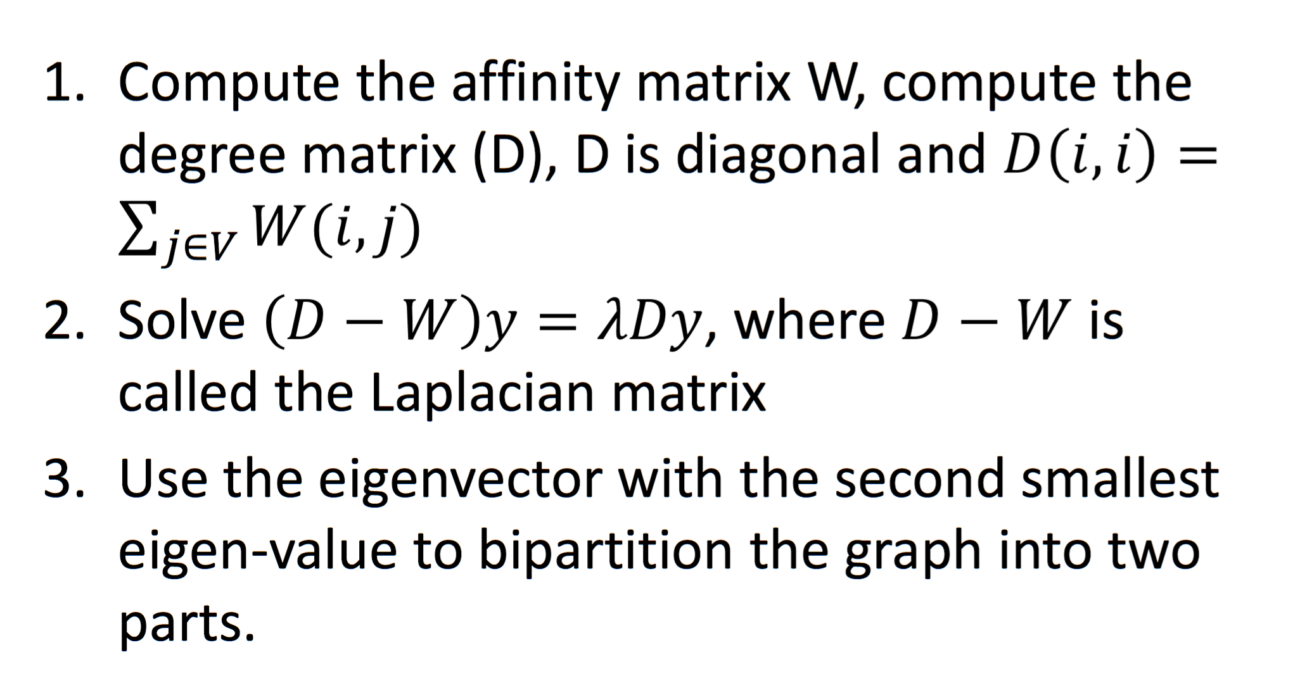
2-way Normalized Cuts

Slide 61
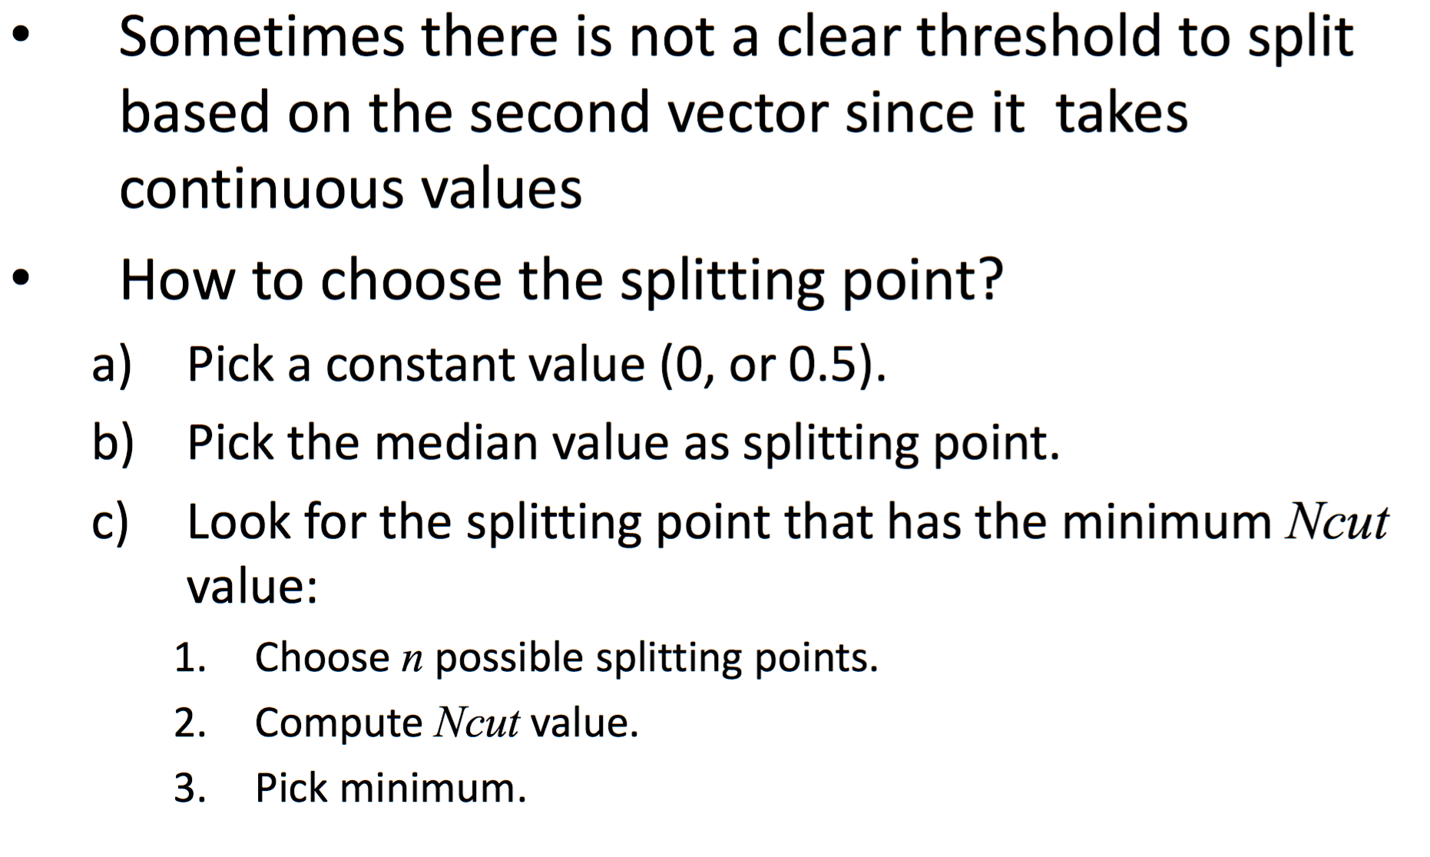
Creating Bi-Partition
Using 2nd Eigenvector

Slide 62
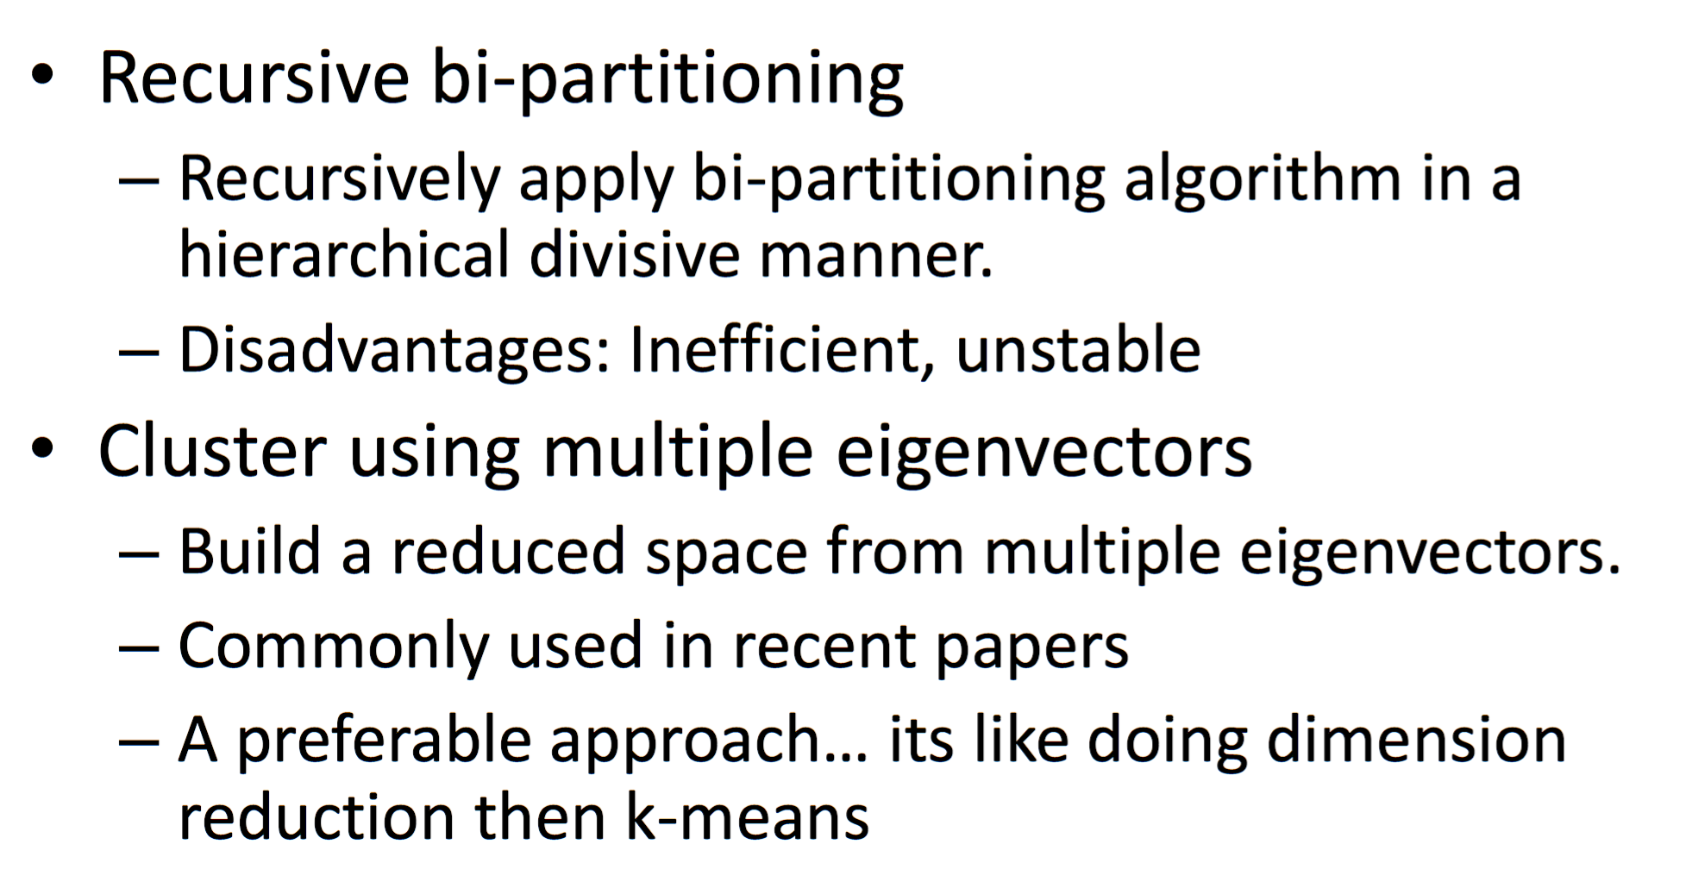
K-way Partition?

Slide 63
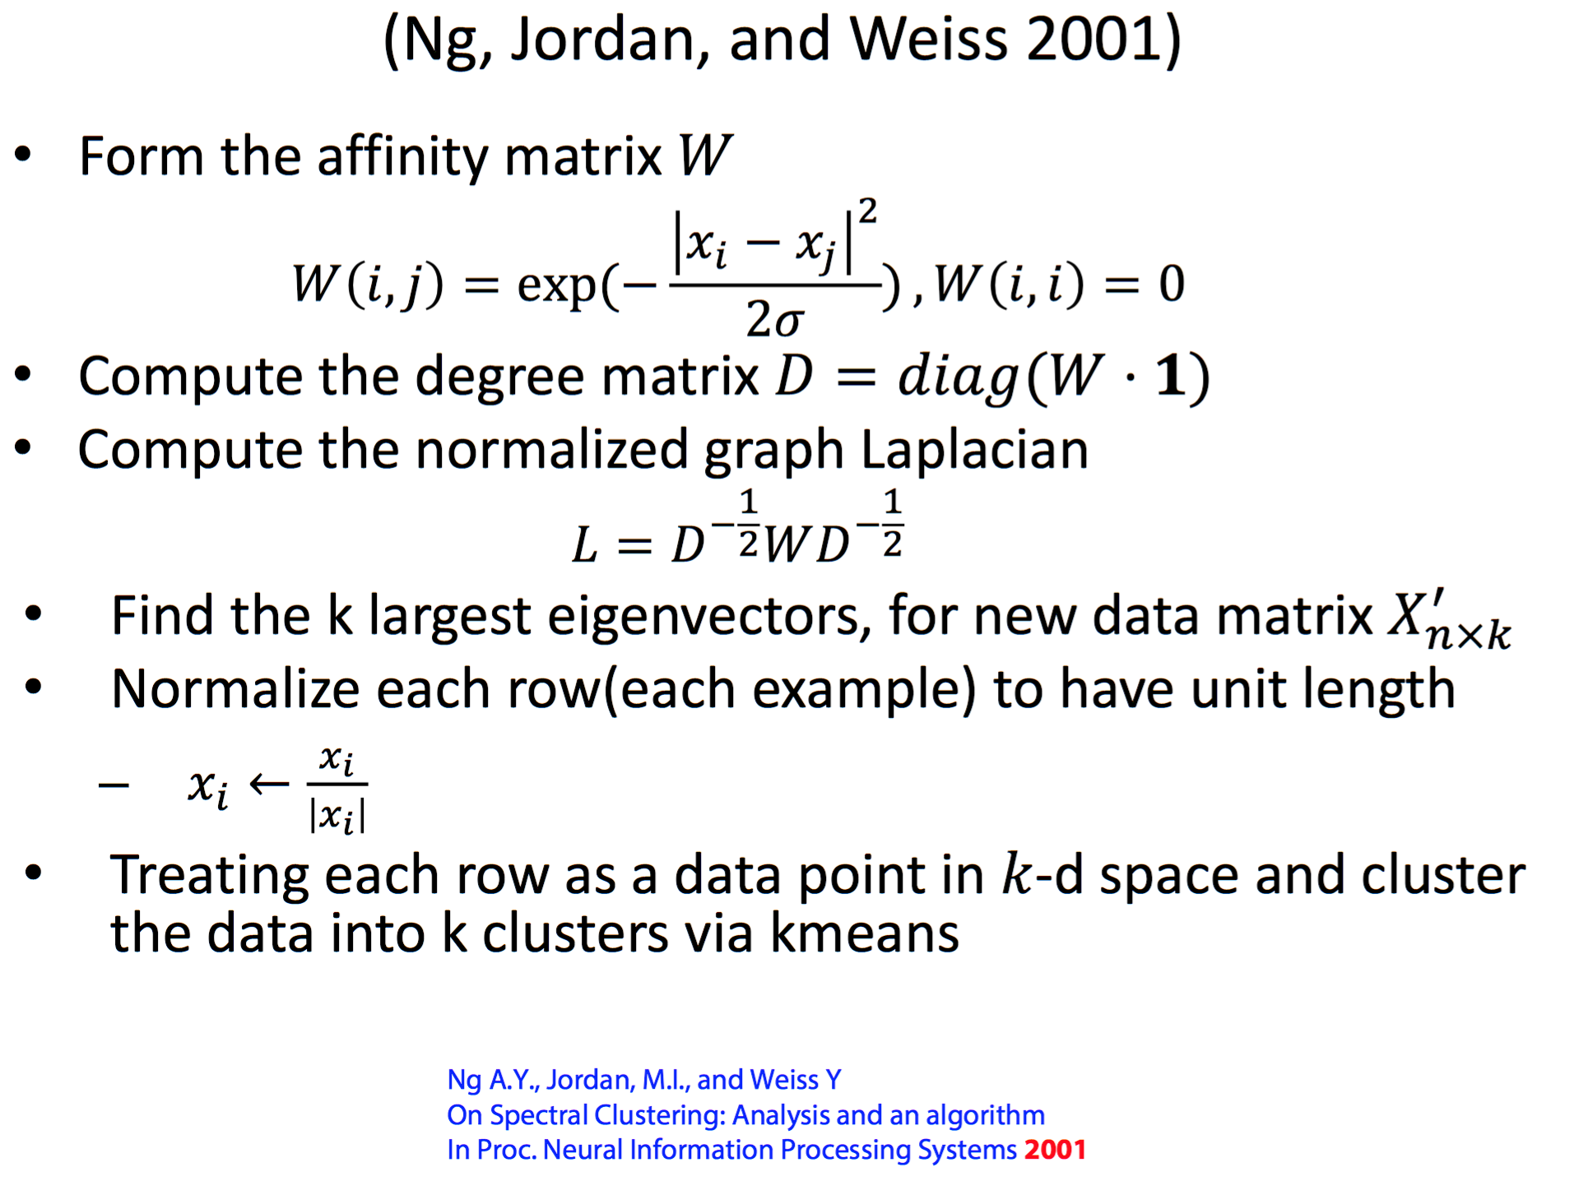
Spectral Clustering

Slide 64
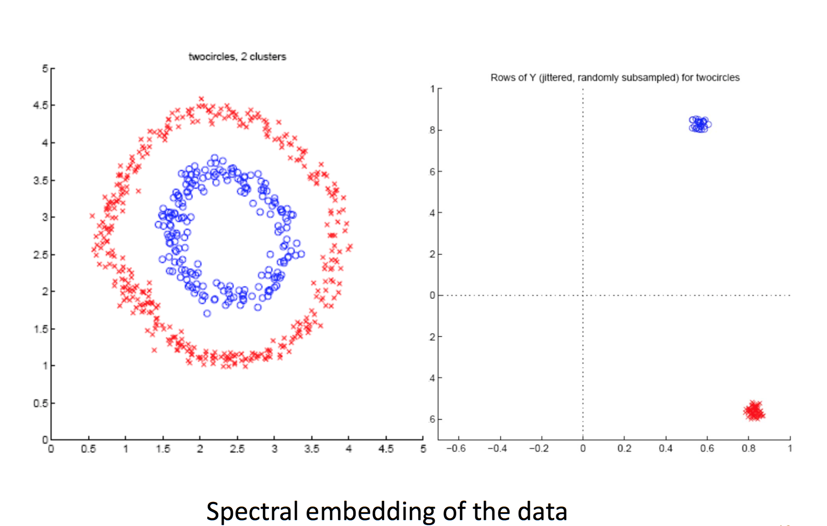

Slide 65
