Slide 1
Web-Mining Agents
Prof. Dr. Ralf Möller
Dr. Özgür Özçep
Universität zu Lübeck
Institut für Informationssysteme
Tanya Braun (Lab Class)

Slide 2
Organizational Issues: Lab Exercises
Start: Wed, 18.10., 2-4pm, IFIS 2032, Class also Thu 2-4pm, IFIS 2032 (2rd floor)
Lab: Fr. 2-4pm, Building 64, IFIS 2032 (2rd floor) (registration via Moodle right after this class)
Lab sheet provided via Moodle after class on Thu.

Slide 3
Organizational Issues: Exam
Registration in class required to be able to participate in oral exam at the end of the semester (2 slots)

Slide 4
Search Engines: State of the Art
Input: Strings (typed or via audio), images, ...
Public services:
Links to web pages plus mini synopses via GUI
Presentations of structured information via GUI excerpts from the Knowledge Vault http://videolectures.net/kdd2014_murphy_knowledge_vault/ (previously known as Knowledge Graph)
NSA services: ?
Methods: Information retrieval, machine learning
Data: Grabbed from free resources (win-win suggested)

Slide 5
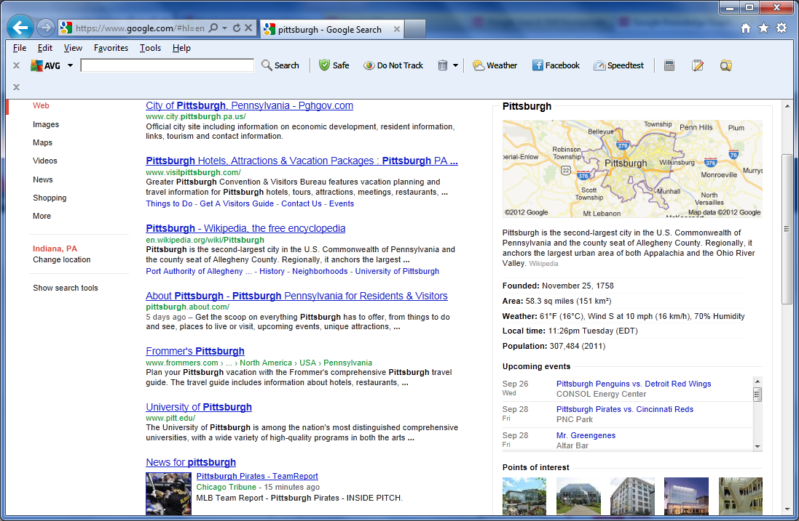
Search Results
Web Results have not changed

Slide 6
Search Results
This is what’s new
Map
General info
Upcoming Events
Points of interest
*The type of information that appears in this panel depends on what you are searching for

Slide 7
Search Engines: State of the Art
Input: Strings (typed or via audio), images, ...
Public services:
Links to web pages plus mini synopses via GUI
Presentations of structured information via GUI excerpts from the Knowledge Vault (previously known as Knowledge Graph)
NSA services: ?
Methods: Information retrieval, machine learning
Data: Grabbed from many resources (win-win suggested):
Web, Wikipedia (DBpedia, Wikidata, …), DBLP, Freebase, ...

Slide 8
Search Engines
Find documents: Papers, articles, presentations, ...
Extremely cool
But…
Hardly any support for interpreting documents w.r.t. certain goals (Knowledge Vault is just a start)
No support for interpreting data
Claim: Standard search engines provide services but copy documents (and possibly data)
Why can’t individuals provide similar services on their document collections and data?
Notes:
For sure „interpretation“ is quite vague but this gives it the flexibility to describe many aspects of getting the things out of the data you are interested in.
First, there is some who interprets (an agent);
second; there is the semantical aspect;
third there is the utitliy aspect (to what end do collect the data)
Fourth you have the context dependency;
Fifth you have complex processes and algorithms that analyze and built something on top of your data
Finding structural Patterns in order to explain something or to predict somethig

Slide 9
Personalized Information Engines
Keep data, provide information
Invite „agents“ to „view“ (i.e., interpret) local documents and data, without giving away all data
Let agents take away „their“ interpretation of local documents and data (just like in a reference library).
Doc/data provider benefits from other agents by (automatically) interacting with them
Agents should be provided with incentives to have them „share“ their interpretations
No GUI-based interaction, but … … semantic interaction via agents

Slide 10
Courses@IFIS
Web and Data Science
Module: Web-Mining Agents
Machine Learning / Data Mining (Wednesdays)
Agents / Information Retrieval (Thursdays)
Requirements:
Algorithms and Data Structures, Logics, Databases, Linear Algebra and Discrete Structures, Stochastics
Module: Foundations of Ontologies and Databases
(Wednesdays 16.00-18.30)
Web-based Information Systems
Data Management
Mobile and Distributed Databases
Semantic Web

Slide 11
Complementary Courses@UzL
Algorithmics, Logics, and Complexity
Signal Processing / Computer Vision
Machine Learning
Pattern Recognition
Artificial Neural Networks (Deep Learning)

Slide 12
Introduction
Overview ML, Data Mining, Uncertainty, Probability

Slide 13
Literature
Stuart Russell, Peter Norvig, Artificial Intelligence – A Modern Approach, Pearson, 2009 (or 2003 ed.)
Ian H. Witten, Eibe Frank, Mark A. Hall, Data Mining: Practical Machine Learning Tools and Techniques, Morgan Kaufmann, 2011
Ethem Alpaydin, Introduction to Machine Learning, MIT Press, 2009
Numerous additional books, presentations, and videos

Slide 14
What We Mean by “Learning”
Machine learning (ML) is programming computers /developing algorithms for
optimizing a performance criterion
using example data or “past experience”
by constructing general models that are good and useful approximations of the data
Role of Statistics: Building mathematical models, core task is inference from a sample
Role of CS: Efficient algorithms to
solve the optimization problem
and represent and evaluate the model for inference

Slide 15
Why and When “Learn” ?
There is no need to “learn” to calculate payrolls
Learning is used in the following cases:
No human expertise
(navigating on planet X)
Humans are unable to explain their expertise (speech recognition)
Solution changes in time
(routing on a computer network)
Solution needs to be adapted to particular cases
(user biometrics)
Notes:
If directly programming a task is not possible then machine learning can be applied, or if problem changes over time.
We have a model defined up to some parameters. And then, learning is the execution of a computer program to optimize the parameters of the model using training data or past experience.
The model may be predictive to make prediction for the near future or descriptive to gain knowledge from the data.
SPEECH: Different people utter the same word differently due to difference in age, gender, or accent.
NT: quality of service for max path
INTELLIGENT USER INTERFACE: adapt to user accent, handwriting, working habits.

Slide 16
Data Mining
Application of machine learning methods to large databases is called ‘’Data mining”.
Retail: Market basket analysis, customer relationship management (CRM, also relevant for wholesale)
Finance: Credit scoring, fraud detection
Manufacturing: Optimization, troubleshooting
Medicine: Medical diagnosis
Telecommunications: Quality of service optimization
Bioinformatics: Sequence or structural motifs, alignment
Web mining: Search engines
...
Notes:
Application of machine learning methods to large databases is called “Data mining”. The analogy is that al large volume of earth and raw material is extracted from a mine, which when processed leads to a small amount of very precious material; similarly in data mining, a large volume of data is processed to construct a simple model with valuable use, for example, having high predictive accuracy.
Through the model we assume that the prediction based on the latest model characterizes the behavior of the near future.

Slide 17
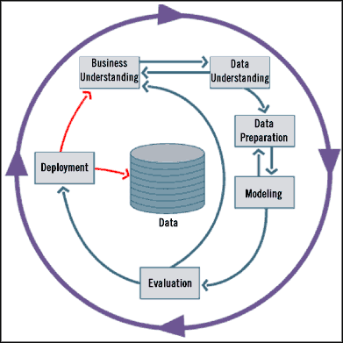
Standard Data Mining Life Cycle
But don‘t let the schema fool you
No full automatism
Handling DM tools require expert knowledge & intervention
Notes:
Business Understanding
Understand project objectives and requirements
Formulation of a data mining problem definition
Data Understanding
Data collection
Evaluate the quality of the data
Perform exploratory data analysis
Data Preparation
Clean, prepare, integrate, and transform the data
Select appropriate attributes and variables
Modeling
Select and apply appropriate modeling techniques
Calibrate/learn model parameters to optimize results
If necessary, return to data preparation phase to satisfy model's data format
Evaluation
Determine if model satisfies objectives set in phase 1
Identify business issues that have not been addressed
Deployment
Organize and present the model to the “user”
Put model into practice
Set up for continuous mining of the data
Fish example: Business Understanding: Want to make money with identifying pricy fish
Data mining: Build classifier for sea brass vs. salmon
Data Understanding: produce data by camera (understand it)
Data Preparation: Identify fish etc; find appropriate attributes

Slide 18
Sample of ML Applications
Learning Associations
Supervised Learning
Classification
Regression
Unsupervised Learning
Reinforcement Learning

Slide 19
Learning Associations
Basket analysis P (Y | X ) probability that somebody who buys X also buys Y where X and Y are products/services.
Example: P ( chips | beer ) = 0.7
If we know more about customers or make a distinction among them:
P (Y | X, D ) where D is the customer profile (age, gender, marital status, …)
In case of a web portal, items correspond to links to be shown/prepared/downloaded in advance

Slide 20
Classification
Example: Credit scoring
Differentiating between low-risk and high-risk customers from their income and savings
Discriminant: IF income > θ₁ AND savings > θ₂
THEN low-risk ELSE high-risk
Notes:
Multi attributes: income, savings, collaterals, profession, age, past financial history, ….
The bank has a record of past loans containing such customer data and whether the loan was paid back or not. From this data, the aim is to infer a general rule coding the associations between a customers attributes and the risk.
That is, the machine learning system fits a model to the past data to be able to calculate the risk for a new application and then decides to accept or refuse it accordingly.

Slide 21
Classification: Applications
Aka Pattern recognition
Character recognition: Different handwriting styles.
Face recognition: Pose, lighting, occlusion (glasses, beard), make-up, hair style
Speech recognition: Temporal dependency
Use of a dictionary for the syntax of the language
Sensor fusion: Combine multiple modalities; e.g., visual (lip image) and acoustic for speech
Medical diagnosis: From symptoms to illnesses
Reading text:
...

Slide 22
Regression
In classification and regression the learned data structures
Are straight forward (concepts, function resp.
In next lecture we will consider other more complex structures
(bayesian networks) for learning
Example: Price of a used car
x : car attribute
y : price
y = g (x | θ ): functional
dependeny
g ( ): model,
θ: parameters
y = wx+w₀
Notes:
Let us say we want to have a system that can predict the price of a used car. Inputs are the car attributes—brand, year, engine capacity, milage, and other information—that we believe affect a car’s worth. The output is the price of the car. Such problems where the output is a number are regression problems. X denote the car attributes and Y be the price of the car. Again surveying the past transactions, we can collect a training data and the machine learning program fits a function to this data to learn Y as a function of X. An example is given in figure 1.2 where the fitted function is of the form for suitable values of w and wo. Both regression and classification are supervised learning problems where there is an input, X, an output, Y, and the task is to learn the mapping from the input to the output. The approach in machine learning is that we assume a model defined up to a set of parameters: where g(-) is the model and theta are its parameters. Y is a number in regression and is a class code (e.g., O/1) in the case of classification. g(-) is the regression function or in classification, it is the discriminant function separating the instances of different classes. The machine learning program optimizes the parameters, theta, such that the approximation error is minimized, that is, our estimates are as close as possible to the correct values given in the training set. For example in figure 1.2, the model is linear and w and wo are the parameters optimized for best fit to the training data. In cases where the linear model is too restrictive, one can use for example a quadratic or a higher-order polynomial, or any other nonlinear function of the input, this time optimizing its parameters for best fit.

Slide 23
Supervised Learning: Uses
Prediction of future cases: Use the rule to predict the output for future inputs
Knowledge extraction: The rule is easy to understand
Compression: The rule is simpler than the data it explains
Outlier detection: Exceptions that are not covered by the rule, e.g., fraud
Notes:
In speech recognition, the input is acoustic and the classes are words that can be uttered. This time the association to be learned is from an acoustic signal to a word of some language. Different people, because of differences in age, gender, or accent, pronounce the same word differently, which makes this task rather difficult. Another difference of speech is that the input is temporal; words are uttered in time as a sequence of speech phonemes and some words are longer than others. A recent approach in speech recognition involves the use of lip movements as recorded by a camera as a second source of information in recognizing speech. This requires sensor fusion, which is the integration of inputs from different modalities, namely, acoustic and visual. Learning a rule from data also allows knowledge extraction. The rule is a simple model that explains the data, and looking at this model we have an explanation about the process underlying the data. For example, once we learn the discriminant separating low-risk and high-risk customers, we have the knowledge of the properties of low-risk customers. We can then use this information to target potential low-risk customers more efficiently, for example, through advertising. Learning also performs compression in that by fitting a rule to the data, we get an explanation that is simpler than the data, requiring less memory to store and less computation to process. Once you have the rules of addition, you do not need to remember the sum of every possible pair of numbers. Another use of machine learning is outlier detection, which is finding the instances that do not obey the rule and are exceptions. In this case, after learning the rule, we are not interested in the rule but the exceptions not covered by the rule, which may imply anomalies requiring attention- for example, fraud.

Slide 24
Unsupervised Learning
Learning “what normally happens”
No output (we do not know the right answer)
Clustering: Grouping similar instances
Example applications
Customer segmentation in CRM (customer relationship manag.)
Company may have different marketing approaches for different groupings of customers
Document classification in unknown domains
Image compression: Color quantization
Instead of using 24 bits to represent 16 million colors, reduce to 6 bits and 64 colors, if the image only uses those 64 colors
Bioinformatics: Learning motifs (sequences of amino acids in proteins)
Notes:
In supervised learning, the aim is to learn a mapping from the input to an output whose correct values are provided bv a supervisor. ln unsupervised learning, there is no such supervisor and we only have input data. The aim is to find the regularities in the input. There is a structure to the input space such that certain patterns occur more often than others, and we want to see what generally happens and what does not. In statistics, this is called density estimation.
One method for density estimation is clustering where the aim is to find clusters or groupings of input. In the case of a company with a data of past customers, the customer data contains the demographic information as well as the past transactions with the company, and the company may want to see the distribution of the profile of its customers, to see what type of customers frequently occur. ln such a case, a clustering model allocates customers similar in their attributes to the same group, providing the company with natural groupings of its customers. Once such groups are found, the company may decide strategies, for example, services and products, specific to different groups. Such a grouping also allows identifying those who are outliers, namely, those who are different from other customers, which may imply a niche in the market that can be further exploited by the company. Machine learning methods are also used in bioinformatics. DNA in our genome is the "blueprint of life" and is a sequence of bases, namely, A, G,C, and T. RNA is transcribed from DNA, and proteins are translated from the RNA. Proteins are what the living body is and does. Just as a DNA is a sequence of bases, a protein is a sequence of amino acids (as defined by bases). One application area of computer science in molecular biology
is alignment, which is matching one sequence to another. This is a difficult string matching problem because strings may be quite long, there
are many template strings to match against, and there may be deletions,insertions, and substitutions. Clustering is used in learning motifs, which are sequences of amino acids that occur repeatedly in proteins. Motifs are of interest because they may correspond to structural or functional elements within the sequences they characterize. The analogy is that if the amino acids are letters and proteins are sentences, motifs are like words, namely, a string of letters with a particular meaning occurringfrequently in different sentences.

Slide 25
Reinforcement Learning
Learning a policy: A sequence of actions/outputs
No supervised output but delayed reward
Credit assignment problem
Game playing
Robot in a maze
Multiple agents, partial observability, ...
Notes:
In some applications, the output of the system is a sequence of actions. In such a case, a single action is not important; what is important is the policy that is the sequence of correct actions to reach the goal. There is no such thing as the best action in any intermediate state; an action is good if it is part of a good policy. In such a case, the machine learning program should be able to assess the goodness of policies and learn from past good action sequences to be able to generate a policy. Such learning methods are called reinforcement learning algorithms. A good example is game playing where a single move by itself is not that important; it is the sequence of right moves that is good. A move is good if it is part of a good game playing policy. Game playing is an important research area in both artificial intelligence and machine learning. This is because games are easy to describe and at the same time, they are quite difficult to play well. A game like chess has a small number of rules but it is very complex because of the large number of possible moves a teach state and the large number of moves that a game contains. Once we have good algorithms that can learn to play games well, we can also apply them to applications with more evident economic utility. A robot navigating in an environment in search of a goal location is another application area of reinforcement learning. At any time, the robot can move in one of a number of directions. After a number of trial runs, it should learn the correct sequence of actions to reach to the goal state from an initial state, doing this as quickly as possible and without hitting any of the obstacles. One factor that makes reinforcement learning harder is when the system has unreliable and partial sensory information. For example, a robot equipped with a video camera has incomplete information and thus at any time is in a partially observable state and should decide taking into account this uncertainty. A task may also re-quire a concurrent operation of multiple agents that should interact and cooperate to accomplish a common goal. An example is a team of robot splaying soccer.

Slide 26
New Trends in ML
In older ML approaches one assumes that the relevant features (of data and target) are given
(i.e., human-hand-made)
Finding the right features is not trivial
Learn features automatically
(-> Deep Learning)
Find (computationally) appropriate feature space
Transform (reduce) feature space
(-> SVMs, Kernels)

Slide 27
Overview Supervised Learning

Slide 28
Learning a Class from Examples
Class C of a “family car”
Prediction: Is car x a family car?
Knowledge extraction: What do people expect from a family car?
Output:
Positive (+) and negative (–) examples
Input representation:
x₁: price, x₂: engine power
Notes:
LET Us say we want to learn the class, C, of a "family car." We have a set of examples of cars, and we have a group of people that we survey to whom we show these cars. The people look at the cars we show them and label them; the cars that they believe are family cars are positive examples and the other cars are negative examples. Class learning is finding a description that is shared by all positive examples and none of the negative examples. Doing this, we can make a prediction: Given a car that we have not seen before, by checking with the description learned, we will be able to say whether it is a family car or not. Or we can do knowledge extraction: This study may be sponsored by a car company, and the aim may be to understand what people expect from a family car. After some discussions with experts in the field, let us say that we reach the conclusion that among all features a car may have, the features that separate a family car from other cars are the price and engine power. These two attributes are the inputs to the class recognizer. Note that when we decide on this particular input representation, we are ignoring various other attributes as irrelevant. Though one may think of other attributes such as seating capacity and color that might be important for distinguishing among car types, we will consider only price and engine power to keep this example simple.

Slide 29
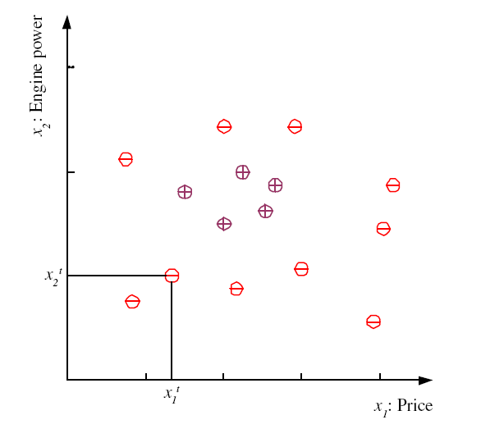
Training set X

Slide 30
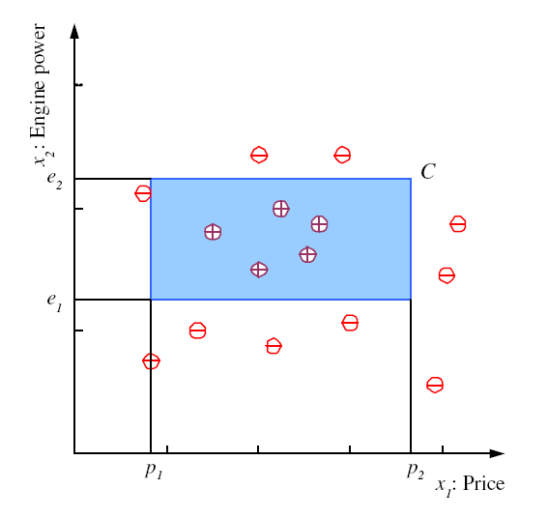
Class C

Slide 31
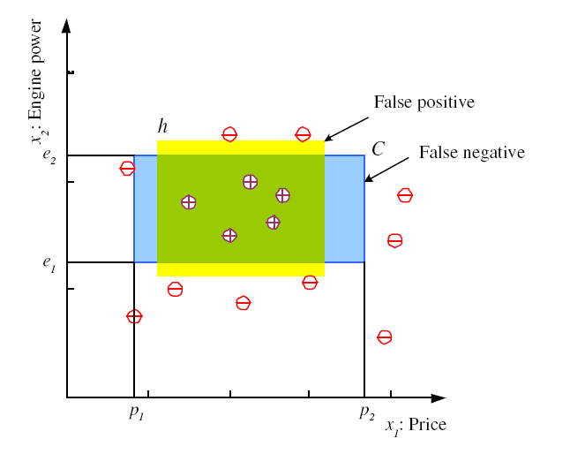
Hypothesis class H
Sometimes one one consideres generalized approach via bounds in so called version spaces (all hypotheses fitting to the data)
Error of h on Χ
(a ≠ b) = 1 if ≠, 0 otherwise

Slide 32
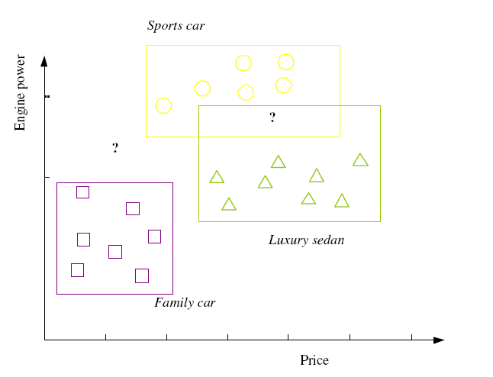
Multiple Classes, C_{i} i=1,...,K
Train hypotheses
h_{i}(x), i =1,...,K:
Notes:
But note that we not necessarily have to have always the same features for all classification. (But makes them at least comparable).
The definitions make sense for disjoint classes Ci (Actually all Ci are assuemd to be pairwise disjoint and jointly exhuastive)

Slide 33
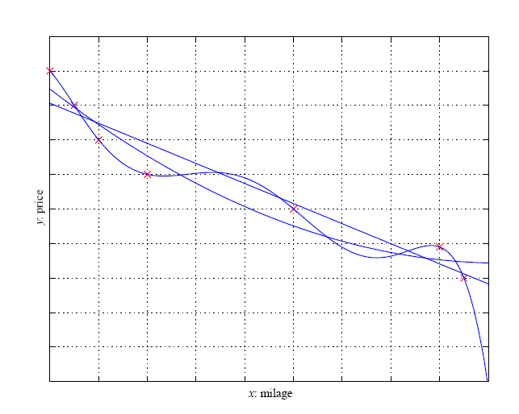
Regression
Partial derivatives of E w.r.t w₁ and w₀ and setting them to 0 -> minimize error
Notes:
Why square?: Bigger differences are weighted more than smaller differences.
Local extremum test: set partial derivative w.r.t. w0 of E(.) to zero and solve equation w.r.t. w0; then set partial derivative w.r.t. w1 of E to 0 and use equation for w0.
overline stands for arithmetical mean

Slide 34
Dimensions of a Supervised Learner
Model:
Loss function:
Optimization procedure:
In most of ML: It‘s all about optimization

Slide 35
Model Selection & Generalization
Learning is an ill-posed problem; data is not sufficient to find a unique solution
The need for inductive bias, assumptions about hypothesis space H
Generalization: How well a model performs on new data
Overfitting: H more complex than concept C
(function f, resp. )
Underfitting: H less complex than C (resp. f)
Notes:
Inductive bias is the set of assumptions that enables learning. For example the family car we assumed a rectangle == inductive bias reducing the set of possible hypothesis. In regression assuming a linear function would also be an inductive bias.
The question how to choose the right inductive bias is called model selection.
a union of two non overlapping rectangles has higher capacity, but it hypotheses are more complex. Similarly in regression, as we increase the order of the polynomial, the capacity and complexity increase. The question now is to decide where to stop. Thus learning is not possible without inductive bias, and now the question is how to choose the right bias. This is called model selection. In answering this question, we should remember that the aim of machine learning is rarely to replicate the training data but the prediction for new cases. That is we would like to be able to generate the right output for an input instance outside the training set, one for which the correct output is not given in the training set. How well a model trained on the training set predicts the right output for new instances is called generalization. For best generalization, we should match the complexity of the hypothesis with the complexity of the function underlying the data. If the hypothesis is less complex than the function, we have underfitting, for example, when trying to fit a line to data sampled from a third-order polynomial. In such a case, as we increase the complexity, both the training error and the validation error decrease. But if we have a hypothesis that is too complex, the data is not enough to constrain it and we may end up with a bad hypothesis, for example, when fitting two rectangles to data sampled from one rectangle. Or if there is noise, an overcomplex hypothesis may learn not only the underlying function but also the noise in the data and may make a bad fit, for example, when fitting a sixth- order polynomial to noisy data sampled from a third-order polynomial. This is called ovefitting. In such a case, having more training data helps but only up to a certain point. We can summarize our discussion citing the triple trade-off (Dietterich 2003). ln all learning algorithms that are trained from example data,

Slide 36
Triple Trade-Off
There is a trade-off between three factors (Dietterich, 2003):
Complexity of H, for short c(H),
Training set size, N,
Generalization error, E, on new data
As N, E↓
As c (H) , first E and then E↓
How then do we chose the right hypothesis space?
Dietterich, T. G. 2003. “Machine Learning.” In Nature Encyclopedia of Cognitive
Science. London: Macmillan
Notes:
there is a trade-off between three factors:
- the complexity of the hypothesis we fit to data, namely, the capacity
of the hypothesis class,
- the amount of training data, and
- the generalization error on new examples.
As the amount of training data increases, the generalization(= error on new data, not training data) error decreases. As the complexity of the model increases, the generalization error decreases first and then starts to increase (the latter: overfitting: at some point you measuer noise only). The generalization error of an overcomplex hypothesis can be kept in check by increasing the amount of training data but only up to a point.

Slide 37
Cross-Validation
To estimate generalization error, we need data unseen during training. We split the data as
Training set (50%)
[ training, say, n models g₁(θ*₁), … g_{n}(θ*_{n}) ]
Validation set (25%)
[ choosing best model:
g_{j}(θ*_{j}) = min arg_{gi(θ*i)} E(g_{i}(θ*_{i})| VS) ]
Test (publication) set (25%)
[ estimating generalization error of best model:
E(g(θ*_{j}) | TS) ]
Resampling when there is few data
Notes:
We can measure the generalization ability of a hypothesis, namely, the quality of its inductive bias, if we have access to data outside the training set. We simulate this by dividing the training set we have into two parts. We use one part for training (i.e., to find a hypothesis), and the remaining part is called the validation set and is used to test the generalization ability. Assuming large enough training and validation sets, the hypothesis that is the most accurate on the validation set is the best one (the one that has the best inductive bias). This process is called cross-validation. So, for example, to find the right order in polynomial regression, given a number of candidate polynomials of different orders, we find their coefficcients on the training set, calculate their errors on the validation set, and take the one that has the least validation error as the best polynomial. Note that if we need to report the error to give an idea about the expected error of our best model, we should not use the validation error. We have used the validation set to choose the best model, and it has effectively become a part of the training set. We need a third set, a test set, sometimes also called the publication set, containing examples not used in training or validation. An analogy from our lives is when we are taking a course: The example problems that the instructor solves in class while teaching a subject form the training set; exam questions are the validation set; and the problems we solve in our later, professional life are the test set.

Slide 38
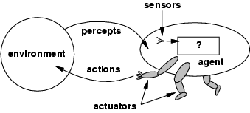
Agents and Environments
The agent function maps from percept histories to actions: [f: P* → A]
The agent program runs on the physical architecture to produce f
agent = architecture + program architecture: PC, robotic car, …
Notes:
Percepts depend on sensor??? Faulty??? Actions might not be fully determenistic???

Slide 39
Special case: Information Retrieval Agents
Agent should be allowed to “extract information” from their host environment …
... and “make the information available” to their creator (owner)
Very simple example: Linear regression
Percepts = Tuples from a database table
Extract information = compute a model (here: a line with parameters w₀, w₁) of the data
“Make information available” = send the model
(w₀, w₁) to the creator, not the data
Data would be too large anyway in general settings

Slide 40
Handling Uncertainty with Probability

Slide 41
Uncertainty
Let action A_{t} = leave for airport t minutes before flight
Will A_{t} get me there on time?
Problems:
partial observability (road state, other drivers' plans, etc.)
noisy sensors (traffic reports)
uncertainty in action outcomes (flat tire, etc.)
immense complexity of modeling and predicting traffic
Hence, it seems that a purely logical approach either
risks falsehood: “A₂₅ will get me there on time”, or
leads to conclusions that are too weak for decision making:
“A₂₅ will get me there on time if there's no accident on the bridge and it doesn't rain and my tires remain intact etc etc.”
(A₁₄₄₀ might reasonably be said to get me there on time but I'd have to stay overnight in the airport …)

Slide 42
Methods for handling uncertainty
Logic:
Assume my car does not have a flat tire
Assume A₂₅ works unless contradicted by evidence
Issues: What assumptions are reasonable? How to handle contradiction?
Rules with fudge factors (belief in the rule):
A₂₅ ⊢_{0.3} get there on time
Sprinkler ⊢_{0.99} WetGrass
WetGrass ⊢ _{0.7} Rain
Issues: Problems with combination, e.g., Sprinkler causes Rain??
Probability
Model agent's degree of belief
Given the available evidence,
A₂₅ will get me there on time with probability 0.04

Slide 43
Probability
Probabilistic assertions summarize effects of
laziness: failure to enumerate exceptions, qualifications, etc.
theoretical ignorance: no complete theory
practical ignorance: lack of relevant facts, initial conditions, tests, etc.
Subjective probability:
Probabilities relate propositions to agent's own state of knowledge
e.g., P(A₂₅ | no reported accidents) = 0.06
These are not assertions about the world
Probabilities of propositions change with new evidence:
e.g., P(A₂₅ | no reported accidents, 5 a.m.) = 0.15
Notes:
The first probability still holds but does not help us much. Probability statements are made relative to the knowledge state which is a partial view of the real world
For the diagnosis. P(cavity| toothache) is 0.8 During the diagnosis this still holds unless the cavity was observed. But if another disease is found (Gum Disease) than this might also drop to 0.4
Source for that evidence might come from statistical data or some general dental knowledge and might be different in different societies

Slide 44
Probability theory: Representation formalism
Basic element: Random variable (RV)
Similar to propositional logic: possible worlds defined by assignment of values to random variables.
Boolean random variables
e.g., Cavity (do I have a cavity?). Domain is < true , false >
Discrete random variables
e.g., Weather is one of < sunny, rainy, cloudy, snow >
Domain values must be exhaustive and mutually exclusive
Elementary propositions are constructed by assignment of a value to a random variable: e.g.,
Weather = sunny,
Cavity = false (abbreviated as ¬cavity)
Cavity = true (abbreviated as cavity)
Complex propositions formed from elementary propositions and standard logical connectives, e.g., Weather = sunny ∨ Cavity = false
Notes:
NB: Technically, random variables are functions RV: PossibleWorlds -> SetofValues
``Domain’’ of a random variable RV: Image RV[PossibleWorlds] of function RV

Slide 45
Syntax
Atomic event: A complete specification of the state of the world about which the agent is uncertain E.g., if the world is described by only two Boolean variables: Cavity and Toothache,
then there are 4 distinct atomic events:
Cavity = false ∧Toothache = false
Cavity = false ∧ Toothache = true
Cavity = true ∧ Toothache = false
Cavity = true ∧ Toothache = true
Atomic events are mutually exclusive and exhaustive
Notes:
Also sometimes called sample space (all possible atomic events) Sum of all world states where the proposition is true

Slide 46
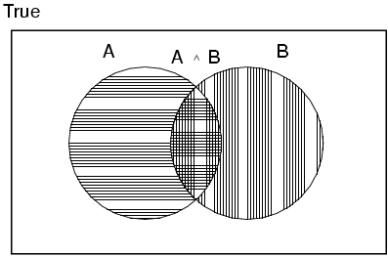
Axioms of probability
For any propositions A, B
0 ≤ P(A) ≤ 1
P(true) = 1 and P(false) = 0
( true stands for a tautology such as (A v ¬A);
false stands for a contradiction such as A & ¬A) )
P(A ∨ B) = P(A) + P(B) - P(A ∧ B)
Notes:
True stands for any tautological proposition (such as A or non A);
False for any contradictory proposition (such as A and non A)
Can derive
P(non A ) = 1 – P(A)

Slide 47
Example World
Example (Dentist problem with four variables)
Toothache (I have a toothache)
Cavity (I have a cavity)
Catch (steel probe catches in my tooth)
Weather (sunny,rainy,cloudy,snow )

Slide 48
Prior probability
Prior or unconditional probabilities of propositions
e.g., P(Cavity = true) = 0.1 and P(Weather = sunny) = 0.72 correspond to belief prior to arrival of any (new) evidence
Probability distribution gives values for all possible assignments:
P(Weather) = <0.72,0.1,0.08,0.1> (normalized, i.e., sums to 1 because one must be the case)
Notes:
Prior can come from statistical date or other insights e.g. dice (computational)

Slide 49
Full joint probability distribution
Joint probability distribution for a set of random variables gives the probability of every atomic event on those random variables
P(Cavity,Whether) describes a 2 × 4 matrix of values:
Weather = sunny rainy cloudy snow
Cavity = true 0.144 0.02 0.016 0.02
Cavity = false 0.576 0.08 0.064 0.08
Full joint probability distribution: all random variables involved
P(Toothache, Catch, Cavity, Weather)
Every query about a domain can be answered by the full joint distribution

Slide 50
Probability for continuous variables
P(a <= X <= b ) = ∫^{b}_{a} U(x) dx
Notes:
For continous variables we cannot write down (the graph of) the distribution explicitly so we define it by a density function. P(20.5)=0 because it is not probable to have exactly 20.5.
Instead probabilty is defined for a small region around 20.5
P(temp=x)= 1/8 for 18<=x<=26 ; = 0 otherwise

Slide 51
Discrete random variables: Notation
Dom(W) = {sunny, rainy, cloudy, snow} and Dom(W) disjoint from domain of other random variables:
Atomic event “W=rainy” often written as “rainy”
Example: P(rainy), the random variable W is instantiated by the value rainy
Boolean variable C
Atomic event “C=true” written as “c”
Atomic event “C=false” written as “¬c”
Examples: P(c) or P(¬c)

Slide 52
Conditional probability
Conditional or posterior probabilities
e.g., P(cavity | toothache) = 0.8 or: <0.8>
i.e., given that toothache is all I know
(Notation for conditional distributions:
P(Cavity | Toothache) = 2-element vector of 2-element vectors)
If we know more, e.g., cavity is also given, then we have
P(cavity | toothache,cavity) = 1
New evidence may be irrelevant, allowing simplification, e.g.,
P(cavity | toothache, sunny) = P(cavity | toothache) = 0.8
This kind of inference, sanctioned by domain knowledge, is crucial

Slide 53
Conditional probability
Definition of conditional probability (in terms of unconditional probability):
P(a | b) = P(a ∧ b) / P(b) if P(b) > 0
Product rule gives an alternative formulation (∧ is commutative):
P(a ∧ b) = P(a | b) P(b) = P(b | a) P(a)
A general version holds for whole distributions, e.g.,
P(Weather,Cavity) = P(Weather | Cavity) P(Cavity)
View as a set of 4 × 2 equations, not matrix mult. (1,1) P(Weather=sunny |Cavity=true) P(Cavity=true)
(1,2) P(Weather=sunny |Cavity=false) P(Cavity=false), ….
Chain rule is derived by successive application of product rule:
P(X₁, …,X_{n}) = P(X₁,...,X_{n-1}) P(X_{n} | X₁,...,X_{n-1})
= P(X₁,...,X_{n-2}) P(X_{n-1} | X₁,...,X_{n-2}) P(X_{n} | X₁,...,X_{n-1})
= …
= ∏^{n}_{i=1} P(X_{i} | X₁, … ,X_{i-1})
Notes:
Proovable Rules are important for algorithmically rewriting of statements.
First rules makes sense because we know that b=true we can rule out other worlds. Reduce view of the world sum also to one because
Sum must be one. Therefore the fraction.
Note that for i = 1 in last formula one has P(X1)

Slide 54
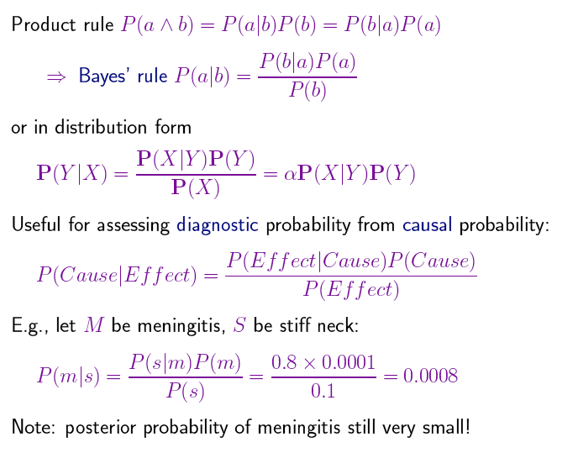
Bayes‘ Rule (…is at the heart of everything)

Slide 55
Inference by enumeration
Start with the joint probability distribution:
For any proposition φ, sum the atomic events where φ is true: P(φ) = Σ_{ω:ω⊨φ} P(ω)

Slide 56
Inference by enumeration
Start with the joint probability distribution:
For any proposition φ, sum the atomic events where it is true:
P(φ) = Σ_{ω:ω╞φ} P(ω)
P(toothache) = 0.108 + 0.012 + 0.016 + 0.064 = 0.2
Unconditional or marginal probability of toothache
Marginalization: P(Y) = Σ_{z ∈ Z}P(Y,z)
Conditioning on Z: P(Y) = Σ_{z ∈ Z}P(Y|z)P(z)

Slide 57
Inference by enumeration
Start with the joint probability distribution:
For any proposition φ, sum over the atomic events ω where it is true: P(φ) = Σ_{ω:ω⊨φ} P(ω)
P(cavity ∨ toothache) = 0.108 + 0.012 + 0.072 + 0.008+ 0.016 + 0.064 = 0.28 (P(cavity ∨ toothache) = P(cavity) + P(toothache) – P(cavity ∧ toothache))

Slide 58
Inference by enumeration
Start with the joint probability distribution:
Can also compute conditional probabilities:
P(¬cavity | toothache) = P(¬cavity ∧ toothache)
P(toothache)
= 0.016+0.064
0.108 + 0.012 + 0.016 + 0.064
= 0.4 P(cavity | toothache) = 0.108+0.012/0.2 = 0.6

Slide 59
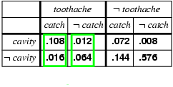
Normalization
Denominator P(z) (or P(toothache) in the example before) can be viewed as a normalization constant α
P(Cavity | toothache) = α P(Cavity,toothache)
= α [P(Cavity,toothache,catch) + P(Cavity,toothache,¬ catch)]
= α [<0.108,0.016> + <0.012,0.064>]
= α <0.12,0.08> = <0.6,0.4>

Slide 60
Inference by enumeration, contd.
Typically interested in P(Y | E = e) = ?
Posterior joint distribution of Y under evidence E = e
Y = query variables
E = evidence variables
X := Y ⋃ Y ⋃ H = all RVs
H = hidden variables
Calculated by summing out the hidden variables:
P(Y | E = e) = P(Y,E = e)/P(E=e) = αP(Y,E = e) =
= αΣ_{h}P(Y,E= e, H = h)
Obvious problems
Worst-case time complexity O(d^{n}) (d = largest domain cardinality and n = #RVs )
Space complexity O(d^{n}) to store the joint distribution
How to calculate joint distribution?

Slide 61
Independence
A and B are independent iff P(A, B) = P(A) P(B)
(or alternatively: iff one of the following holds:
P(A|B) = P(A) and P(A) ≠ 0 and P(B) ≠ 0
P(A) = 0 or P(B) = 0) )
P(Toothache, Catch, Cavity, Weather)
= P(Toothache, Catch, Cavity) P(Weather)
32 (= 2 x 2 x2 x 4) entries reduced to 12 (= 2x2x2 + 4);
for n independent biased coins, O(2^{n}) →O(n) Absolute independence powerful but rare
Dentistry is a large field with hundreds of variables, none of which are independent. What to do?

Slide 62
Conditional independence
P(Toothache, Cavity, Catch) has 2³ – 1 = 7 independent entries
If I have a cavity, the probability that the probe catches in it doesn't depend on whether I have a toothache:
(1) P(catch | toothache, cavity) = P(catch | cavity)
The same independence holds if I haven't got a cavity:
(2) P(catch | toothache,¬cavity) = P(catch | ¬cavity)
Catch is conditionally independent of Toothache given Cavity:
P(Catch | Toothache,Cavity) = P(Catch | Cavity)
Equivalent statements:
P(Toothache | Catch, Cavity) = P(Toothache | Cavity)
P(Toothache, Catch | Cavity) = P(Toothache | Cavity) P(Catch | Cavity)

Slide 63
Conditional independence contd.
Write out full joint distribution using chain rule:
P(Toothache, Catch, Cavity)
= P(Toothache | Catch, Cavity) P(Catch, Cavity)
= P(Toothache | Catch, Cavity) P(Catch | Cavity) P(Cavity)
= P(Toothache | Cavity) P(Catch | Cavity) P(Cavity) (with conditional independence)
i.e., 2 + 2 + 1 = 5 independent numbers
In most cases, the use of conditional independence reduces the size of the representation of the joint distribution from exponential in n to linear in n.
Conditional independence is our most basic and robust form of knowledge about uncertain environments.

