Slide 1
Web-Mining Agents
Data Mining
Prof. Dr. Ralf Möller
Dr. Özgür L. Özçep
Universität zu Lübeck
Institut für Informationssysteme
Tanya Braun (Lab)

Slide 2

Literature
Chapter 14 (Section 1 and 2)

Slide 3
Syntax and Semantics of Bayesian Networks

Slide 4
Bayesian networks
A simple, graphical notation for conditional independence assertions and hence for compact specification of full joint distributions
Syntax:
  a set of nodes, one per variable
  a directed, acyclic graph (link ≈ "directly influences")
  a conditional distribution for each node given its parents:
    P (X_{i} | Parents (X_{i}))
In the simplest case, conditional distribution represented as a conditional probability table (CPT) giving the distribution over X_{i} for each combination of parent values

Slide 5
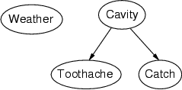
Example
Topology of network encodes conditional independence assertions:
Weather is independent of the other variables
Toothache and Catch are conditionally independent given Cavity

Slide 6
Example
I'm at work, neighbor John calls to say my alarm is ringing, but neighbor Mary doesn't call. Sometimes it's set off by minor earthquakes. Is there a burglar?
Variables: Burglary, Earthquake, Alarm, JohnCalls, MaryCalls
In this case, the network topology reflects "causal" knowledge:
  A burglar can set the alarm off
  An earthquake can set the alarm off
  The alarm can cause Mary to call
  The alarm can cause John to call
A formal in-depth treatment of causality will be given in
lectures 5 to 9
Notes:
Burglar alarm system installed. Judea Pearl researcher and living in LA

Slide 7
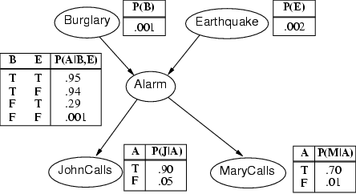
Example contd.
Notes:
John nearly calls ervery time the alarm is ringing but sometimes confuses whether it is the telephone or the alarm.
Mary often hears loud music. J & M only Alarm means we assume that they can not directly observe burglars and minor earthquakes.
. Any irrelevant attributes are encoded in prob-> laziness, ignorance

Slide 8
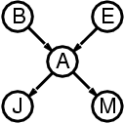
Compactness
A CPT for Boolean X_{i} with k Boolean parents has 2^{k} rows for the combinations of parent values
Each row requires one number p for X_{i} = true
(the number for X_{i} = false is just 1-p)
If each variable has no more than k parents, the complete network requires O(n · 2^{k}) numbers
i.e., grows linearly with n, vs. O(2^{n}) for the full joint distribution
For burglary net, 1 + 1 + 4 + 2 + 2 = 10 numbers (vs. 2⁵-1 = 31)
Notes:
Note that the complexity consideration explicitly requires a bound k on the number of parents which may be appropriate for most scenarios: one has many different components with high depth but bounded degree.

Slide 9
Semantics
The full joint distribution of a BN is defined as the product of the local conditional distributions:
P (X₁, … ,X_{n}) = π_{i = 1} P (X_{i} | Parents(X_{i}))
e.g., P(j ∧ m ∧ a ∧ ¬b ∧ ¬e)
= P(j | a) P(m | a) P(a | ¬b, ¬e) P(¬b) P(¬e)
= 0.90x0.7x0.001x0.999x0.998
≈ 0.00063
n

Slide 10
Constructing Bayesian networks
1. Choose an ordering of variables X₁, … ,X_{n}
2. For i = 1 to n
  add X_{i} to the network
  select parents from X₁, … ,X_{i-1} such that
  P (X_{i} | Parents(X_{i})) = P (X_{i} | X₁, ... X_{i-1})
This choice of parents guarantees:
(chain rule)
P (X₁, … ,X_{n}) = π_{i =1} P (X_{i} | X₁, … , X_{i-1})
(by construction)
= π_{i =1}P (X_{i} | Parents(X_{i}))
n
n

Slide 11
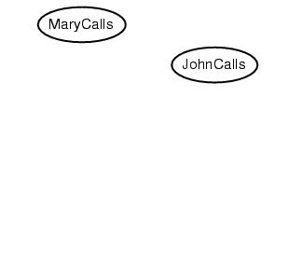
Example
Suppose we choose the ordering M, J, A, B, E
P(J | M) = P(J)?

Slide 12
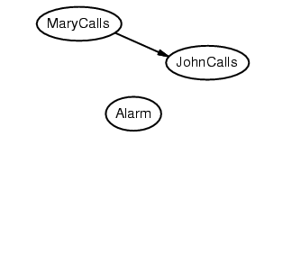
Example
Suppose we choose the ordering M, J, A, B, E
P(J | M) = P(J)? No
P(A | J, M) = P(A)? P(A | J, M) = P(A | J)?

Slide 13
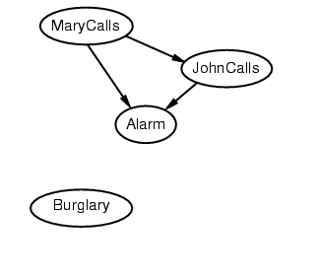
Example
Suppose we choose the ordering M, J, A, B, E
P(J | M) = P(J)? No
P(A | J, M) = P(A)? P(A | J, M) = P(A | J)? No
P(B | A, J, M) = P(B | A)?
P(B | A, J, M) = P(B)?

Slide 14
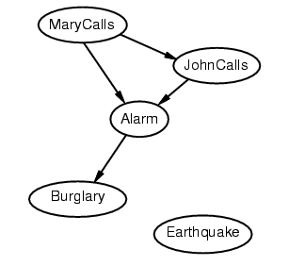
Example
Suppose we choose the ordering M, J, A, B, E
P(J | M) = P(J)? No
P(A | J, M) = P(A | J)? P(A | J, M) = P(A)? No
P(B | A, J, M) = P(B | A)? Yes
P(B | A, J, M) = P(B)? No
P(E | B, A ,J, M) = P(E | A)?
P(E | B, A, J, M) = P(E | A, B)?

Slide 15
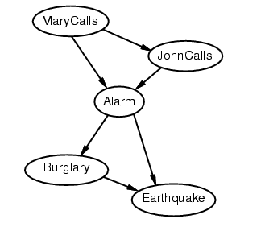
Example
Suppose we choose the ordering M, J, A, B, E
P(J | M) = P(J)? No
P(A | J, M) = P(A | J)? P(A | J, M) = P(A)? No
P(B | A, J, M) = P(B | A)? Yes
P(B | A, J, M) = P(B)? No
P(E | B, A ,J, M) = P(E | A)? No
P(E | B, A, J, M) = P(E | A, B)? Yes

Slide 16
Example contd.
Deciding conditional independence is hard in non-causal directions
(Causal models and conditional independence seem hardwired for humans!)
Network is less compact: 1 + 2 + 4 + 2 + 4 = 13 numbers needed
instead of 10.

Slide 17
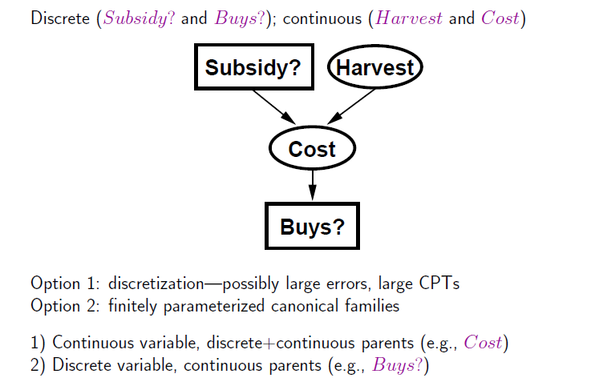
Hybrid (discrete+continuous) networks
BNs can also deal with continuous RVs or even hybrid ones

Slide 18
Exact Inference on Bayesian Networks

Slide 19
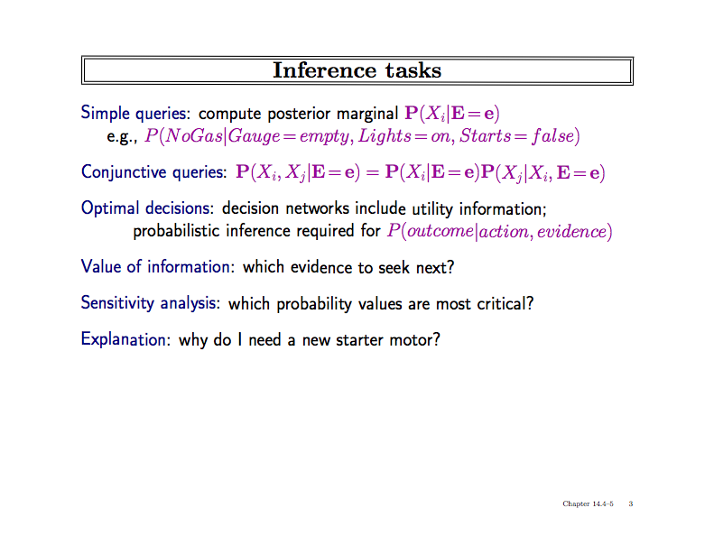

Slide 20
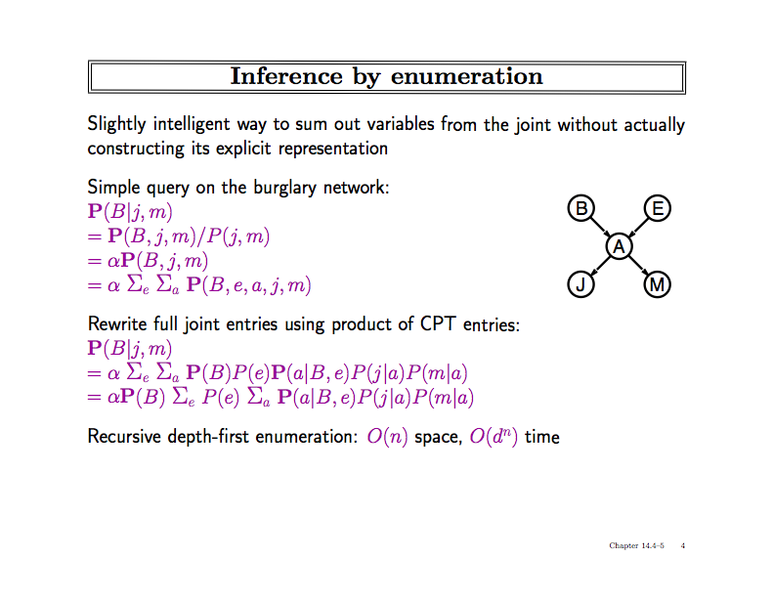
(Calculation over tree sum-product evaluation tree
with path length n (=number of RVs) and degree d
(=maximal number domain elements) )

Slide 21
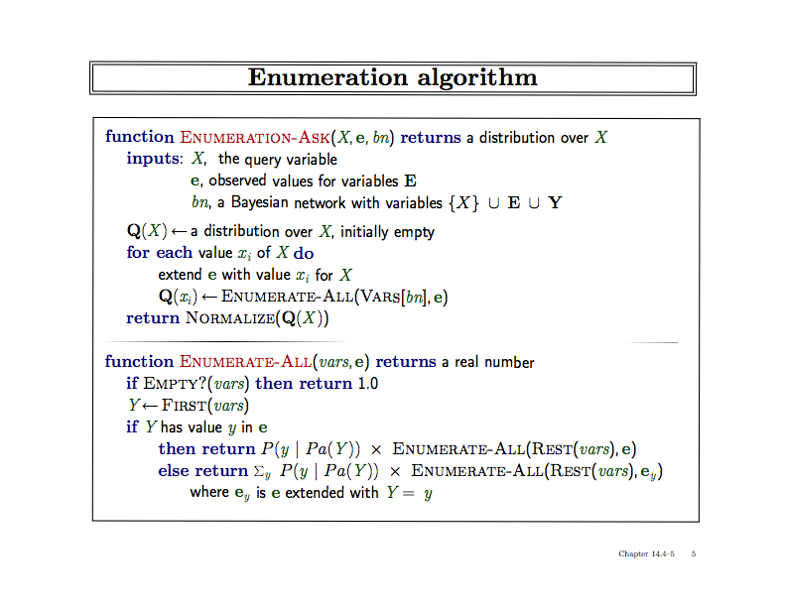

Slide 22
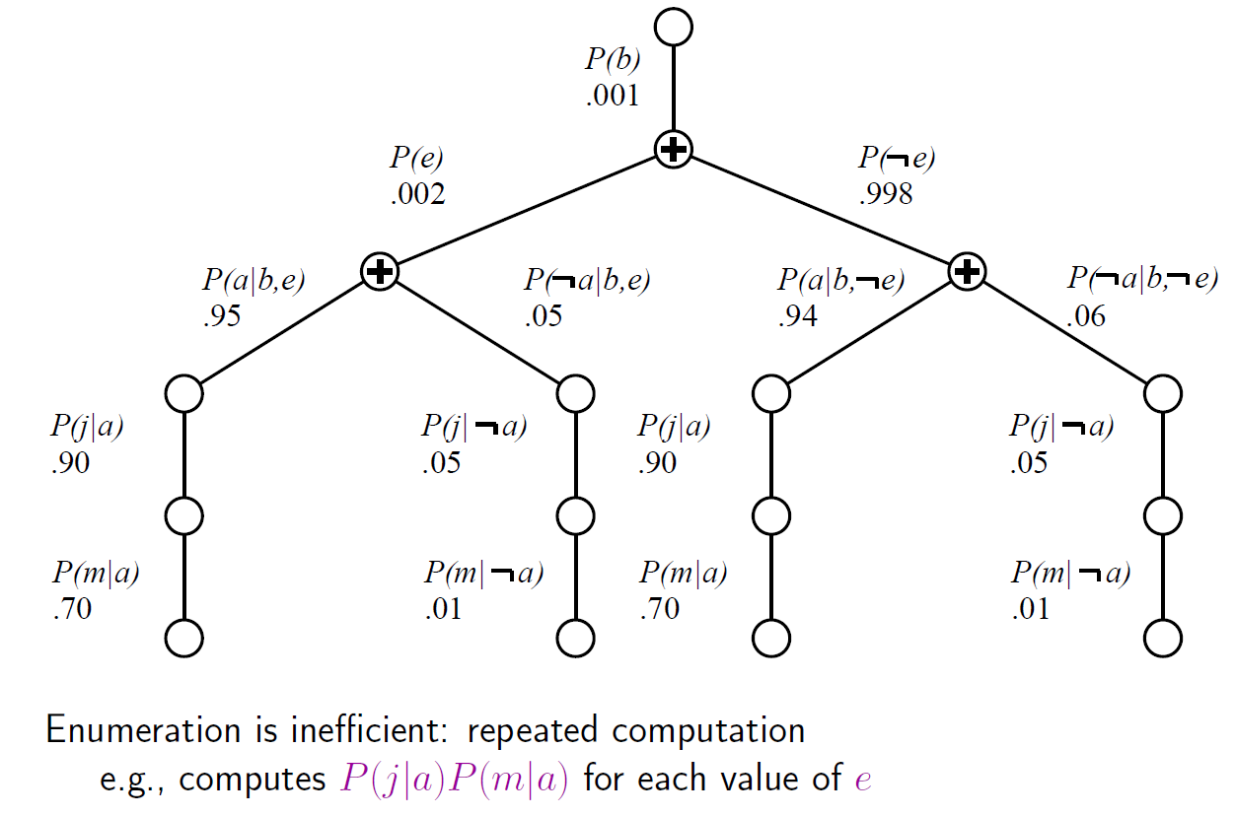
Evaluation Tree
Can do better with Variable Elimination (VE)

Slide 23
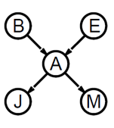
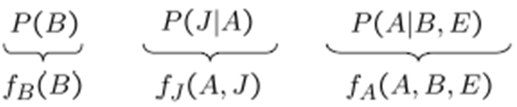
Basic Objects of VE
Track objects called factors
(right-to-left, in tree: bottom up)
Initial factors are local CPTs
During elimination create new factors
Form of Dynamic Programming
P(m|A)
f_{M}(A)

Slide 24
Basic Operations: Pointwise Product
Pointwise product of factors f₁ and f₂
  for example: f₁(A,B) * f₂(B,C)= f(A,B,C)
  in general:
  f₁(X₁,...,X_{j},Y₁,…,Y_{k}) *f₂(Y₁,…,Y_{k},Z₁,…,Z_{l})= f(X₁,...,X_{j},Y₁,…,Y_{k},Z₁,…,Z_{l})
  has 2^{j+k+l} entries (if all variables are binary)

Slide 25

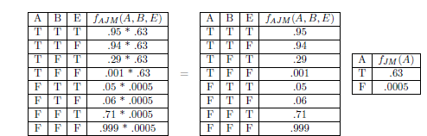
Join by pointwise product

Slide 26
Basic Operations: Summing out
Summing out a variable from a product of factors
  Move any constant factors outside the summation
  Add up submatrices in pointwise product of remaining factors
  𝛴_{x} f₁* …*f_{k} = f₁*…*f_{i}*𝛴_{x} f_{i+1}*…*f_{k}
  = f₁*…*f_{i}* f_{X}
  assuming f₁, …, f_{i} do not depend on X

Slide 27
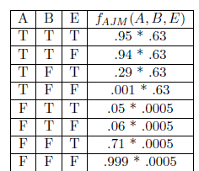
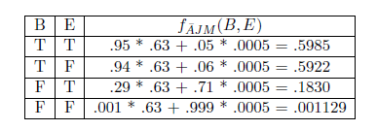
Summing out
Summing out a

Slide 28
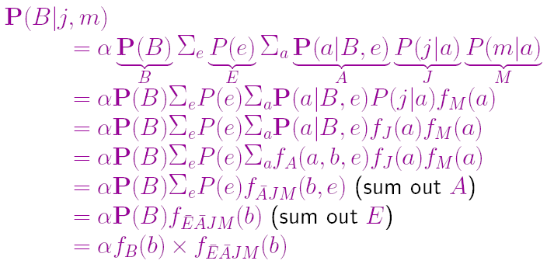
VE result for Burglary Example

Slide 29
Optimization by Finding Irrelevant Variables
{Alarm, Earthquake, Burglary}
Irrelevant variables can be identified by a graph theoretical criterion on the associated moral graph by m-separation

Slide 30
What else can we do?
General methodology: Consider special cases (special data structures)
Here: Consider polytrees (singly connected networks)
Following slides on Pearl‘s belief propagation algorithm based on slides by Tomas Singliar (adapted by Daniel Lowd)

Slide 31
Polytree Bayesian Networks
Bayesian network graph is a polytree (or singly connected network) iff there is at most one path between any two nodes, V_{i} and V_{k} (iff the underlying non-directed graph is a tree)
Exact BN inference is NP-hard but O(n) on polytree
(Non-)Examples:
V₁
V₁
V₄
V₁
V₃
V₂
V₃
V₂
V₃
V₂
V₄
V₄
V₅
V₆
V₅
V₆
-
+
-
Notes:
This slide introduces BBNs and the notion of polytree.

Slide 32
Our inference task
We know the values of some evidence variables E:
We wish to compute the conditional probability P(X_{i} |E)
for all non-evidence variables X_{i}.
IDEA:
  Do variable elimination in parallel (locally on each node/RV)
  Send/receive required knowledge to/from other nodes
Following soldier counting example on message passing adapted from slides of M. Gormley
Notes:
Can have less than all nodes to compute (goal oriented).

Slide 33
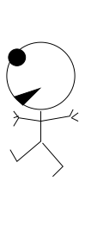
____ ____ __ ______ ______
Counting soldiers example (linear)
there's
1 of me
1
before
you
2 before
you
3 before
you
4 before
you
5 before
you
5 behind you
4 behind you
3 behind you
2 behind you
1 behind you
adapted from MacKay (2003): Information Theory, Inference and Learning Algorithms.
33

Slide 34
Counting soldiers example (beliefs)
Belief:
Must be
2 + 1 + 3 = 6 of us
there's
1 of me
2 before
you
2 before
you
only see
my incoming
messages
3 behind you
34

Slide 35
Counting soldiers example (locality)
Belief:
Must be
1 + 1 + 4 = 6 of us
Belief:
Must be
2 + 1 + 3 = 6 of us
there's
1 of me
1 before
you
only see
my incoming
messages
4 behind you
35

Slide 36
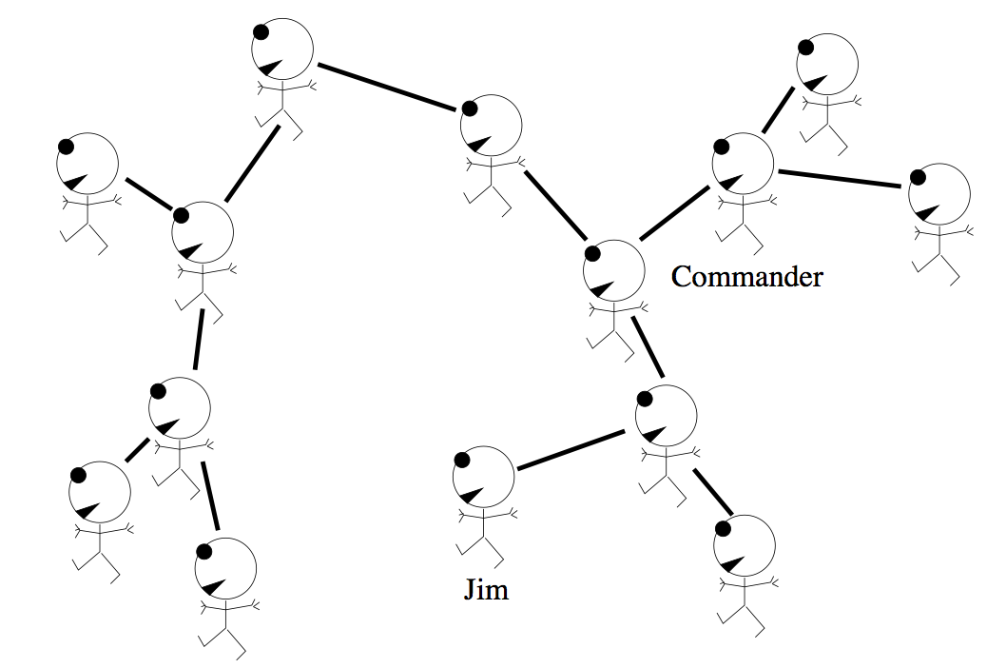
Counting soldiers example (in polytree)
3 here
7 here
1 of me
11 here
(= 7+3+1)
36

Slide 37
Counting soldiers example (in polytree)
3 here
7 here
(= 3+3+1)
3 here
37

Slide 38
Counting soldiers example (in polytree)
11 here
(= 7+3+1)
7 here
3 here
38

Slide 39
Counting soldiers example (in polytree)
3 here
7 here
Belief:
Must be
14 of us
3 here
39

Slide 40
Counting soldiers example (non-circularity)
3 here
7 here
Belief:
Must be
14 of us
3 here
wouldn't work correctly
with a 'loopy' (cyclic) graph
But you might foresee
the junction tree algorithm:
One has to partition the graph
into a tree of clusters
40

Slide 41
Pearl‘s belief propagation algorithm
Local computation for one node V desired
Information flows through the links of G
  flows as messages of two types – λ and π
V splits network into two disjoint parts
  Strong independence assumptions induced – crucial!
Denote E_{V}⁺ the part of evidence accessible
through the parents of V (causal or predictive)
  passed downward in π messages
Analogously, let E_{V}⁻ be the diagnostic evidence
  passed upwards in λ messages

Slide 42
Pearl’s Belief Propagation
U₁
U₂
λ(U₂)
π(U₁)
π(U₂)
λ(U₁)
V
λ(V₁)
π(V₂)
π(V₁)
λ(V₂)
V₁
V₂
Notes:
Arrows are to indicate that this is a general situation.

Slide 43
The π Messages
What are the messages?
For simplicity, let the nodes be binary
V₁=T | 0.8
V₁=F | 0.2
The message passes on information.
What information? Observe:
P(V₂) = P(V₂| V₁=T)P(V₁=T)
+ P(V₂| V₁=F)P(V₁=F)
V₁
P | V₁=T | V₁=F
V₂=T | 0.4 | 0.9
V₂=F | 0.6 | 0.1
The information needed is the CPT of V₁ = π_{V}(V₁)
π Messages capture information passed from parent to child
V₂
Notes:
Let’s figure out what the messages are. Make the reservation that it is not exactly CPT but evidence needs to be incorporated. What is a CPT? It captures what we should believe the value of the node is. Based on parent information – may involve (causal) evidence.

Slide 44
The Evidence
Evidence – values of observed nodes
  V₃ = T, V₆ = 3
Our belief in what the value of V_{i}
‘should’ be changes.
This belief is propagated
As if the CPTs became
V₁
V₃
V₂
V₄
V₃=T | 1.0
V₃=F | 0.0
P | V₂=T | V₂=F
V₆=1 | 0.0 | 0.0
V₆=2 | 0.0 | 0.0
V₆=3 | 1.0 | 1.0
V₅
V₆

Slide 45
The Messages
We know what the π messages are
What about λ?
The messages are π(V)=P(V|E⁺) and λ(V)=P(E⁻|V)
Assume E = { V₂ } and compute by Bayes rule:
The information not available at V₁ is P(V₂|V₁). To be passed upwards by a λ-message. Again, this is not in general exactly the CPT, but the belief based on evidence down the tree.
V₁
V₂

Slide 46
Combination of evidence in node V
Recall that E_{V} = E_{V}⁺ ∪ E_{V}⁻ and let us compute
α is the normalization constant ( 1/P(E⁻|E⁺) )
normalization is not necessary (can do it at the end)
but may prevent numerical underflow problems

Slide 47
λ message combination
Assume X received λ-messages from neighbors
How to compute λ(x) = P(e⁻|x)?
Let Y₁, … , Y_{c} be the children of X
λ_{XY}(x) denotes the λ-message sent between X and Y
Derivation clear: Assume two children Y, Z of X,
then P(e⁻|x) = P(e⁻_{Y}, e⁻_{Z}|x) = P(e⁻_{Y}|x)* P(e⁻_{Z}|x)
(siblings independent given parent)

Slide 48
π message combination
Assume X received π -messages from neighbors
How to compute π(x) = P(x|e⁺) ?
Let U₁, … , U_{p} be the parents of X
π_{XY}(x) denotes the π-message sent between X and Y
summation over the CPT
Derivation: Condition on all U_{i} and note that each pair
(parent U_{i},evidence e⁺_{i}) is independent of the other pairs (U_{j},e⁺_{j})

Slide 49
Messages to pass
We need to compute π_{XY}(x)
Derivation
π_{XYJ}
= P(x | e⁺_{XYj})
= P(x | e – e⁻_{XYj}) =
= [ Bel(x) when evidence e⁻_{Xyj} is surpressed]
= Bel(x) setting λ_{XYj}(x) = 1
= formula above

Slide 50
Messages to pass
e⁺_{XY}
e⁺_{VY}
Derivation hint
λ_{YjX} = P(e⁻_{XYj}|x)
= P(e⁺_{VYj},e⁻_{Yj}|X)
then condition on YJ and V,
And use independences
  Y_{j} seperates e⁺_{VYj} from e⁻_{Yj}
  V seperates e⁺_{VYj} from X
X
V
λ_{YjX}
Yj
λ_{Yj}
e⁻_{Y}
Symbolically, group other (≠X) parents of Yj into single complex
V = V₁, … , V_{q} and treat link X->Yj vs. V-> Yj

Slide 51
Pearl’s Belief Propagation Algorithm
  Initialization step
    For all V_{i}=e_{i} in E:
      λ(x_{i}) = 1 whenever x_{i} = e_{i} ; 0 otherwise
      π(x_{i}) = 1 whenever x_{i} = e_{i} ; 0 otherwise
    For nodes without parents
      π(x_{i}) = p(x_{i}) - prior probabilities
    For nodes without children
      λ(x_{i}) = 1 uniformly (normalize at end)

Slide 52
Pearl’s Belief Propagation Algorithm
  Iterate until no change occurs
    (For each node X) if X has received all the π messages from its parents, calculate π(x)
    (For each node X) if X has received all the λ messages from its children, calculate λ(x)
    (For each node X) if π(x) has been calculated and X received all the λ-messages from all its children (except Y), calculate π_{XY}(x) and send it to Y.
    (For each node X) if λ(x) has been calculated and X received all the π-messages from all parents (except U), calculate λ_{XU}(u) and send it to U.
  Compute BEL(X) = λ(x)π(x) and normalize
Notes:
in step 3, of course the message from Y may have been received too. analogously in step 4

Slide 53
Complexity
On a polytree, the BP algorithm converges in time proportional to diameter of network – at most linear
Work done in a node is proportional to the size of CPT
Hence BP is linear in number of network parameters
For general BNs
  Exact inference is NP-hard
  Approximate inference is NP-hard
Most BNs are not polytrees. What to do?
  Clustering (e.g., junction tree) algorithm (somewhat later) to make graph tree like and then use BP
  Approximate inference (next slides)

Slide 54
Approximate Inference over BNs

Slide 55
Approximation
We are going to approximate answers to queries such as the posterior (PX|E).
Here we assume an intuitive of approximation:
  The answer may be erroneous up to some amount
Formally treated in PAC theory (Probably Approximately Correct) by parameters (δ,ε)
  Confidence (quantified by δ) in that found solution maximally deviates from true solution up to ε
PAC discussed in one of the next lectures

Slide 56
Approximate Inference in Bayesian Networks
Monte Carlo algorithm
  Widely used to estimate quantities that are difficult to calculate exactly (Remember: for BNs NP-hardness)
  Randomized sampling algorithm
  Accuracy depends on the number of samples
  Two families
    Direct sampling
    Markov chain sampling

Slide 57
Inference by stochastic simulation

Slide 58
Example in simple case
P(C)=.5
Sampling
Cloudy
[Cloudy, Sprinkler, Rain, WetGrass]
C P(R|C)
________
t .80
f .20
C P(S|C)
________
t .10
f .50
[true, , , ]
[true, false, , ]
Sprinkler
Rain
[true, false, true, ]
[true, false, true, true]
S R P(W|S,R)
______________
t t .99
t f .90
f t .90
f f .00
WetGrass
Estimating
N = 1000 (# generated samples)
N(Rain=true) = N([ _ , _ , true, _ ]) = 511
(# of samples for this event)
P(Rain=true) = 0.511 (approximated probability)
Notes:
N(e) = Number of samples generated for event e
Explanation of algorithm on next slide. Note that N = 511 is the outcome of the random sampling; it is not calculated.

Slide 59
Sampling from empty network
Generating samples from a network that has no evidence associated with it (empty network)
Basic idea
  sample a value for each variable in topological order
  using the specified conditional probabilities

Slide 60
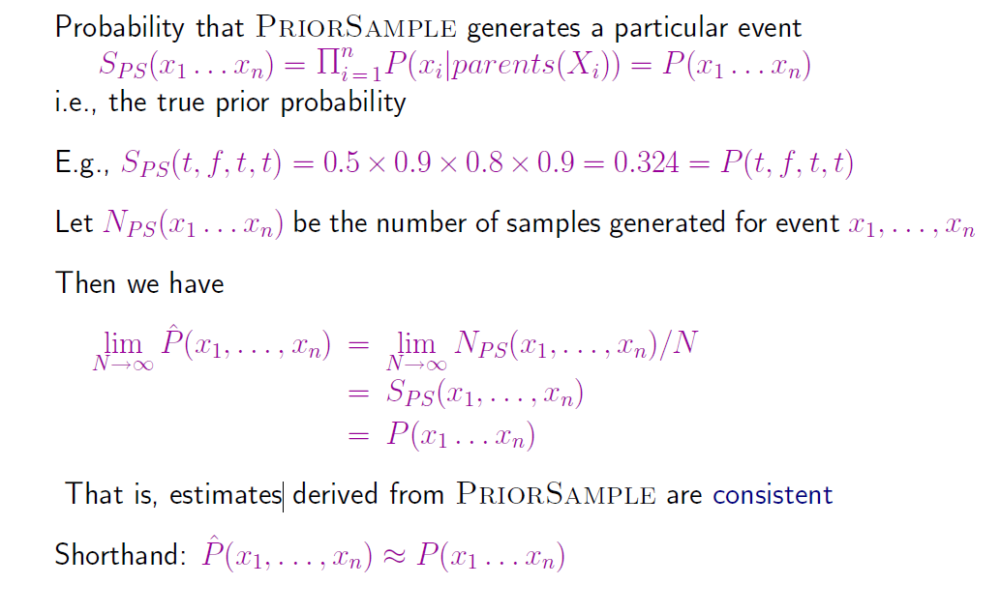
Properties
Notes:
Note: second probability is 0.9 = 1 – 0.1 = 1 – P(S|C)

Slide 61
What if evidence is given?
Sampling as defined above would generate cases that cannot be used

Slide 62
Rejection Sampling
Used to compute conditional probabilities
Procedure
  Generating sample from prior distribution specified by the Bayesian Network
  Rejecting all that do not match the evidence
  Estimating probability

Slide 63
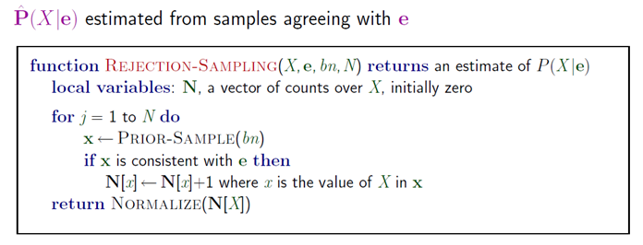
Rejection Sampling

Slide 64
Rejection Sampling Example
Let us assume we want to estimate P(Rain|Sprinkler = true) with 100 samples
100 samples
  73 samples => Sprinkler = false
  27 samples => Sprinkler = true
    8 samples => Rain = true
    19 samples => Rain = false
P(Rain|Sprinkler = true) = NORMALIZE((8,19)) = (0.296,0.704)
Problem
  It rejects too many samples

Slide 65
Analysis of rejection sampling
Notes:
So, many many runs will have to be discarded as the events have small probability

Slide 66
Likelihood Weighting
Goal
  Avoiding inefficiency of rejection sampling
Idea
  Generating only events consistent with evidence
  Each event is weighted by likelihood that the event accords to the evidence

Slide 67
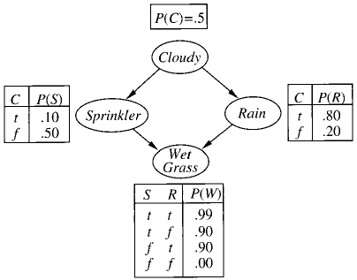
Likelyhood Weighting: Example
P(Rain|Sprinkler=true,
WetGrass = true)?
Sampling
  The weight is set to 1.0
  Sample from P(Cloudy) = (0.5,0.5) => true
  Sprinkler is an evidence variable with value true
  w ⬅ w * P(Sprinkler=true | Cloudy = true) = 0.1
  Sample from P(Rain|Cloudy=true)=(0.8,0.2) => true
  WetGrass is an evidence variable with value true
  w ⬅w * P(WetGrass=true |Sprinkler=true, Rain = true) = 0.099
  [true, true, true, true] with weight 0.099
Estimating
  Accumulating weights to either Rain=true or Rain=false
  Normalize (= divide by sum of weights)
Notes:
Weight is low because its a cloudy day what makes sprinkler unlikley

Slide 68
Likelyhood Weighting: Example
P(Rain|Cloudy=true,
WetGrass = true)?
Sampling
  Cloudy is an evidence
  w ⬅ w * P(Cloudy = true) = 0.5
  Sprinkler no evidence
  Sample from P(Sprinkler| Cloudy=true)=(0.1, 0.9) => false
  Sample from P(Rain|Cloudy=true)=(0.8,0.2) => true
  WetGrass is an evidence variable with value true
  w ⬅w * P(WetGrass=true |Sprinkler=false, Rain = true) = 0.45
  [true, false, true, true] with weight 0.45
Notes:
Weight is high because its a cloudy day and now sprinkler=fase

Slide 69
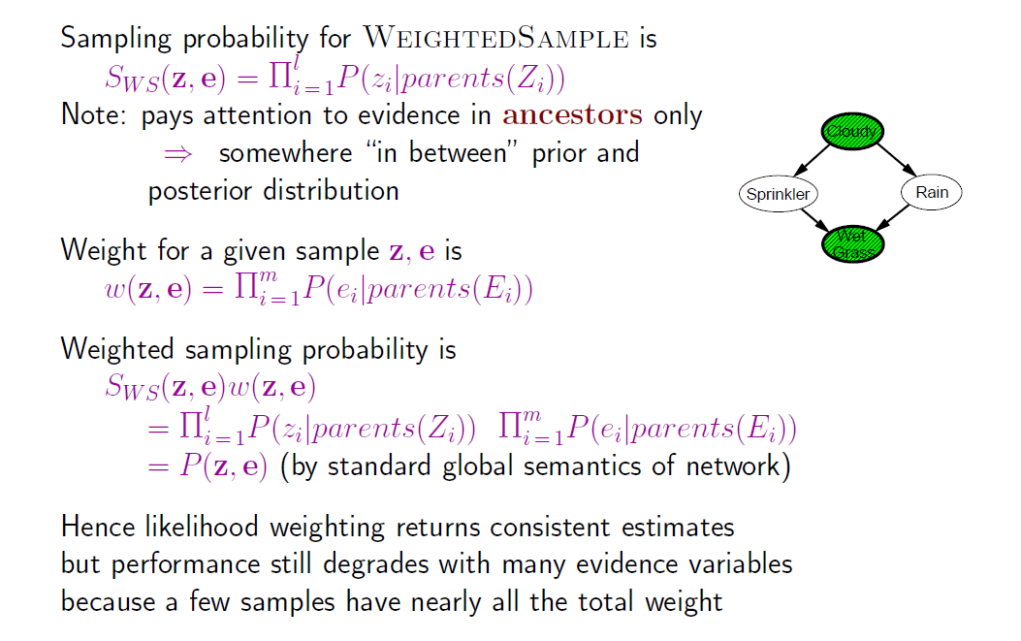
Likelihood analysis

Slide 70
Likelihood weighting

Slide 71
Markov Chain Monte Carlo
Let’s think of the network as being in a particular current state specifying a value for every variable
MCMC generates each event by making a random change to the preceding event
The next state is generated by randomly sampling a value for one of the non-evidence variables X_{i}, conditioned on the current values of the variables in the Markov blanket of X_{i}
Likelihood Weighting only takes into account the evidences of the parents. (Problematic if evidence on leafs).

Slide 72
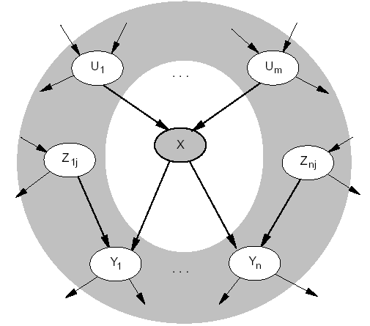
Markov Blanket
Markov blanket: Parents + children + children’s parents
Node is conditionally independent of all other nodes in network, given its Markov Blanket

Slide 73
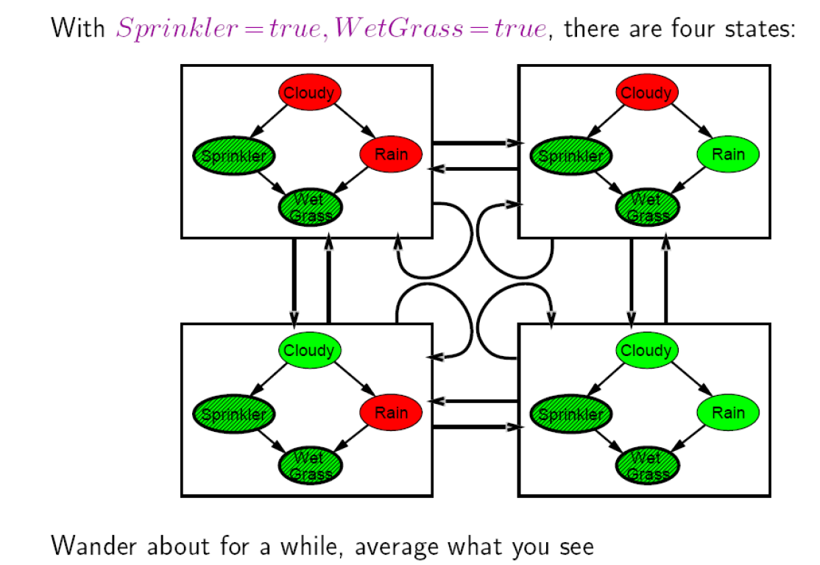
Arrows describe transition probabilities; leads to a (the Markov) chain of states

Slide 74
Markov Chain Monte Carlo: Example
P(Rain|Sprinkler = true, WetGrass = true) = ?
Initial state is [true, true, false, true] (for [Cloudy,Sprinkler,Rain,WetGrass])
The following steps are executed repeatedly:
  Cloudy is sampled, given the current values of its Markov blanket variables
  So, we sample from P(Cloudy|Sprinkler= true, Rain=false)
  Suppose the result is Cloudy = false.
  Now current state is [false, true, false, true] and counts are updated
  Rain is sampled, given the current values of its Markov blanket variables
  So, we sample from P(Rain|Cloudy=false,Sprinkler=true, WetGrass=true)
  Suppose the result is Rain = true.
  Then current state is [false, true, true, true]
After all the iterations, let’s say the process visited 20 states where Rain is true and 60 states where Rain is false then the answer of the query is NORMALIZE((20,60))=(0.25,0.75)

Slide 75
MCMC
s
s
Z
s
s
s

Slide 76
Summary
Bayesian networks provide a natural representation for (causally induced) conditional independence
Topology + CPTs = compact representation of joint distribution
Generally easy for domain experts to construct
Exact inference by variable elimination
  polytime on polytrees, NP-hard on general graphs
  space can be exponential as well
Exact Inference by belief propagation on polytress
Approximate inference based on sampling and counting help to overcome complexity of exact inference

