Slide 1
Intelligent Agents
Knowledge and Seeing
Özgür L. Özçep
Universität zu Lübeck
Institut für Informationssysteme

Slide 2
Todays lecture based on
The AAMAS 2019 Tutorial „EPISTEMIC REASONING IN MULTI-AGENT SYSTEMS“, Part 2: Knowledge and Seeing
http://people.irisa.fr/Francois.Schwarzentruber/2019AAMAStutorial/

Slide 3
Motivation

Slide 4
The Main Scenario
Agents equipped with vision devices, positioned in the plane / space, e.g. robots that cooperate
Aim: Represent and compute visual-epistemic reasoning of agents

Slide 5
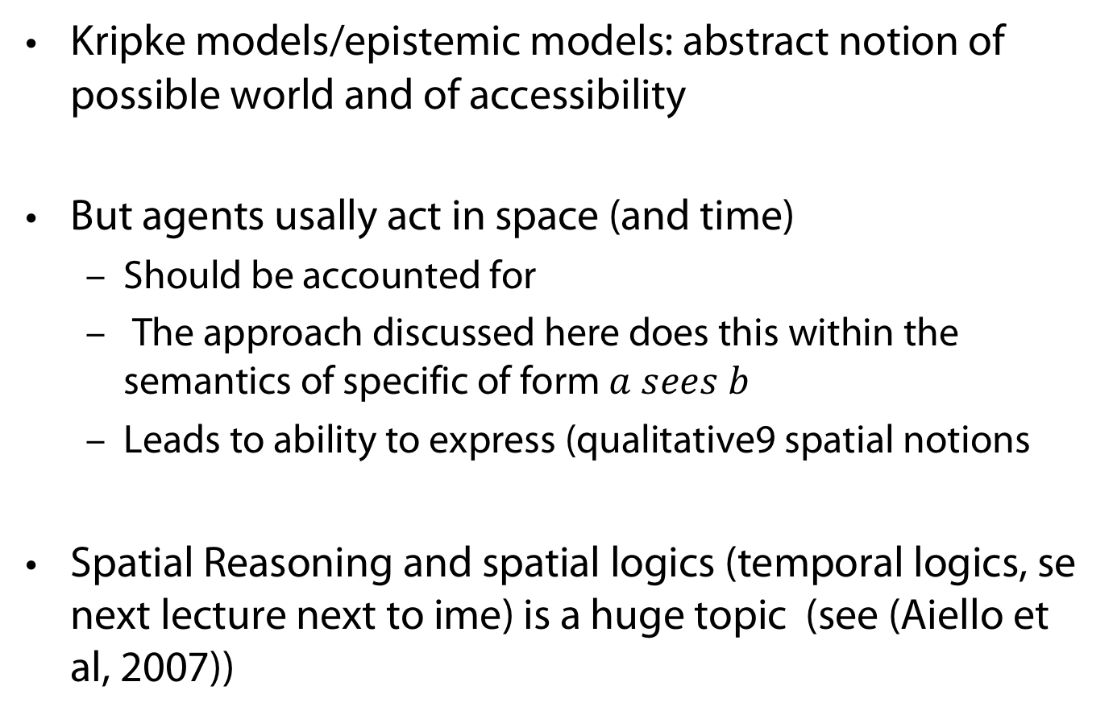
Spatial reasoning
Kripke models/epistemic models: abstract notion of possible world and of accessibility
But agents usally act in space (and time)
  Should be accounted for
  The approach discussed here does this within the semantics of specific of form $a sees b$
  Leads to ability to express (qualitative9 spatial notions
Spatial Reasoning and spatial logics (temporal logics, se next lecture next to ime) is a huge topic (see (Aiello et al, 2007))

Slide 6
MoDeling

Slide 7
Modeling
Assumptions (common knowledge)
Agents are transparent points in the plane
All objects of interest are agents
Agents see infinite sectors
Angles of vision are the same
No obstacles (yet)
Each agent has a sector (cone) of vision

Slide 8
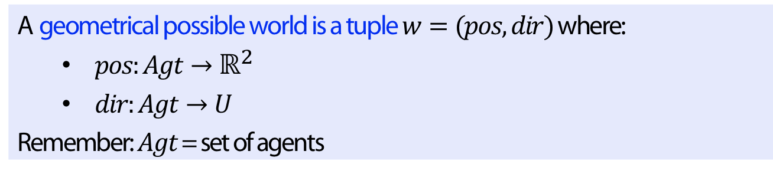
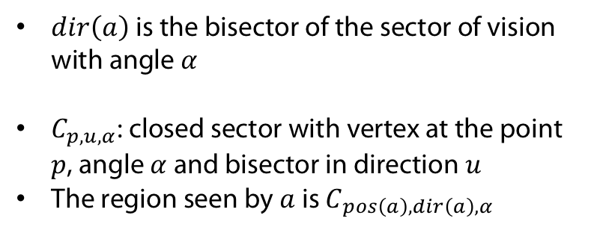
Possible Worlds
$U$ is set of unit vetors of $ℝ^{2}$
Definition
A geometrical possible world is a tuple $w=(pos, dir)$where:
  $pos:Agt→ℝ^{2}$
  $dir:Agt→U$
Remember: $Agt$ = set of agents
$dir\left(a\right)$ is the bisector of the sector of vision with angle $α$
$C_{p,u,α}$: closed sector with vertex at the point $p$, angle $α$ and bisector in direction $u$
The region seen by $a$ is $C_{pos\left(a\right),dir\left(a\right),α}$

Slide 9
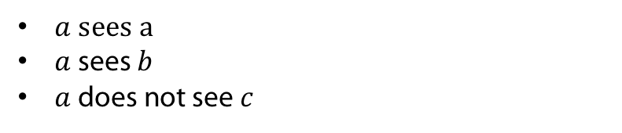
An agent sees another
Definition
$a$ sees $b$ in $w=(pos,dir)$ iff $pos\left(b\right)∈C_{pos\left(a\right),dir\left(a\right),α}$
$a sees a$
$a$ sees $b$
$a$ does not see $c$

Slide 10
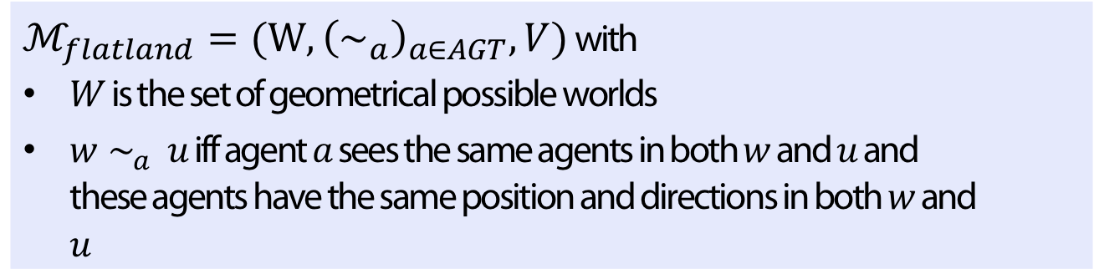

Epistemic model $ℳ_{flatland}$
Definition
$ℳ_{flatland}=(W, {\left(∼_{a}\right)}_{a∈AGT},V)$ with
$W$ is the set of geometrical possible worlds
$w∼_{a} u$ iff agent $a$ sees the same agents in both $w$ and $u$ and these agents have the same position and directions in both $w$ and $u$
Accessibility relation$∼_{a}$ is an equivalence relation. (logic: S5)

Slide 11

Axiomatization: Disjunctive surprises!
$⊨\left(K_{a}a sees b\right)∨K_{a}a sees b$
(Note that this is not an instance of a tautology)
$⊨K_{a}( b sees c ∨d sees e) ↔$
$K_{a}(b sees c)∨K_{a}(d sees e)$

Slide 12

Example
$K_{a}K_{B}CK_{c,d,e}(f sees g)$
(Note that we use now $CK$ instead of $C$ to denote common knowledge operator)

Slide 13
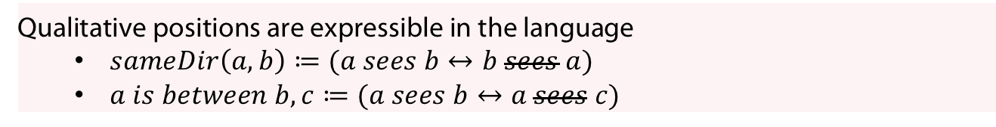
In 1D, only qualitative positions matter
Observation
Qualitative positions are expressible in the language
  $sameDir\left(a,b\right)≔(a sees b↔b sees a)$
  $a is between b,c≔(a sees b↔a sees c)$

Slide 14
Abstraction of the Kripke model in 1D
Definition
$abs\left(w\right)=\{b sees c∣ℳ_{robots, 1D} , w⊨b sees c\}$ with

Slide 15
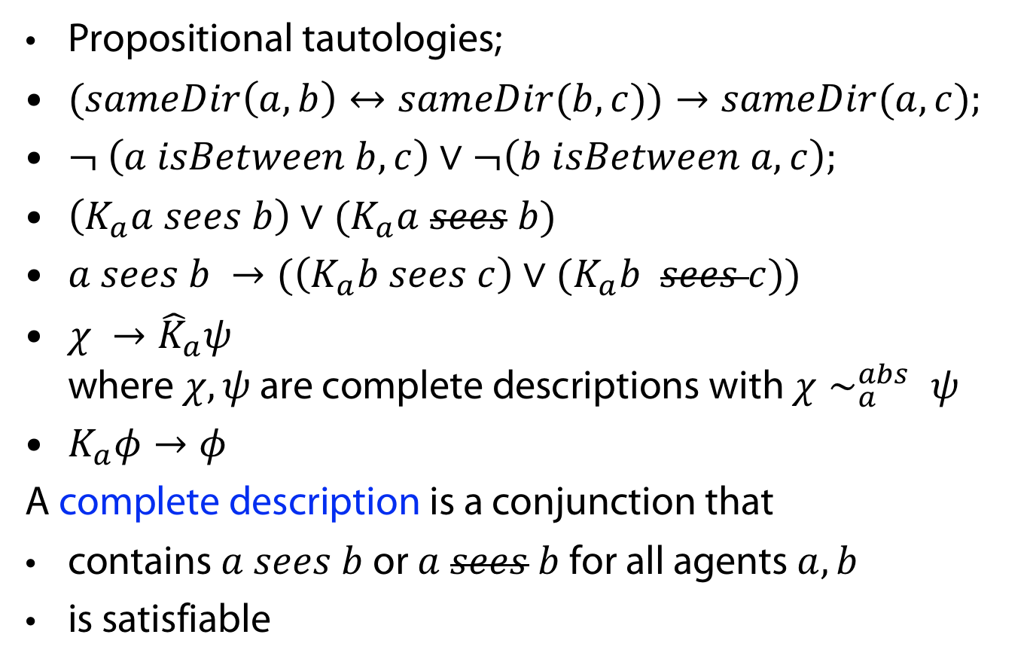
Axiomatization in 1D
Propositional tautologies;
$(sameDir\left(a,b\right)↔sameDir(b,c))→sameDir(a,c);$
$¬ \left(a isBetween b,c\right)∨¬\left(b isBetween a,c\right);$
$\left(K_{a}a sees b\right)∨(K_{a}a sees b)$
$a sees b →(\left(K_{a}b sees c\right)∨(K_{a}b sees c))$
$χ →{\hat{K}}_{a}ψ$
where $χ, ψ$ are complete descriptions with $χ∼_{a}^{abs} ψ$
$K_{a}φ→φ$
A complete description is a conjunction that
contains $a sees b$ or $a sees b$for all agents $a,b$
is satisfiable

Slide 16

In 2D, qualitative representation is open issue
Example
$K_{b}(a sees b ∧a sees d→a sees c)$
(Assuming here that cone of vision is 1-D: $α=0$)

Slide 17
Abstraction of the Kripke model in 2D
Definition
$abs\left(w\right)=\{b sees c∣ℳ_{robots, 2D} , w⊨b sees c\}$ with

Slide 18

Model checking
Input
  A description of a world $w$
  (not the whole model)
  A formula $φ$
Output: yes iff $w⊨φ$

Slide 19
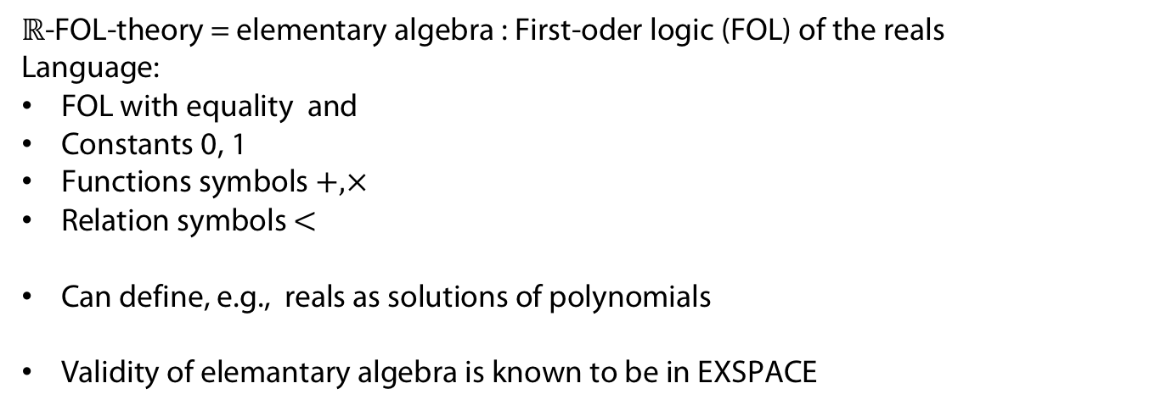
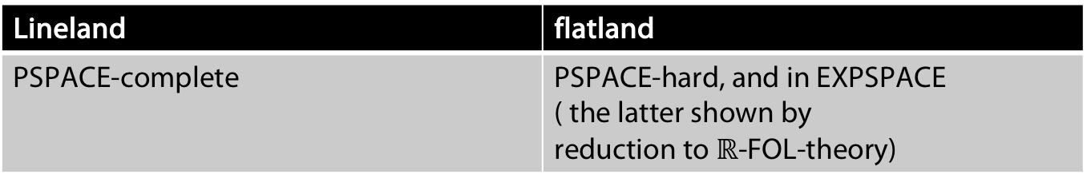
Complexity
Lineland | flatland
PSPACE-complete | PSPACE-hard, and in EXPSPACE ( the latter shown by reduction to $ℝ$-FOL-theory)
$ℝ$-FOL-theory = elementary algebra : First-oder logic (FOL) of the reals
Language:
FOL with equality and
Constants 0, 1
Functions symbols $+, ×$
Relation symbols $<$
Can define, e.g., reals as solutions of polynomials
Validity of elemantary algebra is known to be in EXSPACE

Slide 20

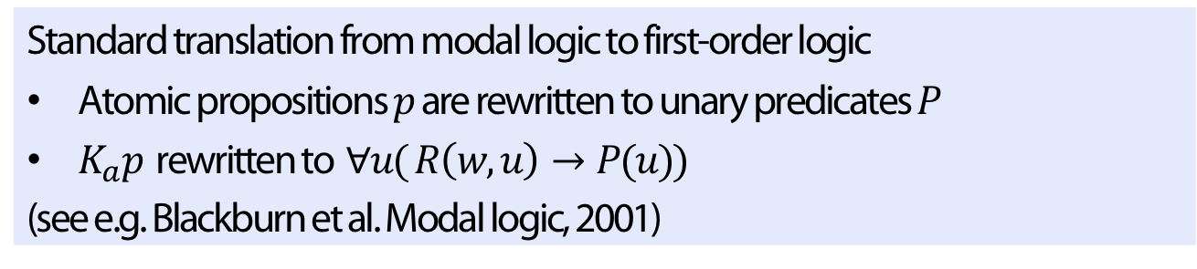
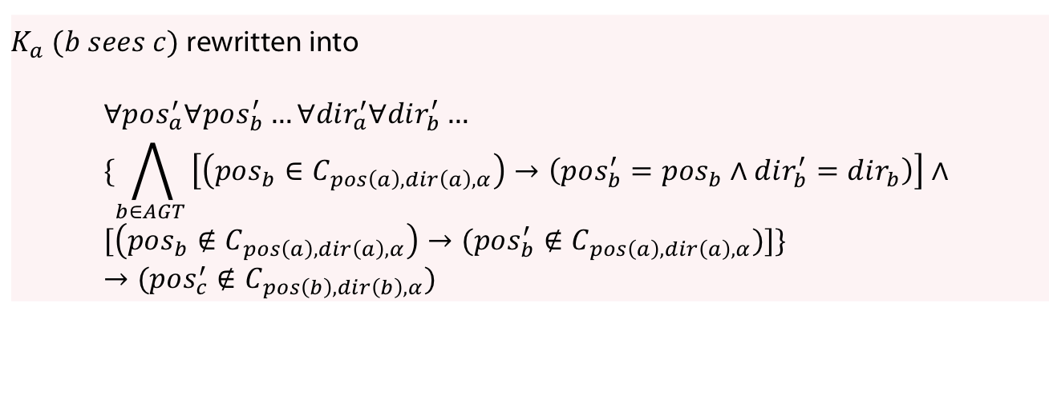
Complexity
Definition
Standard translation from modal logic to first-order logic
Atomic propositions $p$ are rewritten to unary predicates $P$
$K_{a}p$ rewritten to $∀u( R\left(w,u\right)→P(u))$
(see e.g. Blackburn et al. Modal logic, 2001)
Observation (Adapted translation to $ℝ$-FOL-theory
)
$K_{a} (b sees c)$ rewritten into
$$∀pos_{a}^{′}∀pos_{b}^{′}…∀dir_{a}^{′}∀dir_{b}^{′}… \\ \{\bigwedge_{b∈AGT }{\left[\left(pos_{b}∈C_{pos\left(a\right),dir\left(a\right),α}\right)→\left(pos_{b}^{′}=pos_{b}∧dir_{b}^{′}=dir_{b}\right)\right]}∧ \\ [\left(pos_{b}∉C_{pos\left(a\right), dir\left(a\right), α}\right)→(pos_{b}^{′}∉C_{pos\left(a\right),dir\left(a\right),α})]\} \\ →(pos_{c}^{′}∉C_{pos\left(b\right),dir\left(b\right),α})$$

Slide 21
Variant wiTH Cameras

Slide 22
Agents are cameras
Cameras
  Can turn
  Can NOT move
Common knowledge
  Of the positions of agents
  Of the abilities of perception

Slide 23
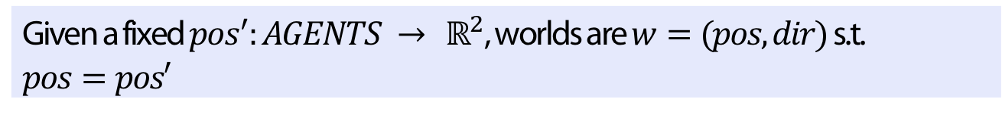
Semantics: restricted set of worlds
Definition
Given a fixed $pos^{′}:AGENTS → ℝ^{2}$, worlds are $w=(pos, dir)$ s.t. $pos=pos′$

Slide 24
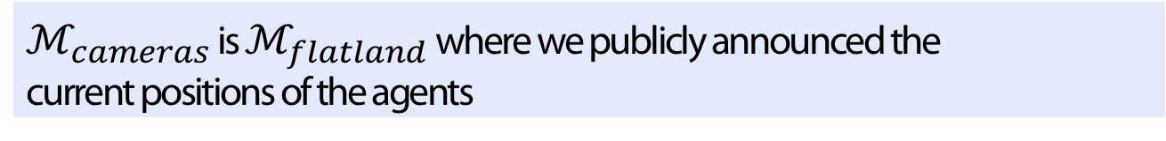

Semantics: $ℳ_{cameras}$
Definition
$ℳ_{cameras}$ is $ℳ_{flatland}$ where we publicly announced the current positions of the agents

Slide 25
Abstraction of the Kripke model in 2D works
Definition
$abs\left(w\right)=\{b sees c∣ℳ_{cameras,}, w⊨b sees c\}$ with

Slide 26
Spectrum of vision
Example (Family of vision sets of agent a)
$$S_{a}=\{\left\{b\right\}, ∅, \left\{c\right\}, \left\{d\right\}, \left\{d,f\right\}, \left\{d,f,e\right\}, \left\{f,e\right\}, \{e\}\}$$
A possible world ($dir$) can be described as ${\left\{S_{a}\right\}}_{a∈AGT}$
(configurations on next slides by $a$ moving counterclockwise)

Slide 27
Spectrum of vision
Example (Family of vision sets of agent a)
$$S_{a}=\{\left\{b\right\}, ∅, \left\{c\right\}, \left\{d\right\}, \left\{d,f\right\}, \left\{d,f,e\right\}, \left\{f,e\right\}, \{e\}\}$$

Slide 28
Spectrum of vision
Example (Family of vision sets of agent a)
$$S_{a}=\{\left\{b\right\}, ∅, \left\{c\right\}, \left\{d\right\}, \left\{d,f\right\}, \left\{d,f,e\right\}, \left\{f,e\right\}, \{e\}\}$$

Slide 29
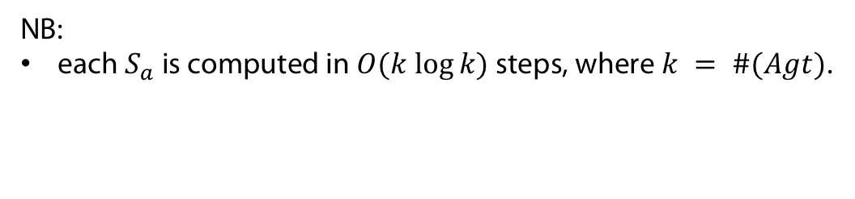
Spectrum of vision
Example (Family of vision sets of agent a)
$$S_{a}=\{\left\{b\right\}, ∅, \left\{c\right\}, \left\{d\right\}, \left\{d,f\right\}, \left\{d,f,e\right\}, \left\{f,e\right\}, \{e\}\}$$
NB:
each $S_{a}$ is computed in $O(k log⁡k)$ steps, where $k = \#(Agt)$.

Slide 30

PDL (Propositional Dynamic Logic)
Definition (PDL Syntax)
$$φ∷=a sees b∣¬φ∣φ∨ψ∣\left[π\right]φ$$
Intended semantics for $\left[π\right]φ:$after all executions of program $π,$it holds that $φ$

Slide 31
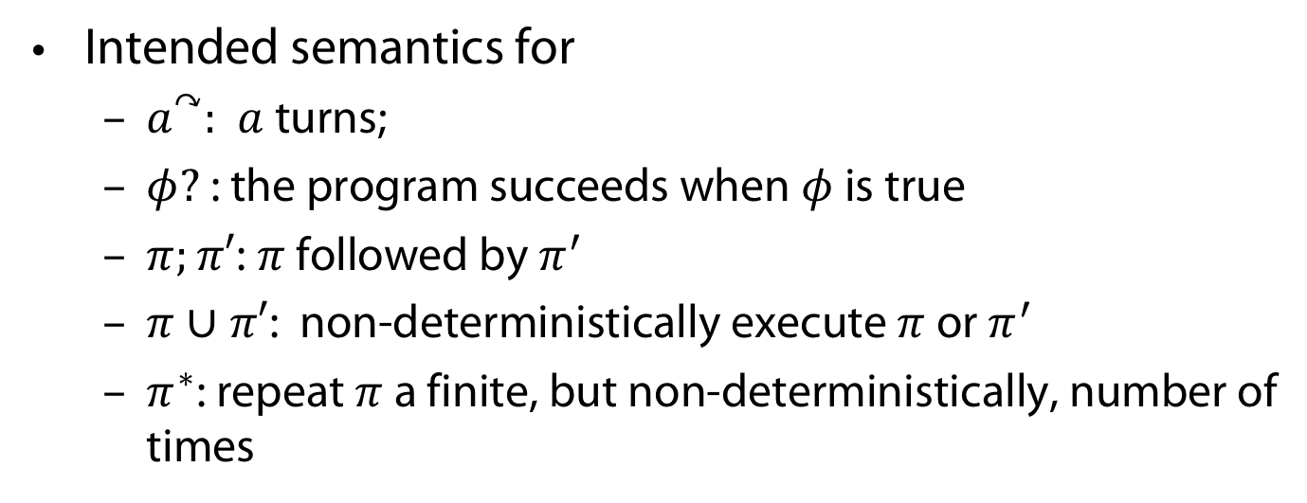
PDL Language
Definition (Syntax of programs)
$π_{…}∷=a^{↷}∣φ?∣π;π^{′}∣π∪π^{′}∣π^{∗}$
Intended semantics for
  $a^{↷}:$ $a$ turns;
  $φ?$: the program succeeds when $φ$ is true
  $π;π′$: $π$ followed by $π^{′}$
  $π∪π′$: non-deterministically execute $π$ or $π^{′}$
  $π^{∗}$: repeat $π$ a finite, but non-deterministically, number of times

Slide 32


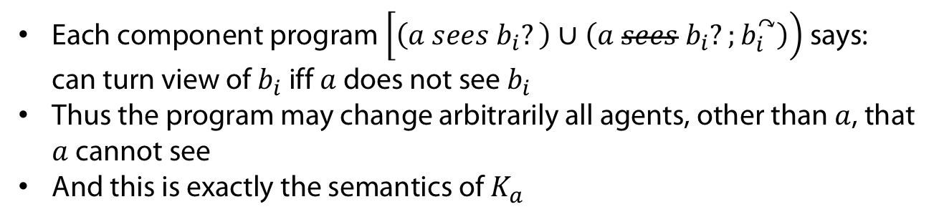
Translating epistemic operators in programs
$K_{a}$ is simulated by
$$\underset{{\begin{aligned} \\ π\end{aligned}}_{a}}{\underbrace{\left[\left(a sees b_{1}?\right)∪\left(a sees b_{1}?;b_{1}^{↷}\right)\right);…;\left(a sees b_{n}?\right)∪\left(a sees b_{n}?;b_{n}^{↷}\right))]}}$$
($b_{i}$ = all agents except for $a$)
Each component program $\left[\left(a sees b_{i}?\right)∪\left(a sees b_{i}?;b_{i}^{↷}\right)\right)$says:
can turn view of $b_{i}$ iff $a$ does not see $b_{i}$
Thus the program may change arbitrarily all agents, other than $a$, that $a$ cannot see
And this is exactly the semantics of $K_{a}$

Slide 33
Model checking
Observation
Model checking of PDL for cameras is PSPACE-complete
(Gasquet et al. 2014)

Slide 34
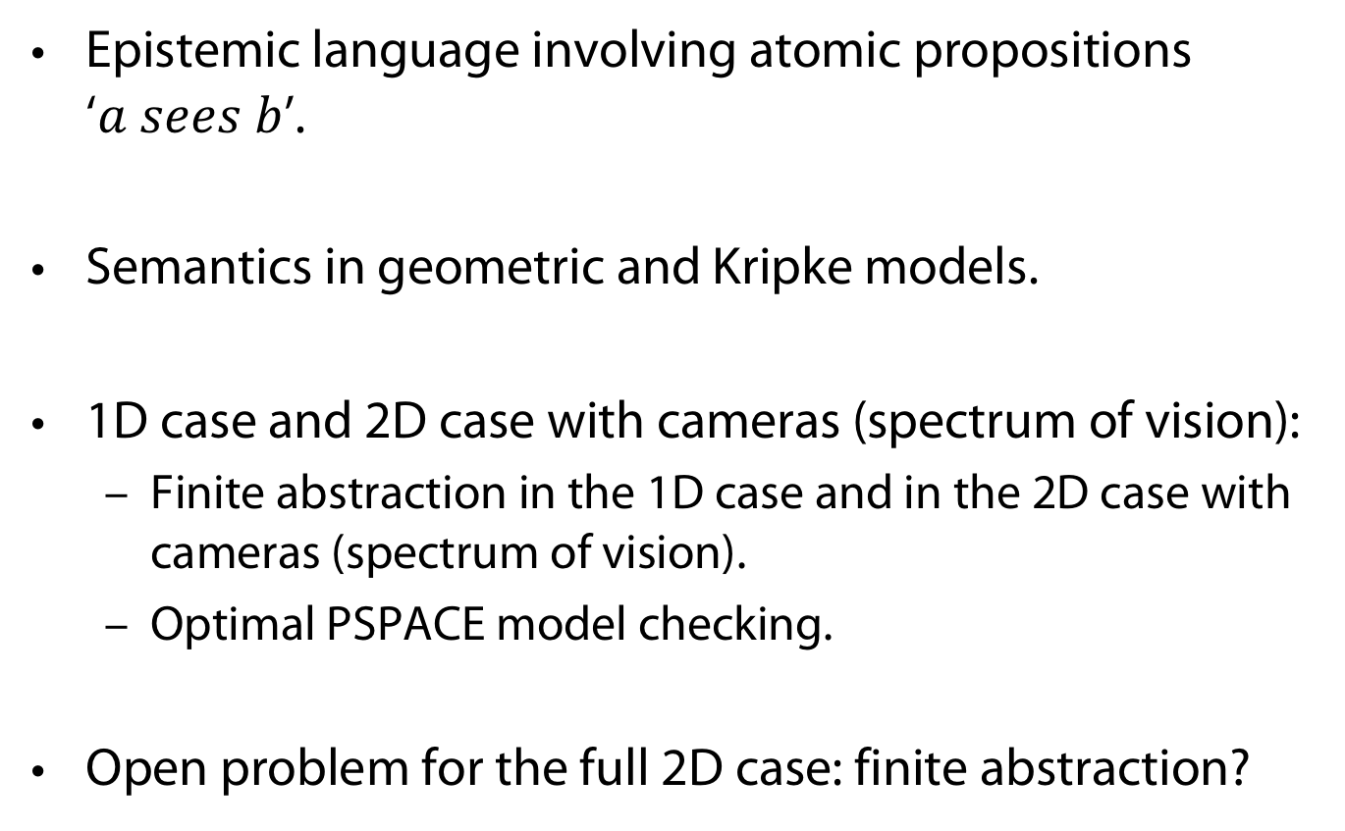
Summary: Visual-epistemic reasoning of agents
Epistemic language involving atomic propositions
‘$a sees b$’.
Semantics in geometric and Kripke models.
1D case and 2D case with cameras (spectrum of vision):
  Finite abstraction in the 1D case and in the 2D case with cameras (spectrum of vision).
  Optimal PSPACE model checking.
Open problem for the full 2D case: finite abstraction?

Slide 35
Future work
Obstacles (occlusion)
Moving agents/cameras in the plane: mathematically more complex; finite abstractions may not work
Agents/cameras in the 3D space

Slide 36
APPENDIX
Uhhh, a lecture with a hoepfully useful

Slide 37
References
M. Aiello, I. Pratt-Hartmann, and J. Benthem, editors. Handbook of Spatial Logics. Springer, 2007.
P. Balbiani, O. Gasquet, and F. Schwarzentruber. Agents that look at one another. Logic Journal fo the IGPL, 21(3):438–467, 12 2012.
P. Blackburn, M. de Rijke, and Y. Venema. Modal Logic, volume 53 of Cambridge Tracts in Theoretical Computer Science. Cambridge University Press, 2. edition, 2002.
O. Gasquet, V. Goranko, and F. Schwarzentruber. Big brother logic: logical modeling and reasoning about agents equipped with surveillance cameras in the plane. In Proceedings of AAMAS ’14, 2014.

Slide 38
Color Convention in this course
Formulae, when occurring inline
Newly introduced terminology and definitions
Important results (observations, theorems) as well as emphasizing some aspects
Examples are given with standard orange with possibly light orange frame
Comments and notes
Algorithms

