Slide 1
Intelligent Agents
Knowledge and Time
Özgür L. Özçep
Universität zu Lübeck
Institut für Informationssysteme

Slide 2
Todays lecture based on
The AAMAS 2019 Tutorial „EPISTEMIC REASONING IN MULTI-AGENT SYSTEMS“, Part 3: Knowledge and Time
http://people.irisa.fr/Francois.Schwarzentruber/2019AAMAStutorial/

Slide 3
LineAr temporal LogiC

Slide 4

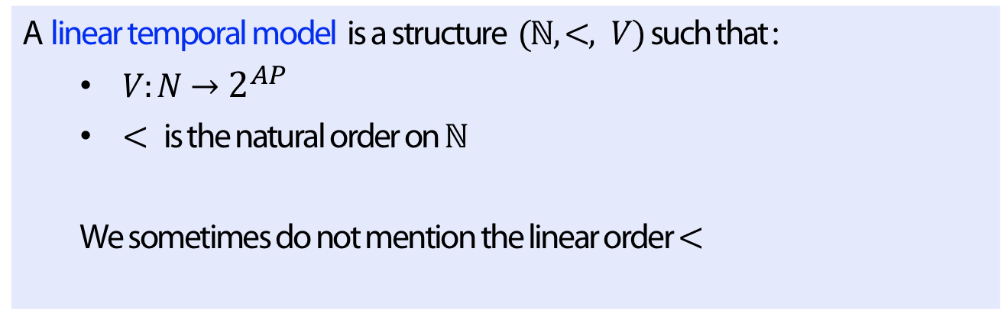



Models
$$p$$
$$p$$
$$p,q$$
$$r$$
Definition
A linear temporal model is a structure $(ℕ,<, V)$such that :
  $V:N→2^{AP}$
  $<$ is the natural order on $ℕ$
  We sometimes do not mention the linear order $<$

Slide 5
Example (traffic light)

Slide 6





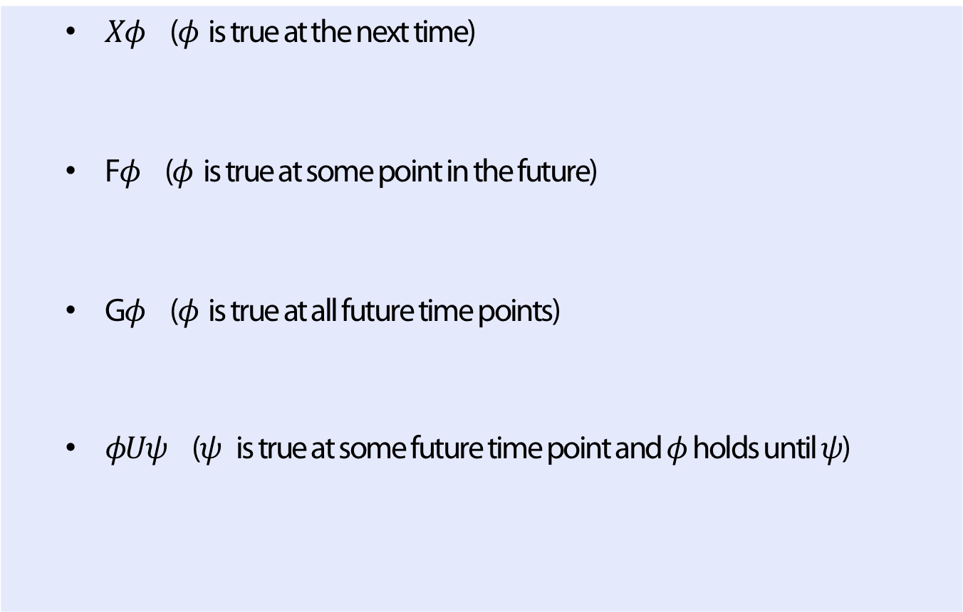







Syntax and semantics
Definition (Temporal Modalities of LTL)
  $Xφ$ ($φ$ is true at the next time)
  F$φ$ ($φ$ is true at some point in the future)
  G$φ$ ($φ$ is true at all future time points)
  $φUψ$ ($ψ$ is true at some future time point and $φ$ holds until $ψ$)
$$Xφ$$
$$φ$$
F$φ$
$$φ$$
G$φ$
$$φ$$
$$φ$$
$$φ$$
$$φ$$
$$φ$$
$$φUφ$$
$$φ$$
$$φ$$
$$φ$$
$$ψ$$

Slide 7
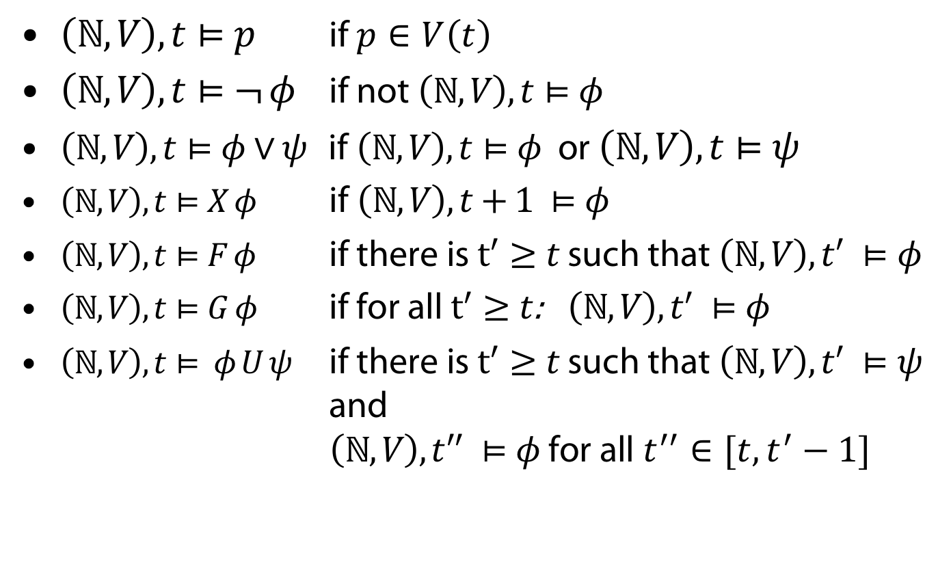
Syntax and semantics
$\left(ℕ,V\right), t⊨p$ if $p∈V\left(t\right)$
$\left(ℕ,V\right), t⊨¬ φ$ if not $\left(ℕ,V\right), t⊨φ$
$\left(ℕ,V\right), t⊨φ∨ψ$ if $\left(ℕ,V\right), t⊨φ$ or $\left(ℕ,V\right), t⊨ψ$
$\left(ℕ,V\right), t⊨X φ$ if $\left(ℕ,V\right), t+1 ⊨φ$
$\left(ℕ,V\right), t⊨F φ$ if there is $t^{′}≥t$ such that $\left(ℕ,V\right), t^{′} ⊨φ$
$\left(ℕ,V\right), t⊨G φ$ if for all $t^{′}≥t$: $\left(ℕ,V\right), t^{′} ⊨φ$
$\left(ℕ,V\right), t⊨ φ U ψ$ if there is $t^{′}≥t$ such that $\left(ℕ,V\right), t^{′} ⊨ψ$ and
$\left(ℕ,V\right), t^{′′} ⊨φ$ for all $t^{′′}∈[t, t^{′}−1]$

Slide 8
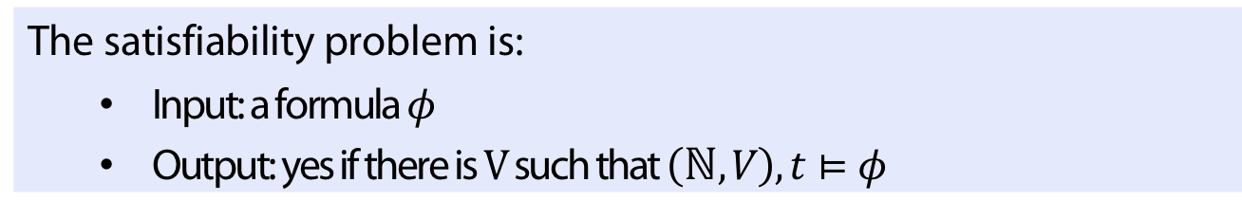
Satisfiability problem (reminder)
Definition
The satisfiability problem is:
  Input: a formula $φ$
  Output: yes if there is $V$such that $\left(ℕ,V\right), t⊨φ$
Theorem
The satisfiability problem is PSPACE-complete

Slide 9
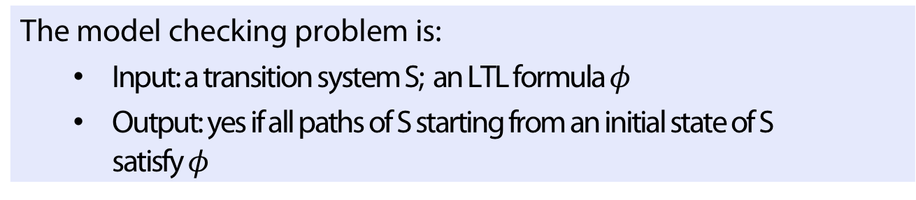
Model checking (reminder)
Definition
The model checking problem is:
  Input: a transition system S; an LTL formula $φ$
  Output: yes if all paths of S starting from an initial state of S satisfy $φ$
Theorem
The model checking problem of LTL is PSPACE-complete

Slide 10
Example
Transition system S:
Paths of S starting from initial state

Slide 11
Epistemic Linear temporal logic

Slide 12
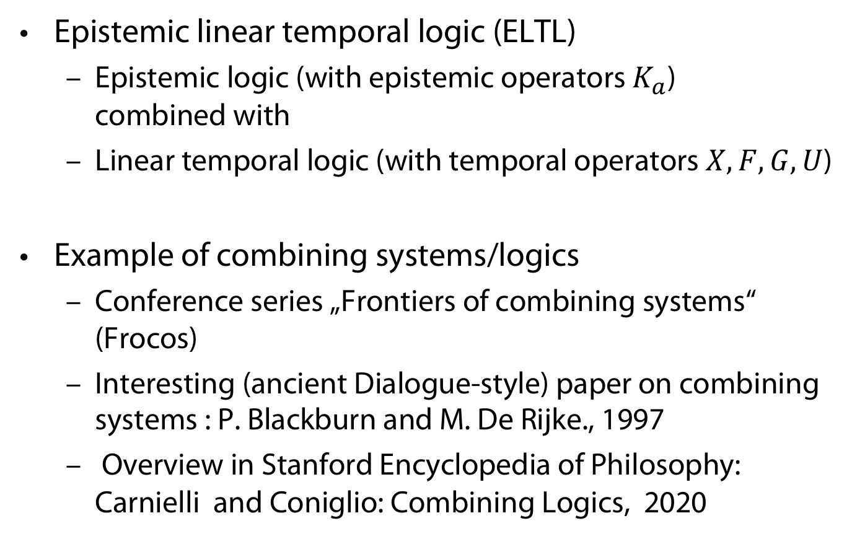
A combined logic
Epistemic linear temporal logic (ELTL)
  Epistemic logic (with epistemic operators $K_{a}$)
  combined with
  Linear temporal logic (with temporal operators $X,F,G,U$)
Example of combining systems/logics
  Conference series „Frontiers of combining systems“ (Frocos)
  Interesting (ancient Dialogue-style) paper on combining systems : P. Blackburn and M. De Rijke., 1997
  Overview in Stanford Encyclopedia of Philosophy: Carnielli and Coniglio: Combining Logics, 2020

Slide 13
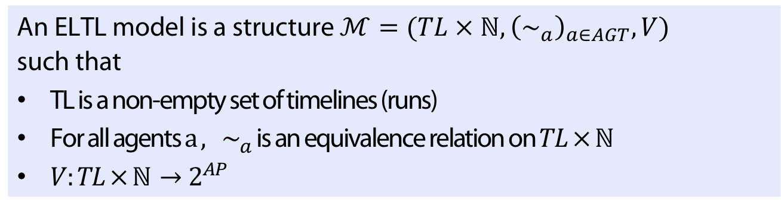
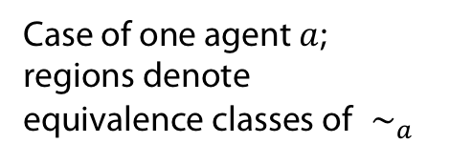
Models
Definition
An ELTL model is a structure $ℳ=(TL × ℕ, {\left(∼_{a}\right)}_{a∈AGT}, V)$ such that
TL is a non-empty set of timelines (runs)
For all agents $a ,$ $∼_{a}$ is an equivalence relation on $TL × ℕ$
$V:TL × ℕ→2^{AP}$
Case of one agent $a$;
regions denote
equivalence classes of$∼_{a}$

Slide 14
Interaction between Knowledge and time

Slide 15
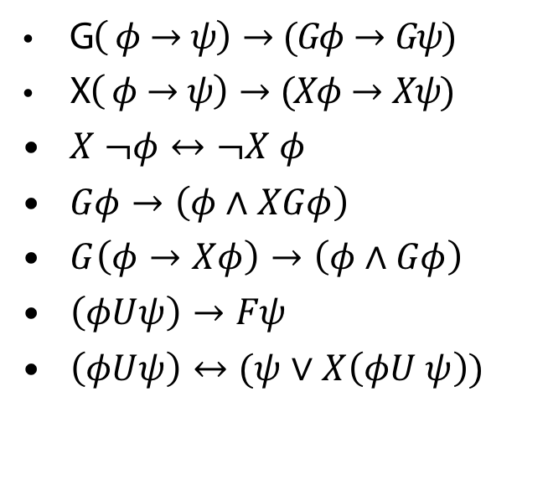
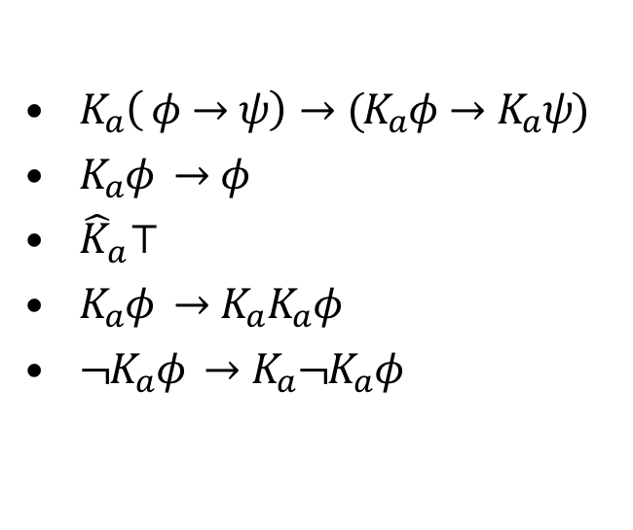
Axiomation in case: no interaction -> Fusion
All classical tautologies (and their uniform substitutions)
$K_{a}\left( φ→ψ\right)→(K_{a}φ→K_{a}ψ)$
$K_{a}φ →φ$
${\hat{K}}_{a}⊤$
$K_{a}φ →K_{a}K_{a}φ$
${¬K}_{a}φ →K_{a}¬K_{a}φ$
G$\left( φ→ψ\right)→(Gφ→Gψ)$
X$\left( φ→ψ\right)→(Xφ→Xψ)$
$X ¬φ↔¬X φ$
$Gφ→\left(φ∧XGφ\right)$
$G\left(φ→Xφ\right)→\left(φ∧Gφ\right)$
$\left(φUψ\right)→Fψ$
$\left(φUψ\right)↔(ψ∨X\left(φU ψ\right))$
EL
LTL

Slide 16
Adding interaction
For additional criteria (resulting in 96 different epistemic temporal logics see:
Halpern/Vardi, 1989)

Slide 17
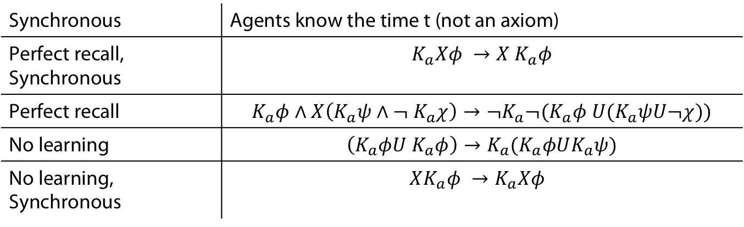
Corresponding axioms
Synchronous | Agents know the time t (not an axiom)
Perfect recall, Synchronous | $$K_{a}Xφ →X K_{a}φ$$
Perfect recall | $$K_{a}φ∧X\left(K_{a}ψ∧¬ K_{a}χ\right)→¬K_{a}¬(K_{a}φ U(K_{a}ψU¬χ))$$
No learning | $$\left(K_{a}φU K_{a}φ\right)→K_{a}(K_{a}φUK_{a}ψ)$$
No learning, Synchronous | $$XK_{a}φ →K_{a}Xφ$$

Slide 18
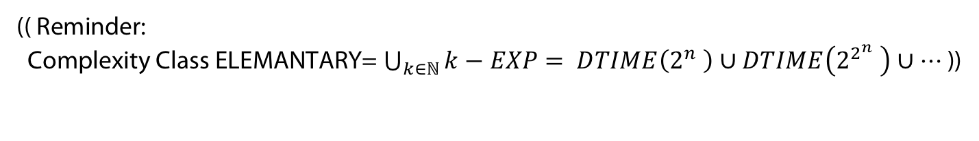
Complexity of the satisfiability problem
No interaction, or syn
PSPACE-c
Perfect recall
NON ELEM-c
Perfect recall, sync
2EXPTIME-c
No learning, sync
NON ELEM-c
No learning
NON ELEM-c
Perfect recall, no learning
EXSPACE-c
Perfect recall, no learning, sync
NON ELEM-c
(( Reminder:
Complexity Class ELEMANTARY= $\bigcup_{k∈ℕ}{k−EXP}$ $= DTIME\left(2^{n} \right)∪DTIME\left(2^{2^{n}} \right)∪…$ ))

Slide 19
Model Checking

Slide 20
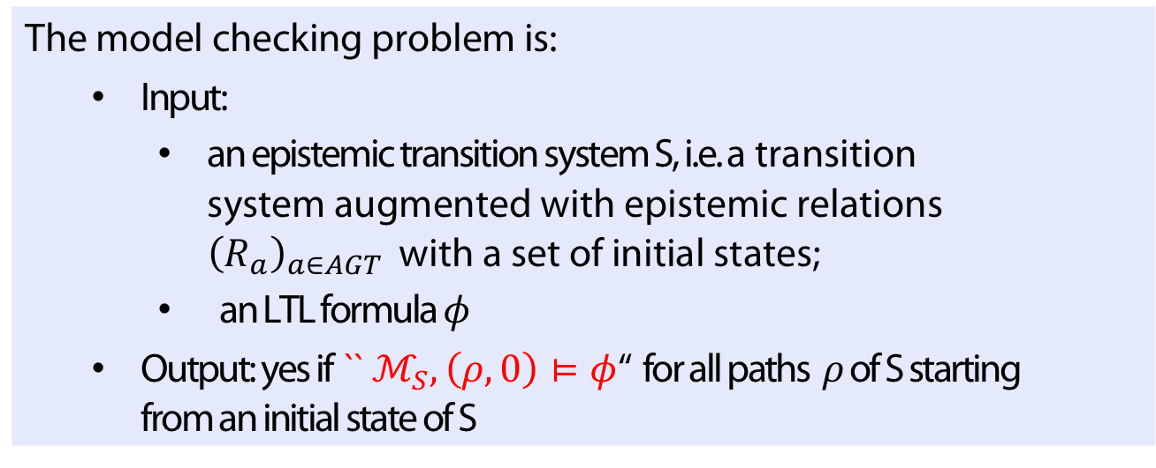
Model checking
Definition
The model checking problem is:
  Input:
    an epistemic transition system S, i.e. a transition system augmented with epistemic relations ${\left(R_{a}\right)}_{a∈AGT }$ with a set of initial states;
    an LTL formula $φ$
  Output: yes if `` $ℳ_{S},\left(ρ,0\right)⊨φ$‘‘ for all paths $ρ$of S starting from an initial state of S

Slide 21
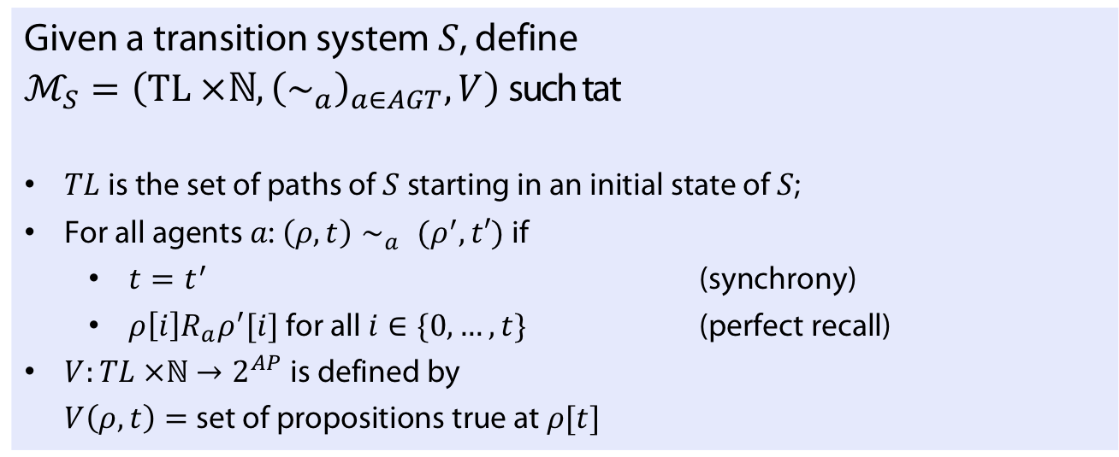

Possible Definition of $ℳ_{S}$
Definition
Given a transition system $S$, define
$ℳ_{S}=\left(TL ×ℕ, {\left(∼_{a}\right)}_{a∈AGT}, V\right)$such tat
$TL$ is the set of paths of $S$ starting in an initial state of $S$;
For all agents $a$: $\left(ρ, t\right)∼_{a} (ρ^{′}, t′)$ if
  $t=t^{′}$ (synchrony)
  $ρ\left[i\right]R_{a}ρ^{′}[i]$ for all $i∈\{0, …, t\}$ (perfect recall)
$V:TL ×ℕ→2^{AP}$ is defined by
$V\left(ρ, t\right)=$set of propositions true at $ρ[t]$

Slide 22
Example
Transition system S:
Perfect recall

Slide 23
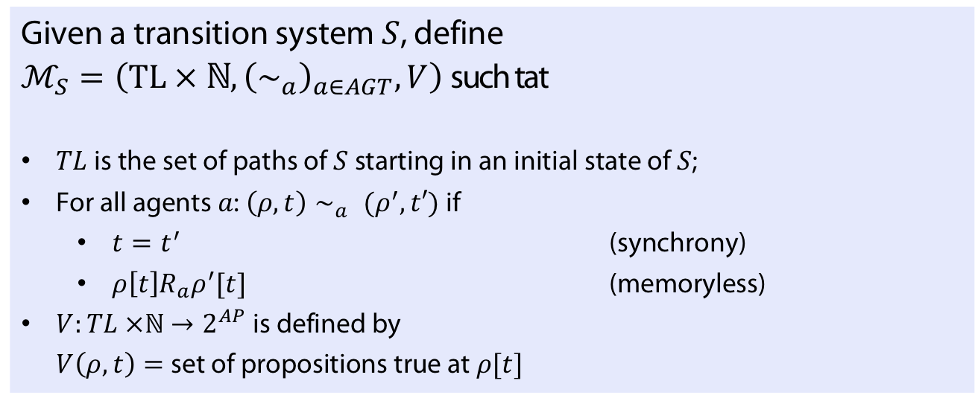

Another Possible Definition of $ℳ_{S}$
Definition
Given a transition system $S$, define
$ℳ_{S}=\left(TL × ℕ, {\left(∼_{a}\right)}_{a∈AGT}, V\right)$such tat
$TL$ is the set of paths of $S$ starting in an initial state of $S$;
For all agents $a$: $\left(ρ, t\right)∼_{a} (ρ^{′}, t′)$ if
  $t=t^{′}$ (synchrony)
  $ρ\left[t\right]R_{a}ρ^{′}[t]$ (memoryless)
$V:TL ×ℕ→2^{AP}$ is defined by
$V\left(ρ, t\right)=$set of propositions true at $ρ[t]$

Slide 24
Example
Transition system S:
Memoryless

Slide 25
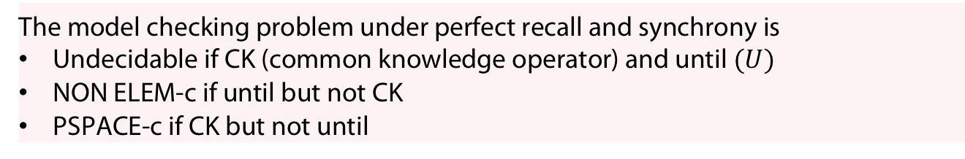
Theorem (Engelhardt et al. 2007)
The model checking problem for memoryless and synchronuos systems is PSPACE-complete
Theorem (van der Meyden and Shilov, 1999)
The model checking problem under perfect recall and synchrony is
Undecidable if CK (common knowledge operator) and until $(U)$
NON ELEM-c if until but not CK
PSPACE-c if CK but not until
See also (Bozzelli et al 2019) for recent results.

Slide 26
APPENDIX
Uhhh, a lecture with a hoepfully useful

Slide 27
References
P. Blackburn and M. De Rijke. Zooming in, zooming out. Journal of Logic, Language and Information, 6(1):5–31, 1997.
W. Carnielli and M. E. Coniglio. Combining logics. The Stanford Encyclopedia of Philosophy (Win- ter 2008 Edition), Edward N. Zalta (ed.), http://plato.stanford.edu/archives/win2008/entries/logic- combining/.
J. Y. Halpern and M. Y. Vardi. The complexity of reasoning about knowledge and time i. lower bounds. Journal of Computer and System Sciences, 38(1):195–237, 1989.
K. Engelhardt, P. Gammie, and R. Meyden. Model checking knowledge and linear time: Pspace cases. In Proceedings of the International Symposium on Logical Foundations of Computer Science, LFCS ’07, pages 195—211, Berlin, Heidelberg, 2007. Springer-Verlag.
L. Bozzelli, B. Maubert, and A. Murano. The complexity of model checking knowledge and time. In Proceedings of the 28th International Joint Conference on Artificial Intelligence, IJCAI’19, pages 1595– 1601. AAAI Press, 2019.

Slide 28
Color Convention in this course
Formulae, when occurring inline
Newly introduced terminology and definitions
Important results (observations, theorems) as well as emphasizing some aspects
Examples are given with standard orange with possibly light orange frame
Comments and notes
Algorithms

