Slide 1
Intelligent Agents
Dynamic Epistemic Logic – Part 1
Özgür L. Özçep
Universität zu Lübeck
Institut für Informationssysteme

Slide 2
Todays lecture based on
The AAMAS 2019 Tutorial „EPISTEMIC REASONING IN MULTI-AGENT SYSTEMS“, Part 4: Dynamic Epistemic Logic
http://people.irisa.fr/Francois.Schwarzentruber/2019AAMAStutorial/

Slide 3
Modeling Actions

Slide 4

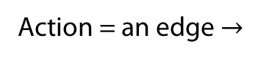
In the verification/model checking community
Action = an edge $→$
Action = an edge $→$
Epistemic =

Slide 5
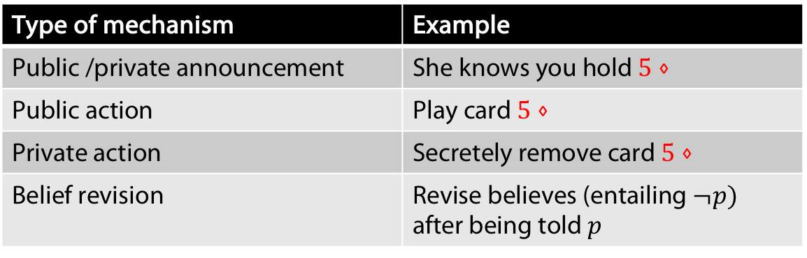
In philosophy and AI
Type of mechanism of actions is important
  There is a dedicated logic for the first type of announcementes: PAL (Public announcement logic)
  What kind of formalism to use to handle all of them?
Type of mechanism | Example
Public /private announcement | She knows you hold $5⋄$
Public action | Play card $5⋄$
Private action | Secretely remove card $5⋄$
Belief revision | Revise believes (entailing $¬p)$ after being told $p$

Slide 6

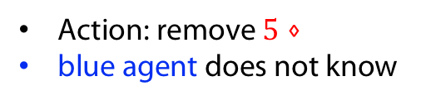
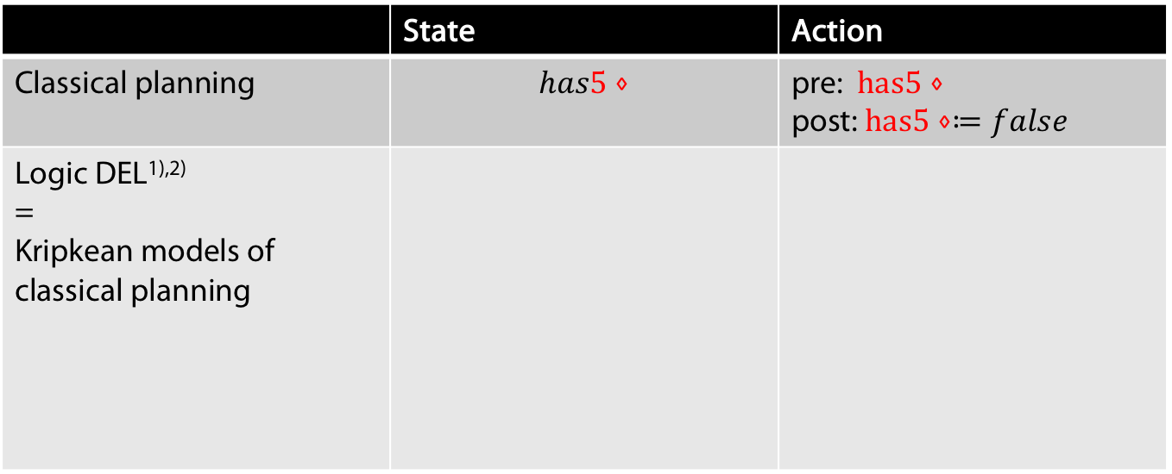
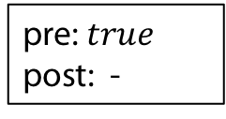


Dynamic Epistemic Logic (DEL)
 | State | Action
Classical planning | $$has5⋄$$ | pre: $has5⋄$ post: $has5⋄≔false$
Logic DEL^{1),2)} = Kripkean models of classical planning
$$has5⋄$$
pre: $has5⋄$
post: $has5⋄≔false$
$$¬ has5⋄$$
pre: $true$
post: -
Action: remove $5⋄$
blue agent does not know
1) (Baltag et al., 1998)
2) (van Ditmarsch et al, 2007)

Slide 7




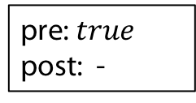


Computing the next state: product update
State | Action | Next State
(epistemic model) | (event model) | (updated epistemic model)
pre: $has5⋄$
post: $has5⋄≔false$
$$¬ has5⋄$$
$$has5⋄$$
$$has5⋄$$
$$¬ has5⋄$$
$$¬ has5⋄$$
pre: $true$
post: -

Slide 8
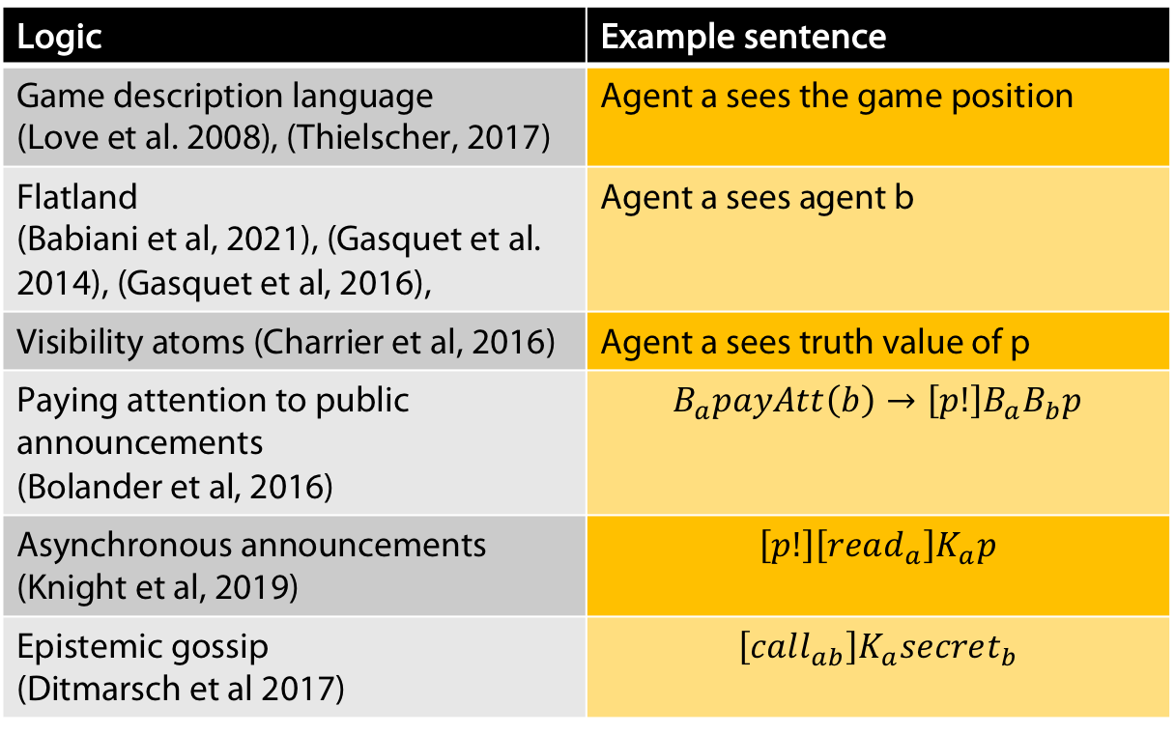
Some syntactic specifications/logics
Logic | Example sentence
Game description language (Love et al. 2008), (Thielscher, 2017) | Agent a sees the game position
Flatland (Babiani et al, 2021), (Gasquet et al. 2014), (Gasquet et al, 2016), | Agent a sees agent b
Visibility atoms (Charrier et al, 2016) | Agent a sees truth value of p
Paying attention to public announcements (Bolander et al, 2016) | $$B_{a}payAtt\left(b\right)→\left[p!\right]B_{a}B_{b}p$$
Asynchronous announcements (Knight et al, 2019) | $$\left[p!\right]\left[read_{a}\right]K_{a}p$$
Epistemic gossip (Ditmarsch et al 2017) | $$\left[call_{ab}\right]K_{a}secret_{b}$$
Notes:
GDL: One knows the language but not the rules of the game beforehand. Competition
Flatland: Clear, see lecture before
Visibility atoms: Insdistinguishability of w and w‘ iff agent for the propostions the agent can see, w and w‘ have the same truth values for them
If agent a knows that b pays attention, then after announcing p a will know that b knows p-
. Knight et al: If p is publicly announced then a has a pending message which after read by her leads to a knowing p.
Epistemic gossip: Gossip protocol: Spread sectreects amoing a group of agents using a connection graph.

Slide 9
From DEL to Epistemic Logics
Syntactic Specification
Models of DEL
Epistemic temporal models

Slide 10
From DEL to Epistemic Logics
+ Easy to specify
+ Succinct
- Ad-hoc languages
- Hand crafted semantics
Syntactic Specification
Models of DEL
Epistemic temporal models

Slide 11
From DEL to Epistemic Logics
+ Elegant Kripkean extension of classical planning
+ Succinct
+ Classification in terms of action types
+ Has probabilistic extension
+ Has extensions that encompass belief revision
- Perfect-recall only
- Synchronous only
Syntactic Specification
Models of DEL
Epistemic temporal models

Slide 12
From DEL to Epistemic Logics
+ Elegant
+ Allows for async/no perfect recall semantics
-Type of actions lost
- Not succinct (usually infinite)
Syntactic Specification
Models of DEL
Epistemic temporal models

Slide 13
Timeline

Slide 14
Timeline
Note ÖÖ: The ``systems‘‘ for belief revision do not necessarily
reflect the classical approaches to belief revision

Slide 15
Event Models

Slide 16
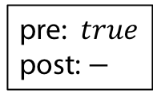
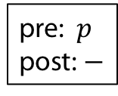





Examples of actions
(Baltag et al. 1998)
Example (public announcement of $p$)
$$a,b$$
pre: $p$
post: $−$
Example (Private announcement of $p$ to $a$)
pre: $p$
post: $−$
$$b$$
pre: $true$
post: $−$
$$a$$
$$a,b$$

Slide 17

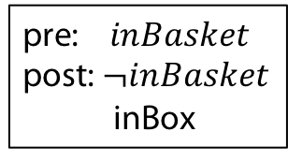
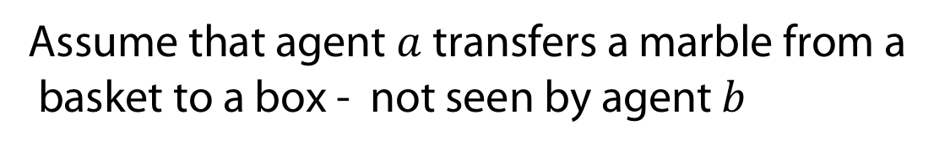

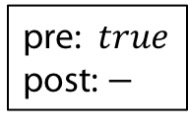
Examples of actions
Assume that agent $a$transfers a marble from a
basket to a box - not seen by agent $b$
Example (Transfer marble from basket to box)
pre: $inBasket$
post: $¬inBasket$
inBox
$$b$$
pre: $true$
post: $−$
$$a$$
$$a,b$$

Slide 18
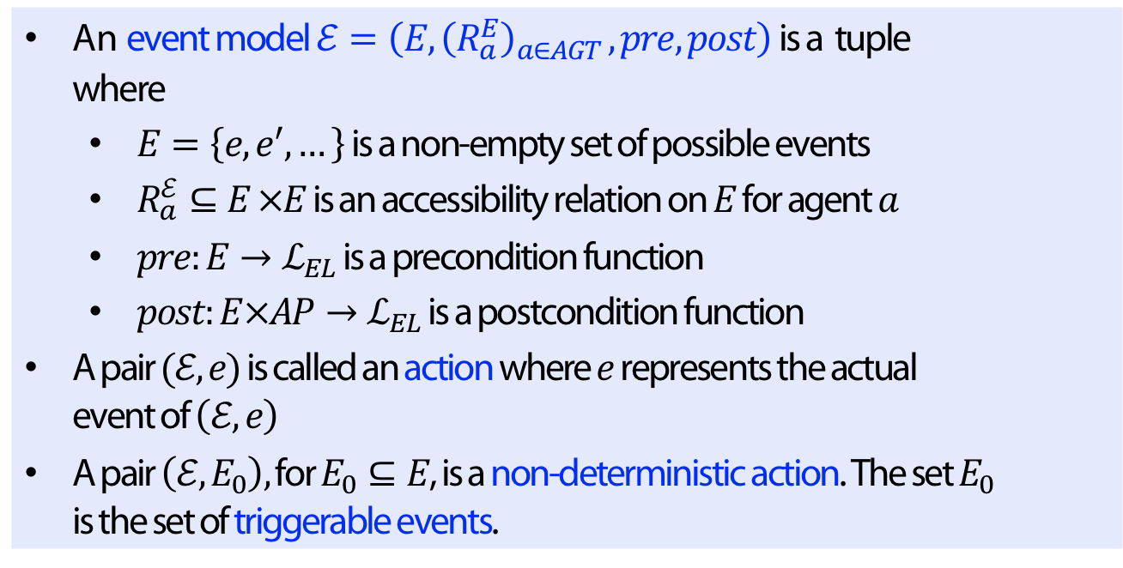
Formal Definition
Definition
An event model$ℰ=\left(E, {\left(R_{a}^{E}\right)}_{a∈AGT }, pre, post\right)$ is a tuple where
  $E=\left\{e,e^{′},…\right\}$ is a non-empty set of possible events
  $R_{a}^{ℰ}⊆E ×E$ is an accessibility relation on $E$ for agent $a$
  $pre:E→ℒ_{EL}$ is a precondition function
  $post:E×AP→ℒ_{EL}$ is a postcondition function
A pair $(ℰ,e)$ is called an action where $e$ represents the actual event of $\left(ℰ,e\right)$
A pair $\left(ℰ,E_{0}\right),$ for $E_{0}⊆E$, is a non-deterministic action. The set $E_{0}$ is the set of triggerable events.
Notes:
The psot-function describes real (ontic changes), telling for each propositional symbol, intow which formula it changes.

Slide 19


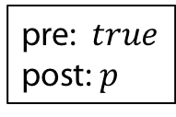

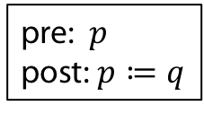

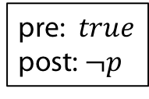

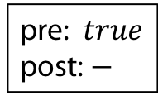
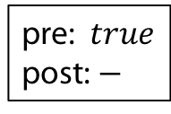
Example (Deterministic action= single-pointed event model)
pre: $p$
post: $p≔q$
$$b$$
pre: $true$
post: $−$
$$a$$
$$a,b$$
Example (Non-deterministic action= multi-pointed event model)
pre: $true$
post: $p$
$$b$$
pre: $true$
post: $−$
$$a$$
$$a,b$$
pre: $true$
post: $¬p$
$$b$$
$$a$$

Slide 20
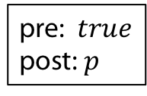
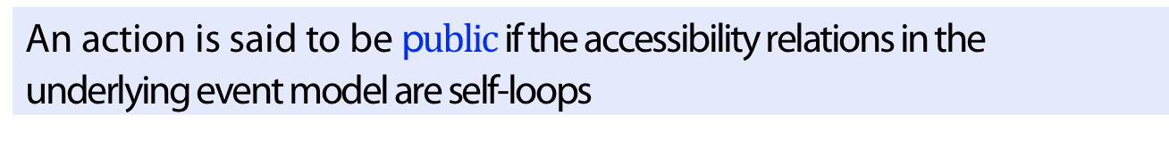
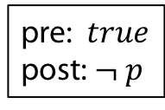
Public Actions
Definition
An action is said to be p$ublic$if the accessibility relations in the underlying event model are self-loops
Example (public)
pre: $true$
post: $p$
pre: $true$
post: $¬ p$
$$a,b$$
$$a,b$$

Slide 21

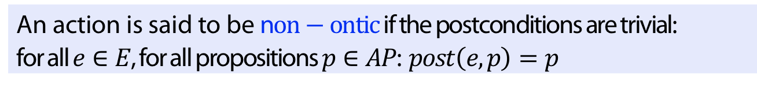

Non-ontic actions
Definition
An action is said to be n$on−ontic$if the postconditions are trivial: for all $e∈E$, for all propositions $p∈AP$: $post\left(e,p\right)=p$
Example (non-ontic)
pre: $p$
post: $−$
$$b$$
pre: $true$
post: $−$
$$a$$
$$a,b$$

Slide 22

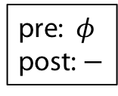
Effect of a public announcement
Publicly announcing $φ$ leads to keeping only the $φ$ worlds.
pre: $φ$
post: $−$
$$a,b$$
Can try this out on several examples in Hintikka‘s world.

Slide 23
Example (Update Product)
Notes:
Note: as b does not know about the content announced to a it thinsk possible that a thinks it does not have mud on his forehead

Slide 24
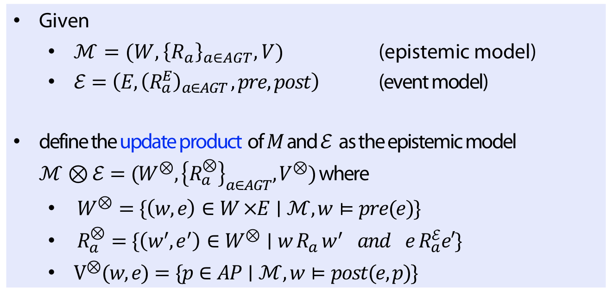
Formal Definition of Update Products
Definition
Given
  $ℳ=(W, {\left\{R_{a}\right\}}_{a∈AGT}, V)$ (epistemic model)
  $ℰ=\left(E, {\left(R_{a}^{E}\right)}_{a∈AGT }, pre, post\right)$ (event model)
define the update product of $M$ and $ℰ$ as the epistemic model
$ℳ⊗ℰ=(W^{⊗},{\left\{R_{a}^{⊗}\right\}}_{a∈AGT}, V^{⊗})$ where
  $W^{⊗}=\{\left(w,e\right)∈W ×E∣ℳ, w⊨pre(e)\}$
  $R_{a}^{⊗}=\{\left(w^{′},e^{′}\right)∈W^{⊗}∣w R_{a} w^{′} and e R_{a}^{ℰ}e′\}$
  $V^{⊗}(w,e)=\{p∈AP∣ℳ,w⊨post(e,p)\}$

Slide 25

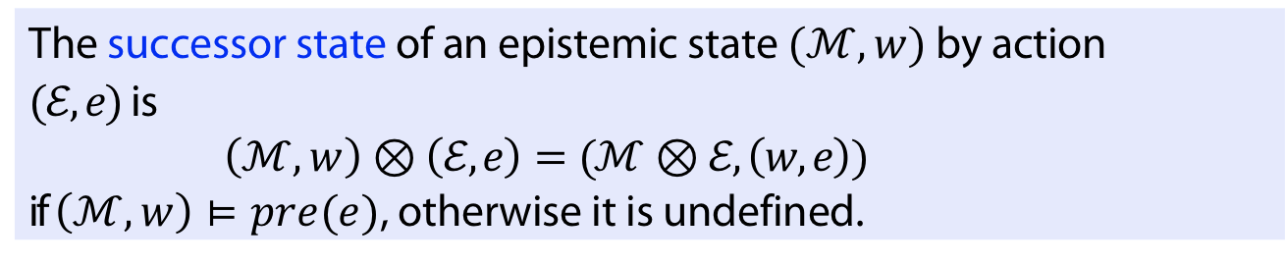
Pointed update products
Definition
The successor state of an epistemic state $(ℳ,w)$ by action $(ℰ,e)$ is
$\left(ℳ,w\right)⊗\left(ℰ,e\right)=(ℳ⊗ℰ, \left(w,e\right))$
if $\left(ℳ,w\right)⊨pre(e)$, otherwise it is undefined.
Notation
Write $e$ for $\left(ℰ,e\right)$
Write `$we$‘ for $(w,e)$
Write$ℳ⊗ℰ^{n}$ for$ℳ⊗ℰ⊗ℰ…⊗ℰ$ (n-times)
Write $we_{1}…e_{n}⊨φ$ for $ℳ⊗ℰ^{n}, we_{1}…e_{n}⊨φ$,

Slide 26
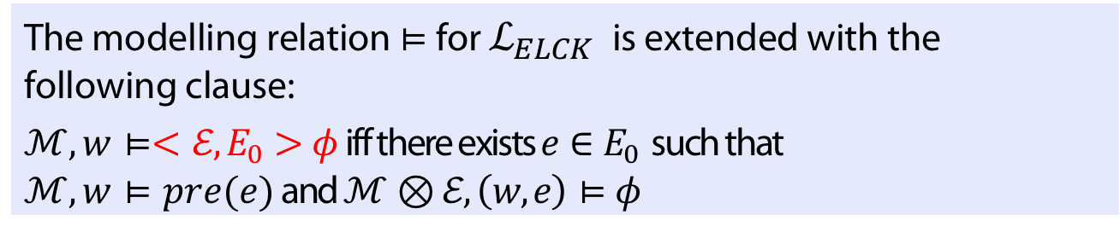

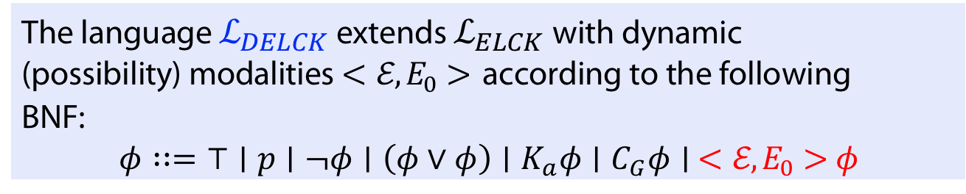
Dynamic epistemic logic $ℒ_{DELCK}$
Definition
The language $ℒ_{DELCK}$ extends $ℒ_{ELCK}$with dynamic (possibility) modalities $<ℰ,E_{0}>$ according to the following BNF:
$φ∷=⊤∣p∣¬φ∣\left(φ∨φ\right)∣K_{a}φ∣C_{G}φ∣ <ℰ,E_{0}>φ$
Definition
The modelling relation $⊨$ for $ℒ_{ELCK}$ is extended with the following clause:
$ℳ,w⊨<ℰ,E_{0}>φ$ iff there exists $e∈E_{0}$ such that
$ℳ,w⊨pre(e)$ and $ℳ⊗ℰ, \left(w,e\right)⊨φ$

Slide 27

Dual operator
Definition (Dual operator)
$$\left[ℰ,E_{0}\right]φ≔¬<ℰ,E_{0}>¬φ$$
The induced semantics is
$ℳ,w⊨[ℰ,E_{0}]φ$ iff for all $e∈E_{0}$ we have:
If $ℳ,w⊨pre(e)$ then $ℳ⊗ℰ, \left(w,e\right)⊨φ$

Slide 28
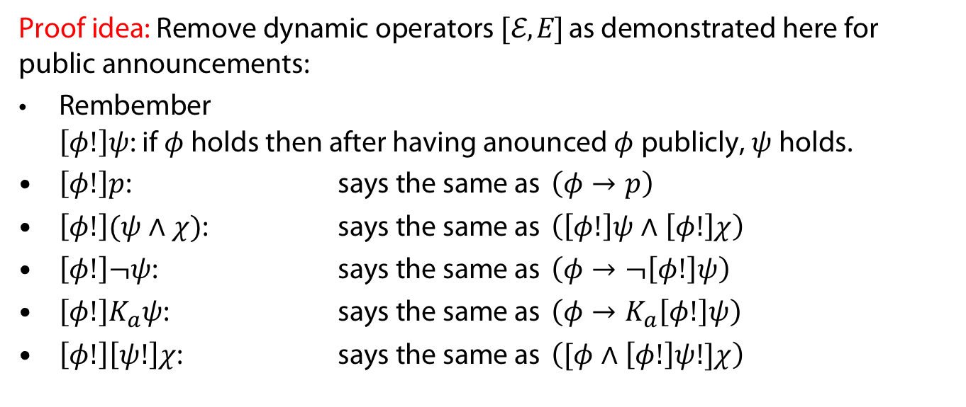
Expressivity and Succinctness
Theorem (Baltag 98)
DEL and EL have the same expressivity
Proof idea: Remove dynamic operators $[ℰ,E]$ as demonstrated here for public announcements:
Rembember
$\left[φ!\right]ψ$: if $φ$ holds then after having anounced $φ$ publicly, $ψ$ holds.
$\left[φ!\right]p$: says the same as $\left(φ→p\right)$
$\left[φ!\right](ψ∧χ)$: says the same as $\left(\left[φ!\right]ψ∧\left[φ!\right]χ\right)$
$\left[φ!\right]¬ψ$: says the same as $\left(φ→¬\left[φ!\right]ψ\right)$
$\left[φ!\right]K_{a}ψ$: says the same as $\left(φ→K_{a}\left[φ!\right]ψ\right)$
$\left[φ!\right]\left[ψ!\right]χ$: says the same as $\left([φ∧\left[φ!\right]ψ!]χ\right)$
Theorem (Lutz 2006)
DEL is more succinct

Slide 29
APPENDIX
Uhhh, a lecture with a hoepfully useful

Slide 30
References
A. Baltag, L. S. Moss, and S. Solecki. The logic of public announcements, common knowledge, and private suspicions. In Proceedings of the 7th Conference on Theoretical Aspects of Rationality and Knowledge, TARK ’98, pages 43—56, San Francisco, CA, USA, 1998. Morgan Kaufmann Publishers Inc.
H. P. van Ditmarsch, W. van der Hoek, and B. P. Kooi. Dynamic epistemic logic and knowledge puzzles. In U. Priss, S. Polovina, and R. Hill, editors, Conceptual Structures: Knowledge Architectures for Smart Applications, 15th International Conference on Conceptual Structures, ICCS 2007, Sheffield, UK, July 22-27, 2007, Proceedings, volume 4604 of Lecture Notes in Computer Science, pages 45–58. Springer, 2007
N. Love, T. Hinrich, D. Haley, E. Schkufza, and M. Genesereth. General game playing: Game descrip- tion language specification. report LG-2006-01, Stanford Logic Group, Computer Science Department, Stanford University, March 2008.
M. Thielscher. Gdl-iii: A description language for epistemic general game playing. In Proceedings of the Twenty-Sixth International Joint Conference on Artificial Intelligence, IJCAI-17, pages 1276–1282, 2017.
P. Balbiani, O. Gasquet, and F. Schwarzentruber. Agents that look at one another. Logic Journal fo the IGPL, 21(3):438–467, 12 2012.

Slide 31
References
O. Gasquet, V. Goranko, and F. Schwarzentruber. Big brother logic: logical modeling and reasoning about agents equipped with surveillance cameras in the plane. In Proceedings of AAMAS ’14, 2014.
O. Gasquet, V. Goranko, and F. Schwarzentruber. Big brother logic: visual-epistemic reasoning in stationary multi-agent systems. Autonomous Agents and Multi-Agent Systems, 30(5):793–825, 2016.
T. Charrier, A. Herzig, E. Lorini, F. Maffre, and F. Schwarzentruber. Building epistemic logic from observations and public announcements. In C. Baral, J. P. Delgrande, and F. Wolter, editors, Principles of Knowledge Representation and Reasoning: Proceedings of the Fifteenth International Conference, KR 2016, Cape Town, South Africa, April 25-29, 2016, pages 268–277. AAAI Press, 2016.
T. Bolander, H. van Ditmarsch, A. Herzig, E. Lorini, P. Pardo, and F. Schwarzentruber. Announcements to attentive agents. J. Log. Lang. Inf., 25(1):1–35, 2016.
S. Knight, B. Maubert, and F. Schwarzentruber. Reasoning about knowledge and messages in asyn- chronous multi-agent systems. Mathematical Structures in Computer Science, 29:127 – 168, 2019.
H. van Ditmarsch, J. van Eijck, P. Pardo, R. Ramezanian, and F. Schwarzentruber. Epistemic protocols for dynamic gossip. Journal of Applied Logic, 20:1–31, 2017.
C. Lutz. Complexity and succinctness of public announcement logic. In Proceedings of the Fifth Inter- national Joint Conference on Autonomous Agents and Multiagent Systems, AAMAS ’06, pages 137–143, New York, NY, USA, 2006. Association for Computing Machinery.

Slide 32
Color Convention in this course
Formulae, when occurring inline
Newly introduced terminology and definitions
Important results (observations, theorems) as well as emphasizing some aspects
Examples are given with standard orange with possibly light orange frame
Comments and notes
Algorithms

