Slide 1
Intelligent Agents
Epistemic Logic
Özgür L. Özçep
Universität zu Lübeck
Institut für Informationssysteme

Slide 2
Todays lecture (and the following five) based on
The AAMAS 2019 Tutorial „EPISTEMIC REASONING IN MULTI-AGENT SYSTEMS“
http://people.irisa.fr/Francois.Schwarzentruber/2019AAMAStutorial/

Slide 3
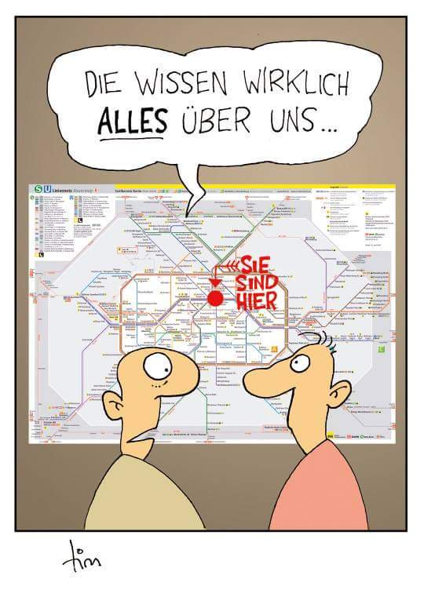
Motivation

Slide 4
The need for knowledge
Many multi-agent systems require to model knowledge of others‘ due to imperfect information
  Agents have local view of environment
  Agents communicate
  Agents act -> Decisions taken w.r.t. knowledge
Similar: Reasoning about other agents „knowledge“ in game theory (second half of this lecture thread
Agents, Mechanism, and Collaboration (lecture))
  Speculation about other one‘s strategies/values of things (and about their speculations on our values...)?
  Collaborative agents (negotiation, communication)
  Imperfect information

Slide 5
Interaction relies on knowledge
if I know it is safe then I go
if I know you are at the market place then I join you
if (I know it is safe) and (I know you do not know it is safe) then I tell you it is safe
if I know you know it is safe then
I do not tell you it is safe
if I know you know I know it is safe or not then
I do not wait for a message from you

Slide 6
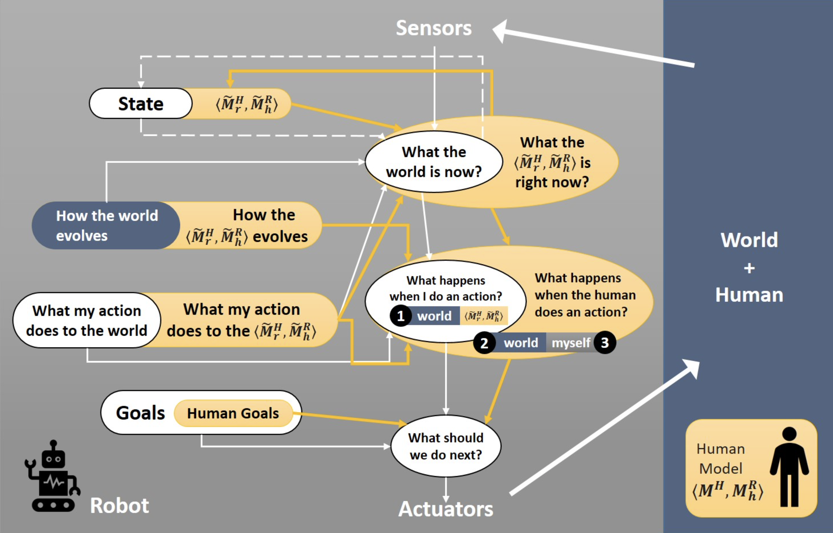
Reminder: Human-compatible AI
Challenges of Human-Aware AI Systems: Subbarao Kambhampati

Slide 7
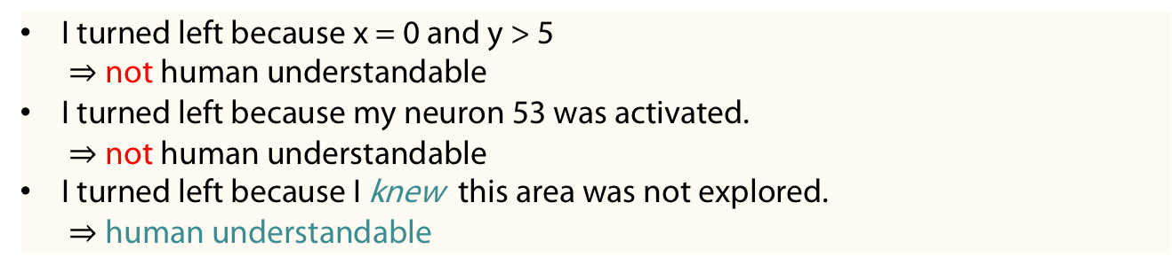
Towards XAI?
XAI = explainable AI: Need to built understandable (human comprehensible) AI systems
XAI for multi-agent systems?
  Example: Robots interacting with humans
  Legal issues in case of failures
Example (Explanations of a robot exploring a world)
I turned left because x = 0 and y > 5
$⇒$not human understandable
I turned left because my neuron 53 was activated.
$⇒$not human understandable
I turned left because I knew this area was not explored.
$⇒$human understandable

Slide 8
The need for reasoning
Given
  what agents sense
  The actions and communications that occurred
What does each agent know?

Slide 9
Once upon a time ... In 2011 -212
Schwarzentruber (2. presenter of AAMAS 2019) says:
„I explained epistemic logic to other researchers in logic/AI/verification ...
... but nobody understood me ..."
P= false
P= true

Slide 10
Possible worlds
„... But, since 2017, everybody understood me with comics ...‘‘
Have a look at http://hintikkasworld.irisa.fr/

Slide 11
Semantics of knowing something
Agent a knows that agent b is dirty
Instance of the famous „muddy children puzzle“

Slide 12
Muddy children Puzzle
„Three children (a,b,c) are playing in the mud. Father calls the children to the house, arranging them in a semicircle so that each child can clearly see every other child. “At least one of you has mud on your forehead”, says Father. The children look around, each examining every other child’s forehead. Of course, no child can examine his or her own. Father continues, “If you know whether your forehead is dirty, then step forward now”. No child steps forward. Father repeats himself a second time, “If you know whether your forehead is dirty, then step forward now”. Some (a,b) but not all of the children step forward. Father repeats himself a third time, “If you know whether your forehead is dirty, then step forward now”. All of the remaining children step forward. Explain why a,b stepped forward after two requests. (In general show: if m children are muddy then after m requests of the father those will step forward“
We will reconsider this puzzle (in the context of dynamic epistemic logic (epistemic logic with operators changing epistemic models))

Slide 13
Epistemic state = pointed Kripke structure
Comics correspond to unravelling of a pointed Kripke structure
Actual word
ma = agent a has muddy forehead
mb = agent b has muddy forehead

Slide 14
Explaining these in many communities

Slide 15
Open-source project Hintikka‘s world
http://hintikkasworld.irisa.fr/
https://gitlab.inria.fr/ fschwarz/hintikkasworld
Web app
Modular source code in Typescript
Easy to add examples
Several contributors

Slide 16
Epistemic LoGics (Syntax and SemanticS)

Slide 17
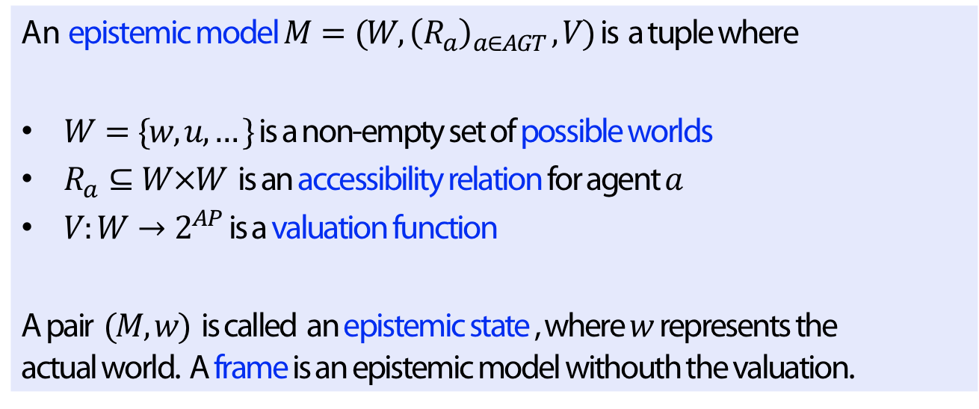
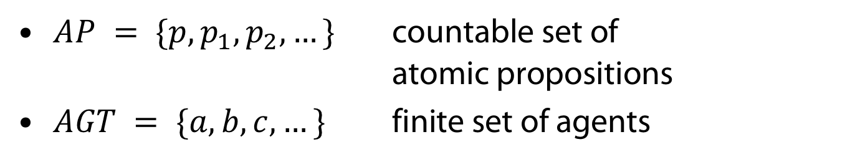
Epistemic states
$AP = \{p, p_{1},p_{2}, …\}$ countable set of
atomic propositions
$AGT = \{a,b,c, …\}$ finite set of agents
Definition
An epistemic model $M=(W, {\left(R_{a}\right)}_{a∈AGT }, V)$ is a tuple where
$W=\{w, u, …\}$ is a non-empty set of possible worlds
$R_{a}⊆W×W$ is an accessibility relation for agent $a$
$V:W→2^{AP}$ is a valuation function
A pair $(M,w)$ is called an epistemic state , where $w$ represents the actual world. A frame is an epistemic model withouth the valuation.

Slide 18

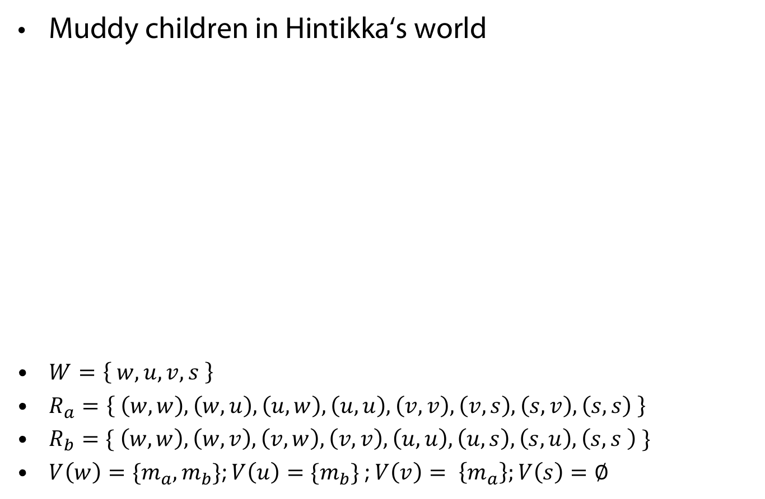



Example of an epistemic state
Muddy children in Hintikka‘s world
$W=\left\{ w,u,v,s \right\}$
$R_{a}=\left\{ \left(w,w\right), \left(w,u\right), \left(u,w\right), \left(u,u\right), \left(v,v\right), \left(v,s\right), \left(s,v\right), \left(s,s\right) \right\}$
$R_{b}=\{ \left(w,w\right), \left(w,v\right), \left(v,w\right), \left(v,v\right), \left(u,u\right), \left(u,s\right), \left(s,u\right), \left(s,s \right) \}$
$V\left(w\right)={\{m}_{a}, m_{b}\}$; $V\left(u\right)=\{m_{b}\}$ ; $V\left(v\right)= \left\{m_{a}\right\};V\left(s\right)=∅$
$$v$$
$$s$$
$$w$$
$$u$$

Slide 19
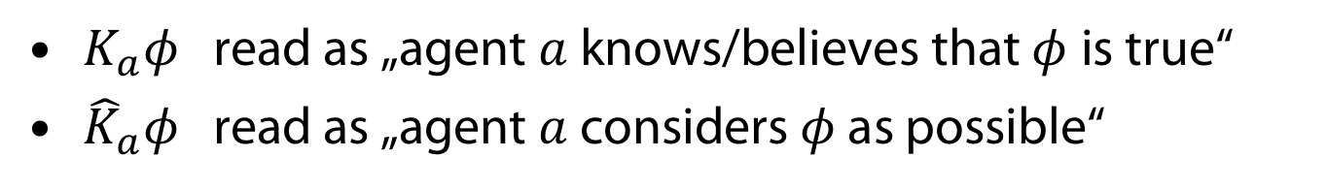

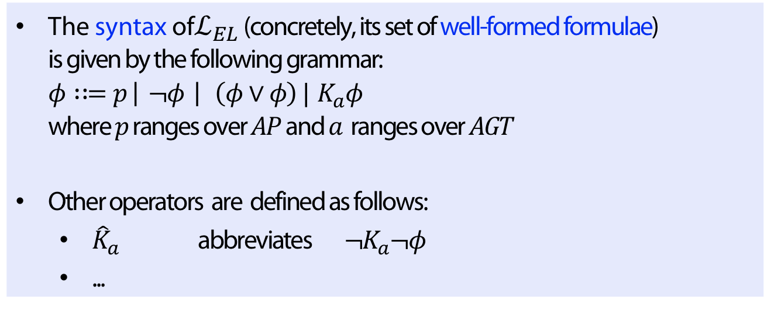
Syntax of $ℒ_{EL}$
Definition
The syntax of$ℒ_{EL}$ (concretely, its set of well-formed formulae)
is given by the following grammar:
$φ∷=p \left| ¬φ \right| \left(φ∨φ\right) | { K}_{a}φ$
where $p$ ranges over $AP$ and $a$ ranges over $AGT$
Other operators are defined as follows:
  ${\hat{K}}_{a}$ abbreviates $¬K_{a}¬φ$
  ...
$K_{a}φ$ read as „agent $a$ knows/believes that $φ$is true“
${\hat{K}}_{a}φ$ read as „agent $a$ considers $φ$ as possible“

Slide 20
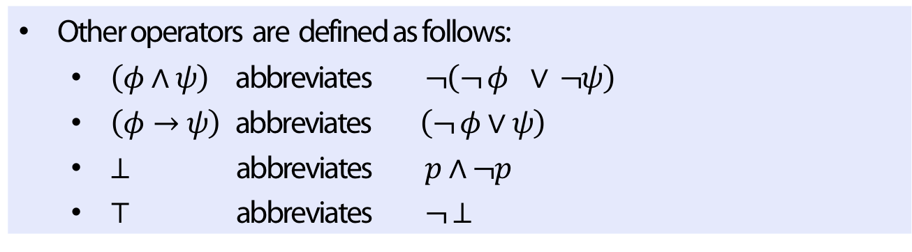
Syntax of $ℒ_{EL}$
Definition
Other operators are defined as follows:
  $\left(φ∧ψ\right)$abbreviates $¬\left(¬ φ ∨ ¬ψ\right)$
  $\left(φ→ψ\right)$ abbreviates $\left(¬ φ∨ψ\right)$
  $⊥$ abbreviates $p∧¬p$
  $⊤$ abbreviates $¬ ⊥$

Slide 21
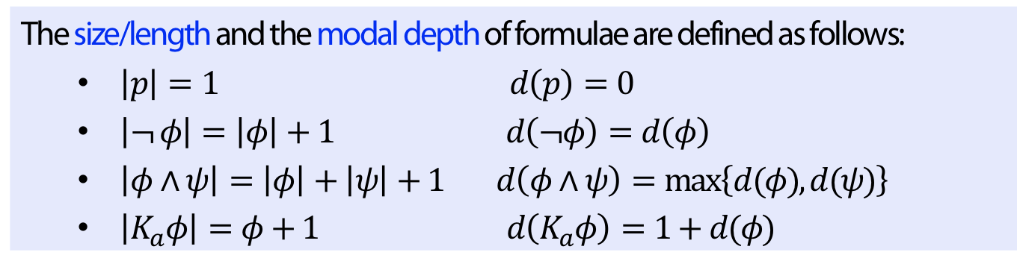
Length and Depth
Definition
The size/length and the modal depth of formulae are defined as follows:
  $\left|p\right|=1$ $d\left(p\right)=0$
  $\left|¬ φ\right|=\left|φ\right|+1$ $d\left(¬φ\right)=d\left(φ\right)$
  $\left|φ∧ψ\right|=\left|φ\right|+\left|ψ\right|+1$ $d\left(φ∧ψ\right)=\max\left\{d(φ), d(ψ)\right\}$
  $\left|K_{a}φ\right|=φ+1$ $d\left(K_{a}φ\right)=1+d(φ)$

Slide 22
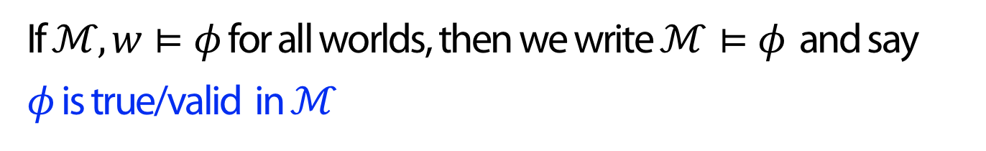

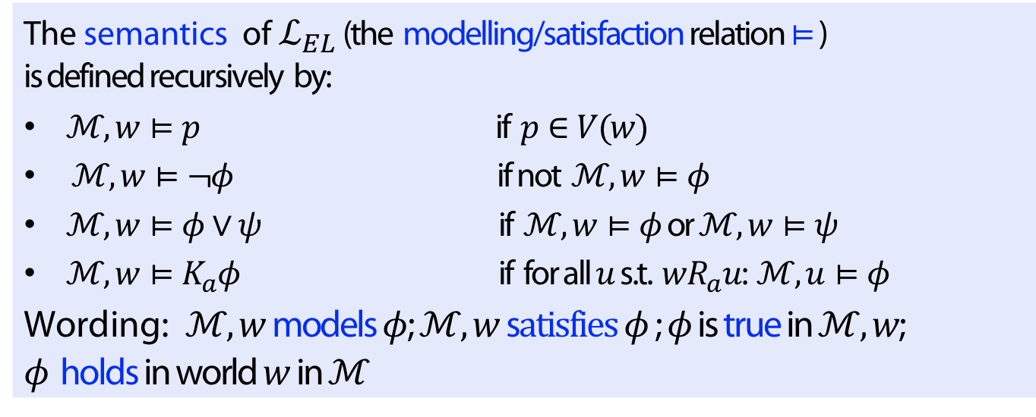
Semantics of $ℒ_{EL}$
Definition
The semantics of $ℒ_{EL}$ (the modelling/satisfaction relation $⊨$)
is defined recursively by:
$ℳ, w⊨p$ if $p∈V(w)$
$ℳ, w⊨¬φ$ if not $ℳ, w⊨φ$
$ℳ, w⊨φ∨ψ$ if $ℳ, w⊨φ$ or $ℳ, w⊨ψ$
$ℳ, w⊨K_{a}φ$ if for all $u$ s.t. $wR_{a}u$: $ℳ, u⊨φ$
Wording: $ℳ,w$ models $φ$; $ℳ,w$ s$atisfies φ$; $φ$ is true in $ℳ,w$; $φ$ holds in world $w$in$ℳ$
If $ℳ,w⊨φ$ for all worlds, then we write$ℳ⊨φ$ and say
$φ$ is true/valid in $ℳ$

Slide 23
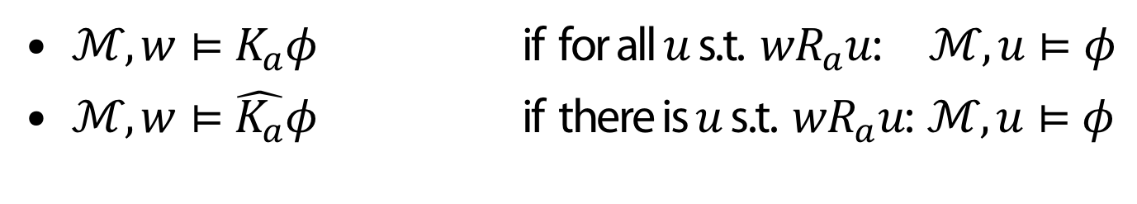

Semantics of dual operators $\hat{K_{a}}$
$ℳ, w⊨K_{a}φ$ if for all $u$ s.t. $wR_{a}u$: $ℳ, u⊨φ$
$ℳ, w⊨\hat{K_{a}}φ$ if there is $u$ s.t. $wR_{a}u$: $ℳ, u⊨φ$

Slide 24
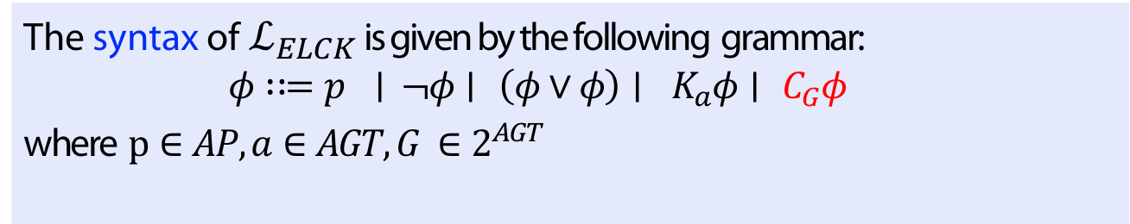
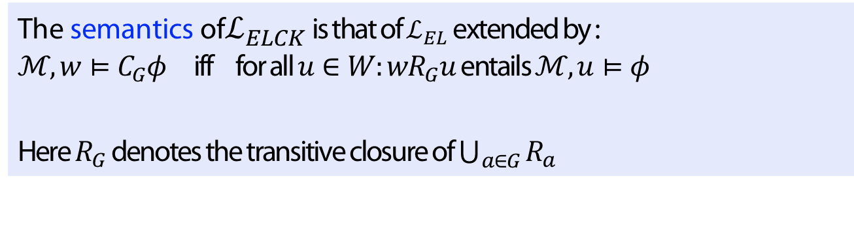
Common knowledge
Definition
The syntax of${ ℒ}_{ELCK}$ is given by the following grammar:
$φ∷=p ∣ ¬φ∣ \left(φ∨φ\right)∣ K_{a}φ∣ C_{G}φ$
where $p∈AP, a∈AGT, G ∈2^{AGT}$
Definition
The semantics of$ℒ_{ELCK}$ is that of $ℒ_{EL}$ extended by :
$ℳ, w⊨C_{G}φ$ iff for all $u∈W:wR_{G}u$entails $ℳ, u⊨φ$
Here $R_{G}$ denotes the transitive closure of $\bigcup_{a∈G}{R_{a}}$

Slide 25
Model Checking

Slide 26
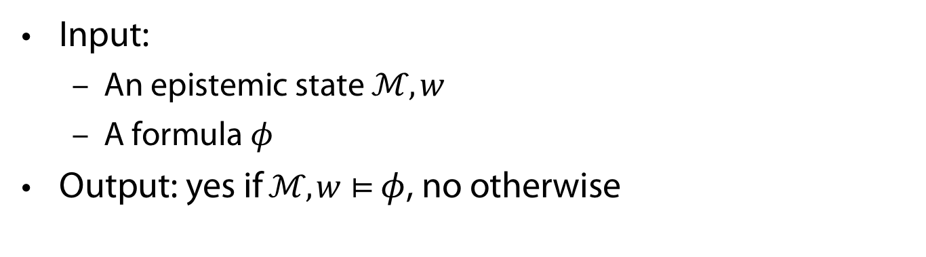
Model checking problem
Input:
  An epistemic state $ℳ, w$
  A formula $φ$
Output: yes if$ℳ, w⊨$ $φ$, no otherwise
Theorem
Model checking (both: with and without common knowledge operators) is P-complete

Slide 27

(Vanilla) Model checking algorithm
Input: a Kripke model$ℳ$, a formula $φ$
Output: set of worlds of $ℳ$ in which $φ$ holds
function $mc\left(ℳ, φ\right)$
match $φ$ do
case $p$: return $\left\{w \right|ℳ, w⊨p\}$
case $¬ψ$: return $W∖mc\left(ℳ, ψ\right)$
case $(ψ_{1}∨ψ_{2})$: return $mc\left(ℳ, ψ_{1}\right)∪mc\left(ℳ, ψ_{2}\right)$
case $K_{a}ψ$: return $\left\{w \right|R_{a}\left(w\right)⊆mc\left(ℳ, ψ\right)\}$

Slide 28

State explosion problem
Example
Minesweeper
  $8 × 8$ with $10$ bombs:
  $>{10}^{12}$ possible worlds
  $10 × 12$ with $20$ bombs:
  $>{10}^{25}$possible worlds

Slide 29
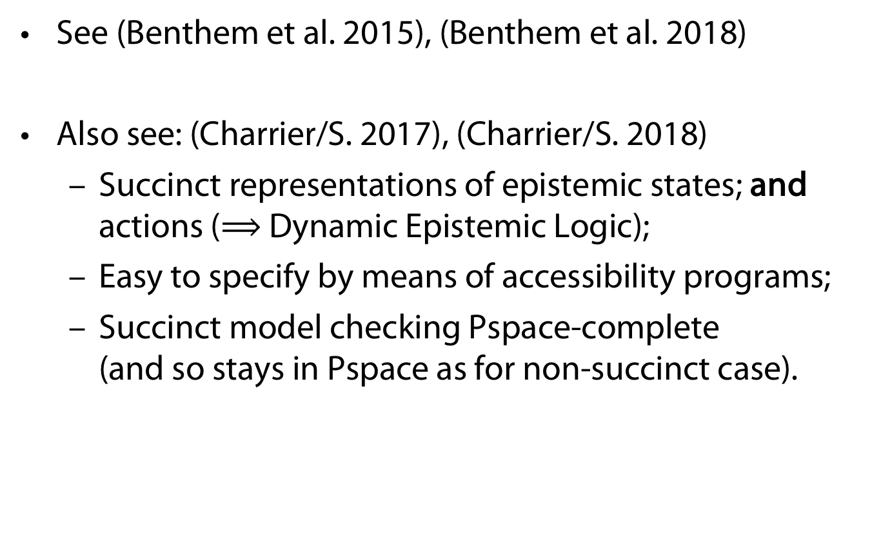
State explosion problem
See (Benthem et al. 2015), (Benthem et al. 2018)
Also see: (Charrier/S. 2017), (Charrier/S. 2018)
  Succinct representations of epistemic states; and actions ($⟹$ Dynamic Epistemic Logic);
  Easy to specify by means of accessibility programs;
  Succinct model checking Pspace-complete
  (and so stays in Pspace as for non-succinct case).

Slide 30
Calculi

Slide 31

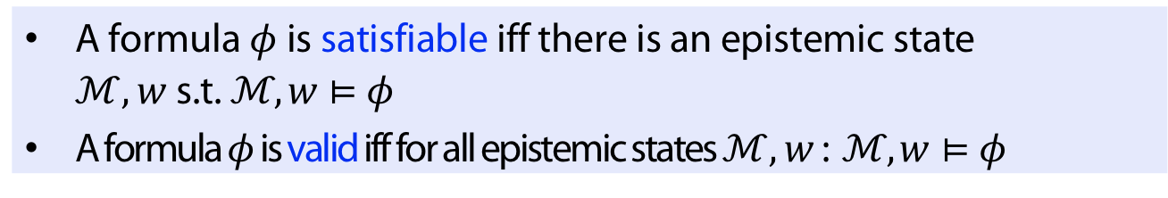
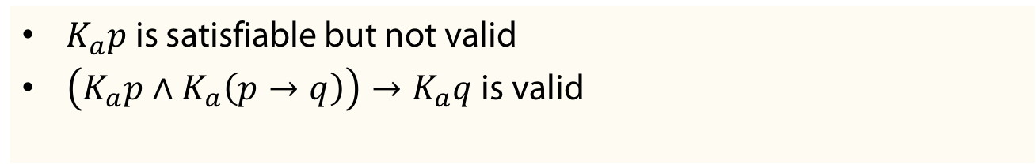
Satisfiability and validity
Definition
A formula $φ$ is satisfiable iff there is an epistemic state $ℳ, w$ s.t. $ℳ, w⊨φ$
A formula $φ$ is valid iff for all epistemic states $ℳ, w$ : $ℳ, w⊨φ$
Clearly $φ$ is valid iff $¬φ$ is not satisfiable
Example
$K_{a}p$ is satisfiable but not valid
$\left(K_{a}p∧K_{a}\left(p→q\right)\right)→K_{a}q$ is valid

Slide 32
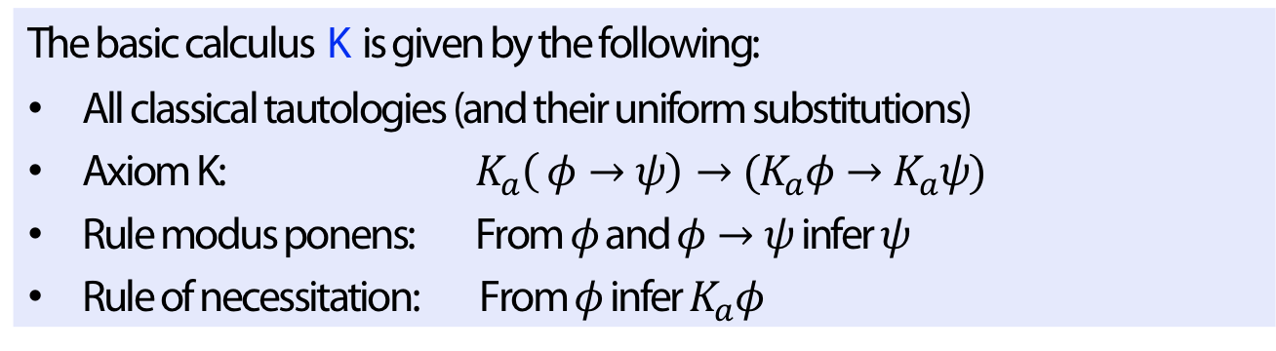
Axiomatization
Checking validity directly not trivial
Solution: Calculus (with axioms and rules)
  Axiom (should be valid); rule = „small“ correct inference
  Derivation/inference: Finite sequence of formulae where
    each formula is an axiom (instance) or
    results from applying rule to formulae appearing before.
Definition (calculus K)
The basic calculus K is given by the following:
All classical tautologies (and their uniform substitutions)
Axiom K: $K_{a}\left( φ→ψ\right)→(K_{a}φ→K_{a}ψ)$
Rule modus ponens: From $φ$ and $φ→ψ$ infer $ψ$
Rule of necessitation: From $φ$ infer $K_{a}φ$

Slide 33
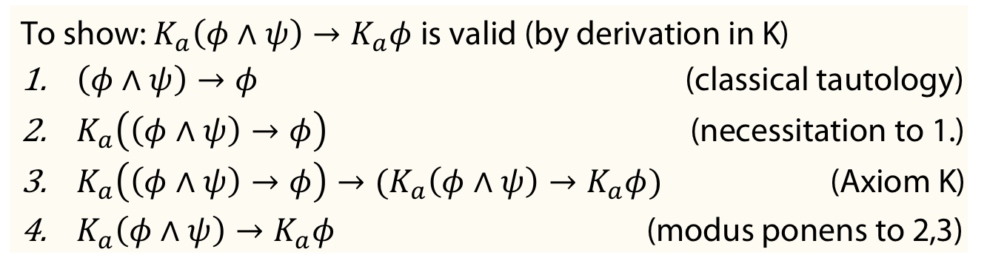
Axiomatization
Theorem
A formula is valid (in the class of all epistemic states) iff it is provable in calculus K
Other wording: K is correct and complete for the class of all epistemic states
Example
To show: $K_{a}\left(φ∧ψ\right)→K_{a}φ$is valid (by derivation in K)
$\left(φ∧ψ\right)→φ$ (classical tautology)
$K_{a}\left(\left(φ∧ψ\right)→φ\right)$ (necessitation to 1.)
$K_{a}\left(\left(φ∧ψ\right)→φ\right)→(K_{a}\left(φ∧ψ\right)→K_{a}φ)$ (Axiom K)
$K_{a}\left(φ∧ψ\right)→K_{a}φ$ (modus ponens to 2,3)

Slide 34
Why axiomatization
the computation of knowledge is modeled;
enables to explain why an agent knows something;
(link with justification logic)
axiomatization helps to understand the principle of the logics
we do not have to design a specific epistemic state, as in model checking („open world“)

Slide 35
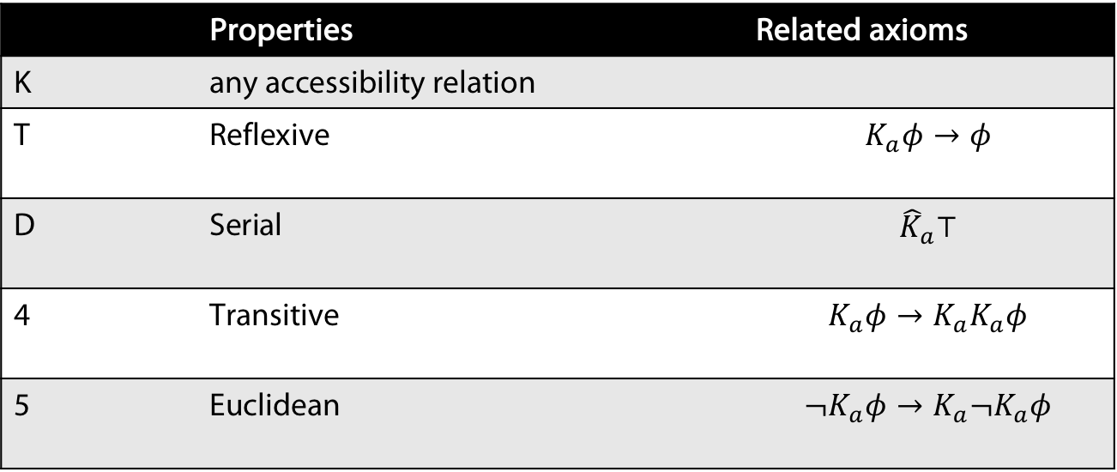
Classes of epistemic states
 | Properties | Related axioms
K | any accessibility relation
T | Reflexive | $$K_{a}φ→φ$$
D | Serial | $${\hat{K}}_{a}⊤$$
4 | Transitive | $$K_{a}φ→K_{a}K_{a}φ$$
5 | Euclidean | $$¬K_{a}φ→K_{a}¬K_{a}φ$$
Notes:
Naming „Euclidean“ due to "Axiom 1" in Euclid's Elements: "Magnitudes which are equal to the same are equal to each other."

Slide 36
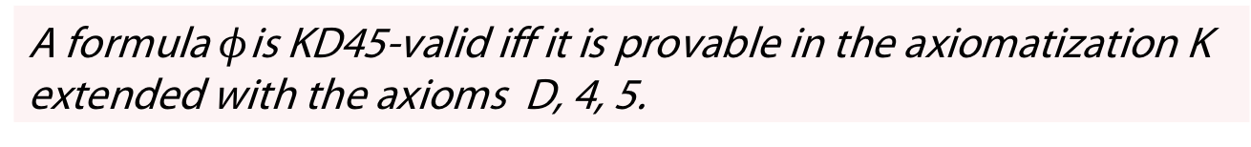
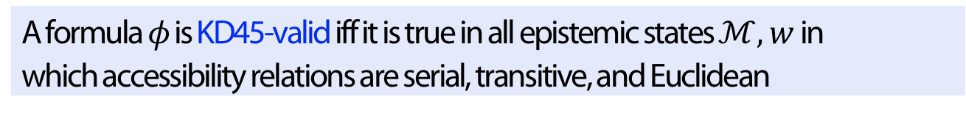
Each row in the table is a completeness and correctness
statement of calculi w.r.t. the given class of epistemic states
Definition
A formula $φ$ is KD45-valid iff it is true in all epistemic states $ℳ, w$ in which accessibility relations are serial, transitive, and Euclidean
Theorem
A formula $φ$is KD45-valid iff it is provable in the axiomatization K extended with the axioms D, 4, 5.

Slide 37

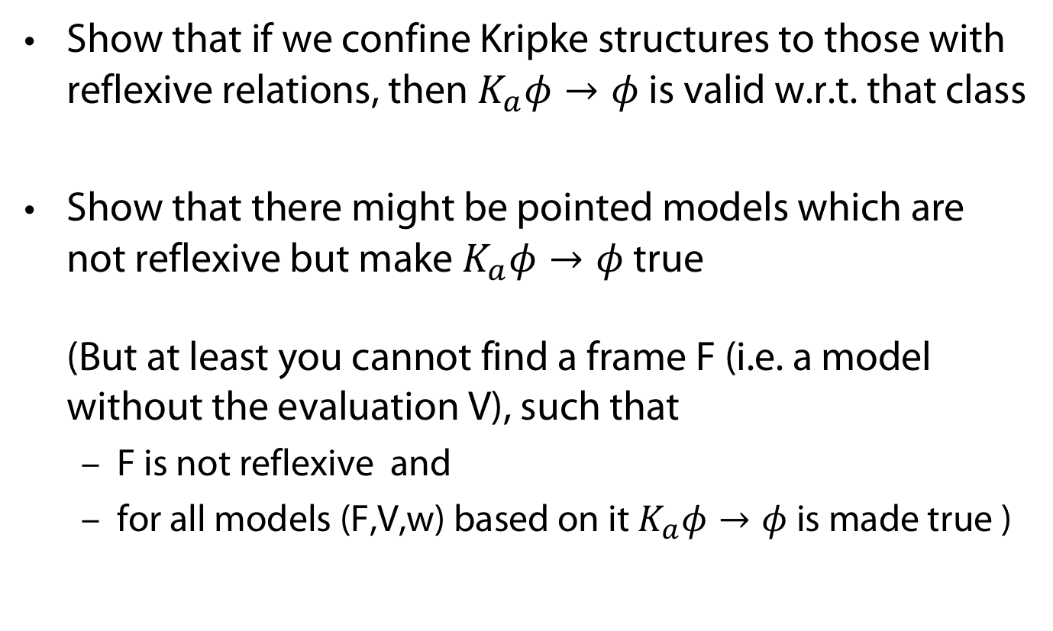
(No it‘s not coffee time but) Time to wake up
Show that if we confine Kripke structures to those with reflexive relations, then $K_{a}φ→φ$ is valid w.r.t. that class
Show that there might be pointed models which are not reflexive but make $K_{a}φ→φ$ true
(But at least you cannot find a frame F (i.e. a model without the evaluation V), such that
  F is not reflexive and
  for all models (F,V,w) based on it $K_{a}φ→φ$ is made true )

Slide 38
Complexity of checking validity
Without common knowledge:
With common knowledge (and several agents): EXPTIME-complete
In general and here: Model checking is more practical than theorem proving
 | Singe agent | Several agents
K | PSPACE-complete | PSPACE-complete
KD45, S5 | NP-complete | PSPACE-complete

Slide 39
Language Properties

Slide 40
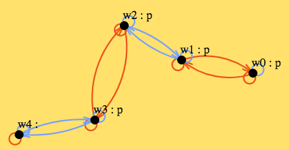
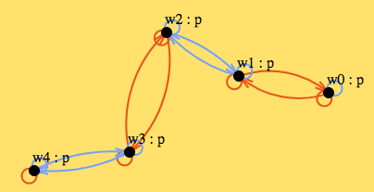
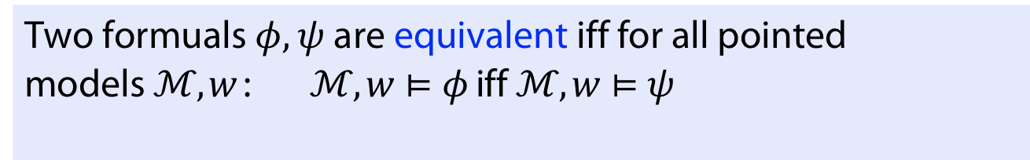

Expressivity
Definition
Two formuals $φ, ψ$ are equivalent iff for all pointed models $ℳ, w$: $ℳ, w⊨φ$ iff $ℳ, w⊨ψ$
Theorem
$ℒ_{ELCK}$ is strictly more expressive than $ℒ_{EL}$: no formula in $ℒ_{EL}$ is equivalent to $C_{\{a,b\}}p$
Proof sketch:
By contradiction, suppose $φ∈ℒ_{EL}$
equivalent to $C_{\{a,b\}}p$.
Let d be the modal depth of $φ$, e.g., $d=3$
Consider two models (from Hinntikka‘s world)
$φ$ has same value in both models but $C_{\{a,b\}}p$ can
distinguish them

Slide 41
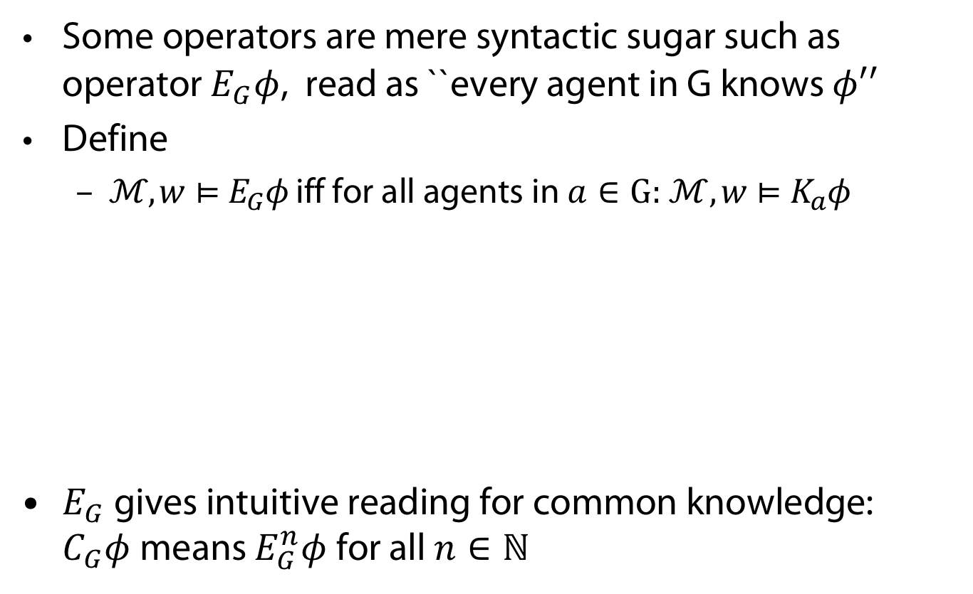
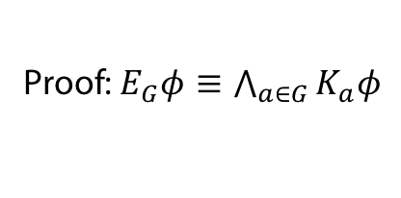
Expressivity
Some operators are mere syntactic sugar such as operator $E_{G}φ$, read as ``every agent in G knows $φ′′$
Define
  $ℳ, w⊨E_{G}φ$ iff for all agents in $a∈\text{G}\text{: }ℳ, w⊨K_{a}φ$
$E_{G}$ gives intuitive reading for common knowledge: $C_{G}φ$means $E_{G}^{n}φ$ for all $n∈ℕ$
Theorem
$ℒ_{EL}$augmented with $E_{G}$ is equally expressive as $ℒ_{EL}$
Proof: $E_{G}φ≡\bigwedge_{a∈G}{K_{a}φ}$

Slide 42

Bisimulation
Modal logics and epistemic logics cannot distinguish between structures with same „transition“ behaviour
Captured by notion of bisimulation
Definition
For two models $M=(W, {\left(R_{a}\right)}_{a∈AGT }, V)$ and $M′=(W′, {\left({R^{′}}_{a}\right)}_{a∈AGT }, V′)$ a set $ℛ ⊆W ×W^{′}$ is a bisimulation iff for all $w∈W,w^{′}∈W′$ with $\left(w,w^{′}\right)∈ℛ$
$V\left(w\right)=V′(w′)$
For all $a∈AGT,$for all $v∈W$: If $R_{a}(w,v)$ then there is $v^{′}∈W′$ with $R_{a}^{′}(w^{′},v′)$ and$\left(v,v^{′}\right)∈ℛ$
For all $a∈AGT,$for all $v^{′}∈W$: If ${R^{′}}_{a}(w′,v′)$ then there is $v∈W$ with $R_{a}(w,v)$ and$\left(v,v^{′}\right)∈ℛ$
$\left(M,w\right)⇆\left(M′,w′\right)$ iff there is a bisimulation linking $w$ and $w$

Slide 43
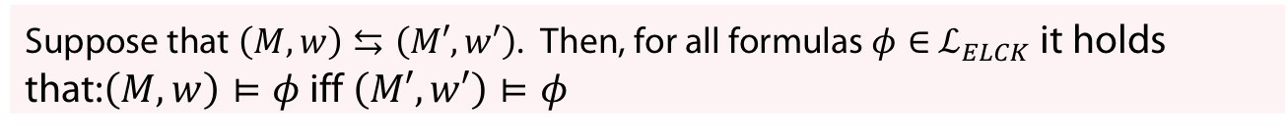
Bisimilarity preserves formulae
Theorem
Suppose that $\left(M,w\right)⇆\left(M′,w′\right)$. Then, for all formulas $φ∈$ $ℒ_{ELCK}$ it holds that:$\left(M,w\right)⊨φ$ iff $\left(M′,w′\right)⊨φ$
So: Though the common knowledge operator can see arbitrarily far
(transitive closure of accesibility relations !; see example on two models before),
it can only do in a accessibility-guarded way
One big meta result regarding bisimulation in the so-called area of
correspondence theory (but not directly relevant here)
Theorem
Modal logics are exactly those fragments of FOL whose formulae are
invariant under bisimilarity
(see, e.g., Blackburn et al, 02)

Slide 44
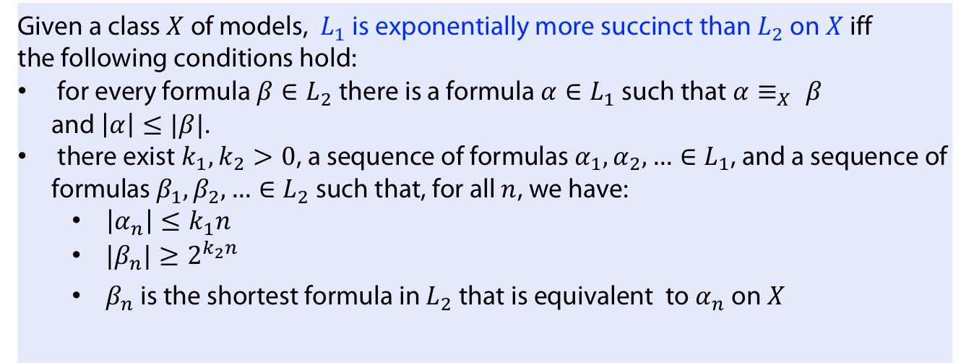
Definition
Given a class $X$ of models, $L_{1}$ is exponentially more succinct than $L_{2}$ on $X$ iff
the following conditions hold:
for every formula $β∈L_{2}$ there is a formula $α∈L_{1}$ such that $α≡_{X} β$
and $\left|α\right|≤|β|$.
there exist $k_{1}, k_{2}>0$, a sequence of formulas $α_{1}, α_{2}, …∈L_{1}$, and a sequence of formulas $β_{1}, β_{2}, …∈L_{2}$ such that, for all $n$, we have:
  $\left|α_{n}\right|≤k_{1}n$
  ${|β}_{n}|≥2^{k_{2}n}$
  $β_{n}$ is the shortest formula in $L_{2}$ that is equivalent to $α_{n}$ on $X$

Slide 45
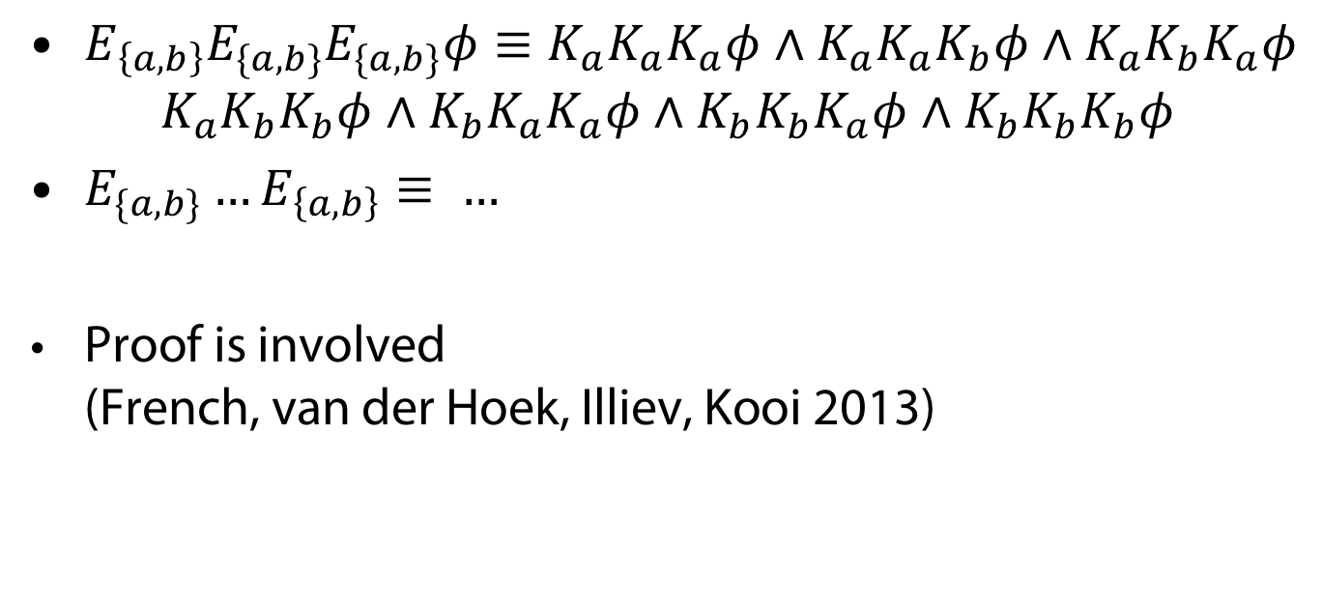
Succinctness
Theorem
$ℒ_{EL}$augmented with $E_{G}$‘s is exponentially more succinct than $ℒ_{EL}$
$E_{\left\{a,b\right\}}E_{\{a,b\}}E_{\{a,b\}}φ≡K_{a}K_{a}K_{a}φ∧K_{a}K_{a}K_{b}φ∧K_{a}K_{b}K_{a}φ$
$K_{a}K_{b}K_{b}φ∧K_{b}K_{a}K_{a}φ∧K_{b}K_{b}K_{a}φ∧K_{b}K_{b}K_{b}φ$
$E_{\{a,b\}}…E_{\left\{a,b\right\}}≡ …$
Proof is involved
(French, van der Hoek, Illiev, Kooi 2013)

Slide 46
Take-Home Message
With epistemic logics there is a firm formal foundation for dealing with knowledge in multi-agents

Slide 47
APPENDIX
Uhhh, a lecture with a hopefully useful

Slide 48
References
J. van Benthem, J. van Eijck, M. Gattinger, and K. Su. Symbolic model checking for dynamic epistemic logic. In W. van der Hoek, W. H. Holliday, and W.-f. Wang, editors, Logic, Rationality, and Interaction, pages 366–378, Berlin, Heidelberg, 2015. Springer Berlin Heidelberg.
J. Van Benthem, J. Van Eijck, M. Gattinger, and K. Su. Symbolic model checking for dynamic epistemic logic — s5 and beyond. Journal of Logic and Computation, 28(2):367–402, Mar. 2018.
T. Charrier and F. Schwarzentruber. A succinct language for dynamic epistemic logic. In K. Larson, M. Winikoff, S. Das, and E. H. Durfee, editors, Proceedings of the 16th Conference on Autonomous Agents and MultiAgent Systems, AAMAS 2017, S ̃ao Paulo, Brazil, May 8-12, 2017, pages 123–131. ACM, 2017.
T. Charrier and F. Schwarzentruber. Complexity of dynamic epistemic logic with common knowledge. In G. Bezhanishvili, G. D’Agostino, G. Metcalfe, and T. Studer, editors, Advances in Modal Logic 12, proceedings of the 12th conference on ”Advances in Modal Logic,” held in Bern, Switzerland, August 27-31, 2018, pages 103–122. College Publications, 2018.
T. French, W. van der Hoek, P. Iliev, and B. P. Kooi. On the succinctness of some modal logics. Artif. Intell., 197:56–85, 2013.

Slide 49
Book references
Jaakko Hintikka. Knowledge and Belief: An Introduction to the Logic of the Two Notions (1962)
J-J Ch. Meyer, van der Hoek, Epistemic logic in AI and computer science, 1995
Joseph Y. Halpern, Moshe Vardi, Ronald Fagin et Yoram Moses. Reasoning about knowledge 1995
van Ditmarsch, van der Hoek, Kooi, Dynamic epistemic logic, 2007
van Ditmarsch, Joseph Y. Halpern, van der Hoek, Kooi, Handbook of epistemic logic, 2015
P. Blackburn, M. de Rijke, and Y. Venema. Modal Logic, volume 53 of Cambridge Tracts in Theoretical Computer Science. Cambridge University Press, 2. edition, 2002.

Slide 50
Color Convention in this course
Formulae, when occurring inline
Newly introduced terminology and definitions
Important results (observations, theorems) as well as emphasizing some aspects
Examples are given with standard orange with possibly light orange frame
Comments and notes
Algorithms

