Slide 1
Intelligent Agents
Knowledge and Time
Özgür L. Özçep
Universität zu Lübeck
Institut für Informationssysteme

Slide 2
Todays lecture based on
The AAMAS 2019 Tutorial „EPISTEMIC REASONING IN MULTI-AGENT SYSTEMS“, Part 3: Knowledge and Time
http://people.irisa.fr/Francois.Schwarzentruber/2019AAMAStutorial/
Parts of „Formal Methods - Lecture III: Linear Temporal Logic“ 2010/11 by Allessandro Artale
https://web.iitd.ac.in/~sumeet/slide3.pdf

Slide 3
temporal LogiC
„What then is time? If no one asks me, I know what it is. If I wish to explain it to him who asks, I do not know.“
(Augustine of Hippo- Confessiones)

Slide 4
Temporal logic
Temporal logic was originally developed in order to
represent tense in natural language.
Within CS, it has achieved a significant role in the formal specification and verification of concurrent reactive systems.
  Reason: a number of useful concepts can be formally, and concisely, specified using temporal logics, e.g.
  • safety properties
  • liveness properties
  • fairness properties
  When Vardi (Vardi 09) speaks of „industrial logics“ he thinks mainly about temporal logics

Slide 5
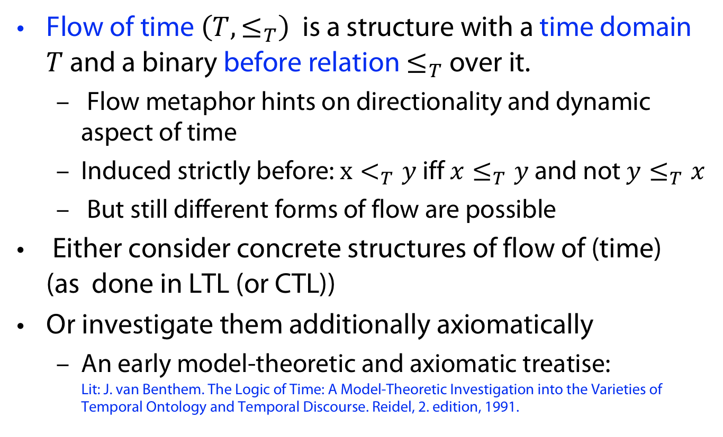
Flow of Time
Flow of time $\left(T, ≤_{T}\right)$ is a structure with a time domain $T$ and a binary before relation $≤_{T}$ over it.
  Flow metaphor hints on directionality and dynamic aspect of time
  Induced strictly before: $x<_{T}y$ iff $x≤_{T}y$ and not $y≤_{T}x$
  But still different forms of flow are possible
Either consider concrete structures of flow of (time)
(as done in LTL (or CTL))
Or investigate them additionally axiomatically
  An early model-theoretic and axiomatic treatise:
  Lit: J. van Benthem. The Logic of Time: A Model-Theoretic Investigation into the Varieties of Temporal Ontology and Temporal Discourse. Reidel, 2. edition, 1991.

Slide 6
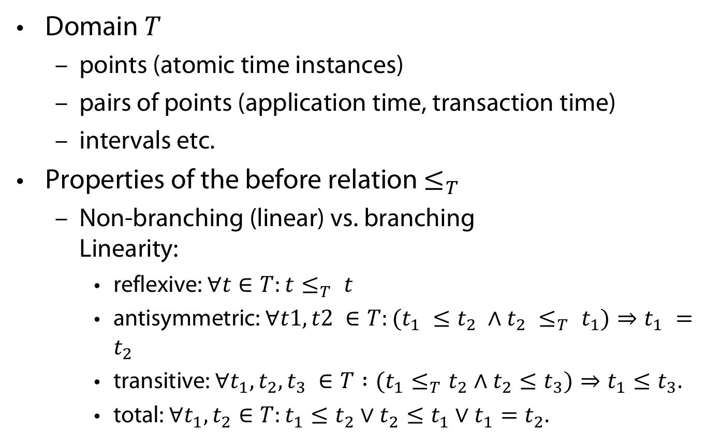
Family of Flows of Time
Domain $T$
  points (atomic time instances)
  pairs of points (application time, transaction time)
  intervals etc.
Properties of the before relation $≤_{T}$
  Non-branching (linear) vs. branching
  Linearity:
    reflexive: $∀t∈T:t≤_{T} t$
    antisymmetric: $∀t1,t2 ∈T:(t_{1} ≤t_{2} ∧t_{2} ≤_{T} t_{1})⇒t_{1} =t_{2}$
    transitive: $∀t_{1},t_{2},t_{3} ∈T :(t_{1}≤_{T}t_{2}∧t_{2}≤t_{3})⇒t_{1}≤t_{3}.$
    total: $∀t_{1},t_{2}∈T:t_{1}≤t_{2}∨t_{2}≤t_{1}∨t_{1}=t_{2}.$

Slide 7
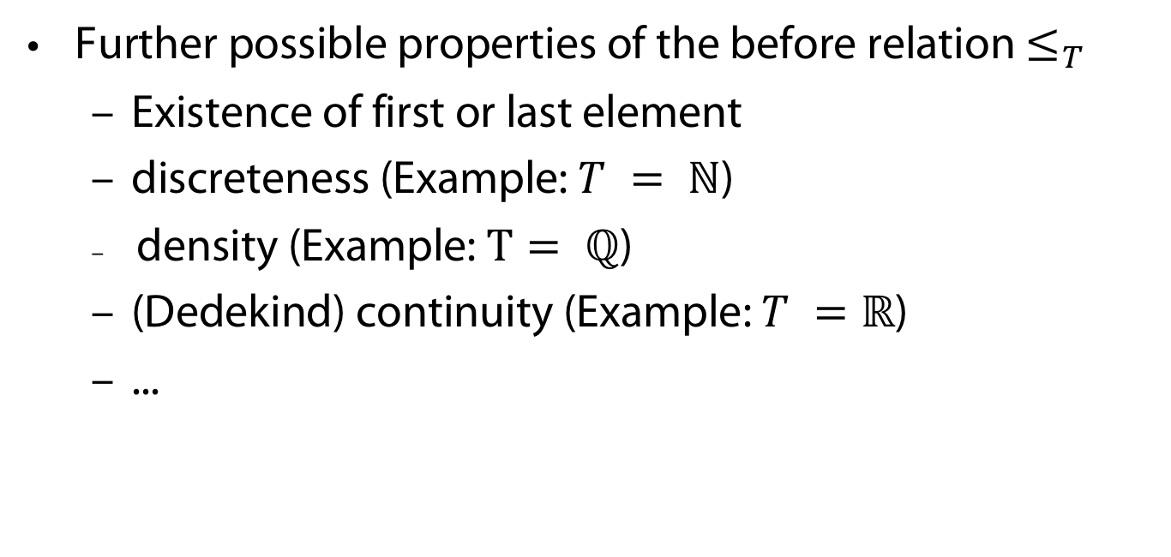
Family of Flows of Time (continued)
Further possible properties of the before relation $≤_{T}$
  Existence of first or last element
  discreteness (Example: $T = ℕ$)
  density (Example: $T= ℚ$)
  (Dedekind) continuity (Example: $T =ℝ$)
  ...

Slide 8
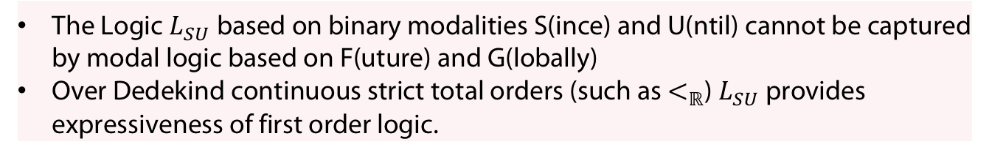
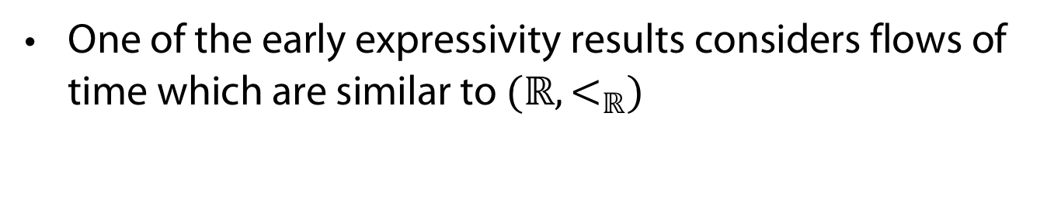
Family of Flows of Time (continued)
One of the early expressivity results considers flows of time which are similar to $(ℝ,<_{ℝ})$
Theorem (Kamp 1968)
The Logic $L_{SU}$ based on binary modalities S(ince) and U(ntil) cannot be captured by modal logic based on F(uture) and G(lobally)
Over Dedekind continuous strict total orders (such as $<_{ℝ}$) $L_{SU}$ provides expressiveness of first order logic.
(see Chapter 7 in (Blackburn et al, 02)

Slide 9
LineAr temporal LogiC

Slide 10

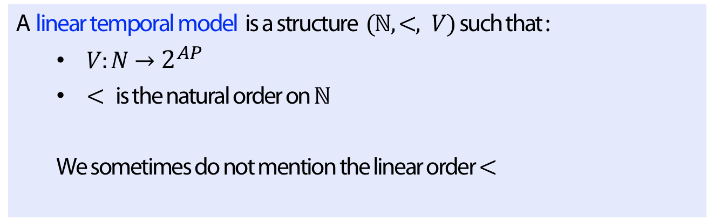



Models
$$p$$
$$p$$
$$p,q$$
$$r$$
Definition
A linear temporal model is a structure $(ℕ,<, V)$such that :
  $V:N→2^{AP}$
  $<$ is the natural order on $ℕ$
  We sometimes do not mention the linear order $<$

Slide 11
Example (traffic light)

Slide 12





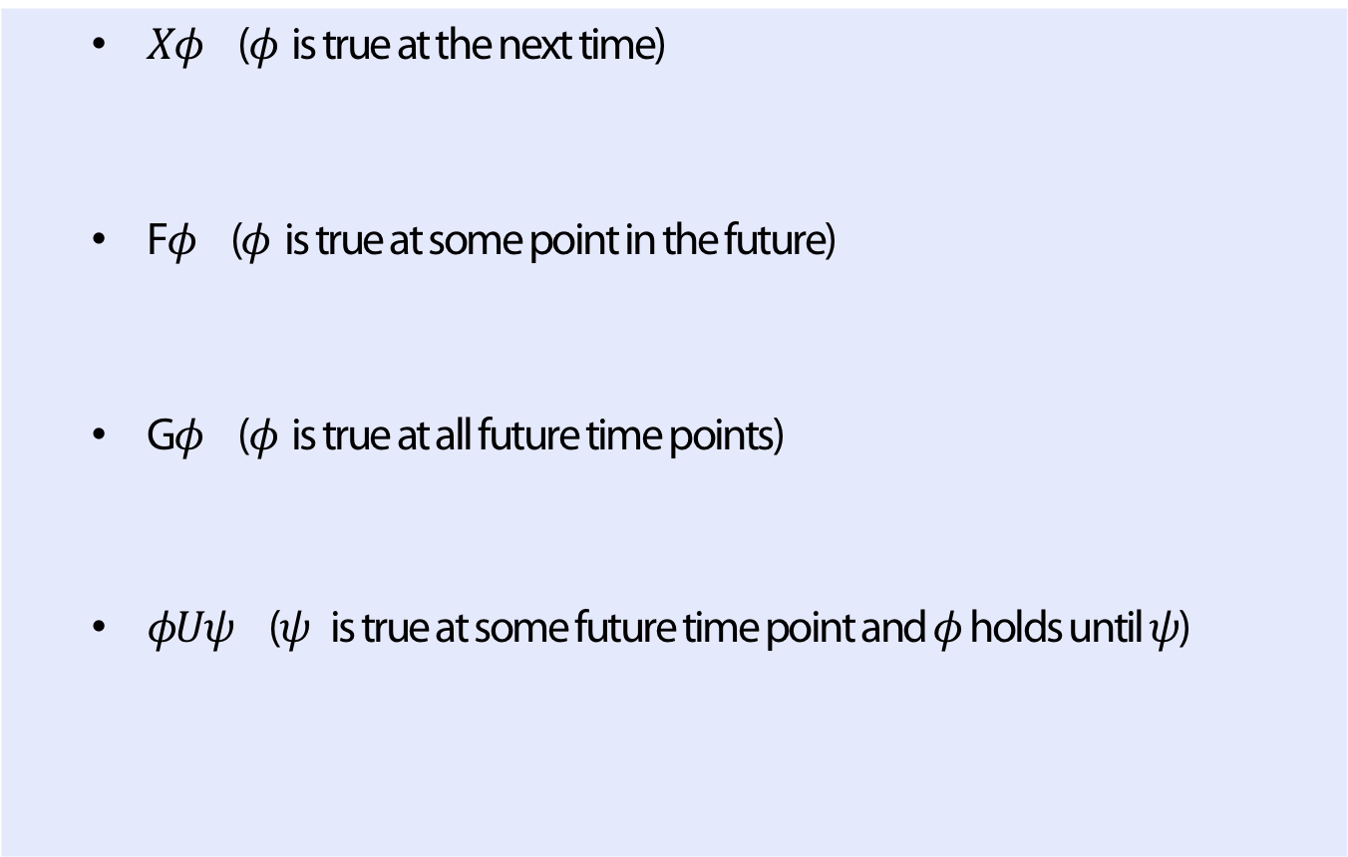







Syntax and semantics
Definition (Temporal Modalities of LTL)
  $Xφ$ ($φ$ is true at the next time)
  F$φ$ ($φ$ is true at some point in the future)
  G$φ$ ($φ$ is true at all future time points)
  $φUψ$ ($ψ$ is true at some future time point and $φ$ holds until $ψ$)
$$Xφ$$
$$φ$$
F$φ$
$$φ$$
G$φ$
$$φ$$
$$φ$$
$$φ$$
$$φ$$
$$φ$$
$$φUφ$$
$$φ$$
$$φ$$
$$φ$$
$$ψ$$

Slide 13
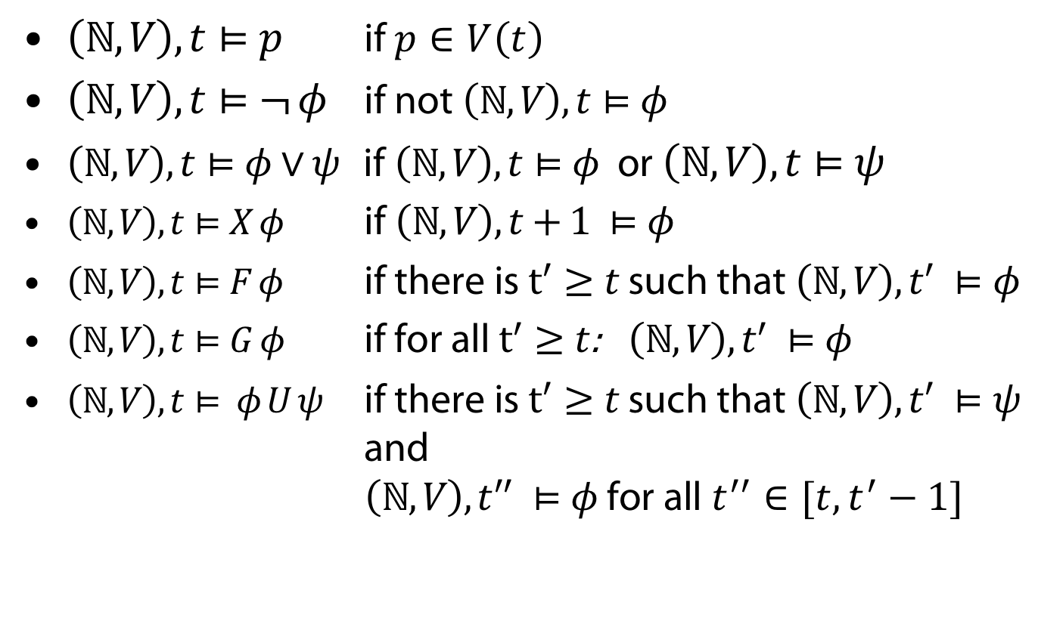
Syntax and semantics
$\left(ℕ,V\right), t⊨p$ if $p∈V\left(t\right)$
$\left(ℕ,V\right), t⊨¬ φ$ if not $\left(ℕ,V\right), t⊨φ$
$\left(ℕ,V\right), t⊨φ∨ψ$ if $\left(ℕ,V\right), t⊨φ$ or $\left(ℕ,V\right), t⊨ψ$
$\left(ℕ,V\right), t⊨X φ$ if $\left(ℕ,V\right), t+1 ⊨φ$
$\left(ℕ,V\right), t⊨F φ$ if there is $t^{′}≥t$ such that $\left(ℕ,V\right), t^{′} ⊨φ$
$\left(ℕ,V\right), t⊨G φ$ if for all $t^{′}≥t$: $\left(ℕ,V\right), t^{′} ⊨φ$
$\left(ℕ,V\right), t⊨ φ U ψ$ if there is $t^{′}≥t$ such that $\left(ℕ,V\right), t^{′} ⊨ψ$ and
$\left(ℕ,V\right), t^{′′} ⊨φ$ for all $t^{′′}∈[t, t^{′}−1]$

Slide 14

Example (traffic light)
Once red, the light cannot become green immediately
$G (red→¬ X green)$ (not fulfilled in model above)
The light becomes green eventually
$F green$ (fulfilled)
Once red, the light becomes green eventually
$G (red→F green )$ (fulfilled in shown prefix)
Once red, the light always becomes green eventually after being yellow for some time inbetween
$G \left[ red→X \left(red U \left(yellow∧X \left(yellow U green \right)\right)\right)\right]$
(not fulfilled)

Slide 15
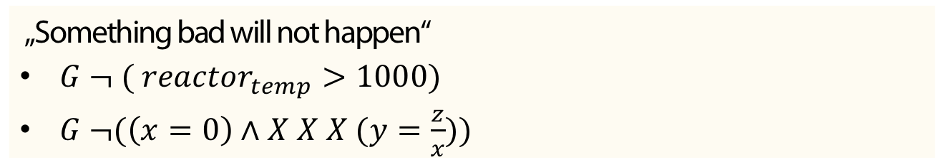
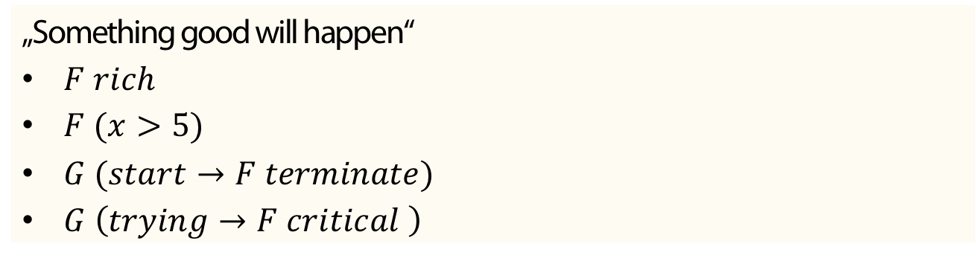
Typical Properties for Verification
Example (safety)
„Something bad will not happen“
$G ¬ ( reactor_{temp}>1000)$
$G ¬(\left(x=0\right)∧X X X (y=\frac{z}{x}))$
Example (liveness)
„Something good will happen“
$F rich$
$F (x>5)$
$G (start→F terminate)$
$G \left(trying→F critical \right)$

Slide 16
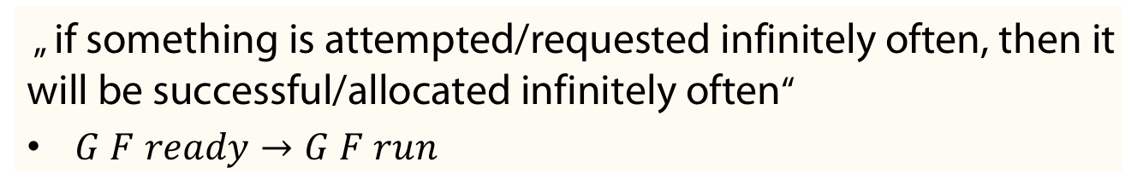
Examples
Example (fairness)
„ if something is attempted/requested infinitely often, then it will be successful/allocated infinitely often“
$G F ready→G F run$

Slide 17
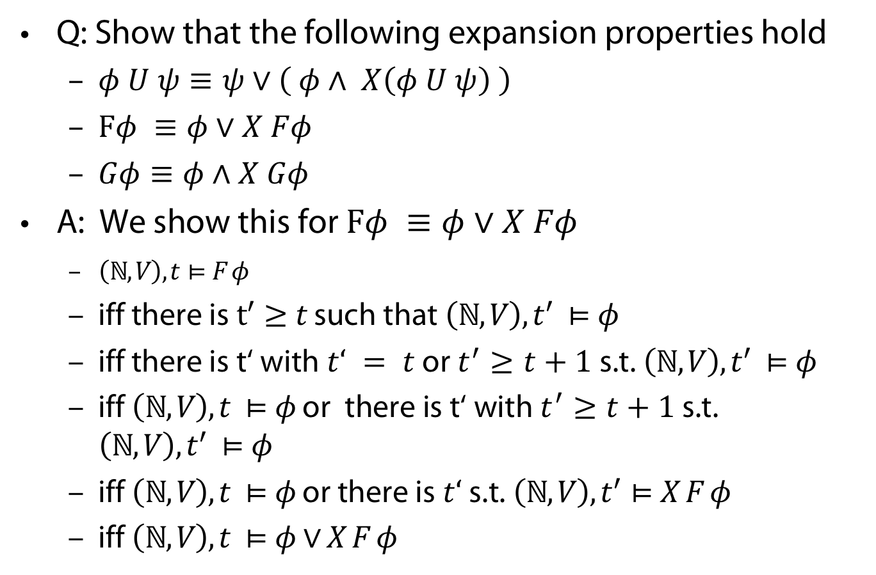
(Early) Wake-Up Exercise
Q: Show that the following expansion properties hold
  $φ U ψ≡ψ∨\left( φ∧ X\left(φ U ψ\right) \right)$
  $Fφ ≡φ∨X Fφ$
  $Gφ≡φ∧X Gφ$
A: We show this for $Fφ ≡φ∨X Fφ$
  $\left(ℕ,V\right), t⊨F φ$
  iff there is $t^{′}≥t$ such that $\left(ℕ,V\right), t^{′} ⊨φ$
  iff there is t‘ with $t‘ = t$ or $t^{′}≥t+1$ s.t. $\left(ℕ,V\right), t^{′} ⊨φ$
  iff $\left(ℕ,V\right), t ⊨φ$ or there is t‘ with $t^{′}≥t+1$ s.t. $\left(ℕ,V\right), t^{′} ⊨φ$
  iff $\left(ℕ,V\right), t ⊨φ$ or there is$t‘$s.t. $\left(ℕ,V\right), t^{′}⊨X F φ$
  iff $\left(ℕ,V\right), t ⊨φ∨X F φ$

Slide 18
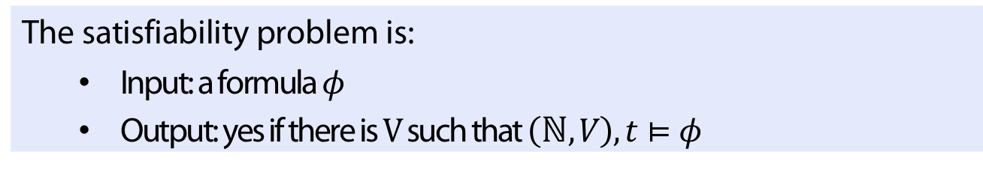
Satisfiability problem (reminder)
Definition
The satisfiability problem is:
  Input: a formula $φ$
  Output: yes if there is $V$such that $\left(ℕ,V\right), t⊨φ$
Theorem
The satisfiability problem is PSPACE-complete

Slide 19
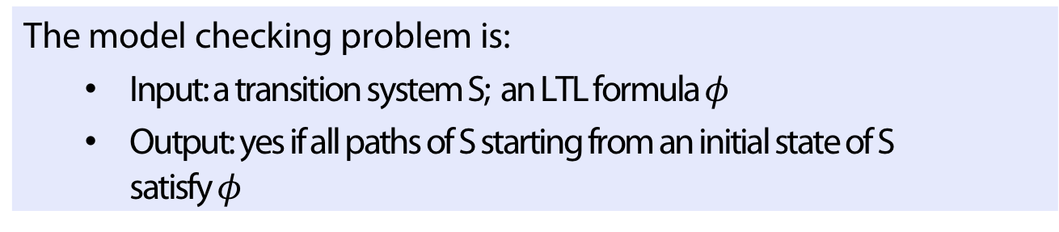
Model checking (reminder)
Definition
The model checking problem is:
  Input: a transition system S; an LTL formula $φ$
  Output: yes if all paths of S starting from an initial state of S satisfy $φ$
Theorem
The model checking problem of LTL is PSPACE-complete

Slide 20
Example
Transition system S:
Paths of S starting from initial state

Slide 21
Example: Mutual Exclusion
N = noncritical, T = trying, C= critical
User 1, User 2
N1,N2
turn=0
T1,N2
turn=1
N1,T2
turn= 2
C1,N2
turn=1
T1,T2
turn=1
T1,T2
turn=2
N1,C2
turn=2
C1,T2
turn=1
T1,C2
turn=2

Slide 22

Example: Mutual Exclusion
N = noncritical, T = trying, C= critical
User 1, User 2
N1,N2
turn=0
T1,N2
turn=1
N1,T2
turn= 2
C1,N2
turn=1
T1,T2
turn=1
T1,T2
turn=2
N1,C2
turn=2
C1,T2
turn=1
T1,C2
turn=2
Safety fulfilled? $S⊨G ¬(C_{1}∧C_{2})$ ?
Yes! There is no reachable state in which $¬(C_{1}∧C_{2})$ holds

Slide 23

Example: Mutual Exclusion
N = noncritical, T = trying, C= critical
User 1, User 2
N1,N2
turn=0
T1,N2
turn=1
N1,T2
turn= 2
C1,N2
turn=1
T1,T2
turn=1
T1,T2
turn=2
N1,C2
turn=2
C1,T2
turn=1
T1,C2
turn=2
(unconditioned) Liveness fulfilled? $S⊨F C_{1}$ ?
No! Blue cyclic path is counterexample

Slide 24

Example: Mutual Exclusion
N = noncritical, T = trying, C= critical
User 1, User 2
N1,N2
turn=0
T1,N2
turn=1
N1,T2
turn= 2
C1,N2
turn=1
T1,T2
turn=1
T1,T2
turn=2
N1,C2
turn=2
C1,T2
turn=1
T1,C2
turn=2
Conditioned liveness fulfilled? $S⊨G (T_{1}→F C_{1})$ ?
Yes! In every path: if $T_{1}$ holds, then eventually $C_{1}$ holds

Slide 25

Example: Mutual Exclusion
N = noncritical, T = trying, C= critical
User 1, User 2
N1,N2
turn=0
T1,N2
turn=1
N1,T2
turn= 2
C1,N2
turn=1
T1,T2
turn=1
T1,T2
turn=2
N1,C2
turn=2
C1,T2
turn=1
T1,C2
turn=2
Fairness fulfilled? $S⊨G F C_{1}$
No! Blue cyclic path is a counterexample.

Slide 26
Example: Mutual Exclusion
N = noncritical, T = trying, C= critical
User 1, User 2
N1,N2
turn=0
T1,N2
turn=1
N1,T2
turn= 2
C1,N2
turn=1
T1,T2
turn=1
T1,T2
turn=2
N1,C2
turn=2
C1,T2
turn=1
T1,C2
turn=2
Strong fairness fulfilled? $S⊨G F T_{1}→G F C_{1}$
Yes! Every path which visits $T_{1}$ infinitely often also visits $C_{1}$ infinitely often

Slide 27
Epistemic Linear temporal logic

Slide 28
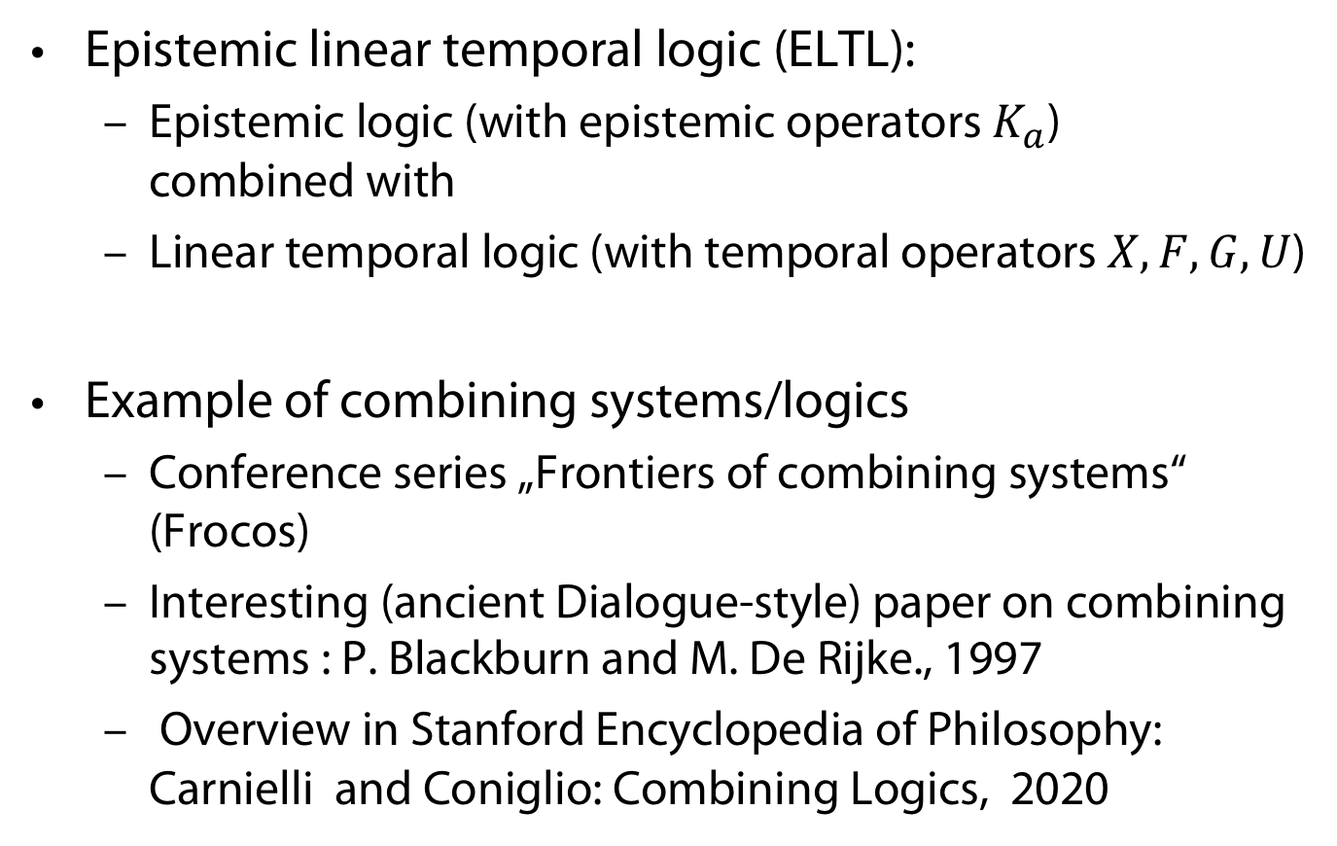
A combined logic
Epistemic linear temporal logic (ELTL):
  Epistemic logic (with epistemic operators $K_{a}$)
  combined with
  Linear temporal logic (with temporal operators $X,F,G,U$)
Example of combining systems/logics
  Conference series „Frontiers of combining systems“ (Frocos)
  Interesting (ancient Dialogue-style) paper on combining systems : P. Blackburn and M. De Rijke., 1997
  Overview in Stanford Encyclopedia of Philosophy: Carnielli and Coniglio: Combining Logics, 2020

Slide 29
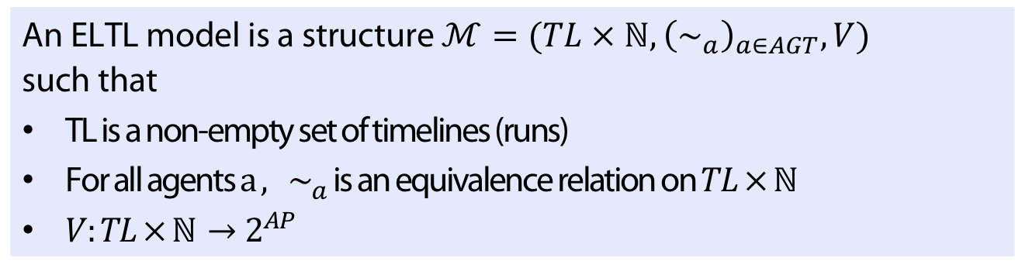
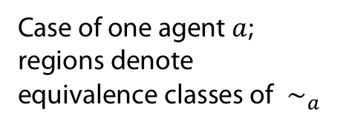
Models
Definition
An ELTL model is a structure $ℳ=(TL × ℕ, {\left(∼_{a}\right)}_{a∈AGT}, V)$ such that
TL is a non-empty set of timelines (runs)
For all agents $a ,$ $∼_{a}$ is an equivalence relation on $TL × ℕ$
$V:TL × ℕ→2^{AP}$
Case of one agent $a$;
regions denote
equivalence classes of$∼_{a}$
Think of run as a function
from ticks of global clock
to a global state, which is a
variable assignment

Slide 30
Interaction between Knowledge and time

Slide 31
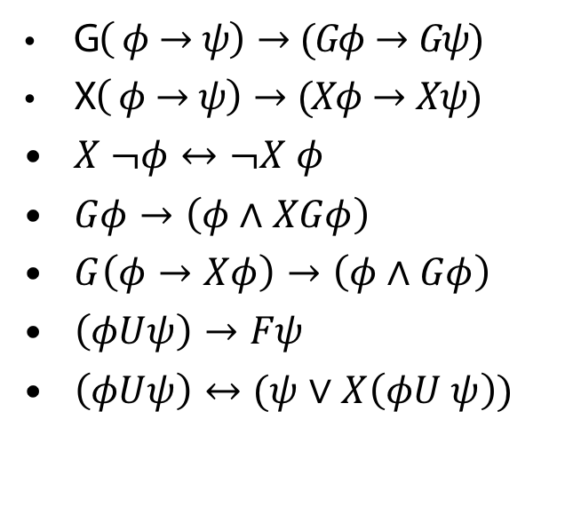
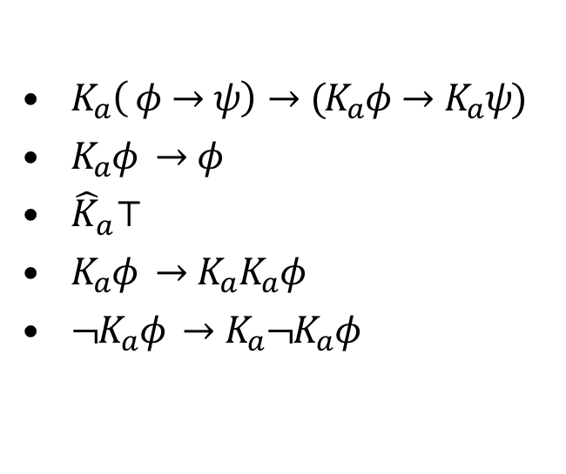
Axiomatisation in case of no interaction: Fusion
All classical tautologies (and their uniform substitutions)
$K_{a}\left( φ→ψ\right)→(K_{a}φ→K_{a}ψ)$
$K_{a}φ →φ$
${\hat{K}}_{a}⊤$
$K_{a}φ →K_{a}K_{a}φ$
${¬K}_{a}φ →K_{a}¬K_{a}φ$
G$\left( φ→ψ\right)→(Gφ→Gψ)$
X$\left( φ→ψ\right)→(Xφ→Xψ)$
$X ¬φ↔¬X φ$
$Gφ→\left(φ∧XGφ\right)$
$G\left(φ→Xφ\right)→\left(φ∧Gφ\right)$
$\left(φUψ\right)→Fψ$
$\left(φUψ\right)↔(ψ∨X\left(φU ψ\right))$
EL
LTL

Slide 32
Adding interaction
For additional criteria (resulting in 96 different epistemic temporal logics) see
(Halpern/Vardi, 1989)

Slide 33
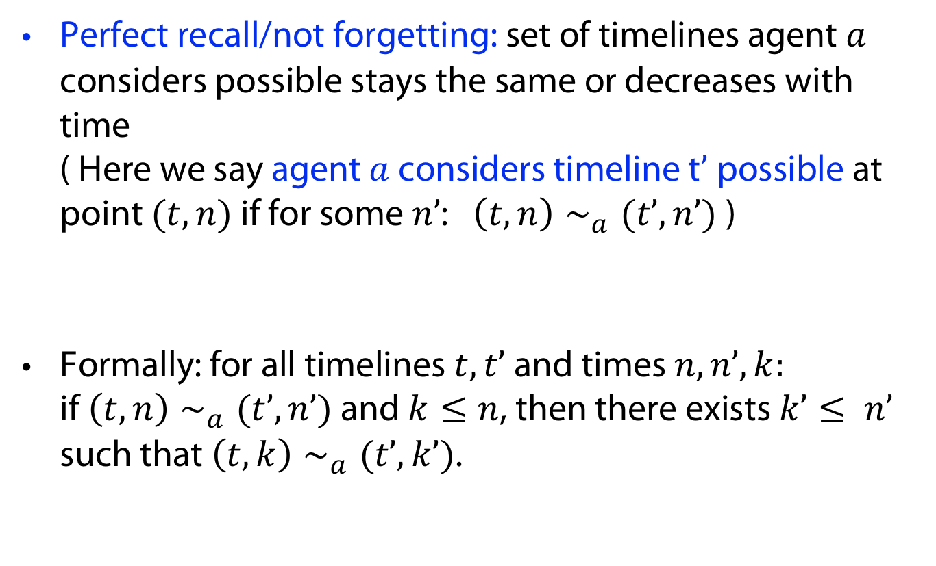
Properties
Perfect recall/not forgetting: set of timelines agent $a$ considers possible stays the same or decreases with time
( Here we say agent $a$ considers timeline t$’$ possible at point $(t, n)$ if for some $n’$: $\left(t, n\right)∼_{a}(t’, n’)$)
Formally: for all timelines $t, t’$and times $n, n’, k:$
if $\left(t, n\right)∼_{a}(t’, n’)$and $k≤n$, then there exists $k’≤ n’$ such that $\left(t, k\right)∼_{a}(t’, k’)$.

Slide 34
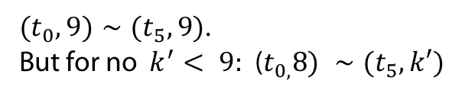
Counterexample Perfect recall
${(t}_{0}, 9)∼(t_{5}, 9)$.
But for no $k^{′}< 9:$ ($t_{0,}8) ∼(t_{5},k′)$

Slide 35
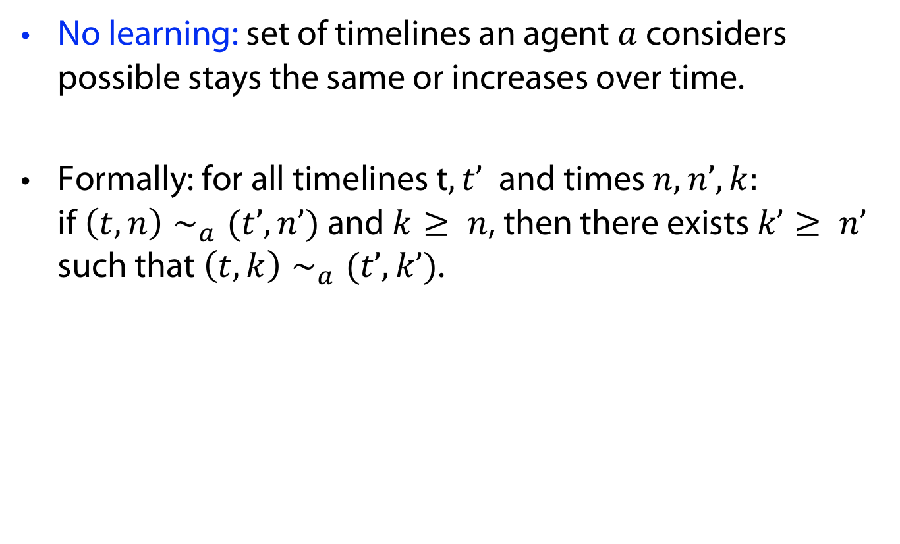
Properties
No learning: set of timelines an agent $a$ considers possible stays the same or increases over time.
Formally: for all timelines t$, t’$ and times $n, n’, k:$
if $\left(t, n\right)∼_{a}(t’, n’)$and $k≥ n$, then there exists $k’≥ n’$ such that $\left(t, k\right)∼_{a}(t’, k’)$.

Slide 36
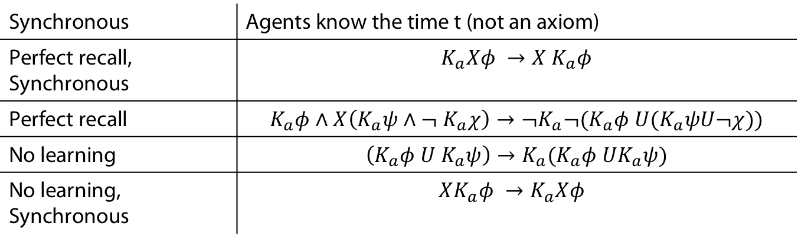
Corresponding properties/axioms
Synchronous | Agents know the time t (not an axiom)
Perfect recall, Synchronous | $$K_{a}Xφ →X K_{a}φ$$
Perfect recall | $$K_{a}φ∧X\left(K_{a}ψ∧¬ K_{a}χ\right)→¬K_{a}¬(K_{a}φ U(K_{a}ψU¬χ))$$
No learning | $$\left(K_{a}φ U K_{a}ψ\right)→K_{a}(K_{a}φ UK_{a}ψ)$$
No learning, Synchronous | $$XK_{a}φ →K_{a}Xφ$$

Slide 37
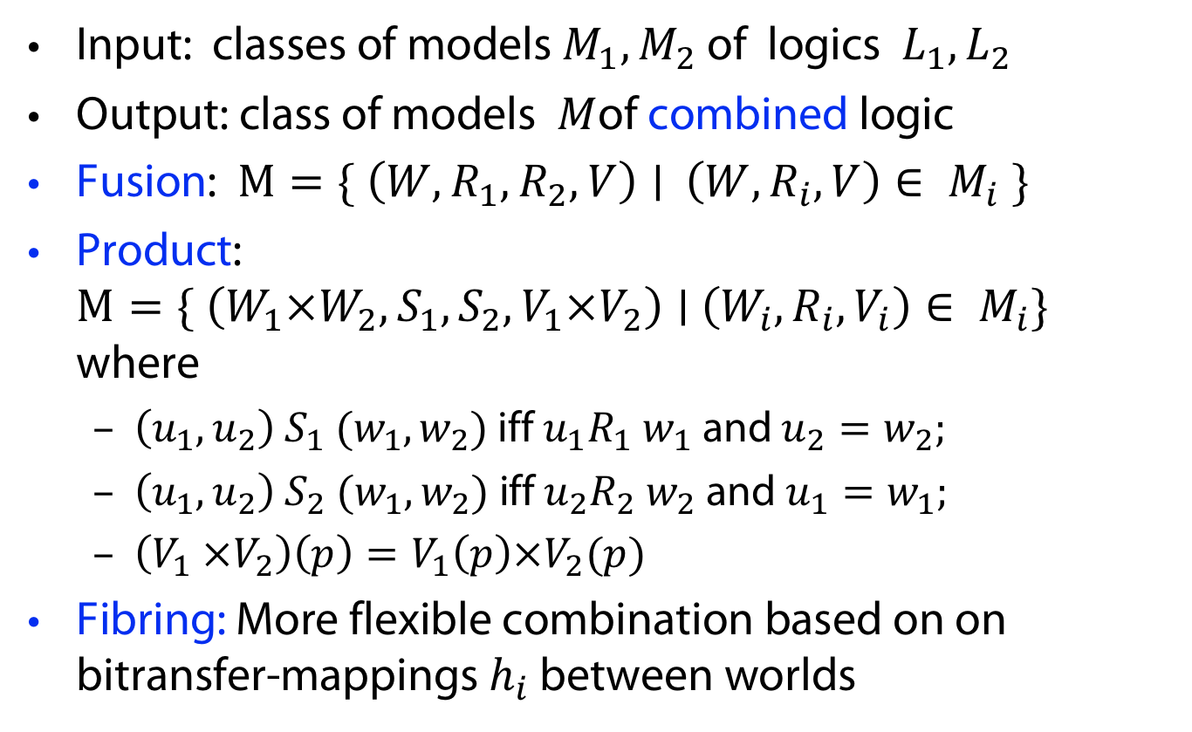
Combinations from a semantical point of view
Input: classes of models $M_{1}, M_{2}$ of logics ${ L}_{1}, L_{2}$
Output: class of models $M$of combined logic
Fusion: $M=\{ \left(W,R_{1}, R_{2}, V\right)∣$ $\left(W,R_{i}, V\right)∈ M_{i} \}$
Product:
$M=\{ \left(W_{1}×W_{2},S_{1},S_{2},V_{1}×V_{2}\right)∣$ $\left(W_{i},R_{i}, V_{i}\right)∈ M_{i}\}$ where
  $\left(u_{1},u_{2}\right) S_{1} (w_{1},w_{2})$ iff $u_{1}R_{1} w_{1}$ and $u_{2}=w_{2};$
  $\left(u_{1},u_{2}\right) S_{2} (w_{1},w_{2})$ iff $u_{2}R_{2} w_{2}$ and $u_{1}=w_{1};$
  $\left(V_{1} ×V_{2}\right)\left(p\right)=V_{1}\left(p\right)×V_{2}(p)$
Fibring: More flexible combination based on on bitransfer-mappings $h_{i}$ between worlds

Slide 38
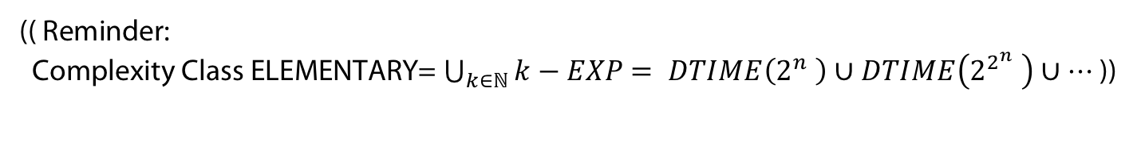
Complexity of the satisfiability problem
No interaction, or syn
PSPACE-c
Perfect recall
NON ELEM-c
No learning
NON ELEM-c
Perfect recall, sync
2EXPTIME-c
No learning, sync
NON ELEM-c
Perfect recall, no learning
EXSPACE-c
Perfect recall, no learning, sync
NON ELEM-c
(( Reminder:
Complexity Class ELEMENTARY= $\bigcup_{k∈ℕ}{k−EXP}$ $= DTIME\left(2^{n} \right)∪DTIME\left(2^{2^{n}} \right)∪…$ ))

Slide 39
Model Checking

Slide 40
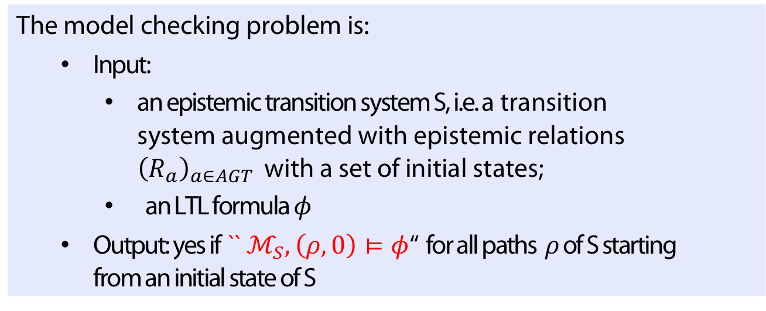
Model checking
Definition
The model checking problem is:
  Input:
    an epistemic transition system S, i.e. a transition system augmented with epistemic relations ${\left(R_{a}\right)}_{a∈AGT }$ with a set of initial states;
    an LTL formula $φ$
  Output: yes if `` $ℳ_{S},\left(ρ,0\right)⊨φ$‘‘ for all paths $ρ$of S starting from an initial state of S

Slide 41
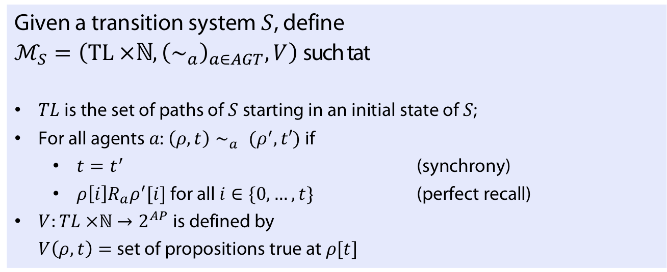

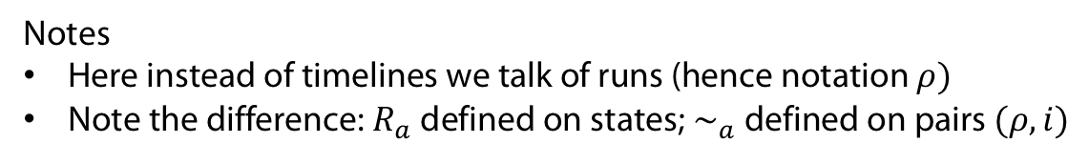
Possible Definition of $ℳ_{S}$
Definition
Given a transition system $S$, define
$ℳ_{S}=\left(TL ×ℕ, {\left(∼_{a}\right)}_{a∈AGT}, V\right)$such tat
$TL$ is the set of paths of $S$ starting in an initial state of $S$;
For all agents $a$: $\left(ρ, t\right)∼_{a} (ρ^{′}, t′)$ if
  $t=t^{′}$ (synchrony)
  $ρ\left[i\right]R_{a}ρ^{′}[i]$ for all $i∈\{0, …, t\}$ (perfect recall)
$V:TL ×ℕ→2^{AP}$ is defined by
$V\left(ρ, t\right)=$set of propositions true at $ρ[t]$
Notes
Here instead of timelines we talk of runs (hence notation $ρ)$
Note the difference: $R_{a}$ defined on states; $∼_{a}$ defined on pairs $(ρ,i)$

Slide 42
Example
Transition system S:
Perfect recall

Slide 43
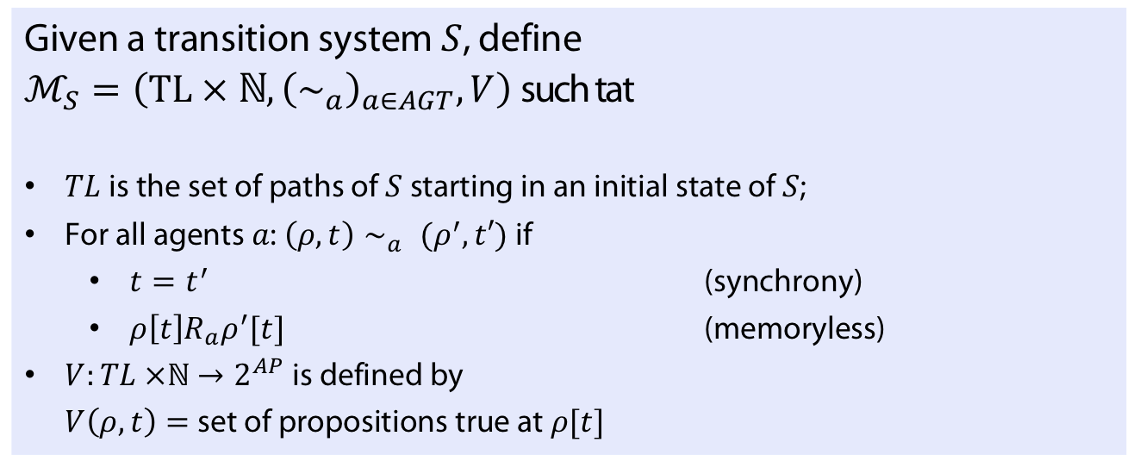

Another Possible Definition of $ℳ_{S}$
Definition
Given a transition system $S$, define
$ℳ_{S}=\left(TL × ℕ, {\left(∼_{a}\right)}_{a∈AGT}, V\right)$such tat
$TL$ is the set of paths of $S$ starting in an initial state of $S$;
For all agents $a$: $\left(ρ, t\right)∼_{a} (ρ^{′}, t′)$ if
  $t=t^{′}$ (synchrony)
  $ρ\left[t\right]R_{a}ρ^{′}[t]$ (memoryless)
$V:TL ×ℕ→2^{AP}$ is defined by
$V\left(ρ, t\right)=$set of propositions true at $ρ[t]$

Slide 44
Example
Transition system S:
Memoryless

Slide 45
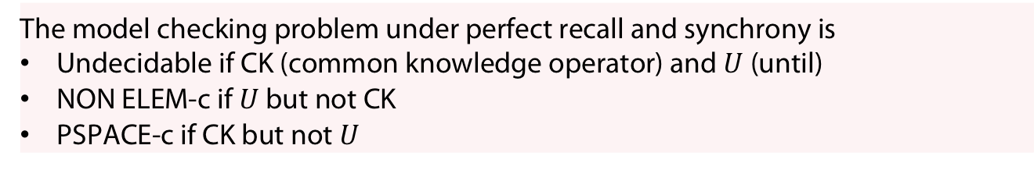
Theorem (Engelhardt et al. 2007)
The model checking problem for memoryless and synchronuos systems is PSPACE-complete
Theorem (van der Meyden and Shilov, 1999)
The model checking problem under perfect recall and synchrony is
Undecidable if CK (common knowledge operator) and $U$ (until)
NON ELEM-c if $U$ but not CK
PSPACE-c if CK but not $U$
See also (Bozzelli et al 2019) for recent results.

Slide 46
APPENDIX
Uhhh, a lecture with a hopefully useful

Slide 47
References
M. Y. Vardi. From philosophical to industrial logics. In Proceedings of the 3rd Indian Conference on Logic and Its Applications, ICLA ’09, pages 89–115, Berlin, Heidelberg, 2009. Springer-Verlag.
P. Blackburn and M. De Rijke. Zooming in, zooming out. Journal of Logic, Language and Information, 6(1):5–31, 1997.
W. Carnielli and M. E. Coniglio. Combining logics. The Stanford Encyclopedia of Philosophy (Win- ter 2008 Edition), Edward N. Zalta (ed.), http://plato.stanford.edu/archives/win2008/entries/logic- combining/.
J. Y. Halpern and M. Y. Vardi. The complexity of reasoning about knowledge and time I. Lower bounds. Journal of Computer and System Sciences, 38(1):195–237, 1989.
K. Engelhardt, P. Gammie, and R. Meyden. Model checking knowledge and linear time: Pspace cases. In Proceedings of the International Symposium on Logical Foundations of Computer Science, LFCS ’07, pages 195—211, Berlin, Heidelberg, 2007. Springer-Verlag.
L. Bozzelli, B. Maubert, and A. Murano. The complexity of model checking knowledge and time. In Proceedings of the 28th International Joint Conference on Artificial Intelligence, IJCAI’19, pages 1595– 1601. AAAI Press, 2019.

Slide 48
Color Convention in this course
Formulae, when occurring inline
Newly introduced terminology and definitions
Important results (observations, theorems) as well as emphasizing some aspects
Examples are given with standard orange with possibly light orange frame
Comments and notes
Algorithms

