Slide 1
Intelligent Agents
Dynamic Epistemic Logic – Part 1
Özgür L. Özçep
Universität zu Lübeck
Institut für Informationssysteme

Slide 2
Todays lecture based on
The AAMAS 2019 Tutorial „EPISTEMIC REASONING IN MULTI-AGENT SYSTEMS“, Part 4: Dynamic Epistemic Logic
http://people.irisa.fr/Francois.Schwarzentruber/2019AAMAStutorial/

Slide 3
Modeling Actions

Slide 4

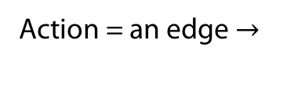
In the verification/model checking community
Action = an edge $→$
Action = an edge $→$
Epistemic =

Slide 5
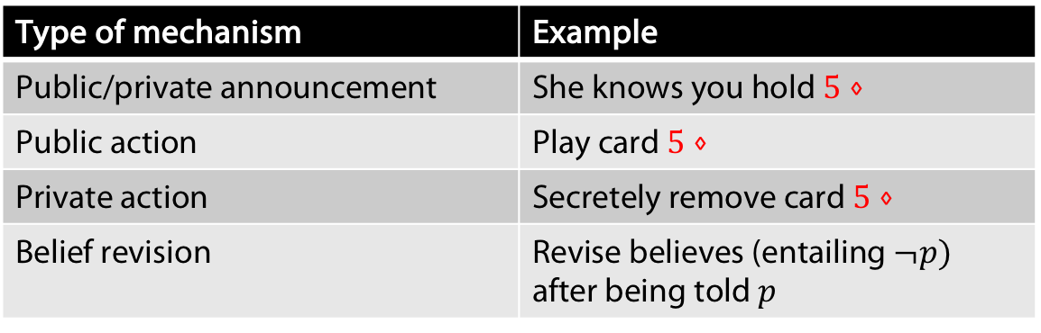
In philosophy and AI
Type of mechanism of actions is important
  There is a dedicated logic for the first type of announcementes: PAL (Public announcement logic)
  What kind of formalism to use to handle all of them?
Type of mechanism | Example
Public/private announcement | She knows you hold $5⋄$
Public action | Play card $5⋄$
Private action | Secretely remove card $5⋄$
Belief revision | Revise believes (entailing $¬p)$ after being told $p$

Slide 6


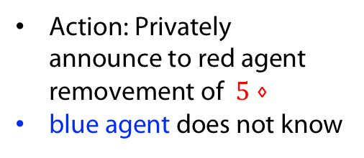
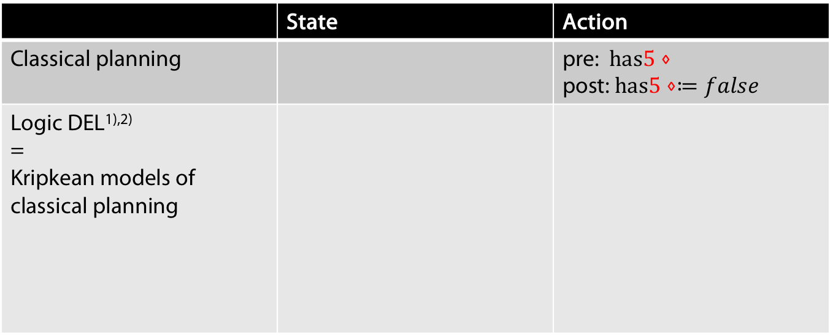
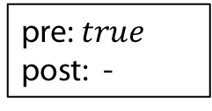


Dynamic Epistemic Logic (DEL)
 | State | Action
Classical planning |  | pre: $has5⋄$ post: $has5⋄≔false$
Logic DEL^{1),2)} = Kripkean models of classical planning
$$has5⋄$$
pre: $has5⋄$
post: $has5⋄≔false$
$$has5⋄$$
pre: $true$
post: -
$$¬ has5⋄$$
1) (Baltag et al., 1998)
2) (van Ditmarsch et al, 2007)
Action: Privately
announce to red agent
removement of $5⋄$
blue agent does not know
Note:
Start states filled white
Implicit self loops for red and blue agent

Slide 7




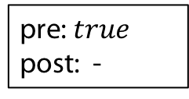


Computing the next state: product update
State | Action | Next State
(epistemic model) | (event model) | (updated epistemic model)
pre: $has5⋄$
post: $has5⋄≔false$
$$¬ has5⋄$$
$$has5⋄$$
$$has5⋄$$
$$¬ has5⋄$$
$$¬ has5⋄$$
pre: $true$
post: -

Slide 8
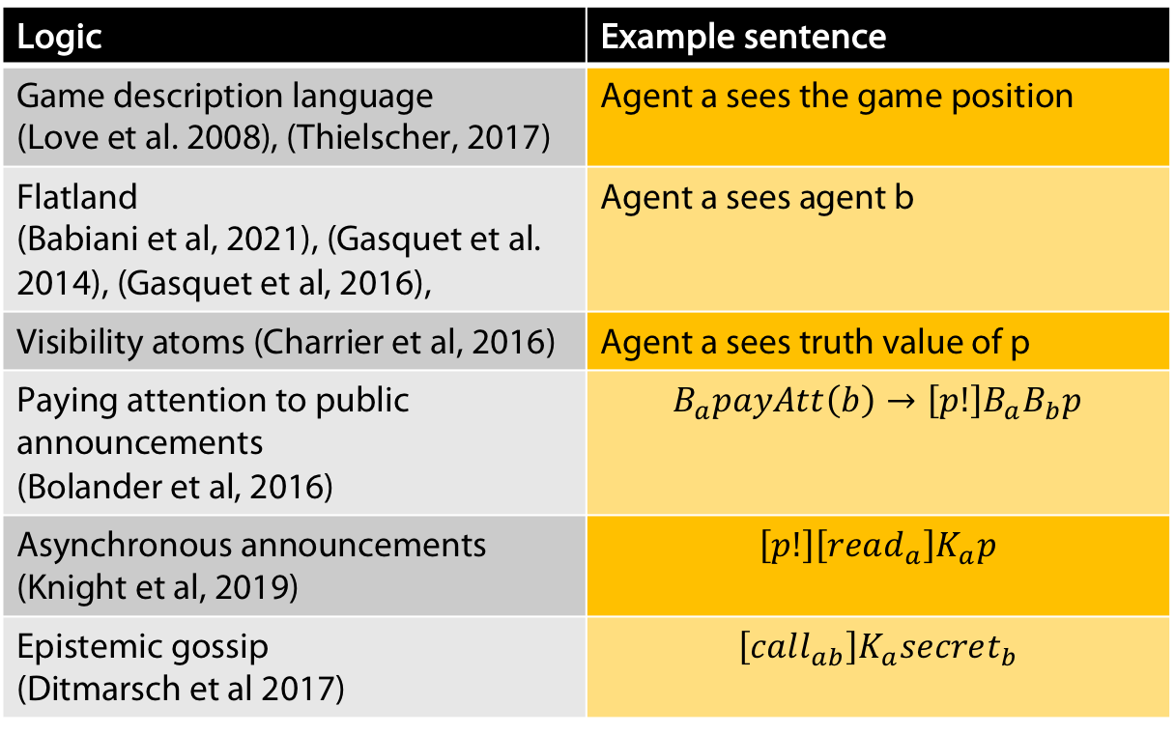
Some syntactic specifications/logics
Logic | Example sentence
Game description language (Love et al. 2008), (Thielscher, 2017) | Agent a sees the game position
Flatland (Babiani et al, 2021), (Gasquet et al. 2014), (Gasquet et al, 2016), | Agent a sees agent b
Visibility atoms (Charrier et al, 2016) | Agent a sees truth value of p
Paying attention to public announcements (Bolander et al, 2016) | $$B_{a}payAtt\left(b\right)→\left[p!\right]B_{a}B_{b}p$$
Asynchronous announcements (Knight et al, 2019) | $$\left[p!\right]\left[read_{a}\right]K_{a}p$$
Epistemic gossip (Ditmarsch et al 2017) | $$\left[call_{ab}\right]K_{a}secret_{b}$$
Notes:
GDL: One knows the language but not the rules of the game beforehand. Competition
Flatland: Clear, see lecture before
Visibility atoms: Indistinguishability of w and w‘ iff for the propostions the agent can see, w and w‘ have the same truth values
If agent a knows that b pays attention, then after announcing p a will know that b knows p-
.Knight et al: If p is publicly announced then a has a pending message which after read by her leads to a knowing p.
Epistemic gossip: Gossip protocol: Spread secrets amoing a group of agents using a connection graph.

Slide 9
From DEL to Epistemic Logics
Syntactic Specification
Models of DEL
Epistemic temporal models

Slide 10
From DEL to Epistemic Logics
+ Easy to specify
+ Succinct
- Ad-hoc languages
- Hand crafted semantics
Syntactic Specification
Models of DEL
Epistemic temporal models

Slide 11
From DEL to Epistemic Temporal Logics
+ Elegant Kripkean extension of classical planning
+ Succinct
+ Classification in terms of action types
+ Has probabilistic extension
+ Has extensions that encompass belief revision
- Perfect-recall only
- Synchronous only
Syntactic Specification
Models of DEL
Epistemic temporal models

Slide 12
From DEL to Epistemic Temporal Logics
+ Elegant
+ Allows for async/no perfect recall semantics
-Type of actions lost
- Not succinct (usually infinite)
Syntactic Specification
Models of DEL
Epistemic temporal models

Slide 13
Timeline

Slide 14
Timeline
Note ÖÖ: The ``systems‘‘ for belief revision do not necessarily
reflect the classical approaches to belief revision

Slide 15
Event Models

Slide 16
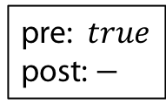
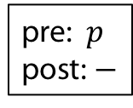





Examples of actions
(Baltag et al. 1998)
Example (public announcement of $p$)
$$a,b$$
pre: $p$
post: $−$
Example (Private announcement of $p$ to $a$)
pre: $p$
post: $−$
$$b$$
pre: $true$
post: $−$
$$a$$
$$a,b$$

Slide 17

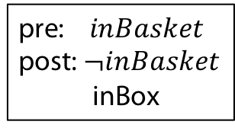
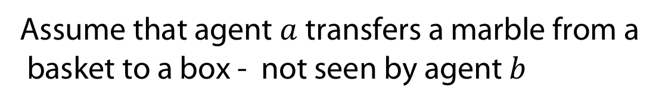

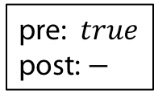
Examples of actions
Assume that agent $a$transfers a marble from a
basket to a box - not seen by agent $b$
Example (Transfer marble from basket to box)
pre: $inBasket$
post: $¬inBasket$
inBox
$$b$$
pre: $true$
post: $−$
$$a$$
$$a,b$$

Slide 18
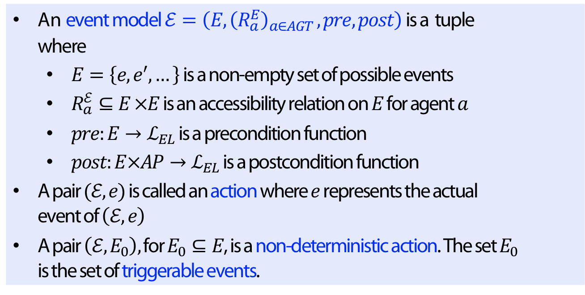
Formal Definition
Definition
An event model$ℰ=\left(E, {\left(R_{a}^{E}\right)}_{a∈AGT }, pre, post\right)$ is a tuple where
  $E=\left\{e,e^{′},…\right\}$ is a non-empty set of possible events
  $R_{a}^{ℰ}⊆E ×E$ is an accessibility relation on $E$ for agent $a$
  $pre:E→ℒ_{EL}$ is a precondition function
  $post:E×AP→ℒ_{EL}$ is a postcondition function
A pair $(ℰ,e)$ is called an action where $e$ represents the actual event of $\left(ℰ,e\right)$
A pair $\left(ℰ,E_{0}\right),$ for $E_{0}⊆E$, is a non-deterministic action. The set $E_{0}$ is the set of triggerable events.
Notes:
The post-function describes real (ontic changes), telling for each propositional symbol, into which formula it changes.

Slide 19


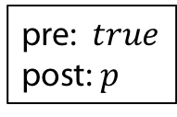

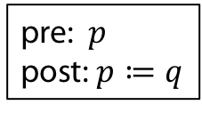

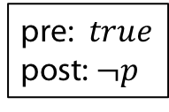

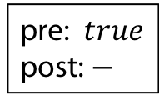
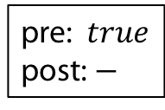
Example (Deterministic action = single-pointed event model)
pre: $p$
post: $p≔q$
$$b$$
pre: $true$
post: $−$
$$a$$
$$a,b$$
Example (Non-deterministic action = multi-pointed event model)
pre: $true$
post: $p$
$$b$$
pre: $true$
post: $−$
$$a$$
$$a,b$$
pre: $true$
post: $¬p$
$$b$$
$$a$$

Slide 20
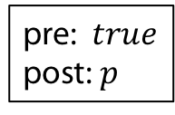
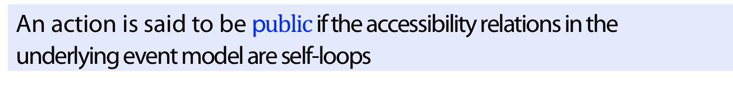
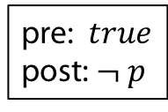
Public Actions
Definition
An action is said to be p$ublic$if the accessibility relations in the underlying event model are self-loops
Example (public)
pre: $true$
post: $p$
pre: $true$
post: $¬ p$
$$a,b$$
$$a,b$$

Slide 21

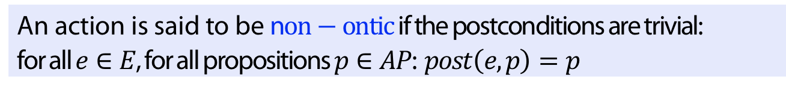

Non-ontic actions
Definition
An action is said to be n$on−ontic$if the postconditions are trivial: for all $e∈E$, for all propositions $p∈AP$: $post\left(e,p\right)=p$
Example (non-ontic)
pre: $p$
post: $−$
$$b$$
pre: $true$
post: $−$
$$a$$
$$a,b$$

Slide 22

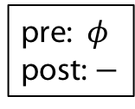
Effect of a public announcement
Publicly announcing $φ$ leads to keeping only the $φ$ worlds.
pre: $φ$
post: $−$
$$a,b$$
Can try this out on several examples in Hintikka‘s world.

Slide 23
Muddy children Puzzle
„Three children (a,b,c) are playing in the mud. Father calls the children to the house, arranging them in a semicircle so that each child can clearly see every other child. “At least one of you has mud on your forehead”, says Father. The children look around, each examining every other child’s forehead. Of course, no child can examine his or her own. Father continues, “If you know whether your forehead is dirty, then step forward now”. No child steps forward. Father repeats himself a second time, “If you know whether your forehead is dirty, then step forward now”. Some (a,b) but not all of the children step forward. Father repeats himself a third time, “If you know whether your forehead is dirty, then step forward now”. All of the remaining children step forward. Explain why a,b stepped forward after two requests. (In general show: if m children are muddy then after m requests of the father those will step forward“
As promised we reconsider this puzzle in the context of dynamic epistemic logic

Slide 24
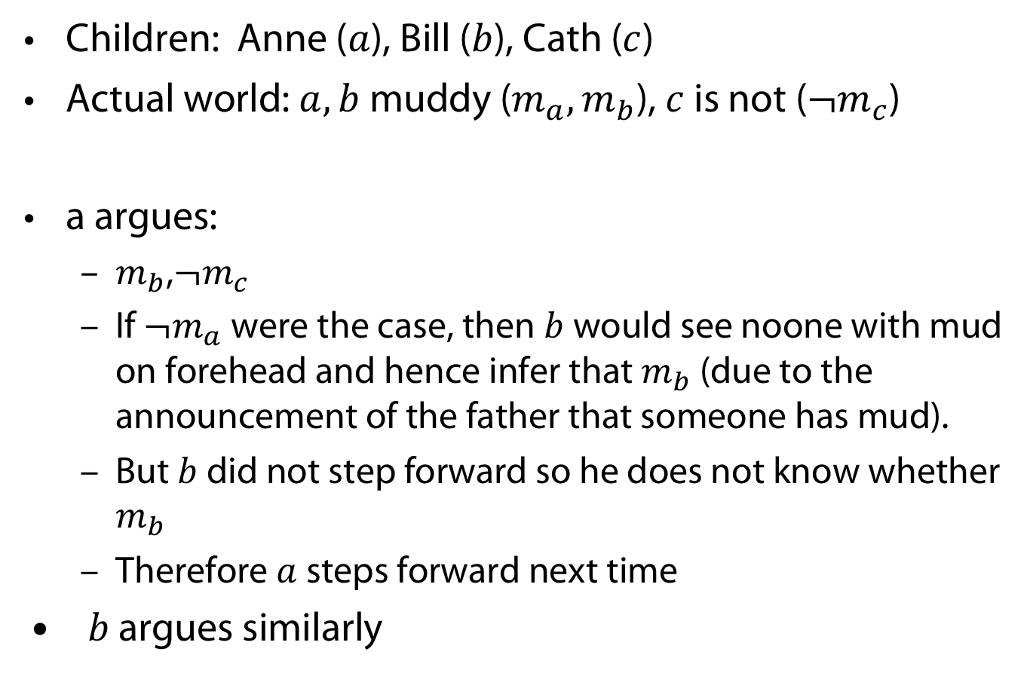
Muddy children: solution
Children: Anne ($a$), Bill ($b$), Cath ($c$)
Actual world: $a,b$ muddy ($m_{a},m_{b}$), $c$ is not (${¬m}_{c}$)
a argues:
  $m_{b}$,${¬m}_{c}$
  If ${¬m}_{a}$were the case, then $b$ would see noone with mud on forehead and hence infer that $m_{b}$ (due to the announcement of the father that someone has mud).
  But $b$ did not step forward so he does not know whether $m_{b}$
  Therefore $a$ steps forward next time
$b$ argues similarly

Slide 25
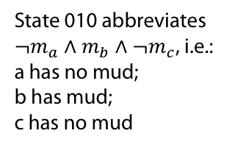
Father announces:
One of you as mud
State 010 abbreviates
${¬m}_{a}∧m_{b}∧¬m_{c}$, i.e.:
a has no mud;
b has mud;
c has no mud

Slide 26
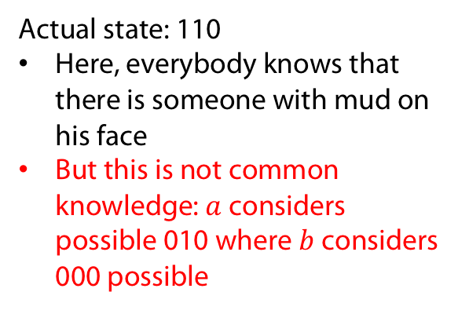
Actual state: 110
Here, everybody knows that there is someone with mud on his face
But this is not common knowledge: $a$ considers possible 010 where $b$ considers 000 possible
Father announces:
One of you as mud
State 010 abbreviates
${¬m}_{a}∧m_{b}∧¬m_{c}$, i.e.:
a has no mud;
b has mud;
c has no mud

Slide 27
Father announces:
„One of you has mud“
So world 000 gets eliminated

Slide 28
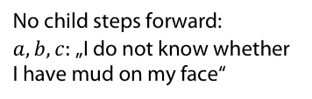

Father announces:
„One of you has mud“
No child steps forward:
$a,b,c:$ „I do not know whether
I have mud on my face“
For example:
$100⊨K_{a}m_{a}$
Hence 100 gets eliminated

Slide 29

Father announces:
„One of you has mud“
No child steps forward:
$a,b,c:$ „I do not know whether
I have mud on my face“
$a$ and $b$ step forward

Slide 30
Computing the next state: product update
State | Action | Next State
(epistemic model) | (event model) | (updated epistemic model)
pre: $has5⋄$
post: $has5⋄≔false$
$$¬ has5⋄$$
$$has5⋄$$
$$has5⋄$$
$$¬ has5⋄$$
$$¬ has5⋄$$
pre: $true$
post: -

Slide 31
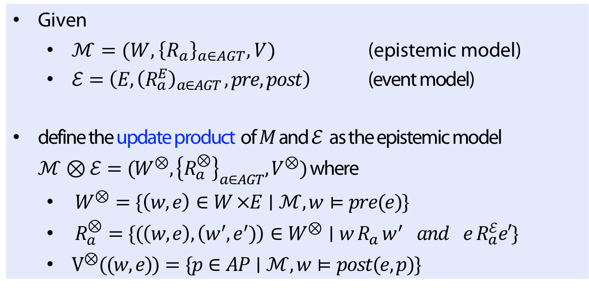
Formal Definition of Update Products
Definition
Given
  $ℳ=(W, {\left\{R_{a}\right\}}_{a∈AGT}, V)$ (epistemic model)
  $ℰ=\left(E, {\left(R_{a}^{E}\right)}_{a∈AGT }, pre, post\right)$ (event model)
define the update product of $M$ and $ℰ$ as the epistemic model
$ℳ⊗ℰ=(W^{⊗},{\left\{R_{a}^{⊗}\right\}}_{a∈AGT}, V^{⊗})$ where
  $W^{⊗}=\{\left(w,e\right)∈W ×E∣ℳ, w⊨pre(e)\}$
  $R_{a}^{⊗}=\{(\left(w,e\right),\left(w^{′},e^{′})\right)∈W^{⊗}∣w R_{a} w^{′} and e R_{a}^{ℰ}e′\}$
  $V^{⊗}((w,e))=\{p∈AP∣ℳ,w⊨post(e,p)\}$

Slide 32

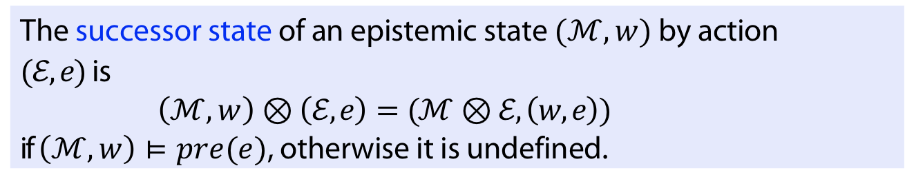
Pointed Update Products
Definition
The successor state of an epistemic state $(ℳ,w)$ by action $(ℰ,e)$ is
$\left(ℳ,w\right)⊗\left(ℰ,e\right)=(ℳ⊗ℰ, \left(w,e\right))$
if $\left(ℳ,w\right)⊨pre(e)$, otherwise it is undefined.
Notation
Write $e$ for $\left(ℰ,e\right)$
Write `$we$‘ for $(w,e)$
Write$ℳ⊗ℰ^{n}$ for$ℳ⊗ℰ⊗ℰ…⊗ℰ$ (n-times)
Write $we_{1}…e_{n}⊨φ$ for $ℳ⊗ℰ^{n}, we_{1}…e_{n}⊨φ$,

Slide 33
Agent a gets private message about its mud
Example (Update Product)
Notes:
Note: as b does not know about the content announced to a it thinks possible that a thinks it does not have mud on his forehead

Slide 34
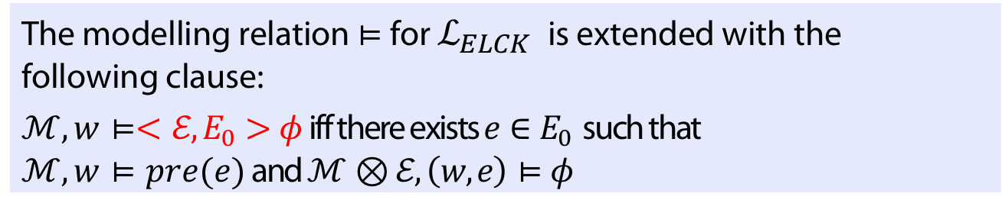

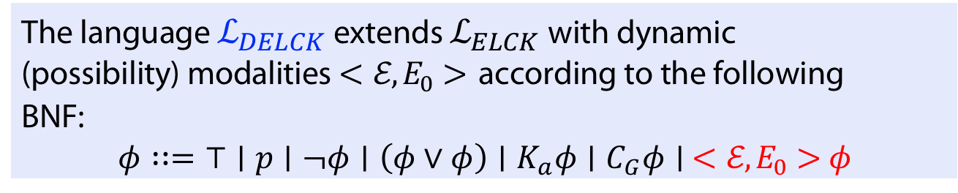
Dynamic epistemic logic $ℒ_{DELCK}$
Definition
The language $ℒ_{DELCK}$ extends $ℒ_{ELCK}$with dynamic (possibility) modalities $<ℰ,E_{0}>$ according to the following BNF:
$φ∷=⊤∣p∣¬φ∣\left(φ∨φ\right)∣K_{a}φ∣C_{G}φ∣ <ℰ,E_{0}>φ$
Definition
The modelling relation $⊨$ for $ℒ_{ELCK}$ is extended with the following clause:
$ℳ,w⊨<ℰ,E_{0}>φ$ iff there exists $e∈E_{0}$ such that
$ℳ,w⊨pre(e)$ and $ℳ⊗ℰ, \left(w,e\right)⊨φ$

Slide 35

Dual operator
Definition (Dual operator)
$$\left[ℰ,E_{0}\right]φ≔¬<ℰ,E_{0}>¬φ$$
The induced semantics is
$ℳ,w⊨[ℰ,E_{0}]φ$ iff for all $e∈E_{0}$ we have:
If $ℳ,w⊨pre(e)$ then $ℳ⊗ℰ, \left(w,e\right)⊨φ$

Slide 36
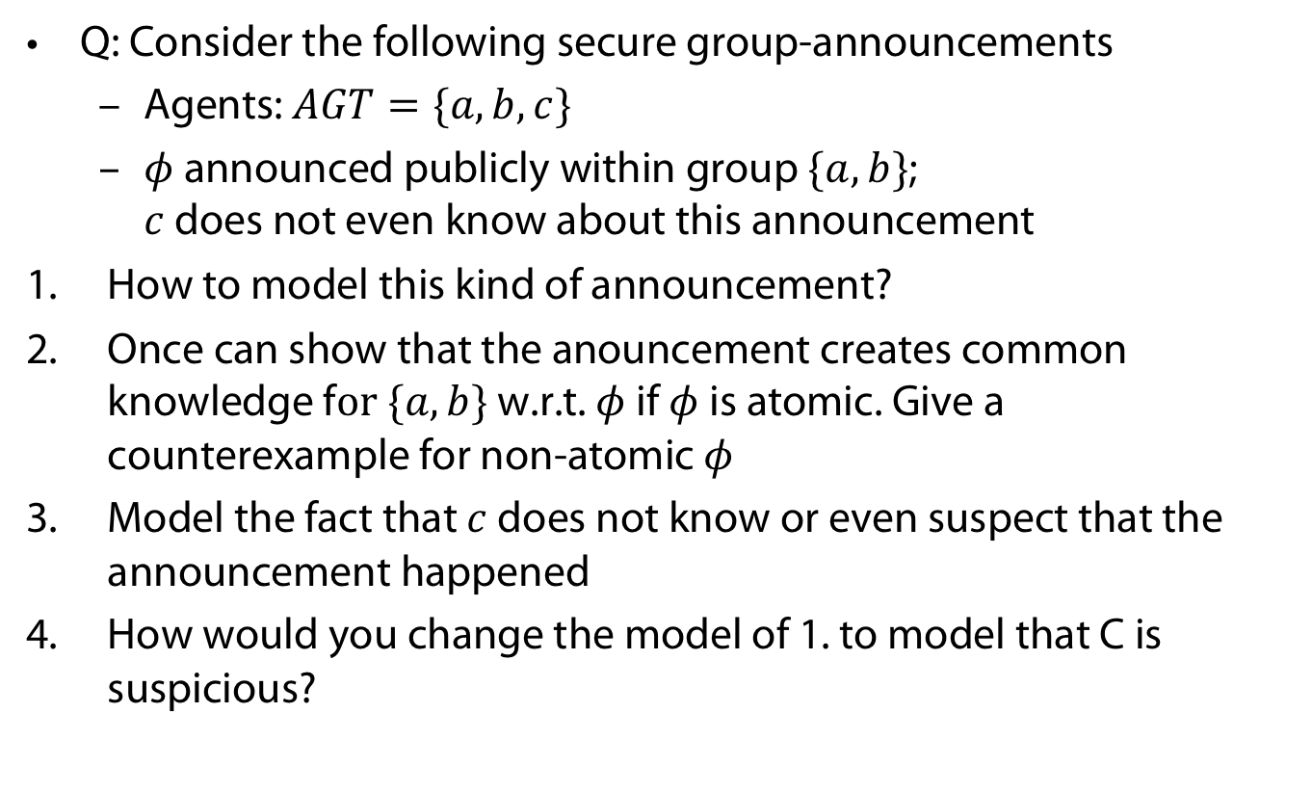
Wake-up: Group announcements
Q: Consider the following secure group-announcements
  Agents: $AGT=\{a,b,c\}$
  $φ$ announced publicly within group $\{a,b\}$;
  $c$ does not even know about this announcement
How to model this kind of announcement?
Once can show that the anouncement creates common knowledge f$or \{a,b\}$ w.r.t. $φ$ if $φ$is atomic. Give a counterexample for non-atomic $φ$
Model the fact that $c$ does not know or even suspect that the announcement happened
How would you change the model of 1. to model that C is suspicious?

Slide 37




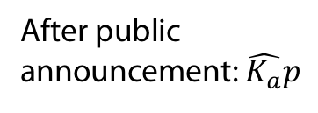




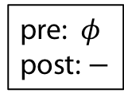


Answers
This is the model$(ℰ,\left\{e\right\})$of the secure announcement
Creation of common knowledge means:
$\left(ℳ,w\right)⊨ <ℰ,\left\{e\right\}>C_{\{a,b\}}φ$. This does not hold if, e.g., $φ=\hat{K_{a}}p$. Take the simplest case of one agent $a$.
pre: $φ$
post: $−$
$$c$$
pre: $true$
post: $−$
e
$$a,b$$
$$a,b, c$$
$$\hat{K_{a}}p ,¬p$$
$p$, $¬\hat{K_{a}}p$
$¬p$, $¬ \hat{K_{a}}(p)$
After public
announcement: $\hat{K_{a}}p$
$$p,¬\hat{K_{a}}p$$
$$¬p,\hat{K_{a}}p$$
$$¬p,¬\hat{K_{a}}p$$

Slide 38

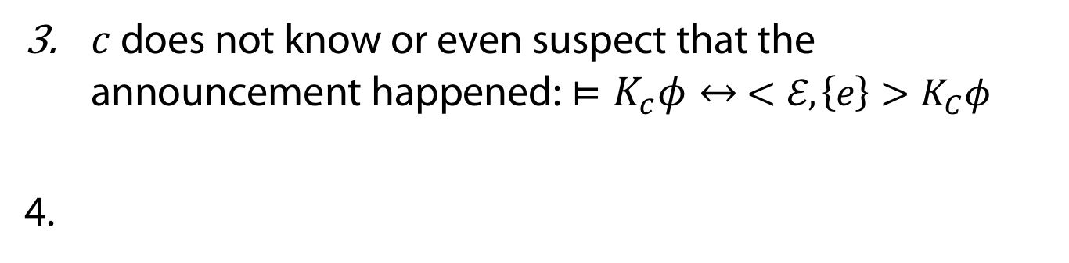



Answers
$c$ does not know or even suspect that the announcement happened: $⊨K_{c}φ↔ <ℰ,\left\{e\right\}>K_{C}φ$
pre: $φ$
post: $−$
$$c$$
pre: $true$
post: $−$
e
$a,b$, c
$$a,b, c$$

Slide 39
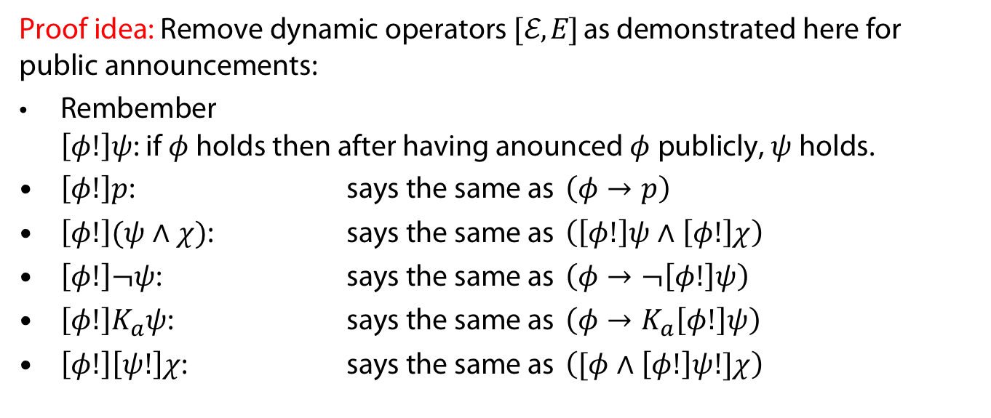
Expressivity and Succinctness
Theorem (Baltag 98)
DEL and EL have the same expressivity
Proof idea: Remove dynamic operators $[ℰ,E]$ as demonstrated here for public announcements:
Rembember
$\left[φ!\right]ψ$: if $φ$ holds then after having anounced $φ$ publicly, $ψ$ holds.
$\left[φ!\right]p$: says the same as $\left(φ→p\right)$
$\left[φ!\right](ψ∧χ)$: says the same as $\left(\left[φ!\right]ψ∧\left[φ!\right]χ\right)$
$\left[φ!\right]¬ψ$: says the same as $\left(φ→¬\left[φ!\right]ψ\right)$
$\left[φ!\right]K_{a}ψ$: says the same as $\left(φ→K_{a}\left[φ!\right]ψ\right)$
$\left[φ!\right]\left[ψ!\right]χ$: says the same as $\left([φ∧\left[φ!\right]ψ!]χ\right)$
Theorem (Lutz 2006)
DEL is more succinct

Slide 40
APPENDIX
Uhhh, a lecture with a hoepfully useful

Slide 41
References
A. Baltag, L. S. Moss, and S. Solecki. The logic of public announcements, common knowledge, and private suspicions. In Proceedings of the 7th Conference on Theoretical Aspects of Rationality and Knowledge, TARK ’98, pages 43—56, San Francisco, CA, USA, 1998. Morgan Kaufmann Publishers Inc.
H. P. van Ditmarsch, W. van der Hoek, and B. P. Kooi. Dynamic epistemic logic and knowledge puzzles. In U. Priss, S. Polovina, and R. Hill, editors, Conceptual Structures: Knowledge Architectures for Smart Applications, 15th International Conference on Conceptual Structures, ICCS 2007, Sheffield, UK, July 22-27, 2007, Proceedings, volume 4604 of Lecture Notes in Computer Science, pages 45–58. Springer, 2007
N. Love, T. Hinrich, D. Haley, E. Schkufza, and M. Genesereth. General game playing: Game descrip- tion language specification. report LG-2006-01, Stanford Logic Group, Computer Science Department, Stanford University, March 2008.
M. Thielscher. Gdl-iii: A description language for epistemic general game playing. In Proceedings of the Twenty-Sixth International Joint Conference on Artificial Intelligence, IJCAI-17, pages 1276–1282, 2017.
P. Balbiani, O. Gasquet, and F. Schwarzentruber. Agents that look at one another. Logic Journal fo the IGPL, 21(3):438–467, 12 2012.

Slide 42
References
O. Gasquet, V. Goranko, and F. Schwarzentruber. Big brother logic: logical modeling and reasoning about agents equipped with surveillance cameras in the plane. In Proceedings of AAMAS ’14, 2014.
O. Gasquet, V. Goranko, and F. Schwarzentruber. Big brother logic: visual-epistemic reasoning in stationary multi-agent systems. Autonomous Agents and Multi-Agent Systems, 30(5):793–825, 2016.
T. Charrier, A. Herzig, E. Lorini, F. Maffre, and F. Schwarzentruber. Building epistemic logic from observations and public announcements. In C. Baral, J. P. Delgrande, and F. Wolter, editors, Principles of Knowledge Representation and Reasoning: Proceedings of the Fifteenth International Conference, KR 2016, Cape Town, South Africa, April 25-29, 2016, pages 268–277. AAAI Press, 2016.
T. Bolander, H. van Ditmarsch, A. Herzig, E. Lorini, P. Pardo, and F. Schwarzentruber. Announcements to attentive agents. J. Log. Lang. Inf., 25(1):1–35, 2016.
S. Knight, B. Maubert, and F. Schwarzentruber. Reasoning about knowledge and messages in asyn- chronous multi-agent systems. Mathematical Structures in Computer Science, 29:127 – 168, 2019.
H. van Ditmarsch, J. van Eijck, P. Pardo, R. Ramezanian, and F. Schwarzentruber. Epistemic protocols for dynamic gossip. Journal of Applied Logic, 20:1–31, 2017.
C. Lutz. Complexity and succinctness of public announcement logic. In Proceedings of the Fifth Inter- national Joint Conference on Autonomous Agents and Multiagent Systems, AAMAS ’06, pages 137–143, New York, NY, USA, 2006. Association for Computing Machinery.

Slide 43
Color Convention in this course
Formulae, when occurring inline
Newly introduced terminology and definitions
Important results (observations, theorems) as well as emphasizing some aspects
Examples are given with standard orange with possibly light orange frame
Comments and notes
Algorithms

