Slide 1
Intelligent Agents
Dynamic Epistemic Logic – Part 2
Özgür L. Özçep
Universität zu Lübeck
Institut für Informationssysteme

Slide 2
Todays lecture based on
The AAMAS 2019 Tutorial „EPISTEMIC REASONING IN MULTI-AGENT SYSTEMS“, Part 4: Dynamic Epistemic Logic
http://people.irisa.fr/Francois.Schwarzentruber/2019AAMAStutorial/

Slide 3
Model Checking

Slide 4
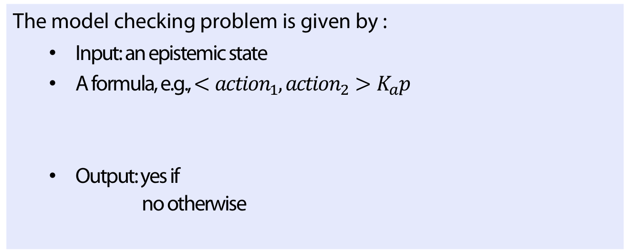



Model checking with actions
Definition
The model checking problem is given by :
  Input: an epistemic state
  A formula, e.g., $<action_{1}, action_{2}>K_{a}p$
  Output: yes if
  no otherwise
$$action_{1}$$
$$action_{2}$$
$$K_{a}p$$

Slide 5
Model checking complexity
Public actions: P-complete (van Benthem 2011)
Any type of action : PSPACE-complete
(Aucher/Schwarzentruber 2013), (Pol et al. 2015)

Slide 6

State explosion problem
Example
Minesweeper
  $8 × 8$ with $10$ bombs:
  $>{10}^{12}$ possible worlds
  $10 × 12$ with $20$ bombs:
  $>{10}^{25}$possible worlds

Slide 7
State explosion problem
See (Benthem et al. 2015), (Benthem et al. 2018)
Also see: (Charrier/S. 2017), (Charrier/S. 2018)
  Succinct representations of epistemic states and actions
  Easy to specify by means of accessibility programs;
  Succinct model checking Pspace-complete (and so stays in PSPACE as for non-succinct case).

Slide 8
Impact
Theoretical
  Example: public announcements do not expand the epistemic model
Practical: Symbolic model checking implemented in Hintikka‘s world
  S. Gamblin and A. Niveau
  Using BDDs (binary decision diagrams)
Theorem (Maubert et al. 2019)
Existence of a (uniform) strategy in bounded¹⁾ imperfect info games is in PSPACE.

Slide 9
Theorem Proving

Slide 10

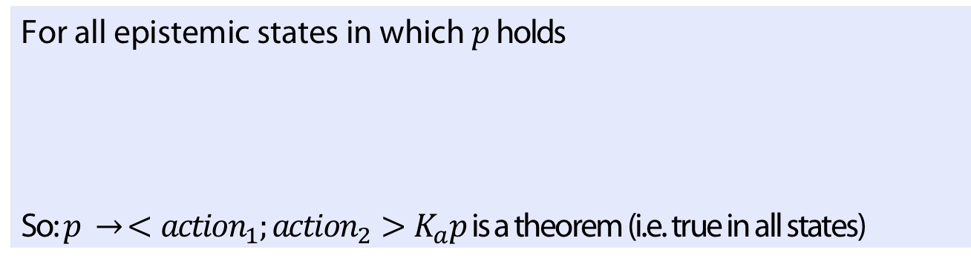

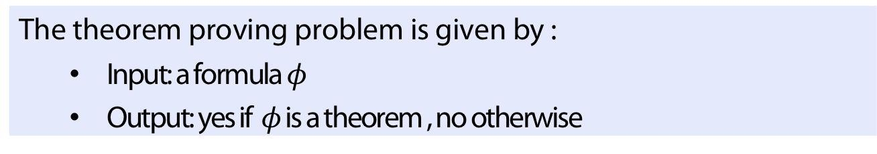


Theorem proving (another point of view)
Motivation: parametrized verification
For all epistemic states in which $p$ holds
So: $p → <action_{1};acti{on}_{2}>K_{a}p$ is a theorem (i.e. true in all states)
$$action_{1}$$
$$action_{2}$$
$$p$$
$$K_{a}p$$
Definition
The theorem proving problem is given by :
  Input: a formula $φ$
  Output: yes if $φ$ is a theorem , no otherwise

Slide 11
Theorem proving is highly intractable
EL: PSPACE-c
(Ladner 1977), (Halpern, Moses 1992)
+ common knowledge
+ actions
ELCK: EXPTIME-c
(Halpern, Moses 1992)
DEL: coNEXPTIME-c
(Aucher/Schwarzentruber 2015)
+ common knowledge
+ actions
DELCK: 2EXPTIME-c
(Charrier/Schwarzentruber 2018)
General Insights
Semi-product modal logics have high complexities (Gabbay et al. 2003)
Model checking more practical than theorem proving
(Halpern/Vardi 1991)

Slide 12
Epistemic Planning

Slide 13

The general scenario of epistemic planning
(Bolander/Andersen 2011)
initial state
initial state
Epistemic
Planning
repertoire of actions
yes if
$∃$ plan
goal
final state
satisfying the goal
(described in DEL)

Slide 14

(Un-)Decidability of epistemic planning
no postconditions : | yes | ? | no | no
Boolean postcondition: | yes | no | no | no
modal depths of
preconditions
0
1
2
3
e.g. $md\left(K_{a}K_{b}K_{a}p\right)=3$

Slide 15
(Un-)Decidability of epistemic planning
(Bolander et al 2015)
(Charrier et al 2016)
(Aucher/Bolander 2013)
(Charrier et al 2016)
No postcondition : | yes | ? | no | no
Boolean postcondition: | yes | no | no | no
Modal depths of
preconditions
0
1
2
3
(Yu et al 2013)
(Aucher et al 2014)
(Doueneau-Tabot et al 2018)
(Bolander/Andersen 2011)
(Le Cong et al. 2018)

Slide 16
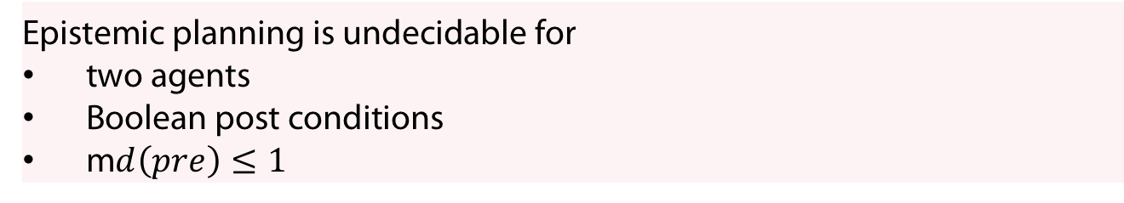
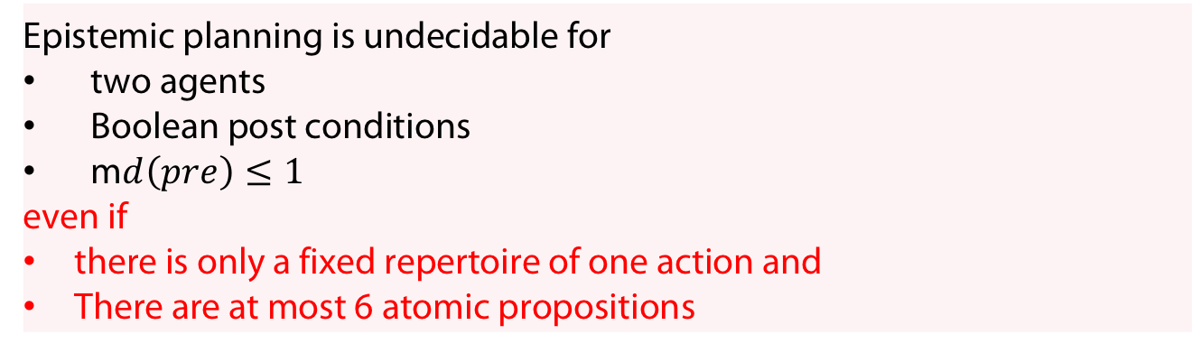
Undecidability
Theorem (Bolander/Andersen 2011)
Epistemic planning is undecidable for
two agents
Boolean post conditions
m$d\left(pre\right)≤1$
Theorem (Le Cong et al 2018)
Epistemic planning is undecidable for
two agents
Boolean post conditions
m$d\left(pre\right)≤1$
even if
there is only a fixed repertoire of one action and
There are at most 6 atomic propositions
Proof idea: Reduction from halting problem of a small universal cellular automaton

Slide 17
Example: the 110 Rule cellular automaton
(von Neumann 1951)
(Wolfram 2002)

Slide 18
Example: the 110 Rule cellular automaton

Slide 19
Example: the 110 Rule cellular automaton

Slide 20
Example: the 110 Rule cellular automaton

Slide 21
Example: the 110 Rule cellular automaton

Slide 22
Encoding automaton configuration in a state
Notes:
Alternating reachability edges between agent red and agent blue. Left worlds in bubbles due to reflexity.
Propositions to encode the content of the cell (0,1) and whether blueagent is on the right of the cell

Slide 23
Encoding automaton configuration in a state

Slide 24
Encoding automaton configuration in a state

Slide 25
Encoding automaton configuration in a state

Slide 26
Encoding automaton configuration in a state

Slide 27
Encoding automaton configuration in a state

Slide 28
Wake-Up Question
Q: Which assumptions do we have to make such that the encoding of a cellular configuration is possible?
Q: Why is it OK to assume that in the precondition of the event model (which we did not specify) we can rely on formula of maximal depth 1?

Slide 29
Answers
Q: Which assumptions do we habe to make such that the encoding of a cellular configuration is possible?
A: Fine support (otherwise we would get an infinite state).
Q: Why is it OK to assume that in the precondition of the event model (which we did not specify) we can rely on formula of maximal depth 1?
A: Rules in a cellular automaton consider only one cell lefto the left and right of the current cell.

Slide 30
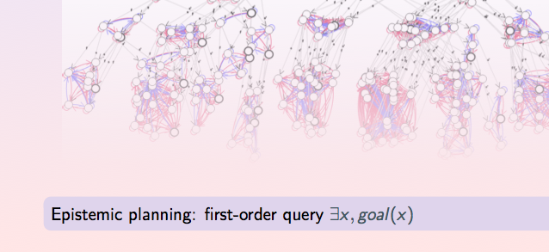

(Infinite) Epistemic temporal structures
Epistemic planning: first-order query $∃x. goal(x)$

Slide 31
Decidability when pre/post are Boolean
Theorem (Yu et al. 13, Aucher et al 14)
When pre/post conditions are Boolean, epistemic planning is decidable
Epistemic planning is a first-order query
first-order query on automatic structures is decidable
Epistemic temporal structures are automatic
Theorem (Doueneau-Tabot et al., 2018)
Even decidable for goals in epistemic linear $μ$-calculus¹⁾.
1) That is, for caclulus with (minimal) fixed point operator

Slide 32
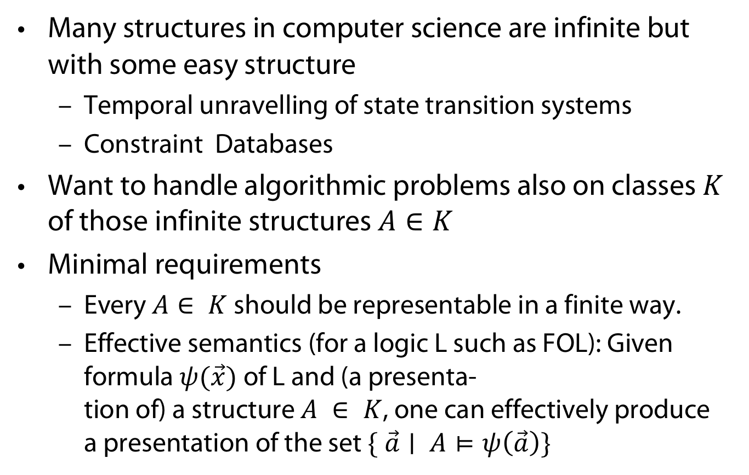
Automatic Structures: Motivation
Many structures in computer science are infinite but with some easy structure
  Temporal unravelling of state transition systems
  Constraint Databases
Want to handle algorithmic problems also on classes $K$ of those infinite structures $A∈K$
Minimal requirements
  Every $A∈ K$ should be representable in a finite way.
  Effective semantics (for a logic L such as FOL): Given formula $ψ(\vec{x})$ of L and (a presenta-
  tion of) a structure $A ∈ K$, one can effectively produce
  a presentation of the set $\{ \vec{a}∣ A⊨ψ\left(\vec{a}\right)\}$

Slide 33



Automatic structure = defined by automaton
$$( ℕ , isEven , ≤ )$$
$$({ 𝒜}_{ℕ}, 𝒜_{isEven} , 𝒜_{≤} )$$
Enc: $ℕ →{\left\{1\right\}}^{∗} ;n↦ 1^{n}$;
${ 𝒜}_{ℕ}$:
$𝒜_{isEven}$
$𝒜_{≤}$
1
1
even
odd
1

Slide 34
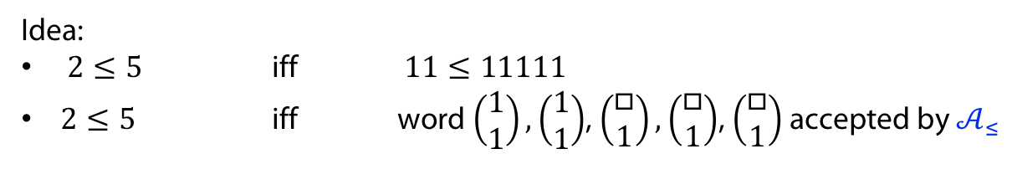




Automatic structure = defined by automaton
$$( ℕ , isEven , ≤ )$$
$$({ 𝒜}_{ℕ}, 𝒜_{isEven} , 𝒜_{≤} )$$
$𝒜_{≤}$:
state
sink
$$\left(\begin{matrix}1 \\ □\end{matrix}\right)$$
$$\left(\begin{matrix}1 \\ 1\end{matrix}\right),\left(\begin{matrix}□ \\ 1\end{matrix}\right)$$
$$\left(\begin{matrix}1 \\ □\end{matrix}\right)$$
Idea:
$2≤5$ iff $11≤11111$
$2≤5$ iff word $\left(\begin{aligned}1 \\ 1\end{aligned}\right),\left(\begin{aligned}1 \\ 1\end{aligned}\right)$, $\left(\begin{aligned}□ \\ 1\end{aligned}\right),\left(\begin{aligned}□ \\ 1\end{aligned}\right)$, $\left(\begin{aligned}□ \\ 1\end{aligned}\right)$ accepted by $𝒜_{≤}$

Slide 35
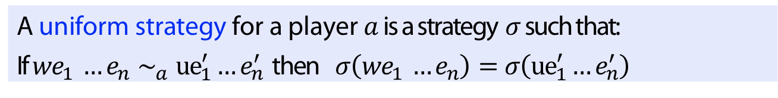
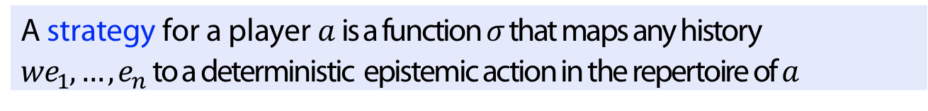
Generalization to multi-player setting
Definition
A strategy for a player $a$ is a function $σ$ that maps any history $we_{1},…, e_{n}$to a deterministic epistemic action in the repertoire of $a$
Definition
A uniform strategy for a player $a$ is a strategy $σ$ such that:
If $we_{1} …e_{n}∼_{a}{ue}_{1}^{′}…e_{n}^{′}$ then $σ\left(we_{1} …e_{n}\right)=σ\left({ue}_{1}^{′}…e_{n}^{′}\right)$

Slide 36
Undecidability even for Boolean pre/post
Theorem (Peterson /Reif 79, Coulombe/Lynch 18, Maubert et al 19)
The existence of uniform strategies for two players against an environment for achieving a goal is undecidable.
Theorem
Decidability of existence of uniform strategies holds when
Only public actions are allowed
(Belardenelli et al 17) (Maubert et al 19))
Hierarchical information is assumed
(Maubert/Muranio 18), Maubert et al 19)

Slide 37
Complexity results in epistemic planning
 | One centralized planner (Bolander et al 2015) | Controller | Many players (Maubert et al 2019)
Public announcements | NP-c | PSPACE-c | PSPACE-c
Public actions | PSPACE-c | EXPTIME-c | EXPTIME-c
Boolean pre/post | Decidable | decidable | undecidable
all | Undecidable | undecidable | Undecidable (Peterson/Reif 79)
Notes:
Note: Onte centralized planner coorespinds to „Plan“ in Maubert 19; Many Players captures „Controller“ and „Distributed Strategy“ under „Many Players“. The reason is that fr both in Maubert 19 one gets the same complexities. In „Controlles one has actually two players: Controller and perturbing environment which chooses´action in turn)

Slide 38
Types of planning
Centralized player:
    Agents by themselves do nothing than following the update of the environment;
    plan, if it exists, is found by centralized planner
Controller:
  two players: controller and a perturbing environment;
  action chosen in turn;
  controller seeks strategy: history (of odd length)-> action;
  uniformity NOT required (hence
Multi-Player: Agents have to find strategies under imperfect information and uniformity condition (not knowing about others‘ strategies)

Slide 39
Perspectives: DEL and Formal Language Theory
Question: Is epistemic planning one agent (pre: md 1, no post) decidable?
FOL query
Is NOT decidable on
FOL query
decidable on
Automatic
structures
Pushdown automata?
Causal hierarchy?
Turing-complete
structures
ÖÖ: See also descriptive complexity
Connections with logics for reasoning about strategies such as Alternating temporal-time logic, Strategy logic et (Maubert et al. 2019)
Describing protocols/policies

Slide 40
Descriptive Complexity

Slide 41
APPENDIX
Uhhh, a lecture with a hopefully useful

Slide 42
References
J. van Benthem. Logical Dynamics of Information and Interaction. Cambridge University Press, 2011.
G. Aucher and F. Schwarzentruber. On the complexity of dynamic epistemic logic. In B. C. Schipper, editor, Proceedings of the 14th Conference on Theoretical Aspects of Rationality and Knowledge (TARK 2013), Chennai, India, January 7-9, 2013, 2013.
I. van de Pol, I. van Rooij, and J. Szymanik. Parameterized complexity results for a model of theory of mind based on dynamic epistemic logic. In R. Ramanujam, editor, Proceedings Fifteenth Conference on Theoretical Aspects of Rationality and Knowledge, TARK 2015, Carnegie Mellon University, Pittsburgh, USA, June 4-6, 2015, volume 215 of EPTCS, pages 246–263, 2015.
J. van Benthem, J. van Eijck, M. Gattinger, and K. Su. Symbolic model checking for dynamic epistemic logic. In W. van der Hoek, W. H. Holliday, and W.-f. Wang, editors, Logic, Rationality, and Interaction, pages 366–378, Berlin, Heidelberg, 2015. Springer Berlin Heidelberg.
J. Van Benthem, J. Van Eijck, M. Gattinger, and K. Su. Symbolic model checking for dynamic epistemic logic — s5 and beyond. Journal of Logic and Computation, 28(2):367–402, Mar. 2018.
T. Charrier and F. Schwarzentruber. A succinct language for dynamic epistemic logic. In K. Larson, M. Winikoff, S. Das, and E. H. Durfee, editors, Proceedings of the 16th Conference on Autonomous Agents and MultiAgent Systems, AAMAS 2017, S ̃ao Paulo, Brazil, May 8-12, 2017, pages 123–131. ACM, 2017.
T. Charrier and F. Schwarzentruber. Complexity of dynamic epistemic logic with common knowledge. In G. Bezhanishvili, G. D’Agostino, G. Metcalfe, and T. Studer, editors, Advances in Modal Logic 12, proceedings of the 12th conference on ”Advances in Modal Logic,” held in Bern, Switzerland, August 27-31, 2018, pages 103–122. College Publications, 2018.
B. Maubert, S. Pinchinat, and F. Schwarzentruber. Reachability games in dynamic epistemic logic. In Proceedings of the Twenty-Eighth International Joint Conference on Artificial Intelligence, IJCAI-19, pages 499–505. International Joint Conferences on Artificial Intelligence Organization, 7 2019.

Slide 43
References
J. von Neumann. The general and logical theory of automata. In Cerebral Mechanisms in Behavior: The Hixon Symposium, pages 1–41. John Wiley & Sons Ltd., 1951.
Stephen Wolfram. A New Kind of Science. Wolfram Media Inc., Champaign, Ilinois, USA, 2002.
D. M. Gabbay, A. Kurucz, F. Wolter, and M. Zakharyaschev. Many-Dimensional Modal Logics: Theory and Applications. Elsevier, 2003.
J. Y. Halpern and M. Y. Vardi. Model checking vs. theorem proving: A manifesto. In Proceedings of the Second International Conference on Principles of Knowledge Representation and Reasoning, KR’91, pages 325–334, San Francisco, CA, USA, 1991. Morgan Kaufmann Publishers Inc.
T. Bolander and M. B. Andersen. Epistemic planning for single- and multi-agent systems. Journal of Applied Non-Classical Logics, 21(1):9–34, 2011.
T. Bolander, M. H. Jensen, and F. Schwarzentruber. Complexity results in epistemic planning. In IJCAI, 2015
T. Charrier, B. Maubert, and F. Schwarzentruber. On the impact of modal depth in epistemic planning. In Proceedings of the Twenty-Fifth International Joint Conference on Artificial Intelligence, IJCAI’16, pages 1030–1036. AAAI Press, 2016
G. Aucher and T. Bolander. Undecidability in epistemic planning. In IJCAI, 2013.
Q. Yu, X. Wen, and Y. Liu. Multi-agent epistemic explanatory diagnosis via reasoning about actions. In Proceedings of the Twenty-Third International Joint Conference on Artificial Intelligence, IJCAI ’13, pages 1183–1190. AAAI Press, 2013.
G. Aucher, B. Maubert, and S. Pinchinat. Automata techniques for epistemic protocol synthesis. In F. Mogavero, A. Murano, and M. Y. Vardi, editors, Proceedings 2nd International Workshop on Strategic Reasoning, SR 2014, Grenoble, France, April 5-6, 2014, volume 146 of EPTCS, pages 97–103, 2014.
G. Doueneau-Tabot, S. Pinchinat, and F. Schwarzentruber. Chain-monadic second order logic over regular automatic trees and epistemic planning synthesis. In G. Bezhanishvili, G. D’Agostino, G. Metcalfe, and T. Studer, editors, Advances in Modal Logic 12, proceedings of the 12th conference on ”Advances in Modal Logic,” held in Bern, Switzerland, August 27-31, 2018, pages 237–256. College Publications, 2018.
S. L. Cong, S. Pinchinat, and F. Schwarzentruber. Small undecidable problems in epistemic planning. In J. Lang, editor, Proceedings of the Twenty-Seventh International Joint Conference on Artificial Intel- ligence, IJCAI 2018, July 13-19, 2018, Stockholm, Sweden, pages 4780–4786. ijcai.org, 2018.

Slide 44
References
[G. L. Peterson and J. H. Reif. Multiple-person alternation. In 20th Annual Symposium on Foundations of Computer Science (sfcs 1979), pages 348–363, 1979.
M. J. Coulombe and J. Lynch. Cooperating in Video Gamesl Impossible! Undecidability of Team Mul- tiplayer Games. In H. Ito, S. Leonardi, L. Pagli, and G. Prencipe, editors, 9th International Conference on Fun with Algorithms (FUN 2018), volume 100 of Leibniz International Proceedings in Informatics (LIPIcs), pages 14:1–14:16, Dagstuhl, Germany, 2018. Schloss Dagstuhl–Leibniz-Zentrum fuer Infor- matik.
F. Belardinelli, A. Lomuscio, A. Murano, and S. Rubin. Verification of multi-agent systems with imper- fect information and public actions. AAMAS ’17, pages 1268–1276, Richland, SC, 2017. International Foundation for Autonomous Agents and Multiagent Systems.
B. Maubert and A. Murano. Reasoning about knowledge and strategies under hierarchical information. In M. Thielscher, F. Toni, and F. Wolter, editors, Principles of Knowledge Representation and Reason- ing: Proceedings of the Sixteenth International Conference, KR 2018, Tempe, Arizona, 30 October - 2 November 2018, pages 530–540. AAAI Press, 2018.

Slide 45
Color Convention in this course
Formulae, when occurring inline
Newly introduced terminology and definitions
Important results (observations, theorems) as well as emphasizing some aspects
Examples are given with standard orange with possibly light orange frame
Comments and notes
Algorithms

