Slide 1
Intelligent Agents
Doxastic logic and dynamics of beliefs
Özgür L. Özçep
Universität zu Lübeck
Institut für Informationssysteme

Slide 2
Todays lecture based on
Parts of Lecture notes „EPISTEMIC LOGICS“ by Andreas Herzig, 2017
https://www.irit.fr/~Andreas.Herzig/Cours/epiLogics.pdf

Slide 3
Doxastic Logic

Slide 4
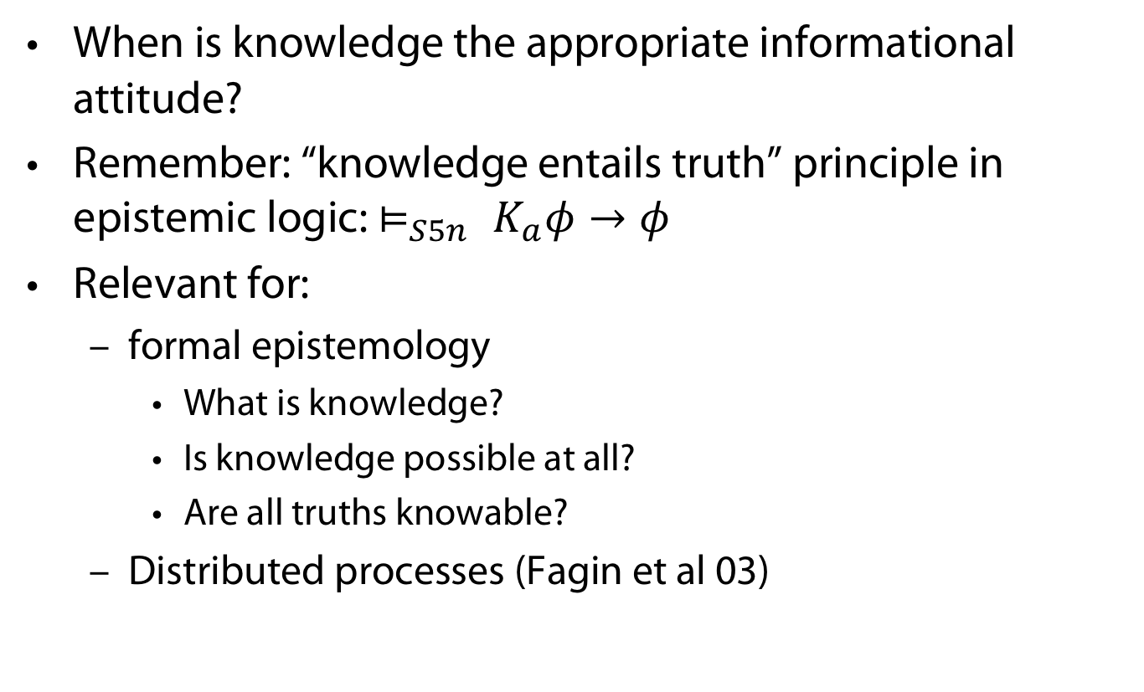
Relevance of Knowledge
When is knowledge the appropriate informational attitude?
Remember: “knowledge entails truth” principle in epistemic logic: $⊨_{S5n} K_{a}φ→φ$
Relevant for:
  formal epistemology
    What is knowledge?
    Is knowledge possible at all?
    Are all truths knowable?
  Distributed processes (Fagin et al 03)

Slide 5
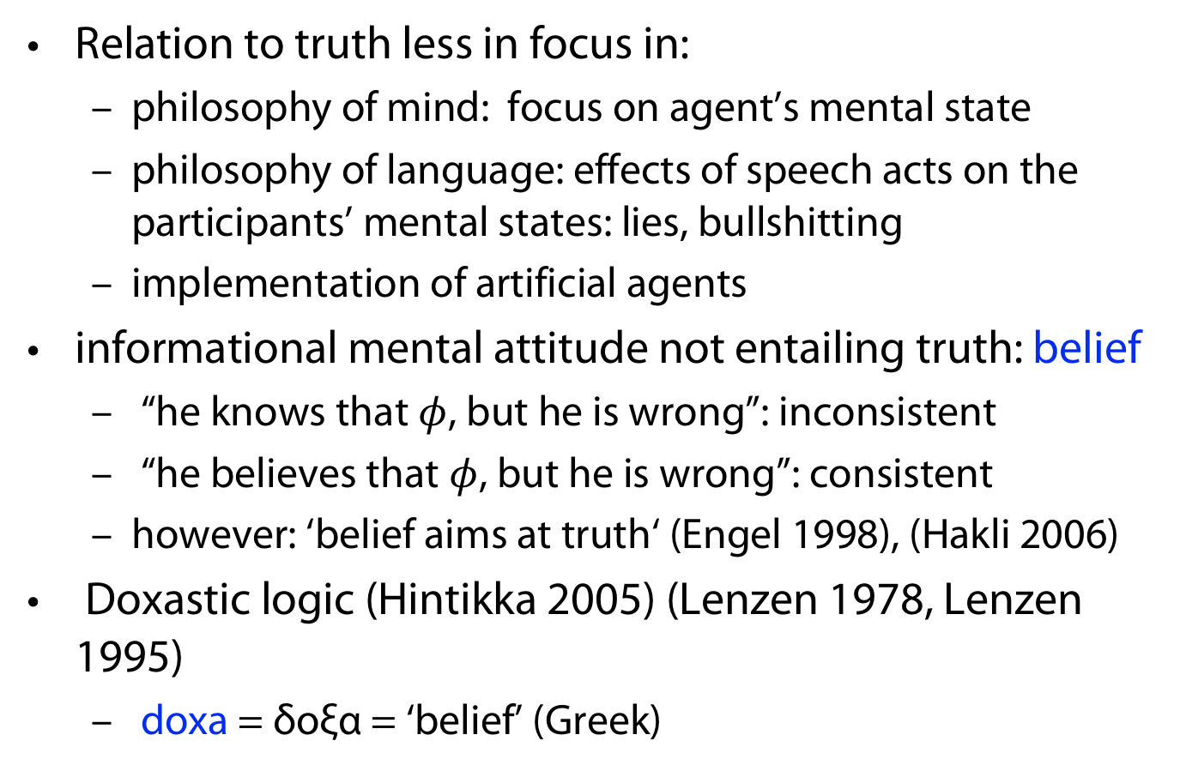
Truth
Relation to truth less in focus in:
  philosophy of mind: focus on agent’s mental state
  philosophy of language: effects of speech acts on the participants’ mental states: lies, bullshitting
  implementation of artificial agents
informational mental attitude not entailing truth: belief
  “he knows that $φ$, but he is wrong”: inconsistent
  “he believes that$φ$, but he is wrong”: consistent
  however: ‘belief aims at truth‘ (Engel 1998), (Hakli 2006)
Doxastic logic (Hintikka 2005) (Lenzen 1978, Lenzen 1995)
  doxa = δoξα = ‘belief’ (Greek)

Slide 6
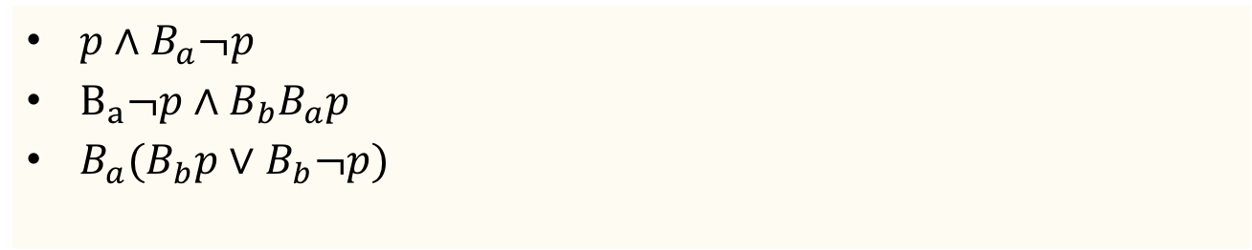
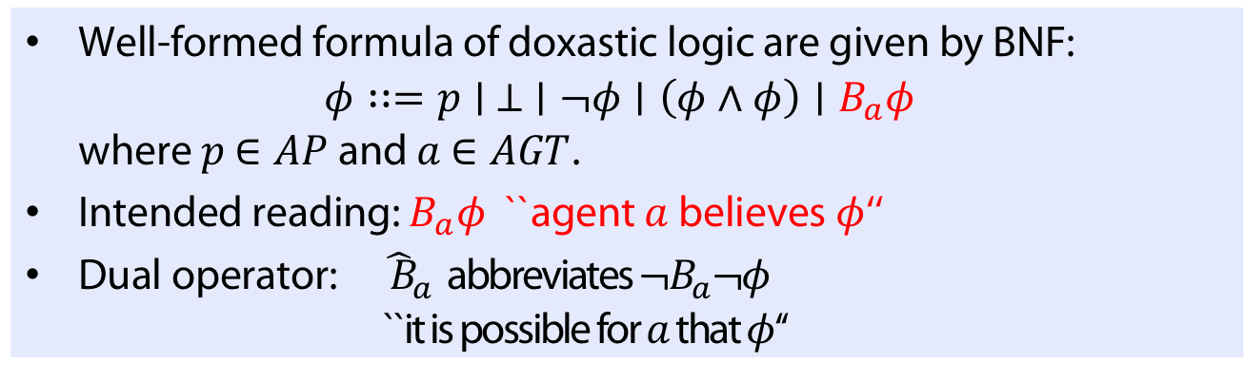
Definition (Syntax of Doxastic Logic: KD45n)
Well-formed formula of doxastic logic are given by BNF:
$φ∷=p∣ ⊥ ∣¬φ∣\left(φ∧φ\right)∣B_{a}φ$
where $p$ $∈AP$ and $a$ $∈AGT$.
Intended reading: $B_{a}φ$ ``agent $a$ believes $φ$‘‘
Dual operator: ${\hat{ B}}_{a}$ abbreviates $¬B_{a}¬φ$
``it is possible for $a$ that $φ$‘‘
Example
$p∧B_{a}¬p$
$B_{a}¬p∧B_{b}B_{a}p$
$B_{a}(B_{b}p∨B_{b}¬p)$

Slide 7
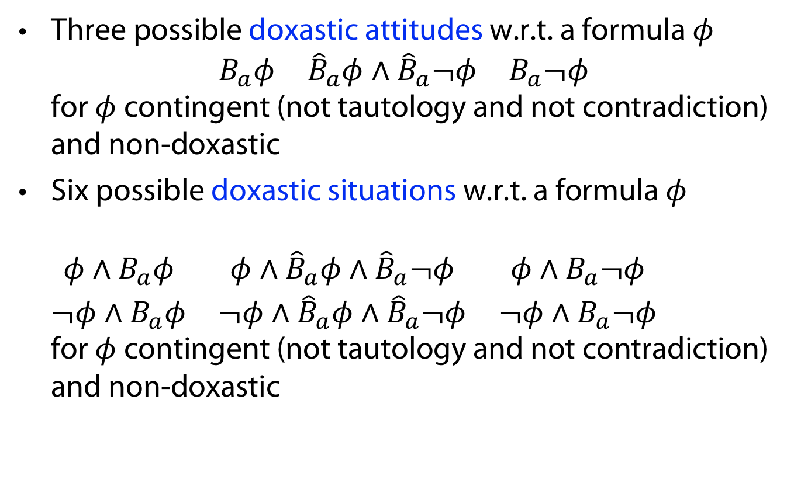
Doxastic attitudes and situations
Three possible doxastic attitudes w.r.t. a formula $φ$
$\begin{matrix}B_{a}φ & {\hat{B}}_{a}φ∧{\hat{B}}_{a}¬φ & B_{a}¬φ\end{matrix}$
for $φ$ contingent (not tautology and not contradiction) and non-doxastic
Six possible doxastic situations w.r.t. a formula $φ$
$\begin{matrix}{φ∧B}_{a}φ & {φ∧\hat{B}}_{a}φ∧{\hat{B}}_{a}¬φ & {φ∧B}_{a}¬φ \\ {¬φ∧B}_{a}φ & {¬φ∧\hat{B}}_{a}φ∧{\hat{B}}_{a}¬φ & {¬φ∧B}_{a}¬φ\end{matrix}$
for $φ$ contingent (not tautology and not contradiction) and non-doxastic

Slide 8
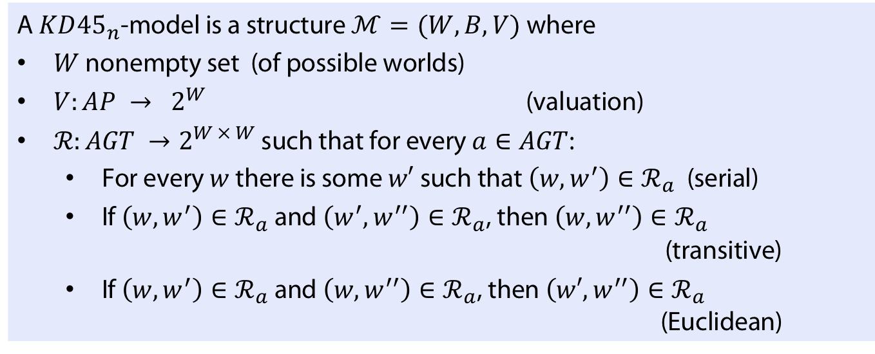
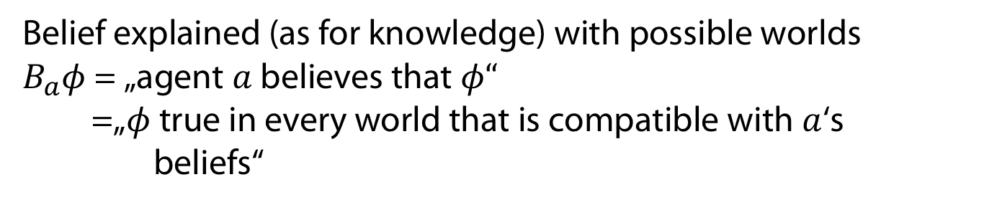
Semantics
Belief explained (as for knowledge) with possible worlds
$B_{a}φ$ = „agent $a$ believes that $φ“$
=„$φ$ true in every world that is compatible with $a$‘s
beliefs“
Definition (Models of KD45n)
A $KD{45}_{n}$-model is a structure$ℳ=(W,B,V)$ where
$W$ nonempty set (of possible worlds)
$V:AP → 2^{W}$ (valuation)
$ℛ:AGT →2^{W × W}$ such that for every $a∈AGT$:
  For every $w$ there is some $w′$ such that $\left(w,w^{′}\right)∈ℛ_{a}$ (serial)
  If $\left(w,w^{′}\right)∈ℛ_{a}$ and $\left(w^{′},w^{′′}\right)∈ℛ_{a}$, then $\left(w,w^{′′}\right)∈ℛ_{a}$ (transitive)
  If $\left(w,w^{′}\right)∈ℛ_{a}$ and $\left(w,w^{′′}\right)∈ℛ_{a}$, then $\left(w′,w^{′′}\right)∈ℛ_{a}$ (Euclidean)

Slide 9
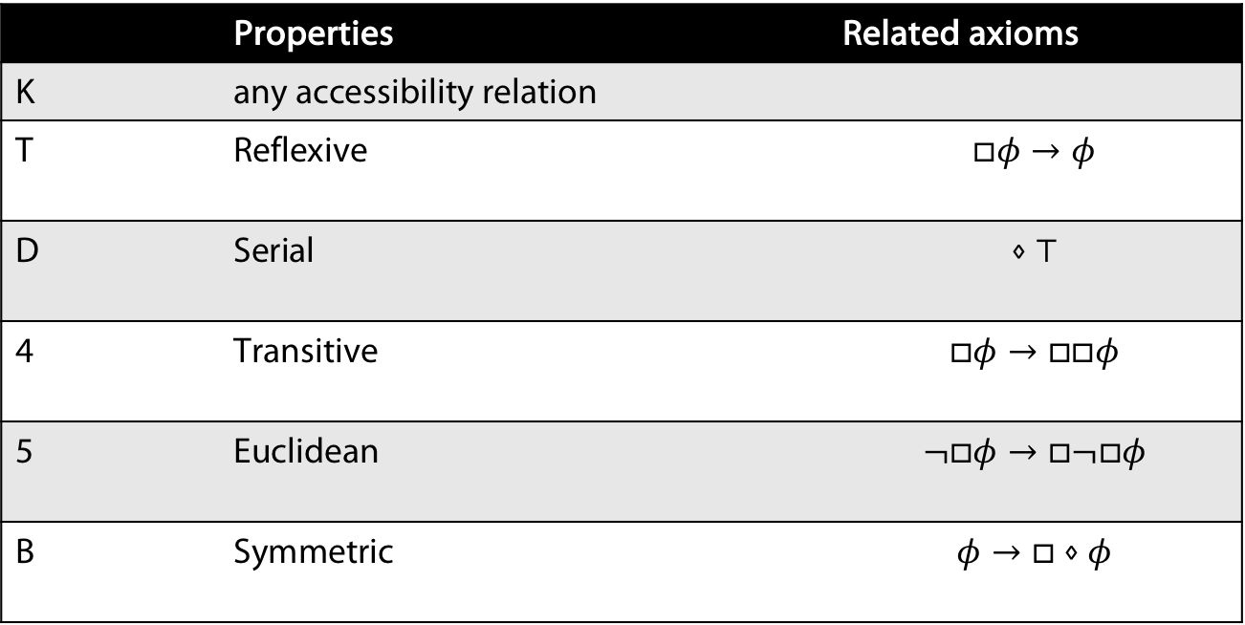
Reminder on notation
 | Properties | Related axioms
K | any accessibility relation
T | Reflexive | $$□φ→φ$$
D | Serial | $$⋄⊤$$
4 | Transitive | $$□φ→□□φ$$
5 | Euclidean | $$¬□φ→□¬□φ$$
B | Symmetric | $$φ→□⋄φ$$
Note that here we use the usual notation $□$ for a necessicity operator
and $⋄=¬□¬$ for its dual, the possibility operator
Notes:
Naming „Euclidean“ due to "Axiom 1" in Euclid's Elements: "Magnitudes which are equal to the same are equal to each other."

Slide 10
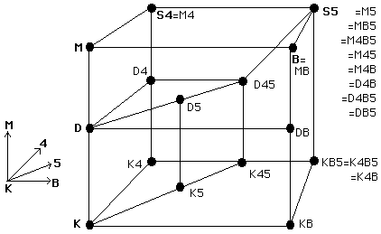
A picture of well known modal logics
https://plato.stanford.edu/entries/logic-modal/
Notation:
M is used for T (reflexivity)
M4B, e.g., is the result of adding M, 4 and B to K

Slide 11
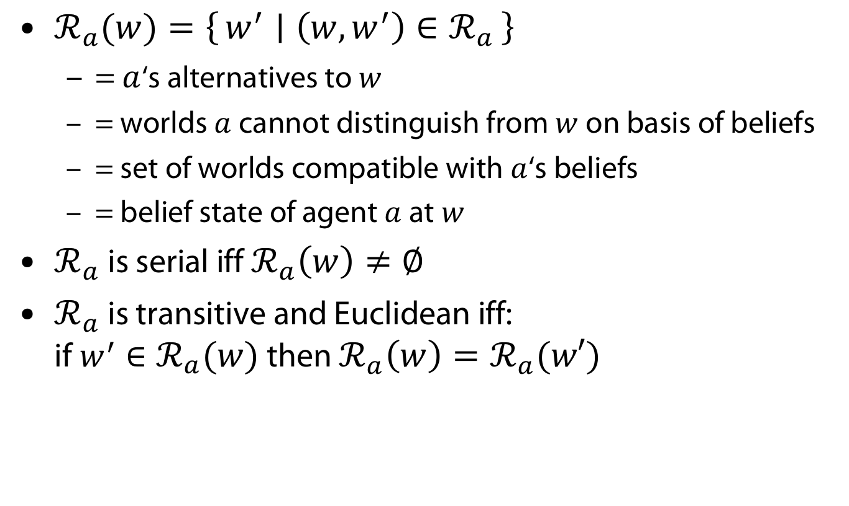
Some derived notions and observations
$ℛ_{a}(w)=\left\{w^{′} ∣ \left(w,w^{′}\right)∈ℛ_{a}\right\}$
  = $a$‘s alternatives to $w$
  = worlds $a$ cannot distinguish from $w$ on basis of beliefs
  = set of worlds compatible with $a$‘s beliefs
  = belief state of agent $a$ at $w$
$ℛ_{a}$ is serial iff $ℛ_{a}\left(w\right)≠∅$
$ℛ_{a}$ is transitive and Euclidean iff:
if $w^{′}∈ℛ_{a}(w)$ then $ℛ_{a}\left(w\right)=ℛ_{a}(w′)$
Definition (modellig relation in KD45n)
$ℳ,w⊨B_{a}φ$ iff$ℳ, w^{′}⊨φ$ for every $w^{′}∈ℛ_{a}(w)$

Slide 12








Example (Variant of muddy children (a, b) with beliefs)
Child $a$ wrongly believes it is not muddy
$$m_{a}$$
$$u$$
$$v$$
$$m_{a},m_{b}$$
$$w$$
$$s$$
$$m_{b}$$
$$R_{a}\left(v\right)=\left\{s\right\} \\ M, v⊨m_{a}∧B_{a} ¬m_{a}$$

Slide 13
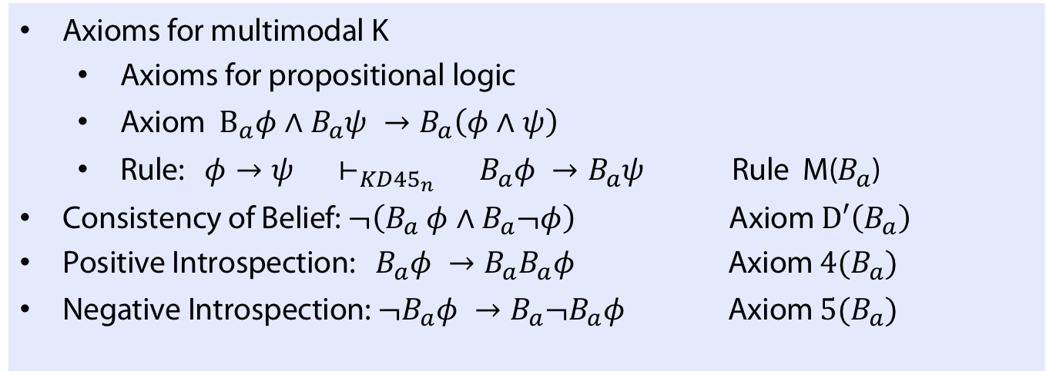
Axiomatics
Definition (A calculus for multimodal KD45n)
Axioms for multimodal K
  Axioms for propositional logic
  Axiom $B_{a}φ∧B_{a}ψ →B_{a}\left(φ∧ψ\right)$
  Rule: $φ→ψ ⊢_{KD{45}_{n}} B_{a}φ →B_{a}ψ$ Rule M($B_{a}$)
Consistency of Belief: $¬\left(B_{a} φ∧B_{a}¬φ\right)$ Axiom $D′\left(B_{a}\right)$
Positive Introspection: $B_{a}φ →B_{a}B_{a}φ$ Axiom $4(B_{a})$
Negative Introspection: $¬B_{a}φ →B_{a}¬B_{a}φ$ Axiom $5(B_{a})$
Note that we do NOT have the axiom for reflexivity (T)

Slide 14
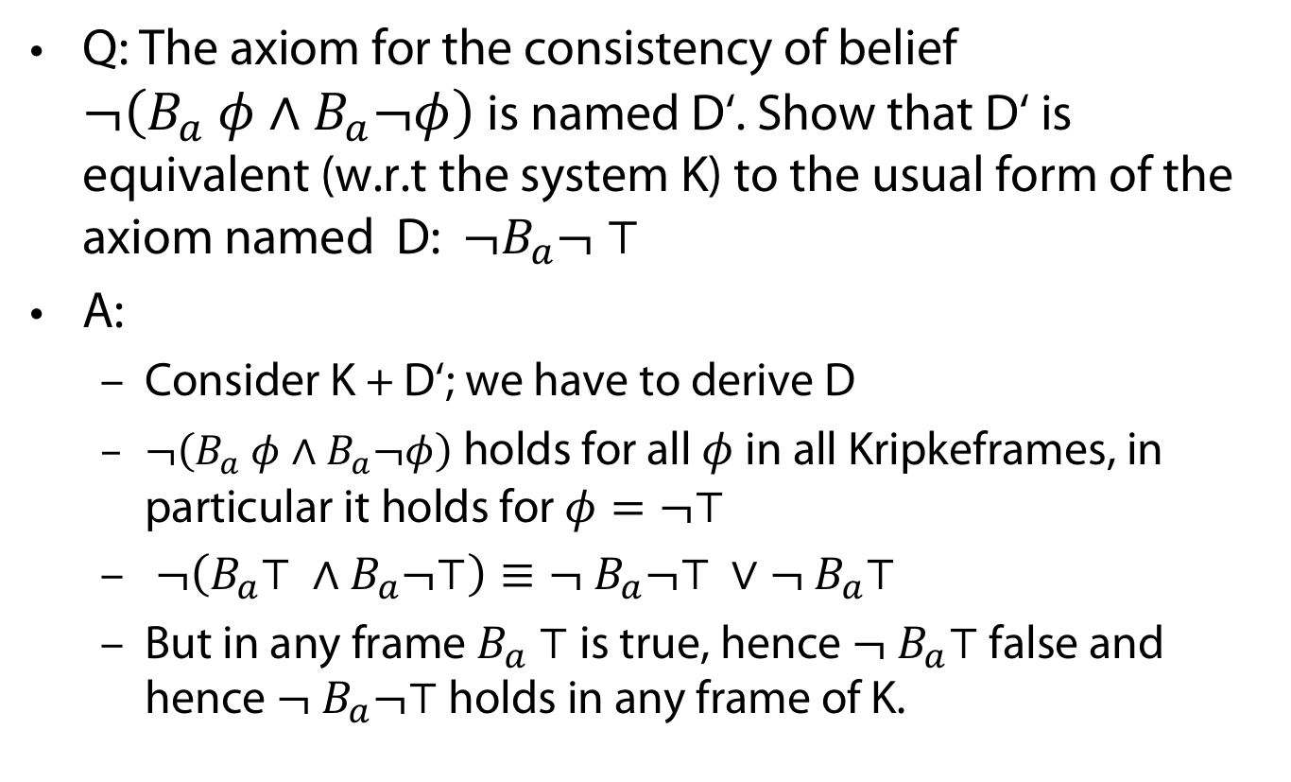
Wake-Up question
Q: The axiom for the consistency of belief
$¬\left(B_{a} φ∧B_{a}¬φ\right)$is named D‘. Show that D‘ is equivalent (w.r.t the system K) to the usual form of the axiom named D: $¬B_{a}¬ ⊤$
A:
  Consider K + D‘; we have to derive D
  $¬\left(B_{a} φ∧B_{a}¬φ\right)$ holds for all $φ$ in all Kripkeframes, in particular it holds for $φ=¬⊤$
  $¬\left(B_{a}⊤ ∧B_{a}¬⊤\right)≡¬ B_{a}¬⊤ ∨¬ B_{a}⊤$
  But in any frame $B_{a} ⊤$ is true, hence $¬ B_{a}⊤$ false and hence $¬ B_{a}¬⊤$ holds in any frame of K.

Slide 15
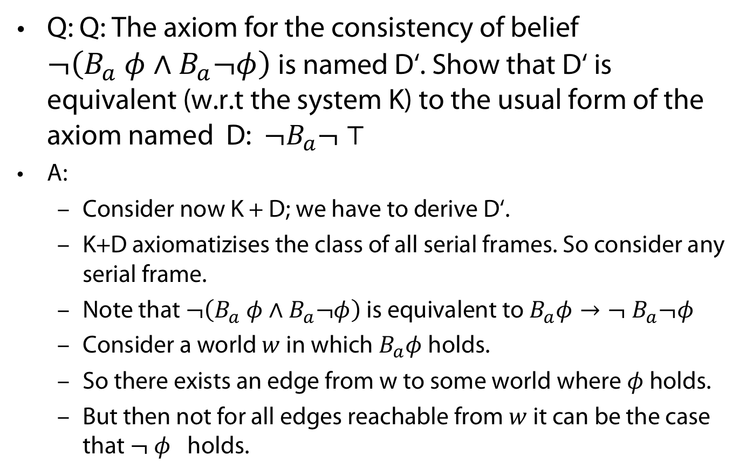
Wake-Up question
Q: Q: The axiom for the consistency of belief
$¬\left(B_{a} φ∧B_{a}¬φ\right)$is named D‘. Show that D‘ is equivalent (w.r.t the system K) to the usual form of the axiom named D: $¬B_{a}¬ ⊤$
A:
  Consider now K + D; we have to derive D‘.
  K+D axiomatizises the class of all serial frames. So consider any serial frame.
  Note that $¬\left(B_{a} φ∧B_{a}¬φ\right)$ is equivalent to $B_{a}φ→{¬ B}_{a}¬φ$
  Consider a world $w$ in which $B_{a}φ$ holds.
  So there exists an edge from w to some world where $φ$ holds.
  But then not for all edges reachable from $w$ it can be the case that $¬ φ$ holds.

Slide 16
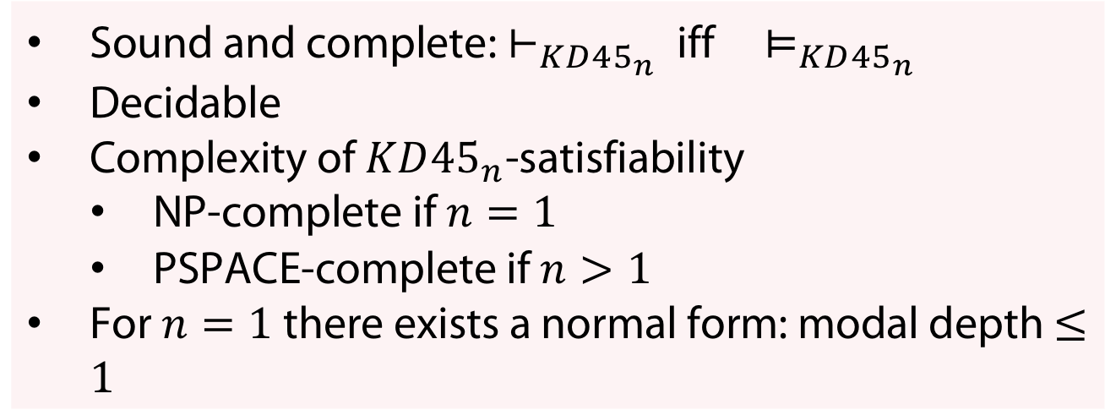
Axiomatics
Theorem (Properties of calculus)
Sound and complete: $⊢_{KD{45}_{n}}$ iff $⊨_{KD{45}_{n}}$
Decidable
Complexity of $KD{45}_{n}$-satisfiability
  NP-complete if $n=1$
  PSPACE-complete if $n>1$
For $n=1$ there exists a normal form: modal depth $≤1$

Slide 17
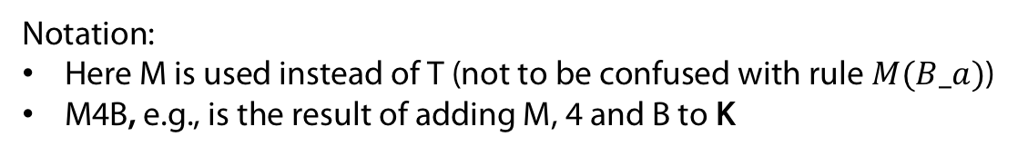
Logic of belief and Logic of knowledge
https://plato.stanford.edu/entries/logic-modal/
Notation:
Here M is used instead of T (not to be confused with rule $M(B_a)$)
M4B, e.g., is the result of adding M, 4 and B to K

Slide 18

Discussion: Omniscience problem
Closure of $B_{a}$ under inference (see only rule in calculus)
This is not realistic - in particular for ressource bounded agents.
(Negative) Introspection also criticised (Lenzen 78)

Slide 19
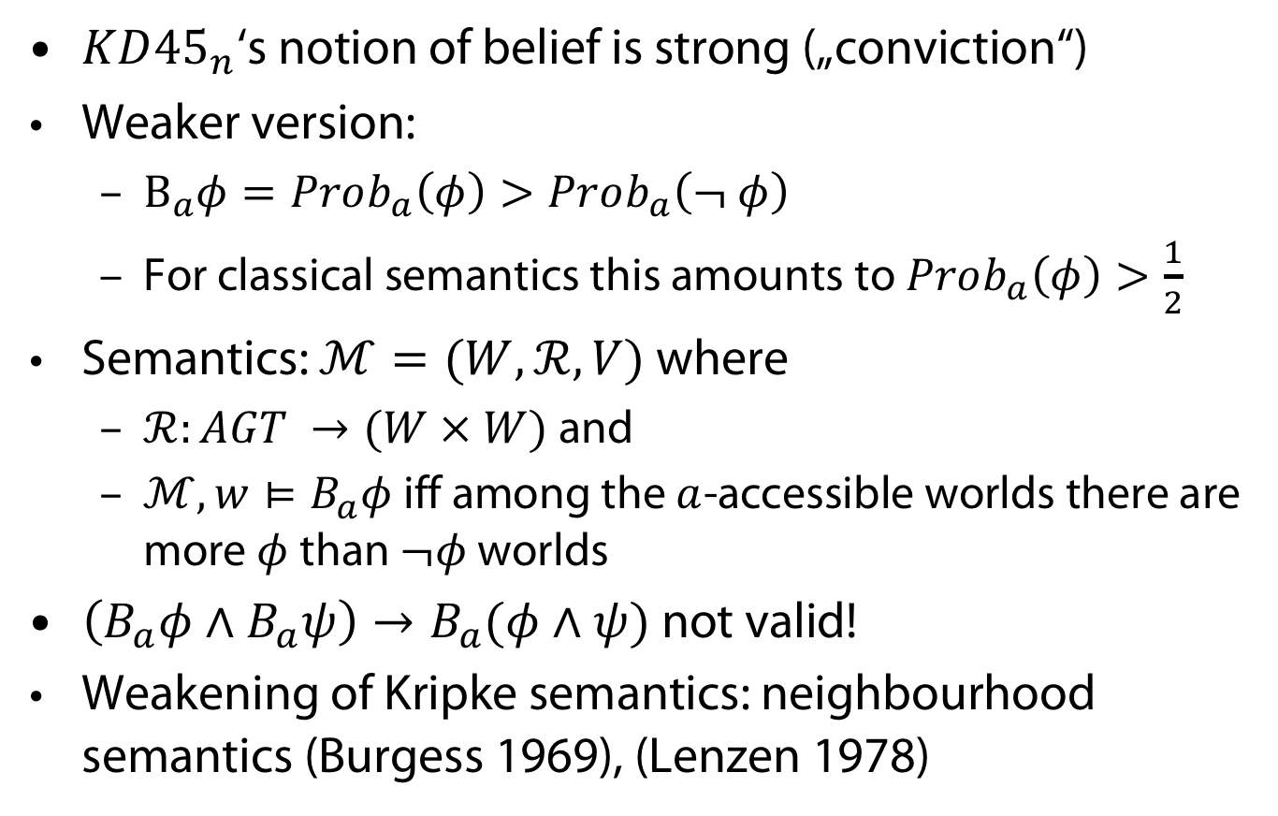
Discussion: belief and probability
$KD{45}_{n}$‘s notion of belief is strong („conviction“)
Weaker version:
  $B_{a}φ=Prob_{a}\left(φ\right)>Prob_{a}\left(¬ φ\right)$
  For classical semantics this amounts to $Prob_{a}\left(φ\right)>\frac{1}{2}$
Semantics: $ℳ=(W,ℛ, V)$ where
  $ℛ:AGT →(W × W)$ and
  $ℳ, w⊨B_{a}φ$ iff among the $a$-accessible worlds there are more $φ$ than $¬φ$ worlds
$\left(B_{a}φ∧B_{a}ψ\right)→B_{a}(φ∧ψ)$ not valid!
Weakening of Kripke semantics: neighbourhood semantics (Burgess 1969), (Lenzen 1978)

Slide 20
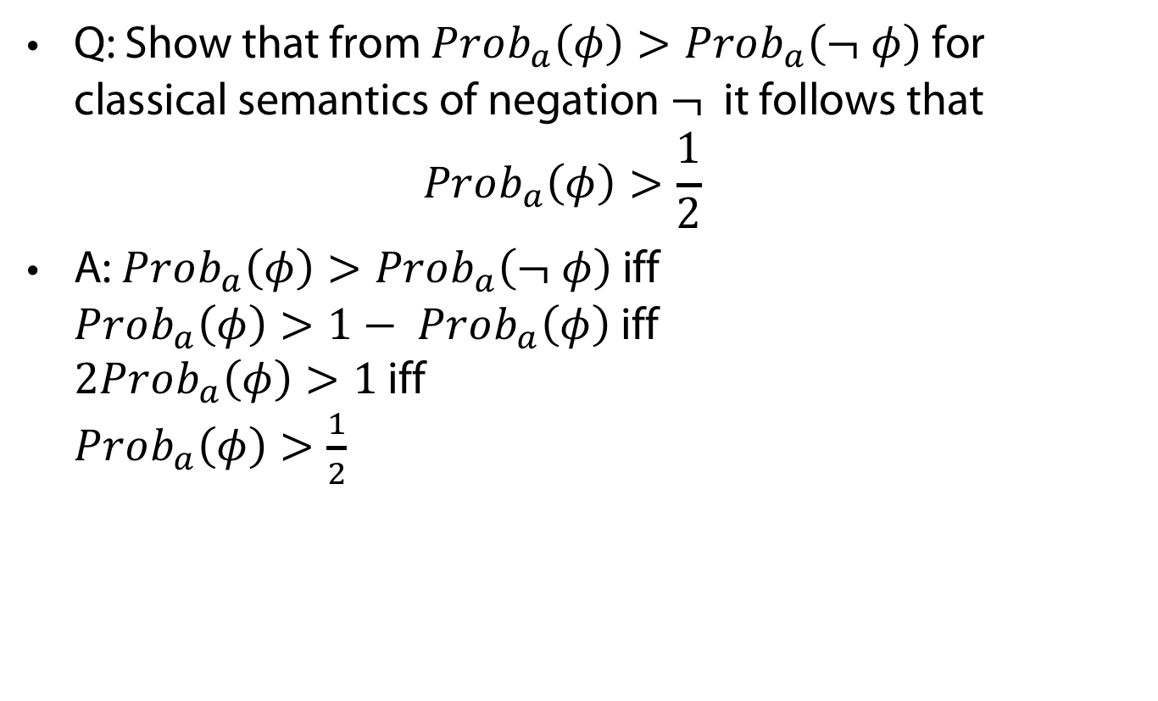
Wake-Up question
Q: Show that from $Prob_{a}\left(φ\right)>Prob_{a}\left(¬ φ\right)$ for classical semantics of negation $¬$ it follows that
$Prob_{a}\left(φ\right)>\frac{1}{2}$
A: $Prob_{a}\left(φ\right)>Prob_{a}\left(¬ φ\right)$ iff
$Prob_{a}\left(φ\right)>1− Prob_{a}\left(φ\right)$ iff
$2Prob_{a}\left(φ\right)>1$ iff
$Prob_{a}\left(φ\right)>\frac{1}{2}$

Slide 21


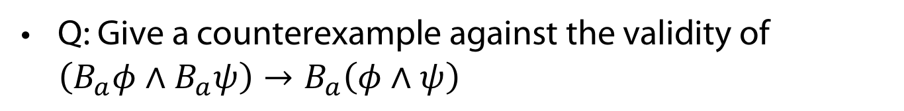



Wake-Up question
Q: Give a counterexample against the validity of $\left(B_{a}φ∧B_{a}ψ\right)→B_{a}\left(φ∧ψ\right)$
$$φ$$
$$φ$$
A:
$$φ,ψ$$
$$ψ$$
$$ψ$$

Slide 22
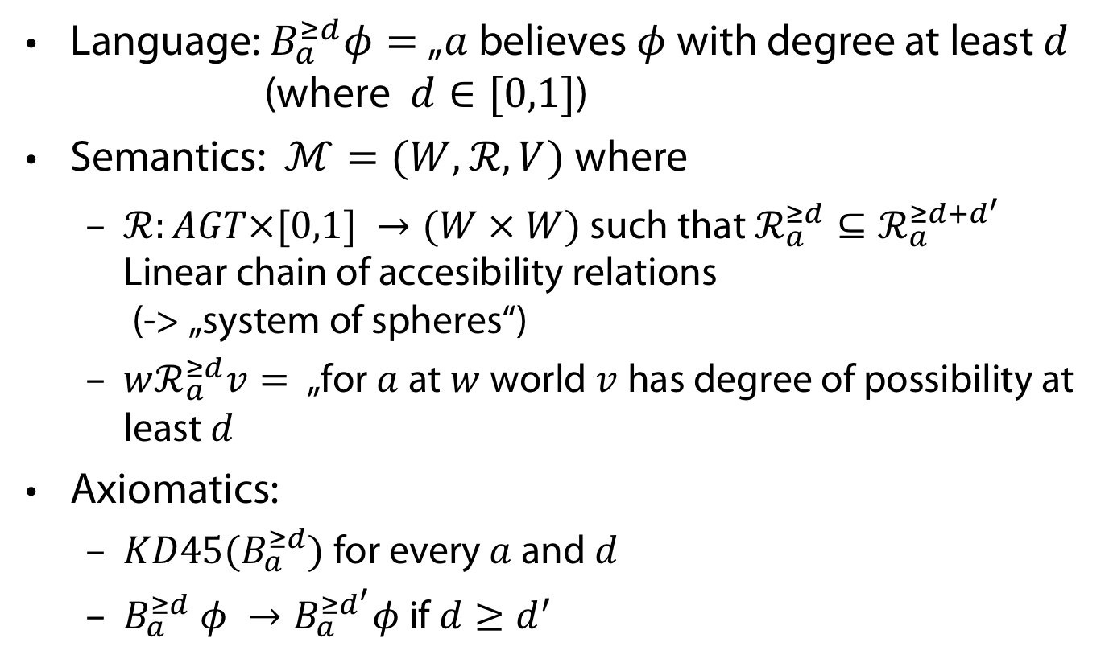
Discussion: Graded Belief
Language: $B_{a}^{≥d}φ=$„$a$ believes $φ$with degree at least $d$
(where $d∈[0,1]$)
Semantics: $ℳ=(W,ℛ, V)$ where
  $ℛ:AGT×[0,1] →(W × W)$ such that $ℛ_{a}^{≥d}{⊆ℛ}_{a}^{≥d+d^{′}}$
  Linear chain of accesibility relations
  (-> „system of spheres“)
  $wℛ_{a}^{≥d}v=$ „for $a$ at $w$world$v$ has degree of possibility at least $d$
Axiomatics:
  $KD45(B_{a}^{≥d})$ for every $a$ and $d$
  $B_{a}^{≥d} φ →B_{a}^{≥d^{′}}φ$if $d≥d^{′}$

Slide 23
Knowledge vs Belief

Slide 24
Logic of belief and knowledge ?
https://plato.stanford.edu/entries/logic-modal/

Slide 25
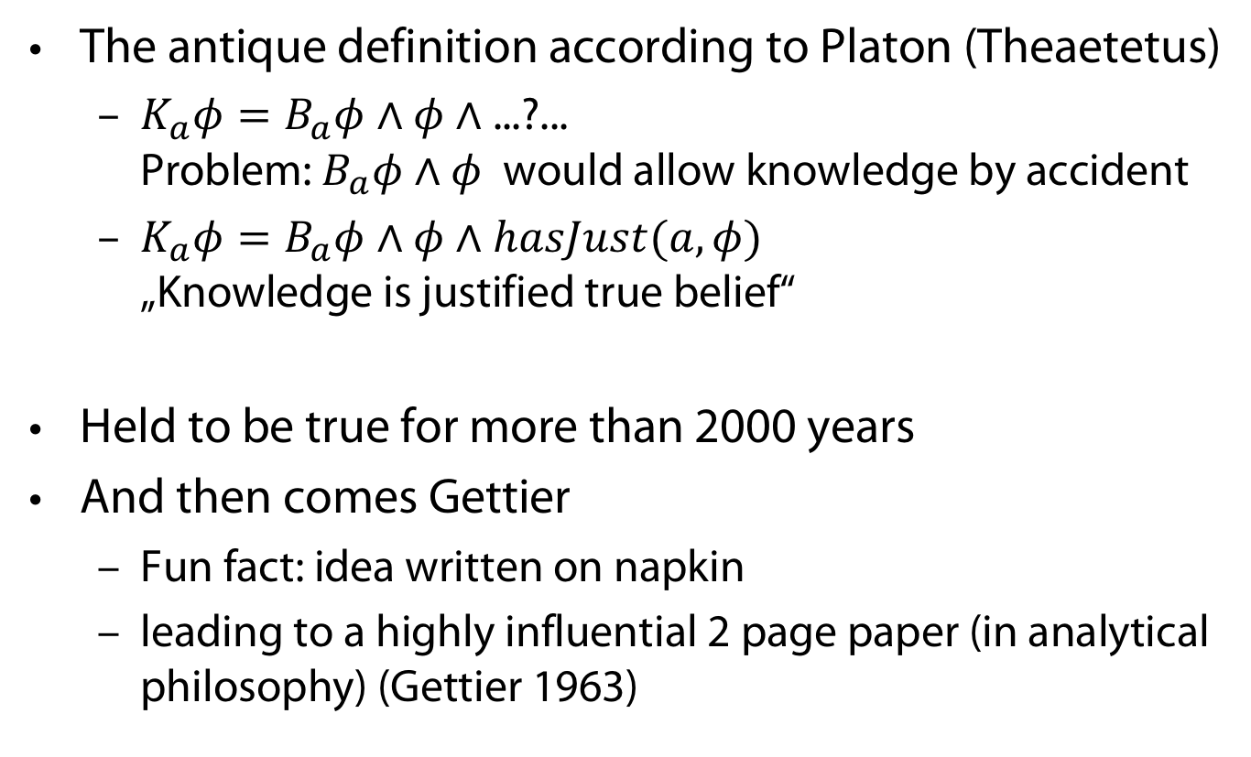
Can knowledge be defined from belief?
The antique definition according to Platon (Theaetetus)
  $K_{a}φ=B_{a}φ∧φ∧$ ...?...
  Problem: $B_{a}φ∧φ$ would allow knowledge by accident
  $K_{a}φ=B_{a}φ∧φ∧hasJust(a, φ)$
  „Knowledge is justified true belief“
Held to be true for more than 2000 years
And then comes Gettier
  Fun fact: idea written on napkin
  leading to a highly influential 2 page paper (in analytical philosophy) (Gettier 1963)

Slide 26
Gettiers two counterexamples
Scenario 1
Smith and Jones apply for a job
Smith believes (justifiably):
(p) Jones will get the Job &
Jones has ten coins in his pocket
Smith believes also in the entailed assertion:
(r) The one who gets the job has ten coins in his pocket.
Coincidence : Smith gets the job and Smith has ten coins in his pocket.
Smith „knew“ (r) only by chance
Scenario 2
Smith justifiably believes
(p) Jones owns a Ford
Smith also believes in entailed assertion
(r) = (p or q): Jones owns a Ford, or Brown lives in Barcelona
(Though Smith has no justification for q)
Coincidence: Jones does not own Ford, but Brown lives in Barcelona
Smith „knew“ (r) only by chance
General idea: decouple justification and truth conditions of propositional
content of belief

Slide 27
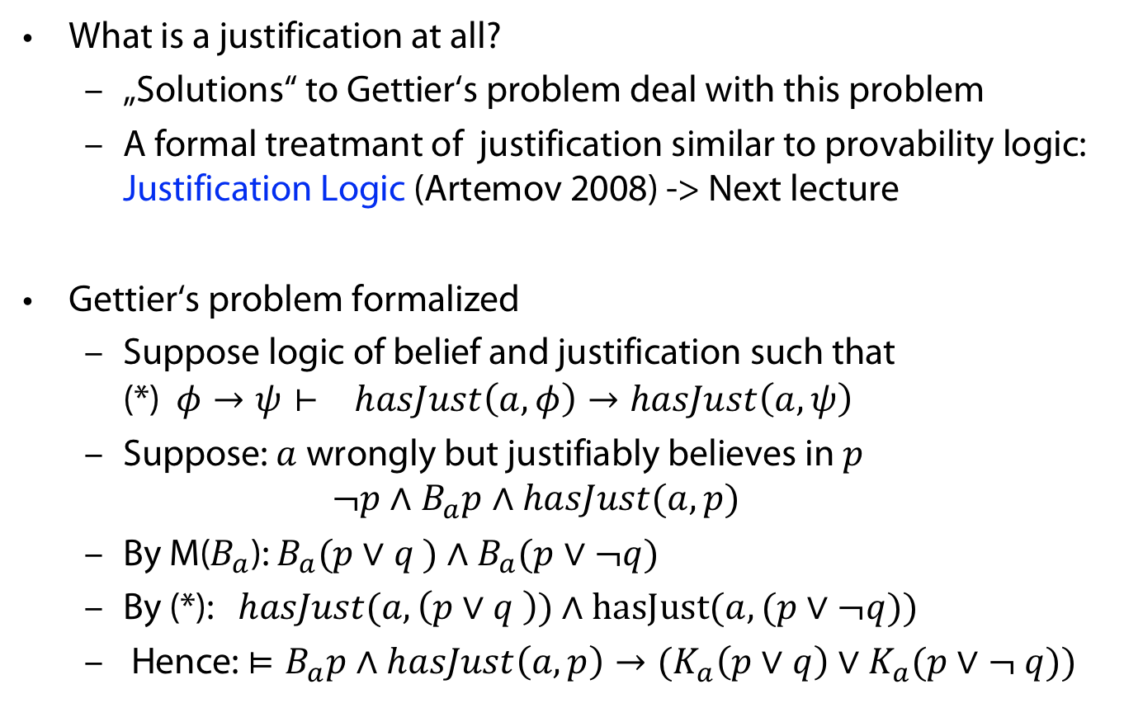
General remarks
What is a justification at all?
  „Solutions“ to Gettier‘s problem deal with this problem
  A formal treatmant of justification similar to provability logic: Justification Logic (Artemov 2008) -> Next lecture
Gettier‘s problem formalized
  Suppose logic of belief and justification such that
  (*) $φ→ψ⊢ hasJust\left(a,φ\right)→hasJust\left(a,ψ\right)$
  Suppose: $a$ wrongly but justifiably believes in $p$
  $¬p∧B_{a}p∧hasJust(a,p)$
  By M($B_{a}$): $B_{a}(p∨q )$ $∧$ $B_{a}(p∨¬q)$
  By (*): $hasJust(a,\left(p∨q \right))$ $∧$ $hasJust(a, (p∨¬q))$
  Hence: $⊨B_{a}p∧hasJust\left(a,p\right)→(K_{a}\left(p∨q\right)∨K_{a}(p∨¬ q))$

Slide 28
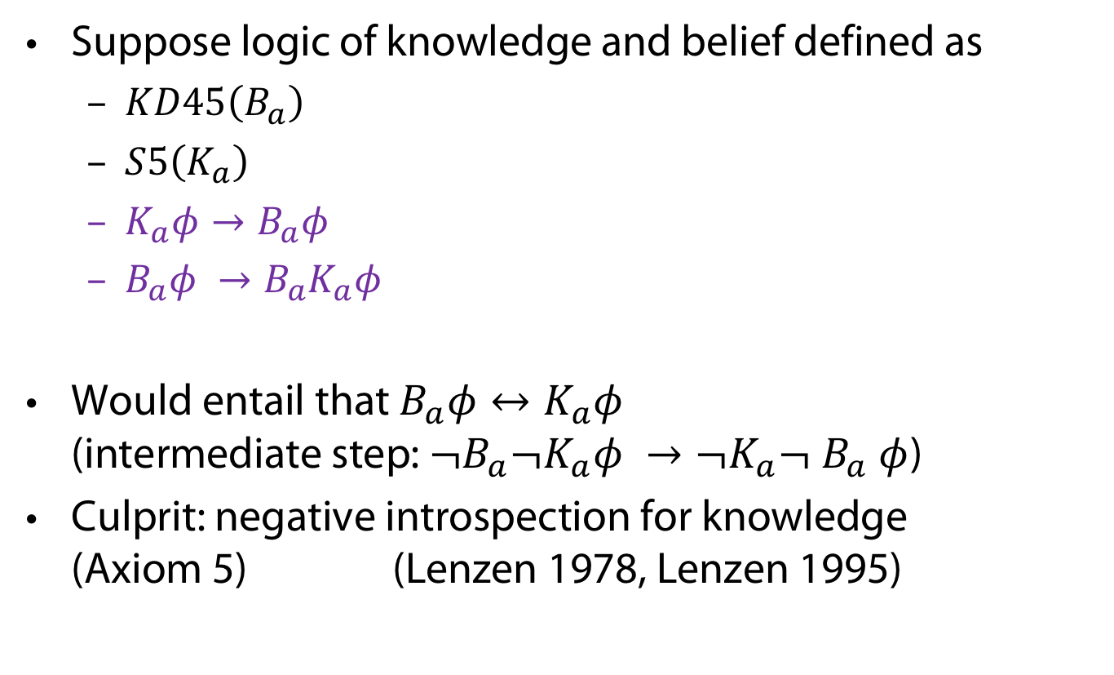
Relation of knowledge and belief not obvious
Suppose logic of knowledge and belief defined as
  $KD45\left(B_{a}\right)$
  $S5\left(K_{a}\right)$
  $K_{a}φ→B_{a}φ$
  $B_{a}φ →B_{a}K_{a}φ$
Would entail that $B_{a}φ↔K_{a}φ$
(intermediate step: $¬B_{a}¬K_{a}φ →¬K_{a}¬ B_{a} φ$)
Culprit: negative introspection for knowledge
(Axiom 5) (Lenzen 1978, Lenzen 1995)

Slide 29
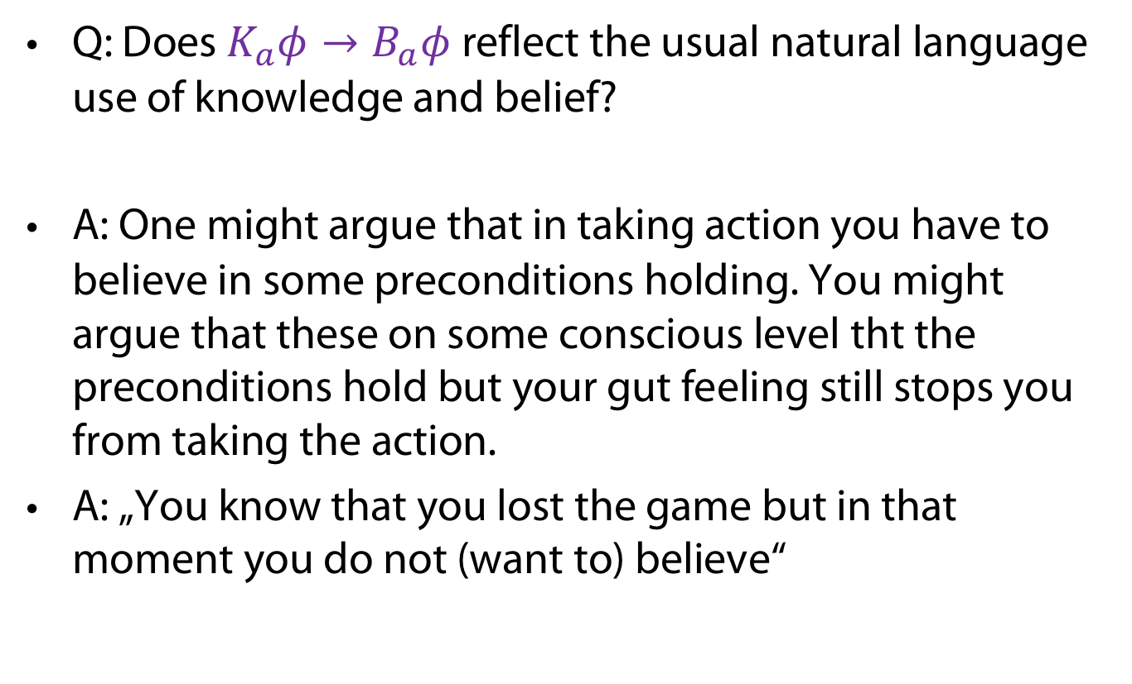
Wake-Up Question
Q: Does $K_{a}φ→B_{a}φ$ reflect the usual natural language use of knowledge and belief?
A: One might argue that in taking action you have to believe in some preconditions holding. You might argue that these on some conscious level tht the preconditions hold but your gut feeling still stops you from taking the action.
A: „You know that you lost the game but in that moment you do not (want to) believe“

Slide 30
Dynamics of Belief

Slide 31
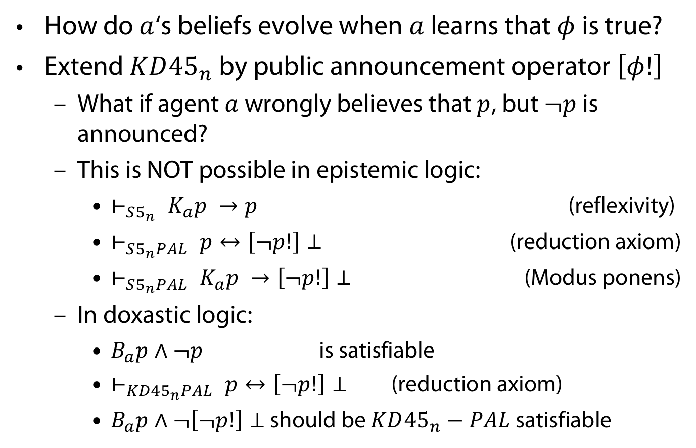
Getting dynamic with beliefs
How do $a$‘s beliefs evolve when $a$ learns that $φ$ is true?
Extend $KD{45}_{n}$ by public announcement operator $\left[φ!\right]$
  What if agent $a$ wrongly believes that $p$, but $¬p$ is announced?
  This is NOT possible in epistemic logic:
    $⊢_{S5_{n}} K_{a}p →p$ (reflexivity)
    $⊢_{S5_{n}PAL} p↔\left[¬p!\right]⊥$ (reduction axiom)
    $⊢_{S5_{n}PAL} K_{a}p →\left[¬p!\right]⊥$ (Modus ponens)
  In doxastic logic:
    $B_{a}p∧¬p$ is satisfiable
    $⊢_{KD45_{n}PAL} p↔\left[¬p!\right]⊥$ (reduction axiom)
    $B_{a}p∧¬\left[¬p!\right]⊥$ should be $KD{45}_{n}−PAL$ satisfiable

Slide 32
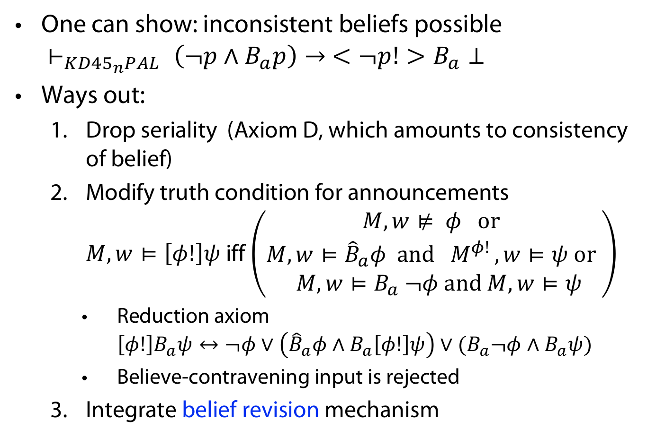
But in doxastic logic dynamics not trivial
One can show: inconsistent beliefs possible
$⊢_{KD45_{n}PAL} \left(¬p∧B_{a}p\right)→ <¬p!>B_{a}⊥$
Ways out:
  Drop seriality (Axiom D, which amounts to consistency of belief)
  Modify truth condition for announcements
  $M, w⊨\left[φ!\right]ψ$ iff $\left(\begin{aligned}M,w⊭ φ or \\ M,w⊨{\hat{B}}_{a}φ and { M}^{φ! }, w⊨ψ or \\ M,w⊨B_{a} ¬φ and M,w⊨ψ\end{aligned}\right)$
    Reduction axiom
    $\left[φ!\right]B_{a}ψ↔¬φ∨\left({\hat{B}}_{a}φ∧B_{a}\left[φ!\right]ψ\right)∨(B_{a}¬φ∧B_{a}ψ)$
    Believe-contravening input is rejected
  Integrate belief revision mechanism

Slide 33
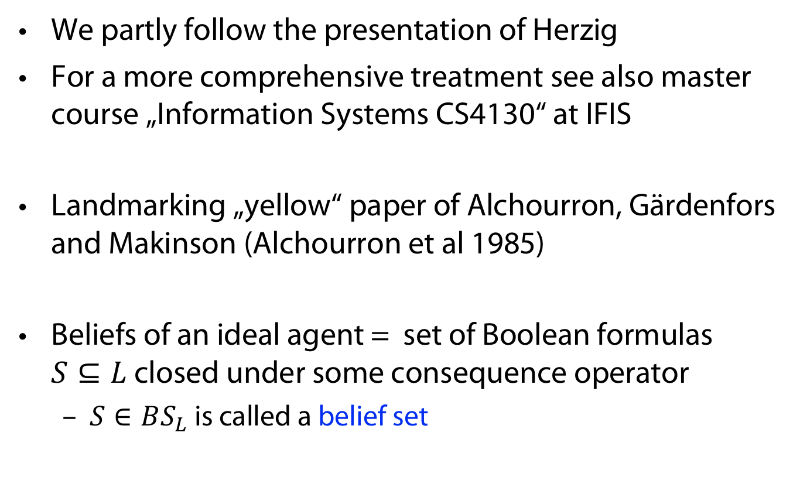
Classical theory of Belief Revision
We partly follow the presentation of Herzig
For a more comprehensive treatment see also master course „Information Systems CS4130“ at IFIS
Landmarking „yellow“ paper of Alchourron, Gärdenfors and Makinson (Alchourron et al 1985)
Beliefs of an ideal agent = set of Boolean formulas
$S⊆L$ closed under some consequence operator
  $S∈BS_{L}$ is called a belief set

Slide 34
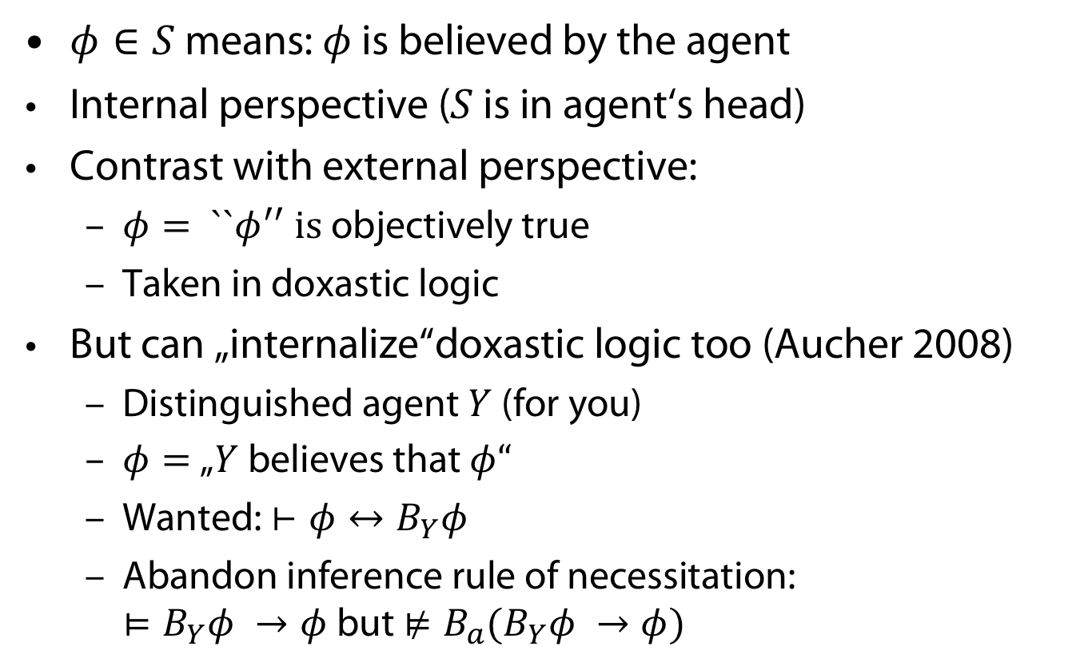
AGM takes an internal perspective
$φ∈S$ means: $φ$ is believed by the agent
Internal perspective ($S$ is in agent‘s head)
Contrast with external perspective:
  $φ= ``φ^{′′} is$ objectively true
  Taken in doxastic logic
But can „internalize“doxastic logic too (Aucher 2008)
  Distinguished agent $Y$ (for you)
  $φ=$„$Y$ believes that $φ“$
  Wanted: $⊢φ↔B_{Y}φ$
  Abandon inference rule of necessitation:
  $⊨B_{Y}φ →φ$ but $⊭B_{a}(B_{Y}φ →φ)$

Slide 35
Coherentism vs foundationalism
Two general approaches in epistemology
Foundationalism:
  All beliefs rest on some basic beliefs (which do not rest by themselves on others, but are assume to be true
  Some tribute to foundationalism in post AGM-work: Belief bases are (arbitrary not necessarily closed) usually finite sets of sentences
Coherentism:
  Beliefs are justified by their relations (consequence, justification..) to other beliefs in a network
  Usually there is no notion of truth
  AGM considers closed sets of beliefs based on a consequence operator (logic not based on a semantics)

Slide 36
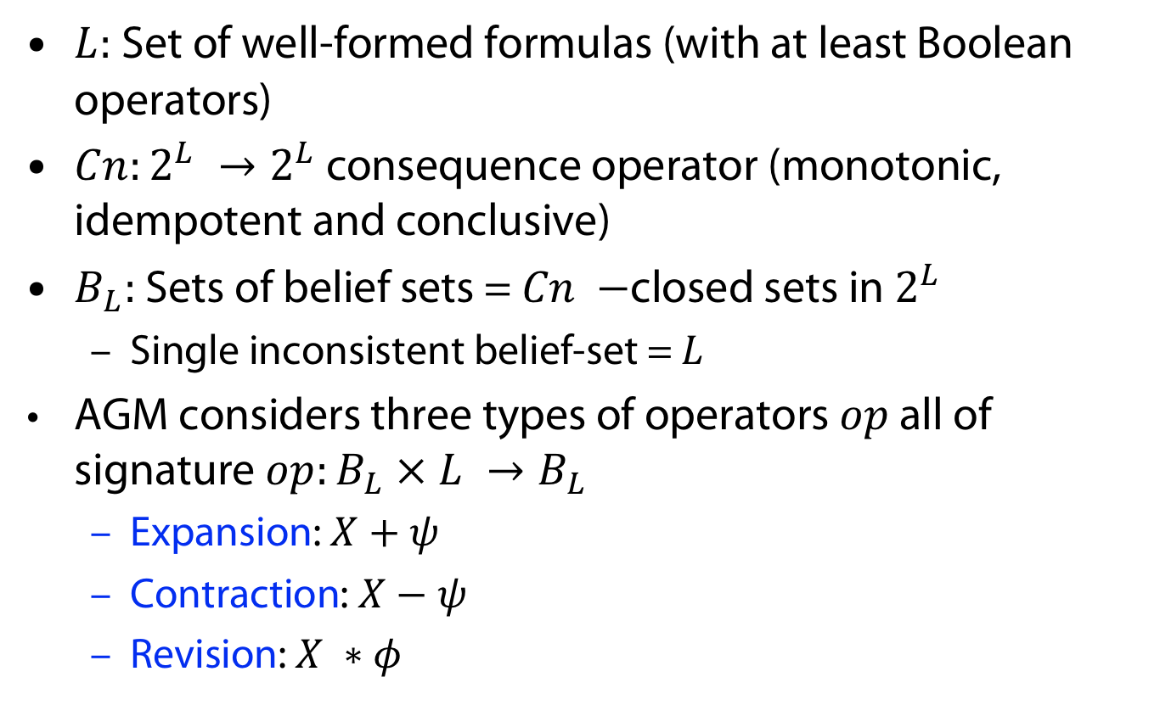
Types of Belief Change
$L:$ Set of well-formed formulas (with at least Boolean operators)
$Cn:2^{L} →2^{L}$ consequence operator (monotonic, idempotent and conclusive)
$B_{L}:$ Sets of belief sets = $Cn −$closed sets in $2^{L}$
  Single inconsistent belief-set = $L$
AGM considers three types of operators $op$ all of signature $op:B_{L} × L →B_{L}$
  Expansion: $X+ψ$
  Contraction: $X−ψ$
  Revision: $X ∗φ$

Slide 37
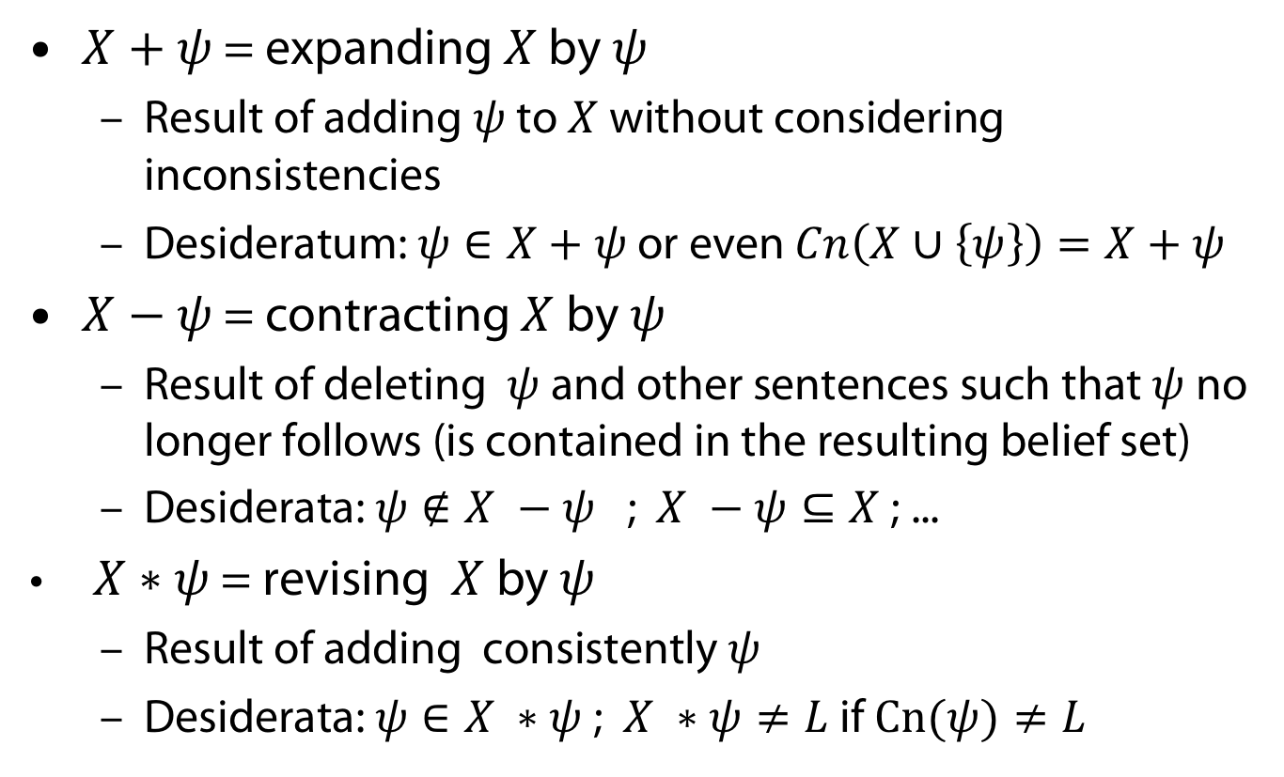
Types of Belief Change
$X+ψ$ = expanding $X$ by $ψ$
  Result of adding $ψ$ to $X$ without considering inconsistencies
  Desideratum: $ψ∈X+ψ$ or even $Cn\left(X∪\left\{ψ\right\}\right)=X+ψ$
$X−ψ$ = contracting $X$ by $ψ$
  Result of deleting $ψ$ and other sentences such that $ψ$ no longer follows (is contained in the resulting belief set)
  Desiderata: $ψ∉X −ψ$ ; $X −ψ⊆X$ ; ...
$X∗ψ$ = revising $X$ by $ψ$
  Result of adding consistently $ψ$
  Desiderata: $ψ∈X ∗ψ$; $X ∗ψ≠L$if $Cn(ψ)≠L$

Slide 38
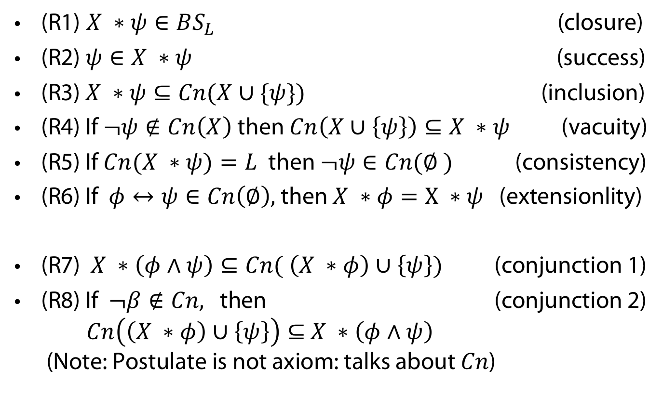
Desiderata captured by AGM postulates
(here for revision)
(R1) $X ∗ψ∈BS_{L}$ (closure)
(R2)$ψ∈X ∗ψ$ (success)
(R3) $X ∗ψ⊆Cn(X∪\{ψ\})$ (inclusion)
(R4) If $¬ψ∉Cn\left(X\right)$ then $Cn\left(X∪\left\{ψ\right\}\right)⊆X ∗ψ$ (vacuity)
(R5) If $Cn(X ∗ψ)=L$ then $¬ψ∈Cn(∅ )$ (consistency)
(R6) If $φ↔ψ∈Cn\left(∅\right),$ then $X ∗φ=X ∗ψ$ (extensionlity)
(R7) $X ∗\left(φ∧ψ\right)⊆Cn( \left(X ∗φ\right)∪\left\{ψ\right\})$ (conjunction 1)
(R8) If $¬β∉Cn,$ then (conjunction 2)
$Cn\left(\left(X ∗φ\right)∪\left\{ψ\right\}\right)⊆$ $X ∗\left(φ∧ψ\right)$
(Note: Postulate is not axiom: talks about $Cn$)

Slide 39
Semantics for AGM
Postulates generally specify whole classes of operators (exception: expansion)
How to construct concrete change operators?
Different design principles
  Partial meet based on remainder sets (considered here)
  Orders (epistremic entrenchment)
  Systems of spheres
  ...

Slide 40
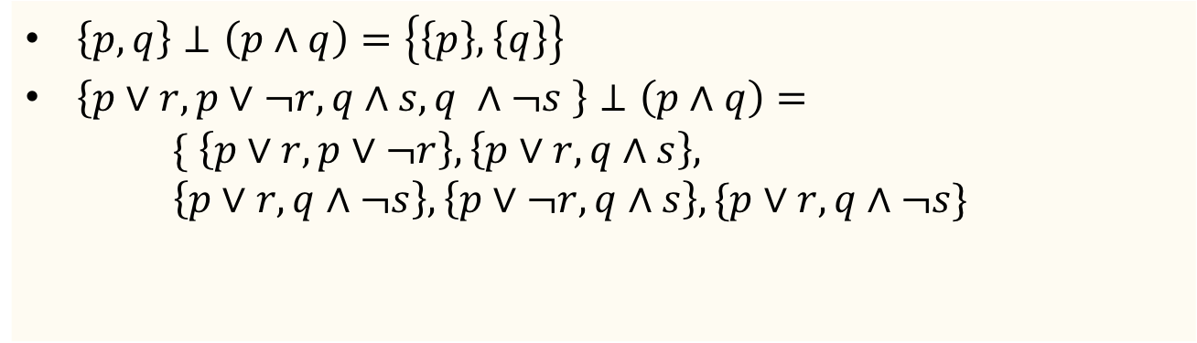
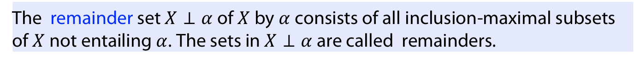
Remainder Sets: „Maximal Scenarios“
Definition (remainder set)
The remainder set $X⊥α$ of $X$ by $α$ consists of all inclusion-maximal subsets of $X$ not entailing $α$. The sets in $X⊥α$ are called remainders.
Example
$\left\{p,q\right\}⊥\left(p∧q\right)=\left\{\left\{p\right\}, \left\{q\right\}\right\}$
$\left\{p∨r, p∨¬r, q∧s, q ∧¬s \right\}⊥\left(p∧q\right)=$
$\{ \left\{p∨r, p∨¬r\right\},\left\{p∨r,q∧s\right\},$
$\left\{p∨r, q∧¬s\right\},\left\{p∨¬r, q∧s\right\},\{p∨r, q∧¬s\}$

Slide 41
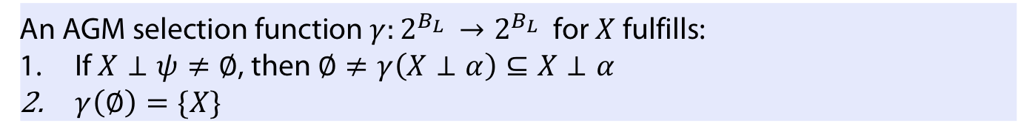
Selection function
Definition (selection function)
An AGM selection function $γ:2^{B_{L} }→2^{B_{L}}$ for $X$ fulfills:
If $X⊥ψ≠∅$, then $∅≠γ\left(X⊥α\right)⊆X⊥α$
$γ\left(∅\right)=\{X\}$
As there are many remainders (maximal scenarios) we need to select
some of them as possible
Chooses some remainders (if not empty).

Slide 42
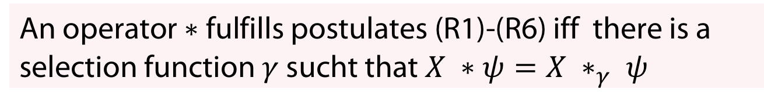
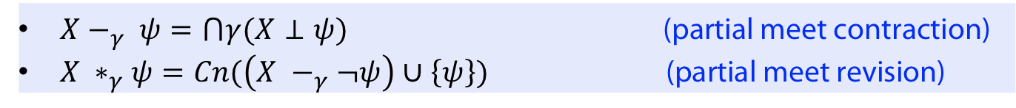
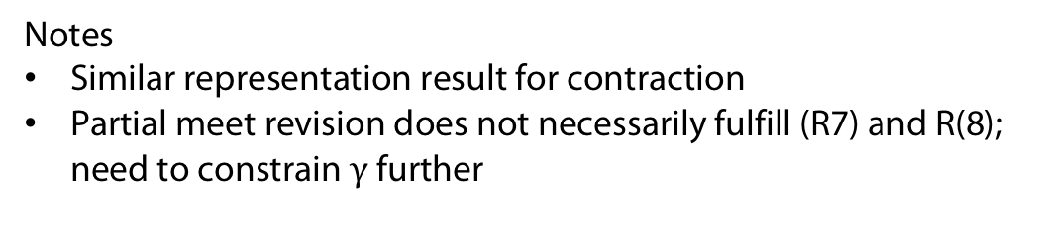
Partial-Meet contraction and revision
Definition
$X−_{γ} ψ=⋂γ(X⊥ψ)$ (partial meet contraction)
$X ∗_{γ}ψ=Cn(\left(X −_{γ}¬ψ\right)∪\left\{ψ\right\})$ (partial meet revision)
Revision operator defined here by so-called Levi-identity from contraction
Theorem (Representation)
An operator $∗$ fulfills postulates (R1)-(R6) iff there is a selection function $γ$ sucht that $X ∗ψ=X ∗_{γ} ψ$
Notes
Similar representation result for contraction
Partial meet revision does not necessarily fulfill (R7) and R(8);
need to constrain $γ$ further

Slide 43
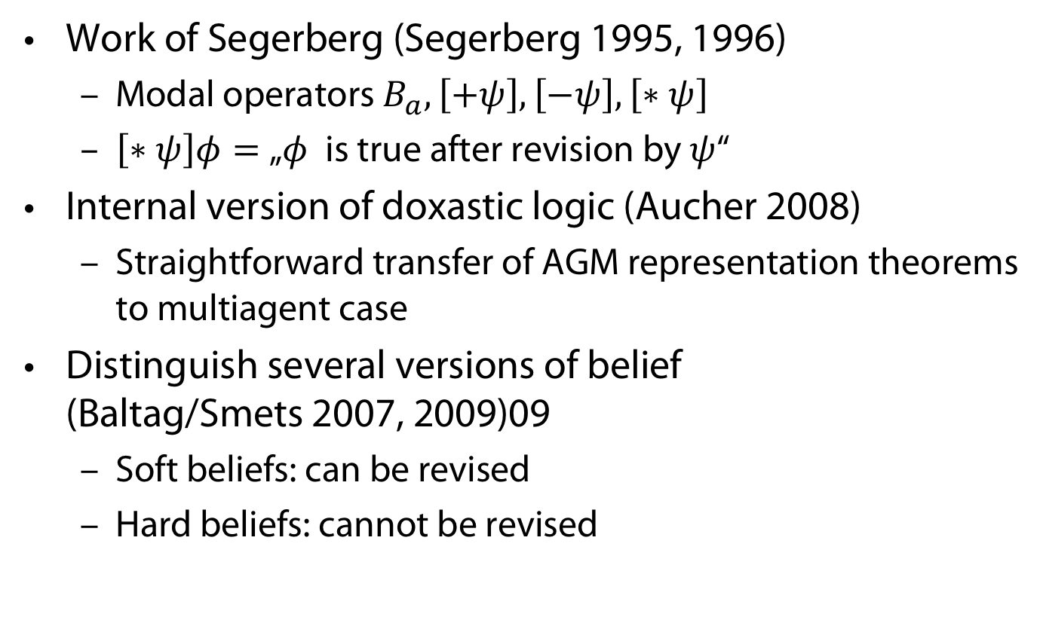
AGM: integration with doxastic logic
Work of Segerberg (Segerberg 1995, 1996)
  Modal operators $B_{a}, \left[+ψ\right], \left[−ψ\right], \left[∗ψ\right]$
  $\left[∗ψ\right]φ=$„$φ$ is true after revision by $ψ$“
Internal version of doxastic logic (Aucher 2008)
  Straightforward transfer of AGM representation theorems to multiagent case
Distinguish several versions of belief
(Baltag/Smets 2007, 2009)09
  Soft beliefs: can be revised
  Hard beliefs: cannot be revised

Slide 44
Group Beliefs

Slide 45
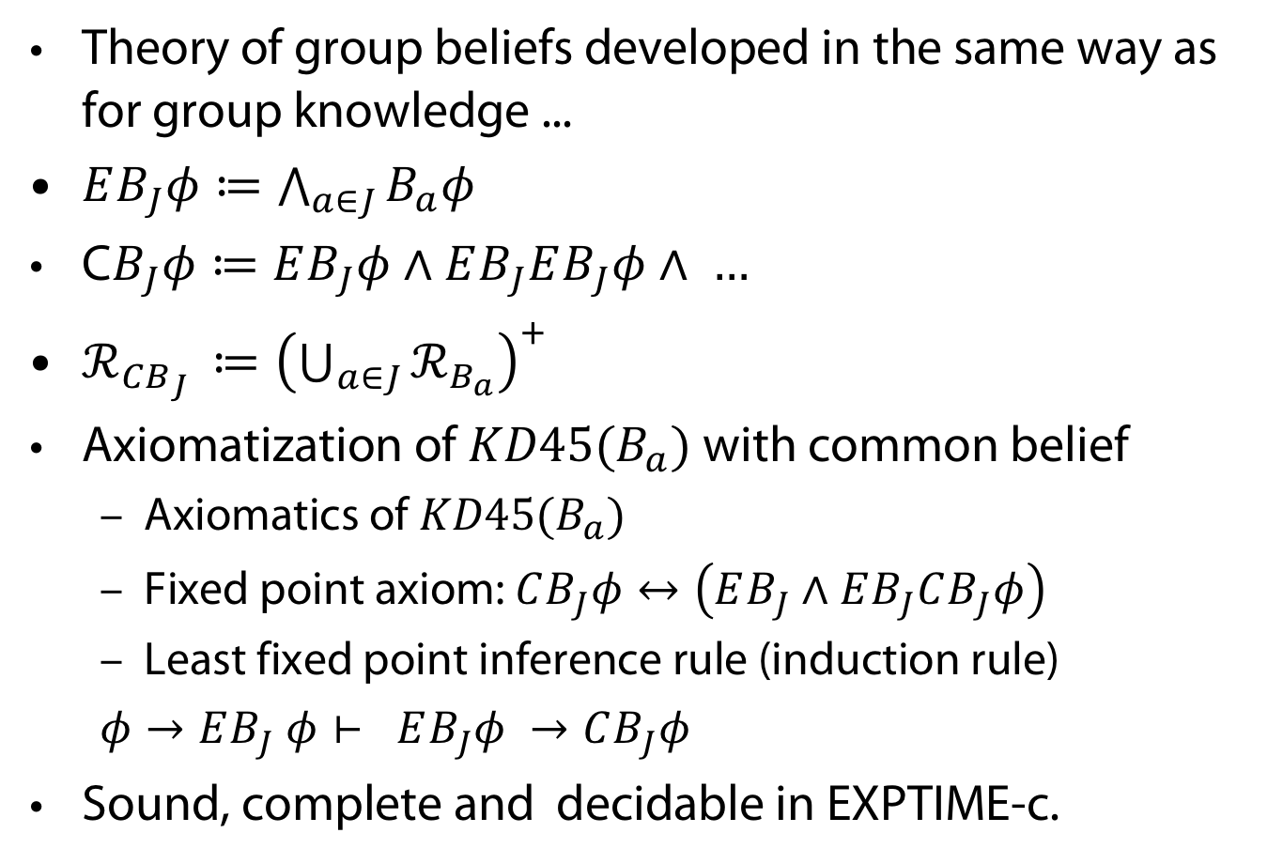
Group beliefs
Theory of group beliefs developed in the same way as for group knowledge ...
$EB_{J}φ≔\bigwedge_{a∈J}{B_{a}φ}$
C$B_{J}φ≔EB_{J}φ∧EB_{J}EB_{J}φ∧ …$
$ℛ_{CB_{J} }≔{\left(\bigcup_{a∈J}{ℛ_{B_{a}}}\right)}^{+}$
Axiomatization of $KD45(B_{a})$ with common belief
  Axiomatics of $KD45(B_{a})$
  Fixed point axiom: $CB_{J}φ↔\left(EB_{J}∧EB_{J}CB_{J}φ\right)$
  Least fixed point inference rule (induction rule)
  $φ→EB_{J} φ⊢ EB_{J}φ →CB_{J}φ$
Sound, complete and decidable in EXPTIME-c.

Slide 46
APPENDIX
Uhhh, a lecture with a hoepfully useful

Slide 47
References
R. Fagin, J. Y. Halpern, Y. Moses, and M. Y. Vardi. Reasoning about Knowledge. MIT Press, 2003.
P. Engel. Believing, holding true, and accepting. Philosophical Explorations, 1(2):140–151, 1998.
R. Hakli. Group beliefs and the distinction between belief and acceptance. Cognitive Systems Research, 7:286–297, 2006. J. Hintikka. Knowledge and Belief: An Introduction to the Logic of the Two Notions. Texts in philosophy. King’s College London Publications, 2005.
W. Lenzen. Recent work in epistemic logic. Acta Philosophica Fennica, 30:1–219, 1978.
W. Lenzen. On the semantics and pragmatics of epistemic attitudes. Knowledge and belief in philosophy and AI, pages 181–197, 1995.
J. P. Burgess. Probability logic. Journal of Symbolic Logic, 34(2):264–274, 1969.
E. L. Gettier. Is Justified True Belief Knowledge? Analysis, 23(6):121–123, 06 1963.
S. Artemov. The logic of justification. The Review of Symbolic Logic, 1(4):477–513, 2008.
C. E. Alchourron, P. Gärdenfors, and D. Makinson. On the logic of theory change: partial meet contrac- tion and revision functions. Journal of Symbolic Logic, 50:510–530, 1985.
G. Aucher. Perspectives on belief and change. PhD thesis, Universite de Toulouse, 2008.
K. Segerberg. Belief revision from the point of view of doxastic logic. Logic Journal of the IGPL, 3(4):535–553, 1995.
K. Segerberg. Two traditions in the logic of belief: Bringing them together. In H. J. Ohlbach and U. Reyle, editors, Logic, Language and Reasoning: essays in honour of Dov Gabbay, volume 5 of Trends in Logic, pages pages 135–147. 1999.
A. Baltag and S. Smets. From conditional probability to the logic of doxastic actions. In Proceedings of the 11th Conference on Theoretical Aspects of Rationality and Knowledge, TARK ’07, pages 52—61, New York, NY, USA, 2007. Association for Computing Machinery.
A. Baltag and S. Smets. Probabilistic dynamic belief revision. Synth., 165(2):179–202, 2008.

Slide 48
Color Convention in this course
Formulae, when occurring inline
Newly introduced terminology and definitions
Important results (observations, theorems) as well as emphasizing some aspects
Examples are given with standard orange with possibly light orange frame
Comments and notes
Algorithms

