Slide 1
Intelligent Agents Justification Logic
Özgür L. Özçep
Universität zu Lübeck
Institut für Informationssysteme

Slide 2
Todays lecture based on
Slides of talk „Justification Logic“ of Thomas Studer, 2016 https://home.inf.unibe.ch/~tstuder/papers/Studer_Iran_16_JL.pdf
Slides of two talks by N. Kotsani on justification logic availabe at
http://corelab.ntua.gr/~nkotsani/slides/JL_session01.pdf
http://corelab.ntua.gr/~nkotsani/slides/JL_session02.pdf
Parts of course CS154, „Polynomial Time with Oracles“ by Omer Reingold https://omereingold.files.wordpress.com/2020/10/37p-polynomial-hierarchy.pptx

Slide 3
Motivation

Slide 4
Two Traditions
Modal logic adds a new connective $□$ to the language of logic. Two traditions:
Epistemic logic: $□A$ means „$A$ is known / believed“
Proof theory: $□A$ means „$A$ is provable in system $S$“

Slide 5
Problem with Epistemic Tradition
We saw: defining „Knowledge is justified true belief“ according to Plato is problematic
$⇒$ Gettier Paradoxa
No explicit treatment of justifications in modal logic

Slide 6
Recap: Gettiers two counterexamples
Scenario 1
Smith and Jones apply for a job
Smith believes (justifiably): (p) Jones will get the Job & Jones has ten coins in his pocket
Smith believes also in the entailed assertion: (r) The one who gets the job has ten coins in his pocket.
Coincidence : Smith gets the job and Smith has ten coins in his pocket.
Smith „knew“ (r) only by chance
Scenario 2
Smith justifiably believes (p) Jones owns a Ford
Smith also believes in entailed assertion
(r) = (p or q): Jones owns a Ford, or Brown lives in Barcelona (Though Smith has no justification for q)
Coincidence: Jones does not own Ford, but Brown lives in Barcelona
Smith „knew“ (r) only by chance
General idea: decouple justification and truth conditions of propositional content of belief

Slide 7
Recap: General remarks
What is a justification at all?
„Solutions“ to Gettier‘s problem deal with this problem
A formal treatmant of justification similar to provability logic: Justification Logic (Artemov 2008) -> Today
Gettier‘s problem „formalized“
Suppose logic of belief and justification such that (*) $φ→ψ⊢ hasJust\left(a,φ\right)→hasJust\left(a,ψ\right)$
Suppose: $a$ wrongly but justifiably believes in $p$ $¬p∧B_{a}p∧hasJust(a,p)$
By M($B_{a}$): $B_{a}(p∨q )$ $∧$ $B_{a}(p∨¬q)$
By (*): $hasJust(a,\left(p∨q \right))$ $∧$ $hasJust(a, (p∨¬q))$
Hence: $⊨B_{a}p∧hasJust\left(a,p\right)→(K_{a}\left(p∨q\right)∨K_{a}(p∨¬ q))$

Slide 8
Problems of proof theoretic tradition
$□⊥ → ⊥$is an axiom
So $¬□⊥$ is provable
By necessication: $□¬□⊥$ is provable
$□⊥$means system S proves $⊥$
$¬□⊥$means S does not proves$⊥$, i.e. $¬□⊥$means S is consistent
$□¬□⊥$means S proves that S is consistent
Famous result of Gödel: if S has a certain strength, it cannot prove its own consistency

Slide 9
Justification Logic
Explicitly account for justifications of assertions
A book-length treatment of justification logic by one of the founders (Artemov/Fitting 19)
Example
$A$ ist justified with $r$ $r : A$
$A→B$is justified with $s$ $s : \left(A→B\right)$
$B$ is justified by $s,r$ $s⋅r :B$

Slide 10
Syntax and Calculus

Slide 11
Syntax of the logic of proofs
The logic of proofs $LP_{CS}$ is the justification counterpart of the modal logic S4 (this statement will be made precise in the following)
LP was suggested by Gödel (Gödel 1995) and formalized by Artemov
Definition (Syntax $LP_{CS}$)
Justification terms $Tm$ $t∷=x∣c∣\left(t⋅t\right)∣\left(t+t\right)∣!t$
Formulas $ℒ_{j}$ $A∷=p∣¬A∣\left(A→A\right)∣t:A$

Slide 12
Axioms for LP
Definition (Axioms for LP)
(CL) All propositional tautologies
(J) $t:\left(A→B\right)→\left(s:A→\left(t⋅ s\right):B\right)$ („application“)
(+) $t:A→\left(t+s\right):A, s:A→\left(t+s\right):A$ („sum/monotonicity“)
(jt) $t:A→A$ („factivity“)
(j4) $t:A→!t:t:A$ („proof checker“)
Notes:
Application rule as in (typed) lambda calculus
Can think of $t+s$ as the whole containing parts $t,s$
„!“ is an operator for positive introspection (knowing that one knows) justification $!t$ for $t:A$ can be thought of meta-evidence such as the evidence of a proof checker
Different relevant (weaker) systems follow by deleting one or other axiom
Eg.: Factivity may be dropped when focus is rather on beliefs (not knowledge)

Slide 13
Wake-Up Question
Q: Consider the logic J0 given as (J), (+), propositional axioms + modus ponens. Sometimes this is characterized as the logic of a skeptical agent. In which sense is this true?
A: (according to SEP entry (Artemov/Fitting 21))
„𝖩0 is the logic of general (not necessarily factive) justifications for an absolutely skeptical agent for whom no formula is provably justified, i.e., 𝖩0 does not derive t:F for any t and F. Such an agent is, however, capable of drawing relative justification conclusions of the form
If x:A,y:B,…,z:C hold, then t:F.
With this capacity 𝖩0 is able to adequately emulate many other Justification Logic systems in its language.

Slide 14
Calculus für $LP_{CS}$
Definition (Constant specification)
A constant specifiction CS is any subset $$CS⊆\left\{ \left(c,A\right)∣c is a constant and A is an axiom\right\}$$
Definition (Calculus für $LP_{CS}$)
Axioms for LP (mentioned before)
Rule of modus ponens: From $A$ and A$→B$ infer $B$
Rule of necessitation: From $\left(c,A\right)∈CS$ infer $c:A$

Slide 15
The role of constant specifications
Principle of Logical Awareness „all (logical) axioms are justified“
This applies only for ideal agents
Constants specifications weaken this principle: „all axioms occuring CS are justified“

Slide 16
Extended example
Recap
Necessitation: From $\left(c,A\right)∈CS$ infer $c:A$
(J) $t:\left(A→B\right)→\left(s:A→\left(t⋅ s\right):B\right)$
(+) $t:A→\left(t+s\right):A, s:A→\left(t+s\right):A$
Example (Justified version of $A∨B→□(A∨B)$)
Assume $LP_{CS}$ with $\left(a, A→\left(A∨B\right)\right)∈CS$ and $\left(b,B→\left(A∨B\right)\right)∈CS$
With necessitation ${LP}_{CS}⊢a:\left(A→\left(A∨B\right)\right)$ and ${LP}_{CS}⊢b:\left(B→\left(A∨B\right)\right)$
With (J) and (MP) we obtain ${LP}_{CS}⊢x:A→(a⋅x)\left(A∨B\right)$ and${ LP}_{CS}⊢y:B→(b⋅y)\left(A∨B\right)$
With (+) we have
${LP}_{CS}⊢\left(a⋅x\right) : \left(A∨B\right)→\left(a⋅x+b⋅y\right) :(A∨B)$ and ${LP}_{CS}⊢\left(b⋅y\right) : \left(A∨B\right)→\left(a⋅x+b⋅y\right) :\left(A∨B\right)$
Using propositional axioms one obtains ${LP}_{CS}⊢ \left(x:A∨y:B\right)→\left(a⋅x+b⋅y\right) :(A∨B)$

Slide 17
Internalization
Definition (axiomatical appropriate)
A constant specification $CS$ for LP is called axiomatically appropriate if for each for each axiom of LP there is a constant $c$ such that $\left(c,F\right)∈CS$
Lemma (Internalization)
Let $CS$ be an axiomatically appropriate constant specification.
For arbitrary formulas $A, B_{1}, …, B_{n}:$
If $B_{1},…,B_{n}⊢_{LP_{CS}} A$, then there is a term $t$ such that
$$x_{1}:B_{1},…,x_{n}:B_{n} ⊢_{LP_{CS}}t:A$$ for fresh variables $x_{1}, . . . , x_{n}.$

Slide 18
Forgetful Projection
Definition (forgetful projection)
The mapping $∘$ of forgetful projection from justified formulas to modal formulas is defined as follows:
$P^{∘}=P$ for $P$atomic
${(¬ A)}^{∘}=¬A^{∘}$
${( A→B )}^{∘}=A^{∘}→B^{∘}$
${\left(t:A\right)}^{∘} =□A^{∘}$
Lemma (forgetful projection)
For any constant specification $CS$ and any formula$F$we have that $LP_{CS}⊢F$entails $S4⊢ F^{∘}$

Slide 19
Realization
Definition (justifications‘ realization)
A realization is a mapping $r$ from modal to justified formulas such that ${\left(r\left(A\right)\right)}^{∘}=A$
Definition (justifications‘ realization)
We say a justification logic $LP_{CS}$realizes S4 if there is a realization $r$ such that for any formula A we have
$S4⊢ A$implies $LP_{CS}⊢ r(A)$

Slide 20
Realization Theorem
Definition (Schematic CS)
We say that a constant specification $CS$ is schematic if it satisfies the following: for each constant $c$, the set of axioms $\left\{A \right|\left(c, A\right)∈ CS\}$ consists of all instances of one or several (possibly zero) axiom schemes of LP.
Theorem (realization)
Let $CS$ be an axiomatically appropriate and schematic constant specification. Then the logic $LP_{CS}$realizes S4 , i.e., there exists a realization $r$ such that for all formulas $A$
$S4⊢A$entails $LP_{CS}⊢r(A)$

Slide 21
Semantics

Slide 22
Arithmetical Semantics
Originally, $LP_{CS}$was developed to provide classical provability semantics for intuitionistic logic
Arithmetical Semantics for $LP_{CS}$
Justification terms interpreted as proofs in Peano arithmetic
Operations on terms correspond to computable operations on proofs in Peano Arithmetics (PA)
Gödel
realization
Arithm. semantics
Intuitionistic Logic
S4
JL
CL + proofs

Slide 23
Intuitionism
Intuitionistic logic is an offshoot of mathematical intuitionism
In classical mathematics: Showing existence of an object does not mean finding a verifier
Interesting debate in philosophy of mathematics whether non-constructive proofs are acceptable
Mathematical Intuitionism: field allowing only constructive proofs
truth = provable = constructively provable
Deviates in many aspects from classical logic
Double Negation elimination $¬¬ A⊢A$ does not hold
Tertium non datur $⊢¬A∨A$ does not hold

Slide 24
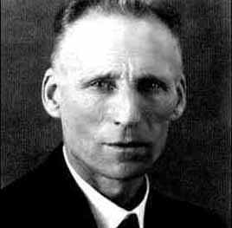
Intuitionism
L.E.J. Brouwer (1881 to 1966)
Fun facts
Guru of intuitionism
Irony of history: Proved many interesting results in classical (non-constructive) mathematics (Brouwer's fixed point theorem)

Slide 25
Self-referentiality
Gödel‘s famous incompletess result for PA uses self-references: „I am not provable“
See also (Halbach/Visser 14a,b) for an overview of self reference in arithmetics
In modal logic (reading $□$ as „is provable“) such self-referentiality is not easy to define
Justification logic helps

Slide 26
Self-referentiality
Definition (Self-referential CS)
A constant specification $CS$ is called self-referential if $\left(c, A\right)∈ CS$ for some axiom $A$ that contains at least one occurrence of the constant $c$.
S4 and $LP_{CS}$ describe self-referential knowledge.
That means if $LP_{CS}$ realizes S4 for some constant specification $CS$,
then that constant specification must be self-referential.
Lemma
Consider the S4-theorem $G := ¬□((P →□P ) → ⊥)$
and let $F$ be any realization of $G$. If $LP_{CS} ⊢F$ , then $CS$ must be self-referential.

Slide 27
Towards a semantics I
Definition (Basic Evaluation)
A basic evaluation $∗$ for $LP_{CS}$ is a function defined on propositions and terms $∗ :Prop →\{0,1\}$ and $∗:Tm→Pow(ℒ_{j})$ such that
$F ∈{\left(s·t\right)}^{∗}$ if $(G→F)∈s^{∗}$ and $G∈t^{∗}$ for some $G$
$F ∈{\left(s+t\right)}^{∗}$ if $F ∈s^{∗}$ or $F ∈t^{∗}$
$F ∈ t^{∗}$ if $(t, F ) ∈ CS$
$s:F ∈{\left(!s\right)}^{∗}$ if $F ∈s^{∗}$

Slide 28
Towards a semantics II
Definition (quasimodel)
A quasimodel is a tuple $ℳ=(W, R, ∗)$ with
a domain of possible worlds $W≠∅,$
an accessibility relation $R⊆W × W$
And an evaluation functions $∗$ mapping each world $w∈W$ to a basic evaluation $∗_{W}$
Definition (Truth in quasimodel)
$ℳ, w⊨p$ iff $p_{w}^{∗}=1$ for $p∈Prop;$
$ℳ, w⊨F →G$ iff not $ℳ, w⊨F$ or $ℳ, w⊨G$
$ℳ, w⊨¬F$ iff not $ℳ, w⊨F$
$ℳ, w⊨t:F$ iff $F∈t_{w}^{∗}$

Slide 29
Towards a semantics III: Model
Given $ℳ=(W, R, ∗)$ and $w∈W, we define$
$$□_{w}≔\{F∈ℒ_{j}∣ℳ, v⊨F whenever R(w,v)\}$$
= formulae true at all successors of $w$
Definition (Modular Model)
A modular model $ℳ=(W, R, ∗)$ is a quasimodel with
$t_{w}^{∗}⊆□_{w}$ for all terms $t∈Tm$ and $w∈W$
$R$ is reflexive
$R$ is transitive
Theorem (Soundness and Completeness)
For all formulas $F∈ℒ_{j}$ and let $F$ be any realization of $G$. $LP_{CS} ⊢F$ iff $ℳ⊨F$ for all modular models $ℳ$

Slide 30
Algorithmic Problems

Slide 31
In modal logic, decidability is a consequence of the finite model property.
For $LP_{CS}$ the situation is more complicated since CS usually is infinite.
Theorem
$LP_{CS}$ is decidable for decidable schematic constant specifications $CS$.
A decidable CS is not sufficient:
Theorem
There exists a decidable constant specification $CS$ such that $LP_{CS}$ is undecidable.

Slide 32
Complexity
Theorem
Let $CS$ be a schematic constant specification.
The problem whether $LP_{CS} ⊢t:B$ is in NP
Definition
A constant specification is called schematically injective if it is schematic and each constant justifies no more that one axiom scheme.
Theorem
Let $CS$ be a schematically injective and axiomatically appropriate constant specification. The derivability problem for $LP_{CS}$ is $Π_{2}^{p}−complete$

Slide 33
Reminder: Polynomical Hierarchy
Two possible definitions, either based on oracle machines (considered here) or quantified boolean formula
How to think about oracles?
Think in terms of Turing Machine pseudocode or a subroutine
An oracle Turing machine M with oracle$B  Γ^{∗}$lets you include the following kind of branching instructions:
“if $z ∈ B$then <do something> else <do something else>”
where $z$ is some string defined earlier in pseudocode.
By definition, the oracle TM can always check the condition ($z ∈ B$) in one step

Slide 34
Some Complexity Classes With Oracles
$PB$ = $\{ L | L$can be decided by some polynomial-time TM with an oracle for $B$ }
$PSAT$= the class of languages decidable in polynomial time with an oracle for SAT
$PNP$= the class of languages decidable by some polynomial-time oracle TM with an oracle for some $B$ in NP

Slide 35
Wake-Up Exercise
Q: Is $PSAT  P^{NP}$?
A: Yes. By definition…
Q: Is P^{NP} ⊆ P^{SAT}?
A: Yes! Every NP language can be reduced to SAT!
For every poly-time TM M with oracle $B∈NP$, we can simulate every query z to oracle $B$ by reducing $z$ to a formula $φ$ in poly-time, then asking an oracle for SAT instead

Slide 36
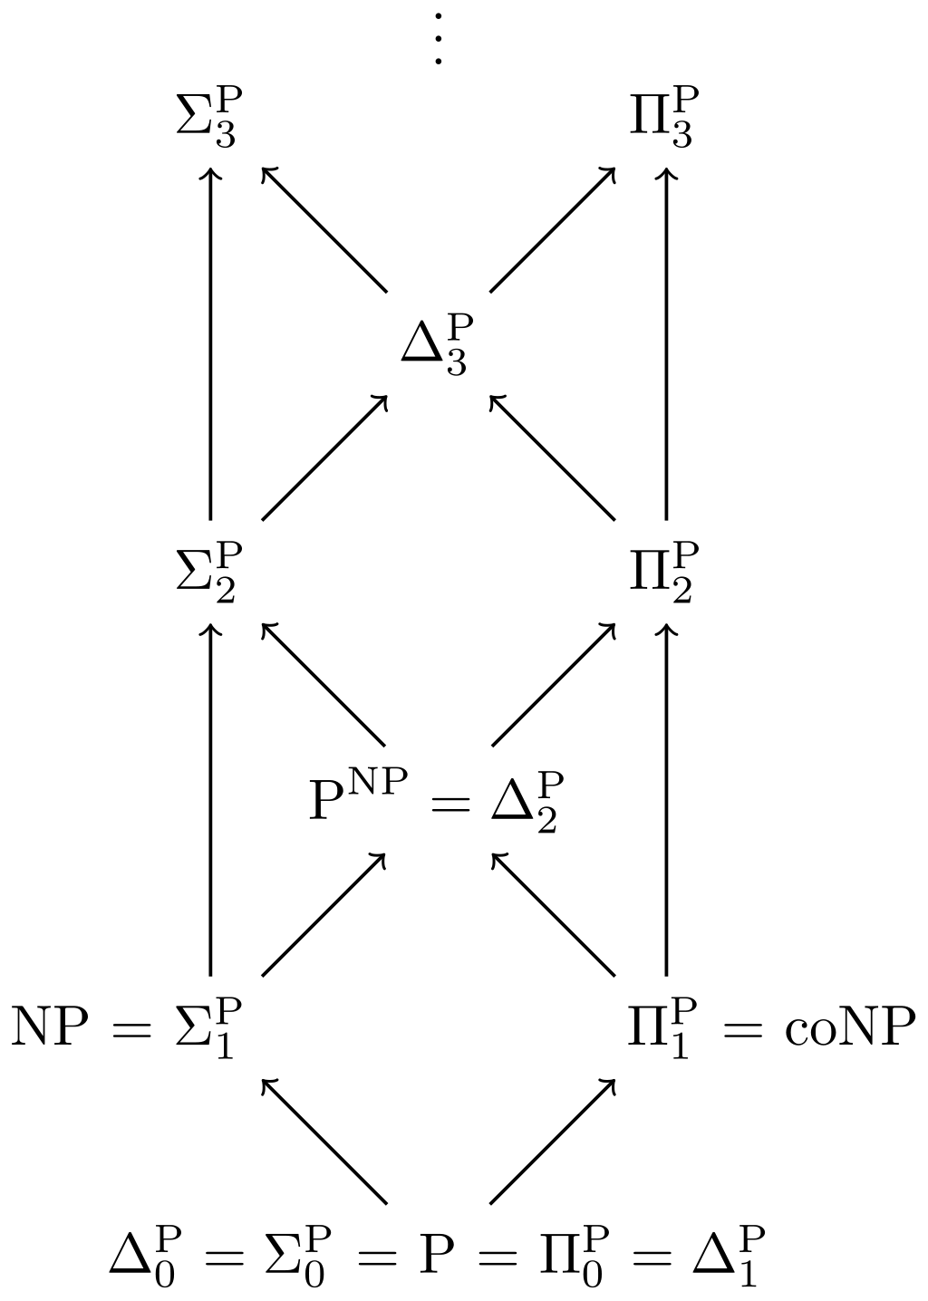
Polynomial Hierarchy (PH)
Definition
Relations within the heirarchy
$Δ_{0}^{P} ≔Σ_{0}^{P} ≔Π_{0}^{P} ≔P$
$Δ_{i+1}^{P} ≔P^{Σ_{i}^{P}}$
$Σ_{i+1}^{P} ≔{NP}^{Σ_{i}^{P}}$
$Π_{i+1}^{P} ≔{coNP}^{Σ_{i}^{P}}$
Example: $Π_{2}^{p}=coNP^{Σ_{1}^{P}}=coNP^{NP^{P}}$
Theorem
$$PH≔⋃{ Σ}_{i}^{p}⊆PSPACE$$
Open: PH = PSPACE

Slide 37
Reconsidering Gettier

Slide 38
Recap: Gettiers two counterexamples
Scenario 1
Smith and Jones apply for a job
Smith believes (justifiably): (p) Jones will get the Job & Jones has ten coins in his pocket
Smith believes also in the entailed assertion: (r) The one who gets the job has ten coins in his pocket.
Coincidence : Smith gets the job and Smith has ten coins in his pocket.
Smith „knew“ (r) only by chance
Scenario 2
Smith justifiably believes (p) Jones owns a Ford
Smith also believes in entailed assertion
(r) = (p or q): Jones owns a Ford, or Brown lives in Barcelona (Though Smith has no justification for q)
Coincidence: Jones does not own Ford, but Brown lives in Barcelona
Smith „knew“ (r) only by chance
General idea: decouple justification and truth conditions of propositional content of belief

Slide 39
Gettier Examples in Justification Logic
Main intention with justification logic (according to Artemov 08) w.r.t. Gettier paradoxa
Show that Gettier reasoning is formally correct
Thereby identify (logical) principles in the reasoning
These have lead to the axioms in LP
Gettier examples inconsistent within Justification Logic systems of factive justifications (factivity axiom)
Can be used also for analyzing approaches that try to resolve the paradox: Justified True Belief + 4th Condition (”no-Gettier-problem condition”)

Slide 40
Principles Involved in Gettier Examples
Gettier uses a version of the epistemic closure principle, closure of justification under logical consequence:
Holds for all justification logic systems due to
Internalization: If $⊢ F$, then there is a t such that $⊢ t : F$
Application axiom:$t:\left(A→B\right)→\left(s:A→\left(t⋅ s\right):B\right)$
Modus ponens
If Smith is justified in believing Q | For some $t, t:P$
and Smith deduces Q from P | $P → Q$
Then Smith is justified in believing Q | For some $t, t:Q$

Slide 41
Goldman‘s reliabilism $→$ Factivity
Goldman (1967) offered the fourth condition to be added to the Justified True Belief definition of knowledge, according to which:
”A subjects belief is justified only if the truth of a belief has caused the subject to have that belief, and for a justified true belief to count as knowledge, the subject must also be able to correctly reconstruct (mentally) that causal chain.”
A situation t justifies F for some t only if F is true, which provides the Factivity Axiom for knowledge-producing justifications:
Factivity axiom: $t:A→A$

Slide 42
Lehrer/Paxson’s indefeasibility $→$monotonicity
Lehrer and Paxson (1969) offered the following ’indefeasibility condition’: ”There is no further truth which, had the subject known it, would have defeated [subjects] present justification for the belief.”
Criticism of this condition: a defeater fact cannot be made precise enough to rule out the Gettier cases without also ruling out a priori cases of knowledge

Slide 43
Lehrer/Paxson’s indefeasibility $→$monotonicity
„there is no justification“
=> „for any further evidence, it is not the case“
$s:F$: „present justification for the belief“ given $s:F$, for any evidence $t$, it is not the case that $t$ would have defeated $s:F$
$s+t$: the joint evidence of $s$ and $t$:
if $s:F$holds, then $s + t$, is also an evidence for $F$
$s:F → (s+t):F$

Slide 44
Gettier‘s implicit assumptions
In the first Gettier example we have the following assumptions which cannot hold:
$J(Smith), C(Smith), C(Jones), ¬J(Jones),$ (*) $u:[\left(Jones=ιx J\left(x\right)\right)∧ C(Jones)].$
Notation
$J\left(x\right)=x$ gets the job;
$C\left(x\right)=x$has coins in his pocket
$ιx S\left(x\right)=$ the $x$ that has the property S$\left(x\right)$ (a so-called definite description)

Slide 45
Gettier‘s implicit assumptions
In the firt Gettier example we have the following assumptions which cannot hold:
$J(Smith), C(Smith), C(Jones), ¬J(Jones),$ (*) $u:[(Jones=ιx J(x)) + C(Jones)].$
With factivity we get a contradiction:
$u:[\left(Jones=ιx J\left(x\right)\right)∧ C(Jones)]$ from (*)
$Jones=ιx J(x),$ Factivity and some propositional logic;
$\left(Jones=ιx J\left(x\right)\right)→ J(Jones),$ natural property of definite descrs;
$J (Jones)$ by Modus Ponens. This contradicts the condition $¬ J (Jones)$from (*).

Slide 46
APPENDIX
Uhhh, a lecture with a hopefully useful

Slide 47
References
(Artemov/Fitting 21) Artemov, Sergei and Melvin Fitting, "Justification Logic", The Stanford Encyclopedia of Philosophy (Spring 2021 Edition), Edward N. Zalta (ed.), URL = https://plato.stanford.edu/archives/spr2021/entries/logic-justification/
(Artemov/Fitting 19) S. Artemov and M. Fitting. Justification Logic: Reasoning with Reasons. Cambridge Tracts in Mathe- matics. Cambridge University Press, 2019.
(Gödel 1995) Vortrag bei Zilsel/Lecture at Zilsel’s (*1938a). In Feferman, S., Dawson, J. W., Jr., Goldfarb, W., Parsons, C., and Solovay, R. M., editors. Unpublished Essays and Lectures, Volume III of Kurt Go ̈del Collected Works. New York: Oxford University Press, pp. 86–113.
(Halbach/Visser 14a) V. Halbach and A. Visser. Self-reference in arithmetic i. The Review of Symbolic Logic, 7:671–691, 2014.
(Halbach/Visser 14b) V. Halbach and A. Visser. Self-reference in arithmetic ii. Review of Symbolic Logic, 7(4):692–712, 2014.
(Artemov 08) S. ARTEMOV. The logic of justification. The Review of Symbolic Logic, 1(4):477–513, 2008.

Slide 48
Color Convention in this course
Formulae, when occurring inline
Newly introduced terminology and definitions
Important results (observations, theorems) as well as emphasizing some aspects
Examples are given with standard orange with possibly light orange frame
Comments and notes
Algorithms

