Slide 1
Intelligent Agents
Knowledge-Based Programs
(for decentralized POMDPs)
Özgür L. Özçep
Universität zu Lübeck
Institut für Informationssysteme

Slide 2
Todays lecture based on
The AAMAS 2019 Tutorial „EPISTEMIC REASONING IN MULTI-AGENT SYSTEMS“
http://people.irisa.fr/Francois.Schwarzentruber/2019AAMAStutorial/

Slide 3
Motivation

Slide 4
Setting
Cooperative agents: in particular, common (offline) joint plan
Common goal
Imperfect information
Decentralized execution by agents
QDec-POMDPs: (qualitative) Decentralized Partially Observable Markov Decision Problems
(Brafman et al 13)
Main observation: Policies are large

Slide 5

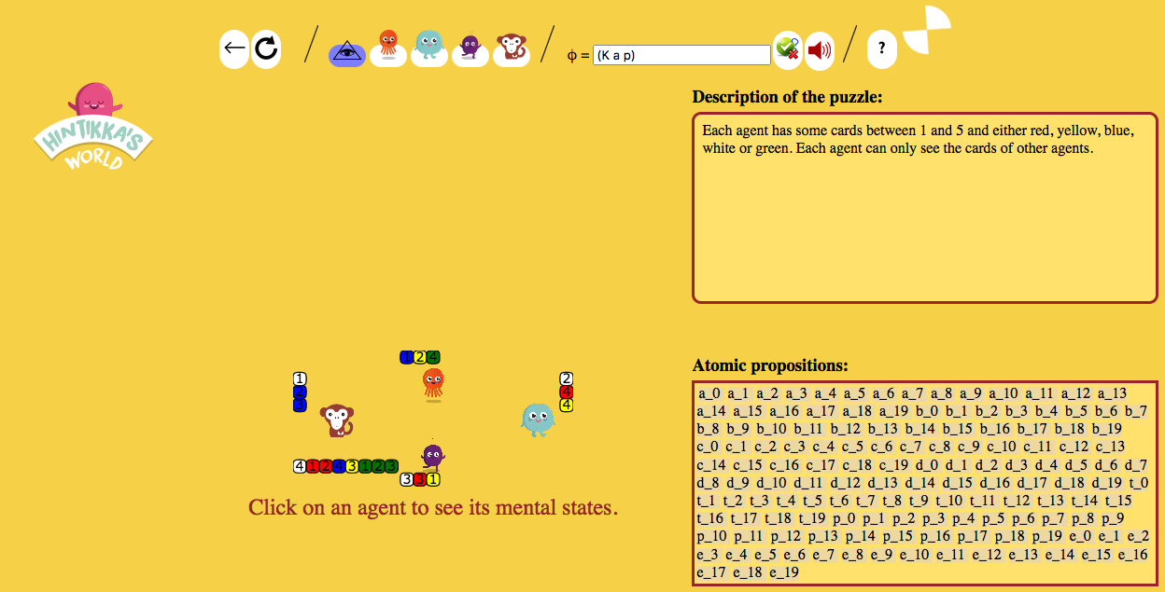
Similar setting ...

Slide 6
Methodology
Planning ...
  Input
    Model
    Goal
  Output
    Program for each agent involved
... That is undestandable (explainable)
  Legal issues in case of failure
  Interaction with humans (-> human-compatible AI)
  Pointers to lines in code that caused error may help but isfar from explainability in a strict sense
... And that is succinct (policies tend to be large)

Slide 7
Running Example (Saffidine et al. 18)
„...assume Alice wants to meet Bob. She may take a train or a flight from her place to his, but there is a risk of air crew strike. Alice and Bob may call each other beforehand (centralized planning phase) to agree on the following plan.
Alice tries to fly. If there is a strike, she takes the train and listens to the radio to know whether Bob can know this. If the strike is not announced on the radio (hence Bob cannot know), after arriving at the station she will reach the airport to meet Bob there. Otherwise they will meet at her place of arrival. It can be seen that this plan, once agreed upon, can be executed successfully in a decentralized fashion.

Slide 8
Using knowledge-based programs (KBPs)
KBP for agent a
listenToRadio
If a knows strike
then toStation
else toAirport
KBP for agent b
readNewsPaper
If b knows strike
then toStation
else toAirport
Operational semantics
Succinctness
(Un)decidability/complexity results
More information to be found in the papers
(Lang/ Zanuttini 12; 13), (Zanuttini et al. 20), (Seffadine et al 18)

Slide 9
Syntax and semantics

Slide 10
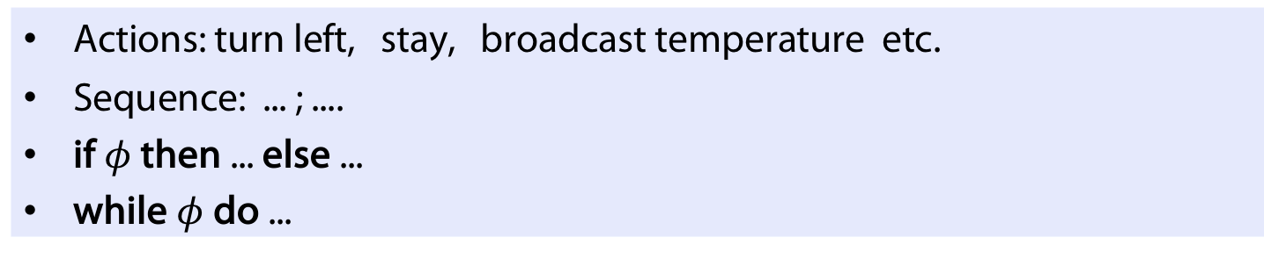
Knowlede-Based Programs: Syntax
See (Fagin et al. 03) for an in-depth treatment of KBPs
Definition (Syntax of KBPs)
Actions: turn left, stay, broadcast temperature etc.
Sequence: ... ; ....
if $φ$ then ... else ...
while $φ$ do ...
Example (KBP for agent a)
  If a knows (door 12 is locked and justobserved(fire)) then
  turn left
  broadcast temperature
  Else
  stay

Slide 11
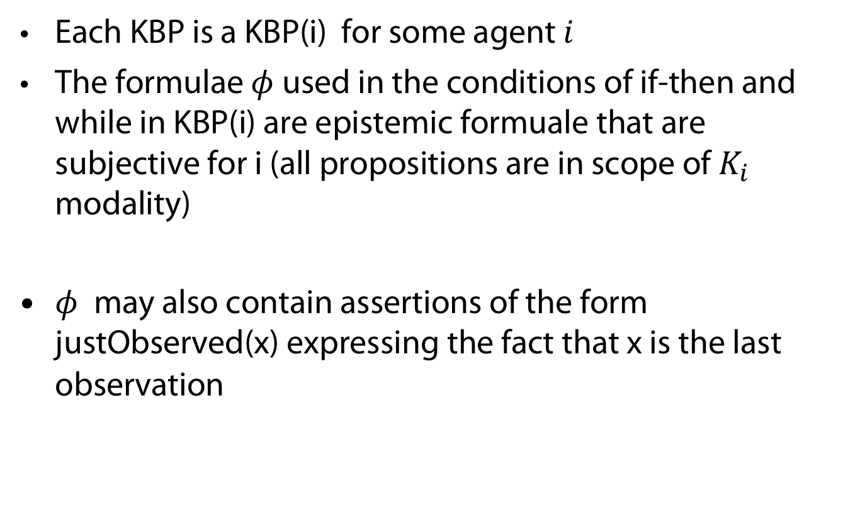
Resctricton on KBPs
Each KBP is a KBP(i) for some agent $i$
The formulae $φ$ used in the conditions of if-then and while in KBP(i) are epistemic formuale that are subjective for i (all propositions are in scope of $K_{i}$ modality)
$φ$ may also contain assertions of the form justObserved(x) expressing the fact that x is the last observation

Slide 12
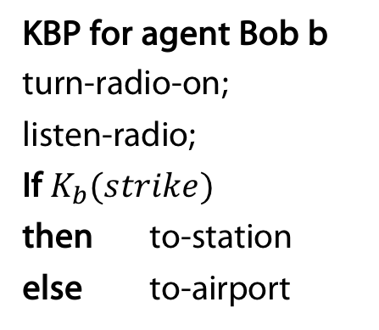
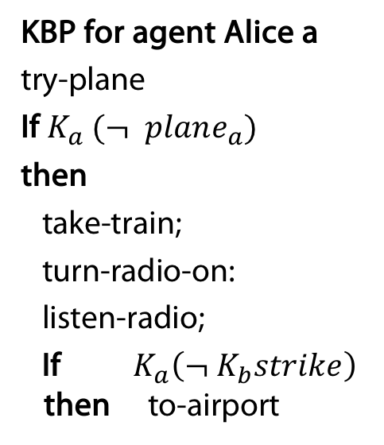
Running Example (Saffidine et al. 18)
KBP for agent Alice a
try-plane
If$K_{a} (¬ plane_{a})$
then
take-train;
turn-radio-on:
listen-radio;
If $K_{a}\left(¬ K_{b}strike\right)$
then to-airport
KBP for agent Bob b
turn-radio-on;
listen-radio;
If $K_{b}(strike)$
then to-station
else to-airport

Slide 13
Semantics
Definition
QdecPomDP = Qualitative decentralized partially Observable Markov Decision Problem
= Concurrent game structures with
observations
Transitions of the form
Non-empty set of possible initial states
Set of goal states
a: stay a: observes fire
b: turn left b: observes ashes
state1
state2

Slide 14
Typically, a state describes
Position of agents
Battery levels
Etc.

Slide 15
Epistemic structure: Higher-order knowledge about:
The current state of the QdecPOMDP
The current program counters in KBPs

Slide 16
Assumptions
Common knowledge of
  The QdecPOMDP
  The KBPs
  Synchrony of the system
    Tests last 0 unit of time
    Actions last 1 unit of time

Slide 17

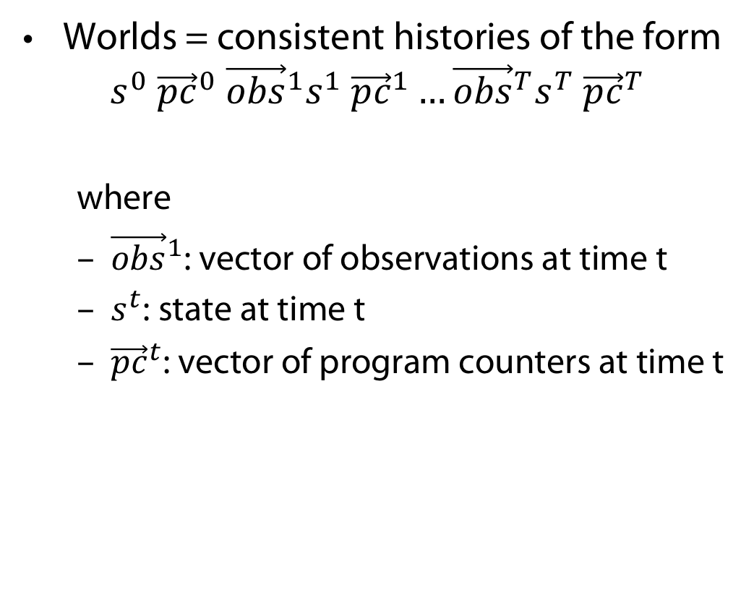
Epistemic Structures at time T: worlds
Worlds = consistent histories of the form
$$s^{0} {\vec{pc}}^{0} {\vec{obs}}^{1}s^{1} {\vec{pc}}^{1}…{\vec{obs}}^{T}s^{T} {\vec{pc}}^{T}$$
  where
  ${\vec{obs}}^{1}$: vector of observations at time t
  $s^{t}$: state at time t
  ${\vec{pc}}^{t}$: vector of program counters at time t
listenToRadio
If $K_{a}$ strike
toStation
else toAirport

Slide 18
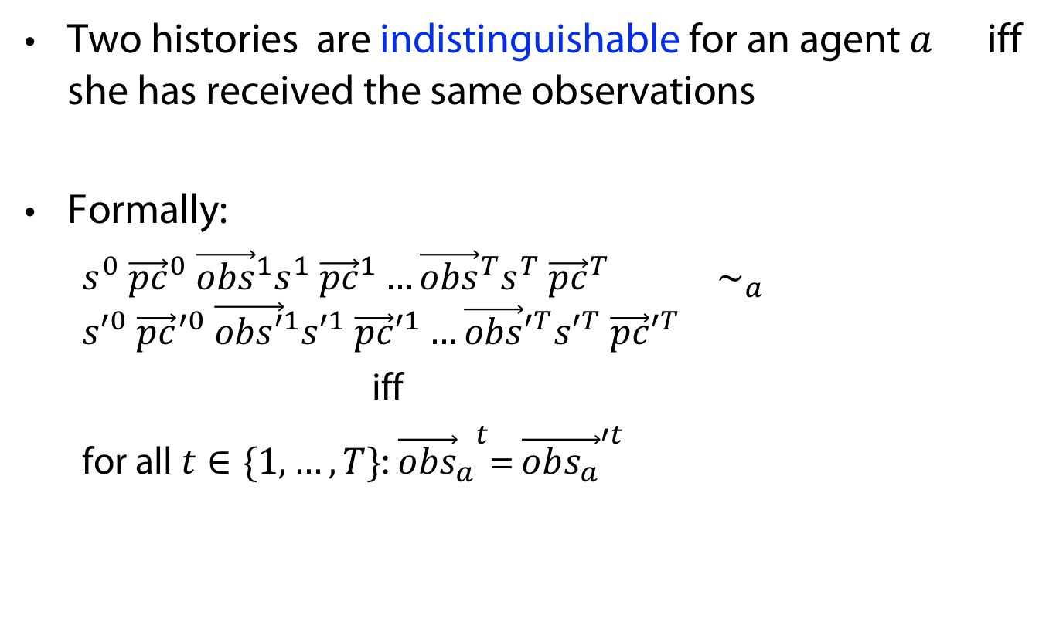
Epistemic struct.: Indistinguishability relations
Two histories are indistinguishable for an agent $a$ iff she has received the same observations
Formally:
  $s^{0} {\vec{pc}}^{0} {\vec{obs}}^{1}s^{1} {\vec{pc}}^{1}…{\vec{obs}}^{T}s^{T} {\vec{pc}}^{T}$ $∼_{a}$ ${s′}^{0} {\vec{pc}}^{′0} {\vec{obs′}}^{1}{s′}^{1} {\vec{pc}′}^{1}…{\vec{obs}′}^{T}{s′}^{T} {\vec{pc}′}^{T}$
  iff
  for all $t∈\{1, …, T\}$: ${{\vec{obs}}_{a}}^{t}$= ${\vec{obs_{a}}}^{′t}$

Slide 19
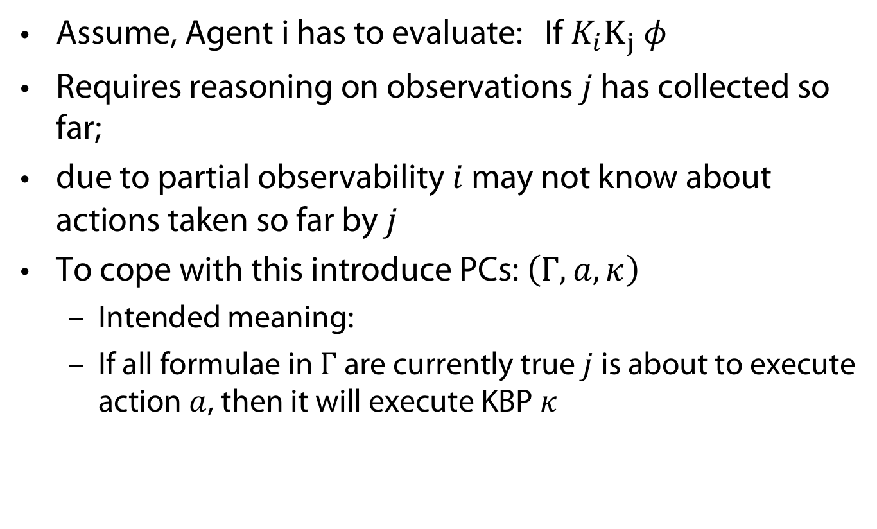
Motivating Program Counters (PCs)
Assume, Agent i has to evaluate: If $K_{i}K_{j} φ$
Requires reasoning on observations $j$ has collected so far;
due to partial observability $i$ may not know about actions taken so far by $j$
To cope with this introduce PCs: $\left(Γ, a, κ\right)$
  Intended meaning:
  If all formulae in $Γ$ are currently true $j$ is about to execute action $a$, then it will execute KBP $κ$

Slide 20

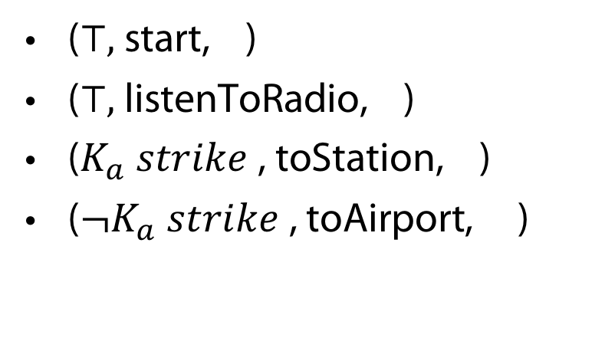
Definition (Program counter)
(guard, action just executed, continuation)
listenToRadio
If $K_{a}$ strike
toStation
else toAirport
($⊤,$ start, )
($⊤,$ listenToRadio, )
($K_{a} strike$, toStation, )
(${¬K}_{a} strike$, toAirport, )

Slide 21





Control flow graph
listenToRadio
If $K_{a}$ strike
toStation
else toAirport
($⊤,$ start, )
($⊤,$ listenToRadio, )
$(K_{a} strike$, toStation, )
(${¬K}_{a} strike$, toAirport, )

Slide 22







Control flow graph
listenToRadio
If $K_{a}$ strike
toStation
else toAirport
($⊤,$ start, )
($⊤,$ listenToRadio, )
$(K_{a} strike$, toStation, )
(${¬K}_{a} strike$, toAirport, )
listenToRadio
In the QdecPOMDP:
$$s^{0}$$
$$s^{1}$$
toStation
$$s^{1}$$
$$s^{2}$$
Consistent history:
$s^{0}$($⊤$, start, ); $s^{1}$($⊤$, listenToRadio, ) ; $s^{2}$($⊤, K_{a} strike$, toStation, )
$$⊨ K_{a} strike$$

Slide 23
Connection to dynamic logic
Structure at time t given by
(iterated ) product update
starting with situation encoding common knowledge of initial belief state,
and event model built from the control-flow graphs of the KBPs.

Slide 24
Algorithmic Problems

Slide 25
Verification problem
Input
  A QDecPOMDP model (given in STRIPS-like symbolic form);
  Knowledge-based programs for each agent
Output: yes if all executions of the KBPs lead to a goal state.

Slide 26
Theorem
The verification problem for while-free KBPs is PSPACE-complete
Proof idea
  Upper bound: on-the-fly model checking
  Lower bound: reduction from TQBF (true quantified Boolean formulae)

Slide 27
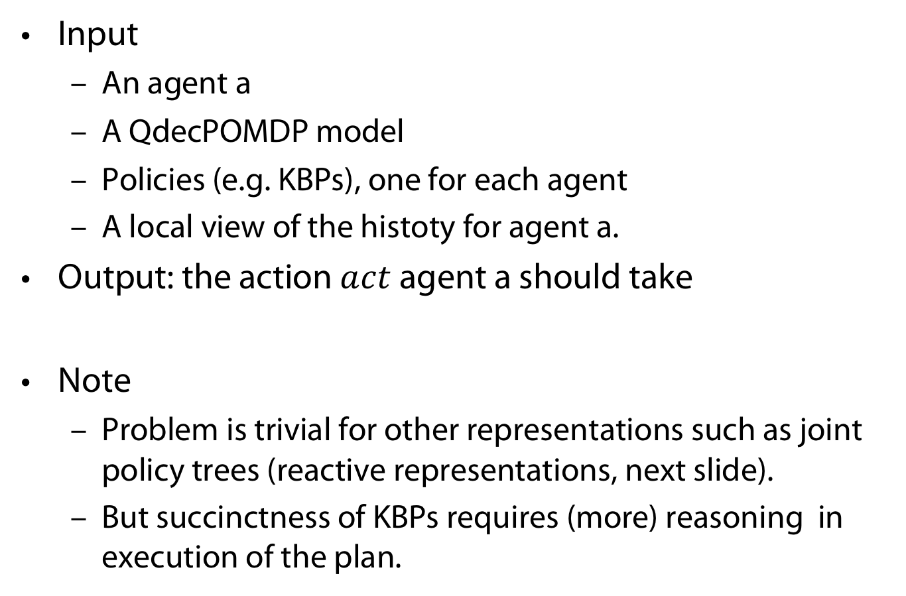
Execution Problem
Input
  An agent a
  A QdecPOMDP model
  Policies (e.g. KBPs), one for each agent
  A local view of the histoty for agent a.
Output: the action $act$agent a should take
Note
  Problem is trivial for other representations such as joint policy trees (reactive representations, next slide).
  But succinctness of KBPs requires (more) reasoning in execution of the plan.

Slide 28
Execution problem
Definition
A class of policy representations is reactive iff
its corresponding execution problem is in P
Example
  Tree policies are reactive policy representations
  If justobserved(fire) then turn left else stay
Unless P = PSPACE, KBPs are not reactive. Indeed:
Proposition
The execution problem for KBPs is PSPACE-complete

Slide 29

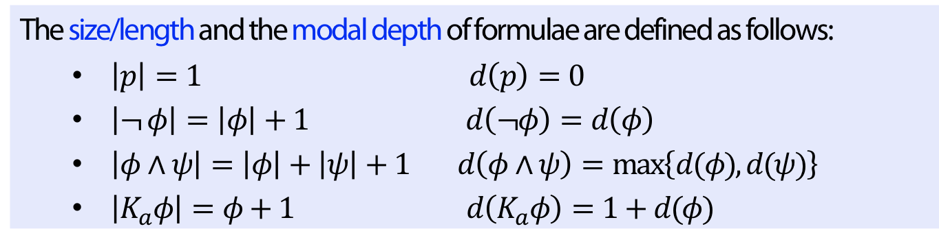
Succinctness
Remember the notion of modal depth
Definition
The size/length and the modal depth of formulae are defined as follows:
  $\left|p\right|=1$ $d\left(p\right)=0$
  $\left|¬ φ\right|=\left|φ\right|+1$ $d\left(¬φ\right)=d\left(φ\right)$
  $\left|φ∧ψ\right|=\left|φ\right|+\left|ψ\right|+1$ $d\left(φ∧ψ\right)=\max\left\{d(φ), d(ψ)\right\}$
  $\left|K_{a}φ\right|=φ+1$ $d\left(K_{a}φ\right)=1+d(φ)$
Example
  $$d(justObserved(fire)) = 0$$
  $$d\left(K_{a} p\right)=1 \\ d\left(K_{a} \left(K_{b} p\right)\right)=2$$

Slide 30
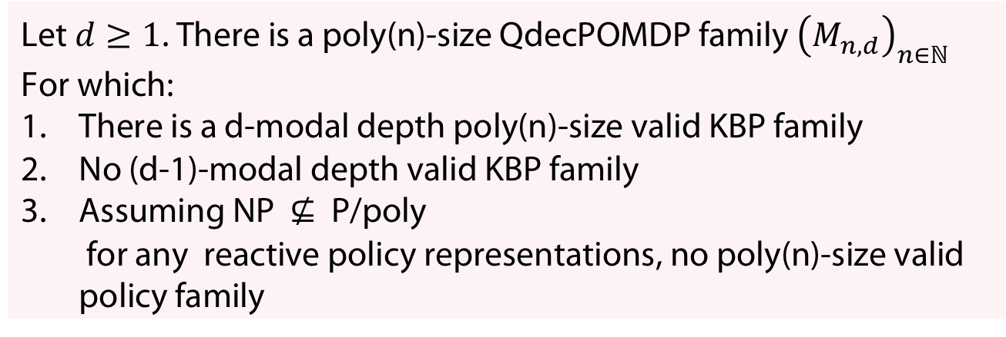
Succinctness
Theorem (Lang/Zanuttini 12 for d = 1; Saffidine et al 18, for d > 1)
Let $d≥1$. There is a poly(n)-size QdecPOMDP family ${\left(M_{n,d}\right)}_{n∈ℕ}$
For which:
There is a d-modal depth poly(n)-size valid KBP family
No (d-1)-modal depth valid KBP family
Assuming NP $⊈$ P/poly
for any reactive policy representations, no poly(n)-size valid policy family
(Complexity theory reminder)
Two (equivalent) definitions of P/Poly
A language L is in P/poly iff
„there is a language A in P and a set of advice strings {a₀,a₁,…} such that |a_{n}|≤n^{O(1)} and x is in L if and only if (x,a_{|x|}) is in A.
there is a family of circuits {C₀,C₁,…} such that |C_{n}|≤n^{O(1)} and for all n and all x=x₁…x_{n}, x is in L if and only if C_{n}(x₁,…,x_{n}) accepts.“
(http://blog.computationalcomplexity.org/2005/09/ppoly.html)

Slide 31
Conclusion

Slide 32
Methodology
Planning ...
  Input
    Model
    Goal
  Output
    Program for each agent involved ->reactive policy for each agent
Higher-order knowledge for
  Getting explainable policies (e.g. for making cooperation visible)
  For concise programs

Slide 33
Perspectives
Efficient implementation of the verification/execution problems;
Heuristics for the planning problem;
More tractable fragments;
decPOMDP (with probabilities);
Temporal properties;
Strategic reasoning;
Develop proof systems for KBPs. Use of Coq, Isabelle?

Slide 34
APPENDIX
Uhhh, a lecture with a hopefully useful

Slide 35
References
(Brafman et al 13)
[1] R. I. Brafman, G. Shani, and S. Zilberstein. Qualitative planning under partial observability in multi- agent domains. In Proceedings of the Twenty-Seventh AAAI Conference on Artificial Intelligence, AAAI’13, pages 130–137. AAAI Press, 2013.
(Lang/Zanuttini 12)
J. Lang and B. Zanuttini. Knowledge-based programs as plans - the complexity of plan verification. In L. D. Raedt, C. Bessiere, D. Dubois, P. Doherty, P. Frasconi, F. Heintz, and P. J. F. Lucas, editors, ECAI 2012 - 20th European Conference on Artificial Intelligence. Including Prestigious Applications of Artificial Intelligence (PAIS-2012) System Demonstrations Track, Montpellier, France, August 27-31 , 2012, volume 242 of Frontiers in Artificial Intelligence and Applications, pages 504–509. IOS Press, 2012.
(Lang/Zanuttini 13)
J. Lang and B. Zanuttini. Knowledge-based programs as plans: Succinctness and the complexity of plan existence. In B. C. Schipper, editor, Proceedings of the 14th Conference on Theoretical Aspects of Rationality and Knowledge (TARK 2013), Chennai, India, January 7-9, 2013, 2013.
(Zannutini et al. 20)
B. Zanuttini, J. Lang, A. Saffidine, and F. Schwarzentruber. Knowledge-based programs as succinct policies for partially observable domains. Artificial Intelligence, 288(C):103365, 2020.
(Fagin et al. 03)
R. Fagin, J. Y. Halpern, Y. Moses, and M. Y. Vardi. Reasoning about Knowledge. MIT Press, 2003.
(Saffidine et al 18)
A. Saffidine, F. Schwarzentruber, and B. Zanuttini. Knowledge-based policies for qualitative decen- tralized pomdps. In S. A. McIlraith and K. Q. Weinberger, editors, Proceedings of the Thirty-Second AAAI Conference on Artificial Intelligence, (AAAI-18), the 30th innovative Applications of Artificial Intelligence (IAAI-18), and the 8th AAAI Symposium on Educational Advances in Artificial Intelligence (EAAI-18), New Orleans, Louisiana, USA, February 2-7, 2018, pages 6270–6277. AAAI Press, 2018.

Slide 36
Color Convention in this course
Formulae, when occurring inline
Newly introduced terminology and definitions
Important results (observations, theorems) as well as emphasizing some aspects
Examples are given with standard orange with possibly light orange frame
Comments and notes
Algorithms

