Slide 1
Web-Mining Agents
Game Theory and Social Choice
Özgür L. Özcep
Universität zu Lübeck
Institut für Informationssysteme

Slide 2
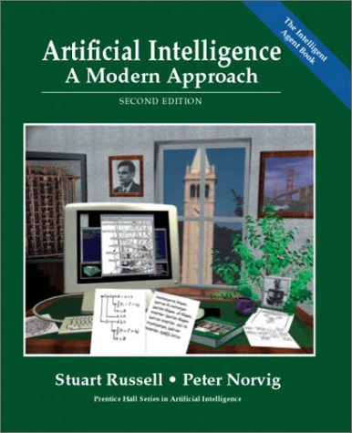
Literature
Chapter 17
Presentations from CS 886
Advanced Topics in AI Electronic Market Design
Kate Larson
Waterloo Univ.

Slide 3
Multiagent Systems: Criteria
Social welfare: max_{outcome} ∑_{i} u_{i}(outcome)
Surplus: social welfare of outcome – social welfare of status quo
  Constant sum games have 0 surplus.
  Markets are not constant sum
Pareto efficiency: An outcome o is Pareto efficient if there exists no other outcome o’ s.t. some agent has higher utility in o’ than in o and no agent has lower
  Implied by social welfare maximization
Individual rationality: Participating in the negotiation (or individual deal) is no worse than not participating
Stability: No agents can increase their utility by changing their strategies (aka policies)
Symmetry: No agent should be inherently preferred, e.g. dictator

Slide 4
Game Theory: The Basics
A game: Formal representation of a situation of strategic interdependence
  Set of agents, I (|I|=n)
    Aka players
  Each agent, j, has a set of actions, A_{j}
    Aka moves
  Actions define outcomes
    For each possible action there is an outcome.
  Outcomes define payoffs
    Agents’ derive utility from different outcomes

Slide 5
Normal form game* (matching pennies)
Agent 2
H
T
Action
Outcome
H
-1, 1
1, -1
Payoffs
Agent 1
T
1, -1
-1, 1
*aka strategic form, matrix form

Slide 6
Extensive form game (matching pennies)
Player 1
Action
T
H
Player 2
H
T
H
T
Terminal node (outcome)
Indicates
indistinguishability
of state
(-1,1)
(1,-1)
(1,-1)
(-1,1)
Payoffs

Slide 7
Strategies (aka Policies)
Strategy:
  A strategy, s_{j}, is a complete contingency plan; defines actions agent j should take for all possible states of the world
Strategy profile: s=(s₁,…,s_{n})
  s_{-i} = (s₁,…,s_{i-1},s_{i+1},…,s_{n})
Utility function: u_{i}(s)
  Note that the utility of an agent depends on the strategy profile, not just its own strategy
  We assume agents are expected utility maximizers

Slide 8
Normal form game* (matching pennies)
Agent 2
Strategy for agent 1: H
H
T
H
Strategy
profile
(H,T)
-1, 1
1, -1
Agent 1
U1((H,T))=1
U2((H,T))=-1
T
1, -1
-1, 1
*aka strategic form, matrix form

Slide 9
Extensive form game (matching pennies)
Strategy for agent 1: T
Player 1
Action
T
H
Strategy profile: (T,T)
Player 2
H
T
T
H
Terminal node (outcome)
U1((T,T))=-1
U2((T,T))=1
(-1,1)
(1,-1)
(1,-1)
(-1,1)
Payoffs

Slide 10
Extensive form game
(matching pennies with sequential moves)
Recall: A strategy is a contingency plan for all states of the game
Strategy for agent 1: T
T
H
Strategy for agent 2: H if 1 plays H, T if 1 plays T (H,T)
H
T
T
H
Strategy profile: (T,(H,T))
U1((T,(H,T)))=-1
U2((T,(H,T)))=1
(-1,1)
(1,-1)
(1,-1)
(-1,1)

Slide 11
Game Representation
H,H
H,T
T,H
T,T
T
H
H
-1,1
-1,1
1,-1
1,-1
H
T
T
H
T
1,-1
-1,1
1,-1
-1,1
(-1,1)
(1,-1)
(1,-1)
(-1,1)
Potential combinatorial explosion

Slide 12
Example: Ascending Auction
State of the world is defined by (x,p)
  x∈{0,1} indicates if the agent has the object
  p is the current next price
Strategy s_{i}((x,p))
p, if v_{i} ≧p and x=0
s_{i}((x,p)) =
No bid otherwise
(v_{i} is the value agent i ascribes to the object)

Slide 13
Dominant Strategies
Recall that
  Agents’ utilities depend on what strategies other agents are playing
  Agents are expected utility maximizers
Agents will play best-response strategies
A dominant strategy is a best-response for all s_{-i}
  They do not always exist
  Inferior strategies are called dominated
s_{i}* is a best response if u_{i}(s_{i}*,s_{-i})≥u_{i}(s_{i}’,s_{-i}) for all s_{i}’

Slide 14
Dominant Strategy Equilibrium
A dominant strategy equilibrium is a strategy profile where the strategy for each player is dominant
  s*=(s₁*,…,s_{n}*)
  u_{i}(s_{i}*,s_{-i})≥u_{i}(s_{i}’,s_{-i}) for all i, for all s_{i}’, for all s_{-i}
GOOD: Agents do not need to counterspeculate!

Slide 15
Example: Prisoner’s Dilemma
Two people are arrested for a crime.
If neither suspect confesses, both are released (ÖÖ: but sentenced semi-heavy).
If both confess then they get sent to jail.
If one confesses and the other does not, then the confessor gets a light sentence and the other gets a heavy sentence.
A: Don’t
Confess
A: Confess
Dom. Str. Eq
B: Confess
B=-5, A=-5 | B=-1, A=-10
B=-10, A=-1 | B=-2, A=-2
Pareto Optimal Outcome
B: Don’t
Confess
Dominant strategy exists but is not Pareto efficient

Slide 16
Example: Split or Steal
Does communication help?
Only if agents do not lie
A: Steal
A: Split
Dom. Str. Eq
B: Steal
B=0, A=0 | B=100, A=-10
B=-10, A=100 | B=50, A=50
Pareto Optimal Outcome
B: Split
ÖÖ: Example from British Game Show „Golden Balls“
See http://blogs.cornell.edu/info2040/2012/09/21/split-or-steal-an-analysis-using-game-theory/
And may be...
https://www.youtube.com/watch?v=p3Uos2fzIJ0

Slide 17
Vickrey *) Auctions
Vickrey auctions are:
  second-price
  sealed-bid
Good is awarded to the agent that made the highest bid; at the price of the second highest bid
Bidding to your true valuation is dominant strategy in Vickrey auctions
Vickrey auctions susceptible to antisocial behavior
*) Russel/Norvig add in a FN:
Named after William Vickrey (1914–1996), who won the 1996 Nobel Prize
in economics for this work and died of a heart attack three days later

Slide 18
Example: Vickrey Auction (2nd price sealed bid)
Each agent i has value v_{i}
Strategy b_{i}(v_{i})∈[0,∞)
b*:= 2nd best bid.
v_{i}-b* if b_{i}>b*
u_{i}(b_{i},b_{-i}) =
0 otherwise
Given value v_{i}, b_{i}(v_{i})=v_{i} is dominant.
Let b’=max_{j⧧i}b_{j}. If b’<v_{i} then any bid b_{i}(v_{i})≥b’ is optimal. If b’≥v_{i}, then any bid b_{i}(v_{i})≤ v_{i} is optimal. Bid b_{i}(v_{i})=v_{i} satisfies both constraints.
Dominant strategy is Pareto efficient

Slide 19
Phone Call Competition Example
Customer wishes to place long-distance call
Carriers simultaneously bid, sending proposed prices
Phone automatically chooses the carrier (dynamically)
MCI
AT&T
Sprint
$0.20
$0.18
$0.23

Slide 20
Best Bid Wins
Phone chooses carrier with lowest bid
Carrier gets amount that it bid
MCI
AT&T
Sprint
$0.20
$0.18
$0.23

Slide 21
Attributes of the Mechanism *)
Distributed
Symmetric
Stable
Simple
Efficient
Carriers have an incentive to invest effort in strategic behavior
AT&T
MCI
Sprint
$0.20
“Maybe I can bid as high as $0.21...”
$0.18
$0.23
*) Mechanism design discussed later

Slide 22
Best Bid Wins, Gets Second Price (Vickrey Auction)
Phone chooses carrier with lowest bid
Carrier gets amount of second-best price
MCI
AT&T
Sprint
$0.20
$0.18
$0.23

Slide 23
Attributes of the Vickrey Mechanism
Distributed
Symmetric
Stable
Simple
Efficient
Carriers have no incentive to invest effort in strategic behavior
AT&T
MCI
Sprint
$0.20
“I have no reason to overbid...”
$0.18
$0.23

Slide 24
Example: Bach or Stravinsky
A couple likes going to concerts together. One loves Bach but not Stravinsky. The other loves Stravinsky but not Bach. However, they prefer being together than being apart.
B
S
2,1 | 0,0
0,0 | 1,2
B
No dom. str. equil.
S

Slide 25
Nash Equilibrium
Sometimes an agent’s best-response depends on the strategies other agents are playing
  No dominant strategy equilibria
A strategy profile is a Nash equilibrium if no player has incentive to deviate from his strategy given that others do not deviate:
  for every agent i, u_{i}(s_{i}*,s*_{-i}) ≥ u_{i}(s_{i}’,s*_{-i}) for all s_{i}’
B
S
B
2,1 | 0,0
0,0 | 1,2
S

Slide 26
Nash Equilibrium
Interpretations:
  Focal points, self-enforcing agreements, stable social convention, consequence of rational inference..
Criticisms
  They may not be unique (Bach or Stravinsky)
    Ways of overcoming this
      Refinements of equilibrium concept, Mediation, Learning
  Do not exist in all games (in the form defined above)
  They may be hard to find
  People don’t always behave based on what equilibria would predict (ultimatum games and notions of fairness,…)

Slide 27
Example: Matching Pennies
H
T
-1, 1 | 1,-1
1,-1 | -1, 1
H
T
So far we have talked only about pure (deterministic) strategy equilibria.
Not all games have pure strategy equilibria. Some equilibria are mixed (randomized) strategy equilibria.

Slide 28
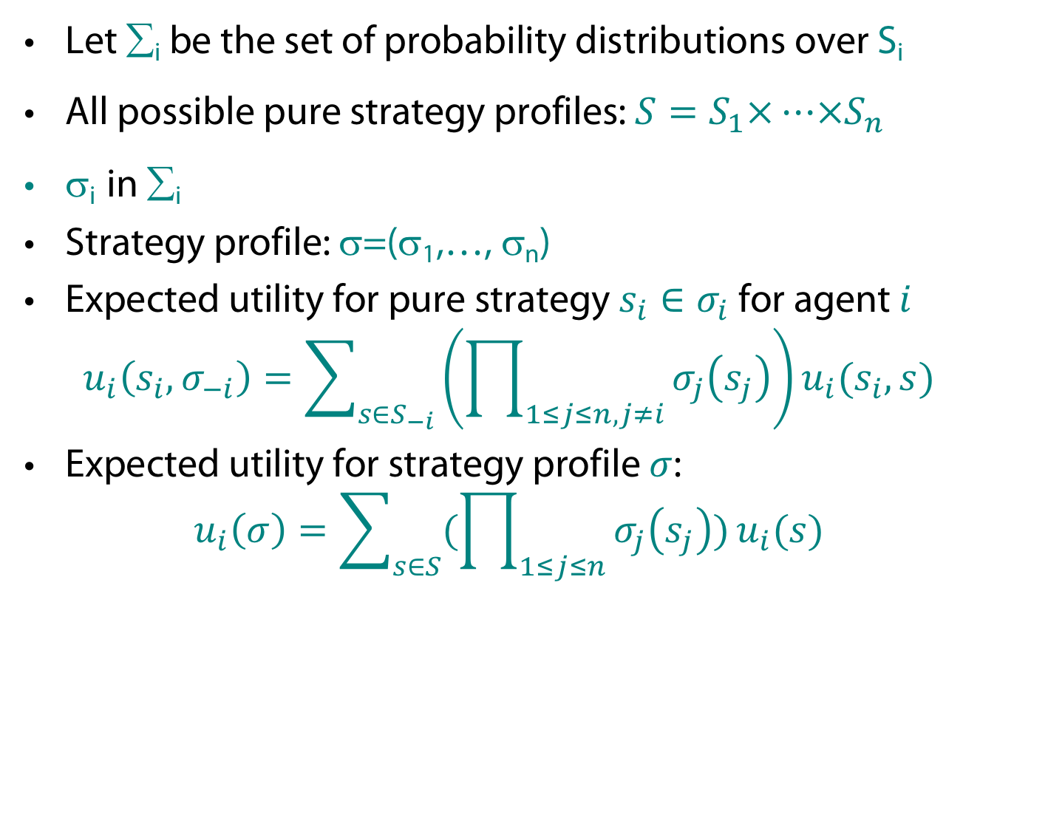
Mixed strategy equilibria
Let ∑_{i} be the set of probability distributions over S_{i}
All possible pure strategy profiles: $S=S_{1}×…×S_{n}$
σ_{i} in ∑_{i}
Strategy profile: σ=(σ₁,…, σ_{n})
Expected utility for pure strategy $s_{i}∈σ_{i}$ for agent $i$
$u_{i}\left(s_{i}, σ_{−i}\right)=\sum_{s∈S_{−i}}{\left(\prod_{1≤j≤n, j≠i}{σ_{j}\left(s_{j}\right)}\right)}u_{i}(s_{i},s)$
Expected utility for strategy profile $σ$:
$u_{i}\left(σ\right)=\sum_{s∈S}{(\prod_{1≤j≤n}{σ_{j}\left(s_{j}\right)})}u_{i}(s)$

Slide 29
Mixed strategy equilibria
Nash Equilibrium:
  σ* is a (mixed) Nash equilibrium iff
  u_{i}(σ*_{i}, σ*_{-i}) ≥ u_{i}(σ_{i}, σ*_{-i}) for all σ_{i}∈∑_{i}, for all i

Slide 30


Example: Matching Pennies
q H
1-q T
$$:σ_{2}$$
-1, 1 | 1,-1
1,-1 | -1, 1
$$σ_{1}:$$
p H
1-p T
Want to play each strategy with a certain probability so that the competitor is indifferent between its own strategies.
$$u_{2}\left(H,σ_{1} \right) = u_{2}(T, σ_{1})$$
1p+(-1)(1-p)=(-1)p+1(1-p)
p=1/2
q-(1-q)=-q+(1-q)
q=1/2

Slide 31
Mixed Nash Equilibrium
Theorem (Nash 50):
  Every game in which the strategy sets, S₁,…,S_{n} have a finite number of elements has a mixed strategy equilibrium.
Complexity of finding Nash Equilibria
  “Together with prime factoring, the complexity of finding a Nash Eq is, in my opinion, the most important concrete open question on the boundary of P today” (Papadimitriou)
  (Daskalakis, Goldberg/Papadimitriou, 2005): Finding Nash equilibrium is very hard (though not NP complete): PPAD complete (Polynomial Parity Arguments on Directed graphs)

Slide 32
Imperfect Information about Strategies and Payoffs
So far we have assumed that agents have complete information about each other (including payoffs)
  Very strong assumption!
Assume agent i has type θ_{i}∈Θ_{i}, which defines the payoff u_{i}(s, θ_{i})
Agents have common prior over distribution of types p(θ)
  Conditional probability p(θ_{-i}| θ_{i}) (obtained by Bayes Rule when possible)

Slide 33
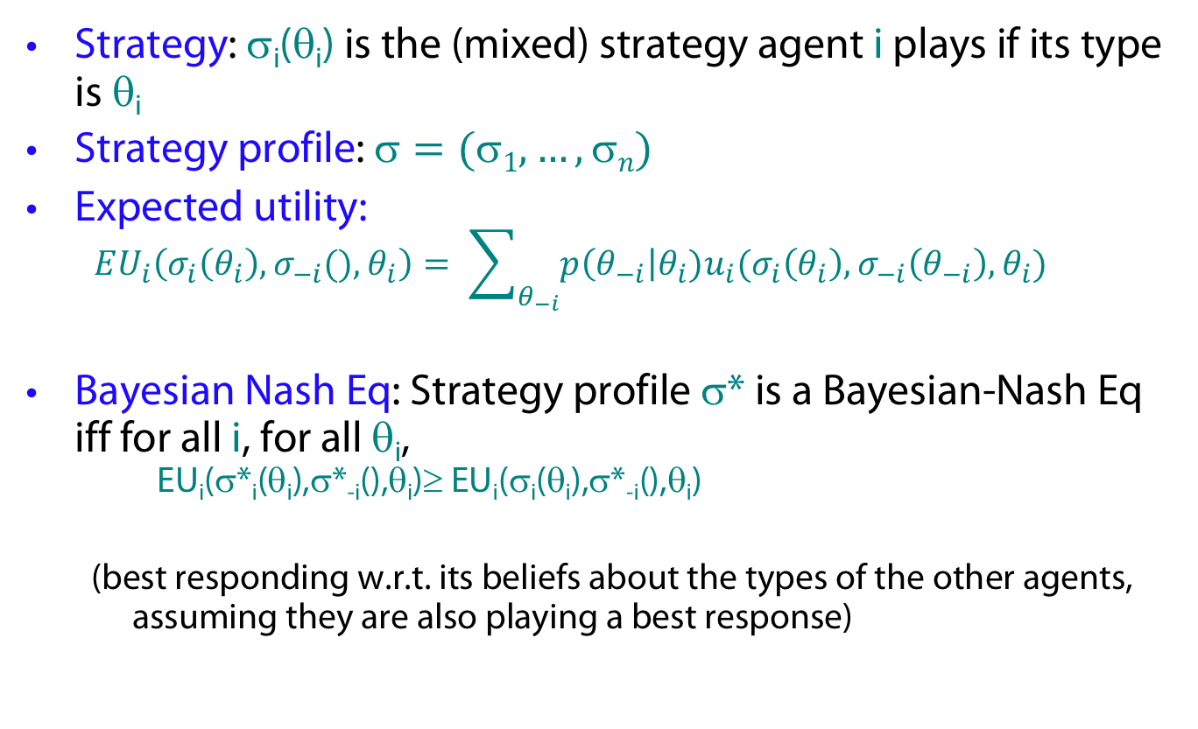
Bayesian-Nash Equilibrium
Strategy: σ_{i}(θ_{i}) is the (mixed) strategy agent i plays if its type is θ_{i}
Strategy profile: $=(1,…, n)$
Expected utility:
  $$EU_{i}\left(σ_{i}\left(θ_{i}\right), σ_{−i}(), θ_{i}\right)= \sum_{θ_{−i}}{p\left(θ_{−i}\right|θ_{i})u_{i}(σ_{i}\left(θ_{i}\right), σ_{−i}\left(θ_{−i}\right), θ_{i})}$$
Bayesian Nash Eq: Strategy profile σ* is a Bayesian-Nash Eq iff for all i, for all θ_{i},
EU_{i}(σ*_{i}(θ_{i}),σ*_{-i}(),θ_{i})≥ EU_{i}(σ_{i}(θ_{i}),σ*_{-i}(),θ_{i})
  (best responding w.r.t. its beliefs about the types of the other agents, assuming they are also playing a best response)
Harsanyi, John C., "Games with Incomplete Information Played by Bayesian Players, I-III." Management Science 14 (3): 159-183 (Part I), 14 (5): 320-334 (Part II), 14 (7): 486-502 (Part III) (1967/68)
John Harsanyi was a co-recipient along with John Nash and Reinhard Selten of the 1994 Nobel Memorial Prize in Economics

Slide 34
Social Choice Theory
Assume a group of agents make a decision
Agents have preferences over alternatives
  Agents can rank order the outcomes
    a>b>c=d is read as “a is preferred to b which is preferred to c which is equivalent to d”
Voters are sincere
  They truthfully tell the center their preferences
Outcome is enforced on all agents

Slide 35
The problem
Majority decision:
  If more agents prefer a to b, then a should be chosen
Two outcome setting is easy
  Choose outcome with more votes!
What happens if you have 3 or more possible outcomes?

Slide 36

Case 1: Agents specify their top preference
Ballot
X

Slide 37
Election System
Plurality Voting
  One name is ticked on a ballot
  One round of voting
  One candidate is chosen
Is this a “good” system?
What do we mean by good?

Slide 38
Example: Plurality
3 candidates
  Lib, NDP, C
21 voters with the preferences
  10 Lib>NDP>C
  6 NDP>C>Lib
  5 C>NDP>Lib
Result: Lib 10, NDP 6, C 5
  But a majority of voters (11) prefer all other parties more than the Libs!

Slide 39
What can we do?
Majority system
  Works well when there are 2 alternatives
  Not great when there are more than 2 choices
Proposal:
  Organize a series of votes between 2 alternatives at a time
  How this is organized is called an agenda
    Or a cup (often in sports)

Slide 40
Agendas
3 candidates {a,b,c}
Agenda a,b,c
Majority vote between a and b
a
b
c
Chosen candidate

Slide 41
Agenda paradox
Binary protocol (majority rule) = cup
Three types of agents:
x > z > y (35%)
y > x > z (33%)
z > y > x (32%)
x
y
z
x
z
y
y
z
x
y
x
z
z
y
x
Power of agenda setter (e.g. chairman)
Vulnerable to irrelevant alternatives (z)
  x vs. y only leads to winner y
  But adding z may lead to x winning (last agenda)

Slide 42
Another problem: Pareto dominated winner paradox
Agents:
x > y > b > a
a > x > y > b
b > a > x > y
x
a
b
y
a
b
BUT
Everyone prefers x to y!
(so y pareto dominated by x)
y

Slide 43
Case 2: Agents specify their complete preferences
Maybe the problem was with the ballots!
Ballot
X>Y>Z
Now have more information

Slide 44
Condorcet
Proposed the following
  Compare each pair of alternatives
  Declare “a” is socially preferred to “b” if more voters strictly prefer a to b
Condorcet Principle: If one alternative is preferred to all other candidates then it should be selected

Slide 45
Example: Condorcet
3 candidates
  Lib, NDP, C
21 voters with the preferences
  10 Lib>NDP>C
  6 NDP>C>Lib
  5 C>NDP>Lib
Result:
  NDP win! (11/21 prefer them to Lib, 16/21 prefer them to C)

Slide 46
A Problem
3 candidates
  Lib, NDP, C
3 voters with the preferences
  Lib>NDP>C
  NDP>C>Lib
  C>Lib>NDP
Result:
  No Condorcet Winner
Lib
NDP
C

Slide 47
Borda Count
Each ballot is a list of ordered alternatives
On each ballot compute the rank of each alternative
Rank order alternatives based on decreasing sum of their ranks
A>B>C
A>C>B
C>A>B
A: 4
B: 8
C: 6

Slide 48
Borda Count
Simple
Always a Borda Winner
BUT does not always choose Condorcet winner!
3 voters
  2: b>a>c>d
  1: a>c>d>b
Borda scores:
a:5, b:6, c:8, d:11
Therefore a wins
BUT b is the Condorcet winner

Slide 49
Inverted-order paradox
Borda rule with 4 alternatives
  Each agent gives 1 point to best option, 2 to second best...
Agents:
x=13, a=18, b=19, c=20
Remove x: c=13, b=14, a=15
x > c > b > a
a > x > c > b
b > a > x > c
x > c > b > a
a > x > c > b
b > a > x > c
x > c > b > a

Slide 50
Borda rule vulnerable to irrelevant alternatives
Three types of agents:
Borda winner is x
Remove z: Borda winner is y
x > z > y (35%)
y > x > z (33%)
z > y > x (32%)

Slide 51
Desirable properties for a voting protocol
No dictators
Universality (unrestricted domain)
  It should work with any set of preferences
Non-imposition (citizen sovereignty)
  Every possible societal preference order should be achievable
Independence of irrelevant alternatives (IIA)
  The comparison of two alternatives should depend only on their standings among agents’ preferences, not on the ranking of other alternatives
Monotonicity
  An individual should not be able to hurt an option by ranking it higher.
Paretian
  If all all agents prefer x to y then in the outcome x should be preferred to y

Slide 52
Arrow’s Theorem (1951)
If there are 3 or more alternatives and a finite number of agents then there is no protocol which satisfies all desired properties

Slide 53
Take-home Message
Despair?
  No ideal voting method
  That would be boring!
A group is more complex than an individual
Weigh the pro’s and con’s of each system and understand the setting they will be used in
Do not believe anyone who says they have the best voting system out there!

