Slide 1
Intelligent Agents
Fourier Analysis II: Social Theory and Proof of Arrow‘s Theorem
Özgür L. Özçep
Universität zu Lübeck
Institut für Informationssysteme

Slide 2
Todays and next weeks lecture based on
Lecture notes „Fourier Analysis of Boolean Functions, Winter term 16/17“ M. Schweighofer
http://www.math.uni-konstanz.de/~schweigh/
Ryan O‘Donnell: Fourier Analyis of Boolean Functions., CUP 2014.
Free PDF available at
https://arxiv.org/pdf/2105.10386.pdf
Talk of Ronald de Wolf: „Fourier analysis of Boolean functions: Some beautiful examples“ available at
https://nvti.nl/slides/deWolf.pdf

Slide 3
SOCIAL CHOICE in FOURIER Anaylyis

Slide 4
Motivation
Social theory can be elegantly treated with Fourier Analysis
The main aim of this lecture is:
  sketch the basic ideas on Fouries analysis treatment of social theory
  and as a highlight demonstrate G. Kalai‘s Fourier-theoretic proof of Arrow‘s theorem (Kalai 02)
As a side effect (as before) we will see the power of the probabilistic method. (Nalon/Spencer 04)

Slide 5
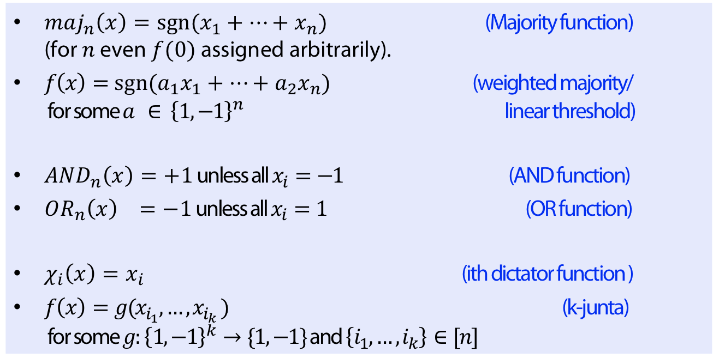
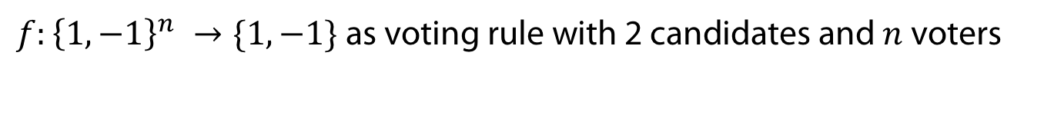
Social Choice
$f:{\left\{1,−1\right\}}^{n} →\{1,−1\}$ as voting rule with 2 candidates and $n$ voters
Definition
$maj_{n}\left(x\right)=sgn⁡(x_{1}+…+x_{n})$ (Majority function)
(for $n$ even $f(0)$ assigned arbitrarily).
$f\left(x\right)=sgn⁡({a_{1}x}_{1}+…+a_{2}x_{n})$ (weighted majority/
for some $a ∈ {\left\{1,−1\right\}}^{n}$ linear threshold)
$AND_{n}\left(x\right)=+1$ unless all $x_{i}=−1$ (AND function)
$OR_{n}\left(x\right) =−1$ unless all $x_{i}=1$ (OR function)
$χ_{i}\left(x\right)=x_{i}$ (ith dictator function )
$f\left(x\right)=g(x_{i_{1}}, …, x_{i_{k}} )$ (k-junta)
for some $g:{\left\{1,−1\right\}}^{k}→\{1,−1\}$ and $\left\{i_{1},…, i_{k}\right\}∈[n]$

Slide 6
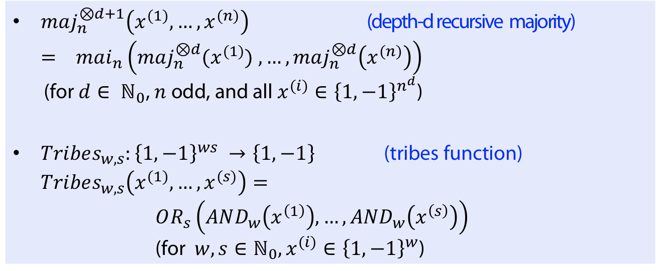
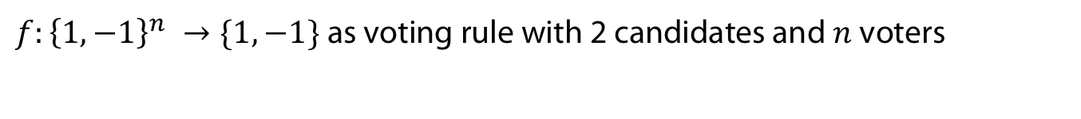
Social Choice
$f:{\left\{1,−1\right\}}^{n} →\{1,−1\}$ as voting rule with 2 candidates and $n$ voters
Definition
$maj_{n}^{⊗d+1}\left(x^{(1)}, …, x^{(n)}\right)$ (depth-d recursive majority)
$= mai_{n}\left(maj_{n}^{⊗d}(x^{(1)}) , …,maj_{n}^{⊗d}\left(x^{(n)}\right)\right)$
(for $d∈ ℕ_{0}$, $n$ odd, and all $x^{(i)}∈{\left\{1,−1\right\}}^{n^{d}}$)
$Tribes_{w,s}:{\left\{1,−1\right\}}^{ws} →\left\{1,−1\right\}$ (tribes function)
$Tribes_{w,s}\left(x^{(1)}, …, x^{(s)}\right)=$
$OR_{s}\left(AND_{w}\left(x^{\left(1\right)}\right), …, AND_{w}\left(x^{\left(s\right)}\right)\right)$
$\text{(}\text{for} {w,s∈ℕ_{0}, x}^{(i)}∈{\left\{1,−1\right\}}^{w}\text{)}$
Depth-2 recursive majority used in presidental elections in USA

Slide 7
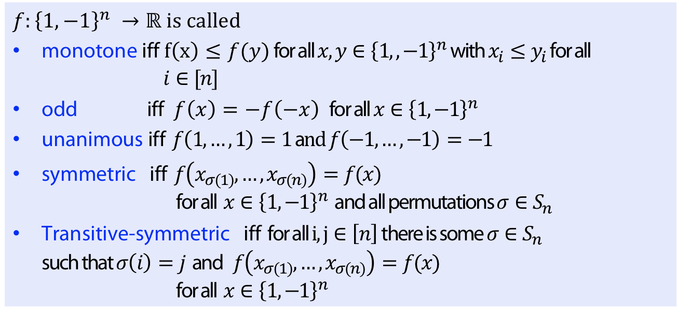
Social Choice
$f:{\left\{1,−1\right\}}^{n} →\{1,−1\}$ as voting rule with 2 candidates and $n$ voters
Definition
$f:{\left\{1,−1\right\}}^{n} →ℝ$ is called
monotone iff $f\left(x\right)≤f(y)$ for all $x,y∈{\left\{1,,−1\right\}}^{n}$with $x_{i}≤y_{i}$ for all
$i∈[n]$
odd iff $f\left(x\right)=−f\left(−x\right)$for all $x∈{\left\{1,−1\right\}}^{n}$
unanimous iff $f\left(1,…, 1\right)=1$a$nd f\left(−1,…, −1\right)=−1$
symmetric iff $f\left(x_{σ(1)},…, x_{σ(n)}\right)=f(x)$
for all $x∈{\left\{1,−1\right\}}^{n}$ and all permutations $σ∈S_{n}$
Transitive-symmetric iff for all $i, j∈\left[n\right]$ there is some $σ∈S_{n}$
such that $σ\left(i\right)=j$ and $f\left(x_{σ(1)},…, x_{σ(n)}\right)=f(x)$
for all $x∈{\left\{1,−1\right\}}^{n}$

Slide 8
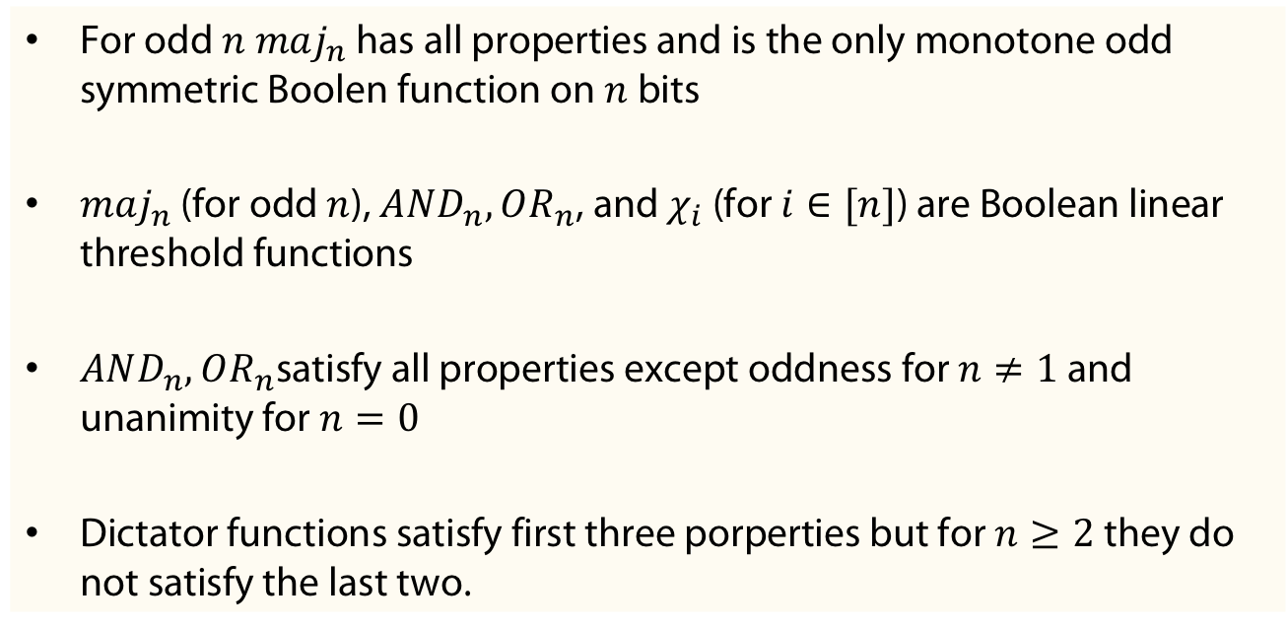
Properties fulfilled by functions
Example
For odd $n$ $maj_{n}$ has all properties and is the only monotone odd symmetric Boolen function on $n$ bits
$maj_{n}$ (for odd $n$), $AND_{n},OR_{n}$, and $χ_{i}$ (for $i∈[n]$) are Boolean linear threshold functions
$AND_{n},OR_{n}$satisfy all properties except oddness for $n≠1$ and unanimity for $n=0$
Dictator functions satisfy first three porperties but for $n≥2$ they do not satisfy the last two.

Slide 9
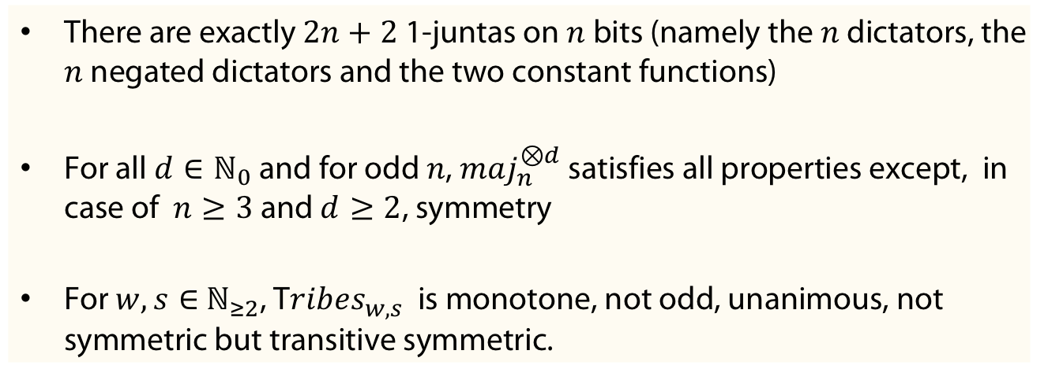
Properties fulfilled by functions
Example
There are exactly $2n+2$ 1-juntas on $n$ bits (namely the $n$dictators, the $n$ negated dictators and the two constant functions)
For all $d∈ℕ_{0}$ and for odd $n$, $maj_{n}^{⊗d}$ satisfies all properties except, in case of $n≥3$and $d≥2$, symmetry
For $w, s∈$ $ℕ_{≥2}$, T$ribes_{w,s}$ is monotone, not odd, unanimous, not symmetric but transitive symmetric.

Slide 10
Influences and Derivatives

Slide 11
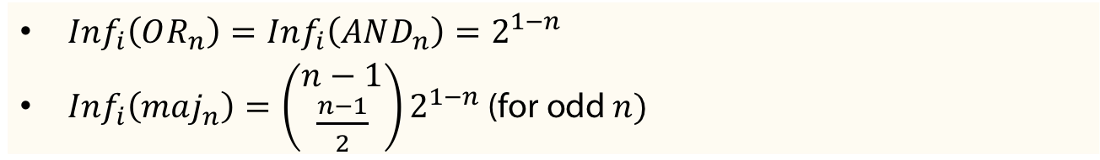
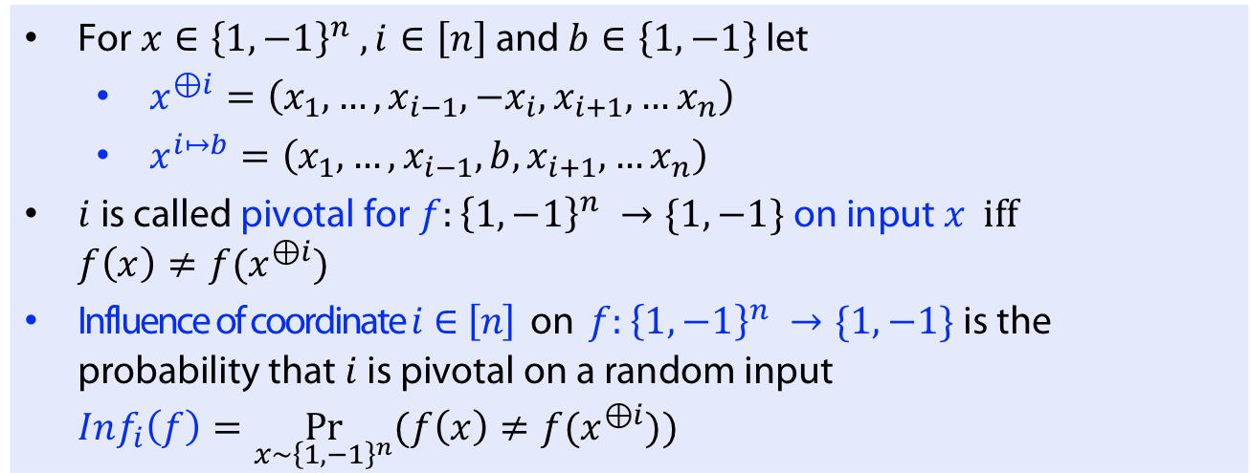
i-th Influence
Definition
For $x∈{\left\{1,−1\right\}}^{n} , i∈\left[n\right]$ and $b∈\left\{1,−1\right\}$ let
  $x^{⊕i}=\left(x_{1}, …, x_{i−1},−x_{i}, x_{i+1}, …x_{n}\right)$
  $x^{i↦b}=\left(x_{1}, …, x_{i−1},b, x_{i+1}, …x_{n}\right)$
$i$ is called pivotal for $f:{\left\{1,−1\right\}}^{n} →\{1,−1\}$ on input $x$ iff $f\left(x\right)≠f(x^{⊕i})$
Influence of coordinate $i∈\left[n\right]$ on $f:{\left\{1,−1\right\}}^{n} →\{1,−1\}$ is the probability that $i$ is pivotal on a random input
$Inf_{i}\left(f\right)=\underset{x∼{\left\{1,−1\right\}}^{n}}{Pr}{(f\left(x\right)≠f(x^{⊕i}))}$
Example
$Inf_{i}\left(OR_{n}\right)=Inf_{i}\left(AND_{n}\right)=2^{1−n}$
$Inf_{i}\left(maj_{n}\right)=\left(\begin{matrix}n−1 \\ \frac{n−1}{2}\end{matrix}\right)2^{1−n}$ (for odd $n)$

Slide 12
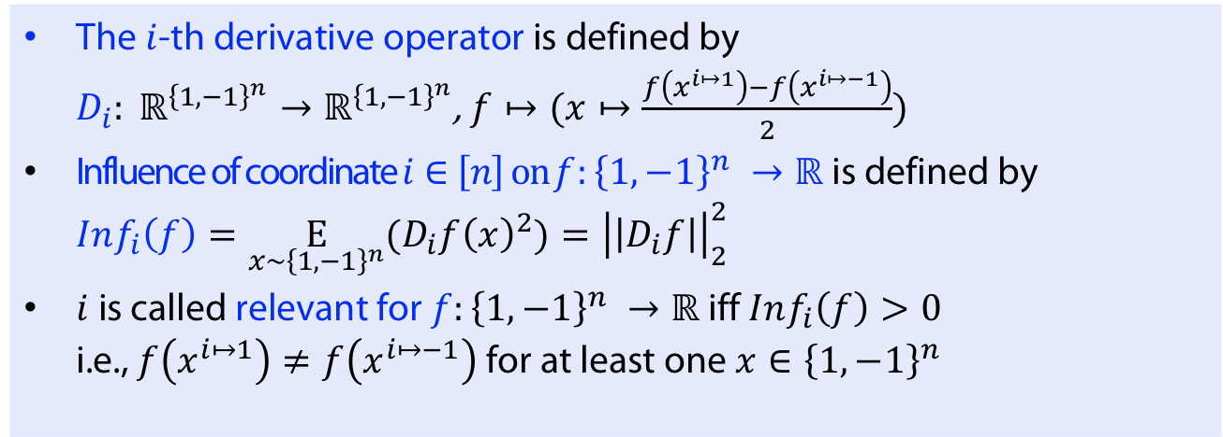
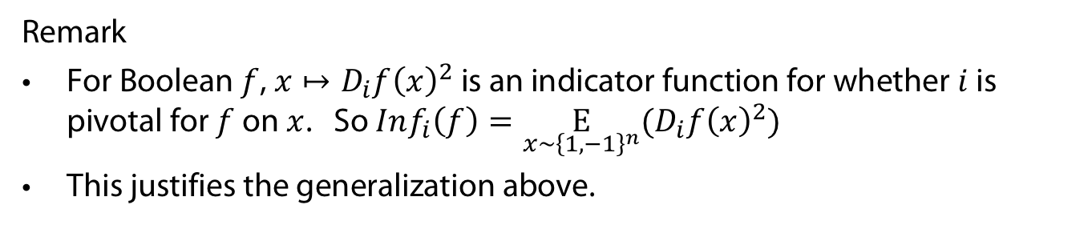
Definition
The $i$-th derivative operator is defined by
$D_{i}: ℝ^{{\left\{1,−1\right\}}^{n}}→ℝ^{{\left\{1,−1\right\}}^{n}}$, $f↦(x↦\frac{f\left(x^{i↦1}\right)−f\left(x^{i↦−1}\right)}{2})$
Influence of coordinate $i∈\left[n\right] on f:{\left\{1,−1\right\}}^{n} →ℝ$ is defined by $Inf_{i}\left(f\right)=\underset{x∼{\left\{1,−1\right\}}^{n}}{E}{(D_{i}f{\left(x\right)}^{2})}={\left|\left|D_{i}f\right|\right|}_{2}^{2}$
$i$ is called relevant for $f:{\left\{1,−1\right\}}^{n} →ℝ$ iff $Inf_{i}\left(f\right)>0$
i.e., $f\left(x^{i↦1}\right)≠f\left(x^{i↦−1}\right)$ for at least one $x∈{\left\{1,−1\right\}}^{n}$
Remark
For Boolean $f$, $x↦D_{i}f{\left(x\right)}^{2}$ is an indicator function for whether $i$ is pivotal for $f$ on $x$. So $Inf_{i}\left(f\right)=\underset{x∼{\left\{1,−1\right\}}^{n}}{E}{(D_{i}f{\left(x\right)}^{2})}$
This justifies the generalization above.

Slide 13
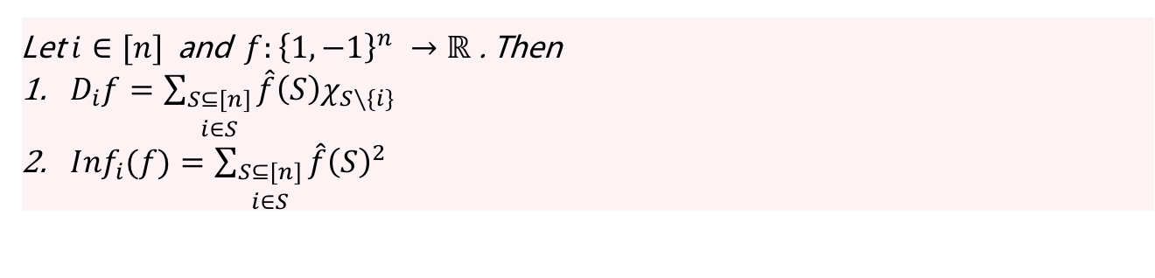
Derivative and Influence
Remark
Let $i∈[n]$ and $f:{\left\{1,−1\right\}}^{n} →ℝ$. Then
$D_{i}f=\sum_{\begin{aligned}S⊆[n] \\ i∈S\end{aligned}}{\hat{f}\left(S\right)χ_{S∖\{i\}}}$
${Inf}_{i}(f)=\sum_{\begin{aligned}S⊆[n] \\ i∈S\end{aligned}}{\hat{f}{\left(S\right)}^{2}}$
Wake-Up-Question: Prove the remark

Slide 14
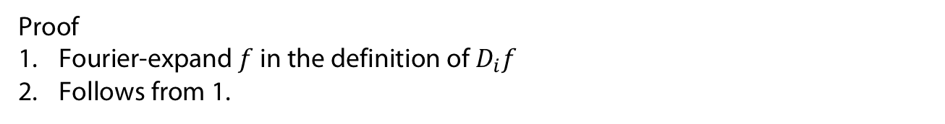
Derivative and Influence
Remark
Let $i∈[n]$ and $f:{\left\{1,−1\right\}}^{n} →ℝ$. Then
$D_{i}f=\sum_{\begin{aligned}S⊆[n] \\ i∈S\end{aligned}}{\hat{f}\left(S\right)χ_{S∖\{i\}}}$
${Inf}_{i}(f)=\sum_{\begin{aligned}S⊆[n] \\ i∈S\end{aligned}}{\hat{f}{\left(S\right)}^{2}}$
Wake-Up-Question: Prove the remark
Proof
Fourier-expand $f$ in the definition of $D_{i}f$
Follows from 1.

Slide 15
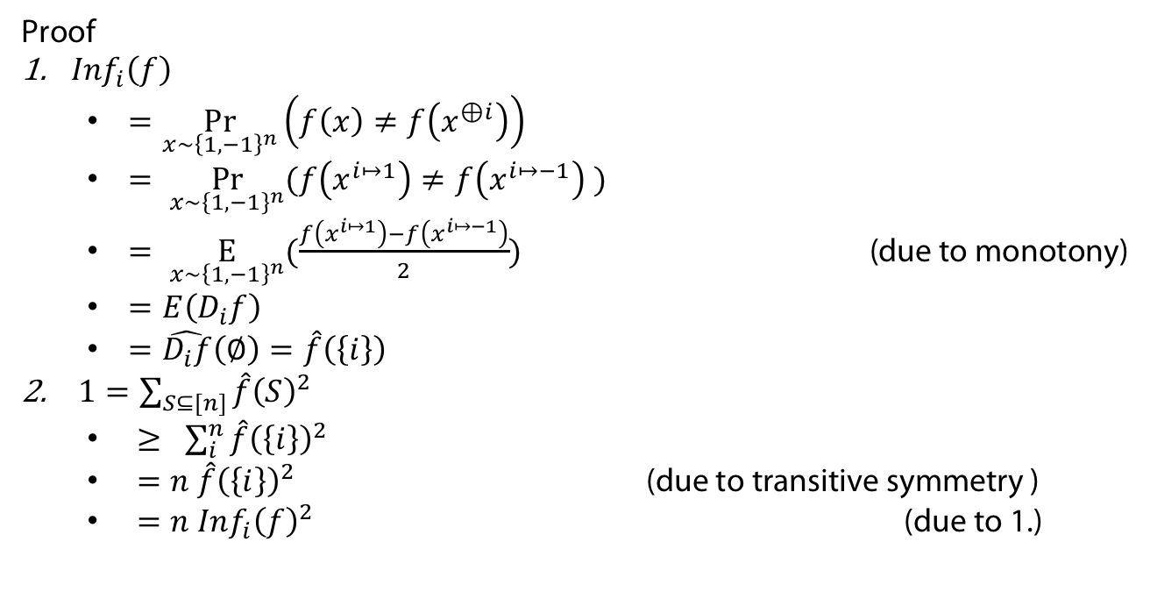
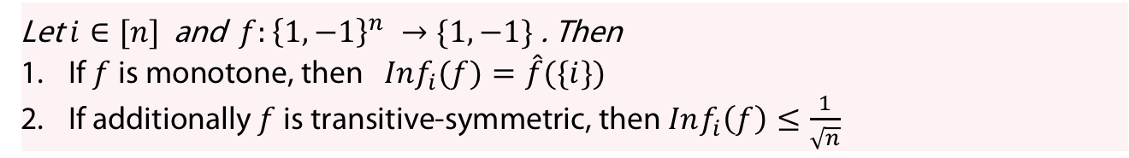
Derivative and Influence
Proposition
Let $i∈[n]$ and $f:{\left\{1,−1\right\}}^{n} →\{1,−1\}$. Then
If $f$ is monotone, then ${Inf}_{i}(f)=\hat{f}(\{i\})$
If additionally $f$ is transitive-symmetric, then $Inf_{i}\left(f\right)≤\frac{1}{\sqrt{n}}$
Proof
${Inf}_{i}\left(f\right)$
  $=\underset{x∼{\left\{1,−1\right\}}^{n}}{Pr}\left(f\left(x\right)≠f\left(x^{⊕i}\right)\right)$
  $= \underset{x∼{\left\{1,−1\right\}}^{n}}{Pr}{(f\left(x^{i↦1}\right)≠f\left(x^{i↦−1}\right) )}$
  $= \underset{x∼{\left\{1,−1\right\}}^{n}}{E}{(\frac{f\left(x^{i↦1}\right)−f\left(x^{i↦−1}\right)}{2}) }$ (due to monotony)
  $=E\left(D_{i}f\right)$
  $=\hat{D_{i}f}\left(∅\right)=\hat{f}\left(\left\{i\right\}\right)$
$1=\sum_{S⊆[n]}{\hat{f}{\left(S\right)}^{2}}$
  $≥ \sum_{i}^{n}{\hat{f}{\left(\left\{i\right\}\right)}^{2}}$
  $=n \hat{f}{\left(\left\{i\right\}\right)}^{2}$ (due to transitive symmetry )
  $=n Inf_{i}{\left(f\right)}^{2}$ (due to 1.)

Slide 16
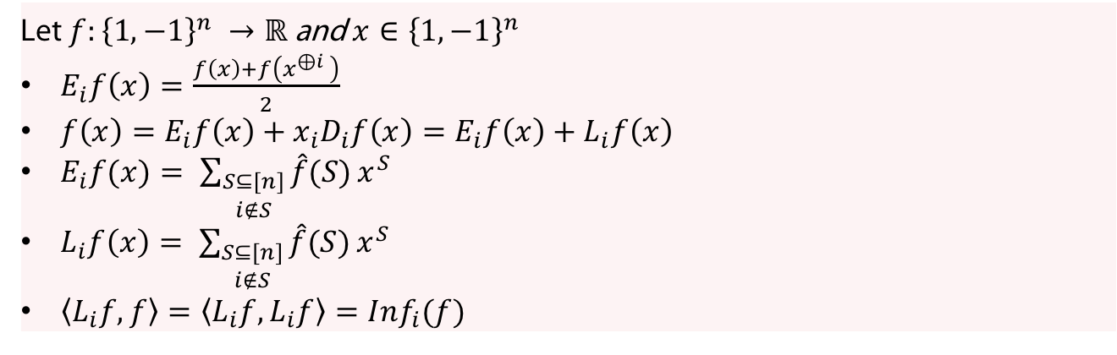
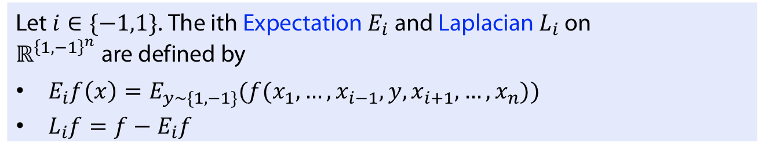
ith Expectation and ith Laplacian
Definition
Let $i∈\{−1,1\}$. The ith Expectation $E_{i}$and Laplacian $L_{i}$ on $ℝ^{{\left\{1,−1\right\}}^{n}}$are defined by
$E_{i}f\left(x\right)=E_{y∼\{1,−1\}}(f(x_{1},…,x_{i−1}, y, x_{i+1}, …, x_{n}))$
$L_{i}f=f−E_{i}f$
Remark
Let $f:{\left\{1,−1\right\}}^{n} →ℝ$ and $x∈{\left\{1,−1\right\}}^{n}$
$E_{i}f\left(x\right)=\frac{f\left(x\right)+f\left(x^{⊕i} \right)}{2}$
$f\left(x\right)=E_{i}f\left(x\right)+x_{i}D_{i}f\left(x\right)=E_{i}f\left(x\right)+L_{i}f\left(x\right)$
$E_{i}f(x)= \sum_{\begin{aligned}S⊆[n] \\ i∉S\end{aligned}}{\hat{f}(S)}x^{S}$
$L_{i}f\left(x\right)= \sum_{\begin{aligned}S⊆[n] \\ i∉S\end{aligned}}{\hat{f}(S)}x^{S}$
$\left\langle L_{i}f,f\right\rangle =\left\langle L_{i}f, L_{i}f\right\rangle =Inf_{i}(f)$

Slide 17
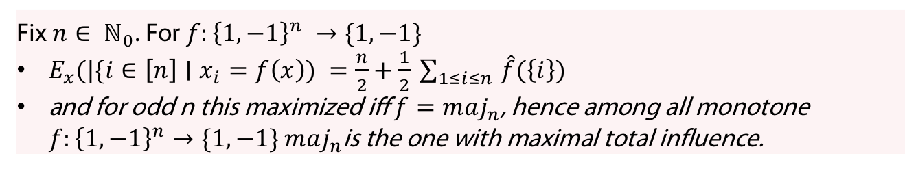
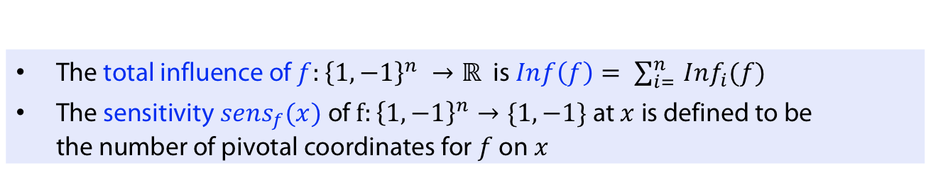
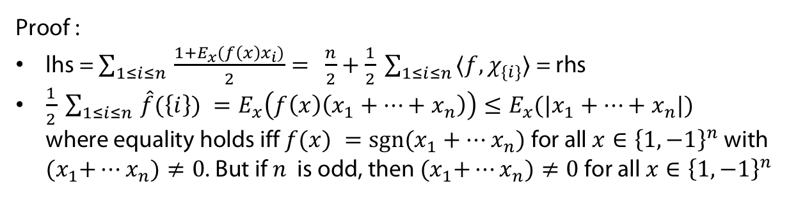
Sensitivity
Definition
The total influence of $f:{\left\{1,−1\right\}}^{n} →ℝ$ is $Inf\left(f\right)= \sum_{i= }^{n}{Inf_{i}(f)}$
The sensitivity $sens_{f}(x)$ of $f:{\left\{1,−1\right\}}^{n}→\{1,−1\}$ at $x$ is defined to be the number of pivotal coordinates for $f$ on $x$
Theorem
Fix $n∈ ℕ_{0}$. For $f:{\left\{1,−1\right\}}^{n} →\{1,−1\}$
$E_{x}(|\{i∈\left[n\right]∣x_{i}=f\left(x\right)) =\frac{n}{2}+\frac{1}{2} \sum_{1≤i≤n }{\hat{f}(\left\{i\right\}) }$
and for odd n this maximized iff $f=maj_{n}$, hence among all monotone $f:{\left\{1,−1\right\}}^{n}→\{1,−1\}$ $maj_{n}$is the one with maximal total influence.
Proof :
lhs = $\sum_{1≤i≤n }{\frac{1+E_{x}(f\left(x\right)x_{i})}{2}= }$ $\frac{n}{2}+\frac{1}{2} \sum_{1≤i≤n }{⟨f, χ_{\{i\}}⟩}$ = rhs
$\frac{1}{2} \sum_{1≤i≤n }{\hat{f}(\left\{i\right\}) }=E_{x}\left(f\left(x\right)\left(x_{1}+…+x_{n}\right)\right)≤E_{x}(|x_{1}+…+x_{n}|)$
where equality holds iff $f(x) =sgn⁡(x_{1}+…x_{n})$ for all $x∈{\left\{1,−1\right\}}^{n}$ with
${(x}_{1}+…x_{n})≠0$. But if $n$ is odd, then ${(x}_{1}+…x_{n})≠0$ for all $x∈{\left\{1,−1\right\}}^{n}$

Slide 18
Getting famous with Fourier analysis research...
A complexity measure related to sensitivity plays a prominent role in a recent breakthrough result described in a short paper (Huang 19)
Concerns the sensitivity conjecture (Nisan/Szegedy 92)
  Roughly: Most complexity measures on boolean functions could be shown to be polynomially reducible to each other
  For a sensitivity based complexity this could not be proved - until Huang‘s insight
There are many nice explanations on various theory-related blogs (see here for the links) and even a short twitter explanation by O‘Donnell.

Slide 19
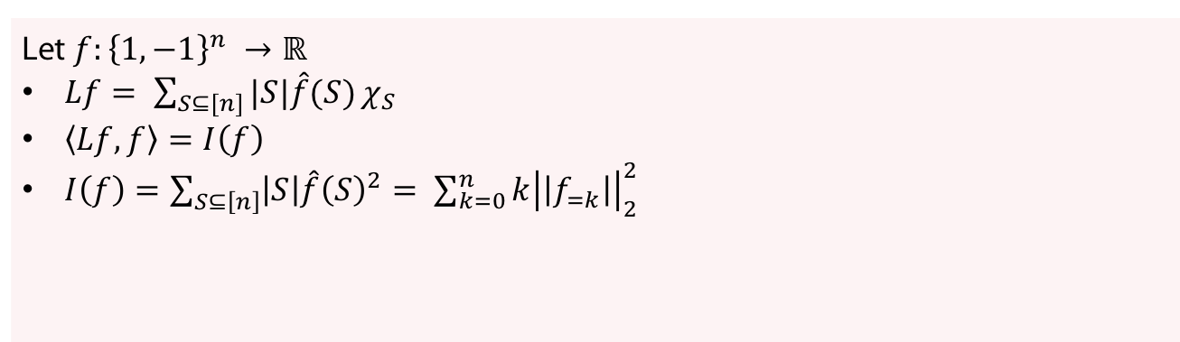
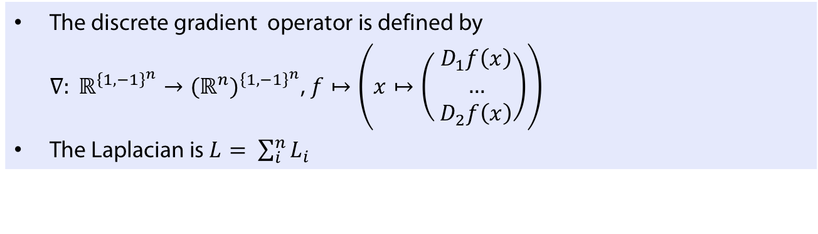
Discrete gradient and Laplacian
Definition
The discrete gradient operator is defined by
$∇: ℝ^{{\left\{1,−1\right\}}^{n}}→{(ℝ^{n})}^{{\left\{1,−1\right\}}^{n}}$, $f↦\left(x↦\left( \begin{matrix}D_{1}f\left(x\right) \\ … \\ D_{2}f\left(x\right)\end{matrix}\right)\right)$
The Laplacian is $L= \sum_{i}^{n}{L_{i}}$
Remark
Let $f:{\left\{1,−1\right\}}^{n} →ℝ$
$Lf= \sum_{S⊆[n]}{|S|\hat{f}(S)}χ_{S}$
$\left\langle Lf,f\right\rangle =I\left(f\right)$
$I\left(f\right)=\sum_{S⊆\left[n\right]}{\left|S\right|\hat{f}{\left(S\right)}^{2}}= \sum_{k=0}^{n}{k{\left|\left|f_{=k}\right|\right|}_{2}^{2}}$

Slide 20
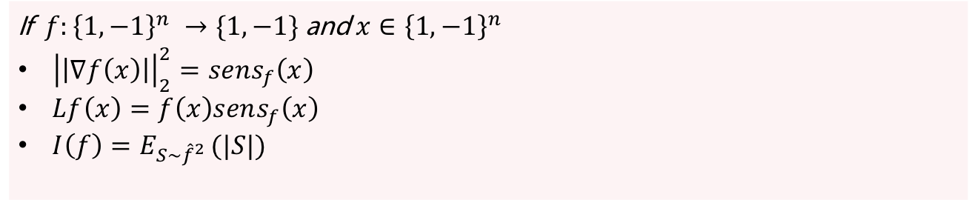
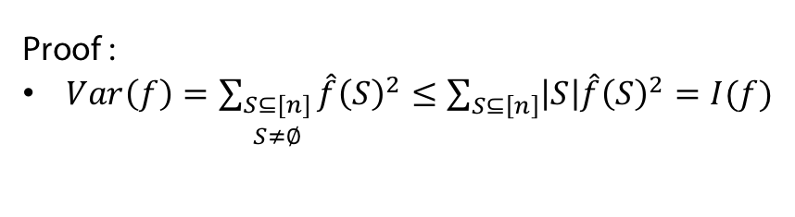
Discrete gradient and Laplacian
Remark
If $f:{\left\{1,−1\right\}}^{n} →\{1,−1\}$ and $x∈{\left\{1,−1\right\}}^{n}$
${\left|\left|∇f\left(x\right)\right|\right|}_{2}^{2}=sens_{f}\left(x\right)$
$Lf\left(x\right)=f\left(x\right)sens_{f}\left(x\right)$
$I\left(f\right)=E_{S∼{\hat{f}}^{2} }(|S|)$
Proposition (Poincare Lemma)
Let $f:{\left\{1,−1\right\}}^{n} →ℝ$. Then $Var\left(f\right)≤I(f)$
Proof :
$Var\left(f\right)=\sum_{\begin{aligned}S⊆[n] \\ S≠∅\end{aligned}}{\hat{f}{\left(S\right)}^{2}}≤\sum_{S⊆\left[n\right]}{\left|S\right|\hat{f}{\left(S\right)}^{2}}=I(f)$

Slide 21
NOISE Stability and ARROW‘S PROOF oF Theorem

Slide 22
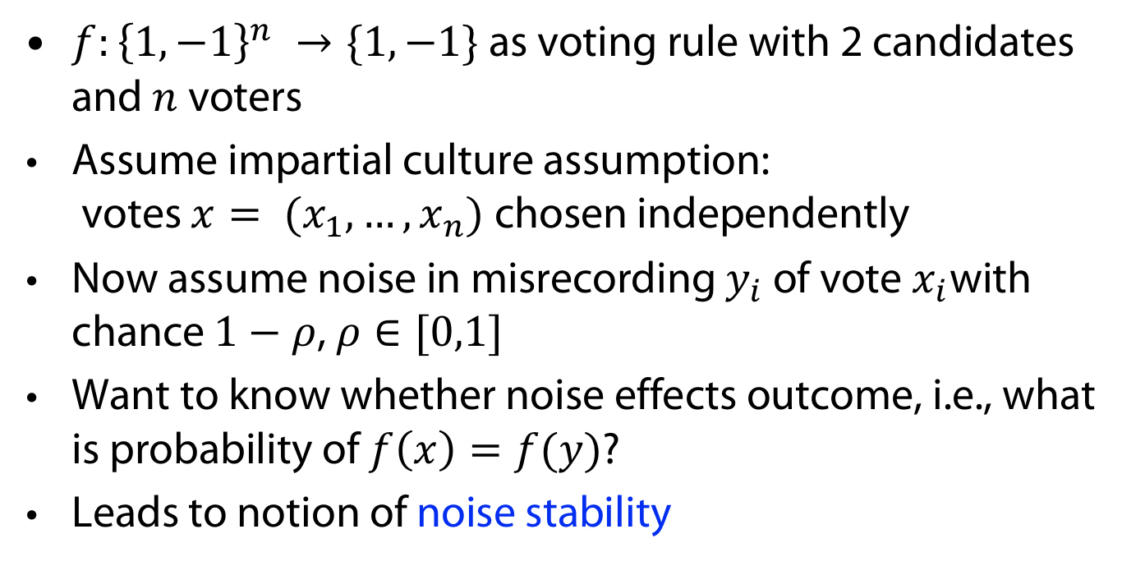
Noise Stability: Motivation
$f:{\left\{1,−1\right\}}^{n} →\{1,−1\}$ as voting rule with 2 candidates and $n$ voters
Assume impartial culture assumption:
votes $x= (x_{1}, …, x_{n})$chosen independently
Now assume noise in misrecording $y_{i}$ of vote $x_{i}$with chance $1−ρ$, $ρ∈[0,1]$
Want to know whether noise effects outcome, i.e., what is probability of $f\left(x\right)=f(y)$?
Leads to notion of noise stability

Slide 23
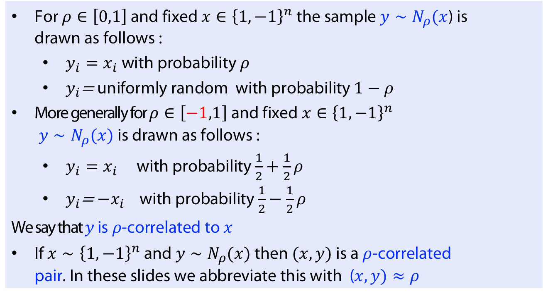
Correlated sampling
Definition
For $ρ∈\left[0,1\right]$ and fixed $x∈{\left\{1,−1\right\}}^{n}$ the sample $y∼N_{ρ}(x$) is drawn as follows :
  $y_{i}=x_{i}$ with probability $ρ$
  $y_{i}$= uniformly random with probability $1−ρ$
More generally for $ρ∈\left[−1,1\right]$ and fixed $x∈{\left\{1,−1\right\}}^{n}$
$y∼N_{ρ}(x)$is drawn as follows :
  $y_{i}=x_{i}$ with probability $\frac{1}{2}+\frac{1}{2}ρ$
  $y_{i}$= $−x_{i}$ with probability $\frac{1}{2}−\frac{1}{2}ρ$
We say that $y$ is $ρ$-correlated to $x$
If $x∼{\left\{1,−1\right\}}^{n}$ and $y∼N_{ρ}(x)$ then $(x,y)$ is a $ρ$-correlated pair. In these slides we abbreviate this with ($x,y)≈ρ$
This is equivalent to saying $E\left(x_{i}\right)=0, E\left(y_{i}\right)=0$ and $E\left(x_{i},y_{i}\right)=ρ$ for each $i$

Slide 24
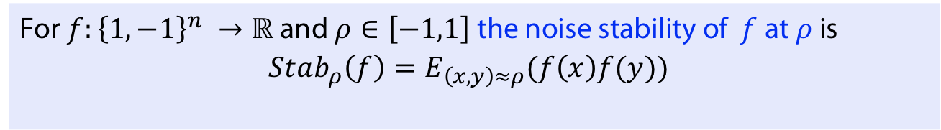
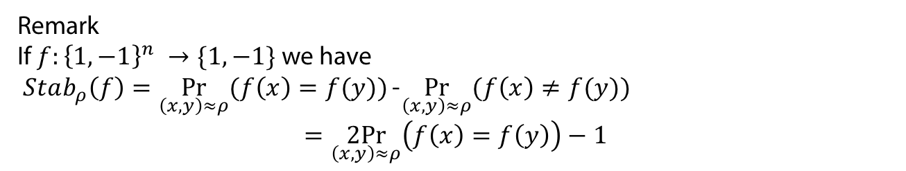
Noise Stability: Definition
$f:{\left\{1,−1\right\}}^{n} →\{1,−1\}$ as voting rule with 2 candidates and $n$ voters
Definition
For $f:{\left\{1,−1\right\}}^{n} →ℝ$ and $ρ∈\left[−1,1\right]$ the noise stability of $f$ at $ρ$ is
$$Stab_{ρ}\left(f\right)=E_{\left(x,y\right)≈ρ}(f\left(x\right)f(y))$$
Remark
If $f:{\left\{1,−1\right\}}^{n} →\{1,−1\}$ we have
$Stab_{ρ}\left(f\right)=\underset{\left(x,y\right)≈ρ}{Pr}{(f\left(x\right)=f(y))}$ - $\underset{\left(x,y\right)≈ρ}{Pr}{(f\left(x\right)≠f(y))}$
$$=\underset{\left(x,y\right)≈ρ}{2Pr}\left(f\left(x\right)=f\left(y\right)\right)−1$$

Slide 25
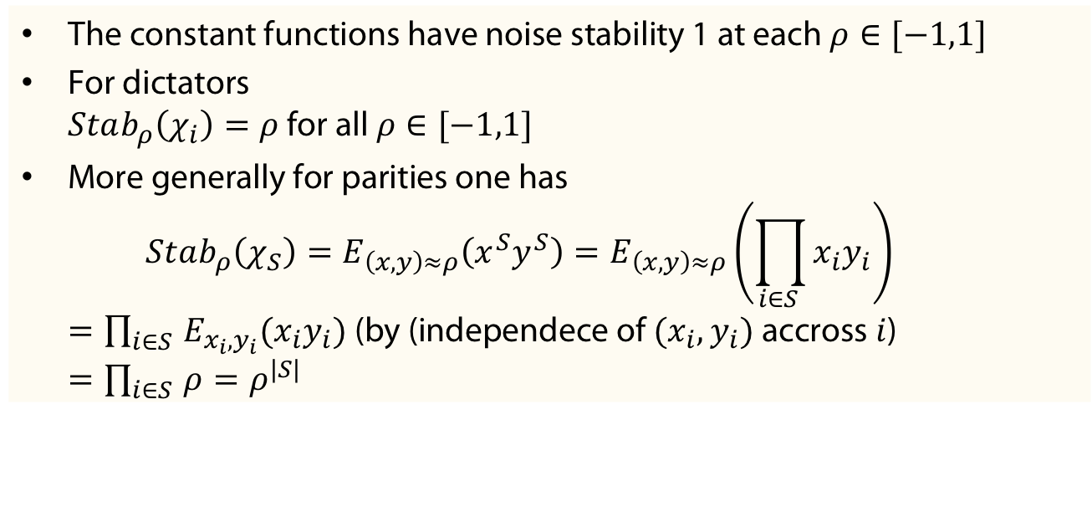
Example
The constant functions have noise stability 1 at each $ρ∈[−1,1]$
For dictators
$Stab_{ρ}\left(χ_{i}\right)=ρ$ for all $ρ∈[−1,1]$
More generally for parities one has
$Stab_{ρ}\left(χ_{S}\right)=E_{\left(x,y\right)≈ρ}\left(x^{S}y^{S}\right)=E_{\left(x,y\right)≈ρ}\left(\prod_{i∈S }{x_{i}y_{i}}\right)$
$=\prod_{i∈S }{{E_{x_{i}, y_{i}}(x}_{i}y_{i})}$ (by (independece of $(x_{i},y_{i})$accross $i$)
$=\prod_{i∈S }{ρ}=ρ^{|S|}$

Slide 26
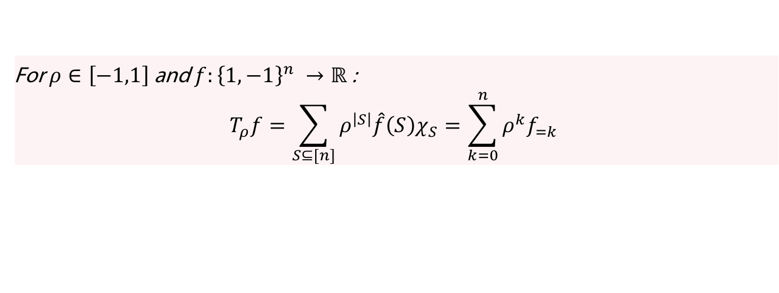
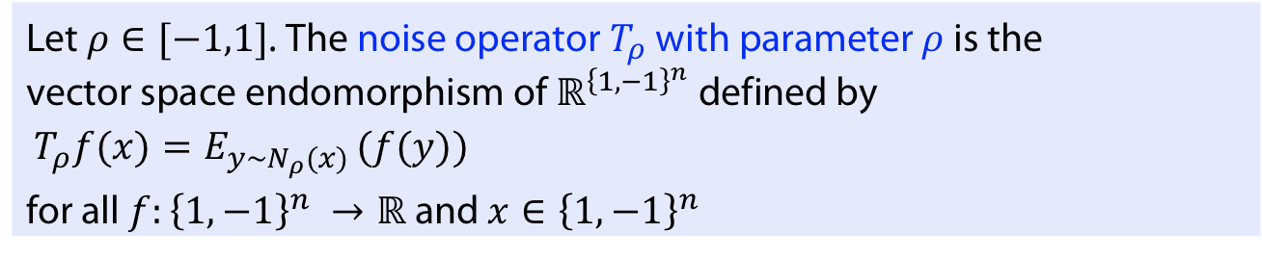
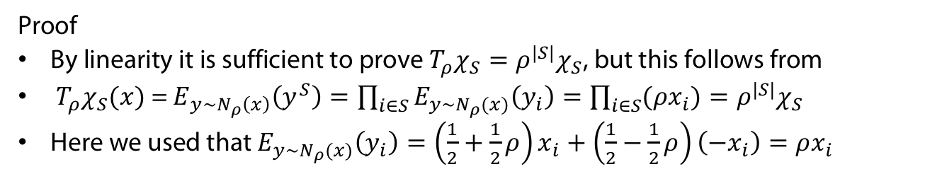
Noise operator
Definition
Let $ρ∈[−1,1]$. The noise operator $T_{ρ}$ with parameter $ρ$ is the vector space endomorphism of$ℝ^{{\left\{1,−1\right\}}^{n}}$ defined by
$T_{ρ}f(x)=E_{y∼N_{ρ}(x) }(f(y))$
for all $f:{\left\{1,−1\right\}}^{n} →ℝ$and $x∈{\left\{1,−1\right\}}^{n}$
Theorem
For $ρ∈\left[−1,1\right]$ and $f:{\left\{1,−1\right\}}^{n} →ℝ$:
$$T_{ρ}f=\sum_{S⊆[n]}{ρ^{\left|S\right|}\hat{f}\left(S\right)χ_{S}}=\sum_{k=0}^{n}{ρ^{k}f_{=k}}$$
Proof
By linearity it is sufficient to prove $T_{ρ}χ_{S}=ρ^{|S|}χ_{S}$, but this follows from
$T_{ρ}χ_{S}(x)$= $E_{y∼N_{ρ}\left(x\right)}\left(y^{S}\right)=\prod_{i∈S}{E_{y∼N_{ρ}(x)}\left(y_{i}\right)=\prod_{i∈S}{(ρx_{i})=ρ^{|S|}χ_{S}}}$
Here we used that $E_{y∼N_{ρ}(x)}\left(y_{i}\right)=\left(\frac{1}{2}+\frac{1}{2}ρ\right)x_{i}+\left(\frac{1}{2}−\frac{1}{2}ρ\right)\left(−x_{i}\right)=ρx_{i}$

Slide 27
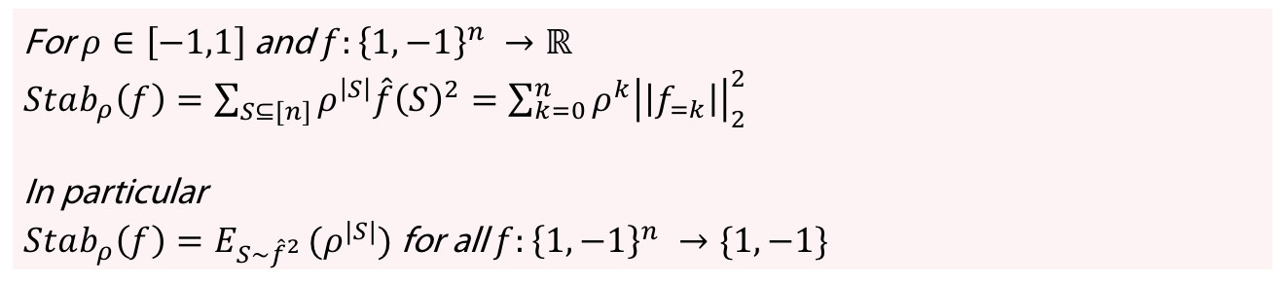
Stability and Noise operator
Theorem
For $ρ∈\left[−1,1\right]$ and $f:{\left\{1,−1\right\}}^{n} →ℝ$
$$Stab_{ρ}\left(f\right)=⟨f, T_{ρ}f⟩$$
Proof
$Stab_{ρ}\left(f\right)=E_{\left(x,y\right)≈ρ}\left(f\left(x\right)f\left(y\right)\right)=E_{x∼{\left\{1,−1\right\}}^{n}}(f\left(x\right)E_{y∼N_{ρ}\left(x\right)}(f(y)))$
Corollary
For $ρ∈\left[−1,1\right]$ and $f:{\left\{1,−1\right\}}^{n} →ℝ$
$Stab_{ρ}\left(f\right)=\sum_{S⊆[n]}{ρ^{\left|S\right|}\hat{f}{\left(S\right)}^{2}}=\sum_{k=0}^{n}{ρ^{k}{\left|\left|f_{=k}\right|\right|}_{2}^{2}}$
In particular
$Stab_{ρ}\left(f\right)=E_{S∼{\hat{f}}^{2} }(ρ^{|S|})$ for all $f:{\left\{1,−1\right\}}^{n} →\{1,−1\}$

Slide 28
Condorcet election
For two candidates, majority function has all good properties
For at least 3 candidates problem of social becomes much mor difficult
Remember Condorcet election:
  Compare each pair of alternatives
  Declare “a” is socially preferred to “b” if more voters strictly prefer a to b
Condorcet winner: Wins all of the pairwise elections in which he participates (for 3 candidates there are two such pairwise elections in which he participates).

Slide 29
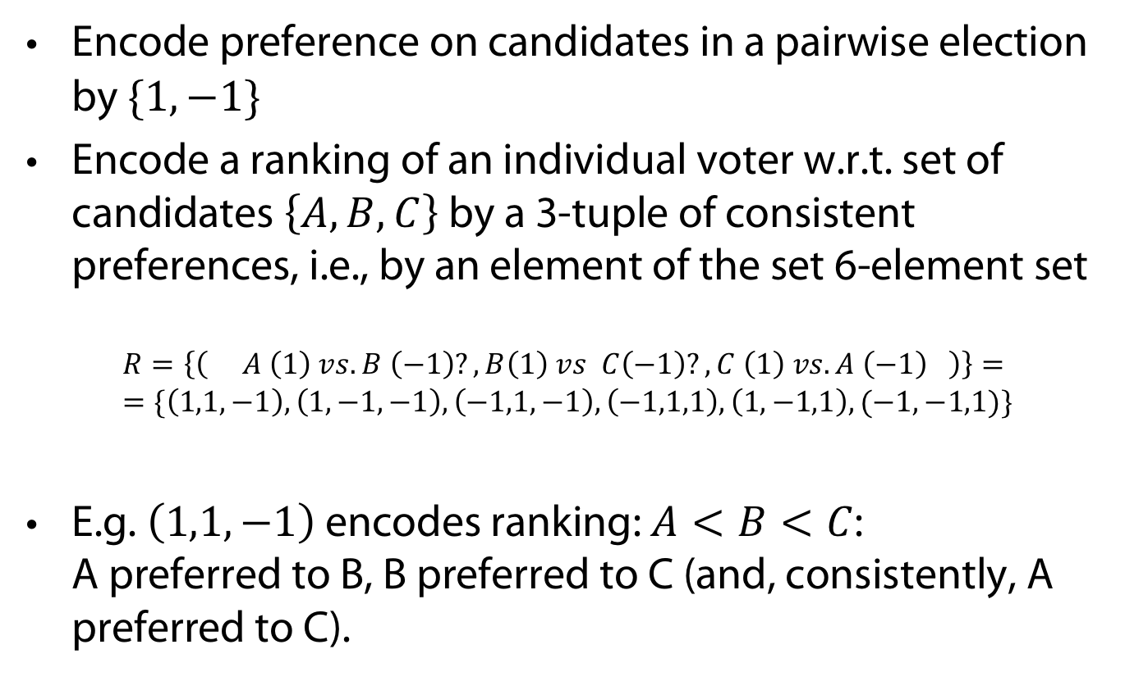
Boolean Encoding of Condorcet
Encode preference on candidates in a pairwise election by $\{1,−1\}$
Encode a ranking of an individual voter w.r.t. set of candidates $\left\{A,B,C\right\}$by a 3-tuple of consistent preferences, i.e., by an element of the set 6-element set
$$R=\left\{\left( A \left(1\right) vs.B \left(−1\right)?, B\left(1\right) vs C\left(−1\right)?, C \left(1\right) vs. A \left(−1\right) \right)\right\}= \\ =\{\left(1,1,−1\right), \left(1,−1,−1\right), \left(−1,1,−1\right), \left(−1,1,1\right), \left(1,−1,1\right),(−1,−1,1)\}$$
E.g. $\left(1,1,−1\right)$ encodes ranking: $A<B<C$:
A preferred to B, B preferred to C (and, consistently, A preferred to C).

Slide 30
Example
Three voters (n= 3), three candidates, f = maj_{n} with existing Condorcet winner a:
 | Voter rankings
 | #1 | #2 | #3 |  | Societal aggregation
A (1) vs. B (-1) | 1 | 1 | -1 | = x | f(x) = 1
B (1) vs. C (-1) | 1 | -1 | 1 | = y | f(y) = 1
C (1) vs. A (-1) | -1 | -1 | 1 | = z | f(z) = -1

Slide 31
Example
Three voters (n= 3), three candidates , f = maj_{n} without existing Condorcet winner
Societal outcome (1,1,1) not consistent (circular)
 | Voter rankings
 | #1 | #2 | #3 |  | Societal aggregation
A (1) vs. B (-1) | 1 | 1 | -1 | = x | f(x) = 1
B (1) vs. C (-1) | 1 | -1 | 1 | = y | f(y) = 1
C (1) vs. A (-1) | -1 | 1 | 1 | = z | f(z) = 1

Slide 32
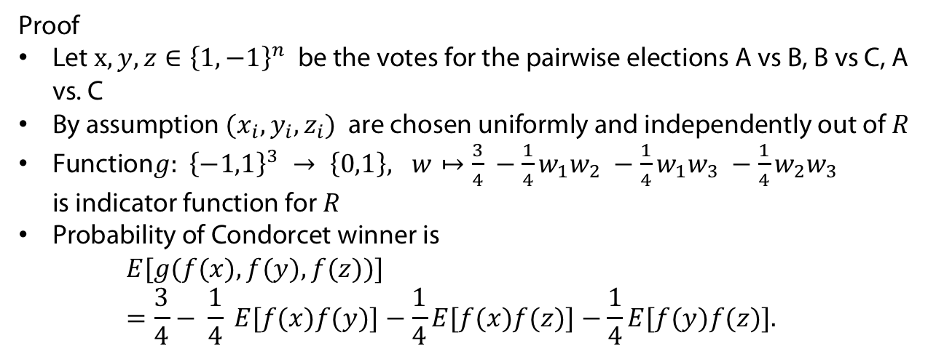
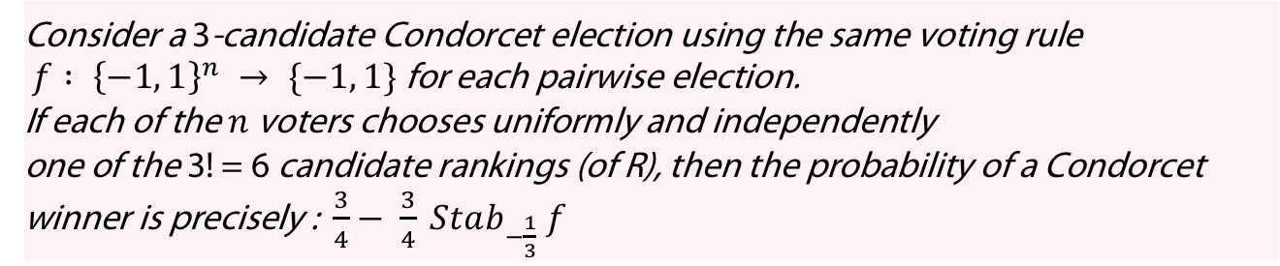
Theorem
Consider a 3-candidate Condorcet election using the same voting rule
$f : {\left\{−1, 1\right\}}^{n} → \{−1, 1\}$ for each pairwise election.
If each of the $n$ voters chooses uniformly and independently
one of the 3! = 6 candidate rankings (of R), then the probability of a Condorcet winner is precisely : $\frac{3}{4}− \frac{3}{4} Stab_{−\frac{1}{3}} f$
Proof
Let $x,y,z∈{\left\{1,−1\right\}}^{n}$ be the votes for the pairwise elections A vs B, B vs C, A vs. C
By assumption ${(x}_{i},y_{i}, z_{i})$ are chosen uniformly and independently out of $R$
Function$g: {\left\{−1,1\right\}}^{3} → \left\{0,1\right\}, w↦\frac{3}{4} −\frac{1}{4}w_{1}w_{2} −\frac{1}{4}w_{1}w_{3} −\frac{1}{4}w_{2}w_{3}$
is indicator function for $R$
Probability of Condorcet winner is
$E[g(f(x), f(y), f(z))] =\frac{3}{4}− \frac{1}{4} E[f(x)f(y)]−\frac{1}{4}E[f(x)f(z)]−\frac{1}{4}E[f(y)f(z)].$

Slide 33
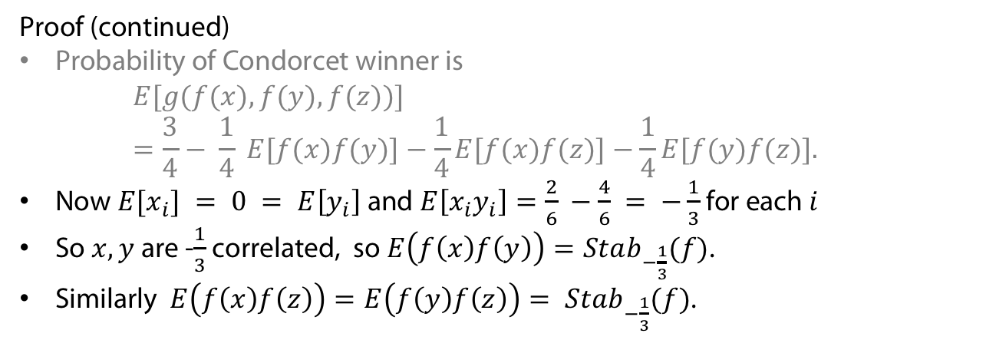
Theorem
Consider a 3-candidate Condorcet election using the same voting rule
$f : {\left\{−1, 1\right\}}^{n} → \{−1, 1\}$ for each pairwise election.
If each of the $n$ voters chooses uniformly and independently
one of the 3! = 6 candidate rankings (of R), then the probability of a Condorcet winner is precisely : $\frac{3}{4}− \frac{3}{4} Stab_{−\frac{1}{3}} f$
Proof (continued)
Probability of Condorcet winner is
$E[g(f(x), f(y), f(z))] =\frac{3}{4}− \frac{1}{4} E[f(x)f(y)]−\frac{1}{4}E[f(x)f(z)]−\frac{1}{4}E[f(y)f(z)].$
Now $E[x_{i}] = 0 = E\left[y_{i}\right]$ and $E\left[x_{i}y_{i}\right]=\frac{2}{6} −\frac{4}{6} = −\frac{1}{3}$for each $i$
So $x,y$ are -$\frac{1}{3}$ correlated, so $E\left(f\left(x\right)f\left(y\right)\right)=Stab_{−\frac{1}{3}}(f)$.
Similarly $E\left(f\left(x\right)f\left(z\right)\right)=E\left(f\left(y\right)f\left(z\right)\right)= Stab_{−\frac{1}{3}}(f)$.

Slide 34
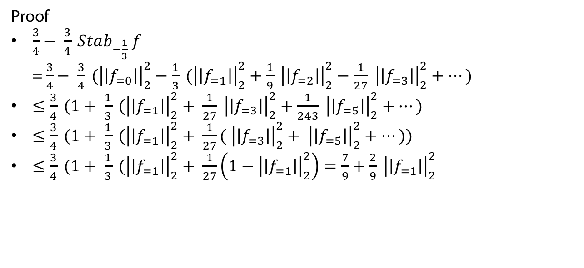
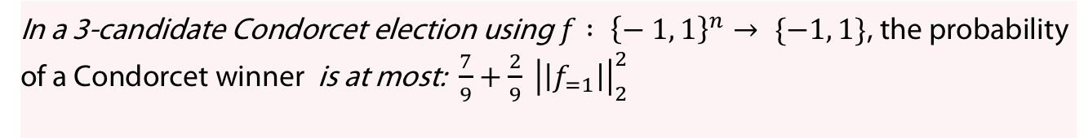
Theorem
In a 3-candidate Condorcet election using $f : {\left\{− 1, 1\right\}}^{n}→ \{−1, 1\}$, the probability of a Condorcet winner is at most: $\frac{7}{9}+\frac{2}{9} {\left|\left|f_{=1}\right|\right|}_{2}^{2}$
Proof
$\frac{3}{4}− \frac{3}{4} Stab_{−\frac{1}{3}} f$
= $\frac{3}{4}− \frac{3}{4} ({\left|\left|f_{=0}\right|\right|}_{2}^{2}−\frac{1}{3} ({\left|\left|f_{=1}\right|\right|}_{2}^{2}+\frac{1}{9} {\left|\left|f_{=2}\right|\right|}_{2}^{2}−\frac{1}{27} {\left|\left|f_{=3}\right|\right|}_{2}^{2}+…)$
$≤\frac{3}{4} (1+ \frac{1}{3} ({\left|\left|f_{=1}\right|\right|}_{2}^{2}+ \frac{1}{27} {\left|\left|f_{=3}\right|\right|}_{2}^{2}+\frac{1}{243} {\left|\left|f_{=5}\right|\right|}_{2}^{2}+…)$
$≤\frac{3}{4} (1+ \frac{1}{3} ({\left|\left|f_{=1}\right|\right|}_{2}^{2}+ \frac{1}{27}( {\left|\left|f_{=3}\right|\right|}_{2}^{2}+ {\left|\left|f_{=5}\right|\right|}_{2}^{2}+…))$
$≤\frac{3}{4} (1+ \frac{1}{3} ({\left|\left|f_{=1}\right|\right|}_{2}^{2}+ \frac{1}{27}\left(1−{\left|\left|f_{=1}\right|\right|}_{2}^{2}\right)=\frac{7}{9}+\frac{2}{9} {\left|\left|f_{=1}\right|\right|}_{2}^{2}$

Slide 35
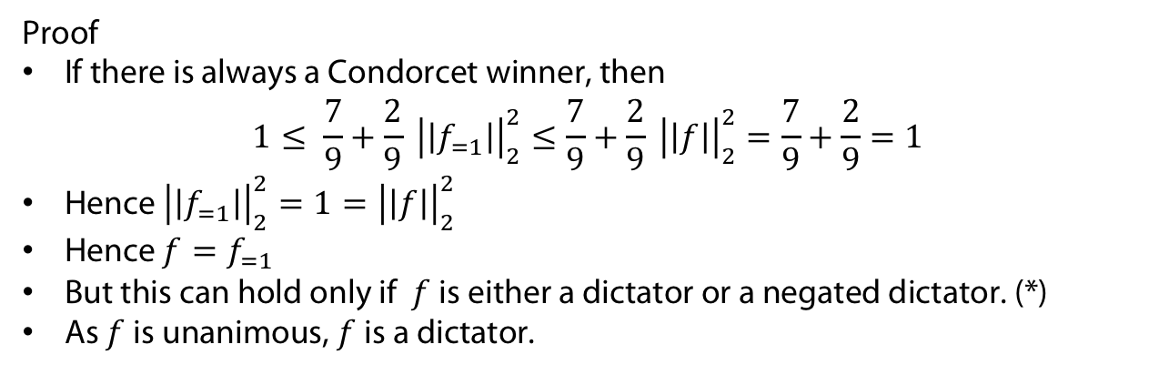
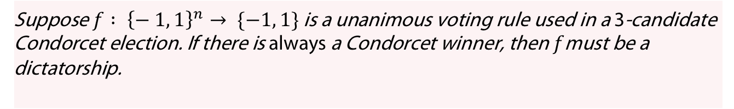
Theorem (Arrows‘ theorem)
Suppose $f : {\left\{− 1, 1\right\}}^{n}→ \{−1, 1\}$ is a unanimous voting rule used in a 3-candidate Condorcet election. If there is always a Condorcet winner, then $f$must be a dictatorship.
Proof
If there is always a Condorcet winner, then
$1≤ \frac{7}{9}+\frac{2}{9} {\left|\left|f_{=1}\right|\right|}_{2}^{2}≤\frac{7}{9}+\frac{2}{9} {\left|\left|f\right|\right|}_{2}^{2}=\frac{7}{9}+\frac{2}{9}=1$
Hence ${\left|\left|f_{=1}\right|\right|}_{2}^{2}=1={\left|\left|f\right|\right|}_{2}^{2}$
Hence $f=f_{=1}$
But this can hold only if $f$ is either a dictator or a negated dictator. (*)
As $f$ is unanimous, $f$ is a dictator.

Slide 36

Wake-up Question
Show (*): If $f=f_{=1}$then $f$ is either a dictator or a negated dictator.

Slide 37
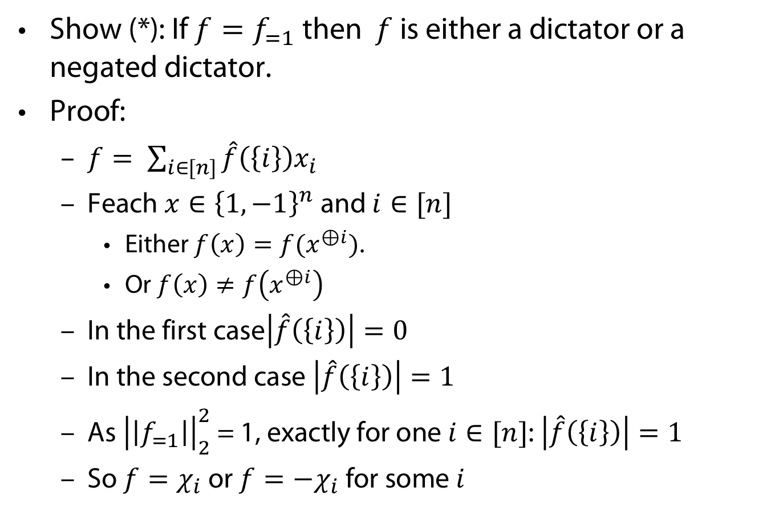
Answer to Wake-up Question
Show (*): If $f=f_{=1}$then $f$ is either a dictator or a negated dictator.
Proof:
  $f= \sum_{i∈[n]}{\hat{f}\left(\left\{i\right\}\right)x_{i} }$
  Feach $x∈{\left\{1,−1\right\}}^{n}$ and $i∈[n]$
    Either $f\left(x\right)=f(x^{⊕i})$.
    Or $f\left(x\right)≠f\left(x^{⊕i}\right)$
  In the first case$\left|\hat{f}\left(\left\{i\right\}\right)\right|=0$
  In the second case $\left|\hat{f}\left(\left\{i\right\}\right)\right|=1$
  As ${\left|\left|f_{=1}\right|\right|}_{2}^{2}$ = 1, exactly for one $i∈[n]$: $\left|\hat{f}\left(\left\{i\right\}\right)\right|=1$
  So $f=χ_{i}$ or $f={−χ}_{i}$ for some $i$

Slide 38
APPENDIX
Uhhh, a lecture with a hopefully useful

Slide 39
References
(Kalai 02)
G. Kalai. A fourier-theoretic perspective on the condorcet paradox and arrow’s theorem. Advances in Applied Mathematics, 29(3):412–426, 2002.
(Nalon/Spencer 04)
N. Alon and J. Spencer. The Probabilistic Method. Wiley-Interscience series in discrete mathematics and optimization. Wiley, 2004.
(Huang 19)
H. Huang. Induced subgraphs of hypercubes and a proof of the Sensitivity Conjecture. arXiv e-prints, page arXiv:1907.00847, July 2019.
(Nisan/Szegedy 92)
N. Nisan and M. Szegedy. On the degree of boolean functions as real polynomials. In Proceedings of the Twenty-Fourth Annual ACM Symposium on Theory of Computing, STOC ’92, pages 462–467, New York, NY, USA, 1992. Association for Computing Machinery.

Slide 40
Color Convention in this course
Formulae, when occurring inline
Newly introduced terminology and definitions
Important results (observations, theorems) as well as emphasizing some aspects
Examples are given with standard orange with possibly light orange frame
Comments and notes
Algorithms

