Slide 1
Intelligent Agents
Dr. Marcel Gehrke
Prof. Dr. Ralf Möller
PD Dr. Özgür Özçep
Universität zu Lübeck
Institut für Informationssysteme

Slide 2
Acknowledgements
Some slides have been taken from lecture material provided by researchers on the web. We hope this material is indicated appropriately. Thank you all.

Slide 3
Organization
Module Intelligent Agents (CS4514-KP12):
  Agents, Mechanism, and Collaboration (lecture)
  Agent Perception (Language and Vision) (lecture)
  Agent Planning, Reinforcement Learning, Relations, and Human-Awareness (lecture)
  Project
Mode of all lectures: classically, on site, with integrated exercises
Lecture slides partly available from last term, but new material produced on the run
Today: overview of the general idea
More details in Moodle (https://moodle.uni-luebeck.de/course/view.php?id=9399)

Slide 4
Organization
Agents, Mechanisms, and Collaboration
  Wednesdays, 14:15 - 15:45 Uhr, IFIS Seminarraum 2035,
  Start: 18.10.2023
  Lecturer: Özgür Özcep
Agent Perception (Language and Vision)
  Thursdays 14:15 - 15:45 Uhr, IFIS Seminarraum 2035
  Start: 19.10.2023
  Lecturer: Ralf Möller
Agent Planning, Reinforcement Learning, Relations, and Human-Awareness
  Fridays, 10:15 - 11:45 Uhr, IFIS Besprechungsraum 2032
  Start: 20.10.2023
  Lecturer: Marcel Gehrke
Project
  Fridays, 12:15 - 13:45 Uhr, IFIS Seminarraum 2035
  Start: 20.10.2023

Slide 5
A vision some time ago
T. Berners-Lee, J. Hendler, and O. Lassila: The semantic web.
Scientific American, 2001. (http://www.scientificamerican.com/)

Slide 6

A vision becomes true???
?
=
ChatGPT
No meaning without perceiving and acting in the world!

Slide 7
Acting was already part of the original vision
“The real power of the Semantic Web will be realized when people create many programs that collect Web content from diverse sources, process the information and exchange the results with other programs. The effectiveness of such software agents will increase exponentially as more machine-readable Web content and automated services (including other agents)
become available. The Semantic Web promotes this synergy: even agents that were not expressly designed to work together can transfer data among themselves when the data come with semantics“
T. Berners-Lee, J. Hendler, and O. Lassila: The semantic web.
Scientific American, 2001. (http://www.scientificamerican.com/)

Slide 8
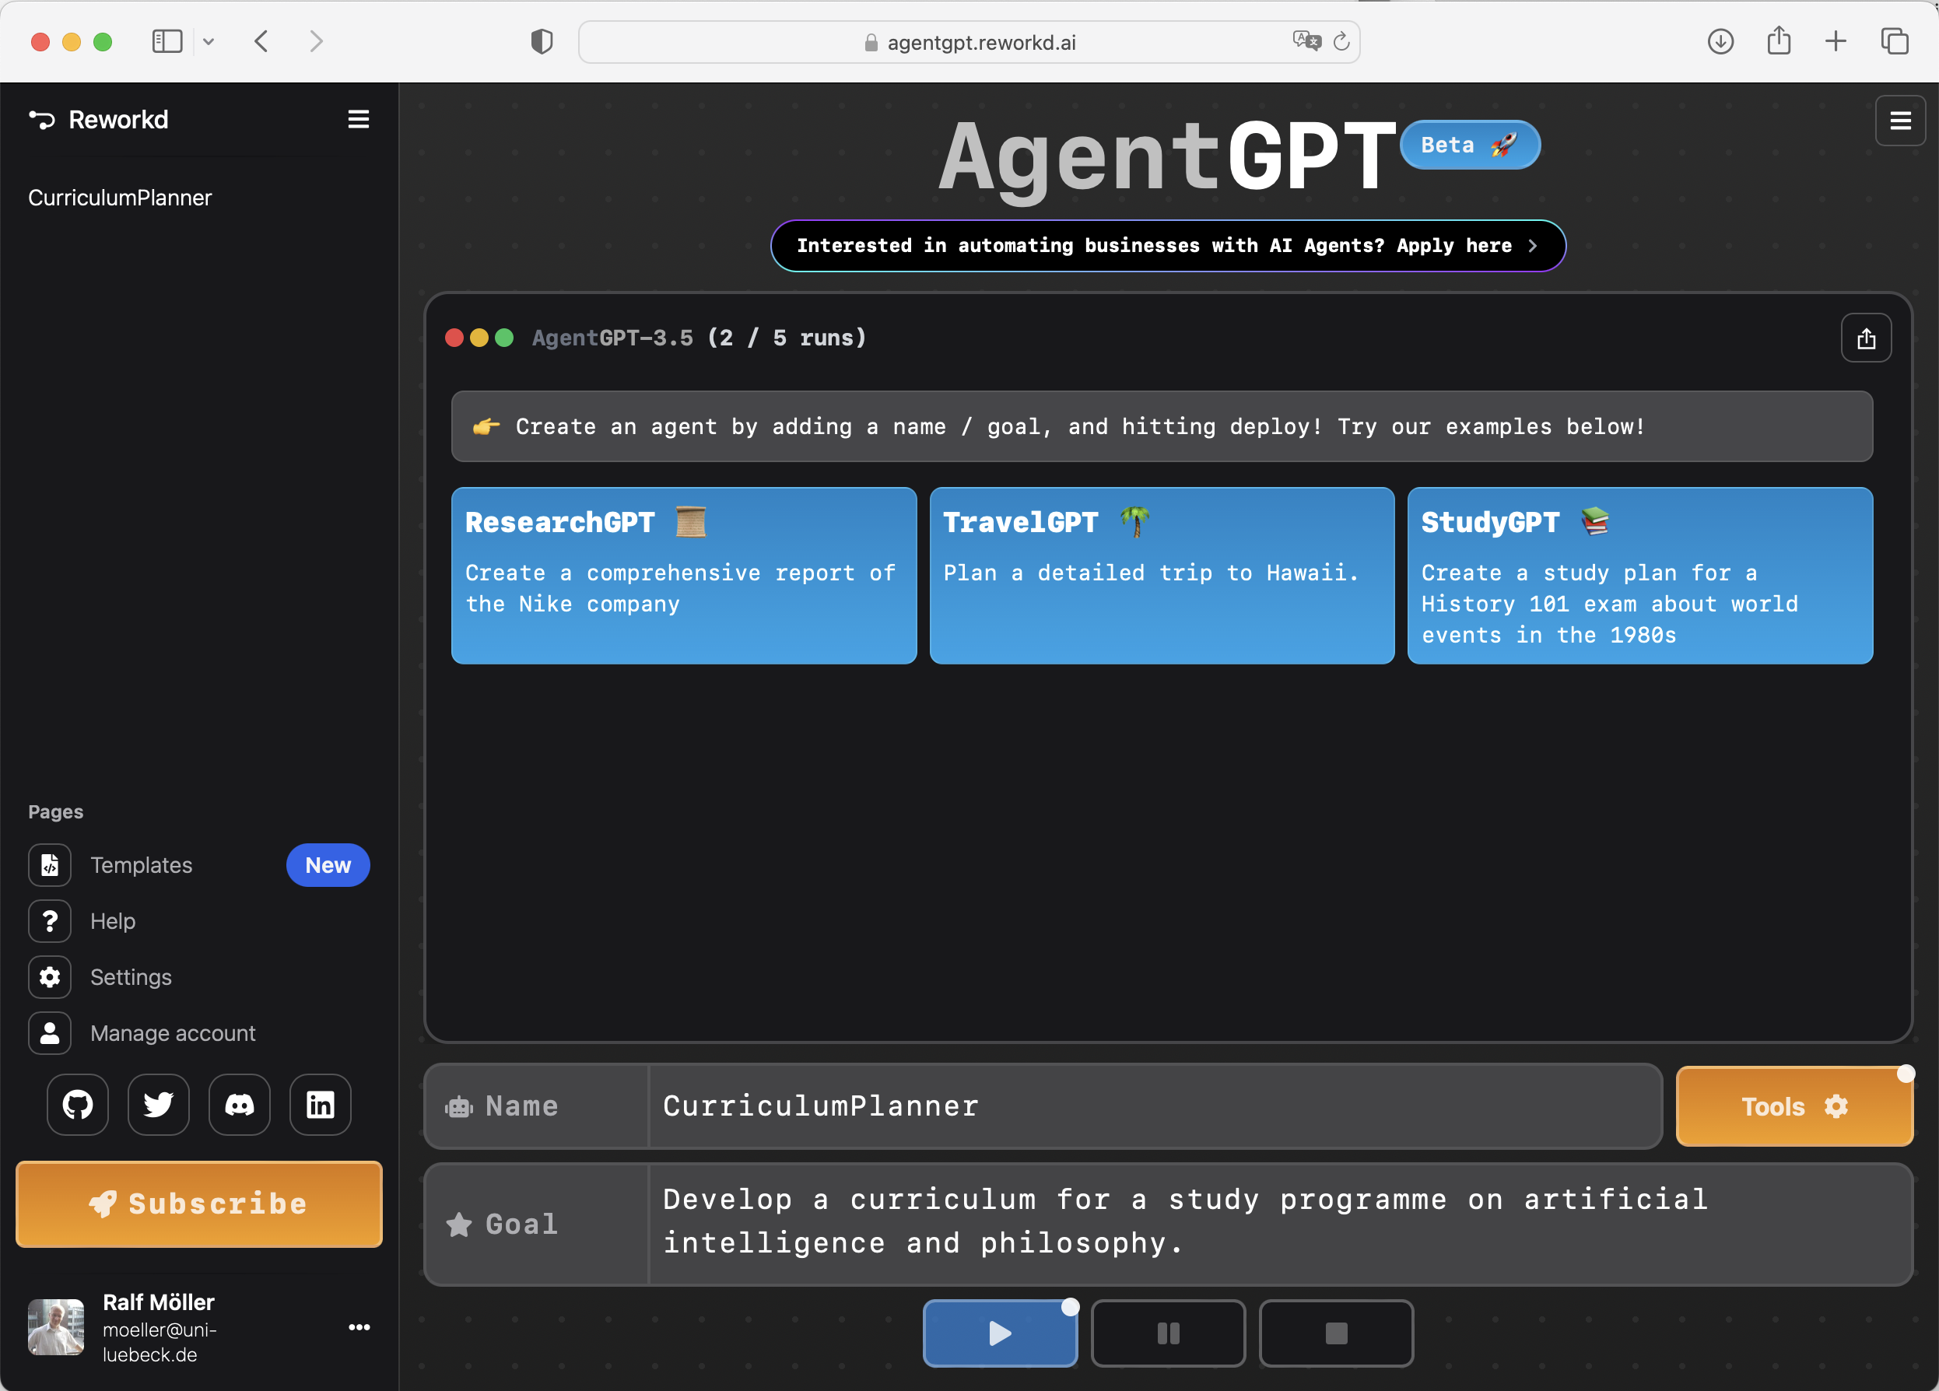
A vision becomes true!!? AgentGPT
T. Berners-Lee, J. Hendler, and O. Lassila: The semantic web.
Scientific American, 2001. (http://www.scientificamerican.com/)
https://agentgpt.reworkd.ai/

Slide 9
Why still a question mark?
Vision itself not realised in the intended form, only ist goals: The semantic web is a cemetery of ontologies
(all died from annotationitis)
On the other hand: can we „trust the semantics“ handled by AgentGPT?
Revival of ontologies (?) -> Neurosymbolic AI NeSy
... though not really neural networks play a role
Even more: we are in an era of Postneural AI

Slide 10
Postneural AI
It‘s about agents
It‘s about humans
It‘s about regulating interaction within the agents/humans
- towards overall goal of beneficiary of humankind
The right global architecture is not that of the semantic web, rather it‘s
  Agents (treated in this course)
  Formal Ethics (descriptive part treated in this course)
  and Mechanism Design (treated in this course)

Slide 11
Artificial Intelligence and Intelligent Agents
Artificial intelligence (AI) is the science of systematic synthesis and analysis of computational agents
that act intelligently
  Agents are central to AI (and vice versa)
  Intelligent agent = computational agent that acts intelligently
  Talking about AI w/o talking about agents
  misses the point (and vice versa)
Need to technically define the notion of
“acting intelligently”
Systems are called computational agents in AI,
or agents for short

Slide 12
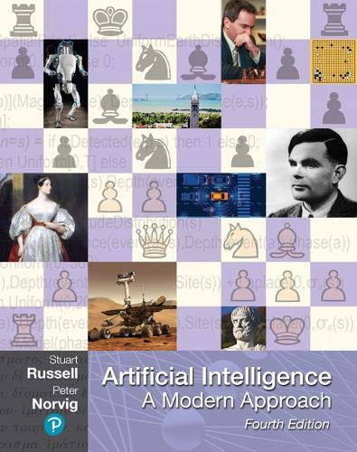
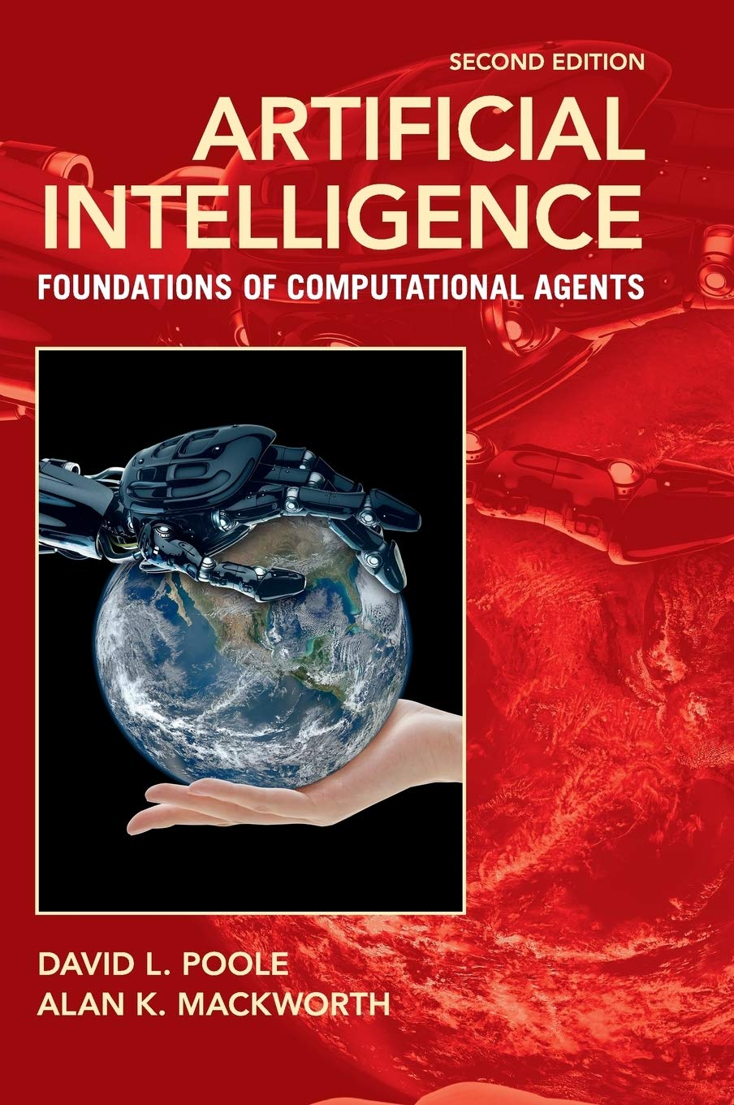
Literature
http://aima.cs.berkeley.edu
(AIMA, 1st edition 1995)
http://artint.info
(AIFCA, 1st edition 2010)

Slide 13
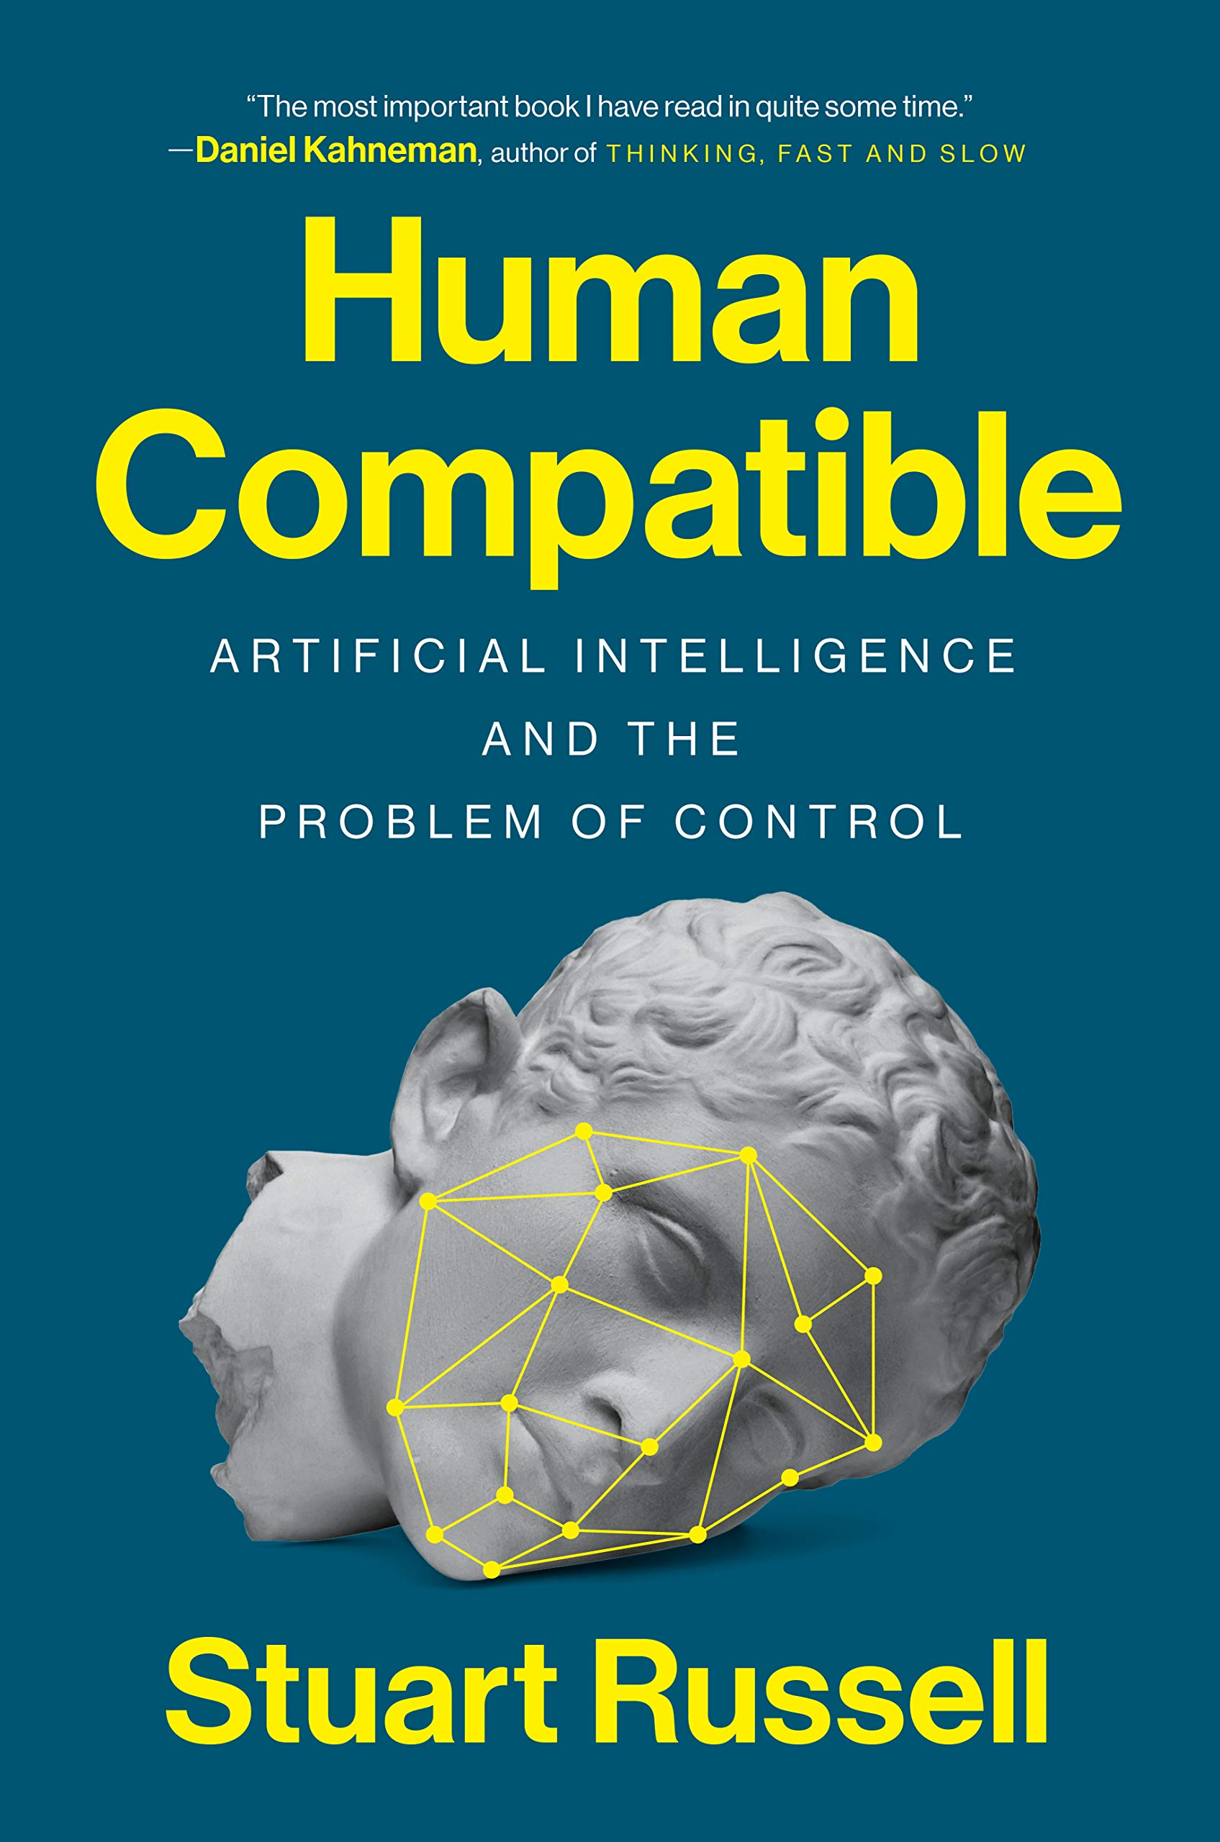
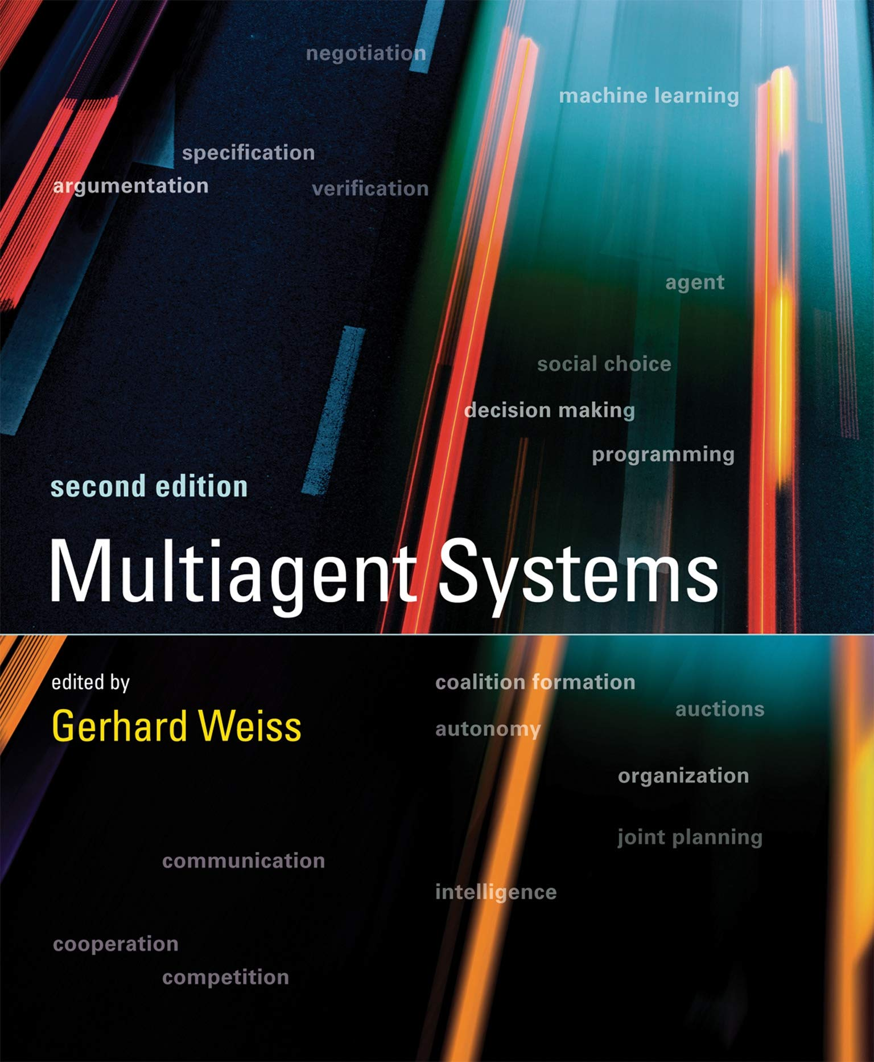
Literature

Slide 14
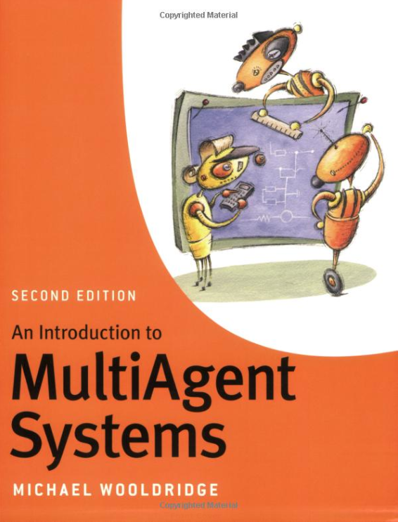

Literature

Slide 15


Literature

Slide 16
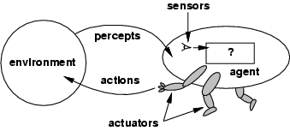
What is an Agent?
Anything that can be viewed as perceiving its environment through sensors and acting upon that environment through actuators
[AIMA-Def]
  Human agent
  eyes, ears, and other
  organs for sensors; hands, legs, mouth, and other body parts for actuators
  Robotic agent
  cameras and infrared range finders for sensors; various motors for actuators
  Software agent
  interfaces, data integration, interpretation, data manipulation/output
Sensors
Percepts
?
Environment
Agent
Actions
Actuators

Slide 17
Abstractions: Agents and Environments
Environment contains other agents -> Mechanism Design
The agent function maps from percept histories to actions:
[f: P* → A]
The agent program runs on
a physical architecture to produce f
Agent = architecture + program
Sensors
Percepts
?
Environment
Agent
Actions
Actuators
Really insist on
functional behavior?

Slide 18
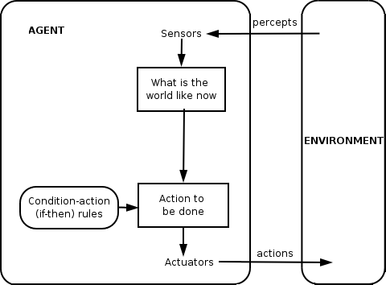
Reactive vs. Goal-based Agents

Slide 19
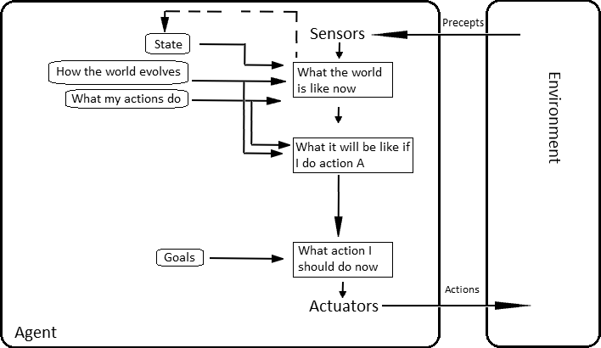
Reactive vs. Goal-based Agents
Agent Perception (Language and Vision)
percepts
Agent Planning, Reinforcement Learning, Relation and Human-Awareness

Slide 20
Balancing Reactive and Goal-Oriented Behavior
We want our agents to be reactive, responding to changing conditions in an appropriate fashion (e.g., timely)
We want our agents to systematically work towards long-term goals
These two considerations can be
at odds with one another
  Designing an agent that can balance the two
  remains an open research problem
  Achieve maximum freedom of action if there is no specific short-term goal (e.g., keep batteries charged)

Slide 21
Social Ability
The real world is a multi-agent environment: we cannot try achieving goals without taking others into account
Some goals can only be achieved with the cooperation of others
Social ability in agents is the ability to interact with other agents (and possibly humans) via some kind of agent-communication language …
-> Agent Perception (Language and Vision)
... with the goal to let other agents to make commitments (of others) or reinforcements (about its own behavior)
Need to represent and reason about
beliefs about other agents
-> Agents, Mechanism, and Collaboration

Slide 22
Rational Agents
Rational Agent: For each possible percept sequence, a rational agent
  should select an action
  that is expected to maximize its local performance measure,
  given the evidence provided by the percept sequence and
  whatever built-in knowledge the agent has
Rational = Intelligent ?
  There is more to intelligence than to meet rationality

Slide 23
Autonomous Agents
Rationality is distinct from omniscience
(all-knowing with infinite knowledge)
Computing the best action usually intractable
Rationality is bounded
Agents can perform actions in order to modify future percepts so as to obtain useful information
An agent is autonomous if its behavior is determined by its own "experience" (with ability to learn and adapt)
  What matters for the "experience" is the
    percept sequence (which the agents can determine), the
    state representation, and the
    "computational success" of computing the best action
    as well as learning and adapting for the future

Slide 24

Autonomy $≠$ No influence possible
Clearly: we do not prescribe concretely the agent function
But one wants and can have influence on the meta-level
(-> see revival of meta-reasoning)
In other words: Have influence on the rules of the interaction game
Agents, autonomously following them, will act towards an environment in a desired, beneficial state
This is part of
mechanism design = game theory + social choice theory

Slide 25
Human-compatible Behavior
Agents act on behalf of humans, whose goals the agents have to fufill (this is the single goal of agents)
Agent should consider its initial goals to be uncertain
Agent should be able to prove their behavior is beneficial to humans
Artificial intelligence, agents, and ethics
  Agents (and their designer) must act in an ethical way
  Developers should be able to prove …
  … that agents are able to prove
  … that they (the agents) act in an ethical way
  Simple technology assessment is not enough
  And yes, there are formal ethics, there is deontic logic, ...

Slide 26
Human-aware Behavior
Agents interact with humans
Selected actions must match human expectations
  Maybe the presumably expected action might not be the best (for the human or the agent, or both)
Selected actions that are assumed to not match human expectations must be explained

Slide 27
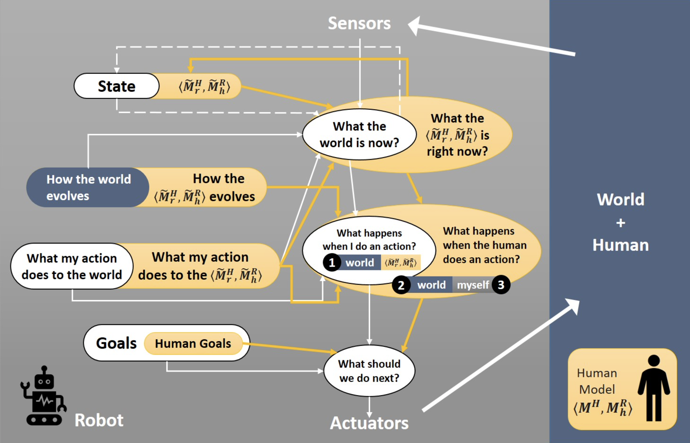
Agent Model vs. Human Model
Agent Planning, Reinforcement Learning, Relations, and Human-Awareness
  Agents, Mechanism, and Collaboration (lecture)
Challenges of Human-Aware AI Systems: Subbarao Kambhampati

Slide 28
Learning Agents (Online)
Ever extended percept sequence (incl. more or less explicitly encoded reinforcement feedback or rewards) is …
  … sparse (no big data), but gives rise to model updates
  … with the aim to better (faster) achieve goals
We say: Agents learn (and we mean: while acting, or online)
  Optimize a performance measure
Setting up agents’ online learning engines
  Dedicated knowledge about online learning required
Setting up an agent’s initial model by exploiting data:
  Dedicated knowledge of machine learning required
  Also basically optimizing a performance measure

Slide 29
Reactive vs. Goal-based Agents

Slide 30
Misunderstandings
Applying ML to implement a function f some people say:
“I have used ML technique X to create an AI”
Unconsciously, AI is used as a synonym for agent, but …
… mostly a very simple one
  f : P → A
Claiming that f is “an AI” is an indication of
lack of understanding …
… even if the last n percepts are considered
  f : P × …× P → A
One is lost w/o an understanding of intelligent agents
  f : P* → A

Slide 31
Frame Agents
Assume that machine learning techniques are used
to build models at agent setup time
Runtime behavior of agent always depends on last n elements of percept sequence only f : P × …× P → A
No interaction w/ environment, no feedback
Agent is fake (simply a frame around standard SW/HW)
  Also holds when setup training data is camouflaged
  as initial percepts (but no actions towards goals are computed until training completed)
Maybe even enlightening for practical applications,
but agent idea …
… does not show its full potential

Slide 32
Learning-based Software Development
There is no need to deliberately
conflate machine learning with agents and AI !
No need to invent frame agents !
Can build extremely cool SW/HW
w/ machine learning techniques
(e.g., for industrial image processing applications)
→ Probabilistic Differential Programming (CS5071-KP04)
→ Deep Learning Lab (CS5071-KP04)

Slide 33
Back to the Future: Human-guided Learning
Develop machine learning techniques that achieve good performace w/o too much training material
Exploit human capabilities
Artificial agents and human agents cooperate
Machine learning becomes agent online learning
  Motivation for studying agents!
  Machine learning cannot go w/o agents in the future
Agents allow for more or less learning (incl. no learning)
Next: Proper agent with no learning

Slide 34
Proper Agent: An Example

Slide 35
Proper Agent: An Example
Given:
  Current state of the
  environment
  Description of goal state
  Set of action descriptions
Find sequence of actions (a plan)
for transforming current state into goal state
Select first action, and hope that plan can be completed

Slide 36
STRIPS Formalism
States modeled as set of ground atoms (database)
  Current state as well as goal state
  Example: Blocks World
    On_Table(A), On_Table(B), On_Table(C)
    On_Block(C, B), On_Block(B, A)
Historical & name convention note
  Nowadays STRIPS = representation language FOL
  Part of PDDL (planning domain definition language)
  Originally, STRIPS also denoted (linear, non-complete) hill-climbing style algorithm
  Here we consider a different algorithm based on partial order plans
STRIPS = Stanford Research Institute Problem Solver (1971)

Slide 37
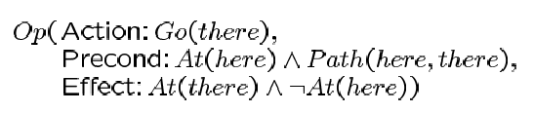
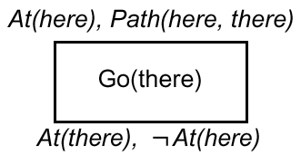
STRIPS Planning Operators

Slide 38
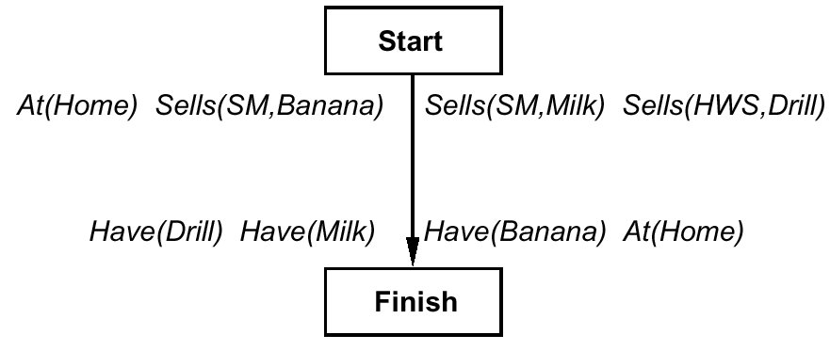
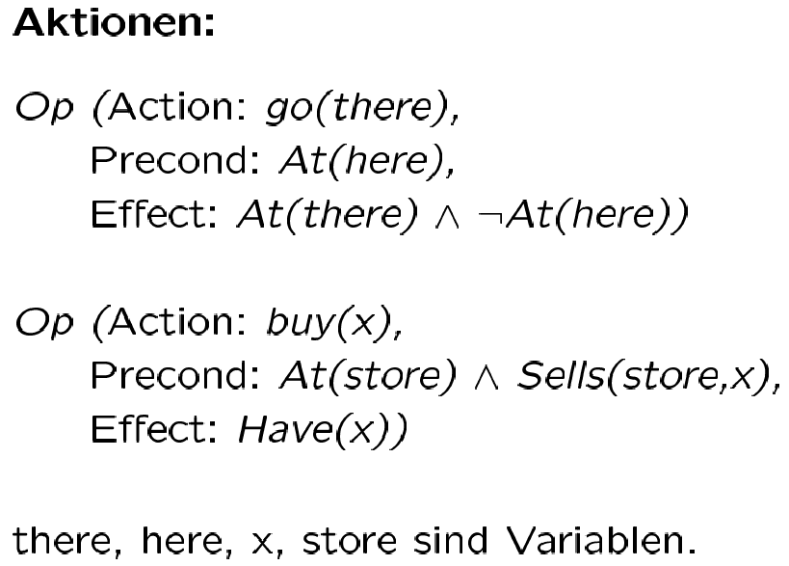
Initial Plan
Action(Type)s:
are variables

Slide 39
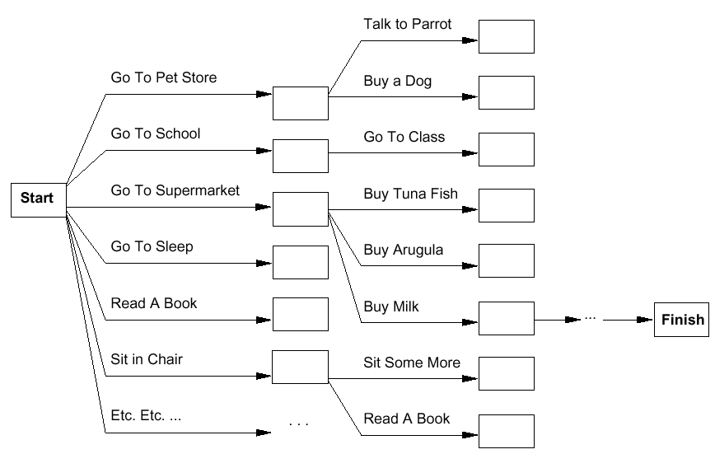
Planning as („Lifted“) Search
Forward
Backward

Slide 40
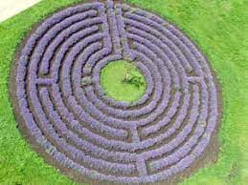

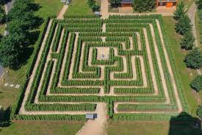
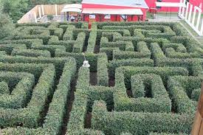
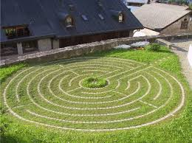
Classical Search vs. Planning
Problem solving by search
Problem = single state space
Program search algorithm
Problem solving by planning
Specify problem declaratively
Solve by general planning algorithm
E.g.: instead of go-to-SM1, go-to-HW
rather go(place)

Slide 41
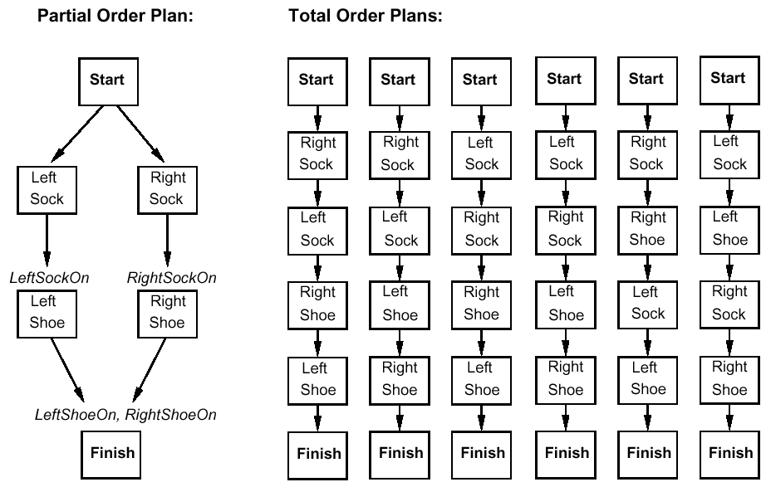
Plan = (Linear) sequence of Actions?
Apply principle of
Least Commitment

Slide 42
Representation of Partial-Order Plans
Plan step = STRIPS Operator
Plan consists of
  Plan steps with partial order (<),
  where S_{i} < S_{j} iff S_{i} is to be executed before S_{j}
  Set of variable assignments x = t ,
  where x is a variable and t is a constant or variable
  Set of causal relations:
  S_{i} →^{c} S_{j} means S_{i} creates the precondition c of S_{j} (entails S_{i} < S_{j})
Solutions to planning problems …
… must satisfy certain conditions
STRIPS = Stanford Research Institute Problem Solver (1971)

Slide 43
Completeness and Consistency
Complete plan
  Every precondition of a step is fulfilled
  ∀S_{j} with c ∈ Precond(S_{j}),
    ∃S_{i} s.t. S_{i} < S_{j} and c ∈ Effects(S_{i}), and
    for every linearization it holds that:
      ∀S_{k} with S_{i} < S_{k} < S_{j} , ¬c ∉ Effects(S_{k})
Consistent plan
  If S_{i} < S_{j} , then S_{j} ≮ S_{i} and
  If x = A, then x ≠ B for different A and B for variable x
  (Unique Names Assumption)
Solution of the planning problem:
complete and consistent plan

Slide 44
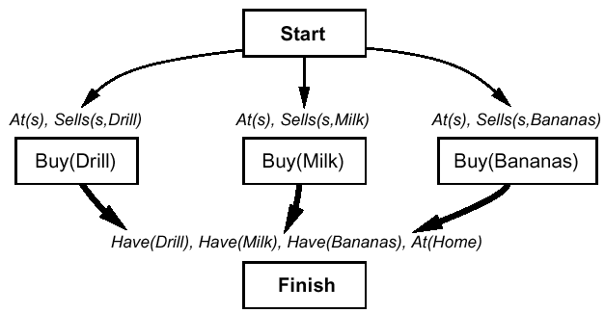

Plan Refinement (1)
Backward planning
Thin arrows = <
Fat arrows = causal relation + <

Slide 45
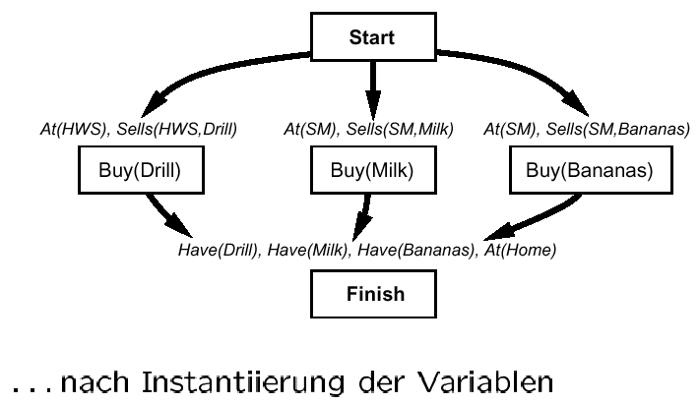
Plan Refinement (1)
after variable instantiation

Slide 46
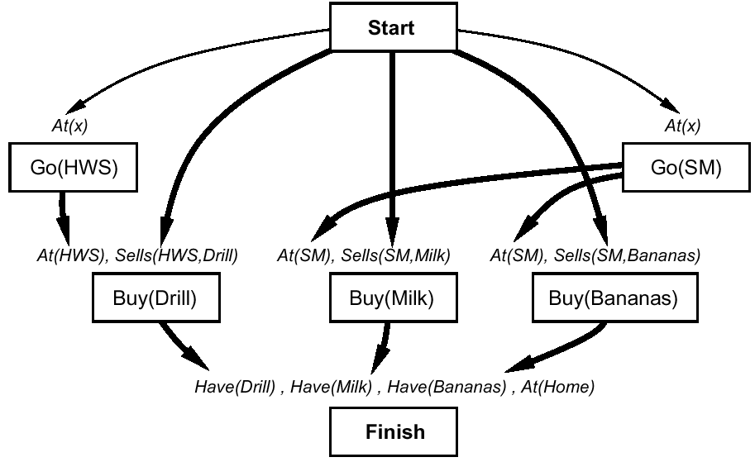
Plan Refinement (2)
... buy at the right store

Slide 47
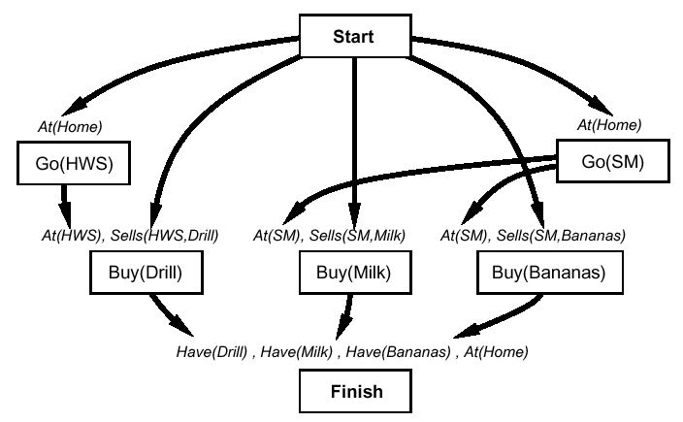
Plan Refinement (3)
... but you must get there

Slide 48
Plan Refinement (3)
Note:
Up to now no search, but simple „backward chaining“
Now:
Conflict! After go(HWS) is executed, At(Home) no longer holds (similarly for go(SM))

Slide 49
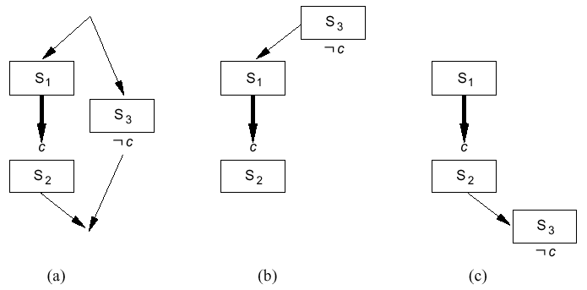
Protection of Causal Relations
Conflict:
  S3 “threatens“ causal relation between S1 and S2
Conflict resolution:
  Promotion: Put threat before causal relation ( b )
  Demotion: Put threat after causal relation ( c )

Slide 50
Another Plan Refinement …
Assumption: Cannot resolve conflict by protection
Made a wrong step during plan refinement
Alternative
  Select x = HWS (with causal relation) while instantiating At(x) in go(SM)

Slide 51
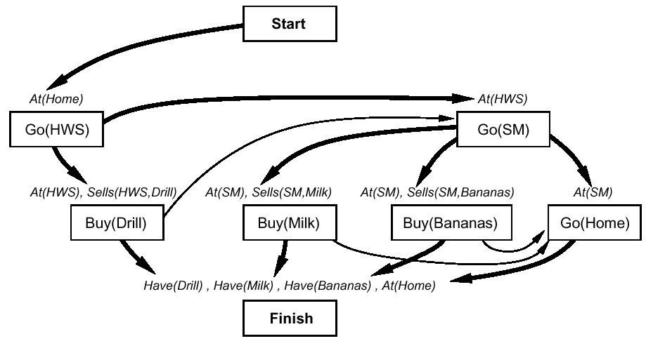
Another Plan Refinement …

Slide 52
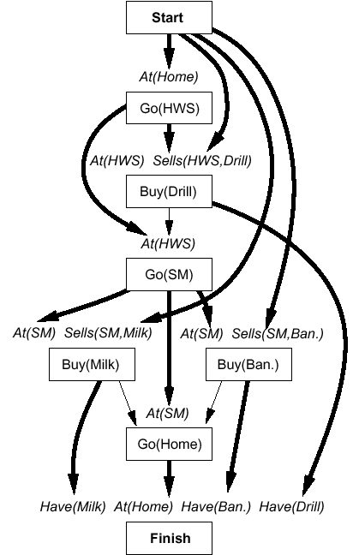
The Complete Solution …
… with all links
Computation by
so-called POP Algorithm
  Complete
  … and correct
Additionally, not
considered here,
correct treatment
of variables

Slide 53
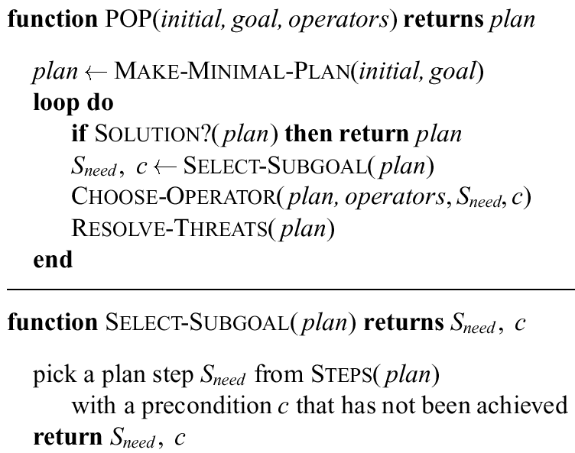

Slide 54
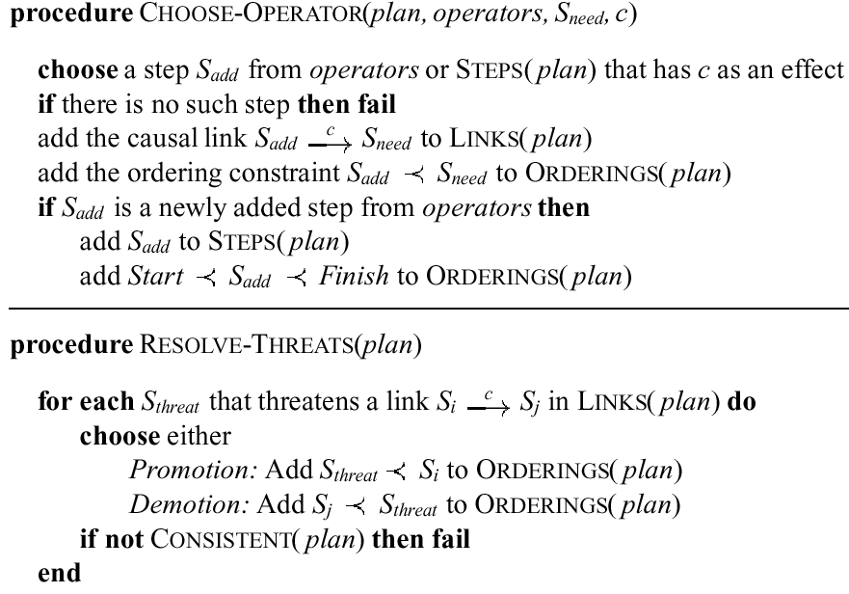

Slide 55
Last Century Planning Systems (Last Decade!)
UCPOP (Weld, UW)
(http://www.cs.washington.edu/ai/ucpop.html )
Sensory Graphplan (Weld, Blum, and Furst: UW)
(http://aiweb.cs.washington.edu/ai/sgp.html )
IPP (Köhler and Nebel: Univ. Freiburg)
(https://idw-online.de/de/news5468)
Prodigy: Planning and Learning (Veloso: CMU)
(http://www-2.cs.cmu.edu/afs/cs.cmu.edu/project/prodigy/Web/prodigy-home.html )
All systems have found interesting applications

Slide 56
Planning is an Active Field of Research
More powerful successors
  Systems learn how to plan fast
  for specific problem instances
  Can deal with uncertainty
    About state estimation
    About effects of actions
Very powerful problem solvers can be set up …
  w/ less effort/knowledge than with mathematical optimization theory and respective tools
→ Lecture Agent Planning, Reinforcement Learning, Relations, and Human-Awarenes of this module
(→ Automated Planning and Acting (CS5072-KP04)
( https://www.ifis.uni-luebeck.de/index.php?id=dski-aktuell-ss20&L=2 ))

Slide 57
Round-Up
Rational agents that:
  Act autonomously and are persistent;
  nonetheless can be influenced via mechanism design
  Achieve goals surprisingly fast
  (despite bounded rationality)
  Learn how to behave in a clever way
  (even learn computational strategies)
Can adapt their goals
to anticipate humans needs and expectations
  Human compatibility, human awareness
Can learn new models online to
  Keep high performance over time
  Support human-guided machine learning

